Slide 1
ESR 2
Presented to
Joint Hall A/C Summer Meeting
By
David Kashy
Physics Division Cryogenic Coordinator
June21/22 2018
Many slides taken from presentations given by the JLab cryogenics group. (R. Ganni, N.Hassan etal)

Slide 2
Baseline plan at present
ESR2 will be comprised of a Refrigerator designed for and tested at the SSC (Accelerator System String Test: ASST-A)
This cold box and many spare parts for it are here on site
ESR2 will connect to the ESR building and the current cryogenic distribution system
Additional features may allow
  Fully separate operation from CHL with
  Helium: Storage, Recovery and Purification
  LN2: Storage

Slide 3
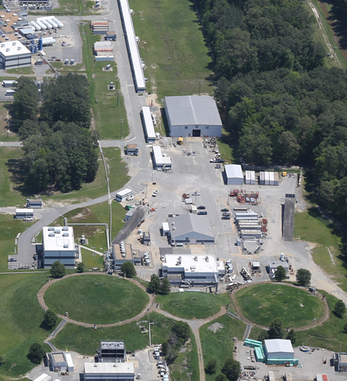
ESR Complex - System Layout
ESR1 Complex:
3 x Warm Compressors
1.5 kW @ 4K Cold Box
Valve Box
- Experimental Hall Distribution Cans
- Liquid Helium and Nitrogen Supply from CHL (ESTL)
- GHe Supply from CHL
- 10,000 liter LHe Dewar
ESR2 Complex:
4 x Warm Compressors
4.0 kW @ 4K Cold Box
CBX Distribution
Additional scope TBD:
  Recovery System
  Helium Purification
  GHe Storage Tanks
  LN Storage
ESTL
ESR2
ESR1
Currently provided to ESR by CHL

Slide 4
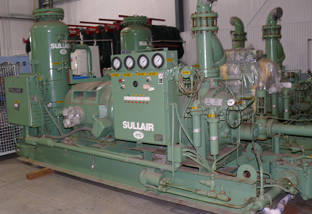
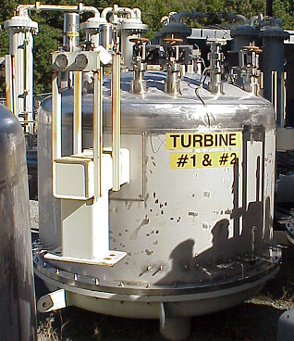
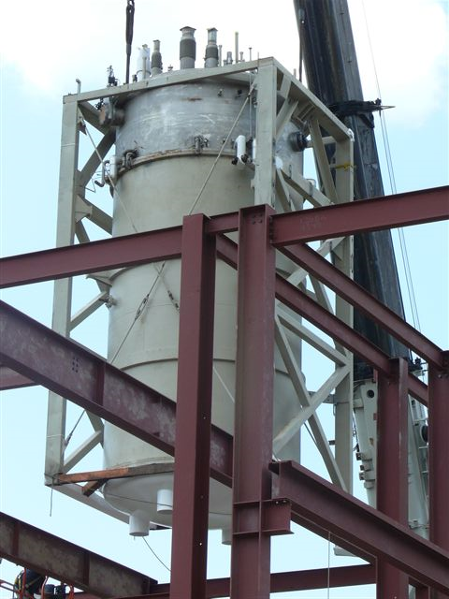
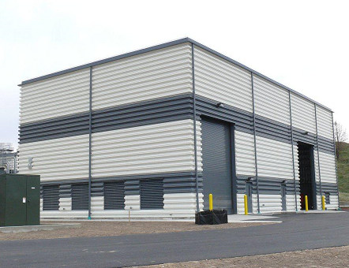
ASST-A Cryogenic System
This Refrigerator was designed and procured by the SSCL in 1992 for the
Accelerator System String Test (ASST) by the Magnet Testing Lab
First implementation of “Floating Pressure Process” (Ganni Cycle)
Developed and successfully used for: Efficient Variable Capacity Operation
Not used after SSCL cancellation
Majority of the components already present at JLab

Slide 5
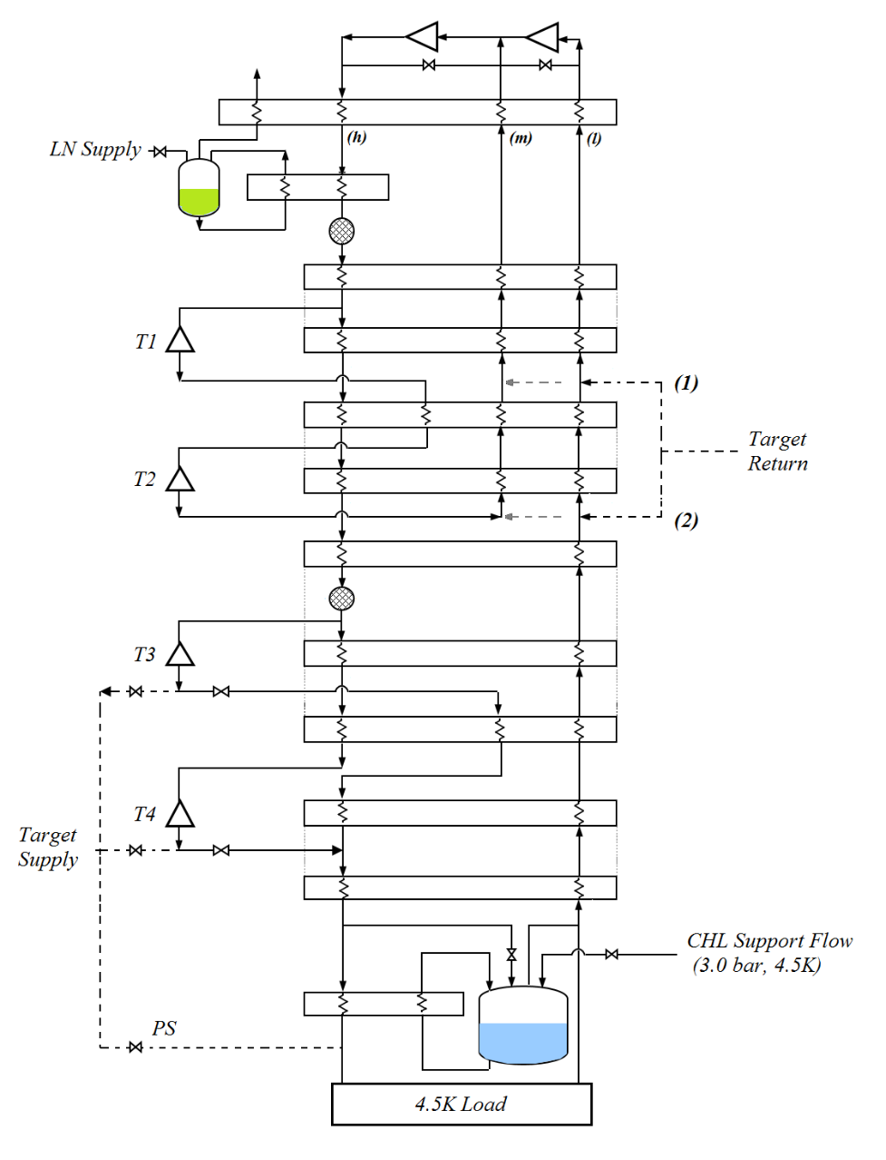
ASST-A Cryogenic System (contd.)
Features
Compressor System (Sullair)
2 x 186 kW (250 hp) 1st stage
2 x 522 kW (700 hp) 2nd stage
Eleven heat exchangers
Grouped into six brazed aluminium cores
Four turbo-expanders
Capacity
4.5 K Refrigeration: 4.0 kW
OR
4.5 K Liquefaction: 37 g/s (Design)
OR
4.5 K Refrigeration: 2.0 kW +
4.5 K Liquefaction: 20 g/s
LN Consumption: 125 gph (Design, Max. Liquefaction)
70 gph (Design, ½ Capacity R+L)
80K
15K
10K
6K
4.5K

Slide 6
Halls A, B, C -Cryogenic Loads
Next 10 years
Year | 2018 | 2019 | 2020 | 2021-2022 | 2023-2026 | 2027-2030
4K Refrigeration (W) | 800 | 800 | 800 | 700 | 480 | 588
Total 4K Liquefaction (g/s) | 7.54 | 7.54 | 7.54 | 6.24 | 4.94 | 5.44
15K Target (W) | 1000 | 1000 | 2000 | 2500 | 6000 | 2000
Moeller Experimental Period
Notes:
When we run Helium targets we will be reducing the 15K loads substantially (~2.3W of 15K must be sacrificed for every 1W of 4K target load
15K loads described above are peak loads.

Slide 7
Cryogenic loads converted to 4.5K Watts
Year | 2018 | 2019 | 2020 | 2021-2022 | 2023-2026 | 2027-2030
Approx. equivalent 4.5K Refrigeration (W) | 2196 | 2196 | 2566 | 2475 | 3374 | 2069
Approx. equivalent 4.5K Liquefaction (g/s) | 17 | 17 | 20 | 19 | 28 | 16
ASST-A Capacity: 4.5 K Refrigeration: 4.0 kW OR 4.5 K Liquefaction: 37 g/s

Slide 8
Project Overview Budget and Schedule
ESR 2 building was Completed in December 2010
Project funds of 9.9M$ awarded – April 2018
Project funds recinded in June 2018
Funds may be re-awarded in FY2018 or FY2019
PEP (Project Execution Plan being written)
Working to get internal funding to start design work
Project is scheduled for 3 years* so if project restarts in FY2019 then ESR2 should be available in FY2022 (*typical duration for SLI-GPP projects is 3 years max)

Slide 9
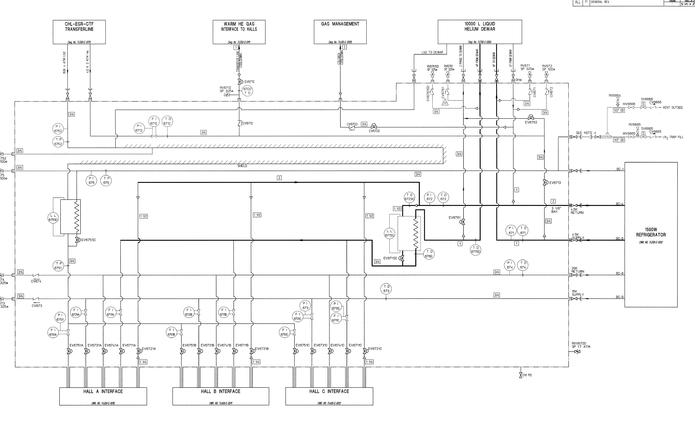
ESR Valve Box (as used with ESR2 & Moeller)
4K Supply
ESR2
4K Return
4-6 K Supply
8-10 K Supply
20K Return

Slide 10
Original use of End Station MTL
15K Supply
5 cold Circuits
4KS/4KR are a heat exchanger
LN2
20K Return
4K Return
4K Supply

Slide 11
Possible End Station MTL- Hall A Moeller
8-10 K Supply
20K Return
20K Return
4-6K supply
No flow

Slide 12
Next Steps
Analyze the Cold Box/Turbine capabilities to determine the best way to modify the cold box and use it at the ESR Complex
Start and complete ESR 2 system design
Look closer at Halls A and C Targets for piping and HX designs

Slide 13
Questions?
Thank You

Slide 14
Backup Slides

Slide 15
Possible End Station MTL- Hall A Moeller
7.6 K Supply
20K Return
20K Return
Spare
Spare

Slide 16
One Analyzed Option
Turbine 3 outlet supplying 7.6K at 4 atm
Return at 20K (2.0 or 1.2 atm)
5kW requires 67g/s (not sure if possible)
Supply pressure drop all the way to target including flow meter in the ESR VB is 0.8 atm
Assumed DP of Target is 0.5 atm
Return on 20K circuit for 34g/s DP is 0.7 atm the rest would return on the LN2 circuit
Total DP ~ 2.0atm ( This Could Work )

