Slide 1

Nuclear Physics at Jefferson Lab
Latifa Elouadrhiri
QCD Evolution 2018

Slide 2
Outline
12 GeV Program
  Overview
  Status
Future Projects
Center for Nuclear Femtography
Recent Highlights
EIC
Summary

Slide 3
Outline
12 GeV Program
  Overview
  Status
Future Projects
Center for Nuclear Femtography
Recent Highlights
EIC
Summary
Gravitational Structure of the Proton
  The pressure distribution inside the proton

Slide 4
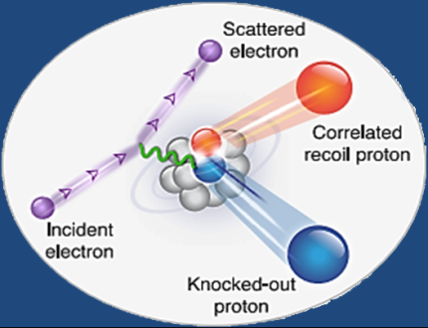

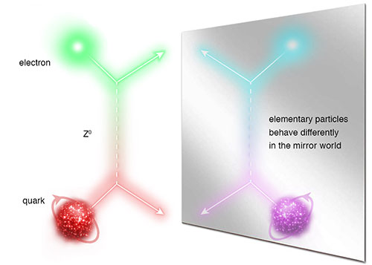
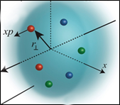
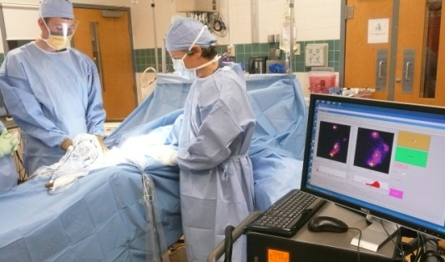
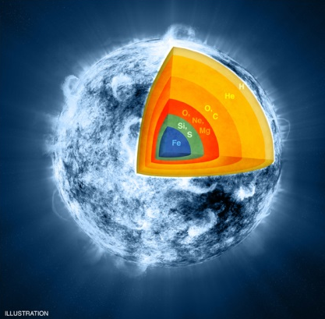
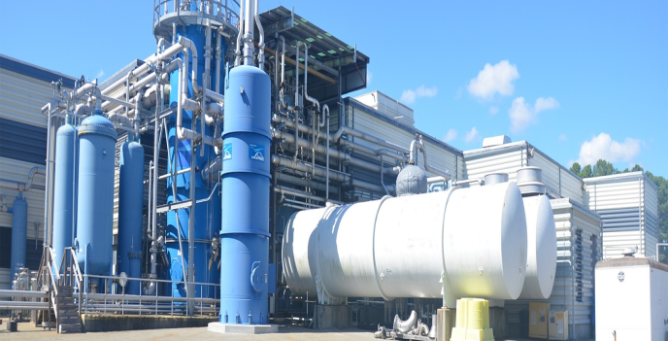
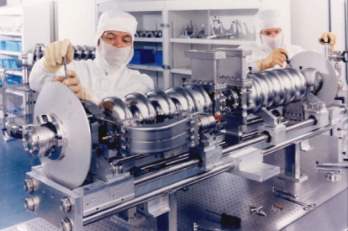

Jefferson Lab: A Laboratory For Nuclear Science
Z⁰
Nuclear Structure
Fundamental
Forces & Symmetries
Structure of Hadrons
Medical Imaging Technology
Nuclear Astrophysics
Cryogenics
Accelerator S&T
Theory & Computation

Slide 5
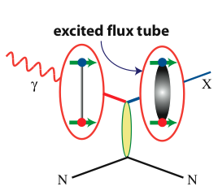
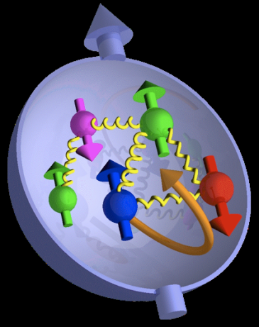

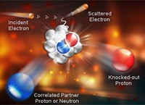
Jefferson Lab @ 12 GeV Science Questions
excited gluon field
What is the role of gluonic excitations in the spectroscopy of light mesons?
Where is the missing spin in the nucleon?
Role of orbital angular momentum?
Can we reveal a novel landscape of nucleon substructure through 3D imaging at the femtometer scale?
What is the relation between short-range N-N correlations , the partonic structure of nuclei, and the nature of the nuclear force?
Can we discover evidence for physics
beyond the standard model
of particle physics?

Slide 6
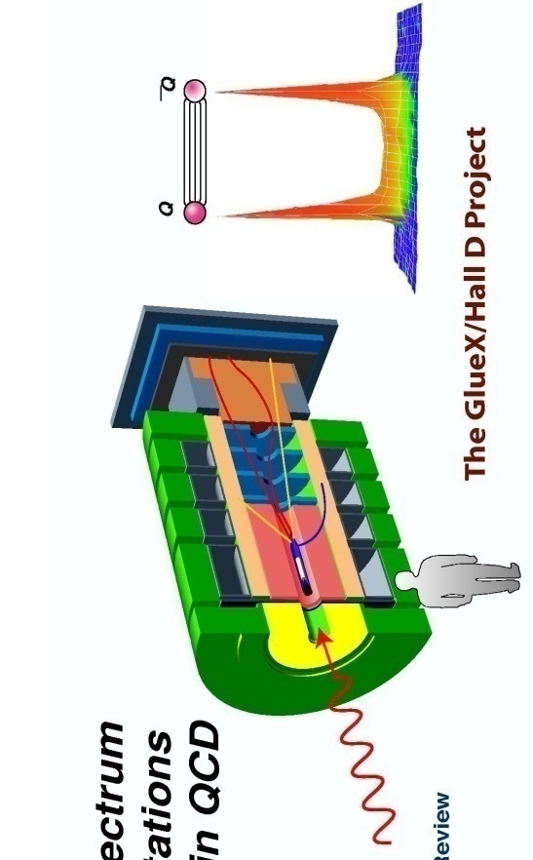
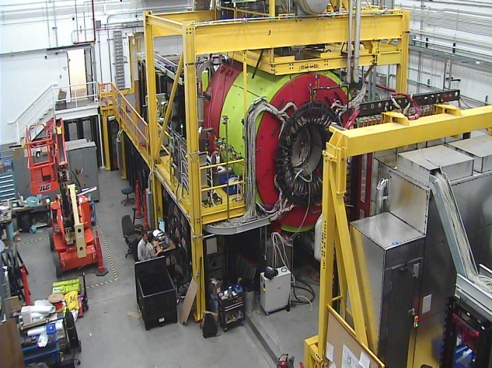
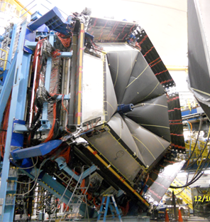
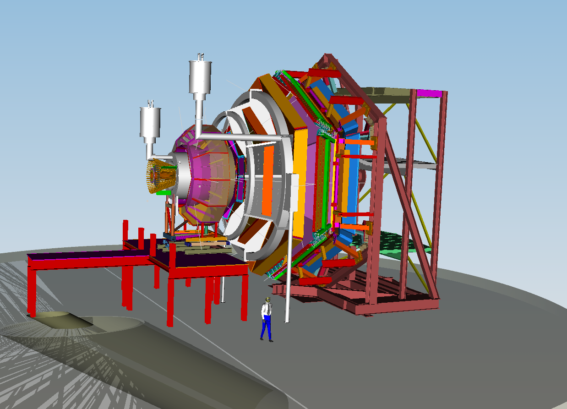
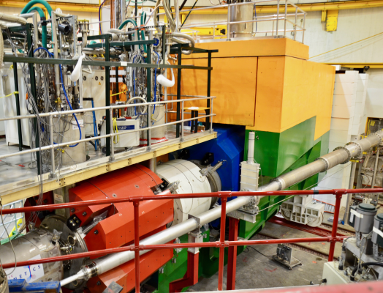
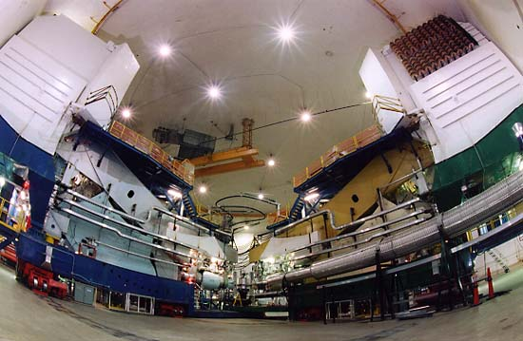

12 GeV Scientific Capabilities
Hall D – exploring origin of confinement by studying
exotic mesons
Hall B – understanding nucleon structure via generalized parton distributions and transverse momentum distributions
Hall C – precision determination of valence quark properties
in nucleons and nuclei
Hall A – short range correlations,
form factors (SBS), hyper-nuclear physics,
future new experiments (e.g., SoLID and MOLLER)
6
Notes:
6

Slide 7
Theory at Jefferson Lab

Slide 8
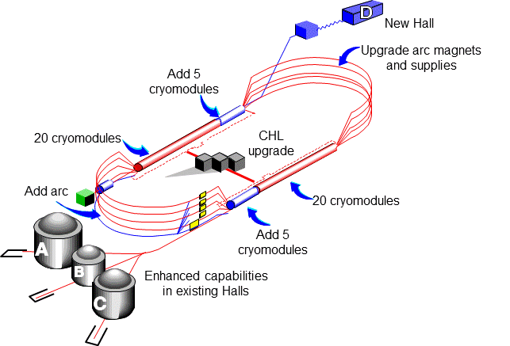
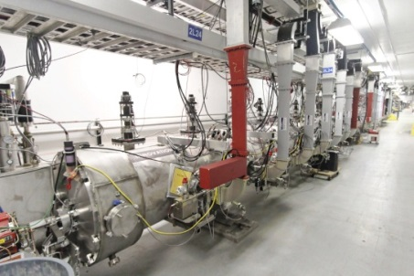
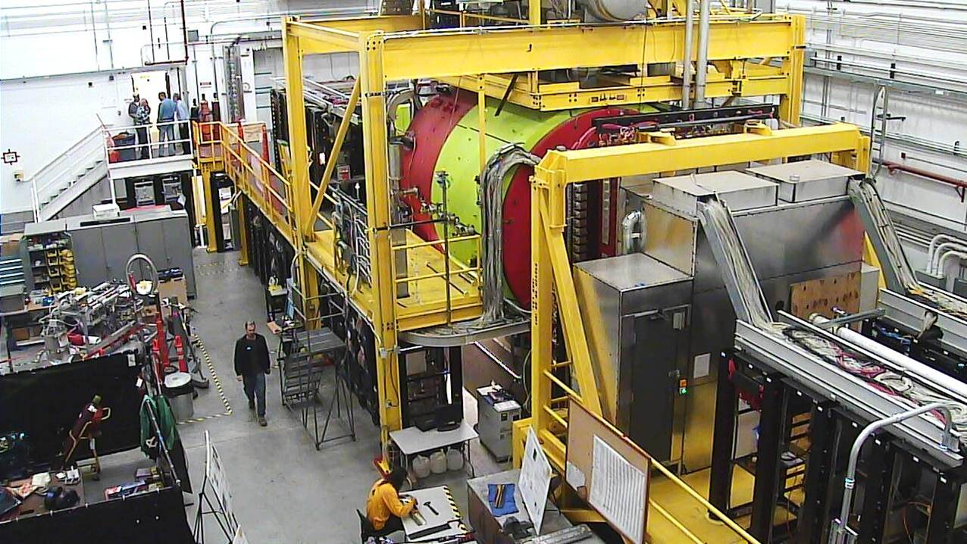
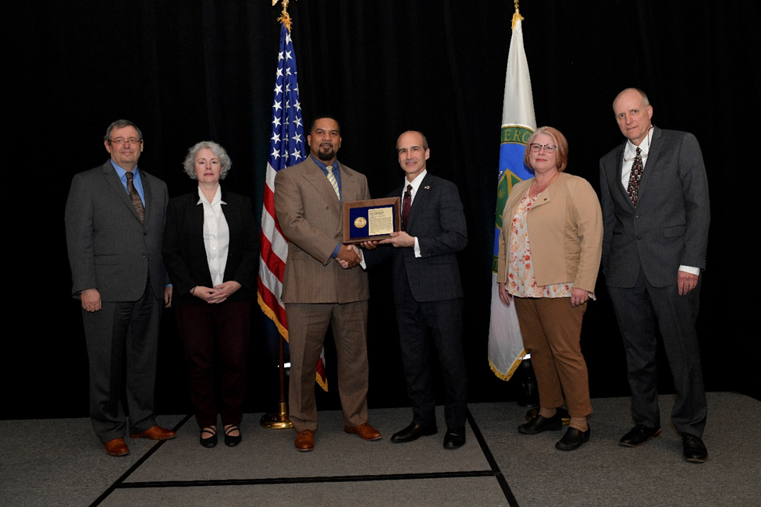
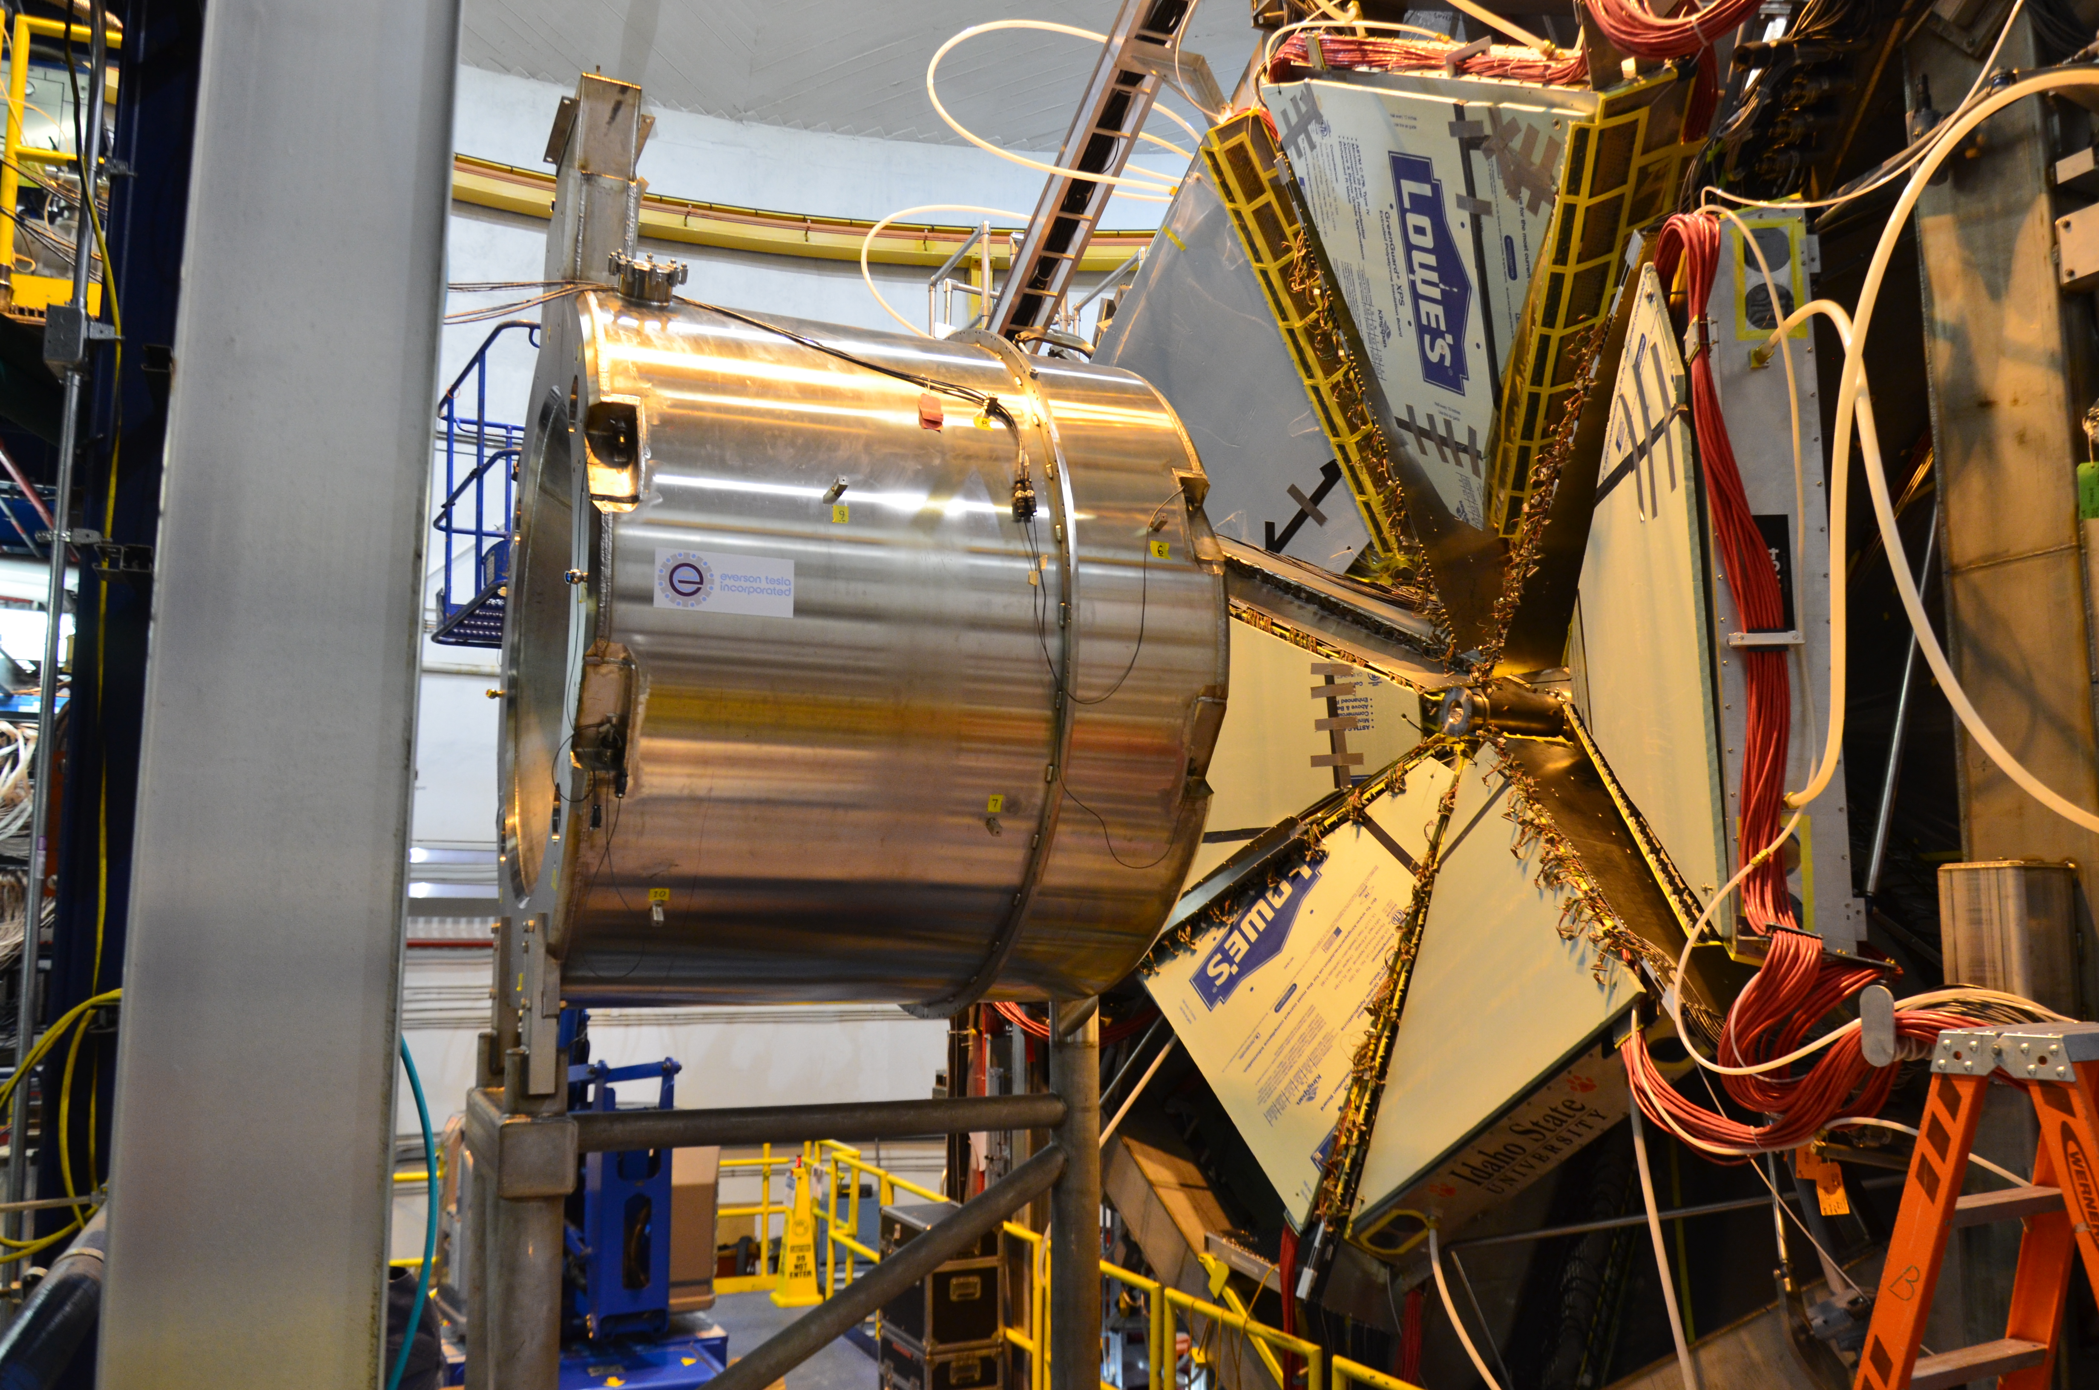
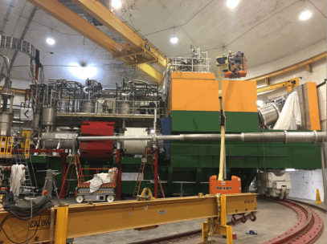
12 GeV CEBAF Upgrade Project Is Complete, On-time and On-Budget!
Secretary of Energy Project Management Achievement Award
Project Completion Approved September 27, 2017

Slide 9
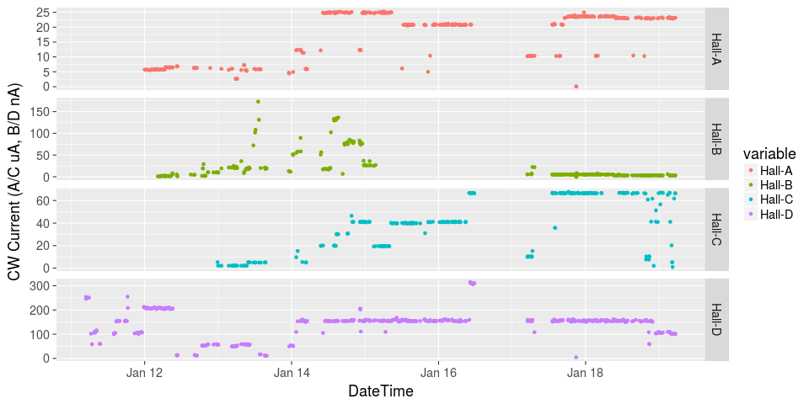
Initiated Four Hall Operation!
μA
A up!
nA
Installation
B up!
Beam Current
Pass Change
μA
C up!
D up!
nA

Slide 10
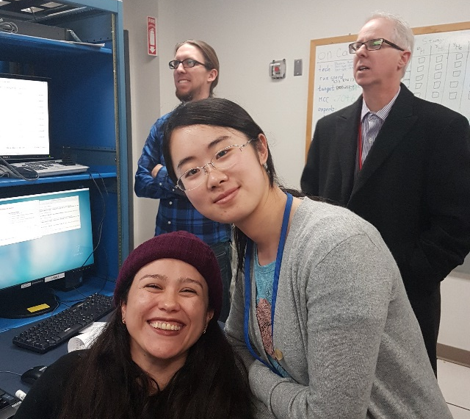
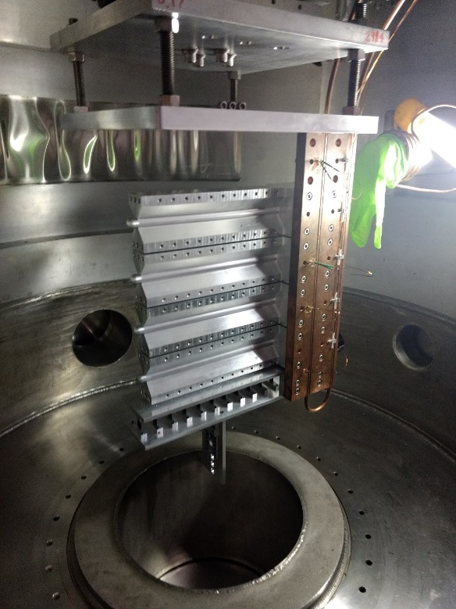
Hall A
First Beam On Tritium Target Cell
On 12/15/17 Hall A put first beam on a tritium target cell – facilitates 4 (3 high impact) experiments!
LEFT Image: Waiting for first beam on the Hall A tritium target: UNH Ph.D. students Nathaly Santiesteban and Shujie Li along with Jefferson Lab postdoc Evan McClellan and lab Director Stuart Henderson.
CENTER Image: Shown are the tritium, He, D target data as compared to running on an empty cell (black). The tritium and other gas targets are clearly visible between the aluminum entrance and exit windows of the target cell.
RIGHT Image: The target cell stack during installation in the Hall A scattering chamber.
MARATHON d/u ratio experiment complete!

Slide 11
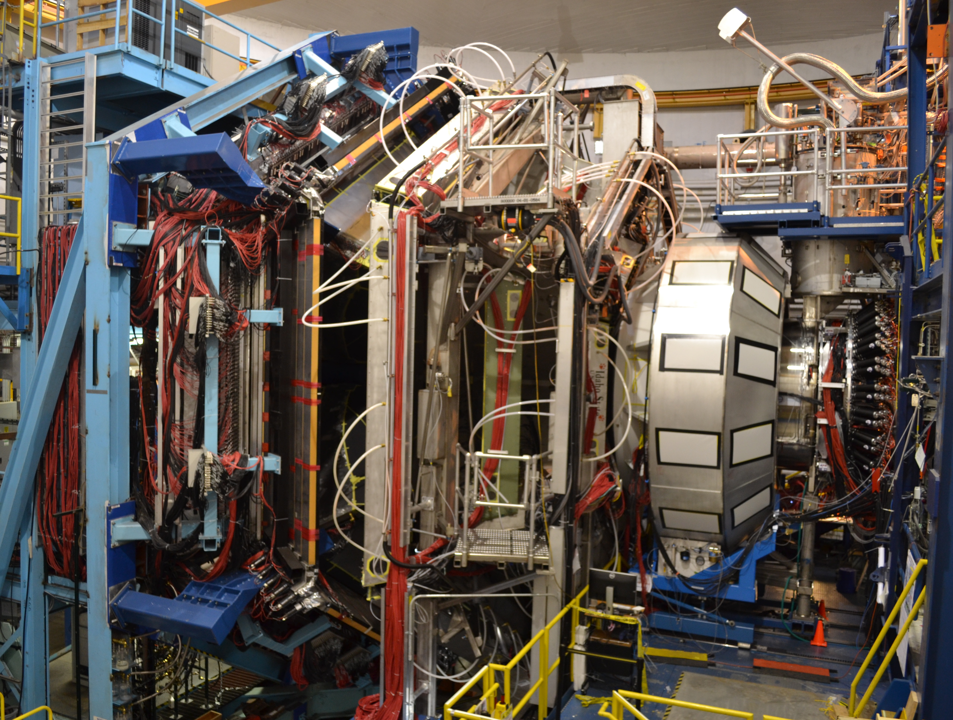
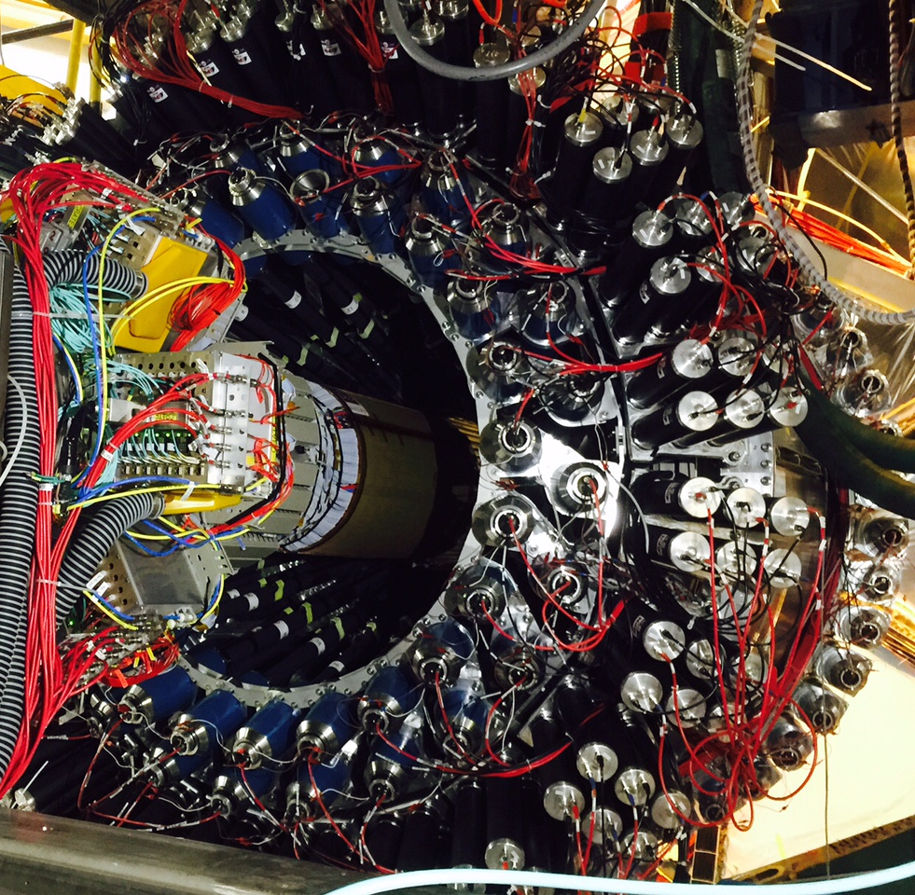
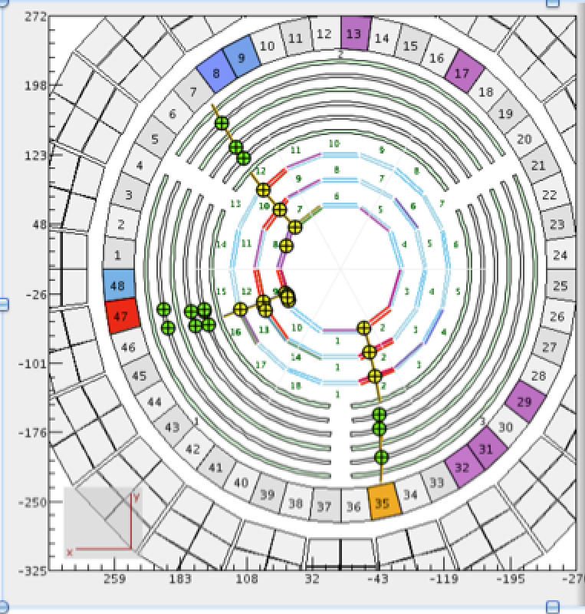
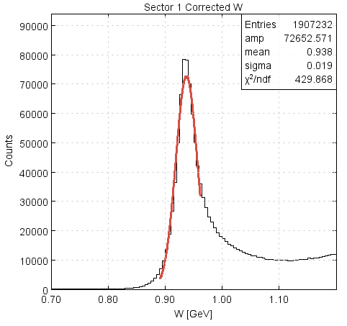
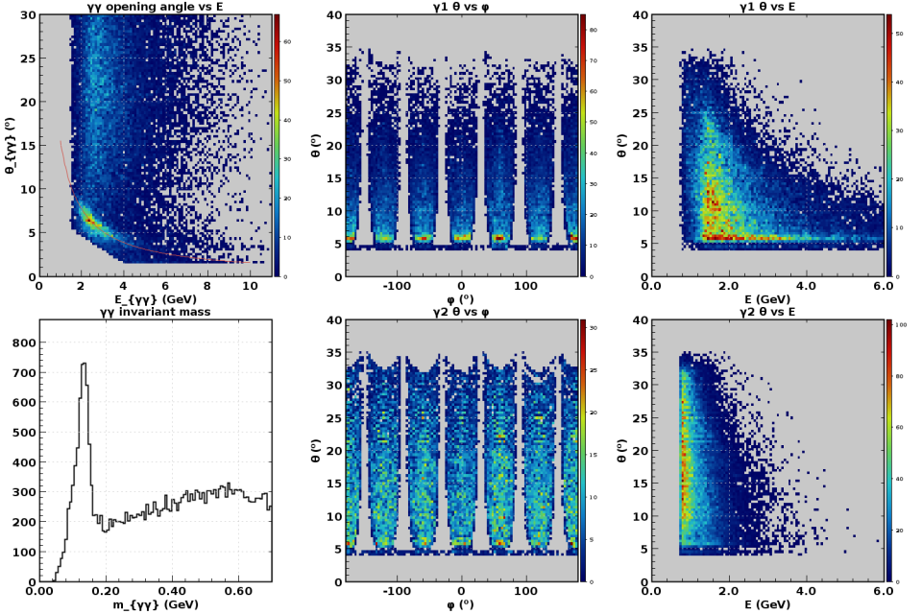
Hall B
CLAS12 Forward Detector
CLAS12 Central Detector with 3 charged particles
p(e,e’)p @ 2.2 GeV
π⁰ @ 10.6 GeV
Detectors were operated during engineering run at luminosities from 0.75 x 10³⁴ to 1.75 x 10³⁵
The latter is nearly twice the design luminosity!
Physics production run started at a luminosity of 0.7 x 10³⁵ – run group A (13 experiments)
π⁰
W (GeV)
m_{γγ}

Slide 12
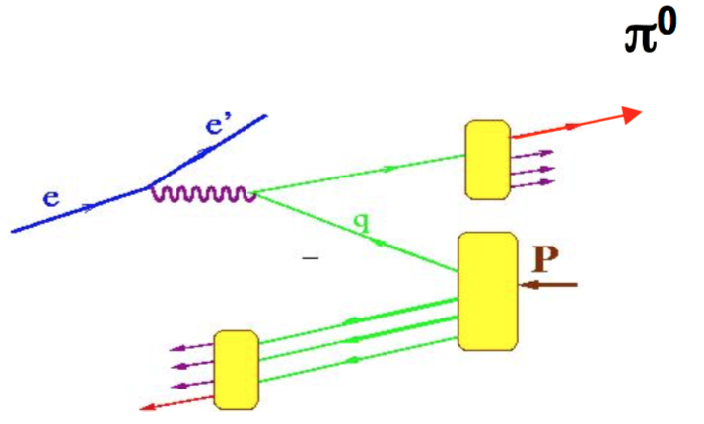
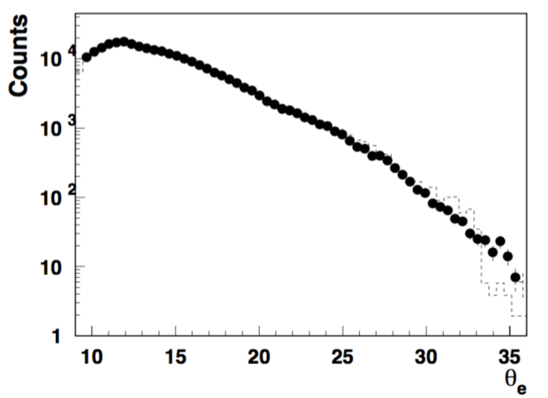
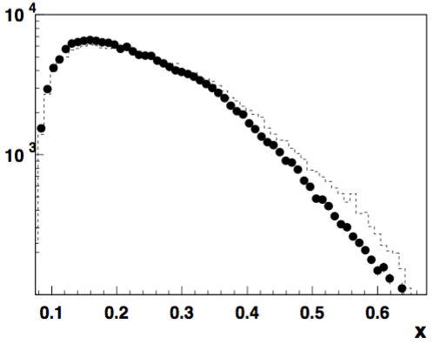
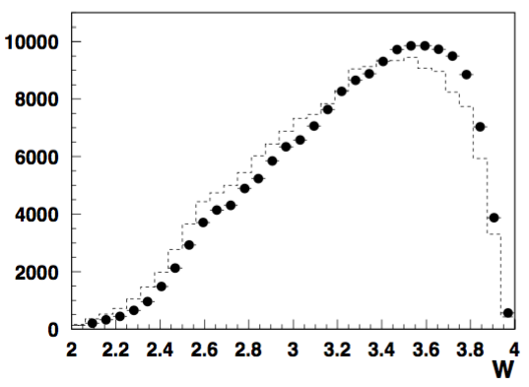
Hall B - CLAS12 - SIDIS: ep → e’π⁰X (First Look at the data)
e’π⁰X/ e'X ratio : Ratio of semi-inclusive π⁰ to inclusive electron need good control over acceptance for neutrals, radiative corrections
In a wide kinematical range scattered lepton distributions are consistent with SIDIS-MC (Lund)
These data represent 0.04% of data from the Spring run

Slide 13
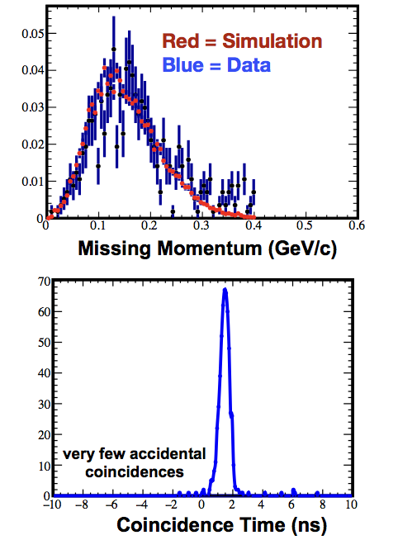
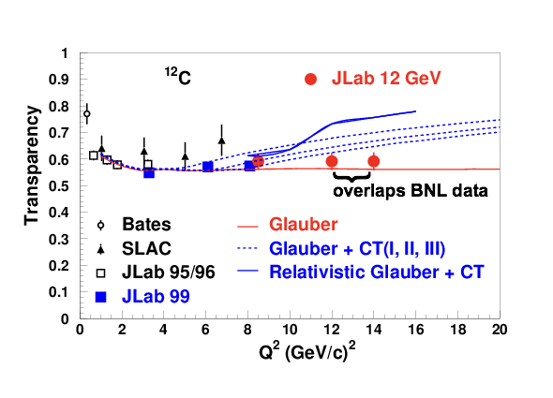
Hall C
SHMS calibration data acquired
Physics Program started:
  F₂^{H,D} structure functions
  D(e,e’p) at high missing momentum
  Color Transparency – ¹²C(e,e’p)
    Data for 2 of 3 points acquired.
    Highest Q² is where BNL A(p,2p) saw rise in transparency
  TMD studies (SIDIS) underway
Online data quality excellent!

Slide 14

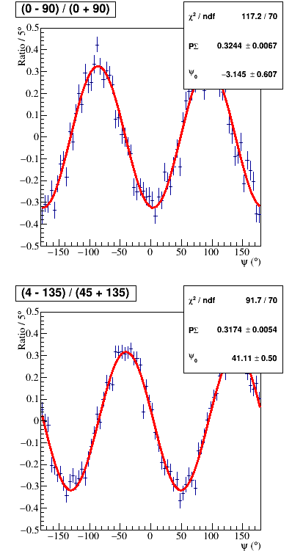
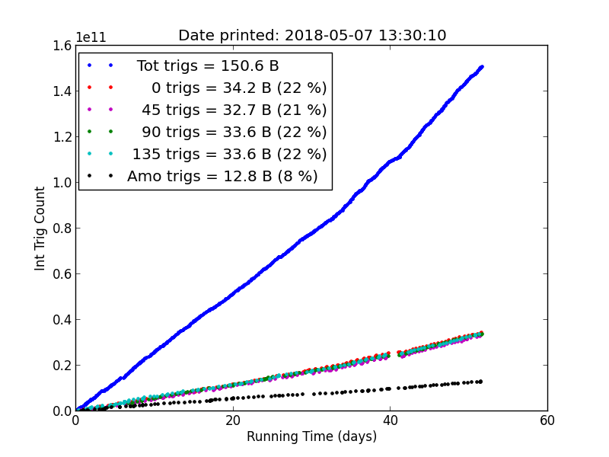

Hall D
Hall D is running GlueX-I (90 PAC days approved)
Spring 2017: 20 PAC days accumulated, ~50B events collected.
Spring 2018: ~150B events collected.
Present estimate: GlueX-I is 80% complete.
Decay asymmetry = ΣP_{beam}, Σ≈1
Data quality monitoring
Beam polarization P_{beam}~35%, similar to 2017
Yields of known resonances are similar to 2017

Slide 15
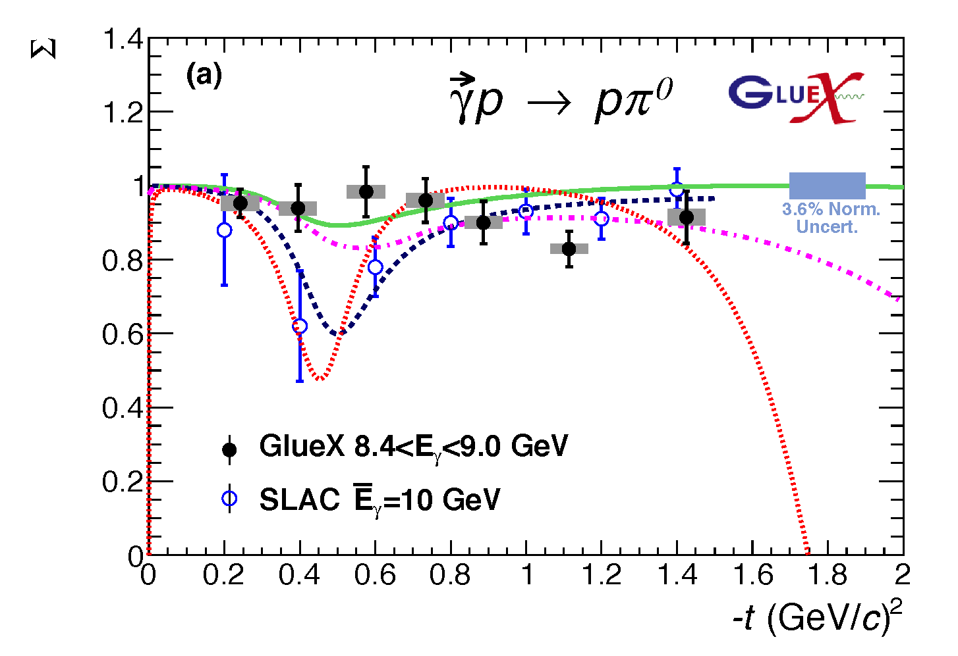

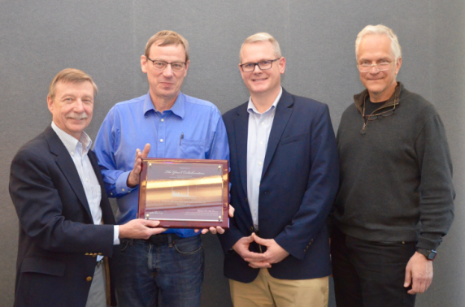
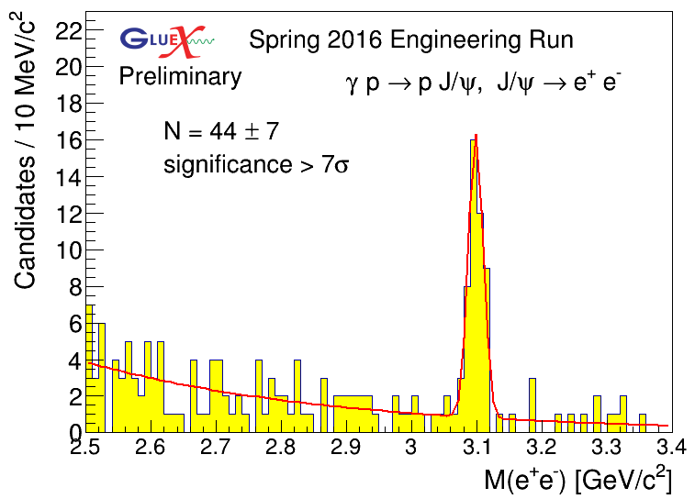
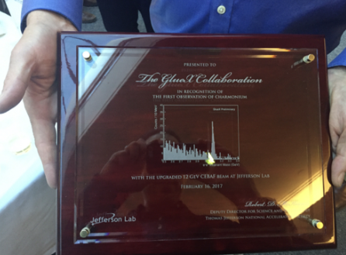
First Published Results from 12 GeV CEBAF
The first experimental results, from data collected in the GlueX engineering run, have been published in Phys. Rev. C.
The new GlueX results show:
• For neutral pions, the reaction mechanism is dominated by pure vector coupling.
• The first data for beam asymmetry for η production >3 GeV.
• The GlueX experiment in Hall D can produce timely results.
Σ
GlueX will search for hybrid mesons, particles in which the strong gluonic field contributes directly to their properties. From the spectrum of these particles, we can learn about the gluonic field in QCD.
Bonus:
First observation of charmonium at JLab!

Slide 16
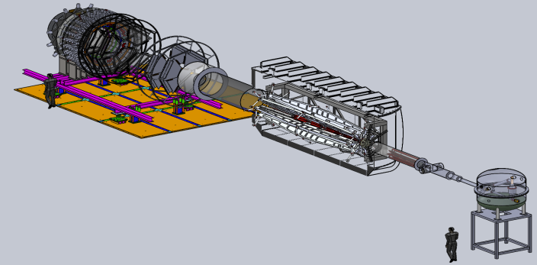
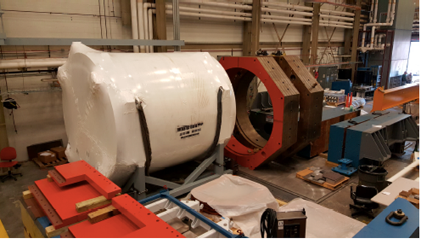

Future Projects
MOLLER experiment
(Possible MIE – FY19-23)
– CD-0 approved
(project paused due to budget)
– Standard Model Test
– DOE science review (September 2014) – strong endorsement
– Director’s review held December 15-16, 2016
– Awaiting green light to proceed
SoLID
– Large acceptance, high lumi
– SIDIS and PVDIS
– CLEO Solenoid 
– International collaboration
– Director’s review (Feb. 2015)
 new pre-CDR complete
– Awaiting science review from ONP
9

Slide 17
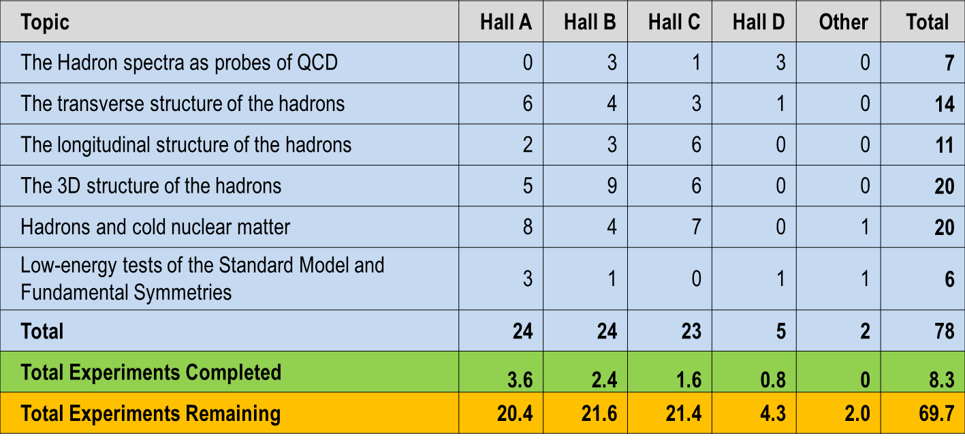
12 GeV Approved Experiments by Physics Topics

Slide 18
12 GeV Approved Experiments by PAC Days
Topic | Hall A | Hall B | Hall C | Hall D | Other | Total
The Hadron spectra as probes of QCD | 0 | 319 | 11 | 540 | 0 | 870
The transverse structure of the hadrons | 150.5 | 185 | 110 | 25 | 0 | 470.5
The longitudinal structure of the hadrons | 65 | 230 | 165 | 0 | 0 | 460
The 3D structure of the hadrons | 409 | 872 | 197 | 0 | 0 | 1478
Hadrons and cold nuclear matter | 220 | 230 | 205 | 0 | 14 | 669
Low-energy tests of the Standard Model and Fundamental Symmetries | 547 | 180 | 0 | 79 | 60 | 866
Total Days | 1392 | 2016 | 688 | 644 | 74 | 4813.5
Total Days - Without SoLID, DarkLIGHT | 917.5 | 2016 | 688 | 644 | 28 | 4294
Total Approved Run Group Days (includes SoLID, DL) | 1392 | 981 | 645 | 444 | 74 | 3536
Total Approved Run Group Days (without SoLID, DL) | 917.5 | 981 | 645 | 444 | 28 | 3016
Total Days Completed | 126 | 44 | 28.3 | 90 | 0 | 288.3
Total Days Remaining | 792 | 937 | 616.8 | 354 | 28 | 2727
“A Decade of Experiments” – could be 8 or 15+ pending budgets etc.

Slide 19
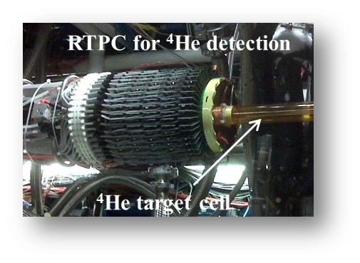

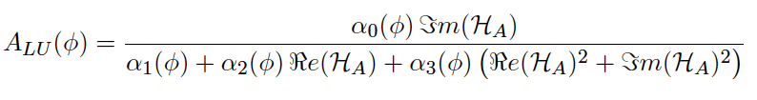
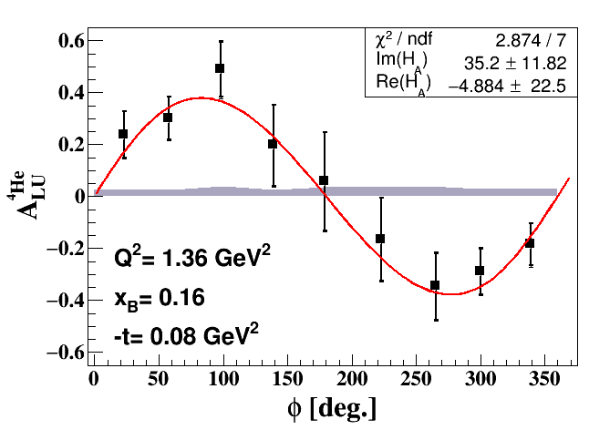
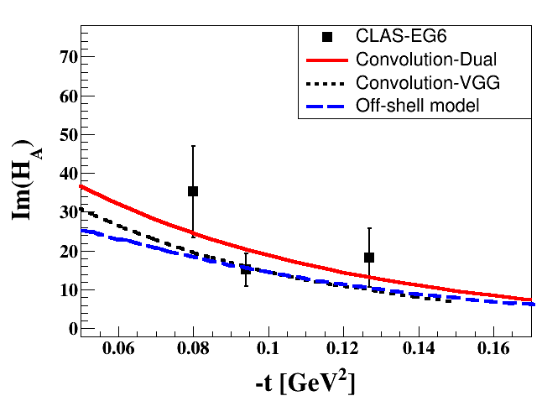
Other Recent 6 GeV Results
DVCS on ⁴He with CLAS; published in PRL: Phys. Rev. Lett. 119, 202004
Multiple nucleon resonances now confirmed; highlighted in Particle Data Group (PDG) tables.
Study the nuclear medium modifications in ⁴He:
one GPD (H_{A}(x,ξ,t)).
State N(mass)J^{P} | PDG pre 2012 | PDG 2018*
N(1710)1/2⁺ | *** | ****
N(1880)1/2⁺ |  | ***
N(1895)1/2⁻ |  | ****
N(1900)3/2⁺ | ** | ****
N(1875)3/2⁻ |  | ***
N(2120)3/2⁻ |  | **
N(2000)5/2⁺ | * | **
N(2060)5/2⁻ |  | **
Δ(2200)7/2⁻ | * | ***
Beam
Asymmetry
**** Existence is certain
*** Existence is very likely
** Evidence of existence is fair
* Evidence of existence is poor
First study of Nuclear GPD  3D Imaging

Slide 20
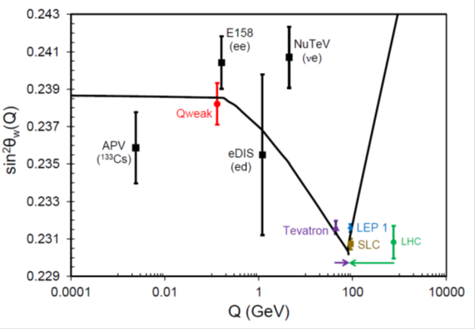

Results Accepted and/or Published in Nature
Final Qweak results published in Nature and in final stages of publication
An accurate calculation of the nucleon axial charge with lattice QCD accepted for publication in Nature.
The weak charge of the proton – “Qweak”, represents the (tiny) difference of the charge of the proton and it’s mirror image
The pressure distribution inside the proton published in Nature
A glimpse of gluons through deeply virtual compton scattering on the proton, published in Nature Communications 8, 1408 (2017). doi:10.1038/s41467-017-01819-3
Analysis of 6 GeV CLAS DVCS data on the proton.
Analysis of 6 GeV Hall A DVCS data on the proton.

Slide 21
Center for Nuclear Femtography
Proposal to Commonwealth of VA
Consortium of VA universities
Theoretical physics, experimental physics, computation, statistics – broad involvement
Initial request of $.5M for pilot study, funding of ~$2M/year envisioned

Slide 22

EIC Developments
National Academies Study underway
  – Co-Chairs: Gordon Baym (UIUC), Ani Aprahamian (Notre Dame)
– First meeting February 1-2, 2017
– Second meeting April 19-20, 2017
– Third meeting September 11-12, 2017
– Expect report in mid-2018
EIC User Group
  Website: http://www.eicug.org/web/
  Steering Committee established
  Bernd Surrow (Temple, Chair), Charles Hyde (ODU, vice Chair)
  Christine Aidala (U. Mich, IB Chair), John Arrington (ANL),
  E. Sichtermann (LBNL), Marco Radici (U Pavia),
  Rik Yoshida (JLab), Thomas Ullrich (BNL), ex-officio
  Daniel Boer (Groningen), European representative
  Yuji Goto (RIKEN), Int’l non-US, non-EU
  2017 EIC UG Meeting in Trieste, Italy – July 18-22
  2018 EIC UG Meeing at CUA in DC, Jul. 30 – Aug. 2

Slide 23


EIC Users Group and International Interest
Formed 2016, currently: 732 members
169 institutions, 29 countries

Slide 24
Recent and Upcoming EIC Events
INT Workshop series:
  Spatial and Momentum Tomography of Hadrons and Nuclei (INT-17-3), August 28, 2017 - September 29, 2017 (I. Cloet, K. Hafidi, Z.-E. Meziani, B. Pasquini)
  The Flavor Structure of Nucleon Sea (INT-17-68W), October 2-13, 2017 (C. Aidala, W. Detmold, J. Qiu, W. Vogelsang)
  Probing Nucleons and Nuclei in High Energy Collisions (INT-18-3), October 1, 2018 - November 18, 2018 (Y. Hatta, Y. Kovchegov, C. Marquet, A. Prokudin)
6th International Workshop on Deep-Inelastic Scattering and Related Topics (DIS 2018), Kobe, Japan, April 16-20, 2018
Physics Opportunities at an ElecTron-Ion Collider (POETIC 2018) conference, Regensburg, Germany, March 19-22, 2018
EICUG meeting 2018 - July 30 – August 4, 2018 / The Catholic University of America hosted by Professor Tanja Horn - Major focus will be on steps after NAS report leading to anticipated CD0 EIC project award!

Slide 25




EIC at Jefferson Lab
JLab EIC Figure 8 Concept
    High Polarization
    High Luminosity
    Energy Range: √s : 20 to 65 - 140 GeV
    (magnet technology choice)
    Low technical risk
    Flexible timeframe for construction
    consistent w/running 12 GeV CEBAF
    Cost effective operations
    Fulfills White Paper Requirements
2015 NSAC recommendation
R&D collaboration with BNL
Collaborations with SLAC, LBNL, ANL
NAS Study underway
Next step would be DOE CD-0
10³⁵
LHC
(
10³⁴
10³³

Slide 26

Electron-Ion Collider Center
The Electron-Ion Collider Center (EIC²@JLab) is an organization to advance and promote the science program at a future electron-ion collider (EIC) facility. Particular emphasis is on the close connection of EIC science to the current Jefferson Lab 12 GeV CEBAF science program.
EIC seminars
Enhance EIC coverage at HUGS and JLab User Meeting
Graduate Fellowships
Postdoctoral Fellowships

Slide 27
Summary
12 GeV science program at JLab is underway
  4 Hall operation is now routine
  A broad program of 78 approved experiments with many opportunities for discovery is planned
  Initial science results are already being reported
Future Equipment projects
  MOLLER: CD0 – hope for FY20 start
  SoLID: Prepare for DOE science review
Future EIC project taking shape, much activity

Slide 28


Gravitational Structure of the Proton
Latifa Elouadrhiri
Jefferson Lab

Slide 29


Probing basic properties of the Proton
Electro-magnetic properties: probed w/ photons interpretation in the infinite momentum frame in 1- or in 2-dimensions.
  Charge: electromagnetic form factors, inelastic structure functions, the proton charge radius, charge densities
  Spin: helicity densities
Gravito-mechanical properties: probed w/ gravitons and interpretation in 3-dimensions
  Mass, gravitational form factors, mechanical radius, mass & energy densities
  Shear forces, pressure distributions
  Spin - orbital angular momentum distribution
F₁(t) F₂(t)

Slide 30


Deeply Virtual Compton Scattering (DVCS)
DVCS and Generalized Parton Distributions
x: average fraction of quark
longitudinal momentum
:fraction of longitudinal
momentum transfer
~
~
H, E, H, E : Generalized Parton Distributions (GPDs)
3-D Imaging conjointly in transverse impact parameter and longitudinal momentum

Slide 31

The GPDs - GFFs Correspondence
Nucleon matrix element of the Energy-Momentum Tensor contains three scalar form factors (R. Pagels, 1966) and can be written as (X. Ji, 1997):
M₂(t) : Mass distribution inside the nucleon
J (t) : Angular momentum distribution
d₁(t) : Forces and pressure distribution
Graviton scattering
p
Gp => p
GPDs
GFFs
G
p
DVCS
p
γ
γγp => p
γ
p
X. Ji, Phys. Rev. Lett. 78, 610 (1997)
X. Ji, Phys. Rev. D55, 7114 (1997)

Slide 32

From GFF to mechanical properties
How is d₁(t) related to the pressure distribution?
d₁(t)
p(r)
M. Polyakov, Phys.Lett. B555 (2003) 57

Slide 33


Results for d₁(t)
Parameterization of d₁(t)
Fit is consistent with α = 3 =>
Fix α = 3 to be consistent with dimensional scaling limits.
d₁(t=0) = - 2.04 ± 0.14(stat) ± 0.33
The negative sign of d₁ at t = 0 is required to provide the proton’s stability.

Slide 34


The pressure distribution inside the proton
Repulsive pressure at
r < 0.6 fm <p> 10³⁵ Pa
Confining pressure at
r > 0.6 fm
Atmospheric pressure: 10⁵ Pa
Pressure in the center of neutron stars < 10³⁴ Pa

Slide 35


Gravitational Structure of the Proton
The forces and
and pressure
inside the
proton
V.D. BURKERT
L. ELOUADRHIRI
F.X. GIROD

Slide 36
Start mapping out for the first time the gravitational form factors which encodes the shear forces on the quarks and pressure distribution in the proton
  First measurement of the pressure inside the proton published
This work opens up a new area of research on the fundamental gravitational properties of protons, neutrons and nuclei, which can provide access to their physical radii, the internal shear forces acting on the quarks and their pressure distributions.
Next generation of experiments with 12 GeV upgrade has started

Slide 37
THANK YOU

Slide 38

This is a very exciting time for us at Jefferson Lab
@latifaelou

Slide 39

DVCS Experiment
Measured both asymmetries and cross sections

Slide 40



Analysis of DVCS data to determine Im(H)
Samples of differential cross sections
Samples of Beam Spin Asymmetry
DVCS - BSA
H.S. Jo et al., Phys.Rev.Lett. 115 (2015) 212003, F.X. Girod et al., Phys.Rev.Lett. 100 (2008) 162002

Slide 41





Dispersion relation analysis
Compton Form Factor H
Subtracted Dispersion Relation at fixed-t
Relation between D(t) and d₁(t)

Slide 42

Comparison with χQSM
Gravitational form factors may be computed in LQCD, e.g. GFF J(t=0) has been computed to determine the proton spin decomposition. No LQCD results exist for d₁(t).
The single model to compute d₁(t) is chiral quark-soliton model (χQSM); K. Goeke et al, Phys.Rev. D75 (2007) 094021. The proton is modeled as a chiral soliton with the constituent quarks bound by a self-consistent pion field.
χQSM, K. Goeke et al.
r²p(r) (GeV fm⁻¹)
χQSM: d₁(0) ≈ -4
d₁(0) = -2.04 ± 0.14 ± 0.33
The d₁(t=0) < 0 is rooted in the spontaneous chiral symmetry breaking (cSB). It relates to the transition from the QGP phase to the phase of confined quarks and gluons in the early Universe. The pion field provides the confining pressure at the proton’s periphery.

