Slide 1
Welc0me to QCD Evolution 2018
Ivan Vitev
Santa Fe, NM
May 20-24, 2018

Slide 2
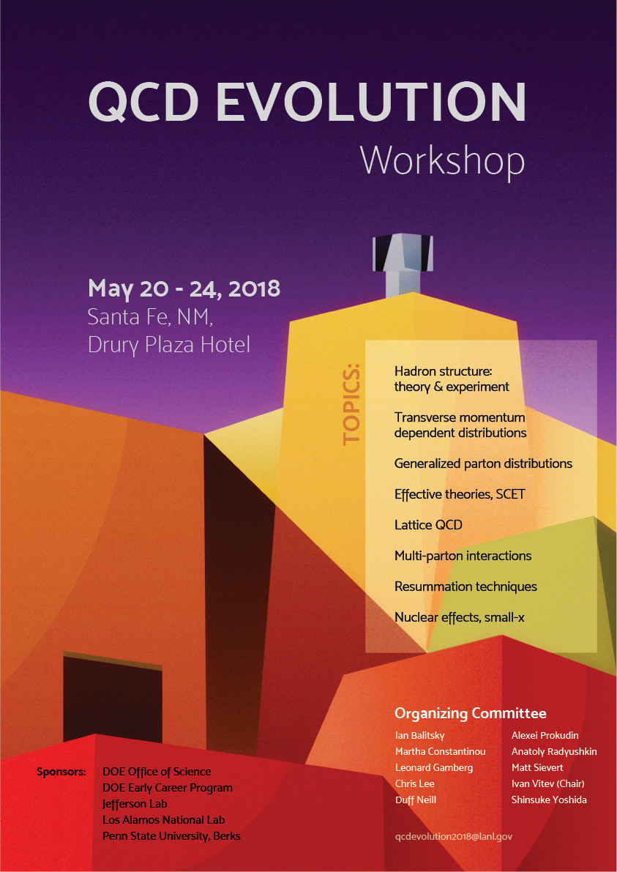
History of the Workshop
Was started in 2011 by Alexei, Ian and Anatoly. Has grown to become a major conference in the field
QCD Evolution 2017 Jefferson Lab, Newport News, VA QCD Evolution 2016 Nikhef, Amsterdam, Netherlands QCD Evolution 2015 Jefferson Lab, Newport News, VA QCD Evolution 2014 Los Alamos National Lab, Los Alamon, NM QCD Evolution 2013 Jefferson Lab, Newport News, VA QCD Evolution 2012 Jefferson Lab, Newport News, VA QCD Evolution 2011 Jefferson Lab, Newport News, VA

Slide 3
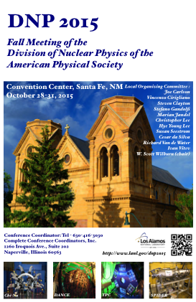
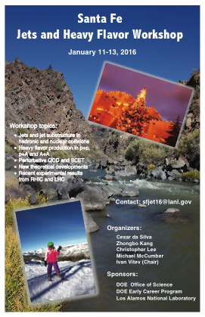
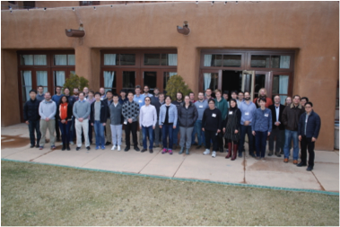
Delighted to Host QCD Evolution
Excited to be part of the community that pushes the boundaries of QCD research. We have organized a wide range of events for the nuclear physics community
Our vision is broadening and merging of interests from NP and HEP communities to advance QCD, understand the structure of nucleons and nuclei at current and future facilities in the US and abroad
Find a balance of senior and junior (student/postdoc) participants

Slide 4
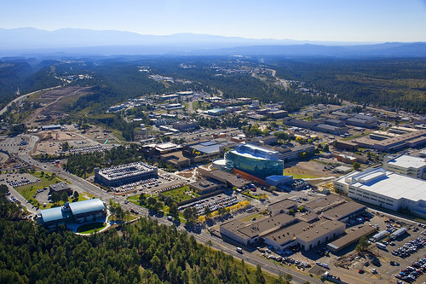
Local Organizers: Los Alamos National Laboratory
LANL is the largest National laboratory (under NNSA) (~11,700 staff, contractors, students, postdocs )
LANL is the largest institution and employer in Northern New Mexico, $2.5 billion budget
T-2 group: Nuclear and Particle Physics, Astrophysics and Cosmology. More that 50 staff, postdoctoral fellows, students, visitors and affiliated scientists
Local support available / local organizers: Lee, Neill, Sievert, Vitev, Yoshida

Slide 5
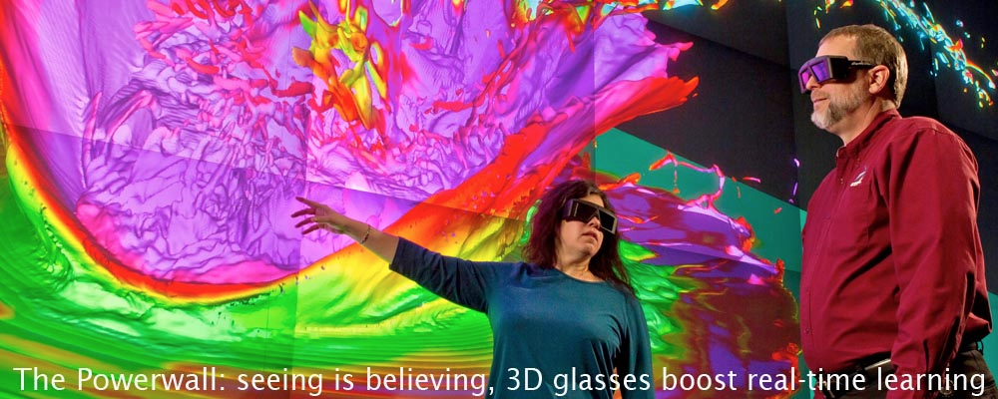
Local Organizers: Los Alamos National Laboratory
LANL is the largest National laboratory (under NNSA) (~11,700 staff, contractors, students, postdocs )
LANL is the largest institution and employer in Northern New Mexico, $2.5 billion budget
Primary mission is national security. Includes but not limited to applied nuclear research

Slide 6
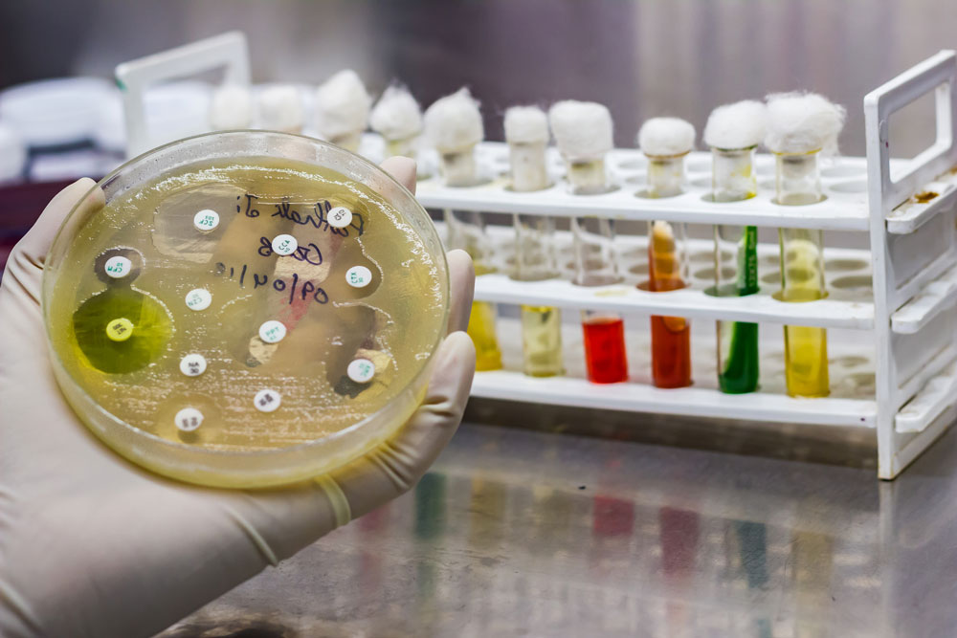
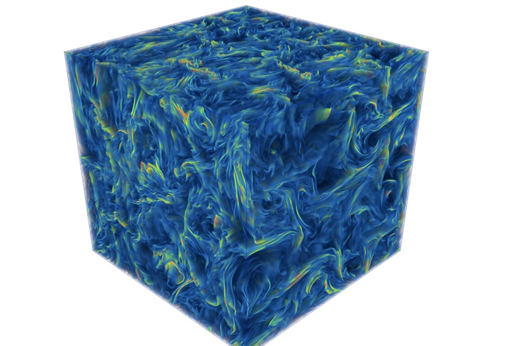
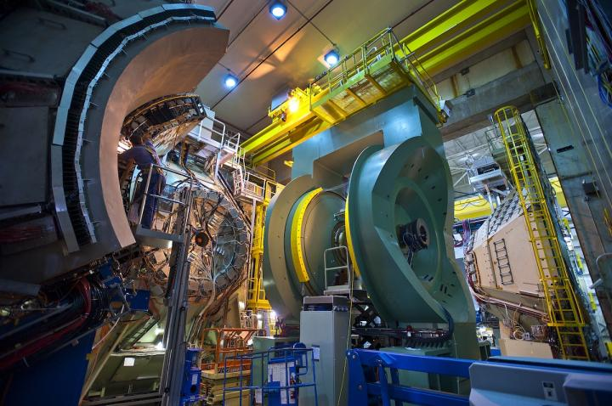
Basic Science
Nuclear and Particle Physics, Astrophysics, Cosmology, Biology, Chemistry, Applied mathematics, Plasma Physics, Environmental Sciences, Geophysics, Energy, Computer Science, Data Science

Slide 7
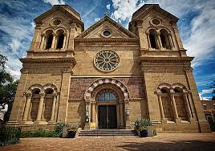
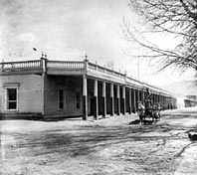
Santa Fe
Second oldest city in the U.S. (1607)
Capital of New Mexico. Fourth largest city in NM. (Oldest capital 1610)
Premier vacation destination. Cultural and outdoor recreation center
Excellent hotels with conference facilities
10 min walking distance to the Plaza/downtown Santa Fe, restaurants, museums, and shops

Slide 8
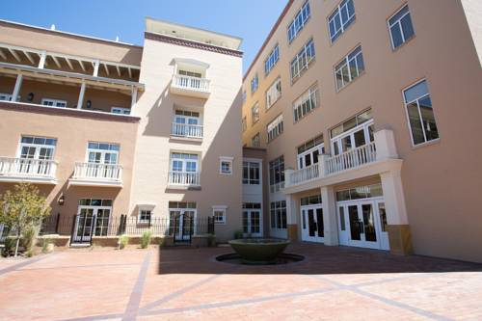
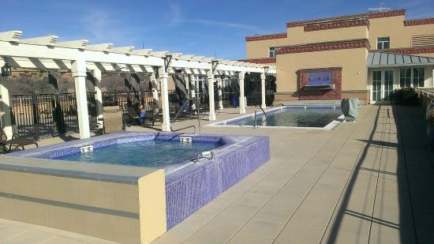
The Drury Hotel
In 1865 Sisters of Charity come to Santa Fe to start a hospital and treat the sic and the poor
The first hospital was opened in the old Seminary and functioned for more than 50 years
By the 1950s the Sisters of Charity completely ran out of rooms
A new building for the hospital –original St. Vincent’s hospital. Designed by local architect John Gaw Meem- Territorial Revival Style
Hospital moved 1977. Occupied by Mew Mexico Cultural affairs
The hotel opened in 2007 and is one of the newest hotels in Santa Fe

Slide 9
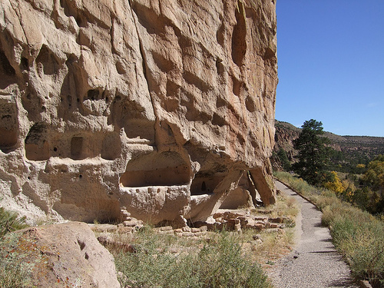
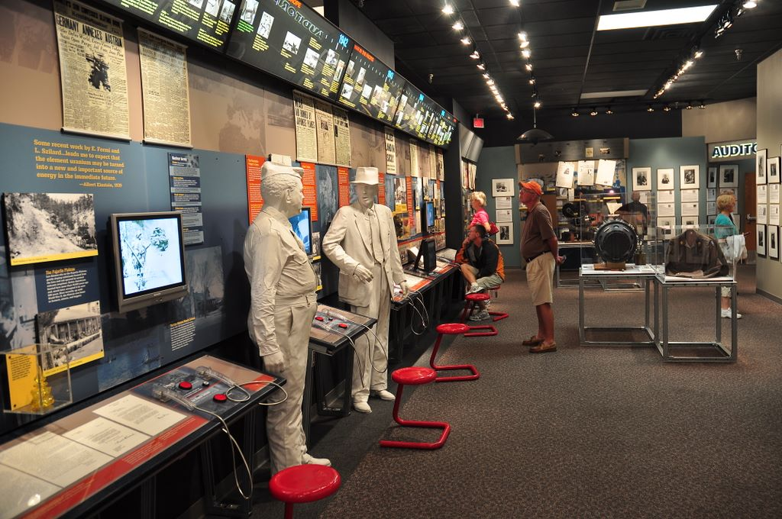
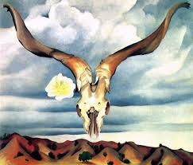
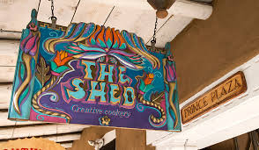
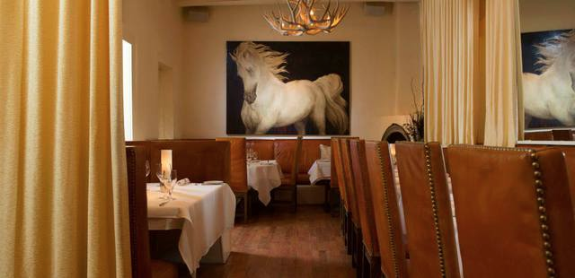
Attractions
Hiking: Atalaya peak, Windsor trail
Trip: Bandelier National Monument or Los Alamos
Santa Fe museums
World class restaurants – Geronimo, The Compound …

Slide 10
Have a Productive Workshop!
Reception, Today Sunday 6pm in Lamy Room
Tuesday Afternoon free
Conference Dinner Tuesday 6pm in Lamy Room

Slide 11
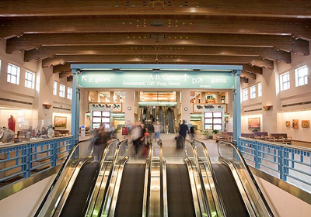
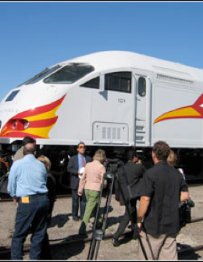
Transportation
Major airport Albuquerque, ~50 miles south of Santa Fe
Local municipal airport in Santa Fe
Railroad connection – the Railrunner
Rental cars at airport
Sandia Shuttle Express
Taxi service - Capitol City Cab

