Slide 1
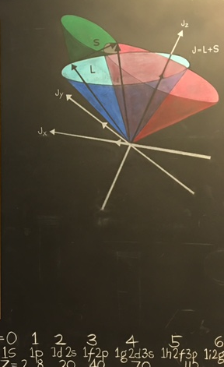
Energy Momentum Tensor for spin 0, ½ and 1 systems
Qcd evolution 2018 santa fe (NM) may 20-24, 2018
Simonetta Liuti
University of Virginia

Slide 2

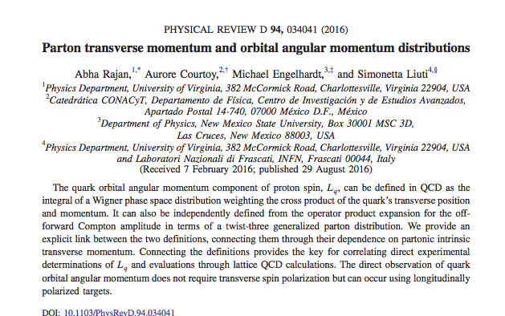
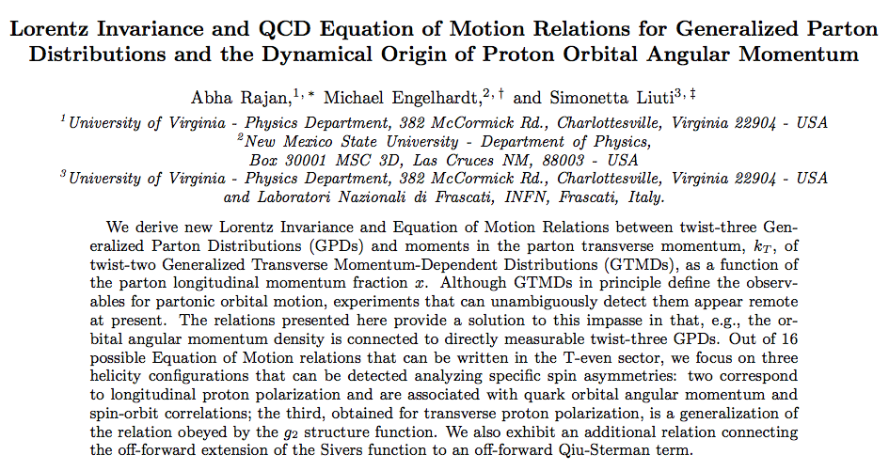
Based on
arXiv:1709.05770

Slide 3



Slide 4
Outline
DVCS and OPE a Moments of GPDs
EMT
  EMT in QCD
  Physical Interpretation/Parametrization for spin 0 ½ 1
Sum rules a connection with moments
Wandzura Wilczek relations and Orbital Angular Momentum
    x moments
    other helicity configurations
To do list…

Slide 5
1. DVCS and OPE

Slide 6
Theoretical Framework: OPE and geometric twist
Q²
Q²
Local Operator Ô
μ
ν
μ
ν
P
W²
P
P
P
W²
… at twist 2
short distance behavior
quark/gluon large distance structure
Mellin Moments

Slide 7

The matrix element of a bi-local operator contains operators of different twist
Example
tw 2
tw 4
Each one of the PDFs corresponds to its own tower of operators/OPE expansion

Slide 8
In a nutshell:
OPE in QCD allows us to order the matrix element by dominant LC singularities while separating out the long and short distance components
Lorentz invariant concept, defined through space-time properties/geometry, independently from quark and gluon dynamics

Slide 9
DVCS
q’
q
Local Operator Ô
μ
ν
p
p’
p
p’
Q²>>M² ➔ “deep”
W²>>M² ➔ equivalent to an “inelastic” process but not directly accessible

Slide 10
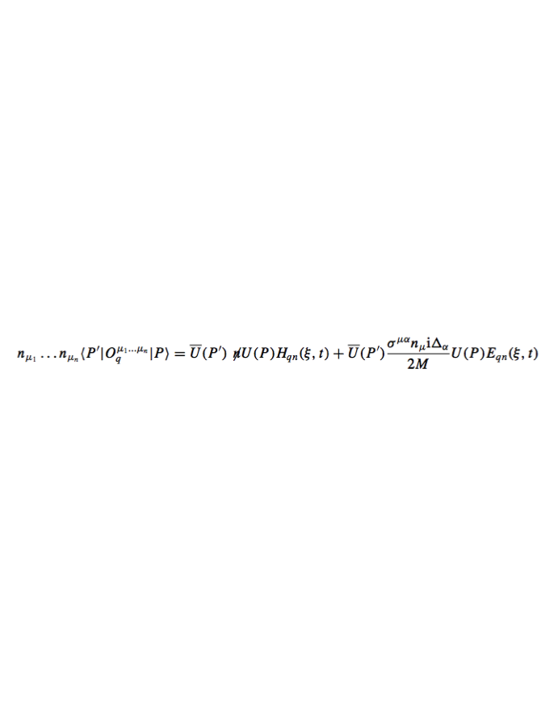
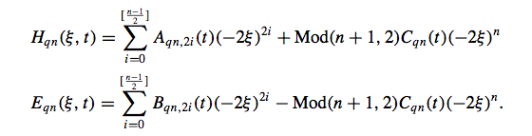
OPE (X. Ji, 1998)
helicity conserving
helicity flip
Mellin Moments

Slide 11
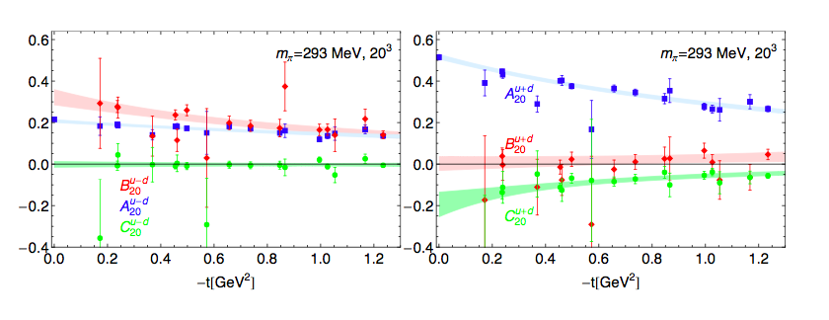
A₂₀, B₂₀, C₂₀
Ph. Haegler, JoP: 295 (2011) 012009
u-d
u+d
Gluons: see Phiala Shanahan’s recent work

Slide 12
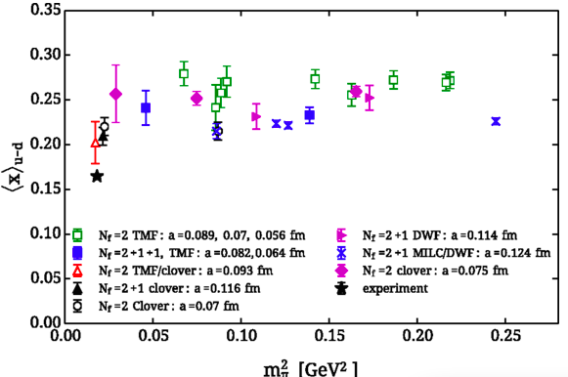
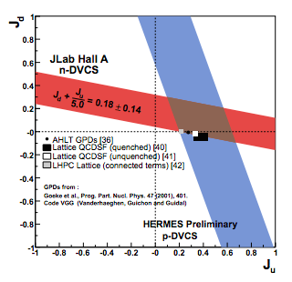
ETMC, Phys. Rev. D 92 , 114513 (2015)
A₂₀
C₂₀
~
B₂₀
A₂₀
Chiral Odd sector
PNDME
Q²=4 GeV²
LHPC
RQCD
Single jet SIDIS
DihadronFF
DVMP
Jlab Hall A, Mazouz et al. PRL
Notes:
This slide should have experimental results on moments and lattice: <x>, d (recent) and J (Mazous) and chiral odd (Courtoy)

Slide 13
2. Energy momentum tensor

Slide 14
Scalar Field
Lagrangian density
Energy, momentum and angular momentum conservation follow from the invariance of L under translations and rotations
translation inv. continuity equation
quantization at equal times
define
rotation inv. continuity equation

Slide 15
Four conserved quantities from translation invariance
Six conserved quantities from rotational invariance

Slide 16
QED/QCD Energy Momentum Tensor
T^{μν}
Energy density
T⁰⁰ | T⁰¹ | T⁰² | T⁰³
T¹⁰ | T¹¹ | T¹² | T¹³
T²⁰ | T²¹ | T²² | T²³
T³⁰ | T³¹ | T³² | T³³
Shear stress
Momentum density
Pressure
5/24/18
Simonetta Liuti
16

Slide 17
Several (still) open issues in QCD…
Conditions of gauge invariance and conservation: symmetric, traceless
The canonical QCD EMT is not symmetric and traceless
-- the trace part of the tensor is the origin of the mass anomaly
-- the anti-symmetric part vanishes upon using the QCD EoM (X.Ji, PRD52, 1995)
Notes:
canonical energy-momentum tensor is really an unphysical object resulting from
a formal construction: it is neither canonical nor does it represent the physical energy
or momentum density of anything.

Slide 18
The energy momentum tensor matrix element in spherically symmetric systems
S=0
S=1/2

Slide 19
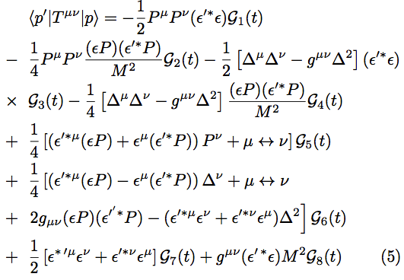

Energy Momentum Tensor in a spin 1 system
(Taneja, Kathuria, SL, Goldstein, PRD86(2012)

Slide 20

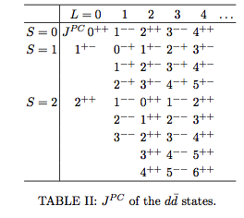
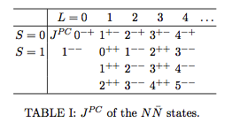
General rule to count form factors: t-channel J^{PC} q. numbers
Match to RHS
Haegler, PLB(2004)
Z.Chen&Ji, PRD(2005)
Deuteron
Nucleon
3
7
Both S and L states considered

Slide 21
3. Sum rules

Slide 22
Spin and 3D structure of Deuteron
Angular Momentum Sum Rule in deuteron
Taneja et al., Phys. Rev. D 86, 036008 (2012)
22
Angular Momentum Sum Rule in proton (Ji)

Slide 23
In terms of EMT form factors
Proton
Deuteron
Momentum
Momentum
OAM
OAM

Slide 24
Physical Interpretation
Form factors
Inclusive Observables

Slide 25
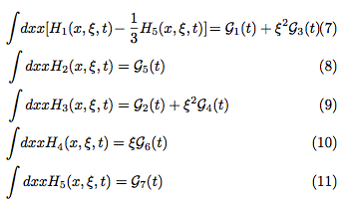
2nd moments
Nucleon
D-term
Deuteron
Charge/Momentum
Angular Momentum
Quadrupole
T-odd
Connected to b₁ SR
Two independent D-terms!

Slide 26
Interpretation of D-term(s) in terms of shear forces: work in progress with Adam Freese, Ian Cloet and Whitney Armstrong

Slide 27
4. WW relations and OAM

Slide 28
Is OAM of twist two or three and why?

Slide 29
Origin of Wandzura Wilczek relations
The difference between the Lorentz invariant structure of OPE and light front quantization produces a mismatch in the geometric and dynamic twist terms of higher twist
The Wandzura-Wilczek (WW) relations are a rendition of this mismatch.
In polarized electron scattering
kinematic tw 3
(measured)
geometric tw 3
twist 2

Slide 30
The Wandzura Wilczek relations are derived in two steps
1. Lorentz Invariance Relations (LIR) and gauge link structure
twist 3 str.func.
tw 3 from
gauge link
2. QCD Equations of Motion (EoM)
sum of tw 3 from
gauge link plus genuine qgq

Slide 31
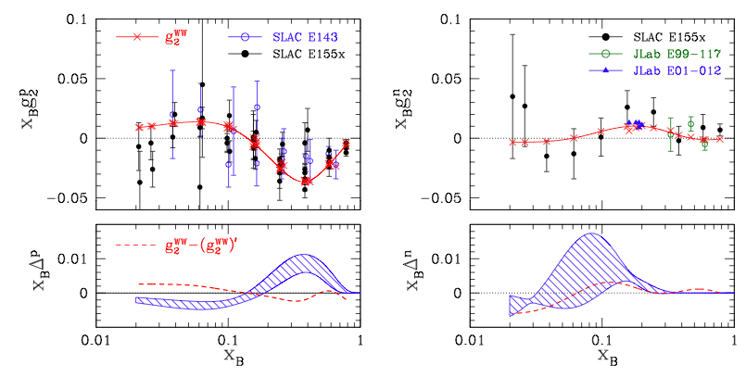
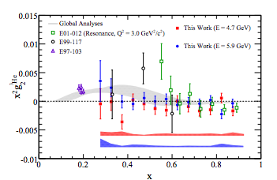
Accardi, Bacchetta, Melnitchouk, Schlegel
JHEP (2009)
The effect of the two twist-three terms combined might be small, each individual contribution can be large, however, it cannot be disentangled.
D. Flay et al, PRC 2016

Slide 32
Partonic OAM: Wigner Distributions
Hatta
Lorce, Pasquini,
Xiong, Yuan
Mukherjee
k_{T}
k_{T}
b
L
P
5/24/18
Simonetta Liuti
32

Slide 33
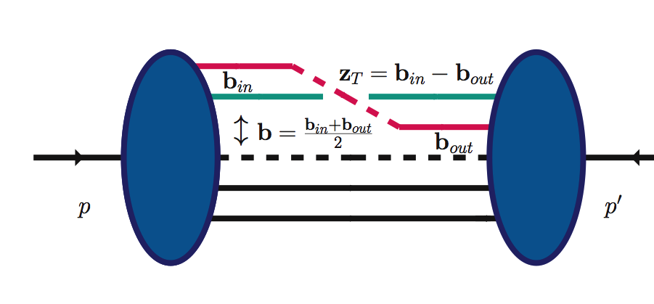
Wigner Distribution and qq correlation function
33
GTMD
5/24/18
p-p’=Δ
Δ_{T} Fourier conjugate: b = transverse position of the quark inside the proton
k_{T} Fourier conjugate: z_{T}= transverse distance traveled by the struck quark between the initial and final scattering

Slide 34

Possible Observable for L_{q}
Simonetta Liuti
34
L_{q}(x)
ξ=0
k_{T}•Δ_{T}=0
Δ_{T}²=0
k_{T} moment of a GTMD
(Lorce and Pasquini)
Can it be measured?
Is there any observable that we can identify OAM with?

Slide 35
A New Relation
A. Rajan, A. Courtoy, M. Engelhardt, S.L., PRD (2016), arXiv:1601.06117
A. Rajan, M. Engelhardt, S.L., submitted to PRD arXiv:1709.05770
Through Generalized Lorentz Invariance Relation (LIR) F₁₄ is connected to twist 3 GPDs
*Different notation!
Polyakov et al.
Meissner, Metz and Schlegel, JHEP(2009)

Slide 36
Generalized LIR
36
z⁻,z_{T}
Generalized LIR for a staple link
∞,z_{T}
0,0
∞,0
LIR violating term
Directly calculable!

Slide 37
Using the QCD EoM to eliminate F₁₄
Straight link
WW term
genuine twist three term
v=0
Staple link
v ≠0
from the staple
Notes:
The genuine twist three comes in through the covariant derivative

Slide 38

LIR violating term is the difference between JM and Ji
Generalized Qiu Sterman term

Slide 39
Integrating over x (either staple or straight links) we re-obtain the OPE based relation
Polyakov et al.(2000), Hatta(2012)
A generalized Wandzura Wilczek relation obtained using OPE for twist 2 and twist 3 operators for the off-forward matrix elements
Staple or straight link treatments always give Ji OAM

Slide 40
Clarifying a few open issues in the literature
The genuine twist 3 term for a staple link contains an extra term that gives JM OAM
The genuine twist 3 term for a straight link does not have this term
An experimental measurement of twist 3 GPDs is sensitive to OAM but it cannot disentangle the difference between JM and Ji decompositions
Similarly, the LIR term does not impact the extraction of the genuine twist 3 contribution to polarized DIS (g₂).

Slide 41

Low x!
≠F₁₄!
Abha Rajan et al., arXiv:1601.06117
G₂
u quark
genuine tw 3
total
WW

Slide 42
4.1 x moments

Slide 43
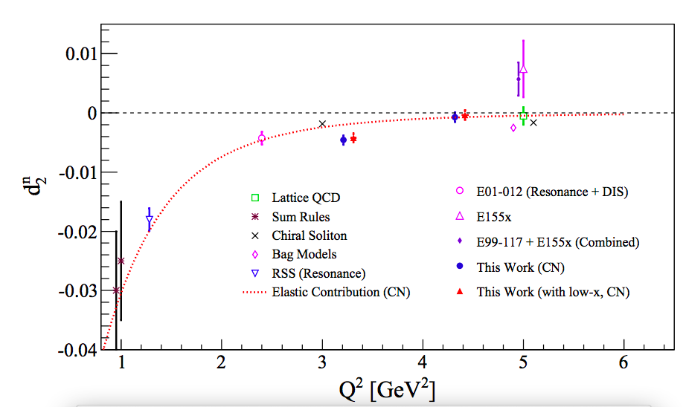
Generalized Burkhardt Cottingham
M₁
M₂
OAM Sum Rule
M₃
Genuine twist three d₂
Lattice calculation

Slide 44
Interpretation
M₂(v⁻)
Force acting on quark
Non zero only for staple link
M₃(v⁻=0)

Slide 45
Relations between derivatives

Slide 46
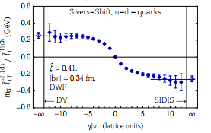
Proton transverse spin configuration
Genuine twist three d₂
Slope of Sivers function in staple length

Slide 47
quantitative results being worked on now…

Slide 48
4.2 Other helicity constructs

Slide 49
SPIN ORBIT
Lorentz Invariance Relation
Use EoM to eliminate G₁₁

Slide 50
x moments
Generalized Burkhardt Cottingham
M₁
total spin orbit
M₂
M₃

Slide 51
GENERALIZED SIVERS
Lorentz Invariance Relation
0

Slide 52
GENERALIZED WORM-GEAR
Lorentz Invariance Relation
g_{1T}
Use EoM to eliminate G₁₂ leads to off-forward extension of

Slide 53
CHIRAL ODD SECTOR
Lorentz Invariance Relation
forward
Use EoM to eliminate H₁₇ leads to off forward WW relation

Slide 54
How do we detect all this?
Experiment
Pheno
Theory

Slide 55
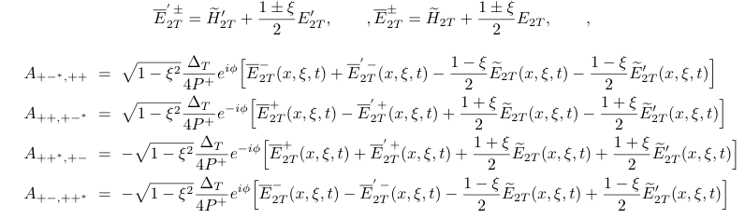
8 twist 3 GPDs = 4 vector + 4 axial-vec.
(parametrization by Meissner, Metz and Schlegel)
8 helicity amps. =4 flip + 4 non-flip
e.g. non-flip
Work in progress: Brandon Kriesten, Abha Rajan

Slide 56
Multi-process, multi-variable analysis
Deeply Virtual Compton Scattering
Deeply Virtual Meson Production
Timelike Compton Scattering
Double DVCS
DVCS, TCS with Recoil Polarization
Need EIC to carry out this program

Slide 57
Quark sector :
q=u-d
A. Rajan et al, PRD (2016) arXiv:1601.06117
J_{q}
EXPERIMENT
=0.633(12)
EXPERIMENT
M. Engelhardt (PRD, 2017)
Lattice LHPC
L_{q}
THEORY

Slide 58
M. Engelhardt, PRD (2017)

Slide 59
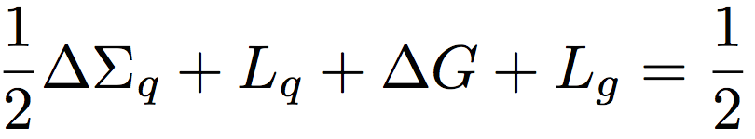
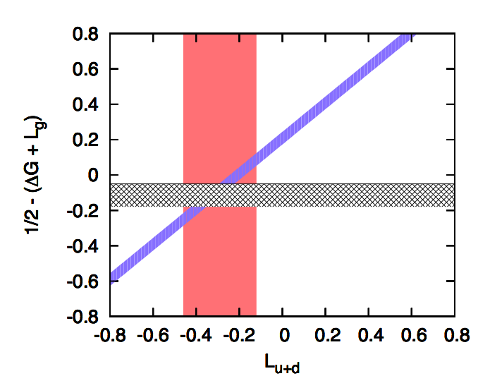
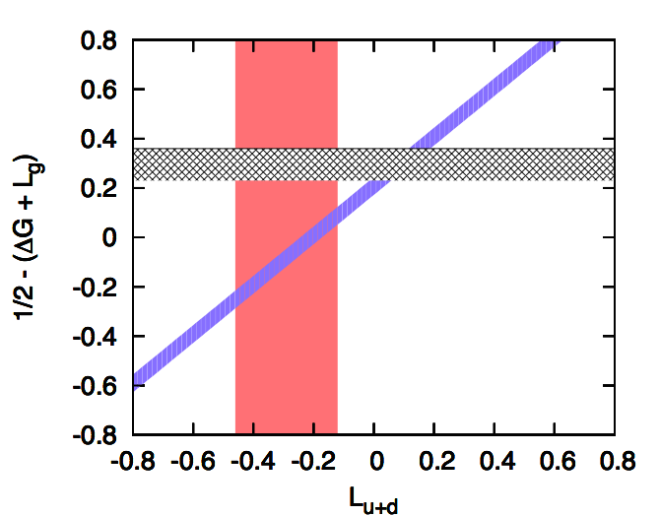
EIC ➔ Adding gluons: Jaffe Manohar Sum Rule
L_{g}=0
Using the “estimated” measured value of ΔG
ΔΣ_{u+d}
L_{g}=-0.4
M. Engelhardt, preliminary
Lattice QCD evaluation of GTMD F₁₄+ gauge link
5/24/18
59

Slide 60
Conclusions and Outlook
The connection established through the new relations between (G)TMDs and Twist 3 GPDs, not only allows us to evaluate the angular momentum sum rule, it also opens many interesting avenues:
It allows us to study in detail the role of quark-gluon correlations, in a framework where the role of k_{T} and off-shellness, k², is manifest.
OAM was obtained so far by subtraction (also in lattice). We can now both calculate OAM on the lattice (GTMD) and validate this through measurements (twist 3 GPD)
It provides an ideal setting to test renormalization issues, evolution etc…
QCD studies at the amplitude level shed light on chiral symmetry breaking
TWIST THREE OBJECTS ARE CRUCIAL TO STUDY QCD AT THE AMPLITUDE LEVEL
Notes:
However, in the definition of these distributions, care must be applied to ensure manifest gauge invariance. In general, this can be accomplished by connecting any non- local correlation function with a Wilson-line gauge link. Specifying a Wilson-line gauge link requires selecting a path along which the vector potential is evaluated. The choice of path raises the immediate issue of how the quantities defined using Wigner distributions (TMDs, OAM, . . .) depend on that choice.

