Slide 1
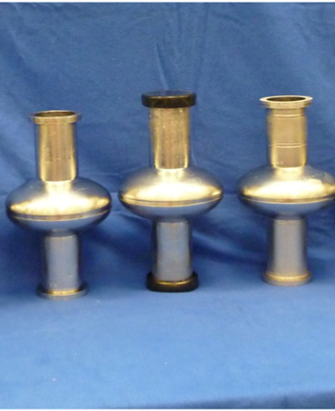
Update from single-cell low temperature doping runs at JLab
TTC High-Q Working Group - 16
Pashupati Dhakal

Slide 2
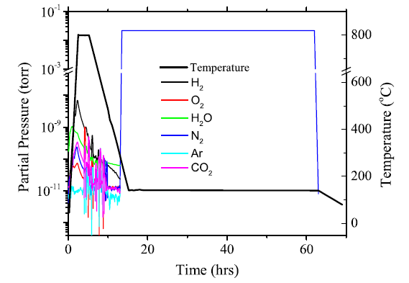
Earlier Results
1.5 GHz single-cell fine-grain Nb cavity (RRR>300)
N-infusion: 800 °C/3h, N₂ at ~25 mTorr at 290°C, cooling to hold temperature maintained for 48 h
P. Dhakal et al., Phys. Rev. Accel. Beams. 21, 032001 (2018)

Slide 3
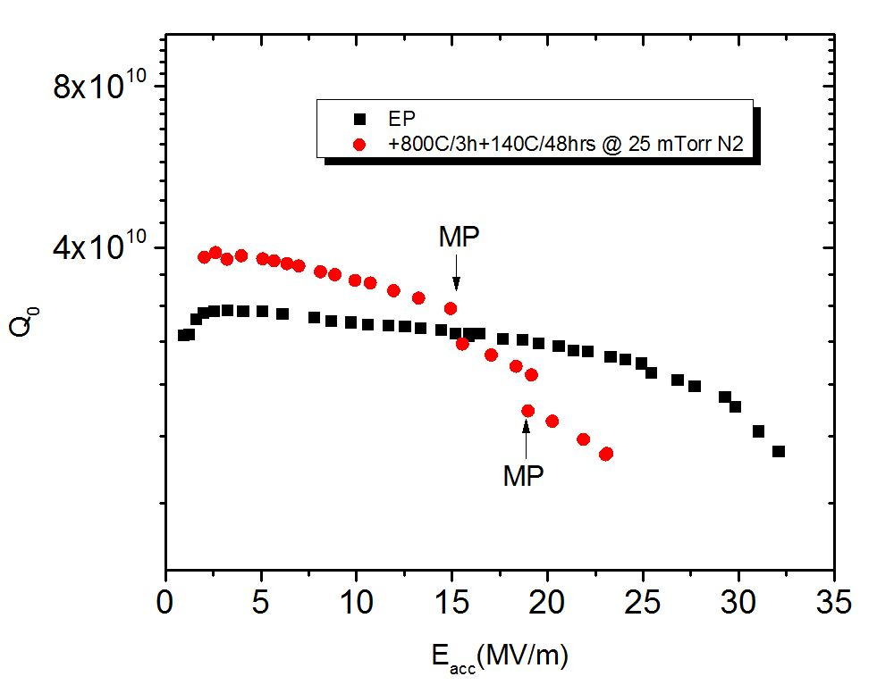
TD5_LG ( gas injected at 140C)

Slide 4
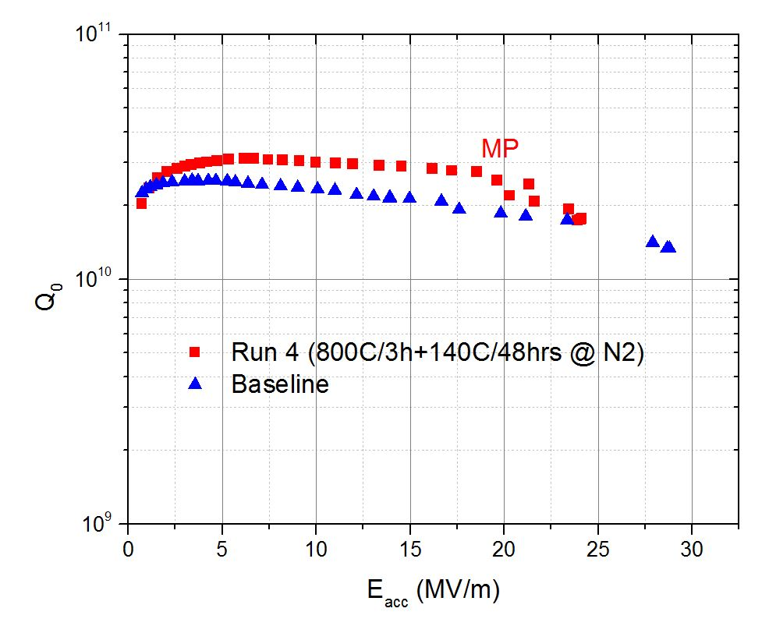
TD5_LG ( gas injected at ~290C)

Slide 5
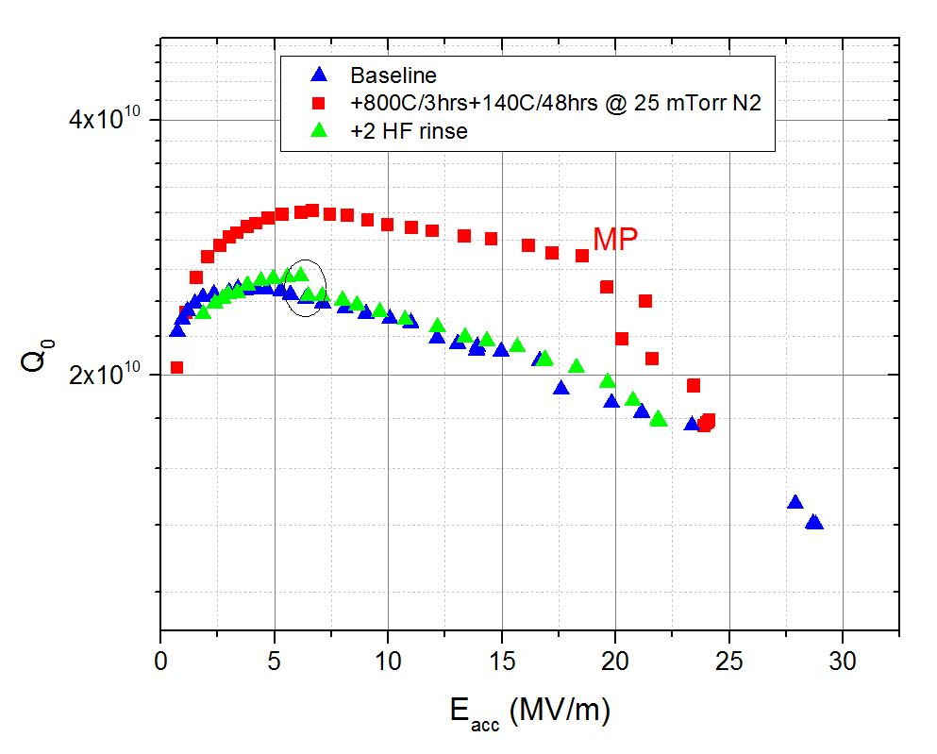
TD5_LG ( gas injected at ~290C)
2 HF rinse took away the effect !

Slide 6
LSF1-3_LG ( gas injected at ~290C)

Slide 7
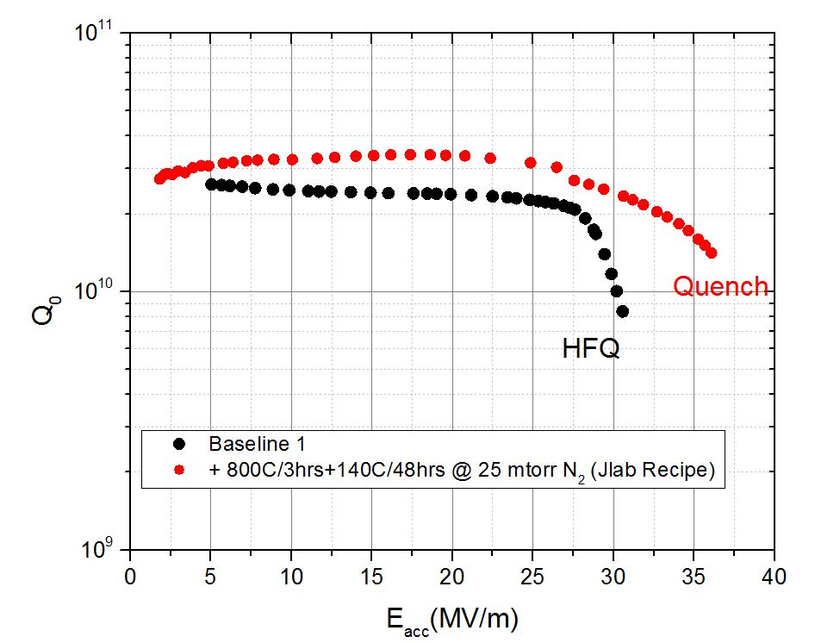
RDT 14_FG (gas injected ~ 280 C)

Slide 8
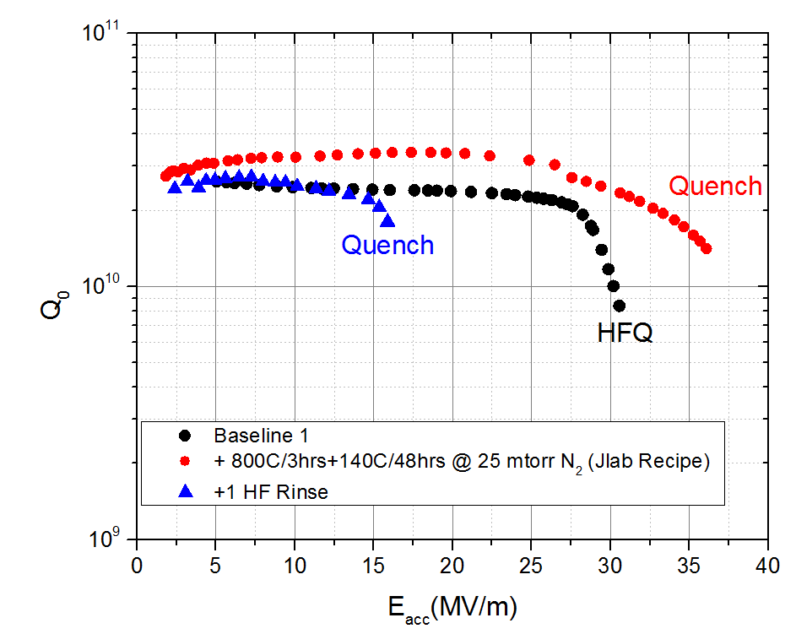
RDT 14_FG (gas injected ~ 280 C)
1 HF rinse took away the effect with E_{acc} degradation

Slide 9
Conclusions
Reproducible when gas injected at higher temperature.
No high Q results when gas injected at lower temperature (3 total runs), cause unknown.
Path Forward:
Furnace upgrade to measure cavity surface temperature.
More sample coupon study when gas injected at different temperature.
Develop consistent, reproducible recipe to achieve high Q and high E_{acc}

