Slide 1
Creating a Targeted Outreach Approach
Leveraging Your Patent Portfolio
Laura A Schoppe | laschoppe@fuentek.com

Slide 2
Introduction
Laura Schoppe
Founder & President
Leads major tech transfer projects at leading universities and government agencies and provides strategic consulting on intellectual assets to Fortune 500s
12 years in advanced development for missile and submarine detection systems
MBA (UNC-Chapel Hill), MSE in mechanical/ aerospace engineering (Princeton University), and BSE in mechanical engineering and engineering/public policy (Carnegie Mellon University)
laschoppe@fuentek.com
@fuentek
www.linkedin.com/in/laschoppe/

Slide 3
About Fuentek
INTELLECTUAL PROPERTY MANAGEMENT
Make and implement well-informed, market-based decisions about patenting, marketing, and licensing the IP portfolio.
MARKETING & COMMUNICATIONS
Raise the profile of the IP portfolio and your office, successfully securing stakeholder support and boosting researcher participation.
STRATEGIC SOLUTIONS
Increase your efficiency and enhance your effectiveness both inside your institution and in the broader innovation ecosystem.

Slide 4
Fuentek’s Experience

Slide 5
Covering the Tech Transfer Lifecycle
Fuentek offers services to support your organization wherever you need it
Investments & Inventions
Keep the pipeline filled with technologies poised for success in the market.
Researcher Relations
Industry-University Relations
Entrepreneurial Ecosystems
Competitive Analysis
Triage
Make strategic decisions for individual inventions and the entire portfolio.
Patenting Decisions
IP Portfolio Management
Marketing
Develop and implement strategies to take techno-logies from lab to market.
Market Validation
Marketing Strategies
Identify, Contact, Vet Prospects
Marketing Materials
Briefings and Webinars
Social Media
Websites
Doing Deals
Secure win-win agreements that align with your goals for the technology.
Due Diligence
Deal Structure, Scope, Terms
Negotiation
Valuation
Sponsored Research
Launching Startups
Celebrating Success
Get the recognition you need — and deserve — for your successes.
Success Stories
Awards
Reports
Presentations
Operations
Where things stand, where you want to go, and how to get there.
Structure
SOPs & Policies
Benchmarking & Metrics
Reporting to Management
Strategic Planning
Communications
Social Media
Websites
Training

Slide 6
Process for Targeted Outreach
Evaluate IP Portfolio Strategically
Identifying Core Capabilities
Identifying Key Players
Present Players Targeted IP
Explore Collaboration Models

Slide 7
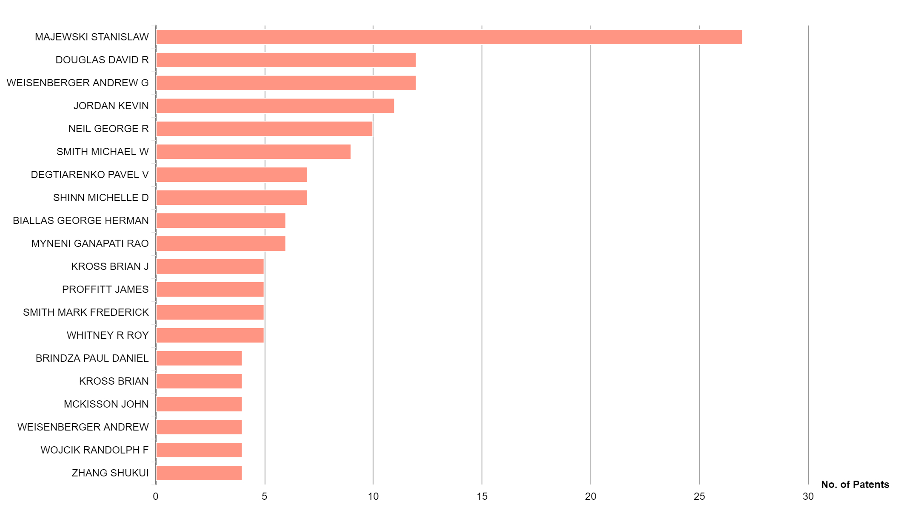
What’s in your IP Portfolio
Who are top inventors
Research collaborations
Area of research
Prolific doesn’t always equal current value

Slide 8
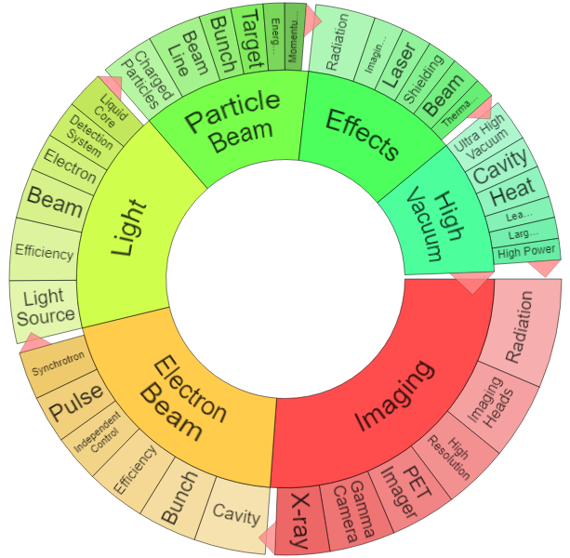
What’s in your IP Portfolio
Who are top inventors
What are core research areas
Market trends
Licensing activity
Substantive contribution

Slide 9
Identify Core Capability
Boron Nitride Nanotube selected as example

Slide 10
Identify Key Players in Similar Space
Use semantic search for similar patents
Selection of key words
Sections of abstracts of top patents

Slide 11
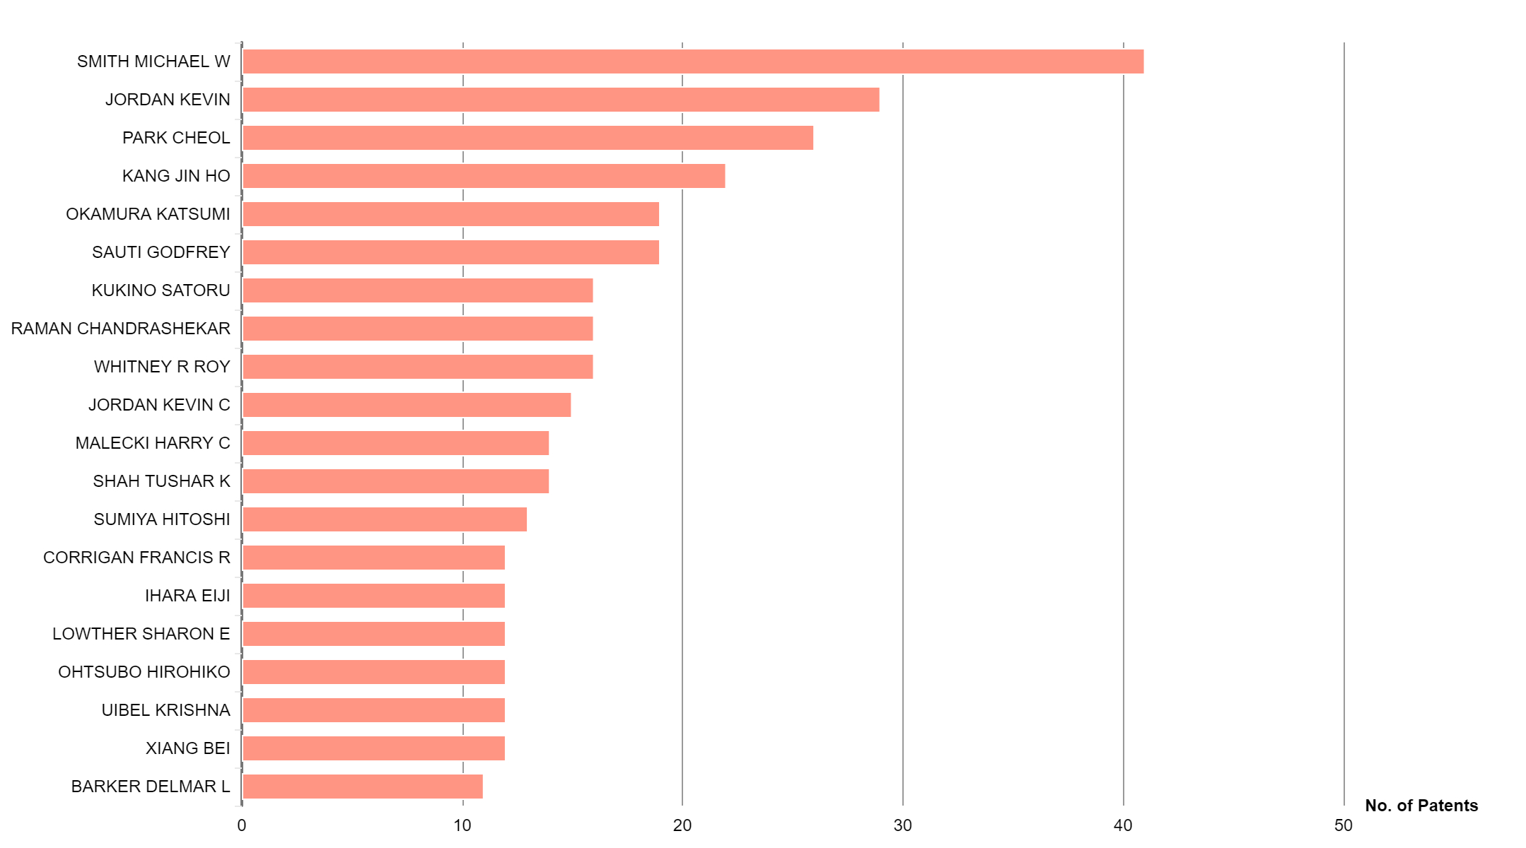
Identify Key Players in Similar Space
Use semantic search for similar patents
Who are top inventors
If it’s you, that’s a selling point
Possible entry point for collaboration discussions
Mike Smith is at BNNT (and was my grad school house mate ☺)
Cheol Park is local

Slide 12
Identify Key Players in Similar Space
Use semantic search for similar patents
Who are top inventors
Investigate proximity
Very close – augment position with licenses (carrot not stick)
Close – complement position with research or licensing
No activity – determine if area for expansion

Slide 13
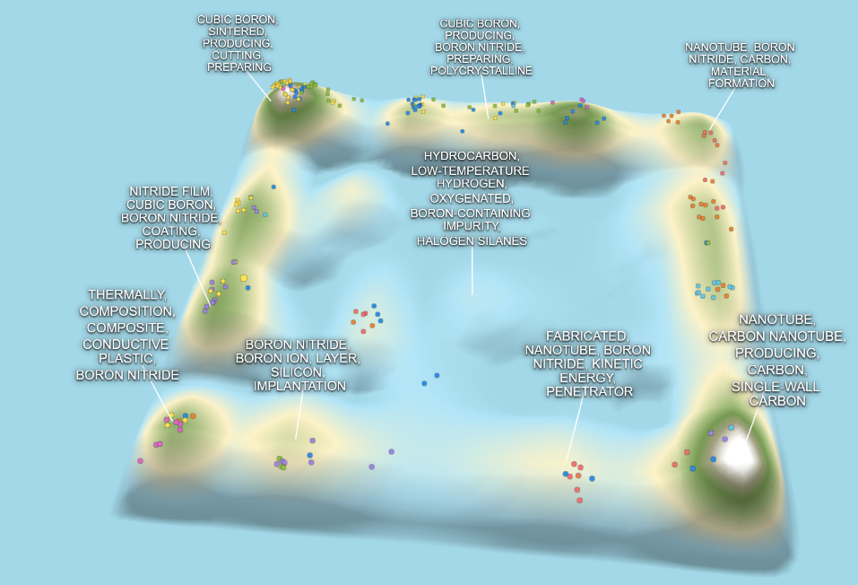
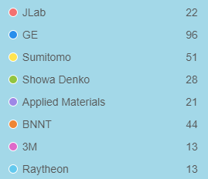
Landscape Shows Proximity
This is the target list

Slide 14
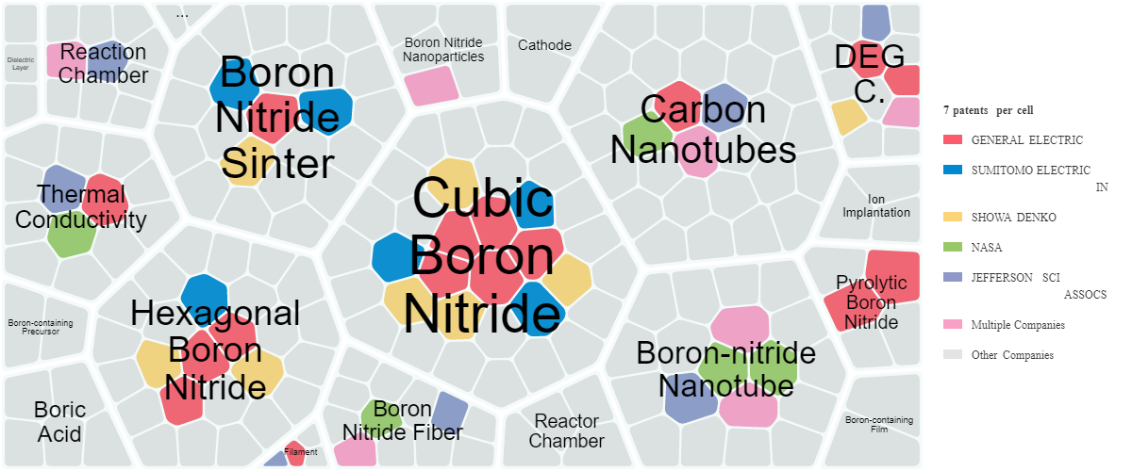
Cell Diagram Shows Concentration

Slide 15
Leverage Tech Transfer Best Practices
Augment and verify with market research
Company activity and contacts
Market trends
Verify inventor/facility interest and availability
Develop marketing materials
Overview for initial contact
Details after vetting interest areas
Webpage for easier outreach

Slide 16
Explore Interest With Key Players
Present opportunity
Only IP in the core area (don’t over whelm them)
Current research activities
Researcher bios
Lab facilities
Explore collaboration options
Licensing
Joint research
Other areas of interest

Slide 17
Thank You
laschoppe@fuentek.com
@fuentek
www.linkedin.com/in/laschoppe

