Slide 1
ORNL Commercialization Program Overview
Mike Paulus
Director, Technology Transfer
March 22, 2018

Slide 2
Technology Transfer is an important part of ORNL’s strategy to disseminate research results
ORNL
FY17
4058 User Facility Users
332 Active Non-Fed Research Agreements
1707 Research Publications
167 Active Licenses
1763 Visiting Scientists
743 Active US Patents

Slide 3
ORNL Partnerships Office
Human Resources Megan Fielden³
Information Systems Bert Callahan⁴
Quality Representative Jeffrey J. Mandl⁵
Acting Director Thomas Zacharia
TBD, Executive Assistant
Advisory Committee
TBD
IP Legal
Marc Filigenzi, Managing Attorney¹
Industrial Partnerships
and Economic Development Tom Rogers, Director
Kelly Wampler, Administrative Assistant
Technology Transfer
Mike Paulus, Director
Brittany Beitz, Administrative Assistant
Finance and Administration
Regina Meredith, Business Manager²
Benji Smith, Finance Officer²
Patent Attorney¹
Michael Johnson
Patent Agents
Colin Cini
Edna Gergel
Paralegals
Karen Vance
Industrial Partnerships and Economic Development Managers
Jeff Cornett
Dan Miller
Jesse Smith
Technology Commercialization
Jennifer Caldwell, Team Leader
Commercialization Managers
Eugene Cochran
Nestor Franco
David Sims
Agreements (NDA/MTA) and Marketing Specialist
Susan Ochs
Commercialization Specialist
Carol Rader
Technology Transfer Intern⁷
Chandler Davis
Royalty Administration
Susan Collins⁶
¹Matrixed from Legal
²Matrixed from Business Services
³Matrixed from Human Resources
⁴Matrixed from Information Systems
⁵Matrixed from Performance Analysis & Quality
⁶Part-time assignment
⁷Sub-Contractor

Slide 4
Elements of a technology commercialization program
Inventor
“In-reach”
Outreach and Marketing
Relationship Management
Licensing

Slide 5
Inventor “In-reach”

Slide 6
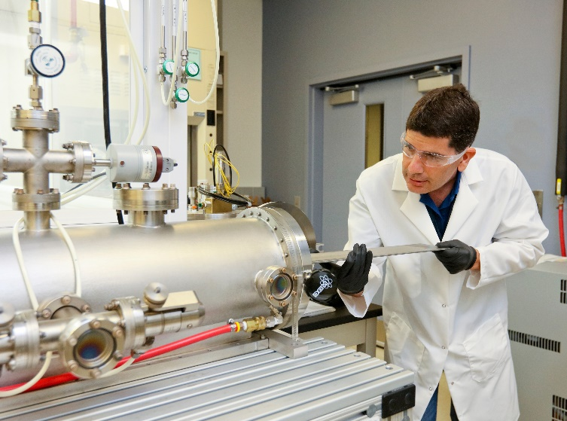
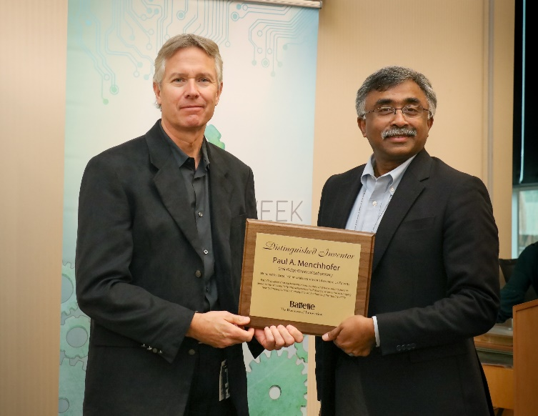
“In-reach” Our researchers’ innovations are our products
S&T staff training sessions
Participation in S&T group and division meetings
Annual Partnerships Awards Luncheon
$750 per issued patent
$500 per registered copyright
Royalty sharing
R&D 100 and FLC Award nominations
Technology Commercialization Fund assistance
Energy I-Corps support
Coffee cups!

Slide 7
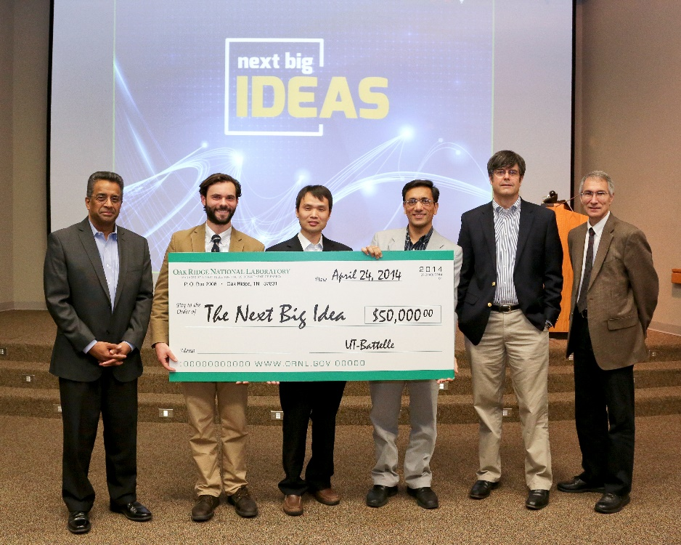
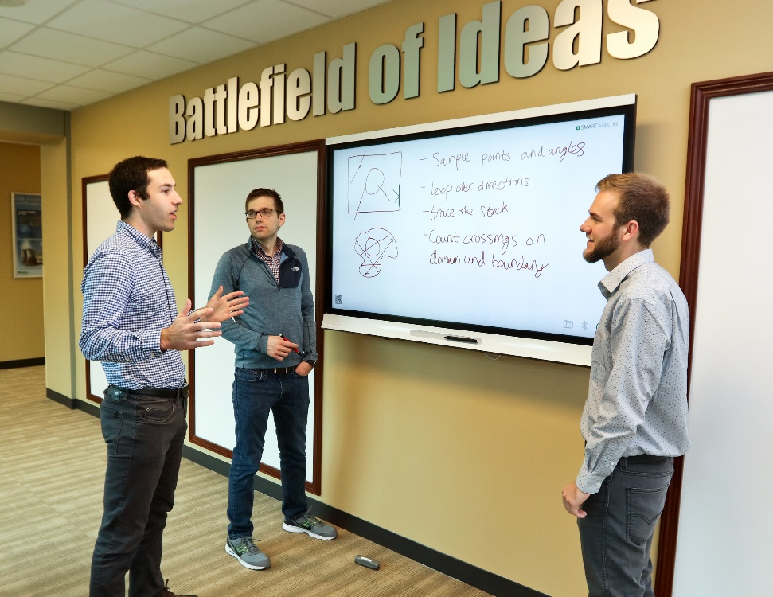
Entrepreneurial “in-reach” activities
Pitch Training
Pitch Competition
Business Plan Training

Slide 8
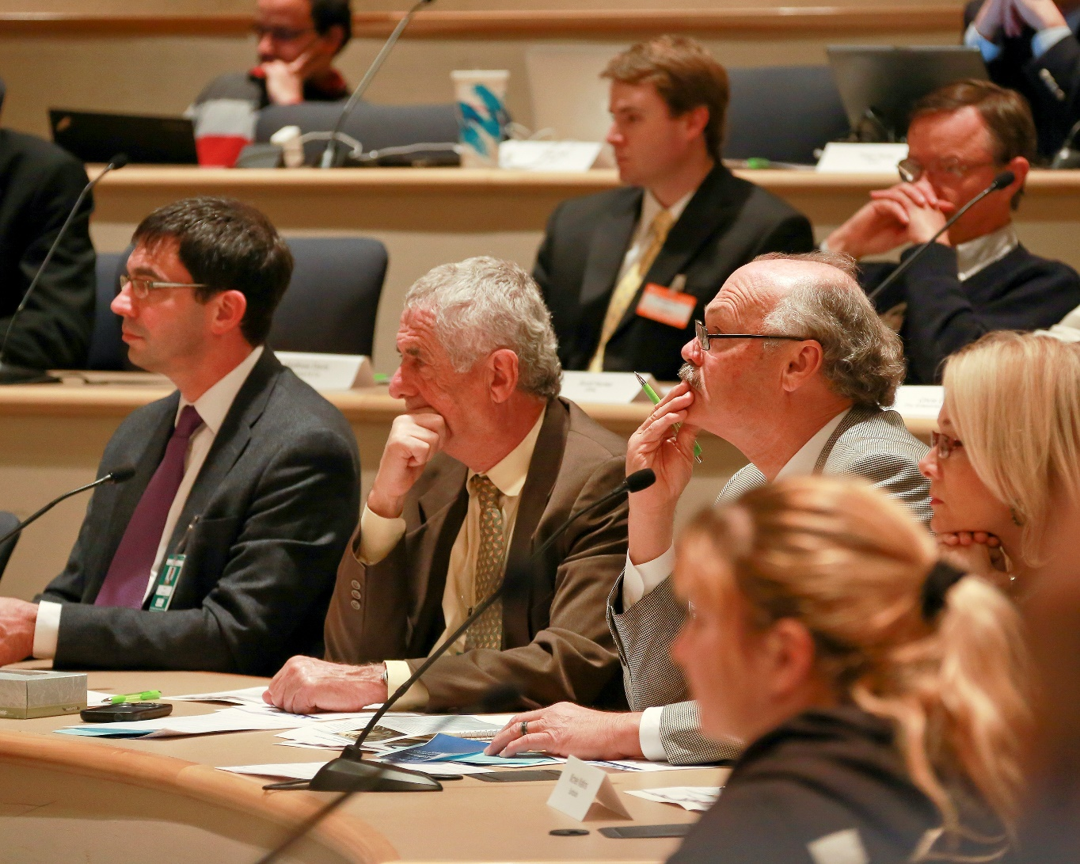
Technology Innovation Program (TIP) goals
Identify and focus resources on ORNL’s most commercially promising technologies
Engage (and energize) researchers in the commercialization process
Rapidly mature technologies for commercialization
Identify and partner with high potential licensees
Create a sense of urgency

Slide 9
TIP Program Overview
Call for 2-slide preproposals (typically ~50 received)
Each proposal team must include a PI and CM. CM does not charge to project.
Internal committee of technical and commercialization leaders select the top ~15 preproposals
TTO performs market opportunity and patent landscape analysis for full proposals
PI and CM contact potential licensees to assess opportunity and seek letters of support
PI submits full proposal. Technical merit and potential commercial impact are equally weighted
Internal / external committee reviews proposals
PI gives 10 minute “VC Pitch” to committee
4-5 projects funded @ up to $200K
PI leads outreach effort; PI leads technical effort
Quarterly project reviews
Competitive call for license applications at month 9
Projects that receive license applications are eligible to compete for Year 2 funding ($100K-300K)
Year 2 funding starts when license executes
Note: frequently teams build on feedback from the TIP process to develop TCF proposals

Slide 10
Internal engagement drives invention disclosures
Outreach Initiative
Outreach Initiative
Outreach Initiative

Slide 11
Intellectual property portfolio

Slide 12
Workflow for inventions and copyrights
Patenting Inventions Asserting Copyrights

Slide 13
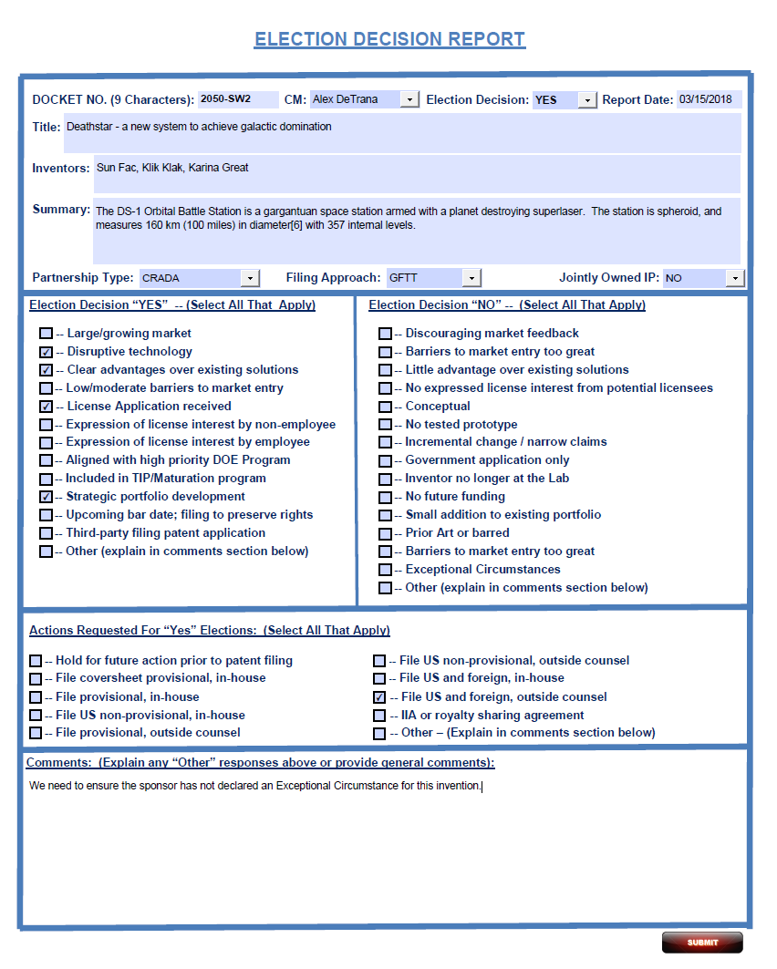
Invention election decisions
Patent Agent is responsible for evaluating patentability
Frequently informed by a prior art search
Commercialization manager is responsible for evaluating market opportunity
Frequently informed by an external market analysis report
Inventor is responsible for evaluating stage of development and potential for future funding
Ideally, PA, CM and Inventor reach consensus
Technology Transfer director and Managing IP Attorney make final decision
Decisions are documented and communicated to inventors and their managers via an Election Decision Report
S&T Division Directors can appeal

Slide 14
IP Portfolio Management
Strategy Shift
~70% of ORNL non-provisional patent applications result in issued patents

Slide 15
Non-provisional patent costs
Prep and file: $10-15K
Prosecution: $3-5K
Issue fee: $1.2K*
3.5 year maintenance: $575**
7.5 year maintenance: $2.4K***
For budgetary purposes, we assume each patent costs $20K over its ~8 year lifetime, with most costs incurred within the first 3 years
*Average 2017 first action pendency = 16 month; average total pendency = 24 months
**ORNL automatically pays 3.5 year maintenance fee
***ORNL typically does not pay 7.5 year maintenance fee unless the patent is licensed

Slide 16
Outreach and Marketing

Slide 17
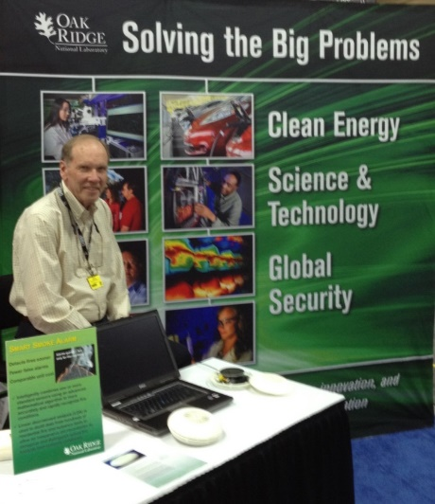
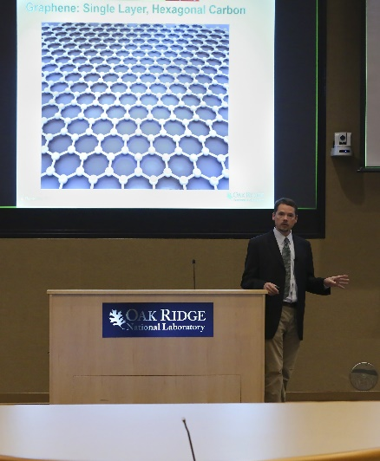
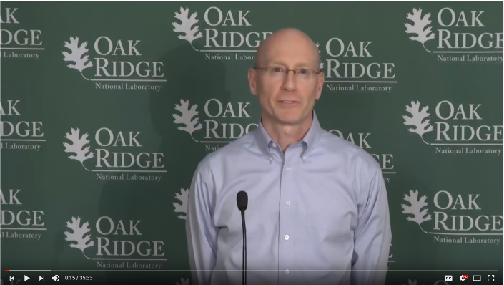
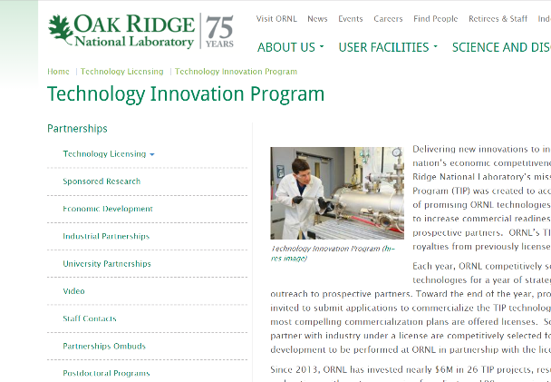
Outreach tools
Trade Shows
Lab Events
Webinars
Brochures
Targeted Calls
Email Blasts
Webpage
FedBizOpps
Press Releases

Slide 18
Outreach efforts for licensing
Intellectual property is made available for licensing by employing the following technology transfer practices:
Publish technology summaries of elected inventions/copyrights.
Broad outreach (email announcements and conference participation).
Targeted marketing campaigns.
Outreach efforts include both standard practice and strategic efforts.
Standard Practice. Broad outreach for all IP in order to engage many partners in licensing while being mindful of selecting quality licensees.
Strategic. Select key IP areas or higher impact technologies for strategic focus.

Slide 19
Outreach efforts for licensing (continued)
Published Technology Summaries
Fact Cards for each elected invention/copyright are posted on the ORNL website. Includes a brief description of the technology and Researcher/Commercialization Manager contact information.
Broad outreach
Email announcements to appropriate market categories when a Fact Card is published.
Tradeshow and conference participation including oral/poster presentations and booth participation.
Targeted Marketing Campaigns
IP Portfolios/ High Impact Technologies
Maturation Investments (TCF, Maturation funds- TIP)
Innovation Centers/Hubs

Slide 20
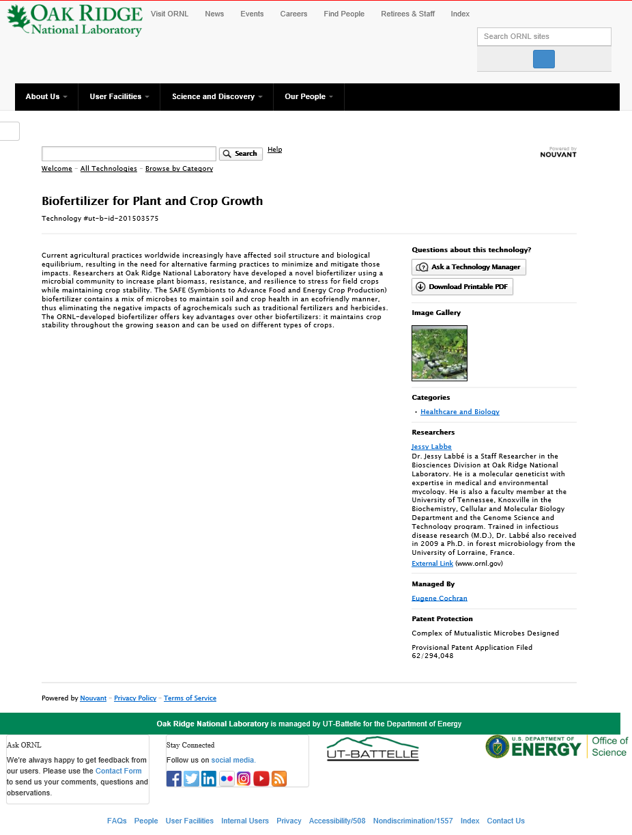
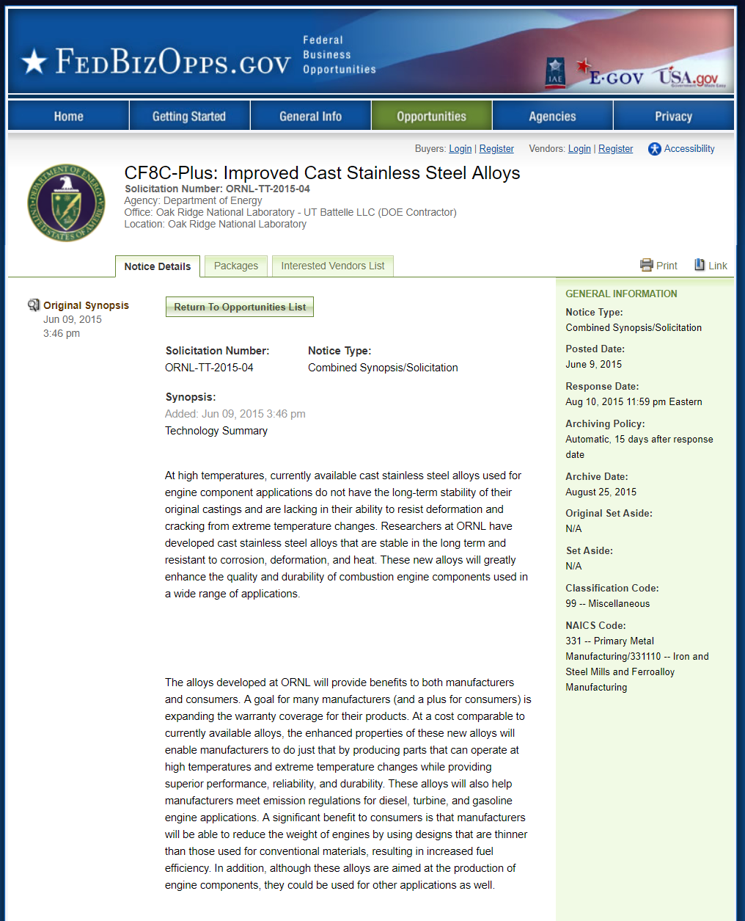
Other platforms

Slide 21
Licensing fairness of opportunity / COI process 8/28/2015
 | Every Newly Elected Invention | Employee Affiliated Company Expresses Interest | Technology Innovation Program Technologies
Web Posting | Automatically upon invention election (back to 2000) | Automatically upon invention election | Automatically upon invention election
Email Notification Recipients | Standard (Opt In / Opt Out) list for market category | Targeted list provided by 3rd party | All parties who have expressed interest during dead period
SPARK or BTG Presentation | Sometimes | Sometimes | Always
Fed Biz Opps Posting | No | Yes | Yes
Diligence Period Before Entering Negotiations | At least 45 days after web posting | At least 45 days after web posting and at least 30 days after Fed Biz Opps posting | After project results are available; typically 6-9 months after project start and at least 30 days after Fed Biz Opps posting
Reviewer if Multiple Applicants | If multiple companies apply to exclusively license a technology, the Tech Transfer Office evaluates proposals using a standard score card. If an employee-affiliated company (including Non-UT-B Researchers and Contractor Affiliated Entities as described below) applies, an expert third party evaluates the proposals using the ORNL score card.
Negotiation with current UT-B Employees | Current UT-B employees with approved outside activities may license ORNL technologies. However, they must appoint a third party representative to negotiate on their behalf. This requirement does not apply to former employees or employees on entrepreneurial leave.
Non-UT-Battelle Researchers | Non UT-Battelle Researchers who have extended access to ORNL research data and results (e.g. visiting faculty, some post-docs, graduate students, ORISE students, staff augmentation subcontractors, etc.) are treated as employees for the purpose of this process. These personnel may have different conflict of interest mitigation obligations and should coordinate their entrepreneurial activities with the UT-B Office of General Counsel (OGC).
Contractor Affiliated Entities | UT, BMI, and UT-Battelle and their corporate affiliates are treated as employees for the purpose of this process. Note this group is narrower than the “Entity” list defined in TTD-06 for Organizational Conflict of Interest reviews.
Agreement review | Per the UT-B prime contract, exclusive licenses to employees, past employees who terminated within 2 years, and Contractor Affiliated Entities must be approved by the DOE Contracting Officer. The UT-Battelle OGC will perform Conflict of Interest and Fairness of Opportunity reviews of non-exclusive licenses to employees and past employees and all licenses to Non-UT-B Researchers.

Slide 22
Licensing

Slide 23
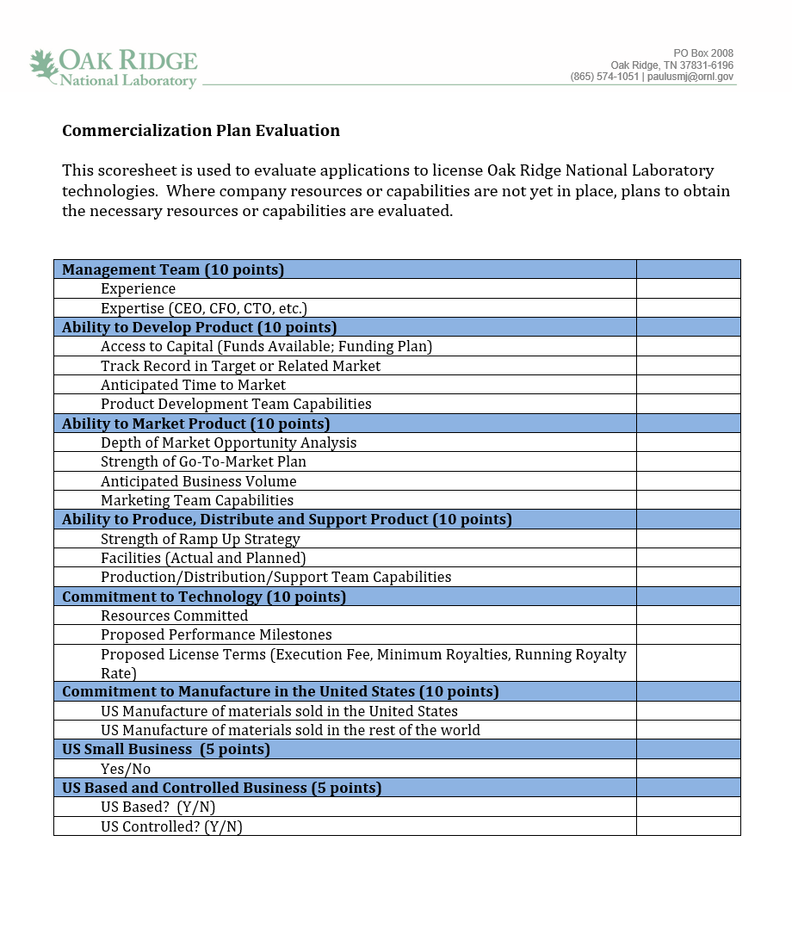
License application score sheet

Slide 24
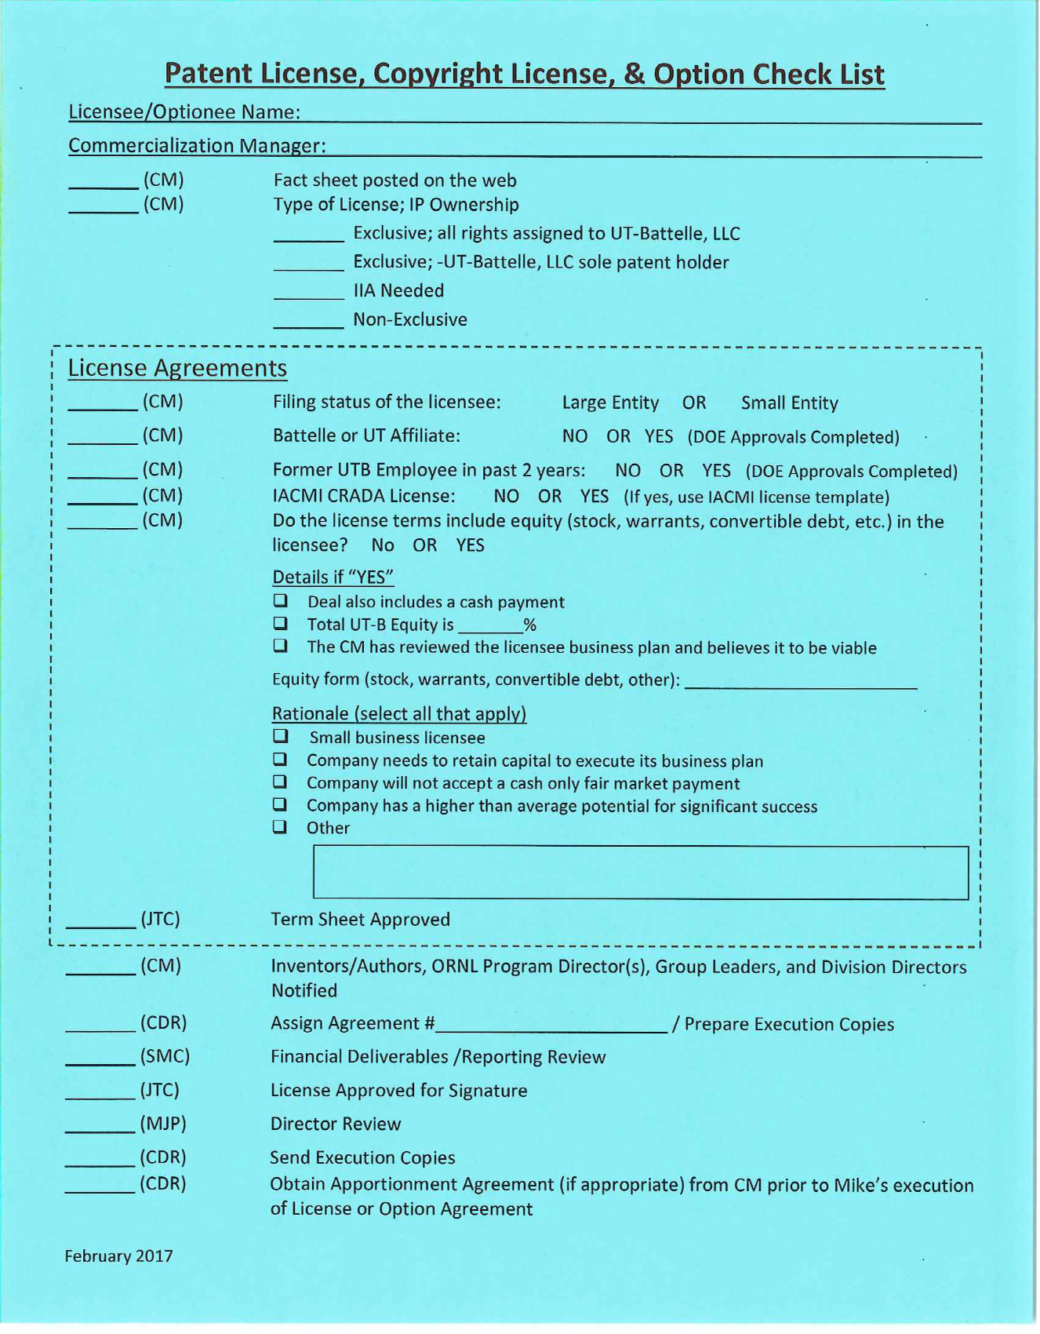
Licensing workflow and roles
(CM) Commercialization Manager
(JTC) Group Leader
(CM) Commercialization Manager
(CDR) Administrative Assistant
Attorney and (SMC) Finance Officer
(JTC) Group Leader
(MJP) Director
(CDR) Administrative Assistant

Slide 25
Thoughts on licensing terms
Execution fee: high enough to require “C-Suite” approval, but low enough to not negatively impact commercialization
Annual minimum payments: high enough to encourage return of IP if it is no longer part of the company strategy; low enough to not negatively impact commercialization
Running royalties: we use the “25% rule” as an objective starting point and then negotiate to meet partner needs
Patent reimbursement: normally required for exclusive licenses; frequently shared among non-exclusive licensees
Avoid being greedy
Be willing to renegotiate

Slide 26
Relationship Management

Slide 27
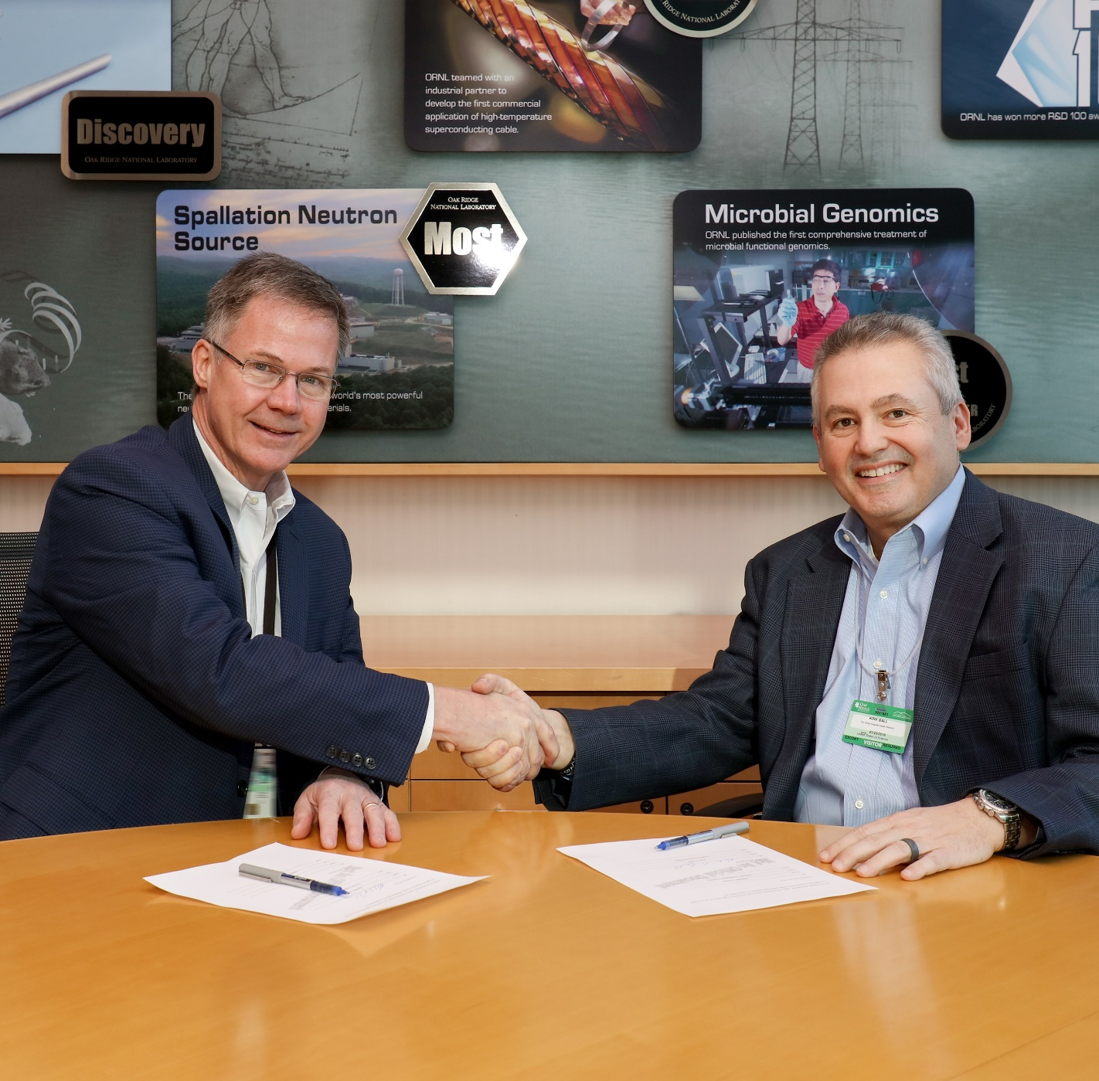
Post-license support
License signing ceremonies and press releases
Hosted investor visits
Access to technical team
Technology Assistance Program funding
Rapid response to due diligence requests
Flexibility in renegotiating agreements
R&D 100 and FLC Awards

Slide 28
Compliance
Visits and “check-in” calls
Annual reporting requirements in licenses
Review of SEC filings and Dunn and Bradstreet etc. data for consistency with annual reports
Audits

Slide 29
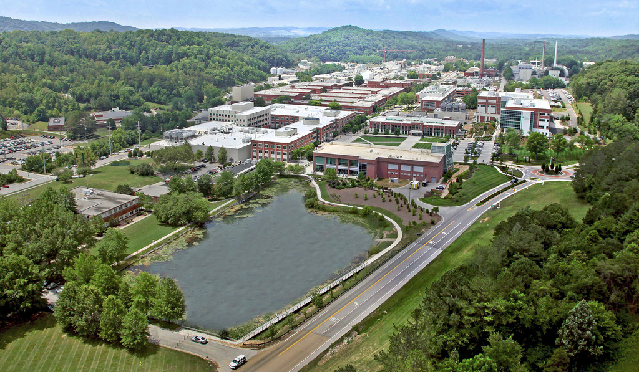
Discussion

