Slide 1
Technology Transfer -
A Dilon Perspective after 20 years
Jefferson Lab In-House Tech Transfer Workshop
March 22, 2018

Slide 2
Outline
History
Technology
Timing
Branding

Slide 3
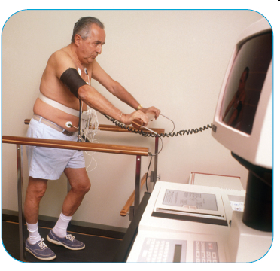
History
Cardiac Perfusion Imaging
Introduced in 1991
Developed at MIT as a cardiac imaging agent
Technicium-99m sestamibi
Licensed by DuPont, sold as Cardiolite

Slide 4
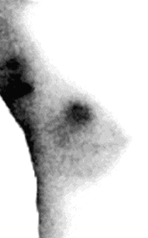
History
Scintimammography
Focal uptake seen in some women
Shown to be breast cancer

Slide 5
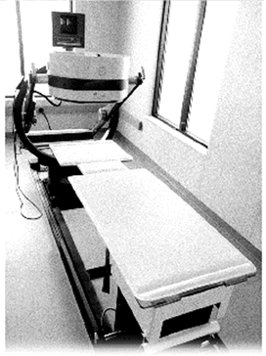
History
Scintimammography
Limited success (> 1 cm size)
Large cameras, patient far from detector

Slide 6
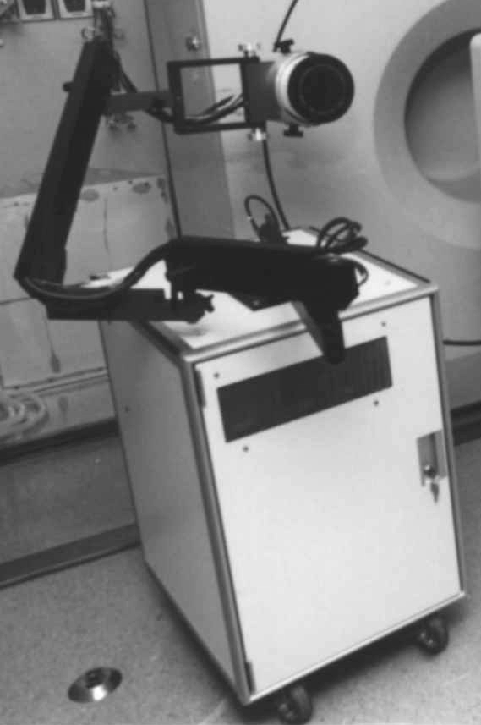
History
JLAB
NIH requested assistance
Development continued on-site
Research prototype completed

Slide 7
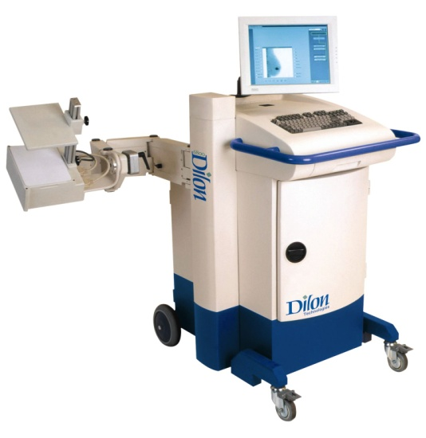
History
Dilon Technologies
Shortcomings of conventional gamma cameras as breast imagers
Cardiolite shown to enhance breast lesions
Novel gamma detector developed at Jefferson Lab

Slide 8
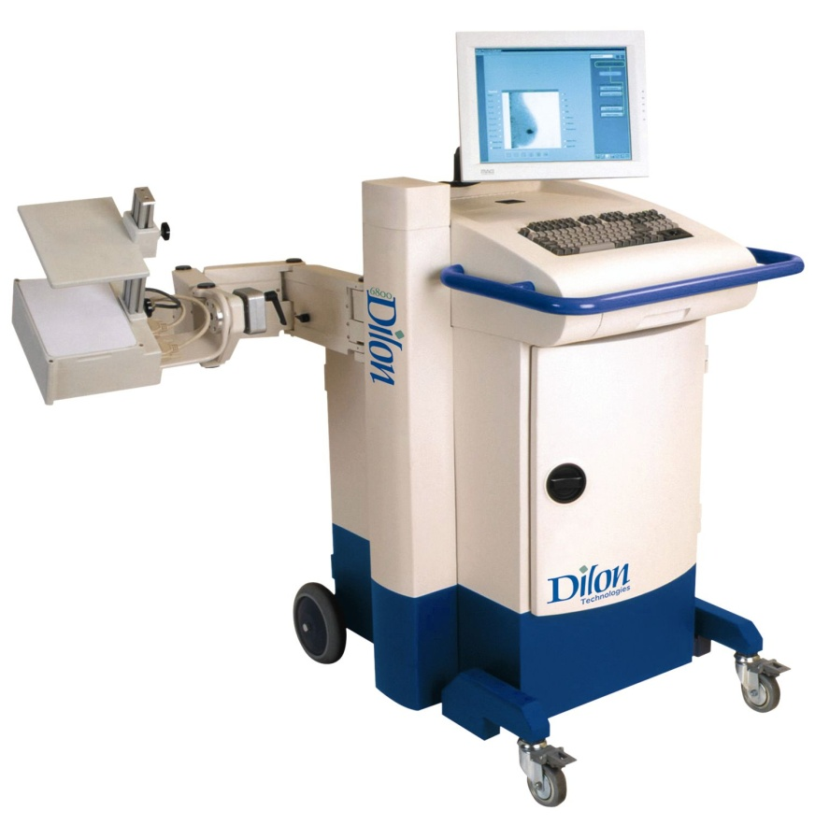
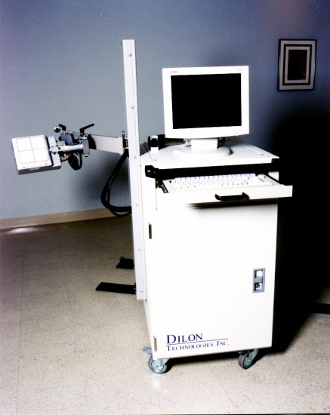
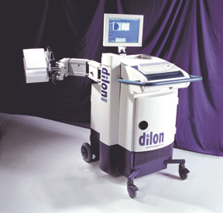
History
Dilon Technologies – Dilon 6800 camera

Slide 9
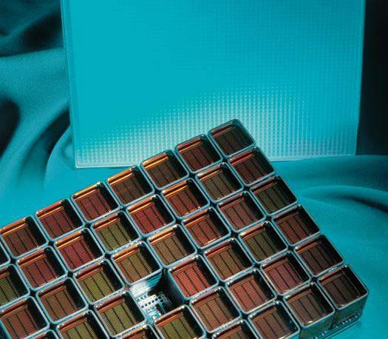
Technology
JLAB Licensed Technology
Position Sensitive Photomultiplier Tube (PSPMT)
Resistive (Anger) network
48 x 12 anodes -> 16 channels
Pixelated NaI(Tl) crystal
64 x 48 pixels
Calibration software
Crystal map
Energy map
Flood calibration

Slide 10
Technology
Standard Anger Camera Technology
Y+
Y-
X-
X+

Slide 11
Technology
Standard Anger Camera Technology
Y+
Y-
X-
X+

Slide 12
Technology
Standard Anger Camera Technology
Y+
Y-
X-
X+

Slide 13
Technology
Standard Anger Camera Technology

Slide 14
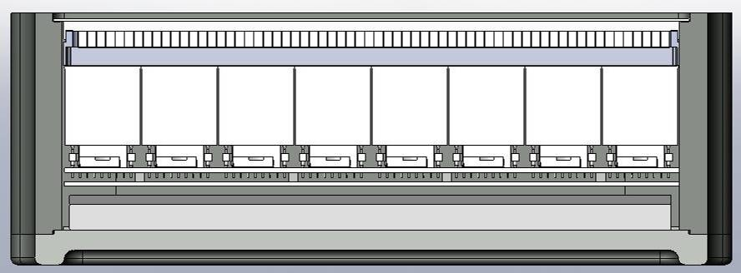
Technology
JLAB/Dilon Camera Technology
Pixelated NaI(Tl)
PSPMT
Resistive Network

Slide 15
Technology
JLAB/Dilon Camera Technology
Signal
Strength

Slide 16
Technology
JLAB/Dilon Camera Technology
Signal
Strength

Slide 17
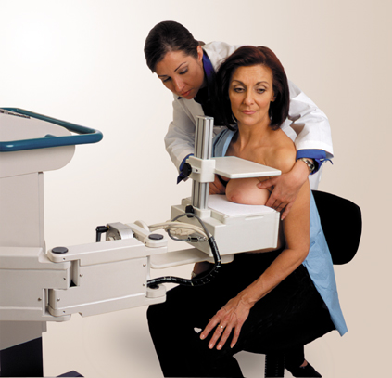
Technology
Breast placed directly on detector
Collimator optimized for near field
Very small “dead-space”
CC & MLO views can be compared directly with mammogram
Mediolateral-oblique (MLO) View
Craniocaudal (CC) View

Slide 18
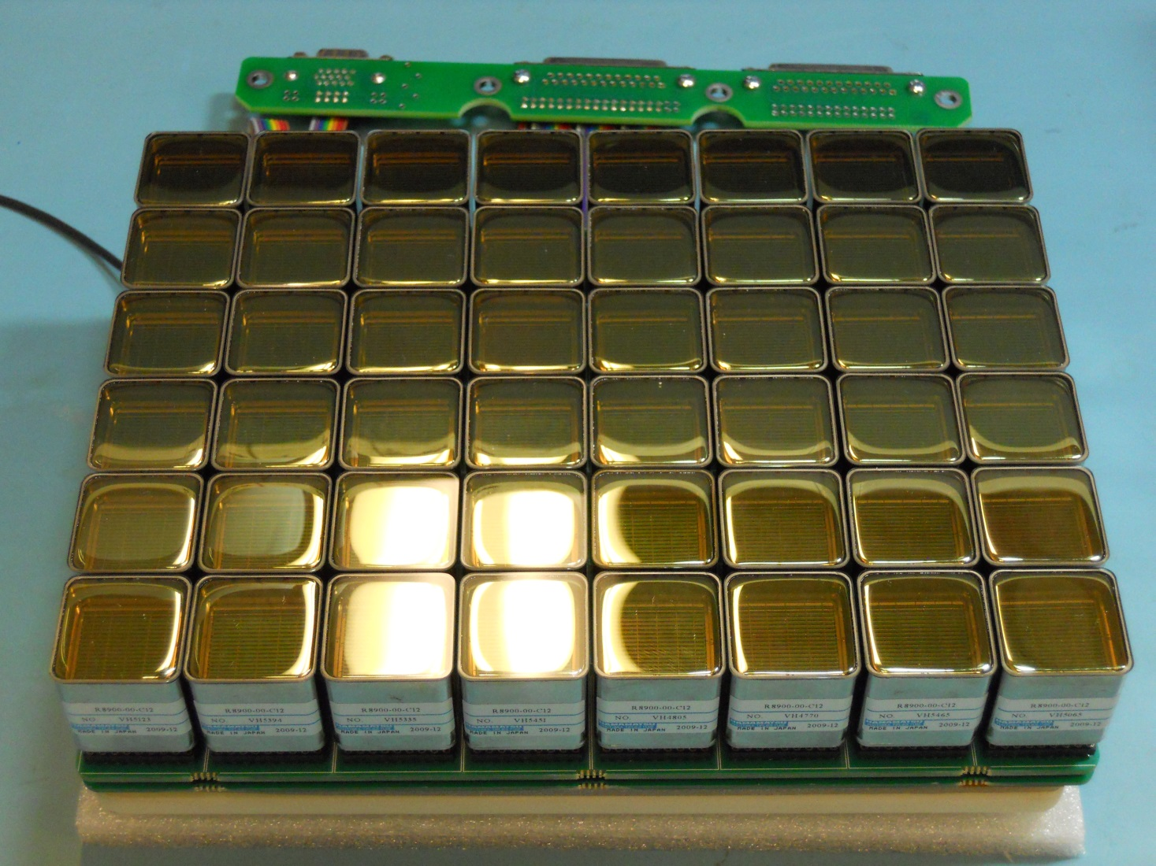
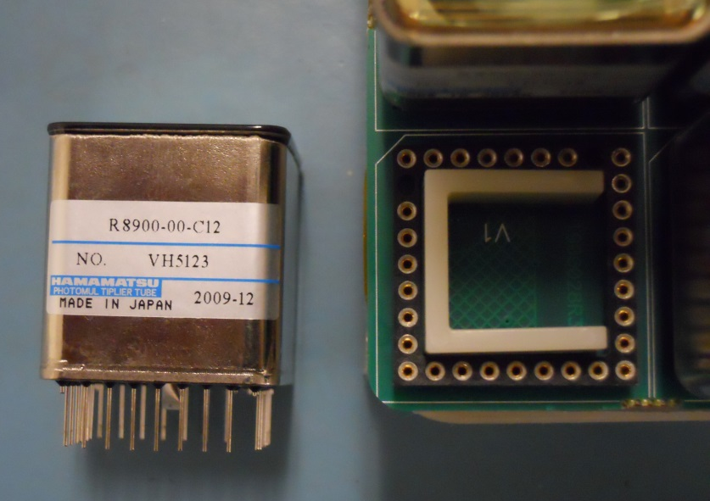
Technology
Position Sensitive Photomultiplier Tubes (48)

Slide 19
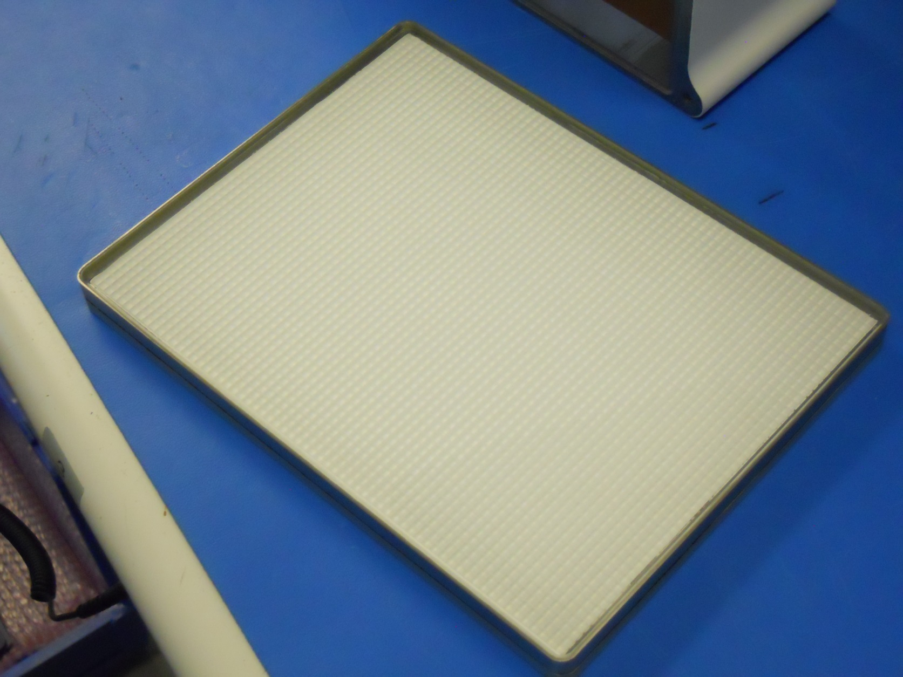
Technology
Pixelated NaI(Tl) crystals
48 x 64 = 3072

Slide 20
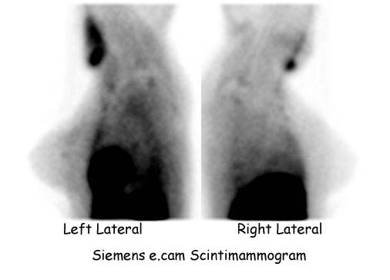
Technology
Standard Anger Camera Image

Slide 21
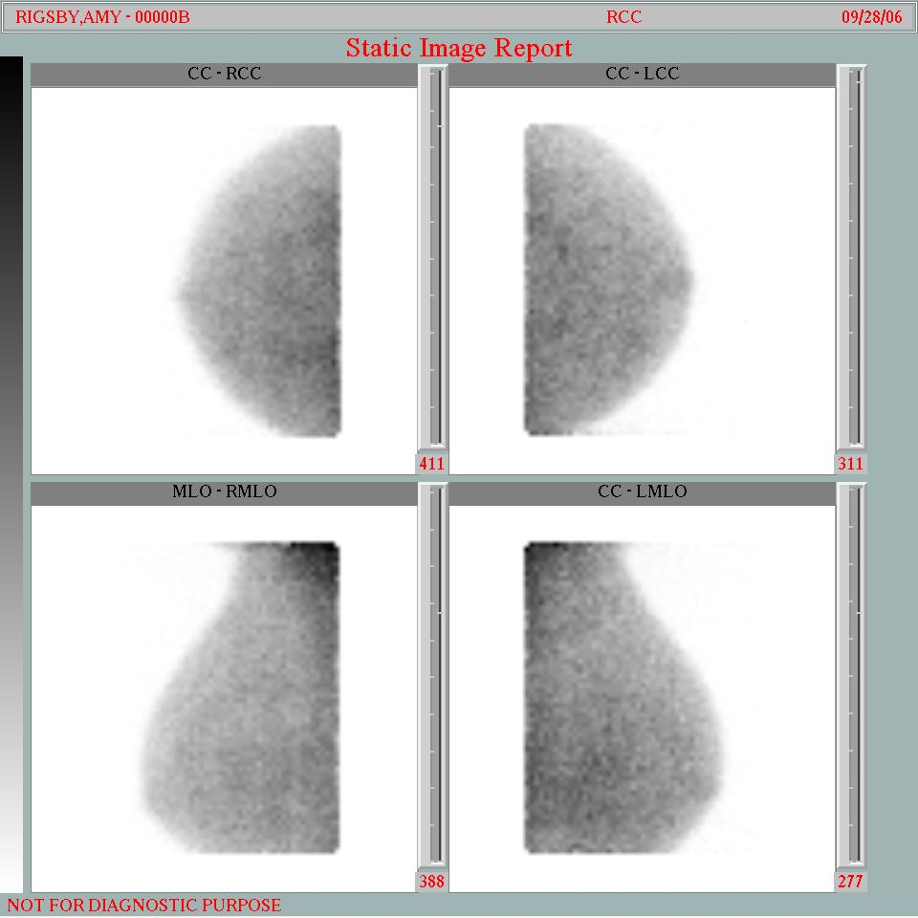
Technology
JLAB/Dilon Camera Image

Slide 22
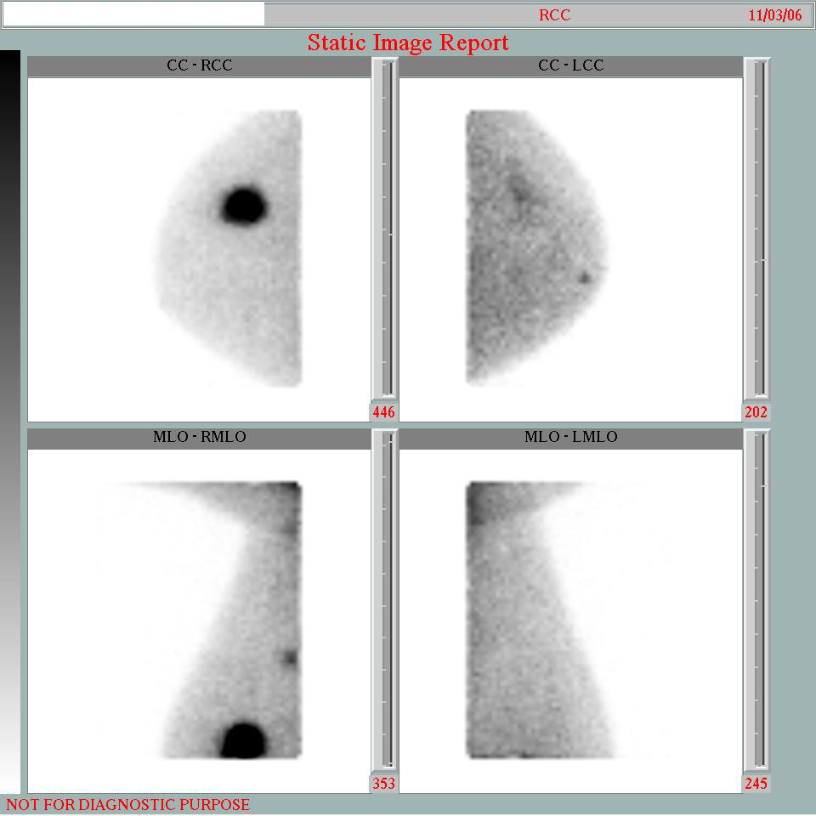
Technology
JLAB/Dilon Camera Image

Slide 23
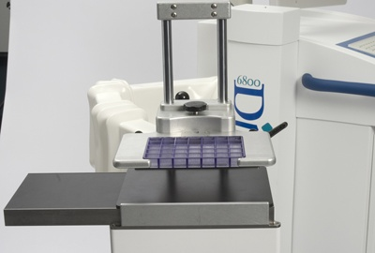
Technology
GammaLoc System with Slant-Hole Collimator for biopsy guidance
Left View
Lesion
Breast
Gamma Camera

Slide 24
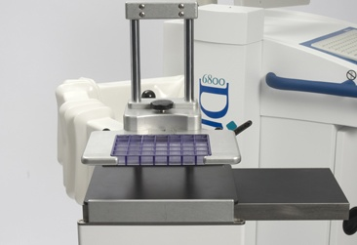
Technology
GammaLoc System with Slant-Hole Collimator for biopsy guidance
Right View
Lesion
Breast
Gamma Camera

Slide 25
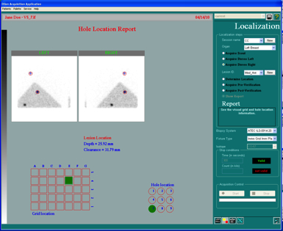
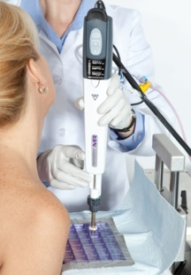
Technology
GammaLoc System with Slant-Hole Collimator for biopsy guidance

Slide 26
Timing
1996 Company formed to commercialize local technologies
1997 Base technology for breast imaging licensed from Jefferson Lab
1998 I joined Dilon
1999 Clinical testing began, Dilon 6800 510(k)
2004 First customer shipment
2005 First European Shipment
2006 CE Mark
2007 First China and Korean shipments
2008 100th camera shipped
2009 GammaLōc 510(k)

Slide 27
Timing
1996 Company formed to commercialize local technologies
1997 Base technology for breast imaging licensed from Jefferson Lab
1998 I joined Dilon
1999 Clinical testing began, Dilon 6800 510(k)
2000 Y2K
2001 911
2004 First customer shipment
2005 First European Shipment
2006 CE Mark
2007 First China and Korean shipments
2008 100th camera shipped
2009 GammaLōc 510(k)

Slide 28
Timing
1996 Company formed to commercialize local technologies
1997 Base technology for breast imaging licensed from Jefferson Lab
1998 I joined Dilon
1999 Clinical testing began, Dilon 6800 510(k)
2004 First customer shipment
2005 First European Shipment
2006 CE Mark
2007 First China and Korean shipments
2008 100th camera shipped
2009 GammaLōc 510(k)

Slide 29
Timing
1996 Company formed to commercialize local technologies
1997 Base technology for breast imaging licensed from Jefferson Lab
1998 I joined Dilon
1999 Clinical testing began, Dilon 6800 510(k)
2004 First customer shipment
2005 First European Shipment
2006 CE Mark
2007 First China and Korean shipments
2008 100th camera shipped
2009 GammaLōc 510(k)
2009 ACA passed, med dev tax, insurance denials, radiation concerns, competing technology (Contrast Mammo, Automated Breast Ultrasound)

Slide 30
Timing
1996 Company formed to commercialize local technologies
1997 Base technology for breast imaging licensed from Jefferson Lab
1998 I joined Dilon
1999 Clinical testing began, Dilon 6800 510(k)
2004 First customer shipment
2005 First European Shipment (16 total)
2006 CE Mark
2007 First China (39 total) and Korean (14) shipments
2008 100th camera shipped
2009 GammaLōc 510(k)
2009 ACA passed
2015 ACA enacted

Slide 31
Timing
2014 Purchased Navigator Gamma Probe Product
2016 Distribution agreement for Discovery NM760b
2017 Purchased Laryngoscope Product

Slide 32
Branding
JLAB Licensed Technology
Dilon 6800 (6” x 8” detector)
Other Licensed Technology
Naviscan (6800 Smart Shield & GammaLoc)
U of Michigan (GammaLoc)
Developed Technology
GammaLoc (Biopsy Guidance)
Acella (8” x 10” detector)

Slide 33
Branding
Acquired Technology
Navigator Gamma Probes (2014 RMD)
CoPilot Video Laryngoscope (2017 Magaw)
Distributed Technology
DeclipeSPECT Freehand SPECT (SurgicEye)
Cardius Cardiac Camera (Digirad)
CoTI I-131 Thyroid Therapy Monitor (AG Medical)
Discovery NM750b Dual Headed Breast Imager (GE)

Slide 34
Conclusions
Good Technology, with a clinical need
Innovation lead to smaller size
Smaller size lead to better results
Diversify
Markets - requirements
US - FDA
Europe – CE
Asia – In-country testing
ISO 13485 / Product testing / continuously changing
Products
Dilon 6800 – Licensed
Dilon GammaLoc – Developed
Navigator & CoPilot – Purchased
DeclipseSPECT, CoTI, Discovery NM760b (GE) - Distribution

Slide 35
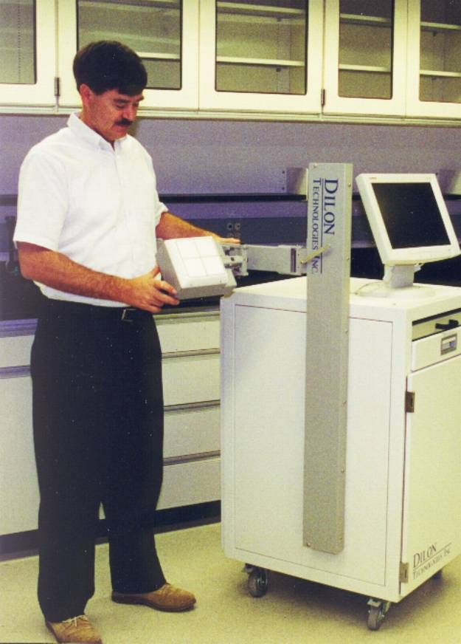
Thank You

