Slide 1
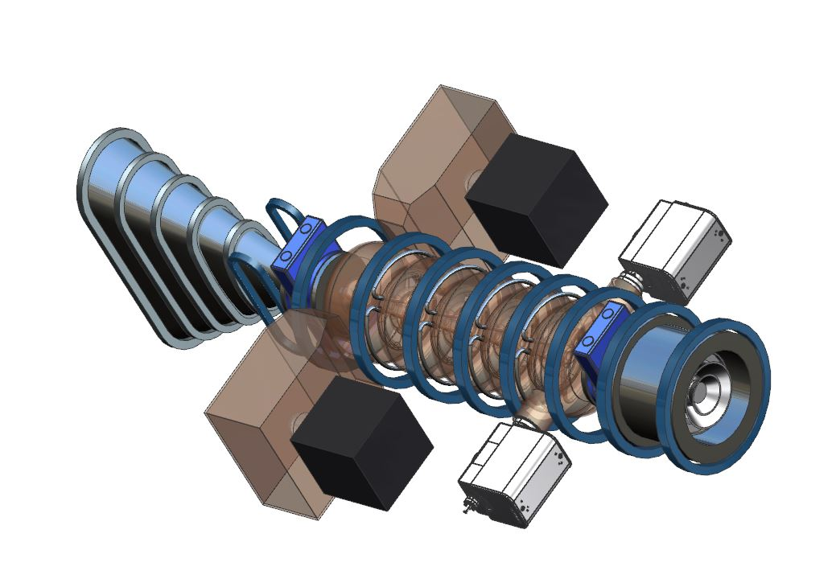
Accelerator Technology Transfer Opportunities
Jefferson Lab Technology Transfer Workshop:
Fostering Market Pull on Technologies
CEBAF Center, F113
R. Rimmer, SRF R&D dept.

Slide 2
Accelerator technology transfer opportunities
Outline
What we do
How we do it
Opportunities for wider use of the technology
Barriers to adoption
What are we doing about it?
Conclusions

Slide 3
Accelerator technology transfer opportunities
What we do
  Big accelerators for discovery science
  CEBAF, SNS, LCLS-II, ILC, JLEIC, FCC
  Specializing in SRF re-circulating and energy recovery linacs

Slide 4
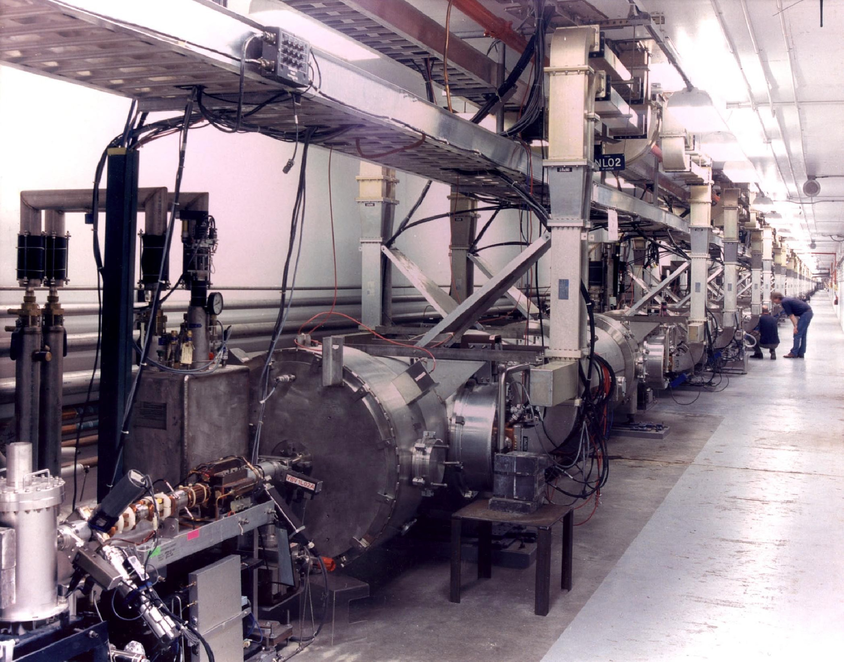
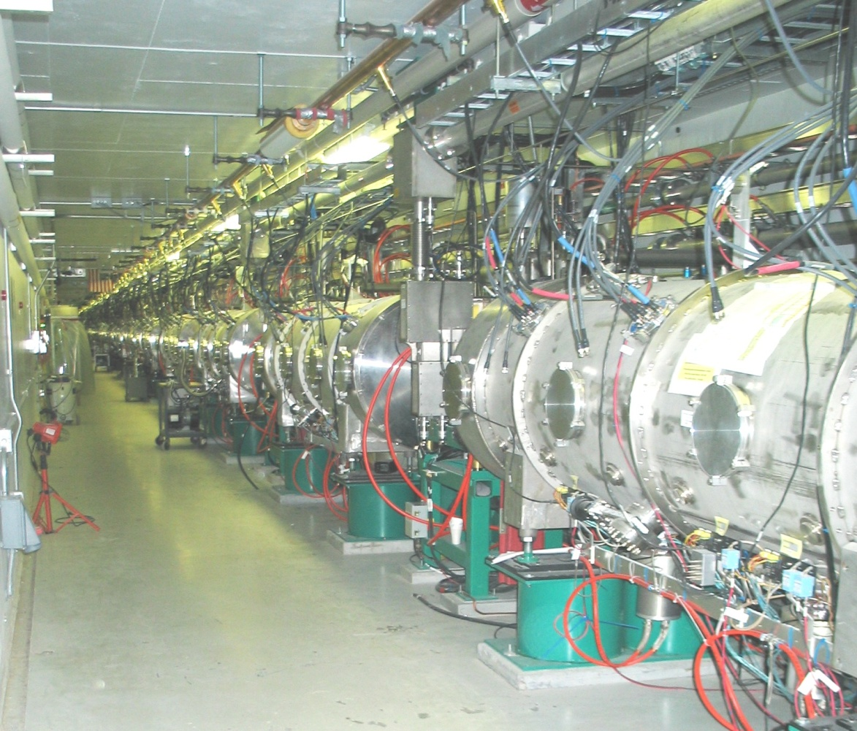
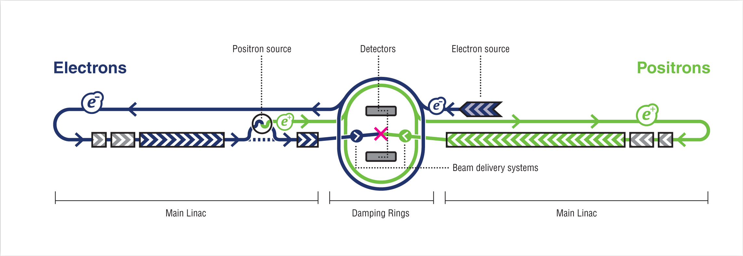
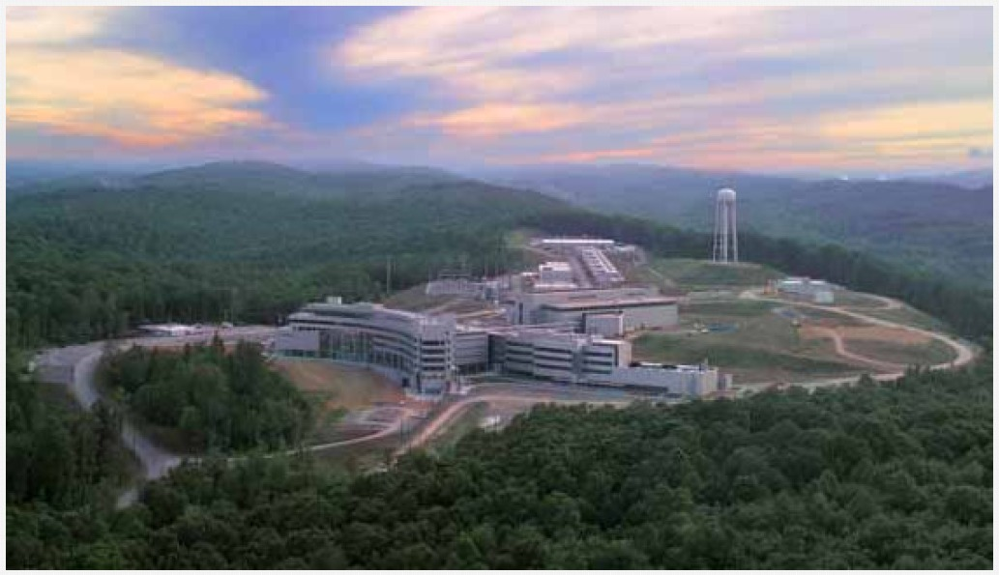
Big Accelerators for Discovery Science
12 GeV CEBAF
New Hall
Add 5 cryomodules
20 cryomodules
Add arc
20 cryomodules
Add 5 cryomodules
CEBAF Linac
SNS
Enhanced capabilities
in existing Halls
ILC
New Hall
Add 5 cryomodules
New Hall
Add 5 cryomodules
New Hall
Add 5 cryomodules
New Hall
Add 5 cryomodules
New Hall
Add 5 cryomodules
20 cryomodules
20 cryomodules
20 cryomodules
Add arc
20 cryomodules
Add arc
20 cryomodules
20 cryomodules
Add arc
20 cryomodules
Add arc
Add 5 cryomodules
20 cryomodules
Add arc
Add 5 cryomodules
20 cryomodules
Add 5 cryomodules
20 cryomodules
Add 5 cryomodules
Enhanced capabilities
in existing Halls
Add 5 cryomodules
Enhanced capabilities
in existing Halls
Enhanced capabilities
in existing Halls
CEBAF linac
Enhanced capabilities
in existing Halls
Enhanced capabilities
in existing Halls

Slide 5

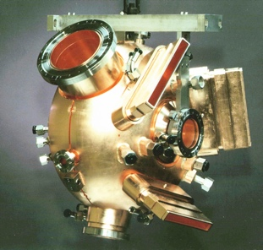
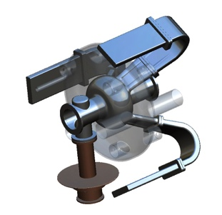
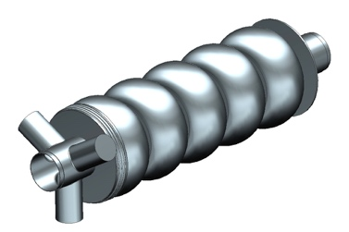
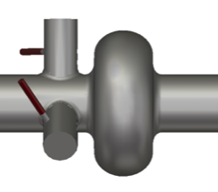
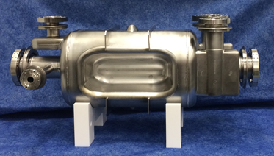
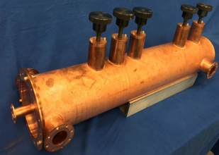
RF cavities for JLEIC
952.6 MHz i-ring
(SCRF)
JLEIC
Collider
Rings
i-SRF +
NCRF
Cooling
952.6 MHz cooler ERL (SCRF)
Crab
IP
e-RF
476.3 MHz e-ring
(NCRF PEP-II)
Crab
e-RF
Future IP
Booster
952.6 MHz booster
(SCRF)
SRF Linac
Ion Source
ODU
952.6 MHz crab
(SCRF)
Electron Injector
Hall D
12 GeV CEBAF
Harmonic Fast kicker for cooling ring
Halls A, B, C

Slide 6
Accelerator technology transfer opportunities
What we do
  Big accelerators for discovery science
  CEBAF, SNS, LCLS-II, ILC, JLEIC, FCC
  Specializing in SRF re-circulating and energy recovery linacs
How we do it
  Develop optimized accelerator solutions for emerging needs
  Prototype in house
  Utilize industry for large scale production
  Qualification and integration in house up to now

Slide 7
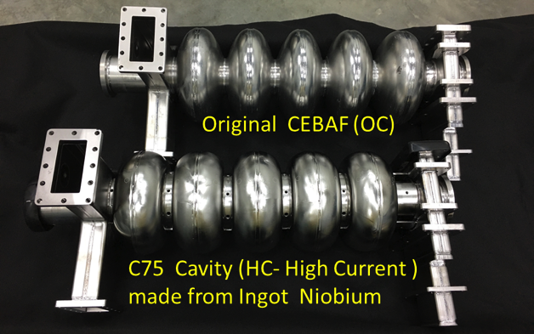
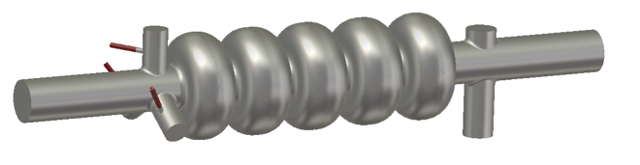




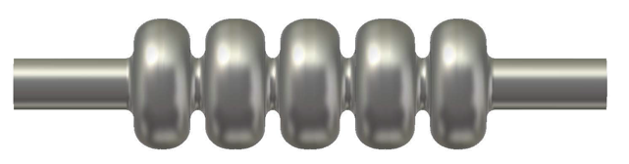
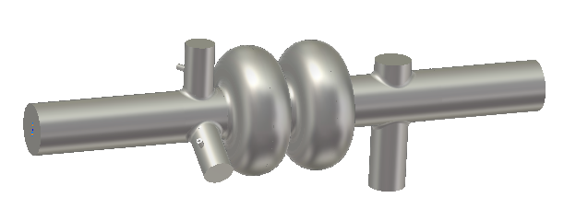
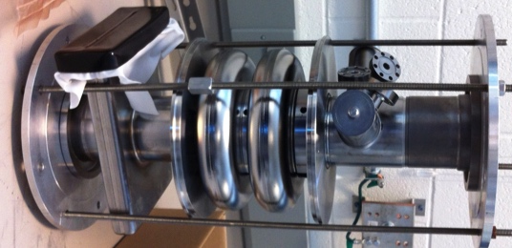
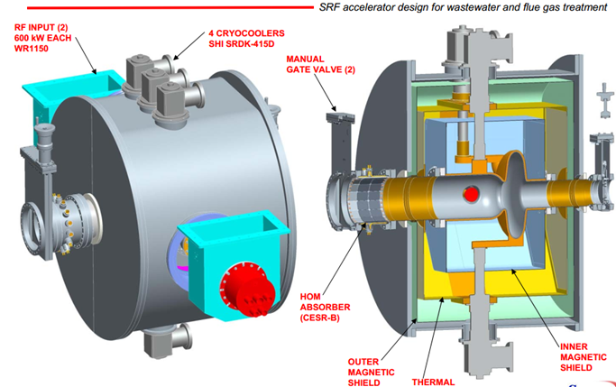
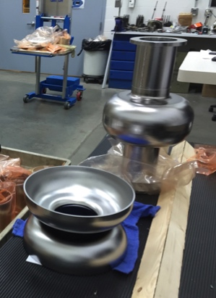

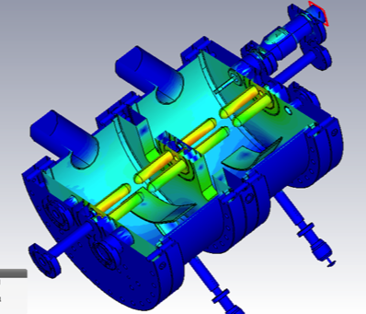
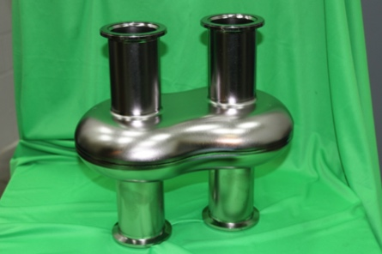
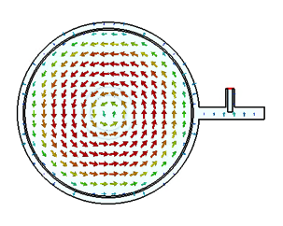

A sampling of JLab’s Cavity R&D
For CEBAF
For JLEIC
For SPPs and R&D
JLEIC 5-cell 952.6 MHz ERL cooler
5-cell 802 MHz ERL main linac cavity (PERLE/Orsay & LHeC/CERN)
HC 5-cell1.5 GHz C75 Cavity (CEBAF)
2-cell 952.6 MHz ion ring cavity
Beta-matched 2-cell for new injector CM
750 MHz compact SRF-based environmental accelerator
First 952.6 MHz cavity parts
CEBAF 750 MHz separator
Harmonic kicker magnetization cavity
1.5 GHz ERL twin-axis cavity

Slide 8
Accelerator technology transfer opportunities
What we do
  Big accelerators for discovery science
  CEBAF, SNS, LCLS-II, ILC, JLEIC, FCC
  Specializing in SRF re-circulating and energy recovery linacs
How we do it
  Develop optimized accelerator solutions for emerging needs
  Prototype in house
  Utilize industry for large scale production
  Qualification and integration in house up to now
Opportunities for wider use of the technology
  Spin off applications
  FEL’s, isotopes, compact light sources, e-beam sources, ADS

Slide 9
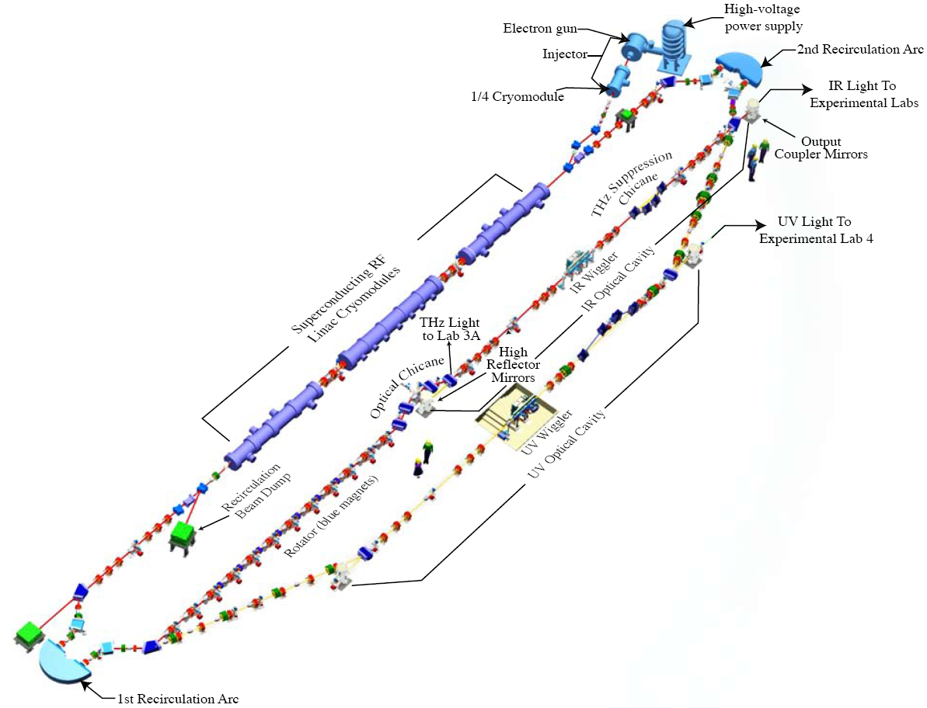
JLab IR/UV FEL Light Sources
E = 135 MeV
Up to135 pC pulses @ 75 MHz
20 μJ/pulse in (250)–700 nm UV-VIS
120 μJ/pulse in 1-10 μm IR
1 μJ/pulse in THz
The first high current ERL
14 kW average power
Ultra-fast (150 fs)
Ultra-bright
Now converted to LERF
Possible location for isotope production
and other accelerator R&D

Slide 10
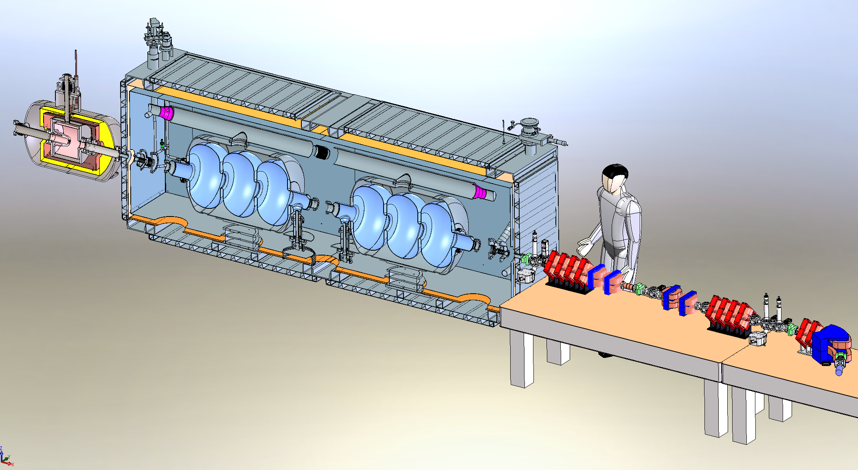
Compact X-ray Light Source Concept
Jefferson Lab: inexpensive SRF linac operating at 4.5K
Emittance exchange line for coherent ICS
SRF Gun
ICS x-ray generator
Project scope includes:
beam simulation,
cavity design and fabrication,
cryostat design and fabrication,
development of Nb3Sn coatings
Clean sheet design, cavity and cryostat!

Slide 11
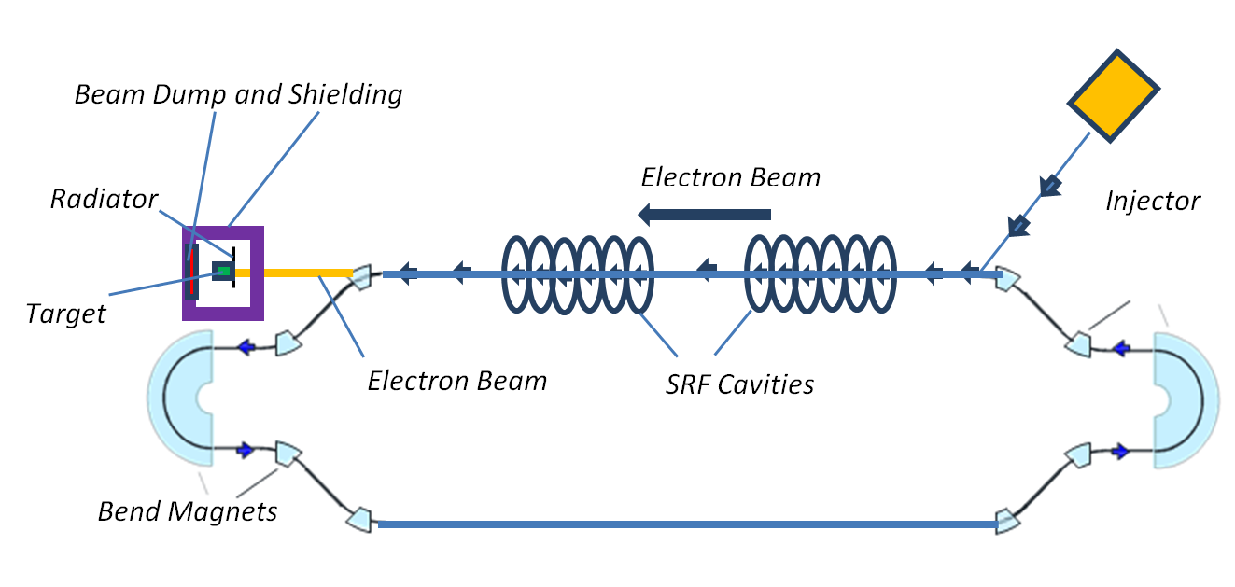
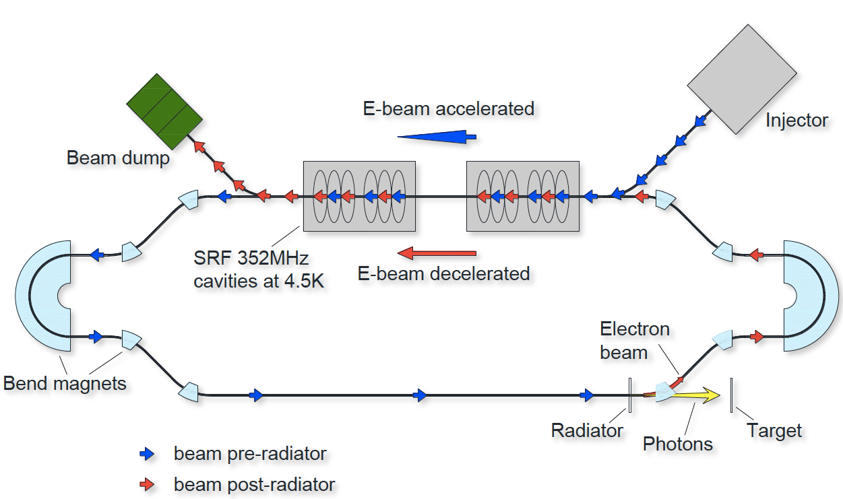
Accelerators for Isotope Production
Low Energy Recirculator Facility (LERF) is proposed for isotope production in non-ERL or ERL mode
  Up to 150 MeV energy electron beam
  Up to 100 kW beam power
A. Hutton, R. Johnson, AccApp’17 Quebec City

Slide 12
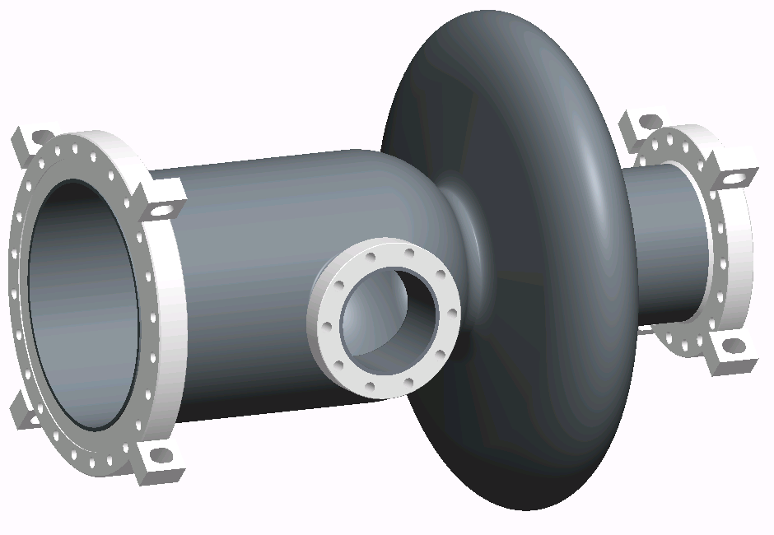
Compact high-power CW SRF accelerator for industrial application
1-year design collaboration among JLAB, AES, General Atomics
Funded by DOE-HEP (Accelerator Stewardship)
Use in wastewater and flue-gas treatment
1 MeV, 1 A electron beam
Nb₃Sn/Nb/Cu β=0.5 single-cell cavity, conduction cooled with four 1.5 W cryocoolers
~6 m
Patent on Cryomodule design filed on 01/29/18

Slide 13
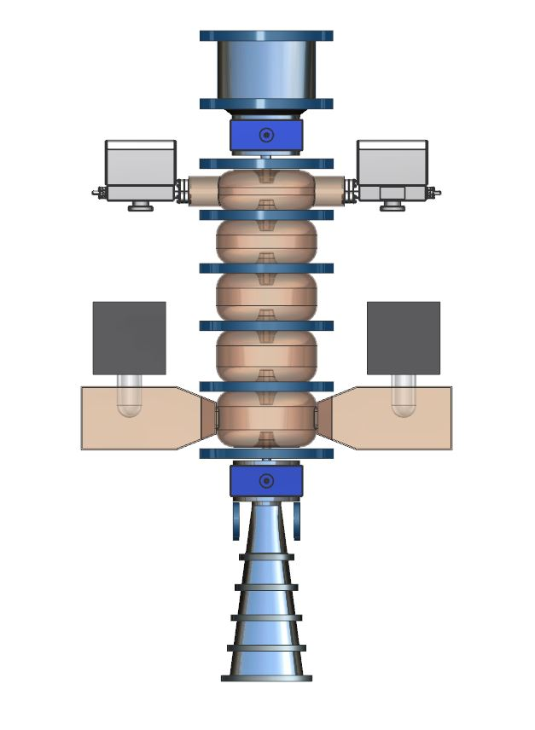
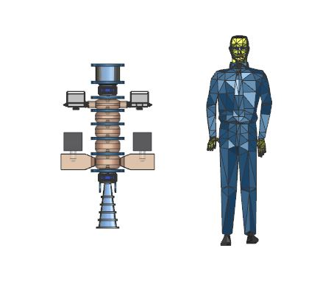
Compact, scalable normal-conducting e-beam source
The source uses new technology developed at JLab as well as established components
Scalable in size (frequency) and power
Additional units could be stacked for higher energy
Gridded electron gun
Vacuum pumping
Focusing coils
Compact graded-β copper linac
Magnetron RF source
Deflecting system
Horn
Exit window
915 MHz 100 kW

Slide 14
Accelerator Driven System: MYRRHA Concept
Accelerator
(600 MeV – ≤ 4 mA proton)
Reactor
Subcritical mode (~85 MW_{th})
Critical mode (~100 MW_{th})
Subcritical reactor
Neutrons from spallation target
Lead-Bismuth cooled or molten salt reactor
Can destroy surplus weapons grade Pu
Can burn spent fuel from conventional reactors or Thorium

Slide 15
Accelerator technology transfer opportunities
What we do
  Big accelerators for discovery science
  CEBAF, SNS, LCLS-II, ILC, JLEIC, FCC
  Specializing in SRF re-circulating and energy recovery linacs
How we do it
  Develop optimized accelerator solutions for emerging needs
  Prototype in house
  Utilize industry for large scale production
  Qualification and integration in house up to now
Opportunities for wider use of the technology
  Spin off applications
  FEL’s, isotopes, compact light sources, e-beam sources, ADS
Barriers to adoption
  High capital cost of SRF-based systems, despite efficiency
  Perception of high maintenance, questionable reliability
  Lack of industry base for long term support

Slide 16
Accelerator technology transfer opportunities
What we do
  Big accelerators for discovery science
  CEBAF, SNS, LCLS-II, ILC, JLEIC, FCC
  Specializing in SRF re-circulating and energy recovery linacs
How we do it
  Develop optimized accelerator solutions for emerging needs
  Prototype in house
  Utilize industry for large scale production
  Qualification and integration in house up to now
Opportunities for wider use of the technology
  Spin off applications
  FEL’s, isotopes, compact light sources, e-beam sources, ADS
Barriers to adoption
  High capital cost of SRF-based systems, despite efficiency
  Perception of high maintenance, questionable reliability
  Lack of industry base for long term support
What are we doing about it?
  R&D on cost reduction, new materials, modular systems, RF power sources

Slide 17
What are we doing about it?
R&D on cost reduction:
  New materials, 4.5K operation
  Cheaper, more efficient RF power sources
  Modular systems
  Safer, cheaper processing methods
Focus on improving CEBAF reliability
  Conservative design for reliability
Outreach to industry (SBIR/STTR etc.)

Slide 18
What are better SRF Materials?
T_{c} [K] | ρ_{n} [μΩcm] | Δ [meV] | H_{c}(0) [T] | H_{sh}(0) [T] | H_{c1}(0) [T] | λ(0) [nm] | Material
9.25 | 0.1 | 1.45 | ~ 0.2 | ~ 0.24 | ~ 0.17 | 40 | Nb
17.2 | 70 | 2.6 | ~ 0.23 | ~ 0.19 | ~ 0.02 | ~ 200 | NbN
17.5 | 35 | 3.0 | ~ 0.28 | ~ 0.24 | ~ 0.03 | ~ 151 | NbTiN
18.3 | 5 | 3.1 | ~ 0.54 | ~ 0.45 | ~ 0.05 | ~ 85 | Nb₃Sn
40 | 2 | 2.3/7.1 | ~ 0.43 | ~ 0.27 | ~ 0.03 | ~ 140 | MgB₂
Material | Nb | Nb₃Sn
T_{c} [K] | 9.25 | 18.3
ρ_{n} [μΩcm] | 0.1 | ~ 5
H_{sh}(0) [T] | 0.24 | ~ 0.45
Δ [meV] | 1.45 | ~ 3.1
Q^{BCS} @ 2K | ~ 5·10¹⁰ | ~ 5·10¹⁴
Q^{BCS} @ 4K | ~ 5·10⁸ | ~ 5·10¹⁰
E_{acc} [MV/m] | ~ 50 | ~ 100
s-wave superconductor
large energy gap
high H_{Sh}
low normal conducting resistivity

Slide 19
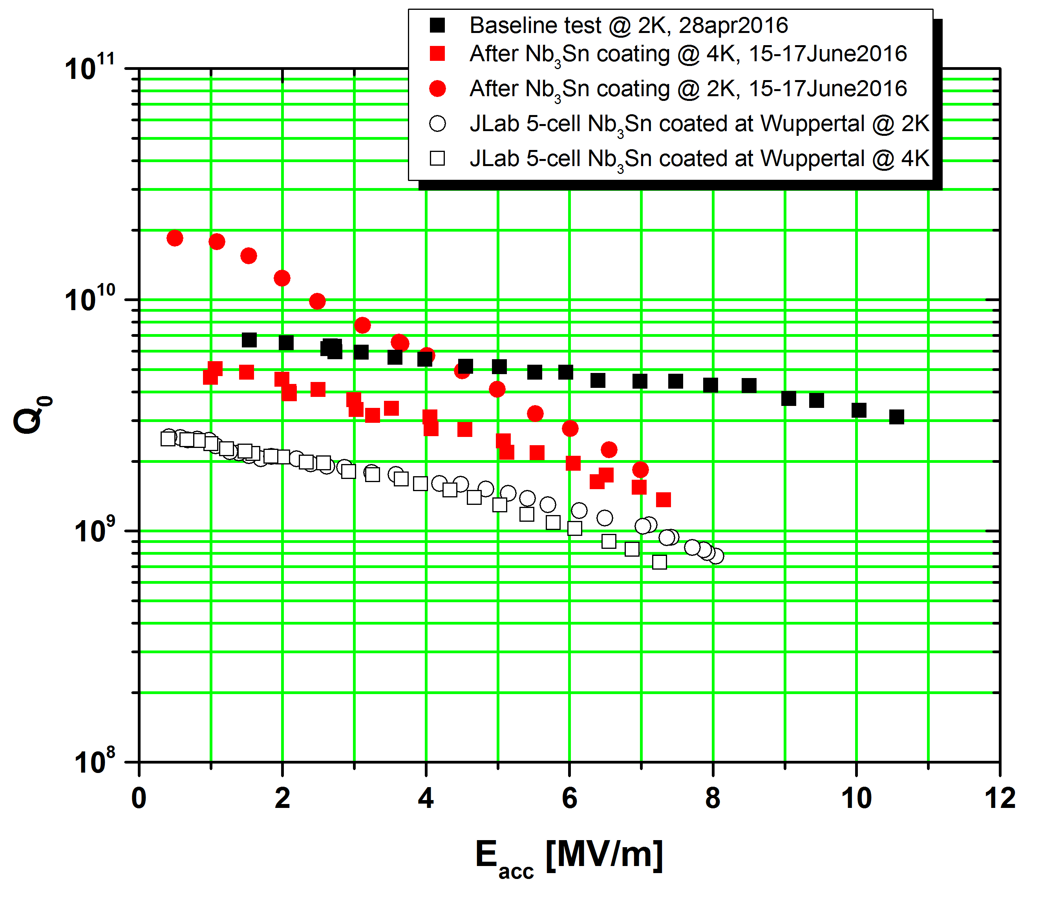
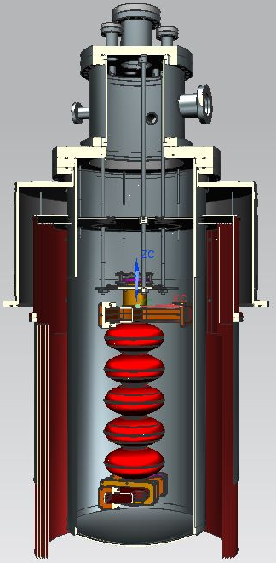
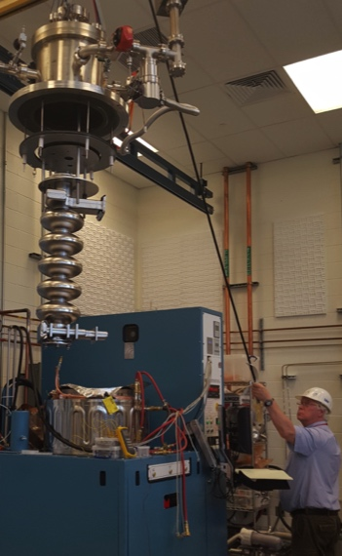
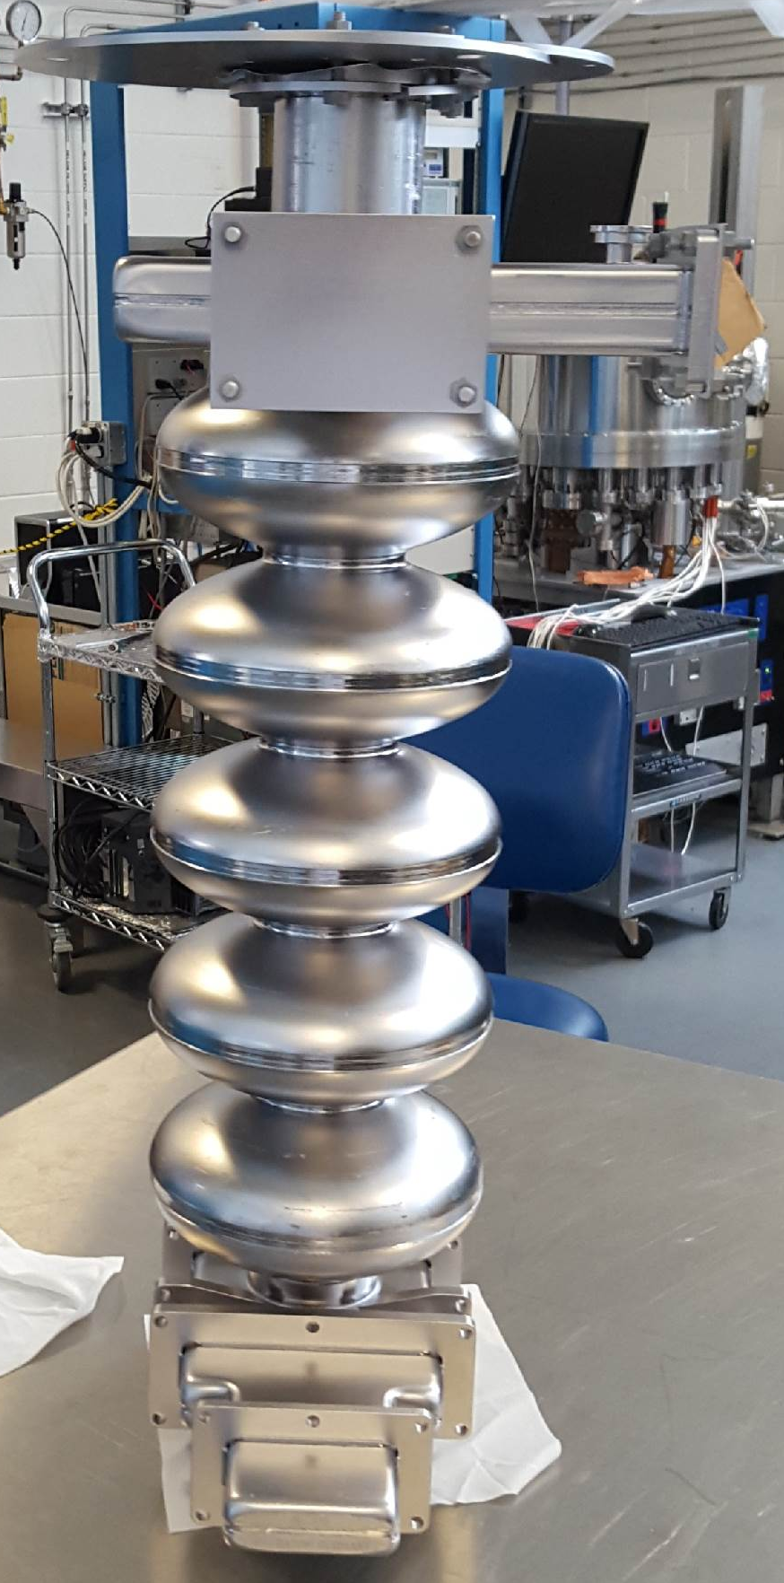
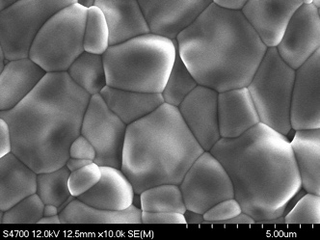
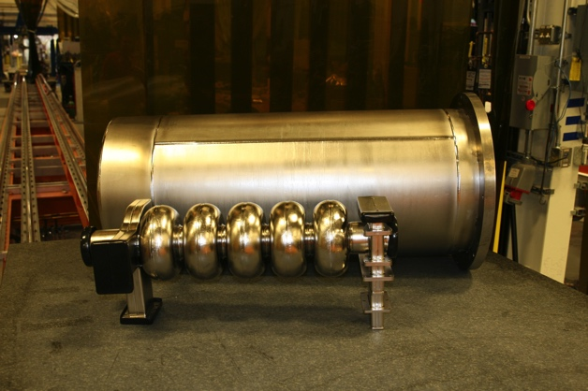
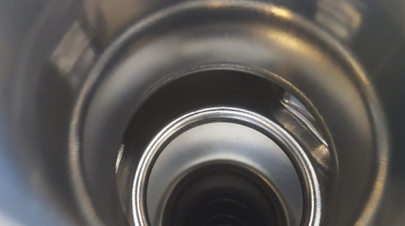
JLab Nb₃Sn 5-cell progress
G. Eremeev early career award
IA007(no end-groups)
C50
2K spec
preliminary
Original CEBAF 2K spec
The new configuration was commissioned up to 1250 °C on May 4, 2017.
More 5-cell cavity tests coming soon!
Nb₃Sn grain structure
Reasonable low-field Q₀, but a strong Q-slope, similar to the one measured in 5-cell cavity coated at Wuppertal University. Medium field Q-slope is likely due to equator features.
Nb₃Sn coating is present, but is not uniform. The top of the cavity seems “shinier” than the bottom
Looking from the top
New 17” OD x 40” furnace insert

Slide 20
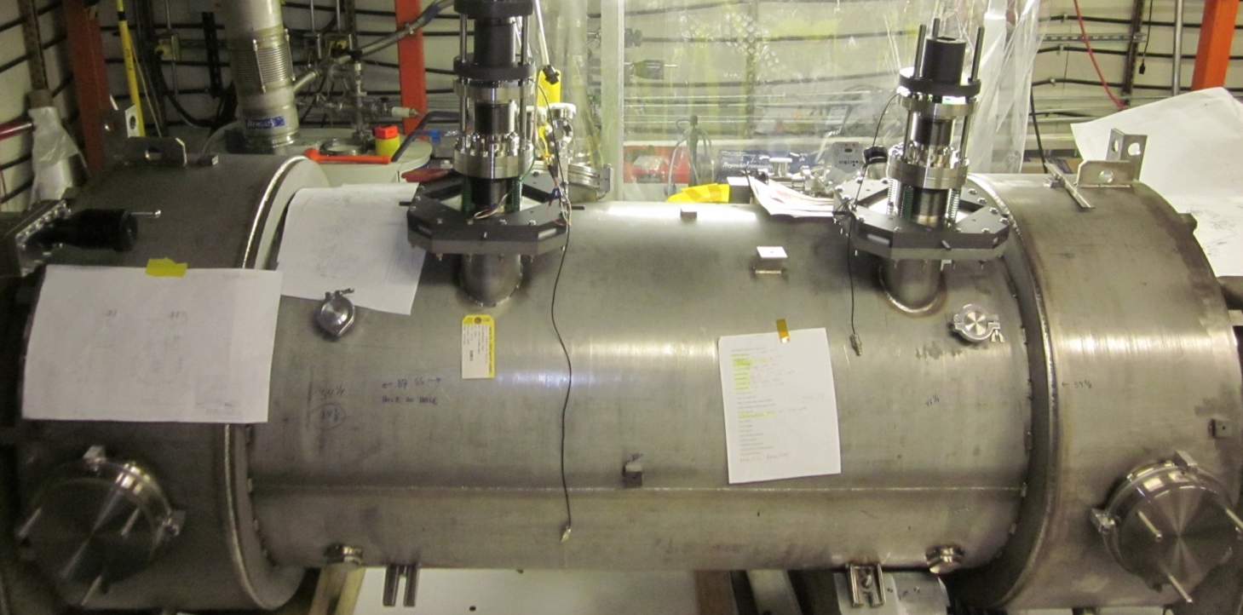
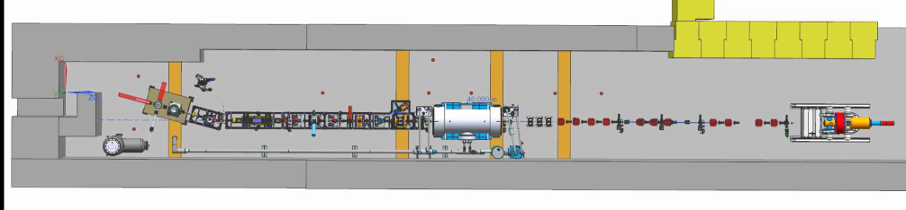
Nb₃Sn: Towards cryomodule testing
Plan to test 2 cavities with beam in the next 2-3 years
CEBAF injector quarter cryomodule
A quarter cryomodule with Nb cavities was tested at 4 K in CEBAF injector. The module accelerated the beam to the nominal energy. There was no discernible difference in the beam quality between 4 K and 2 K.
Nb₃Sn??
The layout of the Upgraded Injector Test Facility (UITF)

Slide 21
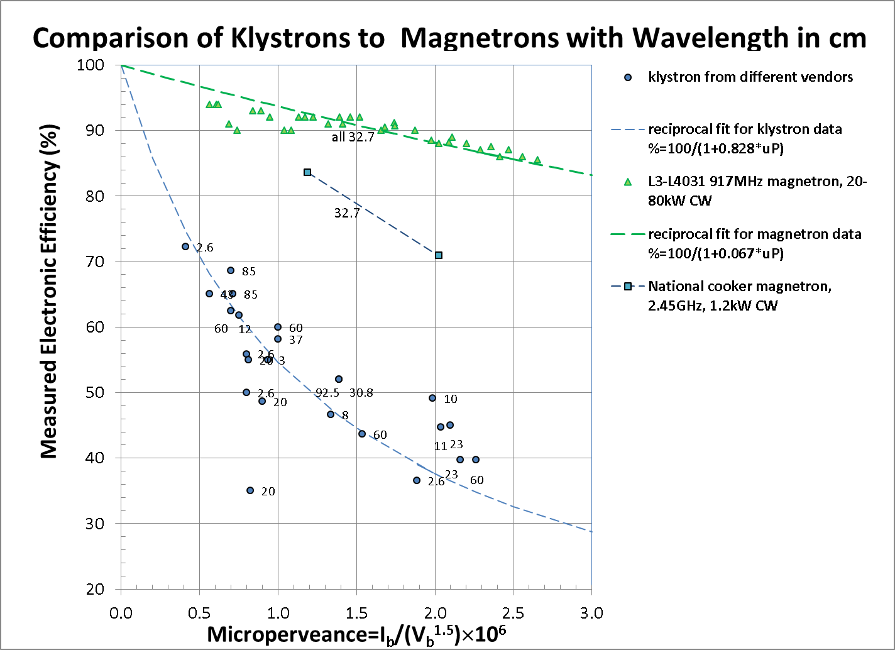
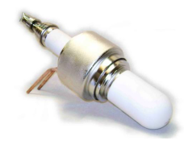
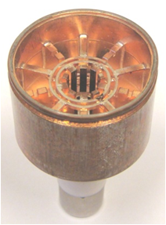
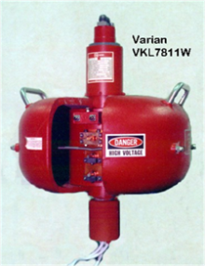
JLab R&D on magnetron RF source
H. Wang
Why?
Klystron: Space-charge effect in electron bunch forming process in linear motion dominates the efficiency. Spent energy deposits in the collector.
Magnetron
forms bunches in spoke-on-hub process in circular motion. Beam-to-RF cavity interaction in multiple passes. Much less wasted energy.
12.2
L3 20-80kW magnetron
Varian 5 kW klystron
L3 13 kW klystron
National 1.2kW oven magnetron

Slide 22
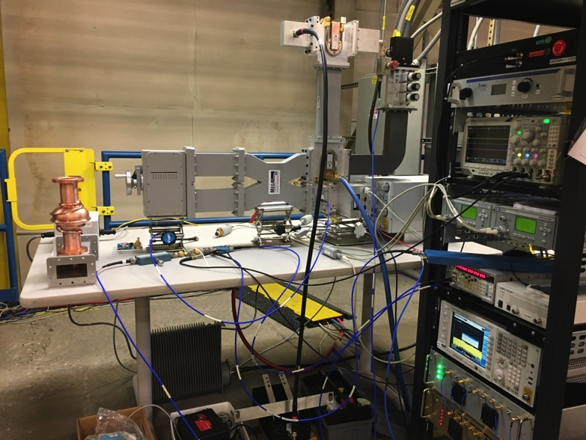
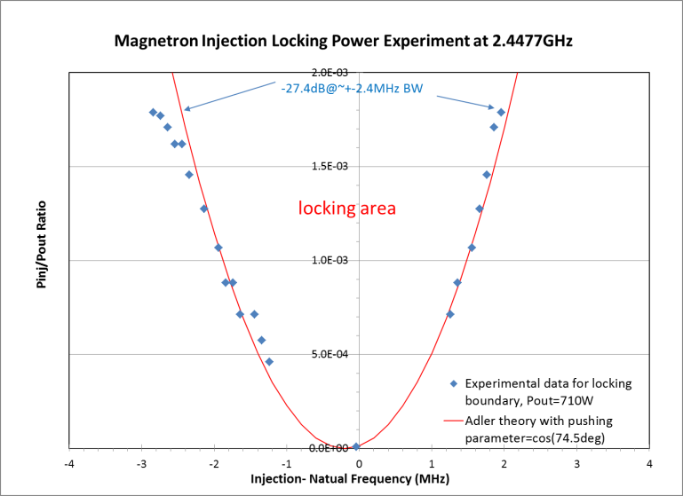
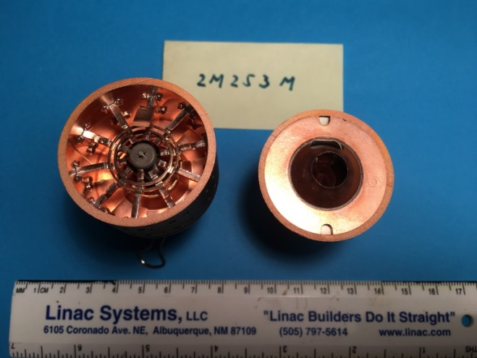
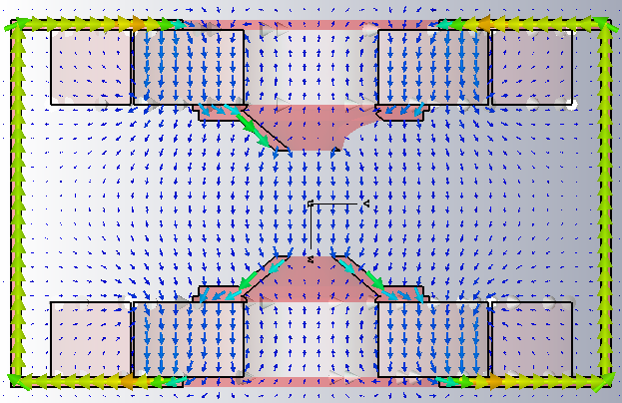
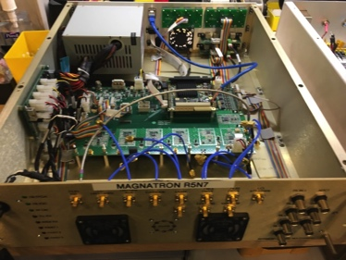
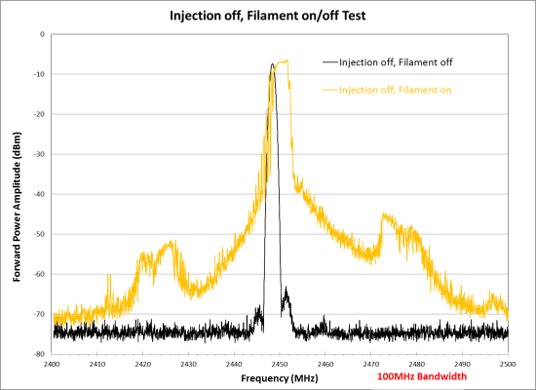
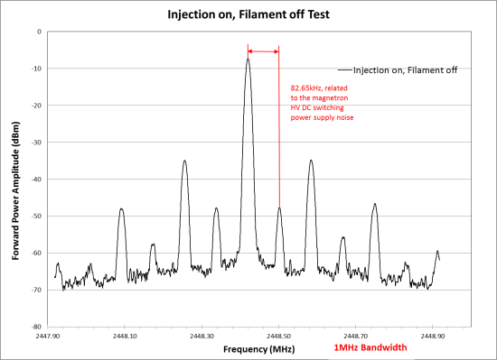
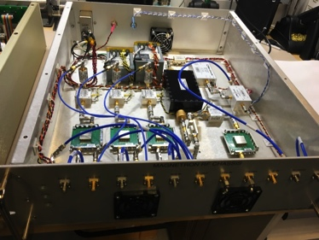
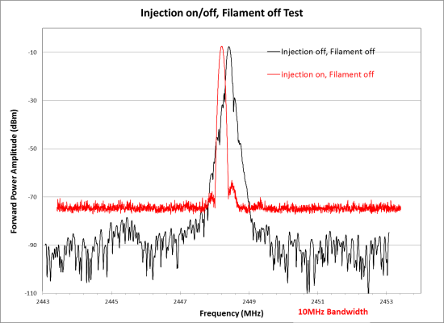


2.45GHz Magnetron R&D Test Stand with SBIR-II Fund
2.45GHz Magnetron RF Test Stand
CST magnetic circuit design with +-10% trimming coils on cooker magnetron
Digital RF FPGA Control Chassis
2.45GHz RF Front End Controller

Slide 23




Modular Cryostat
Take the best features of previous JLab designs
Modular approach to hold various different cavities
Design suitable for industrial production
Simple concepts, low parts count to reduce costs
Cooler ERL, 5-cell cavities
476.3 or 952.6 MHz Crab cavity
952.6 MHz Ion ring concept
476.3 MHz 1-cell?

Slide 24

Lowering the entry point for Commercial SRF production
Partnering with small electrochemistry innovation company
Developing low-hazard niobium polishing chemistry
  Reduce/avoid the use of dangerous hydrofluoric acid
  Safer, greener, cheaper process
Bring general-service metals processing companies into the game
Weak sulfuric acid or even salt water will do the job.
SBIR success story, started with small sample exploration and JLab-supplied scientific analysis
Faraday Technology Inc. has secured international patents.
E. J. Taylor, M. E. Inman, T. D. Hall
"Electrochemical system and method for electropolishing superconductive radio frequency cavities"
U.S. Pat No. 9 006 147, April 14, 2015.

Slide 25
Conclusions
Many promising concepts and technologies at JLab
Active R&D on cost reduction, performance improvement
Engaged in SBIR/STTR partnerships
Keen to see new and non-traditional uses for the technology
How to transition from concepts to first applications?

Slide 26
Back up

Slide 27
2K and 4K JLab Technology Development Areas
Large machines are getting more efficient
Difference between 2K and 4K does not make up for BCS losses
2008 12 GeV PED
Dana Arenius
3x Power Reduction
20-25% Power Reduction

Slide 28


Scalability
The size and power may be simply scaled according to available source frequencies. Higher energies may be obtained using pulsed operation or by stacking additional modules in series.
  915 MHz 1497 MHz 2450 MHz
  ~100 kW 10-50 kW 1-5 kW
  0-1MeV 0-500 keV 0-250 keV
Stationary Applications mobile “portable”

Slide 29

Scale up
For factory processing of sheets prior to installation a larger static installation is preferable. For wide mill runs it may be more convenient to stack multiple compact units in parallel.
Static installation
Beam fan
Direction of
sheet travel

Slide 30


State-of-the-Art Gradient Results
ILC 500 GeV
R&D Gradient Goal
As a result of continued SRF cavity R&D at CERN, Cornell, DESY, JLAB, KEK, SACLAY and other labs, modern 9-cell TTF-style cavities increasingly exceed 35 MV/m at Q₀ P 8×10⁹. Gradient in the range of 40-43 MV/m demonstrated and confirmed independently in real 9-cell (and 7-cell) cavities, corresponding to a surface magnetic field of 160-180 mT.

Slide 31

The Intensity Frontier for Protons
Central challenge at the beam power frontier is controlling beam loss to minimize residual activation
1 nA protons at 1 GeV, a 1 Watt beam, activates stainless steel to 80 mrem/hr at 1 ft after 4 hrs
High beam current
  BBU control (HOMs)
  Low Frequency large aperture cavities
  High power, high efficiency RF sources
J. Wei , “China Spallation Neutron Source Design”, APAC 2007, Indore, India

Slide 32


Magnetron RF source, the potential impact
Capital and operation cost saving for CEBAF in RF power
Low cost of magnetron device
DC-to-RF efficiency from klystron to magnetron improves from ~35% to ~90%
2.22MW of DC power saving
$2.8 million saving in power bill, if 41 weeks/year of CEBAF in 6-12GeV operation
Technology demonstration for all SRF accelerators in the DOE complex
2.45GHz Magnetron RF Test Stand
References:
[1] A. C. Dexter, G. Burt, R. G. Carter, I. Tahir, H. Wang, K. Davis and R. Rimmer, PRST-AB, 14, 032001 (2011).
[2] M. Nuebauer, A. Dudas, R, Rimmer, H. Wang, An Efficient RF Source for JLab, PAC 2013, Pasadena, CA, USA.
[3] H. Wang, T. Plawski, R. Rimmer, Simulation Study Using Injection Phase Locked Magnetron as an Alternative Source for SRF Accelerators , IPAC 2015, May 3-8, 2015, Richmond, VA, USA .
[4] H. Wang, T. Plawski, R. Rimmer, M. Neubauer, A. Dudas, Simulation and Experimental Studies of a 2.45GHz Magnetron Source for an SRF Cavity with Field Amplitude and Phase Controls, IPAC 2016, May 8-13, 2016, Busan, Korea

Slide 33






Moving working point along the fixed frequency line when changing the output amplitude
Magnetic field coil current
Magnetron trim coil modulation experiment
1000 Apmturns=10% B field trimming

Slide 34

FY2018 Accelerator Stewardship Proposal for DOE National Lab 18-1879
More than 85% efficiency of magnetron in mass production
is commercial available

