Slide 1
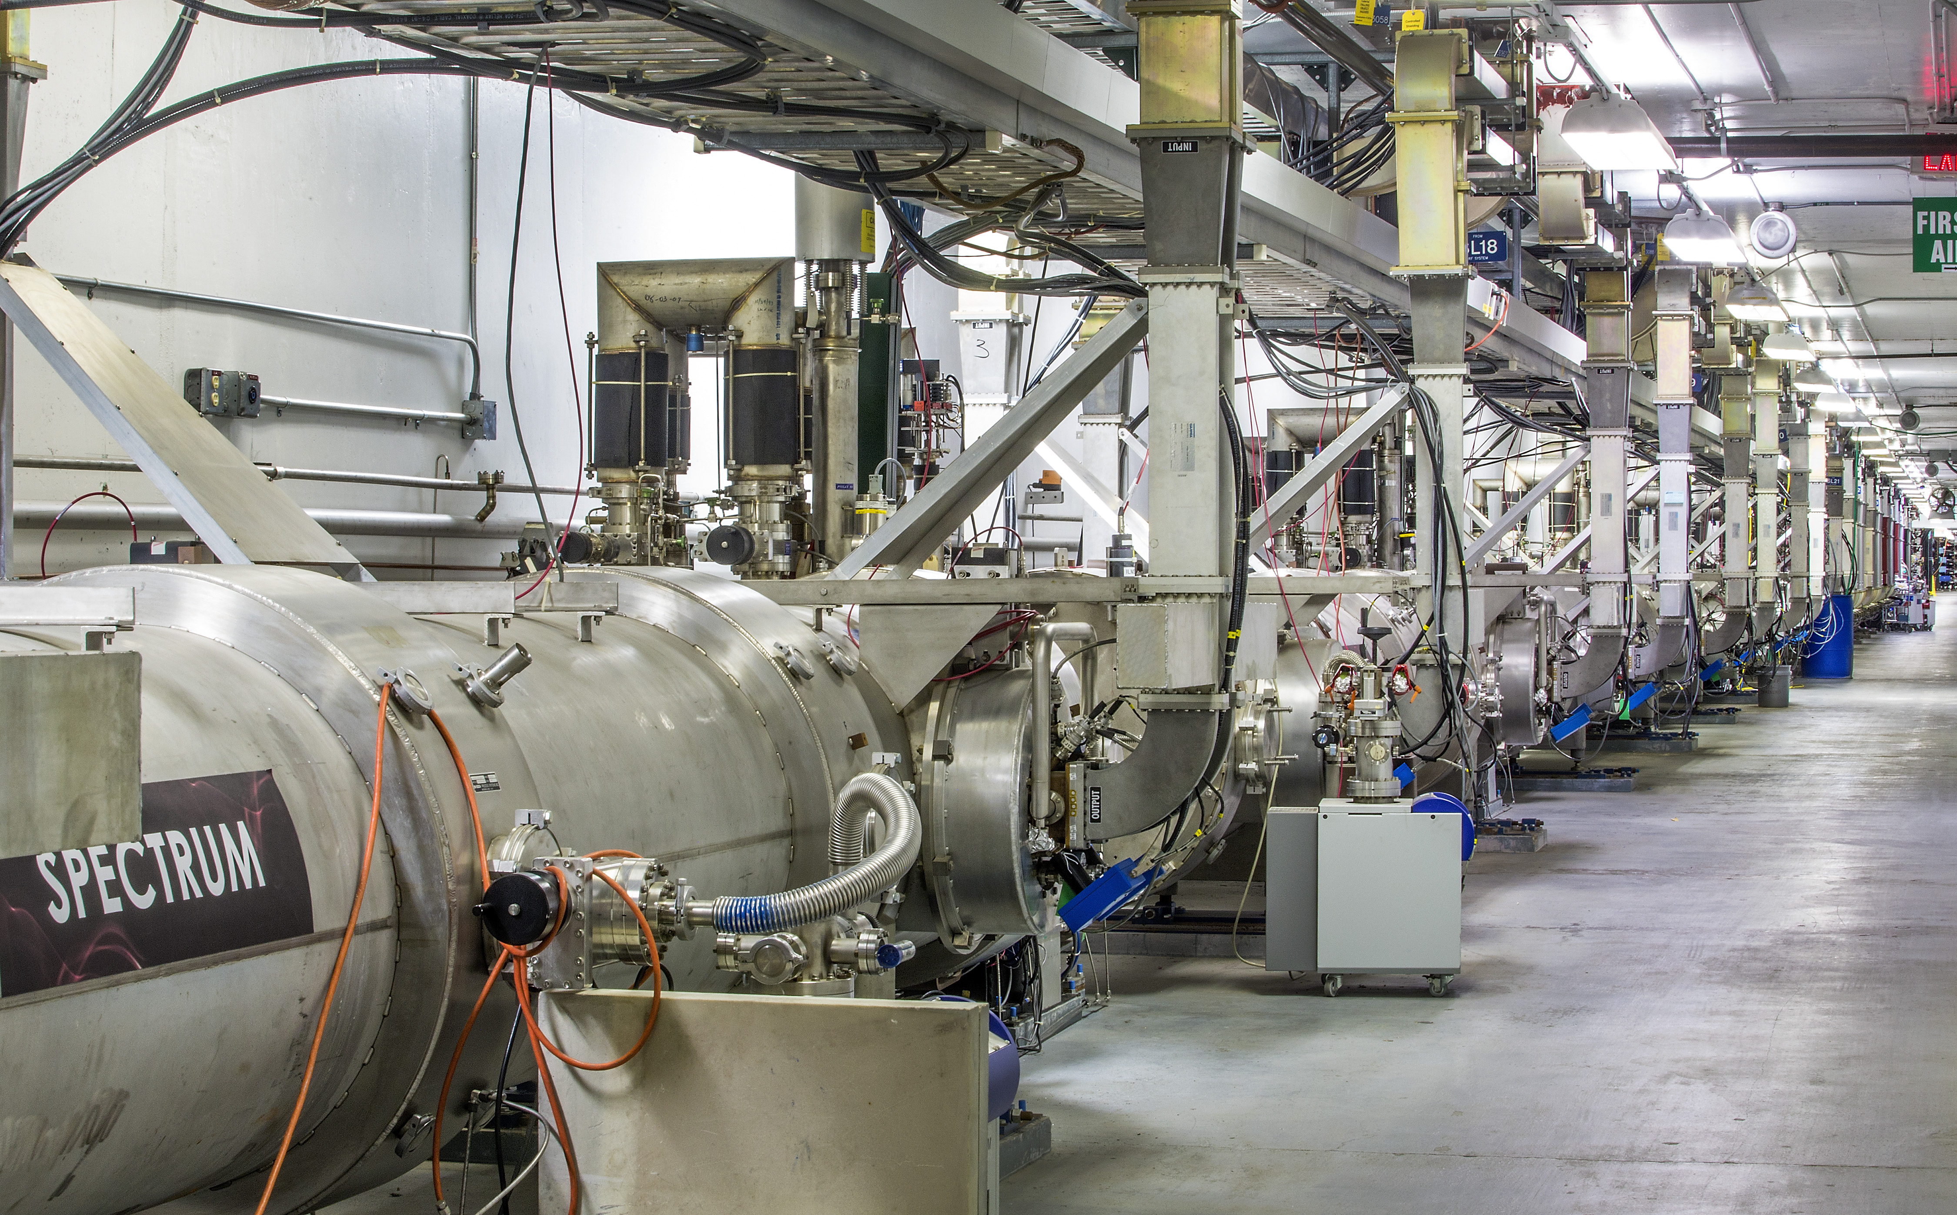
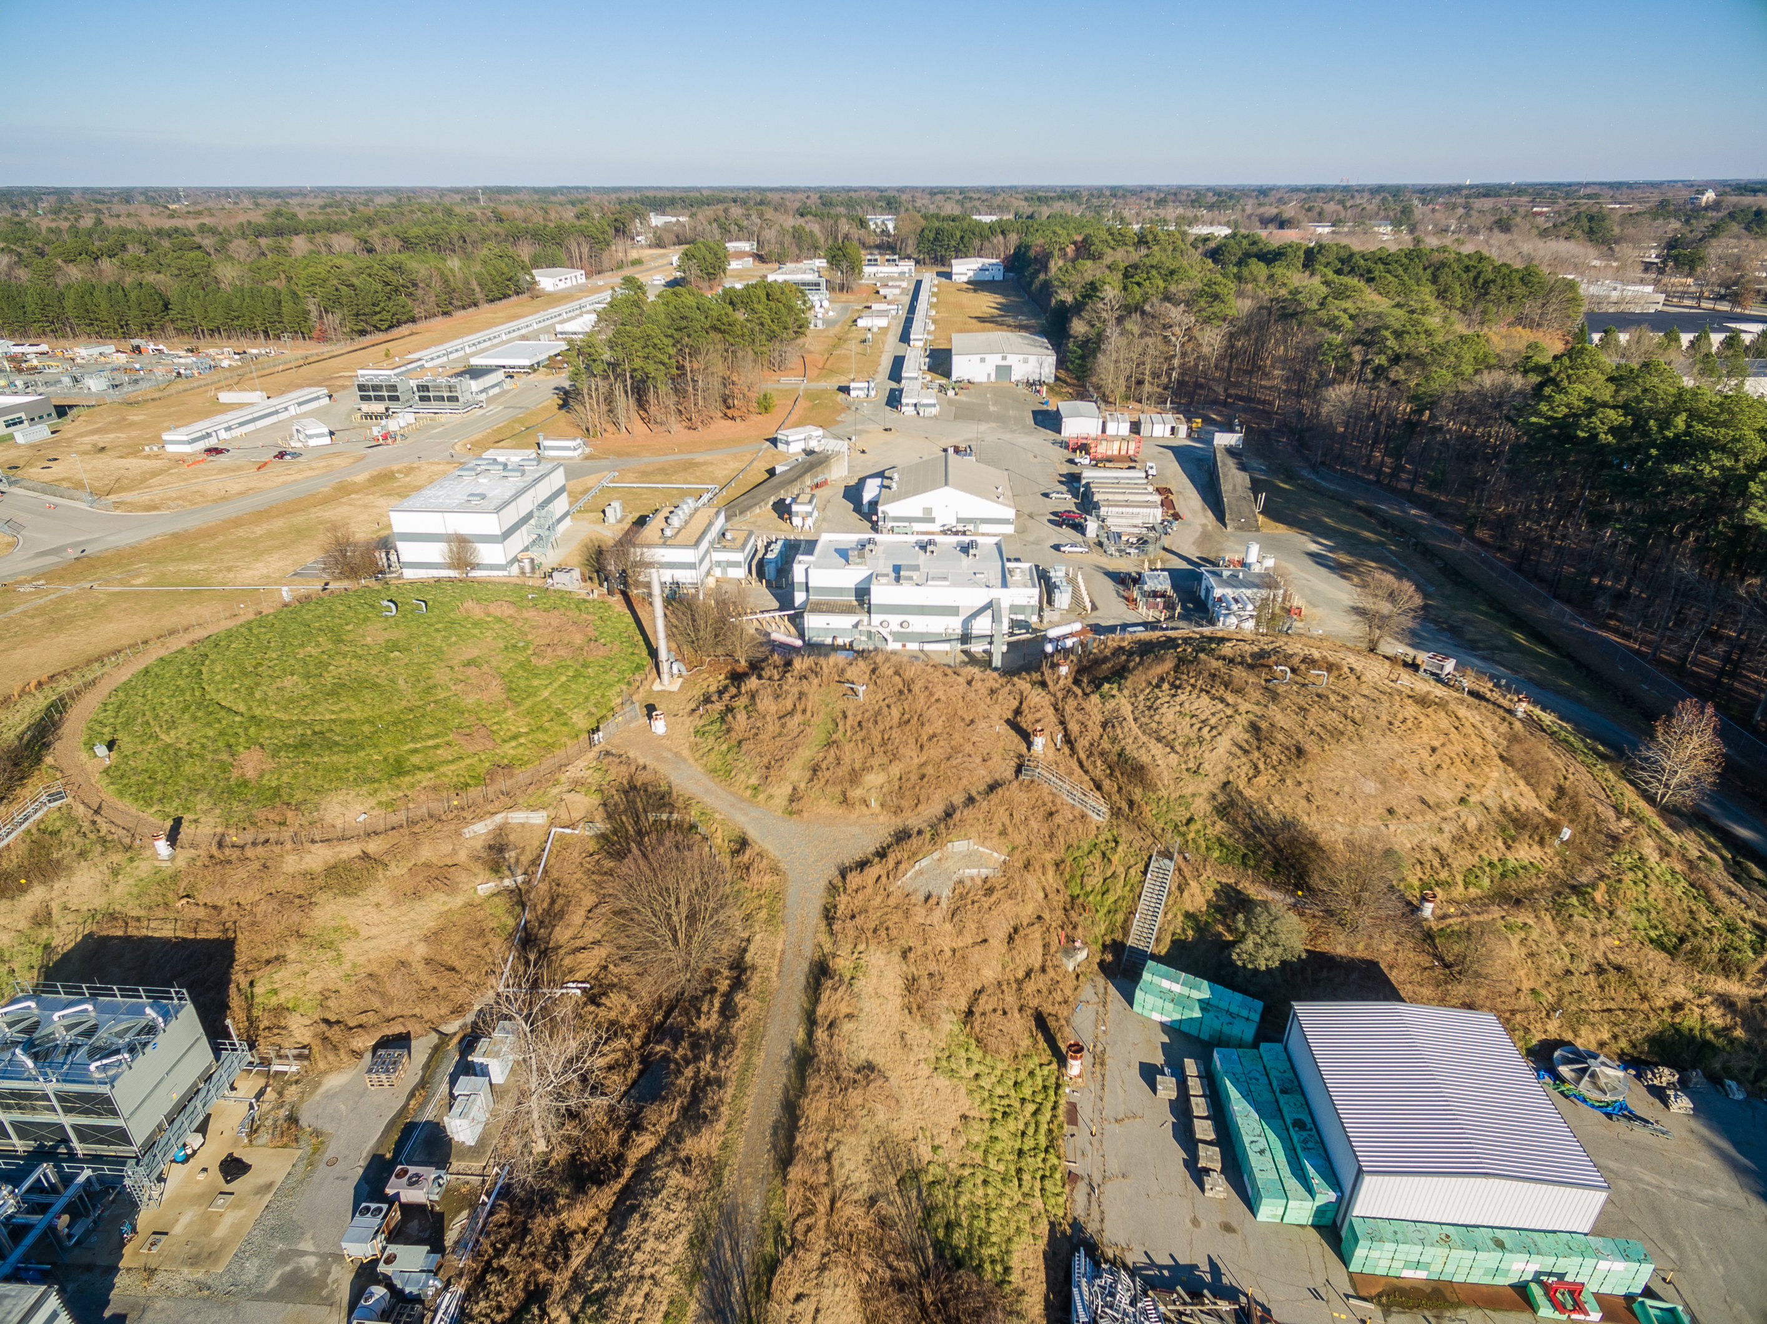
Welcome and Introduction
Stuart Henderson
Laboratory Director
March 22, 2018

Slide 2
Overview of Jefferson Lab
One of 17 U.S. Department of Energy National Laboratories Created to build and operate the Continuous Electron Beam Accelerator Facility (CEBAF), world-unique user facility for Nuclear Physics Mission is to gain a deeper understanding of the structure of matter Through advances in fundamental research in nuclear physics Through advances in accelerator science and technology In operation since 1995 Managed for DOE by Jefferson Science Associates, LLC (JSA)
Jefferson Lab by the numbers: ~725 employees FY2016 Costs: $184.1M FY2017 Costs: $162.1M 169 acre site 72 buildings/trailers; 880k SF 1,597 Active Users 27 Joint faculty 562 PhDs granted to-date (200 in progress)

Slide 3
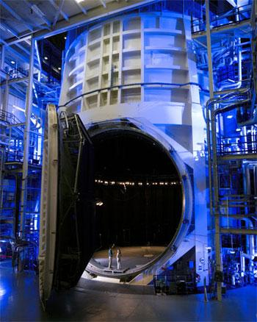
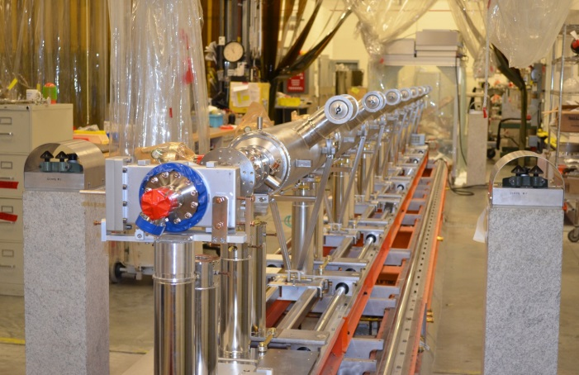
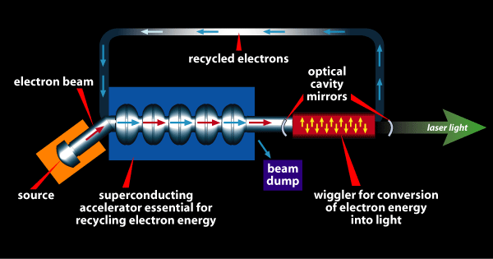
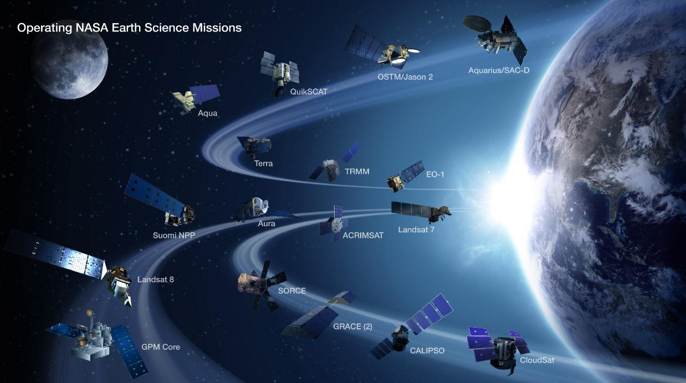
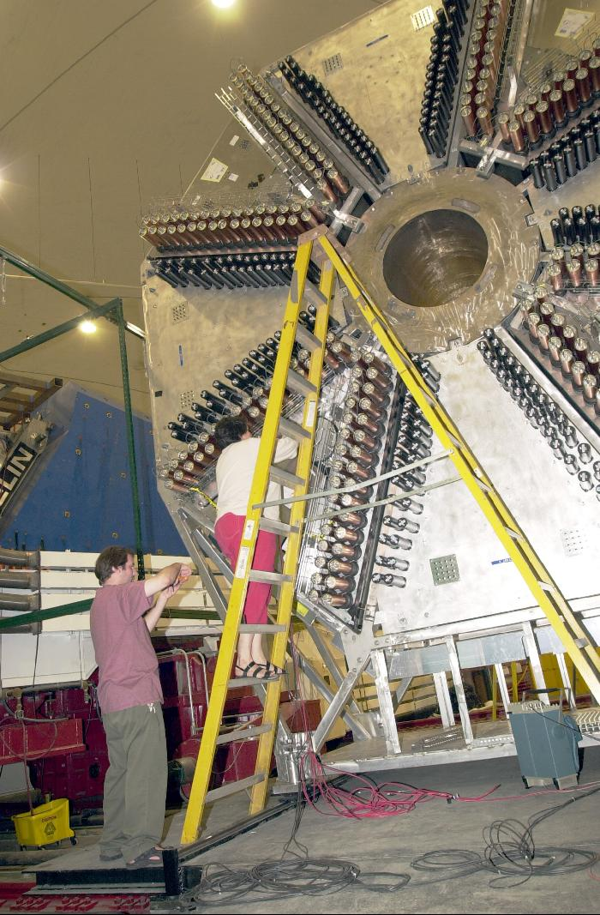
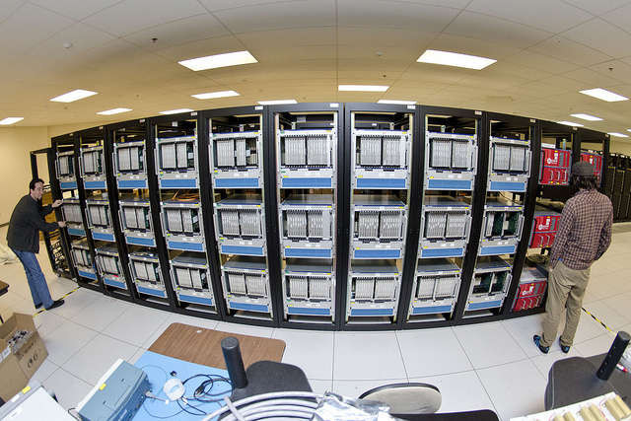
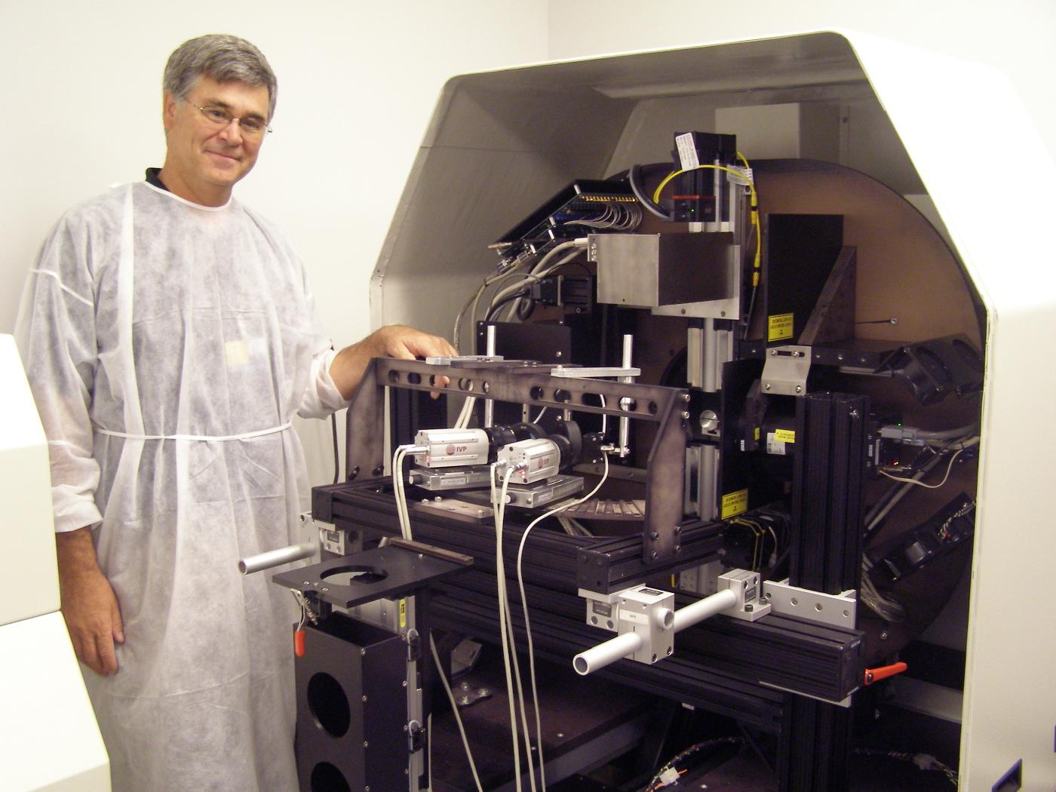
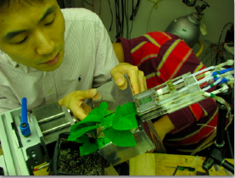
Jefferson Lab’s Technology Portfolio
High-power Free electron lasers (Ex: Record power achieved in Office of Naval Research program at JLAB)
Big Data challenges (Ex: NASA Langley adoption of JLAB software framework for multi-satellite data processing)
Superconducting particle accelerators (Ex: LCLS-II Project)
Large scale Cryogenics
(Ex: NASA James Webb Space Telescope)
Particle Detector Technologies
(Ex: Compact gamma camera for breast cancer detection; AwakeSPECT for functional brain images of conscious, unrestrained mice; molecular imaging for plant biology
High performance computation (Ex: GPU hardware in HPC)

Slide 4
Why this workshop?
The Landscape is shifting
Administration and Department of Energy priorities
Tech Center is a tremendous opportunity
Peninsula tech ecosystem is growing
Emerging application areas are aligning with JLab technology
We have a lot of potential at Jefferson Lab
How to make the most of it?
How to change the paradigm of how we do technology transfer and develop technology partnerships to get greater impact?
How to be more deliberate in identifying opportunities and going after them?
Moving away from passive, “let a thousand flowers bloom” approach
To targeted and deliberate
And striking the balance between the two?

Slide 5
Welcome!

