Slide 1
Technology Transfer at Jefferson Lab
Overview
Drew Weisenberger
Notes:
Thank you . I’m the Chief Technology Officer (CTO) here at Jefferson Lab. I actually wear two hats here. In addition to CTO I also head a small nuclear physics detector development group. Most of my effort goes into leading the radiation Detector and Imaging Group. The group is composed of scientists and engineers who are experts in the nuclear physics detector technology and we participate in several detector based projects throughout the lab. We have also found applications for nuclear physics detector technology beyond basic nuclear physics. So applications of basic nuclear physics is a big interest of mine so it was natural for me to also take up being the CTO. It is no surprise that basic nuclear physics research leads to applications this has been happening for a long time up got a big push through the Manhatten project and beyond

Slide 3
Jefferson Lab Electron-Ion Collider (JLEIC)

Slide 4
Key JLab Technology
Advanced Accelerator Technologies | Nuclear Physics Detector Instrumentation | Novel Materials | High Performance Computing
Superconducting Radiofrequency (SRF) | High energy particle detection | Nanomaterials | Modeling
Electron beam injectors, sources and linear accelerators | Radiation detection and imaging | Radiation damage/ monitoring | Simulations
Cryogenics- 2 K & 4 K | Nuclear medicine imaging | Radiation shielding | Multi-source data processing

Slide 5
JLab Technology & Possible Applications
Cryogenics Engineering
Electron Accelerators
Energy Recovery Linacs
Fast Electronics
Free Electron Laser
High Performance Computing
High Power Optics
Nuclear Physics Detectors
Radiation Shielding & Modeling
SRF (at 2°K and 4°K)
Advanced Materials
Compact Accelerators
Laser Chemistry
Medical Imaging
Nuclear Power
Radiation Therapy
Radioisotope Production
Security Screening
Waste Processing

Slide 6
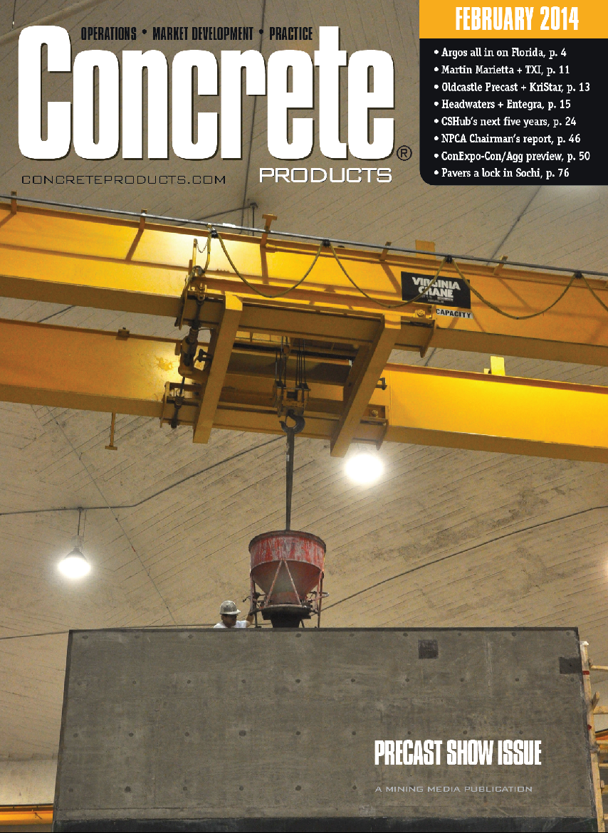
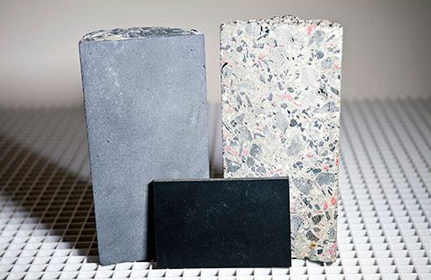
New Recipes for Stopping Neutrons
Concrete: H2 Neutron Moderator
Neutrons are a common byproduct of particle accelerator operations. They can cause radiation damage and single-event upsets causing sensitive data acquisition systems to fail mid-experiment.
Preventing this was a chief goal of nuclear scientists in the design of a shield house for an apparatus at Jefferson Lab, and guided an optimal shielding strategy, with light-weight concrete followed by a boron-rich sheet and finally a layer of lead.
Boron: Thermal Neutron Capture
Pb: Gamma Absorber
Neutron Radiation Sources:
Particle accelerators
Nuclear reactors
Cosmic rays
Applications:
Nuclear power
Experimental particle physics shielding
Shielding for special materials
Shielding around neutron sources (SNS, ESS)
Medical proton therapy facility shielding
Shielding for electronics to prevent “single event failure” (ESA)
Patented boron-rich concrete
Patented light-weight concrete
Patented boron-rich sheet
Notes:
6

Slide 7
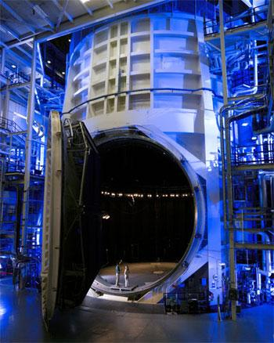
Large Scale Cryogenics
Jefferson Lab's cryogenics group helped NASA scientists design and commission a cryogenics plant to cool the Webb telescope’s components to temperatures its instruments will experience in space, to within 30 degrees Fahrenheit of absolute zero.
tripled the capacity of the refrigeration system.
cut the liquid nitrogen consumption in half
helium refrigerator system now maintains peak efficiency
NASA Johnson Space Center's Space Environment Simulation Lab Chamber A. Photo: NASA.
Notes:
7

Slide 8
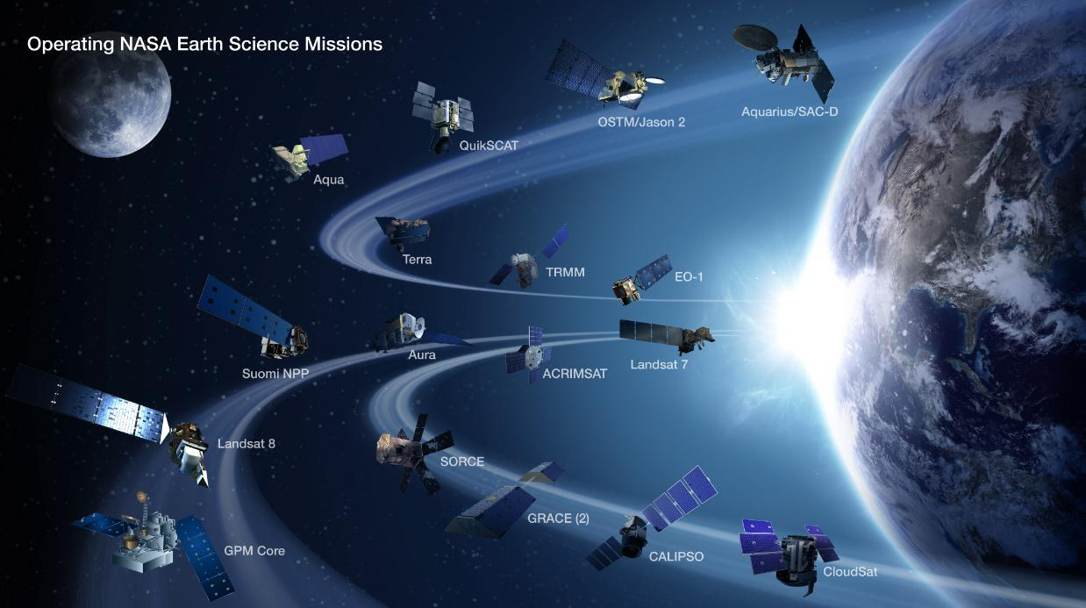
A New Approach for a NASA Challenge
Interagency agreement between NASA’s Langley Research Center and JLab for multi-satellite data processing.
Multiple geo-satellites.
Missions last longer and sensors become more complex.
Open Source Software Engineering is becoming a high priority (large data volume).
Multiple Nuclear Physics detectors.
CLARA is a Jefferson Lab software application built as a network of “black box” independent processes that exchange data.
This renders a software well-suited to multi-user, inter-disciplinary studies.
NASA
JLab
Notes:
8

Slide 9
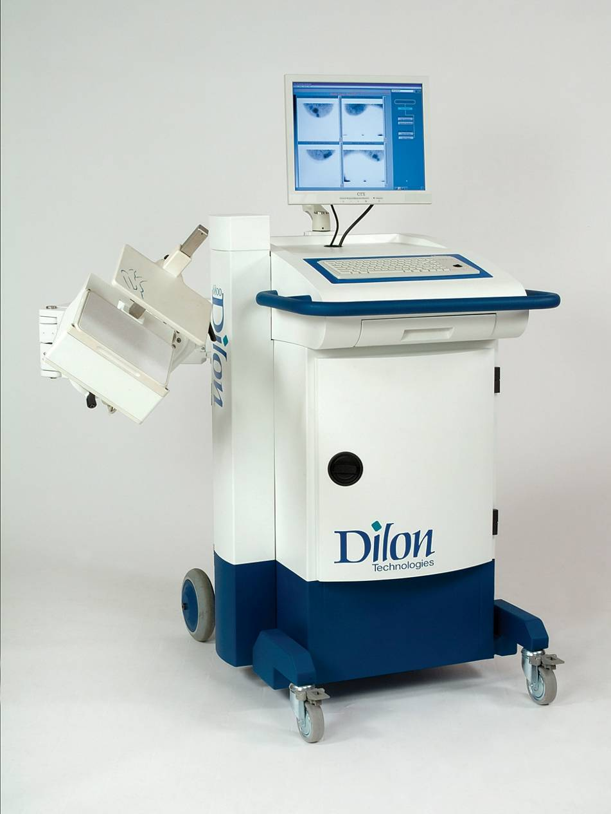
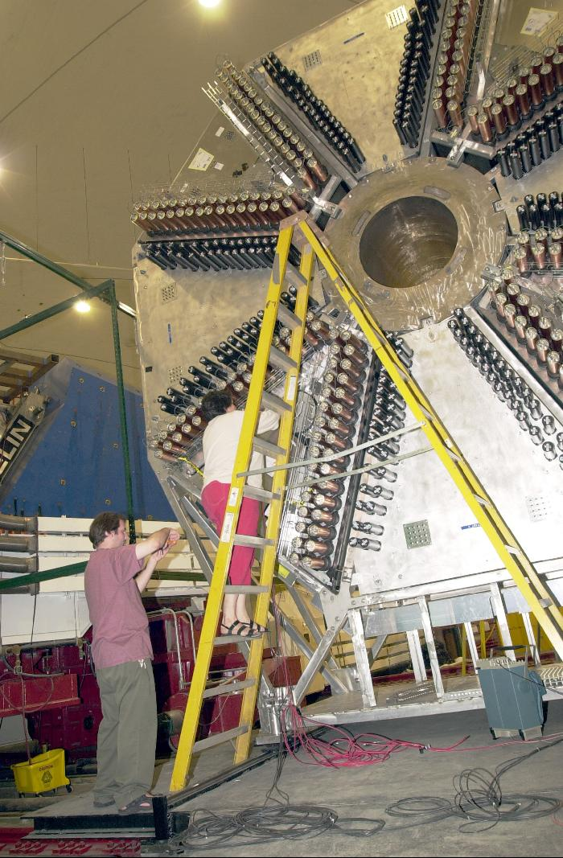
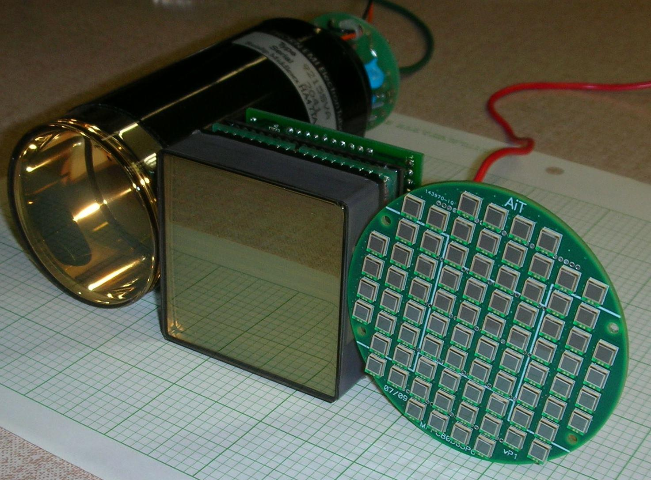
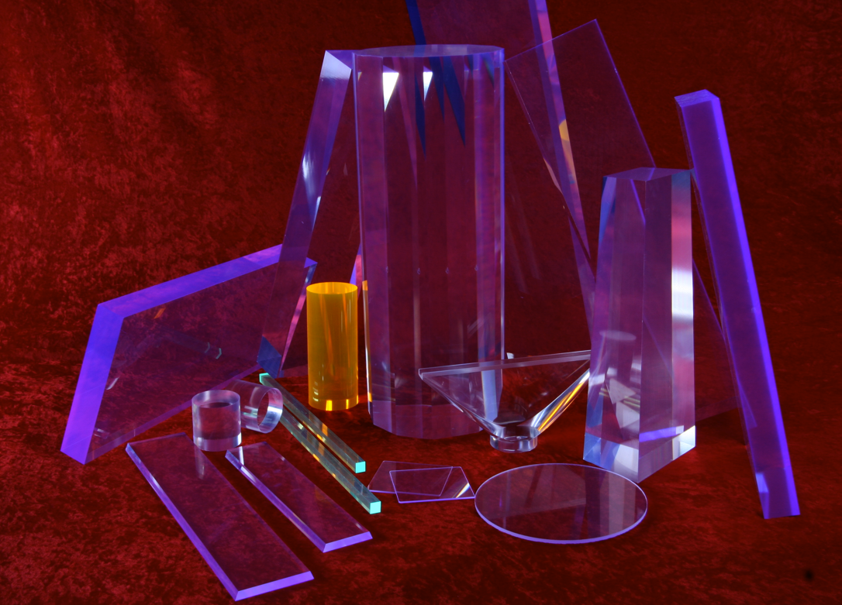
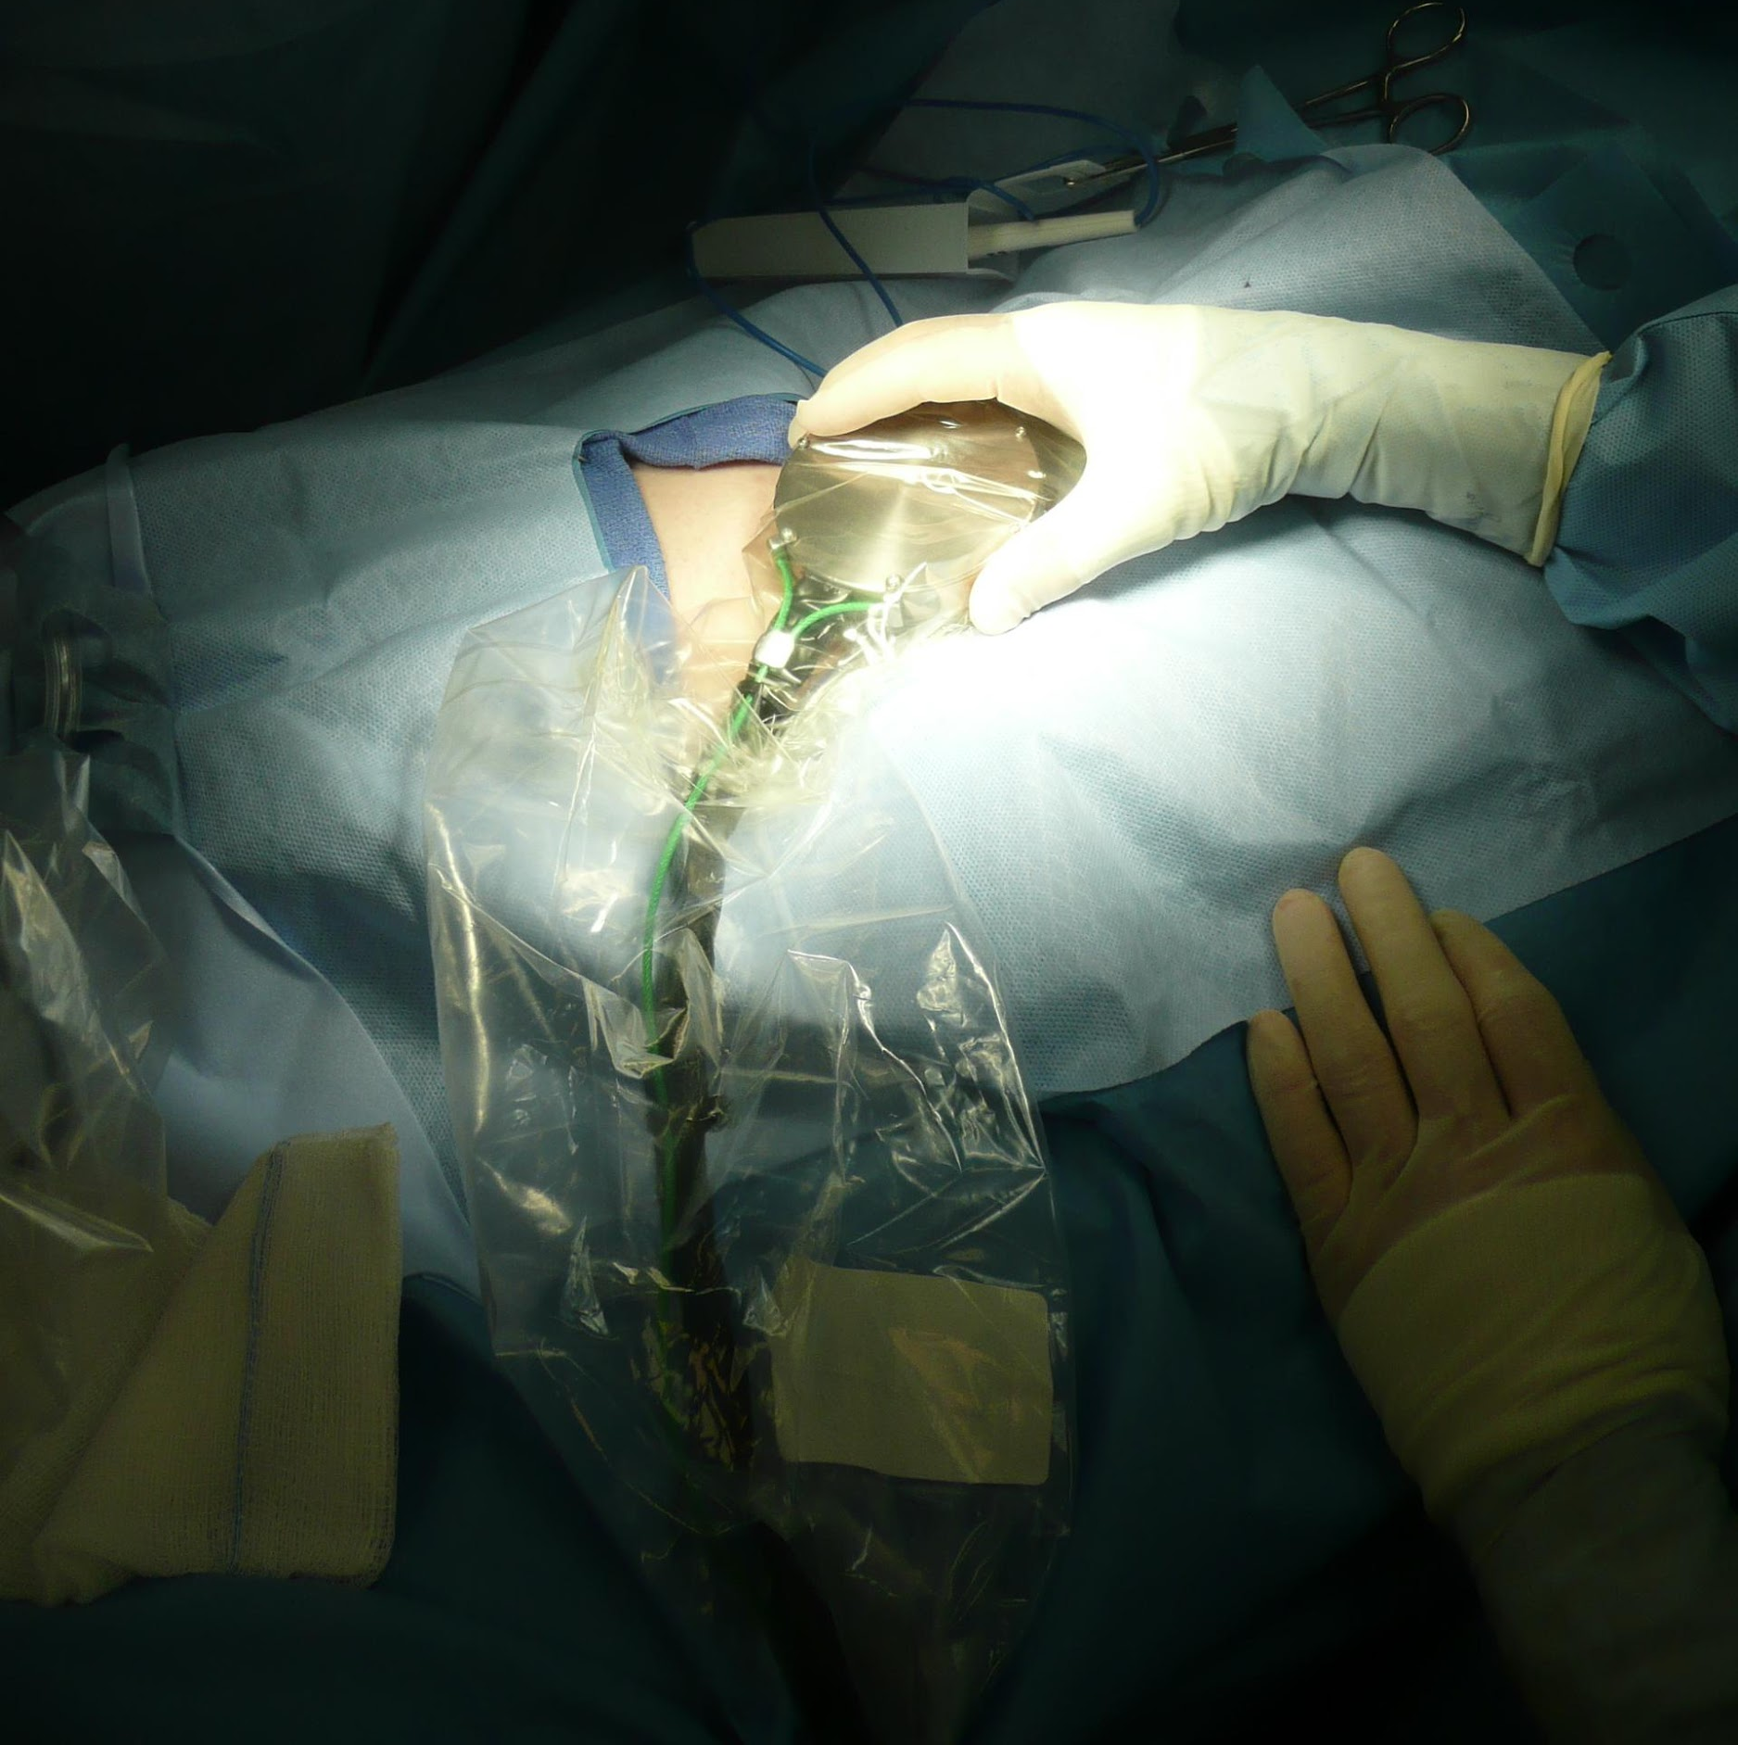
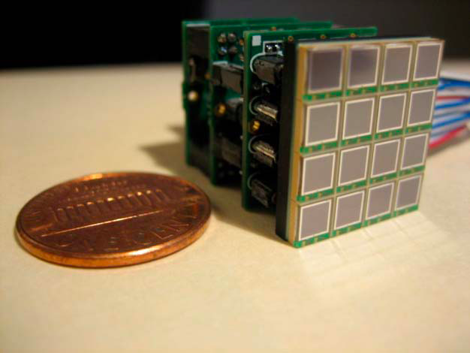
Detector Spin-Off Advances Patient Care
Nuclear physics detector technology developed to explore the structure of matter at Jefferson Lab leads to new and advanced tools for better patient care.
Tools for nuclear physics research: photomultiplier tubes, silicon photo multipliers, scintillator and detector electronics
Tools for better patient care:
Compact gamma camera for breast cancer detection (FLC Award)
Hand held gamma camera to guide surgeons
Notes:
9
Nuclear physics detector technology developed to explore the structure of matter at Jefferson Lab leads to new and advanced tools for better patient care. Tools for nuclear physics research include: photomultiplier tubes, silicon photo multipliers, scintillator and detector electronics. Tools for better patient care were developed including compact gamma camera for breast cancer detection, leading to several Jefferson Lab patents and a start-up company. Also, hand held gamma camera was developed to guide surgeons, allowing silicon photo multipliers to provide precise imaging at low voltages and are now also wire-free and wireless, to give flexible motion without tethering.

Slide 10
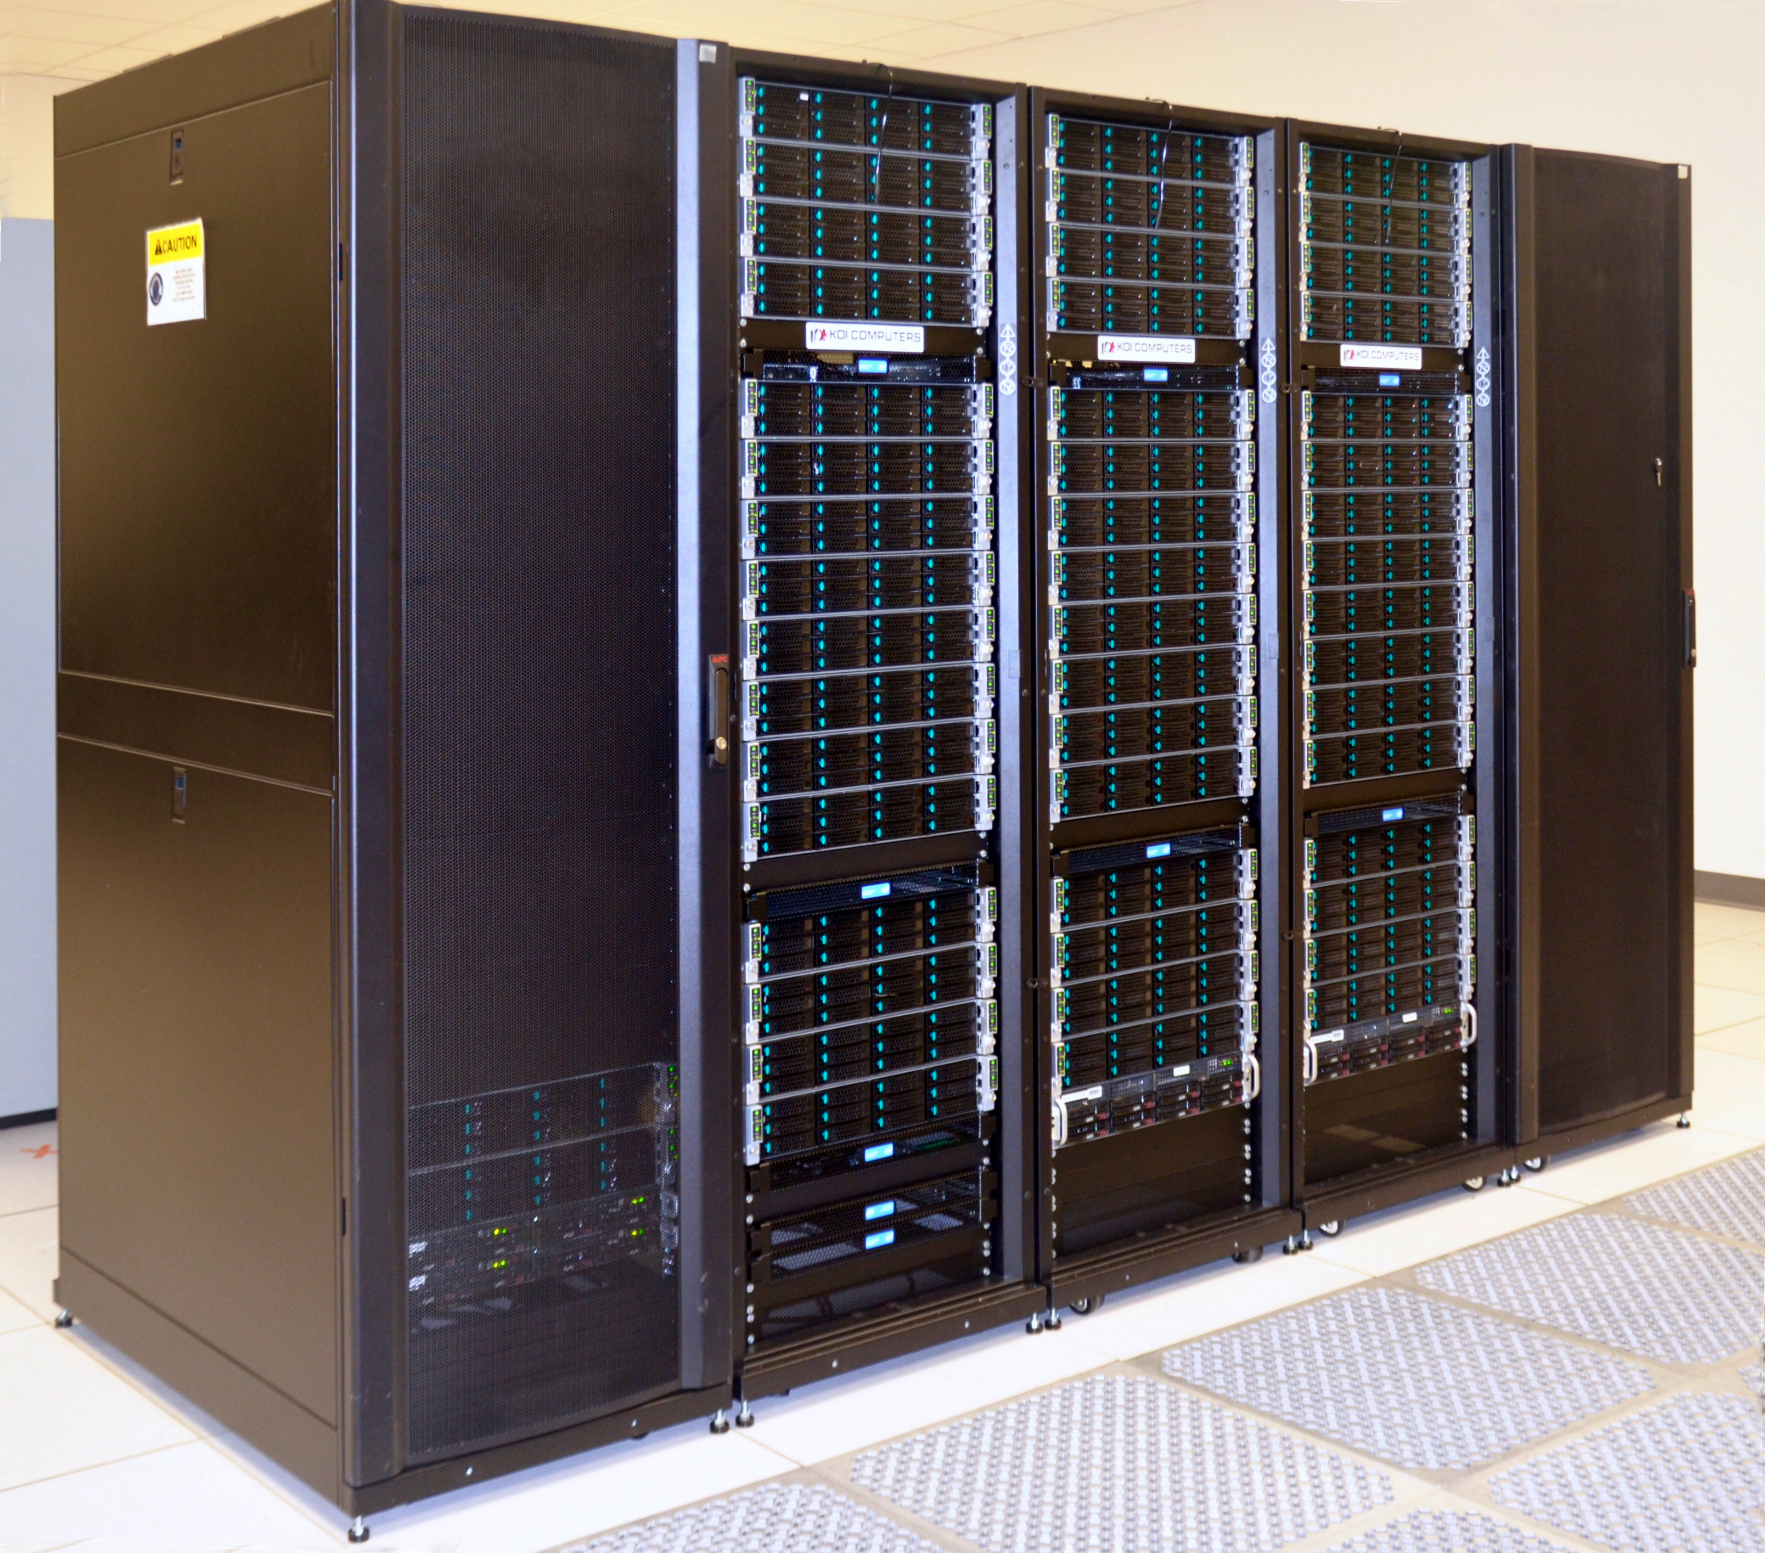
High Performance Computing
There is increasing demand for high-performance computing to solve our understanding of complex many-body systems and predict their behavior.
Use of graphics processing unit (GPU) or graphics cards for the low-cost solution of extremely CPU-intensive, repetitive computations was first implemented in the Jefferson Lab Lattice QCD calculations, gaining computing speedup factors of two to ten.
These capabilities underpin many important scientific challenges, e.g. studying climate and heat transport over the Earth.
The effort to boost the computing capabilities will continue with the Exascale Computing Project and enable a new era of high-precision calculations, including Lattice QCD.
Notes:
10
There is increasing demand for high-performance computing to solve our understanding of complex many-body systems and predict their behavior.
Use of graphics processing unit (GPU) or graphics cards for the low-cost solution of extremely CPU-intensive, repetitive computations was first implemented in the Jefferson Lab Lattice QCD calculations, gaining computing speedup factors of two to ten. This is now applied on leadership GPU systems such as DOE Titan (ORNL) and NSF Blue Waters (NCSA - University of Illinois).
Lattice QCD in collaboration with industry have driven development of new computing paradigms that benefit large scale computation. These capabilities underpin many important scientific challenges, e.g. studying climate and heat transport over the Earth.
The hottest video games on the market often have the most realistic graphics, enabled by performing intense calculations on a device called a graphics processing unit (GPU) or graphics cards.

Slide 11
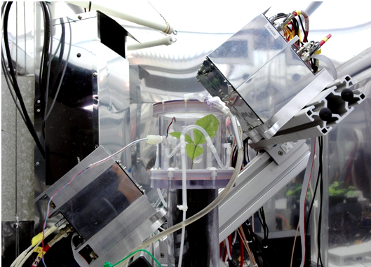
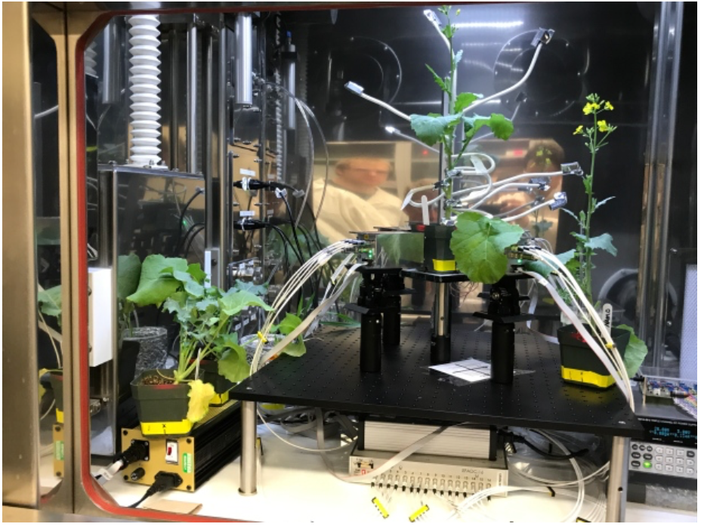
Detector Development for Plant Biology
Oak seedling PhytoPET studies at Duke University Phytotron
CRADA: Saskatoon Plant Phenotyping and Imaging Research Centre- PhytoPET studies development of new strains of lentils, wheat and canola

Slide 12
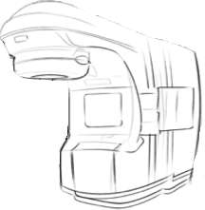
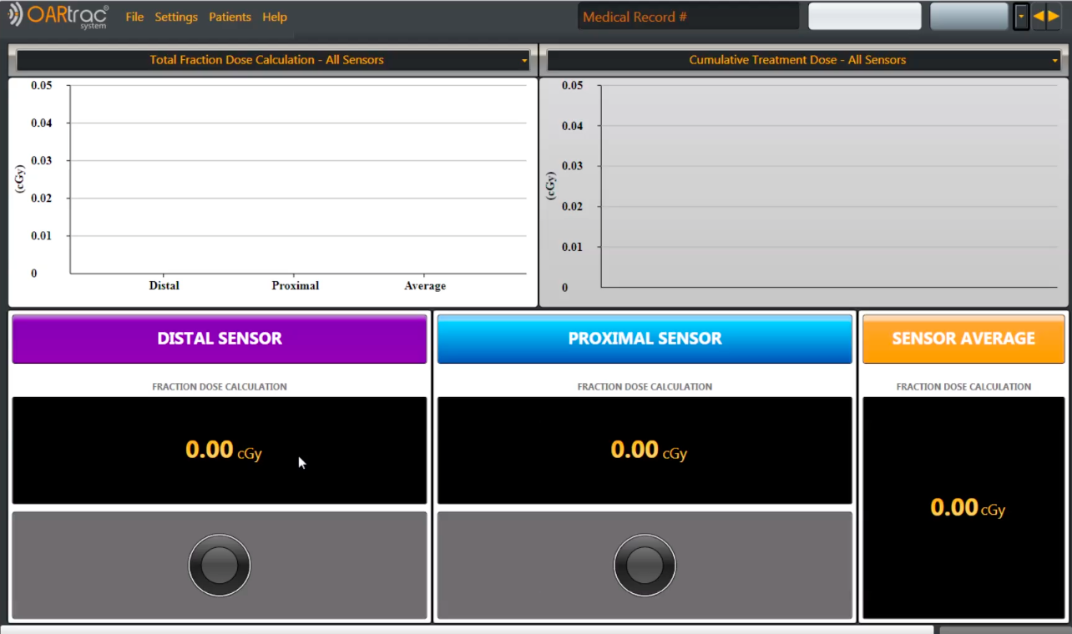
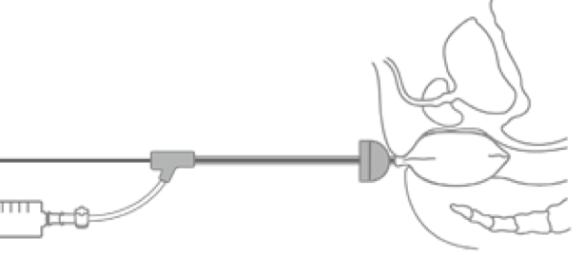
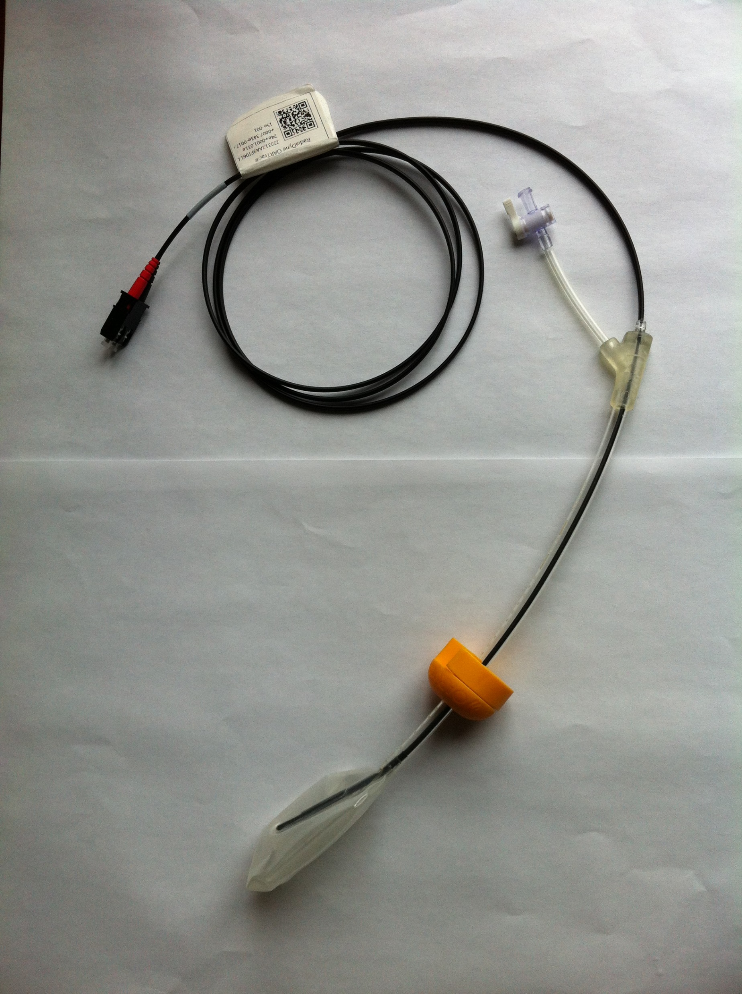
Enabling Real Time Radiation Treatment Dosimetry
Nuclear scientists at Hampton University and Jefferson Lab developed real-time, in vivo, dosimetry technology.
Incorporates real time dosimetry monitoring into radiotherapy cancer treatment procedures
Uses plastic scintillating detector (PSD) fiber technology with balloon-type patient organ immobilizers
Scintillating Fiber
Fiber Core
Fiber Cladding
Fluorescent dopants

Slide 13
Boron Nitride Nanotubes (BNNT)
BNNT is lightweight, very strong, electrically insulating, thermally conductive, likely not cytotoxic
Maintains strength to > 900ºC vs. carbon at 400ºC
Fibril; few defects, NO metal catalyst impurities vs. carbon (not fibril)
Possible applications: biomedical - scaffolding for living tissue; chemical -aircraft, aerospace, jet engine parts, fire retardant cabling, electrical insulation, athletic equipment and more.
BNNT Intellectual Property (IP) developed from research conducted at JLab with NASA Langley Research Center (LaRC) and National Institute of Aerospace (NIA).
Adopted DOE-approved JLab Entrepreneurial Leave Program for JSA/JLab employees to advance technology to commercialization.
BNNT, LLC factory producing BNNT now in Newport News, Virginia. www.bnnt.com
CRADA with JLab

Slide 14
Jefferson Lab Tech Transfer Organization
The matrixed team manages outside technology agreements and JLab IP. The JLab TT Organization interacts with state, regional and local technology transfer organizations as appropriate.
Chief Technology Officer (me):
Interfaces with DOE Office of Technology Transitions
Serves on the National Laboratory Tech Transfer Working Group
Serves on the DOE Tech Transfer Working Group
Legal Counsel (Rhonda Scales)
TT Coordinator (Deborah Dowd)
TT Marketing Committee Chair (Bill Rainey)
CRADA and SPP development managed by JLab Procurement
The CTO heads the JLab Technology Review Committee (TRC). The TRC reviews invention disclosures and identifies intellectual property for possible commercialization opportunities.
Notes:
Jefferson Lab TT activities facilitated through a group consisting of:

Slide 15
Process for JLab Technology Development
Reviewed by TRC
(patentability review)
Invention Disclosure
Return to Inventor
Resources for Marketing & Development
SBIR
LDRD
Marketing Subcommittee Analysis
Industry Day
Glossy 1-pager
FLC and iBridge
Recommend for patent
Provisional Patent
Non-Provisional
To Patent Counsel
Patent Issued

Slide 16
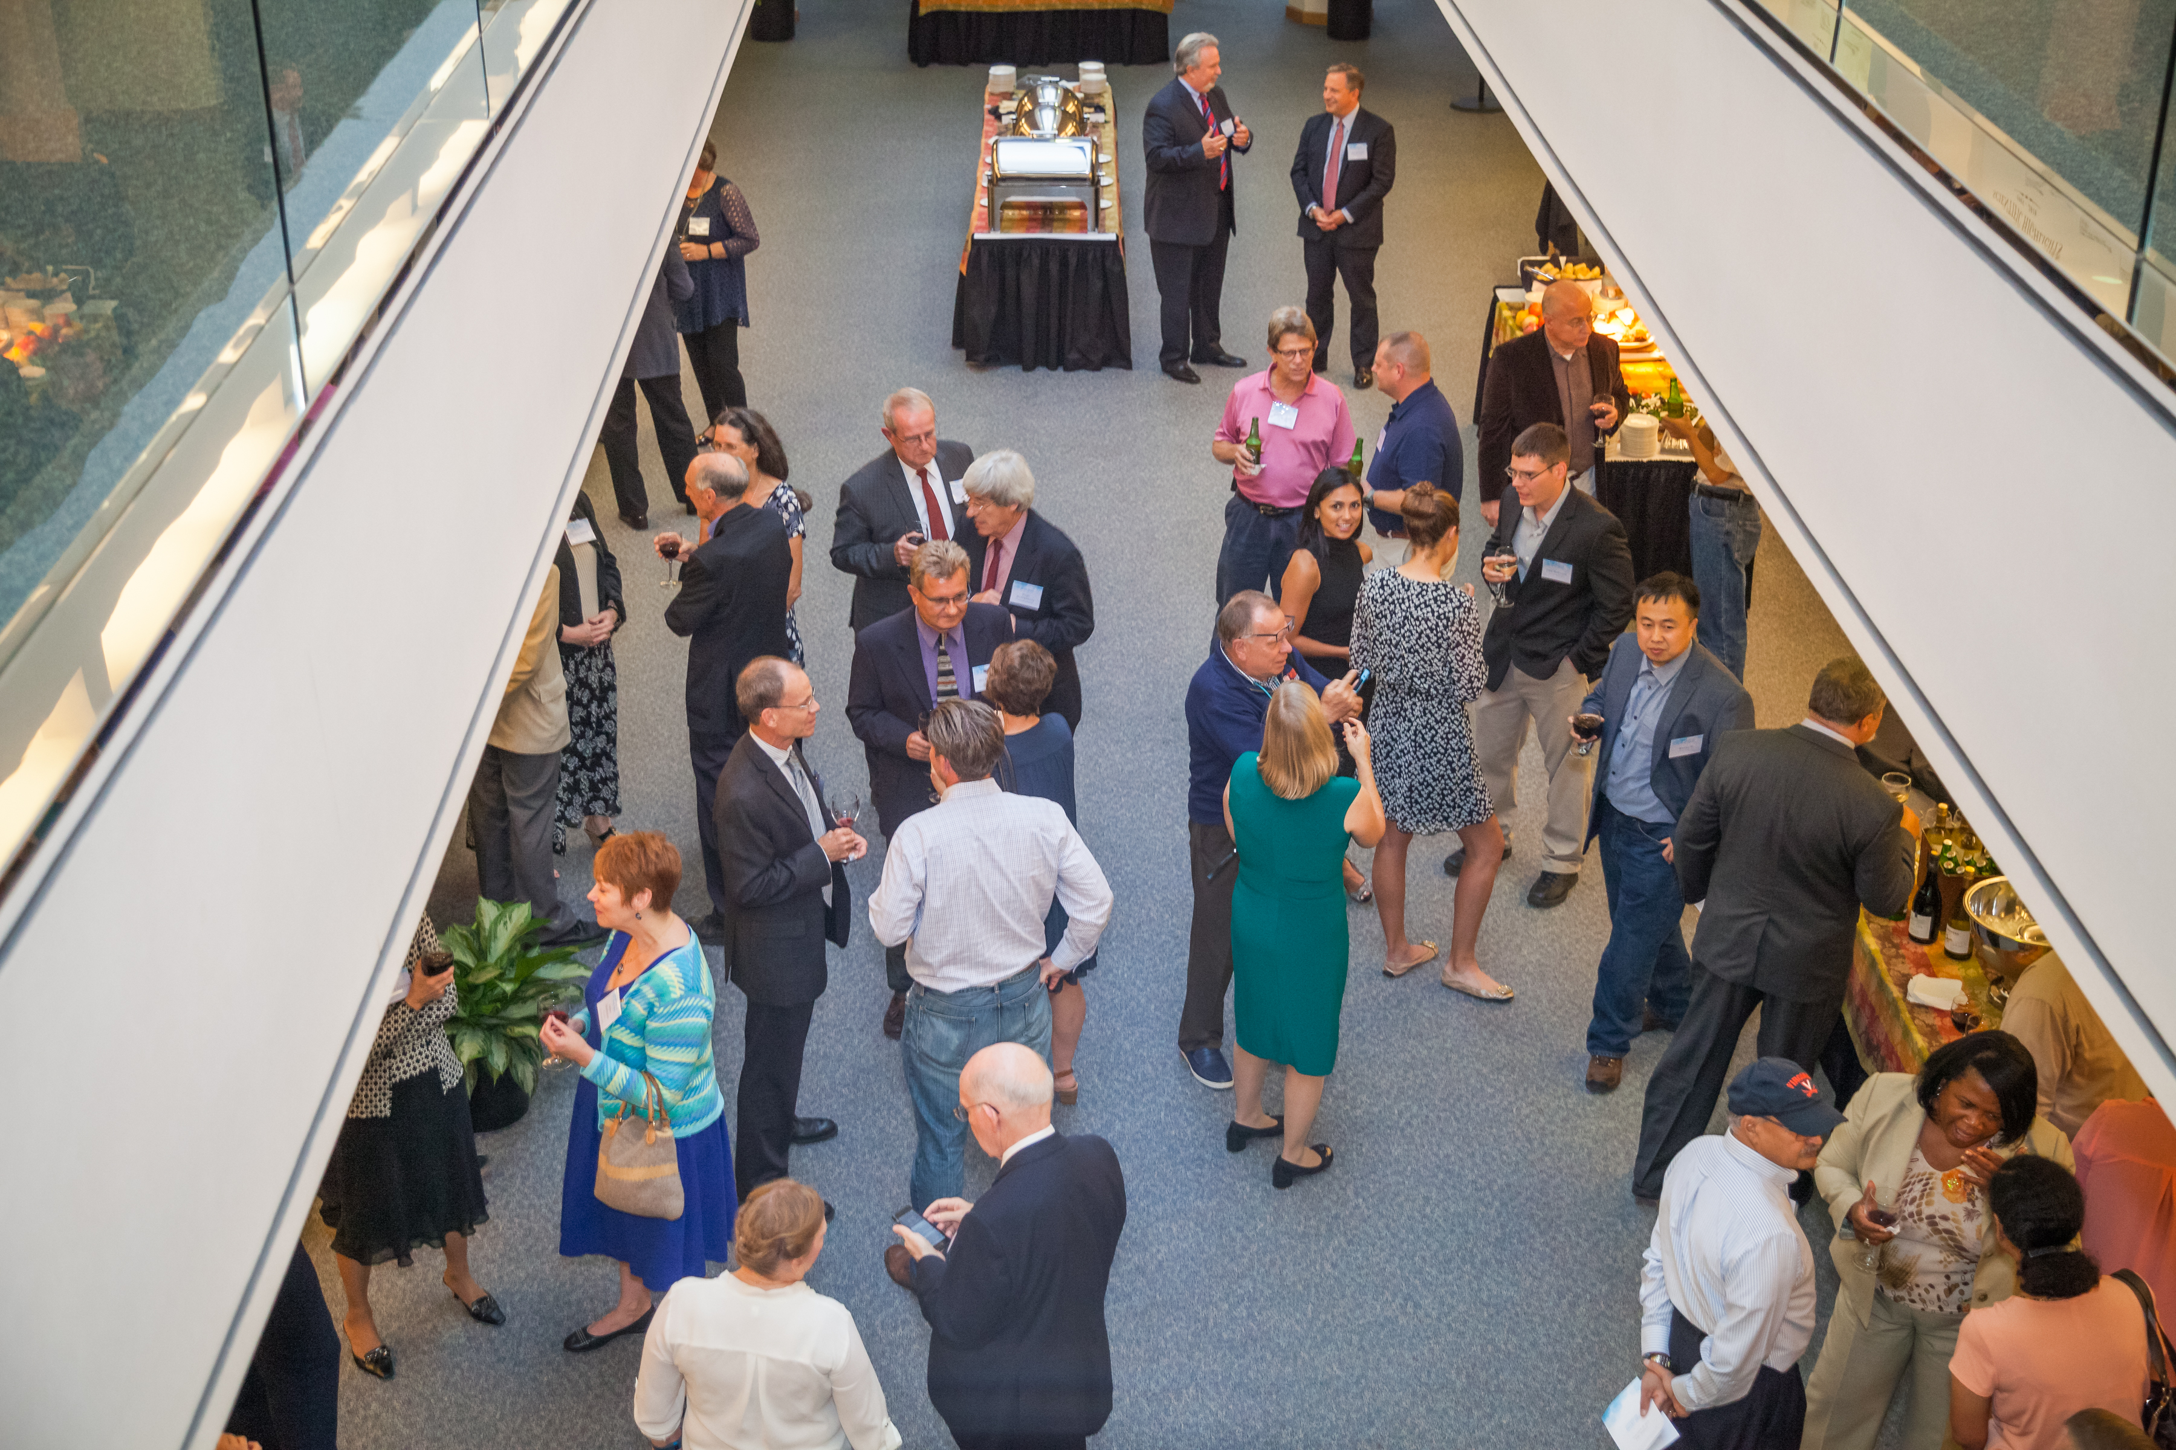
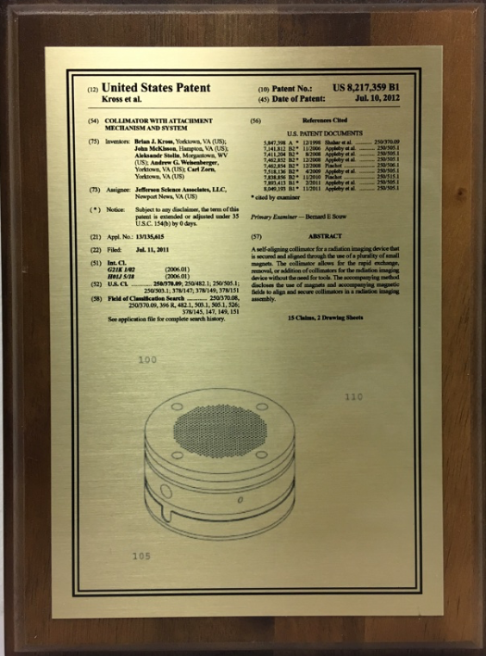
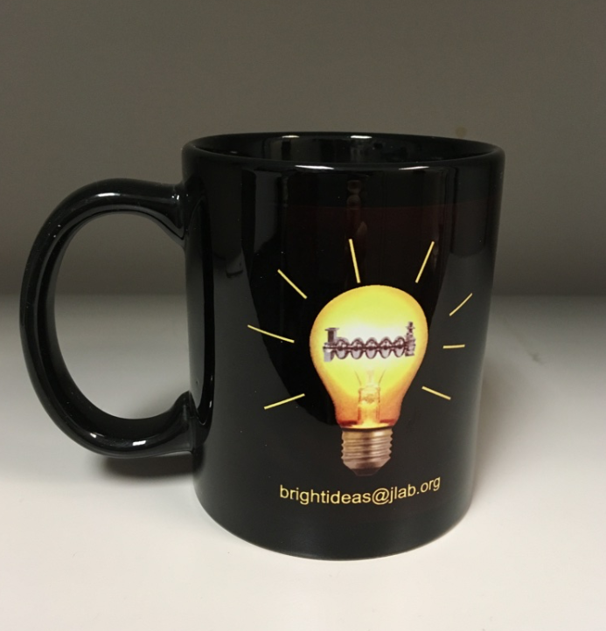
Inventor Engagement
Inventor Appreciation Pizza lunch + mug
Patent Awardee Reception + $500 split among inventors on patent
Royalty Sharing

Slide 17
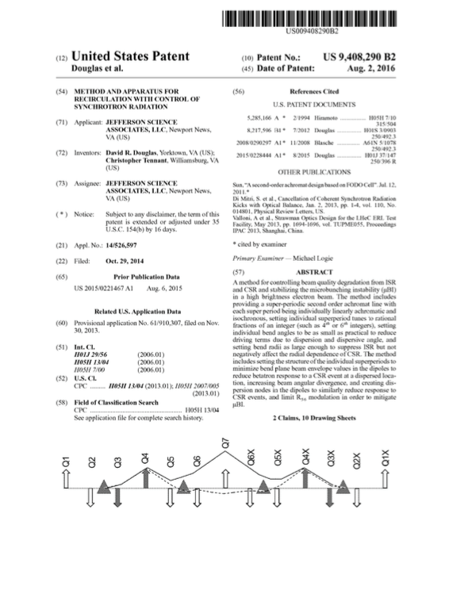
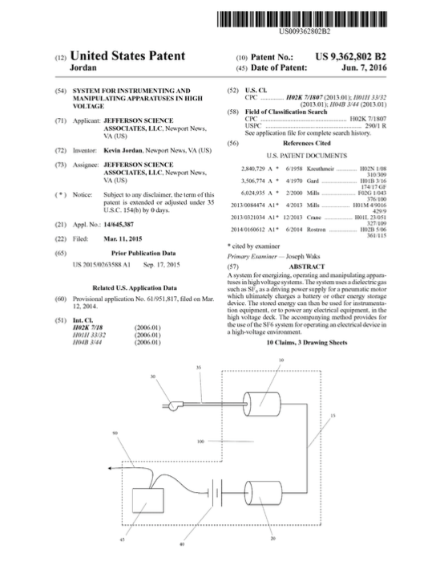
Technology Transitions & Commercialization
JLab has generated to-date:
53 CRADAs
34 SPPs
435 Invention Disclosures
151 Patents
24 (14) Licenses
-to 14 (9) companies
58 SBIR/STTR support letters (FY2016)
Entrepreneurial Leave (3)
Industries that have licensed JLab Technology:
Nuclear medicine imaging (small and large businesses)
High vacuum technology
Gas technology
Specialty technologies for research
Safety industry
Academic publisher

Slide 18
Past and Present Technology Transfer Resources
Industrial Advisory Board (Past) – Panel of high-profile reps from industry that came 2x a year to review our portfolio, and give us direction in what technologies they felt would be most attractive to industry. This group led to the development of the Free Electron Laser at Jefferson Lab and provided us with regular scheduled access to industry leaders
iBridge – We are working to have our portfolio of patents updated on iBridge and to make more of our technologies highlighted there. This is a free resource for Jefferson Lab.
Federal Lab Consortium – Becoming more active with this, updating our profile to leverage our presence there. We have not been using this resource as effectively as we could and are working to leverage our presence there to maximize our use of this resource.
Jefferson Lab Technology Transfer Website – Recently updated, and have plans to make this more interactive with business and industry

Slide 19
Exploring New Commercialization Tools
Dedicated business student during the summer to explore and establish an expanded list of contacts for Jefferson Lab technologies (Funded by JSA Initiatives Fund)
Participating with the NASA Entrepreneurial Opportunity Program (Bill Rainey, Chair Marketing Subcommittee) to gain new insights and training opportunities
Exploring use of external firms i.e. IN-PART, a technology matchmaking firm that several labs and universities have had good success with and that offers resources that complement what we already have available

Slide 20
Strengths and Challenges
Dedicated TT team and lab leadership
Enthusiastic inventors, many have strong initiative and established relationships that move our technologies
New IP management system (IP-Folio) that will help us better track and manage IP
New privately funded Tech Center Research Park under construction adjacent to Jefferson Lab
Matrixed organization makes it difficult to apply the resources needed to enhance and expand TT activities
Jefferson Lab technologies are early stage and often need additional development to be at a stage where they would be interesting to industry
Jefferson Lab is a modest sized single purpose lab – primary mission is basic research, not applied research or commercialization – have to make sure that TT activities are not seen as competing with basic nuclear physics research mission
Limited resources to strengthen our processes and promote licensing IP

Slide 21
Thank You!
“Beside the comfort of knowledge, every science is auxiliary to every other."
Thomas Jefferson
August 26, 1786

