Slide 1

Jefferson Lab News
Robert McKeown
Hall B Collaboration
March 7, 2018

Slide 2
Outline
Recent Highlights
Future Projects
PAC
Center for Nuclear Femtography
Budgets
EIC
Summary

Slide 3
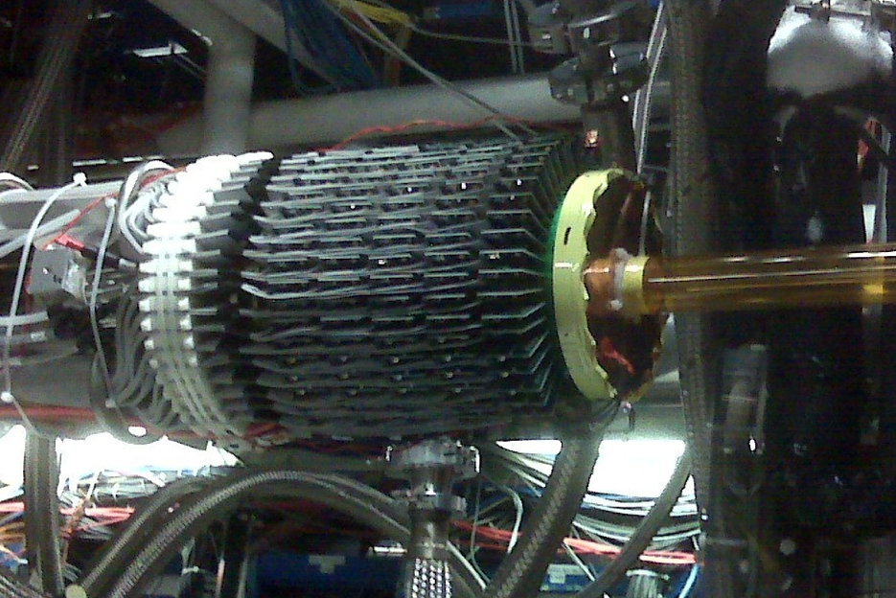
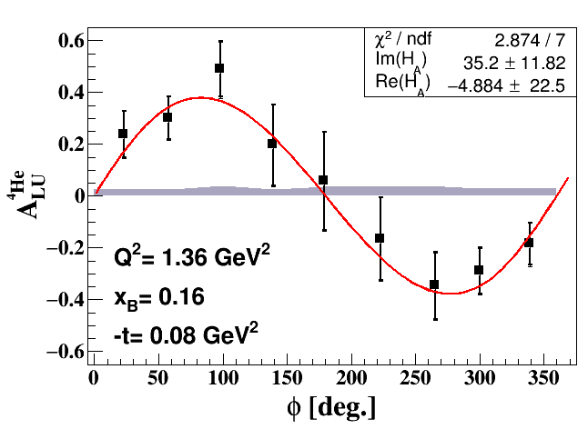

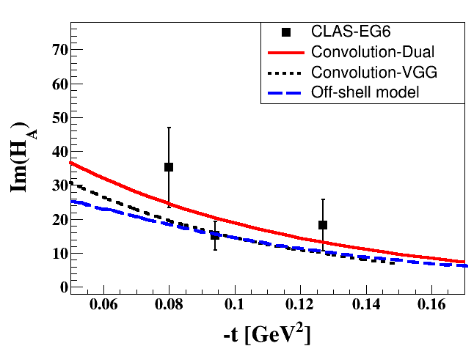
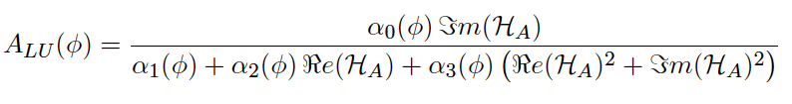
DVCS off ⁴He at CLAS
RTPC for ⁴He detection
Study the nuclear medium modifications in ⁴He: one GPD (H_{A}(x,ξ,t)).
Set of exclusivity cuts based on 4-momentum conservation
Calculation the beam-spin asymmetry (A_{LU}(𝜙)):
𝜙: the angle between the leptonic and the hadronic plans
Model-independent extraction of Compton form factor from A_{LU}(𝜙):
e⁻ ⁴He → e⁻ ⁴He γ
6.06 GeV polarized e⁻ beam
6 atm ⁴He gaseous target
20 PAC days
e⁻ in the CLAS spectrometer
⁴He in a Radial TPC around the target cell
𝛄 in an inner calorimeter (𝜃 [4º, 14º])
⁴He target cell
𝛼_{j}(𝜙): kinematical factors
Convolution-Dual: V. Guzey, PRC 78, 025211 (2008).
Convolution-VGG: M. Guidal, M. V. Polyakov, A. V. Radyushkin and M. Vanderhaeghen, PRD 72, 054013 (2005)
Off-shell model: J. O. Gonzalez-Hernandez, S. Liuti, G. R. Goldstein and K. Kathuria, PRC 88, 065206 (2013)
Notes:
3

Slide 4
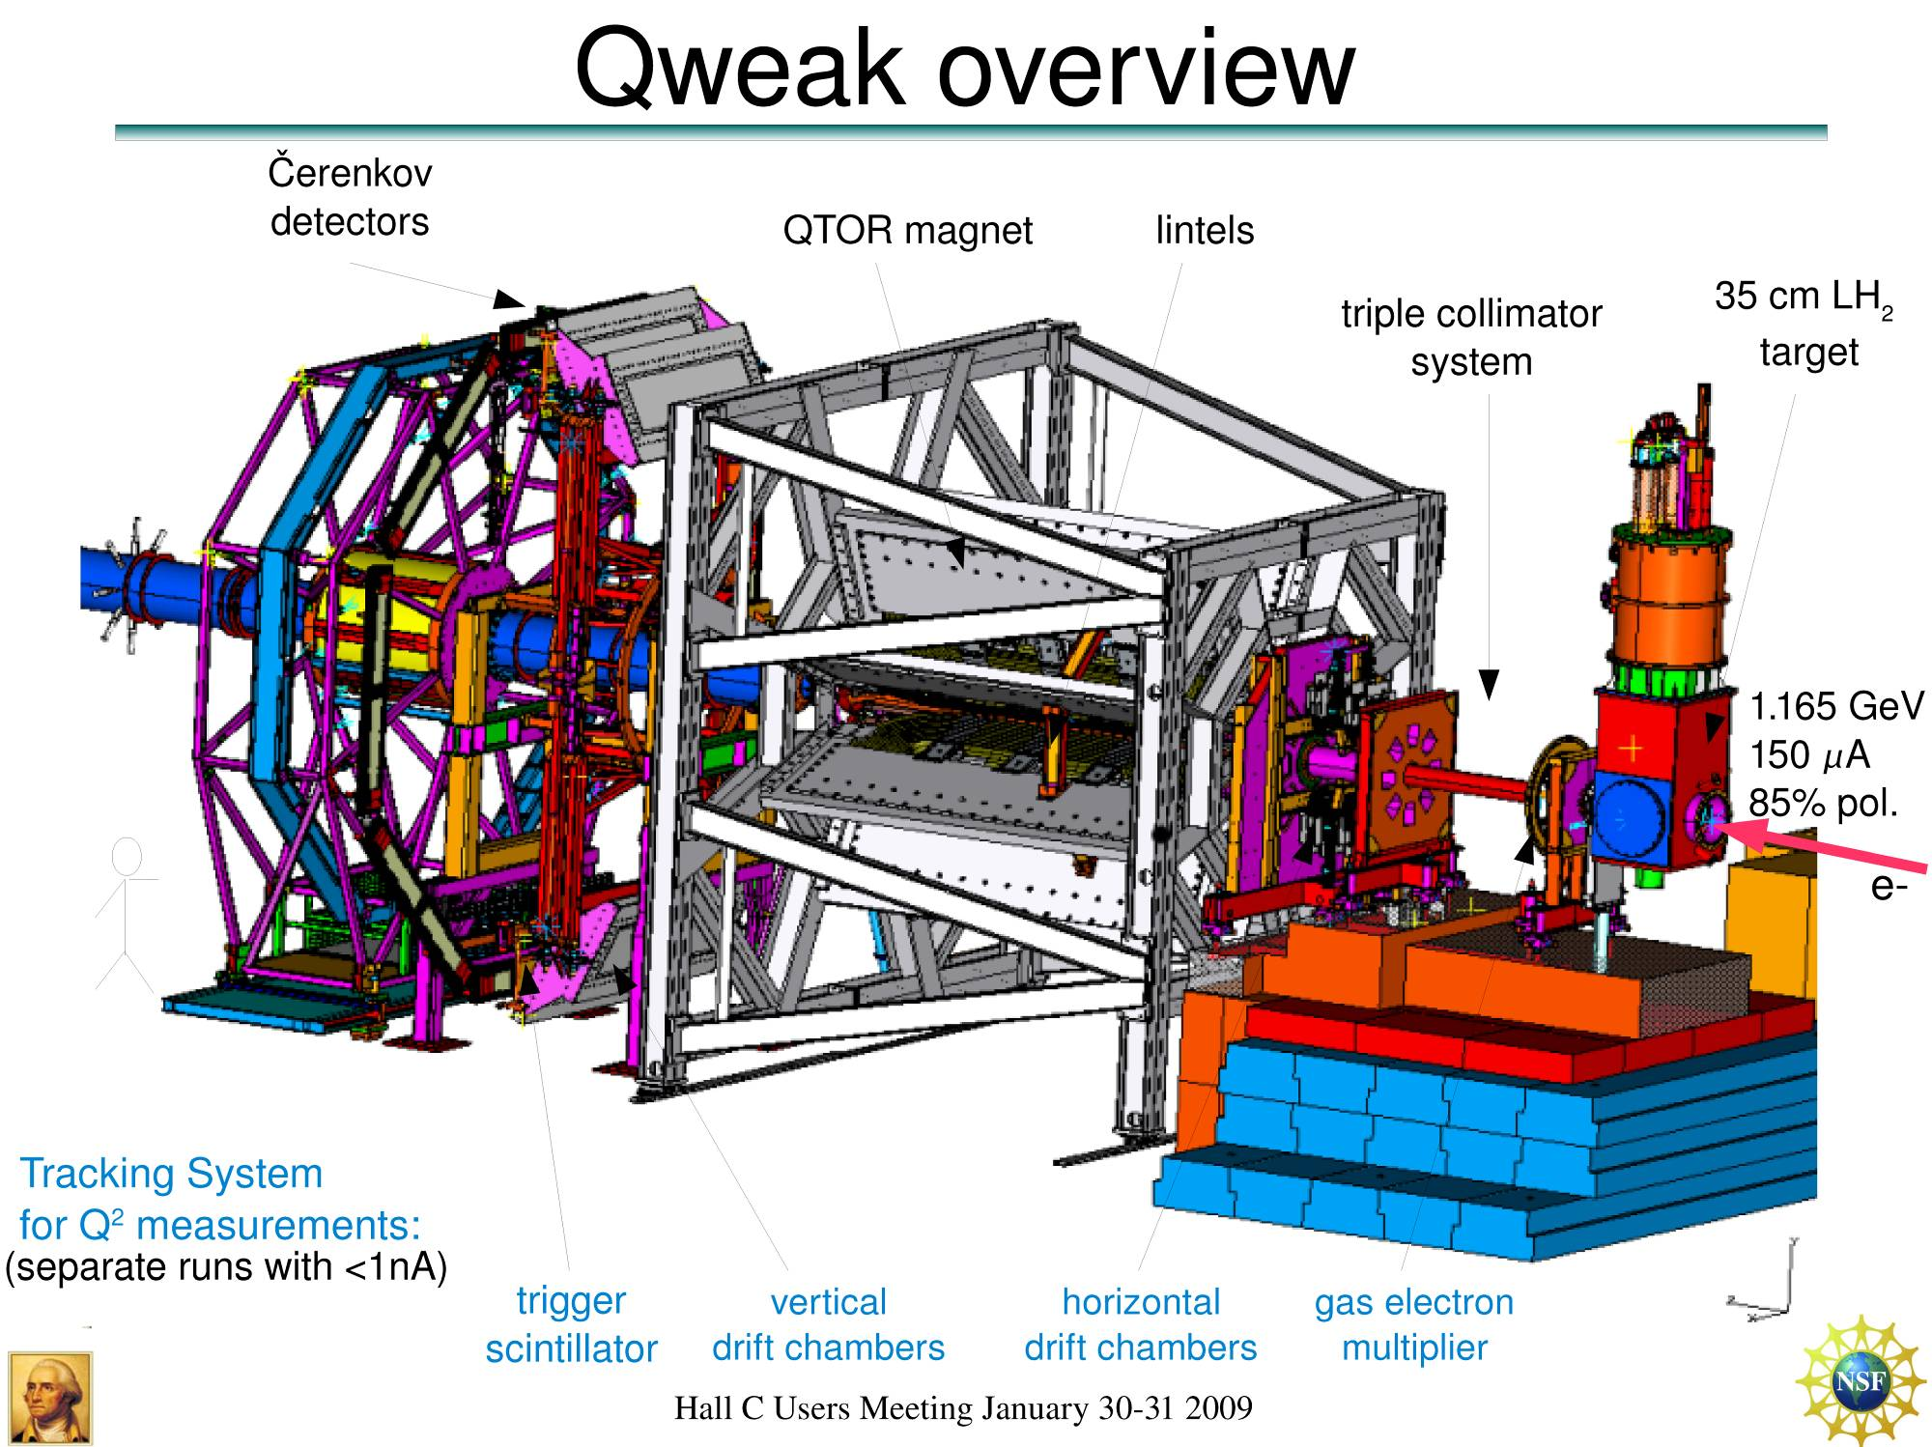
New Qweak Result
Precise determination of
the weak charge of the proton
Q_{w}= -2(2C_{1u}+C_{1d})
= (1 – 4 sin² θ_{W})
Result unblinded March 2017
Submitted to Nature
Luminosity
monitors
scanner

Slide 5
Our Staff and Users are Producing Important Scientific Results…Some Examples
Final Qweak results submitted to Nature and in final stages of publication
A glimpse of gluons through deeply virtual compton scattering on the proton, published in Nature Communications 8, 1408 (2017). doi:10.1038/s41467-017-01819-3
The weak charge of the proton – “Qweak”, represents the (tiny) difference of the charge of the proton and it’s mirror image
State N(mass)J^{P} | PDG pre 2012 | PDG 2018*
N(1710)1/2⁺ | *** | ****
N(1880)1/2⁺ |  | ***
N(1895)1/2⁻ |  | ****
N(1900)3/2⁺ | ** | ****
N(1875)3/2⁻ |  | ***
N(2120)3/2⁻ |  | **
N(2000)5/2⁺ | * | **
N(2060)5/2⁻ |  | **
Δ(2200)7/2⁻ | * | ***
**** Existence is certain
*** Existence is very likely
** Evidence of existence is fair
* Evidence of existence is poor
Multiple nucleon resonances now confirmed; highlighted in Particle Data Group (PDG) tables.
The pressure distribution inside the proton accepted for publication in Nature

Slide 6
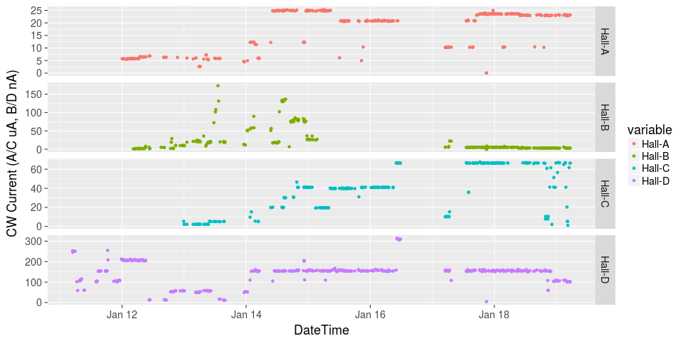
Initiated Four Hall Operation!
μA
A up!
nA
Installation
B up!
Beam Current
Pass Change
μA
C up!
D up!
nA

Slide 7
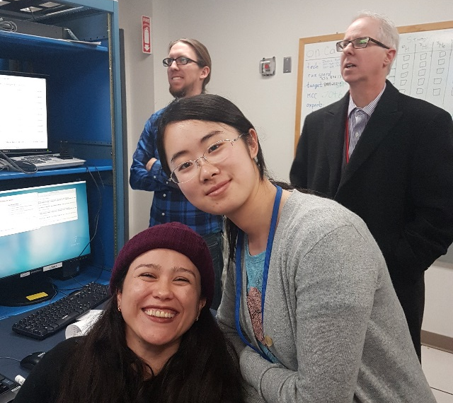
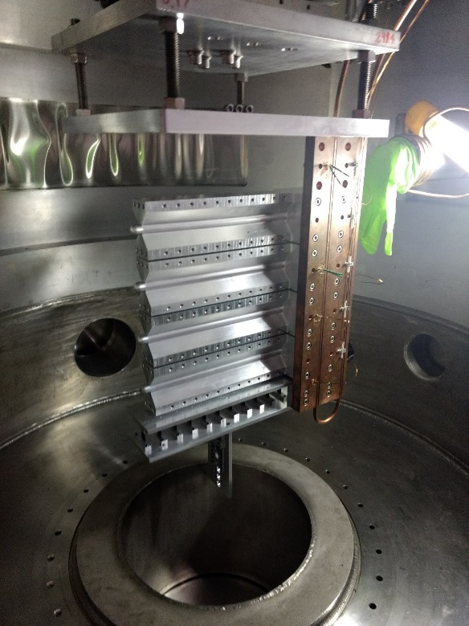
Hall A in Physics Production
First Beam On Tritium Target Cell
On 12/15/17 Hall A put first beam on a tritium target cell – facilitates 4 (3 high impact) experiments!
LEFT Image: Waiting for first beam on the Hall A tritium target: UNH Ph.D. students Nathaly Santiesteban and Shujie Li along with Jefferson Lab postdoc Evan McClellan and lab Director Stuart Henderson.
CENTER Image: Shown are the tritium, He, D target data as compared to running on an empty cell (black). The tritium and other gas targets are clearly visible between the aluminum entrance and exit windows of the target cell.
RIGHT Image: The target cell stack during installation in the Hall A scattering chamber.
As the first Hall to receive beam in the 12 GeV era, Hall A has previously completed running for 2.5 non-tritium experiments.

Slide 8
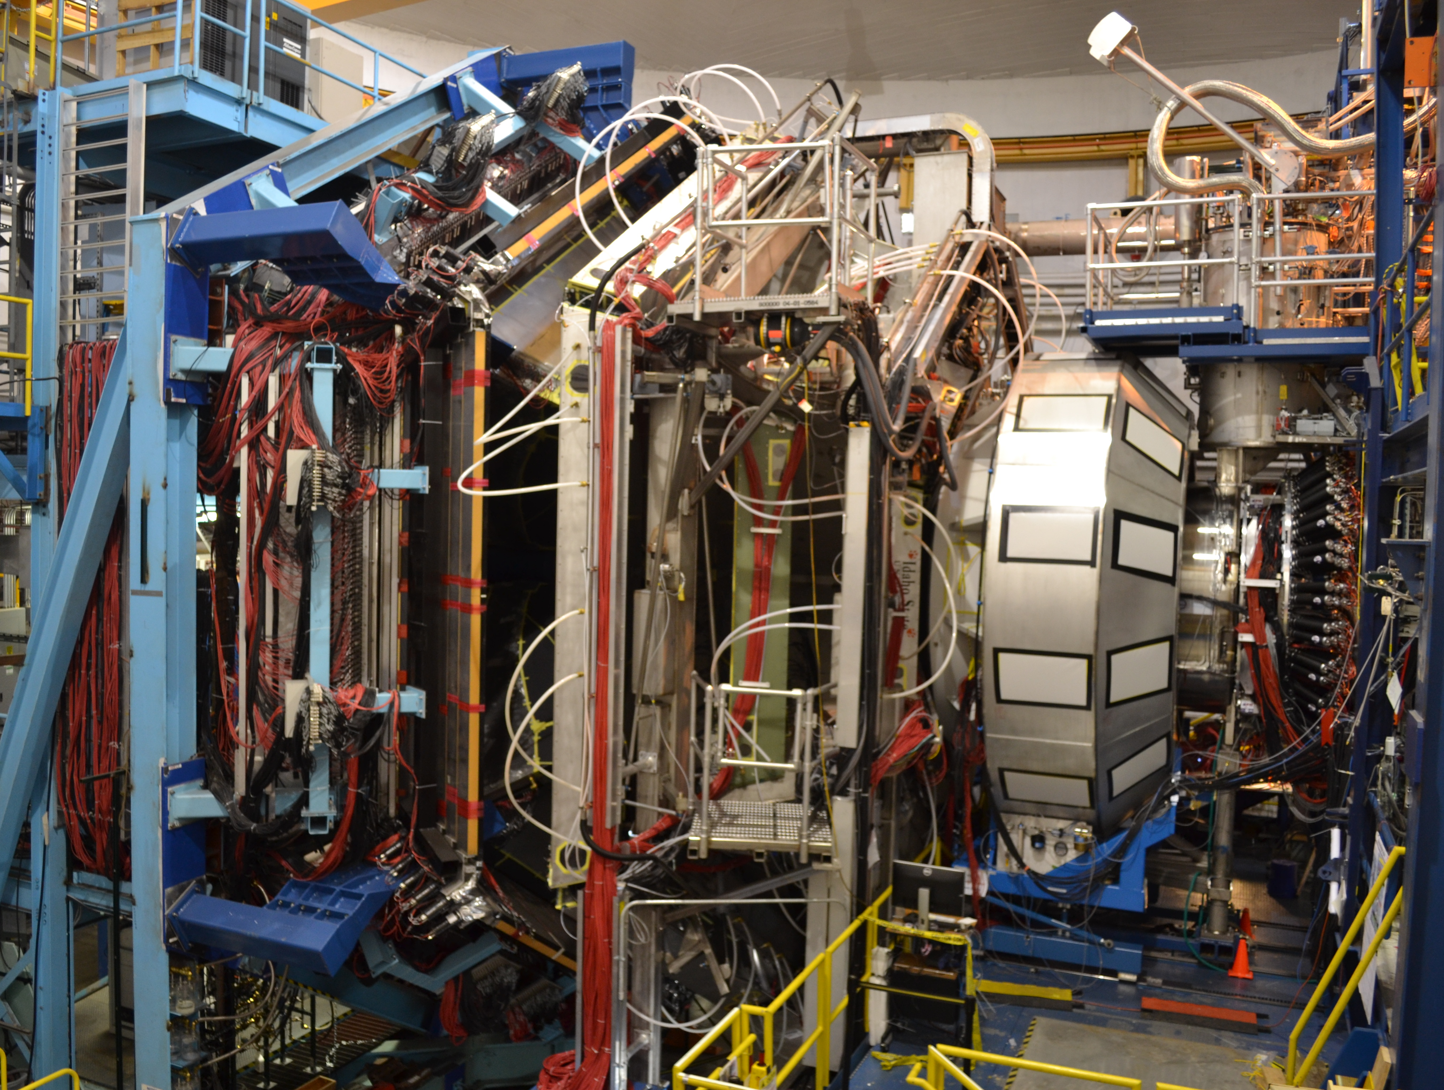
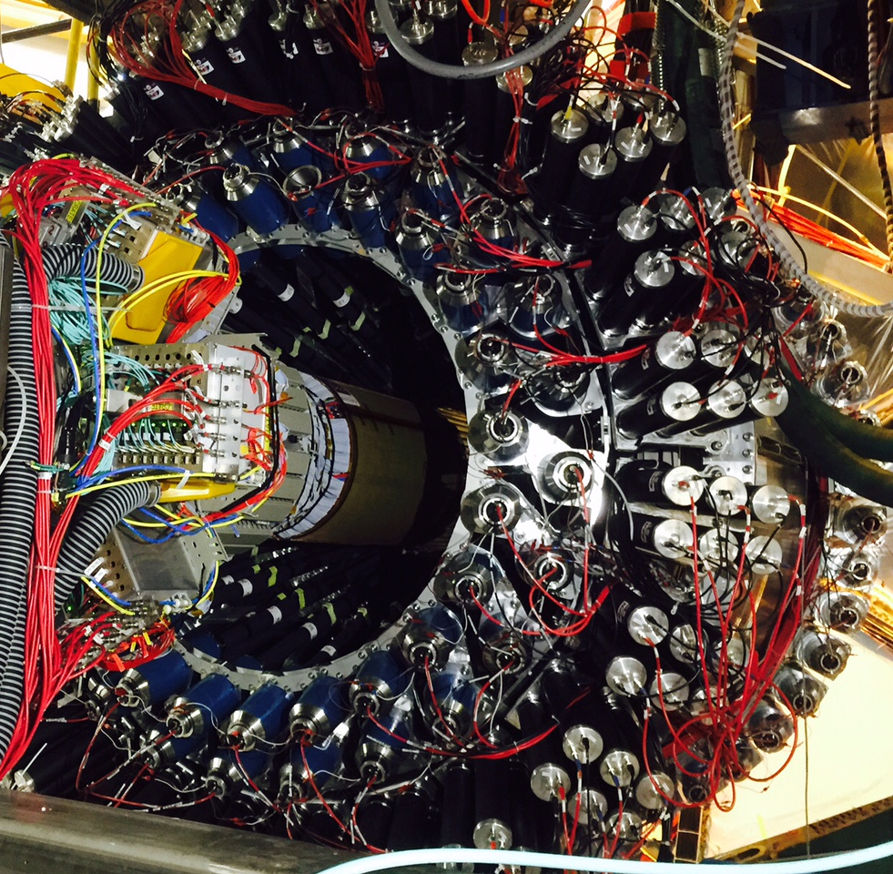
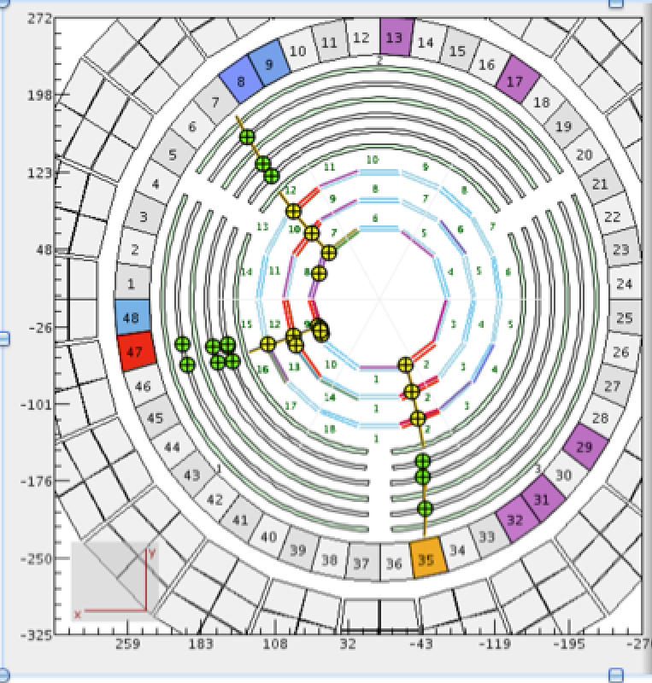
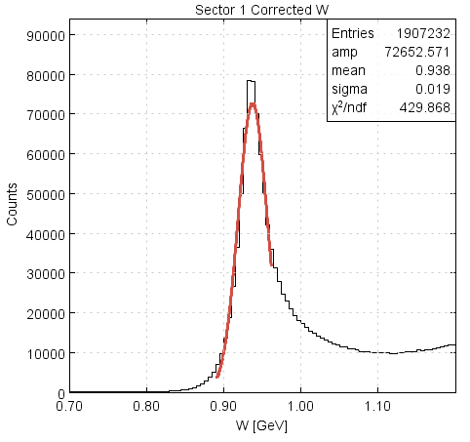
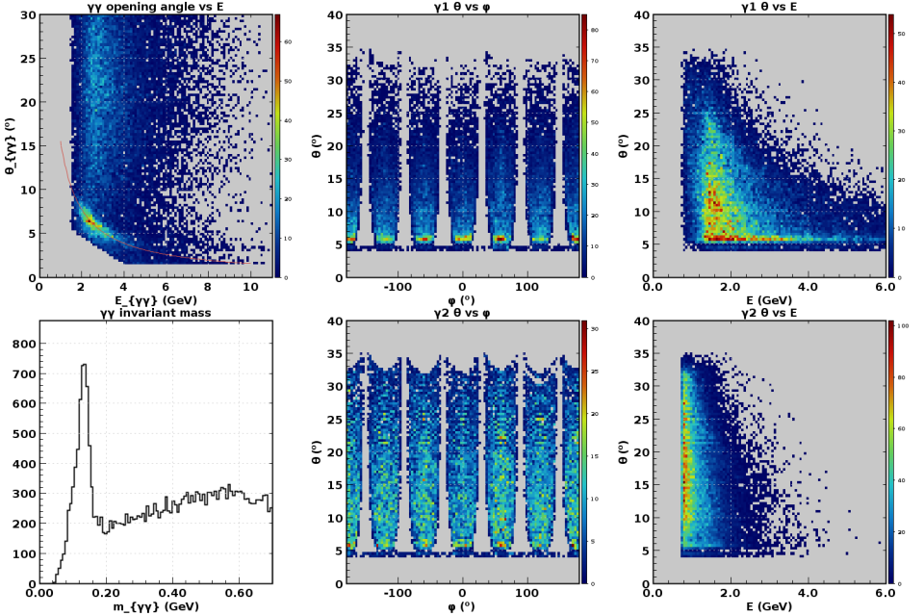
Hall B in Physics Production (since 02/05/18)!
CLAS12 Forward Detector
CLAS12 Central Detector with 3 charged particles
p(e,e’)p @ 2.2 GeV
π⁰ @ 10.6 GeV
Detectors were operated during engineering run at luminosities from 0.75 x 10³⁴ to 1.75 x 10³⁵
The latter is nearly twice the design luminosity!
Physics production run started at a luminosity of 3 x 10³⁴ to facilitate understanding of the detector efficiencies and calibrations.
π⁰
W (GeV)
m_{γγ}

Slide 9
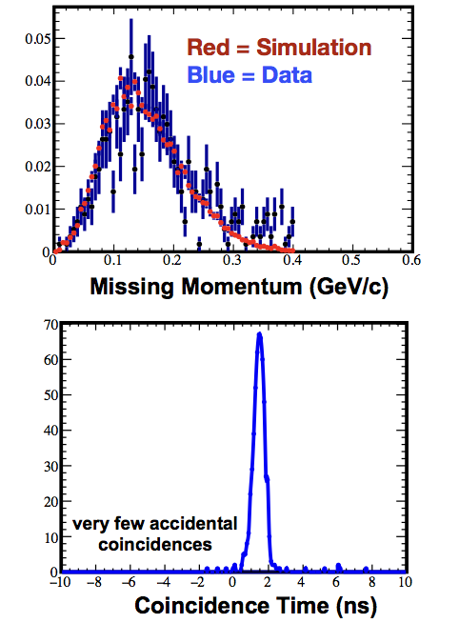
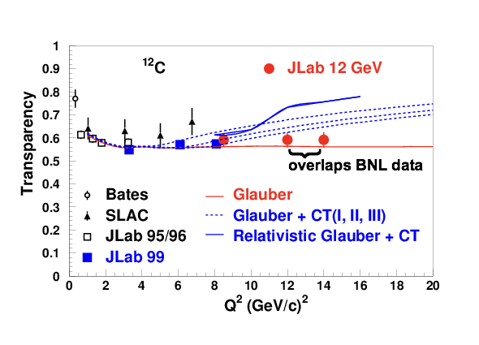
Hall C in Physics Production (since 01/20/18)!
SHMS calibration data acquired
Physics Program started:
  F₂^{H,D} structure functions
  D(e,e’p) at high missing momentum
  Color Transparency – ¹²C(e,e’p)
    Data for 2 of 3 points acquired.
    Highest Q² is where BNL A(p,2p) saw rise in transparency
Online data quality excellent!

Slide 10

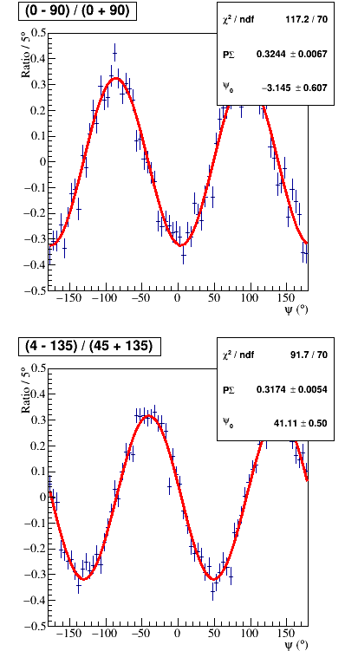
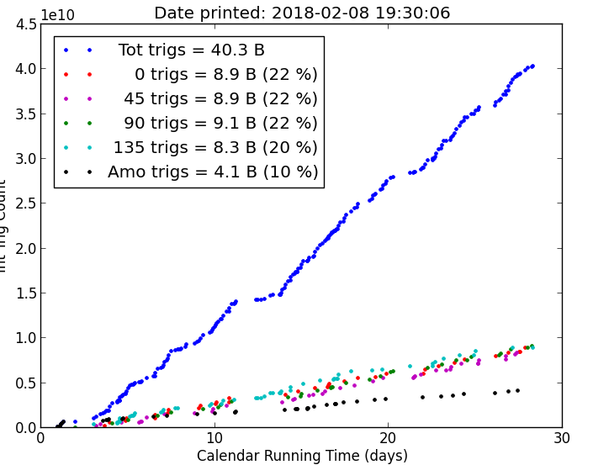

Hall D in Physics Production
Hall D is running GlueX-I (90 PAC days approved)
Spring 2017: 20 PAC days accumulated, ~50B events collected.
Spring 2018: as of Feb. 8, 14 PAC days, ~40B events collected.
Decay asymmetry = ΣP_{beam}, Σ≈1
Data quality monitoring
Beam polarization P_{beam}~35%, similar to 2017
Yields of known resonances are similar to 2017

Slide 11
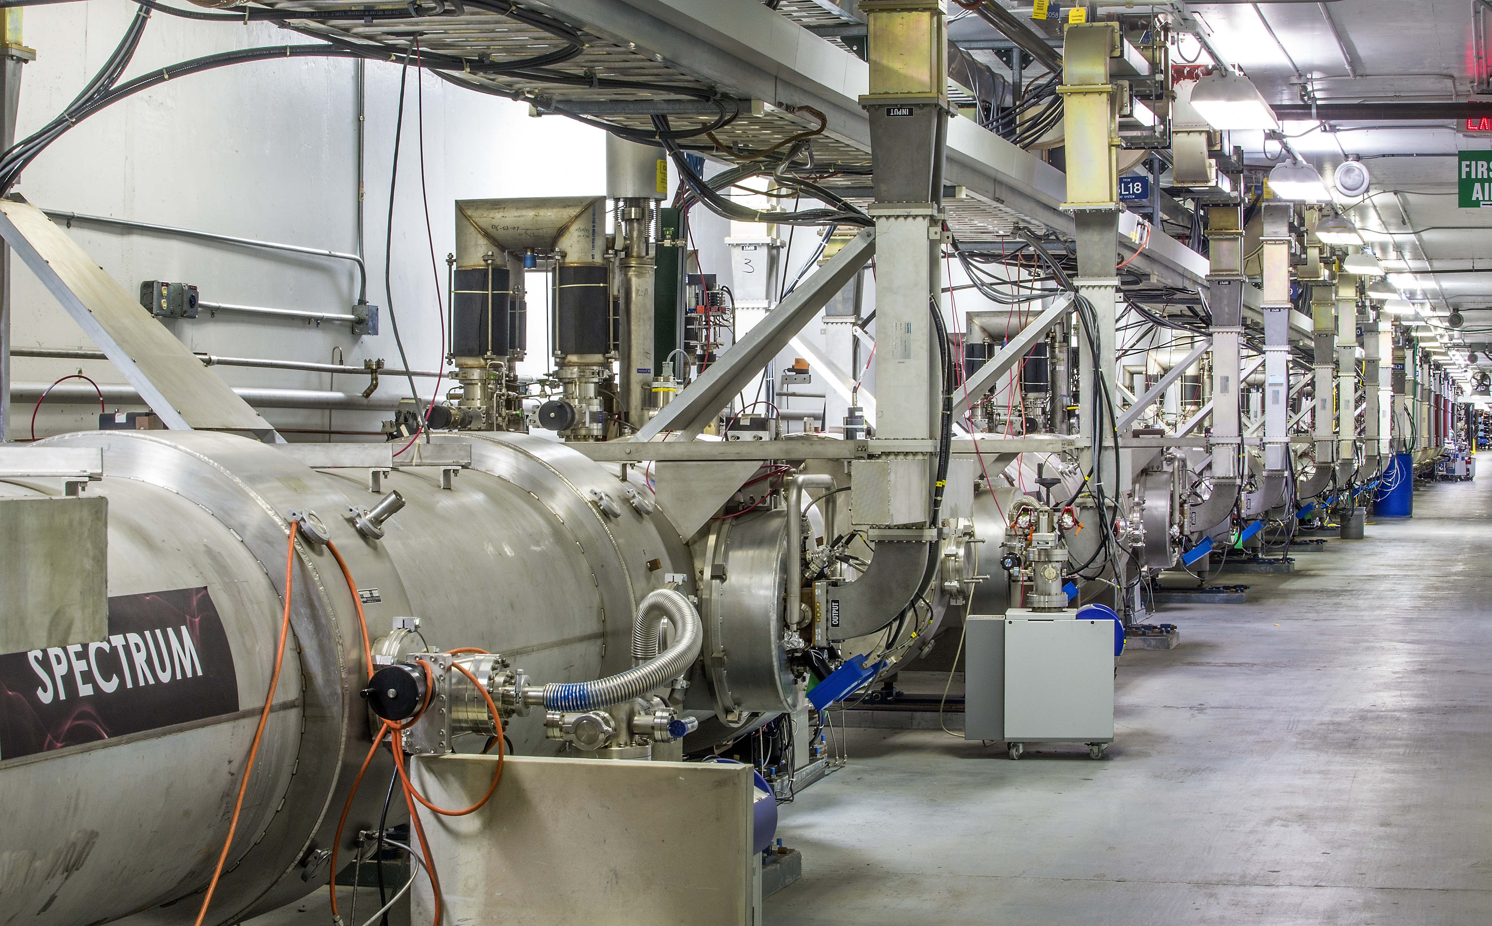
Achieving Sustainable Long-term CEBAF Operation is a Very High Priority
While 12 GeV Upgrade Project provides important capabilities for the future, many components and systems are “original equipment”
  Some are difficult to maintain, require adequate spare parts, will reach obsolescence
We have developed a “CEBAF Reliability Plan” to improve reliability of the facility and energy reach of the accelerator
We are funding a significant investment in CEBAF performance in FY18, and are planning for the FY19-21 timeframe
  Focus on critical spares, deferred maintenance, obsolescence and increasing CEBAF energy
  Enabled in part by remaining 12 GeV Project contingency
FY17 appropriations includes funding for a new 2K cold-box to remedy severe long-term vulnerability in our Cryogenic systems

Slide 12
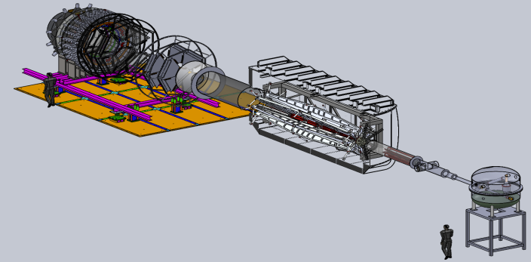
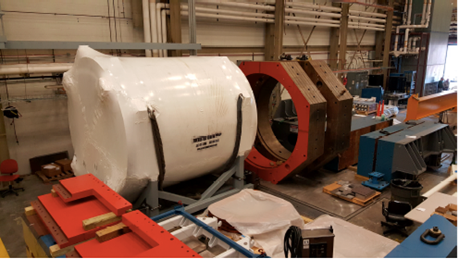

Future Projects
MOLLER experiment
(Possible MIE – FY19-23)
– CD-0 approved
(project paused due to budget)
– Standard Model Test
– DOE science review (September 2014) – strong endorsement
– Director’s review held December 15-16, 2016
Technical, cost & schedule
SoLID
– Large acceptance, high lumi
– SIDIS and PVDIS
– CLEO Solenoid 
– International collaboration
– Director’s review (Feb. 2015)
 new pre-CDR complete

Slide 13
PAC Meetings
PAC45 Changes:
Better communication on previously approved related proposals.
Stricter procedures on conflicts of interest
New user chair role as observer/watchdog on above issues and others to ensure fairness and QA
Seems to have worked well
PAC46:
Scheduled for week of July 16, 2018
Proposals due: 8:00 a.m. EDT on Monday, June 4, 2018.
New members: A. Bacchetta, S. Paul

Slide 14
12 GeV Approved Experiments by Physics Topics
Topic | Hall A | Hall B | Hall C | Hall D | Other | Total
Hadron spectra as probes of QCD | 0 | 3 | 1 | 3 | 0 | 7
Transverse structure of the hadrons | 5 | 4 | 3 | 1 | 0 | 13
Longitudinal structure of the hadrons | 2 | 3 | 6 | 0 | 0 | 11
3D structure of the hadrons | 5 | 9 | 7 | 0 | 0 | 21
Hadrons and cold nuclear matter | 7 | 3 | 7 | 0 | 1 | 18
Low-energy tests of the Standard Model and Fundamental Symmetries | 3 | 1 | 0 | 1 | 1 | 6
Total | 22 | 23 | 24 | 5 | 2 | 76
Total Experiments Completed | 2.5 | 1.1 | 0 | 0.4 | 0 | 4.0
Total Experiments Remaining | 19.5 | 21.9 | 24 | 4.6 | 2 | 72.0

Slide 15
12 GeV Approved Experiments by PAC Days
Topic | Hall A | Hall B | Hall C | Hall D | Other | Total
The Hadron spectra as probes of QCD | 0 | 319 | 11 | 540 | 0 | 870
The transverse structure of the hadrons | 150.5 | 185 | 110 | 25 | 0 | 470.5
The longitudinal structure of the hadrons | 65 | 230 | 165 | 0 | 0 | 460
The 3D structure of the hadrons | 409 | 872 | 197 | 0 | 0 | 1478
Hadrons and cold nuclear matter | 220 | 230 | 205 | 0 | 14 | 669
Low-energy tests of the Standard Model and Fundamental Symmetries | 547 | 180 | 0 | 79 | 60 | 866
Total Days | 1392 | 2016 | 688 | 644 | 74 | 4813.5
Total Days - Without SoLID, DarkLIGHT | 917.5 | 2016 | 688 | 644 | 28 | 4294
Total Approved Run Group Days (includes SoLID, DL) | 1392 | 981 | 645 | 444 | 74 | 3536
Total Approved Run Group Days (without SoLID, DL) | 917.5 | 981 | 645 | 444 | 28 | 3016
Total Days Completed | 83 | 30 | 0 | 48 | 0 | 161
Total Days Remaining | 835 | 951 | 645 | 396 | 28 | 2855
“A Decade of Experiments” – could be 8 or 15+ pending budgets etc.

Slide 16
Center for Nuclear Femtography
Proposal to Commonwealth of VA
Consortium of VA universities
Theoretical physics, experimental physics, computation, statistics – broad involvement
Initial request of $.5M for pilot study, funding of ~$2M/year envisioned

Slide 17
Budget Update
Fiscal Year | Office of Nuclear Physics ($M) | Jefferson Lab ($M)
FY16 | 617 | 107.6
FY17 | 622 | 111.2
FY18 (Request) | 503 (-19%) | 96.8 (-12%)
FY18 (House) | 619 (-0.5%)
FY18 (Senate) | 639 (+3%)
FY18 (Expected under flat funding) | 622 | 110
FY19 (Request) | 600 | 109
FY18 Appropriations language:
  House: “Within available funds, the Department is encouraged to fund optimal operations at Thomas Jefferson National Accelerator Facility to support runtime at the 12 GeV Continuous Electron Beam Accelerator Facility…”
  Senate: “The Committee further recommends…optimal operations for the Continuous Electron Beam Accelerator Facility, …”
Presently operating under a Continuing Resolution (funding at FY17 levels), awaiting resolution of FY18 Budget

Slide 18
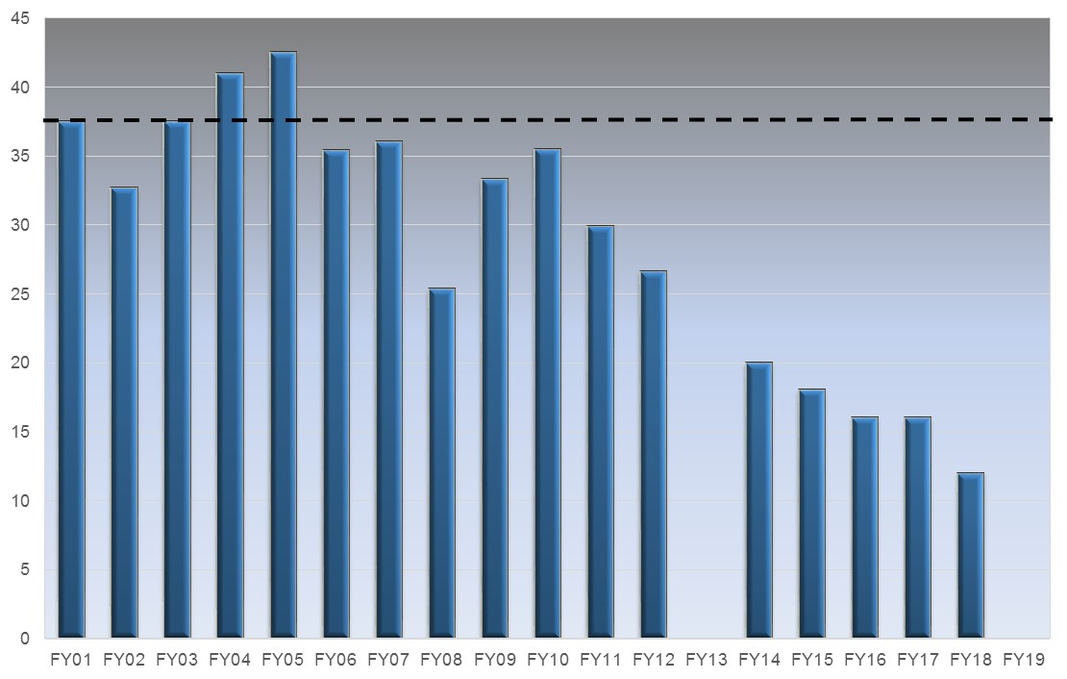
Key Challenges for the Laboratory
The single highest priority is operating CEBAF with high reliability for more than 30 weeks per year
  Optimal operation of CEBAF is 37 weeks per year
  FY18 plan supports only 12 weeks of operation (FY18 PBR had 10 weeks)
This requires sufficient funding to
  Improve reliability in aging equipment
  Increase weeks of operation; each week of operation brings additional costs for utilities, cryogens and operations support
Closely related is the challenge of moving forward with mid-scale projects MOLLER and SoLID
Optimal
12 GeV Construction
?
Weeks of OPS Delivered

Slide 19
Budget Outlook and Key Points to Remember
Federal budget formulation is a multi-step process, and the Request is Step 1
Congress is responsible for appropriations. As evidenced by recent budget negotiations, Congress holds the value of scientific research in high regard
JSA is actively engaged with our congressional delegation and other stakeholders to communicate the value of what we do, and the importance of the scientific community whom we serve
The Nuclear Physics field needs to maintain solidarity, to stand strong together. We need a united front on the importance of what we do, and the importance of Science funding in general
“NP on the Hill” Day is scheduled for Monday April 9th - http://nuclearphysicsdcday.com/

Slide 20
EIC Developments
EIC User Group
  Website: http://www.eicug.org/web/
  Steering Committee established
  Christine Aidala (U. Mich, IB Chair), John Arrington (ANL), E. Sichtermann (LBNL),
  Charles Hyde (ODU, vice Chair), Marco Radici (U Pavia),
  Bernd Surrow (Temple, Chair)
  Rik Yoshida (JLab), Thomas Ullrich (BNL), ex-officio
  Daniel Boer (Groningen), European representative
  To add: additional international member
  2017 EIC UG Meeting in Trieste, Italy – July 18-22
DOE-NP plans to increase EIC accelerator R&D
– Through ‘tax’ on JLab and BNL
– Peer review held for November 29-December 2
    Report released in February
    FY17 in progress, FY18 proposals submitted Jan. 19, 2018
National Academies Study underway
  – Co-Chairs: Gordon Baym (UIUC), Ani Aprahamian (Notre Dame)
– First meeting February 1-2, 2017
– Second meeting April 19-20, 2017
– Third meeting September 11-12, 2017
– Expect report in spring 2018

Slide 21

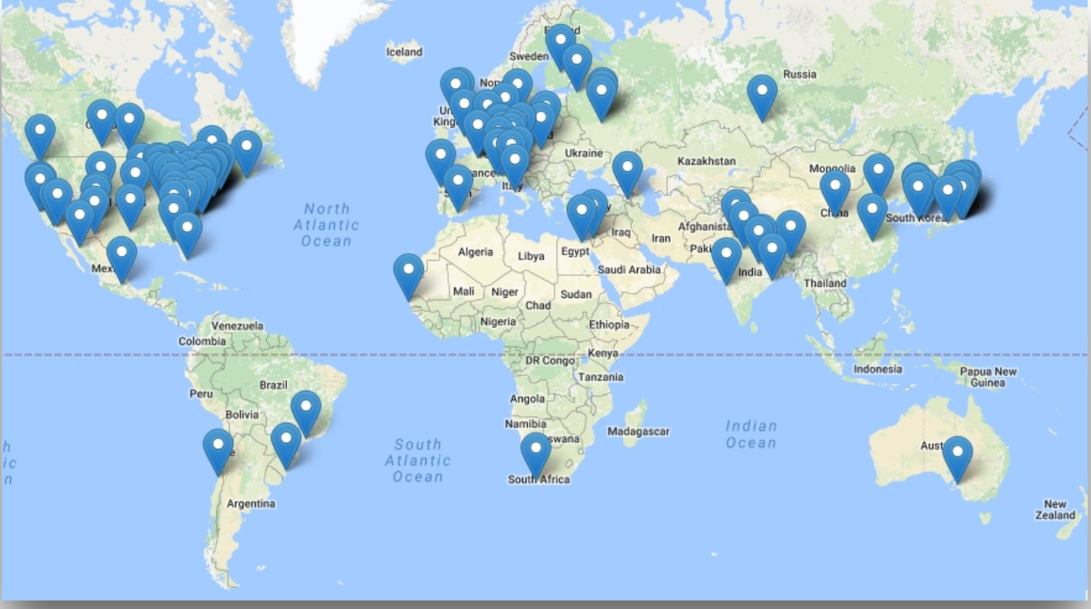
EIC Users Group and International Interest
Formed 2016, currently: 732 members
169 institutions, 29 countries

Slide 22
Recent and Upcoming EIC Events
INT Workshop series:
  Spatial and Momentum Tomography of Hadrons and Nuclei (INT-17-3), August 28, 2017 - September 29, 2017 (I. Cloet, K. Hafidi, Z.-E. Meziani, B. Pasquini)
  The Flavor Structure of Nucleon Sea (INT-17-68W), October 2-13, 2017 (C. Aidala, W. Detmold, J. Qiu, W. Vogelsang)
  Probing Nucleons and Nuclei in High Energy Collisions (INT-18-3), October 1, 2018 - November 18, 2018 (Y. Hatta, Y. Kovchegov, C. Marquet, A. Prokudin)
6th International Workshop on Deep-Inelastic Scattering and Related Topics (DIS 2018), Kobe, Japan, April 16-20, 2018
Physics Opportunities at an ElecTron-Ion Collider (POETIC 2018) conference, Regensburg, Germany, March 19-22, 2018
EICUG meeting 2018 - July 30 – August 4, 2018 / The Catholic University of America hosted by Professor Tanja Horn - Major focus will be on steps after NAS report leading to anticipated CD0 EIC project award!

Slide 23

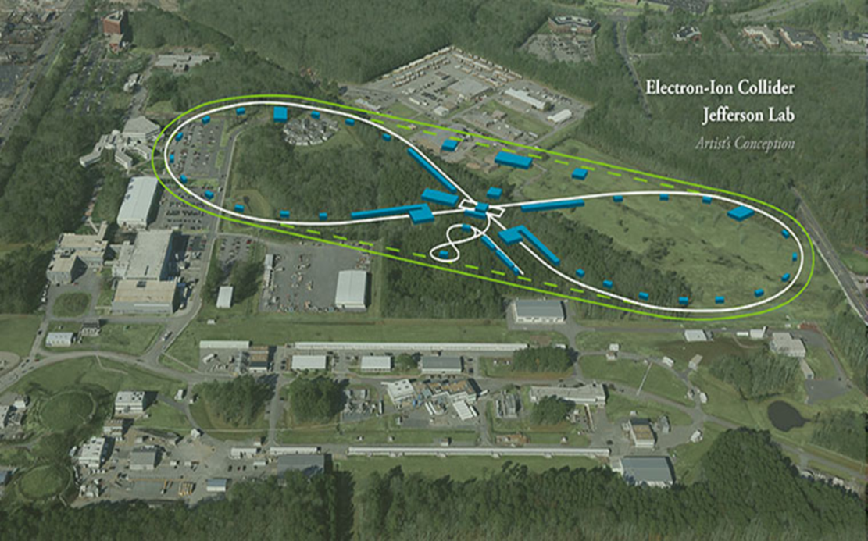
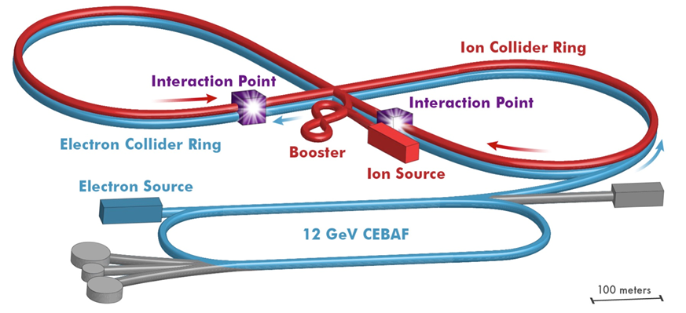
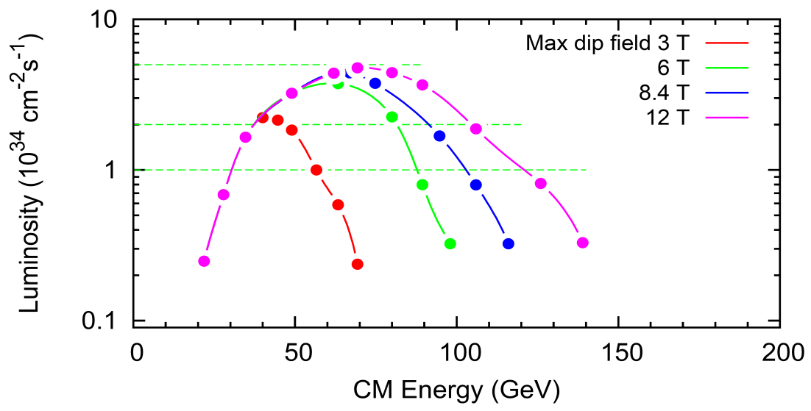
EIC at Jefferson Lab
JLab EIC Figure 8 Concept
    High Polarization
    High Luminosity
    Energy Range: √s : 20 to 65 - 140 GeV
    (magnet technology choice)
    Low technical risk
    Flexible timeframe for construction
    consistent w/running 12 GeV CEBAF
    Cost effective operations
    Fulfills White Paper Requirements
2015 NSAC recommendation
R&D collaboration with BNL
Collaborations with SLAC, LBNL, ANL
NAS Study underway
Next step would be DOE CD-0
10³⁵
LHC
(
10³⁴
10³³

Slide 24

JLEIC Developments
14 accelerator R&D proposals submitted to DOE Jan. 19. (>$10M total requested by JLab)
Pre-CDR development in progress, to be completed before October 2018. Status report at JLab user meeting in June.
Magnetized beam for e-cooler making good progress (LDRD)
$1.4M state funding received for e-ring and crab cavity prototype fabrication and test, and for beam dynamics studies. $1M to continue next year.

Slide 25
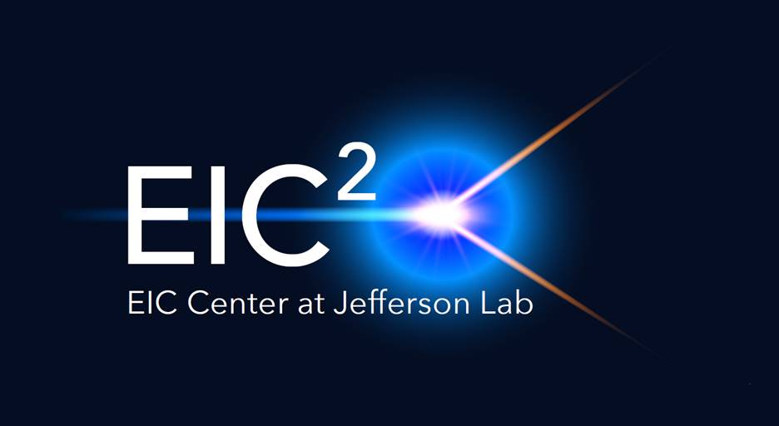
Electron-Ion Collider Center
The Electron-Ion Collider Center (EIC²@JLab) is an organization to advance and promote the science program at a future electron-ion collier (EIC) facility. Particular emphasis is on the close connection of EIC science to the current Jefferson Lab 12 GeV CEBAF science program.
EIC seminars
Enhance EIC coverage at HUGS and JLab User Meeting
Graduate Fellowships
Postdoctoral Fellowships
Still under development – stay tuned.

Slide 26
Summary
12 GeV science program at JLab
  Initial science results are already being reported
  A broad program of 74 approved experiments with many opportunities for discovery is planned
  PAC procedures working well
Future Equipment projects
  MOLLER: CD0 – hope for FY20 start
  SoLID: Prepare for DOE science review
Budget uncertainties continue
Longer term: future EIC project taking shape

