Slide 1
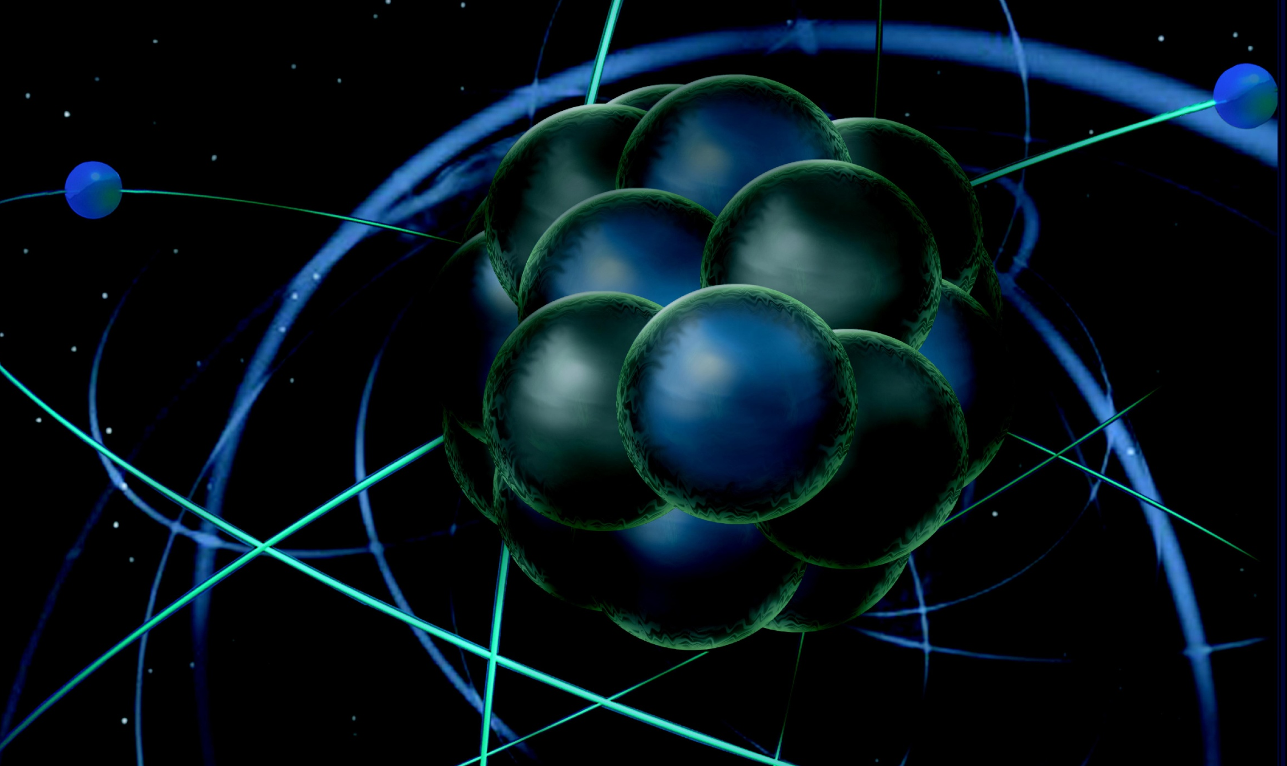
CLAS12 First Experiment Workshop General Introduction & Experiment Configuration
Latifa Elouadrhiri
Jefferson Lab
CLAS12 First Experiment Workshop
CLAS Collaboration
March 6, 2018

Slide 2
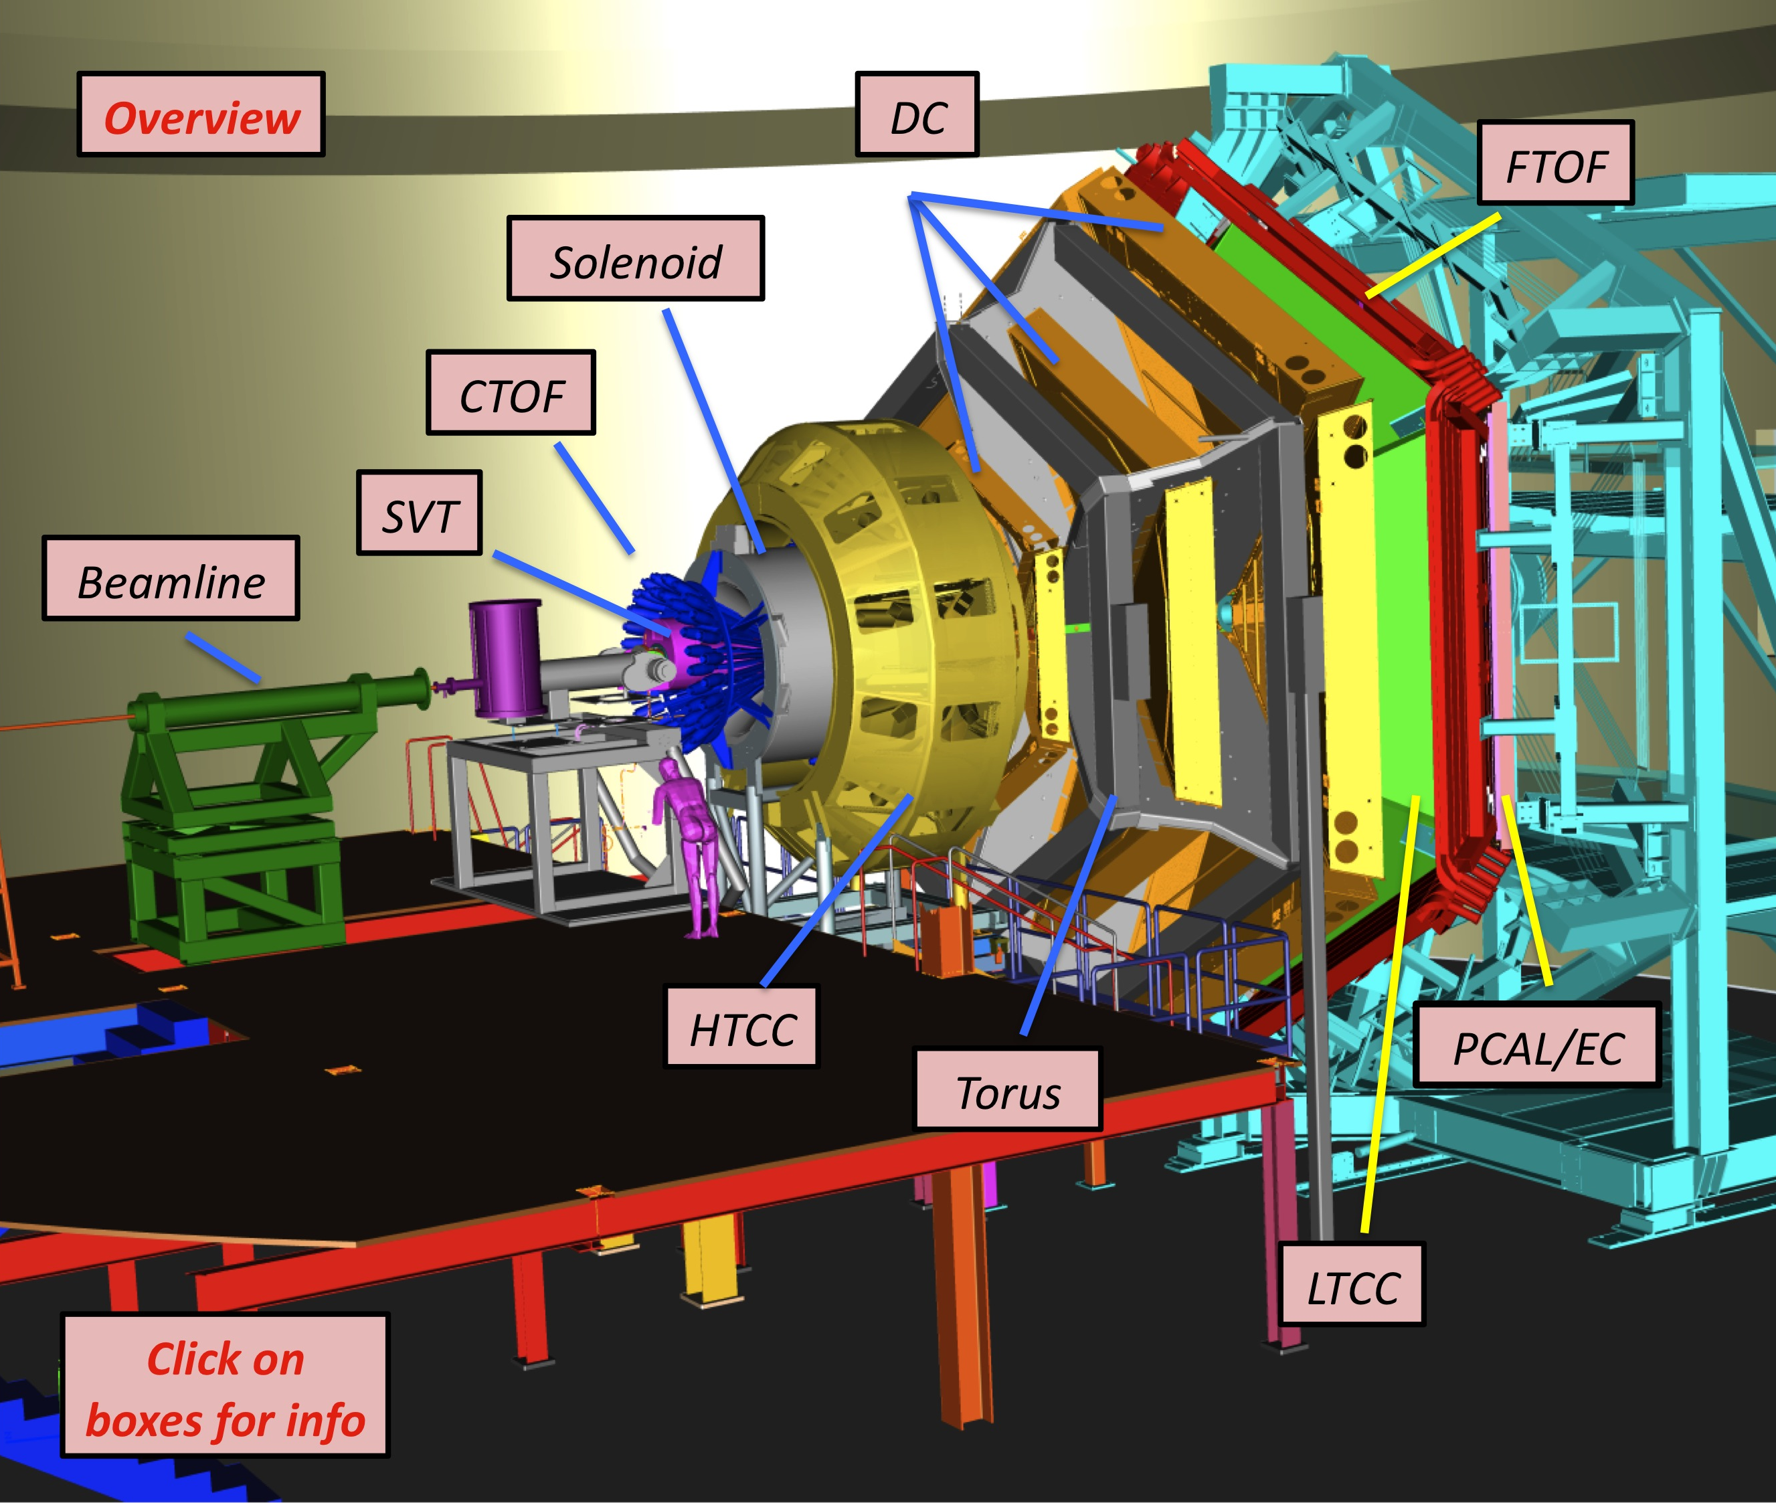
Equipment
CLAS12
Hall B
Forward Detector (FD)
TORUS magnet
HT Cherenkov Counter
Drift chamber system
LT Cherenkov Counter
Forward ToF System
Pre-shower calorimeter
E.M. calorimeter
Forward Tagger
RICH detector
Central Detector (CD)
Solenoid magnet
Silicon Vertex Tracker
Central Time-of-Flight
Central Neutron Det.
- MicroMegas
Beamline
Photon Tagger
Shielding
Polarized Targets
MM
CND
FT
RICH
Number of readout channels : 111, 832

Slide 3
First Experiment- Run Group A
Proposal | Physics | Contact | Rating | Days | Group | New equipment | Energy | Run Group | Target
E12-06-108 | Hard exclusive electro-production of π⁰, η | Stoler | B | 80 | 139 | RICH (1 sector) Forward tagger | 11 | A F. Sabatié | liquid H₂
E12-06-108A | Exclusive N*->KY Studies with CLAS12 | Carman |  | (60)
E12-06-108B | Transition Form Factor of the η’ Meson with CLAS12 | Kunkel |  | (80)
E12-06-112 | Proton’s quark dynamics in SIDIS pion production | Avakian | A | 60
E12-06-112A | Semi-inclusive Λ productiuon in target fragmentation region | Mirazita |  | (60)
E12-06-112B | Colinear nucleon structure at twist-3 | Pisano |  | (60)
E12-06-119(a) | Deeply Virtual Compton Scattering | Sabatie | A | 80
E12-09-003 | Excitation of nucleon resonances at high Q² | Gothe | B+ | 40
E12-11-005 | Hadron spectroscopy with forward tagger | Battaglieri | A- | 119
E12-11-005A | Photoproduction of the very strangest baryon | Guo |  | (120)
E12-12-001 | Timelike Compton Scatt. & J/ψ production in e+e- | Nadel-Turonski | A- | 120
E12-12-001A | J/ψ Photoproduction & study of LHCb pentaquarks | Stepanyan |  | (120)
E12-12-007 | Exclusive φ meson electroproduction with CLAS12 | Stoler, Weiss | B+ | 60
Beam time partial sum |  |  |  | 559 (1,049) | 139
Experiment ending with A or B are run group experiments approved by the CLAS collaboration. They are running parallel to the experiments with same experiment number. Experiments ending with (a) and (b) take data with both run groups.

Slide 4
CLAS12 First Experiment Configuration
Duration: 139 days
20 days commissioning
60 days high luminosity (10³⁵cm⁻²s⁻¹)
39 days low luminosity (5x10³³cm⁻²s⁻¹)
20 days torus polarity = negative
Energy: 11 GeV
Target: LH2
Experiment parameters
Beam energy | 10.6 GeV, electrons polarized
Beam current | 4nA (5x 10³³) to 80 nA (1x10³⁵)
Torus field and polarity | 100% (negative particles in-bending)
Solenoid field and polarity | 100% (nominal)
Trigger(s) | Electron trigger (HTCC/PCAL/EC) Electron (1 - 5 GeV) in the FT and ≥ 2 (3) hadrons in CLAS12
Target | 5cm LH2

Slide 5
CLAS12 First Experiment Configuration
Duration: 139 days
20 days commissioning
60 days high luminosity (10³⁵cm⁻²s⁻¹)
39 days low luminosity (5x10³³cm⁻²s⁻¹)
20 days torus polarity = negative
Energy: 11 GeV
Target: LH2
Experiment parameters
Beam energy | 10.6 GeV, electrons polarized
Beam current | 4nA (5x 10³³) to 80 nA (1x10³⁵)
Torus field and polarity | 100% (negative particles in-bending)
Solenoid field and polarity | 100% (nominal)
Trigger(s) | Electron trigger (HTCC/PCAL/EC) Electron (1 - 5 GeV) in the FT and ≥ 2 (3) hadrons in CLAS12
Target | 5cm LH2

Slide 6
CLAS12 Components for First Experiment
Torus magnet - to be operated up to ±100% of design current
Solenoid magnet – to be operated up to 100% of design current
Forward Detector (FD) – High Threshold Cherenkov Counter (HTCC), Forward Micromegas Tracker (FMT), Drift Chamber system (DC -R1, R2, R3), Low Threshold Cherenkov Counter (LTCC, 1 sector), RICH (1 sector), Forward Time-of-Flight (FTOF 1b/1a), Preshower Calorimeter (PCAL), Electromagnetic Calorimeter (EC)
Forward Tagger (FT) – FT-calorimeter, FT-Hodoscope, FT-Tracker
Central Detector (CD) – Silicon Vertex Tracker (SVT), Barrel MicroMegas Tracker (BMT), Central Time-of-Flight (CTOF) (being Installed), Central Neutron Detector (CND)
Slow Controls
DAQ/Online computing
Trigger
Beamline equipment
Offline Software

Slide 7
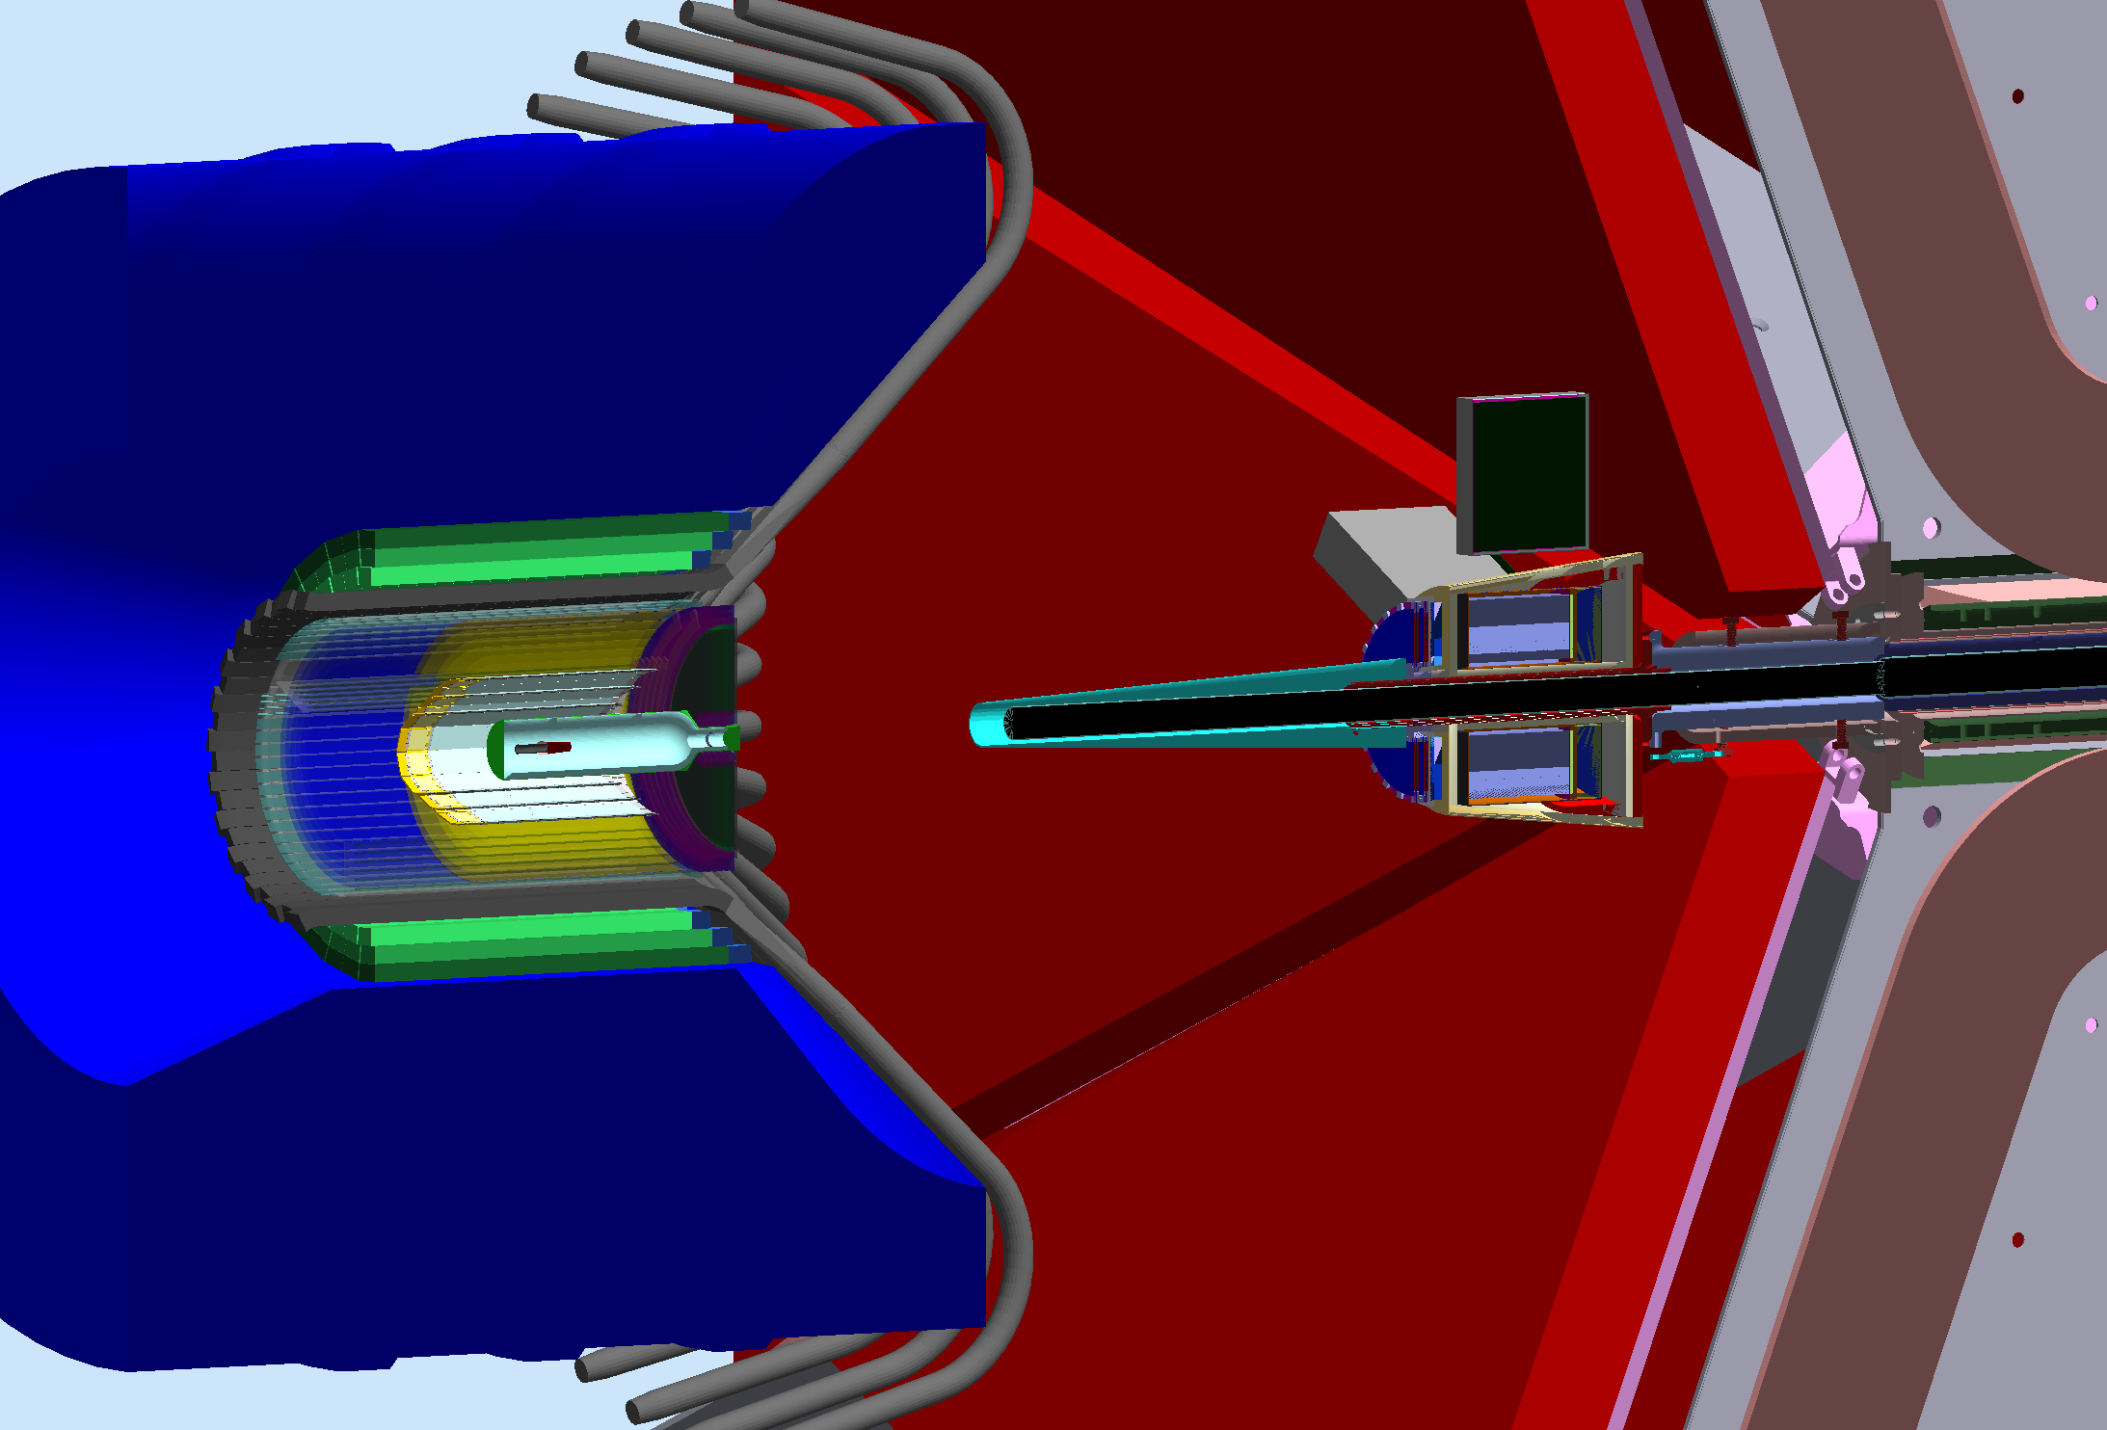
Beamline Configuration
“FT ON”

Slide 8
Schedule
Run Schedule: Hall B is scheduled for an Commissioning /Engineering Run for a total of 30 calendar days beginning December 4, 2017, and ending January 28, 2018. (Completed)
First Experiment is scheduled to begin February 5. There are 8 days of no-beam built into the schedule that can be used to implement changes to CLAS12 components if needed (for example as a result of findings during the engineering run). Ongoing.

Slide 9
CLAS12 complete Major achievement!

Slide 10
CLAS12 Completed
is a great achievement and the final milestone on our way to new science

