Slide 1
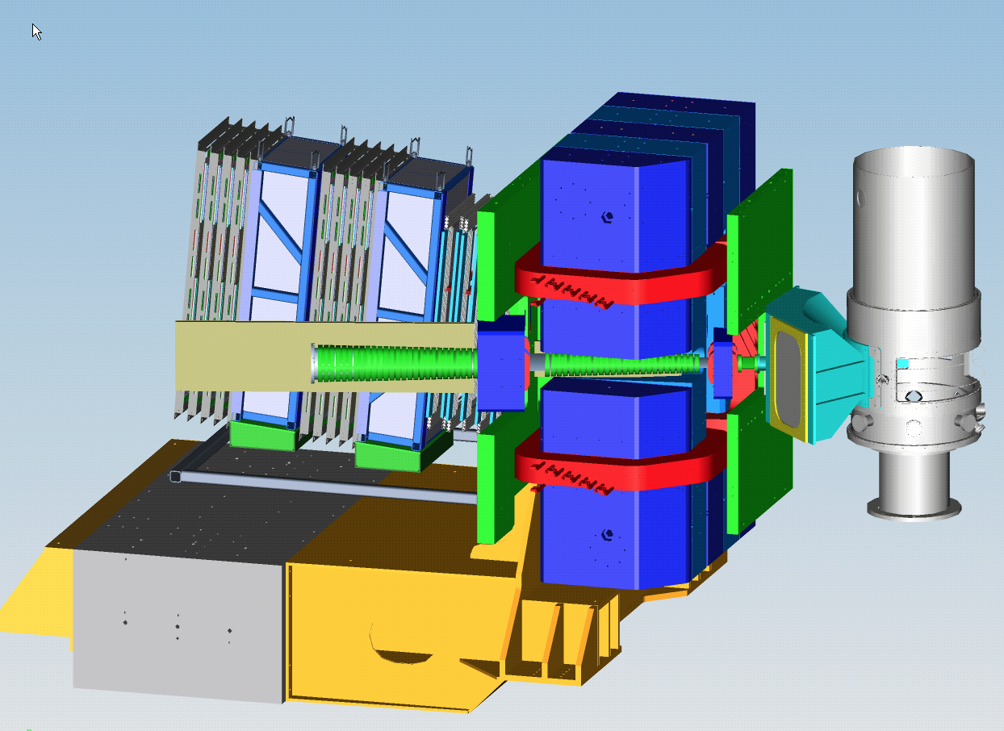
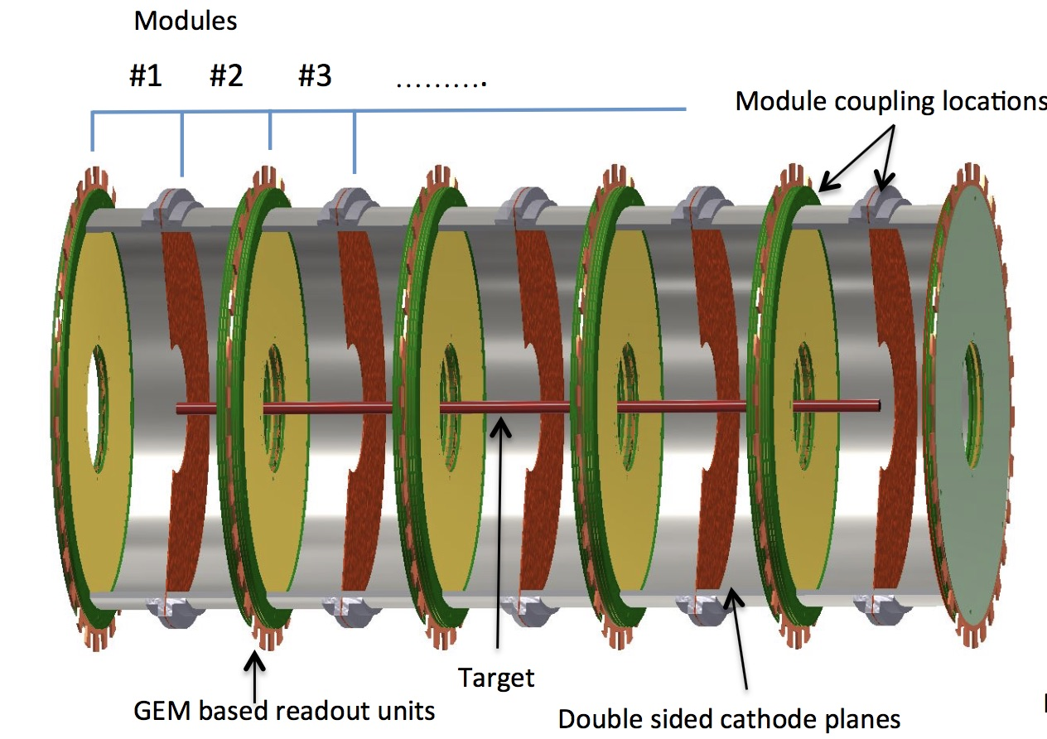
Summary and Path Forward
TDIS Collaboration Meeting
February 2018
Thia Keppel

Slide 2
Lots of progress so far…
Theory! A new framework for pion (kaon) pdf extraction, incorporates HERA/all data
Tension between Drell-Yan and tagged neutron HERA
Appears pion responsible for d_bar-u_bar difference
mTPC
New design, shortened drift times (up to ~1 microsec, not 40)
UVA pilot grant
MRI proposal led by UVA submitted
Use MRI as basis for CDR?*
Prototype development plan
Study plan outlined
Rates
Inner ring rate (highest) ~1 MHz/5mm pad, 63%occupancy, ~1.5 Gb/s
Test stand en route…
SAMPA chips, max data rate 3.52 Gb/s (10 MHz sampling)
Simulation
Digitization
Looking at kaon requirements
Need to study delta production, gas mixtures,….
Multiple efforts, coordination meeting tomorrow
Magnet here at JLab,
LAC and RICH refurbishing plans
New ideas (nDVCS, electron identification,..)

Slide 3
And, there’s still much to do…
mTPC – GEM operation in 47 kG axial field, ion flow
Target – needs progress with R&D, what thicknes possible
Collimation (simulate), FSDs,…
Do we really need low temperature? Low pressure?
Progress with MC for the full apparatus. Gas vessel design/tests.
Plan for tests of critical items of mTPC
Solenoid stray field aspects (also forces with SBS)
Add steel? Shielding?
Electron trigger, DAQ,..
Work with Sao Paolo for 80 ns shaping time… partner with BNL?
Better for measuring longitudinal momentum
Change gas for pion identification?
Simulation
Lots of opportunities to contribute!

Slide 4
Path forward
Let’s keep up the momentum!
Should be an exciting time – prototype mTPC, DAQ test stand, sophisticated simulations,...
When should we make a document for JLab?
Aim at full approval
Sooner rather than later might optimize MRI competitiveness

