Slide 1



Recent results on hadronic physics from Belle and prospects at Belle II
Anselm Vossen
For the Belle & Belle II Collaborations
Lightcone 2018
5/14 - 5/18
Notes:
8:18

Slide 2
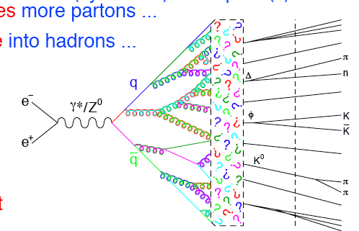
Hadronic Physics in e+e⁻ b factories
Exotics
ElectroWeak
pQCD
Decays
Detector
Study of the formation of hadrons →e.g. Phys.Rev. D97 (2018) no.7, 072005
Study of hadronization, microscopic quark properties ←→ macroscopic hadron properties
  Relativisitc, non-perturbative QCD dynamics →Fragmentation functions
Study of the produced hadrons, spectroscopy

Slide 3
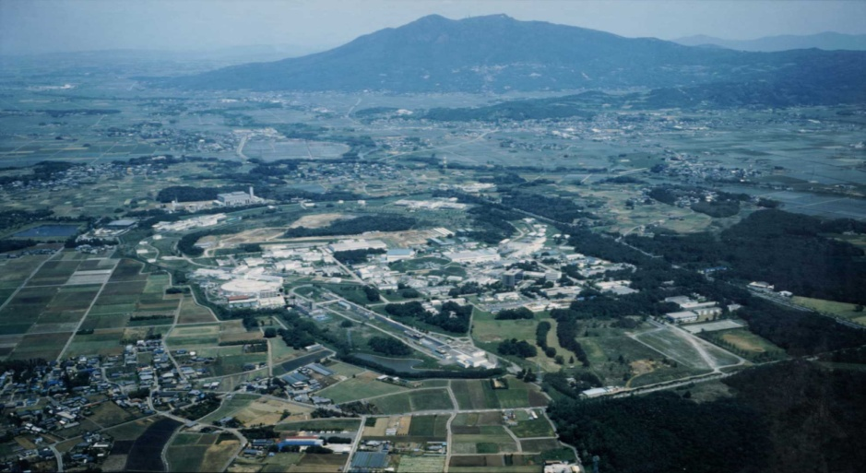
Belle (II) detector
KEKB
3/18

Slide 4
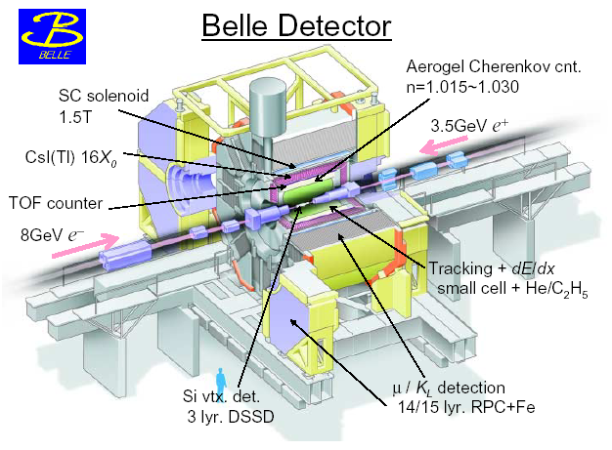
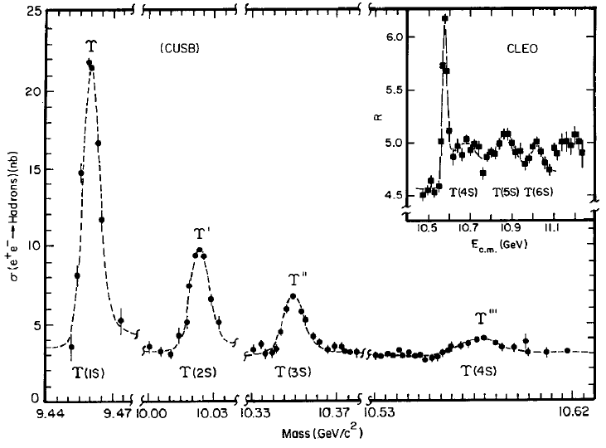
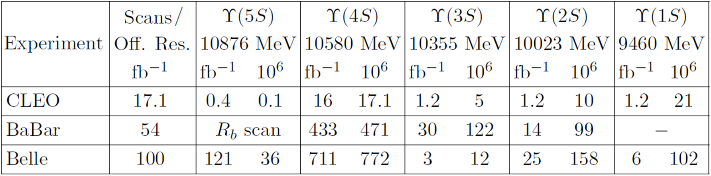
Belle Experiment (1999 - 2010)
+About 4x10⁶ events per fb in continuum

Slide 5
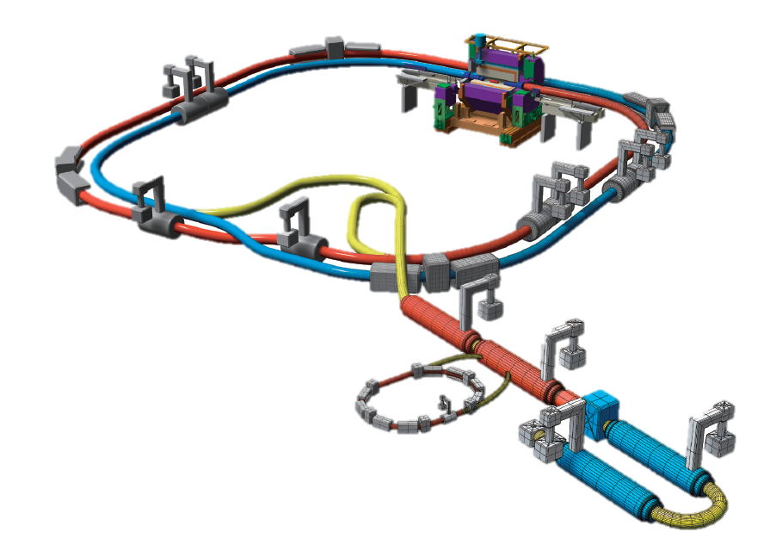
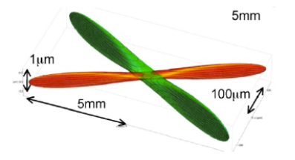
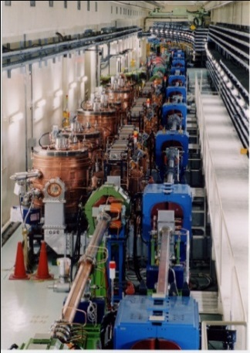

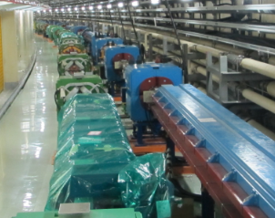

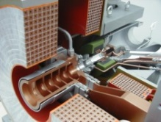
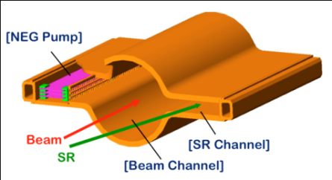
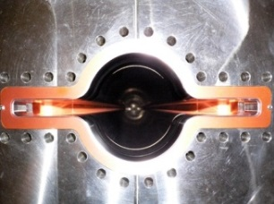

KEKB →SuperKEKB: Deliver Instantaneous Luminosity x 40
Belle II
New superconducting final focusing quads (QCS) near the IP
e⁺ 4GeV 3.6 A
`
e⁻ 7GeV 2.6 A
New IR
Nano beam collision
(~2x KEKB)
SuperKEKB
Target: L = 8x10³⁵/cm²/s
Replace short dipoles with longer ones (LER)
Reinforce RF systems for higher beam current
Positron source
New positron target / capture section
Redesign the lattices of HER & LER to squeeze the emittance
Damping ring (new)
TiN-coated beam pipe with antechambers
Cu for wigglers and Al alloy for the rest
@1.1 GeV
To inject low emittance positrons
Low emittance gun
To inject low emittance electrons

Slide 6
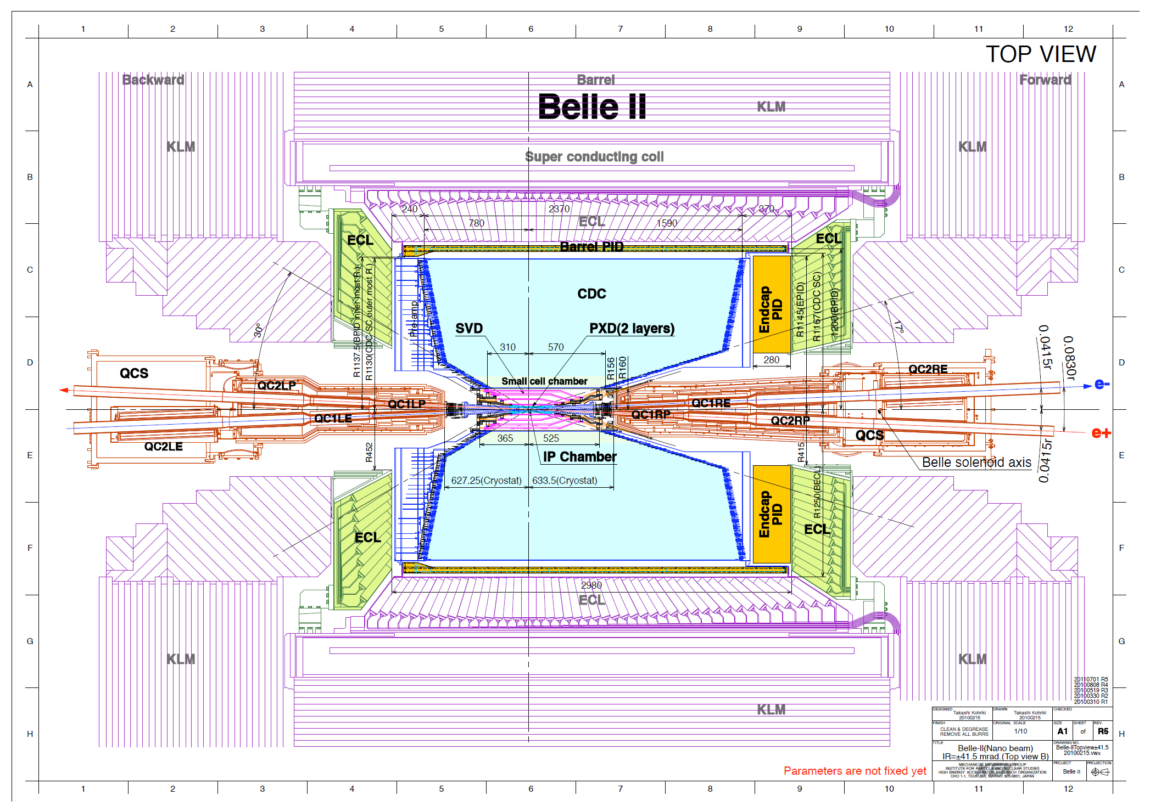
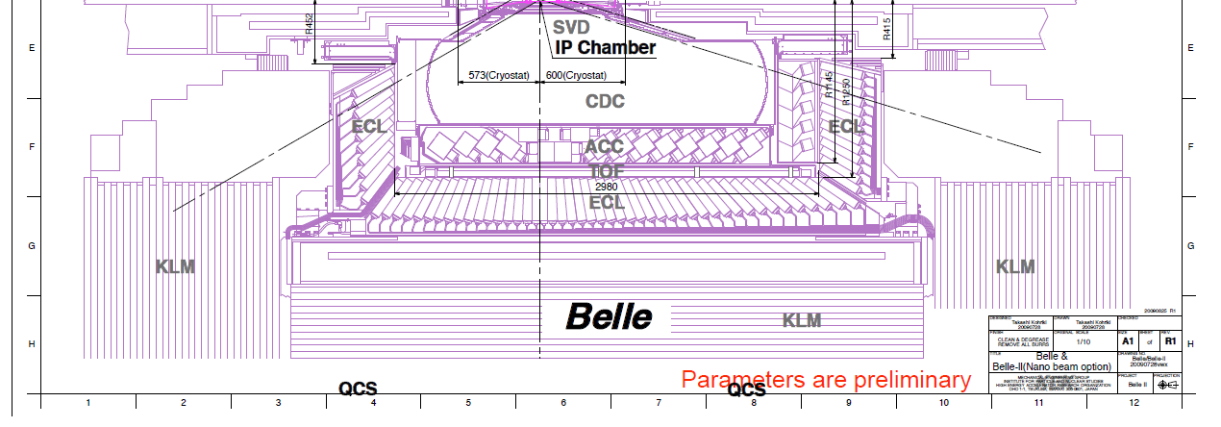
Belle II Detector (comp. to Belle)

Slide 7
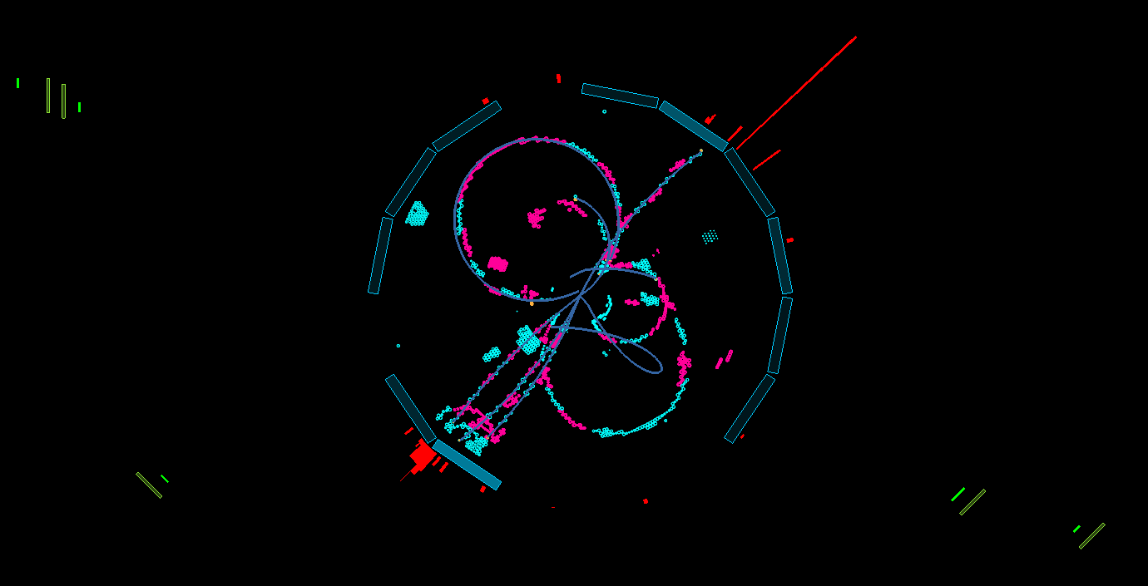
26 April 2018 00:38 GMT+09:00: First Collisions
MuID
EMCal
CDC
ToP
beamview

Slide 8
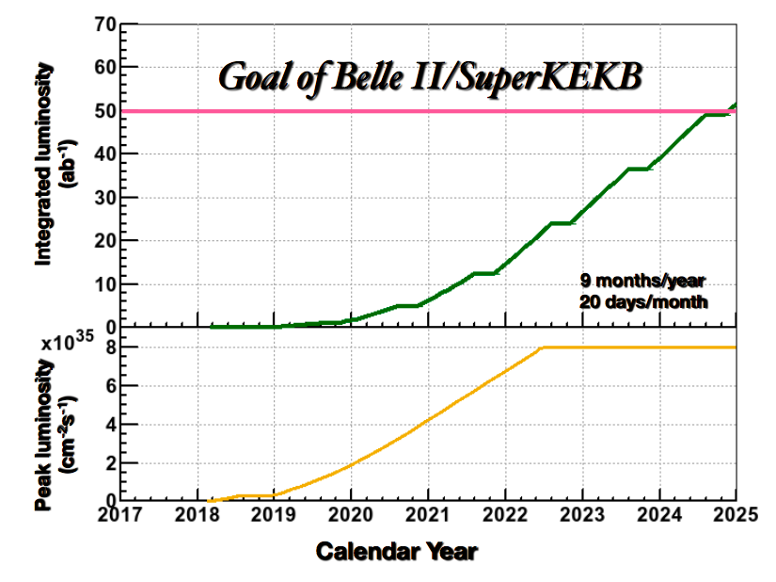
Current Status and Schedule
Phase 1 (complete)
  Accelerator commissioning
Phase 2 (now)
  First collisions (20±20 fb⁻¹)
  Partial detector
  Background study
  Physics possible
Phase 3 (“Run 1”, early 2019)
  Nominal Belle II start
Ultimate goal: 50 ab⁻¹

Slide 9
Fragmentation Functions with additional degrees of freedom: Novel probes of the Nucleon structure and hadronization
Di-hadron fragmentation functions
Polarized Hyperons

Slide 10
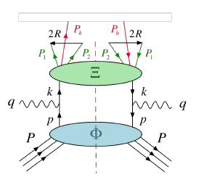
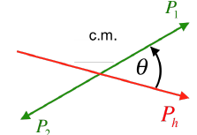

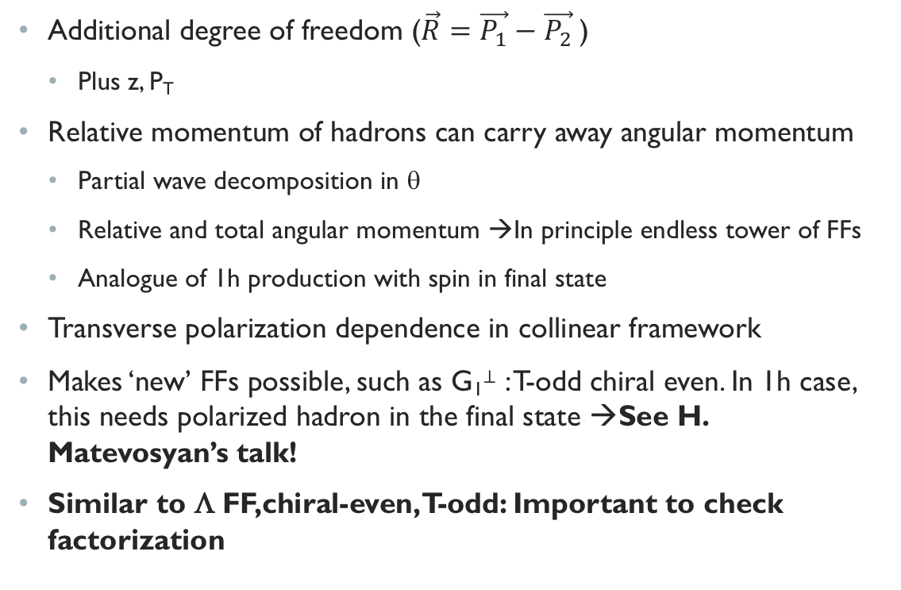
Di-hadron fragmentation functions
Additional degree of freedom ($\vec{R}=\vec{P_{1}}−\vec{P_{2}}$)
  Plus z, P_{T}
Relative momentum of hadrons can carry away angular momentum
  Partial wave decomposition in θ
  Relative and total angular momentum →In principle endless tower of FFs
  Analogue of 1h production with spin in final state
Transverse polarization dependence in collinear framework
Makes ‘new’ FFs possible, such as G₁⊥ : T-odd chiral even. In 1h case, this needs polarized hadron in the final state →See H. Matevosyan’s talk!
Similar to Λ FF,chiral-even, T-odd: Important to check factorization
-

Slide 11
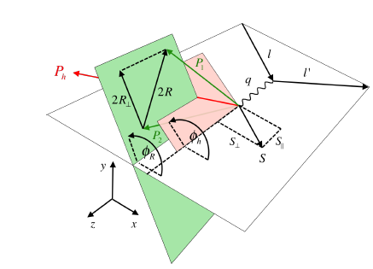
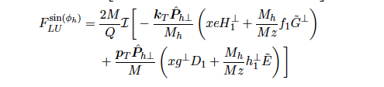
Example, Access of e(x) in SIDIS x-section
Di-hadron cross section
Single hadron cross-section: mixes other contributions:
WW Approximation

Slide 12
RECENT Belle result
(Seidl et. al. Phys.Rev. D96 (2017) no.3, 032005)
m [GeV]

Slide 13
Results Systematics Dominated
Low z: Dominated by PID uncertainties
Belle II prospects: Improved PID, higher statistics to improve uncertainties on PID
High z: Dominated by ISR uncertainties
Belle II prospects: better understanding of ISR radiation with better statistics
Seidl et. al. Phys.Rev. D96 (2017) no.3, 032005
m [GeV]

Slide 14
Belle II prospects
Partial Wave decomposition (more general: θ dependence)
Higher order PWs lead to different moments in θ and φ
In models, evolution of the different PWs different
Important to have a full picture to understand mixing effects in ratios/partial integrals/acceptance
Missing info from partial wave estimated to have effects up to 10% e.g. on extraction of transversity

Slide 15
Acceptance Impact on Partial Wave composition
Belle II prospects: Sufficient statistics for full partial wave decomposition
Seidl et. al. Phys.Rev. D96 (2017) no.3, 032005
m [GeV]

Slide 16
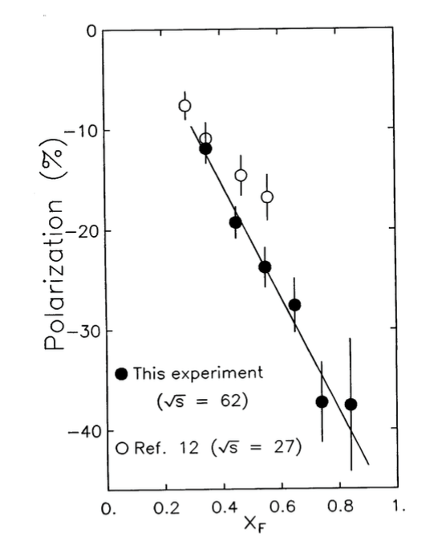
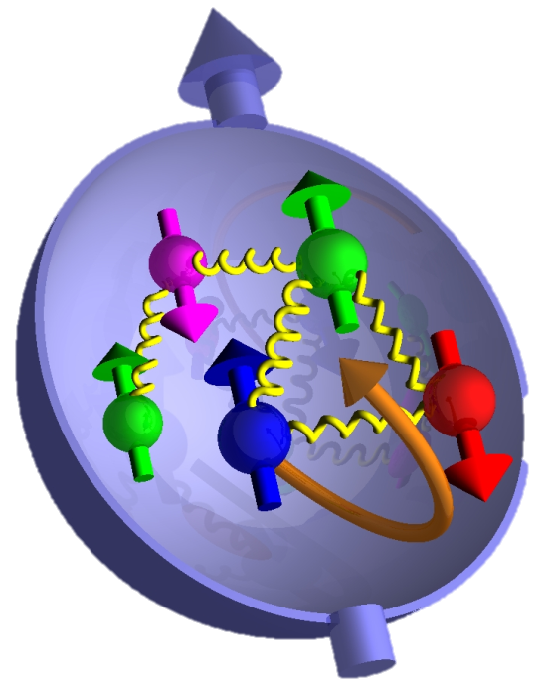
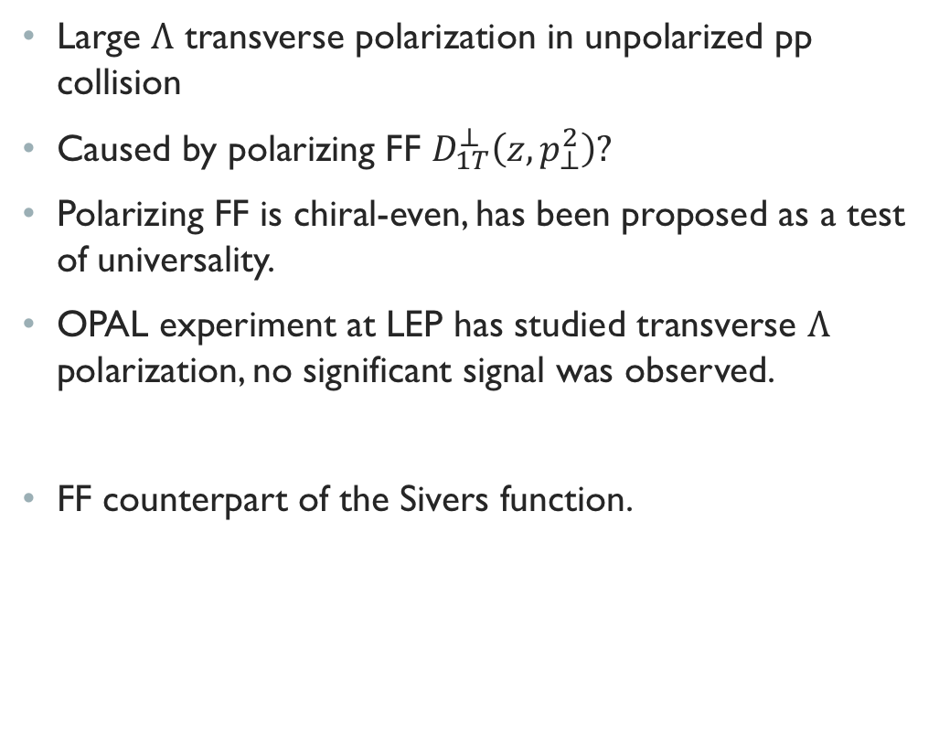

Polarized Hyperon Production
Large $Λ$ transverse polarization in unpolarized pp collision
Caused by polarizing FF $D_{1T}^{⊥}\left(z,p_{⊥}^{2}\right)?$
Polarizing FF is chiral-even, has been proposed as a test of universality.
OPAL experiment at LEP has studied transverse $Λ$ polarization, no significant signal was observed.
FF counterpart of the Sivers function.
PRL36, 1113 (1976); PRL41, 607 (1978)
$$p+p→Λ^{↑}+X$$
PRL105,202001（2010）
Fermilab
ISR data
(Phys.Lett. B185 (1987) 209)
Eur. Phys. J. C2, 49 (1998)
$$x_{F}=p_{L}/\max_{}{p_{L}\sim _{LO}x_{1}−x_{2}\sim _{forward}x_{1}}$$
p_{T}
q

Slide 17
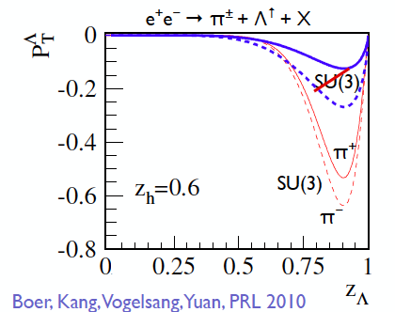
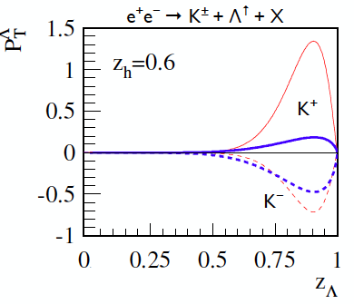

z_{Λ}, p_{T} Dependence of observed Λ polarization
Y. Guan, arXiv:1611.0668
Polarization rises with $p_{t}$ in the lowest $z_{Λ}$ and highest $z_{Λ}$ bin. But the dependence reverses around 1 GeV in the intermediate $z_{Λ}$ bins→Unexpected! (might be related to fragmenting quark flavor dependence on z₁,z₂)
Correlation with opposite hemisphere light meson →quark flav/charge dependence

Slide 18
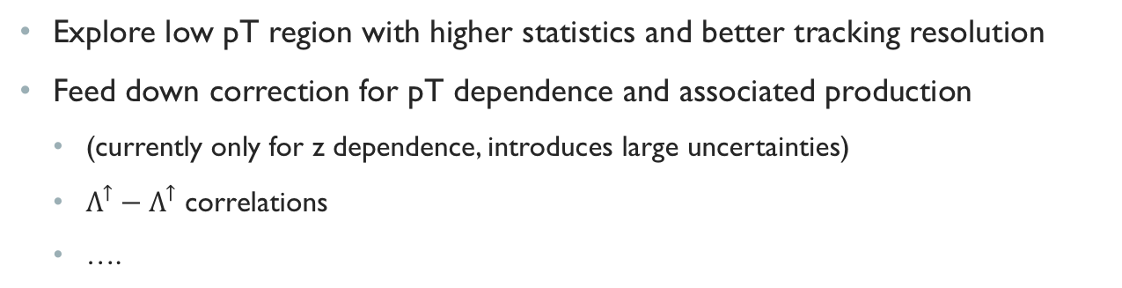
Belle II Prospects
Y. Guan, arXiv:1611.0668
Explore low pT region with higher statistics and better tracking resolution
Feed down correction for pT dependence and associated production
  (currently only for z dependence, introduces large uncertainties)
  $Λ^{↑}−Λ^{↑}$ correlations
  ….

Slide 19
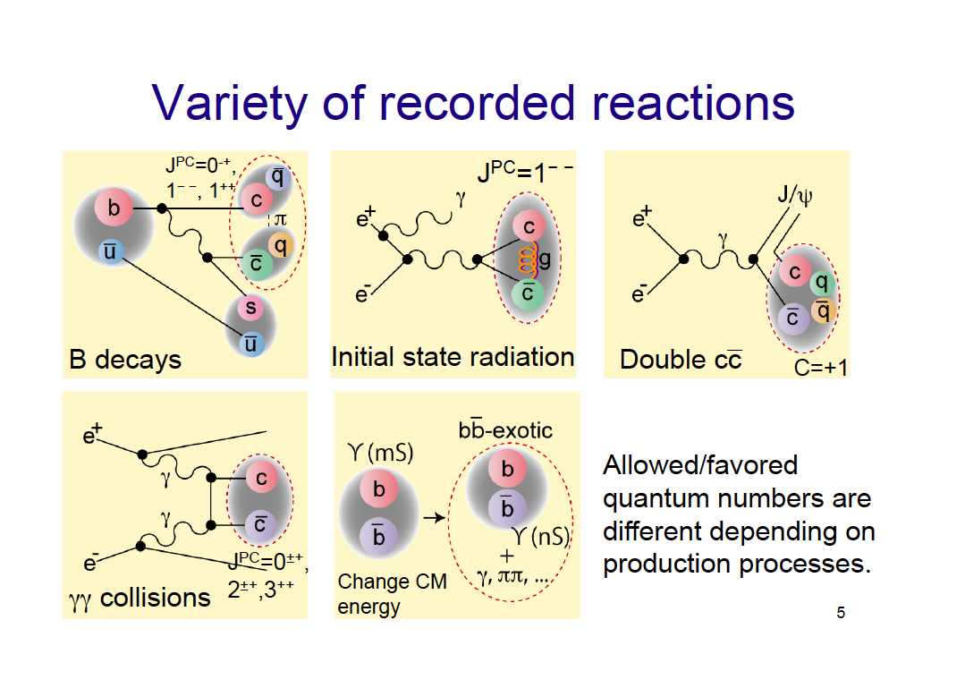
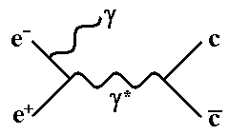
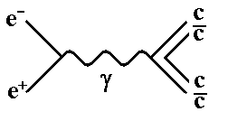
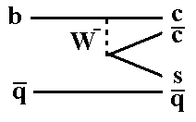
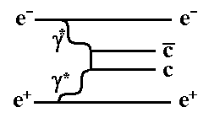
Belle Legacy in Hadronic physics – Quarkonium (-like) Production
B decays
  Charmonium only
  All quantum numbers available
Direct production / Initial State Radiation (ISR)
  E_{CM} or below
  J^{PC}=1⁻⁻
Two-photon interaction
  J^{PC} = 0-+, 0++, 2++
Double charmonium production
  Seen for J^{PC}=1⁻⁻ (J/ψ, ψ(2S)) plus J=0 states (C=1? )
Quarkonium transitions
  Hadronic/radiative decays between states

Slide 20
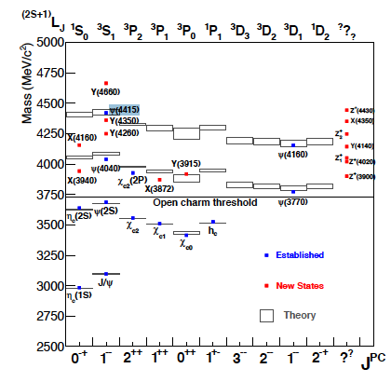
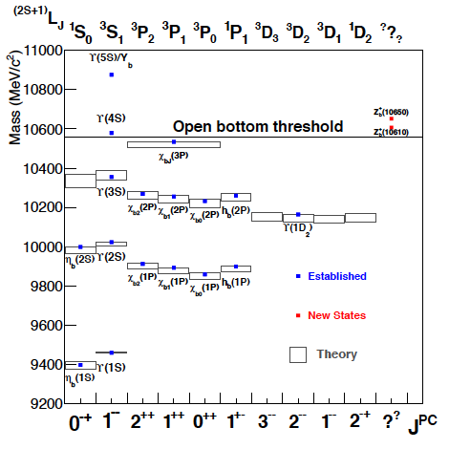
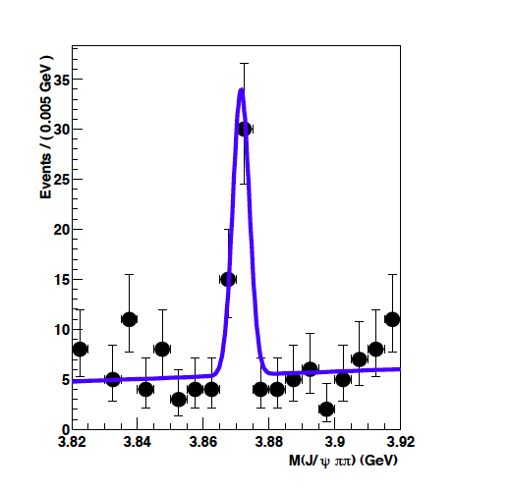
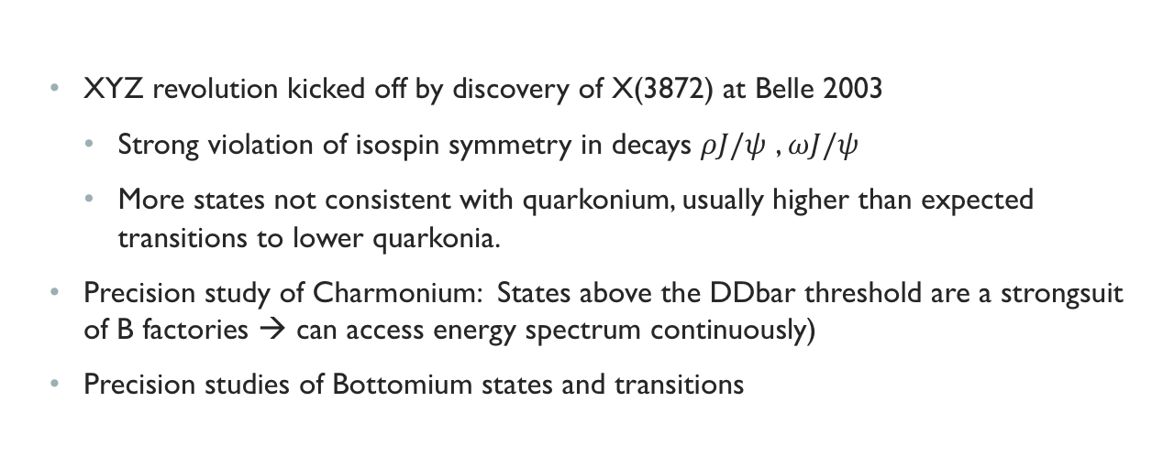
Quarkonium Studies at Belle II build on the successful Belle Program
  XYZ revolution kicked off by discovery of X(3872) at Belle 2003
    Strong violation of isospin symmetry in decays $ρJ/ψ$ , $ωJ/ψ$
    More states not consistent with quarkonium, usually higher than expected transitions to lower quarkonia.
  Precision study of Charmonium: States above the DDbar threshold are a strongsuit of B factories → can access energy spectrum continuously)
  Precision studies of Bottomium states and transitions
X(3872)
K
(Choi et al, PRL91 (26) 262001)

Slide 21
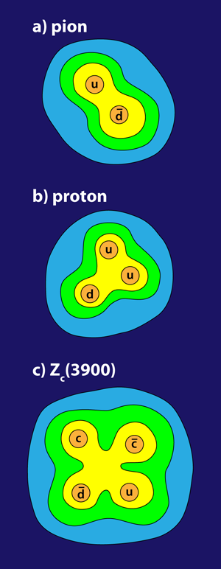

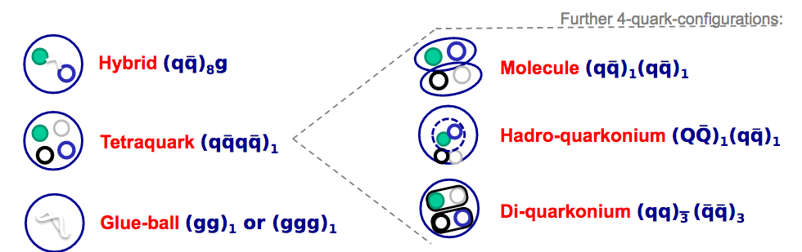
Z: evidently exotic, needs 4 quarks
APS highlight 2013

Slide 22
Recent Spectroscopy results
Phys. Rev. D 95, 112003 (2017) Observation of an alternative χc0(2P) candidate in e+e−→J/ψDD¯
Phys. Rev. D 97, 012002 (2018) Angular analysis of the e+e−→D(∗)±D∗∓ process near the open charm threshold using initial-state radiation
Phys. Rev. D 97, 012005 (2018) Measurements of the absolute branching fractions of B+→Xcc¯K+ and B+→D¯(∗)0π+ at Belle
Phys. Rev. D 96, 051102 (2017) Search for Λ+c→φpπ0 and branching fraction measurement of Λ+c→K−π+pπ0
Phys. Rev. D 95, 012001 (2017) Search for the 0−− Glueball in Υ(1S) and Υ(2S) decays
  Phys. Rev. D 96, 052005 (2017) Study of η and dipion transitions in Υ(4S) decays to lower bottomonia
Phys. Rev. D 96, 112002 (2017) Search for light tetraquark states in Υ(1S) and Υ(2S) decays

Slide 23
Wishlist
More data will help Quarkonium
  Map out resonances
  Can reach Υ(6S) with same boost as Υ(4S)
  More data at/above Υ(4S)→search molecular structures near open bottom thresholds
  Experimental information of charmonium > Ddbar threshold very incomplete,
  More data below Y(4S) →test predictions for unobserved bottomium states
  Determine transitions and quantum numbers
  Precision scans of bottomium sector, comparison with charmonium states should shed light on some properties (spin symmetry suppression not as strong)
  Need enough data for amplitude analysis to check if found states are the expected ones

Slide 24
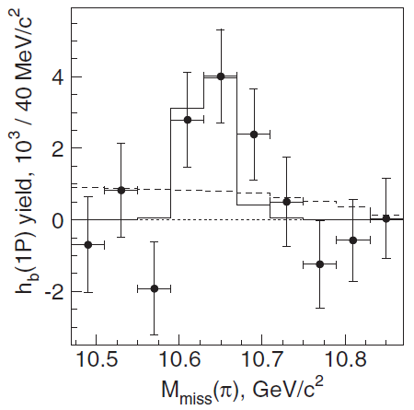
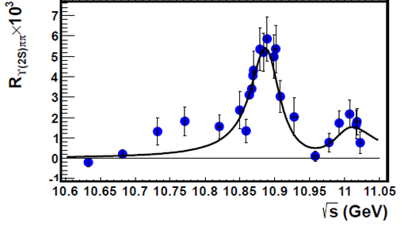
Belle II Early Physics Prospects
Existing B-Factories ~1.5 ab⁻¹: opportunity for other results in Phase 2/3?
Early phase 3: Above ϒ(4S)
  Study of Y(nS) states in (hadronic) transitions
  Study of exotic four-quark states (e.g. Z_{b} at Y(6S))
  BB** threshold? : R_{b} dip versus ππϒ rise
ϒ(1S)
ϒ(5S/6S)
σ(e⁺e⁻→hadrons) (nb)
ϒ(2S)
ϒ(3S)
ϒ(4S)
Potential impact with O(10-100) fb⁻¹
Mass (GeV/c²)
Phys.Rev.Lett. 117 (2016) no.14, 142001
Z_{b}
?

Slide 25
Summary & Outlook
Belle II will integrate 50x Belle luminosity (= 50 ab⁻¹)over ~6 years
State of the art detector
Precision studies of Quarkonia, hadronization
Physics program with first data focusing on E_{CM}>Υ(4S) already promising!
Precision hadronization studies crucial for JLab12 SIDIS program

Slide 26
Backup

Slide 27
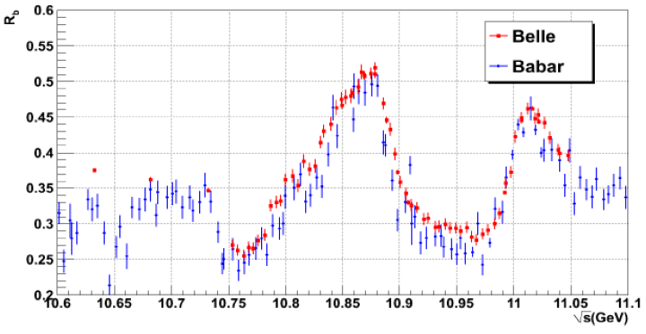
Belle II Early Physics Prospects
Existing B-Factories ~1.5 ab⁻¹: opportunity for other results in Phase 2/3?
Phase 2: Above ϒ(4S)
  Study of exotic four-quark states (e.g. Zb at Y(6S))
  →Study possible with limited tracking resolution
  BB** threshold? : R_{b} dip versus ππϒ rise
  <6fb⁻¹ accumulated by Belle at E_{CM}=ϒ(6S)
Early phase 3: Below ϒ(4S)
  ϒ(2S,3S) access to bottomonium
  Scan for direct production of ϒ(1³D_{J}) triplet, η_{b}(1S,2S) studies
Phys.Rev.Lett.102:012001,2009, (Babar)
PRD 82, 091106 (2010). 0810.3829. (Belle)
?
?
Potential impact with O(10-100) fb⁻¹
Z_{b}
?

Slide 29
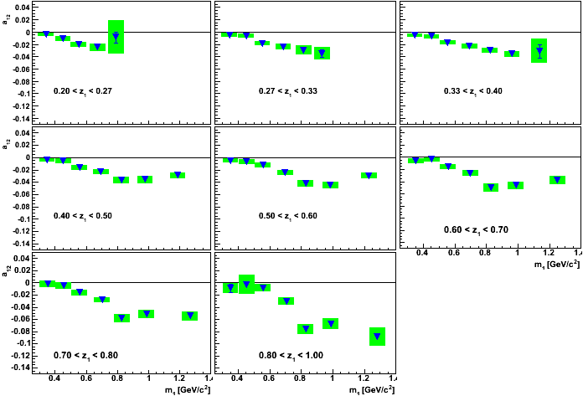
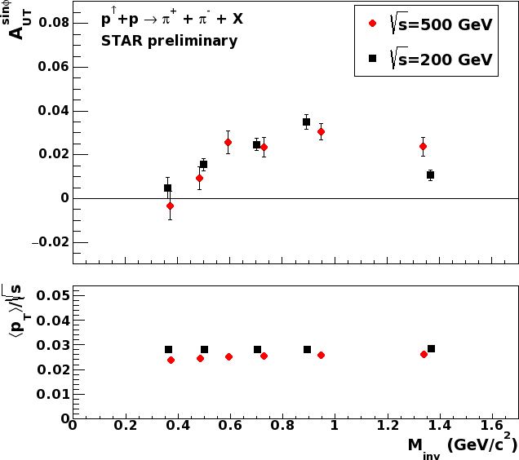
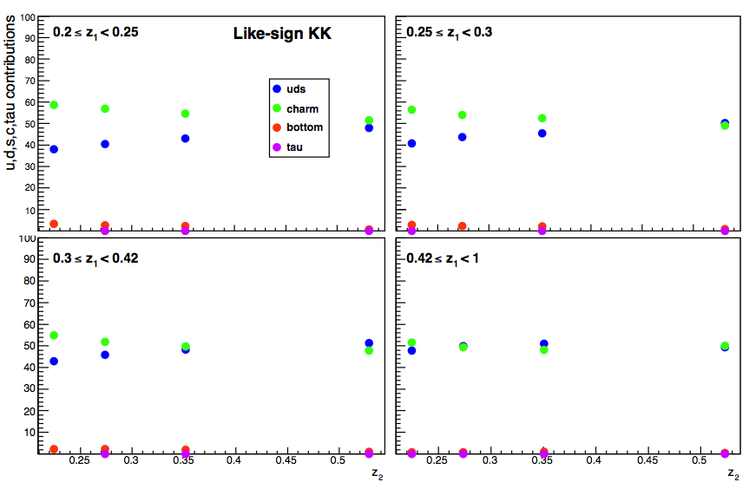
Other Perks
Transverse polarization
Dependent di-hadron
Asymmetries in e+e- from Belle
More statistics and better vertexing will help with charm corrections
Systematics will also be reduced since the main sources are dependent on MC statistics
Better PID will help with multi-kaon final states
PID performance
Belle II MC preliminary
Charm vs uds in b2b kaon production
(likesign)
~45% uds

Slide 30
Baryon FOrmation

Slide 31
Production of Charmed and non charmed baryons
Ξ⁻, Ξ(1530), Ω⁻ Σ_{c}, Ω_{c}, Ξ_{c} not shown

Slide 32
Mass Dependence confirms diquark model

Slide 33
Outline
Belle (I) Legacy
  Quarkonium (like)
  Hadronization (Fragmentation function measurements)
SuperKEKB and Belle II
  Upgrade
  Status
  Early Physics program
  Outlook

Slide 34
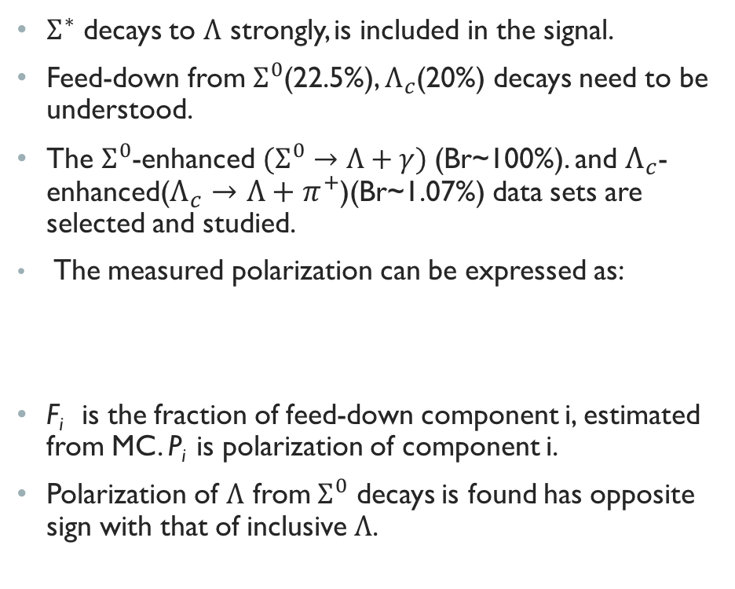
Background unfolding
$Σ^{∗}$ decays to $Λ$ strongly, is included in the signal.
Feed-down from $Σ^{0}$(22.5%), $Λ_{c}$(20%) decays need to be understood.
The $Σ^{0}$-enhanced $(Σ^{0}→Λ+γ)$(Br~100%). and $Λ_{c}$-enhanced($Λ_{c}→Λ+π^{+}$)(Br~1.07%) data sets are selected and studied.
  The measured polarization can be expressed as:
F_{i} is the fraction of feed-down component i, estimated from MC. P_{i} is polarization of component i.
Polarization of $Λ$ from $Σ^{0}$ decays is found has opposite sign with that of inclusive $Λ$.
Belle preliminary
Belle preliminary
Belle preliminary
R. Gatto, Phys. Rev. 109, 610 (1958); Phys.Lett.B303,350(1993)

Slide 35
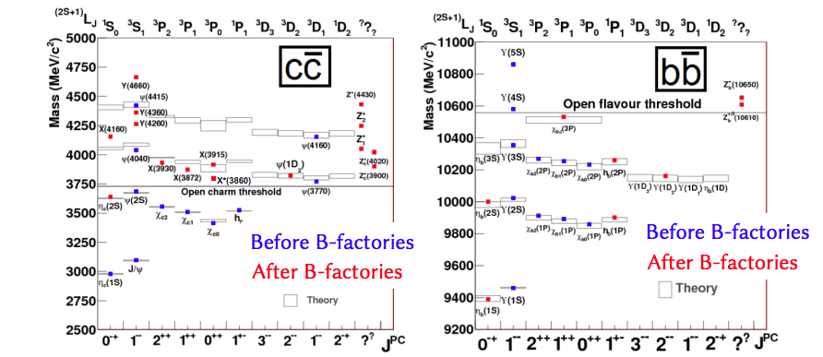

Slide 36
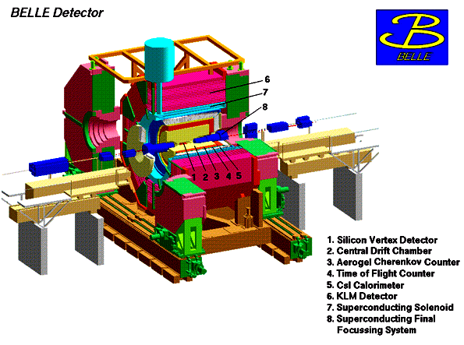
Before there was
KEKB: asymmetric e⁺ (3.5 GeV) e⁻ (8 GeV) collider:
-√s = 10.58 GeV, e⁺e⁻→Υ(nS)→B/B + continuum
-√s = 10.52 GeV, e+e-→ qqbar (u,d,s,c) ‘continuum’
Ideal (at the time) detector for high precision measurements:
- tracking acceptance θ [17 °;150°]: Azimuthally symmetric
- particle identification (PID): dE/dx, Cherenkov, ToF, EMcal, MuID
Available data:
  ~1 ab⁻¹ total
  ~1.8 *10⁹ events at 10.58 GeV,
  ~220 *10⁶ events at 10.52 GeV
(took data till 2010)
Belle detector
KEKB
Notes:
Check number of events for continuum

Slide 37
Belle Legacy in Hadronic physics – Quarkonium (-like) Production
B decays
  Charmonium only
  All quantum numbers available
Direct production / Initial State Radiation (ISR)
  E_{CM} or below
  J^{PC}=1⁻⁻
Two-photon interaction
  J^{PC} = 0-+, 0++, 2++
Double charmonium production
  Seen for J^{PC}=1⁻⁻ (J/ψ, ψ(2S)) plus J=0 states (C=1? )
Quarkonium transitions
  Hadronic/radiative decays between states

Slide 38
Quarkonium Studies at Belle II build on the successful Belle Program
  XYZ revolution kicked off by discovery of X(3872) at Belle 2003
  Precision study of Charmonium: States above the DDbar threshold are a strongsuit of B factories → can access energy spectrum continuously)
  Precision studies of Bottomium states and transitions
(Choi et al, PRL91 (26) 262001)

