Slide 1
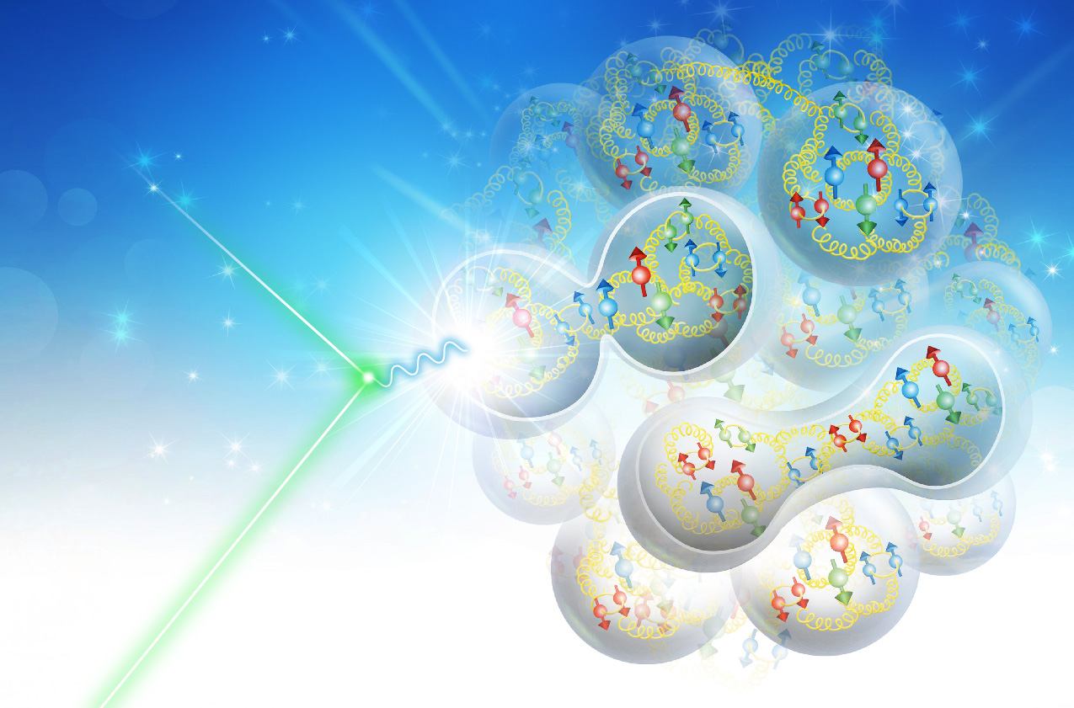
From 12 GeV CEBAF to the EIC
Beginnings of a New Science
Rik Yoshida, Light Cone 2018

Slide 2

Welcome to the Last Talk of the Last Session
It’s been a very intense week
with a lot of great science.
As a change of pace:
This talk is mostly a personal take
on where Nuclear Science may
be going in the next decades.

Slide 3
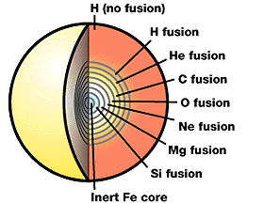

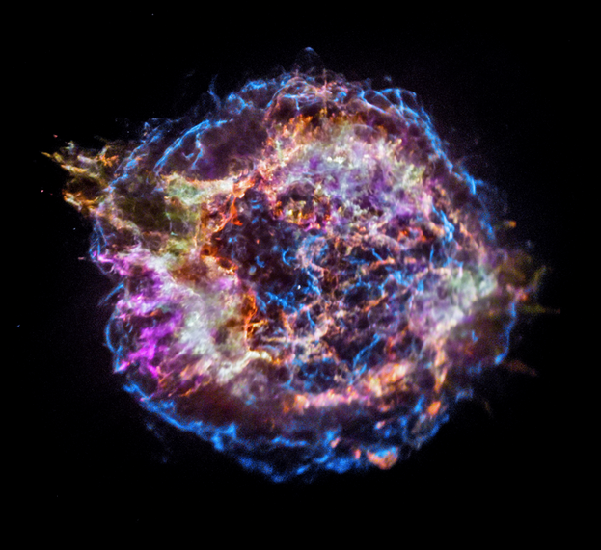

Nuclear Science and the Origin of the Cosmos
Characteristics of Protons and Neutrons (Nucleons),
singly and collectively in Nuclei, in concert
with EW and Gravity forms the visible Cosmos.
Stellar Fusion
He through Fe
Big Bang
~15 to 5 Billon
Years ago
Nova
~200 Thousand
Years ago
H, He
~16 Billion Years ago
Heavier than Fe

Slide 4
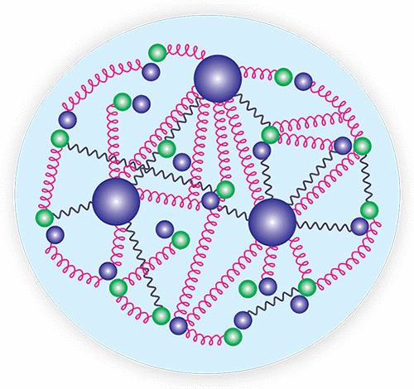
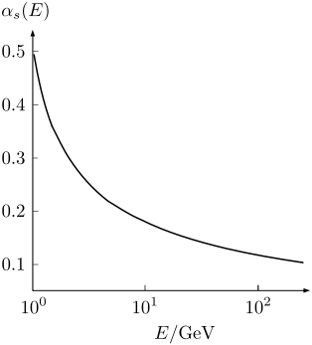
Nucleons and Nuclei
Nucleons
Mass
Spin
Bulk
NN interactions
…
Arise out of quarks and gluons interacting
through Quantum Chromodynamics (QCD)
We have little quantitative idea of how this
happens because QCD is strongly coupled
in the energy regime of the mass of Nucleons.
Nucleons and Nuclei can thought of emergent phenomenon of QCD
We know this happens—the Quest is to understand exactly HOW.

Slide 5


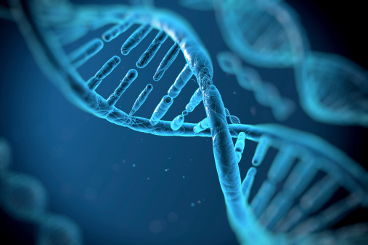
Modern Technology
We live in a world that would have been unimaginable 100 years ago

Slide 6
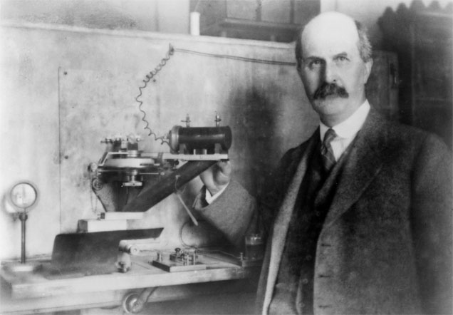
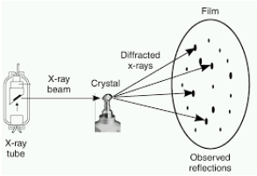
100 Years ago..
William Henry Bragg (ca. 1915)
We learned to map atoms inside matter using x-ray crystallography.
This is where it all begins.
The deep knowledge of atomic structures and electromagnetism
is the basis of today’s technology. Atomic- or nanotechnology.

Slide 7
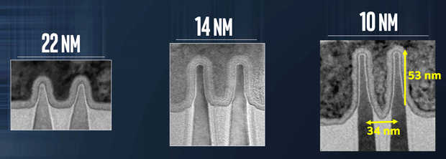
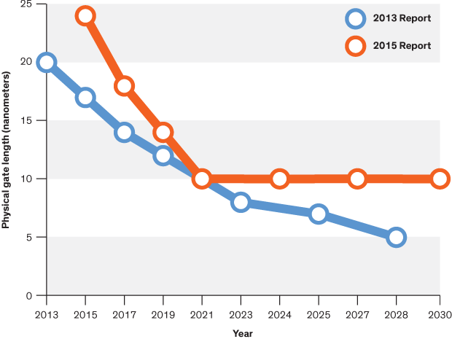
Limits of Nano-technology: Atoms
Microelectronics improve with
reduction of the “feature size”
We are now down to
10 nanometers.
(about 100 atoms wide).
Progress becomes more
and more difficult.
2015 International Technology
Roadmap for Semiconductors
Can we go smaller?

Slide 8
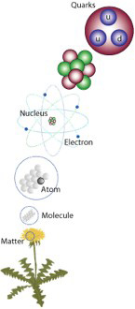
Structure of Matter
Can we manipulate quarks and gluons?
Femtoworld (scale ~10⁻¹⁵ meters)
A million times smaller
Nanoworld (scale ~10⁻⁹ meters)
We have known for half a century that
quarks (and gluons) and their interactions
make up 99% of mass in the visible universe.
But we have not gotten nowhere near understanding them in the
way we understand atoms and electromagnetism. Why not?

Slide 9
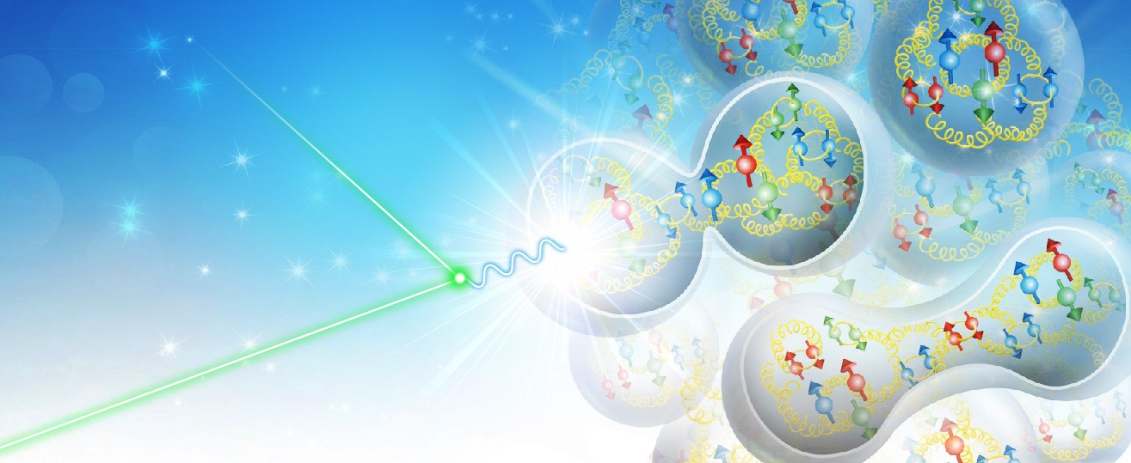
Unraveling the Emergent Nucleon
Three Approaches in Nuclear Science:
Empirical NN (and NNN) interactions. (Nuclear Structure Theory and low energy NP)
Solve non-perturbative QCD computationally. (Lattice QCD)
Use high-energy interaction to probe the non-perturbative structure. (pQCD and medium-high energy NP)
High enough energy to localize quarks and gluons (CMS energies of 10-100 GeV range)
At the same time sensitive to nucleon and nuclear energy scale (0.1 to 0.01 GeV)
12 GeV CEBAF
Electron-Ion Collider

Slide 10
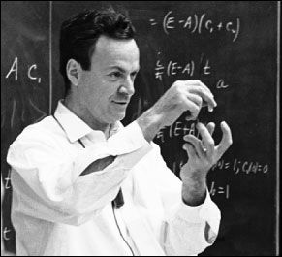
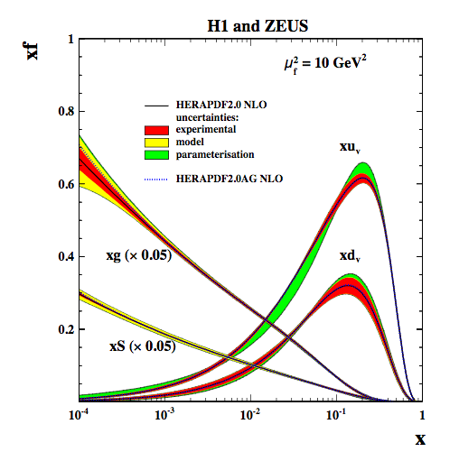
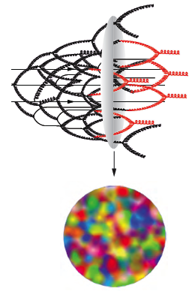
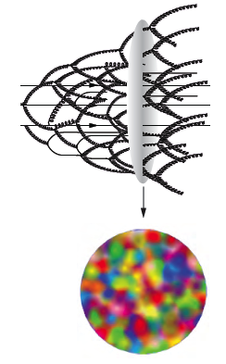
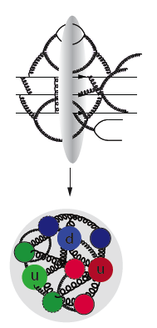
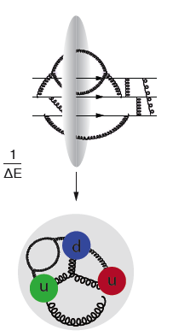
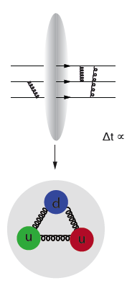
In the Beginning…
Feynman’s parton model
Asymptotic freedom → pQCD
Factorization allows measurement to extract non-perturbative PDFs.
However: incomplete as a description of the proton.

Slide 11
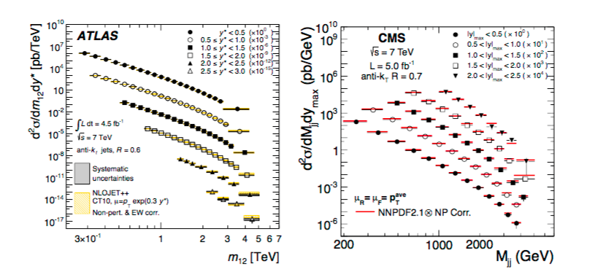
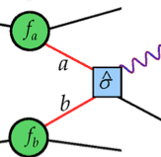
Leading to..
Protons at high momentum can be treated as a beam of partons— now identified as free quarks and gluons: (Asymptotic freedom!)
QCD nature of quark and gluons make their densities “evolve” with Q²
This evolution itself is conceptually simple and the partons behave incoherently.
You can measure DIS (and other) cross-sections -> extract pdfs -> predict cross-sections for another process. (Factorization!)
Jet cross-sections at the LHC predicted and measured
This is great if you are
interested in studying
the hard interaction
(LHC physics)

Slide 12
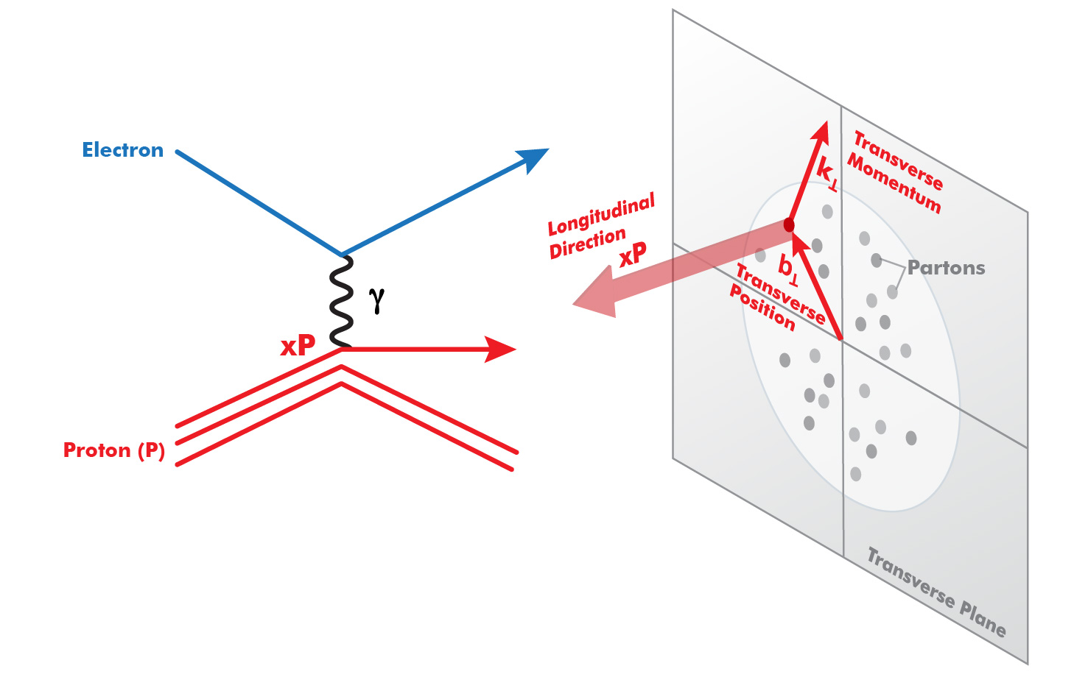
Progress of pQCD (~1990 – Present)
Factorization II
(Q²)
Parton Distribution Functions:
Longitudinal only—No way to interpret nucleon partonic structure in rest frame
3D (Transverse) Structure
TMD’s, GPD’s—Now we know what to measure to
understand the 3D structure of nucleons
Transverse Momentum Dependent Distributions (TMD): k_{t} Generalized Parton Distributions (GPD): b_{t}

Slide 13
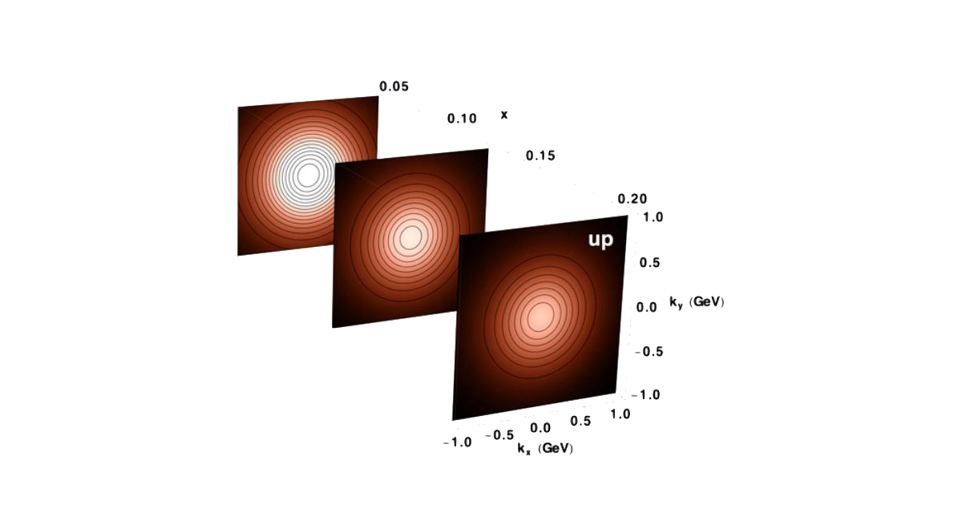
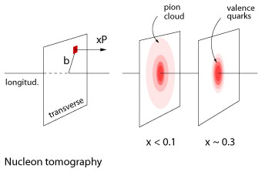
Nuclear Imaging (Femtography!) is a New Frontier at JLAB12 and EIC
Enabled by theoretical developments → TMD, GPD, Factorization II

Slide 14
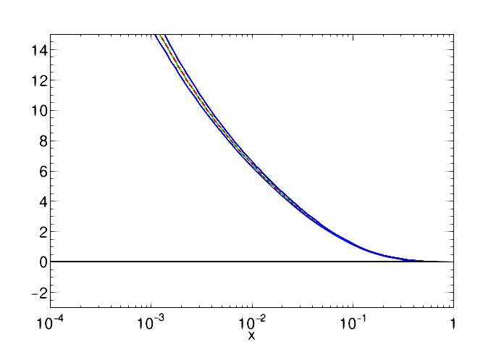
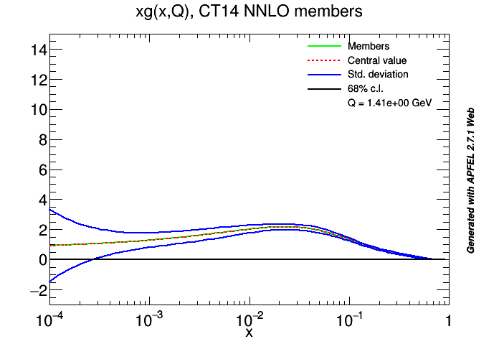
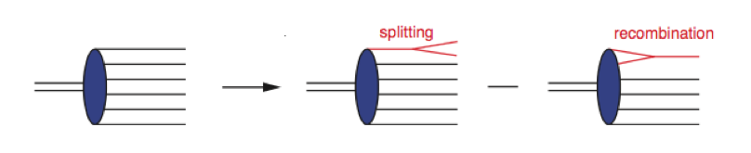
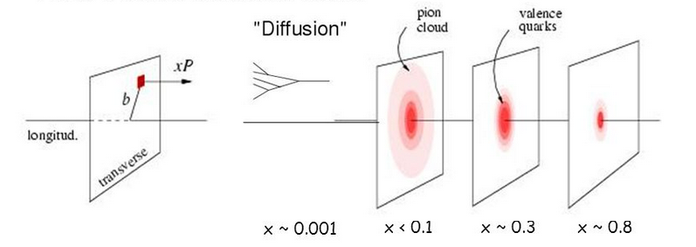
What is the QCD radius of the nucleon?
HERA discovered a dramatic rise in the number
of gluons carrying a small fractional longitudinal
momentum of the proton (i.e. small-x)
at large Q² (> ~5 GeV²).
CTEQ 14 NNLO
Proton gluon density
Q²= 10 GeV²
Pb A^{⅓}
Q²= 2 GeV²
In nuclei, the interaction probability enhanced by A^{⅓}
Is this really happening?
EIC can measure this!
Will nuclei saturate faster as color leaks out of nucleons?

Slide 15
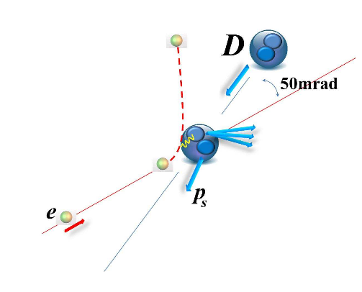
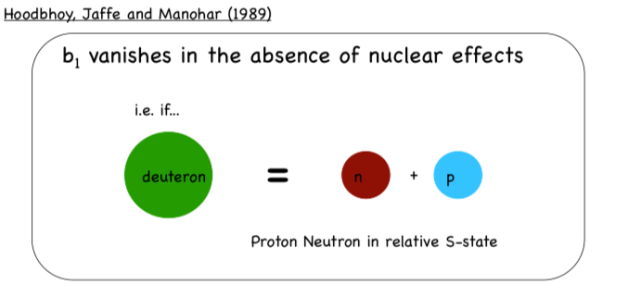
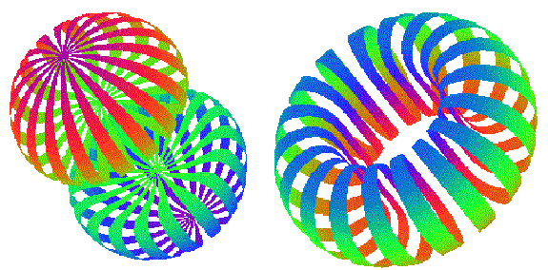
Measuring Correlations between Nuclear Effects and Partonic DOF
Example: Polarized Deuterons
What is the spatial and momentum
distributions of quarks and gluons
in such system?
=
Polarized Deuteron St. Function b1
Constant density surface for
tensor and vector polarized Deuterons

Slide 16
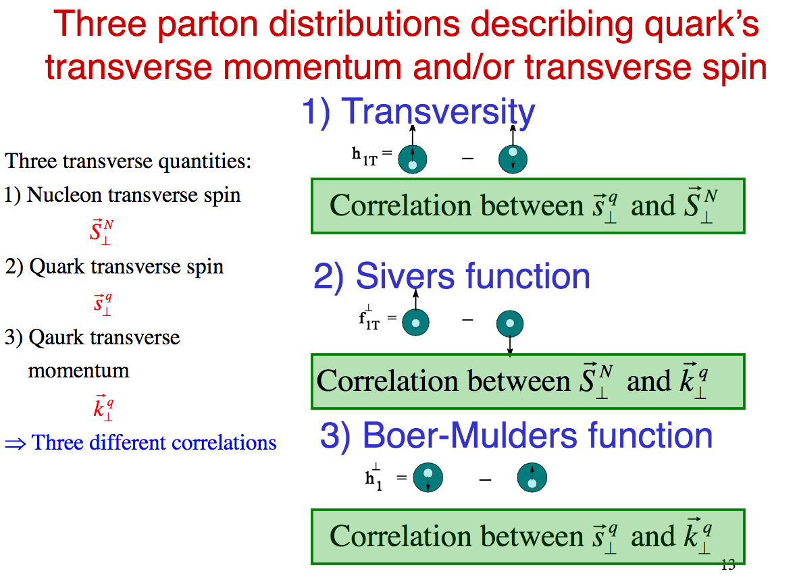
TMDs are all about correlations
More than “solving the spin puzzle”.
What is the relationship between
dynamics, structure and the emergent
characteristics?
Jen-Chieh Peng

Slide 17
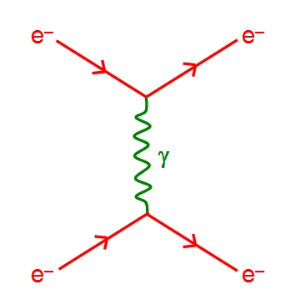
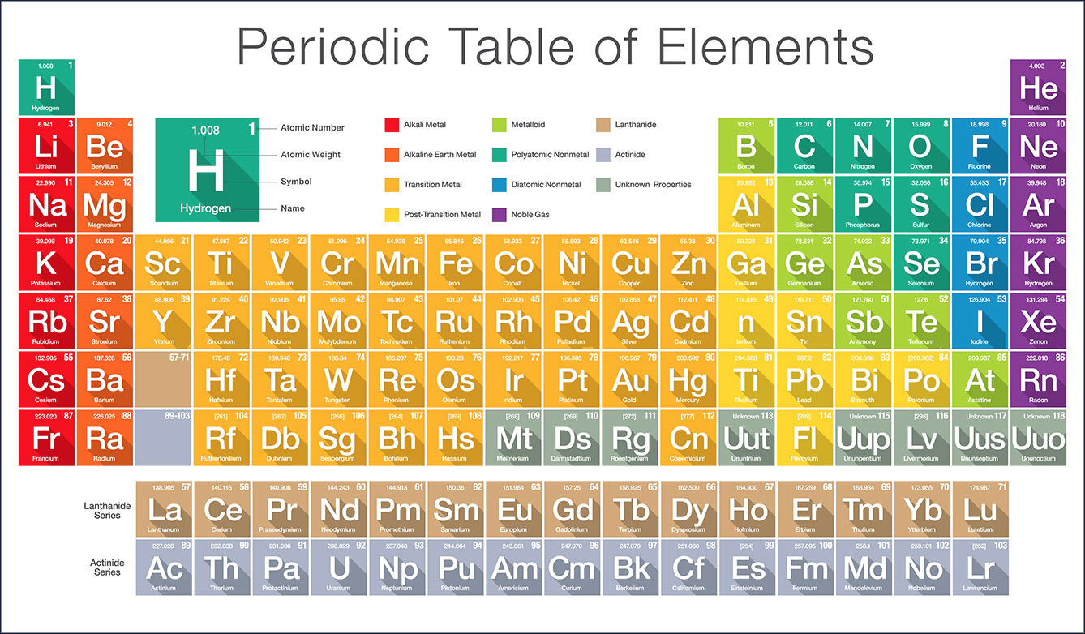
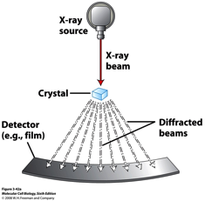
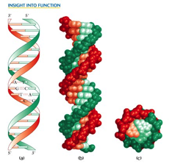
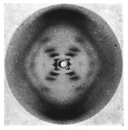
What is Transformative Science?
Electro-magnetism + Atoms → “We know everything in principle”
Leads to things we didn’t know existed:
New Science
A new instrument: X-ray Crystallography

Slide 18
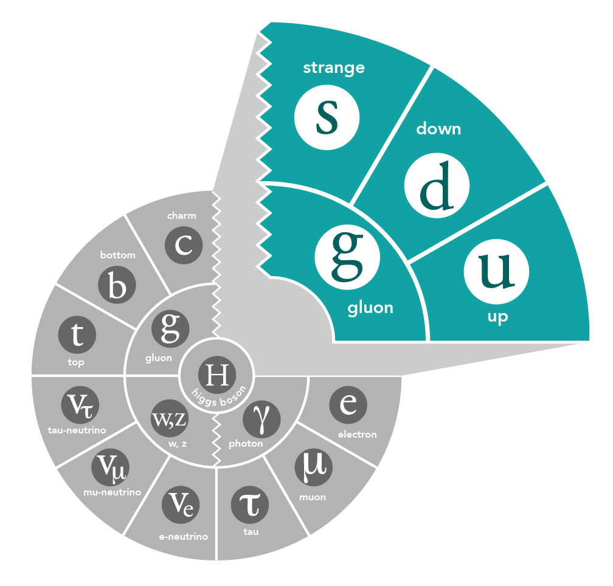
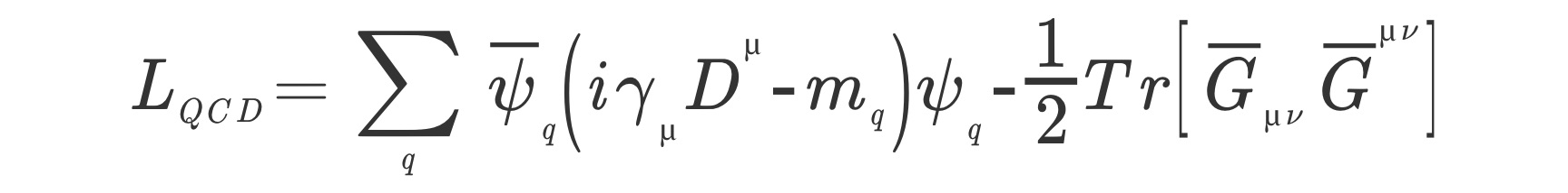
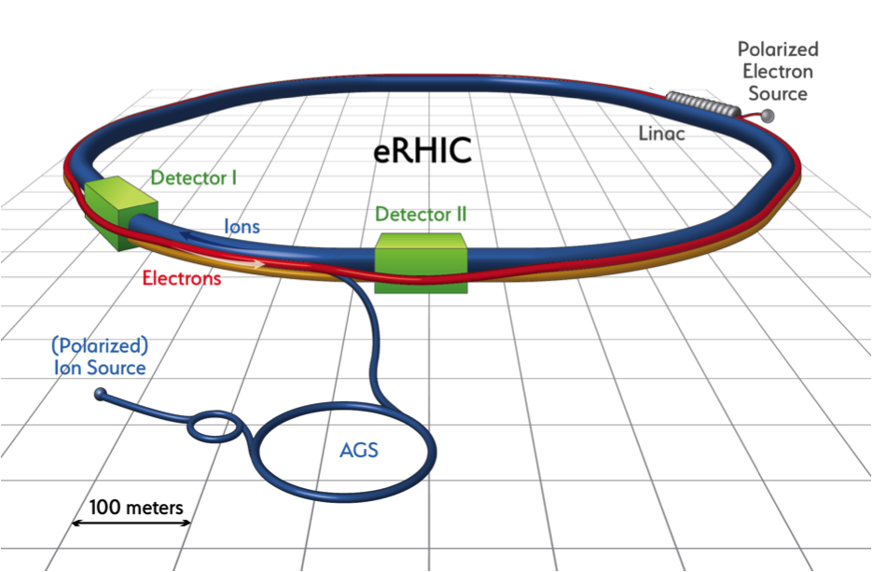



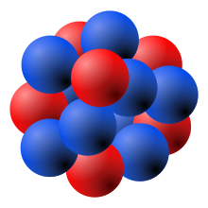
Transformation of hadron physics
QCD Lagrangian + SM particles → “we know everything in principle”
A New Instrument: Electron-Ion Collider

Slide 19
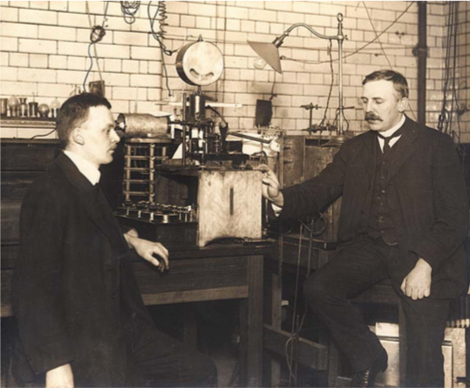
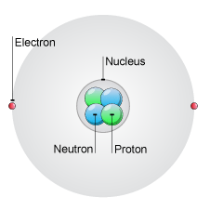
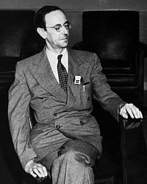
Where Nuclear Science began—discovery of protons and neutrons
Chadwick
Rutherford
Nuclei made of protons and neutrons

Slide 20
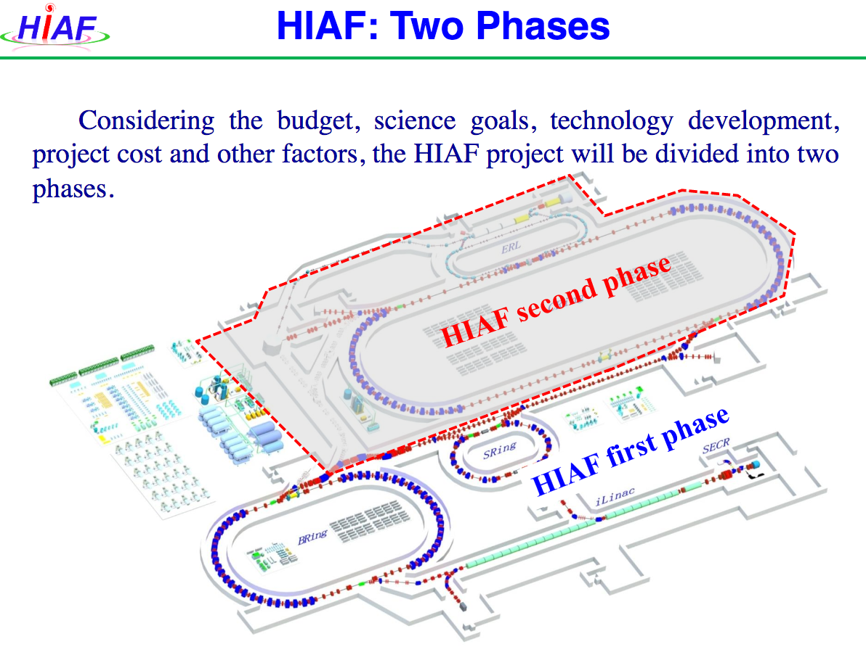
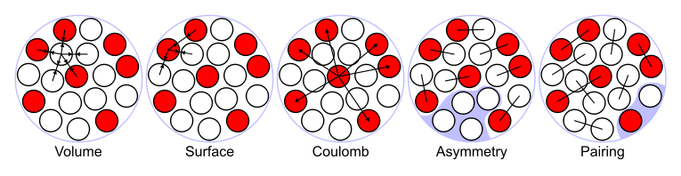
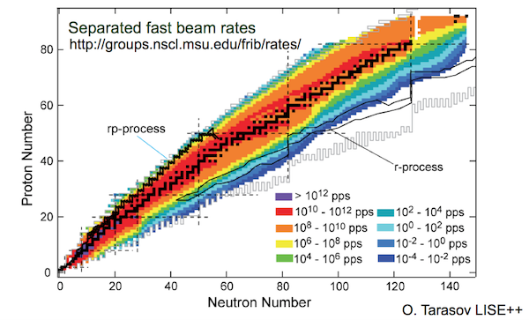
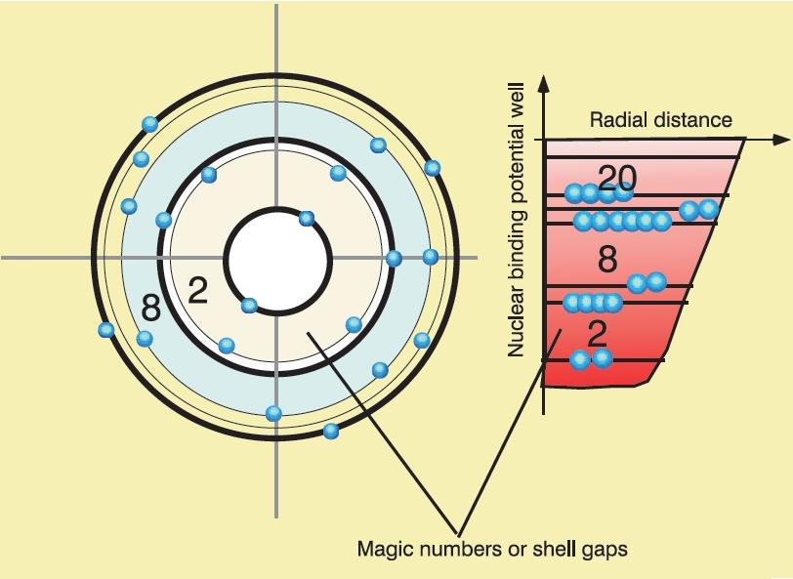
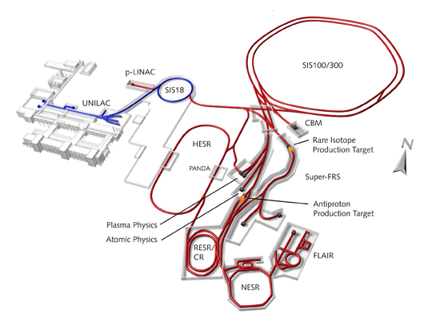
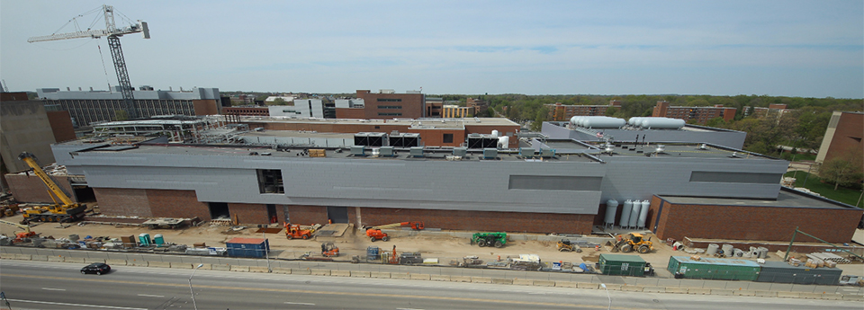
Understanding Nuclei in terms of NN(N) interactions:
Low –energy nuclear facilities
coming on line in the next decades
FAIR
FRIB

Slide 21




Lattice QCD: Dealing with strong-coupling
EXASCALE Computing is coming in the next decade

Slide 22
Electron-Ion Collider
We know the right kinematic region to measure the quark and gluon structures of nucleon and nuclei.
The advances in accelerator technologies (and existing infrastructure) enable us to build an EIC, with the right characteristics in the US.
Tentative Timescale: ~2023-2030 construction start

Slide 23



EIC²@JLab
eiccenter.org
The Electron-Ion Collider Center (EIC²@JLab) is an organization to advance and promote the science program at a future electron-ion collider (EIC) facility. Particular emphasis is on the close connection of EIC science to the current Jefferson Lab 12 GeV CEBAF science program.
First Dedicated Space in F-wing coming July 2018
EIC themed seminars
Enhanced EIC content in HUGS summer school.
Graduate Fellowships
Post-doc Fellowships

Slide 24
US Nuclear Physics Landscape ca. 2030
EIC/ Quark-gluon Structure
FRIB/Nuclear Structure Science
LQCD
Three powerful tools
to understand nuclear matter

Slide 25

Towards a Unified Description of Nuclear Matter?
Nuclear
Structure
pQCD
Nuclear Femtography
LQCD
Structure Functions

Slide 26



How do we cross the Threshold to New Science?
Annunciation, 1930
On the Threshold of Liberty
1937
Rene Magritte
L’Idee Fixe, 1928
What is just beyond the understandings we currently have?

Slide 27
Final Comments
Theoretical advances have began to make clear what we need to do to begin to understand nucleons and nuclei in terms of quarks and gluons, in what we might call nuclear femtography.
  This investigation is beginning in earnest with the JLab 12 GeV program.
  Electron-Ion Collider is the ultimate femtoscope
  We are beginning to organize the CENTER for NUCLEAR FEMTOGRAPHY
    Expecting seed funding from Virginia in July
    You will hear more about this in the next months!
We are at a similar point for QCD and quark-gluons as we were in 1920 for EM and atoms!
FRIB, LQCD with Exascale computing and EIC will all come on-line in the US in the next decades.
It seems to me that all ingredients for major breakthroughs are there for nuclear science.

