Slide 1
C75 Commissioning
Michael Drury
SRF Operations Support

Slide 2
Outline
C50-13 Commissioning Results
C50-13 Operational Performance
C75 Test Plan – Schedule and Labor

Slide 3
First C75 Cavities – Commissioning Results
Two C75 cavities installed in the the C50-13 cryomodule in the 1 and 2 positions
Cryomodule skipped Acceptance Testing in the CMTF
Cryomodule was installed in the North Linac in zone 1L13
Commissioned in October 2017
First test run was completed prior to connecting cryomodule to the beamline
Beamline connections accomplished using new particulate mitigation procedures
Slow bleed up pumps
Improved clean rooms with separate gowning area.
Improvements in work area hygiene
After beamline connection, a reduced set of tests were completed to identify changes in Field Emission characteristics and maximum gradient.
No degradation was observed
Some improvement was noted –particularly Cavity 1
Confirms that new particulate hygiene procedures are valid

Slide 4
First C75 Cavities – Commissioning Results
Cavity | QextFPC | Emax VTA | Emax tunnel | Emax (GMES) | Emaxop | DRVH | FE Onset VTA | FE Onset tunnel | Limit | Qo VTA | Qo tunnel
1 | 1.26E+07 | 19.4 | 19.1 | 18.0 | 18.6 | 13.5 | 17.9 |  | Quench | 9.0E+09 | 7.6E+09
2 | 1.89E+07 | 13.7 | 14.2 | 13.6 | 13.7 | 13.5 | 9.9 | 10.9 | Quench | 8.3E+09 | 7.7E+09
3 | 1.59E+07 | 18.3 | 16.6 | 16.6 | 16.1 | 13.5 | 15.6 |  | Quench | 9.6E+09 | 6.5E+09
4 | 1.50E+07 | 19.9 | 17.4 | 17.6 | 16.9 | 13.5 | 15.0 | 9.4 | WGVac | 8.5E+09 | 4.3E+09
5 | 1.58E+07 | 9.2 | 9.1 | 9.1 | 8.7 | 8.7 | 8.5 |  | quench | *7.6e+09 | *7.0E+09
6 | 9.81E+06 | 15.1 | 14.0 | 14.4 | 13.5 | 13.5 | 14.1 |  | quench | 7.8E+09 | 5.8E+09
7 | 1.32E+07 | 18.0 | 16.9 | 17.1 | 16.4 | 13.5 |  |  | quench | 7.0E+09 | 6.0E+09
8 | 7.44E+06 | 17.1 | 15.5 | 15.8 | 15.0 | 13.5 | 10.9 | 7.6 | quench | 6.7E+09 | 4.5E+09
Qo’s listed are at 12.5 MV/m and T = 2.07K
Highest Qo’s measured in a C50 cryomodule
DRVH = suggested Max GSET for Operations
13.5 MV/m is a limit imposed by the analog llrf
Cavity 1 currently operating at 13.5 MV/m
Cavity 2 currently operating at 13.0 MV/m
Operated for several days at 13.5 MV/m before quenching
13.5 MV/m too close to quench gradient
Potential Voltage = 51.6 MV

Slide 5
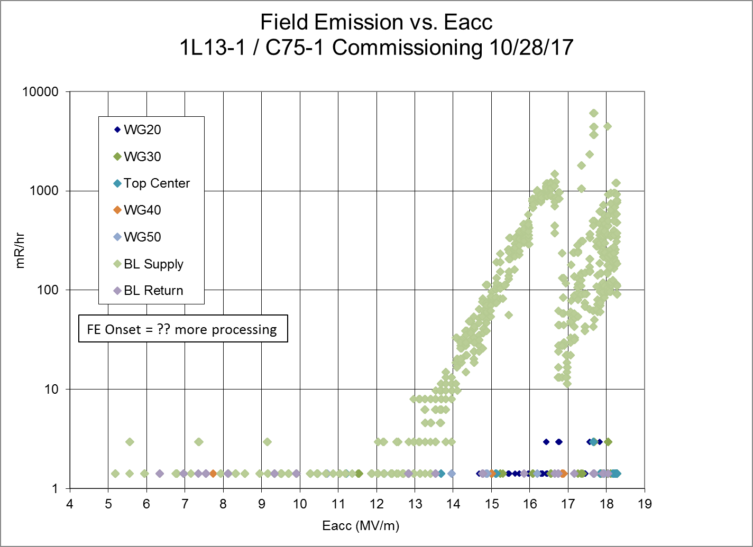
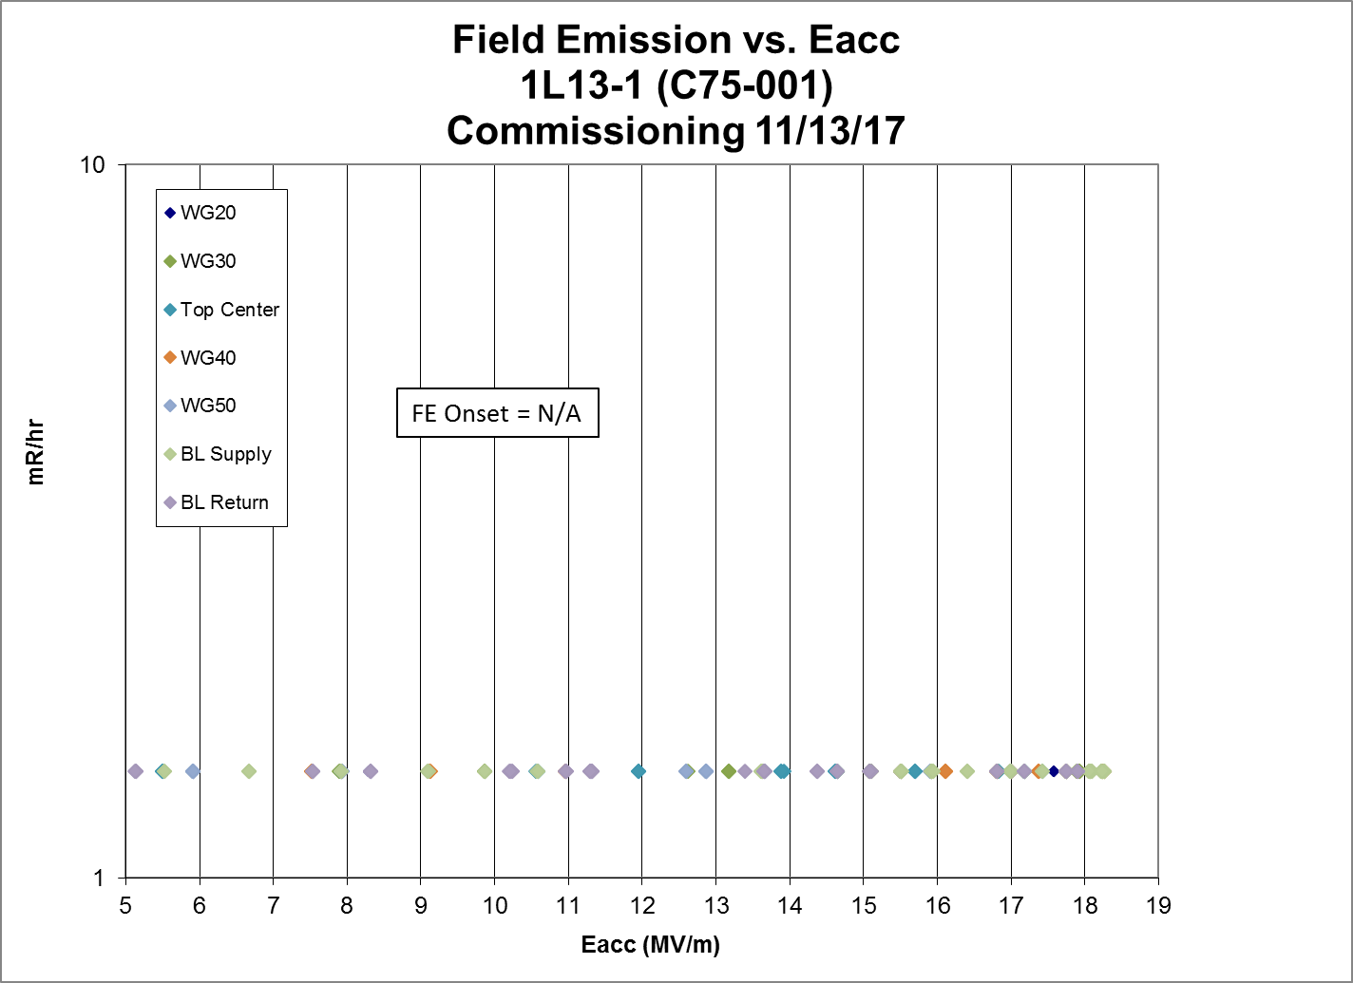
C75-1 Field Emission
VTA field emission onset at 17.9 MV/m
Initial Commissioning measurements indicated lower onset gradient along with apparent processing.
After beamline connection, Field emission had processed away .

Slide 6
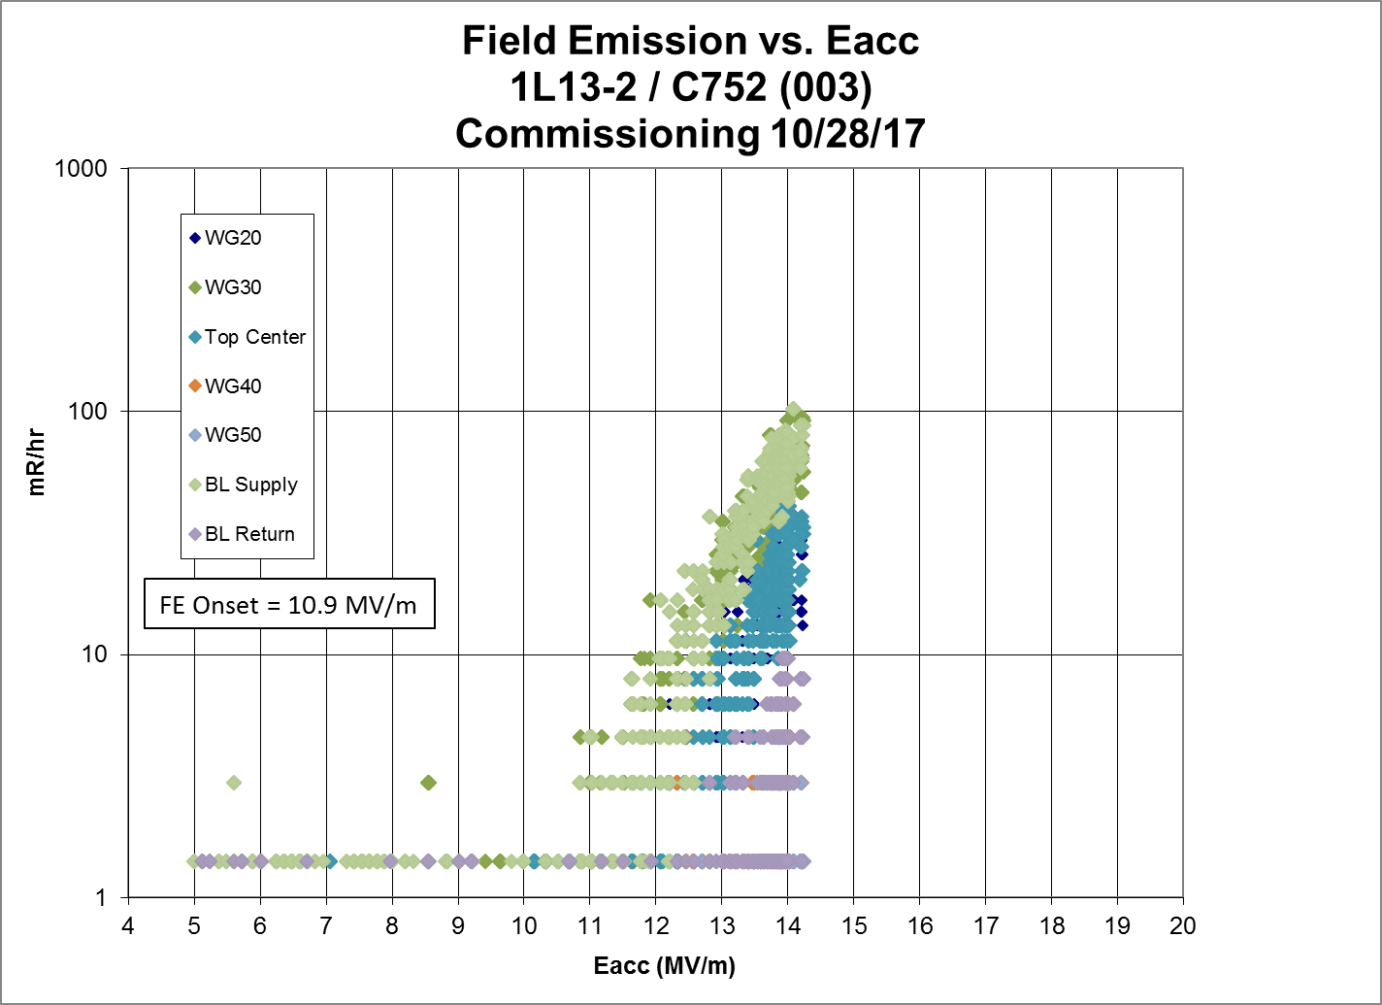
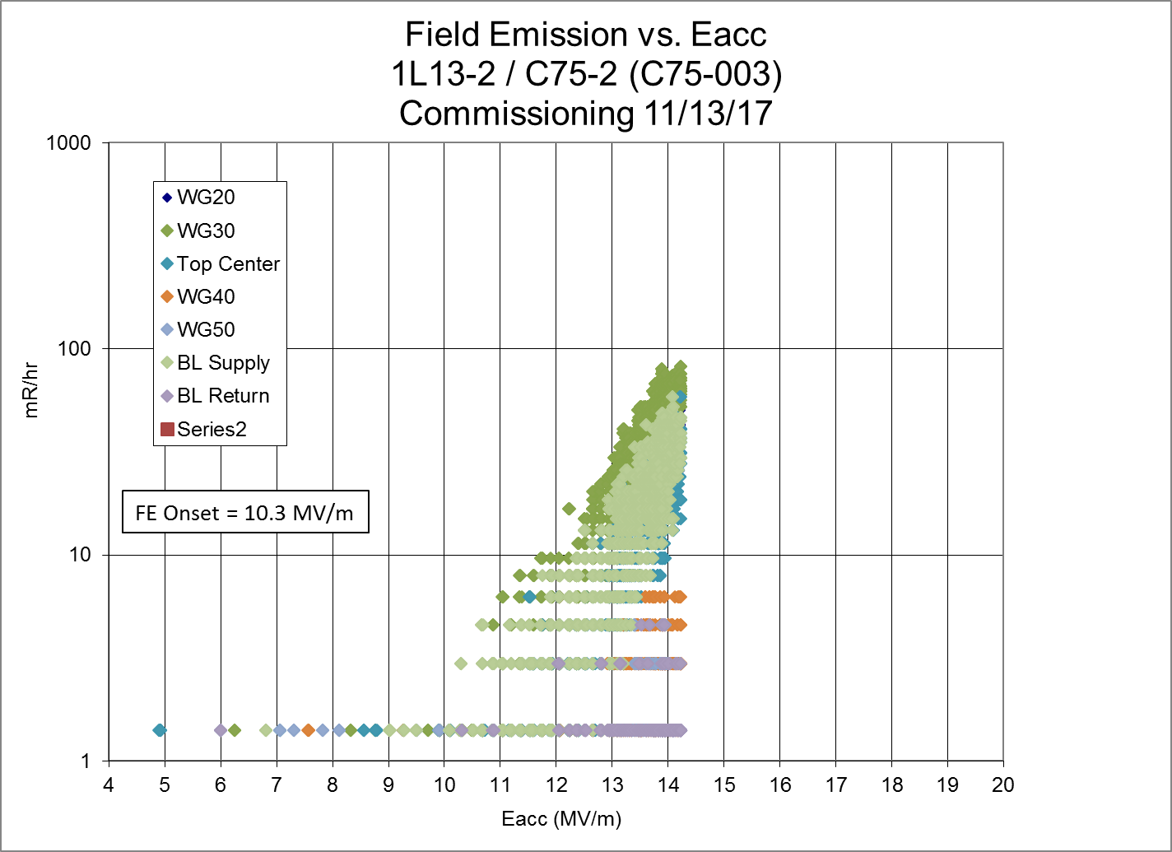
C75-2 Field Emission
VTA field emission onset at 9.9 MV/m
Commissioning measurements indicated higher onset gradient
After beamline connection, approximately unchanged

Slide 7
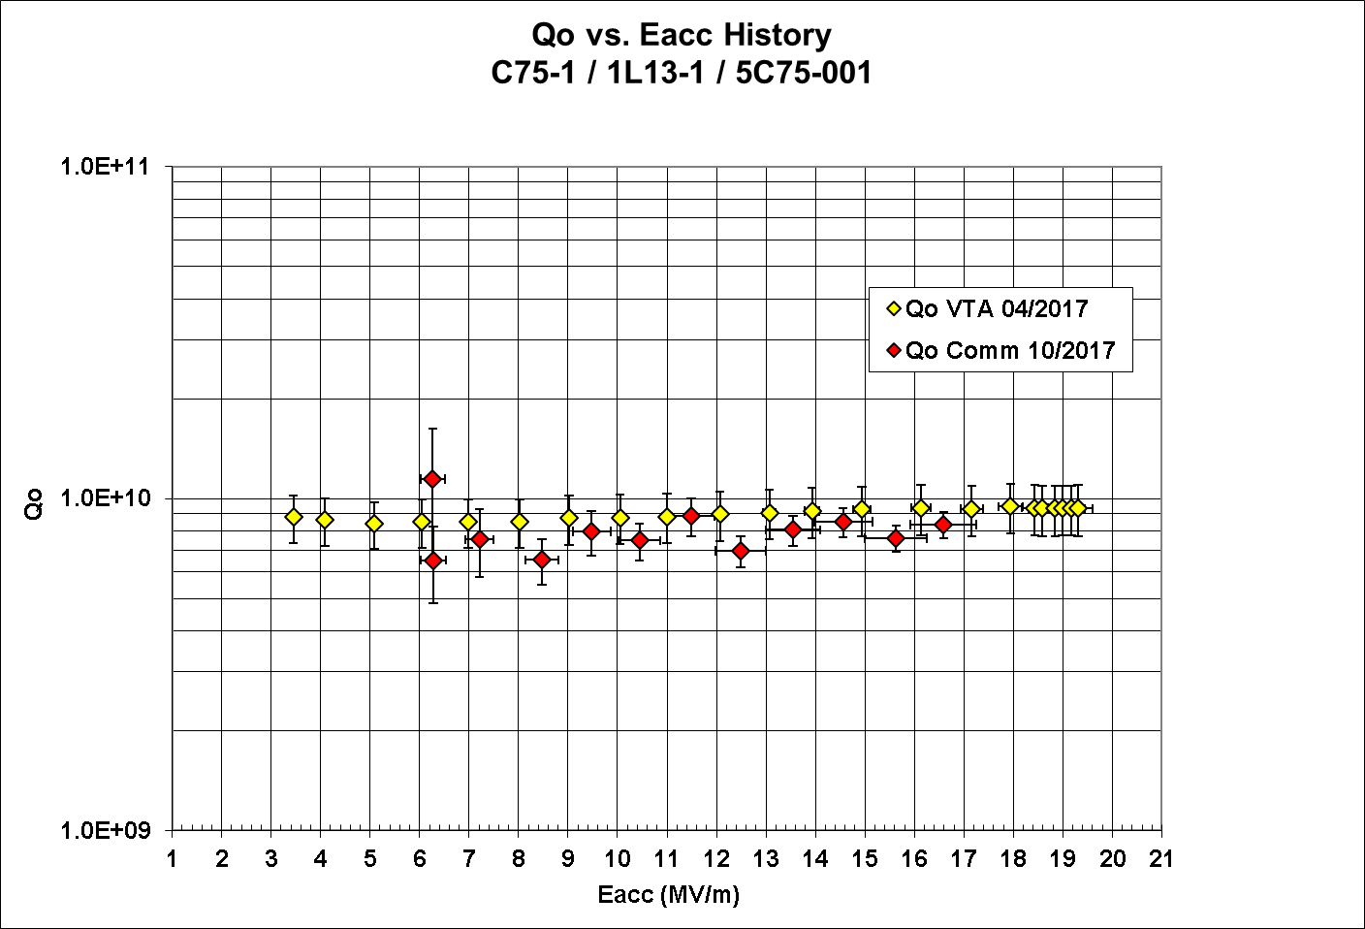
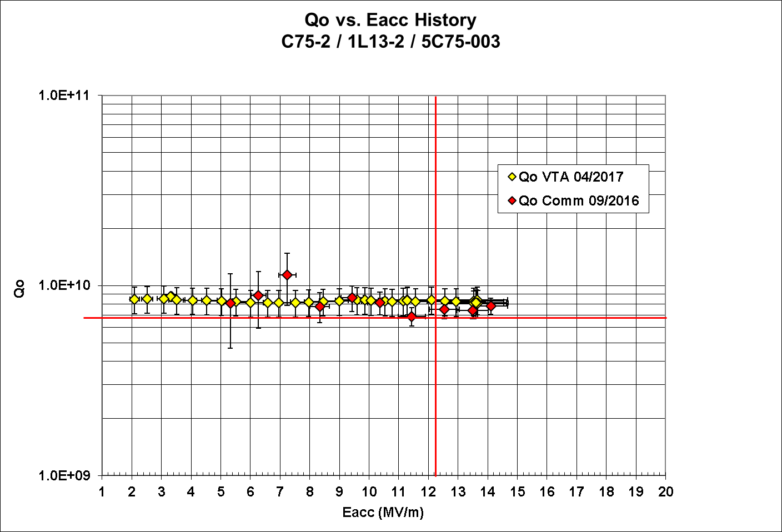
C75 Qo vs. Eacc
Typical C50 Qo’s 5E+09 or lower
C75 Qo’s > 7E=09

Slide 8
C50-13 Microphonics Summary
Data taken on individual cavities using FCC in SEL mode.
I/Q data recorded at 20 kS/s and converted to delta F
25 seconds of data taken for each data series. Three to five data series were collected for each cavity.
Peak microphonics ranged from 7.5 Hz to 21 Hz.
The C75 cavities were cavities 1 and 2. Their microphonics were in the middle of the group.
For some reason cavity 6 was very quiet. It is possible, but I do not think probable, that this was because the microphonics went quiet when we took that data.
120 Hz was present and probably due to a turbo pump which was on the insulating vacuum. Removing this harmonic from the data only caused slight improvements (less than a few Hz).
Data and images of the plots can be found at:
M:\asd\asddata\CMTF\C50 cryomodule tests\C50-13\Microphonics

Slide 9
C75 – Microphonic Spectrum
Cavity 1
Cavity 2
Turbo pump

Slide 10
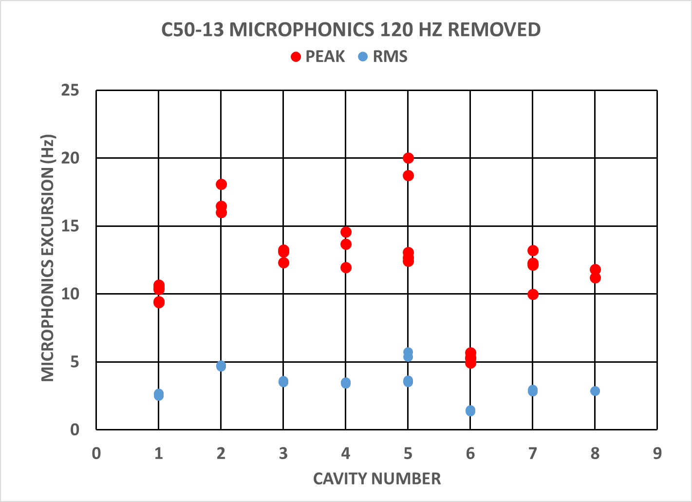
Summary of Peak and RMS Microphonics
C75 Commissioning

Slide 11
C50-13 Performance after Commissioning
Cavity | Proposed DRVH | Current GSET | Comments
1 | 13.5 | 13.5
2 | 13.5 | 13.0 | Will run at 13.5 but will too close too quench gradient
3 | 13.5 | 10.0 | WGVac?
4 | 13.5 | 13.1 | Arc Rate Management
5 | 8.7 | 8.7
6 | 13.5 | 9.0 | Mode Anode Current
7 | 13.5 | 11.2 | Reason for reduction unknown – appeared to be quenching at 11.7 MV/m
8 | 13.5 | 10.0 | Unable to operate at higher gradient –reason unclear
Total Voltage | 51.6 | 44.3

Slide 12
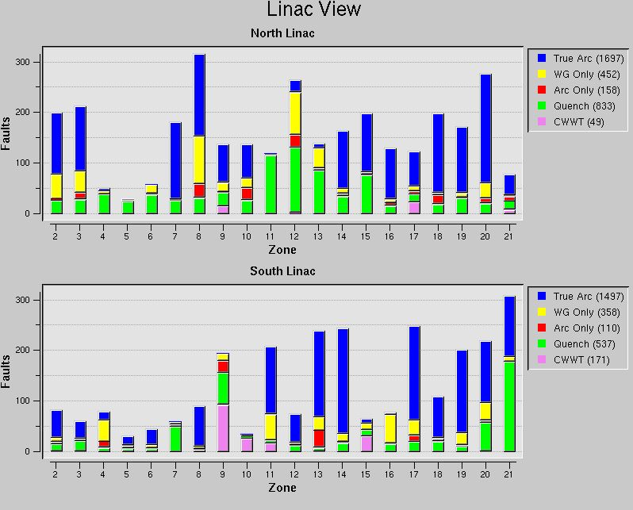
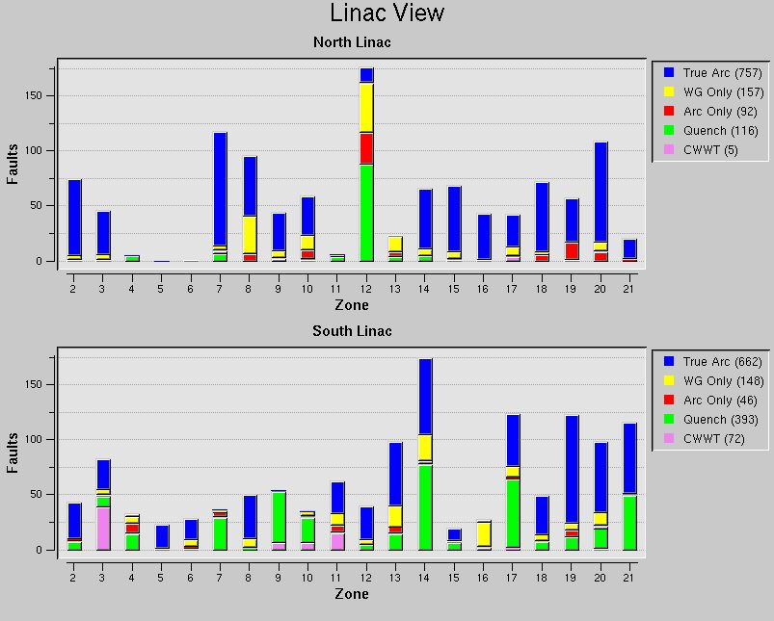
C50-13 Trip Rates after Commissioning

Slide 13
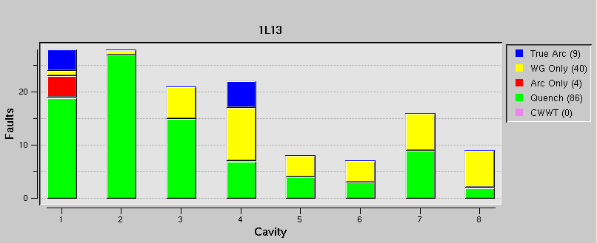
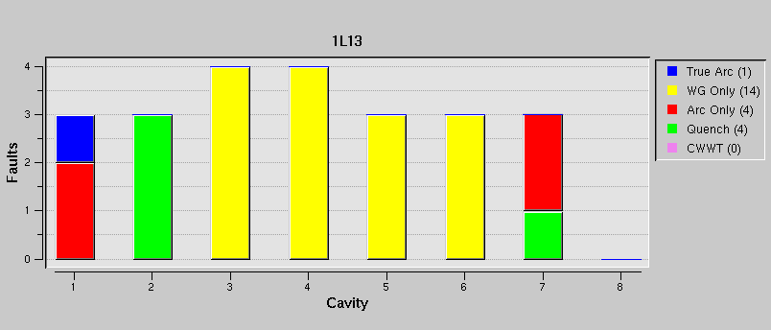
C50-13 Trip Rates
January:
261 trips total (3.5% of total trips)
C75 trips – 106 total
Feb so far:
23 trips total (0.9% of total trips)
C75 trips – 6 total

Slide 14
C75 Test Plan – V1
Task Name | Duration
C75 Acceptance | 20 days
Install and Prep Cryomodule | 4 days
Install Cryomodule
Leak Checks / Clean He Circuits etc.
Electrical Connections
Degaussing?
Waveguide Connects
Software Checks
Cool down | 2 days
Low Pwr Test | 2 days
Initial Frequencies
Tuner Range and Hysteresis (LP or HP)
Passbands
HOM spectra
High Power Test | 7 days
High Pwr Checklist
Max Gradient / Field Emission
Qo Measurements / Pressure Sensitivity
Lorentz Detuning
microphonics
Other Tests? | ?
Warm up | 3 days
Disconnect Module / Prep for Move | 2 days
Move CM to NL | 1 day
Installation Activities (more degaussing?) | ~ 1.5 week
C75 Commission | 15 days
Cool down | 2 days
High Power Test | 9 days
Tune cavities
Max Gradient / Field Emission
Qo Measurements / Pressure Sensitivity
microphonics
Eight Cavity run | 1 - 2 days
Other Tests?
Assume Cryomodule Installation single shift / 5 day schedule (CMTF or tunnel)
Assume CMTF testing on a 2 shift / 7 day schedule
Assume linac testing on a 1 shift / 7 day schedule
Acceptance Testing ~20 days Install to remove
Move and install in tunnel ~ 8 days
Commission ~15 days
Note Acceptance Testing is a necessity
Detects typical mechanical failures (feedthrus) before installation in the tunnel
Digital llrf is available in CMTF and as part of commissioning test stands.
Labview used with epics to collect data and automate testing
C75 Commissioning

Slide 15
C75 Test Plan – V1
Task Name | Duration | Person Hours
 |  | Mech Tech / Mech Eng | Elec Tech /Elec Eng
C75 Acceptance | 20 days
Install and Prep Cryomodule | 4 days
Install Cryomodule |  | 16
Leak Checks / Clean He Circuits etc. |  | 8
Electrical Connections |  |  | 16
Degaussing? |  |  | 8
Waveguide Connects |  | 8
Software Checks |  |  | 8
Cool down | 2 days | 30
Low Pwr Test | 2 days
Initial Frequencies |  |  | 4
Tuner Range and Hysteresis (LP or HP) |  |  | 16
Passbands |  |  | 4
HOM spectra |  |  | 16
High Power Test | 7 days
High Pwr Checklist |  |  | 4
Max Gradient / Field Emission |  | 16 | 64
Qo Measurements / Pressure Sensitivity |  | 24 | 24
Lorentz Detuning |  | 1 | 8
microphonics |  | 8 | 8
Other Tests? | ? | ? | ?
Warm up | 3 days | 5
Disconnect Module / Prep for Move | 2 days | 16 | 8
Move CM to NL | 1 day | 24
Installation Activities (more degaussing?) | ~ 1.5 week | 120 | 20
C75 Commission | 15 days
Cool down | 2 days | 20
High Power Test | 9 days
Tune cavities |  |  | 8
Max Gradient / Field Emission |  | 10 | 70
Qo Measurements / Pressure Sensitivity |  | 24 | 24
microphonics |  | 8 | 8
Eight Cavity run | 1 - 2 days | 8 | 16
Other Tests?
Some variability in labor types available for testing
Acceptance Testing
Mech Eng / Mech Tech ~130 hours
Elec Tech / Elec Eng ~ 180 hours
SStaff ~20 hours
Move / Install
Mech Eng / Mech Tech ~120 hours
(mostly Mech Tech)
Elec Tech / Elec Eng ~ 20 hours
Commissioning
Mech Eng / Mech Tech ~70 hours
Elec Tech / Elec Eng ~ 130 hours
SStaff ~20 hours
C75 Commissioning

Slide 16
Summary
Testing of the first two C75 cavities demonstrates improvements with respect to Qo’s over the C50 model
Improved Qo’s
Low or zero field emission
Performance Comparisons before and after beampipe connection validate new particulate mitigation procedures.
C50-13 currently operating at 85% of predicted voltage
Testing and Installation activities require minimum ~2 months calendar time
At least 4 months of labor.

