Slide 1
C75 LLRF
Curt Hovater
Also Contributing: Tomasz Plawski, Rama Bachimanchi, Dave Seidman and Clyde Mounts

Slide 2
Outline
Existing C20/50 & C100 LLRF
LCLSII LLRF
Path to New Digital LLRF
C75 LLRF
RF Front End
Digitizer
FPGA Carrier
Interface to Controls
Questions/Comments/Thoughts

Slide 3
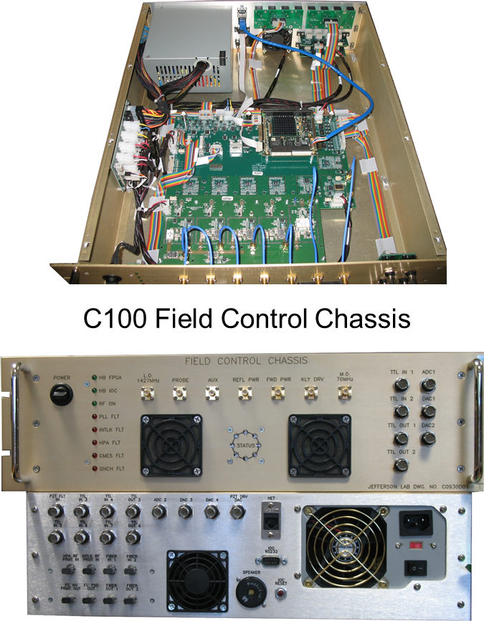
Where We Have Been …Analog…Digital
Obsolete
Parts
Analog LLRF
Circa 1992
The present Analog RF system is labor intensive to maintain and repair
System has obsolete and hard to find parts
Crates are dying
C75s can utilize the existing analog LLRF systems but gradient and operability will be reduced because of Lorentz detuning.
C100 Digital LLRF System
Been a workhorse
But…next slide
Analog LLRF

Slide 4
Unfortunately Continuing with C100 LLRF is Impossible
Design is 10 years old (hard to believe)
Parts are difficult to obtain or not recommended for new design/production
PC104 version is not available
FPGA: Cyclone Three is not for “new” designs
ADCs are 15 year old design …better components out there now
Design has flaws
Channel Isolation barely met specification, limiting our gain and field control
Clock chip can over heat and the modification is not optimum
Lack of digital board (ADC/DAC/Clock and FPGA share same board) modularity makes it difficult to upgrade
PC104 while a workable solution in 2006 is now cumbersome …there are better ways of doing this
At the time this was a good design and digital flexibility has allowed us to make up for some of the operational C100 flaws. It has become a work horse for SRF cavity testing

Slide 5
A Sample of Obsolete Parts
Part | number | Board | Comment
Attenuator | TVA0200N05 | RF | All 4 of these attenuators are very hard to get and install.
Attenuator | TVA0300N03 | RF
Attenuator | TVA0600P08 | RF
Attenuator | TVA1000N07 | RF
FPGA | EP3C55F484C8 | Digital | Getting very hard to find. Will be phased out soon. FPGA - Cyclone III 3491 LABs 327 IO
Resistor | EZA-DT21AAAJ | Digital | Obsolete. Resistor Networks & Arrays Resistor-Cap Network Chip 4 RC's 1206
Transformer | MABACT0034 | Digital | Obsolete. Audio Transformers / Signal Transformers 4.5-3000MHz Imp 1:1 50 and 75 Ohm
Memory | EPCS64SI16N | Digital | End of life. FPGA - Configuration Memory IC - Ser. Config Mem Flash 64Mb 40 MHz
Memory | MT48LC16M16A2TG-75:D | Digital | Obsolete. IC SDRAM 256MBIT 133MHZ 54TSOP
Processor | PC104 | Digital | Chad is working on a solution or we need to re-qualify another PC104 for our Network

Slide 6
Which Way Next …
XFEL: Just completed …first light
μTCA …compact but noisy for high performance RF receivers
Good for taking a lot of signals in …like with a 32 cavity vector sum.
Single cavity single source operating CW …not so much.
SLAC: Mission Readiness (replacing legacy LLRF) is prototyping with ATCA (big brother to μTCA).
Design is having a hard time meeting isolation/noise specifications.
LCLSII: Going into production, design meets specification. …hmm…
An optimized hybrid of the LCLSII design using JLAB field control requirements.

Slide 7
Leveraging LCLSII LLRF
JLAB has been in the LCLSII LLRF collaboration for four years. Its time that relationship pays off!
System was designed by SLAC/LBNL/FNAL/JLAB
C100 LLRF Functional Requirements were the basis for the LCLSII LLRF requirements.
It’s a great design both for performance and economic reasons.
LCSLII RF specifications and CEBAF RF specifications are similar.
1.497 GHz and the LCLSII cavity, 1.3 GHz, share some common components.
It’s been reviewed by system experts
Final design review was held in July 2017
It’s been prototyped and tested on LCLSII cryomodules
It’s modular, so in 10 years if we need to change the FPGA carrier board we can with out upsetting the HW or SW.
It was designed with EPICS in mind.

Slide 8
LCLSII Design Philosophy…We will CO-OPT
Requirements (0.5º/0.04%) demand ultra low noise design.
Keep noise generators far from critical components i.e. no fans in RF chassis!
Channel to channel isolation very good > 70 dB
Isolate cavity signals from forward, reverse and drive signals
Receiver noise floors < -150 dBc/Hz
High gain system requires low group delay
Value Engineering: Build upon what has been done in the immediate past and what is commercially available.
Designs based on LBNL/FNAL/JLAB recent work
Components (Mixers/ADCs/Amps) commercially (Mini-circuits/ADI/TI) available.
NAD system based around a common carrier board
Resources: Make the best use of available resources

Slide 9
LCLS-II/CEBAF LINAC RF Requirements
LCLSII
Required Field Control is derived from the linac energy spread and beam jitter tolerances at the undulator.
LCLSII Cavity Field Control Design Specification
For the time period > 1 Hz : 0.01% and 0.01º
For the time period < 1Hz: 5.0% and 5.0º
LCLS-II LINAC
Courtesy Paul Emma
CEBAF
Required Field Control is derived from the linac energy spread and based on the NP users requirements.
Both CEBAF and LCLSII dp/p is similar ~ 1e-4
CEBAF Field Control Design Specification
For the time period > 1 Hz : 0.04% and 0.5º (the tough one for CEBAF has been 0.04%)
For the time period < 1Hz: ~ 3.0% and 3.0º

Slide 10
Key Parameter Comparison Table
Parameter | CEBAF Specification | C100 LLRF Measured (rms.) | LCLSII LLRF Measured (rms.)
Phase Control | 0.5 | 0.2* | 0.002
Amplitude Control | 0.044% | 0.04%-0.05% | 0.003%
Channel Isolation | 60 dB | < 60 dB | 80 dB
The most important parameter in reaching our field control specification has been the channel to channel isolation. The original CEBAF specification was 60 dB which was based on the C20 cavity to cavity isolation. At the time (1990) this was a reach for RF electronics. The C100 had higher cavity to cavity isolation, but we stuck with the original specification for the electronics. As you can see from the table above the LCLSII isolation is much higher and this is reflected in the amplitude field control.
My suggestion is that we should raise the isolation specification (~ 70 dB) so that the we can achieve better amplitude field control, ultimately leading to lower energy spread.
*phase control is determined by our reference oscillator

Slide 11
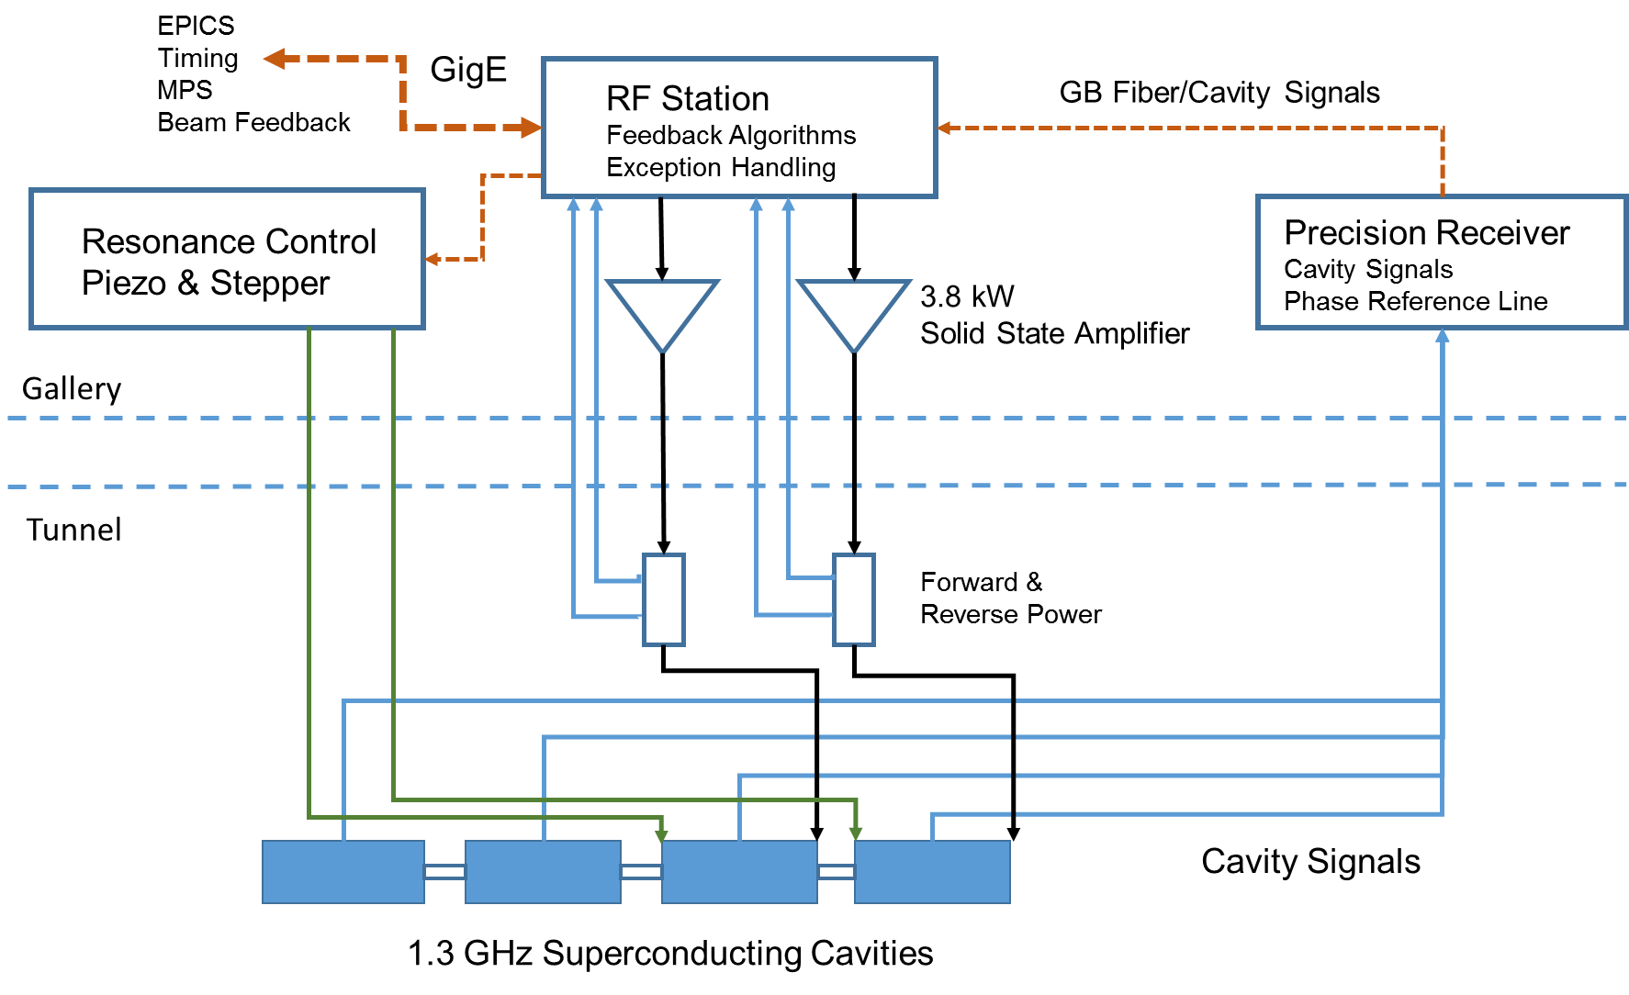
LCLSII LLRF Architecture*

Slide 12
CEBAF LLRF (assumes one cavity/chassis)
EPICS
Timing
Beam Feedback
GigE
RF Station
Feedback Algorithms
Exception Handling
No PRC
Resonance Control
Stepper
8 kW
Klystron
Piezo Control
Cavity Signal
Forward &
Reverse Power
Gallery
Tunnel
1.497 GHz Superconducting Cavities

Slide 13
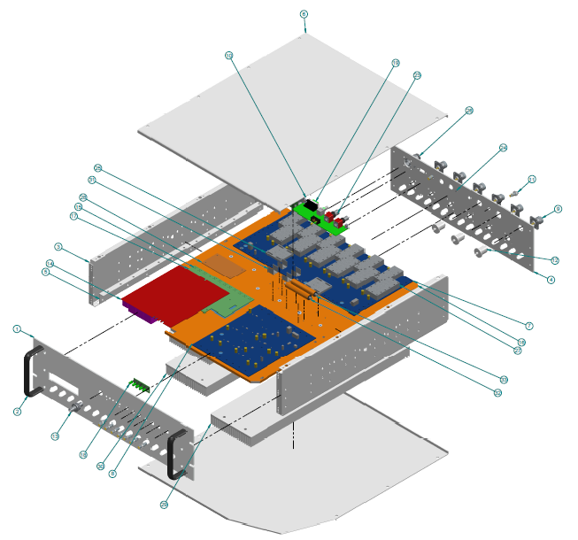
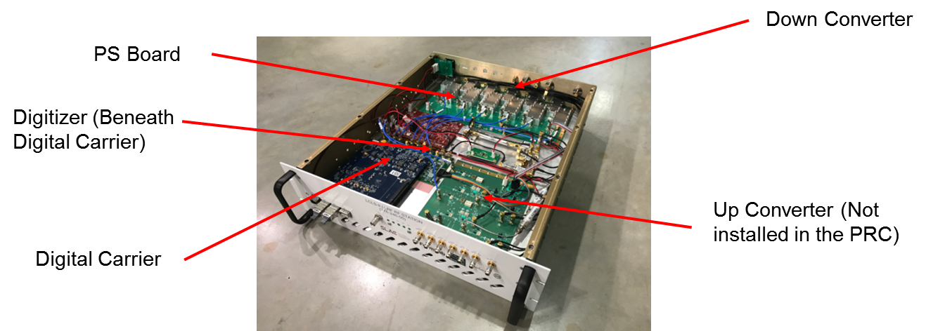
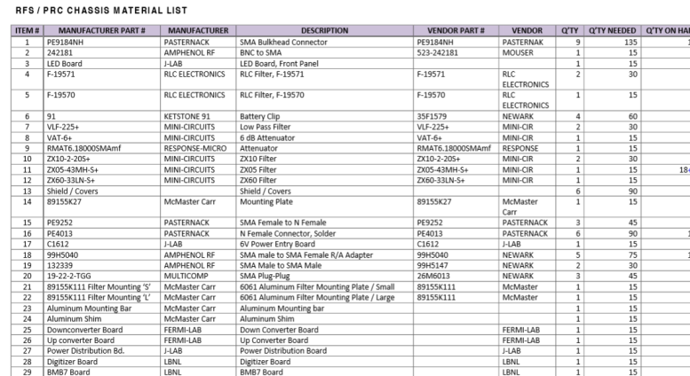
LCLSII RF Station/Precision Receiver Chassis
Chassis tested at all LBNL and all partner laboratories
Tests have exceeded specifications – data later
Full documentation package has been developed
Gerber files for all PCBs
Cable drawings for all internal cabling
BOMs for boards and chassis parts: heat sinks, filters, connectors, etc.
Mechanical drawings for chassis enclosure, mounting plates, etc.
Schematic Diagrams

Slide 14
LLRF Architecture
Field Control Chassis (RF Station)
Receiver/Transmitter
One cavities/chassis
Probe, Forward, Reverse and Drive power
Klystron Amplifier Drive
IF Processor and FPGA
Channel Isolation in the RFS is better (~80 dB) than the 60 dB we designed to 10 years ago, so it easily meets our specification
Greatly simplifies design
One RFS can control one/two C75 cavities
Resonance Control
Stepper Motor Control
Eight cavities per chassis
Same FPGA/carrier as RFS
Fiber communication with RF station
Interlocks (Modified Design)
Similar to C100
Eight cavities per chassis
Same FPGA/carrier as RFS
Fiber communication with RF station
HPA Controller (Modified Design)
Similar to R100
Eight klystron per chassis
Same FPGA/carrier as RFS
Fiber communication with RF station

Slide 15
Where We Are …
RF Front End: Tomasz is investigating what can, what needs modification and what can’t be used from the LCLSII RR front end.
Presently prototyping a three channel receiver to test
As we get further along it appears that while we can use the LCLSII RF as a guide, we will need to build our own receiver.
FPGA Carrier Card: Rama is taking the LCLSII Xlinx carrier card design and investigating Intel (Altera) FPGA for our use.
Low start up costs, Initial tests can be done with evaluation boards
Goal is to develop the UDP between the FPGA and the EPICS IOC (this has already been done for LCLSII, and in use in the CMTF and LERF).
Big Incentive: Eliminates PC104 and reduces the EPICS IOC count/zone from 11 to 1!

Slide 16
RF Front End
RF boards key features
Standard heterodyning architecture with passive, level 13 mixers
CEBAF 70 MHz IF – although we are still investigating the possibility to use lower IF frequency (35 MHz)
Single DAC transmitter with the oversampling (280 MHz) and heterodyning
LCLS-II Similarities
Aluminum cooling plate underneath the RF boards instead of forced air flow above
Separated boards for the receivers and the transmitters
6 channel receiver and 2 channel transmitter in one chassis (not decided yet)
High quality RF shielding
Some PCB solutions , Rogers laminates (?) , very similar layout
Power supply outside of the LLRF chassis

Slide 17
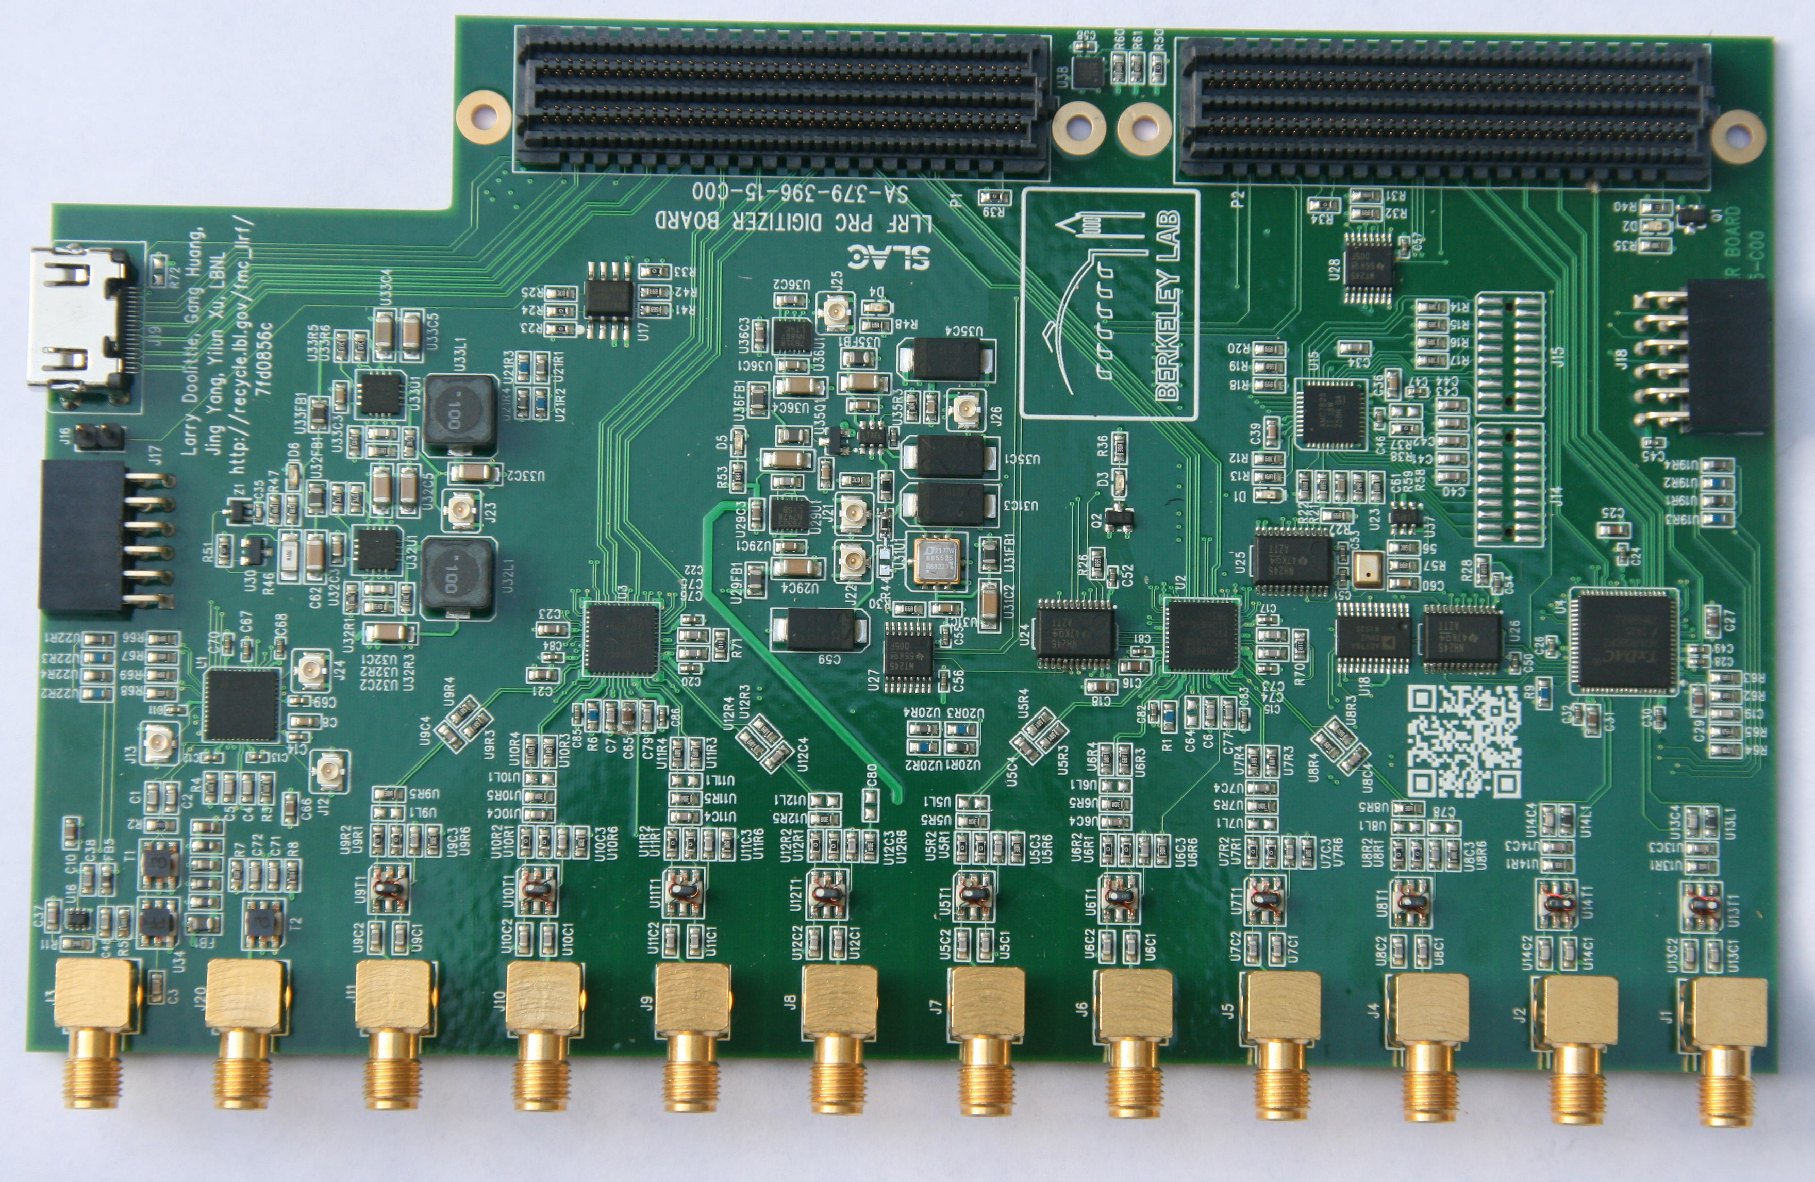
Digitizer Board
Modular design
High speed ADC
High speed DAC
Clock distribution
GPIO and diagnostic ADC/DAC
CAD: Altium (what JLAB uses)
Plan: Take the LCLSII design add frequency correct transformers (for ADC) and go from there.
LCLSII Digitizer Board

Slide 18
FPGA Board
Generic FPGA board with Ethernet PHY (10/100/1000 Mbps) and SFP (Small form-factor pluggable transceiver) capability
HSMC (High Speed Mezzanine Card) connector for Altera FPGA
FMC (FPGA Mezzanine Card) connector for Xilinx FPGA
Faster time to develop a system with a generic FPGA board
Will reduce time and cost for one of a system e.g. 4 Laser
Don’t have to design a board with FPGA every single time
Cost and complexity will be lower for systems
Interfaces to network switch over copper/fiber
Compatible with test boards from manufacturers (TI, ADI etc.)

Slide 19
EPICS IOC
One IOC per zone (e.g. computer)
Now we have 11+ IOCs/zone!
All the FPGAs are connected to IOC over a private LAN (copper/fiber)
UDP for communication between IOC and FPGA
Being used for resonance and interlocks in the CMTF Now!
This architecture eliminates the need to have one IOC per chassis
Allows hardware to be moved from zone to zone easier …

Slide 20
RF Racks
General Rack area needs to be temperature controlled between 20 and 25C (basically what we have now)
This is needed for noise issues. There are no fans planned for the FCC chassis.
Rack Components
LO and RF Signals
Field Control Chassis
Resonance Control
Power Supply
Cavity/Cryomodule Interlocks
HPA Controller
RF signals (cavity, forward, reflected) are brought to the front panel.
Switch
Switch
Power Supply
L
L
FCC 1
L
FCC 2
Power Supply
L
FCC 3
HPA Controller
L
FCC 4
Resonance
LO Distribution
L
Interlocks
FCC 5
L
FCC 6
L
FCC 7
L
FCC 8
20

Slide 21
System Q&A
Three Design Reviews
Preliminary
Final
Production Readiness
Production Test Benches/Stands
Similar to C100 LLRF
All chassis tested automatically using EPICS
Individual boards tested on bench
Zone/Commissioning Tests
Similar to C100 with a complete interlock, calibration and RF performance checkout.

Slide 22
SUMMARY
New LLRF has a solid design foundation
Flexible: Meets the needs of C75s and all/aging LLRF systems elsewhere in the CEBAF LINACs
Modular design allows for continual production as parts become obsolete
Fits into existing “two-rack” footprint
Allows C75s to meet their operational expectations
Thank you for your time
Questions, Comments and Thoughts

