Slide 1


Perspective on Nuclear Physics at Jefferson Lab – Why Should We Be Excited?
Rolf Ent
Halls A & C Collaboration Meetings
Student Luncheon, January 25, 2018

Slide 2
Outline
Topics interspersed in this talk:
Baryon and Light-Meson Spectroscopy
Nucleon Form Factors and Low-Energy Hadron Structure
Electroweak Studies – Searches for Physics BSM
Partonic Structure of Nucleons and Nuclei
    Parton Distributions
    3D Imaging
    Nuclear Effects
Meson Structure
The Emergence of Hadrons with Mass and Spin
The theme of this talk may be that while we may think we know a lot about the quark-gluon structure of nucleons and nuclei, there are many outstanding issues. Progress is good, and prospects are good, and we are in my view on the verge of a true transformation.

Slide 3
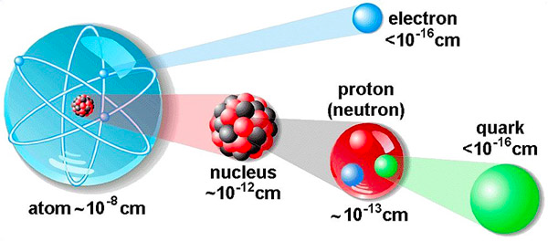
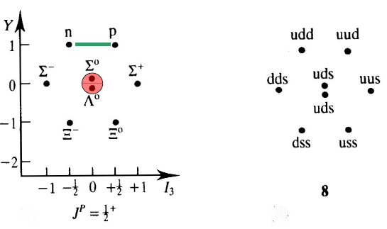
The low- and high-energy side of nuclei
The Low Energy View of Nuclear Matter
  nucleus = protons + neutrons
  nucleon ↔ quark model
  (valence) quark model ↔ QCD
The High Energy View of Nuclear Matter
The visible Universe is generated by quarks, but dominated by gluons!
But what influence does this have on hadron structure?
Remove
factor 20
quark model

Slide 4

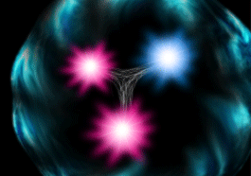
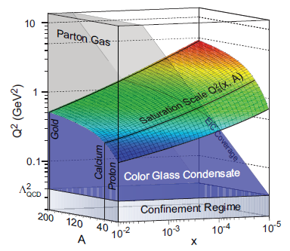
The Structure of the Proton
Naïve Quark Model: proton = uud (valence quarks)
QCD: proton = uud + uu + dd + ss + …
The proton sea has a non-trivial structure: u ≠ d
& gluons are abundant
gluon dynamics
Non-trivial sea structure
The proton is far more than just its up + up + down (valence) quark structure
Gluon photon:
Radiates
and recombines:

Slide 5
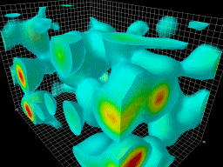
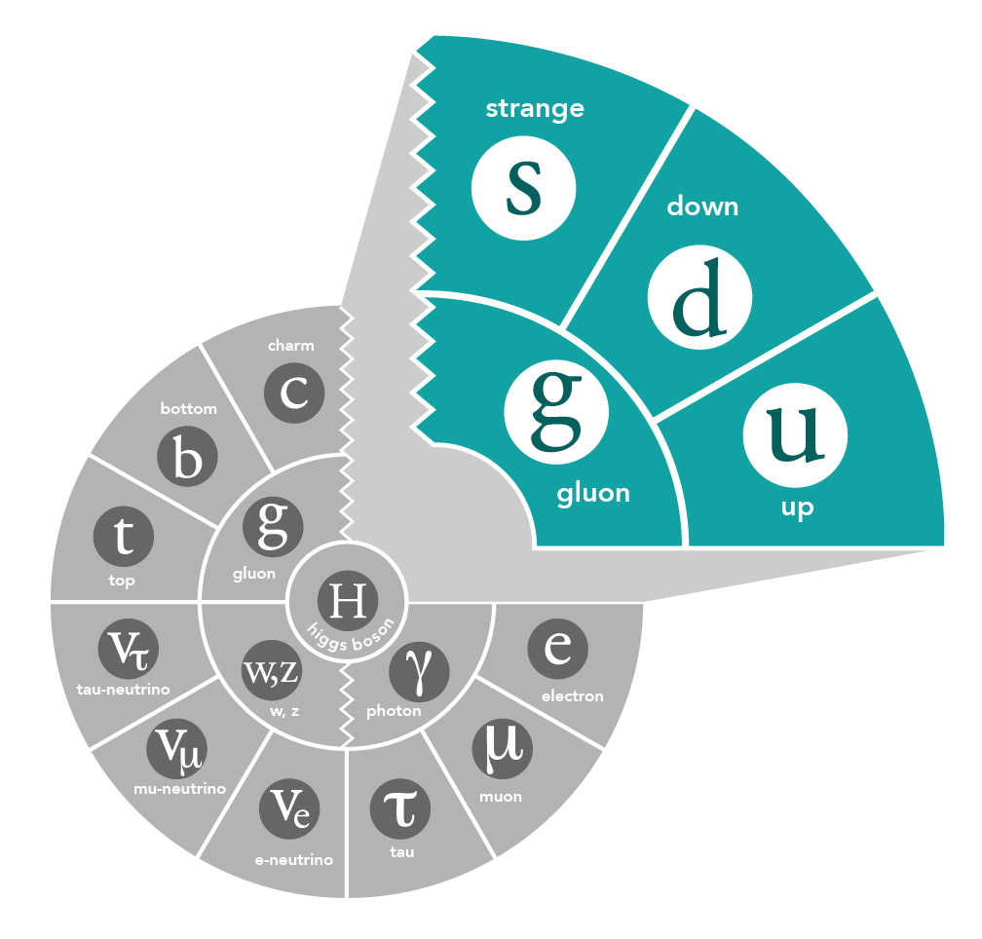
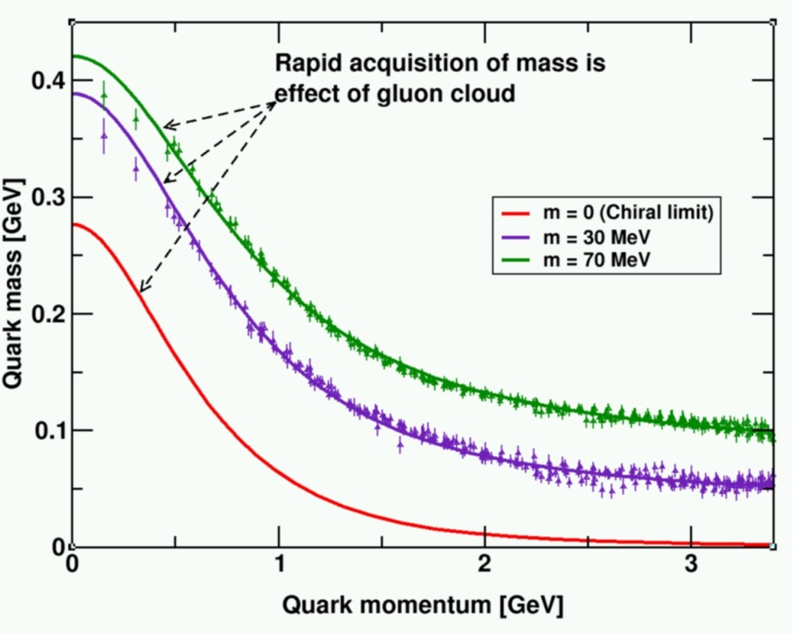
Gluons and QCD
QCD is the fundamental theory that describes structure and interactions in nuclear matter.
Without gluons there are no protons, no neutrons, and no atomic nuclei
Gluons dominate the structure of the QCD vacuum
Facts:
  The essential features of QCD (e.g. asymptotic freedom, dynamical chiral symmetry breaking, and color confinement) are driven by gluons!
  Unique aspect of QCD is the self interaction of the gluons
  Mass from massless gluons and nearly massless quarks
    Most of the mass of the visible universe emerges from quark-gluon interactions
    The Higgs mechanism has almost no role here

Slide 6


Nuclear Science Long-Range Planning
Every 5-7 years the US Nuclear Science community produces a Long-Range Planning (LRP) Document
From Recommendation I:
“With the imminent completion of the CEBAF 12-GeV Upgrade, its forefront program of using electrons to unfold the quark and gluon structure of hadrons and nuclei and to probe the Standard Model must be realized.”

Slide 7


Still New Science Highlights of the 6-GeV Era
Final Qweak results submitted to Nature and in final stages of reviewing – to appear soon!
Multiple nucleon resonances now confirmed as highlighted in Particle Data Group (PDG) tables.
The weak charge of the proton – “Qweak”, represents the (tiny) difference of the charge of the proton and it’s mirror image
State N(mass)J^{P} | PDG pre 2012 | PDG 2018*
N(1710)1/2⁺ | *** | ****
N(1880)1/2⁺ |  | ***
N(1895)1/2⁻ |  | ****
N(1900)3/2⁺ | ** | ****
N(1875)3/2⁻ |  | ***
N(2120)3/2⁻ |  | **
N(2000)5/2⁺ | * | **
N(2060)5/2⁻ |  | **
Δ(2200)7/2⁻ | * | ***
A glimpse of gluons through deeply virtual compton scattering on the proton
Published in:
Nature Communications 8,
Article number: 1408 (2017)
doi:10.1038/s41467-017-01819-3
**** Existence is certain
*** Existence is very likely
** Evidence of existence is fair
* Evidence of existence is poor

Slide 8



12 GeV Science Era in all 4 Halls!
Hall A: In physics operations
  2.5 Experiments completed to date
  First 12 GeV era publications will be this year
  December 15, 2017: First Beam on Tritium Target!
  Series of measurements on nuclear structure & quark properties that use that Helium-3 (2p + n) and Tritium (2n + p) are (Isotope) Mirror Nuclei
Hall B: In engineering run operations
  Good progress, over ½-way of engineering run
  Anticipate to start CLAS12 Physics early-February
  Hall B Proton Radius and Heavy Photon Search of pre-CLAS12 measurements publications anticipated
Hall C: In physics operations
  New spectrometer engineering run completed
  Physics data taking started January 19, 2018!
  Series of “simple” measurements on Nucleon and Nuclear Structure that can lead to early publications.
Hall D: In physics operations (GlueX)
  Engineering Run Complete: Basis for > dozens papers at both American Physical Society (APS) Division of Nuclear Physics 2016 & 2017 Meetings
  First 12 GeV era publication: 24 April, 2017!
  Working on several other publications
  First physics run (GlueX – search for exotic mesons) in Spring 2017 and continuing in Spring 2018

Slide 9
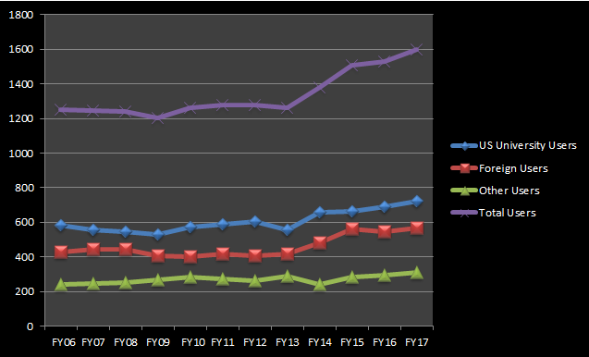
Jefferson Lab User Growth
“Other Users” include US National Labs and Industry

Slide 10
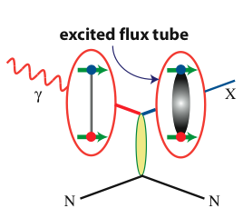

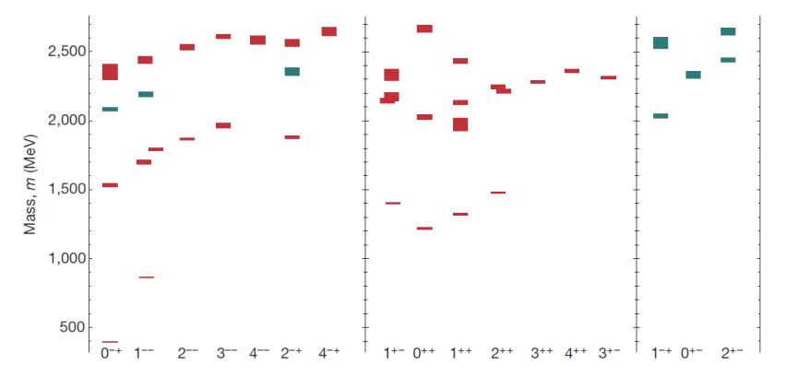
Hadron Spectroscopy in the 21st Century
Searching for the rules that govern hadron construction
M. R. Shepherd, J. J. Dudek, R. E. Mitchell
Heavy quarks:
XYZ states in the charmonium sector
Excited Glue
States with Exotic Quantum Numbers

Slide 11
FY19 Halls C & B – nature of charmed pentaquark
What is the exact nature of the charmed pentaquark states discovered by the LHCb collaboration at CERN?
5-quark bound state
Hadronic molecule
high impact
Hall C
Hall B

Slide 12
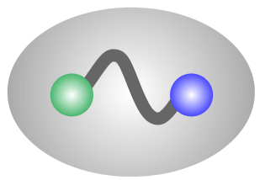
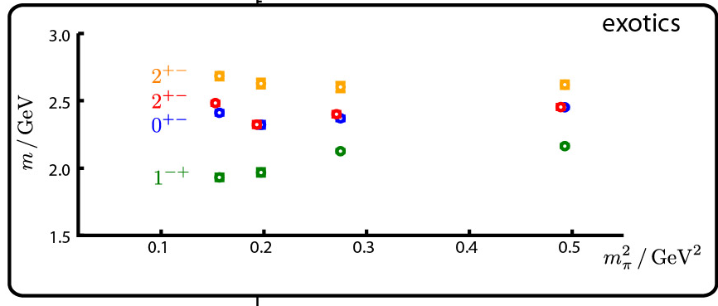
Gluonic Excitations and the mechanism for confinement
QCD predicts a rich spectrum of as yet to be discovered gluonic excitations - whose experimental verification is crucial for our understanding of QCD in the confinement regime.
With the upgraded CEBAF, a linearly polarized photon beam, and the GlueX detector, Jefferson Lab will be uniquely poised to: - discover these states,
- map out their spectrum, and
- measure their properties
q
_
q
Dudek et al.
States with Exotic Quantum Numbers
q
q
γ
beam
before
after
q
q

Slide 13
Nucleon Form Factors
The discrepancy between the proton form factor ratio as determined by the Rosenbluth and the Polarization Transfer technique is well established.
e⁺/e⁻ ratio
P_{2γ}
Polarization transfer
We believe two-photon exchange causes the difference. Problem remains that positron-electron comparisons undershoot the required effect, and are at lower Q².

Slide 14
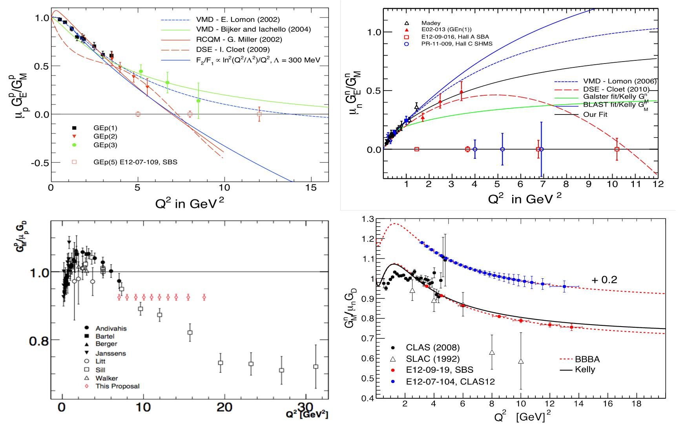
Extending Q² Range of Nucleon Form Factors
Physics Reach extended by Super BigBite Spectrometer (SBS) in Hall A:
- Use high luminosity + open geometry + GEM detectors
  - Pushes G_{E}^{p}/G_{M}^{p}, G_{E}^{n}, G_{M}^{n} to high Q² (>10 GeV²)
  - Allows for flavor decomposition to distance scales deep inside the nucleon

Slide 15
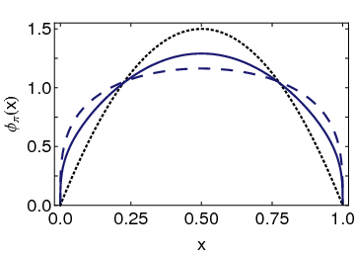
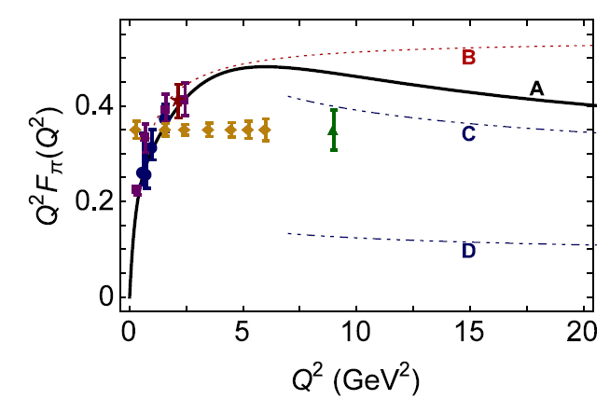
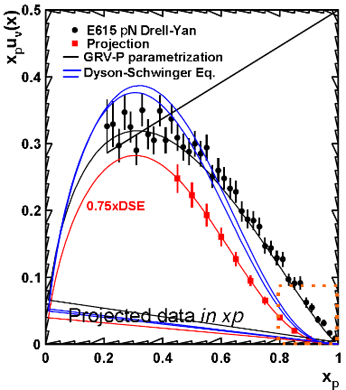
Pion Form Factor and Structure Function
Conformal QCD
DSE
RL
Real-world PDAs are squat and fat
Implications if so: two longstanding puzzles could be solved
Magnitude of pion form factor in hard scaling regime
Power of pion parton behavior at large x
Also implications for nucleon and N* form factor interpretation (not shown here).
monopole
Hard QCD obtained with the PDA appropriate to the scale of the experiment
Hard QCD obtained with φ_{π}^{asy}(x)
Pion FF – first quantitative access to hard scattering scaling regime?
Pion SF – (1-x)⁻¹ or (1-x)⁻² dependence at large x?

Slide 16
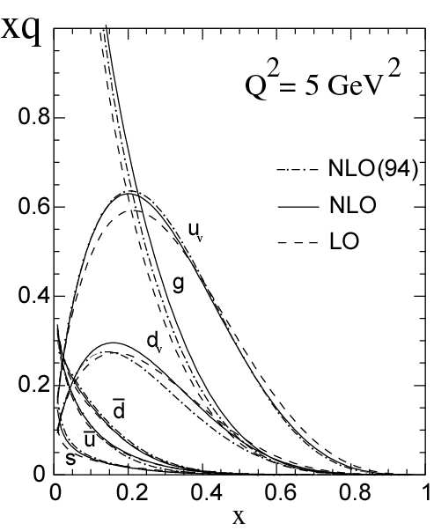
Measuring High-x Structure Functions
REQUIRES:
High beam polarization
High electron current
High target polarization
Large solid angle spectrometers
BONUS
3H/3He
PVDIS
x →1 predictions | F₂^{n}/F₂^{p} | d/u | A₁^{n} | A₁^{p}
SU(6) | 2/3 | 1/2 | 0 | 5/9
Diquark Model/Feynman | 1/4 | 0 | 1 | 1
Quark Model/Isgur | 1/4 | 0 | 1 | 1
Perturbative QCD | 3/7 | 1/5 | 1 | 1
QCD Counting Rules | 3/7 | 1/5 | 1 | 1
12 GeV will access the regime (x > 0.3), where valence quarks dominate

Slide 17
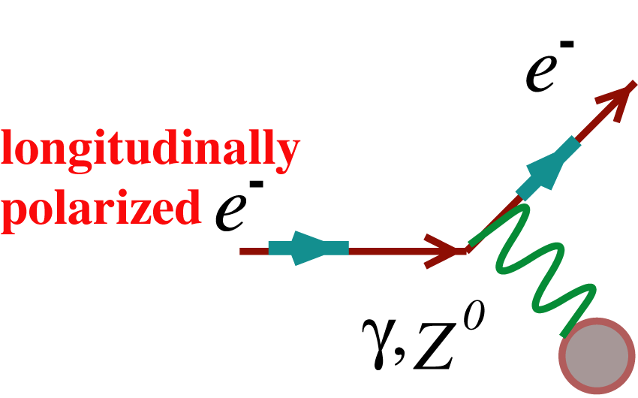
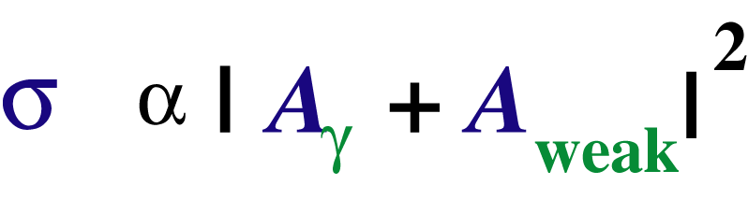
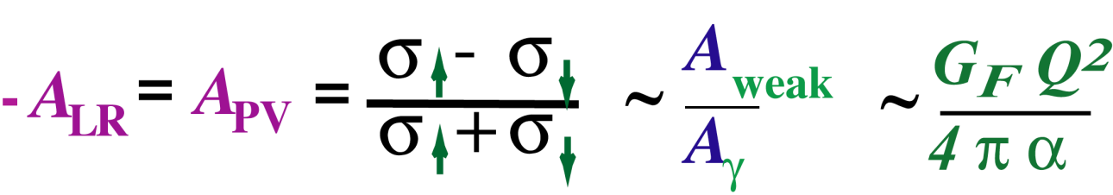
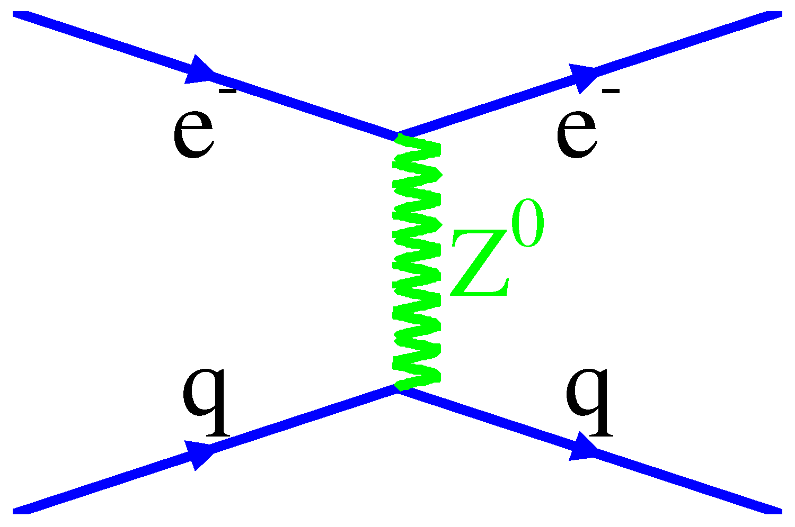
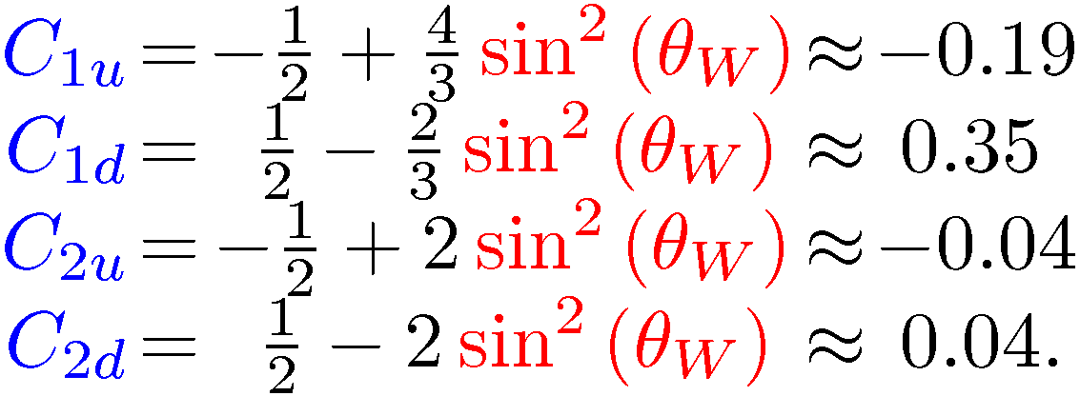
Parity-Violating Asymmetries
Weak Neutral Current (WNC) Interactions at Q² << M_{Z}²
Longitudinally Polarized Electron Scattering off Unpolarized Fixed Targets
(g_{A}^{e}g_{V}^{T} +β g_{V}^{e}g_{A}^{T})
The couplings g depend on both electroweak physics and the weak vector and axial-vector hadronic current, and are functions of sin²Θ_{w}
A
V
Mid 70s goal was to show sin²Θ_{w} was the same as in ν scattering
1990-2010 target couplings probe novel aspects of hadron structure
Ongoing precision measurements with carefully chosen kinematics to probe new physics at multi-TeV high energy scales
V
A

Slide 18
Qweak Results → Constraints
Constraints on the vector-quark, axial-electron weak coupling constants C_{1u} and C_{1d} provided by the Qweak and APV results.
Combined constraint raises the Θ_{h}-independent for generic new semi-leptonic Parity-Violating Beyond the Standard Model physics to 3.6 TeV (mass reach in Λ/g).

Slide 19
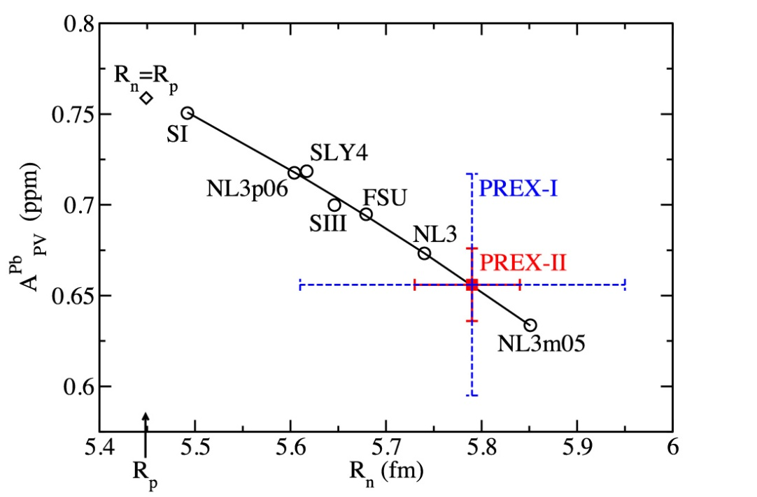
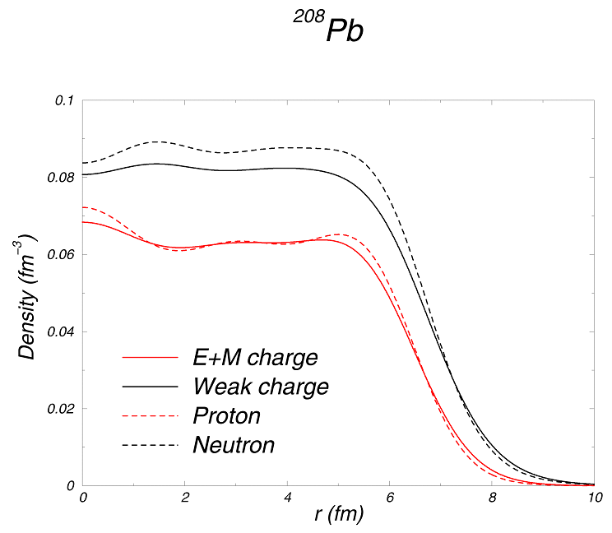
Nuclear Theory Predicts Neutron Skin on Heavy Nuclei
Elastic Scattering Parity-Violating Asymmetry A_{PV}
Q_{w}^{p} =(1 – 4 sin² θ_{W})
Q_{W}^{n} = -1
Z⁰ : Clean Probe Couples Mainly to Neutrons
Neutron star is 18 orders of magnitude larger than Pb nucleus but has same neutrons, strong interactions and equation of state.
A neutron skin of 0.2 fm or more has implications for our understanding of neutron stars and their ultimate fate

Slide 20

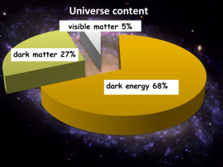
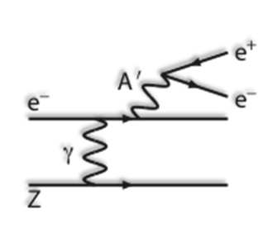
Heavy Photon Search – First Results
Search for a U(1) Heavy Gauge Boson following up on cosmological observations (PAMELA, AMS)
2015 Engineering Run
1.7 PAC days @ 1.05 GeV
2 GeV data taken in 2016,
under analysis
1 mm gap between Si
tracker detectors for
passage of electron beam
Future Program: more HPS, APEX, DarkLIGHT

Slide 21
Exploring the 3D Nucleon Structure
After decades of study of the partonic structure of the nucleon we finally have the experimental and theoretical tools to systematically move beyond a 1D momentum fraction (x_{Bj}) picture of the nucleon.
    High luminosity, large acceptance experiments with polarized beams and targets.
    Theoretical description of the nucleon in terms of a 5D Wigner distribution that can be used to encode both 3D momentum and transverse spatial distributions.
Deep Exclusive Scattering (DES) cross sections give sensitivity to electron-quark scattering off quarks with longitudinal momentum fraction (Bjorken) x at a transverse location b.
Semi-Inclusive Deep Inelastic Scattering (SIDIS) cross sections depend on transverse momentum of hadron, P_{h⊥}, but this arises from both intrinsic transverse momentum (k_{T}) of a parton and transverse momentum (p_{T}) created during the [parton → hadron] fragmentation process.

Slide 22

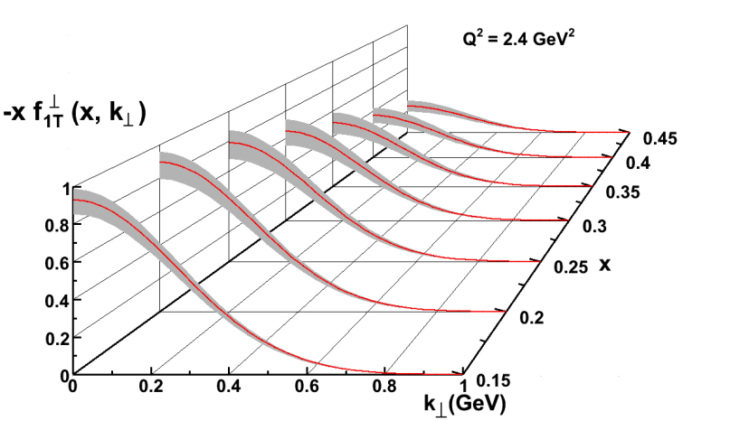
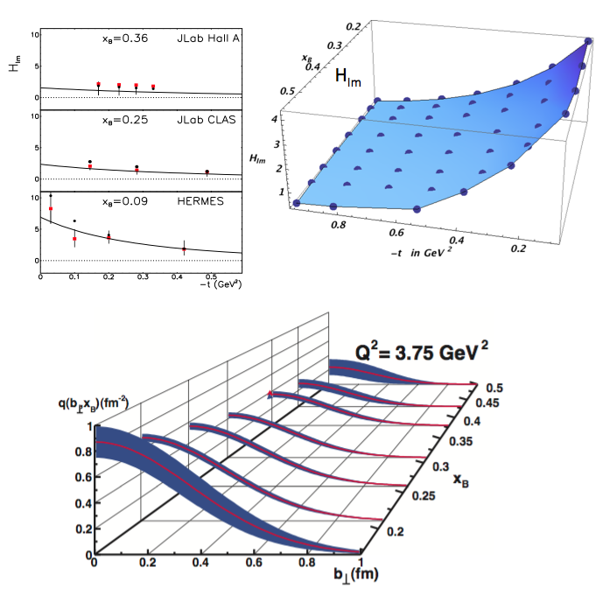
New Paradigm for Nucleon Structure
5D
TMDs
– Confined motion in a nucleon
(semi-inclusive DIS)
GPDs
– Spatial imaging
(exclusive DIS)
Requires
− High luminosity
− Polarized beams and targets
− Sophisticated detector systems
3D
Major new capability with JLab12

Slide 23
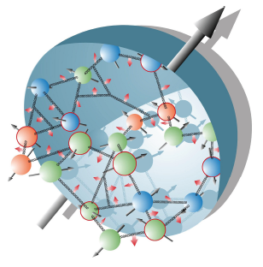
The Incomplete Nucleon: Spin Puzzle
Proton has spin-1/2
Proton is a composite system consisting of spin-1/2 quarks and spin-1 gluons
This implies that the sum of angular momentum of quarks and gluons together must amount to 1/2. Can be due to:
Quark spin Quark orbital momentum
Gluon spin Gluon orbital momentum
Classical: ~ r x p
Needs a cross-product or something three-dimensional!

Slide 24
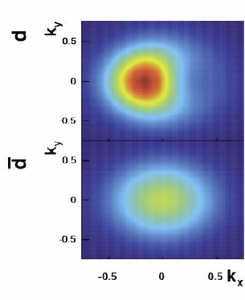
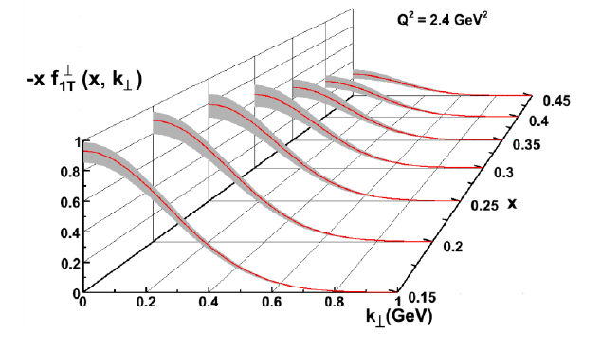
Momentum Tomography with TMDs
JLab/12 GeV Goal → Precision in 3D Momentum Imaging of the Nucleon!
Sivers function for d-quarks extracted from model simulations with a transverse polarized ³He target.
δk_{x}
d-quark momentum tomography for Sivers function. The d-quark momentum density shows a distortion and shift in k_{x}. A non-zero δk_{x} value requires a non-zero orbital angular momentum.
12 GeV ~ Valence Quark Region (x > 0.1)

Slide 25
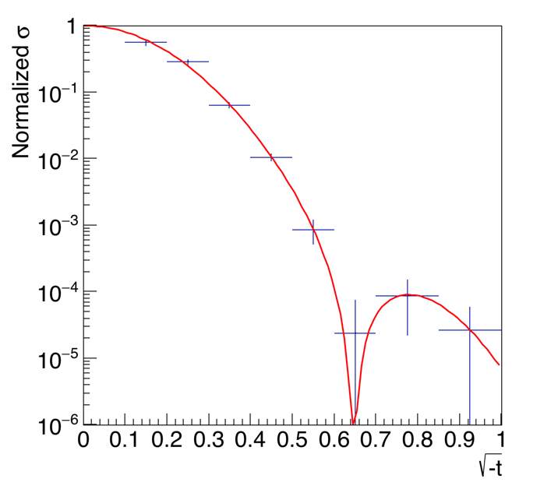
Tomography of ⁴He Nucleus
Deep-Virtual Exclusive φ Production projections
JLab DVCS Beam-Spin Asymmetry projections
Spin-0 ⁴He Nucleus makes for much simpler extraction of GPDs → Tomography in terms of q and g
(R. Dupe and S. Scopetta,
EPJA 52 (2016) 159)
x_{B}

Slide 26
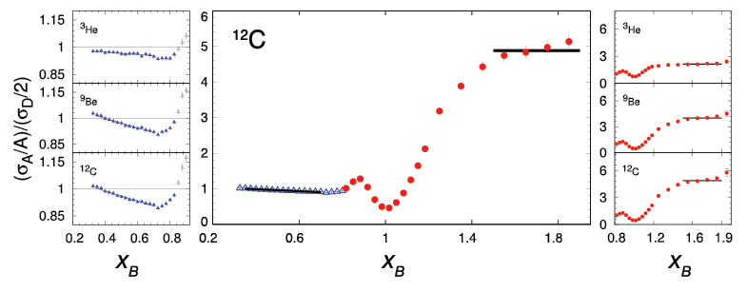
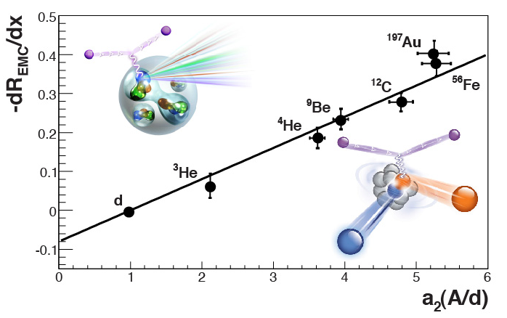
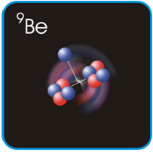
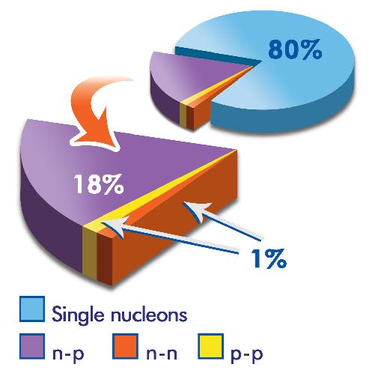
Parton Dynamics and N-N Correlations
EMC effect: quark momentum in nucleus is altered
N-N Correlations: pairing due to tensor force and strong repulsive core
EMC Slopes 0.35 ≤ x_{B} ≤ 0.7
a₂(A/d)
Luminosity, nuclei
N-N correlated pairs x_{B} ≥ 1.4
12 GeV science quest:
isospin dependence: ³H, ³He, ^{6,7}Li, ⁹Be ^{10,11}B, ^{40,48}Ca
spin dependence
“tagged” deep-inelastic scattering off ²H
  with both slow and fast protons
⁹Be ~
ααn

Slide 27
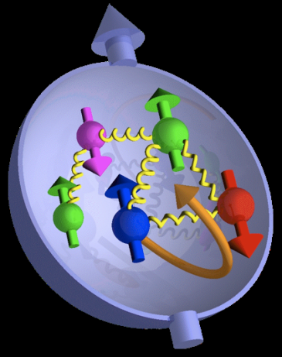

JLab: 21st Century Science Questions
What is the role of gluonic excitations in the spectroscopy of light mesons? Can these excitations elucidate the origin of quark confinement?
excited gluon field
Where is the missing spin in the nucleon? Is there a significant contribution from valence quark orbital angular momentum?
Can we reveal a novel landscape of nucleon substructure through measurements of new multidimensional distribution functions?
What is the relation between short-range N-N correlations, the partonic structure of nuclei, and the nature of the nuclear force?
Can we discover evidence for physics beyond the standard model of particle physics?

Slide 28
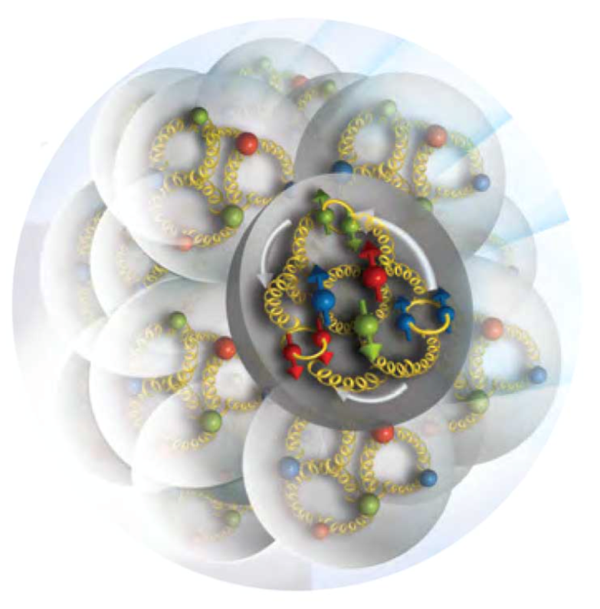
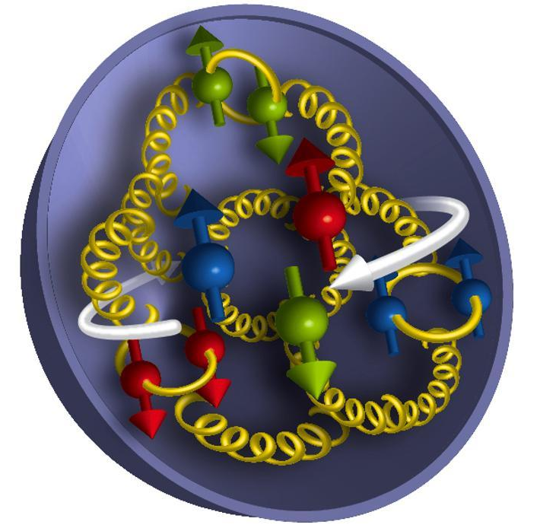
Nuclear Femtography
Science of mapping the position and motion of quarks and
gluons in the nucleus.
Artist’s Conception
of Quark and Gluons
in a proton and nucleus
12 GeV
REQUIRES:
High beam polarization
High electron current
High target polarization
Large solid angle spectrometers
.. is just beginning
EIC

Slide 29
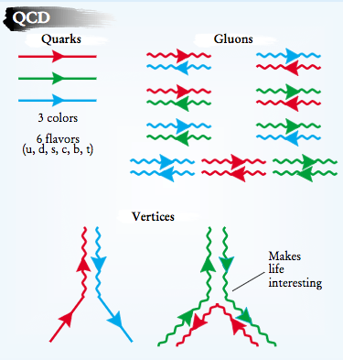
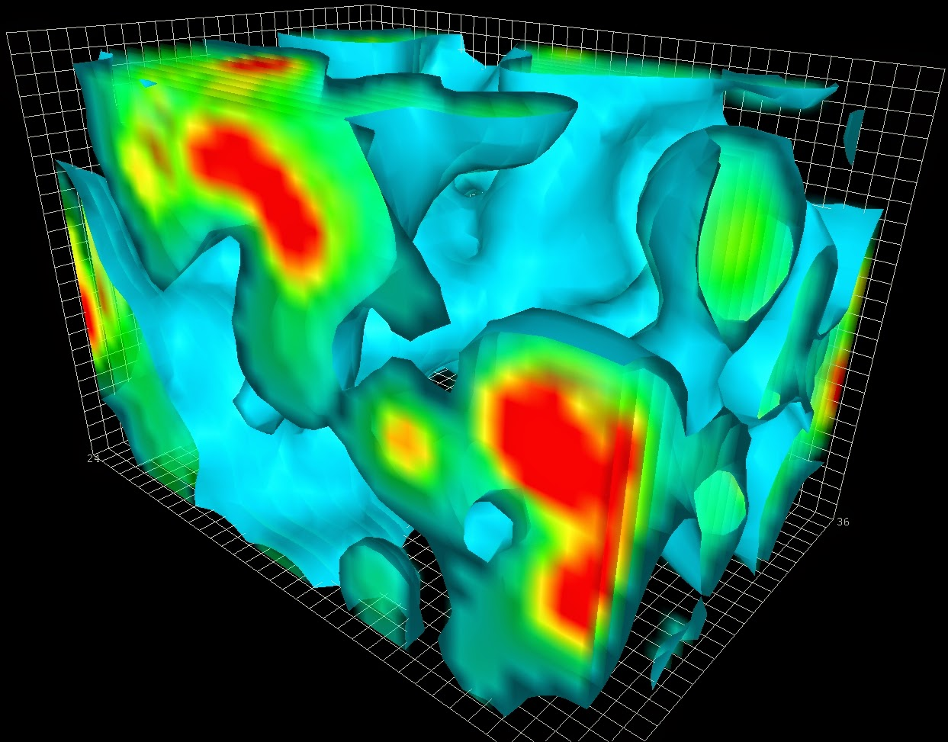
Cold Matter is Unique
Interactions and Structure are entangled
because of gluon self-interaction.
Observed properties such as mass and spin emerge from this complex system.
EIC needed to explore the gluon dominated region
JLAB 12 to explore the valence quark region

Slide 30
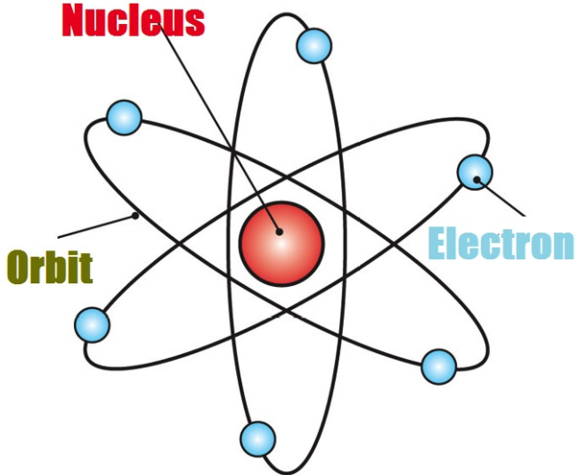
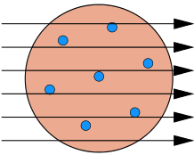
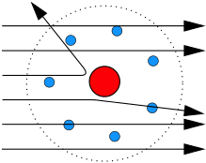
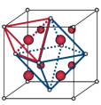
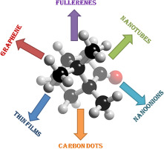
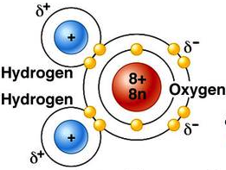
From 3D atomic structure to the quantum world
Atomic structure: dating back to Rutherford’s experiment :
α + Au ➔ α + X
Over 100 years ago
Experiment
Theory
Atom:
J.J. Thomson’s
plum-pudding model
Rutherford’s
Experiment - Data
Quantum orbitals
Discovery:
Tiny nucleus - less than 1 trillionth in volume of an atom
Quantum probability - the Quantum World!
Localized mass and charge centers – vast “open” space:
Molecule:
Crystal:
Nanomaterial:
“Water”
Rare-Earth metal
Carbon-based

Slide 31
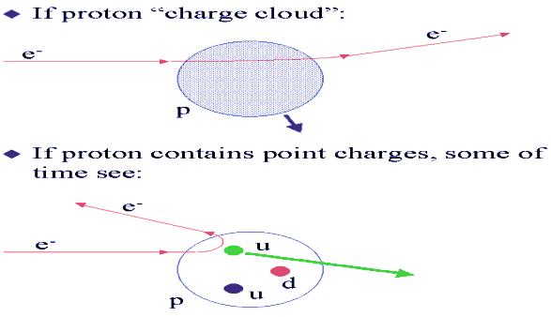
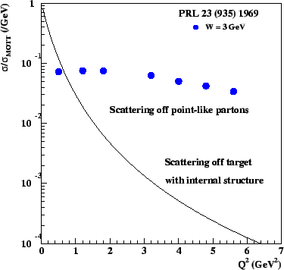
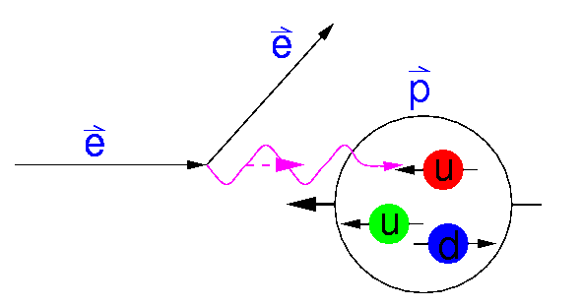

From 3D hadron structure to QCD
A modern “Rutherford” experiment (about 50 years ago):
Nucleon:
The building unit of all atomic nuclei
Prediction
Discovery
e + p ➔ e + X
1968
Quark
model
Discovery of quarks!
Discovery of Quantum Chromodynamics (QCD):
Gluons
No still picture!
No fixed structure!
Nanometer
Femtometer
Quantum Probability

Slide 32



From 3D hadron structure to QCD
A modern “Rutherford” experiment (about 50 years ago):
Nucleon:
The building unit of all atomic nuclei
Prediction
Discovery
e + p ➔ e + X
1968
Quark
model
Discovery of quarks!
No localized mass and charge centers:
New frontier of hadron physics … !
Nuclei – “Molecule”
XYZ – “Nuclei”
“Femtography”
Short-range
correlation
“Light-flavor”
“Heavy-flavor”

Slide 33
EIC and the NSAC 2015 Long Range Plan

Slide 34


US-Based EICs
Brookhaven Lab
Long Island, NY
JLEIC
Jefferson Lab
Newport News, VA
Notes:
34

Slide 35


Worldwide Interest in EIC Physics
The EIC Users Group: EICUG.ORG
(no students included as of yet)
730 collaborators, 29 countries, 168 institutions... (December 12, 2017)
Map of institution’s locations

Slide 36

EIC – World’s First Polarized eN Collider
A spin factory of polarized electrons and polarized protons/light nuclei:
imaging the quarks and gluons
How are the sea quarks and gluons, and their spins, distributed in space and momentum inside the nucleon?
How do the nucleon properties emerge from them and their interactions?
Notes:
36

Slide 37

What does a proton or (nucleus) look like?
Static Boosted
Bag Model: Gluon field distribution is wider than the fast moving quarks. Gluon radius > Charge Radius
Constituent Quark Model: Gluons and sea quarks hide inside massive quarks. Gluon radius ~ Charge Radius
Lattice Gauge theory (with slow moving quarks), gluons more concentrated inside the quarks: Gluon radius < Charge Radius
Need transverse images of the quarks and gluons in protons and nuclei

Slide 38




2+1 D partonic image of the proton
Spatial distance from origin X Transverse Momentum → Orbital Angular Momentum
Helicity Distributions: ΔG and ΔΣ
Transverse Momentum Distributions
Transverse Position Distributions
Notes:
38

Slide 39




The Incomplete Nucleon: Mass Puzzle
“… The vast majority of the nucleon’s mass is due to quantum fluctuations of quark-antiquark pairs, the gluons, and the energy associated with quarks moving around at close to the speed of light. …”
MeV
GeV
EIC’s expected contribution in:
Trace anomaly:
J/Ψ, Y, …
Upsilon production
near the threshold
Proton: Mass ~ 940 MeV
  preliminary LQCD results on mass budget, or view as mass acquisition by DχSB
Kaon: Mass ~ 490 MeV
  at a given scale, less gluons than in pion
Pion: Mass ~ 140 MeV
  mass enigma – gluons vs Goldstone boson
Quark-gluon energy:
quark-gluon momentum fractions
In nucleon with
DIS and SIDIS
COMPASS’ expected contribution:
In pions and kaons with Sullivan process
In kaons with Drell-Yan process → gluons in kaons

Slide 40
EIC – Versatility is Key
EIC: A Versatile Collider with a Hermetic Detector
How do color-charged quarks and gluons, and colorless jets, interact with a nuclear medium?
How do the confined hadronic states emerge from these quarks and gluons?
How do the quark-gluon interactions create nuclear binding?
Notes:
40

Slide 41

Timeline of the Universe
In Steven Weinberg’s seminal treaty on The First Three Minutes, a modern view of the origin of the universe, he conveniently starts with a ‘first frame” when the cosmic temperature has already cooled to 100,000 million degrees Kelvin, carefully chosen to be below the threshold temperature for all hadrons. Two reasons underlie this choice, the first that the quark-gluon description of hadrons was not universally accepted yet at that time, the second that the choice evades questions on the emergence of hadrons from quarks and gluons.
Notes:
41
Note BSM not included in project

Slide 42

Exotic Glue in Nuclei
Exotic Glue in Nuclei =
gluons not associated with individual nucleons in nucleus
operator in nucleon = 0 & operator in nuclei ≠ 0
Targets with J ≥ 1 have leading twist gluon contribution
Δ(x,Q²): double helicity flip (Jaffe and Manohar, 1989)
Changes both photon and target helicity by two units…
Measurable in unpolarized Deep Inelastic Scattering with a transversely polarized J ≥ 1 target like the deuteron as azimuthal variation.
Parton model interpretation:
Δ(x,Q²) informs how much more momentum of a transversely polarized particle is carried by a gluon with spin aligned rather than perpendicular to it in the transverse plane.
Shanahan, Detmold, et al.
LQCD calculation: gluon transversity distribution in the deuteron, m_{π} = 800 MeV → First evidence for non-nucleonic gluon contributions to nuclear structure
Notes:
42

Slide 43

EIC – World’s First eA Collider
gluon
emission
gluon recombination
?=?
The Nucleus:
A laboratory for QCD
How does a dense nuclear environment affect the quarks and gluons, their correlations, and their interactions?
What happens to the gluon density in nuclei? Does it saturate at high energy, giving rise to a gluonic matter with universal properties in all nuclei, even the proton?
Notes:
43

Slide 44


Exposing different layers of the nuclear landscape with electron scattering
History:
Electromagnetic
Elastic electron-nucleus scattering → charge distribution of nuclei
Present/Near-future:
Electroweak
Parity-violating elastic electron-nucleus scattering (or hadronic reactions e.g. at FRIB) → neutron skin
Future:
Color dipole
φ Production in coherent electron-nucleus scattering → gluon spatial distribution of nuclei
Fourier transform gives unprecedented info on gluon spatial distribution, including impact of gluon saturation

Slide 45























EIC: A Portal to a New Frontier
Dynamical System | Fundamental Knowns | Unknowns | Breakthrough Structure Probes | New Sciences, New Frontiers
Solids
Electromagnetism
Atoms
Structure
X-ray Diffraction
(~1920)
Solid state physics
Molecular biology
1801
DNA
Universe
General Relativity
Standard Model
Quantum Gravity,
Dark matter, Dark
energy. Structure
Large Scale Surveys
CMB Probes
(~2000)
Precision
Observational
Cosmology
CMB 1965
Nuclei
and Nucleons
Perturbative QCD
Quarks and Gluons
Non-perturbative QCD. Structure
Electron-Ion Collider
(2025+)
Structure & Dynamics in QCD
2017

Slide 46
Outlook – Proton Structure in the 21st Century
The theme of this talk may be that while we may think we know a lot about the quark-gluon structure of nucleons and nuclei, there are many outstanding issues. Progress is good, and prospects are good, and we are in my view on the verge of a true transformation.
The electromagnetic structure of nucleons and nuclei is full of surprises and dynamics – there is much work to do but in a decade or so we can be in excellent shape to acquire a transformative view of the 3D quark-gluon structure of matter and the underlying strong QCD dynamics. These can become good and exciting times.

Slide 47
BACKUP

Slide 48









Project Completion Approved September 27, 2017

Slide 49
Generalized Parton Distributions
(Quantum phase-space quark distribution in the nucleon)
5D
(Polarized) DVCS directly probes GPDs
Integrate over transverse momentum space
Sensitivity to GPD
~
UP
LP
TP
H, H, E
Generalized Parton Distributions (GPD) H, H, E, E
~
~
Nucleon polarization
~
H, H, E
3D nucleon imaging in transverse coordinate and longitudinal momentum space
E, H
3D
DVMP is required for flavor separation

Slide 50

Transverse Momentum Structure of Nucleon – TMDs
(Quantum phase-space quark distribution in the nucleon)
5D
Integrate over
spatial dimensions
Quark spin polarization
Transverse Momentum-dependent Distributions (TMD)
Nucleon polarization
3D imaging of the nucleon in momentum space
3D
JLab has planned a complete SIDIS program with π/K to access quark TMDs, COMPASS can access sea quark region

Slide 51



1st Results from 12-GeV JLab
The new GlueX results (PRC 95 (2017) 042201) show:
• The reaction mechanism for neutral pions is dominated by pure vector coupling.
• The first data for beam asymmetry for η production >3 GeV.
• The GlueX experiment in Hall D can produce timely results.
Beam Spin Asymmetry Σ
Next: γp → pJ/Ψ
J/Ψ photoproduction at threshold
Gives insight on J/Ψ production mechanism (2-gluon vs 3-gluon)
Can also point to nature of charmed LHCb pentaquark
The overall normalization of the GlueX data will shift the black points up or down, but the size of the errors is preserved on the log scale.
t = (p_{target} – p_{p})²

Slide 52


Solving the Proton Radius Puzzle
Elastic e-p
scattering
Atomic H
PRad@JLab:
(projected)
Muonic H
PRad: new experiment to address proton radius @ Jlab
NSF MRI: H₂ gas target, DOE GEM tracking detectors
Successful run in summer 2016
Cross sections shown at DNP 2017
Also MUSE @ PSI in preparation

Slide 53

Solving the “missing resonances” puzzle
State N(mass)J^{P} | PDG pre 2012 | PDG 2018*
N(1710)1/2⁺ | *** | ****
N(1880)1/2⁺ |  | ***
N(1895)1/2⁻ |  | ****
N(1900)3/2⁺ | ** | ****
N(1875)3/2⁻ |  | ***
N(2120)3/2⁻ |  | **
N(2000)5/2⁺ | * | **
N(2060)5/2⁻ |  | **
Δ(2200)7/2⁻ | * | ***
Star ratings of PDG before 2012 and projections for 2018, following a worldwide experimental and theoretical effort.
**** Existence is certain
*** Existence is very likely
** Evidence of existence is fair
* Evidence of existence is poor
*) projected
Notes:
This slides shows a summary of the results in this analysis. The green column shows the rating by the PDG. The two columns show the importance of the strangeness channel in this results.

Slide 54





Pion and Kaon Structure Functions – Gluons?
gluon content of the kaon
Pion (or Kaon) Drell-Yan
0%
10%
1st DSE analysis (Tandy et al., fully numerical DSE solutions)
DIS (Sullivan Process)
Based on Lattice QCD calculations and DSE calculations:
Valence quarks carry some 52% of the pion’s momentum at the light front, at the scale used for Lattice QCD calculations, or ~65% at the perturbative hadronic scale
At the same scale, valence-quarks carry ⅔ of the kaon’s light-front momentum, or roughly 95% at the perturbative hadronic scale
Thus, at a given scale, there is far less glue in the kaon than the pion.

Slide 55



World Data on F₂^{p}
World Data on g₁^{p}
World Data on h₁^{p}
Similar for F₂^{n}
Similar for g₂^{p}, g₂^{n} (and b₁^{d})
F_{UT}^{sin(φh+φs)}(x,Q²) + C(x) $∝h1$
Note: need to update plots for COMPASS data
An EIC makes it possible!
EIC coverage
COMPASS
HERMES
transverse spin ~ angular momentum
momentum
spin

Slide 56
Uniqueness of EIC among all DIS Facilities
All DIS facilities in the world.
However,
if we ask for:
high luminosity & wide reach in √s
polarized lepton & hadron beams
nuclear beams
EIC stands out as
unique facility …

Slide 57


3D Structure of Nucleons and Nuclei
EIC is a machine to completely map the 3D structure of the nucleons and nuclei
We need to measure positions and momenta of the partons transverse to its direction of motion.
These quantities (k_{T}, b_{T}) are of the order of a few hundred MeV.
Also their polarization!
k_{T}, b_{T} (~100 MeV)
Proton and Ion Beam
Need to keep [100 MeV]_{T}/E_{proton,Ion} manageable (~ >10⁻³) ➔ E_{proton} ~< 100 GeV
Electron-Ion Collider: Cannot be HERA or LHeC: proton energy too high

