Slide 1
Cryogenic Department
Jonathan Creel
Cryogenic Department
Engineering Division
2018 Hall Collaborators Meeting

Slide 2
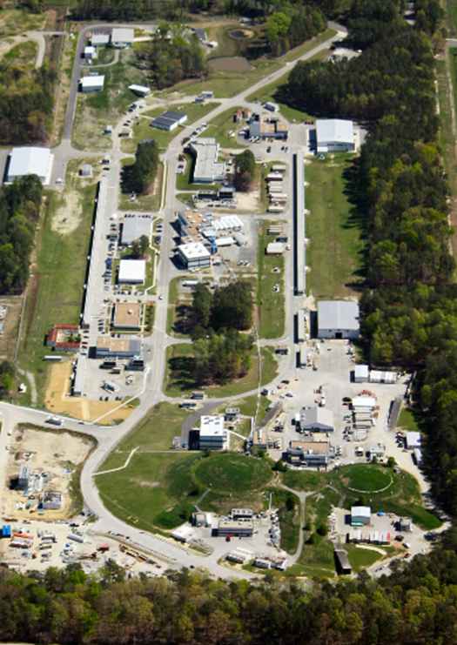
Outline
Overview of Cryogenics at JLab
Central Helium Liquefier's CHL1 & CHL2
Hall D Refrigerator HDR
Cryogenic Test Facility CTF
End Station Refrigerator ESR
Maintenance Cycles
ESR summer maintenance
Reliability
Recent upgrades
Future upgrades at ESR

Slide 3
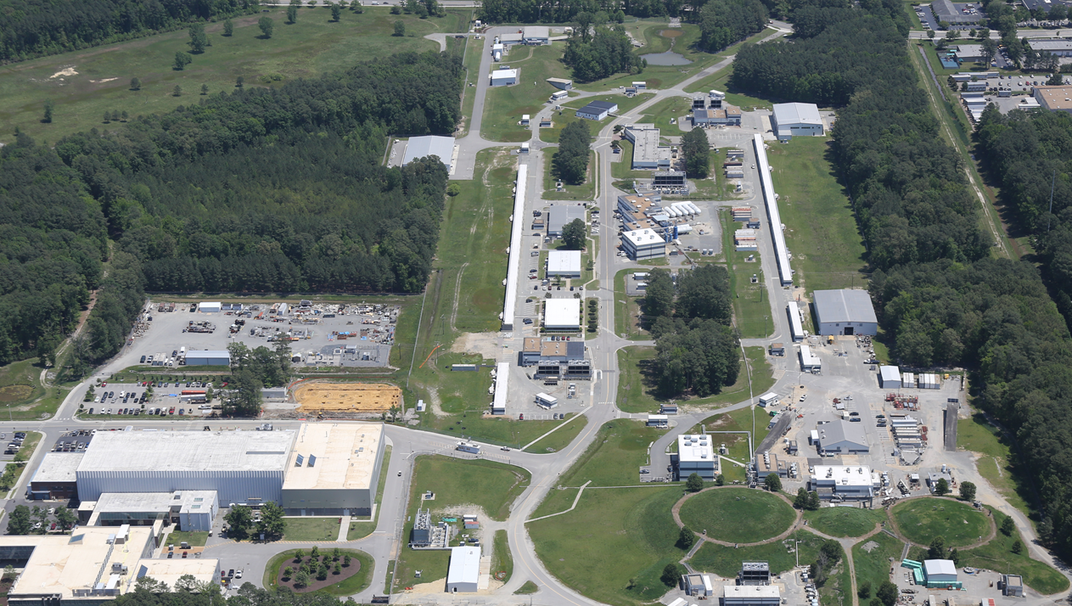
Cryogenic Plants and Transfer Lines
N
HDR, 4.5K
CHL1 + CHL2, 2.1K/4.5K/35K
CHL/ESR 4.5K Transferline
CTF, 2.1K/4.5K/35K
Proposed ES
Upgrade
ESR, 4.5K/15K
Notes:
Be brief

Slide 4
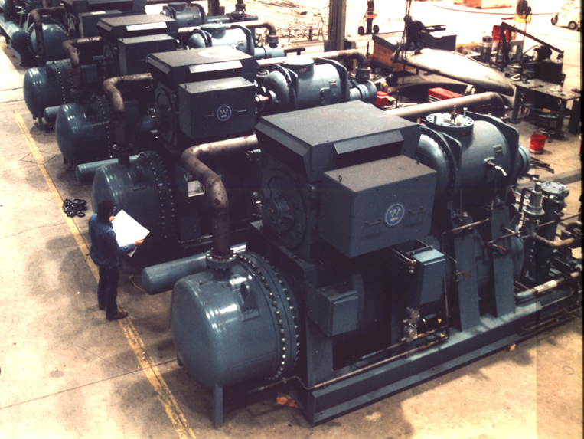
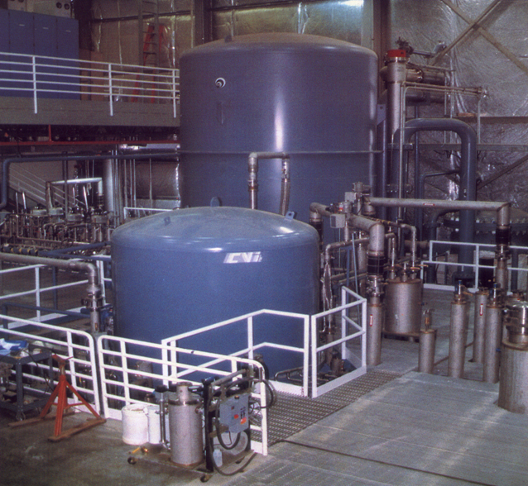
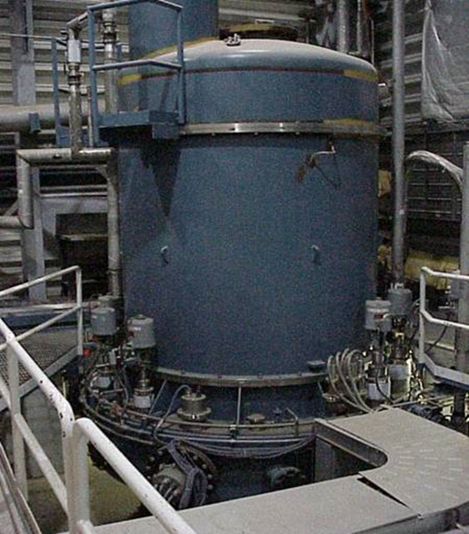
CENTRAL HELIUM LIQUEFIER (CHL1)
Warm Compressors
4.5K Cold Box
2.1K Cold Box
Capacity: 12KW at 35K shield, 4.6KW at 2.1K primary, 10 g/s Liquefaction
Service: Maintains South Linac & LERF super-conducting cryomodules at 2.1K ( 72,800 liquid liter inventory)
Provides shield circuit for linac cryomodules and transfer lines at 35K
Commission Date: 1991 (4K), 1994 (2K) Service Duty: 24/7/365 Continuous Unattended,
Operation Hours to Date: > 215,000 Main Compressors: 3-600HP 1st stage, 3-2250HP 2nd stage
Cold Compressors: 2.1K Cold Box 250 g/s 5 stage 0.039 atm to 1.1 atm
Cooling Water: 3300 gal/min Electric Power: 5.5 MW, 4160V LN2 Precooling: 330 gal/hour

Slide 5
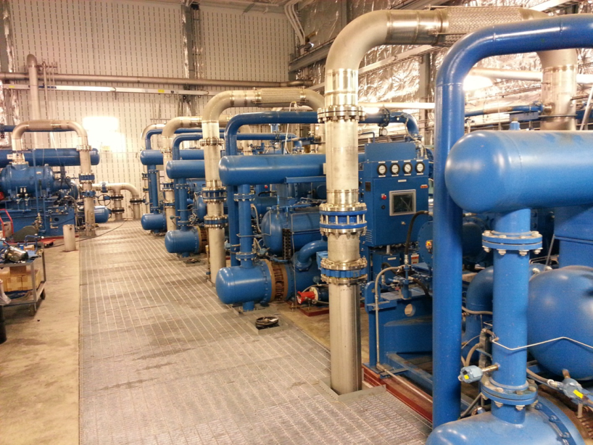
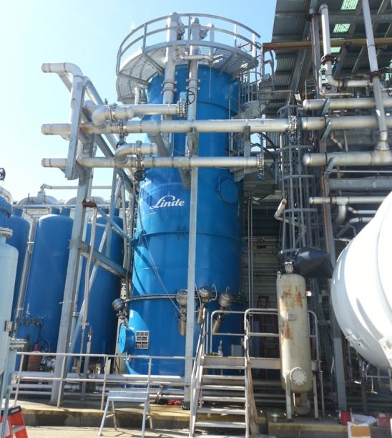
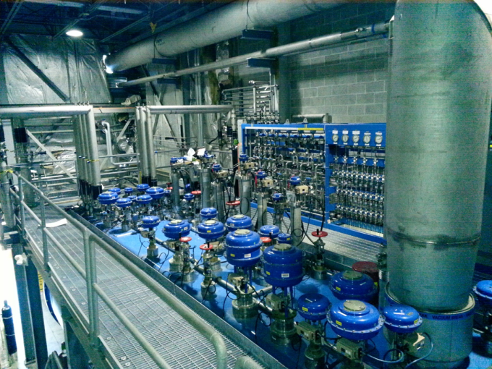
CENTRAL HELIUM LIQUEFIER (CHL2)
Warm Compressors
300-65K Cold Box
65-4.5K Cold Box
Capacity: 12.6KW 35K shield, 4.8KW 2.1K primary, 20 g/s Liquefaction
Service: Maintains North Linac & Injector super-conducting cryomodules at 2.1K ( 72,800 liquid liter inventory)
Provides shield circuit for linac cryomodules and transfer lines at 35K
Commission Date: 2013 Service Duty: 24/7/365 Continuous Unattended,
Operation Hours to Date: >33,000 Main Compressors: 4-800HP 1st stage, 2-2500HP 2nd stage
Cold Compressors: 2.1K Cold Box 250 g/s 5 stage 0.039 atm to 1.1 atm
Cooling Water: 2600 gal/min Electric Power: 3.8 MW, 4160V LN2 Precooling: 120 gal/hour

Slide 6
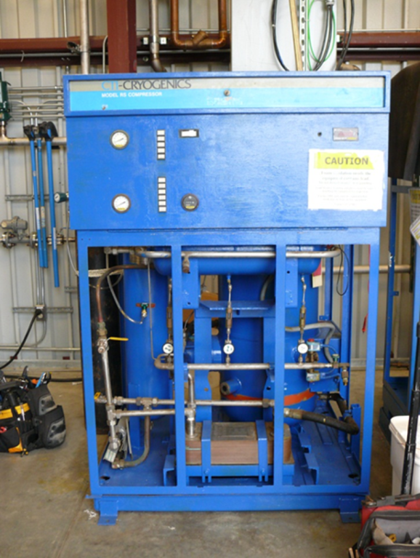
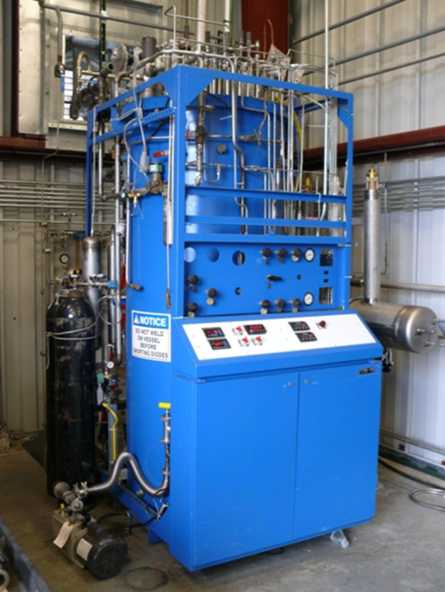
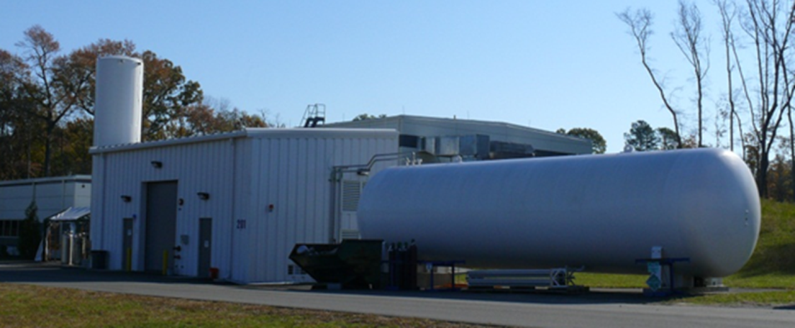
Hall D Refrigerator (HDR)
Warm Compressors
M2800 Cold Box
Helium Gas and Liquid Storage
Capacity: 170W 4.5K twin turbine
Service: Hall D Solenoid
Commission Date: 1980 Princeton Plasma Lab Service Duty: 24/7/365 Continuous Unattended
1988 JLab Cryogenic Test Facility
2013 JLab Hall D
Operation Hours to Date: >30,000 PPL/CTF Main Compressors: 3 x 150HP single stage
>25,000 HDR
Cooling Water: 75 gal/min Electric Power: 0.3 MW, 480V LN2 Precooling: 15 gal/hour

Slide 7
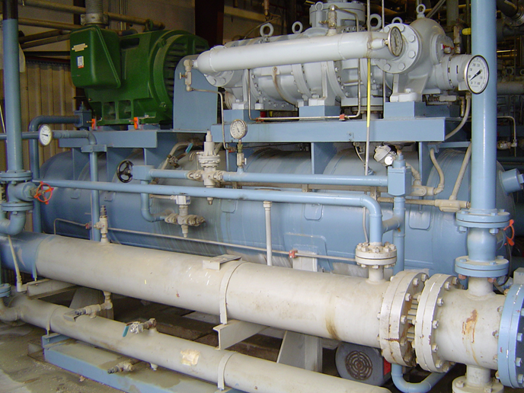
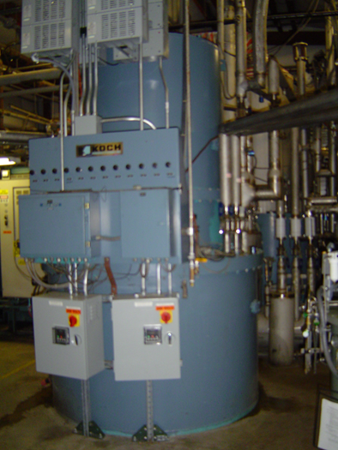
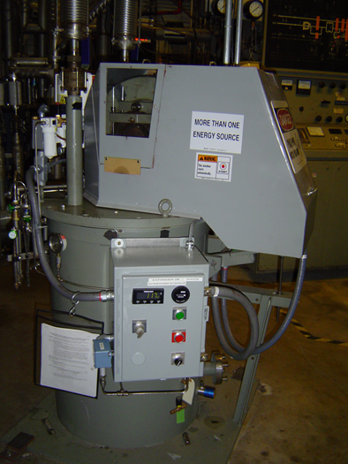
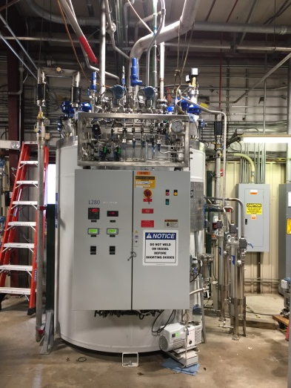
Cryogenic Test Facility (CTF)
Warm Compressors
L280 Cold Box
M2200 Cold Box
Reciprocating Expander
Capacity: 700W 4.5K OR > 7 g/s Liquefaction twin turbine (back up 750W 4.5K w/reciprocating expanders)
800W 35K w/reciprocating expander
Service: Vertical Test Area, Cryomodule Test Cave, Injector Test Facility (in construction)
Commission Date: 1988 M2200 Service Duty: 24/7/365 Continuous Unattended
2017 L280
Operation Hours to Date: >1,400 L280 Main Compressors: 3 x 400HP Compound 1st/2nd stage
>225,000 M2200
Cooling Water: 600 gal/min Electric Power: 0.8 MW, 480V LN2 Precooling: 30 gal/hour

Slide 8
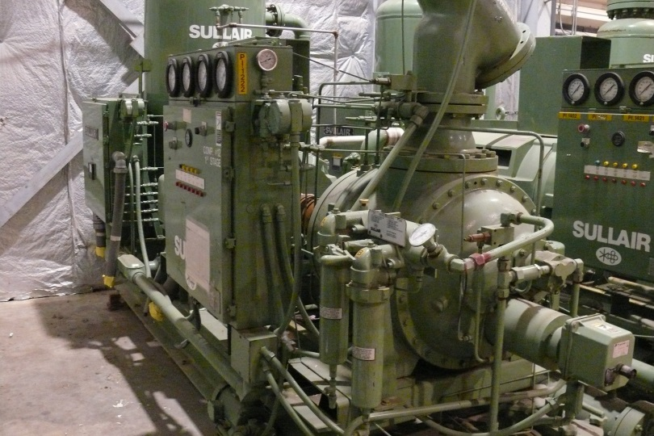
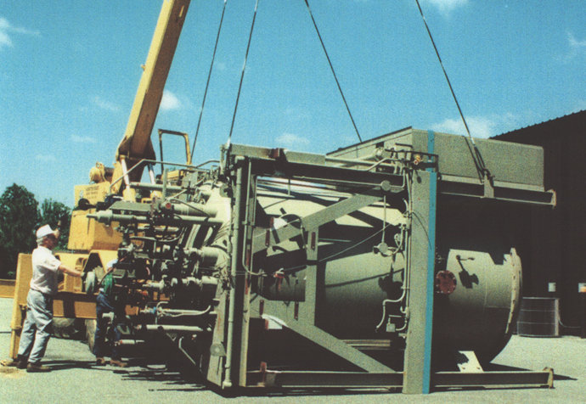
End Station Refrigerator (ESR)
Warm Compressors
4.5K Cold Box
Capacity: 1.5KW 4.5K or 800W 4.5K plus 1.2kW 15K
Service: Maintains Hall’s A, B, and C 4.5K spectrometer magnets and 4.5K/15K targets
Commission Date: 1978 LBL Escar Service Duty: 24/7/365 Continuous Unattended
1994 JLab
Operation Hours to Date: < 900 Escar Main Compressors: 1 x 250HP 1st stage, 2 x 1000HP 2nd stage
> 175,000 JLab
Cooling Water: 450 gal/min Electric Power: 1.2 MW, 480/4160V LN2 Precooling: 40 gal/hour

Slide 9
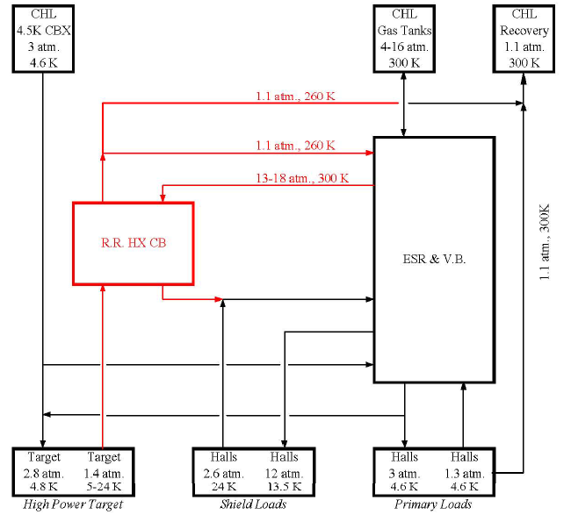
End Station Refrigerator (ESR) (contd.)
ESR Manifolded to all Hall’s
Problems in one Hall can effect other Hall’s
Coordination is critical
Dependent on CHL for:
Warm gas purification system
GHe storage system
LN storage
Typical Cryogenic Loads:
4.5 K Refrigeration
4.5 K Liquefaction (Lead Flows)
15K Targets
SCHe Support Flow from CHL:
3.0 bar, 4.5 K
Trip Recovery, ESR booster, or supporting High Powered Targets (Qweak ~3kW)
Knudsen et al., Refrigeration recovery for Experiment hall high target loads (CEC 2009)

Slide 10
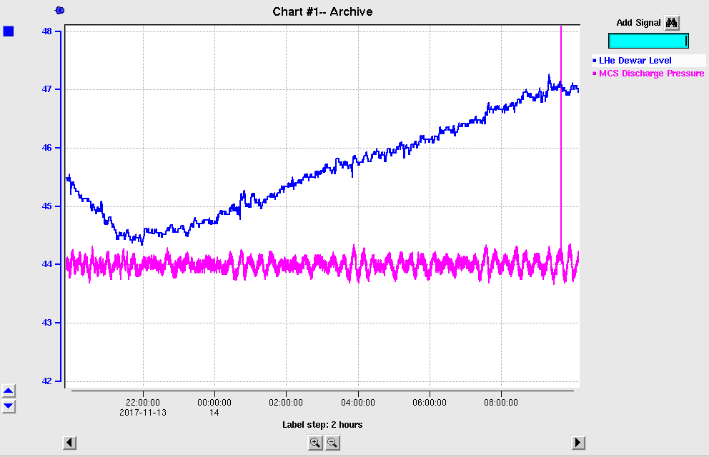
ESR Capacity Tests
Summary of ESR Capacity Test (Fall 2017 Run, 13-14 Nov 2017)
ESR Warm Compressors ramped to full capacity (18 atm).
10kL LHe Dewar filled @ 0.25%/hr.
This excess capacity is equivalent to:
~0.8 g/s of 4.5 K Liquefaction OR
~80 W of 4.5 K Refrigeration
OR
~250 W of 15 K
Notes:
No SCHe (3.0 atm, 4.5 K) flow was provided to ESR.
All magnets at 4.5 K (but not Powered but leads flows simulated).
No Target (15 K) Loads.
Without CHL-ESR TL, LHe dewar loss rate is ~ 4%/day (based on operational experience during Fall 2017 run). SCHe flow (3.0 atm, 4.5 K) of ~ 5-6 g/s from CHL is required to meet this additional load.

Slide 11
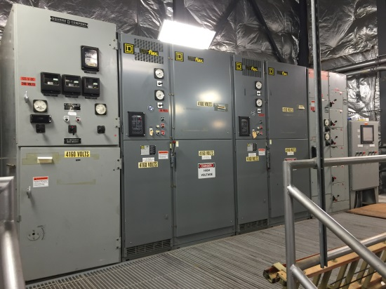
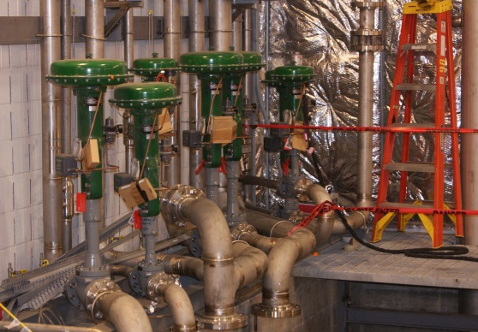
Maintenance Cycles
Some maintenance performed while plant operating
PM maintenance on redundant equipment
Some maintenance performed while plant shutdown
Electrical systems maintenance every 1-2 years
Control valve rebuilds every 7-10 years
Replace adsorber carbon every 7-10 years
CHL1 and CHL2
Alternating annual shutdowns
Allows maintenance and saves utilities
CHL1 will be off summer 2018
ESR summer 2018
HDR summer 2017

Slide 12
ESR Maintenance Summer 2018 (contd)
ESR will be shutdown and warmed to 300K
Hall’s can maintain magnets at 100K as desired
Decontaminate main cold box process piping and heat exchangers
Regenerate cold box internal 80K beds
Electrical and Controls Maintenance
Replace CAMAC control system with Allen Bradley Programmable Logic Controller
PM electrical systems including circuit breakers, and terminal cleaning and tightening
Mechanical Maintenance
PM main compressors and vacuum pumps
Rebuild main warm gas control valves
Rebuild cold turbine inlet valves
Replace and regenerate activated carbon in primary adsorber

Slide 13
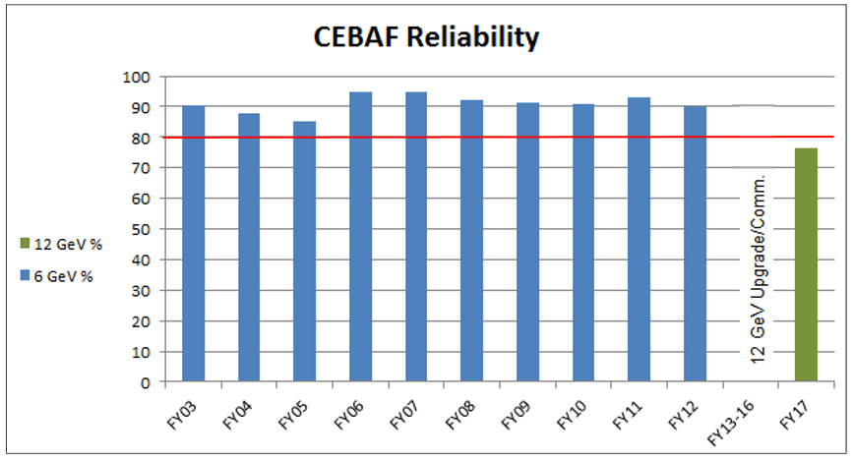
Reliability
Reliability following 12GeV upgrade has been lower than desired
Designing a site-wide approach with a plan
Continue normal maintenance
Expand learned maintenance (things learned as equipment ages)
Critical spares (expensive or long lead time items)

Slide 14
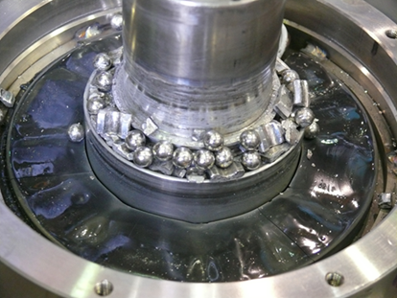
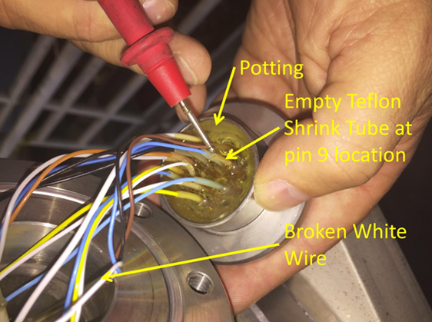
Cryogenics Reliability
CHL1 SC1 Cold Compressor #4 March 2015
Cold compressor bearings failed after site wide power outage
Spare compressor was installed
CHL1 SC1 Cold Compressor #5 March 2017
Compressor stopped spinning
Broken wire on radial position sensor connector
Issue repaired and cold box returned to service
CHL1 Contamination Issue During Maintenance Period
Unusual partial power outage within CHL complex
Resulted in ingestion of large amounts of air
CHL2 brought online to support LINACS
CHL1 cleaned and returned to service

Slide 15
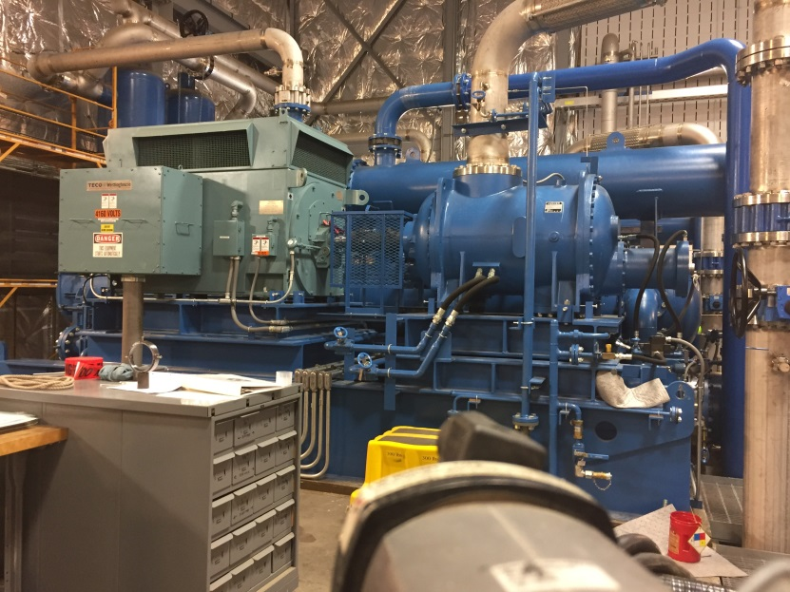
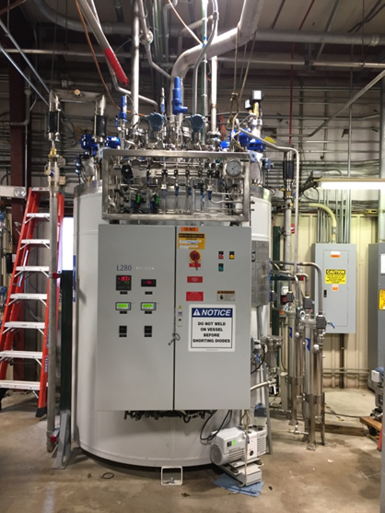
Recent Upgrades
CHL2 Main Compressor Summer 2016
New 6th warm 2500hp compressor installed
JLab design
Provides redundancy for other first and second stages because it can be valved in as low, medium, or high pressure stage for maintenance or repair activity
CTF Cold Box 3 Summer 2017
New Linde L280 cold box installed
Increased liquefaction capacity
Turbines instead of reciprocating expanders reduces maintenance load

Slide 16
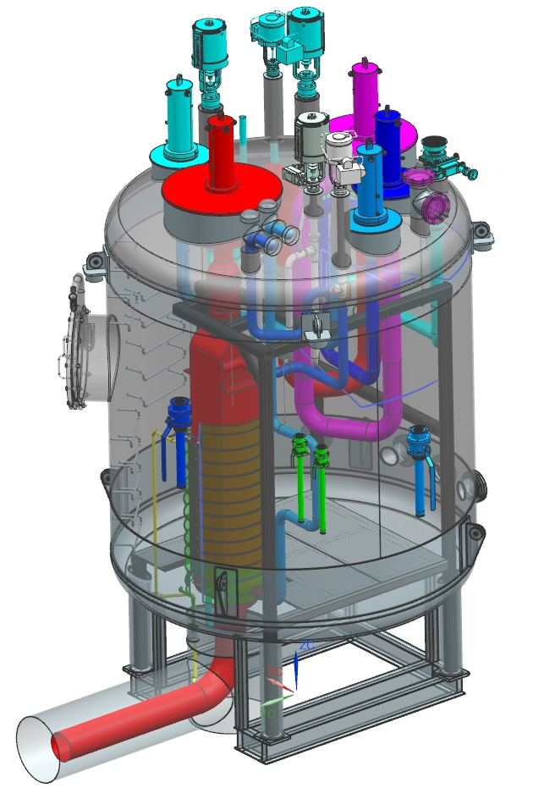
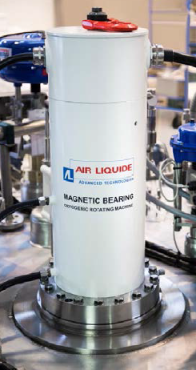
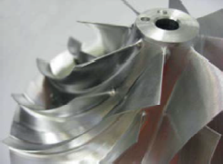
2.1 K Cold Box Replacement
This project is funded to replace the existing SC1/M 2.1 K cold box. It is being designed for the following 3 modes of operation:
Maximum Capacity: 250 g/s @ 28 mbar (CC1 suction)
Nominal Capacity: 200 g/s @ 31 mbar (CC1 suction)
Minimum Capacity: 170 g/s @ 31 mbar (CC1 suction)
CC Discharge will be ~1.2 bar and ≤ 30 K
Water Cooled Motors
3D Impellers for Cold Compressors
Replicates capacity of the existing 2.1K Cold Boxes
MSU-FRIB and LCLSII will be using similar systems
Expected to install and commission by Dec 2020.

Slide 17
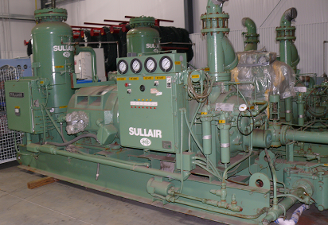
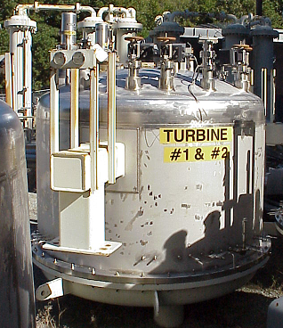
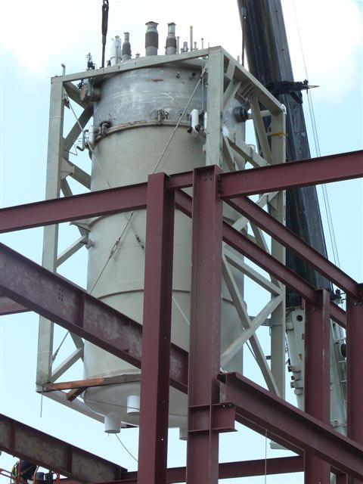
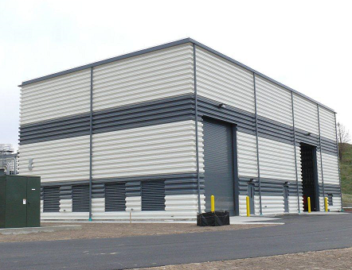
End Station Cryogenics Upgrade
History: ASST-A Cryogenic System
Originally procured in 1992 by SSCL
Magnet Testing Lab for Magnet String Test
Preliminary concept of Floating pressure process (Ganni Cycle)
Developed and successfully used for the variable capacity operation
to recover after the magnet string quench test
Majority of the components already present at Jlab
Attempting to obtain SLI funding to complete design, installation, and commissioning

Slide 18
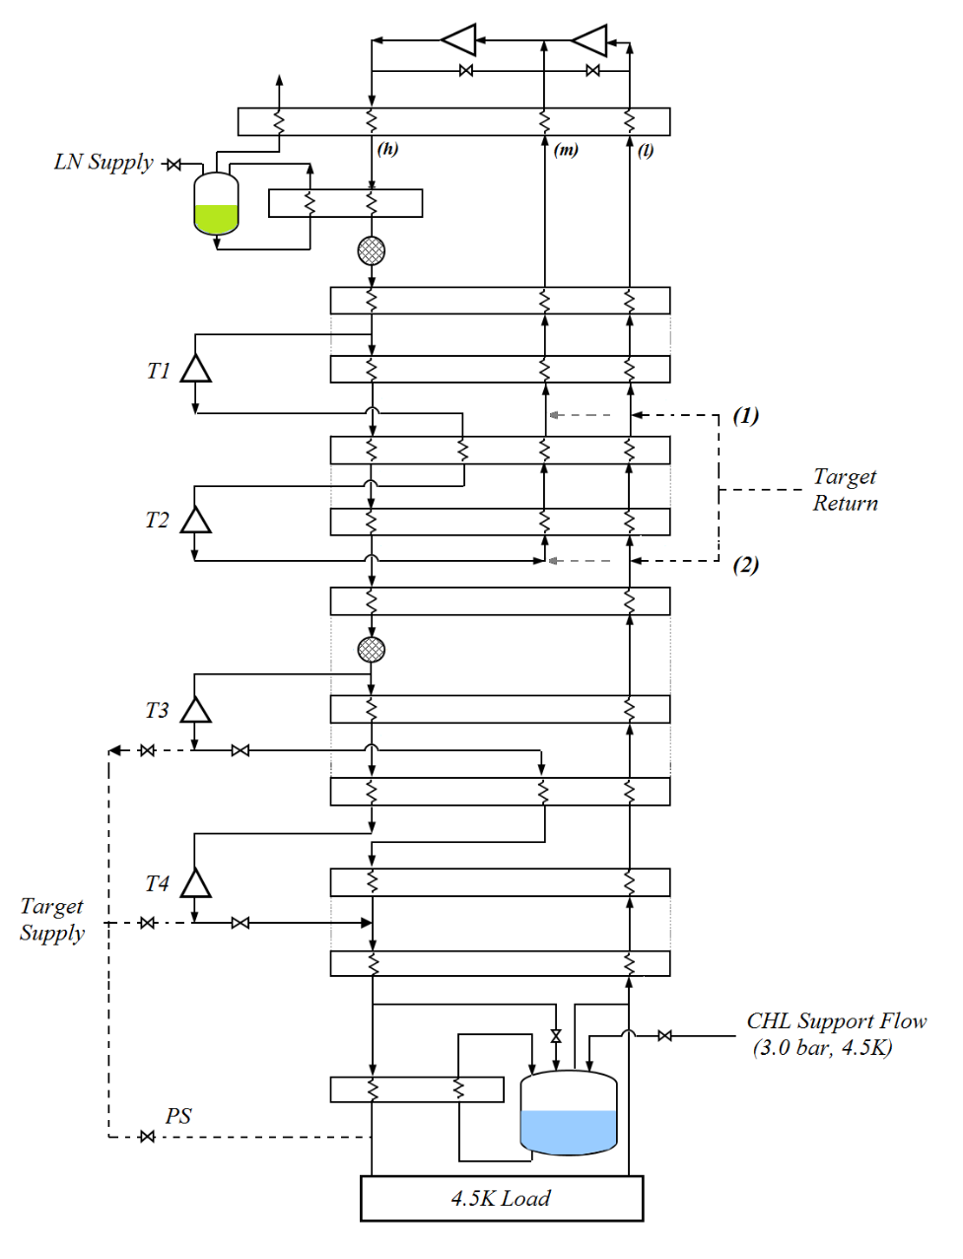
ASST-A Cryogenic System (contd.)
Features¹
4.0 kW 4.5 K cold box
Tested Capacity:
Compressor System (Sullair)
2x 186 kW (250 hp) 1st stage
2x 522 kW (700 hp) 2nd stage
Four turbo-expanders
Eleven heat exchangers
Grouped into six brazed aluminium cores
Two 80 K beds, One 20 K bed
Will modify to add 15K/20K taps
Mode | 4.5K Refrigeration Capacity | 4.5K Liquefaction Capacity
Refrigeration | 4026 W | -
Liquefaction | - | 34.3 g/s
Mixed | 2235 W | 22.6 g/s
¹ Ganni and Apparao, Design, verification and acceptance testing of the ASST-A helium refrigeration system

Slide 19
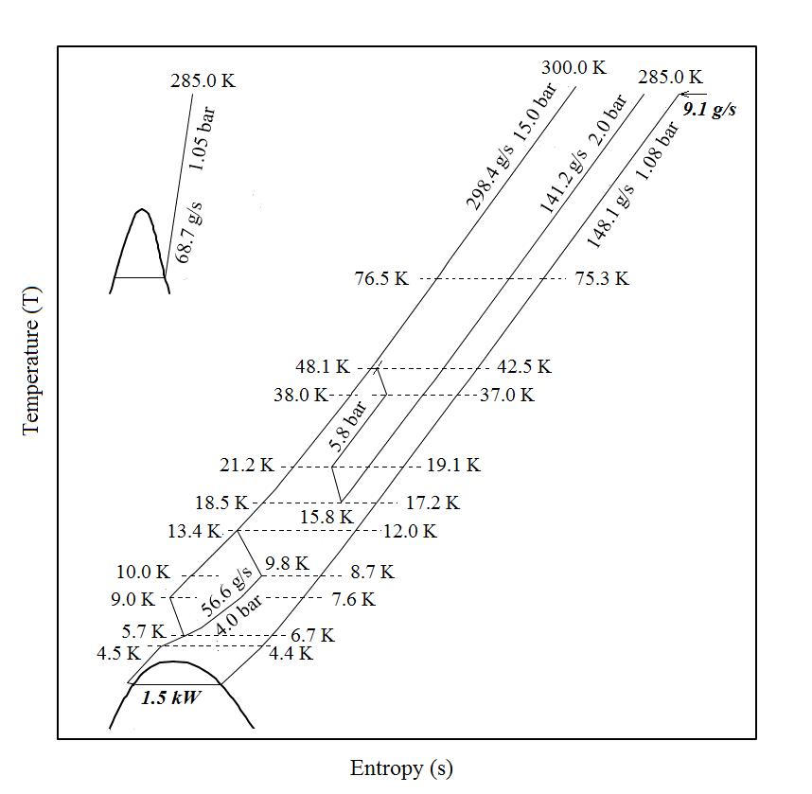
Applicability to 12 GeV Loads
Performance of ASST-A supporting baseline 12 GeV era cryogenic loads
Started Process Simulations:
15.0 bar Supply to Cold Box
Medium pressure (MP) stream at 2.0 bar
Significant 1st Stage Bypass (102.1 g/s) available
LN Consumption 68.7 g/s (~ 80 gph)
No Target load is considered in this case.
Supporting a 5.0 kW (20K) target additionally would require ~ 25 g/s of 3.0 atm, 4.5 K SCHe flow from CHL.
Working to secure SLI funding

Slide 20
Conclusion
Jefferson Lab Cryogenics Department
Operates five major cryogenic facilities at JLab
Performs maintenance and repairs across the facilities year round
Perform upgrades for expanded capabilities or equipment end of life
Qweak heat exchanger
CHL2 C6 compressor
CTF cold box 3
CHL1 2K cold box replacement
End station cryogenics upgrade
Continuously improve the next generation cryogenics equipment
More flexibility
Lower power consumption
Lower LN2 usage
Improved reliability

