Slide 1
The g₂p Experiment: A Measurement of the Proton’s Spin Structure Functions 2018 Status Update
University of New Hampshire Nuclear & Particle Physics Group
David Ruth
Hall A Collaboration Meeting
January 24, 2018
Most Slides & Figures by Ryan Zielinski

Slide 2
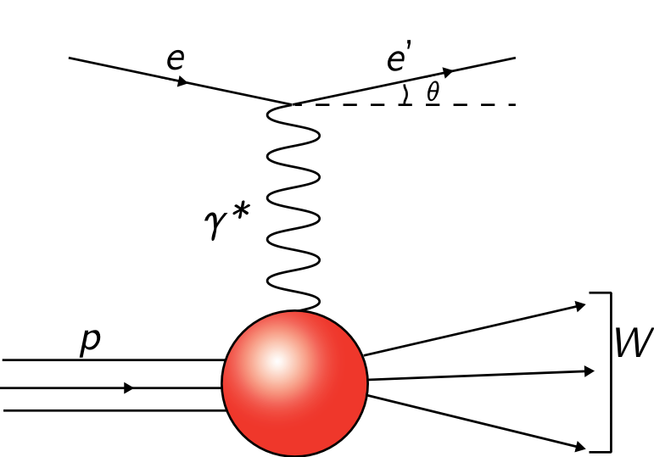
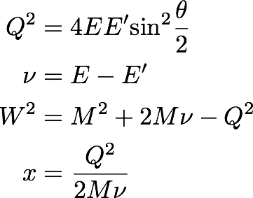
Essential Quantities in ep Scattering
Detectors
Electron and QED are known quantities so define everything in those terms:
Detectors
Electron and proton exchange a virtual photon in EM interaction

Slide 3
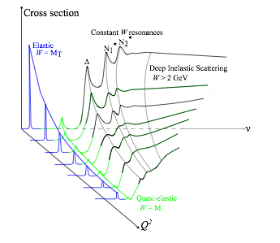
Inclusive ep Scattering Cross Sections describe normalized interaction rate
Elastic scattering: target remains in the ground state after interaction
Mott cross section describes scattering from point-particle:
Rosenbluth cross section describes deviation from point-particle:
GE and GM related to charge and current distributions
Notes:
highlight resonance region

Slide 4
Inclusive ep Scattering Cross Sections describe normalized interaction rate
Inelastic scattering: Target is in excited state after interaction
Structure Functions:
Inclusive unpolarized cross sections
F₁ and F₂ related to quark/gluon distribution
Adding a polarized beam and target adds two more structure functions
g₁ and g₂ related to spin distribution
Notes:
highlight resonance region

Slide 5
Extracting Spin Structure by Looking at Cross Section Differences
Inclusive polarized cross sections
Parallel
Perpendicular
Two equations, two unknowns…

Slide 6
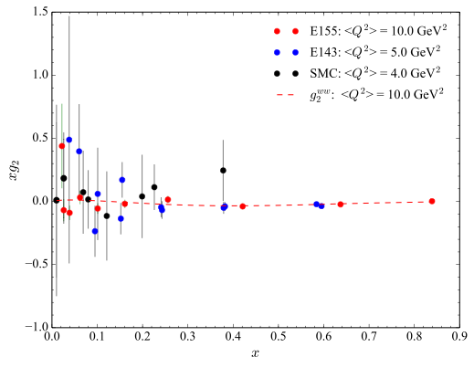
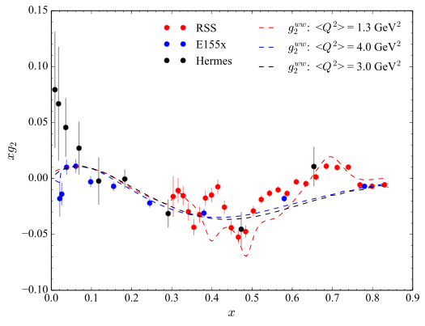
Motivation:
Measure a fundamental spin observable (g₂ ) in the region 0.02 < Q² < 0.20 GeV² for the first time
Measurements at Jefferson Lab:
RSS – medium Q² ( 1-2 GeV²) (published)
SANE – high Q² (2-6 GeV²) (analysis)
g₂p – low Q² (0.02-0.20 GeV²) (analysis)
Low Q² is difficult:
Electrons strongly influenced by target field
Strong kinematic dependence on observables
Low Q² is useful:
Test predictions of Chiral Perturbation Theory (χPT)
Test sum rules and measure moments of g₂
Study finite size effects of the proton
g₂p experiment ran spring 2012 in Hall A
g2

Slide 7
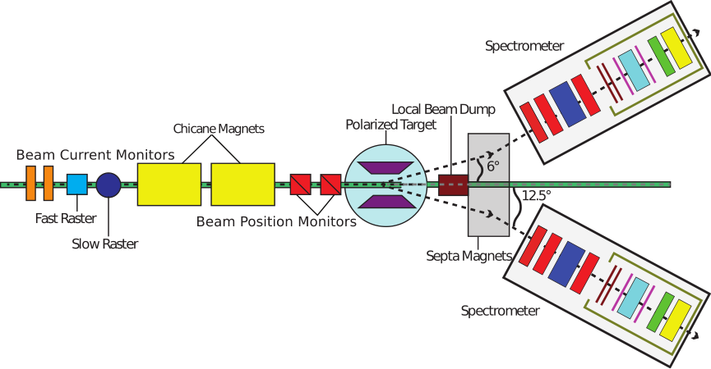
Hall A Experimental Setup:
Transverse polarized NH₃ target (2.5/5.0T)
Dipole chicane magnets help compensate for target field bending of beam
Measuring
Electron Beam
Polarized Proton Target
Spectrometer/Detectors
Small Scattering Angle
Dipole septa magnets get around space limitations of spectrometer
Spectrometer detectors provide trigger, tracking and particle identification
Achieved record Hall A DAQ rate of 6-7 kHz during the run period
Spectrometer detectors provide trigger, tracking and particle identification
Achieved record Hall A DAQ rate of 6-7 kHz during the run period
Spectrometer detectors provide trigger, tracking and particle identification
Achieved record Hall A DAQ rate of 6-7 kHz during the run period

Slide 8
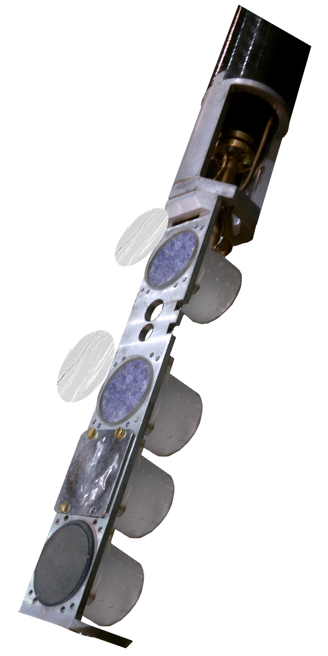
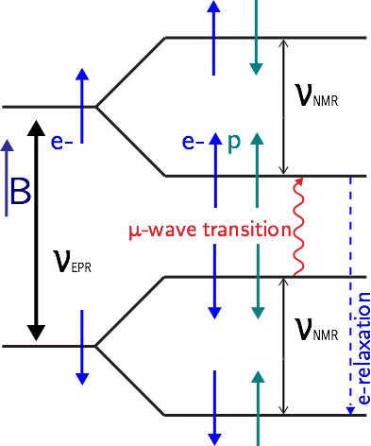
Polarized Protons Created with Dynamic Nuclear Polarization (DNP)
Creating initial polarization:
Align spins in large B and low T
5.0 T/ 2.5 T @ 1 K
Large μe (~660μp) creates large electron polarization (~99% at 5T/1K)
Enhancing initial polarization:
Proton pol. much smaller (~0.5% 5T) at TE
ep spin coupling and microwaves drive pol.
Electrons relax much quicker than protons so polarization is sustained
Large μe (~660μp) creates large electron polarization (~99% at 5T/1K)

Slide 9
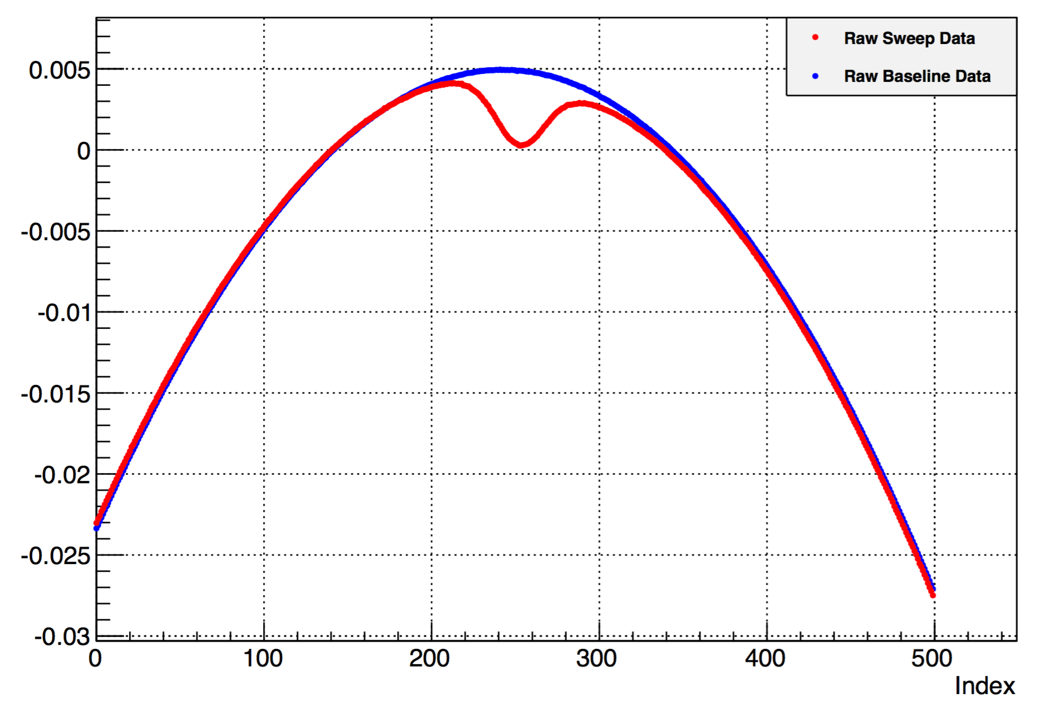
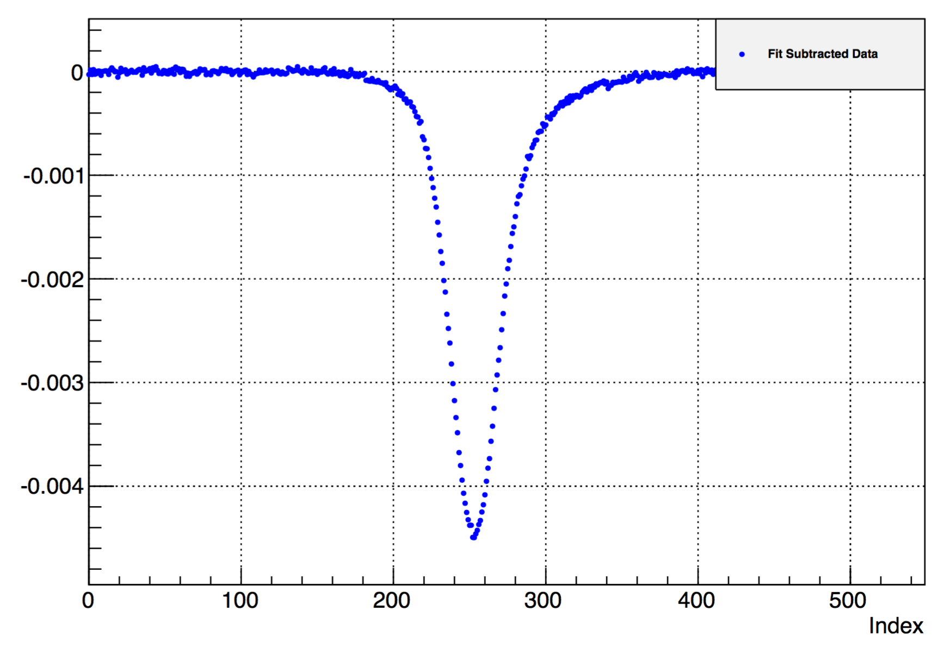
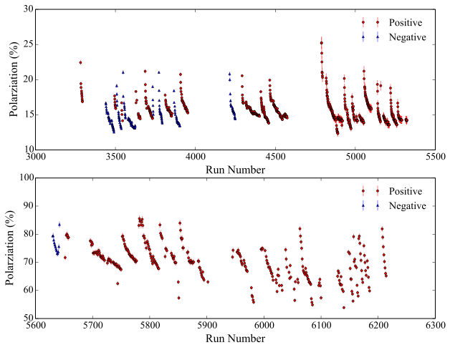
Proton Polarization Measured with Q-Meter
LRC circuit where proton spin’s couple with and change inductance
Average proton polarizations ~75% (5.0T)
T. Badman (2013) TN #08:
http://hallaweb.jlab.org/experiment/g2p/collaborators/toby/technotes/target.pdf

Slide 10
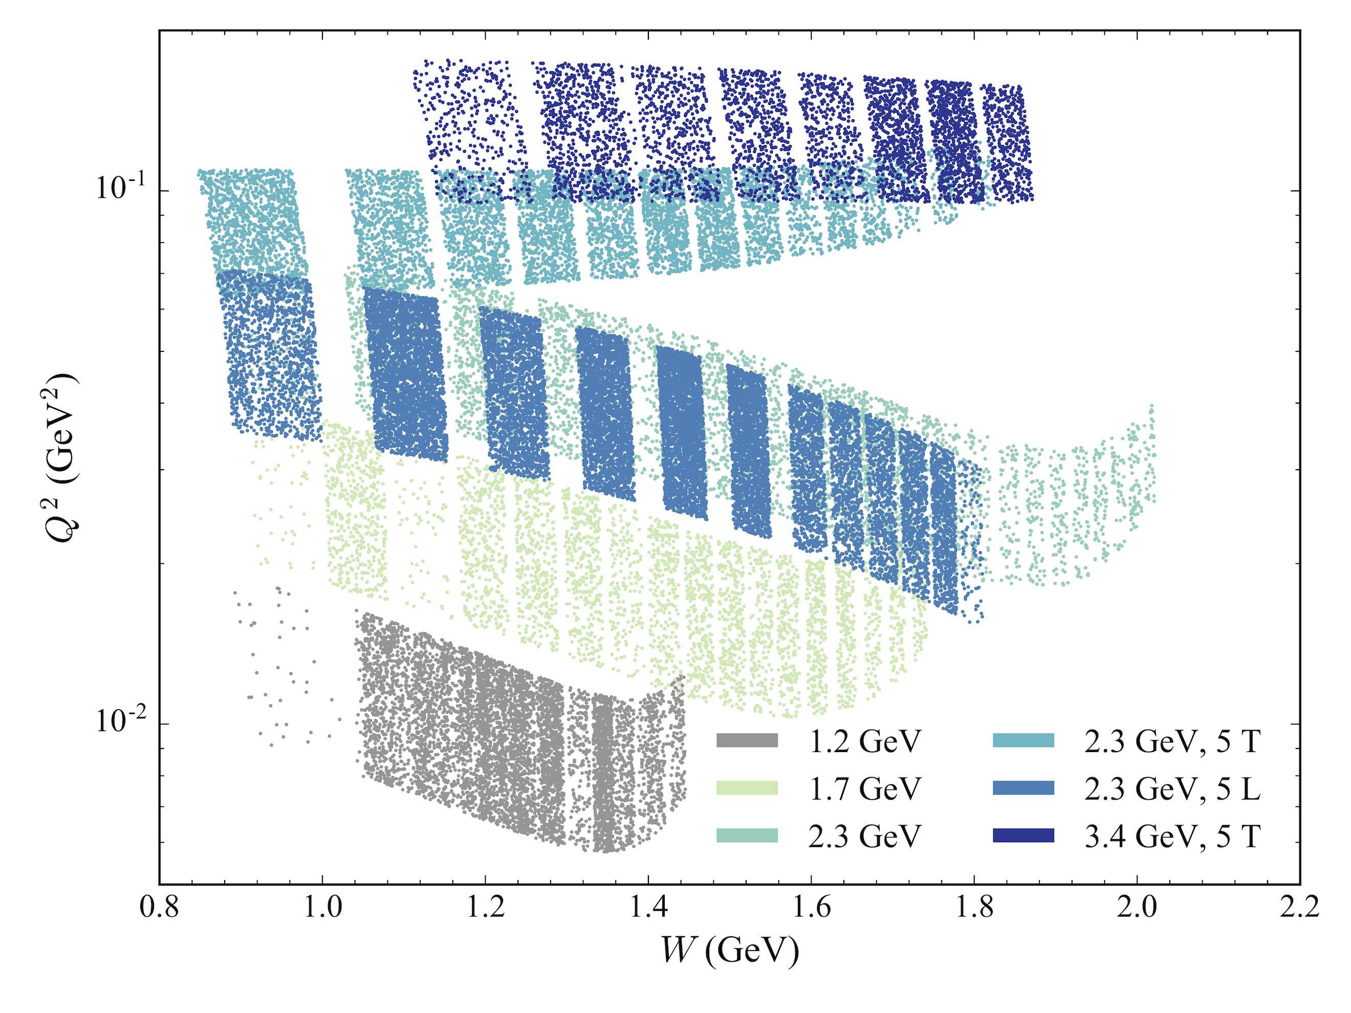
g₂p Kinematic Coverage

Slide 11
MEASURING g1,2 from data
What can we measure?
Helicity dependent asymmetries
Unpolarized cross sections
Polarized cross sections
1.
2.
3.
Similar equation for parallel polarized cross section
Why do it this way?
Asymmetries are easy to measure
Lots of data on unpolarized cross sections so models are a possibility
Need to be mindful of contributions from scattering from anything other than protons

Slide 12
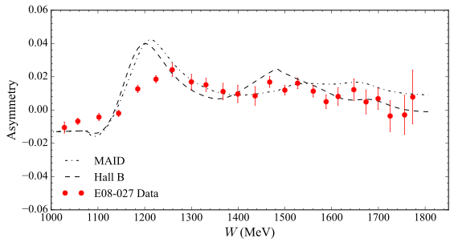
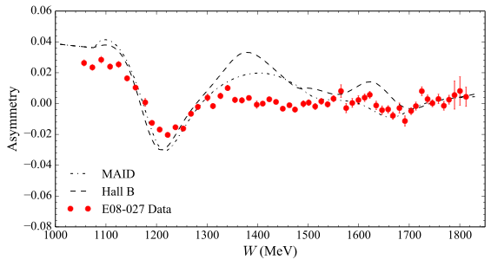
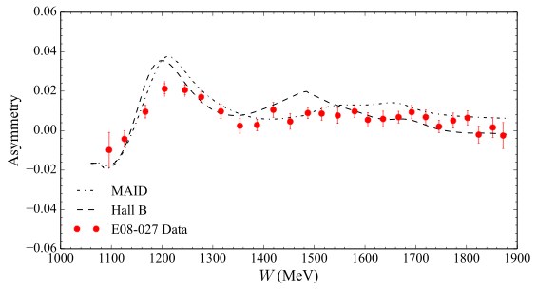
5T Proton Asymmetries
2.2 GeV
Transverse
2.2 GeV
Parallel
Preliminary
Preliminary
Raw Counts:
3.3 GeV
Transverse
Measured Asymmetries:
Preliminary
raw
Combine both HRS for best statistics!
dilution factor
beam/target pol

Slide 13
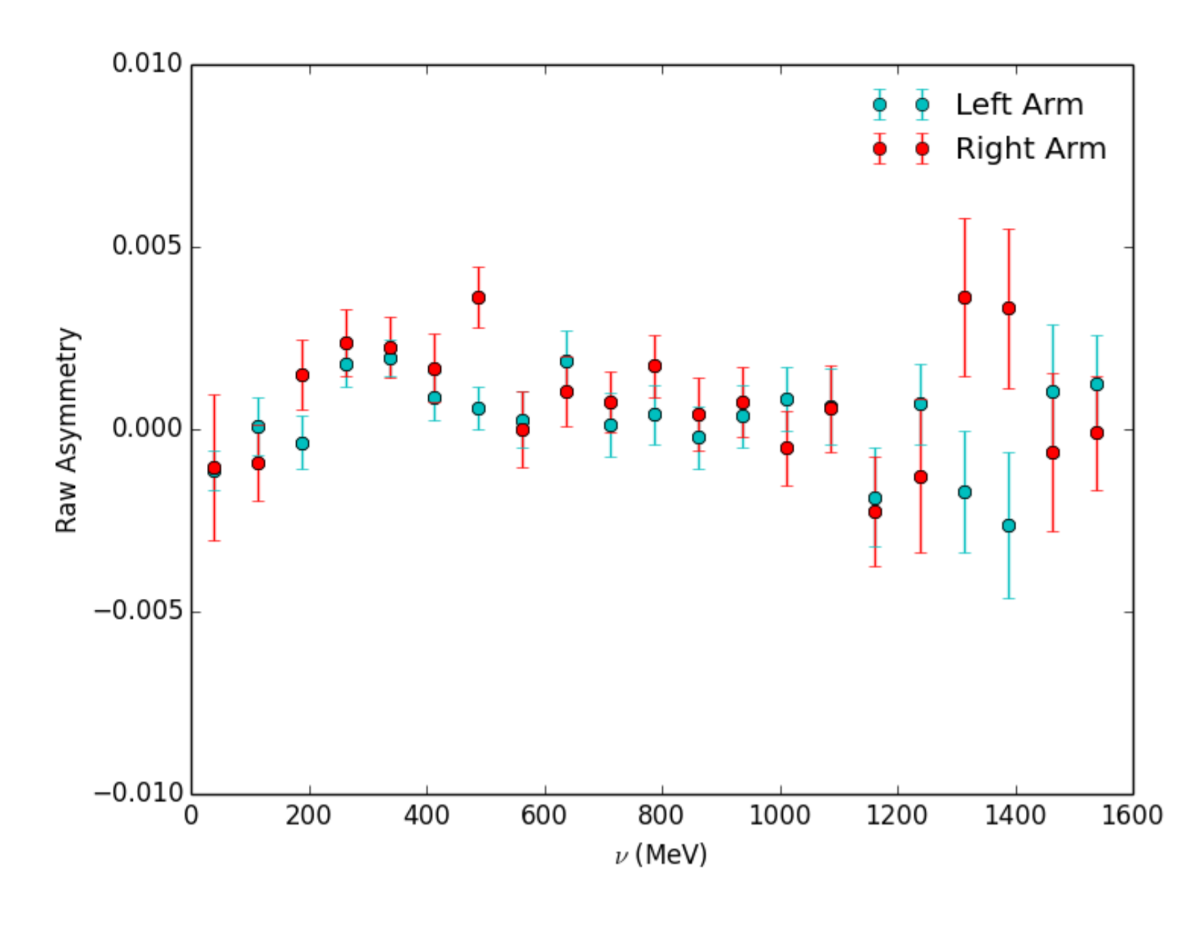
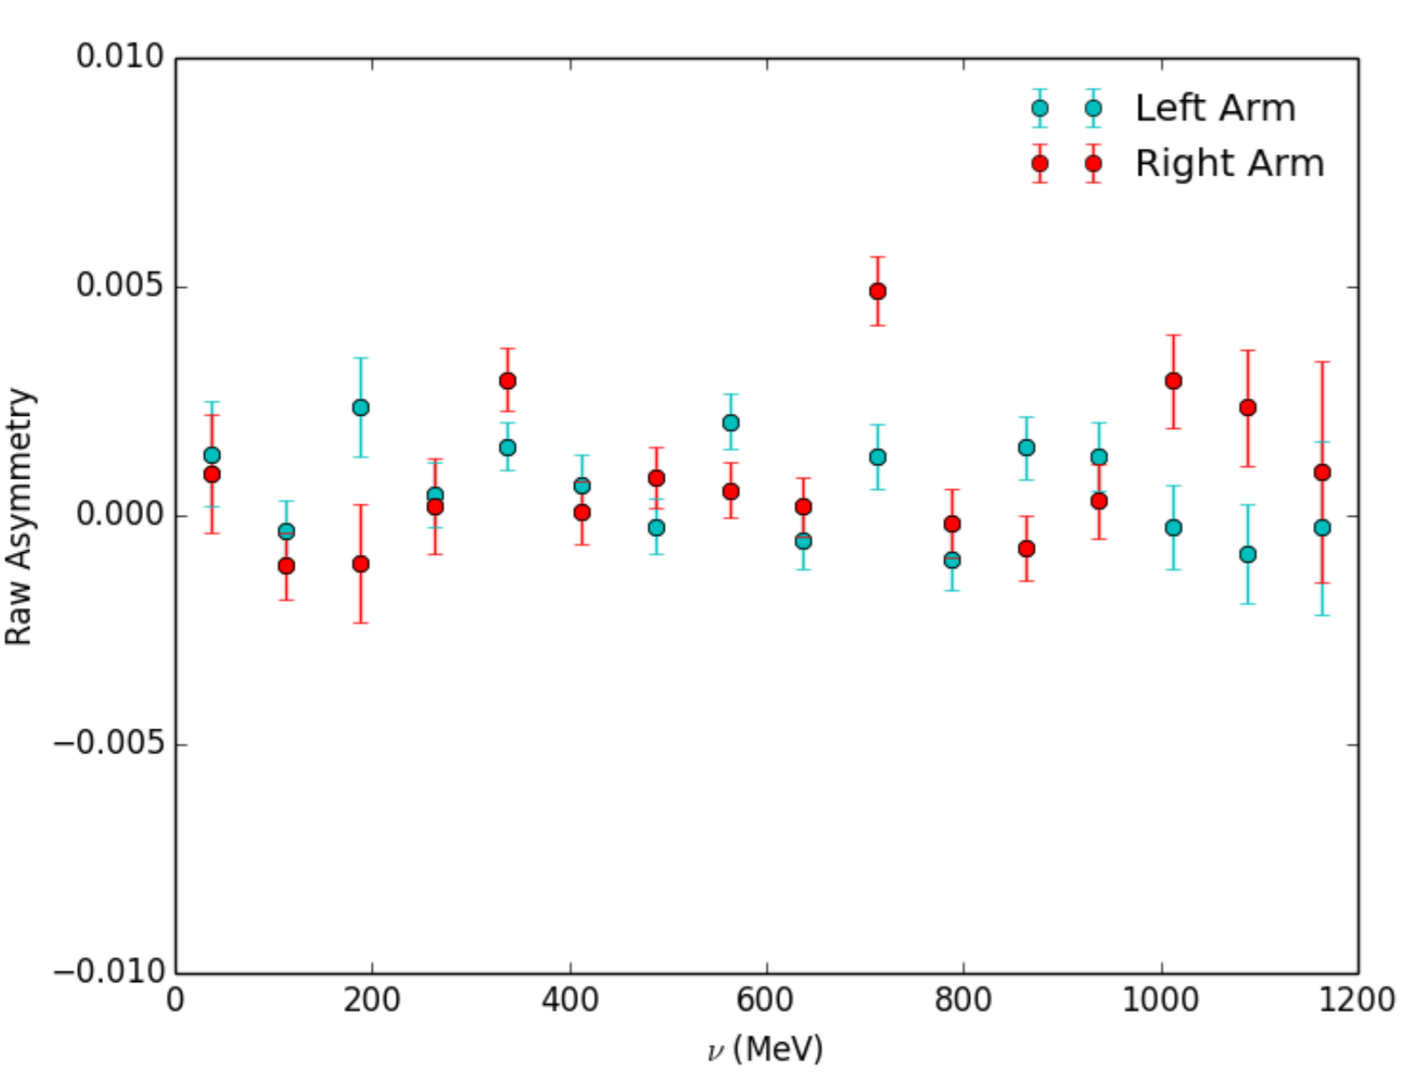
2.5T Proton Asymmetries
2.2 GeV
Transverse
1.7 GeV
Preliminary
Unfinished
Unfinished
2.5T Asymmetries show systematic shift in many places, working on resolving before data is usable
1.1 GeV data has large systematics
that make it hard to work with.

Slide 14
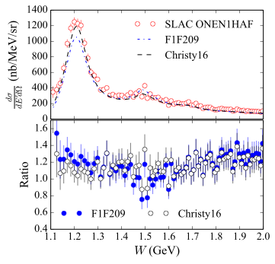
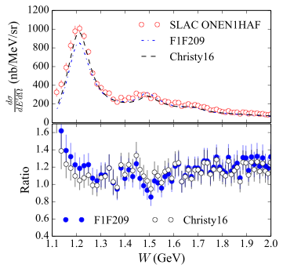
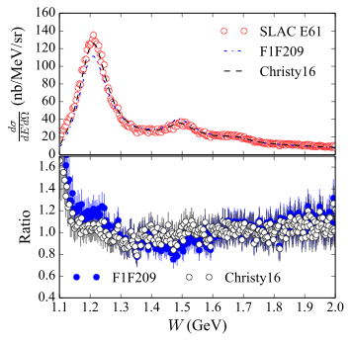
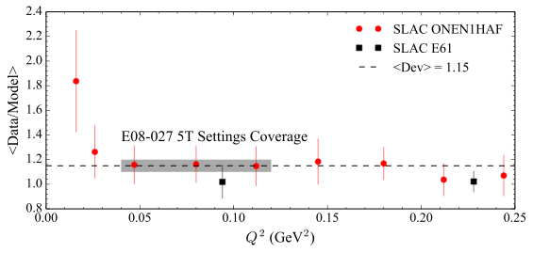
Model Cross Section
Use proton model for unpolarized cross section
Does a good job of reproducing data at E08-027 kinematics

Slide 15
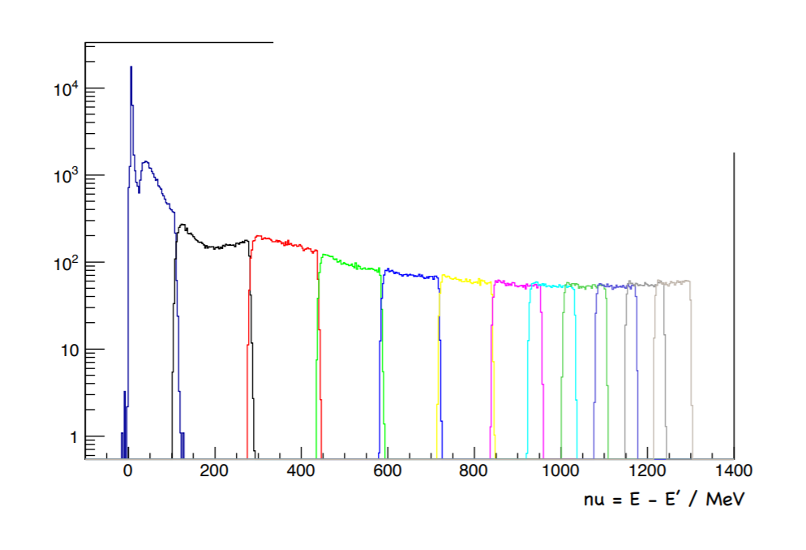
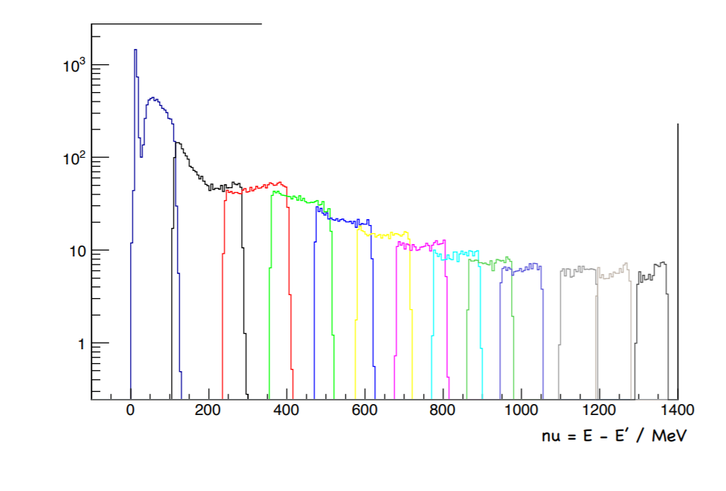
Acceptance Study
Acceptance study is on-going, we hope to be able to use data
instead of model cross sections soon
Continuity on longitudinal spectrum for most recent acceptance is good, not as much on transverse
Longitudinal
Transverse

Slide 16
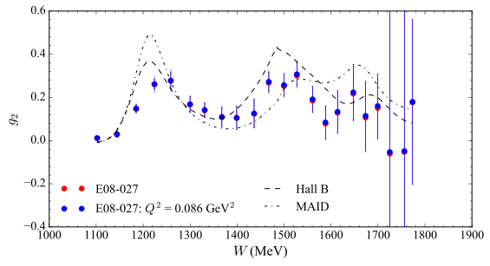
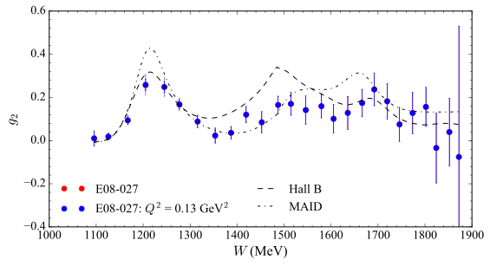
Extracting the Spin Structure Functions : g₂
2.2 GeV
Model driven procedure for unmeasured part
Preliminary
3.3 GeV
Adjusting to a constant Q²
Preliminary
Small effect at the transverse settings

Slide 17
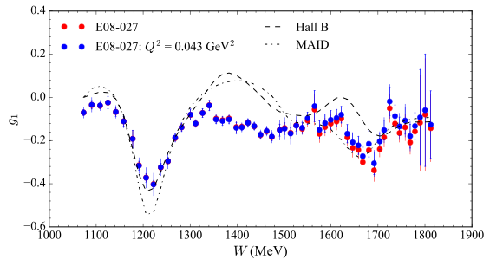
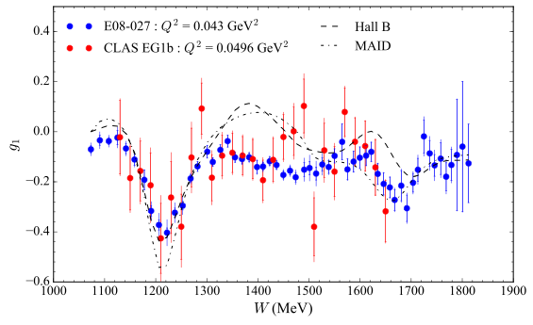
Extracting the Spin Structure Functions: g₁
Model driven procedure for unmeasured part
Preliminary
2.2 GeV
E08-027 data is consistent with previously published data from CLAS
But with much better statistics!!
http://clas.sinp.msu.ru/cgi-bin/jlab/db.cgi

Slide 18
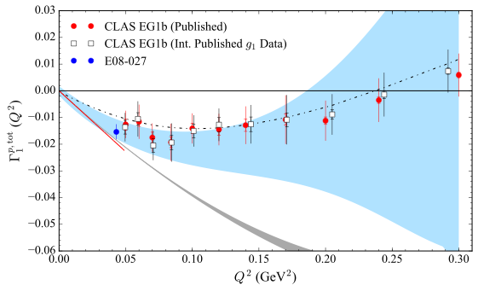
First Moment of g1 (x,Q²)
Moments provide a useful quantity that can be related back to
theory predictions!
Preliminary
K.V. Dharmawardane (2006) et al.
https://doi.org/10.1016/j.physletb.2006.08.011

Slide 19
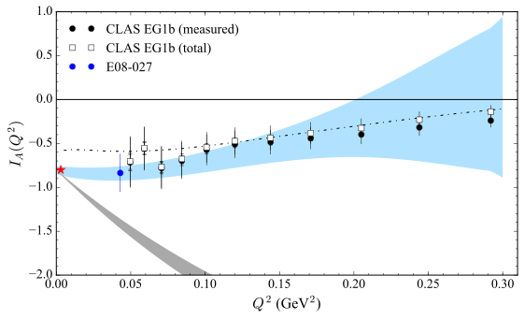
Extended GDH Sum
Preliminary
http://clas.sinp.msu.ru/cgi-bin/jlab/db.cgi

Slide 20
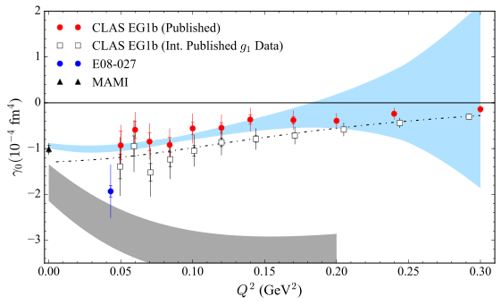
Forward Spin Polarizability
Preliminary
CLAS Pub:
doi.org/10.1103/PhysRevLett.91.192001
Y. Prok (2008) et al.
10.1016/j.physletb.2008.12.063
H. Dutz (2003) et al.

Slide 21
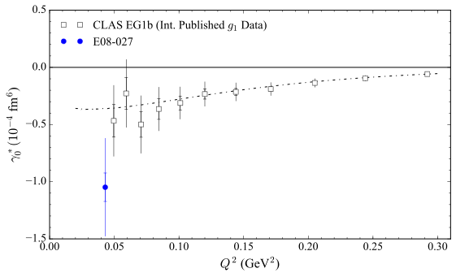
Higher Order Polarizability
Preliminary

Slide 22
Conclusions
Experimental measurements of proton structure are key to understanding the proton!
The g₂p experiment was a precision measurement of proton g₂ in low Q² region for the first time!
Longitudinal data agrees with previous measurements.
5T Data Analysis is complete, 2.5T Analysis is ongoing. We hope to have publishable data at both the 2.2 GeV and 1.7 GeV energy levels at this target field.
Acceptance study is on-going, to allow us to use experimental unpolarized cross sections.
Packing fraction/dilution analysis also complete for 5T data, but may need more investigation for 2.5T data.

Slide 23
Acknowledgements
g2p Analysis Team
Spokespeople:
Alexandre Camsonne
JP Chen
Don Crabb
Karl Slifer
Graduate Students:
Toby Badman
Melissa Cummings
Chao Gu
Min Huang
Jie Liu
Pengjia Zhu
Ryan Zielinski
Post-Docs:
Kalyan Allada
James Maxwell
Vince Sulkosky
Jixie Zhang
Special thanks again to Ryan Zielinski for allowing me to adapt his slides
for this presentation.

