Slide 1
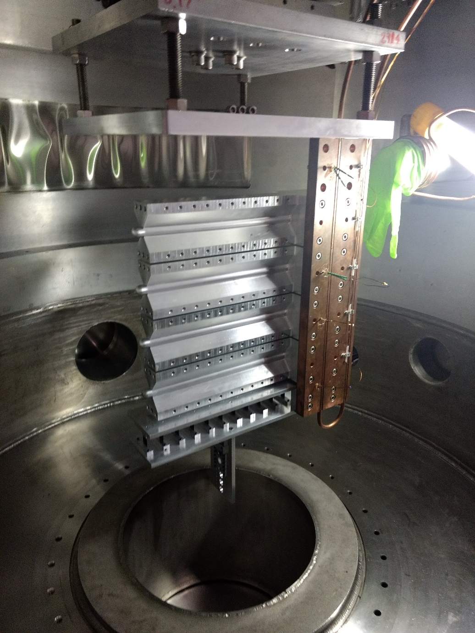
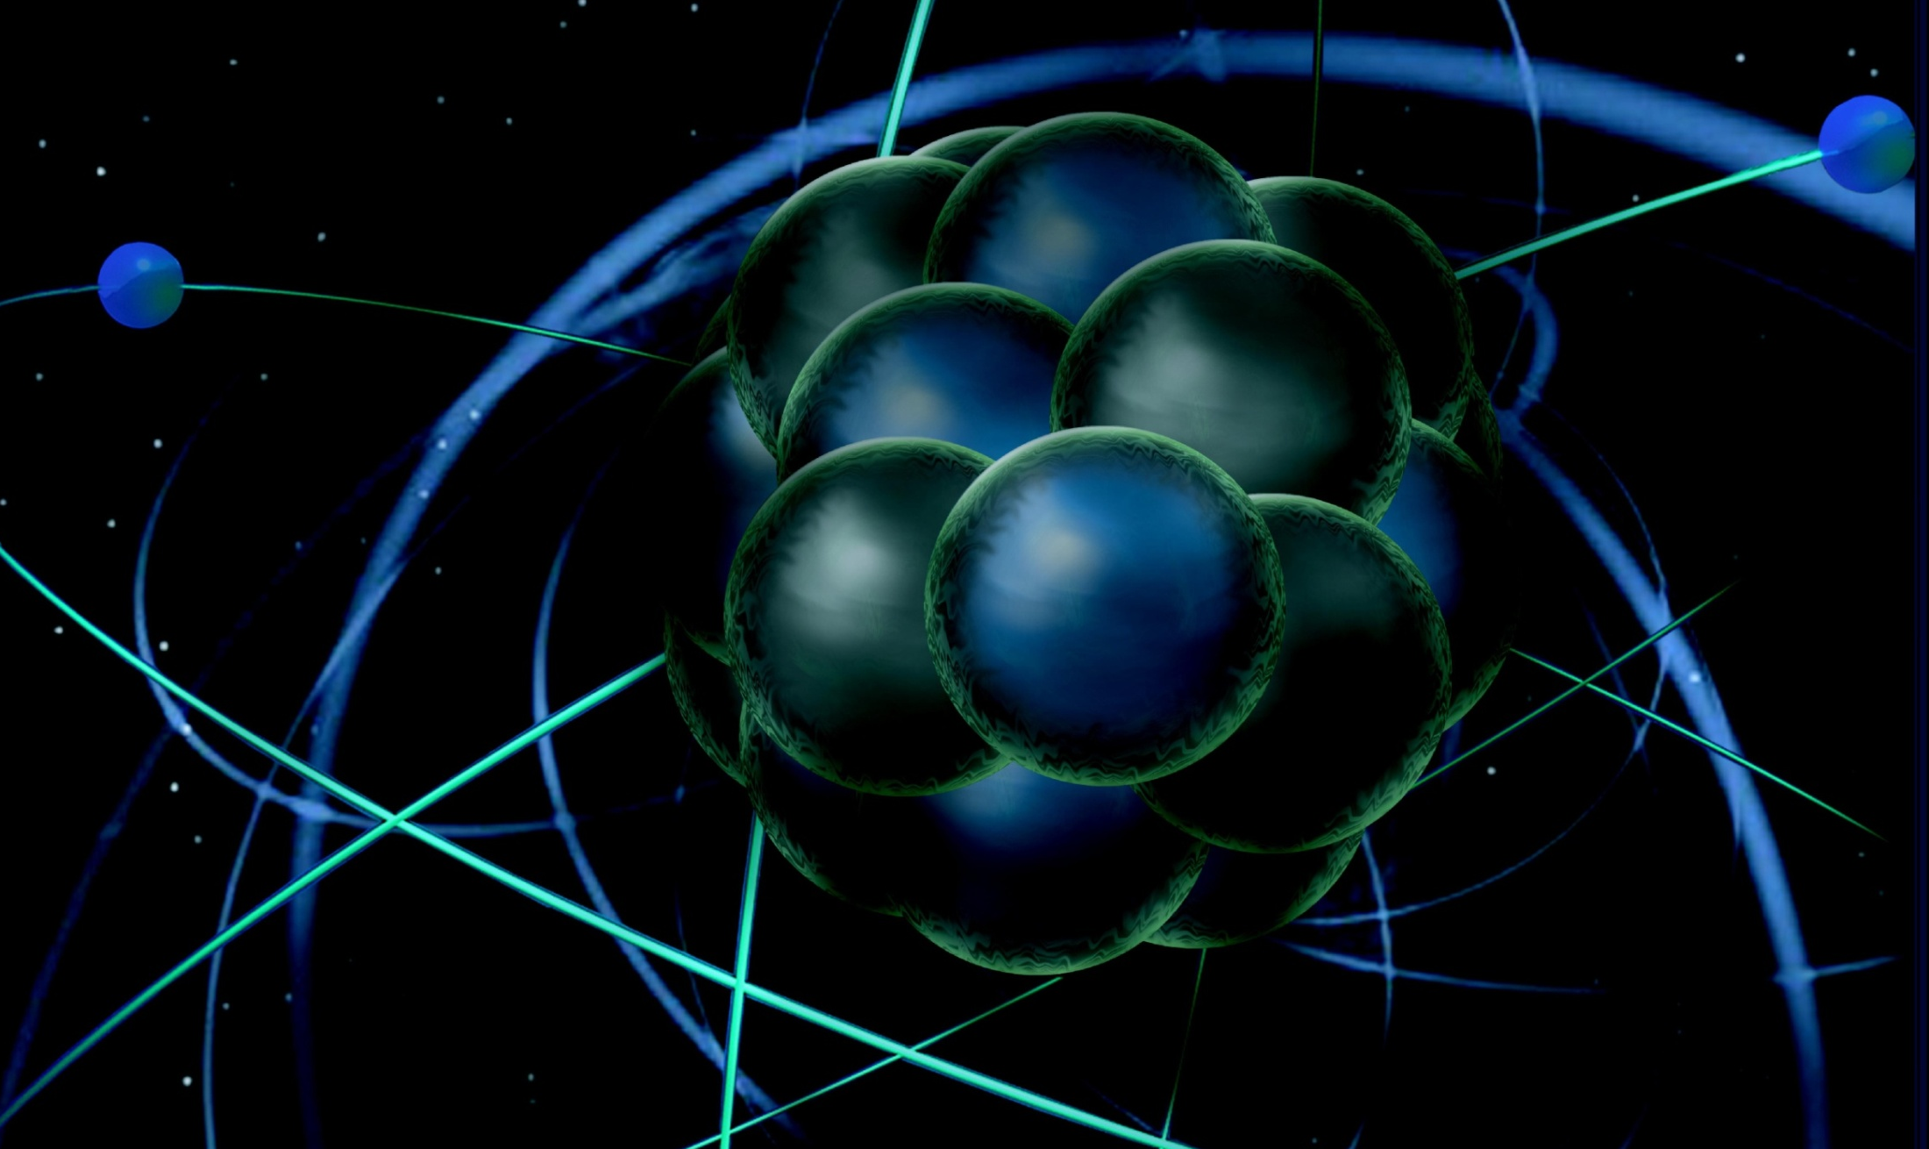
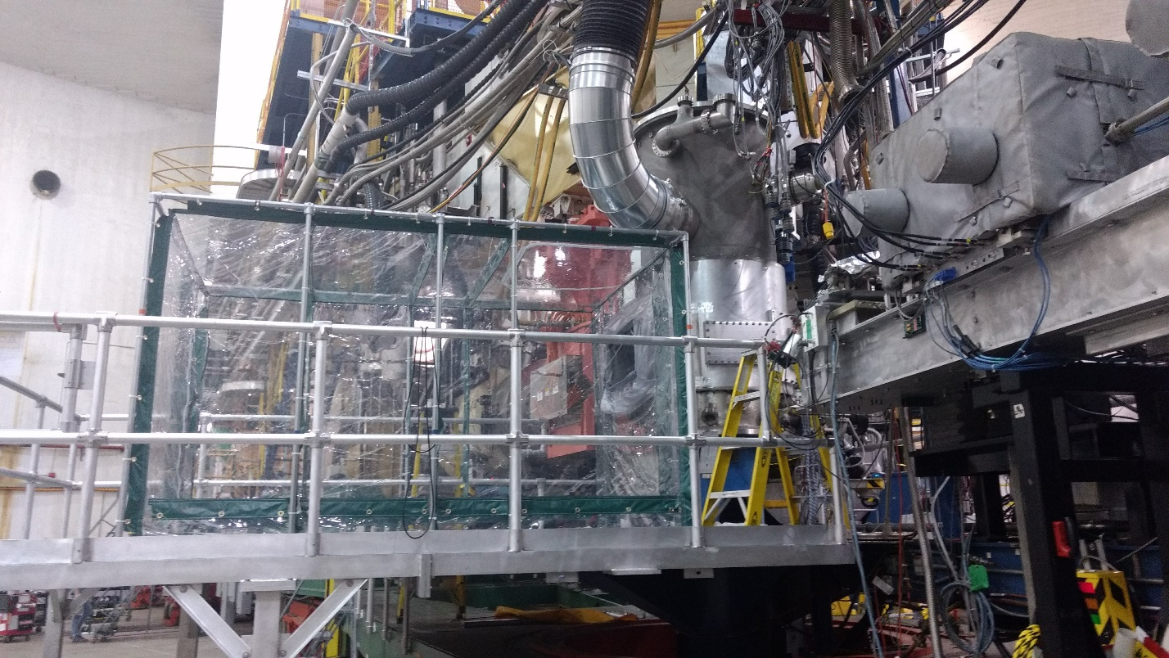
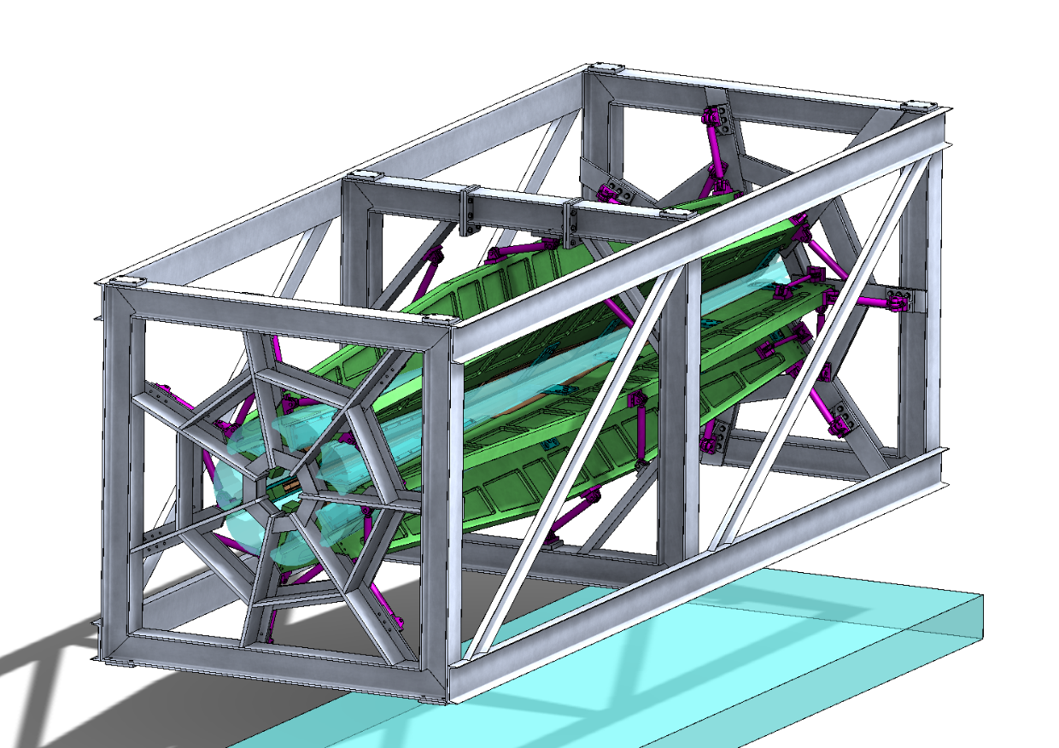
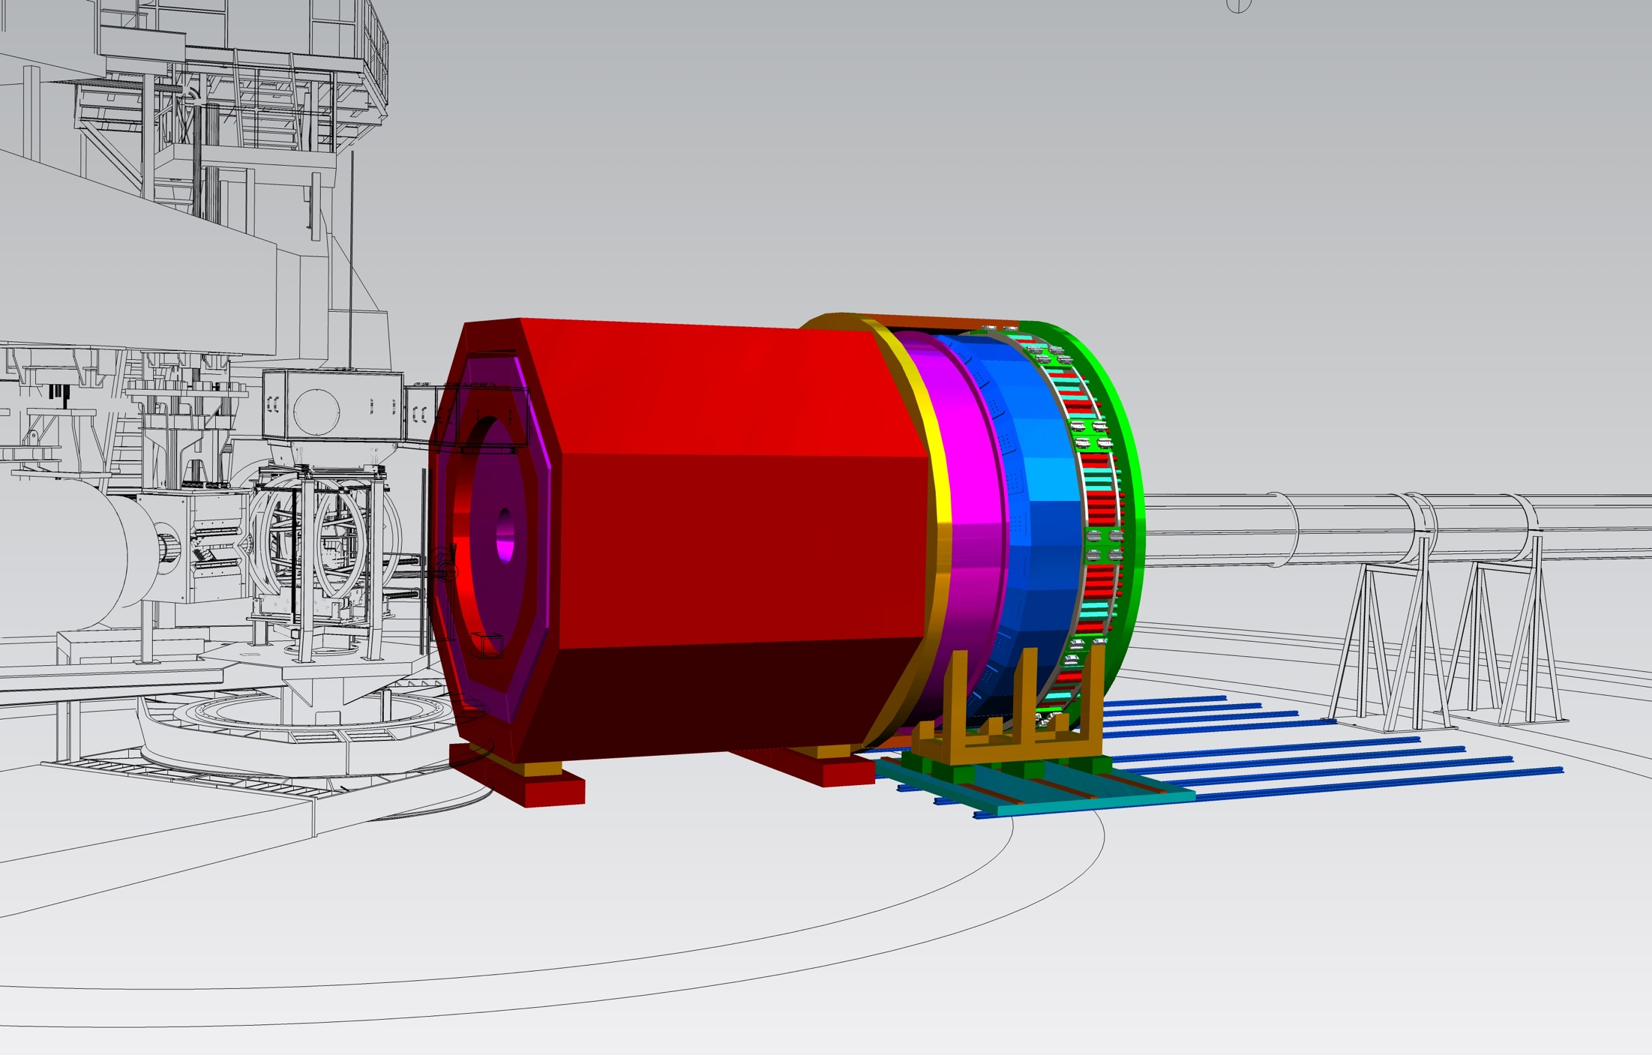
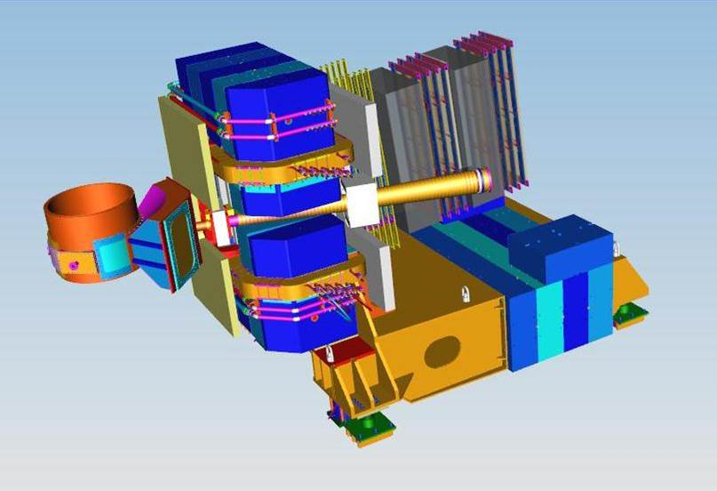
Hall A Status
Thia Keppel
Winter Hall A Collaboration Meeting
January 2018

Slide 2
Hall A Projected Experiment Schedule as of 1/18 (also see https://www.jlab.org/exp_prog/experiment_schedule/2018/20180108.2a.pdf through 12/18)
Spring | Fall | Spring | Fall | Spring | Summer !!!!
Ar(e,e’p) | ³H/³He group*
 |  | ³H/³He group | ³H/³He group
 |  |  |  | APEX | PREX2
Fall
CREX
CY
2017
CY 2018
CY
2019
New and exciting news!
This is the plan…
…BUT...there are caveats….
SBS 2020
MOLLER?, SoLID? →
Experiments in red represent PAC “high impact” experiments
11

Slide 3
Near(ish) term run plan caveats….
Assumes tritium run successful
No major difficulties causing a need to continue this run into Spring 2019
Assumes engineering, design, procurements ~complete in FY2018
Assumes (internal) budget planning was reasonable
Robin and team think possible – please respond promptly when they ask for information!
Trying for long lead time first, but can’t always anticipate vendor issues
Assumes summer 2019 running
A must for PREX2 (energy conflict with high priority multi-Hall running)
Not yet approved, in part FY19 budget dependent
Assumes fast installations are possible
Jessie thinks so, but is cautious….
Will take enhanced manpower (Hall C)
Plus all the usual assumptions
Aging spectrometer magnets still working, etc…

Slide 4
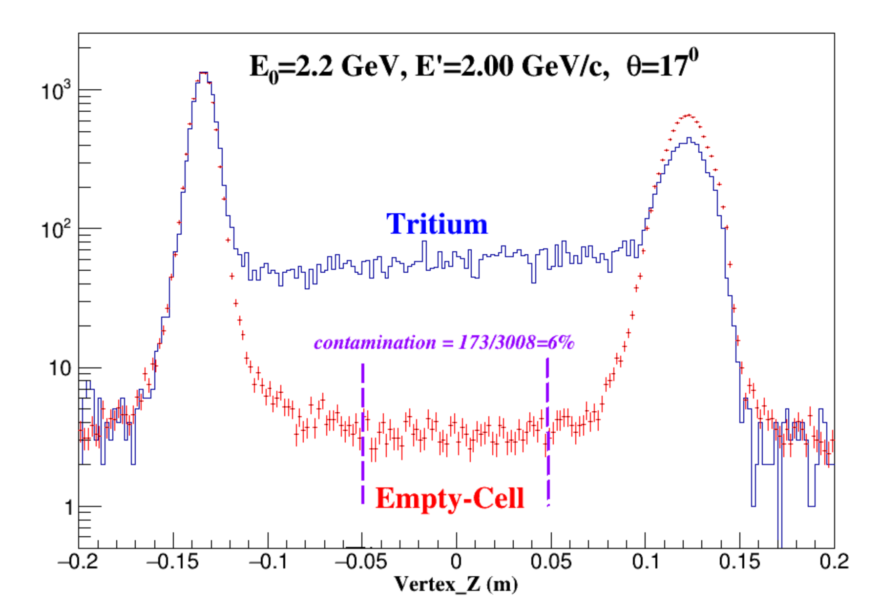
First Beam On Tritium Target Cell
On Friday the 15th of December Hall A put first beam on a tritium target cell.
Unfortunately, shortly after first beam on target, Hall A had a problem with the target lifter. This problem was quickly found and addressed by the Jefferson Lab target group.
Hall A restarted and is presently on-track with the tritium family of experiments Friday, January 12th.
LEFT Image: Waiting for first beam on the Hall A tritium target: UNH Ph.D. students Nathie Santiesteban and Shujie Li along with Jefferson Lab postdoc Evan McClellan and lab Director Stuart Henderson.
RIGHT Image: Shown is the tritium target data as compared to running a empty cell. The tritium gas is clearly visible in between the aluminum entrance and exit windows of the target cell.

Slide 5
HATT (Hall A Tritium Target)
See Makis, Shujie, Liguang, Rey talks this afternoon!!

Slide 6
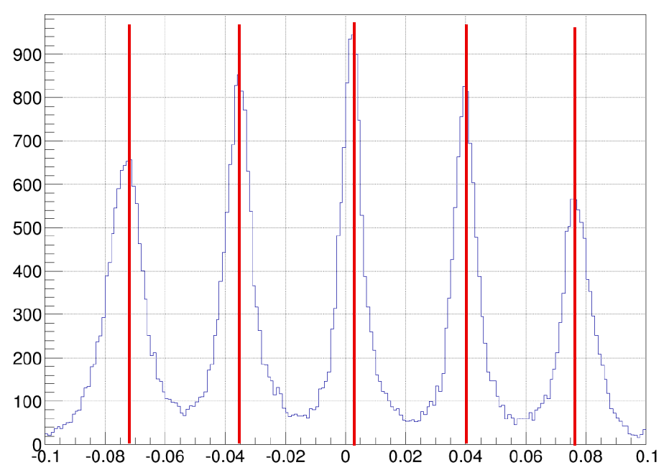
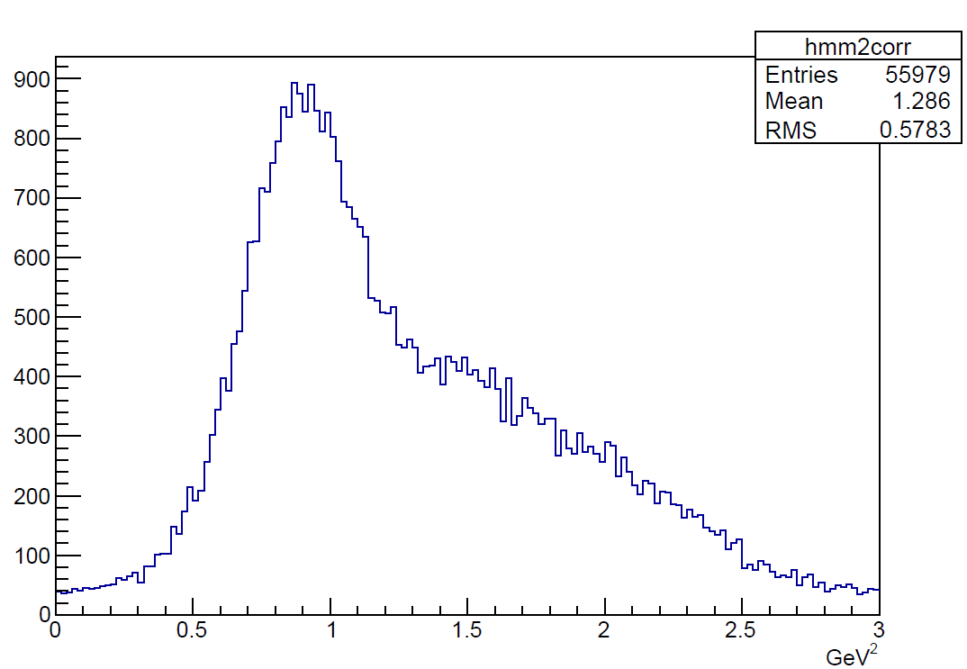
E12-06-114 DVCS at 11 GeV – See Bishnu’s talk this afternoon!
100 PAC days approved:
High impact experiment for nucleon 3D imaging program
High precision scaling tests of the DVCS cross section at constant x_{B}
CEBAF12 will allow to explore for the first time the high x_{B} region
HRS optics calibration
with detuned Q1 (C multi-foil target)
50% of experiment planned & completed in 2014-2016
Target vertex (m)
All calibrations (beamline+HRS+calo) completed
DVCS & π⁰ cross section analyses well underway
ep->eπ⁰X missing mass squared
Analysis path:
Jun’18: Preliminary results on π⁰ at x_{B}=0.36
Oct’18: Preliminary results on DVCS
Nov’18: Short paper submitted to PRL on π⁰
Jan’19: Letter to PRL on DVCS
Jul’19: Long paper to PRC (DVCS & π⁰)
Notes:
Suggested rework
Add bullet on What we are doing
Rolf to find another plot

Slide 7
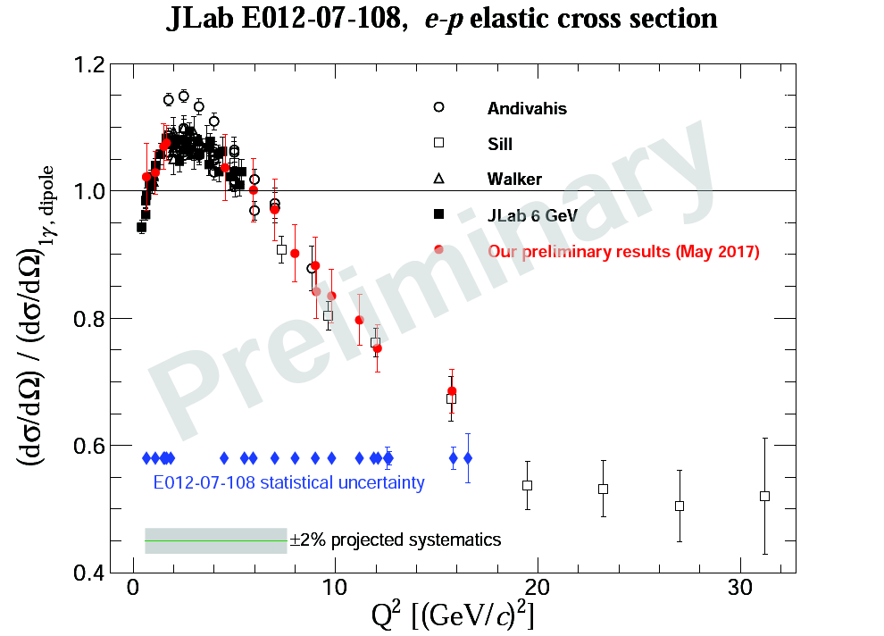
Precision Measurement of the Proton Elastic Cross-Section at High Q² – See Longwu’s talk this afternoon!
Precision e-p elastic cross-section necessary to:
Constrain two-photon exchange (TPE) contribution through global analysis
Determine GEp, GMp and TPE effect at high Q², in combination with future polarization measurements
Preliminary cross-section results presented below with 5% uncertainty (total)
The results with 3% uncertainty will be presented at April 2018 APS meeting.
As of January 9, 2018…
Completed analysis of:
Beam line
Target
Detector efficiency
Particle ID
SIMC model
W reconstruction
In final stage:
Optics for each HRS/Q1
3% level cross section

Slide 8
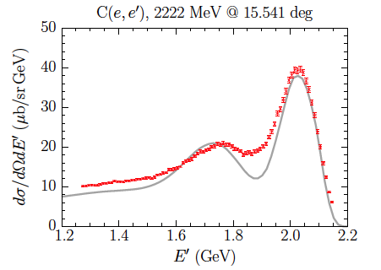
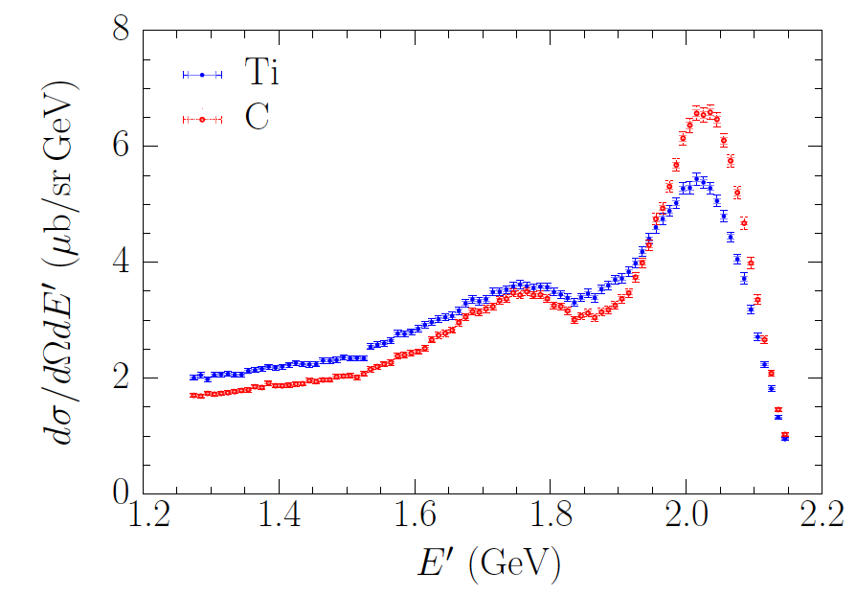
E12-14-012: Ti and Ar Measurements – see Vishvas’ talk this afternoon!
During 2017, Hall A completed experiment E12-14-012 to make measurements on Ti, Ar, and C targets in order to further our understanding of these many body systems, which are of particular interest to the neutrino scattering community.
Three Ph.D. students (two at VA Tech and one at the UVA) are working on the data analysis, with inclusive Ti and C cross section results nearly ready for publication (draft in circulation).
C
Theoretical prediction
obtained using SF
Left Image: The inclusive Carbon cross section compared to theoretical predictions using a Spectral Function from (Co-Spokesperson) Omar Benhar.
Right image: The per proton cross section of Carbon as compared to Titanium where Fermi motion broadens the quasi-elastic peak.

Slide 9
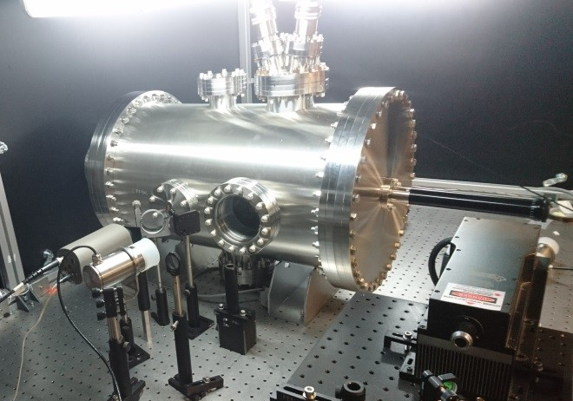
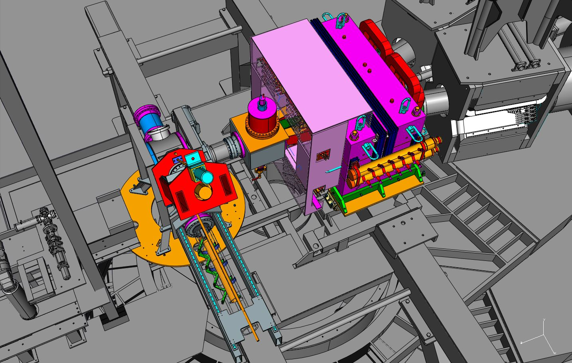
2019 Run Preparations
APEX
The septum magnet is in the Hall, ready to install vacuum channels and field test.
Nearly all equipment on site
Computation fluid dynamics for target design, target heating tests
Looking towards Spring 2019 run (but only part more compatible with PREX2/CREX)
See Vardan and Bob’s talks tomorrow afternoon!
target heating tests in LERF
PREX2/CREX
Successful ERR May 2017
Combined target chamber, shielding design, new target position
Computation fluid dynamics for target design, target heating tests
Polarimetry – Moller now removed from Hall for Kerr effect measurements, new target ladder design and installation
Regular parity quality beam meetings, beamline diagnostics during DVCS/GMp
Looking towards Summer 2019 run
combined PREX2/CREX design assembly in Hall

Slide 10
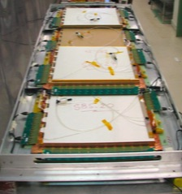
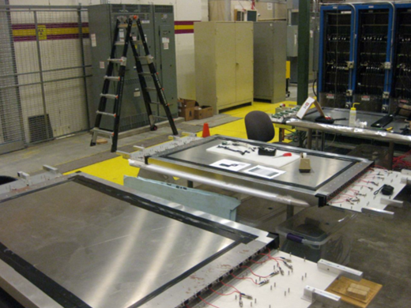
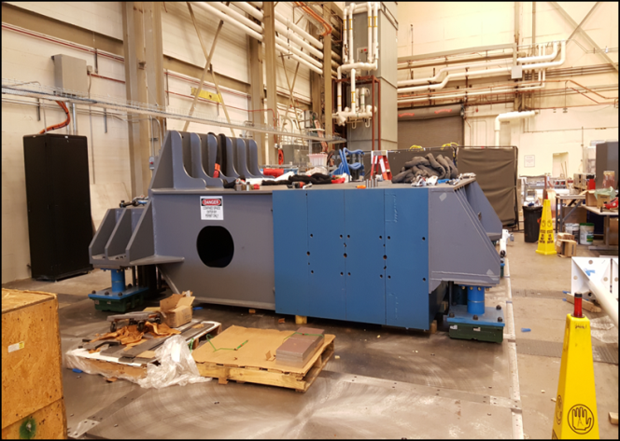
SBS Status/Timeline
GEM BT 3x50x40 cm² modules
SBS Project completed June 2017
Closeout document:
“As noted in previous review summaries, it is highly commendable that the base WBS projects were accomplished on time and budget.”
“In addition, some variants to the original planning were included ... which enhanced the capability of the base project.”
“The panel looks forward to seeing these components being put on the floor for final commissioning to enable the start of an exciting SBS physics program.”
Quarterly Reporting to DOE/NP on progress on dependencies.
Successful G_{M}^{n} Experiment Readiness Review June 2017, looking towards run after PREX2/CREX
Coordinate Detector
See Mark, John, Eric, Todd talks tomorrow afternoon!
Counterweight on floor plates

Slide 11
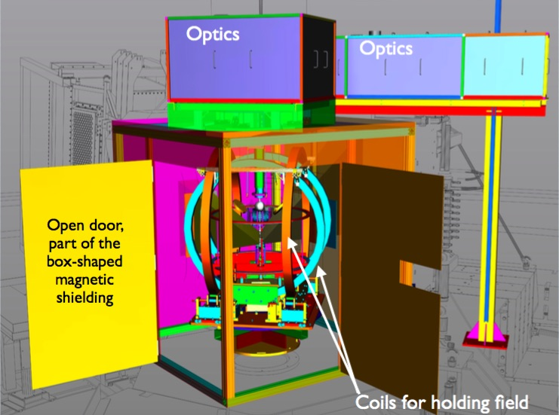
Polarized 3He Target
Improvements and continued development
Two capital equipment projects
Phase I upgrade of existing target
Implementable in either Hall
40 cm convection cell
Phase I could be installed with ~6 month notice
Phase II (SBS GEn type) design frozen as of Summer 2016
Convection cell
Dual pumping
60 cm
Metal end windows for high current
Phase II (SBS Gen type) ready by Summer 2019

Slide 12
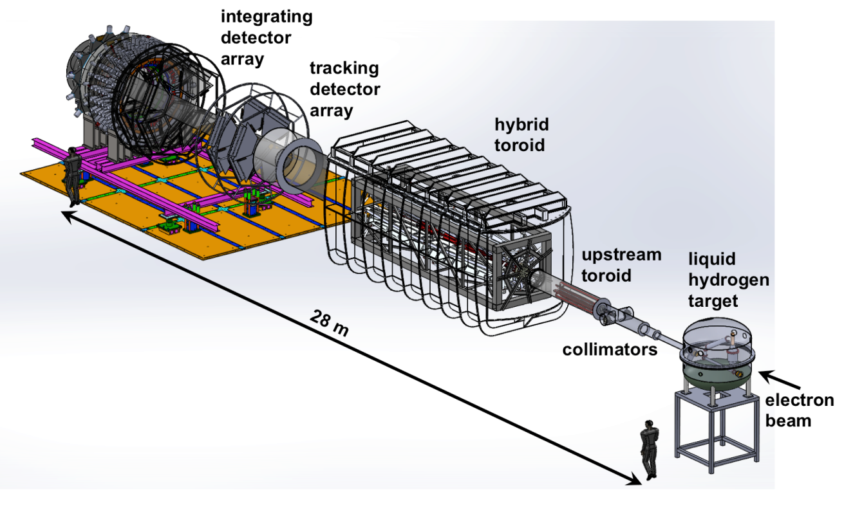
MOLLER - see Ciprian’s talk tomorrow afternoon!
2014: DOE Science Review, Strong Endorsement
December 2016: Director’s Technical Cost and Schedule Review
“scientific case … remains as strong as ever”, “...Committee finds that the substantial progress since the last Director’s Review suggests that the experiment is ready to move to the next stage”
CD-0 achieved on Dec. 21, 2016 with caveat that project is “paused”
Work proceeding to address recommendations from 12/16 Director’s Review
Pre-R&D continues to refine design choices and reduce risk
Project management organization
Spectrometer magnet and collimator systems conceptual design, coil prototyping
Radiation shielding optimization
Continued detector development
Parity quality beam working group with parasitic studies
(Generic) High power target development

Slide 13
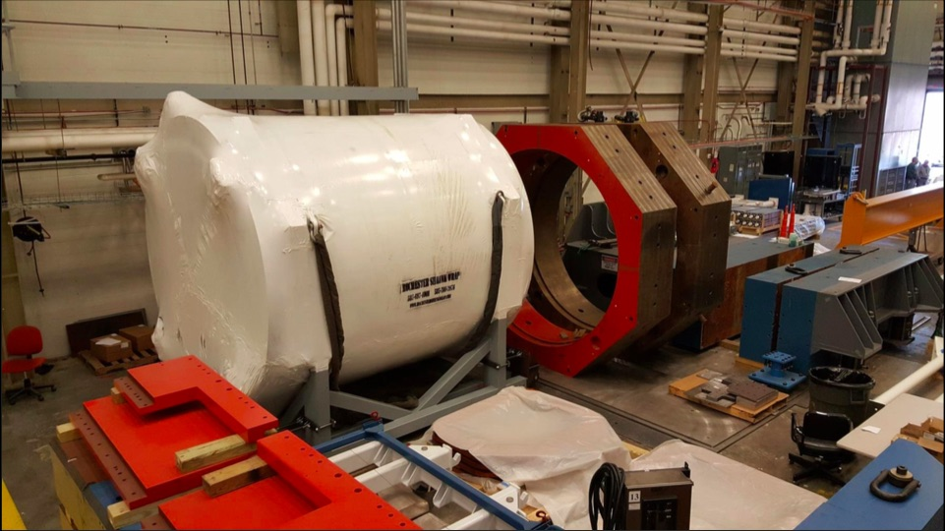
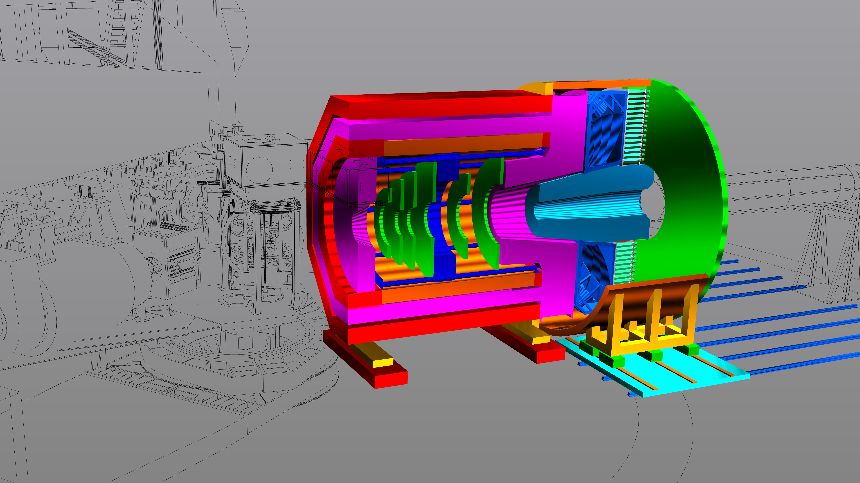
SoLID – see Ye’s talk tomorrow afternoon!
Director’s Review Feb. 2015
Updated pCDR submitted to JLab Director’s Office May 2017, review committee report received October 2017: “The Committee believes that the SoLID Experiment is ready for its DOE Critical Decision Zero (CD0) Review.”
Looking towards Science Review in CY 2018, CD0 in 2020
Support structures
Data acquisition
CLEOII magnetic field analysis – see Jay’s talk tomorrow!
(Generic) target development
Backgrounds and simulation
Detector pre-R&D
Run group proposal approved last PAC, Transverse Target Single-Spin Asymmetry in Exclusive Pi- Production (G. Huber)
10

Slide 14
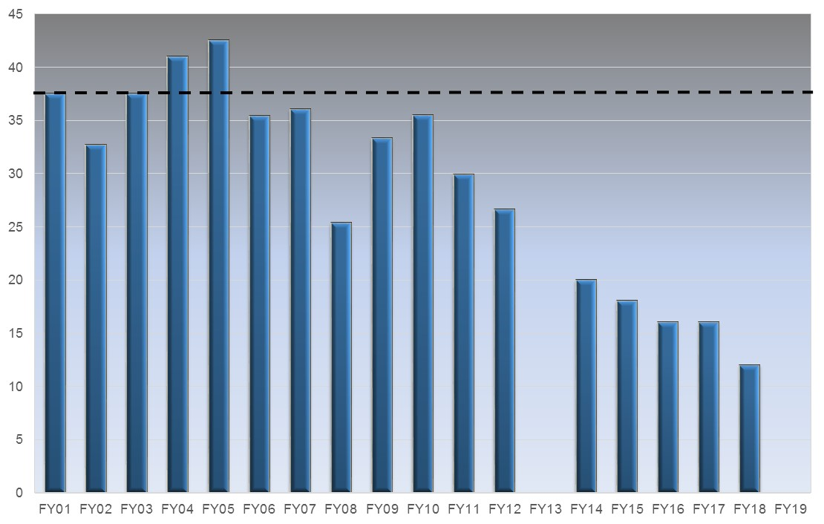
Key Challenges for the Laboratory
The single highest priority is operating CEBAF with high reliability for more than 30 weeks per year
Optimal operation of CEBAF is 37 weeks per year
FY18 plan supports only 12 weeks of operation (FY18 PBR had 10 weeks)
This requires sufficient funding to
Improve reliability in aging equipment
Increase weeks of operation; each week of operation brings additional costs for utilities, cryogens and operations support
Closely related is the challenge of moving forward with mid-scale projects MOLLER and SoLID
Slide from R. McKeown, MOLLER collaboration meeting last week
Optimal
12 GeV Construction
?
Weeks of OPS Delivered

Slide 15
A New Run Paradigm... (Beware! My view here)...
Schedules are inherently tied to budget scenarios. The actuals for Fall 2018 and 2019 will depend on the budget situation.
Example: still an outstanding issue that Fall 2018 operations may be delayed to startup in the next FY (i.e., a few weeks delay) due to an FY18 budget shortfall.
Given this, how to plan?...
JLab used to run ~30 weeks/year. In this time, PAC days could reasonably be translated to calendar days and fully committed.
In a reduced beam time scenario the lab and users need to work together to optimize science output (including student theses,…) rather than focus on running approved days.
The focus may switch somewhat from “what experiment can be scheduled” to “what science can maximally be accomplished in a run period?”
DVCS/GMp and the tritium group did/are doing this somewhat already – we’re pioneering!
Other practical issues – as ever – will still come into play (cross Hall energy compatibility, beam current requirements, ESR cryogenic load, installation time…).
15

Slide 16
Planning for Sustainable Long-term CEBAF Operation
While 12 GeV Upgrade Project provides important capabilities for the future, many components and systems are “original equipment”
Some are difficult to maintain, require adequate spare parts, will reach obsolescence
We have developed a “CEBAF Performance Plan” to improve reliability and energy reach in the accelerator
Planning like a Project, with A. Freyberger as Project Director, R. Michaud as Manager
We are funding a significant investment in CEBAF performance in FY18, and are planning for the FY19-21 timeframe
Scale of investment is ~$5M assuming flat funding in FY18
Focus on critical spares, spare klystrons, obsolescence and energy reach
Enabled in part by remaining 12 GeV Project contingency
We received funding in FY17 for a new 2K cold-box to remedy CHL1 severe long-term vulnerability
ESR2: taking a double-pronged approach:
Preparing an SLI request for ESR-2
Considering what cryogenics we could provide in various ESR and CHL configurations, and what target power(s) can be sustained
Dave Kashy is the Physics Cryogenic Coordinator
see Jonathan’s talk tomorrow!
Slide from R. McKeown, MOLLER collaboration meeting last week

Slide 17
Overall, the Hall Outlook is Highly Positive!
The accelerator is running well.
5(.5) pass beam – at high current in A/C – delivered to 4 Halls
Good uptime thus far
We have electrons on a tritium target!
We are preparing formally for PREX2/CREX
SBS – all experiments and equipment - is well on track
MOLLER and SoLID progressing well
Within external budget, scheduling constraints

