Slide 1
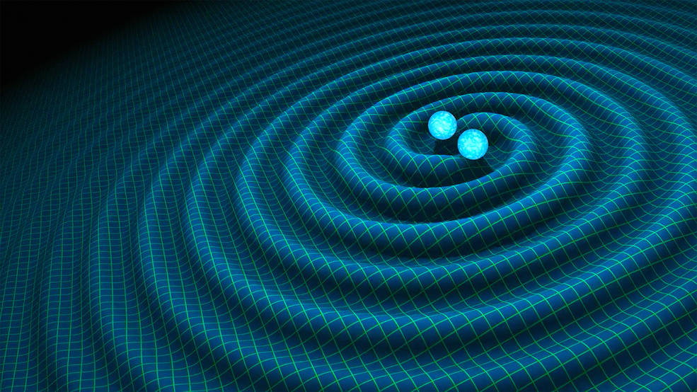
Connecting Neutron Skins to Gravitational Waves (arXiv: 1710.10367, submitted to PRL)
aasnova.org
Farrukh J. Fattoyev
In Collaboration with: Jorge Piekarewicz and Charles J. Horowitz
(arXiv:1711.06615)
Hall A Collaboration Meeting
Jefferson Laboratory, Newport News, VA
January 24, 2018

Slide 2
Neutron Star Mergers as Astrophysical Colliders
On August 17 2017, 12:41:04.43 two
neutron stars merged. The gravitational
waves produced by this merger were
detected by LIGO and Virgo GW detectors.
The historical GW detection with the
follow-up EM observation had already
provided insights into astrophysics,
gravitation, cosmology, and nature of dense matter.
In particular, the GW signal placed a tight constraint on the
tidal polarizability of the neutron stars, which is strongly correlated
with the neutron-star radius and the neutron skins of medium to
heavy nuclei.
I will discuss these constraints from GW observation, as well as analyze
the impact of the current PREX and future PREX/CREX measurements
of neutron skins to the tidal polarizability and GW signals.
Artist’s impressions. Taken from Wikipedia.

Slide 3
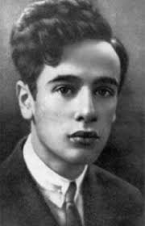
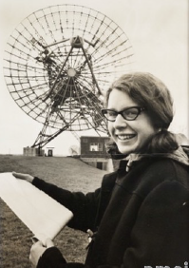
Neutron Star as a Giant Nucleus
1931 – “The density of matter becomes so great that atomic nuclei come in close contact, forming one gigantic nucleus.” L. Landau
1932 – J. Chadwick discovers neutrons.
1934 – “…supernovae represent the transitions from ordinary stars to neutron stars...” Baade & Zwicky
1967 – Neutron star is discovered by J. Bell & A. Hewish.

Slide 4
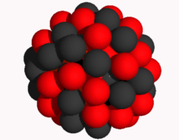
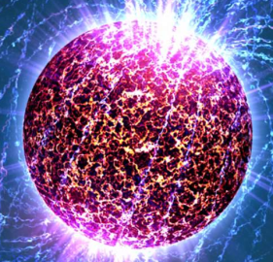
Neutron Star as a Giant Nucleus
1931 – “The density of matter becomes so great that atomic nuclei come in close contact, forming one gigantic nucleus.” L. Landau
1932 – J. Chadwick discovers neutrons.
1934 – “…supernovae represent the transitions from ordinary stars to neutron stars...” Baade & Zwicky
1967 – Neutron star is discovered by J. Bell & A. Hewish.
Nucleus of an atom
A ≃ 10²
ρ_{ave} ≃ 0.7 ρ₀
Supported by surface tension.
R ≃ 10⁻¹⁴ m
Neutron Star
A ≃ 10⁵⁹
ρ_{ave} ≃ 2.0 ρ₀
Supported by gravity.
R ≃ 10⁴ m

Slide 5
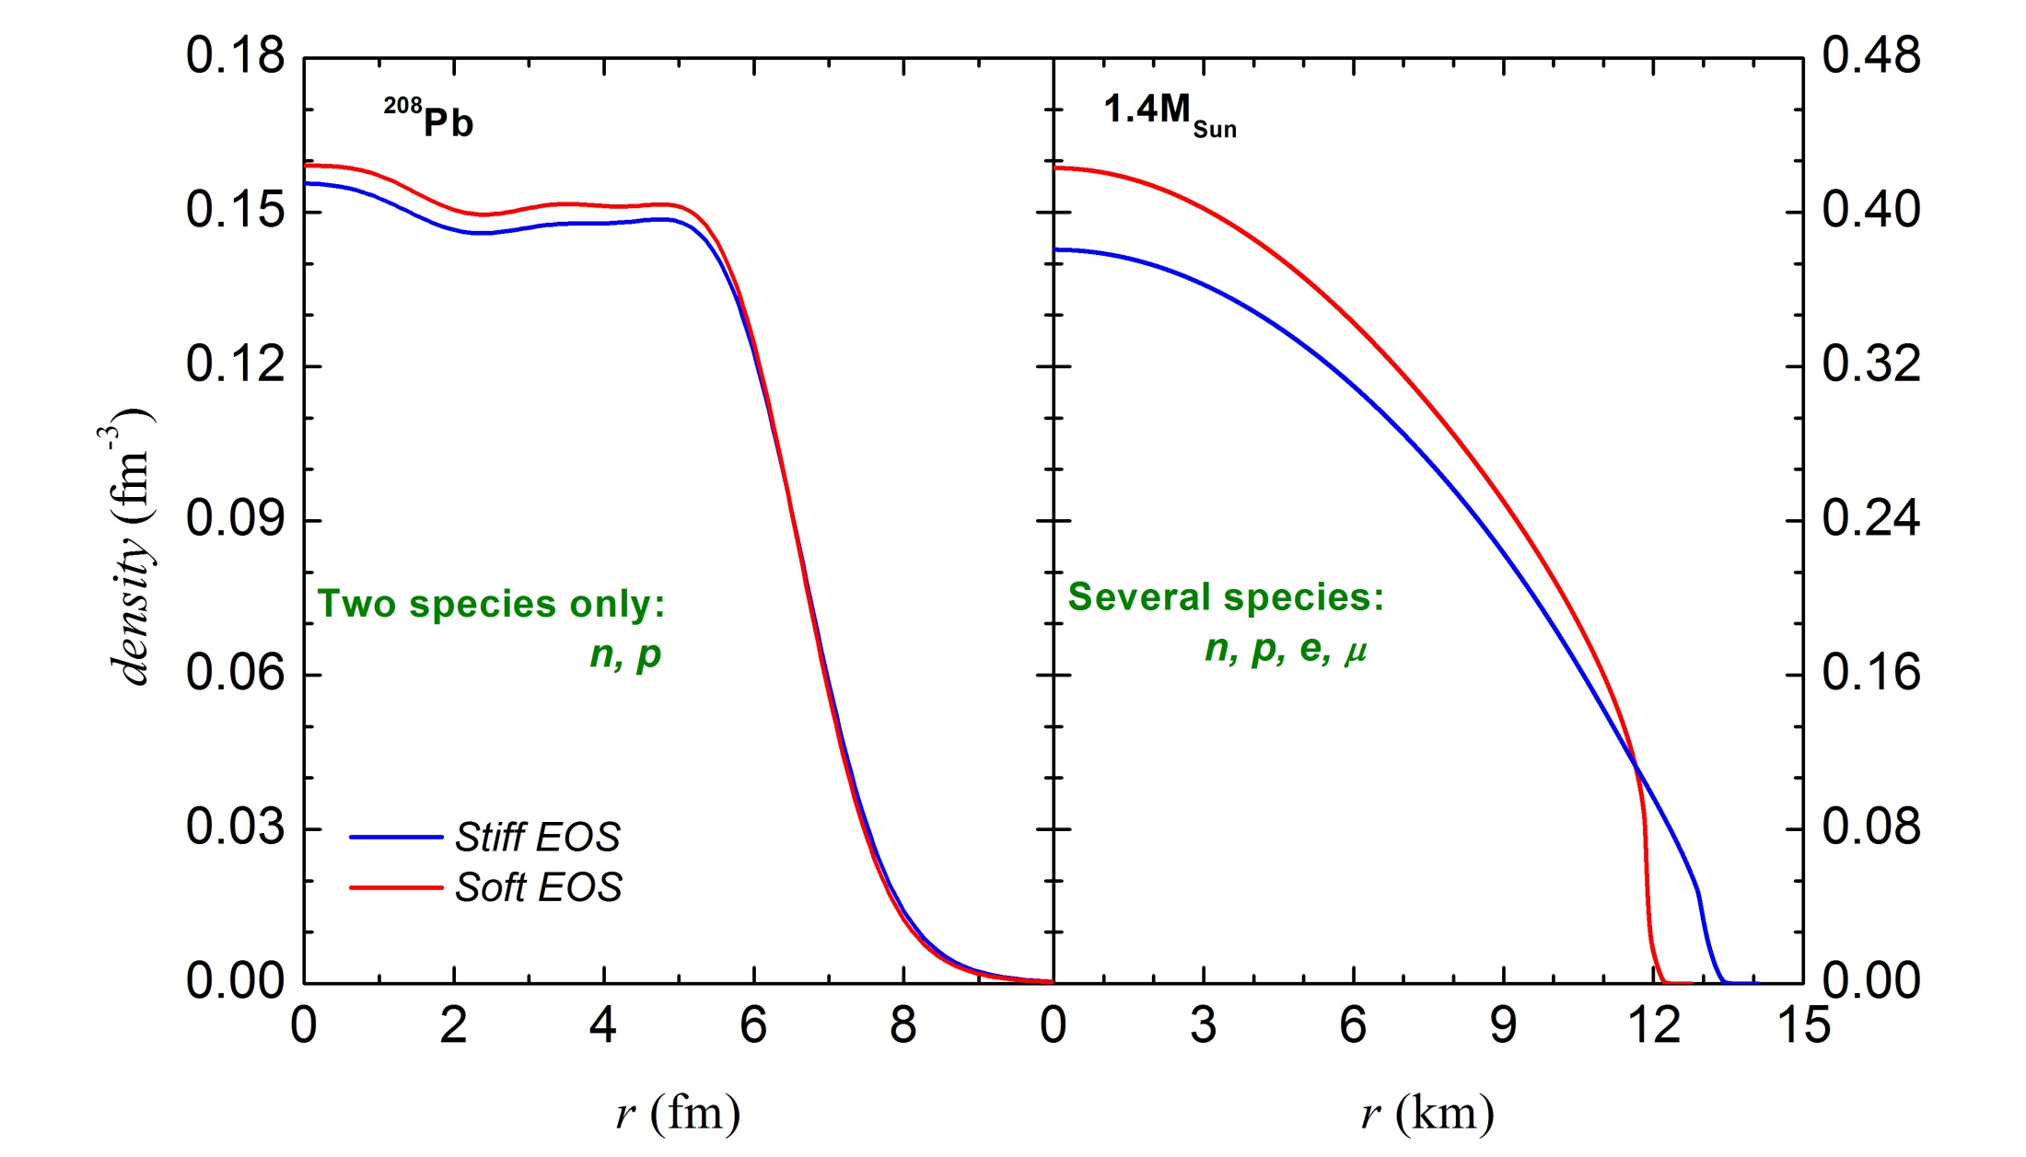
Neutron Star as a Giant Nucleus
Nucleus of an atom
Neutron Star
The sole ingredient required: the Equation of State of Neutron-Rich Matter!

Slide 6
Tidal Polarizability and the Equation of State

Slide 7
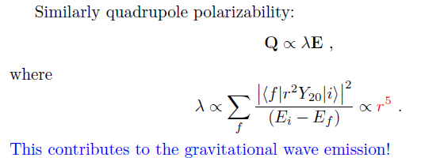
Tidal Polarizability and the Equation of State

Slide 8
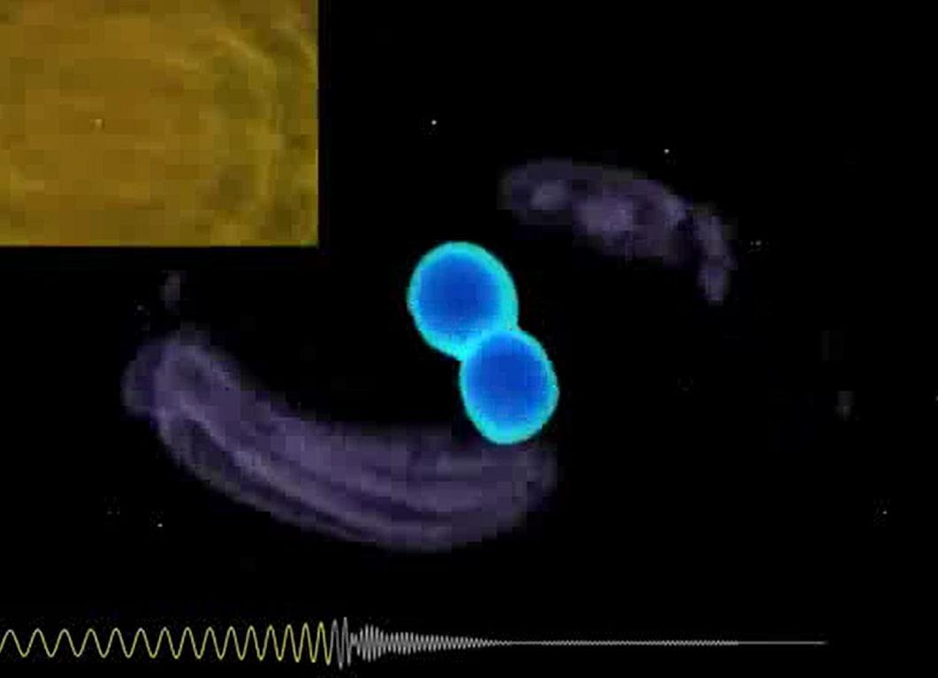
Tidal Polarizability and the Equation of State
external gravitational field
quadrupole
deformation
tidal Love number
tidal polarizability
Quadrupole deformation scales as the
5th power of the Radius!

Slide 9
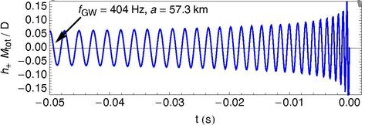
Tidal Polarizability and the Equation of State
The induced quadrupole deformation advances the orbit and changes the
rotational phase.
BH-BH merger:
1
2
Image Credit: Jocelyn Read

Slide 10
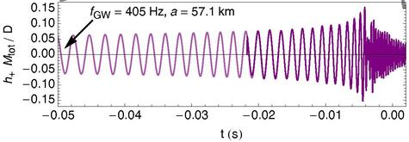
Tidal Polarizability and the Equation of State
The induced quadrupole deformation advances the orbit and changes the
rotational phase.
NS-NS merger:
1
2
Image Credit: Jocelyn Read

Slide 11
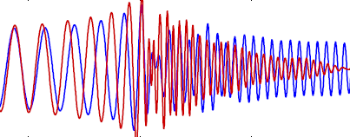
Tidal Polarizability and the Equation of State
Fluffy stars collide earlier, thus merge at lower frequency.
Compact stars continue to orbit until later time and merge at higher frequency.
NS-NS merger:
1
2
Credit: Takami et al. (2014)
APR4 (compact) and GNH3 (fluffy)
-6.5 ms 0 ms 6.5 ms

Slide 12
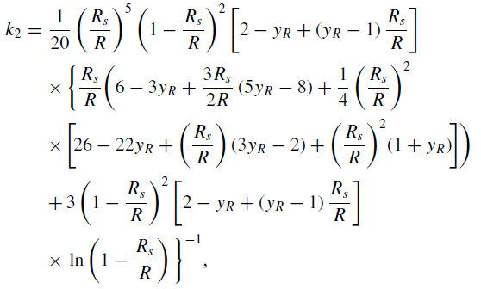
Tidal Polarizability and the Equation of State
2
1
compactness
Equations of stellar structure (TOV)
Equation of State
The only input required is the EOS of neutron-rich matter!

Slide 13
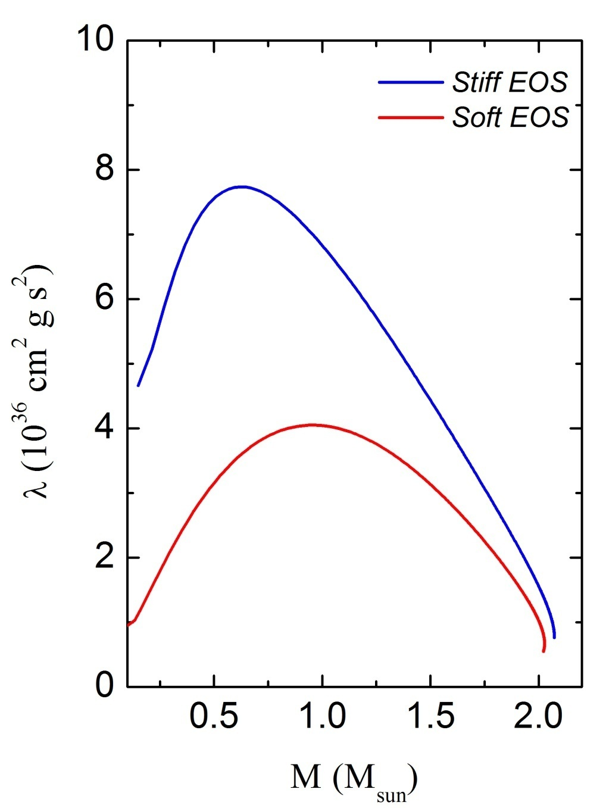
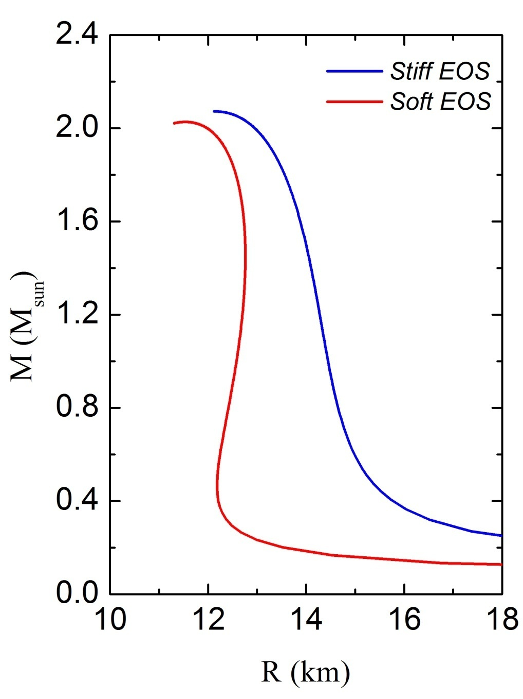
Tidal Polarizability and the Equation of State

Slide 14
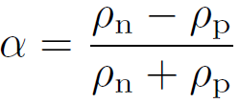
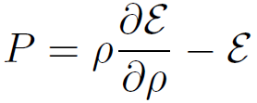
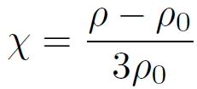
Equation of State: Symmetry Energy
Neutron star properties and neutron skins are both determined
by the EOS of neutron-rich matter:
isospin asymmetry
Thermodynamic consistency
For a neutron-rich matter it is useful to expand:
Binding energy per nucleon in symmetric nuclear matter (SNM).
a useful expansion parameter

Slide 15
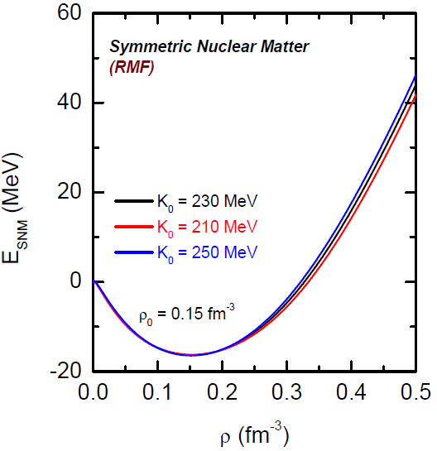
Equation of State: Symmetry Energy
Neutron star properties and neutron skins are both determined
by the EOS of neutron-rich matter:
isospin asymmetry
Thermodynamic consistency
For a neutron-rich matter it is useful to expand:
Binding energy per nucleon in symmetric nuclear matter (SNM).
a useful expansion parameter

Slide 16
Equation of State: Symmetry Energy
Neutron star properties and neutron skins are both determined
by the EOS of neutron-rich matter:
isospin asymmetry
Thermodynamic consistency
For a neutron-rich matter it is useful to expand:
Binding energy per nucleon in symmetric nuclear matter (SNM).
Nuclear Symmetry Energy is a penalty to break N=Z symmetry
a useful expansion parameter

Slide 17
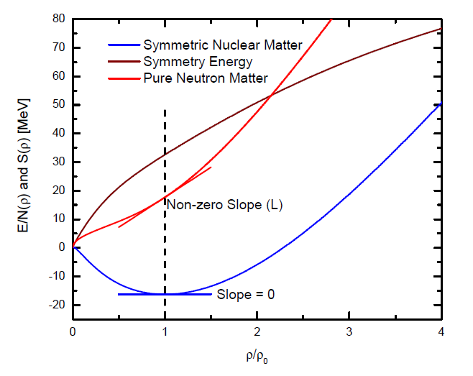
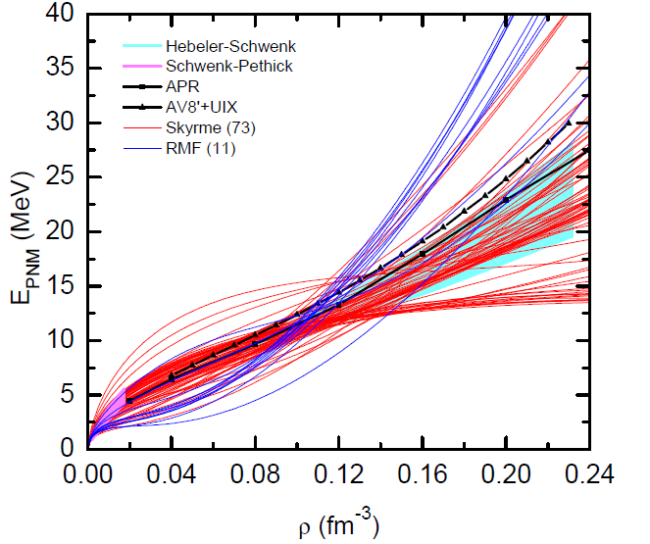
Equation of State: Symmetry Energy
Neutron star properties and neutron skins are both determined
by the EOS of neutron-rich matter:
isospin asymmetry
Thermodynamic consistency
For a neutron-rich matter it is useful to expand:
Binding energy per nucleon in symmetric nuclear matter (SNM).
Nuclear Symmetry Energy is a penalty to break N=Z symmetry
a useful expansion parameter

Slide 18
Equation of State Model: Relativistic Mean-Field
Most parameters are extracted from a fit to nuclear masses and giant resonances.

Slide 19
Equation of State Model: Relativistic Mean-Field
Most parameters are extracted from a fit to nuclear masses and giant resonances.
Parameter ζ can solely be constrained by the maximum mass of a neutron star.
Current constraints: 0.00 <ζ ≤ 0.03.
The upper constraint comes from the maximum observed two-solar mass neutron star.
Antoniadis et al. Science 340, 6131 (2013), Demorest et al. Nature 467, 1081, (2010)
The GW170817 data analysis suggest that the lower limit could be higher: 0.01<ζ ≤ 0.03.
Magdalit and Mertzger, ApJ Letters, 850, 2 (2017)

Slide 20
Equation of State Model: Relativistic Mean-Field
Most parameters are extracted from a fit to nuclear masses and giant resonances.
Parameter ζ can solely be constrained by the maximum mass of a neutron star.
Current constraints: 0.00 <ζ ≤ 0.03.
The upper constraint comes from the maximum observed two-solar mass neutron star.
Antoniadis et al. Science 340, 6131 (2013), Demorest et al. Nature 467, 1081, (2010)
The GW170817 data analysis suggest that the lower limit could be higher: 0.01<ζ ≤ 0.03.
Magdalit and Mertzger, ApJ Letters, 850, 2 (2017)
Parameters g_{ρ} and Λ_{V} can be tuned efficiently to control the density dependence of the
nuclear symmetry energy [First proposed by Horowitz & Piekarewicz, PRL86, 5647 (2001)].
FSUGold2 original model → R_{skin}(²⁰⁸Pb) = 0.29 fm.
“FSUGold2 family” → 0.15 fm < R_{skin}(²⁰⁸Pb) < 0.29 fm

Slide 21
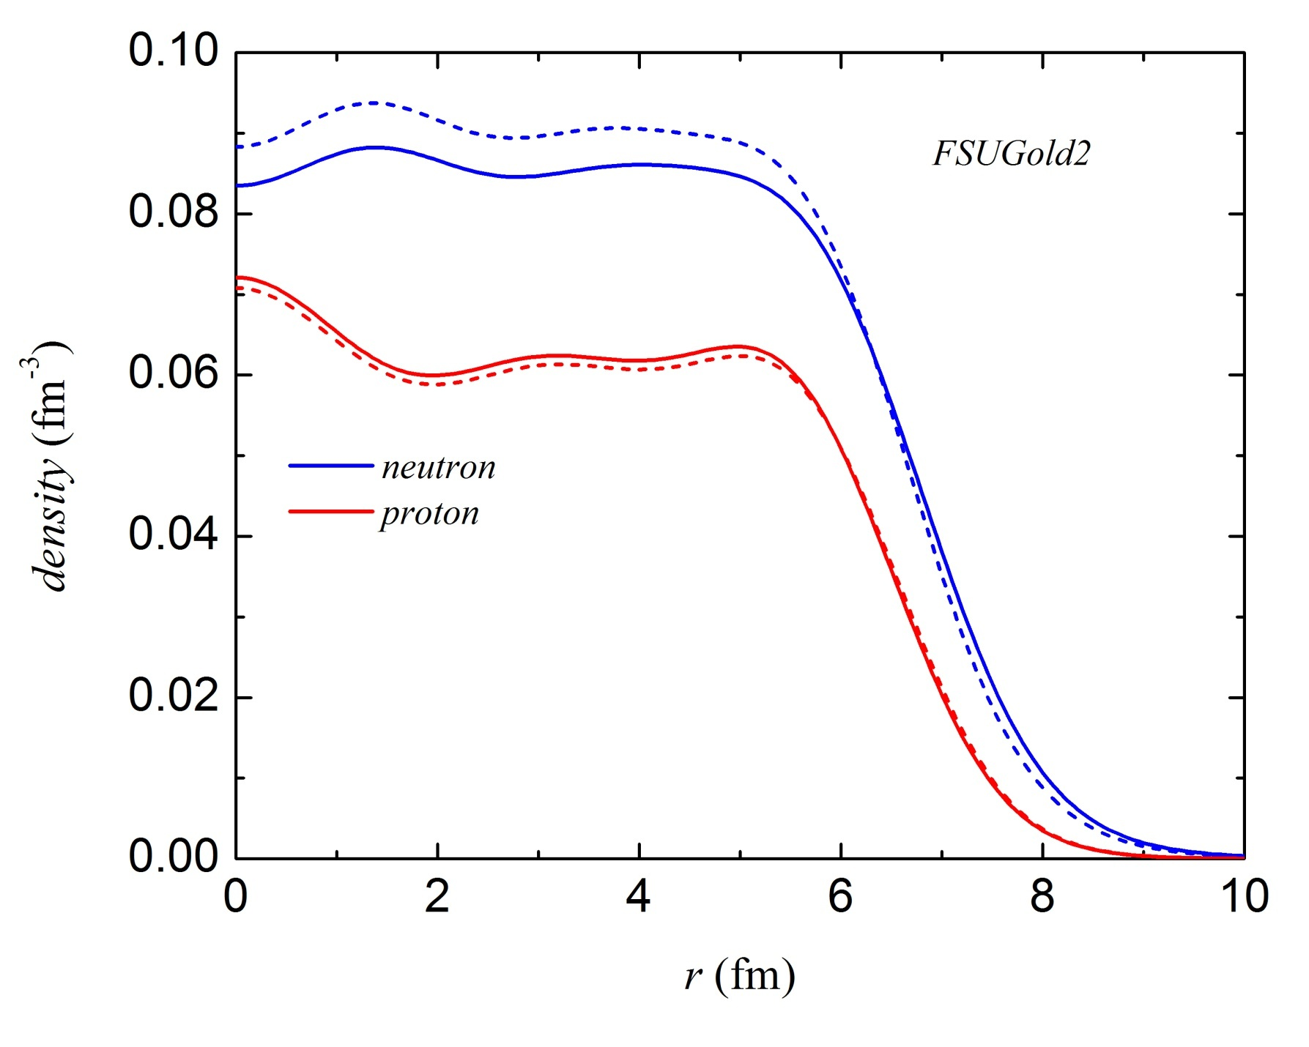
Neutron Skins and the Equation of State
neutron skin
²⁰⁸Pb
PREX will measure with higher accuracy how much neutrons stick out past protons.

Slide 22
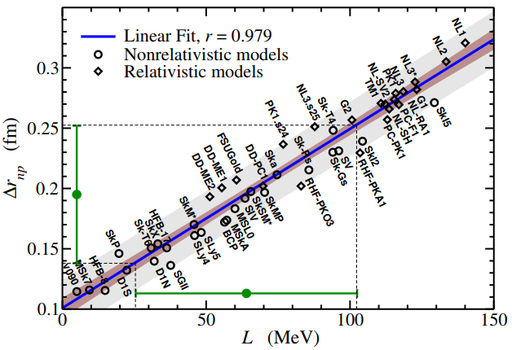
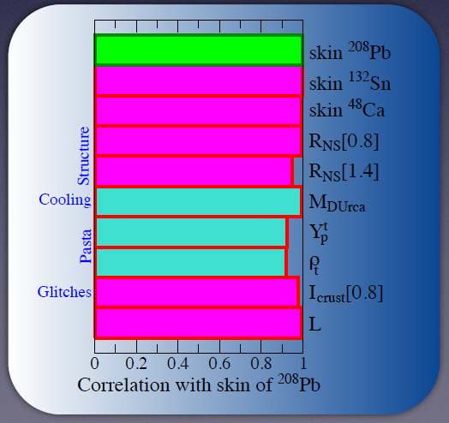
Neutron Skins and the Equation of State
Roca-Maza et al.
PRL106,252501(2011)
Fattoyev & Piekarewicz
PRC86,015802(2012)
Neutron skin is strongly correlated to the pressure of PNM.
Pressure of PNM pushes against surface tension ⇒ neutron skin!
Pressure of PNM pushes against gravity ⇒ neutron-star radius!
The larger the neutron skin, the larger the neutron-star radius!

Slide 23
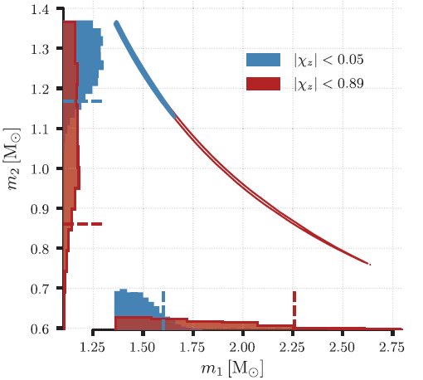
GW170817: Chirp Mass
The chirp mass determines the leading-order amplitude and frequency evolution of GW signal during the inspiral.
Chirp mass

Slide 24
GW170817: Chirp Mass
Equal-mass
of 1.365 Msun
A very well constrained chirp mass.

Slide 25
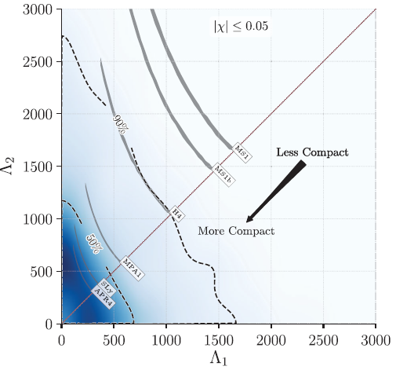
GW170817: Tidal Polarizability
The gravitational waveform depends on the weight-averaged tidal polarizability.

Slide 26
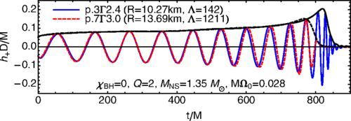
GW170817: Tidal Polarizability
Lackey et al PRD 89, 043009 (2014)
The gravitational waveform depends on the weight-averaged tidal polarizability.

Slide 27
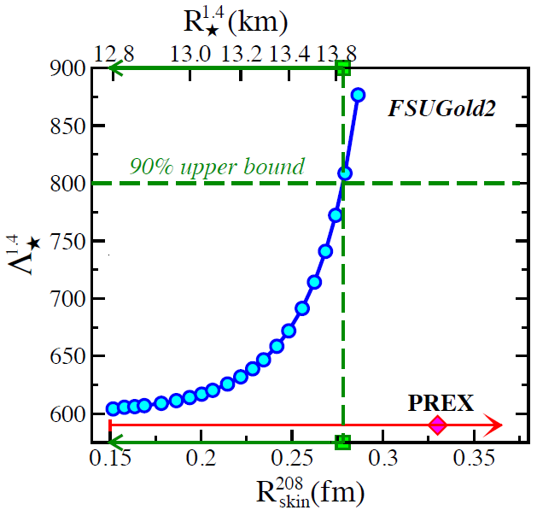
Connecting Neutron Skins to Tidal Polarizabilities
Scales as Radius
to the 5th power!
region is ruled out!
neutron stars are not
overly fluffy.

Slide 28
Connecting Neutron Skins to Tidal Polarizabilities
What if the large central value of 0.33 fm is confirmed by the
upcoming PREX-II experiment?
The average nuclear density is about 0.7 saturation density.
The average density of neutron star-matter depends on the
mass of the star, but is several times nuclear saturation density.
This may suggest that there is a phase transition at
higher densities to an exotic phase of dense matter that makes
the EOS soft. Or one can think of a soft symmetry energy
at high densities.

Slide 29
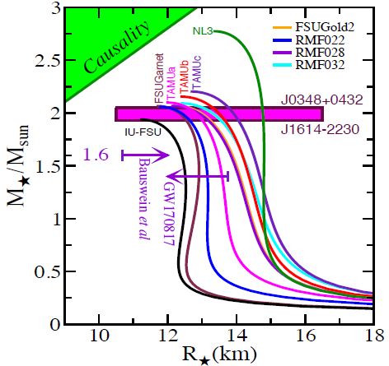
Connecting Neutron Skins to Tidal Polarizabilities
More Robust Analysis:
Ten distinct RMF models.
The SNM EOS at high-densities
now becomes important.
Models with stiff SNM EOS, such
as NL3, may have already been
ruled out.
Recent analyses show models
that predict masses below
2.17 Msun may have been
ruled out.
(e.g. Margalit & Metzger, ApJL-2017).

Slide 30
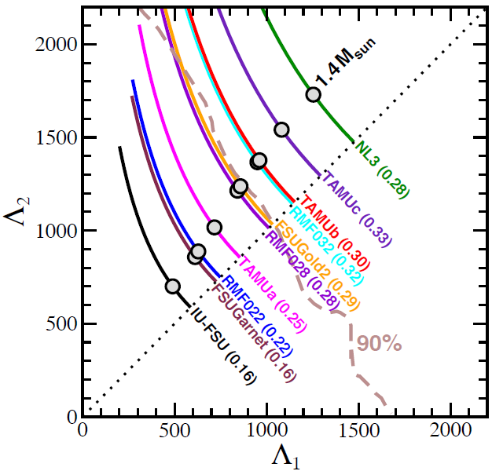
Connecting Neutron Skins to Tidal Polarizabilities
More Robust Analysis:
Ten distinct RMF models.
The SNM EOS at high-densities
now becomes important.
Models with stiff SNM EOS, such
as NL3, may have already been
ruled out.
Recent analyses show models
that predict masses below
2.17 Msun may have been
ruled out.
(e.g. Margalit & Metzger, ApJL-2017).

Slide 31
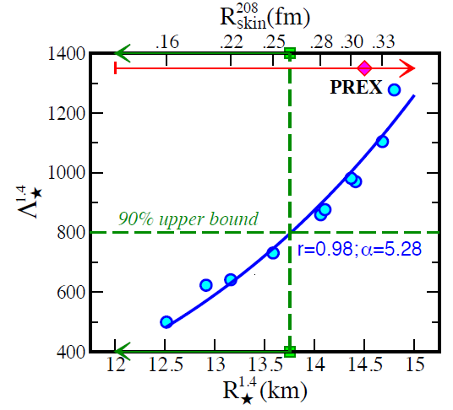
Connecting Neutron Skins to Tidal Polarizabilities
in perfect agreement with
the FSUGold2 family.

Slide 32
Connecting Neutron Skins to Tidal Polarizabilities
Tidal polarizability constrains neutron skins to be ≲ 0.25 fm.
PREX had already imposed a lower bound to the neutron skin thickness of 0.15 fm.
What does this imply on tidal polarizabilities?

Slide 33
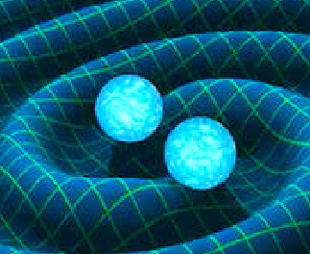
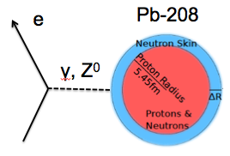
Connecting Neutron Skins to Tidal Polarizabilities
Tidal polarizability constrains neutron skins to be ≲ 0.25 fm.
PREX had already imposed a lower bound to the neutron skin thickness of 0.15 fm.
What does this imply on tidal polarizabilities?
Joint PREX + GW170817 constraint:
GW170817
PREX
Wait for me!
CREX

Slide 34
Concluding Remarks
Historical first detection of GW from BNS merger GW170817 has already
improved the EOS of dense matter.
We connected this observational measurement with a laboratory
observable: neutron skin! Such connection was possible because they
were both sensitive to the neutron star radius through the EOS.
In particular, we find that: and
PREX had already provided the lower limit to the neutron skin.
This suggests:
PREX-II/CREX measurement of neutron skins provide information on the EOS
below saturation.
Future BNS mergers provides information to put tighter constraints on the
EOS of neutron-rich matter at supra-saturation densities.
More exciting opportunities are ahead!
Thank You!

