Slide 1
CEBAF Operations
Arne Freyberger
Operations Department
Accelerator Division
Jefferson Lab

Slide 2
Outline
Accelerator System Availability
Recent Accelerator Performance

Slide 3
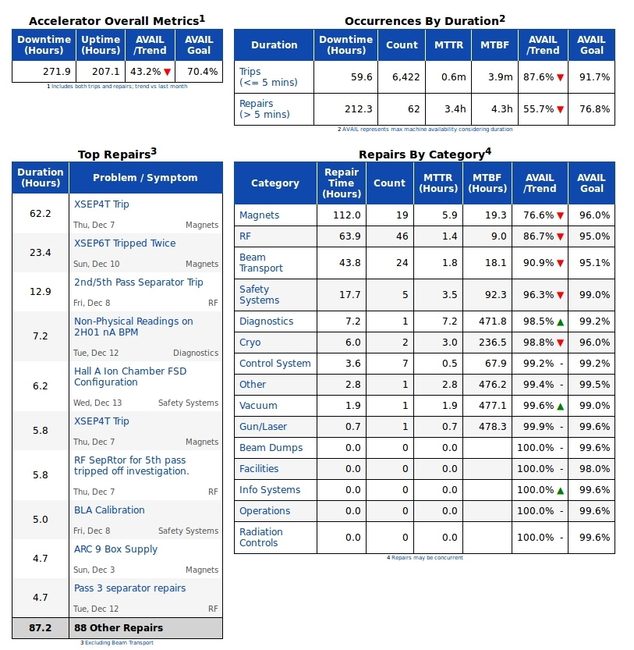
Dec 2017 CEBAF System Availability

Slide 4
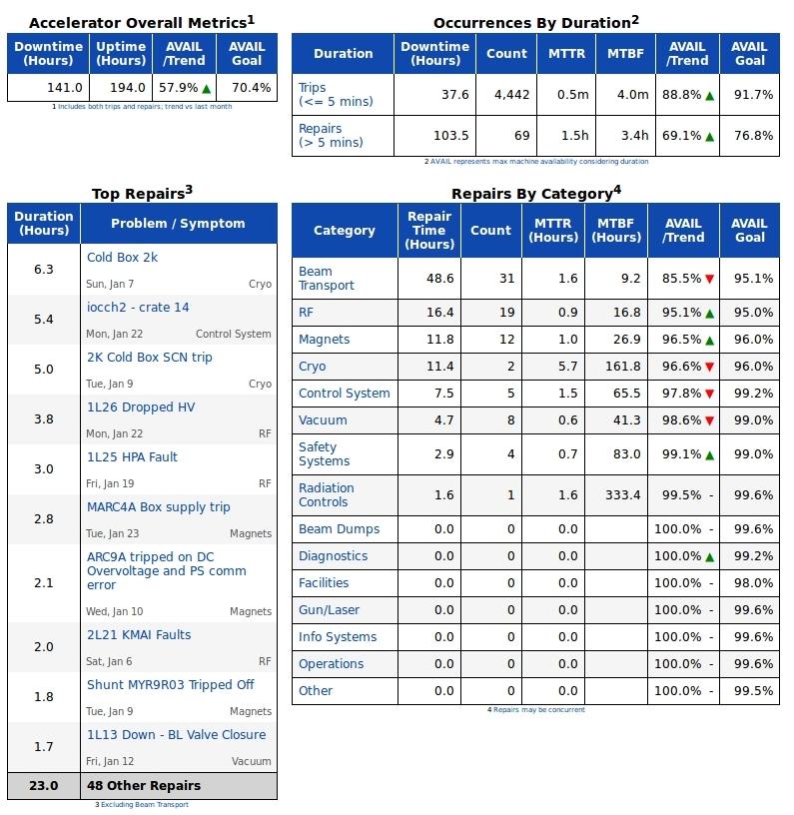
CEBAF System Availability Jan 2018

Slide 5
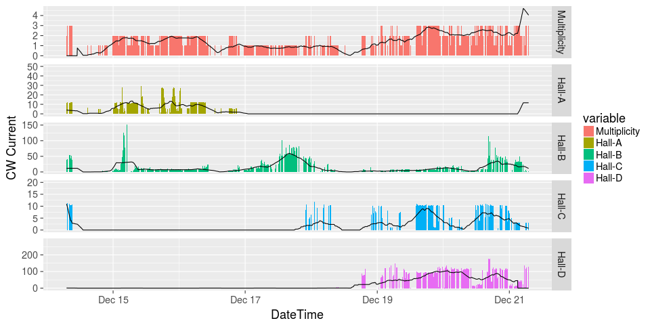
Dec 2017 Final Week: Beam Delivery

Slide 6
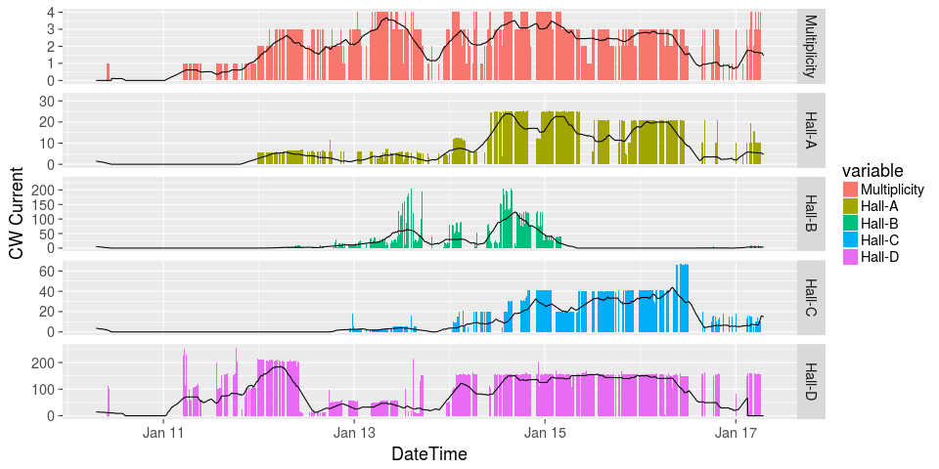
Jan 2018 Week 1 (Restore/Physics)

Slide 7
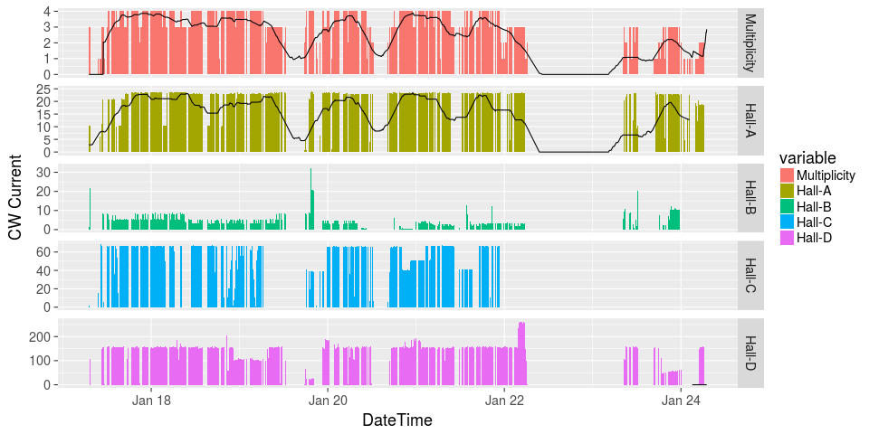
Jan 2018 Week 2 Beam Deliviery

