Slide 1
PREX / CREX Status
Jan 25, 2018
Bob Michaels, on behalf of the PREX collaboration.
Wiki
https://prex.jlab.org/wiki/index.php/Main_Page
http://prex.jlab.org/cgi-bin/DocDB/public/DocumentDatabase
http://hallaweb.jlab.org/parity/prex
docDB
( private and public )
Web page
Robert Michaels, Hall A Collaboration Meeting, Jan 25, 2018
p1 / 18

Slide 2
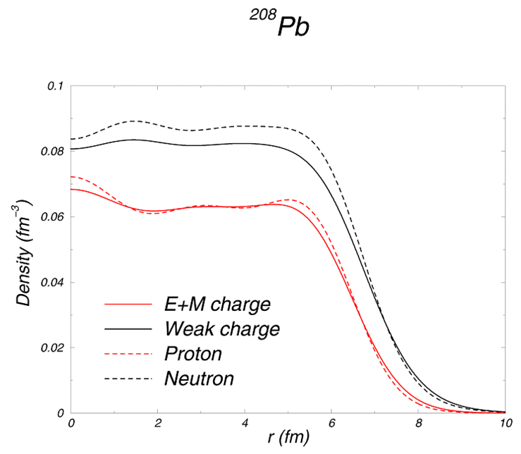
PREX and CREX
Electroweak Asymmetry in
Elastic Electron-Nucleus Scattering :
Z⁰ sees the neutrons
²⁰⁸Pb
⁴⁸Ca
2
+
C. J. Horowitz
(PREX-I) PRL 108 (2012) 112502
243 citations, Jan 2018
Neutron Skin
1/15

Slide 3
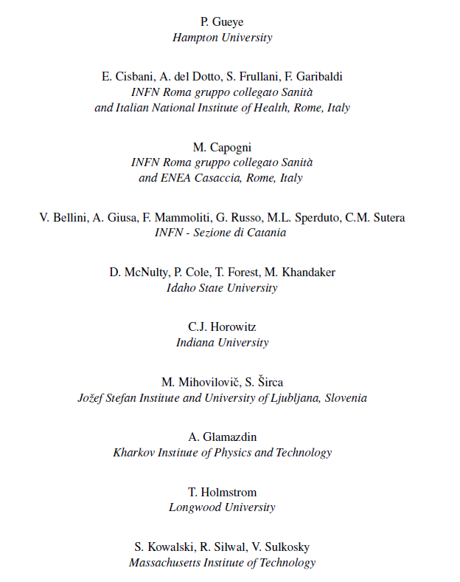
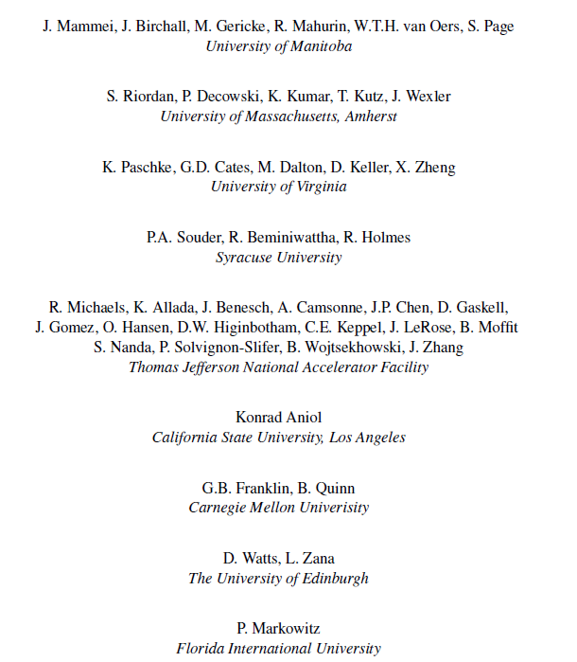
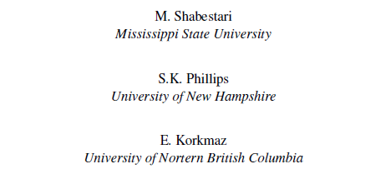
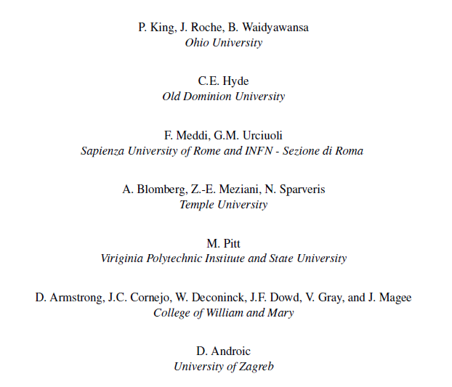
PREX
CREX
Seamus Riordan* | Argonne National Lab
Robert Michaels | Jefferson Lab
Kent Paschke | UVa
Paul Souder | Syracuse Univeristy
Dustin McNulty | Idaho State University
Juliette Mammei | Manitoba University
Silviu Covrig | Jefferson Lab
Kent Paschke * | UVa
Krishna Kumar | Stony Brook University
Robert Michaels | Jefferson Lab
Paul Souder | Syracuse Univeristy
Guido Urcioli | INFN Rome
* contact persons
p3 / 18

Slide 4
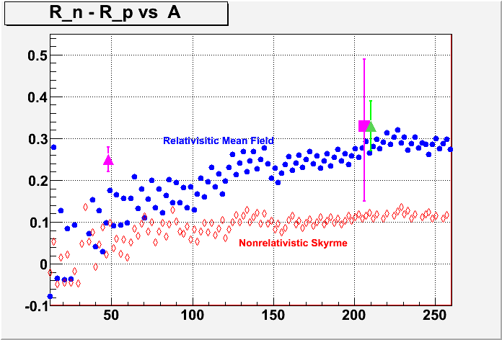
Neutron Skin vs Mass Number A
C-REX
PREX-I
PREX-II
published
Approved proposal
Approved proposal
R_{N} – R_{P} (fm)
Theory : P. Ring et al. NPA 624, 349 (1997)
A
Robert Michaels, Hall A Collaboration Meeting, Jan 25, 2018
p4 / 18

Slide 5
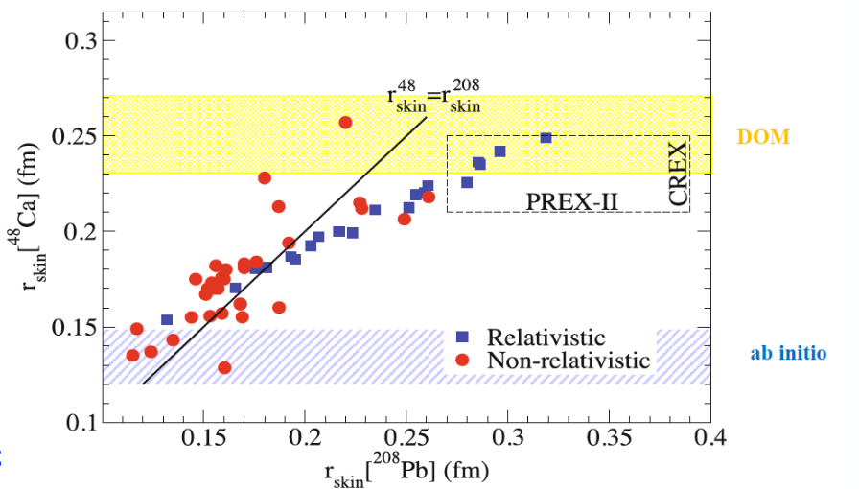
“Ab Initio” (exact microscopic) calculations of R_{skin} for ⁴⁸Ca have recently been published. G. Hagen et al., Nature Physics 12, 186 (2016).
Can be compared to Density Functional Theory (the red and blue points) and Dispersive Optical Model (DOM).
W. Dickhoff, et al.
PRL 119, 222503 (2017)
Fattoyev, Piekarewicz
PRC 86, 015802 (2012)
G. Hagen, et al.
Nature 12, 186 (2015)
p5 / 18

Slide 6
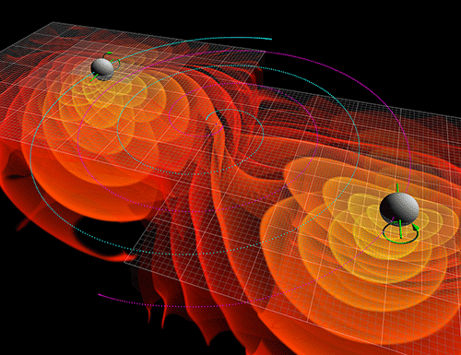
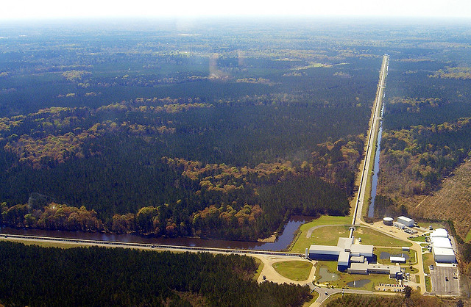
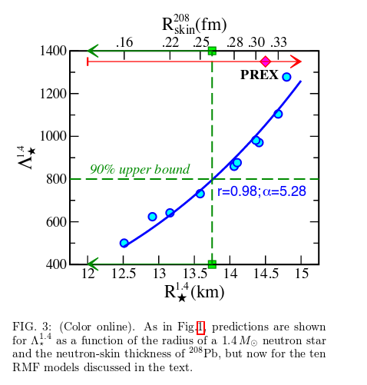
LIGO has recently (2017) detected a Neutron Star Merger
Tidal Deformability ( Λ ) vs Neutron Star Radius ( R ).
Upper limit of Λ from LIGO data. Points: RMF models.
PREX constrains the equation of state of neutron-rich matter. If data are inconsistent it could signal a phase transition at the extremely high density of neutron stars.
Fattoyev, Piekarewicz, Horowitz arXiv 1711.06615
Robert Michaels, Hall A Collaboration Meeting, Jan 25, 2018
p6 / 18

Slide 7
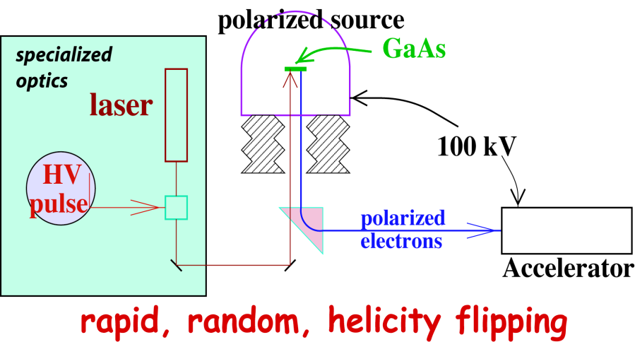
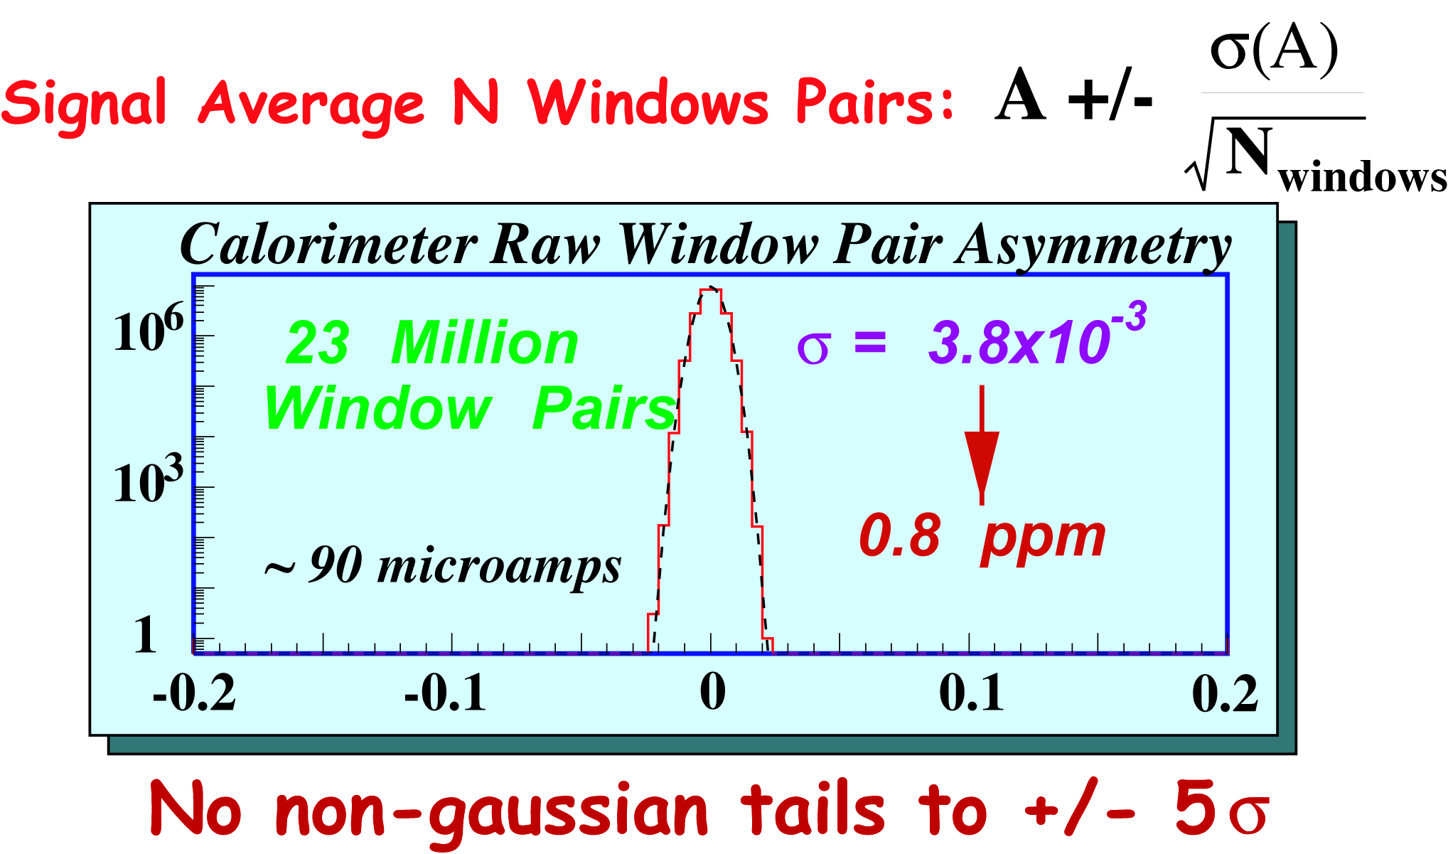
Parity Experiment Method
(integrating mode)
Flux Integration Technique:
C-REX : 140 MHz
PREX: 500 MHz
Example : HAPPEX

Slide 8
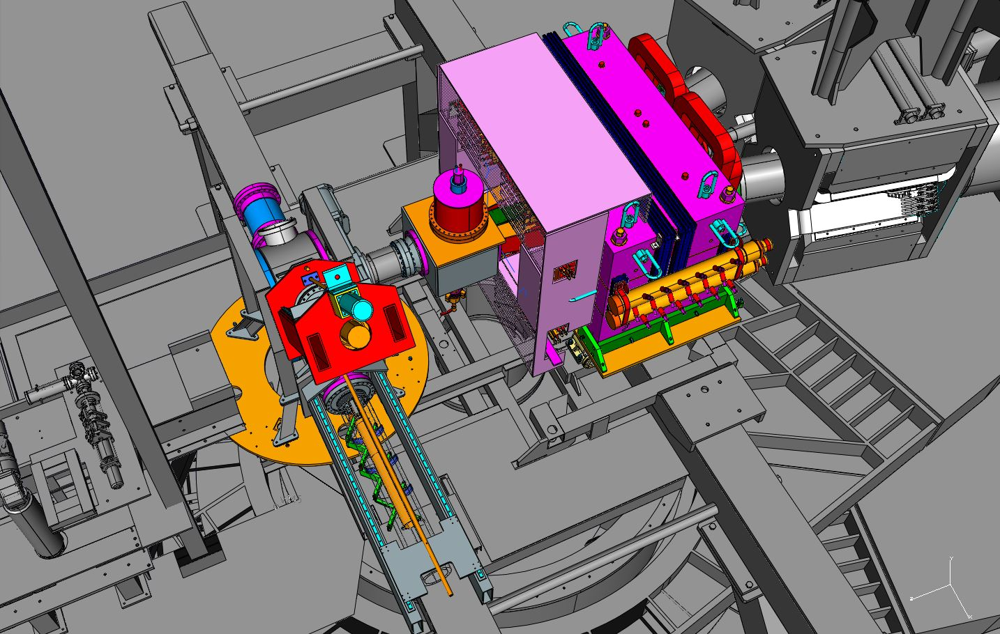
Hall Configuration
Credit: Robin Wines
Resistive Q1 Magnets
Septum
Collimator
Scattering Chamber
beam
Septum Support
Robert Michaels, Hall A Collaboration Meeting, Jan 25, 2018
ERR Design Drawings

Slide 9
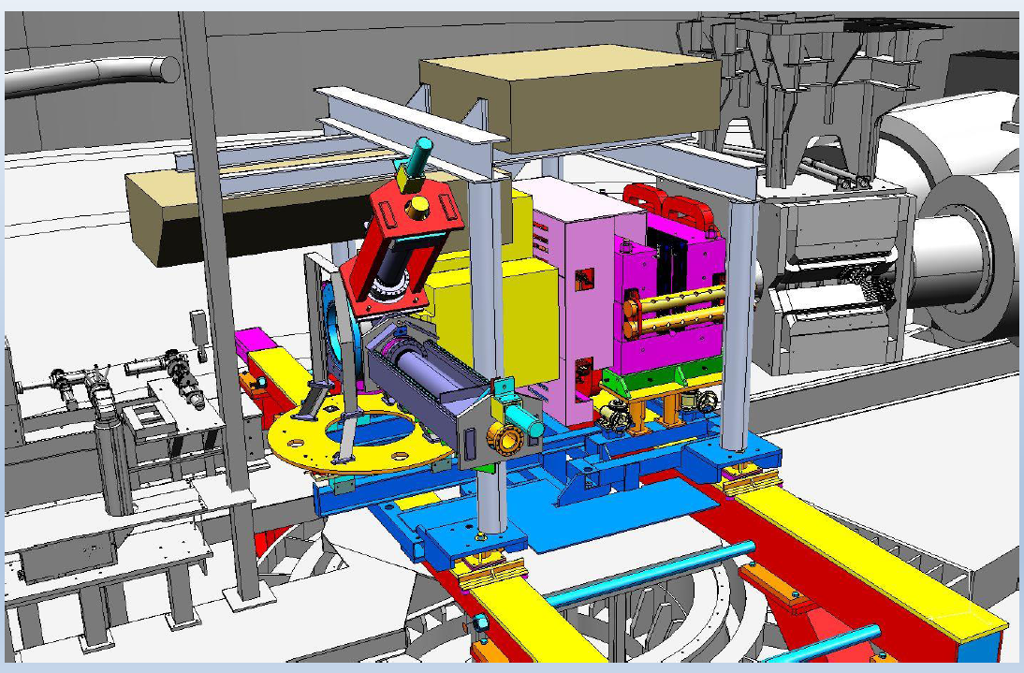
New apparatus in target region
ERR Design Drawings
Credit: Robin Wines
Skyshine shield
Target
collimator
Septum Magnet
HRS Quad 1
beam
Man-weeks design
24 Man-weeks engineering
(minus target)
Jessie Butler: ~70 days installation
Robert Michaels, Hall A Collaboration Meeting, Jan 25, 2018
p9 / 18

Slide 10
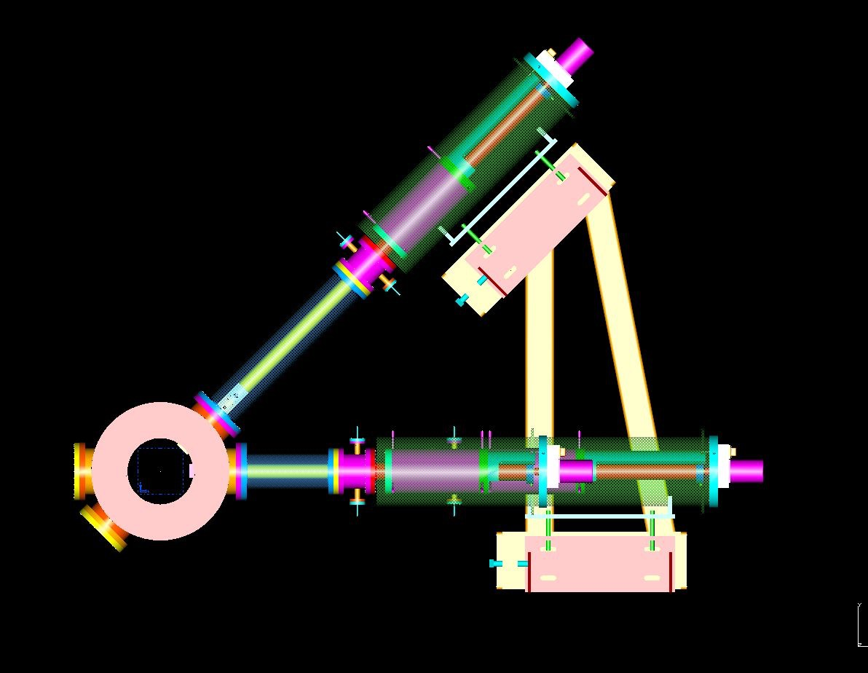
New PREX / CREX Scattering Chamber
Silviu Covrig & target group
One cryo-cooled production target ladder and one calibration-target ladder.
Improved (hard) vacuum seals
Run PREX and CREX with one installation
Small chamber allows efficient shielding
Beam
Septum magnet
Collimator Box
Scattering Chamber
Beam
10 / 18

Slide 11
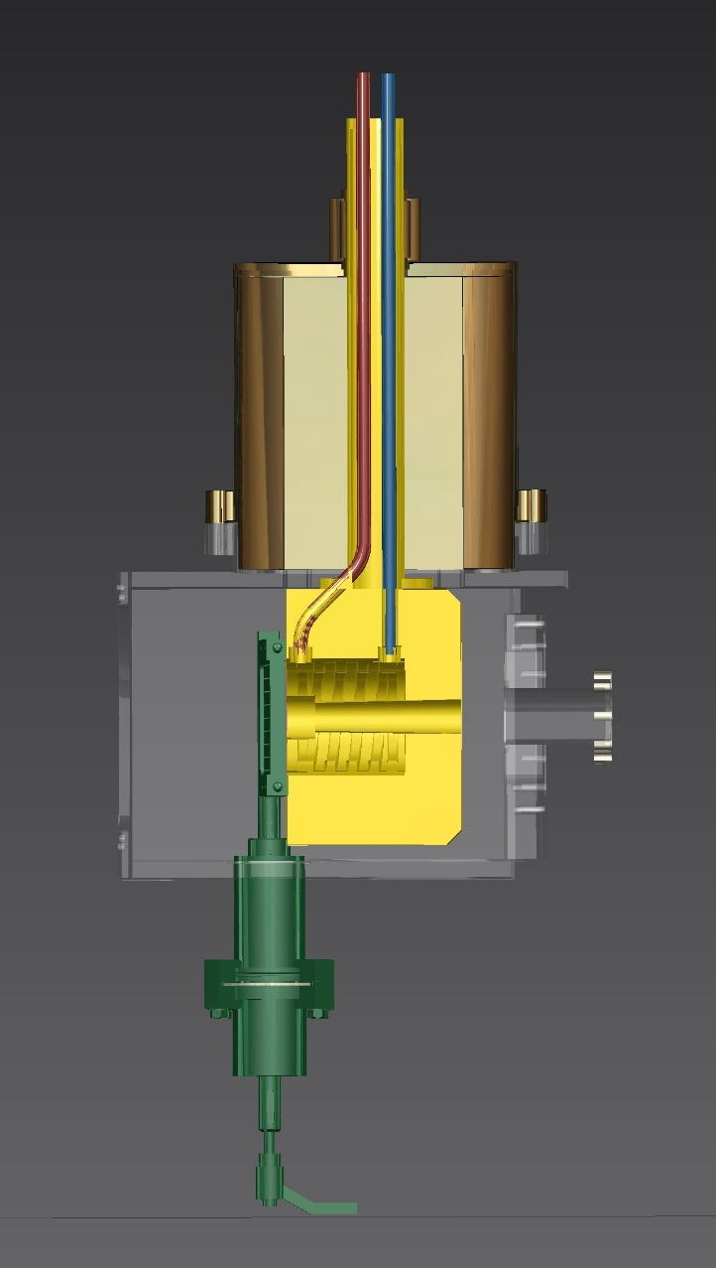
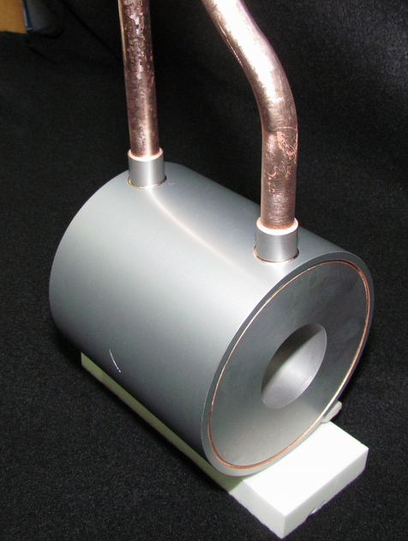
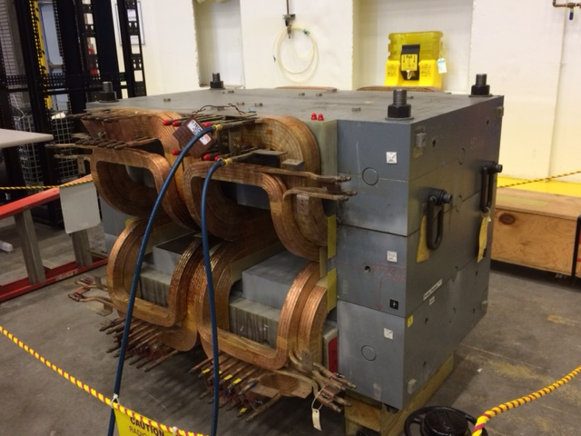
Collimator Box -- located after target, intercepts small-angle scatters so they don’t hit beamline elements.
Cu / W
collimator
coolant
Septum Magnet
beam
Sieve slits
Robert Michaels, Hall A Collaboration Meeting, Jan 25, 2018

Slide 12
PREX/CREX Detectors
Dustin McNulty (Idaho State)
Krishna Kumar (Stony Brook)
GEMs (3)
Quartz (2)
Quartz (2)
Robert Michaels, Hall A Collaboration Meeting, Jan 25, 2018
p12 / 18

Slide 13
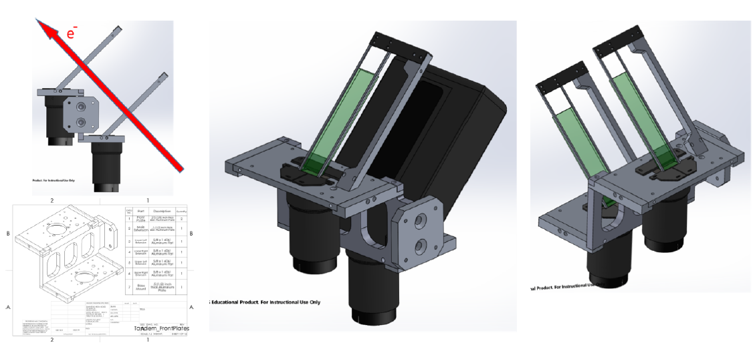
Integrating Detectors
Dustin McNulty (Idaho State)
Krishna Kumar (Stony Brook)
Placed above the VDCs in HRS detector stack
Quartz bar
PMT
Two (redundant) quartz bars, which intercept elastically scattered electrons.
We integrate this signal for our main signal.
Design similar to PREX-I. Beam tests at Mainz confirm simulation.
p13 / 18

Slide 14
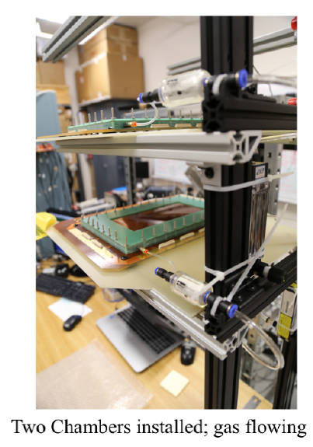
GEMs
Dustin McNulty (Idaho State)
Krishna Kumar (Stony Brook)
Supplement the VDCs in HRS
So we can do Q² measurements at ~1 uA (rates high)
These are “small” 10 x 20 cm²
400 um pitch
Capitalizes on SBS developments (INFN / Uva)
Robert Michaels, Hall A Collaboration Meeting, Jan 25, 2018
p14 / 18

Slide 15
p15 / 18

Slide 17
PREX / CREX Experiments
PREX-2: 3% stat, 0.06 fm
CREX: 2.4% stat, 0.02fm
PREX-I
E=1.1 GeV, 5º
A=0.6 ppm
PREX-II
E=1.1 GeV, 5º
A=0.6 ppm
70 μA, 25+10 days
CREX
E=1.9 GeV, 5º
A = 2.3 ppm
150 μA, 35 + 10 days
Charge Normalization | 0.2%
Beam Asymmetries | 1.1%
Detector Non-linearity | 1.2%
Transverse Asym | 0.2%
Polarization | 1.3%
Target Backing | 0.4%
Inelastic Contribution | <0.1%
Effective Q² | 0.5%
Total Systematic | 2.1%
Total Statistical | 9%
Charge Normalization | 0.1%
Beam Asymmetries* | 1.1%
Detector Non-linearity* | 1.0%
Transverse Asym | 0.2%
Polarization* | 1.1%
Target Backing | 0.4%
Inelastic Contribution | <0.1%
Effective Q² | 0.4%
Total Systematic | 2%
Total Statistical | 3%
Charge Normalization | 0.1%
Beam Asymmetries | 0.3%
Detector Non-linearity | 0.3%
Transverse Asym | 0.1%
Polarization | 0.8%
Target Contamination | 0.2%
Inelastic Contribution | 0.2%
Effective Q² | 0.8%
Total Systematic | 1.2%
Total Statistical | 2.4%
Achieved, published
*Experience suggests that leading systematic errors can be improved beyond proposal
statistics limited result, systematics well under control
p 17 / 18

Slide 18
PREX, C-REX : Summary
Fundamental Nuclear Physics with many applications.
Results are highly anticipated by a broad community.
PREX-I achieved systematic error goals
Problems being fixed:
shielding and rad-hard vacuum seals.
PREX-II & C-REX passed the Experiment Readiness Review (ERR) in 2017
Please join us !
Robert Michaels, Hall A Collaboration Meeting, Jan 25, 2018

