Slide 1
Jefferson Lab Users Organization
J. Roche
Ohio University
Chair-elect,
JLab User Group
Board of Directors
NEED new JLUO logo
Roche’s work is supported by

Slide 2
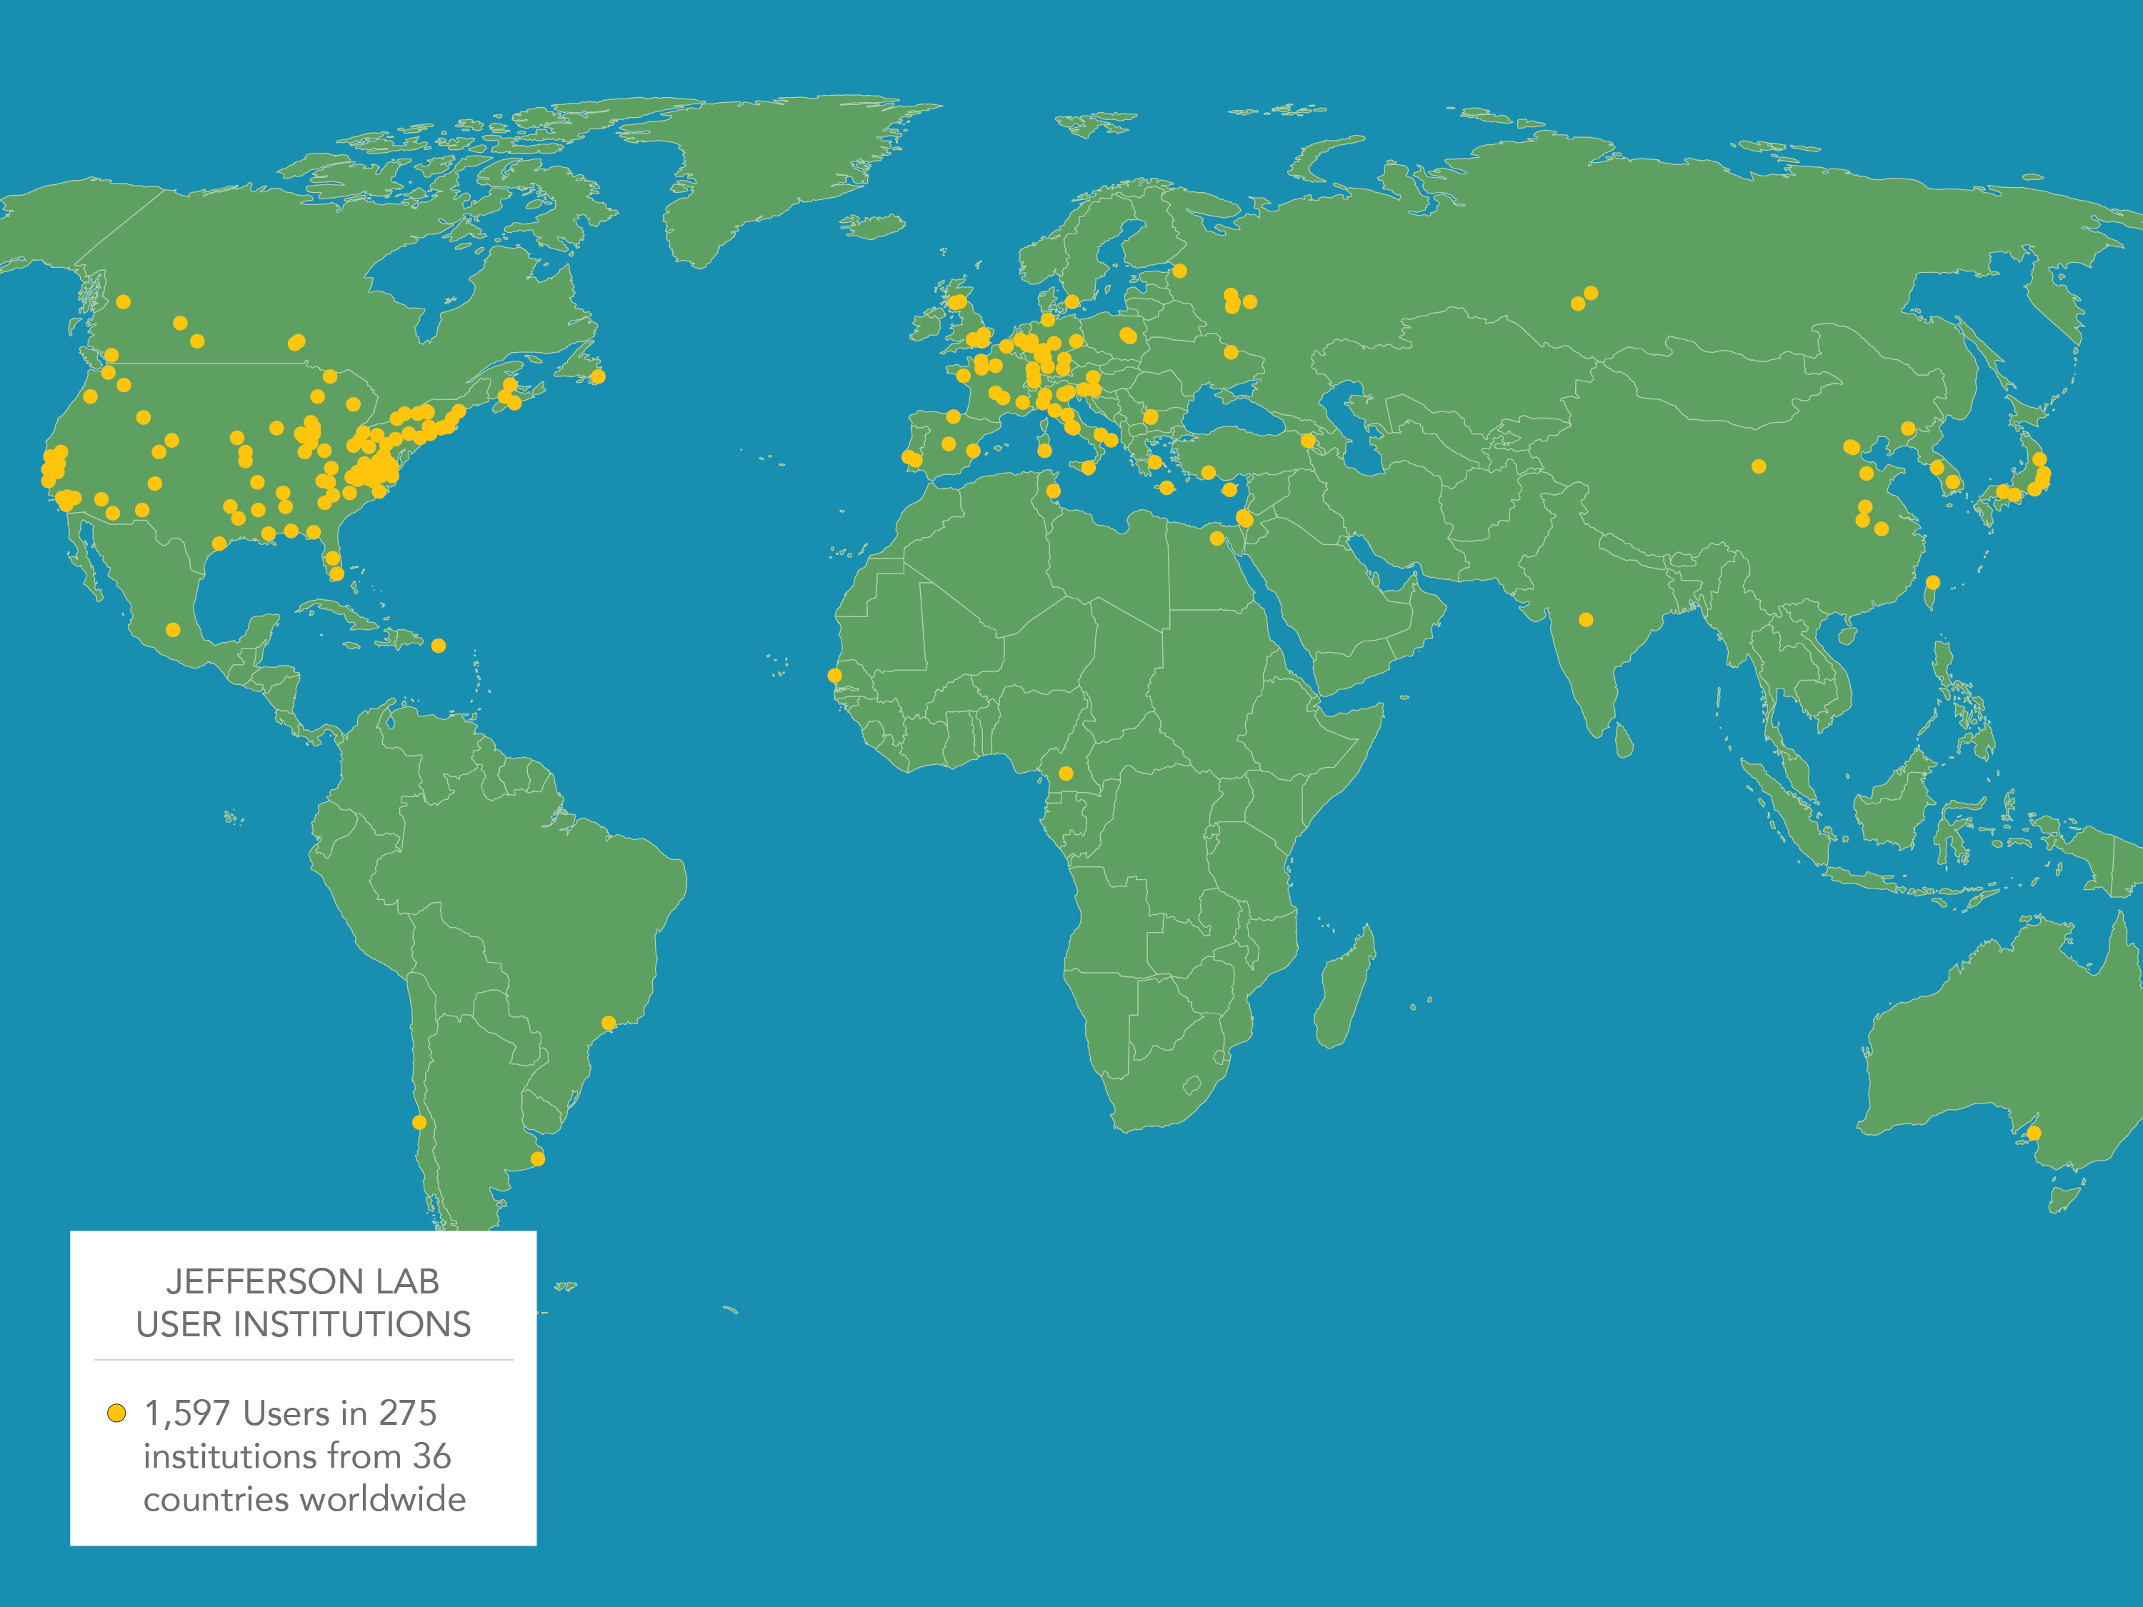
2
JLab Serves a Vibrant and Enthusiastic User Community
1,597 Active Users –
425 Physics Letters and Physical Review Letters publications; 1,459 in other refereed journals
608 PhDs granted; 211 more in-progress
JLab produces ~1/3 of US PhDs in Nuclear Physics

Slide 3
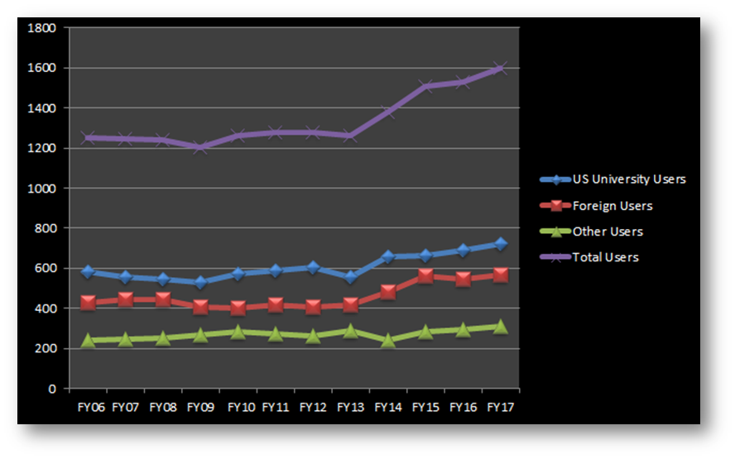
Keen Anticipation Worldwide for the Start of 12 GeV Science
The User Group has grown significantly in recent years
Reflection of the increasing breadth of nuclear science topics and the powerful new capabilities of the upgraded CEBAF

Slide 4
4
JLab User Organization’s purpose
Encourage and assist scientists and engineers in the use of the Continuous Electron Beam Accelerator Facility, (Community building)
Create and maintain effective channels for the exchange of information between the staff of JLab and other scientists and engineers interested in using CEBAF,
Create and maintain effective methods of offering advice and counsel to the JLab management on matters of policy affecting the development and utilization of the facility, and (Representation of users within JLab)
Support, encourage, and assist in the advancement of basic scientific knowledge, and to promote the most effective utilization of CEBAF for the common good and welfare of society. (Outreach)
https://wiki.jlab.org/cugwiki/

Slide 5
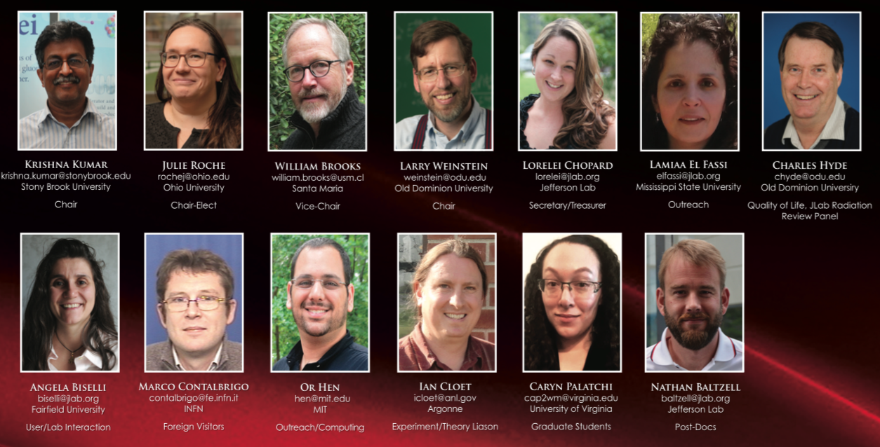
Users Group Board of Directors (UGBoD)
Four year chair line:
Krishna Kumar (Chair), Julie Roche (Chair-Elect), William Brooks (Vice Chair), Lawrence Weinstein (Past Chair)
Much greater support for the chair
Initiated specific responsibilities for each officer

Slide 6
Users Group Board of Directors (UGBoD)
Lamiaa El Fassi (Mississippi State U): Outreach
Charles Hyde (Old Dominion U): Quality of Life
Angela Biselli (Fairfield U): User/JLab interaction
Marco Contalbrigo (INFN Ferrara): Foreign Visitors
Or Hen (MIT): Outreach and Computing
Ian Cloet (Argonne): Experiment/Theory Liaison
Caryn Palatchi (UVa): Graduate Students
Nathan Baltzell (Jefferson Lab): Postdocs
Elected board
Nomination committee
led by John Arrington
johna@anl.gov
*
*
*
*

Slide 7
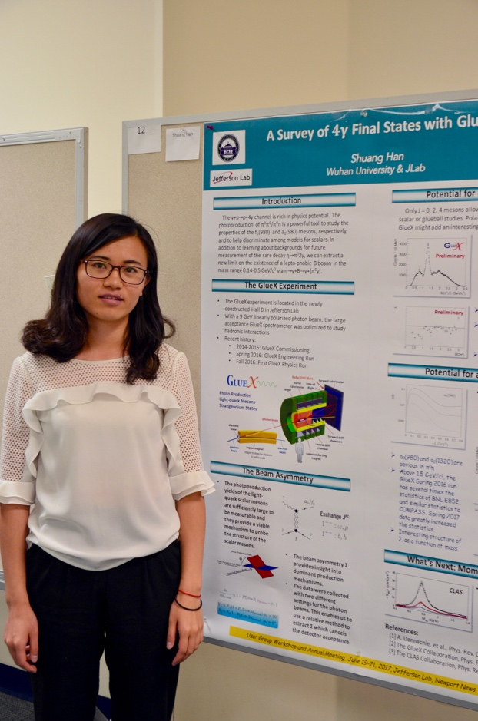
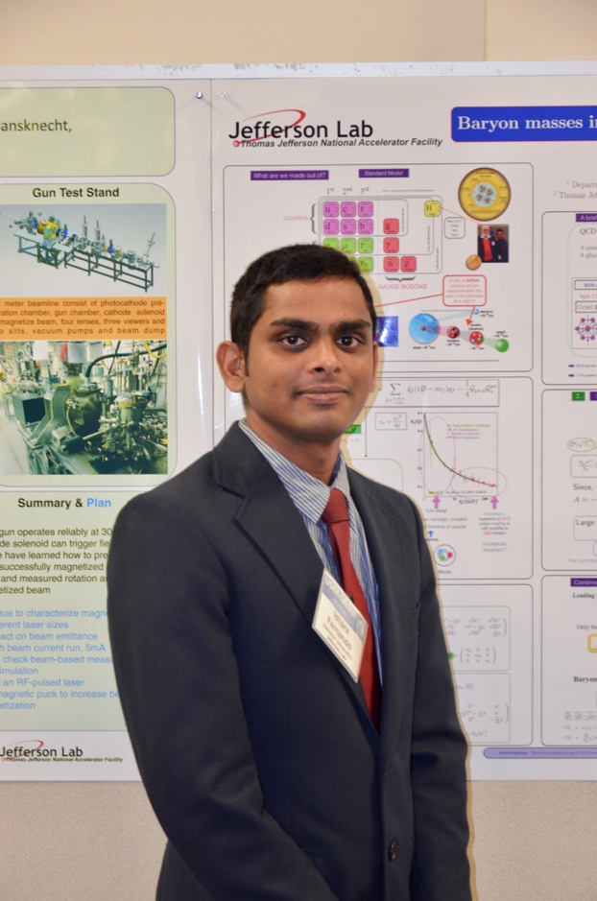
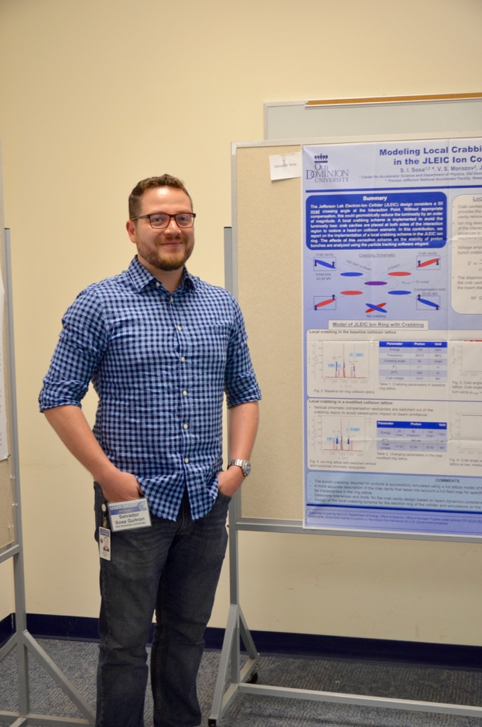
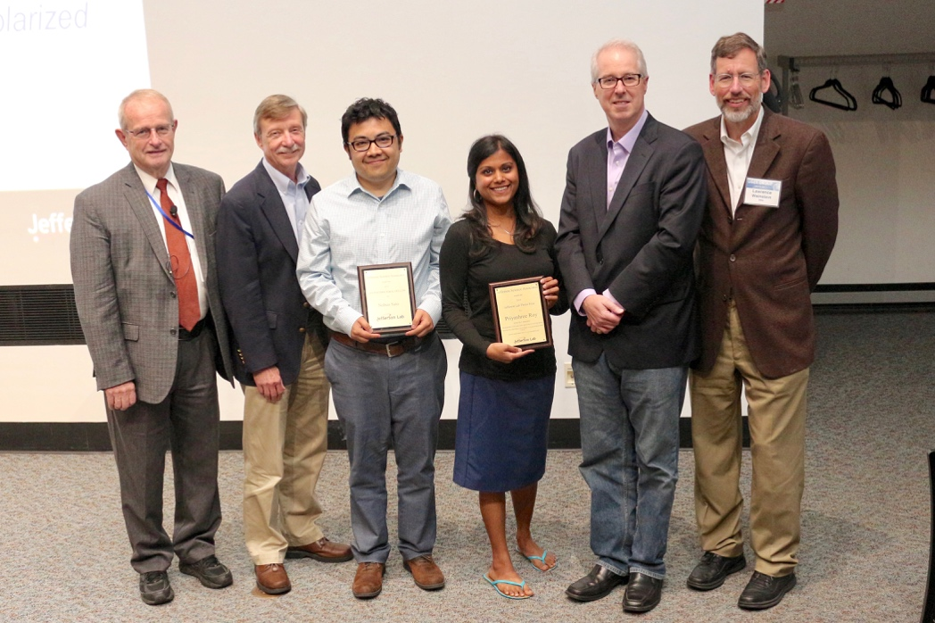
User group Meeting
Poster competition winners (top)
Postdoc and Thesis Prize winners (right)
In 2018:
June 18th to 20th
From 12 GeV to EIC
Apply to this year Postdoc prize
Deadline extended to February 13

Slide 8
8
Examples of JLUO activities: Community building
Organize the Annual User Meeting and 2 satellite meetings (APS April and DNP Fall meetings)
Manage JSA awards (Thesis Prize, Postdoc Prize, Poster Prize…)
Submit several continuing Initiatives Fund (IF) proposals
Most of the JLUO activities are supported by JSA (thanks!)
Help with Software Carpentry Workshop
Examples of JLUO activities: Representing users at JLab
Representation on Director’s Safety Council (E. Brash), JLab radiation review committee (C. Hyde) , Director’s Inclusion and Diversity Council (A. Biselli)
Worked with B. McKeown on PAC-related issues
Suggestions for new PAC members
Role of User Chair on PAC: KK served on 2017 PAC
guidelines for engagement developed with PAC Chair Jim Napolitano
Meet with JLab management twice a year (Jan, Jun) and with JSA

Slide 9
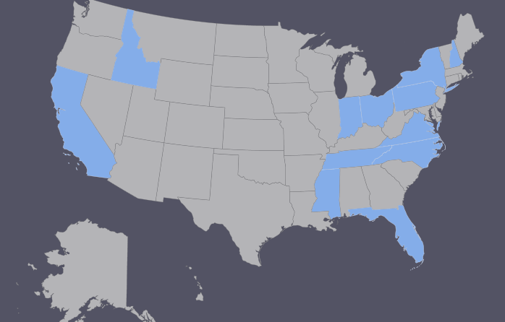
Nuclear Physics on the Hill
JLab, RHIC and FRIB user groups meet with the offices of senators and representatives
JLab participants (6th year)
2016: 25 from 12 states
2017: 23 from 13 states
In 2018:
Coordinated by L. El Fassi
Meeting on April 9
Register interest by March 9

Slide 10
10
Examples of JLUO activities: Outreach
Select and nominate users for APS Fellowships (raise JLab User profiles)
Expanded purview of Nominating Committee beyond UGBOD membership:
John Arrington will serve as Chair for 2017-18
UGBOD Engagement with Congress on Office of Science 2018 Budget
Urged Users to write to elected officials
Send letters to Congressional subcommittees; coordinated with other national user organizations
Strengthening User Group communication with DoE NP Office
Germantown visit May 2017 (another visit is being planned for this year)
Conveyed excitement and breadth of 12 GeV Physics
Communicated User concerns
JLab operations budget affects accelerator availability and performance
Timely thesis topics for graduate students and research output for postdocs and junior faculty
with JLab, produced a “broader impacts” slide show with profiles of former users.
Do register to cuga@jlab.org using a non JLab address (wiki has instructions)

Slide 11
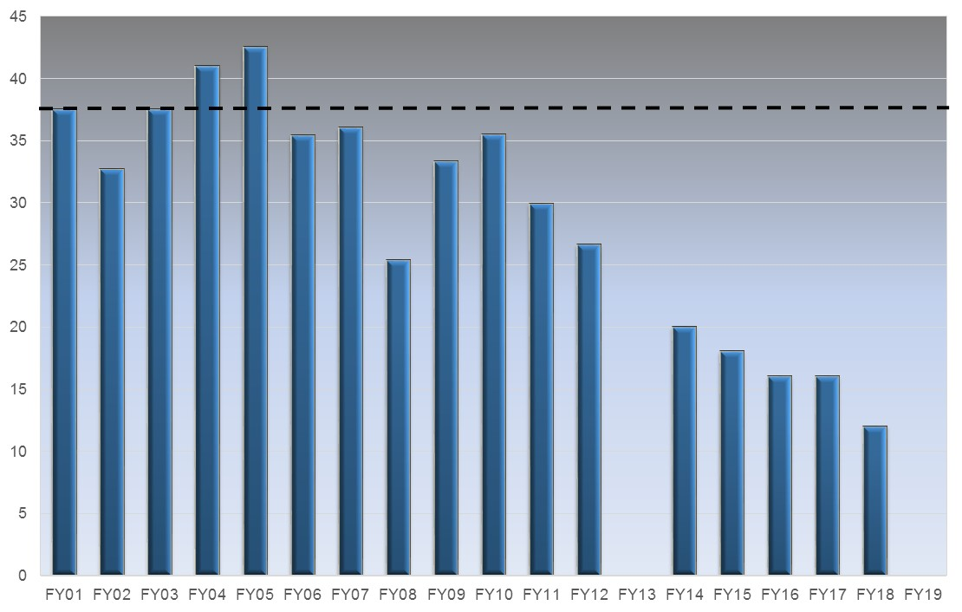
Looking Ahead: The Urgency of Full Operational Funding
Tremendous user excitement for the 12 GeV physics program
More beam time needed to maintain user morale
Optimal
12 GeV Construction
?
Weeks of OPS Delivered

Slide 12
https://wiki.jlab.org/cugwiki/
cuga@jlab.org
The User Group Board helps
Bring the users together
Represent the users to the lab and the lab to the users
Represent the lab+users to Congress and the DOE
JSA Initiatives Fund support is critically needed for UG Board activities
User group board of directors concerns:
MOUs with foreign institutions,
Accelerator performance ,
Lab budget and available running time, and
Your issues here: tell us your concerns

