Slide 1
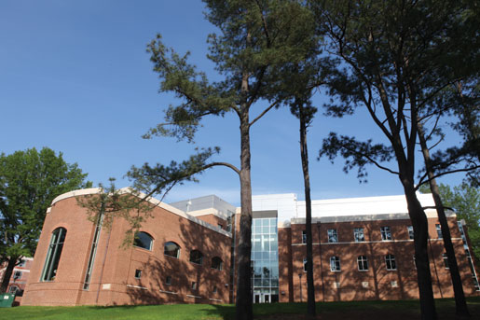
Update on the BigBite Gas Ring Imaging Cherenkov (GRINCH) Detector for SBS
Hall A Meeting
22-Jan-2018
Todd Averett
Department of Physics
The College of William and Mary
Williamsburg, VA USA
Physics Department at William and Mary
In collaboration with:
C. Ayerbe-Gayoso, William and Mary
B. Wojtsekhowski, Jefferson Lab
Ahmidouch, S. Danagoulian, NC A&T
I. Niculescu, G. Niculescu, JMU
J. Annand, Glasgow
Wiki: http://wm-jlab.physics.wm.edu/mediawiki/index.php/Bigbite_Gas_Cherenkov
Email: tdaver@wm.edu

Slide 2
Motivation: SBS High Rate Running
Heavy Gas threshold Cherenkov detector for pi/e separation.
For SBS: expect 4-5x increase in total luminosity over previous BigBite running.
Assume 4-5x larger background rate.
30 degree scattering angle
Segmented PMT array (qty= 512, 29mm tubes)
Search for timing clusters/rings in 5-10 ns window.
No ADCs—timing only
Magnetic shielding between rows.
Locate PMT array on large angle side away from beam line.
C₄F₁₀ heavy gas at 1 atm**

Slide 3
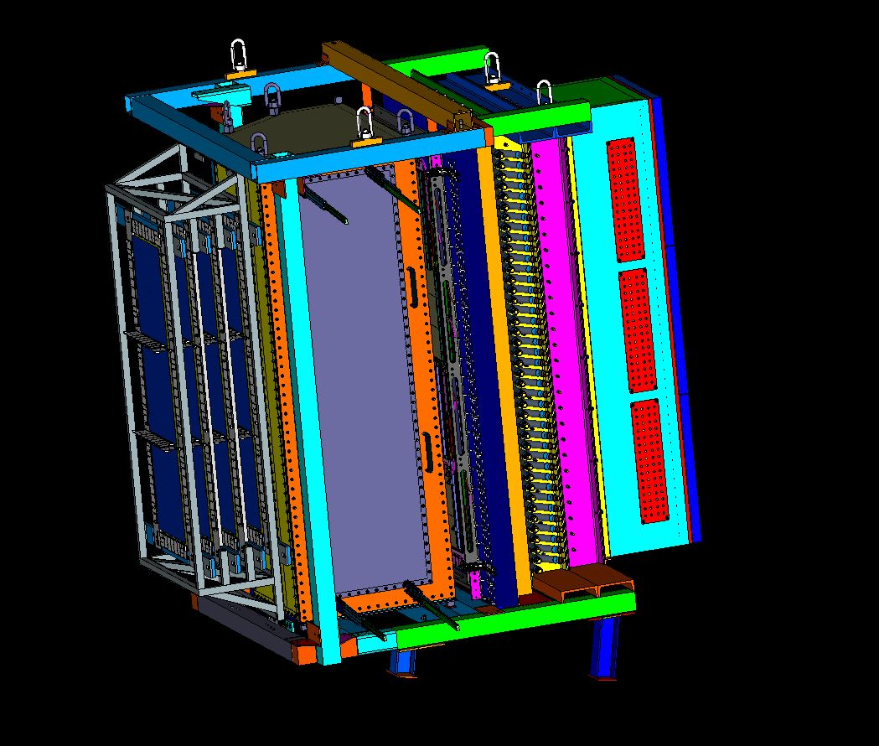
BigBite Detector Stack – 12 GeV
GEM x 4
Cherenkov
PreSh
Shower
GEM
Hodo

Slide 4
Top View of Geometry
Mirror
PMT
Array
Mirror
Frame
Incoming
Particles

Slide 5
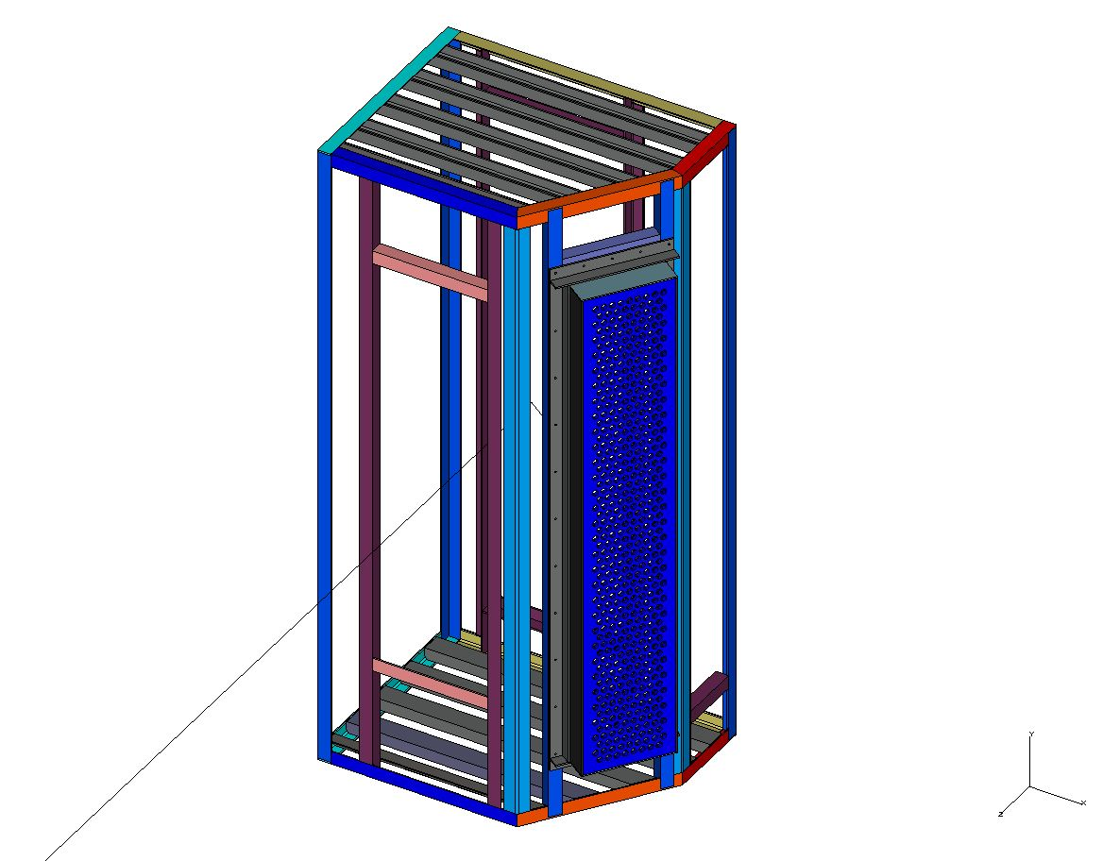
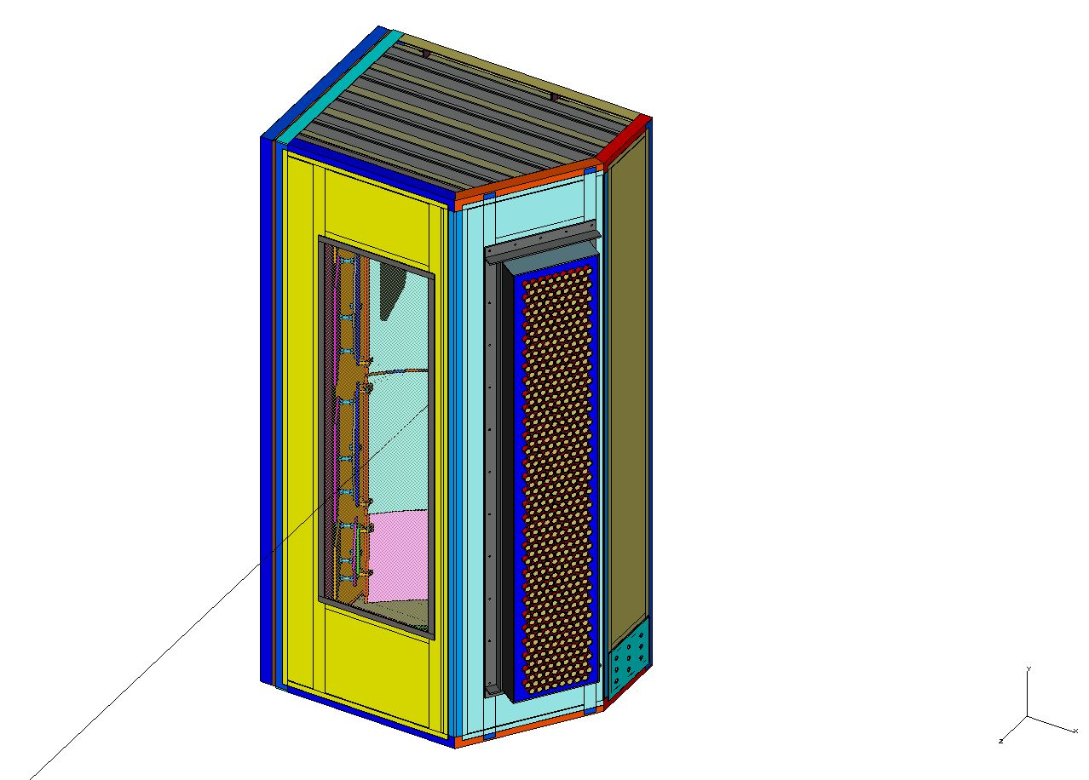
Design—S. Esp, JLab
Vessel Weldment
Front View
Complete Assembly
Front View

Slide 6
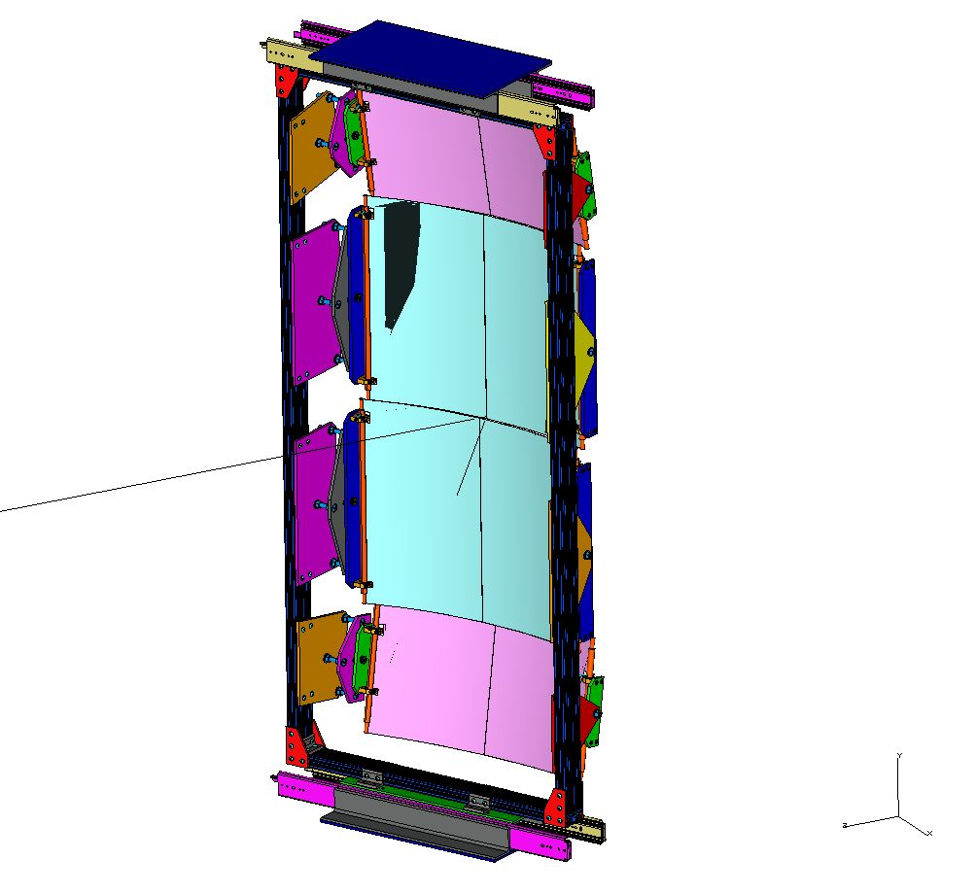
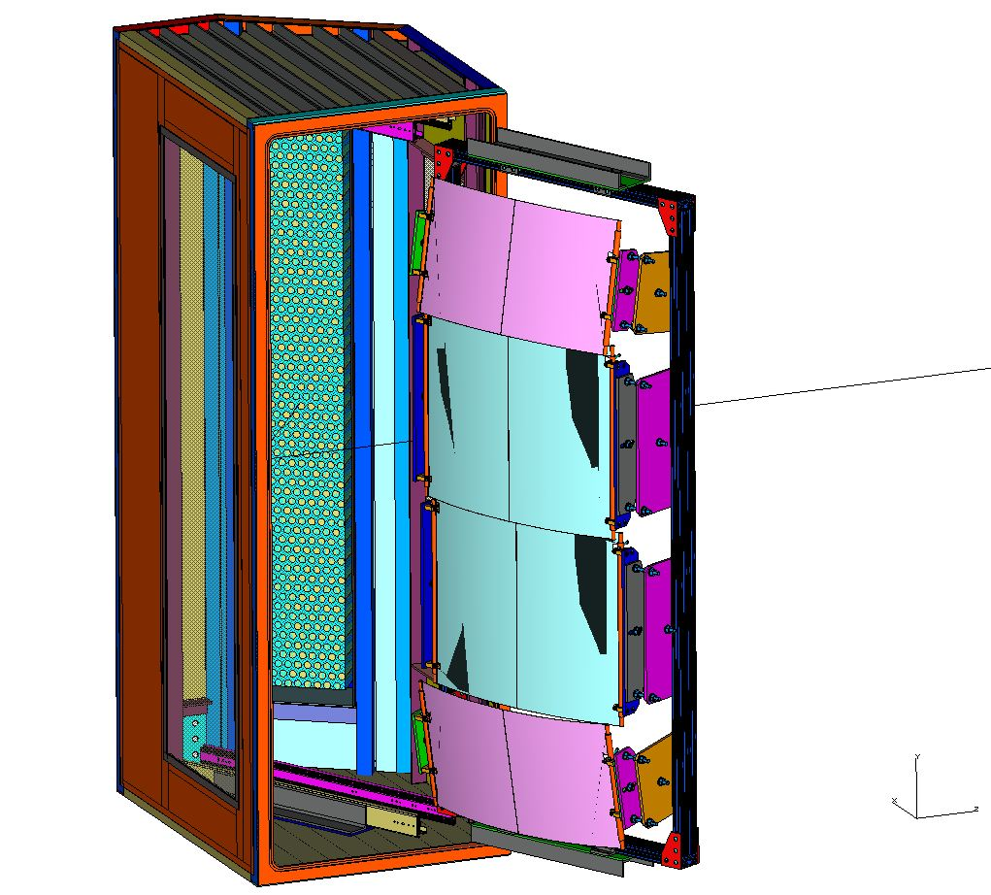
Mirrors and Frame
Front View
Mirrors Out of Vessel
Rear View

Slide 7
Mechanical Assembly Status
Vessel complete, windows installed, 120 um Al
Mirrors installed, aligned according to
E. Fuchey simulation
All PMTs tested, gain matched, installed
Light catcher cones installed
Gas system complete, in use
Removable door is leaking-work in “progress”

Slide 8
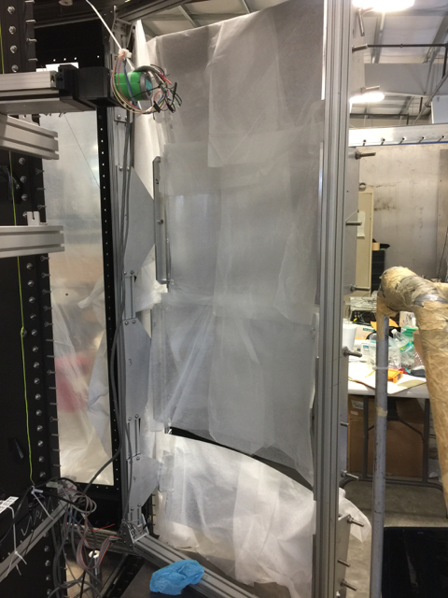
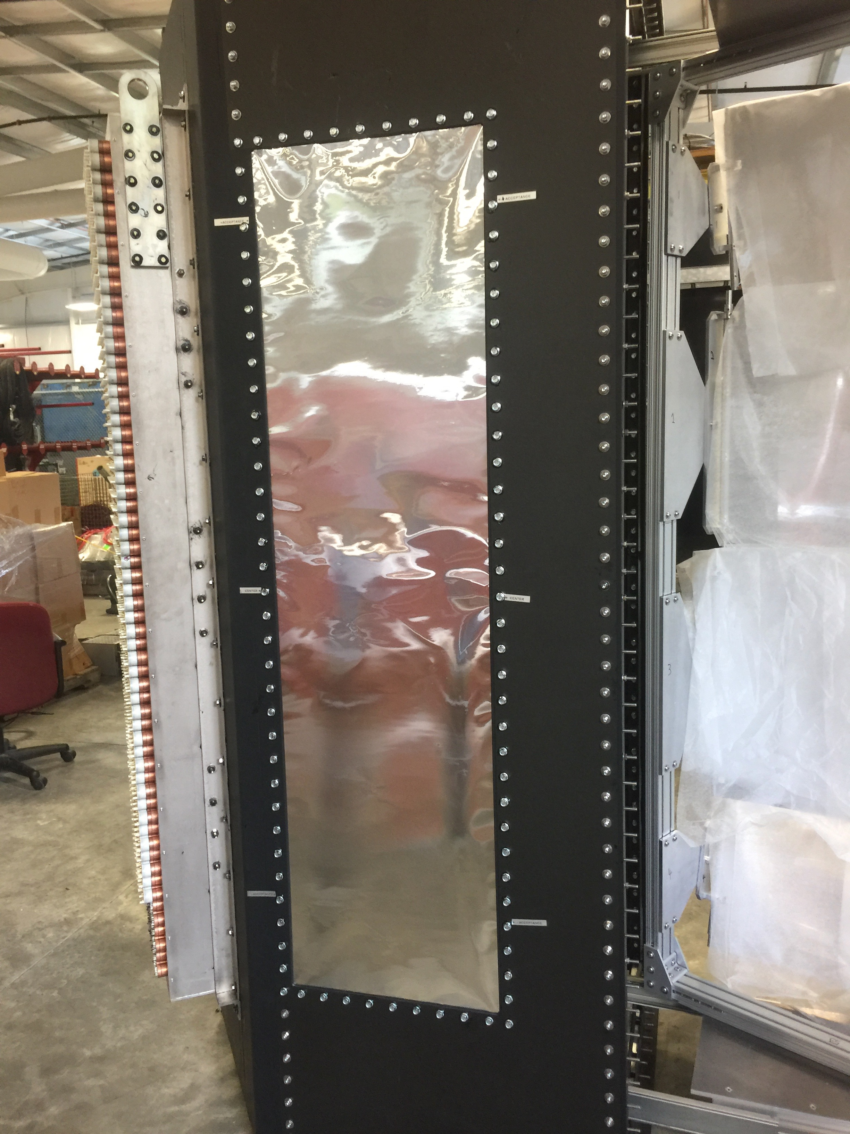
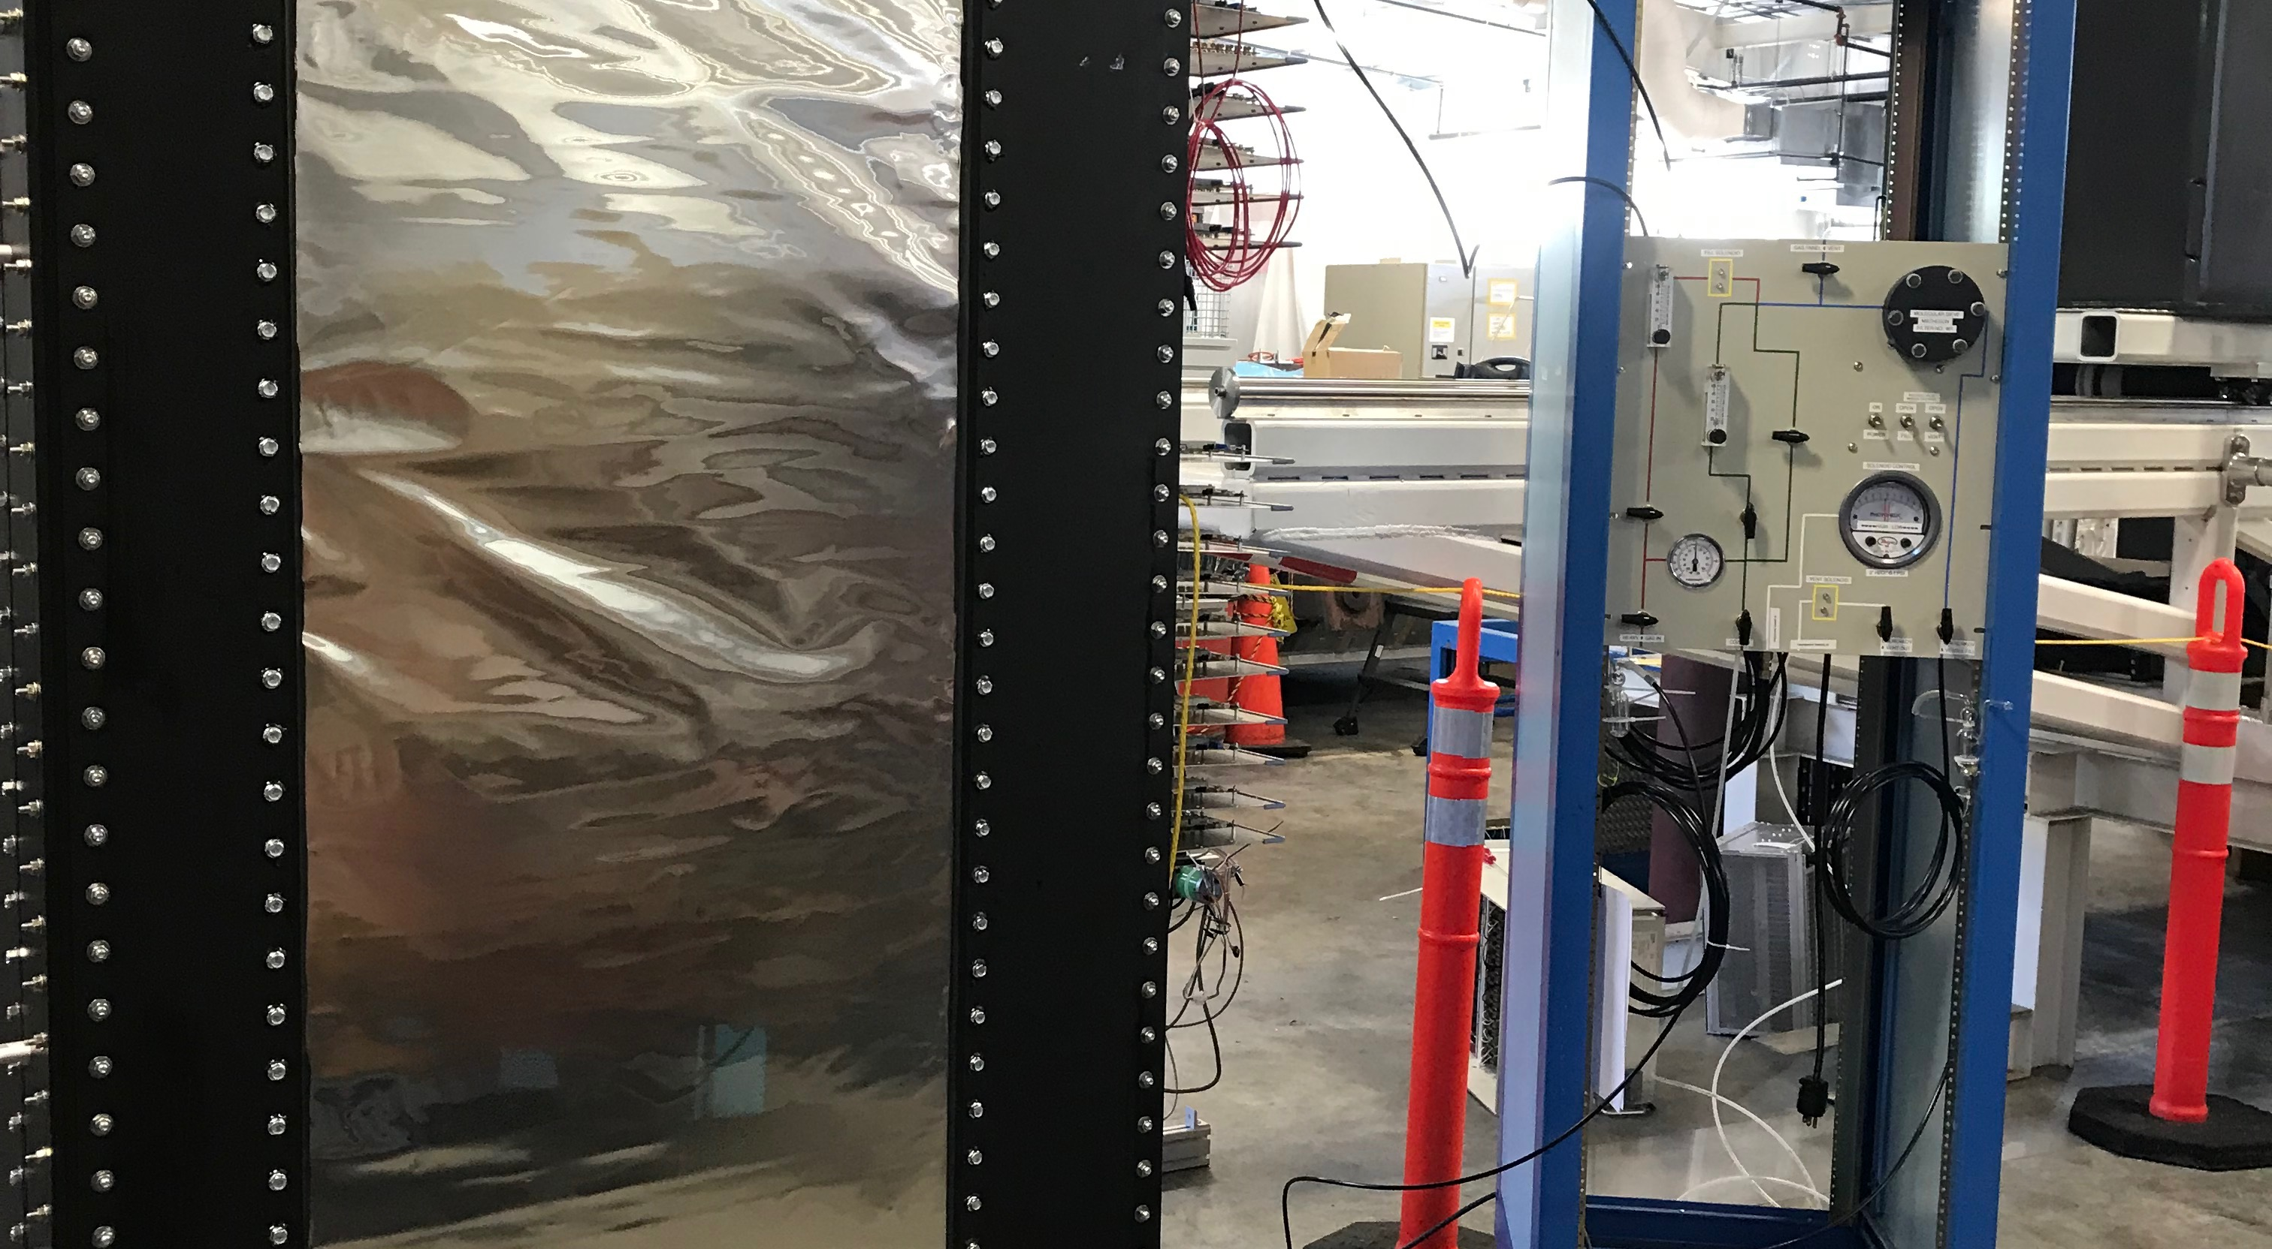
Pictures
Mirror Frame
Entrance Window
Exit Window and Gas Panel

Slide 9
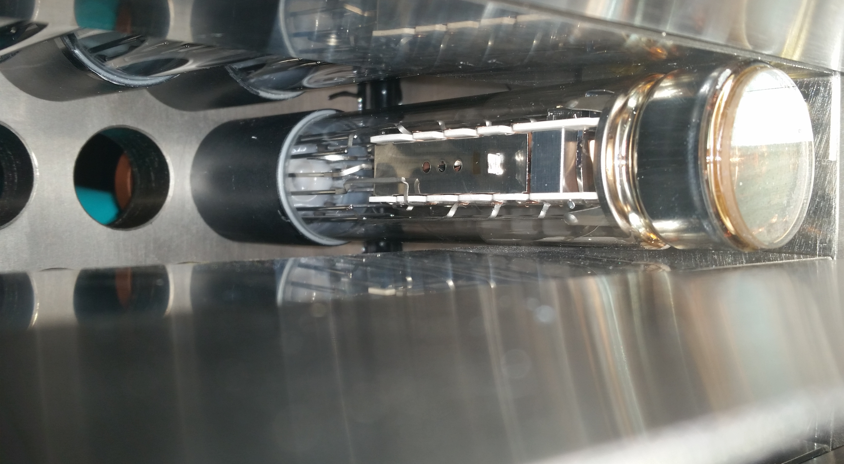
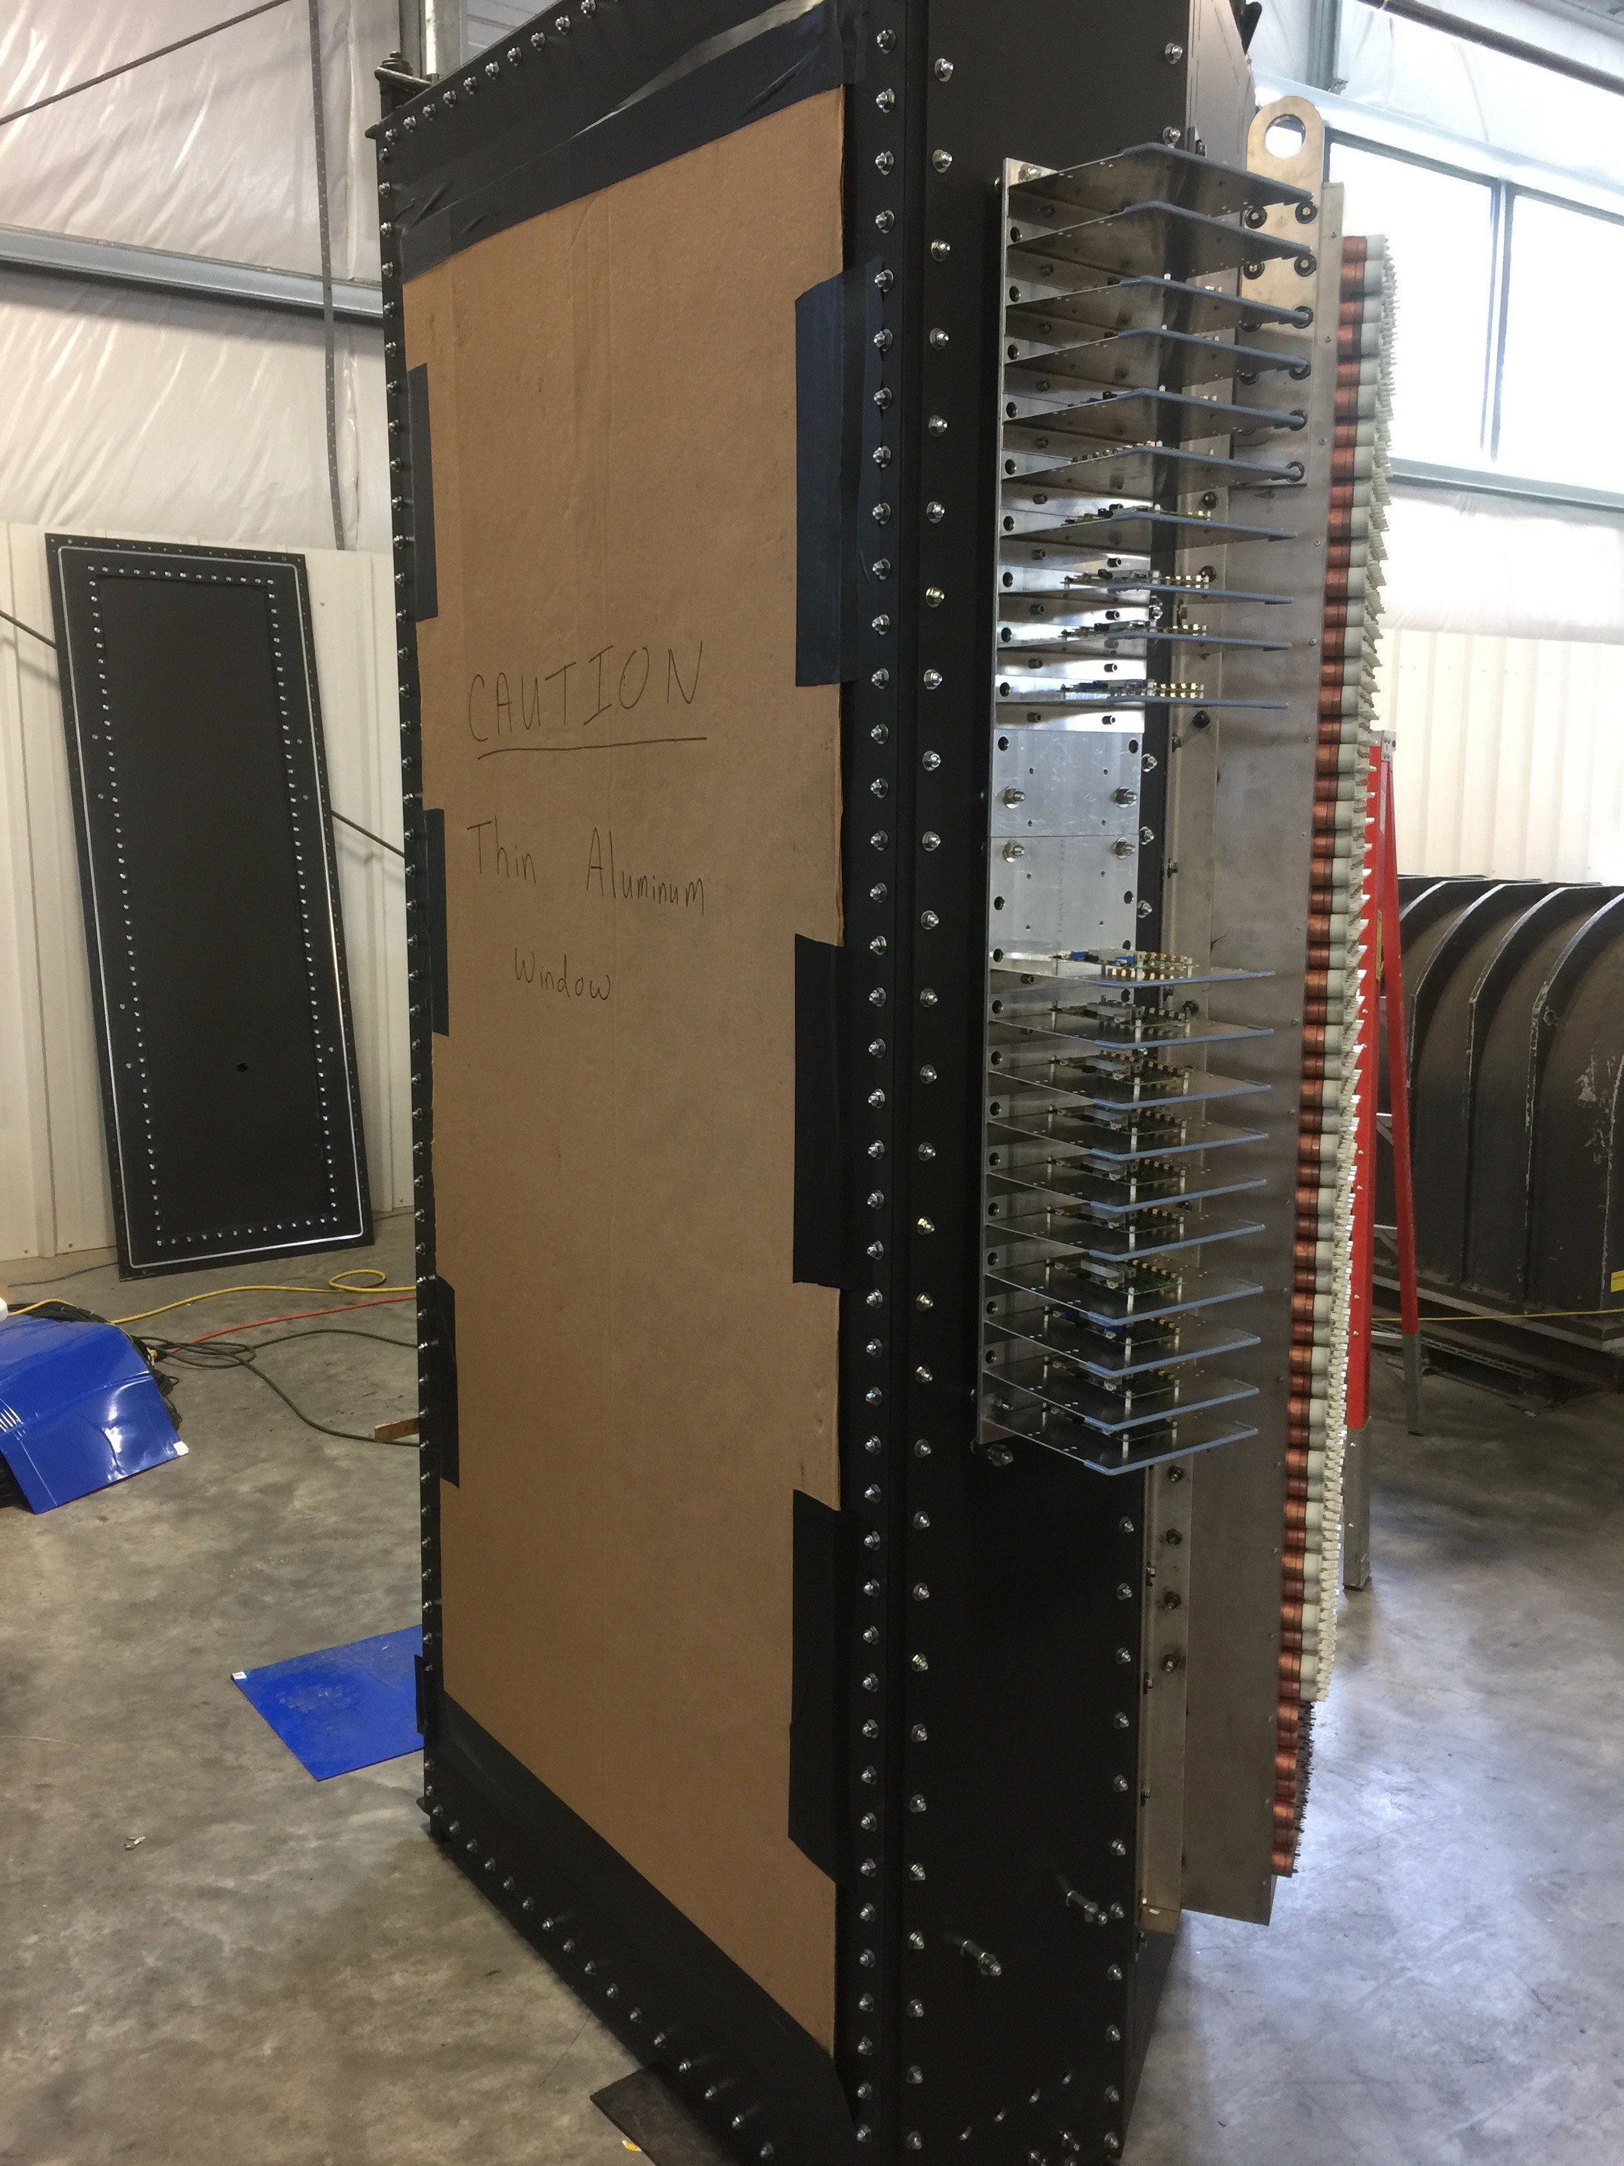
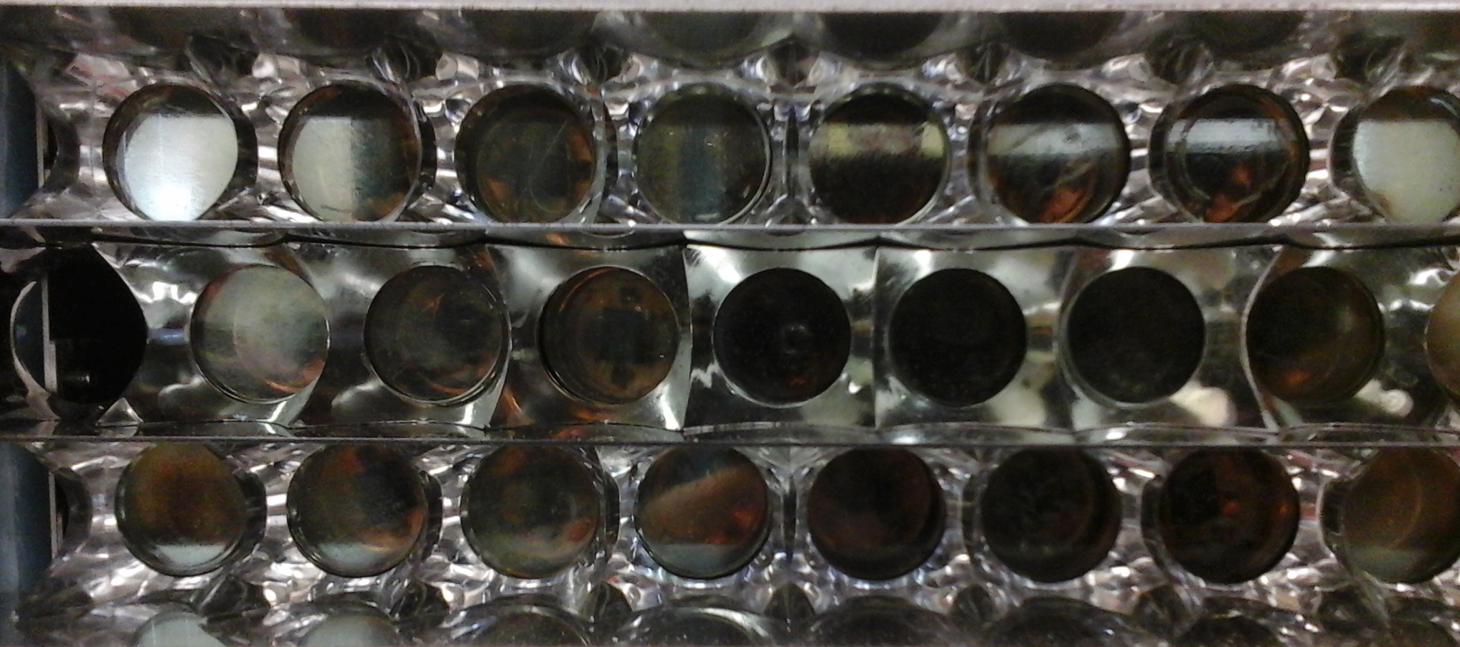
Pictures
PMT between iron & mu metal
Nino front end cards
PMT array
PMTs with light catcher cones

Slide 10
DAQ Status
Front-end NINO cards installed, PMT cables complete.
Power supply distribution board complete.
DAQ—VME-based VETROC system for timing, possible online cluster finding trigger.
VME ADCs for 15% of tubes.
64 Channel DAQ system testing ongoing with prototype detector.
Trigger up to 10 kHz.

Slide 11
DAQ Info

Slide 12
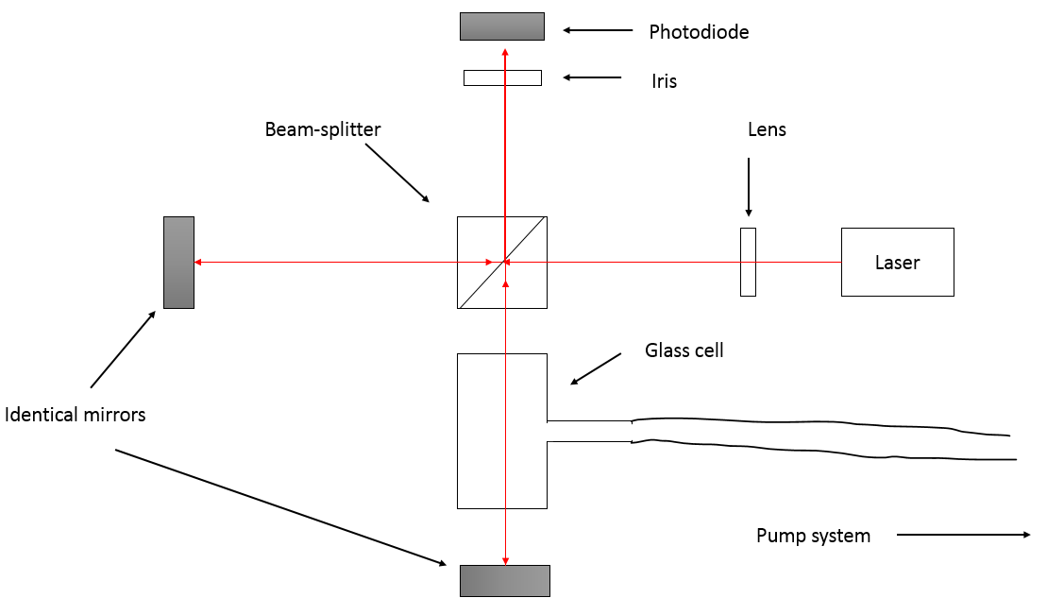
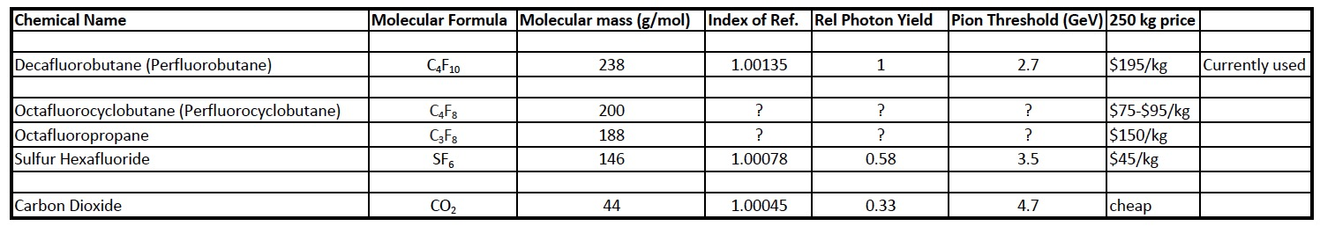
Gas Possibilities
C₄F₁₀ looks prohibitively expensive. Largest loss is through leakage based on Hall A and B experience.
Measuring index of refraction and UV absorbance of 3 less-expensive gases: SF₆ , C₄F₈ , C₃F_{8.}
Possibility of using CO₂ for G_{M}^{n} experiment which only needs 10:1 pion rejection. But CO₂ gives a factor of three fewer photons.
Non-toxic, non-flammable; all are greenhouse gases
W&M interferometer for measuring refractive index

Slide 13
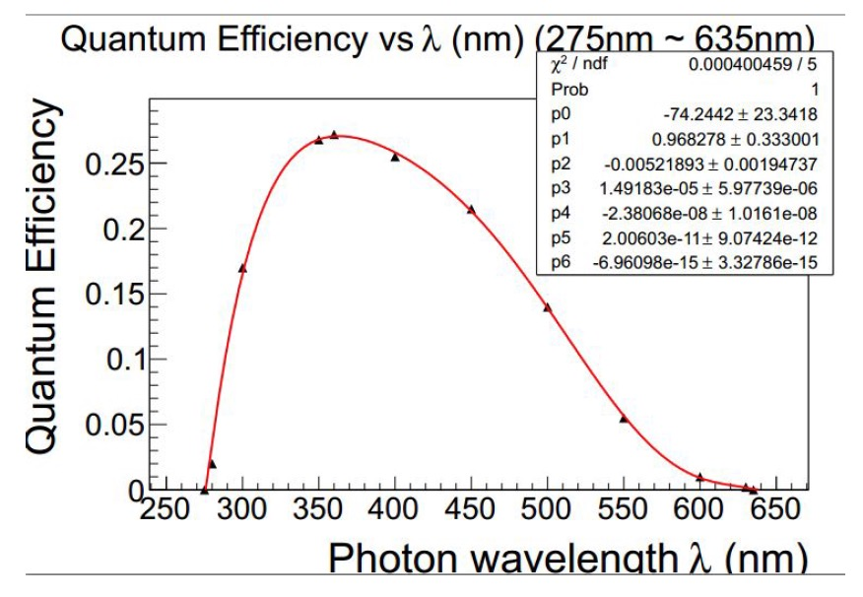
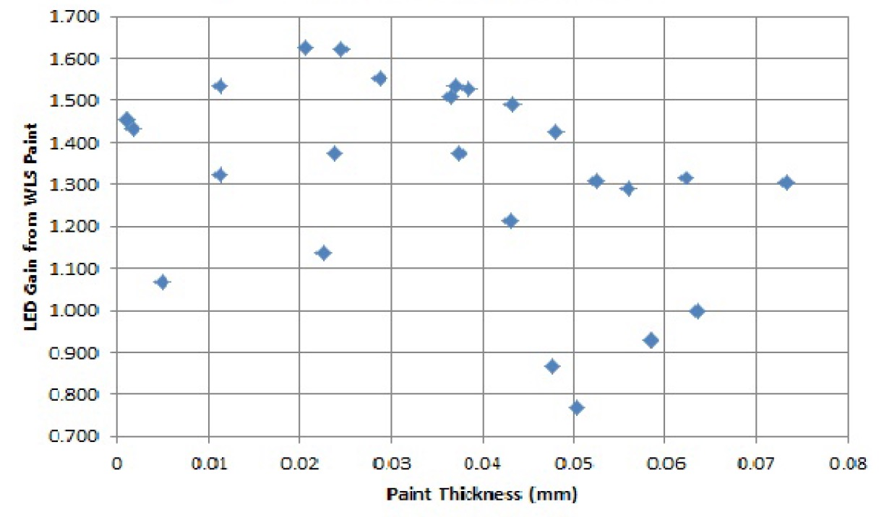
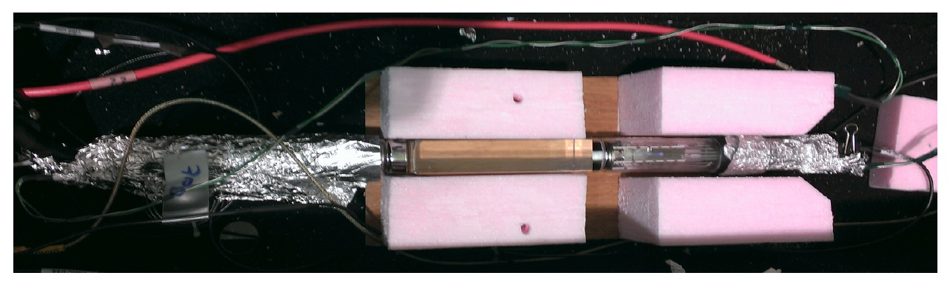
Jlab WLS Paint Studies—S. Barcus, B. Wojtsekhowski
PMTs not sensitive to UV but Cherenkov spectrum most intense UV
Try using WLS paint that is used successfully in HRS Cherenkov
Using quartz rod with cosmics—seems to work

Slide 14
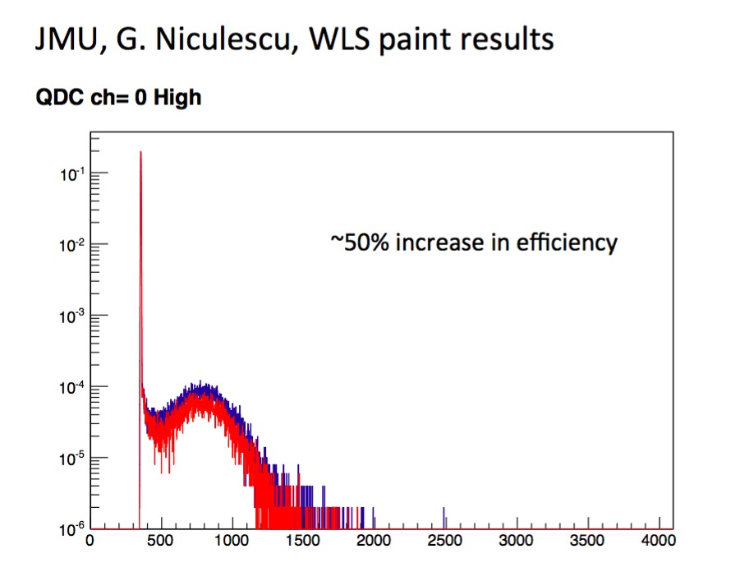
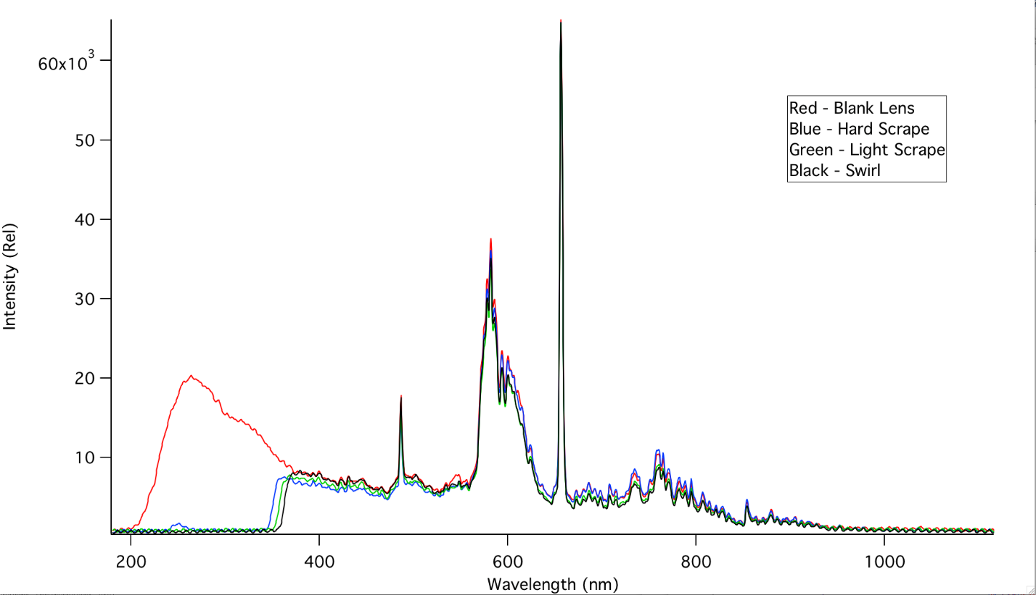
WLS Studies
W&M results using D₂ lamp and
Spectrometer—Paint not working
JMU ADC using UV LED— Clear improvement

Slide 15
Plans
Seal leaking door
Continue DAQ tests with prototype
Install all cables
Assemble full DAQ
Finish testing gases
Full detector checkout
Estimate completion Fall 2018

