Slide 1
SBS Construction Status
Mark Jones

Slide 2
Overview
SBS Project focused on equipment for three form factor experiments.
SBS Project Closeout in June 2017.
In “Transition to Operation”, monitoring the SBS Dependencies
SBS weekly meetings. Minutes and talks are available.
SBS Collaboration meeting on Feb 23-24, 2018.
GMN experiment passed its ERR last year.

Slide 3
Overview of SBS Program
 | Apparatus | Experiment
Projects
WBS 1 SBSBAS | SBS Magnet with platform and power supply, beamline upgrades. Hall LCW and power upgrades | GEn, GMn , GEp
WBS 2 SBSNFF | Coordinate Detector HCAL trigger Detector frames, Electronics Hut, Lead shielding | GEn, GMn , GEp
WBS 3 SBSPFF | Rear GEM tracker | GEp
SBS dependencies
 | Front Tracker GEMS | GEn, GMn , GEp
 | Polarized 3He target | GEn
 | Gas Cherenkov (GRINCH) in BigBite | GEn, GMn
 | Hadron Calorimeter (HCAL) | GEn, GMn , GEp
 | Electron calorimeter (ECAL) | GEp
Existing Hall A equipment
 | BigBite Magnet and Platform , Scintillator Array BigBite PreShower /Shower calorimeter and HRS-Right | GEn, GMn
 | LD2 and LH2 cryotarget | GMn , GEp

Slide 4
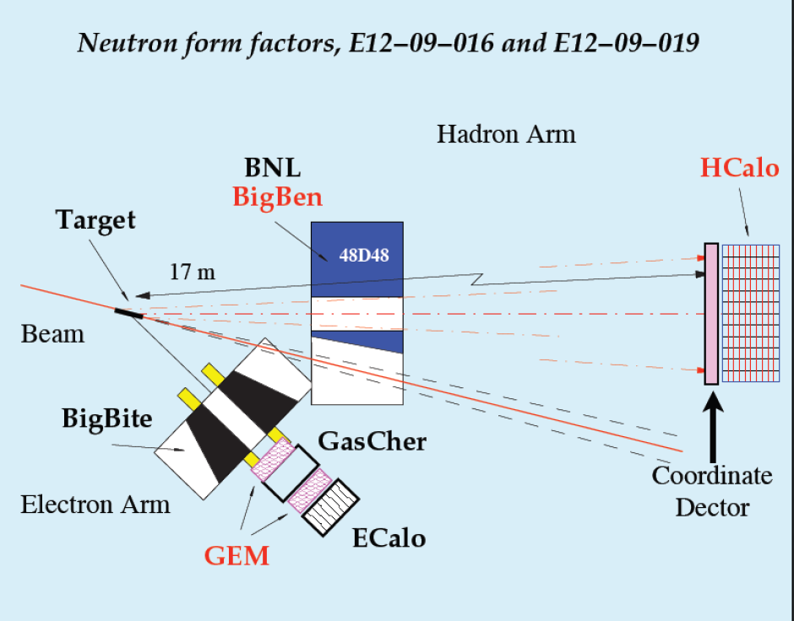
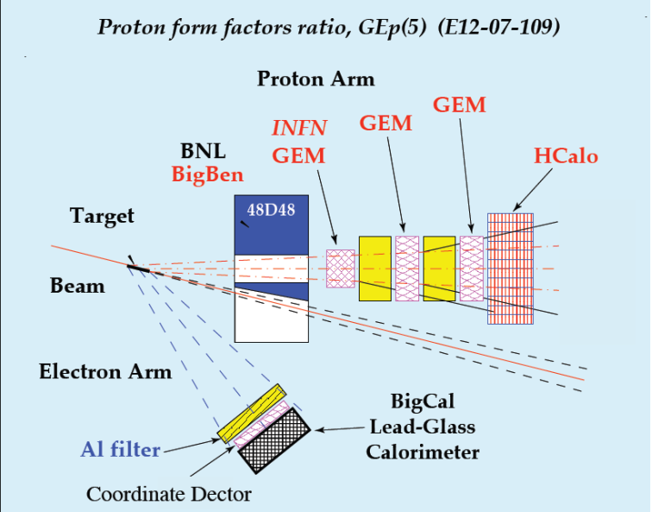
Experimental Layout

Slide 5
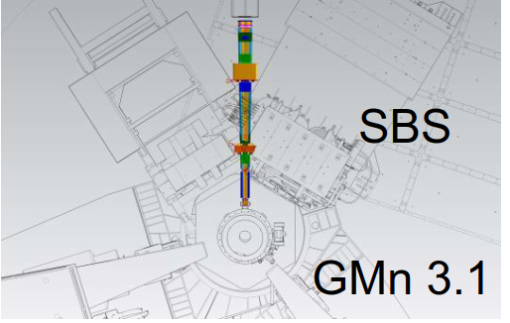
GMN Experimental Layout
Bigbite

Slide 6
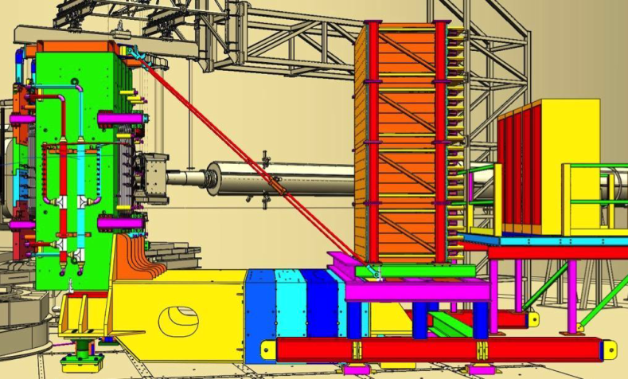
GMN Experimental Layout

Slide 7
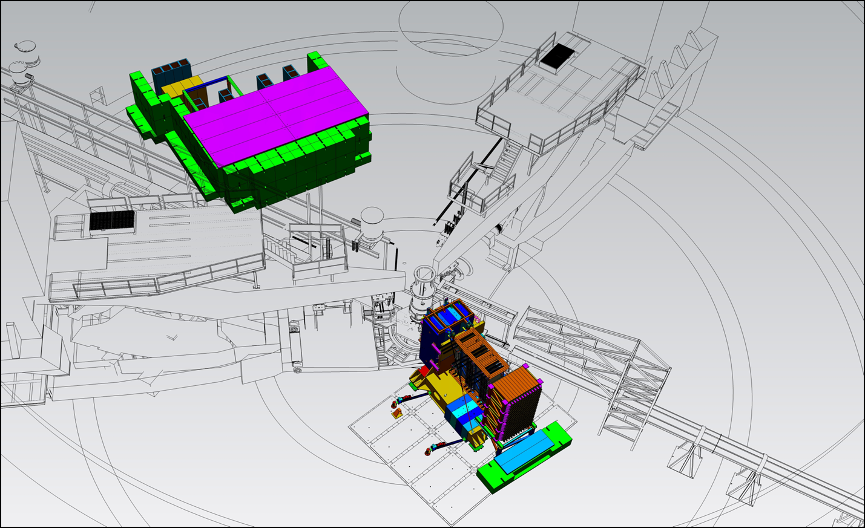
GEp Experimental Layout
Ecal here

Slide 8
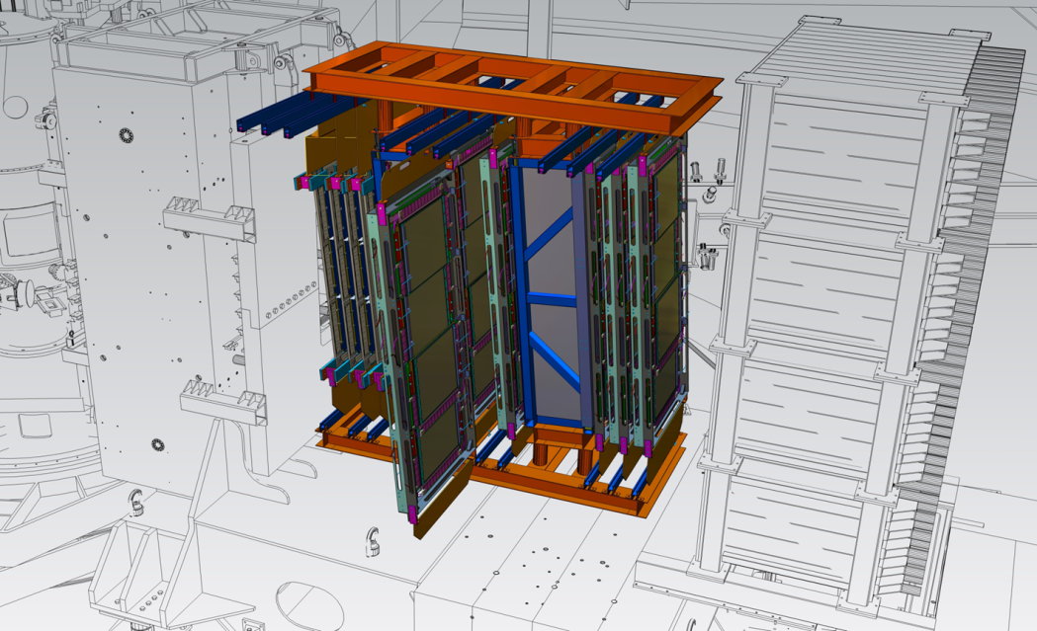
GEp Experimental Layout

Slide 9
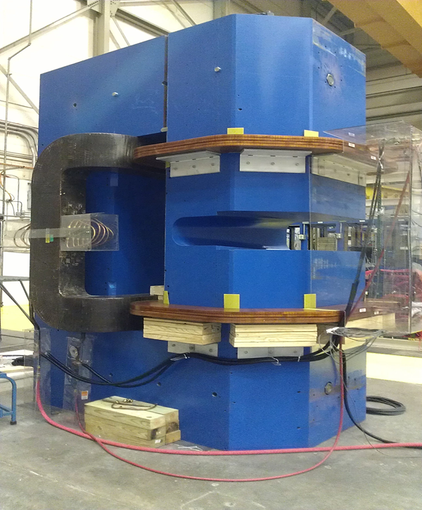
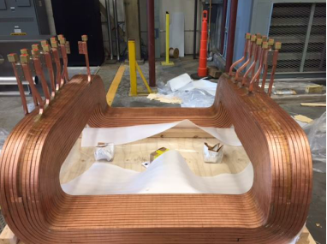
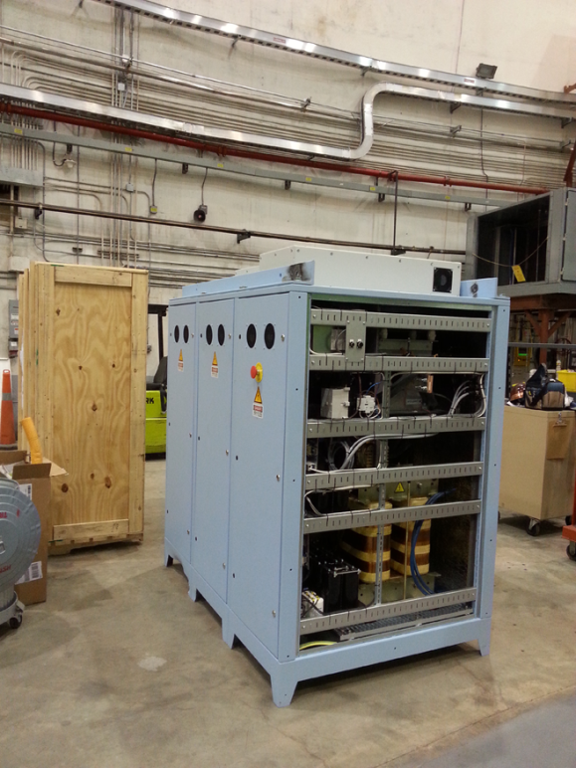
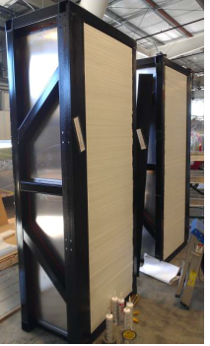
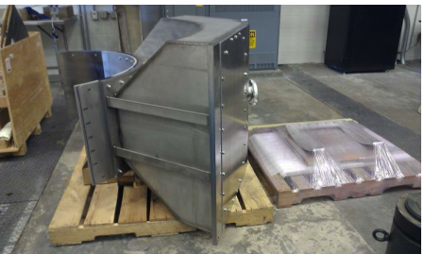
WBS 1 Completed Jan 22, 2016
Saddle coil
Power Supply
Modified 48D48 magnet with racetrack coils.
Two plastic analyzers
Target chamber snout

Slide 10
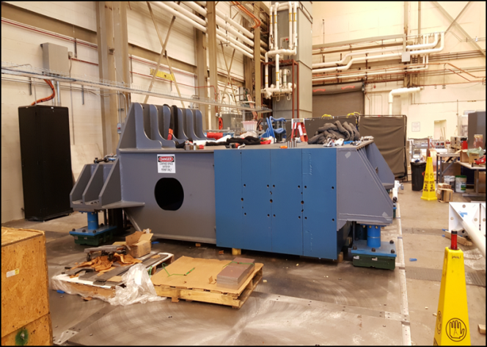
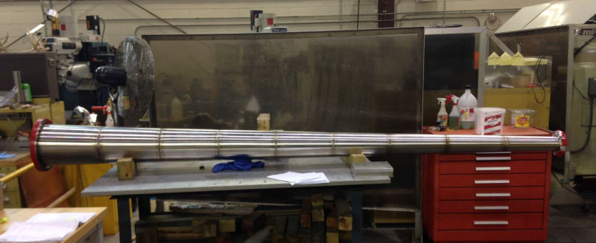
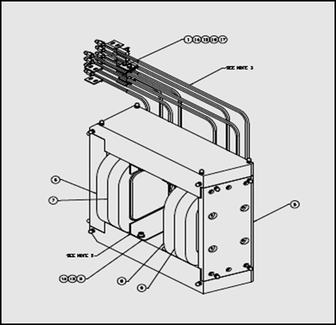
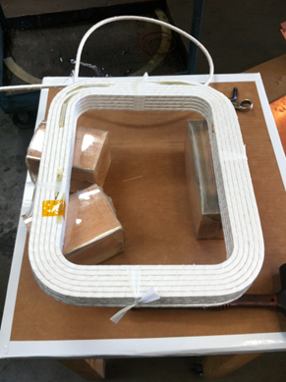
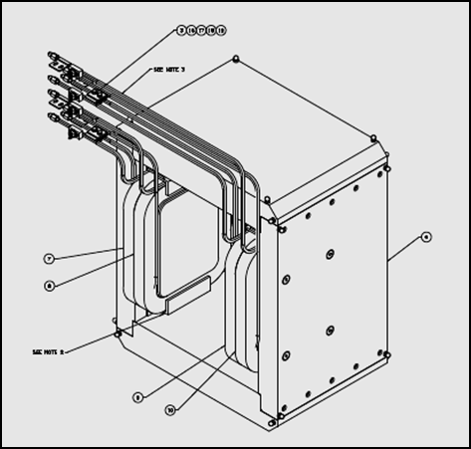
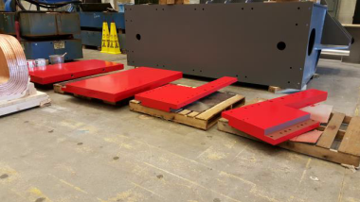
WBS 1 Completed Jan 22, 2016
Beam pipe
Counterweight on floor plates
Front clamp
Upstream
Downstream
Corrector magnets

Slide 11
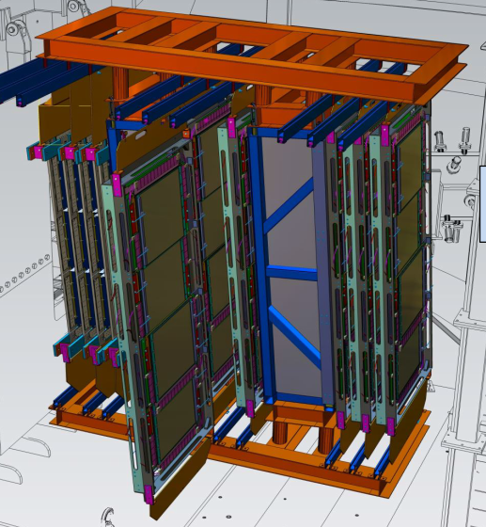
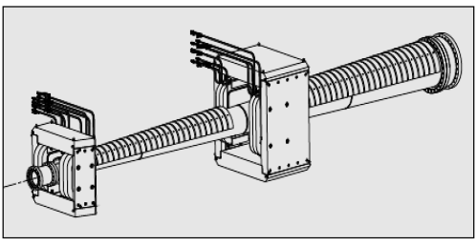
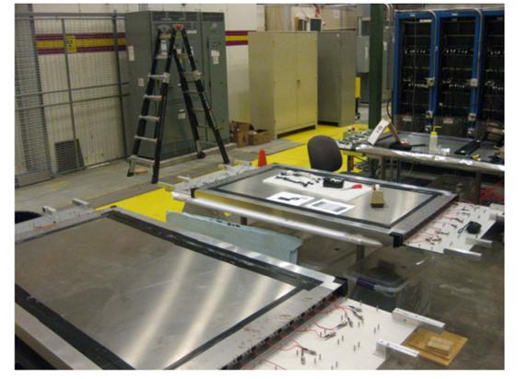
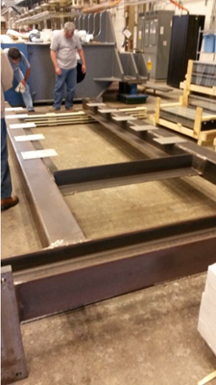
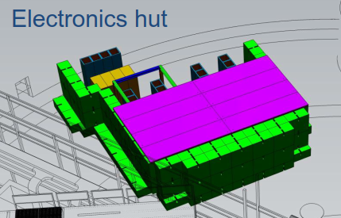
WBS2 Completed Jan 23rd 2017
Iron shielding
Beamline support
GEM frames and support
Three of the six CDET modules
CDet frame

Slide 12
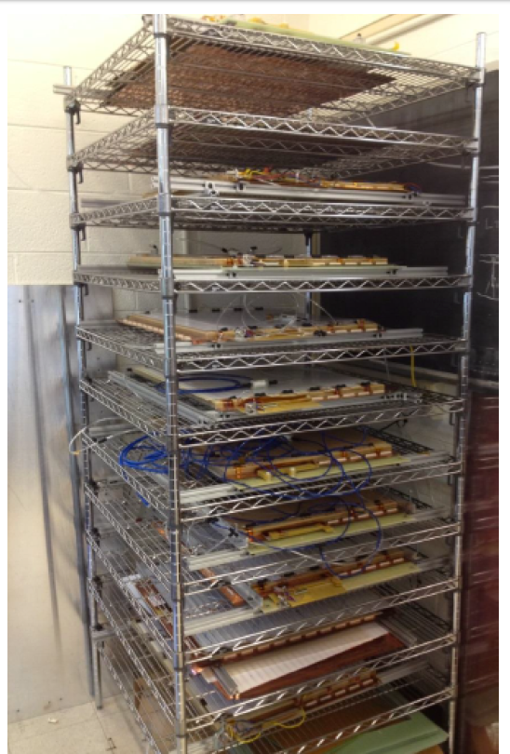
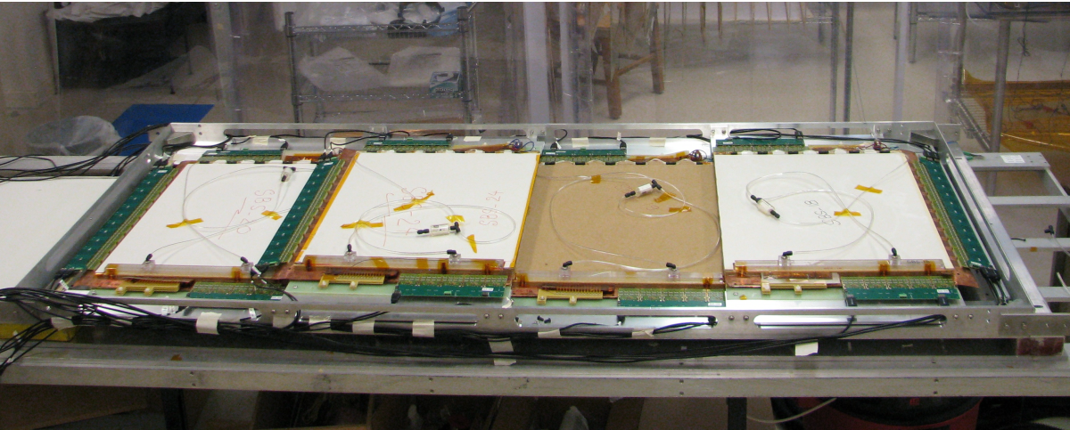
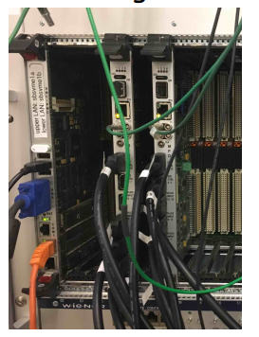
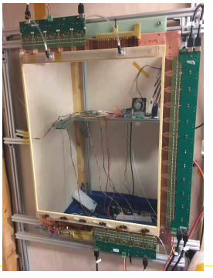
WBS3 Completed Feb 1st 2017
Forty modules built!
Four modules arranged as one chamber
Ready and waiting to be shipped to JLab cleanroom
Electronics is being used in X-ray source setup and separate cosmic ray setup

Slide 13
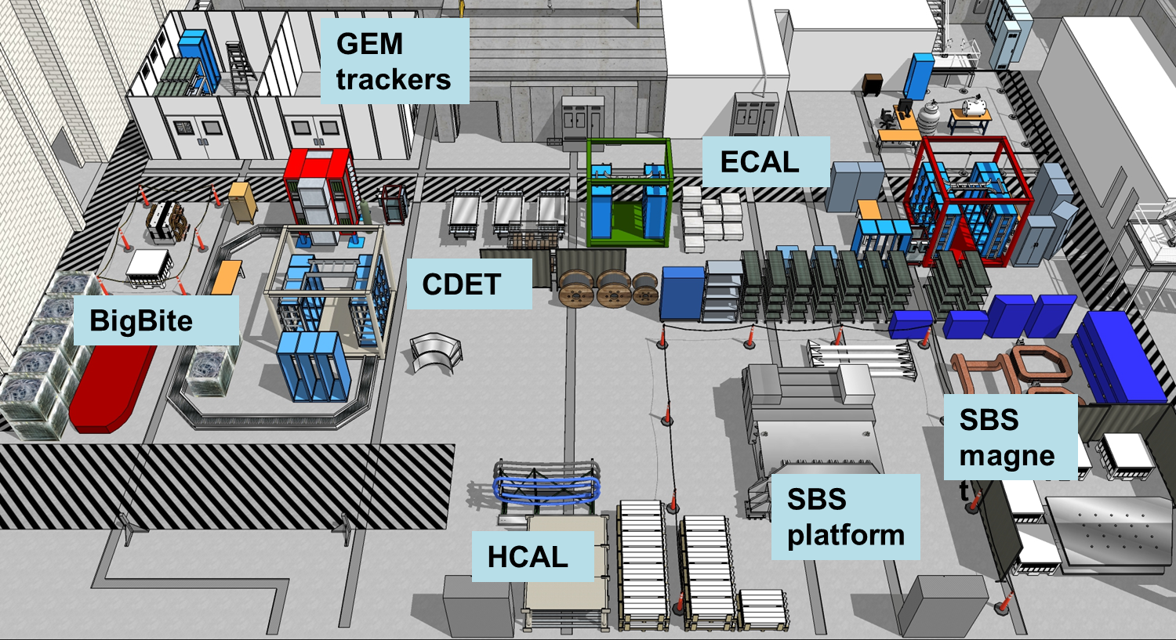
Transition from construction to commissioning
Work in TestLab (except for GRINCH).

Slide 14
Transition from construction to commissioning
But in Dec 2017, BigBite moved to ESB with pit stop in Testlab HiBay.

Slide 15
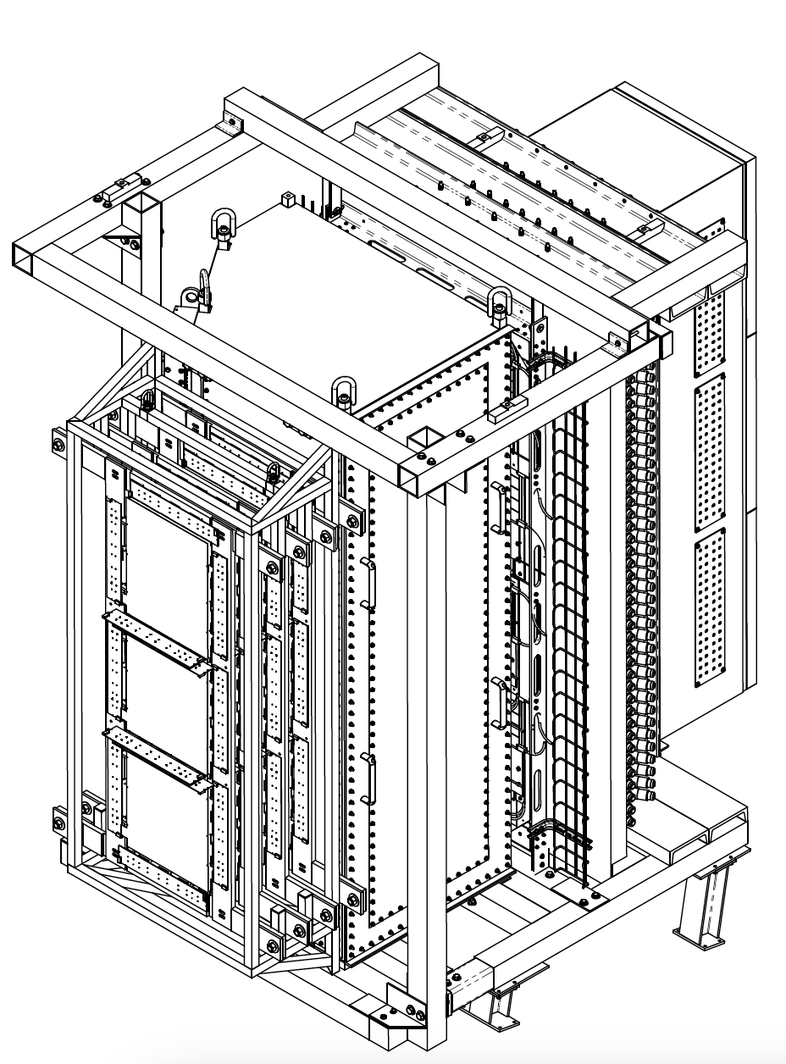
Updated BigBite Detector Package
Approved Frame Modifications
Shower
Hodoscope
Pre-shower
GEM
Grinch
GEMs

Slide 16
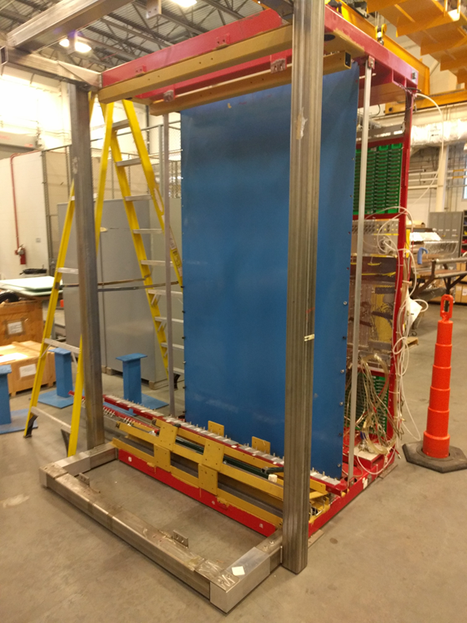
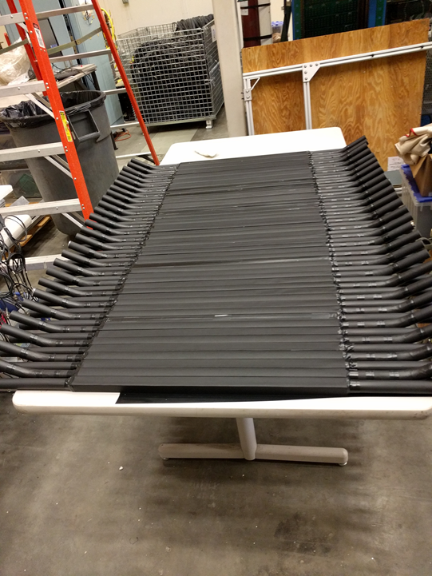
BigBite Status
Frame in TestLab High Bay.
Modification drawings complete and reviewed with Walter and Jessie.
Walter Kellner & crew will do modifications
New Hodoscope plane built by Glasgow is at JLab
Summer 2018 full integration of BigBite detectors

Slide 17
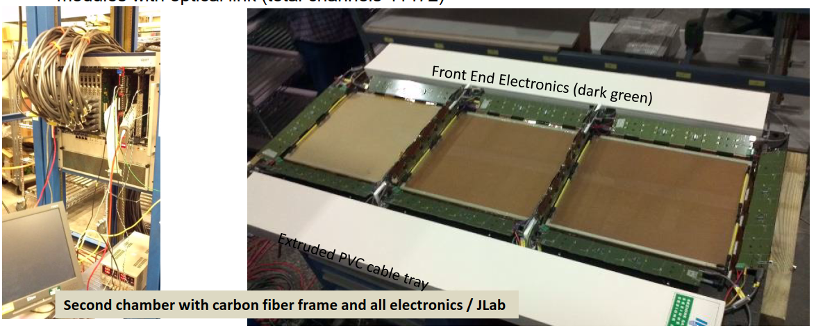
Front GEM Tracker
The Italian group has come multiple times to JLab in 2017 to prepare the chambers.

Slide 18
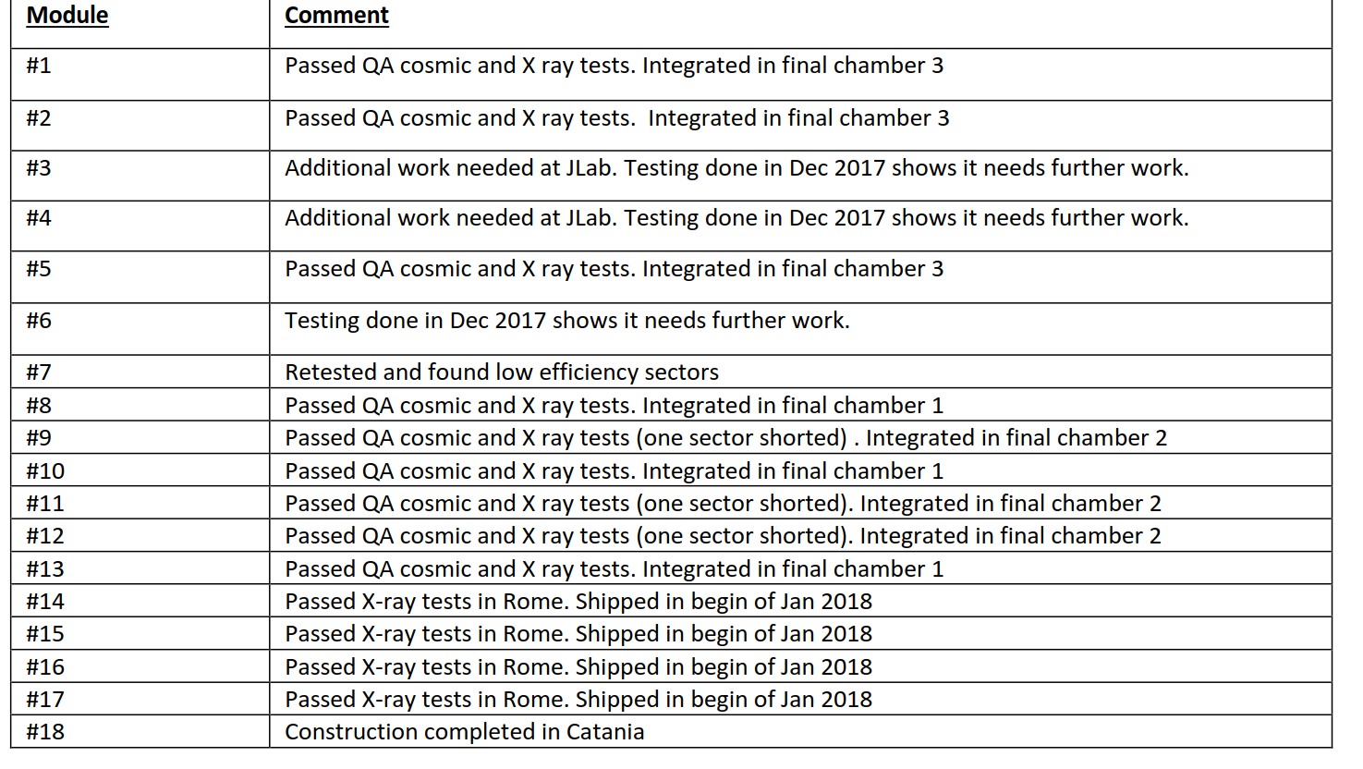
Front GEM Tracker
Three spare GEM modules under construction in Catania.

Slide 19
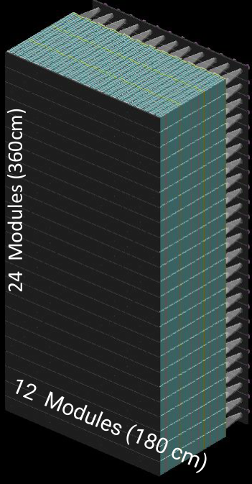
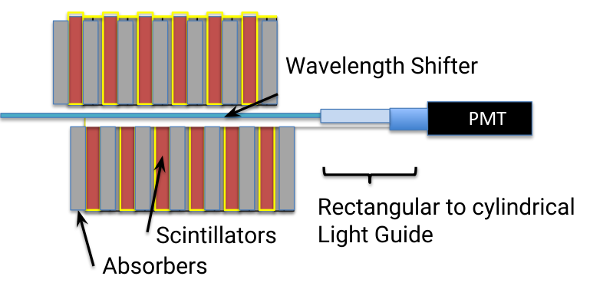
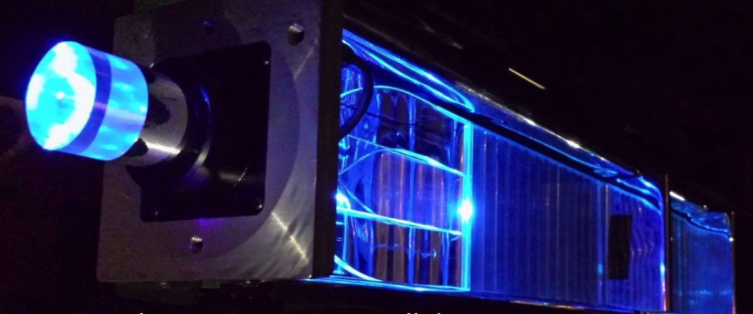
HCal
All modules were constructed by May 2017

Slide 20
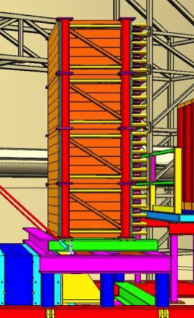
HCal
Need to be assembled into groups of
6x12 modules for final stacking

Slide 21
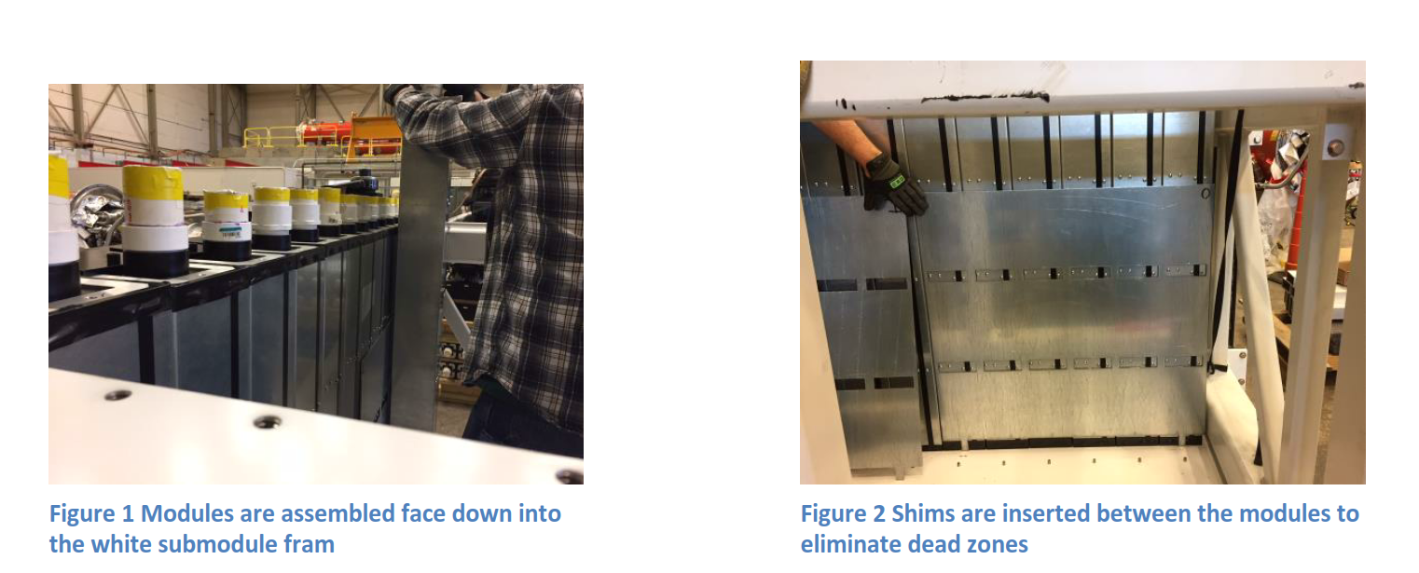
Hcal

Slide 22
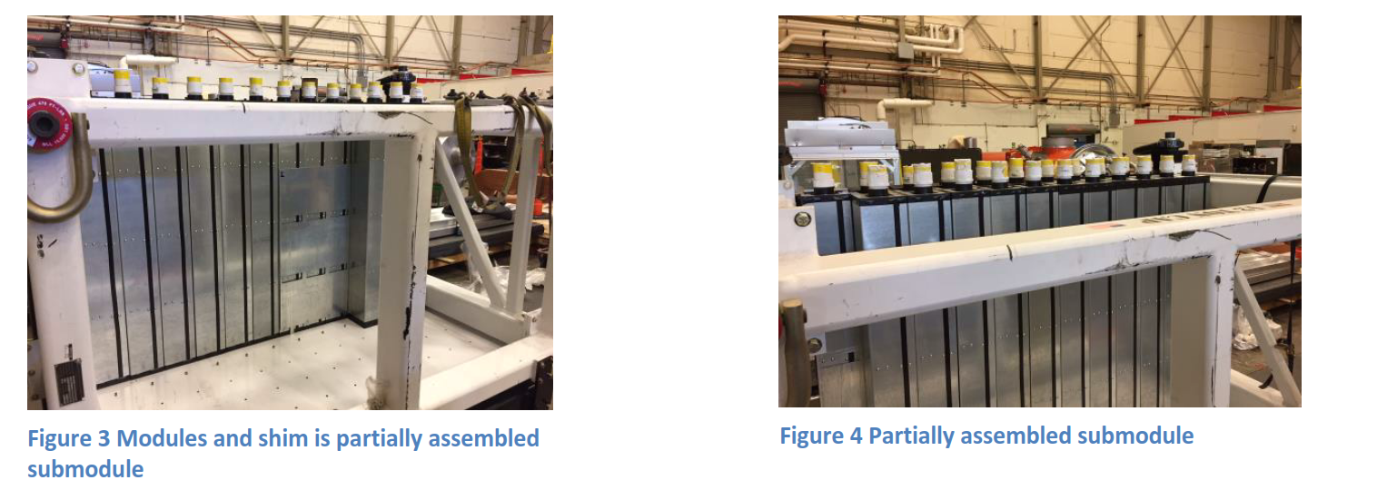
HCal

Slide 23
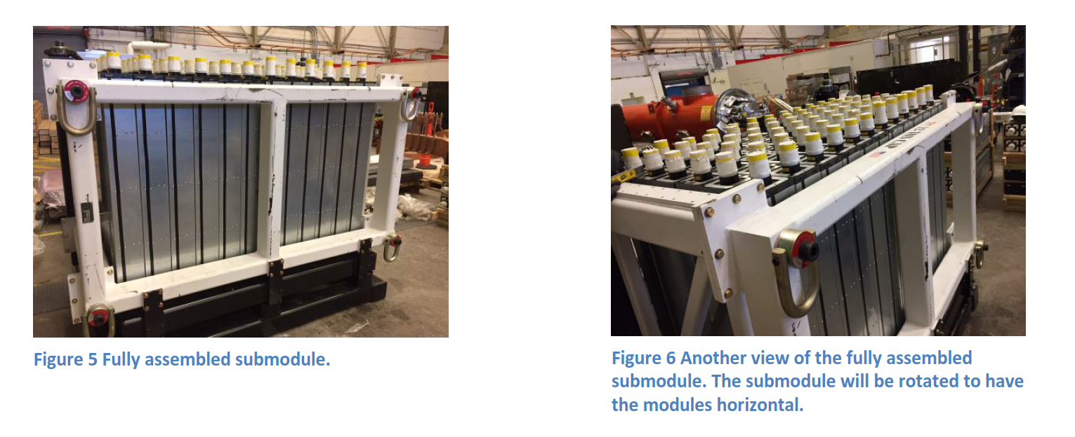
HCal

Slide 24
Polarized helium target
Goal is 60cm long cell with metal endcap.

Slide 25
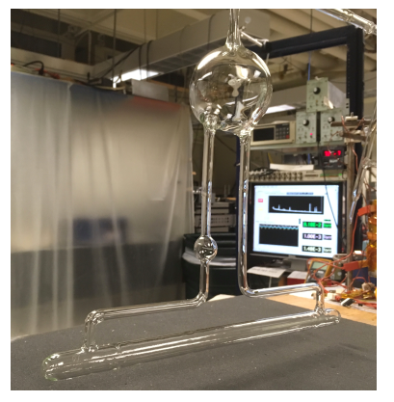
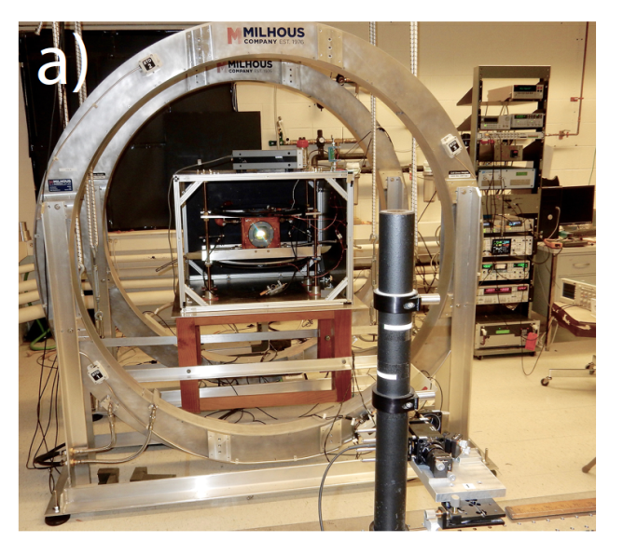
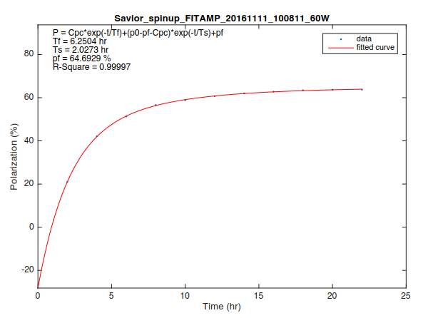
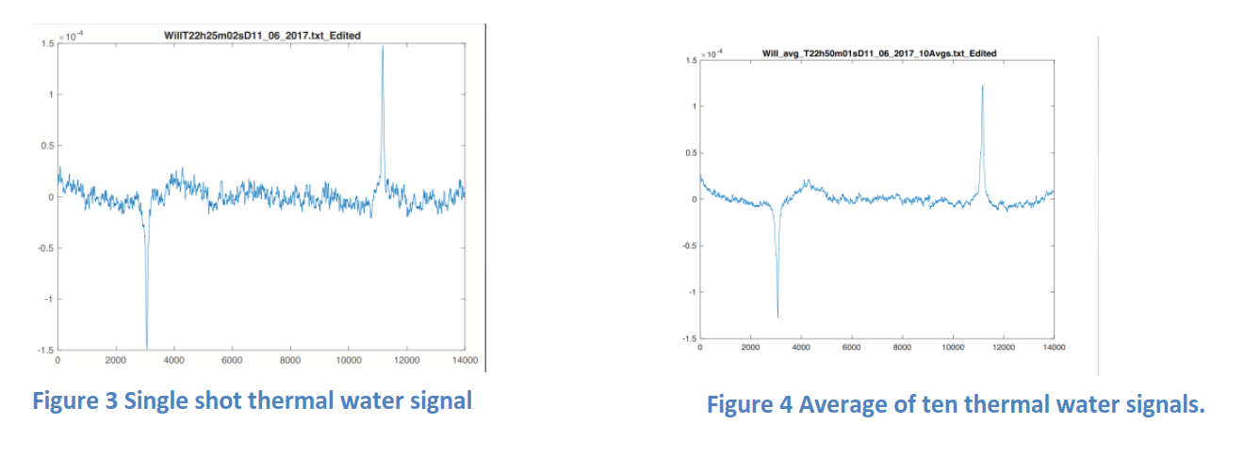
Polarized target work at UVa
Stage-1
30cm convection target cell
Apparatus to measure κ₀, needed for polarimetry
Polarization = 65%
Signal to noise in water signal 1-2 orders order magnitude better than previously achieved at UVa

Slide 26
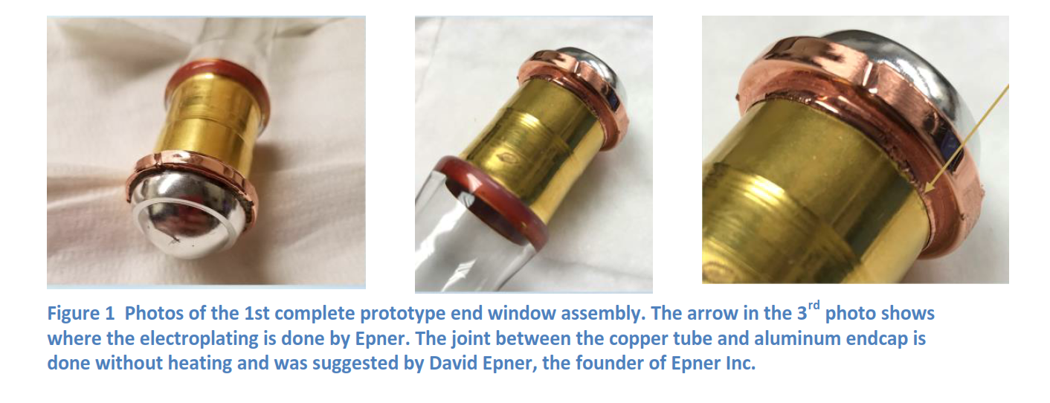
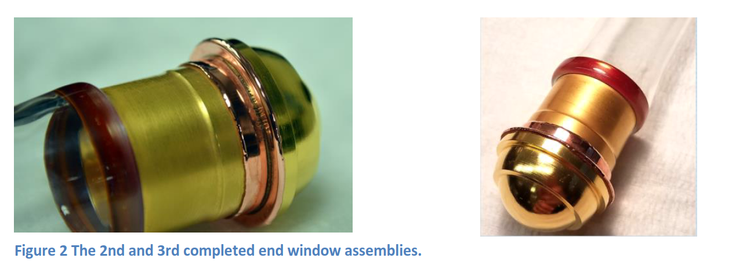
Polarized Helium target at UVa

Slide 27
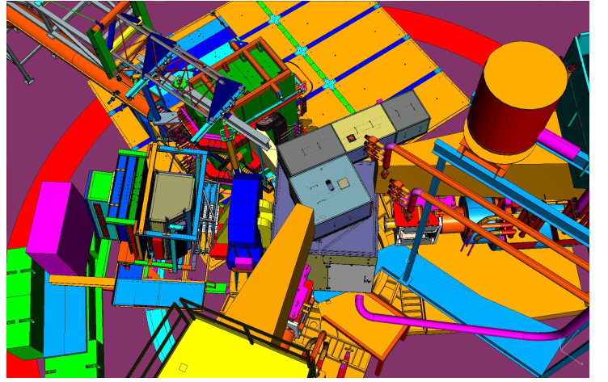
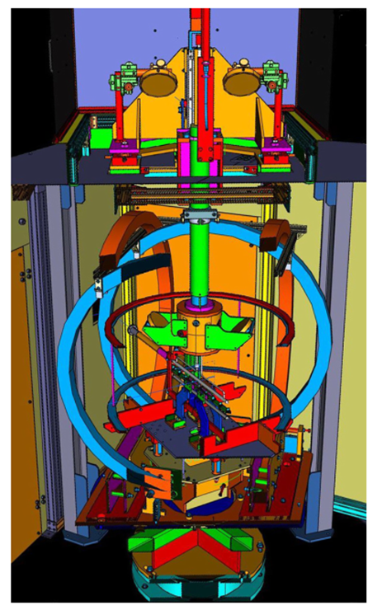
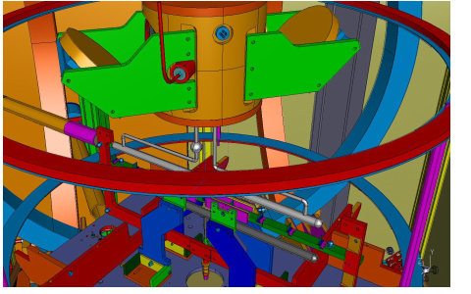
Polarized target design/engineering
SBS magnet
Dual optical pumping
Laser optics
Beam dump
BigBite
Oven with mirrors
Soft-iron box
Incoming beam
Close up view of target oven and 60cm target

Slide 28
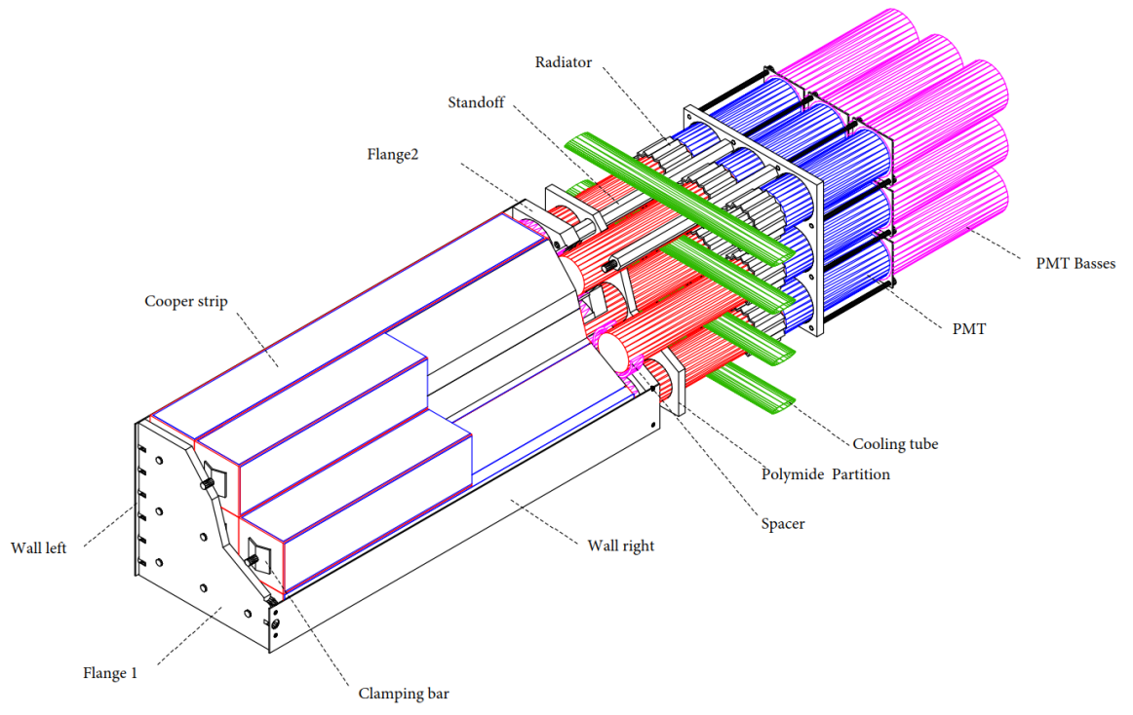
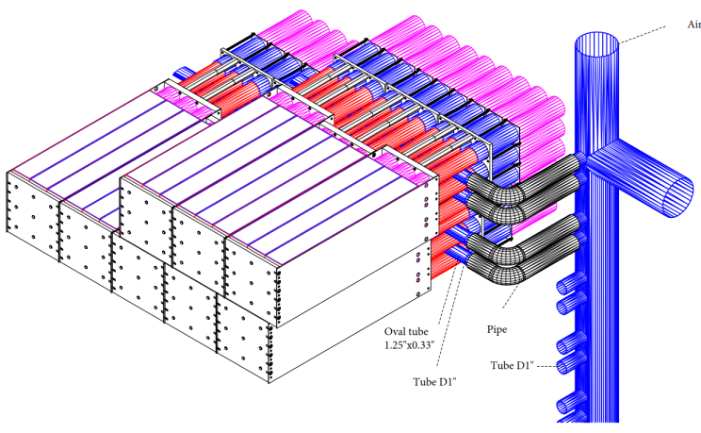
ECal Supermodule
Desired temperature profile is 225⁰C to 185⁰C from front to back of leadglass with a drop to 50⁰C at end of light guide.
Close up of cooling region

Slide 29
ECal Oven Enclosure
Thermal Insulation
Commercial Foam-Glass blocks used as thermal insulation for top, bottom and sides.
Rear Light tight box
Panels attach to frame with light tight gasket around edges of panel

Slide 30
ECal status
Supermodules parts have start to arrive in December.
Drawings of oven frame and associated parts will be completed by mid February.
Procurement of oven frame by NCCU will follow.

