Slide 1
Update on Cornell Low Temperature Doping Studies
P. N. Koufalis
Cornell University

Slide 2
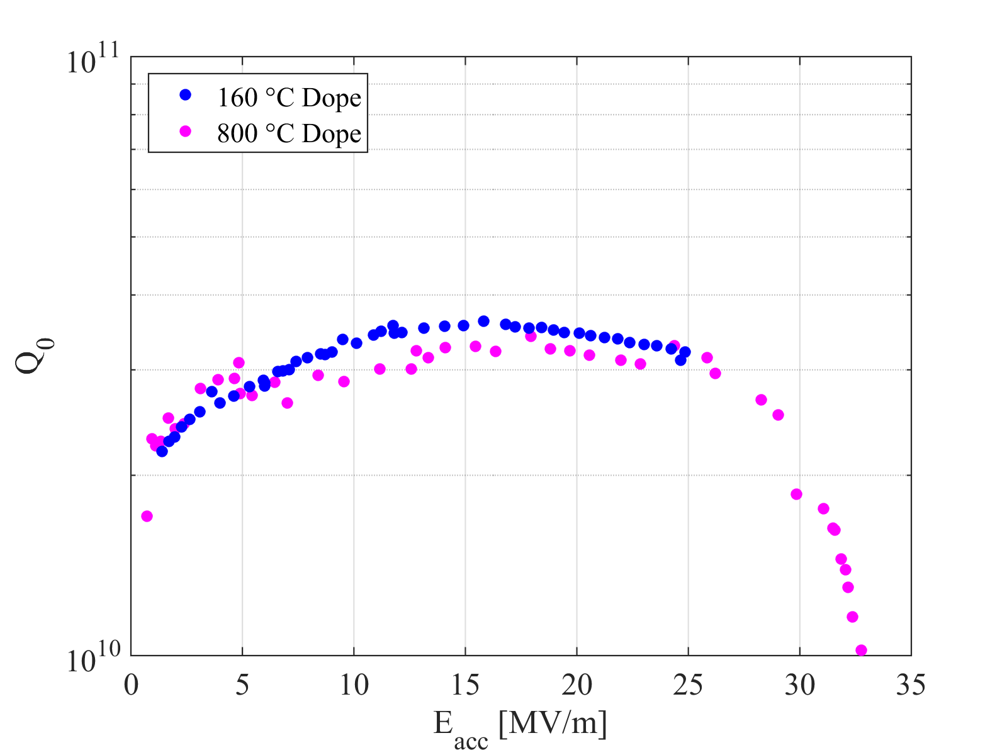
Introduction
Low temperature baking (120 – 160 ºC) in a low pressure nitrogen atmosphere results in ‘Q-rise’ and higher low-field Q₀ values
A . Grassellino et al., Unprecedented Quality Factors at Accelerating Gradients up to 45 MV/m in Niobium Superconducting Resonators via Low Temperature Nitrogen Infusion. arXiv:1701.06077.
P. N. Koufalis, D. L. Hall, M. Liepe, J. T. Maniscalco. Effects of Interstitial Oxygen and Carbon on Niobium Superconducting Cavities. arXiv:161208291.
Nitrogen diffuses only 2 – 5 nm into niobium at these temperatures
Observed that carbon and oxygen diffuse significantly into niobium at 160 ºC

Slide 3
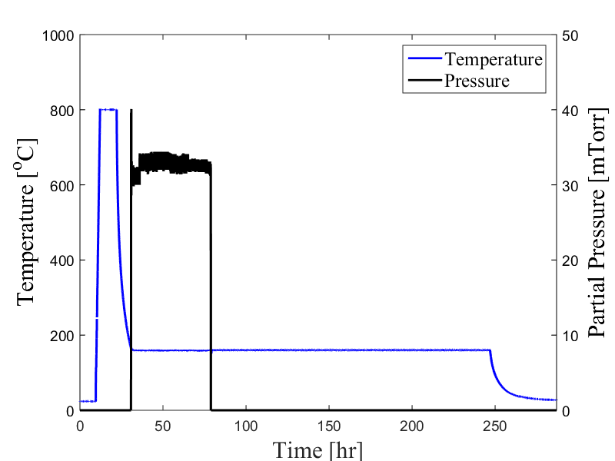
RF Performance
160 ºC
low T dope
Continuously flowing N₂ atmosphere
anti-Q-slope
800 ºC
high T dope
higher Q₀
low T bake profile
Max Quality Factor:
Q₀ = 3.6 × 10¹⁰ @ 16 MV/m
Thermal Quench:
25 MV/m (B_{pk} ~ 107 mT)

Slide 4
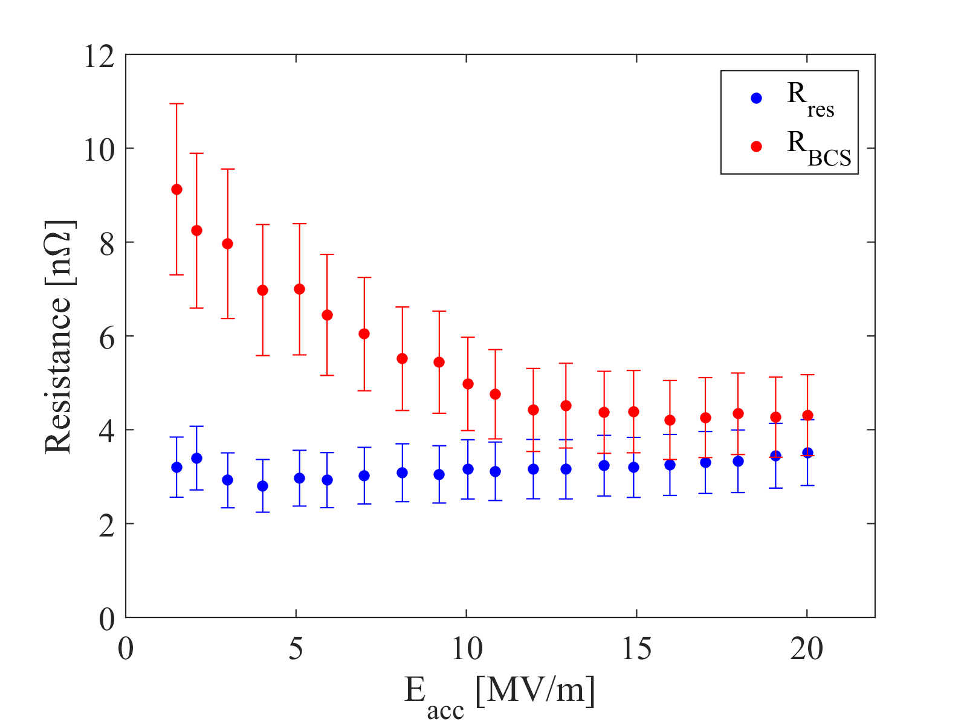
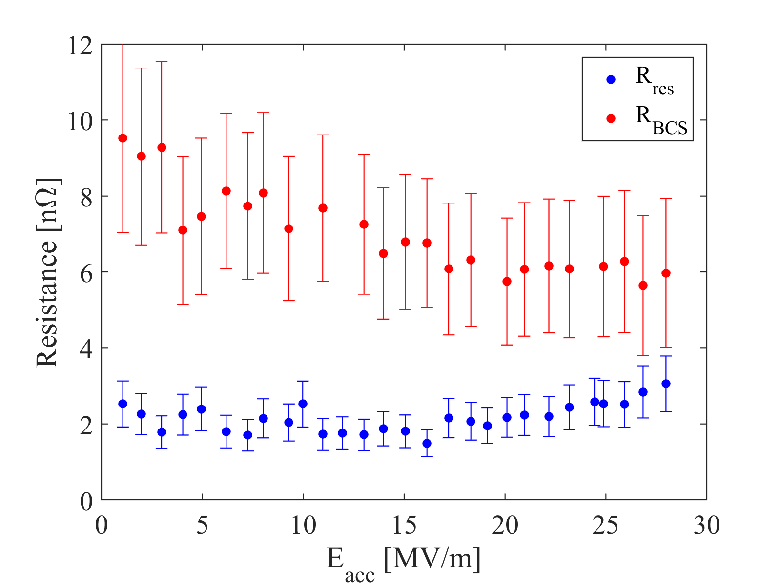
Field Dependence of $RS$
R_{BCS} decreases with increasing E_{acc}; same effect seen in high-T nitrogen-doped cavities (caused by reduction of mean free path!)
Which impurity is reducing the mean free path?
Low T Dope
High T Dope

Slide 5
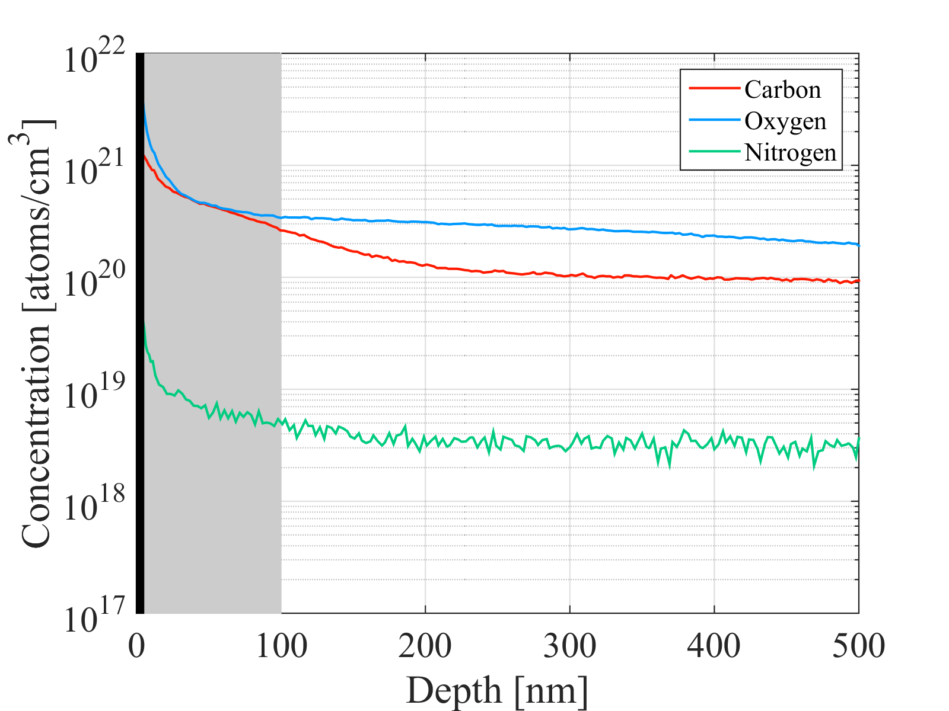
SIMS Analysis
Oxide layer (~5 nm)
160 ºC
low T dope
RF layer (~${2λ}_{L}$)
Carbon and oxygen concentrations two orders of magnitude higher than nitrogen in RF layer

Slide 6
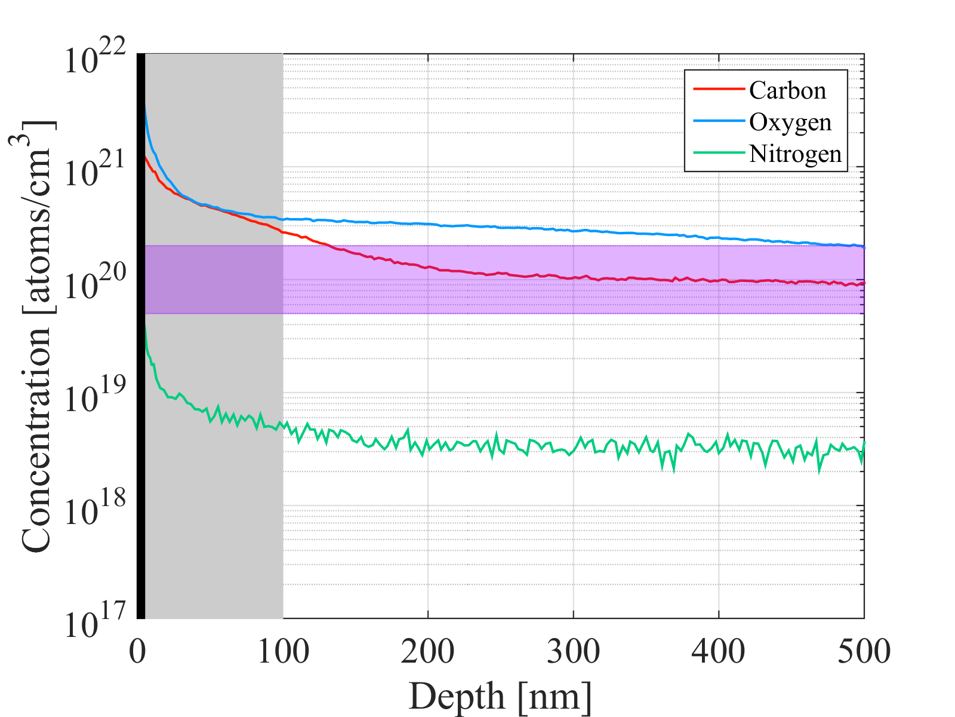
SIMS Analysis
Oxide layer (~5 nm)
160 ºC
low T dope
Typical 800 ºC N dope
RF layer (~${2λ}_{L}$)
Carbon and oxygen concentrations two orders of magnitude higher than nitrogen in RF layer
Typical concentration between $\sim 5×{10}^{19}$ – $2×{10}^{20}$ cm⁻³ or (0.09 – 0.36 at. % N) for 800 ºC N-doped cavities

Slide 7
Other Impurities:
C and O

Slide 8
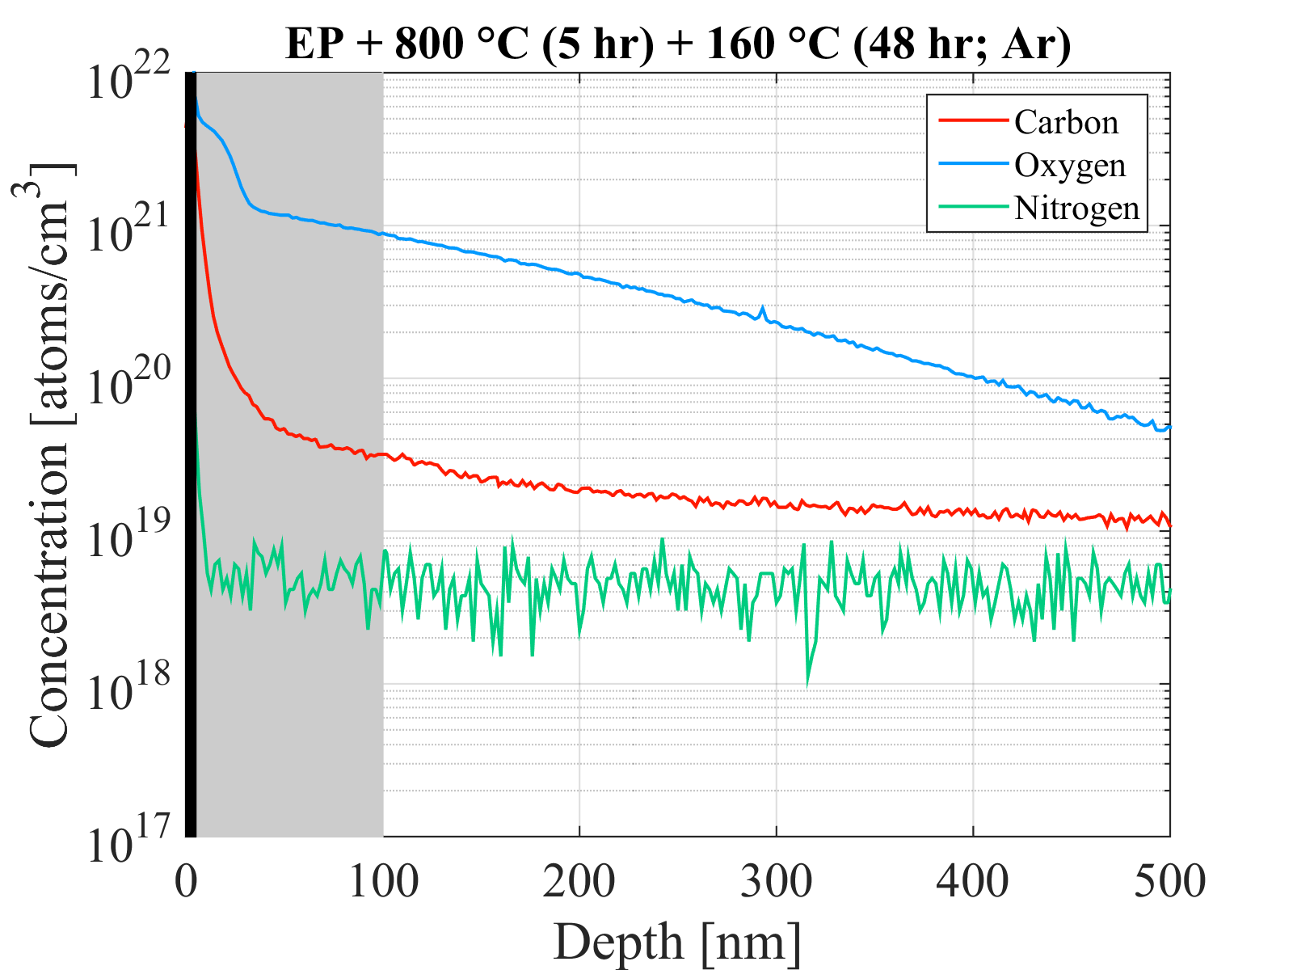
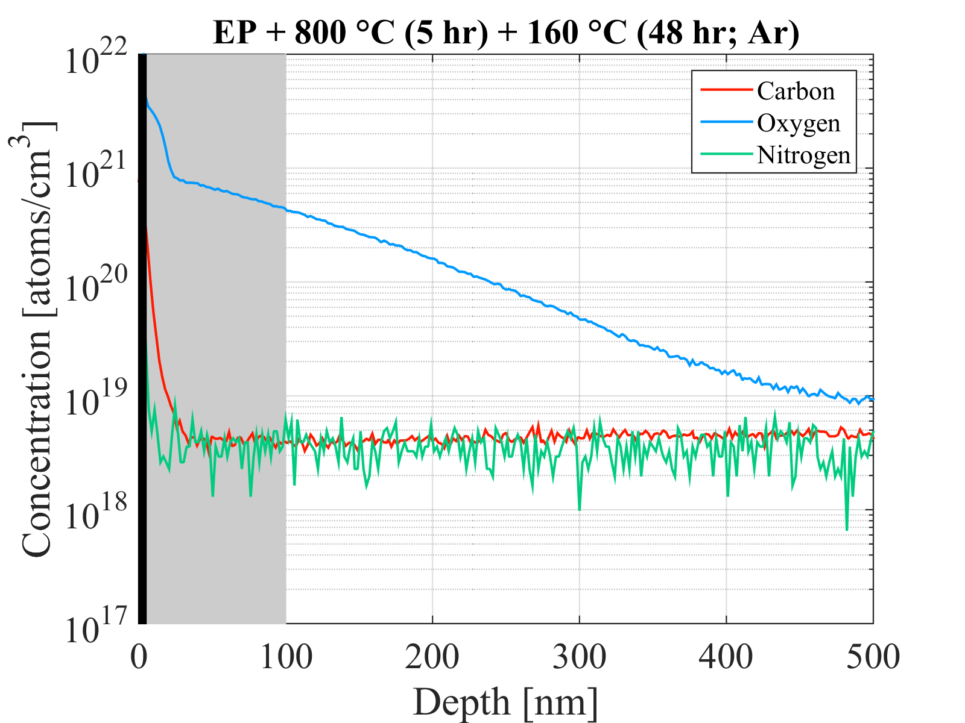
Gas Purity
Ultra High Purity Argon (99.999 %)
Research Plus Argon (99.9999 %)
The purity of gas used has a high impact on the impurity concentration! The argon with higher trace impurities leads to a higher concentration in the RF layer.

Slide 9
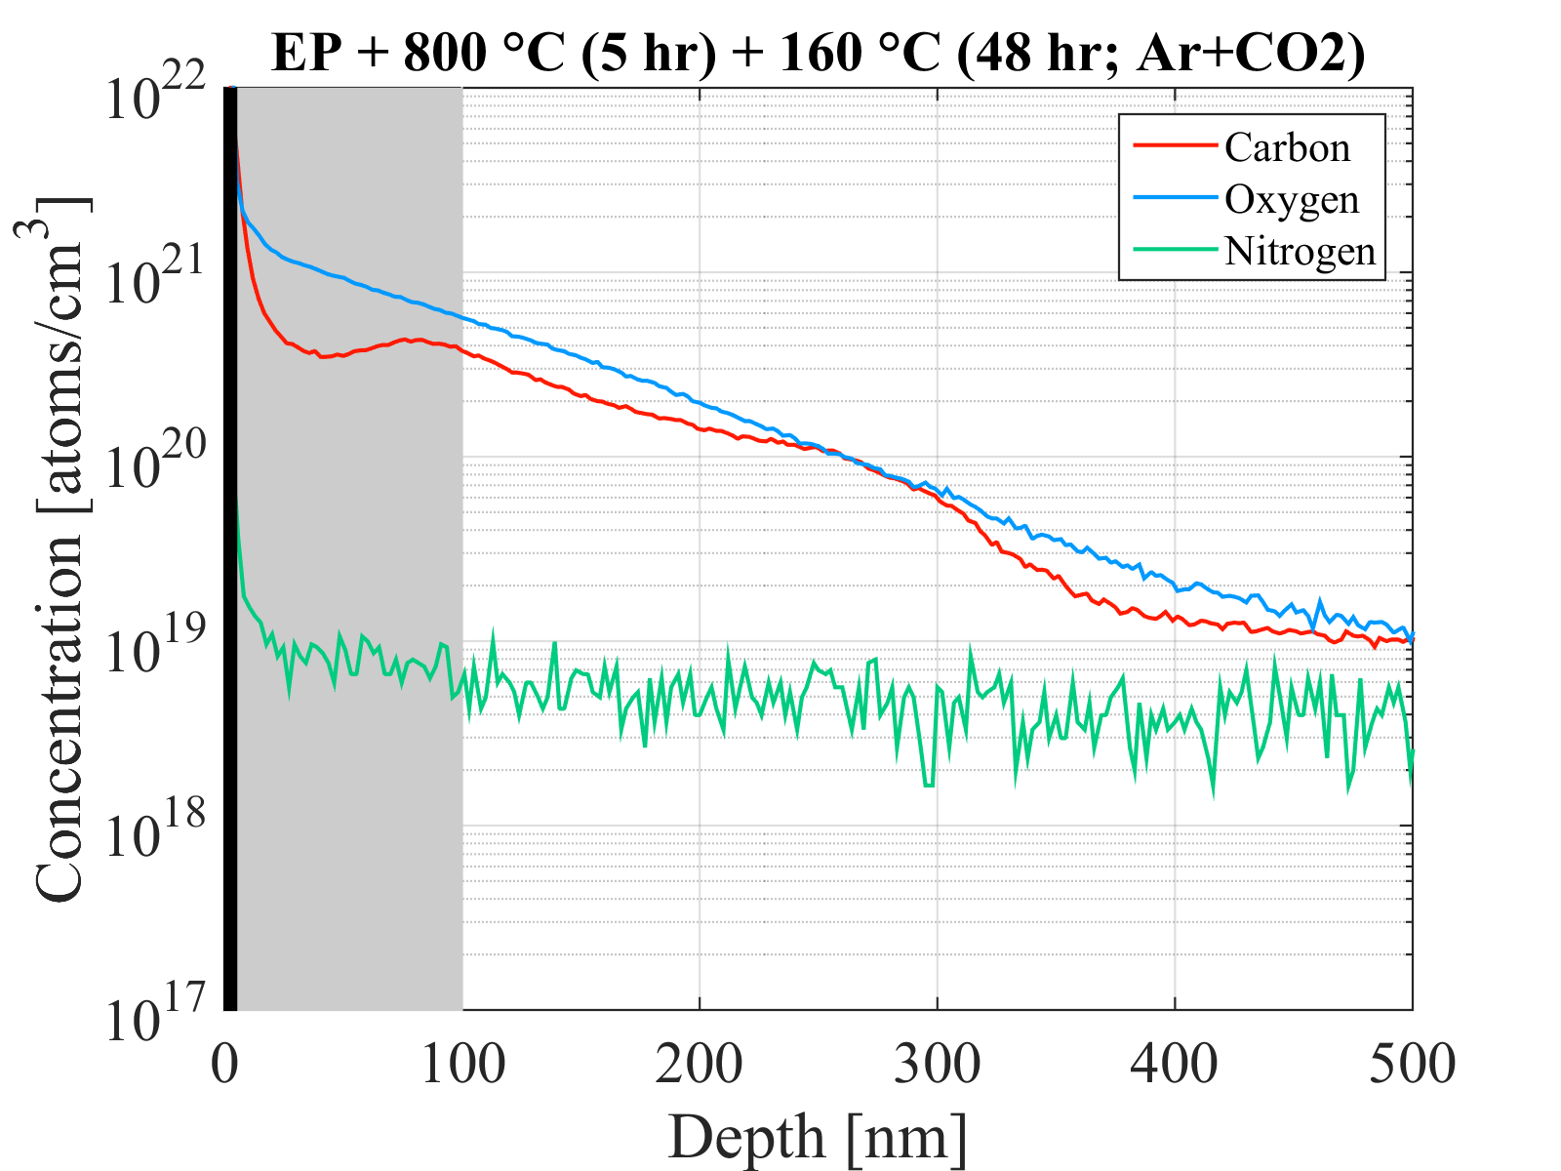
Research Plus Argon (99.9999 %)
Research Plus Argon + 10 ppm CO₂
(99.9999 %)
The research plus argon mixed with 10 ppm CO₂ significantly increases the concentration of carbon in the niobium! Trace impurities in the gas play important role.

Slide 10
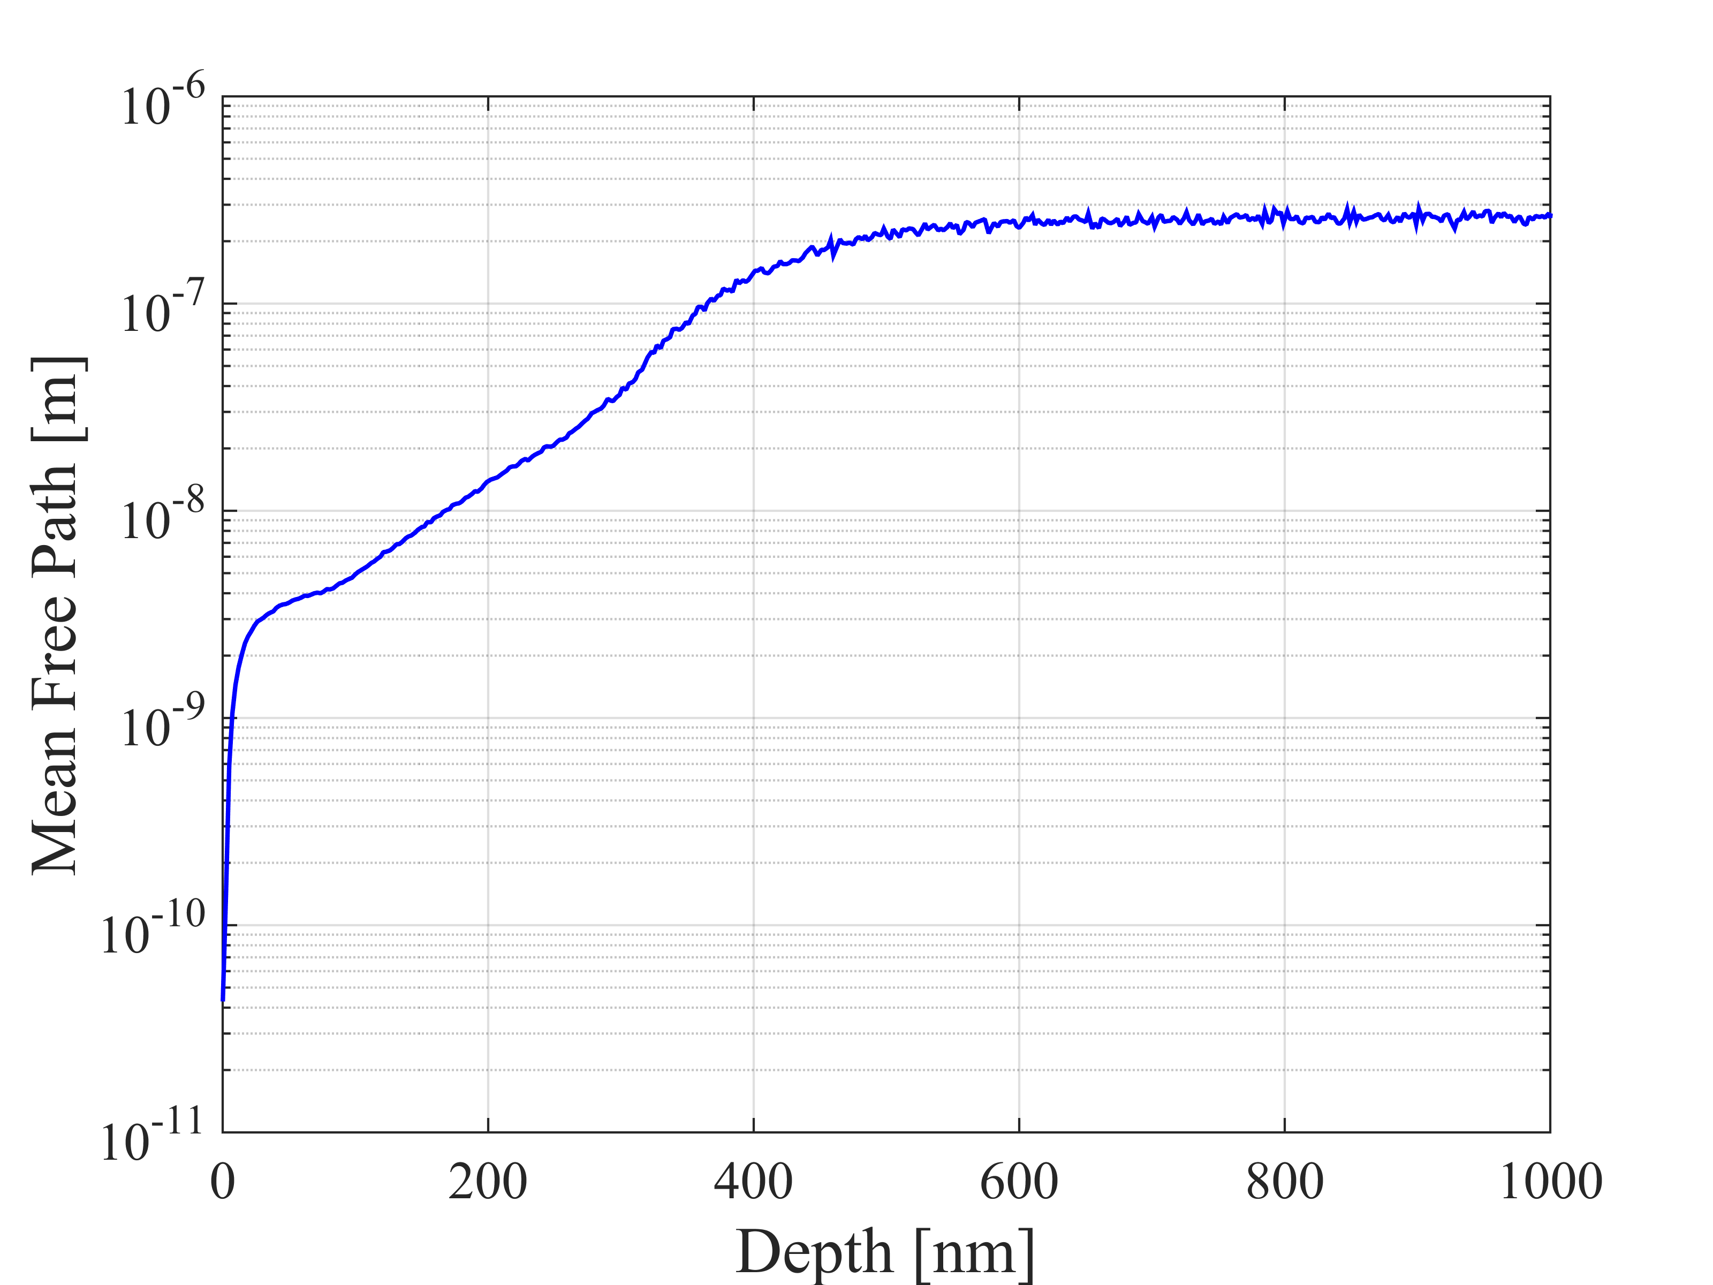
Depth dependence of mean free path is given by the relation to the impurity concentration
$$l=\frac{σ}{a⋅c}$$
Mean free path changes rapidly with increasing depth then levels off throughout the penetration depth
$σ$ and $a$ are constants that depend on impurity species and $c$ is the impurity concentration

Slide 11
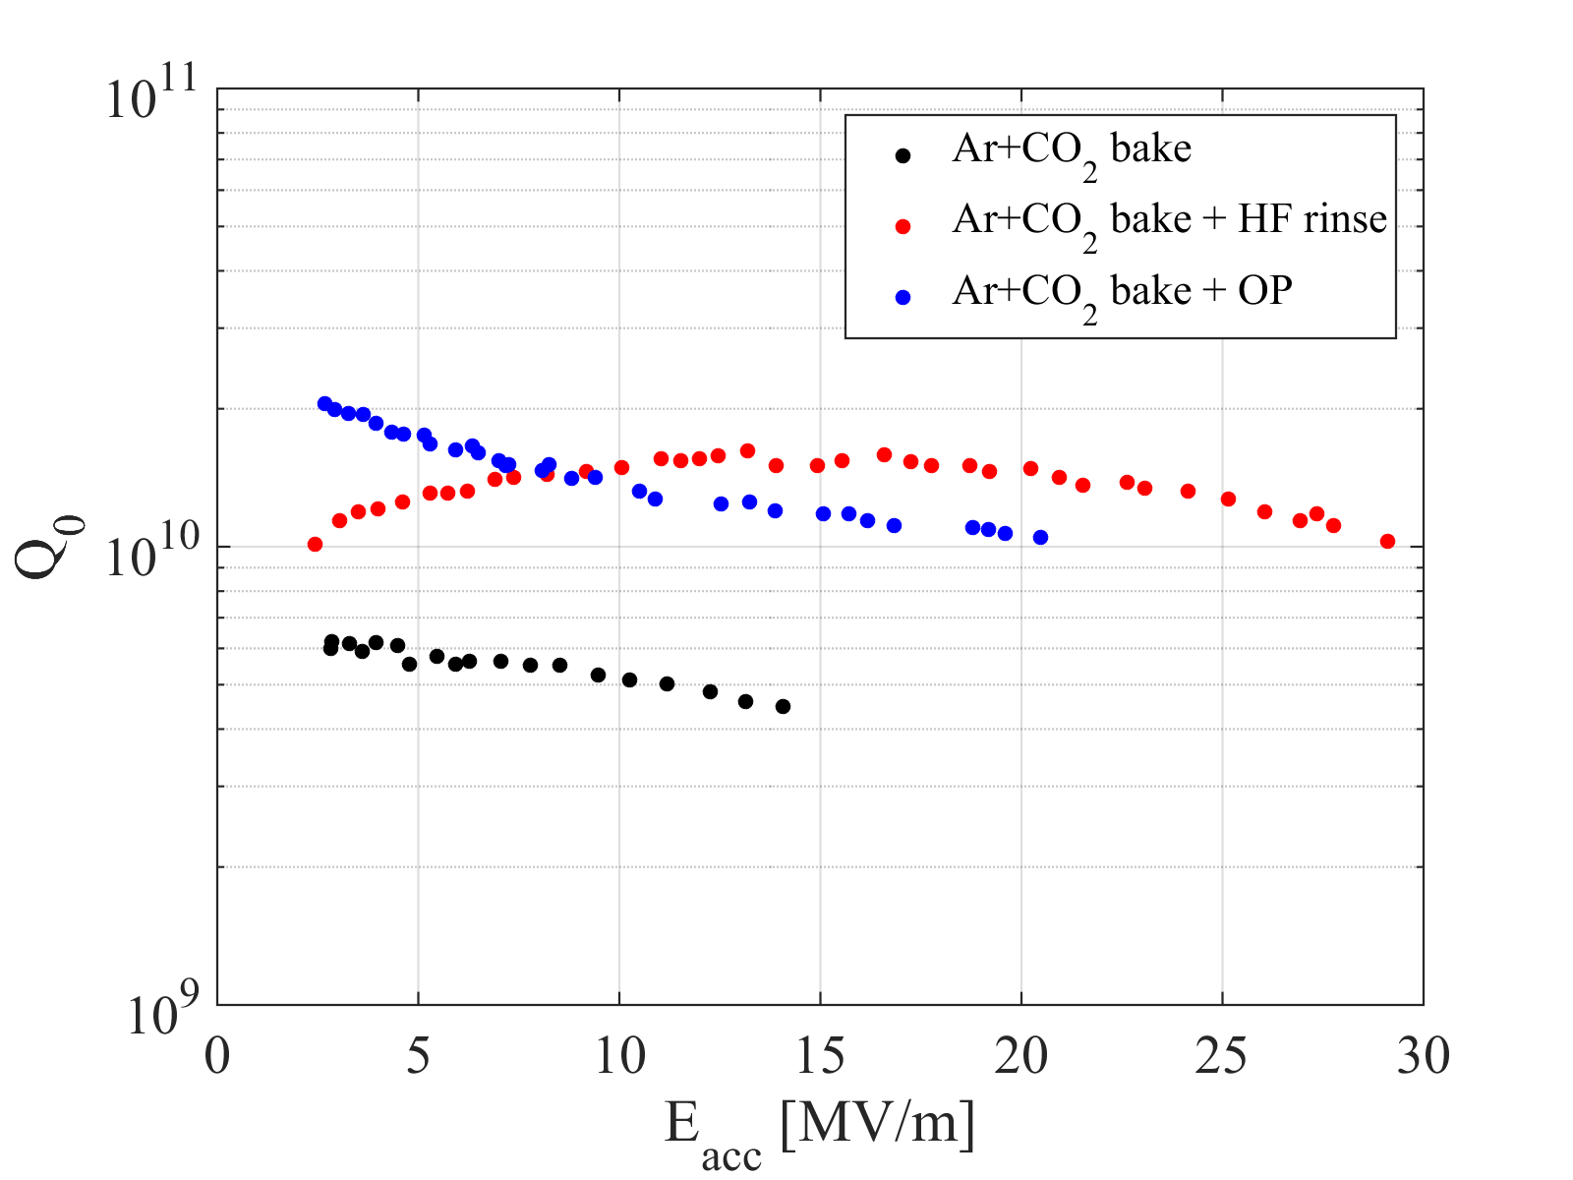
Argon-Carbon Dioxide Bakes
Initial performance is very poor with both a strong Q-slope, low Q, and small quench field
After HF rinsing, anti-Q-slope becomes apparent and Q rises significantly!
lossy oxide layer?
Oxypolishing after the bake results in a strong Q-slope but overall higher Q than the cavity with no post-bake etching
LTE1-1
LTE1-2
LTE1-2

Slide 12
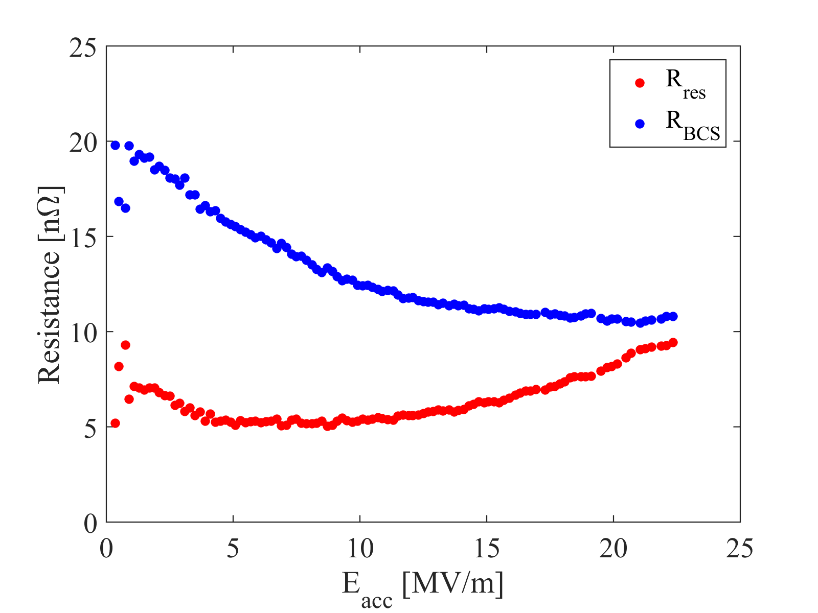
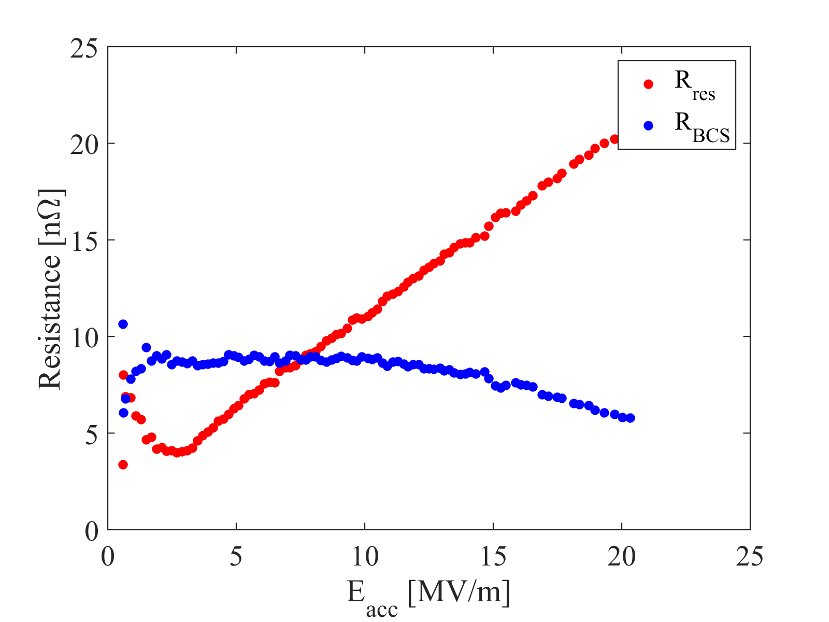
BCS Resistance
$R_{BCS}$ shown at 2.0 K!
HF Rinse
Oxypolish
anti-Q-slope
anti-Q-slope
Anti-Q-slope in after HF rinse due to decrease in $R_{BCS}$
Decrease in $R_{BCS}$ w/ oxypolishing but curve has different shape
Linear dependence of $R_{res}$ on $H_{RF}$ looks similar to Nb₃Sn

Slide 13
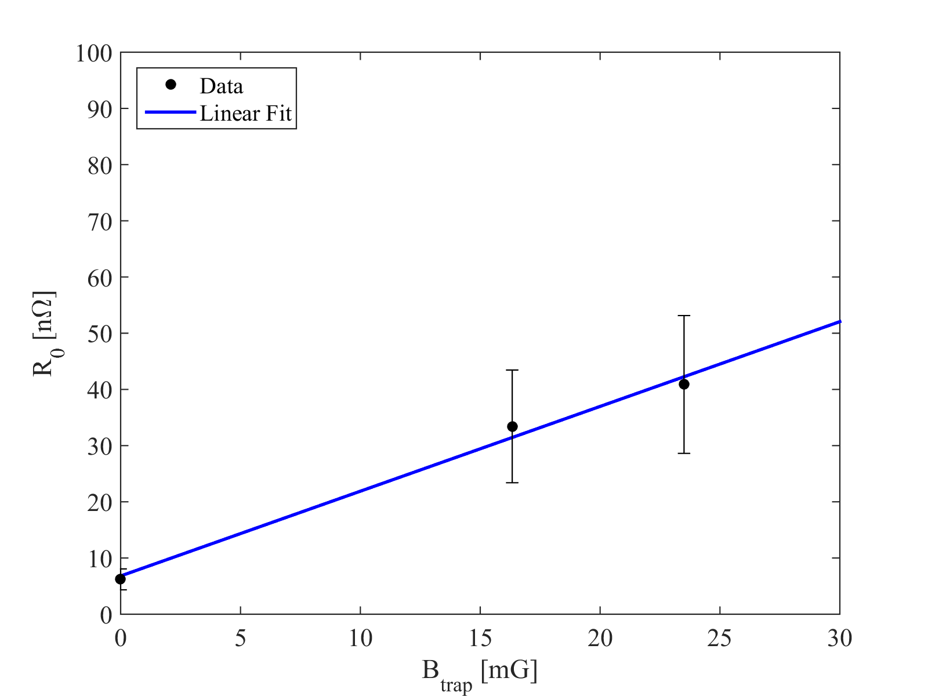
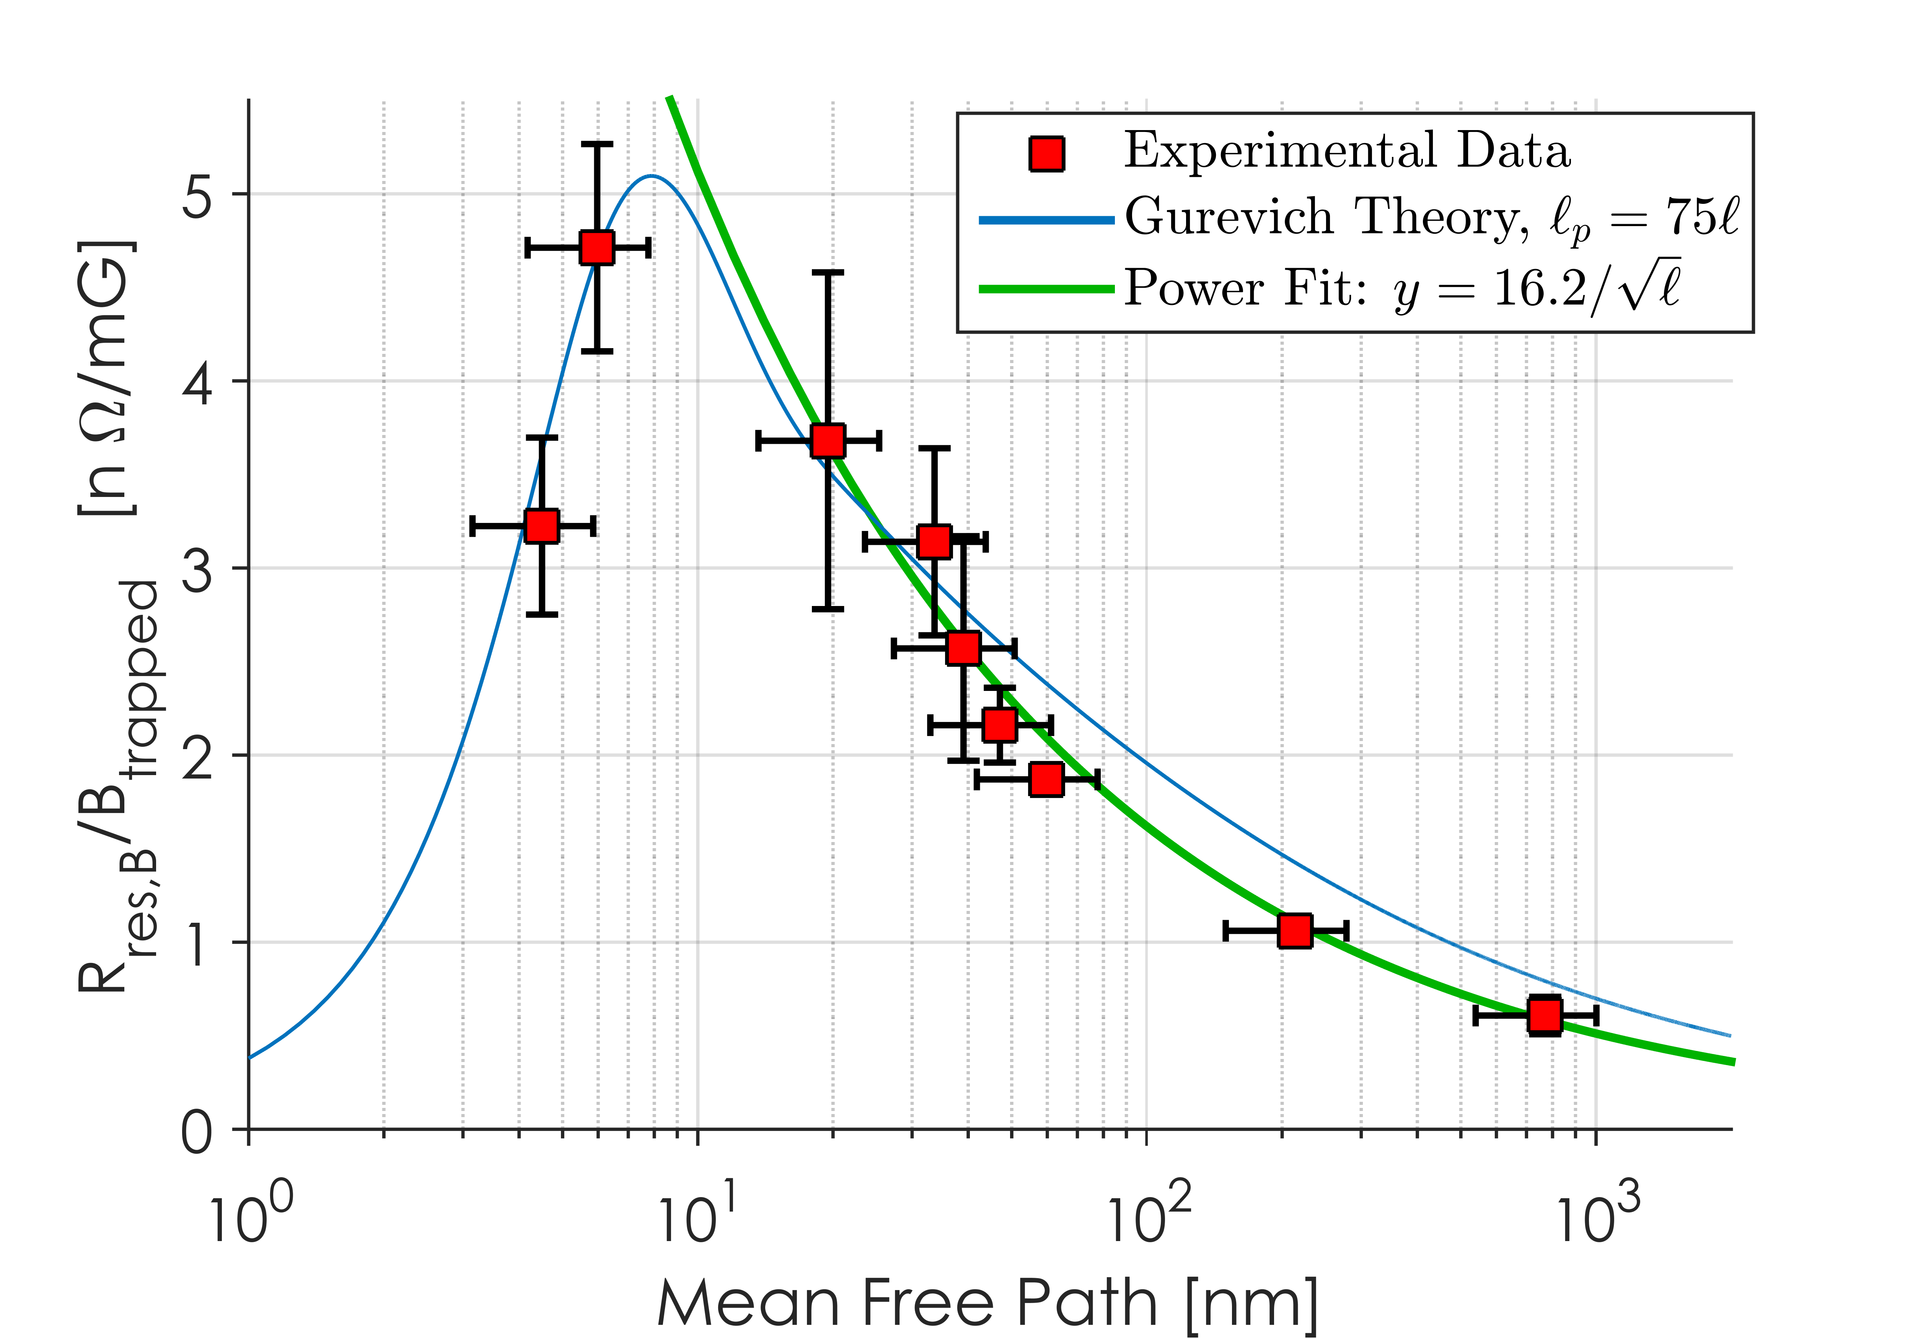
Material Properties
$$l=19 nm$$
$$\frac{Δ\left(0\right)}{kBTc}=1.85$$
$$Rres=6 nΩ$$
$$S=1.51 nΩ/mG$$
High T N doped
Low T dope

Slide 14
Concluding Remarks
Baking in CO₂-rich Ar atmosphere at low $T$ results in high impurity concentrations of C and O
Mean free path dramatically reduced in the RF penetration layer but quickly reduces to the clean limit as you go deeper into the material
Lossy oxide layer seems to be cause of low Q
HF rinsing restores Q and reveals anti-Q-slope!
Oxypolishing dramatically changes behavior of the surface resistance
Why?
Residual resistance increases linearly with RF field; also seen in Nb₃Sn cavities
Need more data with various amounts of etching to see how the surface resistance evolves

