Slide 1
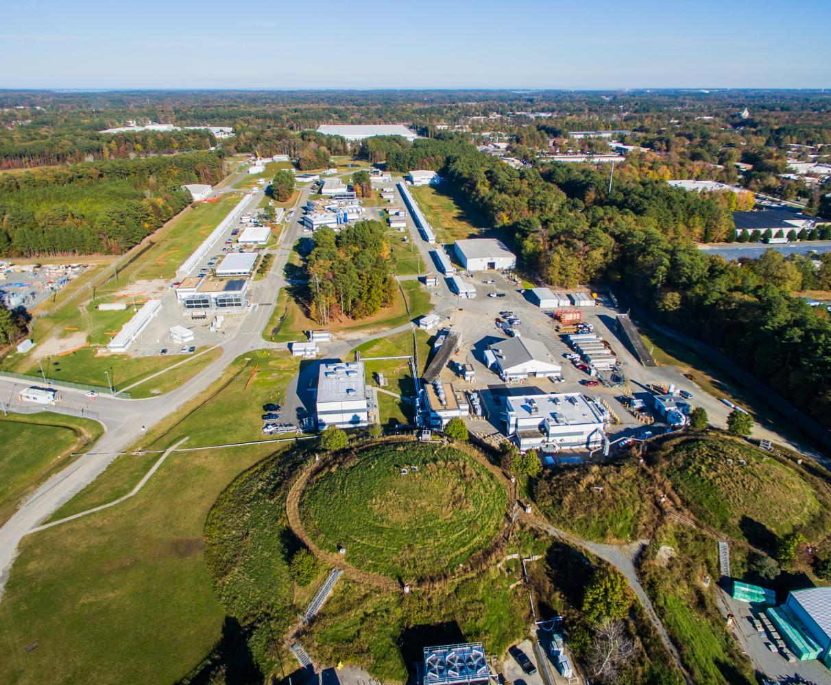
Scientific Computing At Jefferson Lab
Amber Boehnlein
Chief Information Officer
IT Division Director

Slide 2
S&T Recommendations
Received recommendations at the July 2017 S&T review to assess computing needs for Experimental and Theory programs
  Generate a cost-effective plan to ensure sufficient computing resources for data analysis and simulation in FY18 and a longer-term approach to address the needs in FY2019 and beyond. The plan for FY2019+ resources should include a time line and detailed plan to evaluate the feasibility of the proposed approach, including off-site computing resources, such that the plan can be place and tested before the FY2019 running. Synergy with the theory computing needs should be considered.
  Develop a 5-year plan of computational needs related to Office of Nuclear Physics (NP) activities for the theory group on local JLAB computers, in the context of all available computing resources. Submit to DOE NP by June 1, 2018.
  DOE OPS review charge for July 2018:
  Do the plans for the provision of computing resources meet the needs of the Facility and planned experimental program?".

Slide 3
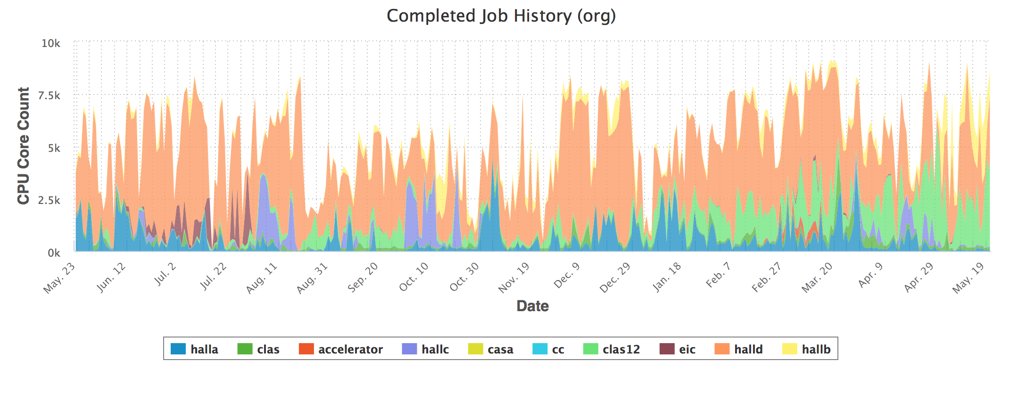
Experimental Computing Performance Plan
Experimental program
  Local resources at ‘Shutdown’ level
    Investment needed
  Spreadsheet Model projections
    key parameters benchmarked
    against actual performance
    Construct run scenarios
Projections
Usage (May 2017-May 2018)
JSA Director’s Operations Review

Slide 4
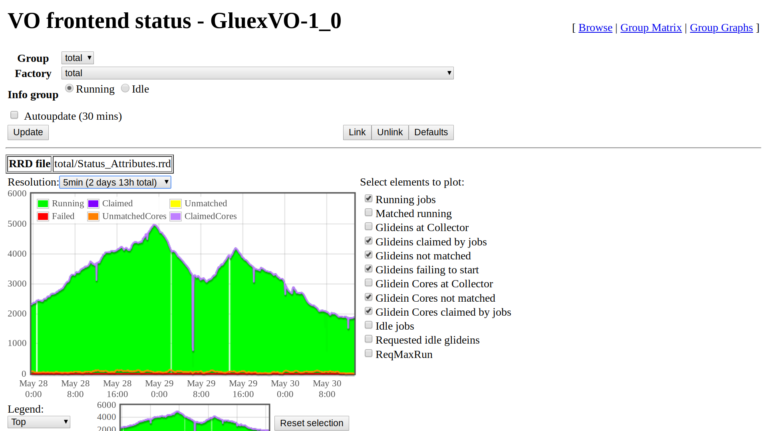
Experimental Computing Performance Plan
Insure adequate computing resources
with $850K investment in FY18
  Use local farm for reconstruction,
  calibration and analysis
  Use distributed resources for MC
  Storage and associated bandwidth
  scaled to support all resources
Open Science Grid
  GlueX -6 institutions contribute resources
  In a recent 2 week period ~1M core-hours
  Expect yearly 35M-50M core-hours
  Investigating options for CLAS12
GlueX reconstruction code at NERSC
  Scale test in July
  Anticipate 70M core-hours/year
Cloud Computing available for bursts
 | Current | FY19 | FY20
CPU (M-core-hours/year) | 37 | 70 | 90
Scratch Disk & Cache Disk (PB) | 0.65 | 1.1 | 2
Tape (GB/s) | 3 | 5 | 7
WAN bandwidth (Gbps) | 10 | 10 | 10
Current and Projected Capacity
June 26, 2018
JSA Director’s Operations Review

Slide 5
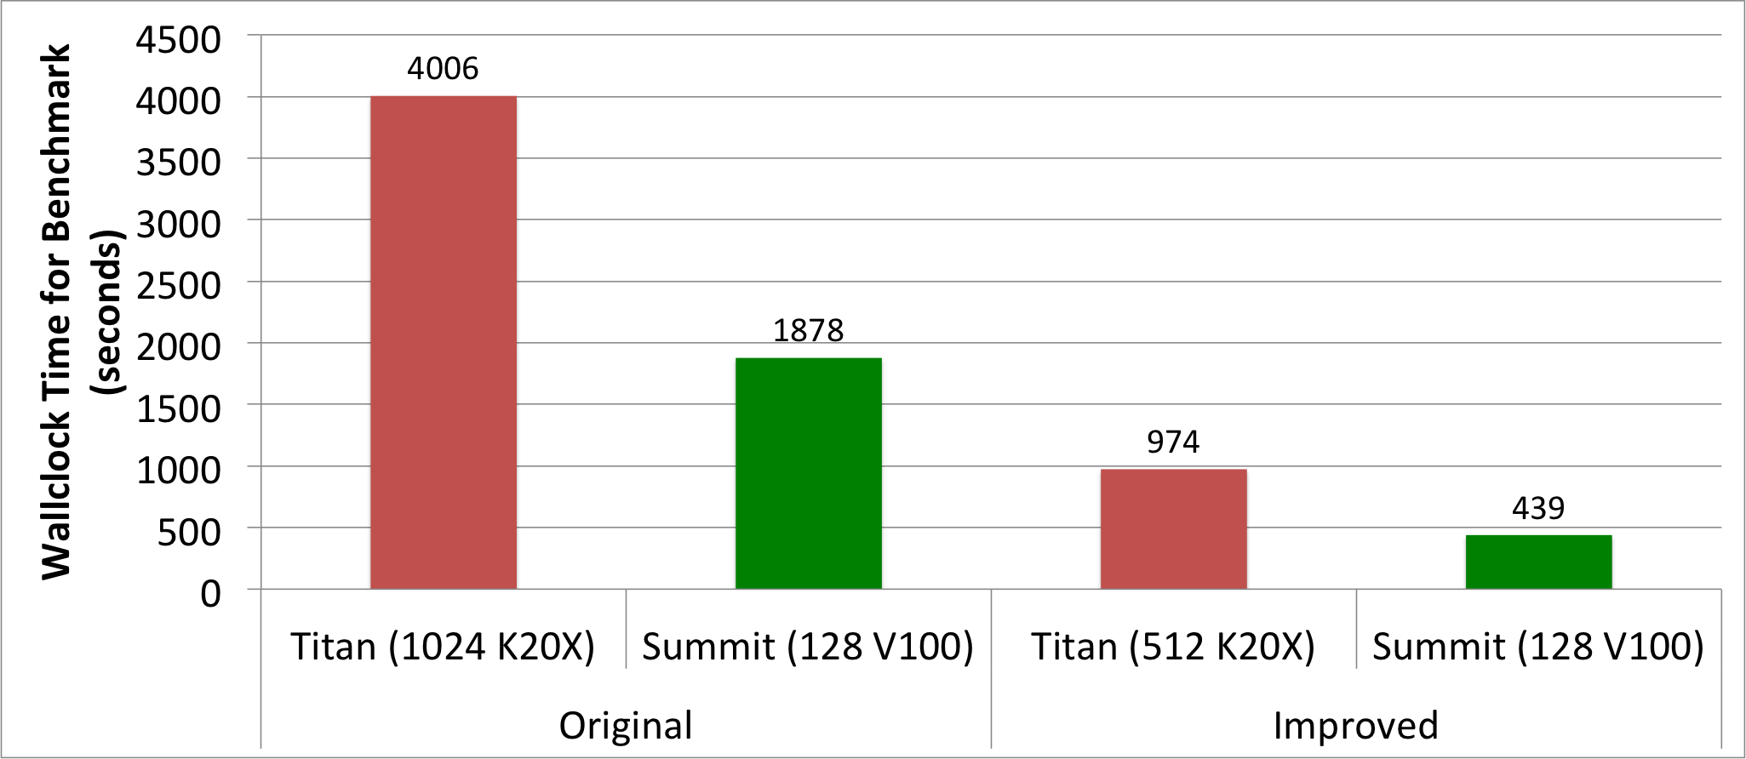
LQCD Computing
Estimated Science needs captured in Exascale Requirements Process
  Advances will allow previously unaffordable calculations critical to 12 GeV science program
Two Stage process
  Highly parallel calculations require supercomputers
  Computationally intensive analysis uses ‘smaller’ scale resources
  Both types of resources must scale together to accomplish the science
    Analyzing results from Summit system require doubling of Jlab resources
NP funded a new 4 year Jefferson Lab based Hardware Program for USQCD allocations
  Extended SciPhy XVI cluster (17K cores) Xeon Phi KNL by
  12,240 cores.
  Deploy new GPU cluster this fall
Software deliverables from SciDAC
and Exascale Computing Project
making excellent progress
4.1x faster
on 2x fewer
GPUs
~8x gain
9.1x faster
on 8x fewer
GPUs
~73x gain
JSA Director’s Operations Review

