Slide 1
Overview and Opportunities for Collaboration
Maria Girone – CERN openlab CTO
2/08/2018

Slide 2
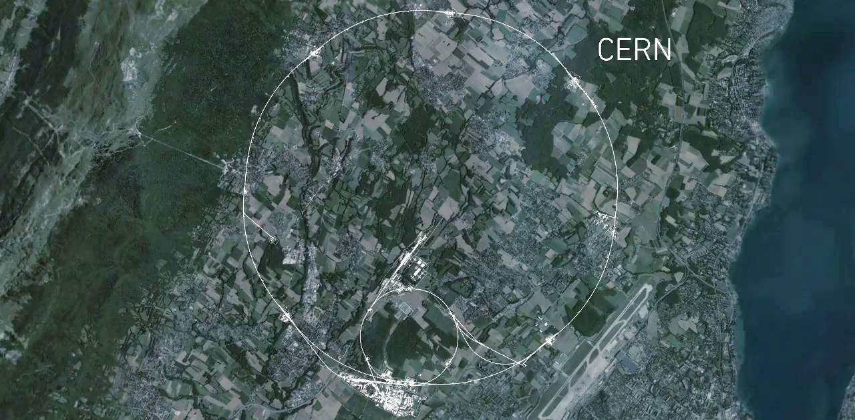

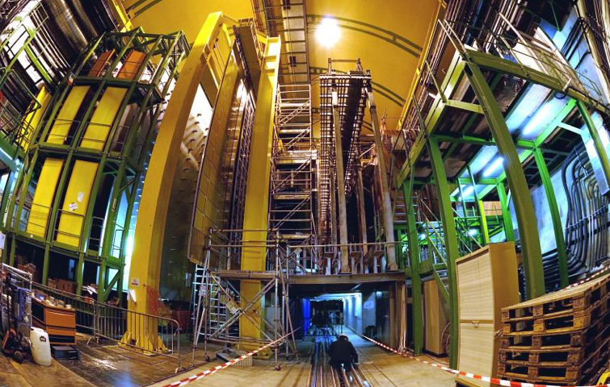

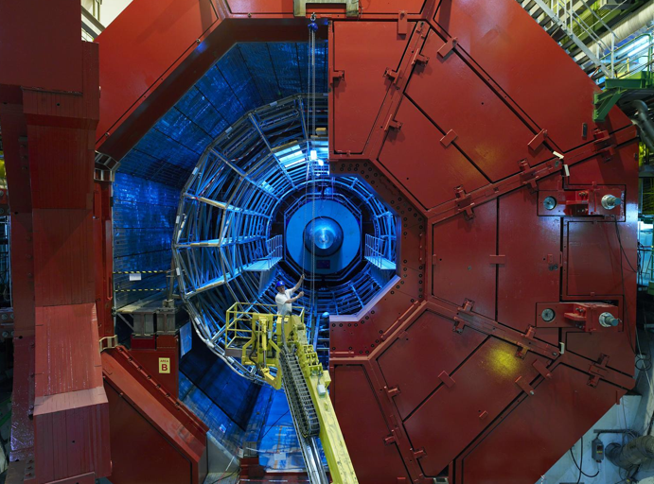
Driving CERN Development
Planned upgrades at the LHC are driving computing innovation
CMS
CMS
LHCb
ALICE
ALICE
ATLAS
ATLAS
LHCb

Slide 3
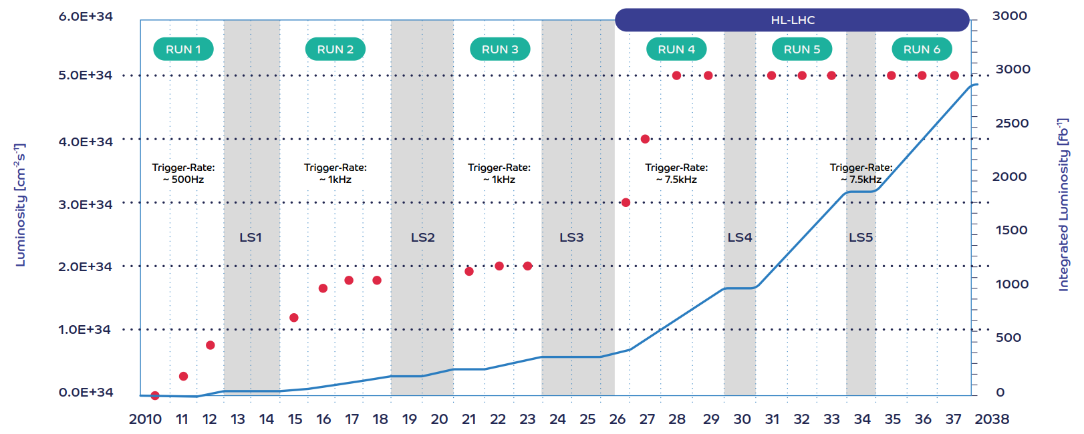
LHC Planned Upgrades
  The LHC has been The LHC has been designed to follow a carefully set out programme of upgrades. The Increased luminosity will greatly extend the scientific reach.
RUN 3
ALICE & LHCb upgrades
RUN 4
ATLAS & CMS upgrades

Slide 4
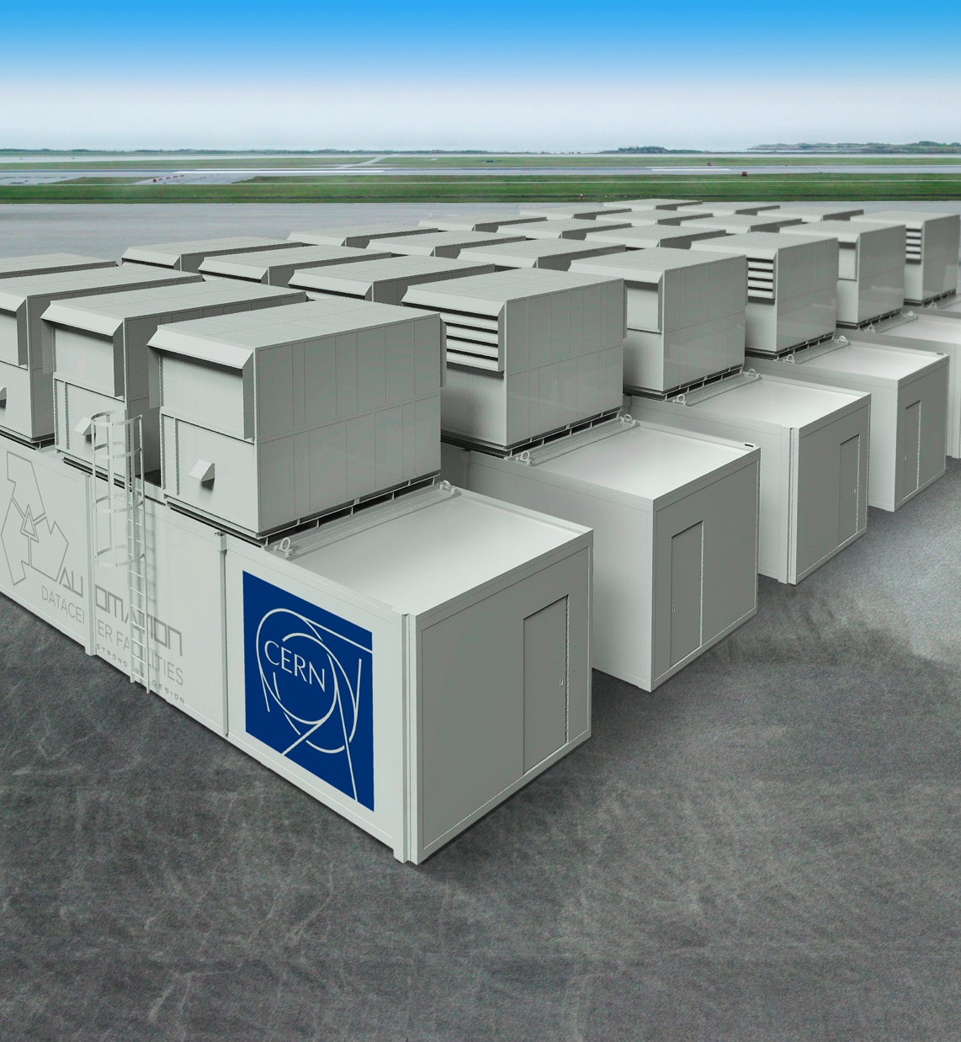
Real Time Computing
LHCb and ALICE will move offline processing closer to the online data collection chain
  Performing processing and data analysis in near real-time
  Solutions under investigation
New HLT farms for Run3
  Flexible and efficient system with ambitious PUE ratio

Slide 5
More collisions increase the probably to observe rare processes
Rate of new physics is 1 event in 10¹²
Selecting a new physics event is like choosing 1 grain of sand in 20 volley ball courts

Slide 6
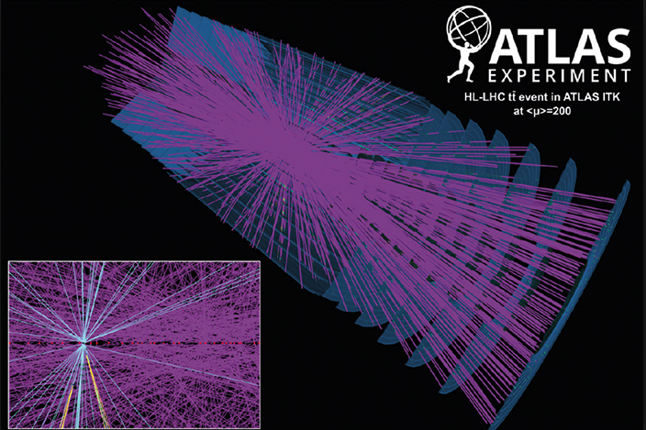
More collisions also make more complex events
CMS: event from 2017 with 78
reconstructed vertices
ATLAS: simulation for HL-LHC with 200 vertices

Slide 7
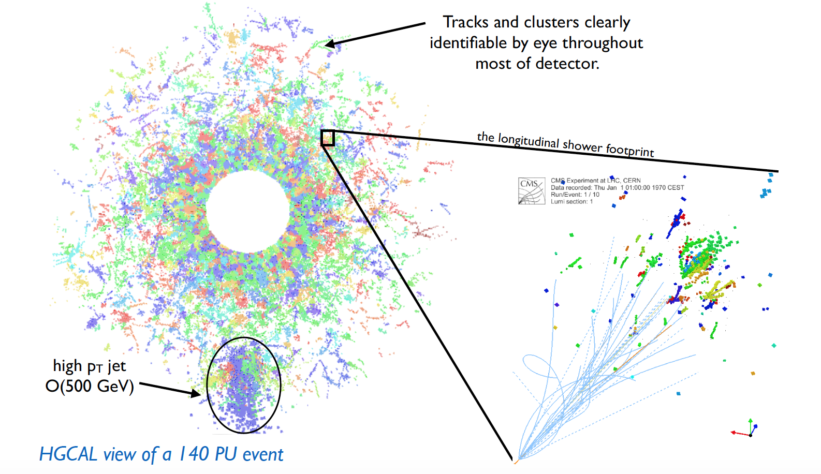
In order to reconstruct complex events the detectors must be upgraded
By Run4, the detectors will become more granular and more radiation hard.
Reconstructing more particles with more granular detectors will be computationally more expensive.

Slide 8
COMPUTING NEEDS
Factor 4
Factor 8
With current techniques the

Slide 9
Closing the gap
Improvements in hardware performance and capacity.
Software innovation,
New Architectures, Techniques
and Methods
Innovation and revolutionary thinking.

Slide 10
CERN OPENLAB’S MISSION
Our recipe for success
Evaluate and test state-of-the-art technologies in a
challenging environment and improve them in collaboration with industry.
Collaborate and exchange ideas with other communities to create knowledge and innovation.
Communicate results, demostrate impact, and reach new audiences.
Train the next generation of engineers/researchers, promote education and cultural exchanges.

Slide 11
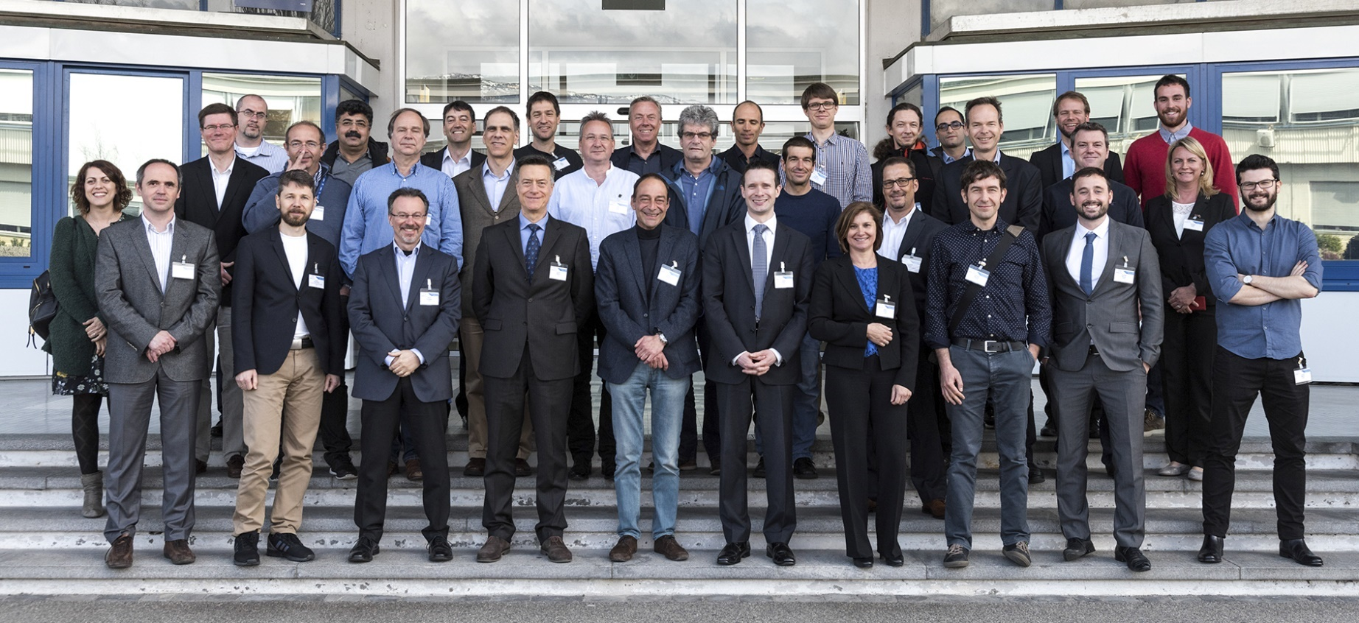
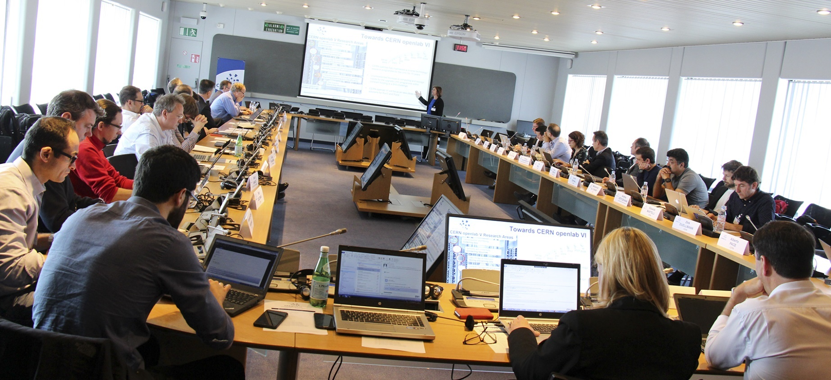
DRIVING INNOVATION SINCE 2001
CERN openlab is in its sixth three-year phase
CERN openlab Collaboration Board 2017

Slide 12

ICT White paper 2017
Published on 21 September 2017
Summarises the results of extensive consultations with CERN experts, LHC Experiments representatives, ICT companies and international research labs and academic institutes
Based on 4 major research topics and 16 challenge areas
A solid starting point for a very challenging and constructive Phase VI
Focused CERN openlab activities on helping to prepare for the HL-LHC

Slide 13
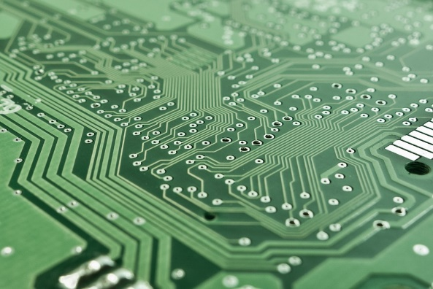
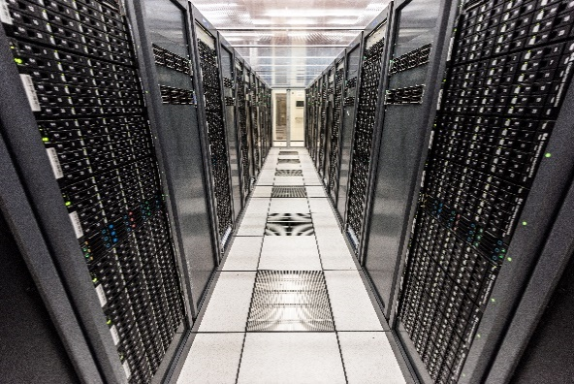
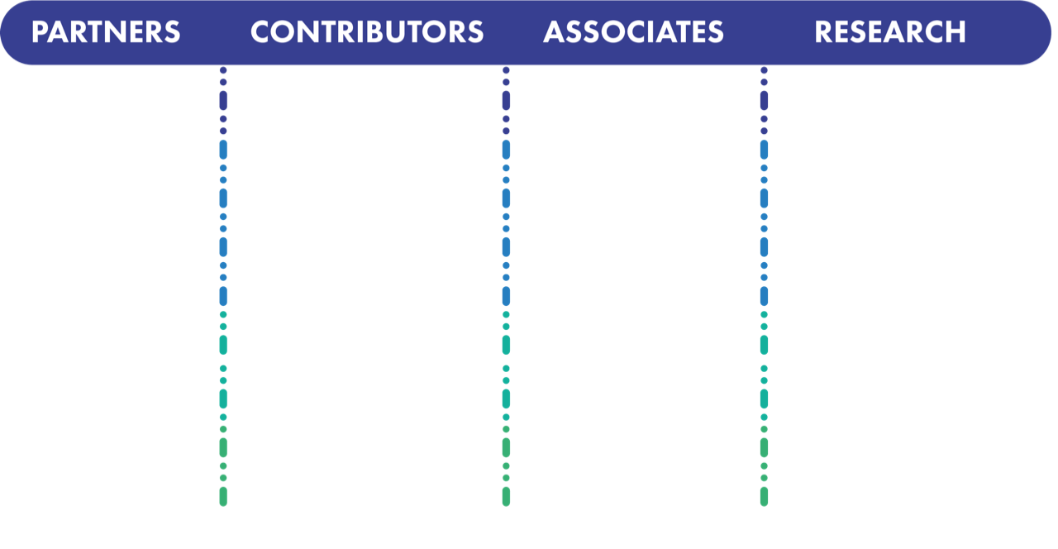


















Three Main Areas of R&D
Increase data centre performance with hardware accelerators (FPGAs, GPUs, ..)
optimized software
COMPUTING
CHALLENGES
Scale out capacity with public clouds, HPC, new architectures
New techniques with Machine Learning, Deep Learning, Advanced Data Analytics

Slide 14







Joint R&D Projects
High-bandwidth fabrics, accelerated platforms for data acquisition
Data Acquisition (LHCb, CMS, Dune, IT-CF)
Code modernization (EP-SFT, IT-CF)
Cloud infra (IT-CM)
Data Storage (IT-ST, IT-DB)
Data Analytics, Machine Learning (many)
Networks (IT-CS)
Control Systems
(BE-ICS)
Data quality monitoring, anomaly detection, physics data reduction, benchmarking/scalability, systems biology and large-scale multi-disciplinary platforms
Simulation, HPC on the Cloud,
benchmarking
Predictive/proactive maintenance and operations
Cloud federations, containers, scalability
Software Defined Networks, Security
Storage architectures, scalability, monitoring

Slide 15
Virtualizing Services for Efficiency
CERN is one of the early adopters and largest contributors to OpenStack
90% of the resources are provided through a private cloud
Allows for flexible and dynamic deployment
Moving to containers for even more flexibility
Current investigations within CERN openlab
320k cores
End Users
Experiment Pilot Factories
CI/CD
IT & Experiment Services
HTCondor
(LSF)
APIs
CLIs
GUIs
Volunteer Computing
Public Cloud
OpenStack Resource Provisioning
(>1 physical data centre)
Bare Metal and HPC
Containers
VMs

Slide 16
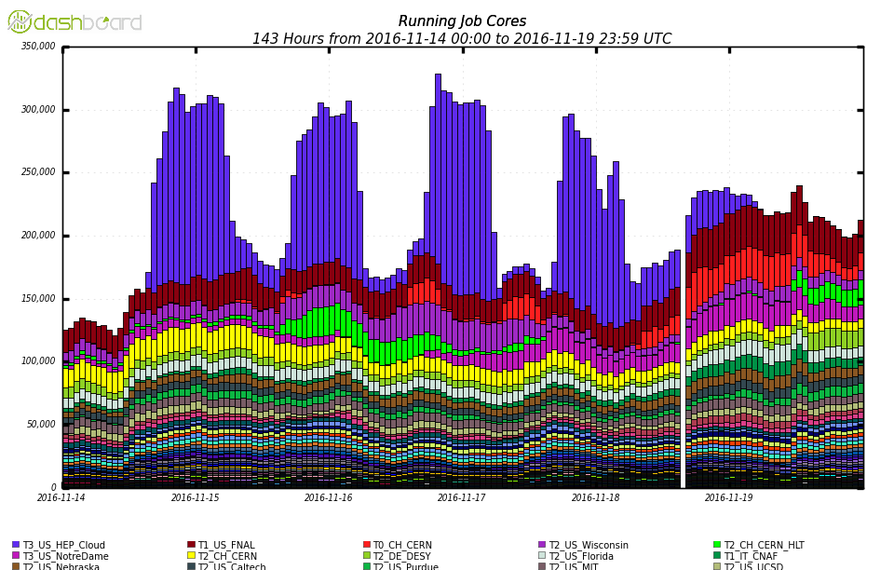
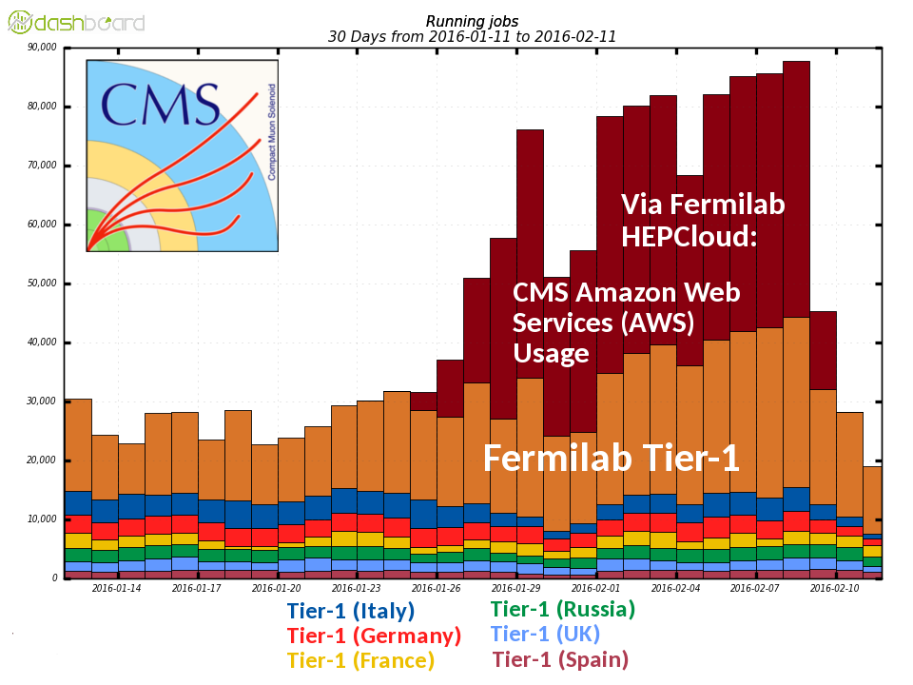
Scaling out capacity
80k Cores
300k Cores
Experiments have demonstrated that it is possible to elastically and dynamically expand production resources to commercial clouds.
Active discussions are ongoing between CERN openlab and Google.

Slide 17
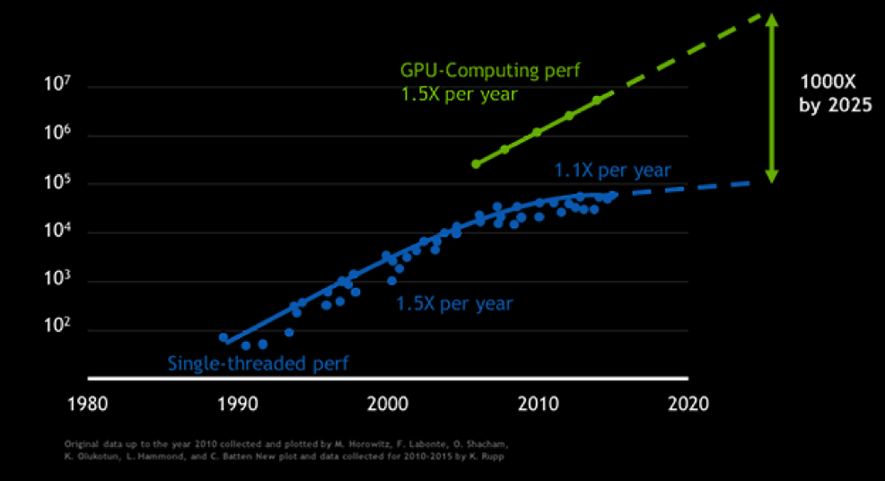
Exploring Accelerated Hardware
CERN openlab is invested in R&Ds on alternative hardware architectures
GPUs are currently experiencing a ~18 month doubling cycle
As compared to ~36 months for CPUs
If this trend continues the separation becomes very significant on the time scale of HL-LHC
We are actively working on benchmarking our applications on GPUs
Currently GPUs are also more expensive than CPUs
Another promising technology for reconstruction and data transformations is FPGAs
Very low power
Improving development environment for facilitating adoption
A number of R&D activities in HEP in high data rate applications

Slide 18
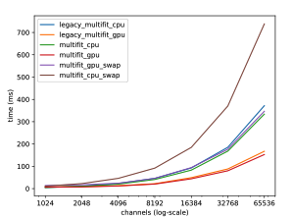
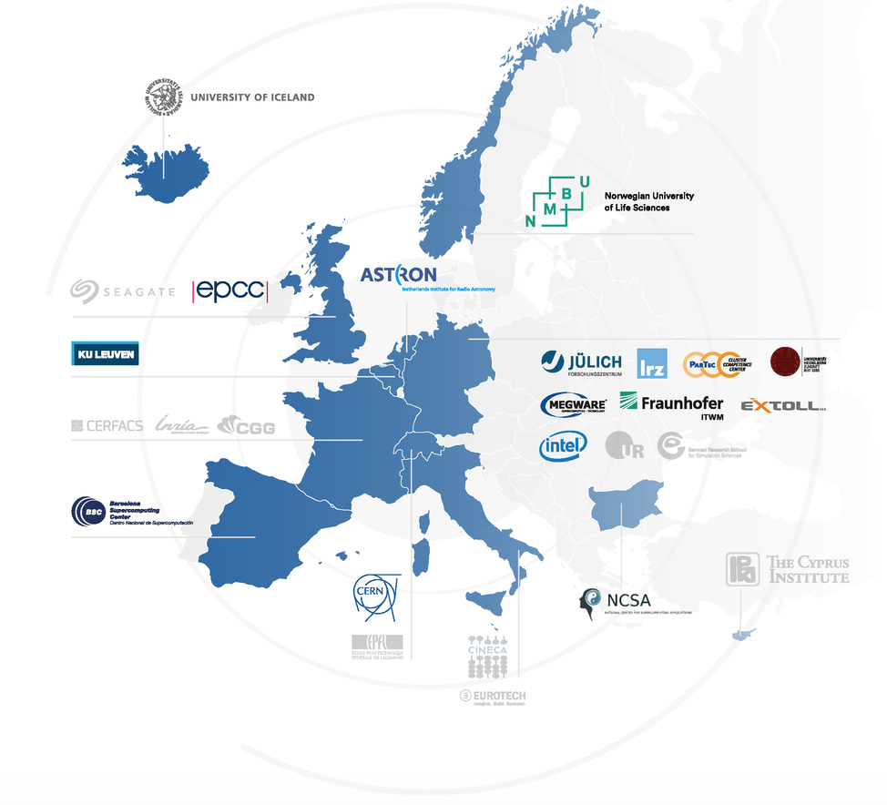
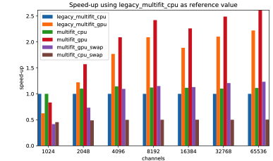
Working with Accelerated Hardware
DEEP-EST: EU funded blueprint modular HPC architectures
Work within the DEEP-EST project, demonstrated the usefulness and advantages of heterogeneous architectures (GPUs)
The idea is to offload some of the reconstruction workload from CPU to GPU
The algorithm performs a regression for every calorimeter channel
  the optimized algorithm is 30% faster on CPU
  achieved a factor up to 2.5 parallelizing on GPUs
  Need to benchmark further
DEEP-EST: Dynamical Exascale Entry Platform - Extreme Scale Technologies
Results achieved comparing a 3.5GHz Haswell CPU and a Tesla K40c GPU

Slide 19

Low latency and high data rate applications
  The ALICE and LHCb experiments will increase their data acceptance rates for Run 3
  LHCb is investigating FPGAs and GPUs to allow reconstruction of 5 TB/s of events in real time. Deep learning techniques under investigation.
  At HL-LHC higher data rates will require more selective triggering and faster reconstruction
CMS is porting heavy ”offline” tasks to real-time processing for HL-LHC
  Integrate GPUs in the HLT farm to give high-quality reconstruction in 200 msec latency (as opposed to tens of sec)
  Two projects in CERN openlab with and
5-10 GB/s

Slide 20
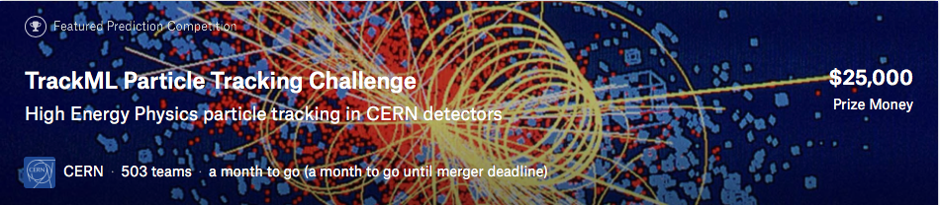

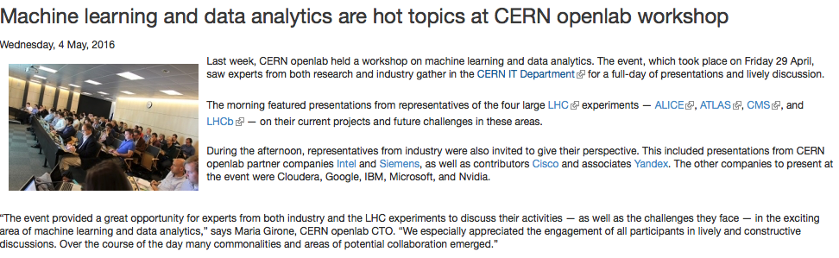
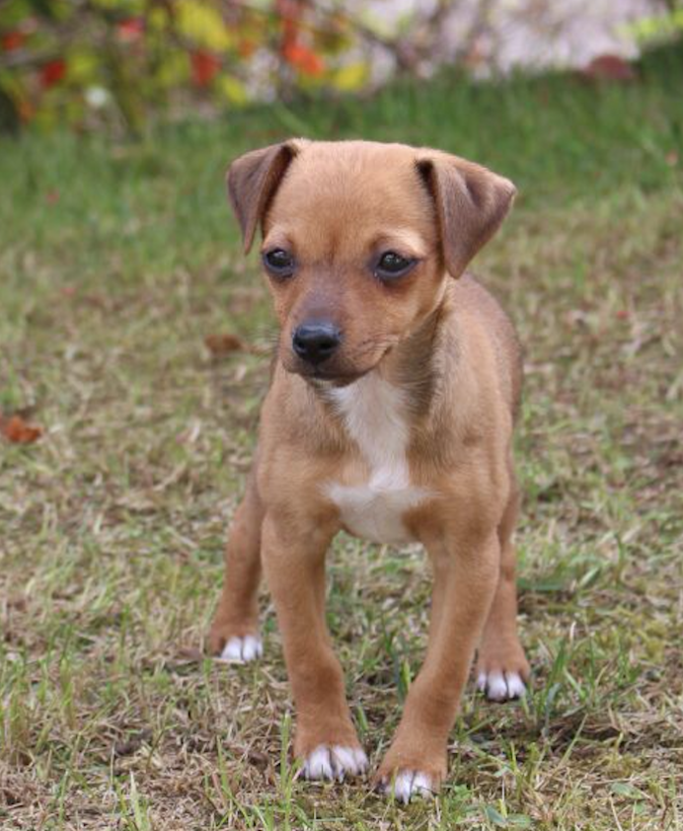
Machine Learning in HEP
The LHC experiments are working closely with industry via CERN openlab on machine learning
  Focus on adoption of accelerators (GPUs, FPGAs)
  Engineering resources dedicated to support the application porting and increase knowhow on deep learning techniques
Data acquisition
Real time event categorization
Data monitoring & certification
Fast inference for trigger systems
Data Reconstruction
Calorimeter reconstruction
Boosted object jet tagging
Data Processing
Computing resource optimization
Predicting data popularity
Intelligent networking
Data Simulation
Adversarial networks
Fast simulation
Data Analysis
Knowledge base
Data reduction
Searches for new physics

Slide 21
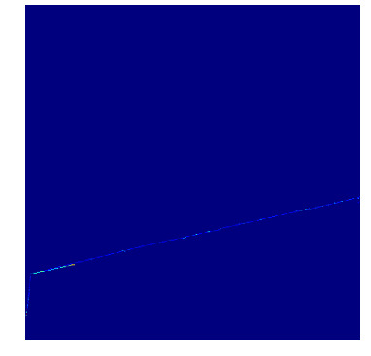
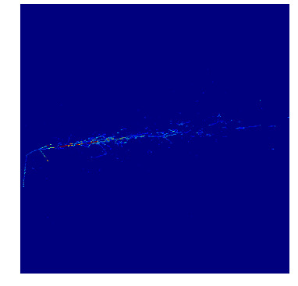
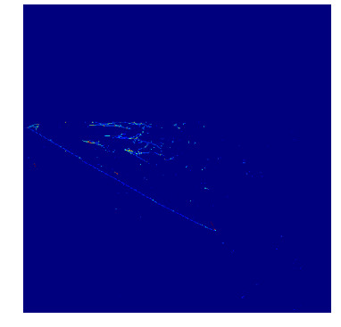
Exploring Accelerated Machine Learning For Experiment Data Analytics
CERN openlab is launching a a project with to investigate applications of Machine Learning in data intensive environments
Using an FPGA based co-processor from Micron
  In CMS show that ML techniques can be applied in the Level-1 trigger. Complex decisions very close to real time (micro-seconds)
  In DUNE the challenge is application in large data volumes
    events are 5GB and the data rate is 5TB/s

Slide 22
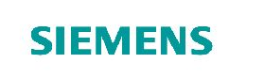
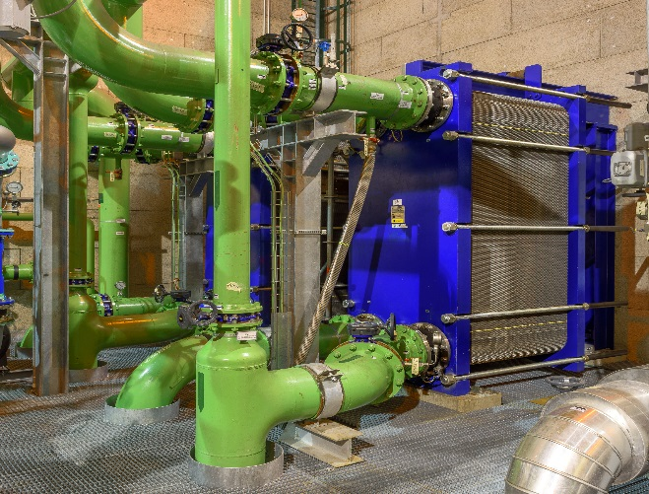
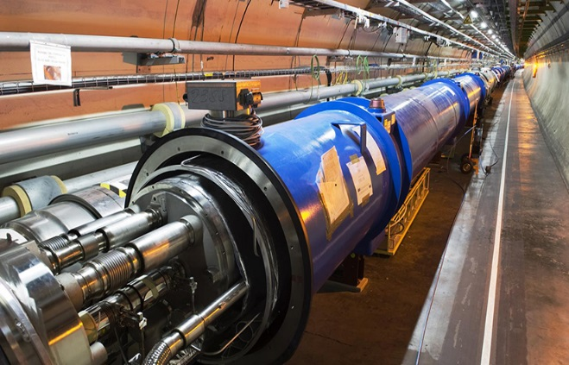
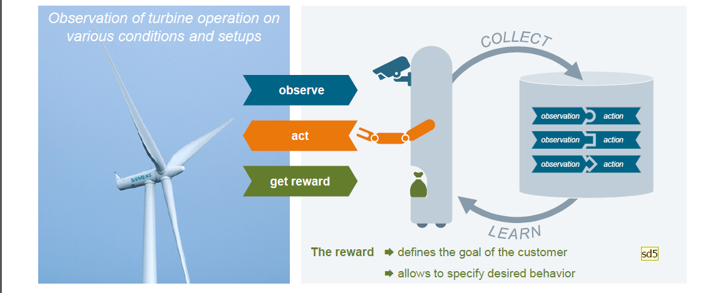
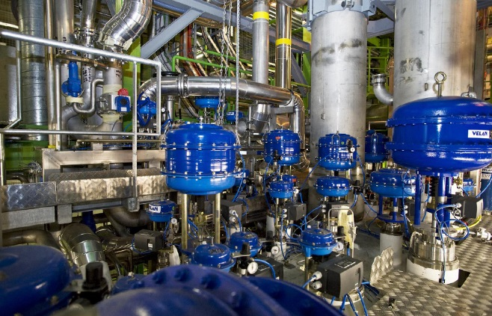
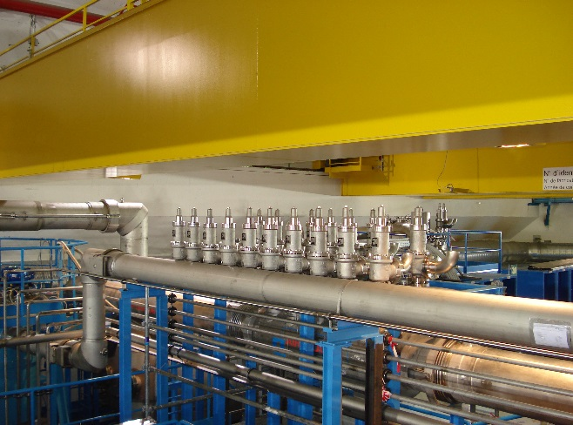
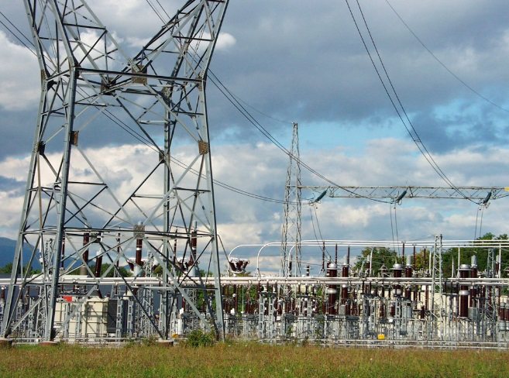
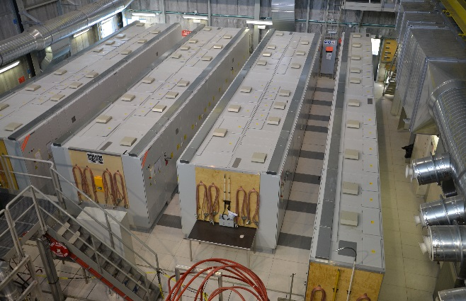
Monitoring, Automation and Anomaly Detection
Network security and fraud detection
Industrial monitoring and predictive failures
  Looking at optimizing performance of complex systems
    Minimize costs and improve resource utilization
LHC magnets, industrial controls, …
Detector Health
  Complex system monitoring to minimize downtime and reduce operations costs
Resource Utilization (scheduling, data placement, I/O optimization)
Two projects in CERN openlab with and
A multitude of Industrial Control Systems
Reinforcement learning
Cooling & Ventilation
VACUUM
Cryogenics
GAS
Electric Grid
LHC Circuit,
QPS, WIC, PIC, …

Slide 23
Data Quality Monitoring
Monitoring the data continuously is effort intensive and critical
data is monitored by shift teams looking for anomalies in distributions
CMS uses supervised learning on reconstructed data with multi-head NN to predict a probability of anomaly in separated channels
Results are combined to establish the quality of the data
CMS is also working with on automated online monitoring at sub-detector data and metadata level
Predict anomalies in Ecal and Hcal using deep learning recursive NN
Goal is to integrate detector control systems for a comprehensive monitoring overview

Slide 24
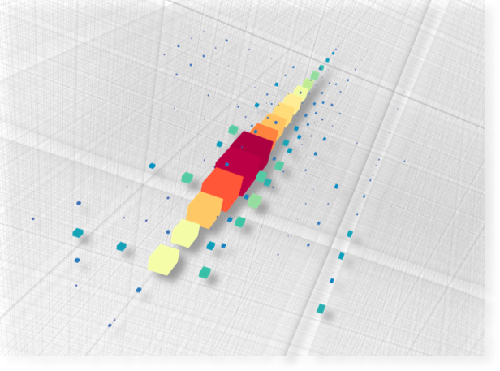
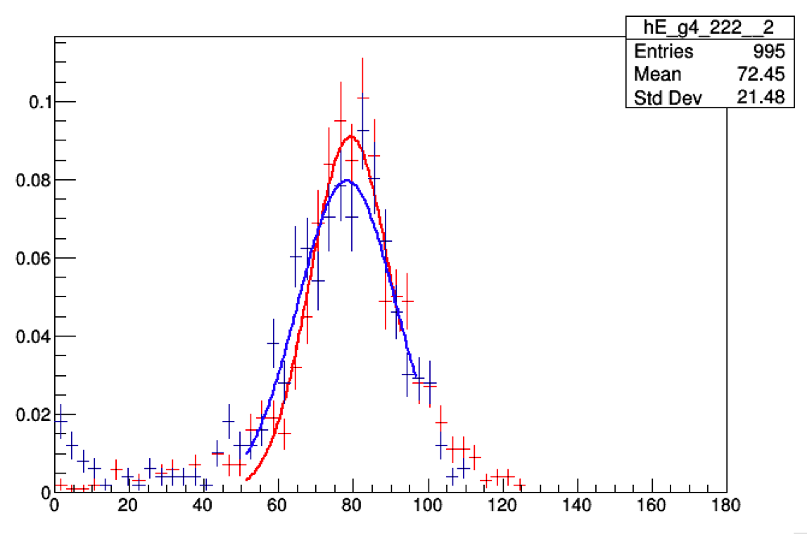
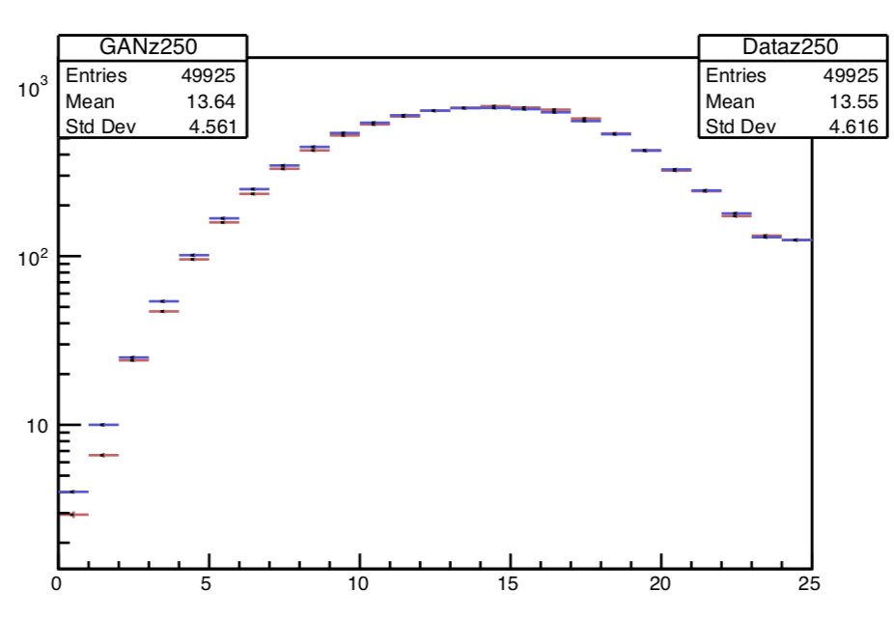
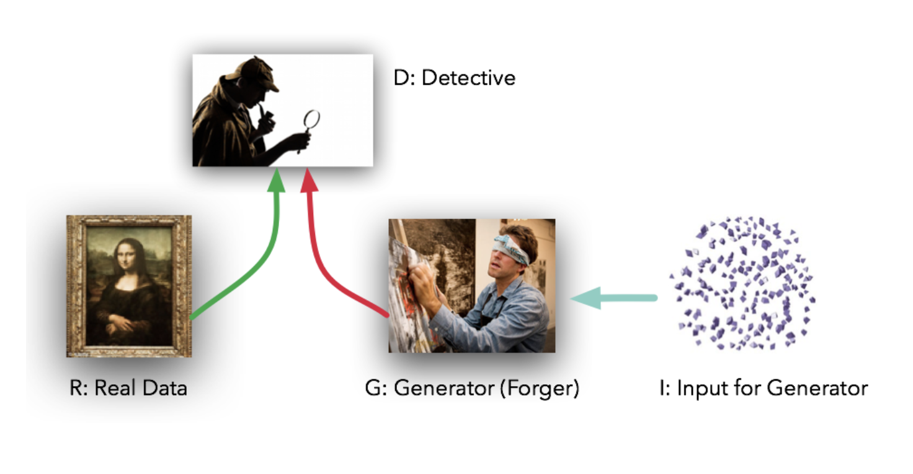
Improving Simulation
Two main R&D areas
  Adapting the existing code to new computing architectures
  Replacing complex algorithms with deep-learning approaches (FAST SIMULATION)
Looking at adversarial networks to improve speed without giving up accuracy of simulated events
  One network attempts to simulate events that match a data distribution
  While a second network tries to distinguish data and simulation

Slide 25
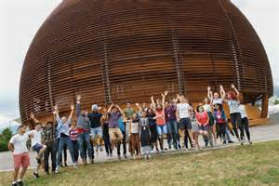
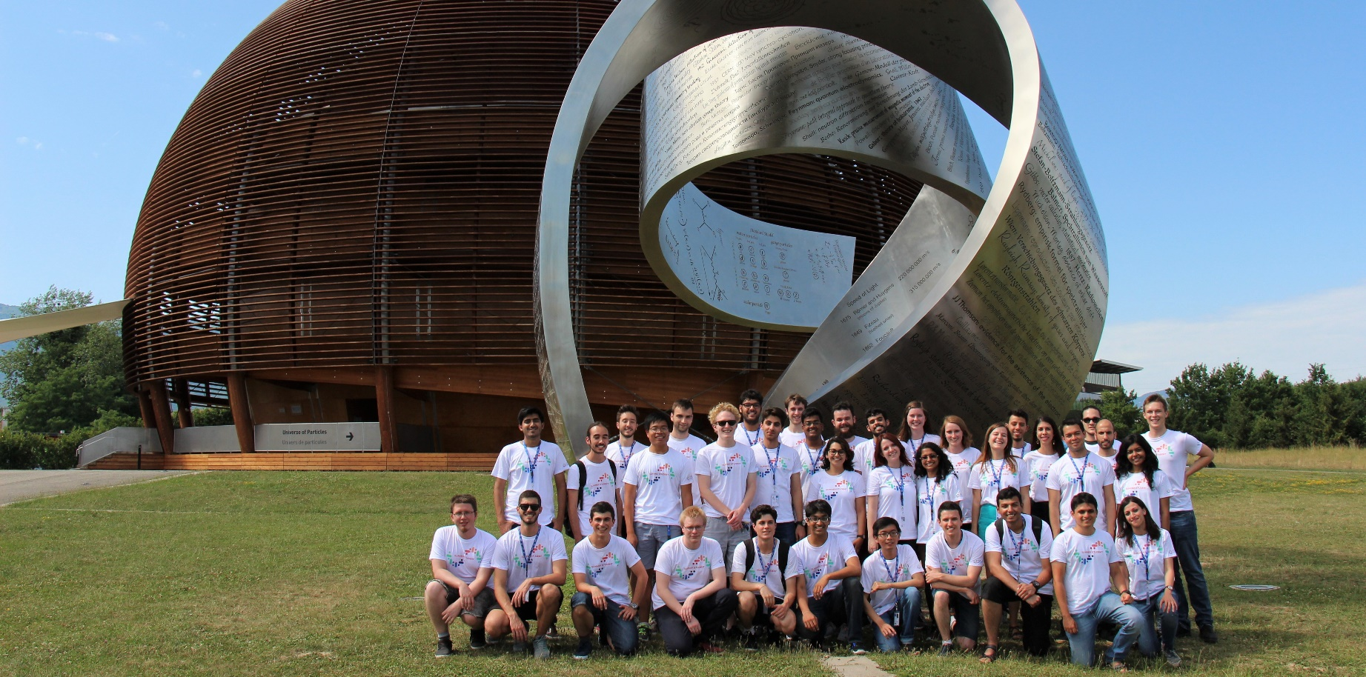
Education and Training
CERN openlab Summer Student Programme
CERN openlab runs a highly competitive summer-student programme
Most dedicated CERN openlab personnel are young, talented ‘fellows’.
Workshops, training courses, and other initiatives run with our collaborators.
Experts from industry and research give lectures.
~ 40 students selected from around 1500 applicants
Receive hands-on experience with cutting-edge technologies
Competitions, challenges, online training, hackathons.
Participate in events both inside and outside CERN.
Notes:
All student lightning talks can be found on Indico (presentations and webcast). Also perhaps worth mentioning code modernization challenge with Intel.

Slide 26
Outlook
CERN has an exciting research program over the next decade, which is facing serious computing resources shortages for the HL-LHC
  Success will depend on exploiting new hardware and techniques that perform selection , reconstruction, simulation and analysis more efficiently
CERN openlab has established several research lab partnerships that are doing innovating R&D
We would be happy to explore collaboration with Jefferson Lab on areas of common interest

Slide 27
Backup Slides

Slide 28
CERN openlab Governance
Collaboration Board
(Chaired by CERN DG)
CERN openlab Head
Chief Technology Officer
Chief Research Officer
Chief Innovation Officer
Communications
Administration and Finance
CERN Director of Research and Computing
CERN Legal Office, KT Office, HR
Projects with HEP and LHC Experiments
Knowledge sharing with other scientific communities
Disruptive technologies
The Collaboration Board is composed of the representatives of the member Companies and Research Institutes

