Slide 1

Polarized Ion Beams with JLEIC
V.S. Morozov, Ya.S. Derbenev, F. Lin, Y. Zhang – JLab, Newport News, VA
A.M. Kondratenko, M.A. Kondratenko – Zaryad, Novosibirsk, Russia
Yu.N. Filatov – MIPT, Dolgoprudny, Russia
Zgoubi support: F. Meot – BNL, Upton, NY
Workshop on polarized light ion physics with EIC
Ghent University, Ghent, Belgium, February 8, 2018

Slide 2
Outline
Overall layout of JLEIC
Vector and tensor beam polarizations
Polarized ion sources
Polarimetry
Polarization rotation and its experimental demonstration
Figure-8 concept
Polarized beam acceleration in the JLEIC booster
Polarized beam acceleration, control and spin-flip in the JLEIC ion collider ring
Polarization measurement strategy
Summary and future work

Slide 3


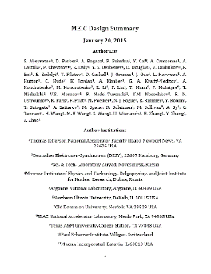
JLEIC Layout
Electron complex
  CEBAF
  Electron collider ring
Ion complex
  Ion source
  SRF linac (285 MeV/u for protons)
  Booster
  Ion collider ring
Optimum detector location
for minimizing background
8-100(400) GeV
3-12 GeV
8 GeV
SRF Linac &
2015
arXiv:1504.07961
May 17 update:
https://eic.jlab.org/wiki/index.php/Main_Page

Slide 4
Key Design Concepts
High luminosity: high collision rate of
short modest-charge low-emittance bunches
  Small beam size
    Small β* ⇒ Short bunch length ⇒
    Low bunch charge, high repetition rate
    Small emittance ⇒ Cooling
  Similar to lepton colliders such as
  KEK-B with L > 2×10³⁴ cm⁻²s⁻¹
High polarization: figure-8 ring design
  Net spin precession zero
  Spin easily controlled by small
  magnetic fields for any particle
  species
Full acceptance primary detector including far-forward acceptance
Beam Design
High repetition rate
Low bunch charge
Short bunch length
Small emittance
Damping
Synchrotron radiation
Electron cooling
IR Design
Small β*
Crab crossing

Slide 5
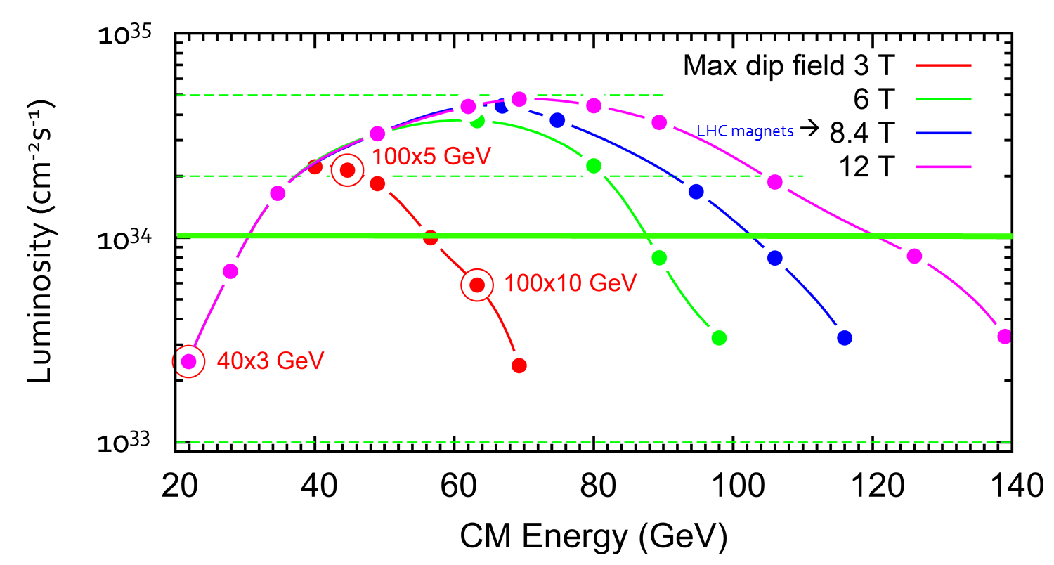
JLEIC Energy Reach and Luminosity
CM Energy (in each scenario) | Main luminosity limitation
low | space charge
medium | beam-beam
high | synchrotron radiation

Slide 6
JLEIC Parameters (3T option)
CM energy | GeV | 21.9 (low) |  | 44.7 (medium) |  | 63.3 (high)
 |  | p | e | p | e | p | e
Beam energy | GeV | 40 | 3 | 100 | 5 | 100 | 10
Collision frequency | MHz | 476 |  | 476 |  | 476/4=119
Particles per bunch | 10¹⁰ | 0.98 | 3.7 | 0.98 | 3.7 | 3.9 | 3.7
Beam current | A | 0.75 | 2.8 | 0.75 | 2.8 | 0.75 | 0.71
Polarization | % | 80% | 80% | 80% | 80% | 80% | 75%
Bunch length, RMS | cm | 3 | 1 | 1 | 1 | 2.2 | 1
Norm. emittance, hor / ver | μm | 0.3/0.3 | 24/24 | 0.5/0.1 | 54/10.8 | 0.9/0.18 | 432/86.4
Horizontal & vertical β* | cm | 8/8 | 13.5/13.5 | 6/1.2 | 5.1/1.0 | 10.5/2.1 | 4/0.8
Ver. beam-beam parameter |  | 0.015 | 0.092 | 0.015 | 0.068 | 0.008 | 0.034
Laslett tune-shift |  | 0.06 | 7x10⁻⁴ | 0.055 | 6x10⁻⁴ | 0.056 | 7x10⁻⁵
Detector space, up/down | m | 3.6/7 | 3.2/3 | 3.6/7 | 3.2/3 | 3.6/7 | 3.2/3
Hourglass(HG) reduction |  | 1 |  | 0.87 |  | 0.75
Luminosity/IP, w/HG, 10³³ | cm⁻²s⁻¹ | 2.5 |  | 21.4 |  | 5.9

Slide 7


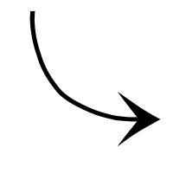


Interaction Region Concept
Possible to get ~100% acceptance for the whole event
Central Detector/Solenoid
Ion beamline
Scattered Electron
Electron beamline
Dipole
Dipole
Forward (Ion) Detector
Particles Associated
with struck parton
Particles Associated
with Initial Ion
Courtesy of R. Yoshida

Slide 8
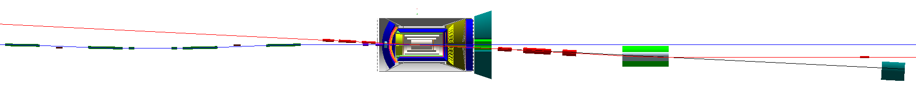
Detector Region
Integrated detector region design developed satisfying the requirements of
  Detection – Beam dynamics – Geometric match
GEANT4 detector model developed, simulations in progress
IP
e
Compton polarimetry
forward ion detection
ions
forward e detection
spectrometers
dispersion suppressor/
geometric match
p
(top view in GEANT4)
e
low-Q² electron detection
and Compton polarimeter
Forward hadron spectrometer
ZDC

Slide 9
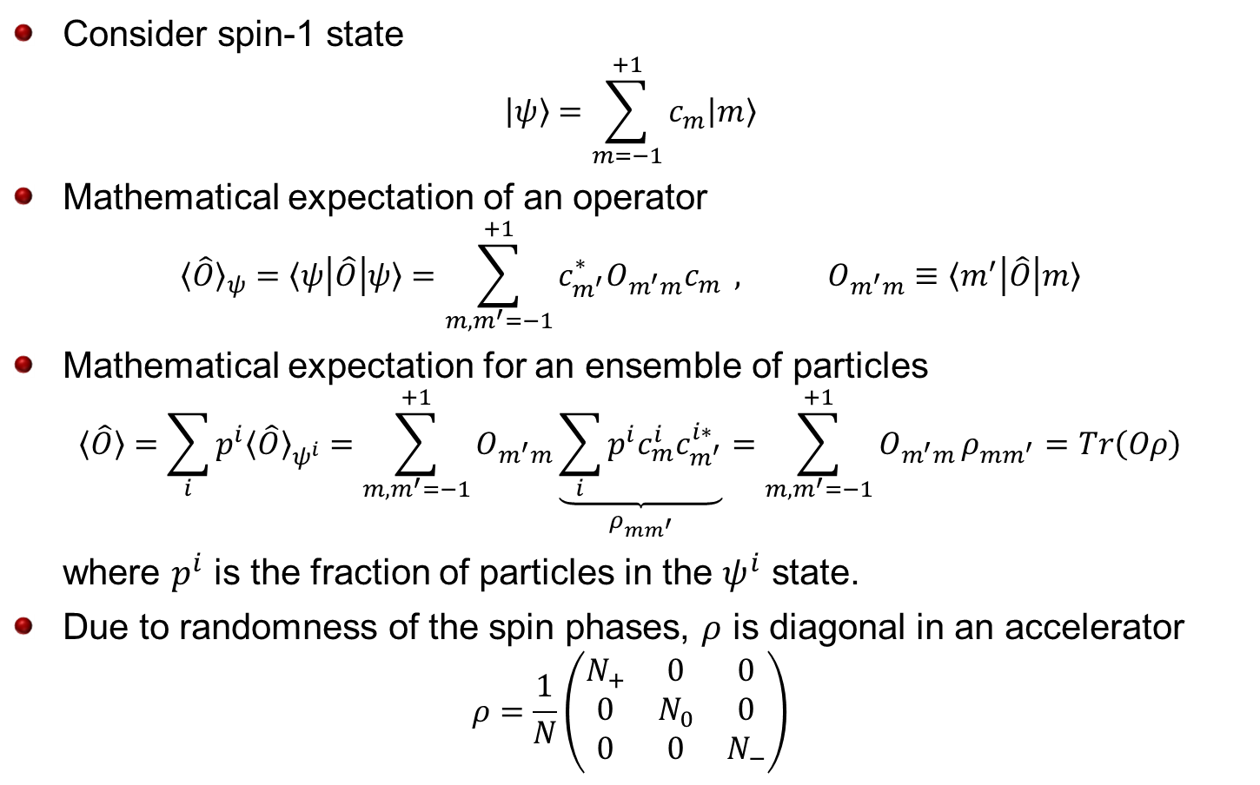
Spin Density Matrix
Consider spin-1 state
$$|ψ〉=\sum_{m=−1}^{+1}{c_{m}|m〉}$$
Mathematical expectation of an operator
$${〈\hat{O}〉}_{ψ}=〈ψ\left|\hat{O}\right|ψ〉=\sum_{m, m^{′}=−1}^{+1}{c_{m^{′}}^{∗}O_{m^{′}m}c_{m}} , O_{m^{′}m}≡〈m^{′}\left|\hat{O}\right|m〉$$
Mathematical expectation for an ensemble of particles
$$〈\hat{O}〉=\sum_{i}{p^{i}{〈\hat{O}〉}_{ψ^{i}}}=\sum_{m, m^{′}=−1}^{+1}{O_{m^{′}m}}\underset{ρ_{mm^{′}}}{\underbrace{\sum_{i}{p^{i}c_{m}^{i}c_{m^{′}}^{i∗}}}}=\sum_{m, m^{′}=−1}^{+1}{O_{m^{′}m}}ρ_{mm^{′}}=Tr\left(Oρ\right)$$
where $p^{i}$ is the fraction of particles in the $ψ^{i}$ state.
Due to randomness of the spin phases, $ρ$ is diagonal in an accelerator
$$ρ=\frac{1}{N}\left(\begin{matrix}N_{+} & 0 & 0 \\ 0 & N_{0} & 0 \\ 0 & 0 & N_{−}\end{matrix}\right)$$

Slide 10
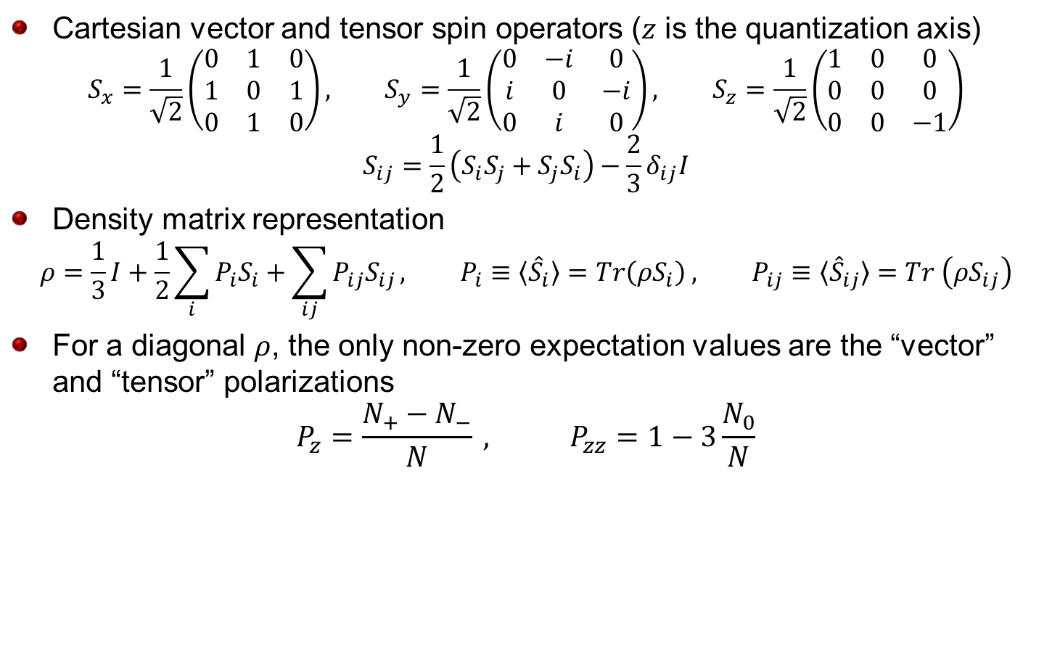
Beam Polarization
Cartesian vector and tensor spin operators ($z$ is the quantization axis)
$$S_{x}=\frac{1}{\sqrt{2}}\left(\begin{matrix}0 & 1 & 0 \\ 1 & 0 & 1 \\ 0 & 1 & 0\end{matrix}\right), S_{y}=\frac{1}{\sqrt{2}}\left(\begin{matrix}0 & −i & 0 \\ i & 0 & −i \\ 0 & i & 0\end{matrix}\right), S_{z}=\frac{1}{\sqrt{2}}\left(\begin{matrix}1 & 0 & 0 \\ 0 & 0 & 0 \\ 0 & 0 & −1\end{matrix}\right)$$
$$S_{ij}=\frac{1}{2}\left(S_{i}S_{j}+S_{j}S_{i}\right)−\frac{2}{3}δ_{ij}I$$
Density matrix representation
$$ρ=\frac{1}{3}I+\frac{1}{2}\sum_{i}{P_{i}S_{i}}+\sum_{ij}{P_{ij}S_{ij}}, P_{i}≡〈{\hat{S}}_{i}〉=Tr\left(ρS_{i}\right) , P_{ij}≡〈{\hat{S}}_{ij}〉=Tr \left(ρS_{ij}\right)$$
For a diagonal $ρ$, the only non-zero expectation values are the “vector” and “tensor” polarizations
$$P_{z}=\frac{N_{+}−N_{−}}{N} , P_{zz}=1−3\frac{N_{0}}{N}$$

Slide 11
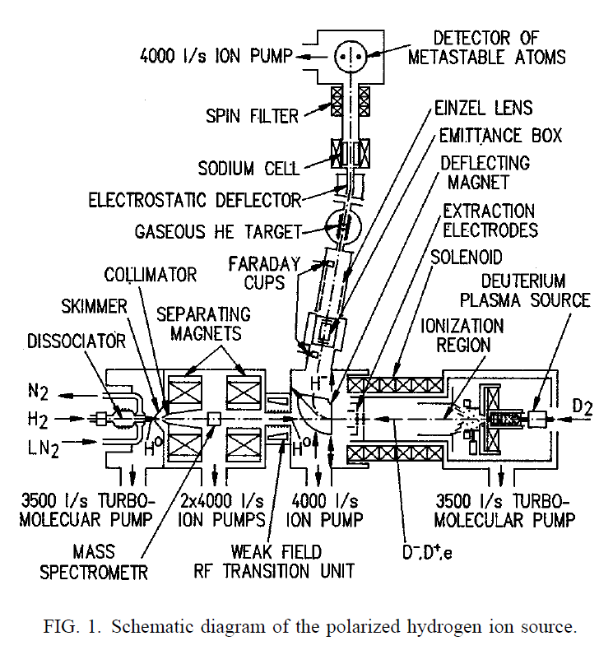
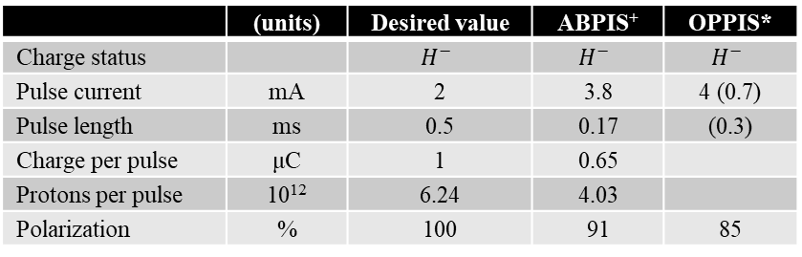

Polarized Ion Sources
ABPIS: Atomic Beam Polarized Ion Source (IUCF, COSY)
OPPIS: Optically-Pumped Polarized Ion Source (RHIC)
Demonstrated technology
ABPIS has similar performance with
polarized $D^{−}$
There are ideas for modification of ABPIS to produce polarized $3He$ and $Li$
 | (units) | Desired value | ABPIS⁺ | OPPIS*
Charge status |  | $$H^{−}$$ | $$H^{−}$$ | $$H^{−}$$
Pulse current | mA | 2 | 3.8 | 4 (0.7)
Pulse length | ms | 0.5 | 0.17 | (0.3)
Charge per pulse | μC | 1 | 0.65
Protons per pulse | 10¹² | 6.24 | 4.03
Polarization | % | 100 | 91 | 85
⁺[Belov et al., Rev. Sci. Instrum. 77, 03A522 2006]
*[Zelenski et al., Rev. Sci. Instrum. 87, 02B705 (2016)]
-Linac parameters in parentheses; 85% polarization at 200 MeV
[Belov et al., Rev. Sci. Instrum. 67 (3) (1996)]
[Belov et al., Rev. Sci. Instrum. 77, 03A522 (2006)]

Slide 12
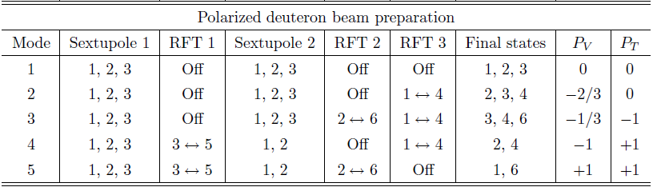
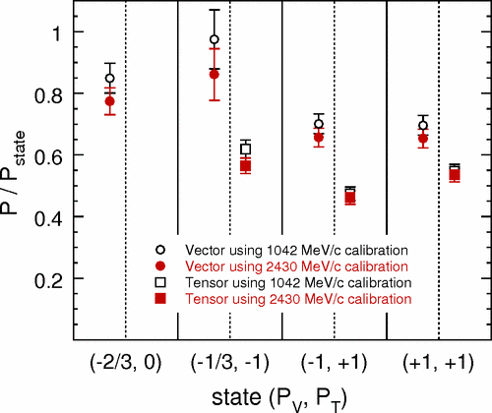
Polarized Deuteron Source
Deuterium hyperfine states
(in strong magnetic field)
COSY’s polarized ion source

Slide 13
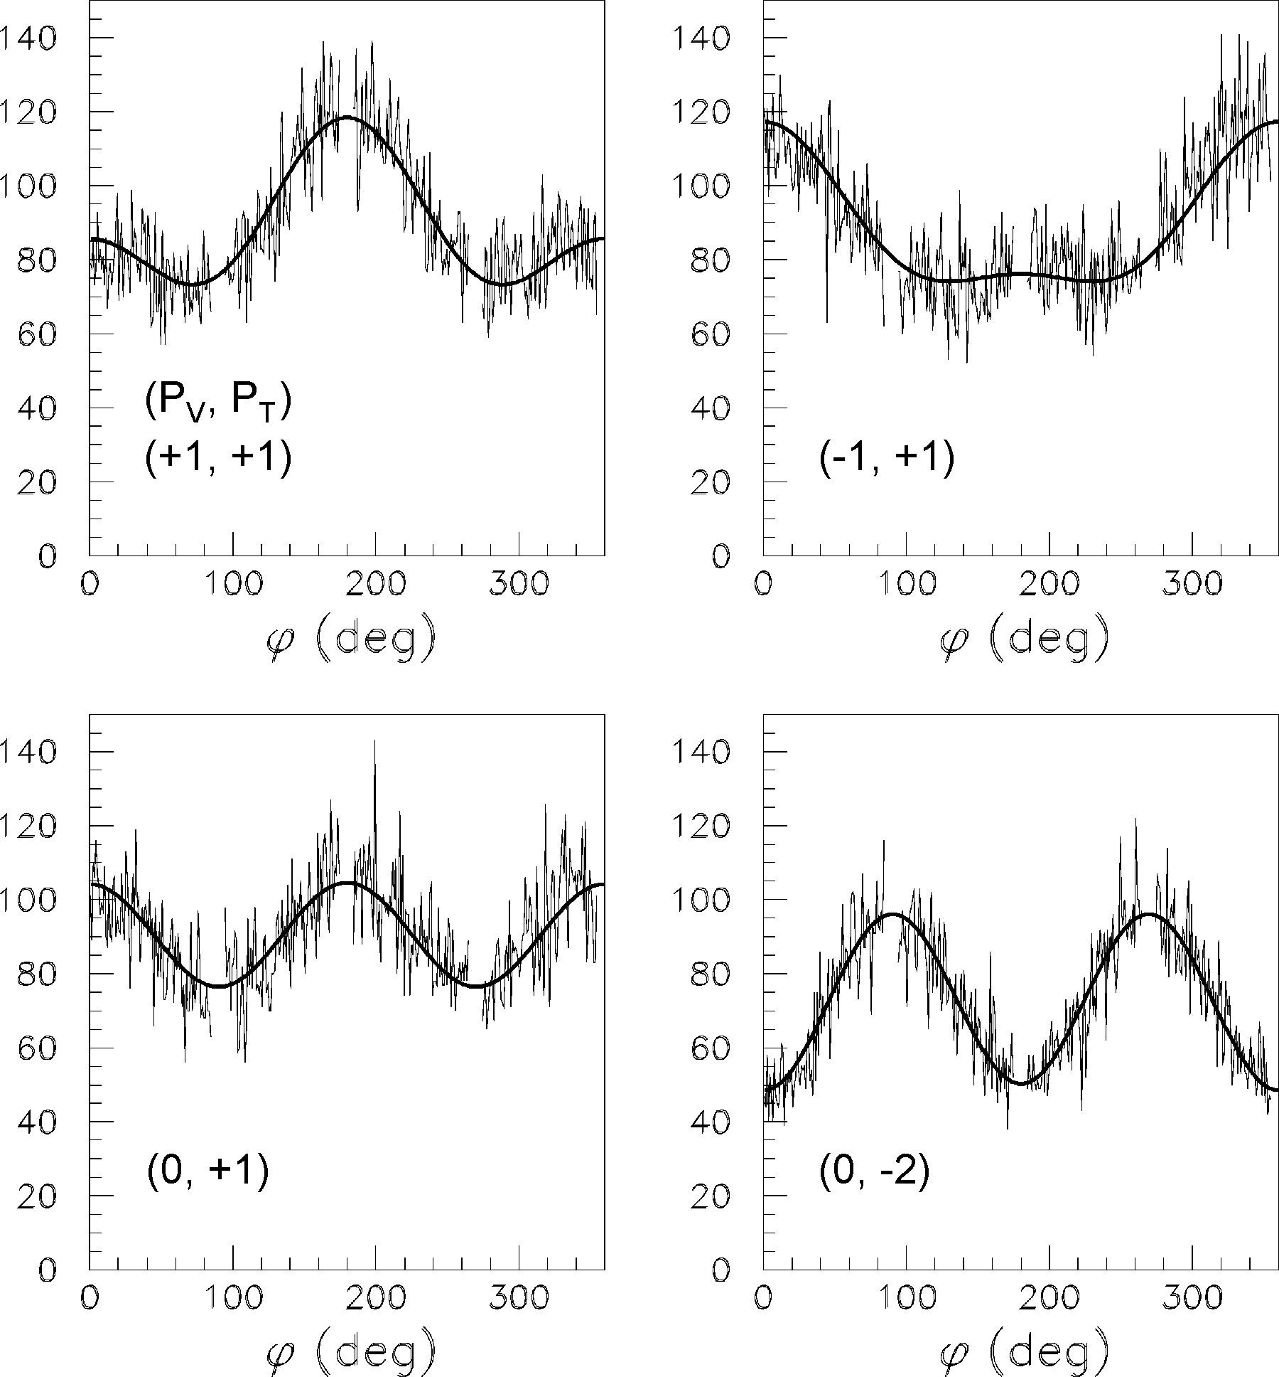

Polarimetry
Differential spin-dependent cross-section (using lab-frame polarizations)
$$\frac{dσ}{dΩ}=\frac{dσ_{0}}{dΩ}\left[1+\frac{3}{2}A_{y}P_{V}\cos{φ}−\frac{1}{4}A_{zz}P_{T}−\frac{1}{4}\left(A_{xx}−A_{yy}\right)P_{T}\cos\left(2φ\right)\right]$$
$pp$, $pC$ for protons
$dp$, $dC$ for deuterons
Polarizations extracted
using azimuthal count
rate dependence and
effective analyzing
powers $A_{y}$, $(A_{xx}−A_{yy})$.
For fast measurement,
one can calibrate
$P_{V}$ in terms of “left-right”
scattering asymmetry and
$P_{T}$ in terms of “left-right-
top-bottom” asymmetries

Slide 14
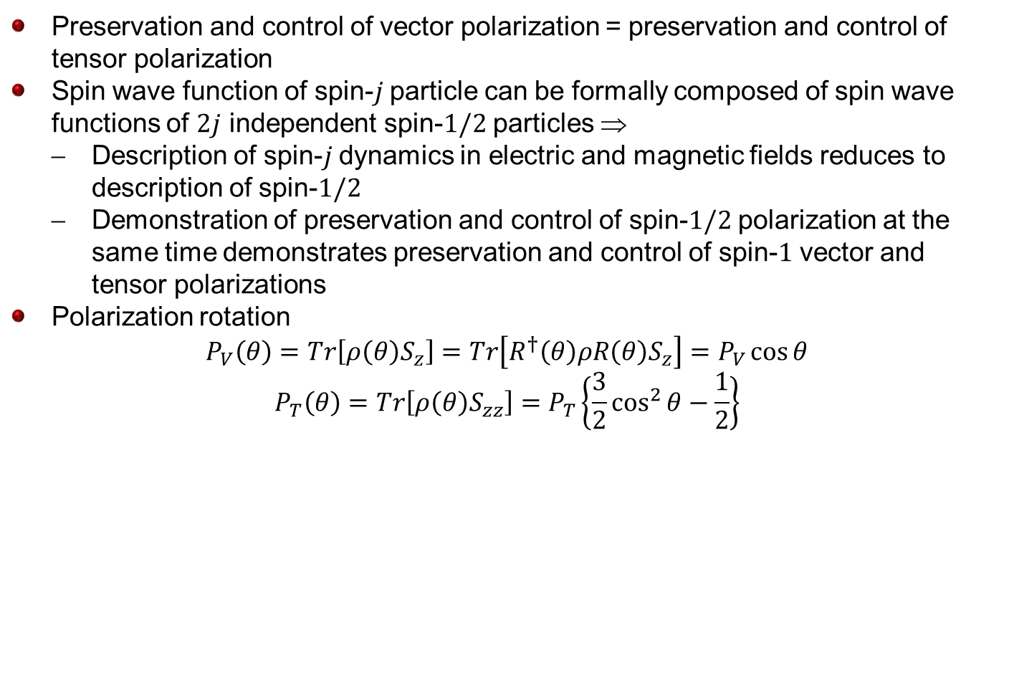
Tensor Polarization Dynamics
Preservation and control of vector polarization = preservation and control of tensor polarization
Spin wave function of spin-$j$ particle can be formally composed of spin wave functions of $2j$ independent spin-$1/2$ particles $$
  Description of spin-$j$ dynamics in electric and magnetic fields reduces to description of spin-$1/2$
  Demonstration of preservation and control of spin-$1/2$ polarization at the same time demonstrates preservation and control of spin-$1$ vector and tensor polarizations
Polarization rotation
$$P_{V}\left(θ\right)=Tr\left[ρ\left(θ\right)S_{z}\right]=Tr\left[R^{†}\left(θ\right)ρR\left(θ\right)S_{z}\right]=P_{V}\cos{θ}$$
$$P_{T}\left(θ\right)=Tr\left[ρ\left(θ\right)S_{zz}\right]=P_{T}\left\{\frac{3}{2}\cos^{2}{θ}−\frac{1}{2}\right\}$$

Slide 15

Experimental Demonstration
Sweeping an rf magnet’s frequency through a spin resonance can rotate the polarization
Spin rotation and
Froissart-Stora formula
$$\frac{P_{V}}{P_{V}^{i}}=\cos{θ}=2\exp\left(−\frac{{\left(πwf_{c}\right)}^{2}}{Δf/Δt}\right)−1$$
$$\frac{P_{T}}{P_{T}^{i}}=\frac{3}{2}\cos^{2}{θ}−\frac{1}{2}=\frac{3}{2}{\left(\frac{P_{V}}{P_{V}^{i}}\right)}^{2}−\frac{1}{2}$$
$$=\frac{3}{2}{\left[2\exp\left(−\frac{{\left(πwf_{c}\right)}^{2}}{Δf/Δt}\right)−1\right]}^{2}−\frac{1}{2}$$
Demonstrated experimentally at
COSY

Slide 16
Ion Polarization Requirements
Major JLEIC ion complex components
Polarization design requirements
  High polarization (~80%) of protons and light ions (d, ³He⁺⁺, and possibly ⁶Li⁺⁺⁺)
  Both longitudinal and transverse polarization orientations available at all IPs
  Sufficiently long polarization lifetime
  Spin flipping
Cooling
Cooling
Ion
source
SRF linac
Booster
285 – 7062 MeV
(accumulator ring)
Ion collider ring
8-100 GeV/c

Slide 17
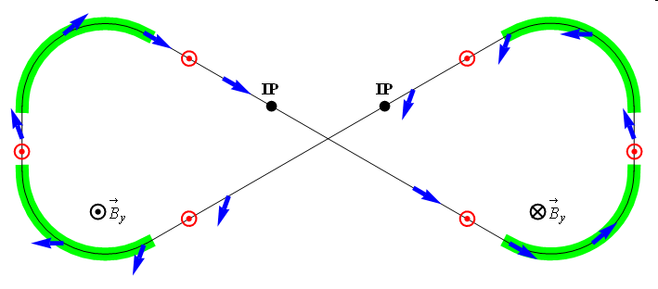
Ion Polarization
Figure-8 concept: Spin precession in one arc is exactly cancelled in the other
Spin stabilization by small fields: ~3 Tm vs. < 400 Tm for deuterons at 100 GeV
  Criterion: induced spin rotation >> spin rotation due to orbit errors
3D spin rotator: combination of small rotations about different axes provides
any polarization orientation at any point in the collider ring
No effect on the orbit
Polarized deuterons
Frequent adiabatic spin flips
ν = 0

Slide 18
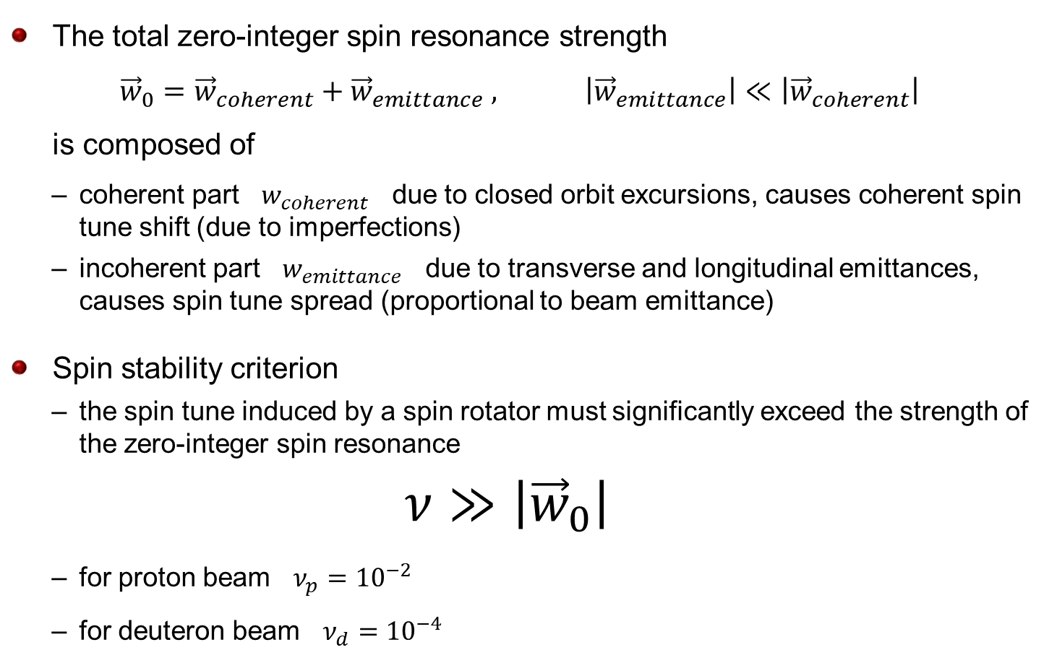
Zero-Integer Spin Resonance & Spin Stability Criterion
The total zero-integer spin resonance strength
${\vec{w}}_{0}={\vec{w}}_{coherent}+{\vec{w}}_{emittance} , \left|{\vec{w}}_{emittance}\right|≪\left|{\vec{w}}_{coherent}\right|$
is composed of
  coherent part $w_{coherent}$ due to closed orbit excursions, causes coherent spin tune shift (due to imperfections)
  incoherent part $w_{emittance}$ due to transverse and longitudinal emittances, causes spin tune spread (proportional to beam emittance)
Spin stability criterion
  the spin tune induced by a spin rotator must significantly exceed the strength of the zero-integer spin resonance
  $$ν≫\left|{\vec{w}}_{0}\right|$$
  for proton beam $ν_{p}={10}^{−2}$
  for deuteron beam $ν_{d}={10}^{−4}$

Slide 19
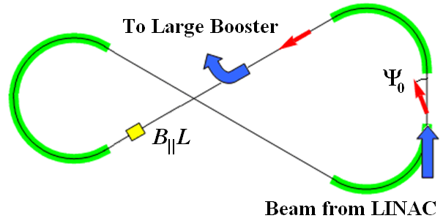
Pre-Acceleration & Spin Matching
Polarization in Booster stabilized and preserved by a single weak solenoid
  0.6 T⋅m at 8 GeV/c
  ν_{d} / ν_{p} = 0.003 / 0.01
Longitudinal polarization in the straight with the solenoid
Conventional 8 GeV accelerators require B||L of ~30 Tm for protons and ~100 Tm for deuterons
B_{II}L
Booster
beam from Linac
to Collider Ring

Slide 20
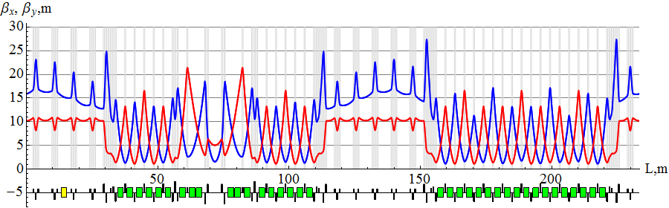
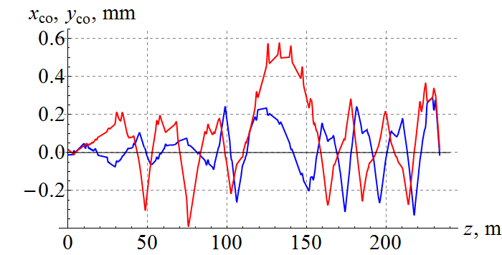
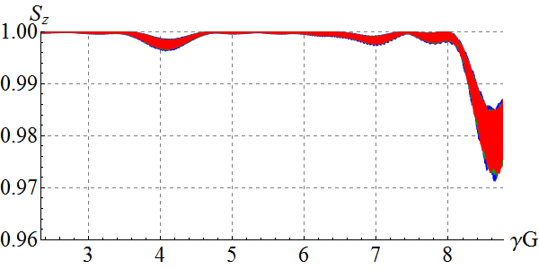
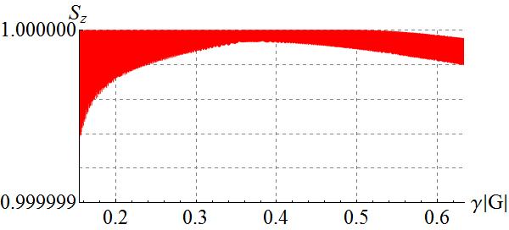
Spin Dynamics in Booster
Acceleration in figure-8 booster with transverse quadrupole misalignments
0.1 Tm (maximum) spin stabilizing solenoid
Spin tracking simulation using Zgoubi (developed by F. Meot, BNL)
protons
x₀ = y₀ = 1 cm
Δp/p =0
deuterons
x₀ = y₀ = 1 cm
Δp/p = 0

Slide 21
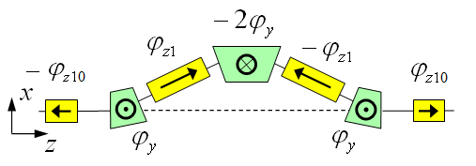
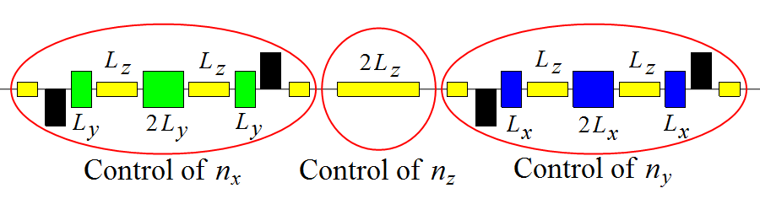
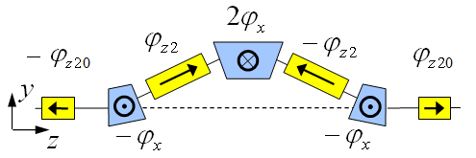
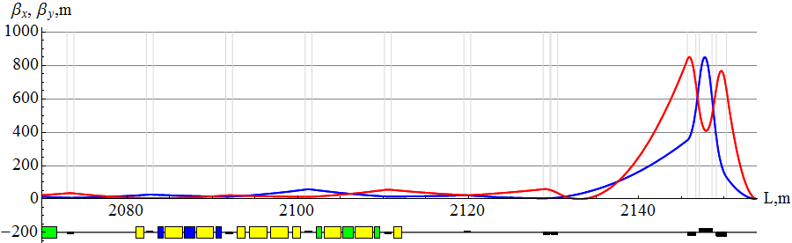

Polarization Control in Ion Collider Ring
3D spin rotator: control of the radial, vertical, and longitudinal spin components
Module for control of the radial component (fixed radial orbit bump)
Module for control of the vertical
component (fixed vertical orbit bump)
Module for control of the longitudinal
component
3D spin rotator
IP
ions

Slide 22
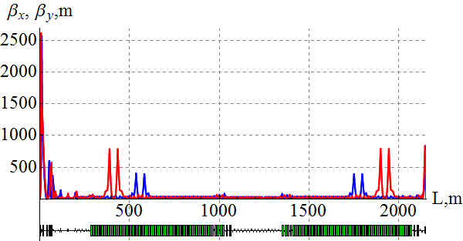
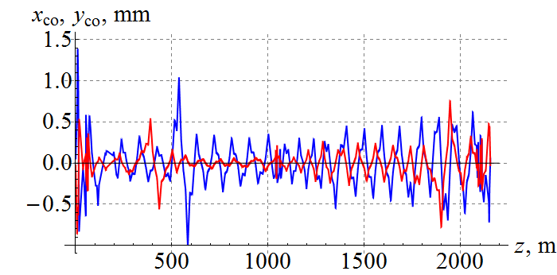
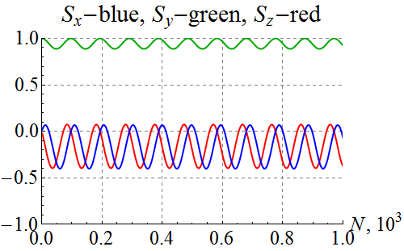
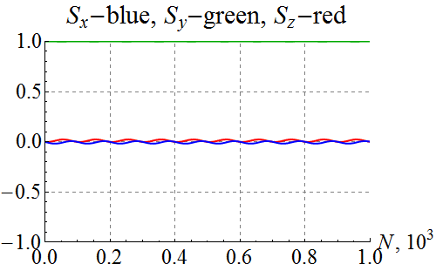
Spin Dynamics in Ion Collider Ring
100 GeV/c figure-8 ion collider ring with transverse quadrupole misalignments
Example of vertical proton polarization at IP. The 1st 3D rotator: ν = 10⁻² , n_{y}=1. The 2nd 3D rotator is used for compensation of coherent part of the zero-integer spin resonance strength
1st 3D rotator
for control
2nd 3D rotator
for compensation
Zgoubi
without compensation
with compensation

Slide 23
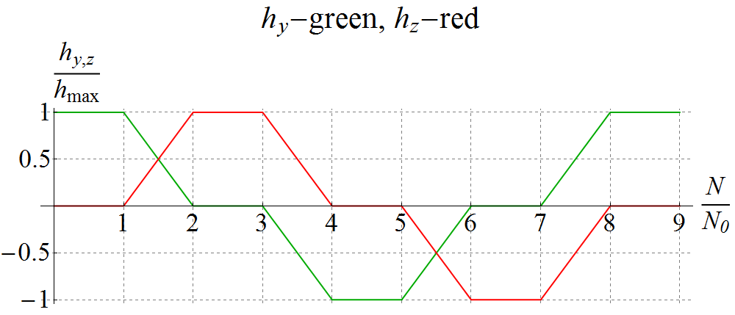
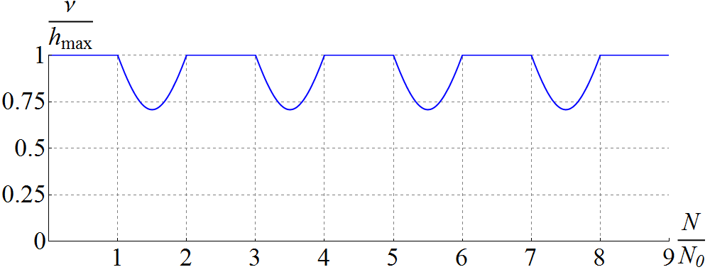
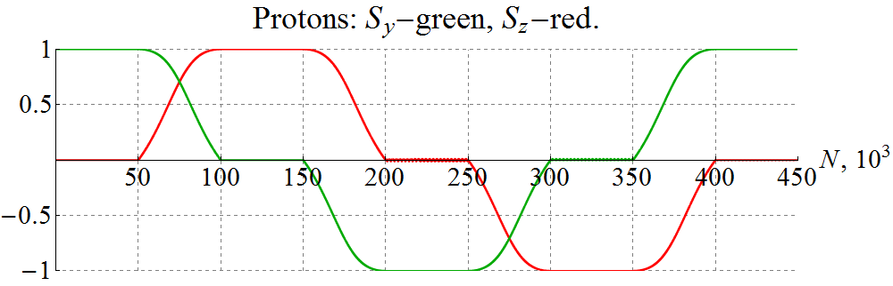
Spin Flipping
Adiabaticity criterion: spin reversal time must be much longer than spin precession period
⇒ τ_{flip} >> 1 ms for protons and 0.1 s for deuterons
Vertical (h_{y}) & longitudinal (h_{z}) spin field components as set by the spin rotator vs time ⇒ Spin tune vs time (changes due to piece-wise linear shape)
Vertical & longitudinal components of proton polarization vs time at 100 GeV/c
$$\vec{P}:↑ → ↓ ← ↑$$

Slide 24
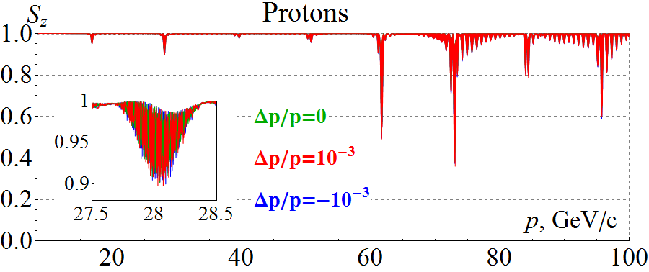
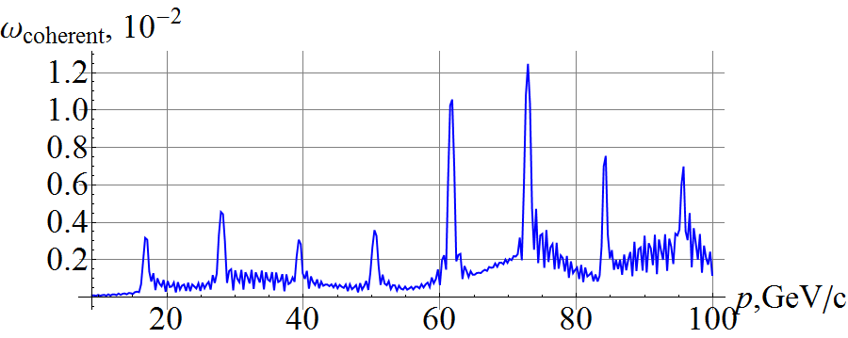
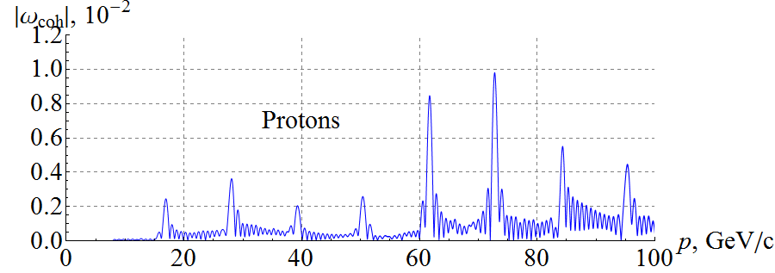
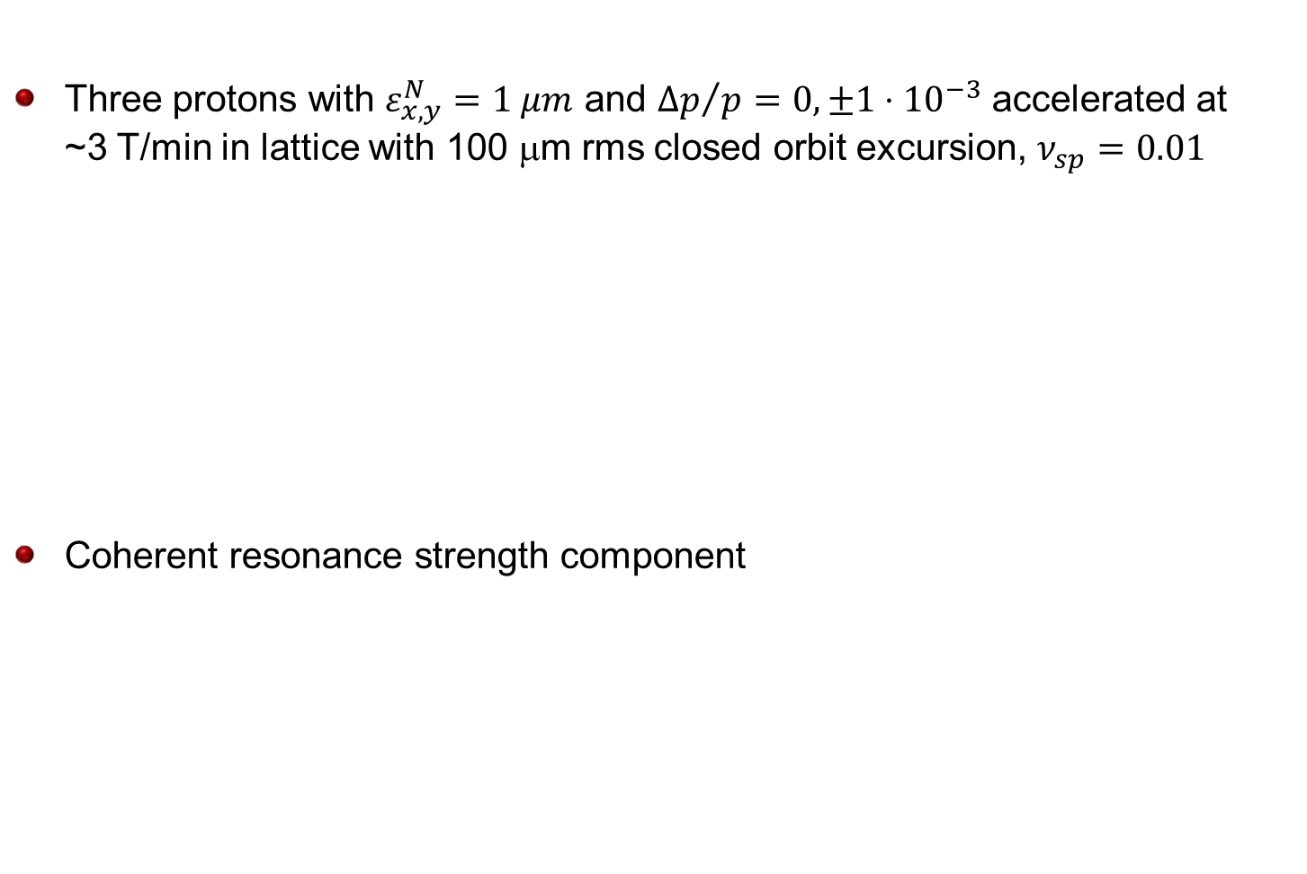
Start-to-End Proton Acceleration
Three protons with $ε_{x,y}^{N}=1 μm$ and ${Δp}/p=0, ±1⋅{10}^{−3}$ accelerated at
~3 T/min in lattice with 100 μm rms closed orbit excursion, $ν_{sp}=0.01$
Coherent resonance strength component
Analytic prediction
Zgoubi simulation

Slide 25
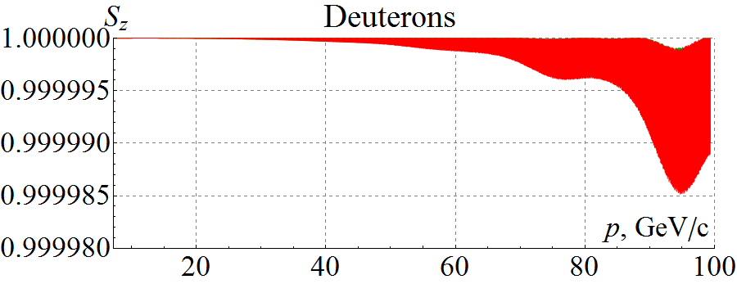
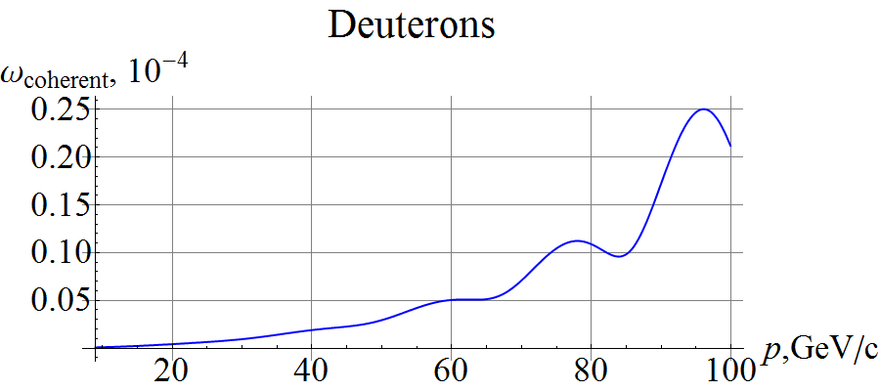
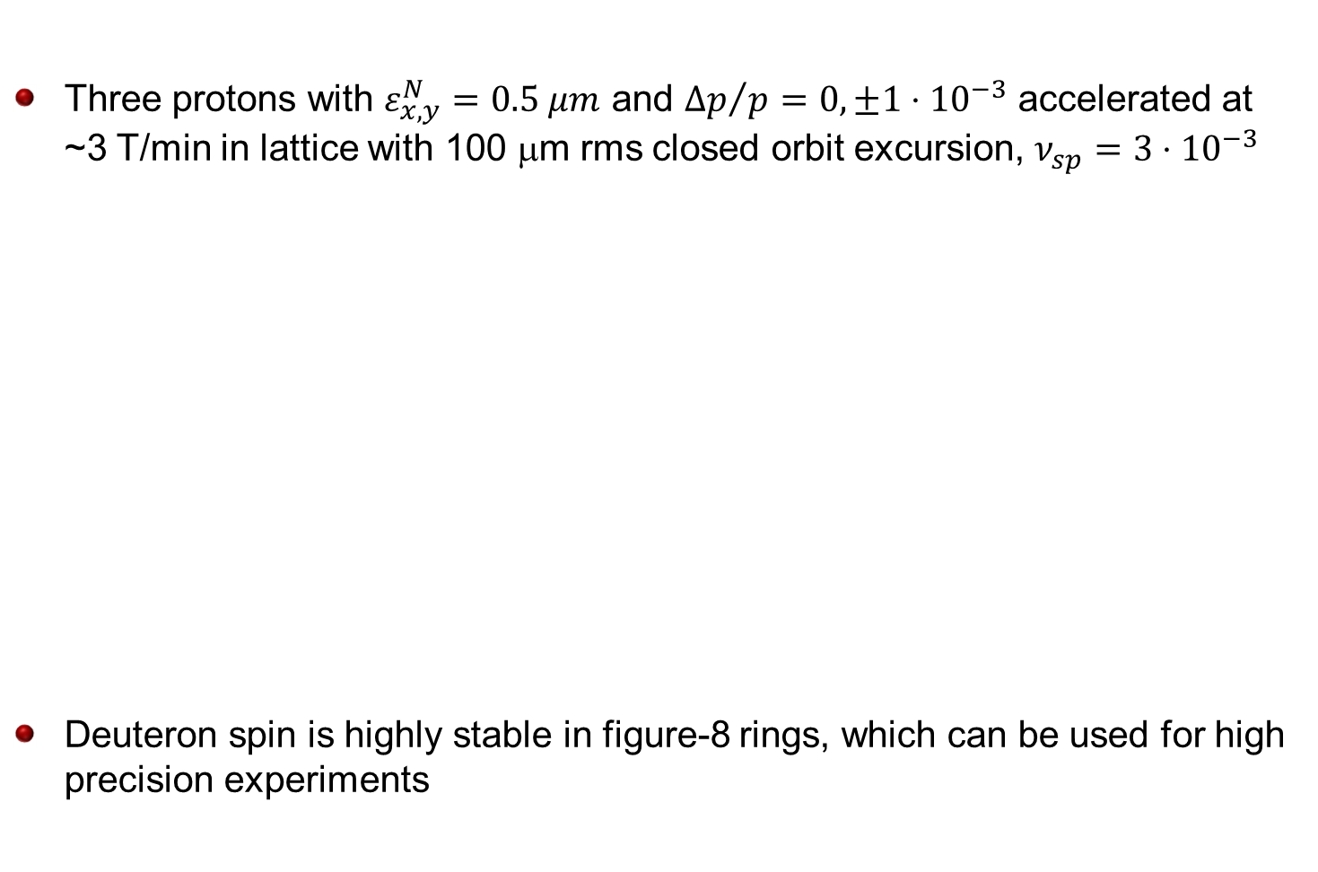
Start-to-End Deuteron Acceleration
Three protons with $ε_{x,y}^{N}=0.5 μm$ and ${Δp}/p=0, ±1⋅{10}^{−3}$ accelerated at
~3 T/min in lattice with 100 μm rms closed orbit excursion, $ν_{sp}=3⋅{10}^{−3}$
Deuteron spin is highly stable in figure-8 rings, which can be used for high precision experiments
Analytic prediction

Slide 26
Ion Polarimeter Location
Ion polarization in the straight section upstream of the IP is the same at the IP,
however:
  Polarimeter target would generate detector background
  Polarimeter only measures transverse polarization, placing polarimeter upstream does not help with measurement of the longitudinal polarization
Polarization is rotated at any other potential polarimeter location
Determining polarization at IP becomes a question of knowing
  Polarization rotation angle from IP to polarimeter
  Polarization orientation at the polarimeter
  Calibration of the spin rotator
ion polarimeter
80 m
IP
e
Compton polarimetry
forward ion detection
ions
forward e detection
spectrometers
dispersion suppressor/
geometric match

Slide 27
Polarimetry with Short Bunch Spacing
It is difficult to resolve individual bunches in a polarimeter with JLEIC’s short bunch spacing
It may be possible to measure polarizations of individual bunch trains
  There are 26 trains of 128 bunches each
  Individual bunches within each train have identical polarizations because of the way they are formed
  Polarimeter data may be gated during transitions between trains
JLEIC bunch formation
  26 bunches are injected into the ion collider ring
  Beam is accelerated to collision energy
  Each bunch is split in half 7 times, i.e. into 128 smaller bunches
2. Accumulating coasting beam
4. Accelerate and cool
Step 6/7. Bucket-to-bucket transfer to the collider ring and BB cooling, repeat 26 times (Nh=28)
DC cooler
DC cooler
BB cooler
3. Capture to bucket
5. Bunch compression to ~56m
2x80m gaps

Slide 28
Summary and Future Work
It has been experimentally demonstrated that ion sources can provide vector and tensor polarizations of about 80% and potentially even higher
Figure-8 ring configuration should provide complete preservation and efficient control of the polarization; this has been verified by start-to-end simulations of polarized ion beam acceleration in JLEIC ion rings
Ion polarization control system has been developed and verified by simulations for the JLEIC ion collider ring; any polarization orientation can be adjusted at the IP
Adiabatic spin-flip has been demonstrated in simulations
Polarimetry concepts have been developed
Effects of detector solenoid, betatron coupling, and nonlinearities have been studied and understood
Ongoing and future studies
  Effects of crab crossing, beam-beam interaction, and electron cooling
  Benchmarking simulations against available data

Slide 29
Backup

Slide 30
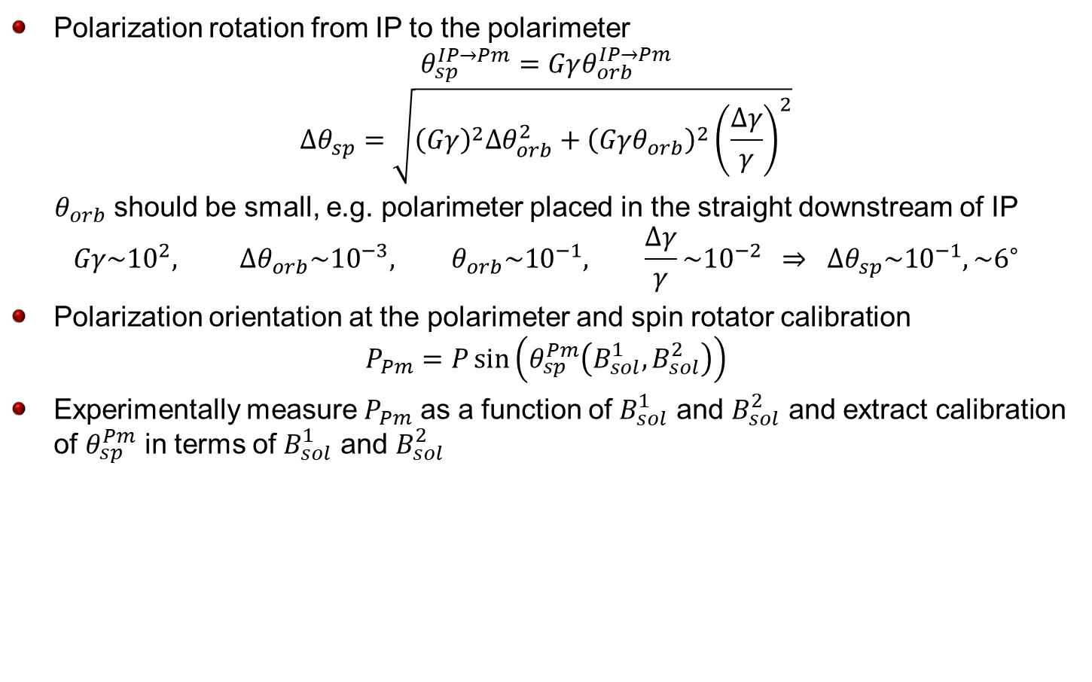
Extracting Polarization at IP
Polarization rotation from IP to the polarimeter
$$θ_{sp}^{IP→Pm}=Gγθ_{orb}^{IP→Pm}$$
$$Δθ_{sp}=\sqrt{{\left(Gγ\right)}^{2}Δθ_{orb}^{2}+{\left(Gγθ_{orb}\right)}^{2}{\left(\frac{Δγ}{γ}\right)}^{2}}$$
$θ_{orb}$ should be small, e.g. polarimeter placed in the straight downstream of IP
$$Gγ\sim {10}^{2}, Δθ_{orb}\sim {10}^{−3}, θ_{orb}\sim {10}^{−1}, \frac{Δγ}{γ}\sim {10}^{−2} ⇒ Δθ_{sp}\sim {10}^{−1}, \sim 6^{∘}$$
Polarization orientation at the polarimeter and spin rotator calibration
$$P_{Pm}=P\sin\left(θ_{sp}^{Pm}\left(B_{sol}^{1}, B_{sol}^{2}\right)\right)$$
Experimentally measure $P_{Pm}$ as a function of $B_{sol}^{1}$ and $B_{sol}^{2}$ and extract calibration of $θ_{sp}^{Pm}$ in terms of $B_{sol}^{1}$ and $B_{sol}^{2}$

