Slide 1


Neutron Structure Status and Challenges
Rolf Ent
Jefferson Lab
Polarized Light Ion Physics with EIC,
Ghent University, Belgium, February 5-9, 2018

Slide 2
Outline
Why Neutron Structure?
Challenges to Access Neutron Structure
Polarized Deuteron and Polarized 3He Beams
EIC Science with Unpolarized & Polarized Deuteron Beams
EIC Science with Light Ion Beams
Summary

Slide 3
Why Neutron (or Light Ion) Structure?
One view: 1) Measure proton structure in detail
  2) Use light nuclei to extract neutron info where required for flavor decomposition
  → Reality: measurement of neutron structure is essential to understand non-perturbative structure in nucleon
One view: 1) Nucleus is a bunch of protons and neutrons
2) Nucleus is an amplifier towards saturation
→ Reality: measurement of range of nuclei from light to heavy and polarization effects is essential to understand how quarks and gluons lead to a plethora of nuclei and rich arena of nuclear effects

Slide 4
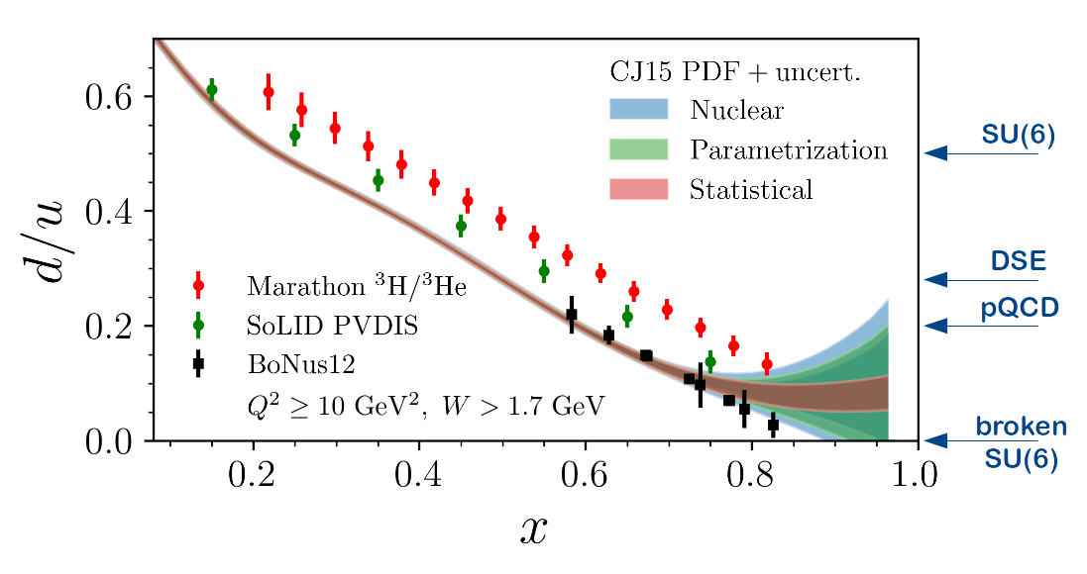
Why Neutron (or Light Ion) Structure?
  Reality: measurement of neutron structure is essential to understand non-perturbative structure in nucleon
  Effects for down quarks can be quite different from up!
Known example: down quark versus up quark parton distributions at large-x impacted by symmetry mechanisms at work to create diquarks (or not)

Slide 5
Why Neutron (or Light Ion) Structure?
  Reality: measurement of neutron structure is essential to understand non-perturbative structure in nucleon
  Effects for down quarks can be quite different from up!
Second example: down quark versus up quark spatial distributions impacted by symmetry mechanisms at work to create diquarks (or not)?
Much different!

Slide 6
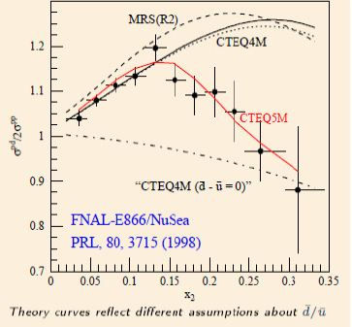
Why Neutron (or Light Ion) Structure?
  Reality: measurement of neutron structure is essential to understand non-perturbative structure in nucleon
  Effects for down quarks can be quite different from up!
Third example: nonperturbative structure (meson cloud) remains perturbative energy scales affecting anti-down and anti-up parton distributions
Quantum fluctuations play a role in nucleon structure:
d(x) ≠ u(x)
-
-
Need (clean) neutron structure in detail, as much as proton structure, to disentangle the important nonperturbative structures.

Slide 7
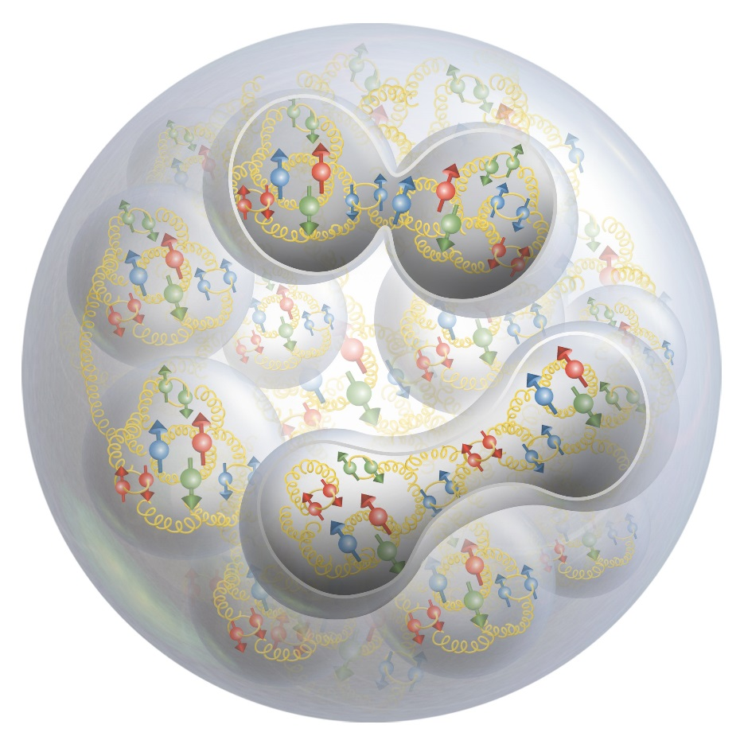
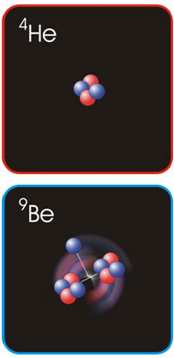
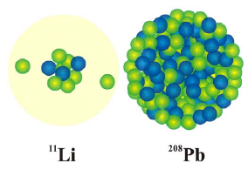
Why Neutron (or Light Ion) Structure?
→ Reality: measurement of range of nuclei from light to heavy and polarization effects is essential to understand how quarks and gluons lead to a plethora of nuclei and rich arena of nuclear effects
⁹Be ~
ααn
Can we understand:
The clustering in nuclei?
The binding of nuclei?
Nuclear binding vs anti-shadowing?
SRC vs EMC Effect?
Exotic gluon effects in nuclear structure?

Slide 8
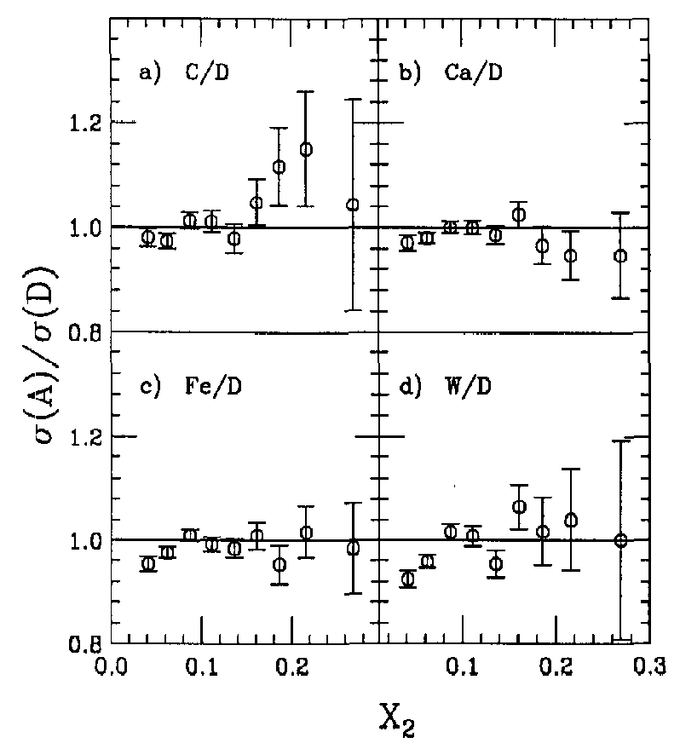
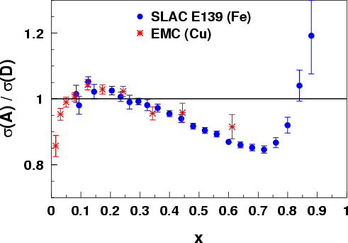
Why Neutron (or Light Ion) Structure?
→ Reality: measurement of range of nuclei from light to heavy and polarization effects is essential to understand how quarks and gluons lead to a plethora of nuclei and rich arena of nuclear effects
Many original ideas failed: Nucleus is more than set of bound nucleons, pions correlated with nuclear force do not show clear excess of antiquarks
E772
F₂^{A}/F₂^{D}

Slide 9
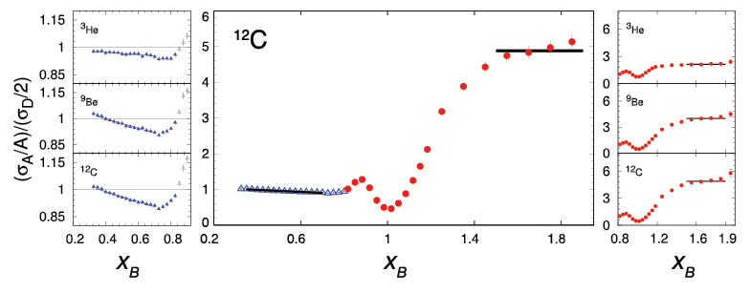
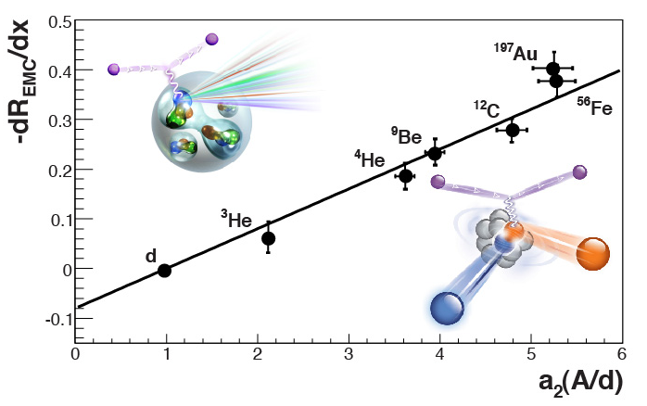
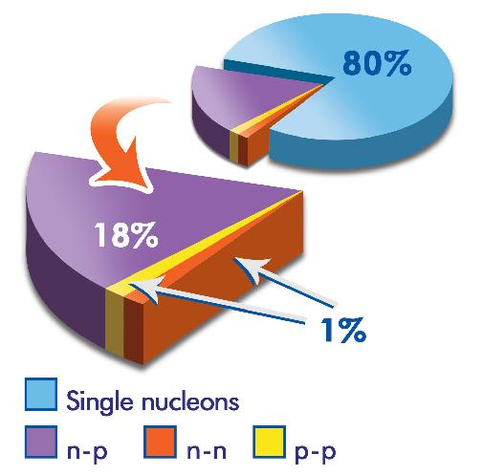
Parton Dynamics and N-N Correlations
EMC effect: quark momentum in nucleus is altered
N-N Correlations: pairing due to tensor force and strong repulsive core
EMC Slopes 0.35 ≤ x_{B} ≤ 0.7
a₂(A/d)
Luminosity, nuclei
N-N correlated pairs x_{B} ≥ 1.4
12 GeV science quest:
isospin dependence: ³H, ³He, ^{6,7}Li, ⁹Be ^{10,11}B, ^{40,48}Ca
initial spin dependence (⁷Li)
“tagged” deep-inelastic scattering off ²H
  with both slow and fast protons
⁹Be ~
ααn

Slide 10
2H vs 3He – Regions of Nuclear Corrections
Understanding of EMC effect in anti-shadowing region: sea quarks? Nuclear binding? Merging of two parton ladders?
Understanding of EMC effect in valence quark region: virtuality? SRC?
Region of large x – very sensitive to nuclear corrections. Large efforts to incorporate such effects by CJ (CTEQ-JLab collaboration)
F₂^{A}/F₂^{D}
Understanding of EMC effect in the shadowing region: LT vs HT?
FGS, Phys. Rep. 512 (2012) 255.
All regions: Impact on nuclear corrections on multi-dimensional measurements

Slide 11
Outline
Why Neutron Structure?
Challenges to Access Neutron Structure
Polarized Deuteron and Polarized 3He Beams
EIC Science with Unpolarized & Polarized Deuteron Beams
EIC Science with Light Ion Beams
Summary

Slide 12
Polarized 3He vs Polarized 2H
Polarized 3He is ideal:
μ_{3He} ~ μ_{n}
and also not…
Spin-dependent spectral function
FSI – Generalized Eikonal seems o.k.
Tagging/extrapolating to free neutrons a challenge
Virtuality/offshell corrections non-trivial
EMC effect less “known”
Polarized 2H is not ideal:
μ_{2H} ~ μ_{n} + μ_{p}
but on the other hand is!
n
p
n
p
S
D
Nuclear structure simplest
FSI – Generalized Eikonal seems o.k.
Tagging/extrapolating fo free neutrons doable
Virtuality/offshell corrections easier
EMC effect “known”

Slide 13
EMC Effect in Deuteron
Measurement of the EMC Effect in the Deuteron
Phys. Rev. C92 (2015) 015211
Likely more difficult to understand in Helium-3

Slide 14
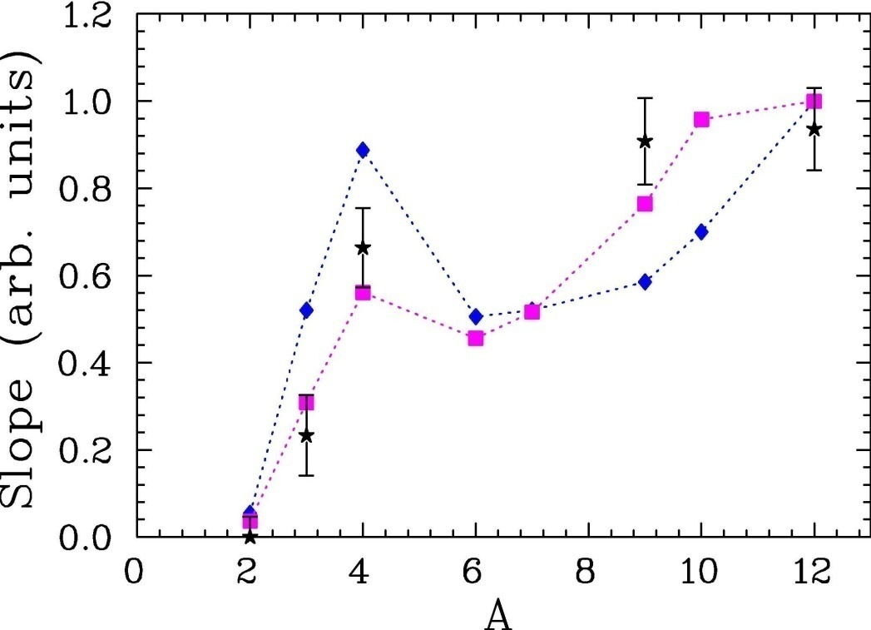
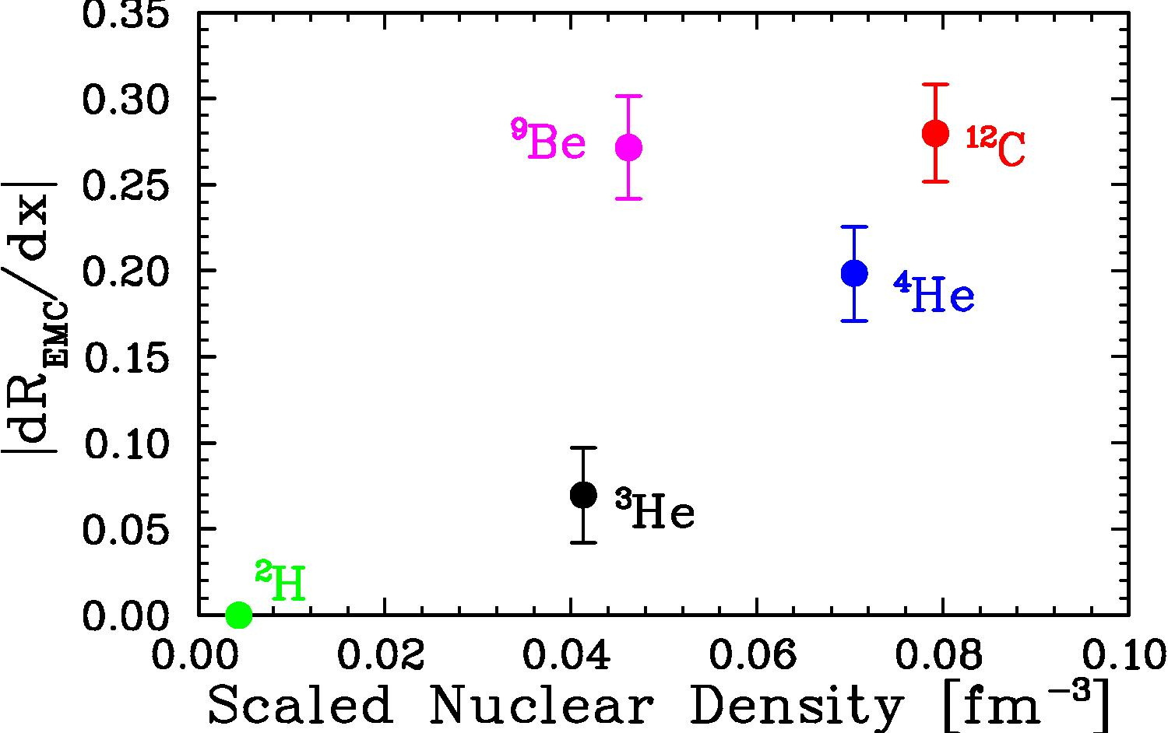
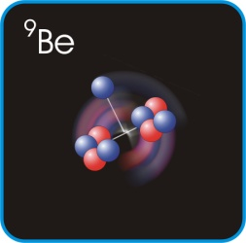
EMC Effect in Helium-3
Understanding of EMC Effect in 3He more complicated than in 2H
EMC ~ density
~ local density
EMC ∼ (A^{α} – 1)

Slide 15
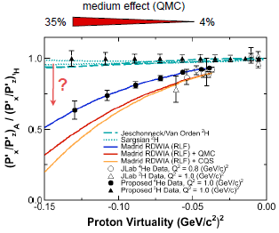
12 GeV ^{1,2}H,⁴He(e,e’p) Experiment
Investigation of the role of medium modifications
Study bound-proton momentum and density dependence of recoil-polarization observables → ⁴He and ²H data over a large range of proton virtuality.
Much cleaner to understand in 2H (plus likely further constraints from 12 GeV)

Slide 16
Outline
Why Neutron Structure?
Challenges to Access Neutron Structure
Polarized Deuteron and Polarized 3He Beams
EIC Science with Unpolarized & Polarized Deuteron Beams
EIC Science with Light Ion Beams
Summary

Slide 17
Polarized 3He Beams
Polarized 3He beams have been done before…
… even with high polarization (up to 95% with Stern-Gerlach!)
But, beam currents were limited.
What seems the obvious solution: use EBIS
(Electron Beam Ion Source injector)

Slide 18
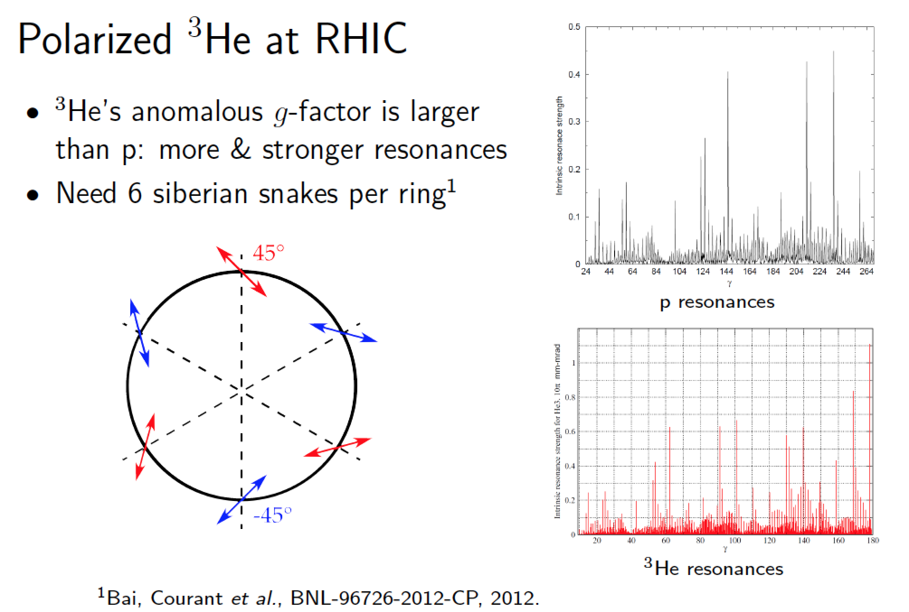
Polarized 3He at RHIC

Slide 19
Polarized 3He Beams

Slide 20
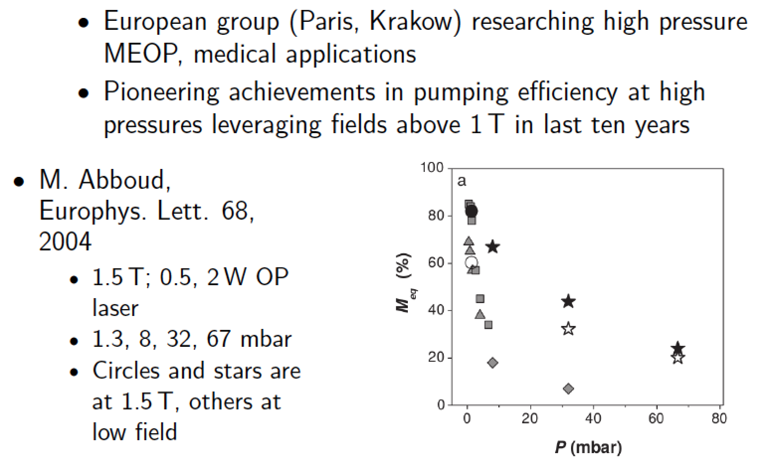
3He Polarization at High Fields Revisited
3He polarized through Metastability-Exchange Optical Pumping

Slide 21
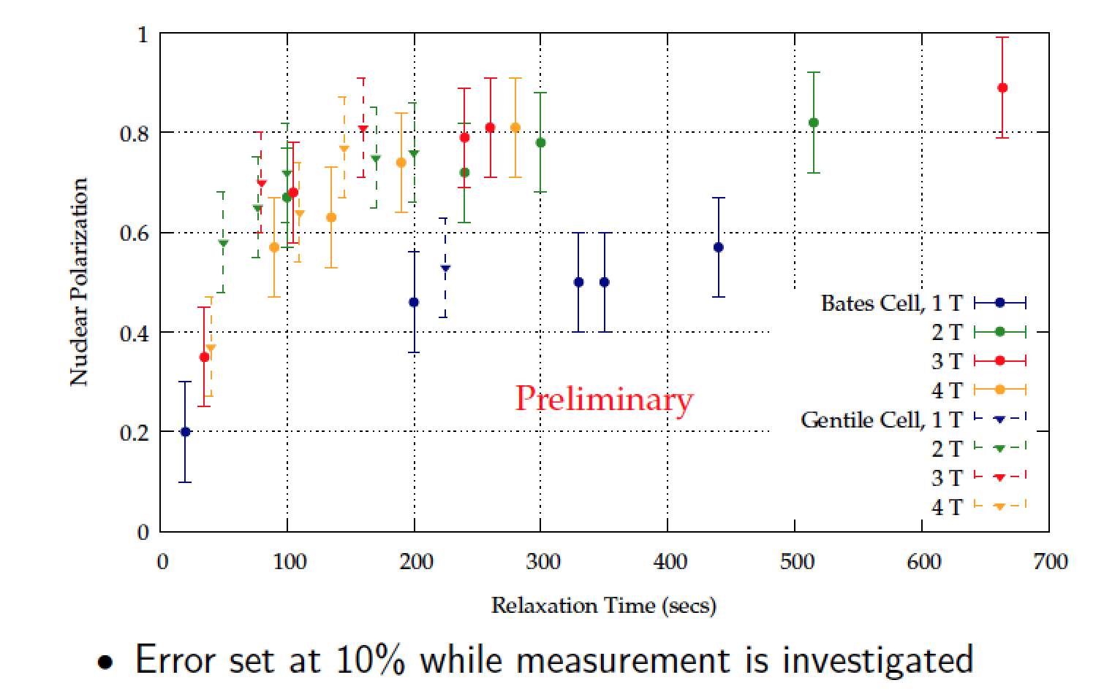
High Field Polarization Results
As part of RHIC and EIC related accelerator R&D at MIT & BNL

Slide 22
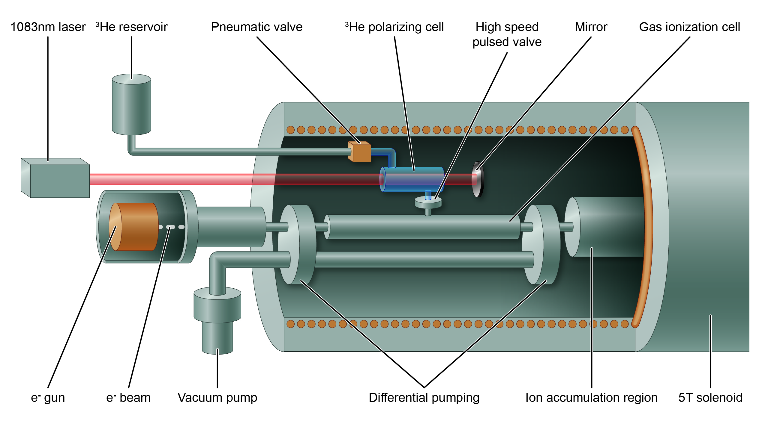
On Track for Polarized 3He run in RHIC ~2020
EBIS Upgrade with New Injector Solenoid for Polarized ³He⁺⁺ ion production

Slide 23
Polarized 2H Beams
Polarized 2H beams have been done before at IUCF and COSY*…
… even with high polarization and with good (RF) spin-flip efficiency (~98%)
But, one needs to overcome depolarizing spin resonances above ~10 GeV beam energies, as the deuteron is so sensitive to them due to its small (g-2) value. It is the higher-order resonances that ruin polarization and polarization lifetime in a racetrack.
What seems the obvious solution: use a figure-8 ring
* SPIN@COSY: Spin-manipulating polarized deuterons and protons
M.A. Leonova, A.W. Chao, A.D. Krisch, V.S. Morozov, R.S. Raymond, D.W. Sivers, V.K. Wong (Michigan U.) , A. Garishvili, R. Gebel, A. Lehrach (Julich, Forschungszentrum) et al.
AIP Conf.Proc. 1149 (2009) 168-173
* Spin-Manipulating Polarized Deuterons
E.J. Stephenson (Indiana U., IUCF) , A. Chao (SLAC & Michigan U.) , A.M. Kondratenko (Novosibirsk, GOO Zaryad) , V.S. Morozov (Jefferson Lab) , F. Hinterberger (Bonn U., HISKP) , A.D. Krisch, M.A. Leonova, R.S. Raymond, D.W. Sivers, V.K. Wong (Michigan U.)
Conf.Proc. C110328 (2011) 747-751

Slide 24
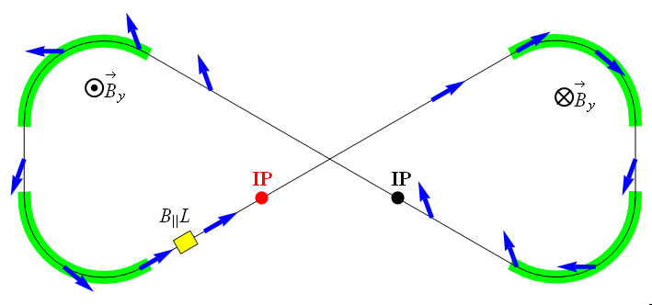
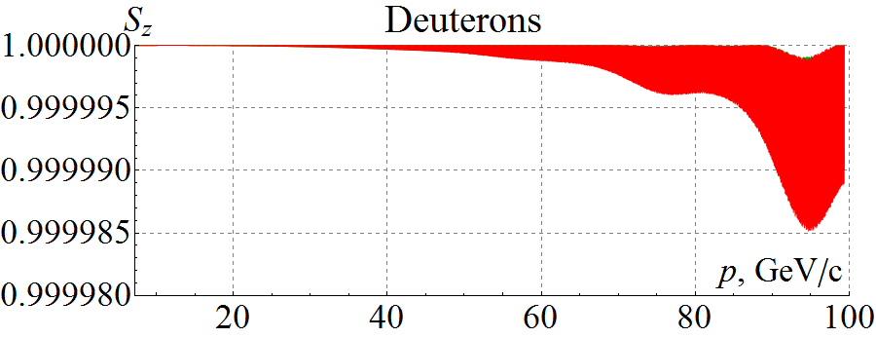
Polarized 2H Beams
Properties of a figure-8 structure
  Spin precessions in the two arcs are exactly cancelled
  In an ideal structure (without perturbations) all solutions are periodic
  The spin tune is zero independent of energy
A figure-8 ring provides unique capabilities for polarization control
  Local spin rotator determines spin tune and local spin direction
  B||L of only 3 Tm provides deuteron polarization stability up to 100 GeV
  A conventional ring at 100 GeV would require B||L of 1200 Tm or B⊥L of 400 Tm
Phys.Part.Nucl. 45 (2014) 323-324
Recent progress:
  Start-to-end deuteron acceleration (folding in analytic-calculated spin tune requirement and orbit excursion due to magnet misalignments)
  Deuteron spin is highly stable in figure-8 rings
J.Phys.Conf.Ser. 874 (2017) no.1, 012011

Slide 25
Tensor-Polarized 2H Beams
Measured tensor polarizations at 270 MeV at IUCF are plotted against the rf solenoid’s fixed frequency.
V.S. Morozov et al.,
Phys. Rev. Lett. 91, 214801 (2003)
>80% tensor polarization is achievable (+0.8, -1.6)
Multiple spin flips were performed to determine the spin-flip efficiency of the deuteron (vector and) tensor polarization: a measured spin-flip efficiency of 98.5 ± 0.3% was reached for two separate runs with 1.85 GeV/c vertically-polarized spin-1 deuterons stored in the COSY ring.
V.S. Morozov et al.,
Phys. Rev. Special Topics, Accelerator and Beams 8, 061001 (2005)

Slide 26
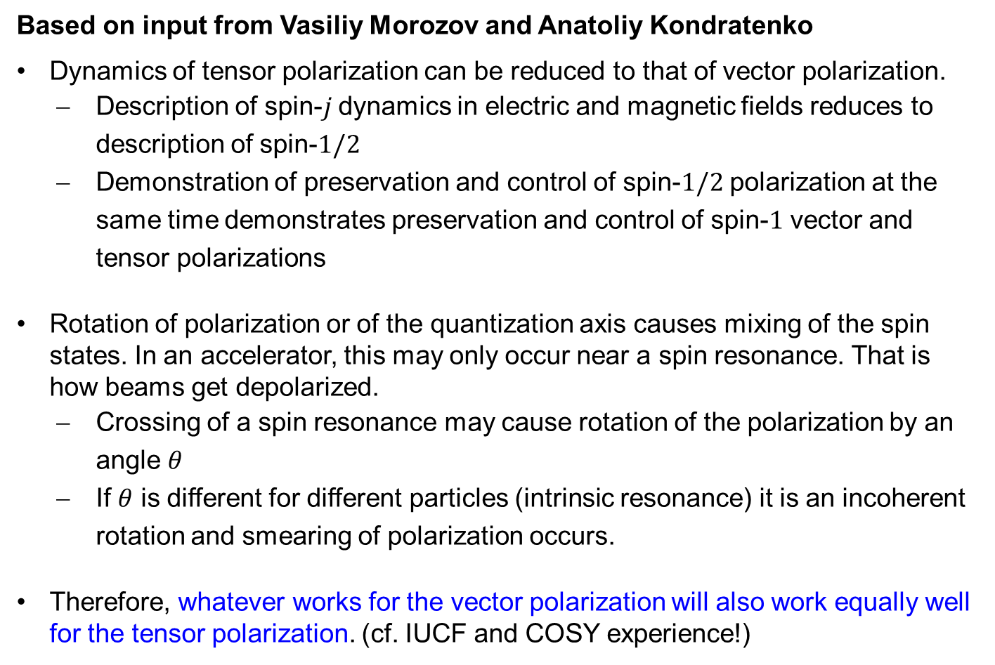
Maintaining Tensor Polarization
Based on input from Vasiliy Morozov and Anatoliy Kondratenko
Dynamics of tensor polarization can be reduced to that of vector polarization.
  Description of spin-$j$ dynamics in electric and magnetic fields reduces to description of spin-$1/2$
  Demonstration of preservation and control of spin-$1/2$ polarization at the same time demonstrates preservation and control of spin-$1$ vector and tensor polarizations
Rotation of polarization or of the quantization axis causes mixing of the spin states. In an accelerator, this may only occur near a spin resonance. That is how beams get depolarized.
  Crossing of a spin resonance may cause rotation of the polarization by an angle $θ$
  If $θ$ is different for different particles (intrinsic resonance) it is an incoherent rotation and smearing of polarization occurs.
Therefore, whatever works for the vector polarization will also work equally well for the tensor polarization. (cf. IUCF and COSY experience!)

Slide 27
Outline
Why Neutron Structure?
Challenges to Access Neutron Structure
Polarized Deuteron and Polarized 3He Beams
EIC Science with Unpolarized & Polarized Deuteron Beams
EIC Science with Light Ion Beams
Summary

Slide 28
EIC Science with Unpolarized & Polarized Deuteron Beams
Need to obtain a consistent high-precision data set, allowing for multi-dimensional mapping, of BOTH proton and neutron.
Consistent = similar bins
similar systematics
Given that one gets the “cleanest” neutron structure information from tagging with spectator protons, this may very well imply longer run times for e-d than for e-p…

Slide 29
(Tagged) Neutron Structure Extrapolation in t
Much more difficult for 3He beams! (need to tag with pair of protons)
t resolution better than 20 MeV, < fermi momentum
Resolution limited/given by ion momentum spread
Allow precision extraction of F₂^{n} neutron structure function
C. Weiss et al, see https://www.jlab.org/theory/tag/

Slide 30
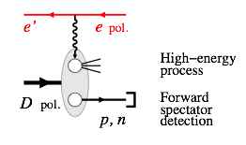
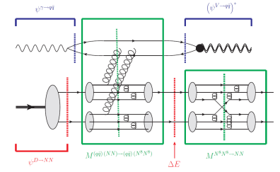
Tagging → study of nuclear binding
Another area of interest: Measurement of the kinematics of the spectator nucleon indicator of the strength and (hence) the nature of its binding with the in-play nucleon(s):
→ quark-gluon origin of the nuclear binding
(also for other light nuclei: ^{3,4}He, ^{6,7}Li, ⁹Be, ^{10,11}B, ¹²C)
C. Weiss et al, see https://www.jlab.org/theory/tag/
Feb. 5-9, Workshop at Ghent University
Alternatively, also with e-d:
e + D → e’ + p + n + J/Ψ
Exclusive measurements of tagged (polarized) protons and neutrons in coincidence with vector mesons probe the short-range quark-gluon nature of nuclear forces
Miller, Sievert and Venugopalan, Phys. Rev. C 93 (2016) 045202
Notes:
30

Slide 31
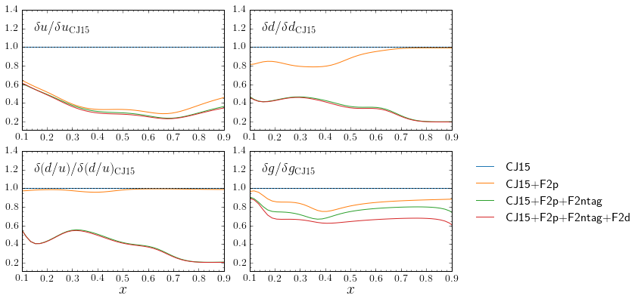
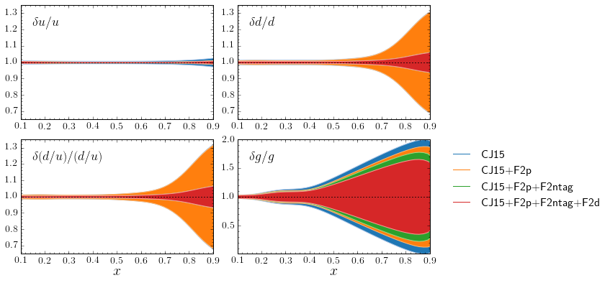
EIC e-d (with n_{tag}) projection with 100/fb luminosity
d quark precision will become comparable to current u!!
(becomes ~5% at x = 0.9)
similar improvement in g(x)
The u quark uncertainty becomes less than ~1%; may be important for large mass BSM new particles.
With d quark nailed by F₂^{n}, fitting F₂^{d} data will explore details of nuclear effects
31

Slide 32
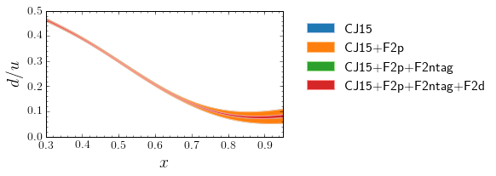
Improved d(x) precision is good news
The d-quark goes from a few 10% to ~few% percent level
Resolve long-standing mystery of d/u at large x, bell-weather for fundamental models of nucleon structure
D/(p+n) in one experiment for the first time – unprecedented handle on nuclear medium modifications
Facilitate accurate neutron excess/isoscalar corrections
  Important also for neutrino physics and nuclear PDFs
32

Slide 33
Determining large-x Parton Distributions with EIC
Procedure: use projected EIC data in CTEQ-Jefferson Lab “CJ” PDF Fits
So far, have used JLEIC 10x100 GeV² projections in bins 0.1 < x < 0.9 for:
F₂^{p}
F₂^{n} from deuterium with tagged proton spectator
F₂^{d}
Measurements ranging to high (up to a few 1000 GeV2) will enable studies of target mass, higher twist, perturbative/nonperturbative studies)
Can check on-shell extrapolation by measuring F₂^{p} from deuterium with tagged neutron spectator, comparing to proton target data
Can check nuclear corrections to F₂^{d} against F₂^{n (tagged)}
A. Accardi (Hampton),
R. Ent, J. Furletova,
C. Keppel, K. Park,
R. Yoshida (JLab),
M. Wing (UC London)

Slide 34
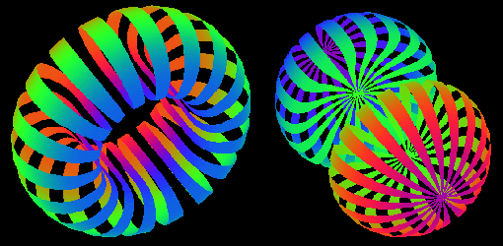
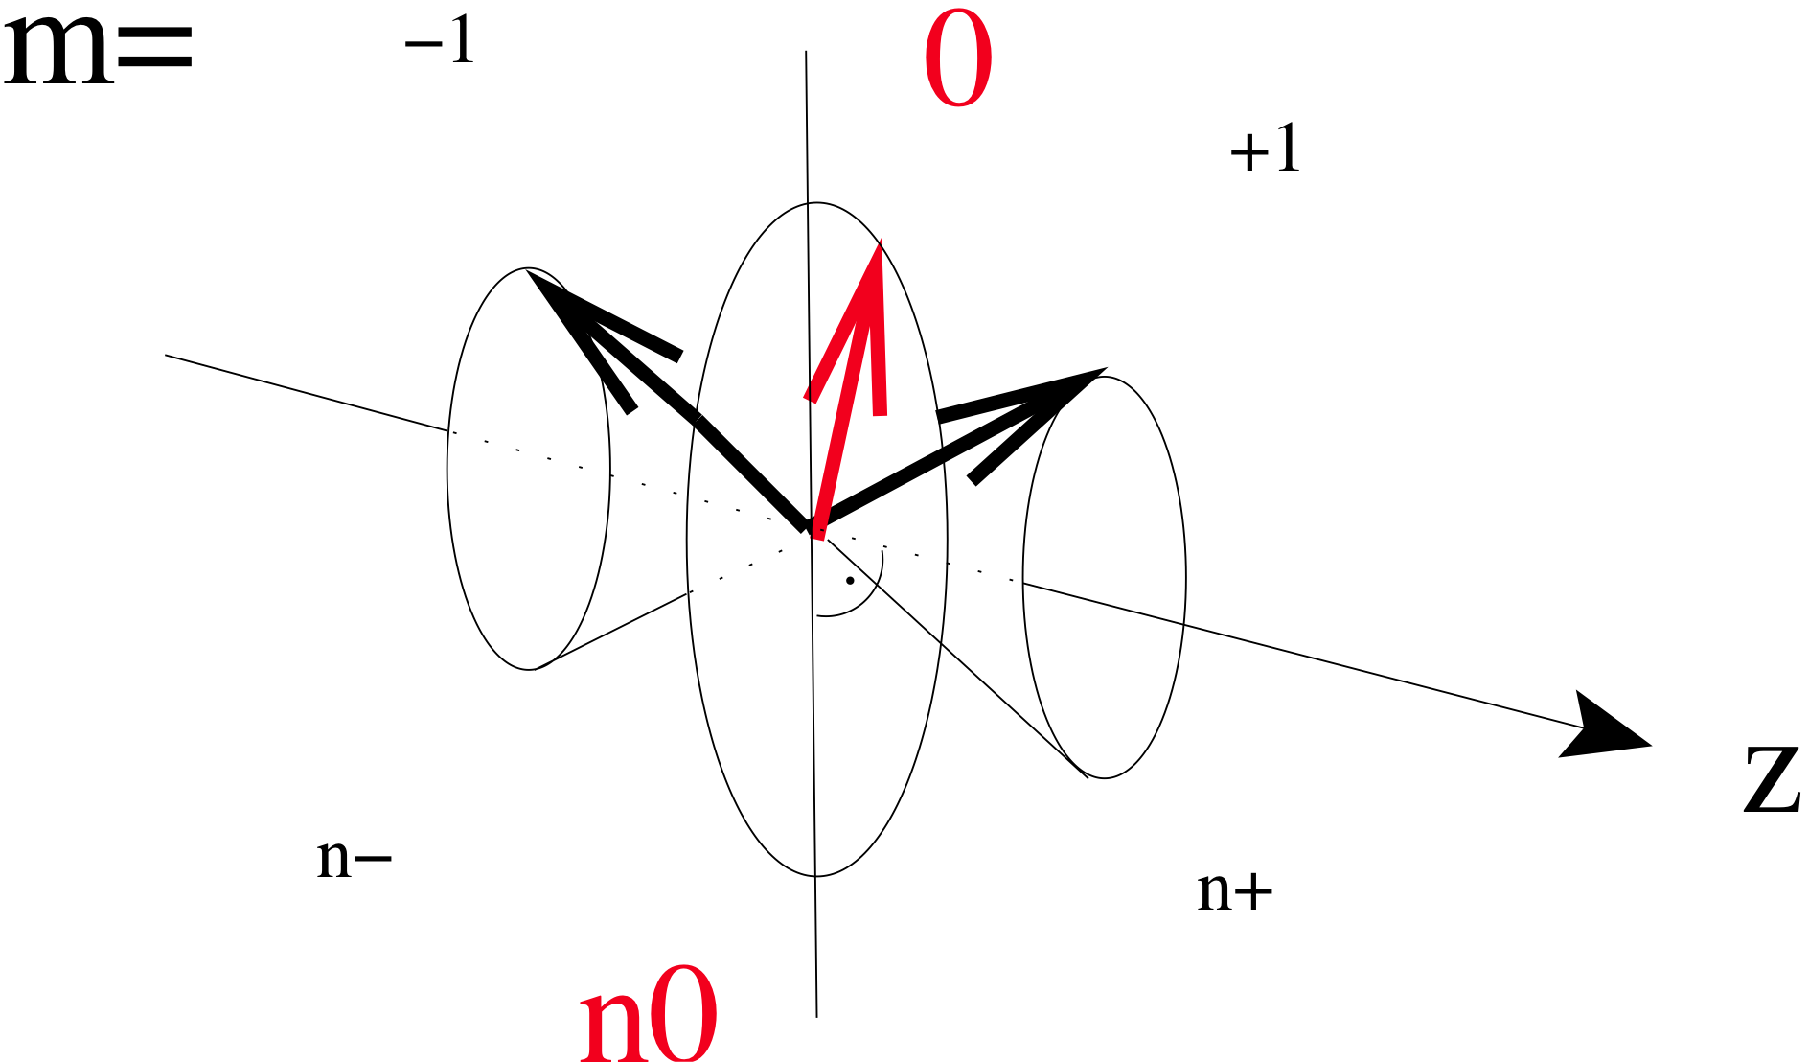
Polarized Deuteron Structure
m = 0
m = ±1
Deuteron spatial distribution depends on the spin state m
Spin-1 in B-field leads to 3 Zeeman sublevels
Normalization
(n⁺ + n⁻ + n⁰) = 1
m=+1
m=0
m=-1
Vector Polarization
P_{z} : (n⁺ - n⁻)
(-1 < P_{z} < +1)
Tensor polarization
P_{zz} : (n⁺ - n⁰) – (n⁰ – n⁻)
(-2 < P_{zz} < +1)

Slide 35
(Tagged) Polarized Neutron Structure
C. Weiss et al, see https://www.jlab.org/theory/tag/

Slide 36
Tagging → Neutron spin structure
Tag the recoil proton:
Study the neutron’s q-g spin structure function.
Also for other few body nuclei
Notes:
36

Slide 37
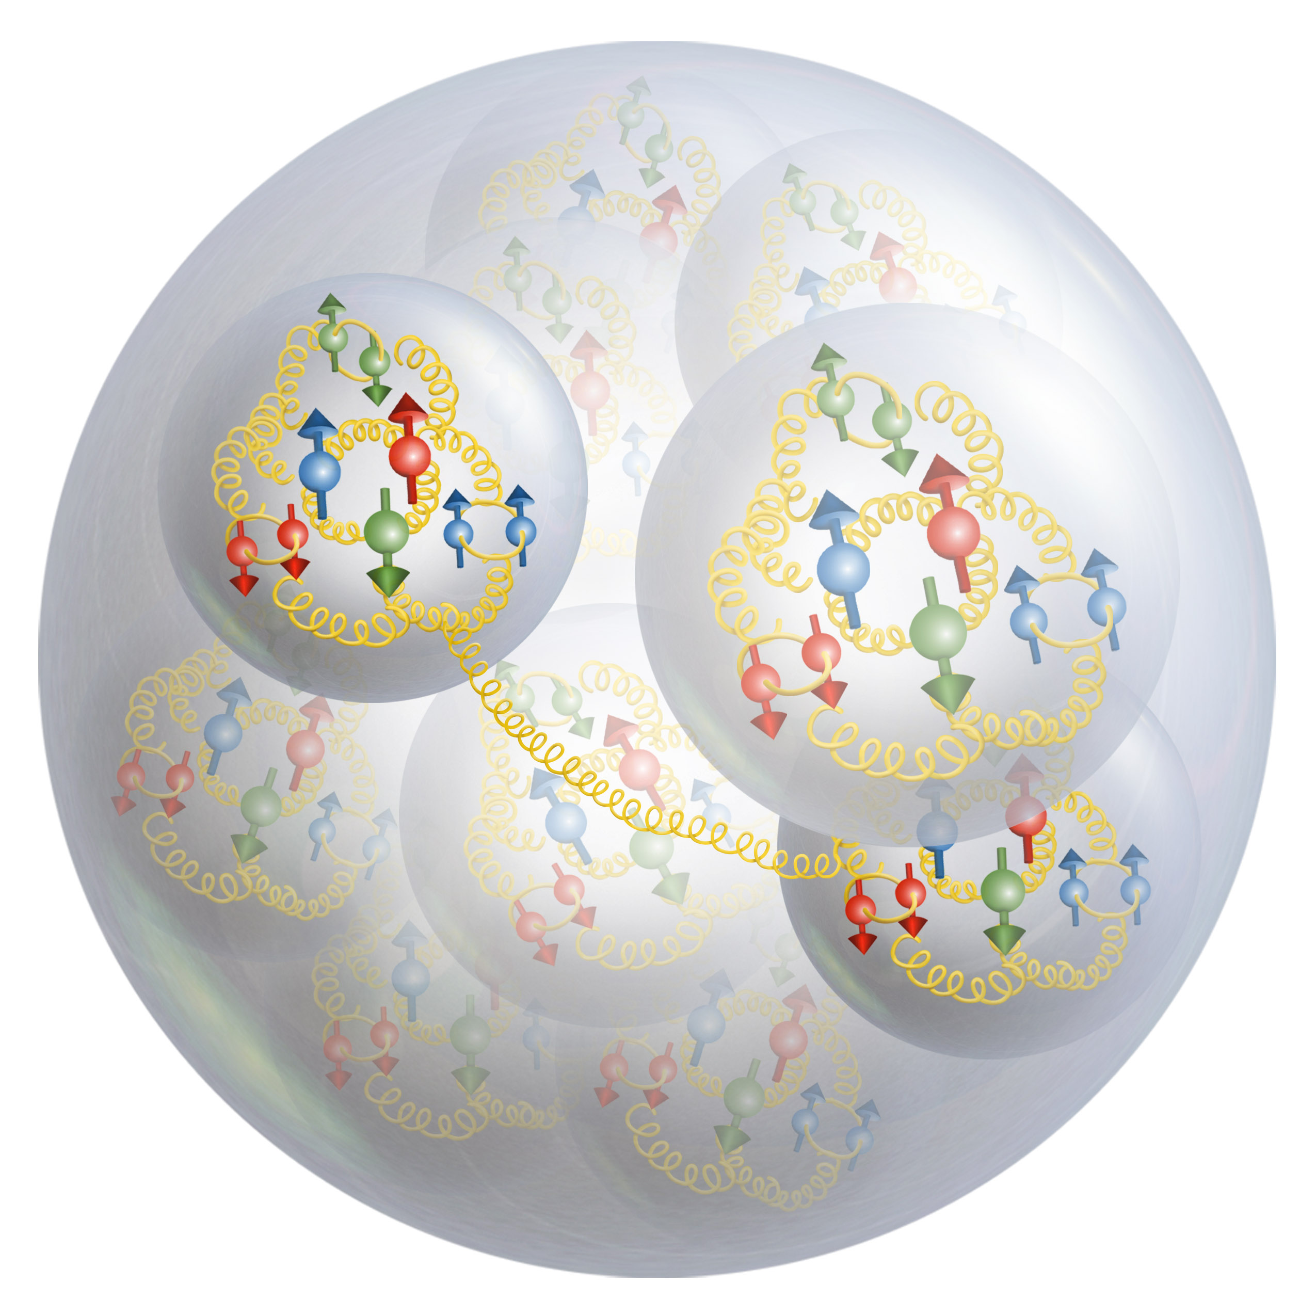
Exotic Glue in Nuclei
Exotic Glue in Nuclei =
gluons not associated with individual nucleons in nucleus
operator in nucleon = 0 & operator in nuclei ≠ 0
Targets with J ≥ 1 have leading twist gluon contribution
Δ(x,Q²): double helicity flip (Jaffe and Manohar, 1989)
Changes both photon and target helicity by two units…
Measurable in unpolarized Deep Inelastic Scattering with a transversely polarized J ≥ 1 target like the deuteron as azimuthal variation.
Parton model interpretation:
Δ(x,Q²) informs how much more momentum of a transversely polarized particle is carried by a gluon with spin aligned rather than perpendicular to it in the transverse plane.
Shanahan, Detmold, et al.
LQCD calculation: gluon transversity distribution in the deuteron, m_{π} = 800 MeV → First evidence for non-nucleonic gluon contributions to nuclear structure
Notes:
37

Slide 38

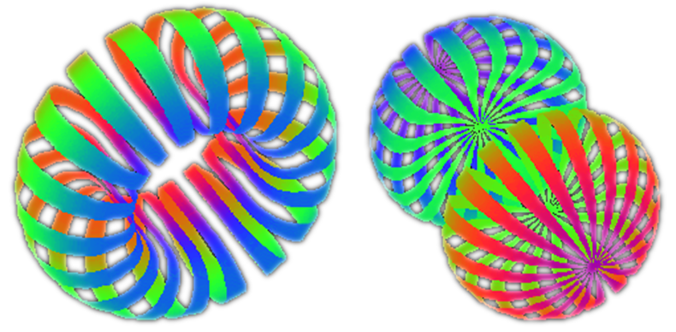
b1 Structure Function
Leading Twist
b₁ =
difference of helicity-0/helicity non-zero states of the deuteron
Probe the tensor polarization of the sea quarks.
Signature of “exotic” effects in nuclei.
i.e. deviation of deuteron from a simple system of two bound nucleons.
q⁰ : Probability to scatter from a quark (any flavor) carrying momentum fraction x while
the Deuteron is in state m=0
q¹ : Probability to scatter from a quark (any flavor) carrying momentum fraction x while
the Deuteron is in state |m| = 1
Nice mix of nuclear and quark physics
Measured in DIS (so probing quarks), but depends solely on the deuteron spin state

Slide 39
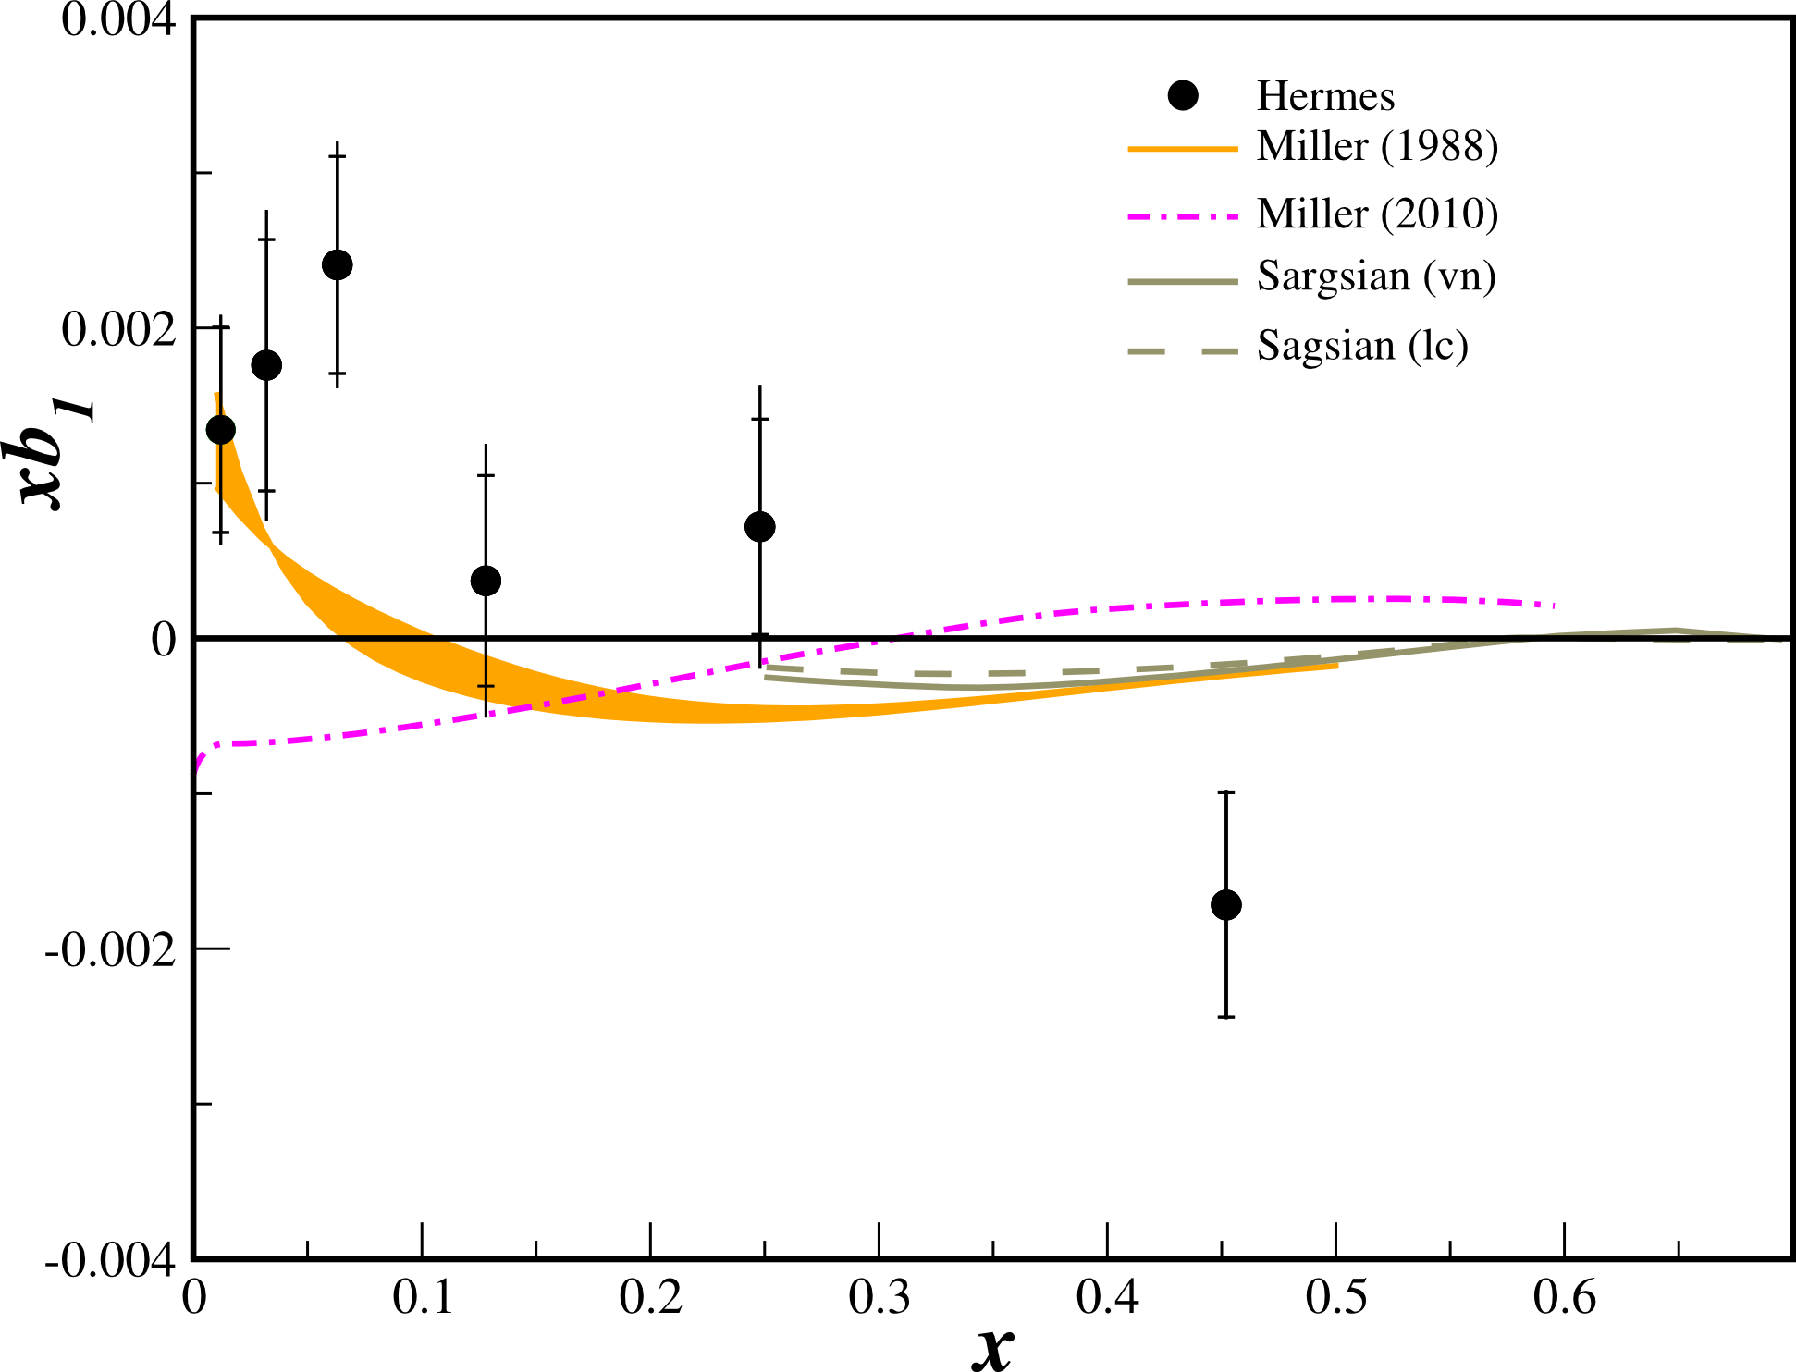
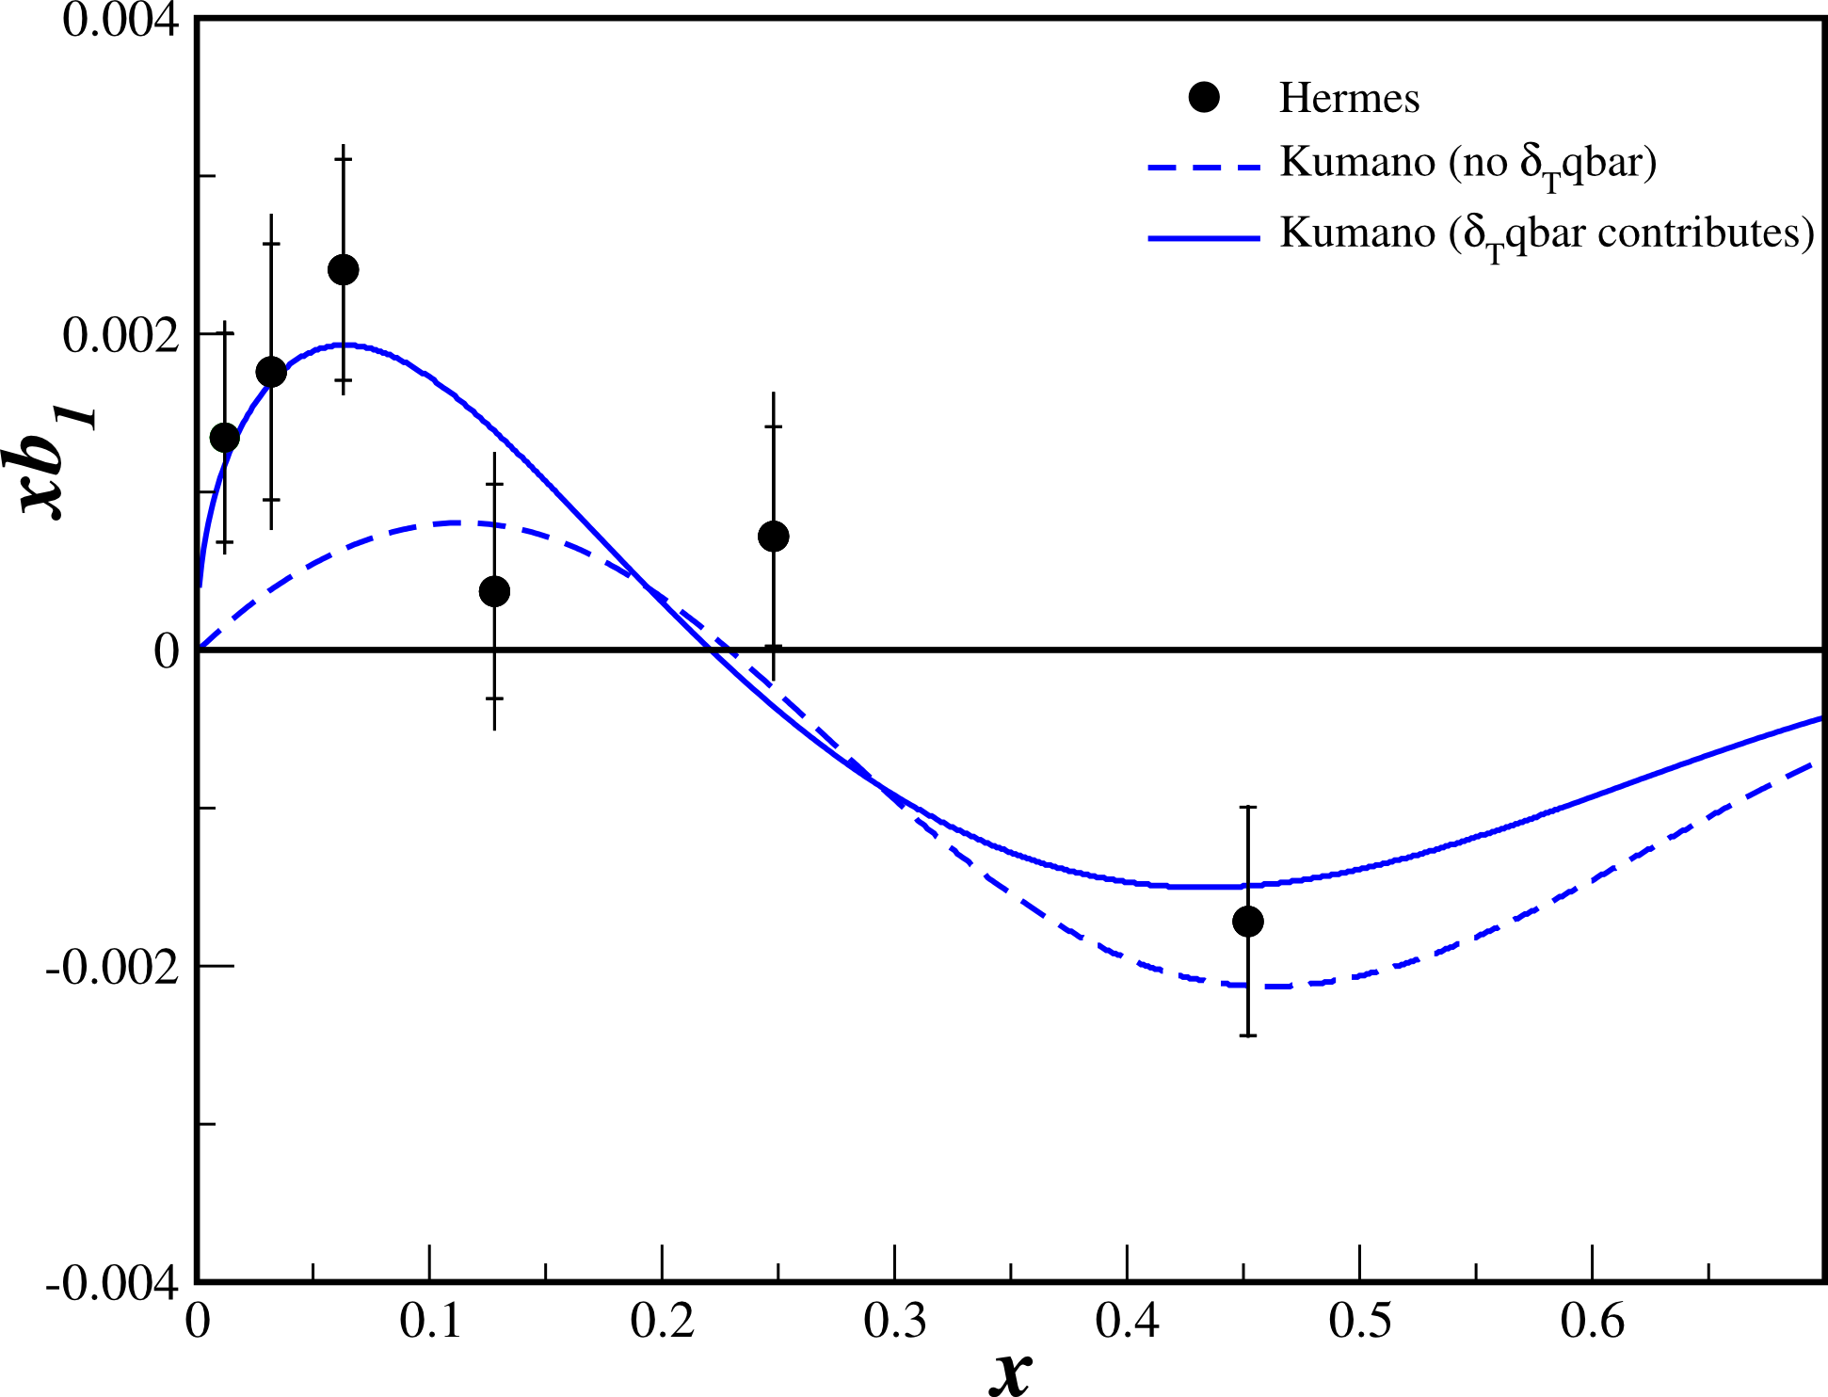



Existing b1 data – only from HERMES
PRL 95, 242001 (2005)
All Conventional Models predict small or vanishing values of b1 in contrast to the HERMES data
Kumano Fit to the Data
Requires tensor polarized sea for best fit.

Slide 40
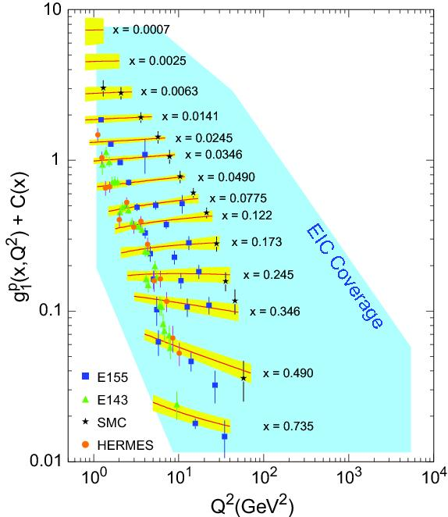
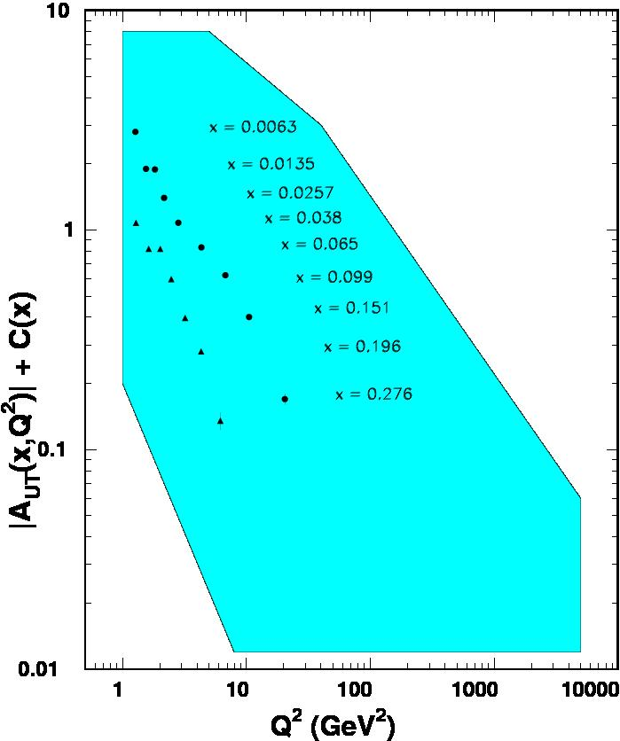

World Data on F₂^{p}
World Data on g₁^{p}
World Data on h₁^{p}
Similar for F₂^{n}
Similar for g₂^{p}, g₂^{n} (and b₁^{d})
F_{UT}^{sin(φh+φs)}(x,Q²) + C(x) $∝h1$
Note: need to update plots for COMPASS data
An EIC makes it possible!
EIC coverage
COMPASS
HERMES
transverse spin ~ angular momentum
momentum
spin

Slide 41
Outline
Why Neutron Structure?
Challenges to Access Neutron Structure
Polarized Deuteron and Polarized 3He Beams
EIC Science with Unpolarized & Polarized Deuteron Beams
EIC Science with Light Ion Beams
Summary

Slide 42
Parton Dynamics and N-N Correlations
EMC effect: quark momentum in nucleus is altered
N-N Correlations: pairing due to tensor force and strong repulsive core
EMC Slopes 0.35 ≤ x_{B} ≤ 0.7
Luminosity, light ions
N-N correlated pairs x_{B} ≥ 1.4
EIC possibilities:
“tagged” deep-inelastic scattering off: ³H, ^{3,4}He, ^{6,7}Li, ⁹Be, ^{10,11}B, ¹²C, ^{40,48}Ca
isospin dependence
with both slow and fast spectators (study structure and SRC)
spin dependence (next slide)
⁹Be ~
ααn

Slide 43
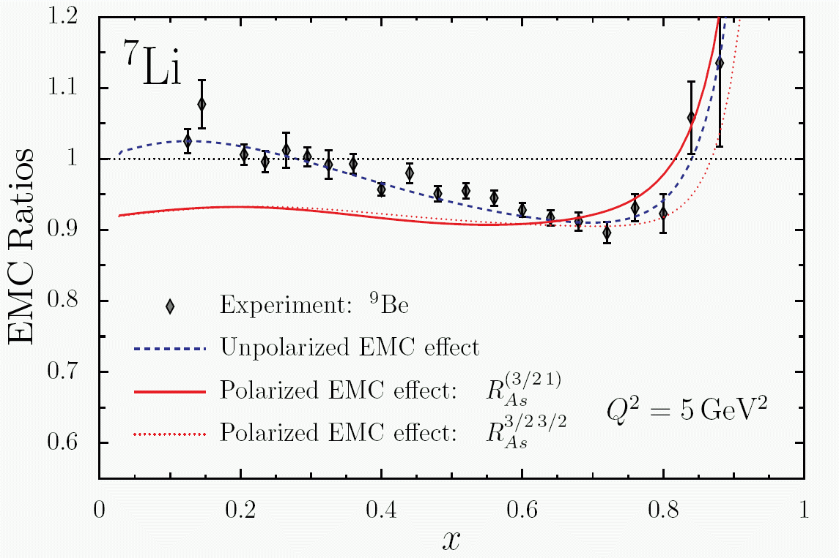
g₁(A) – “Polarized EMC Effect”
Calculations indicate larger effect for polarized structure function ratio than for unpolarized: scalar field modifies lower components of Dirac wave function
Spin-dependent parton distribution functions for nuclei nearly unknown
QMC
With EIC definite possibilities with polarized ions like ^{1,2}H, ³He, ^{6,7}Li, ^{14,15}N, …
Spin degrees of freedom access specific nuclear orbitals and dynamical mechanisms

Slide 44
Summary
  → Reality: measurement of neutron structure is essential to understand non-perturbative structure in nucleon
→ Reality: measurement of range of nuclei from light to heavy and polarization effects is essential to understand how quarks and gluons lead to a plethora of nuclei and rich arena of nuclear effects
Measurements with polarized (& unpolarized) deuterium in the optimal tagging collider character of EIC are essential.
Measurements with polarized (& unpolarized) 3He, and measurements with a range of polarized (& unpolarized) light ions are similarly a must!
This imposes strict demands on the versatility of the EIC

Slide 46
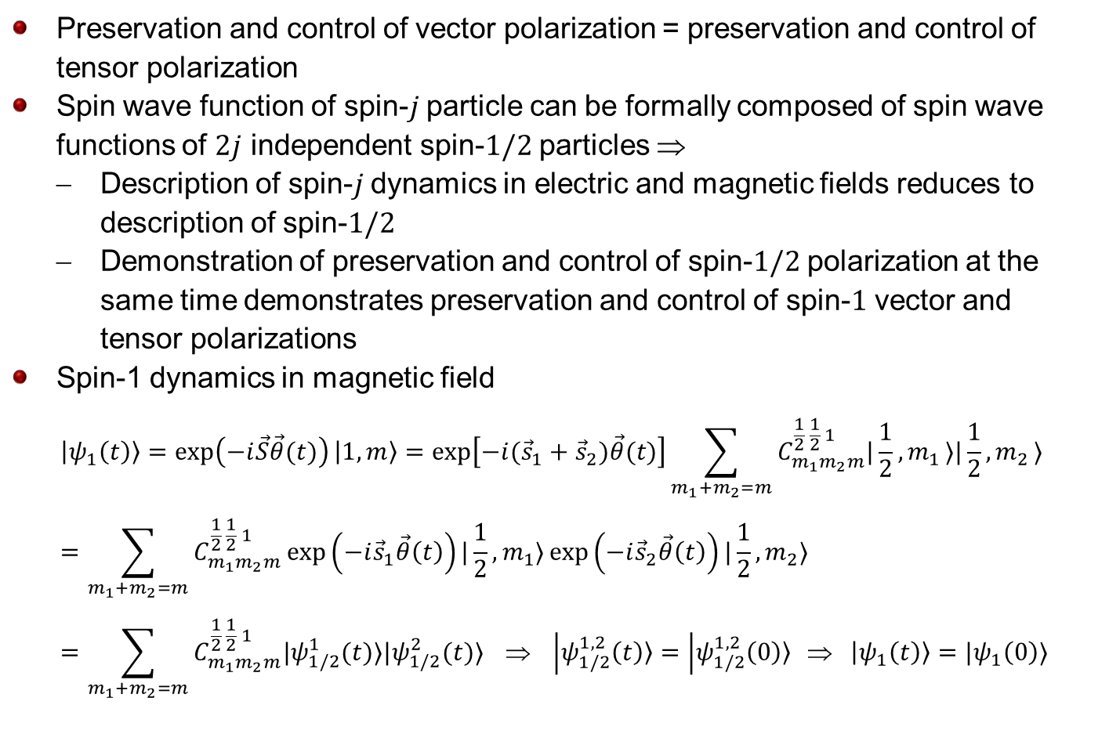
Tensor Polarization
Preservation and control of vector polarization = preservation and control of tensor polarization
Spin wave function of spin-$j$ particle can be formally composed of spin wave functions of $2j$ independent spin-$1/2$ particles $$
  Description of spin-$j$ dynamics in electric and magnetic fields reduces to description of spin-$1/2$
  Demonstration of preservation and control of spin-$1/2$ polarization at the same time demonstrates preservation and control of spin-$1$ vector and tensor polarizations
Spin-1 dynamics in magnetic field
$$|ψ_{1}\left(t\right)〉=\exp\left(−i\vec{S}\vec{θ}(t)\right)|1, m〉=\exp\left[−i({\vec{s}}_{1}+{\vec{s}}_{2})\vec{θ}(t)\right]\sum_{m_{1}+m_{2}=m}{C_{m_{1}m_{2}m}^{\frac{1}{2} \frac{1}{2} 1}|\frac{1}{2}{,m}_{1}〉|\frac{1}{2}{,m}_{2}〉}=\sum_{m_{1}+m_{2}=m}{C_{m_{1}m_{2}m}^{\frac{1}{2} \frac{1}{2} 1}\exp\left(−i{\vec{s}}_{1}\vec{θ}\left(t\right)\right)|\frac{1}{2},m_{1}〉\exp\left(−i{\vec{s}}_{2}\vec{θ}\left(t\right)\right)|\frac{1}{2},m_{2}〉}=\sum_{m_{1}+m_{2}=m}{C_{m_{1}m_{2}m}^{\frac{1}{2} \frac{1}{2} 1}|ψ_{1/2}^{1}(t)〉|ψ_{1/2}^{2}(t)〉} ⇒ |ψ_{1/2}^{1,2}\left(t\right)〉=|ψ_{1/2}^{1,2}\left(0\right)〉 ⇒ |ψ_{1}\left(t\right)〉=|ψ_{1}\left(0\right)〉$$

Slide 47
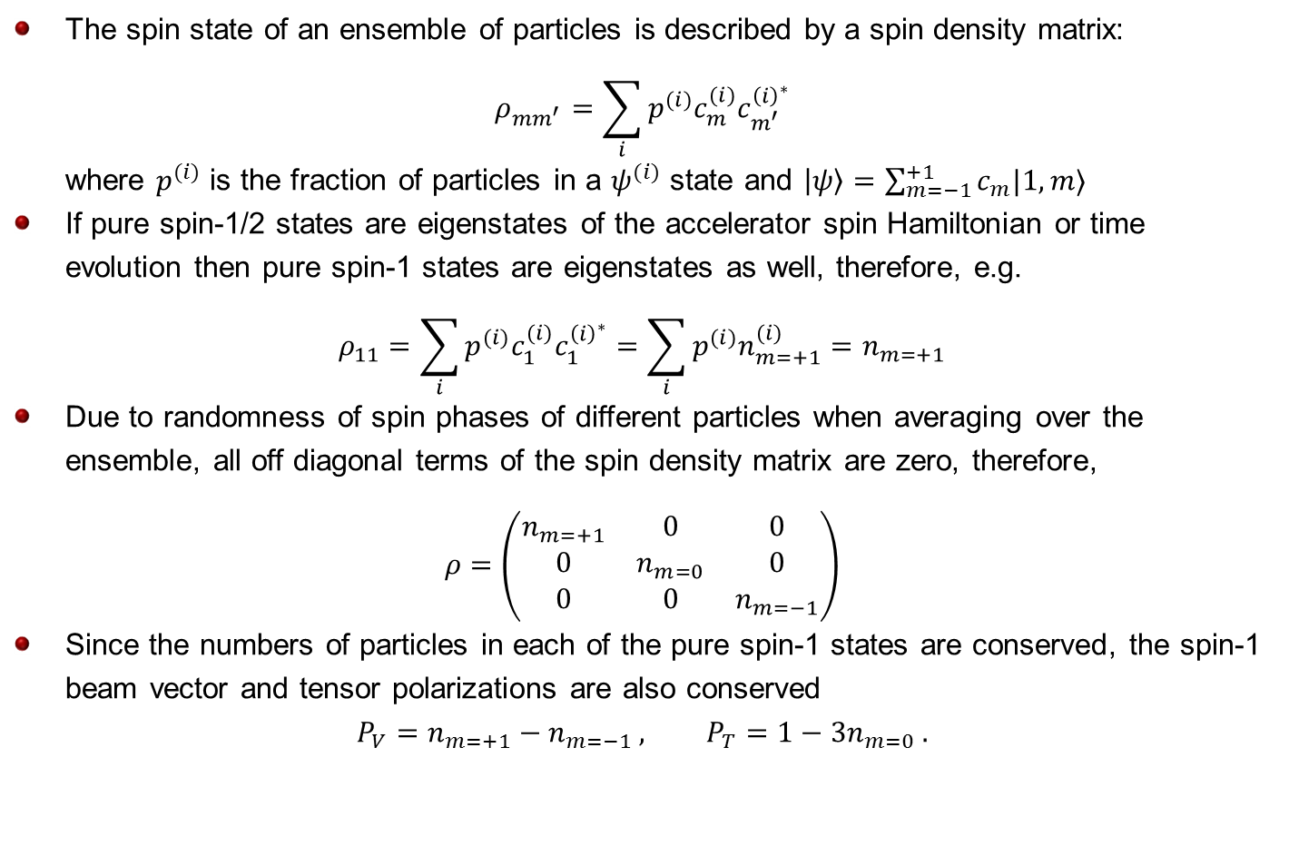
Spin Density Matrix
The spin state of an ensemble of particles is described by a spin density matrix:
$$ρ_{mm^{′}}=\sum_{i}{p^{(i)}c_{m}^{(i)}c_{m^{′}}^{{\left(i\right)}^{∗}}}$$
where $p^{(i)}$ is the fraction of particles in a $ψ^{(i)}$ state and $|ψ〉=\sum_{m=−1}^{+1}{c_{m}|1,m〉}$
If pure spin-1/2 states are eigenstates of the accelerator spin Hamiltonian or time evolution then pure spin-1 states are eigenstates as well, therefore, e.g.
$$ρ_{11}=\sum_{i}{p^{(i)}c_{1}^{(i)}c_{1}^{{\left(i\right)}^{∗}}}=\sum_{i}{p^{(i)}n_{m=+1}^{(i)}}=n_{m=+1}$$
Due to randomness of spin phases of different particles when averaging over the ensemble, all off diagonal terms of the spin density matrix are zero, therefore,
$$ρ=\left(\begin{matrix}n_{m=+1} & 0 & 0 \\ 0 & n_{m=0} & 0 \\ 0 & 0 & n_{m=−1}\end{matrix}\right)$$
Since the numbers of particles in each of the pure spin-1 states are conserved, the spin-1 beam vector and tensor polarizations are also conserved
$$P_{V}=n_{m=+1}−n_{m=−1} , P_{T}=1−3n_{m=0} .$$

Slide 48
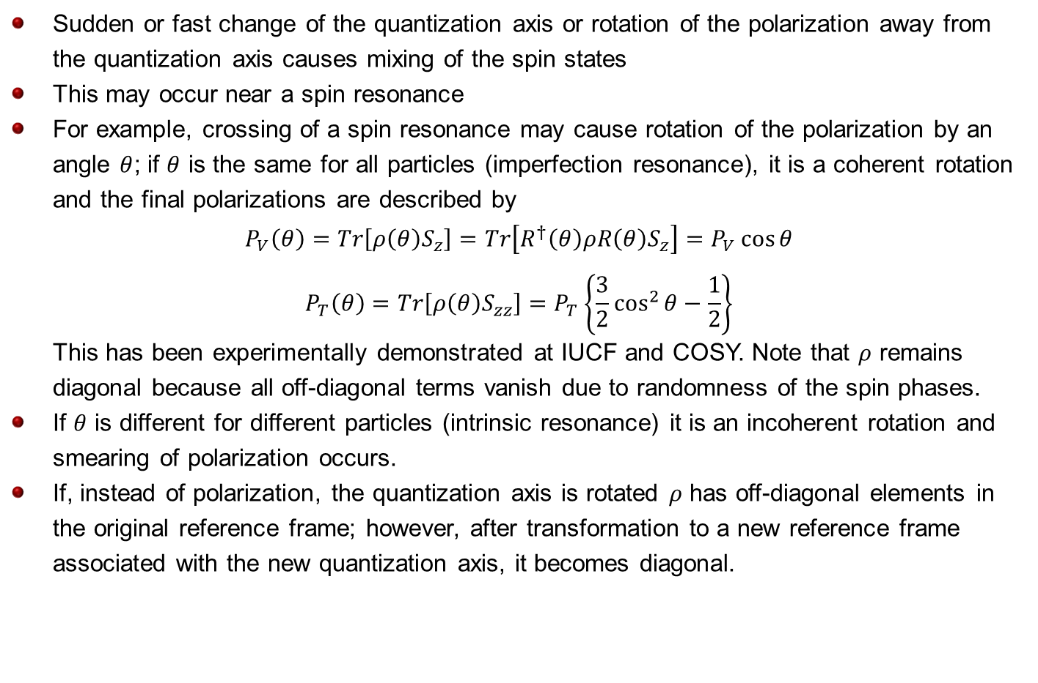
Spin Rotations
Sudden or fast change of the quantization axis or rotation of the polarization away from the quantization axis causes mixing of the spin states
This may occur near a spin resonance
For example, crossing of a spin resonance may cause rotation of the polarization by an angle $θ$; if $θ$ is the same for all particles (imperfection resonance), it is a coherent rotation and the final polarizations are described by
$$P_{V}\left(θ\right)=Tr\left[ρ\left(θ\right)S_{z}\right]=Tr\left[R^{†}\left(θ\right)ρR\left(θ\right)S_{z}\right]=P_{V}\cos{θ}$$
$$P_{T}\left(θ\right)=Tr\left[ρ\left(θ\right)S_{zz}\right]=P_{T}\left\{\frac{3}{2}\cos^{2}{θ}−\frac{1}{2}\right\}$$
This has been experimentally demonstrated at IUCF and COSY. Note that $ρ$ remains diagonal because all off-diagonal terms vanish due to randomness of the spin phases.
If $θ$ is different for different particles (intrinsic resonance) it is an incoherent rotation and smearing of polarization occurs.
If, instead of polarization, the quantization axis is rotated $ρ$ has off-diagonal elements in the original reference frame; however, after transformation to a new reference frame associated with the new quantization axis, it becomes diagonal.

Slide 49
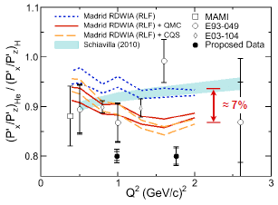
12 GeV ^{1,2}H,⁴He(e,e’p) Experiment
Investigation of the role of medium modifications
Study bound-proton momentum and density dependence of recoil-polarization observables → ⁴He and ²H data over a large range of proton virtuality.
Much cleaner to understand in 2H (plus likely further constraints from 12 GeV)

Slide 50
g₁(A) – “Polarized EMC Effect”
Calculations indicate larger effect for polarized structure function ratio than for unpolarized: scalar field modifies lower components of Dirac wave function
Spin-dependent parton distribution functions for nuclei nearly unknown
QMC
Expected Results – A|| Ratio
After 30 years, still no universally accepted model of the EMC-effect
Spin degrees of freedom access specific nuclear orbitals and dynamical mechanisms
Part of four-pronged EMC effect attack at 12-GeV: precision (while varying n/p ratio), extraction of F₂^{n}, tagging, polarized

Slide 51
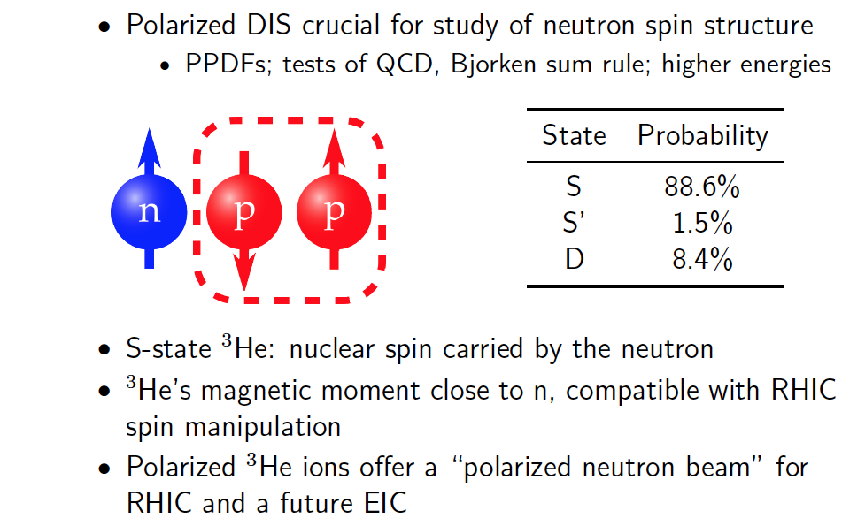
Why a Polarized 3He Source?

Slide 52
Exotic Glue in Nuclei
Lattice QCD calculation (W. Detmold, and P.E. Shanahan,
Phys. Rev. D 94, 014507 (2016))
Initially calculated for φ meson and shown to be ≠ 0
Nuclear Physics Lattice QCD calculation (arXiv:1709.00395v1):
First Lattice QCD calculation of the gluonic structure of light nuclei
First moment of gluon transversity distribution in the deuteron, m_{π} = 800 MeV → First evidence for non-nucleonic gluon contributions to nuclear structure
Notes:
52

