Slide 1
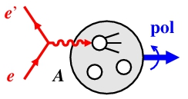

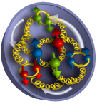
Spectator Tagging with the Electron Ion Collider
Polarized Light Ion Physics with EIC
5–9 Feb 2018, Ghent, Belgium
Charles Hyde
Old Dominion University

Slide 2
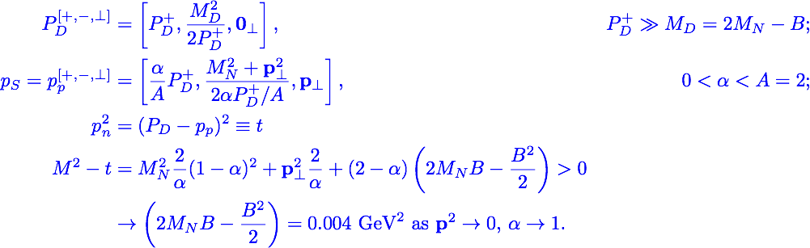

Light-Cone Variables
X
P_{n}
P_{D}
𝛹
Spectator
P_{p}

Slide 3
Collider Kinematics
Natural light-cone direction is event-by-event frame with q and P_{D} anti-collinear.
  Spectator proton (or neutron) emitted in forward direction with ~ 50% of beam momentum
Beam emittance envelope is comparable to Far-Forward tracking resolution of spectator proton
Both effects (and crossing angle) included in e D→ e´ p X Monte-Carlo (Jlab LDRD 2014).

Slide 4
Beam Emittance
& Detector Resolution
Beam emittance envelope
  σ(P_{D})/P_{D} ≈3•10^{–4}, σ(P⟘)/P_{D} ≈ 2•10^{–4}
Spectator tracking resolution
    σ(x) ≈ 100μm, Dispersion ≈ 1m
    σ(P||, P⟘)/P_{p} ≤ 2•10^{–4}
  Lower √s gives better spectator resolution
    P_{D} = 100 GeV/c
      σ(p⟘) ≈ 15 MeV/c
      σ(𝛂) ≈ 0.0002

Slide 5
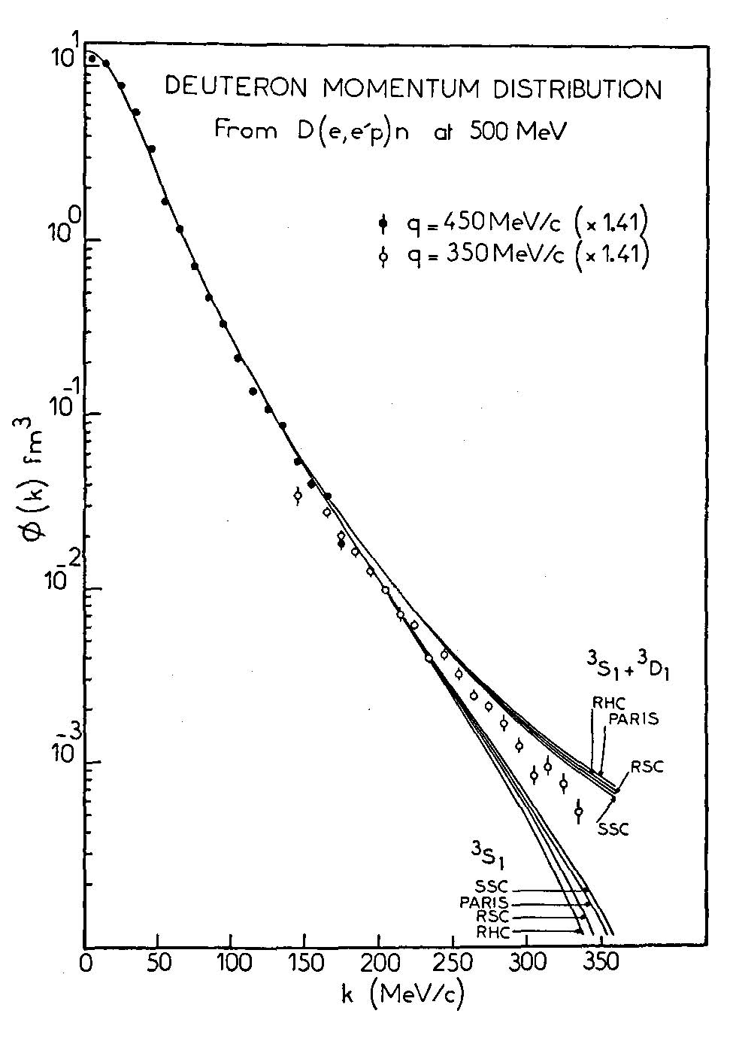
Detector implementation
JLEIC example
GEMC:
–– e–
---- D
— p
D(e,e’p)X
CLAS12
α≈ k/Μ
EIC
CLAS12 + BoNuS12/ALERT

Slide 6
Neutron F2
On-shell extrapolation
One (small) bin in Q²

Slide 7
The EMC Effect in the Deuteron
Concept: EMC effect arises from short range fluctuations in D wave-function
Extract on-shell point
for |𝛂–1|<0.02
Dashed line is IA for
𝛂 = 0.9
Pseudo-data shows
possible magnitude of
EMC effect
Notes:
PRC 92 015211 (2015)

Slide 8
Polarization: On-Shell Extrapolation
S-state only
  Asymmetry independent of t.
D-state coming soon (MS, CW)

Slide 9
Polarization
1 year @ 10³⁴/cm²/s
Depolarization favors lower energy:
D = y(2–y)/(2-2y+y²)
p±n
  flavor
  Bjorken Sum Rule
  𝛂_{S}(Q²)
(A.D.)²

Slide 10
Diffraction, (Anti-)Shadowing,
NN interaction
X
D(e,e’ pn)X, D(e,e’Vpn)
Detect final state neutron in ZDC
V. Guzey, next talk
P_{n}
P_{D}
𝛹
P_{p}

Slide 11
DIS from Bound Proton
Tag spectator neutron
  D(e,e’n) X
  State-of-the-art HCal
  σ(E)/E ≳ 30%/√E
  NIM A 866 (2017) 76.
3 contours/decade in D momentum distribution.
Ovals are 1-σ envelope of tagged neutron resolution.

Slide 12
Conclusions
EIC can study deuteron with unprecedented precision
  Polarization without target dilution
  Spectator tagging to p_{S} = 0
  Tensor Polarization
  EMC effect
    Exotic components
  Coherent D imaging: eD→ eDV (over-complete exclusivity).

Slide 13
Deuteron: NIJM-II, NN-Online.org

