Slide 1



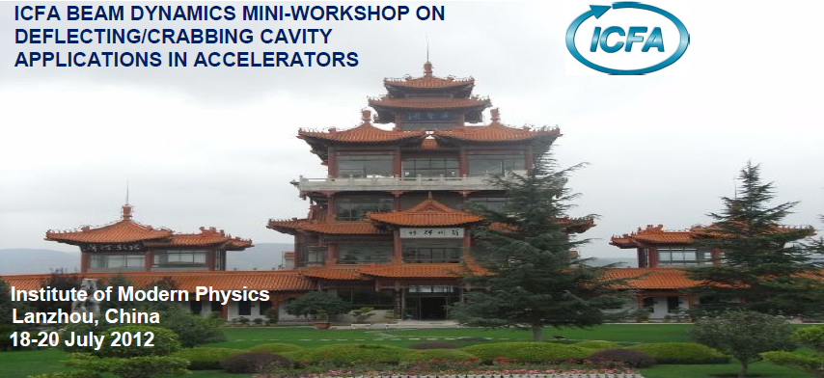
Workshop Summary
Alireza Nassiri ( ANL)
TESLA Technology Collaboration (TTC) Meeting
November 5-8, 2012
Thomas Jefferson National Accelerator Facility

Slide 2
Outline
Participation
Program
Highlights

Slide 3
Participation
Institute
IMP | 15
ANL | 5
IHEP | 4
LBNL | 2
JLAB | 2
SLAC | 2
ODU | 1
IHIP | 1
Nanjing University | 1
Lancaster University | 2
CERN | 1
Tech-X | 1
Shanghai Institute of Applied Physics | 2
Tsinghua University | 3
Total | 42

Slide 4
Program (Wednesday 07/18/12)
 | Wednesday, July 18, 2012
 | Plenary session I ( Chair: Huaibi Chen)
8:30 | Registration
9:30 | Welcome | XIAO, Guoqing | IMP
9:15 | Program Overview | Li, Derun | LBNL
9:30 | Accelerator activities at IMP | ZHAO, Hongwei | IMP
10:00 | Science of Short Pulse x-rays in Light Sources | NASSIRI, Alireza | ANL
10:30 | Coffee break
 | Plenary session II ( Chairs: Ali Nassiri, Kwang-Je Kim)
11:00 | LHC Luminosity Upgrade and Deflecting Cavities Strategy | CALAGA, Rama | CERN
11:30 | Experiences with KEK-B crab cavity | HOSOYAMA, Kenji | KEK
12:00 | Lunch
 | Plenary session III (Chair: Derun Li)
13:30 | Deflecting cavities development in UK (canceled) | BURT, Graeme | Lancaster
14:00 | Compact TEM-type deflecting cavities | DELAYEN, Jean | ODU
14:30 | Emittance-exchange-based high harmonic generation scheme for FEL | JIANG, Bochen | SINAP
15:00 | Coffee break
 | Plenary session IV( Chairs: Jie Gao, Kexin Liu)
15:30 | The theory of beam manipulation and emittance exchange | KIM, Kwang-Je | ANL
16:00 | Beam dynamics of chirp scheme in storage ring | SAJEAV, Vadim | ANL
16:30 | Applications of deflecting cavities in x-ray free electron lasers | DING, Yuantao

Slide 5
Program (Thursday 07/19/12)
 | Thursday, July 19, 2012
 | Plenary session I ( Chairs: Hongwei Zhao, Wenhui Huang)
9:00 | Application of shaped beam for wakefield acceleration | GAI, Wei | ANL
9:30 | Status of the SPX R&D (SPX0) | WU, Genfa | ANL
10:00 | Coffee break
 | Plenary session II ( Chairs: Ali Nassiri)
11:00 | Advanced simulations techniques of deflecting/crabbing cavities | LI, Zenghai | SLAC
11:30 | Advanced simulation techniques and multipactoring simulations | ZHOU, Chuandoung
12:00 | Lunch
 | Working Group I – Cavity-beam interaction (Chair: Robert Rimmer)
13:30
 | Working Group II – Cavity design, coupler, damper and optimization (Chair: Kenji Hosoyama)
19:30 | Workshop Banquet

Slide 6
Program (Friday 07/20/12)
 | Friday, July 20, 2012
 | Plenary session I ( Chairs: Rama Galaga, Robert Rimmer)
9:00 | Accelerator activities at Tsinghua University | HUANG, Wenhui | Tsinghua
9:30 | Experimental studies for ILC and CLIC crab cavity system | AMBATTU, Praveen | Lancaster
10:00 | Coffee break
 | Plenary session II ( Chairs: Jean Delayen, Wei Gai)
10:30 | SPX cavities and cryomodule development | RIMMER, Robert | JLAB
11:00 | Wakefield/impedance consideration for APS and LHC crab cavities | WANG, Haipeng | JLAB
11:30 | Closing Remarks
12:00 | Tour of IMP Facility

Slide 7
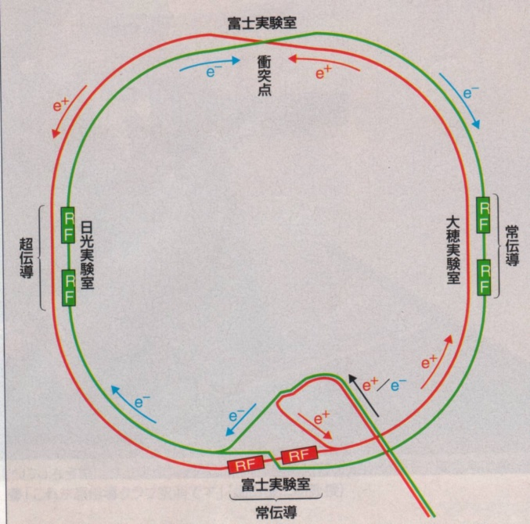
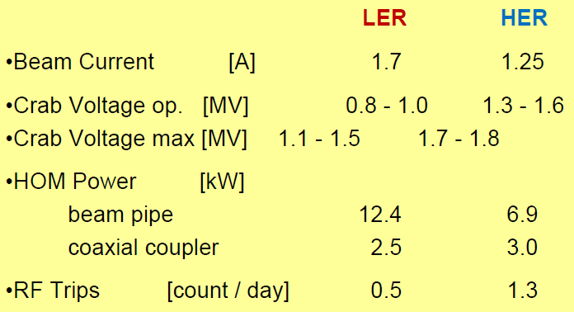
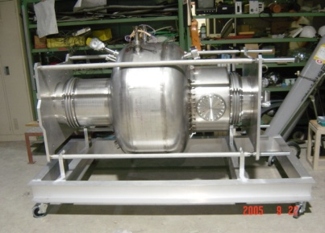
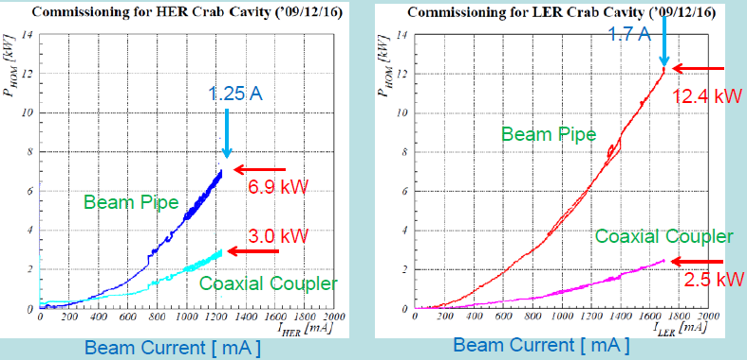

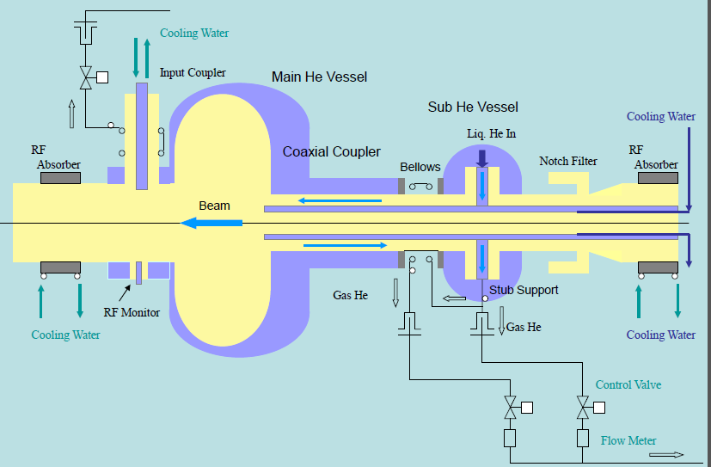
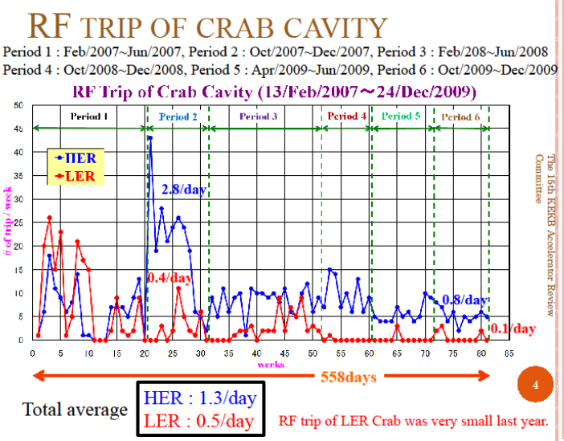
Experiences with KEK-B Crab Cavity ( Kenji Hosoyama – KEK)
Performance
LER 3.5 GeV
HER 8.0 GeV
RF freq. 508.9 MHz
Cross. Ang. 2 x 11 m rad.
Tsukuba
Nikko
Collision Point
8 SC-Cavities
Oho
2 Crab Cavities
HOM power
Fuji
Input Coupler Port
Installation of crab cavities
  HER Jan. 8 2007, LER Jan. 11 2007
  Cool-down Jan. 29, 2007
  Beam operation started on Feb. 13, 2007
The crab cavities operate
about 3 years without serious problems.
Peak Luminosity Leak =19.6 x 10³³ /cm²/s
attained under crab on operation.

Slide 8
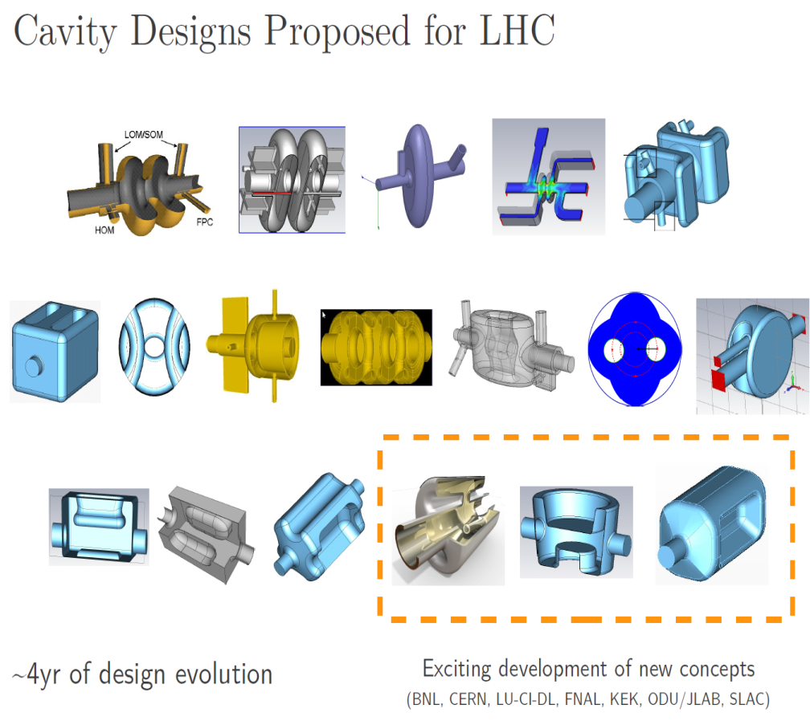

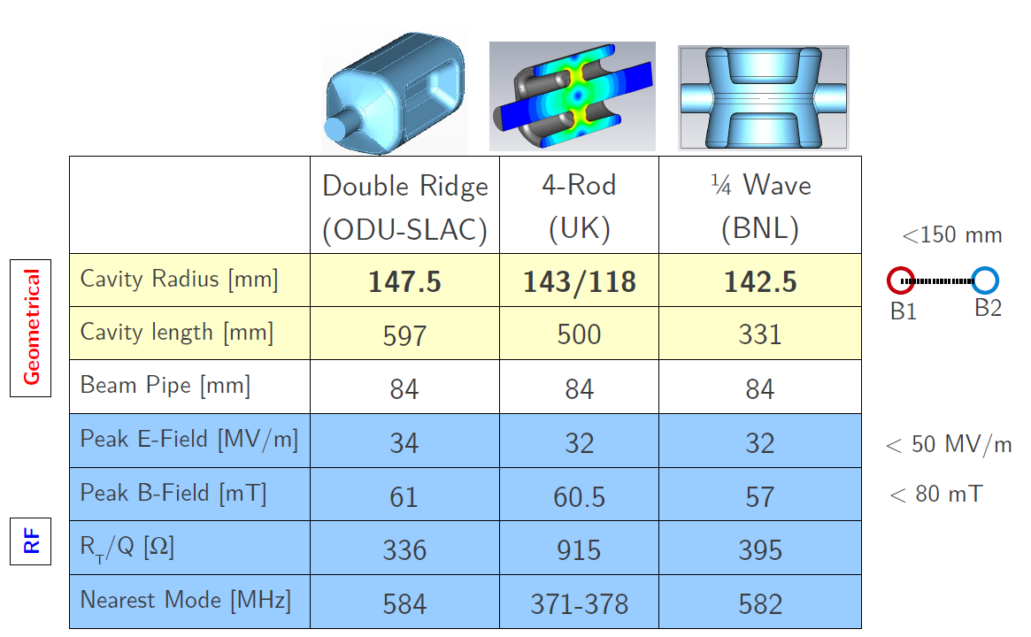
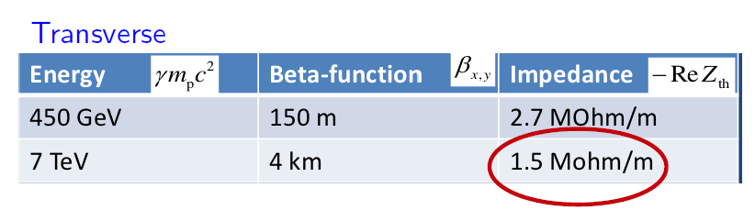
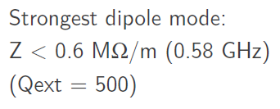
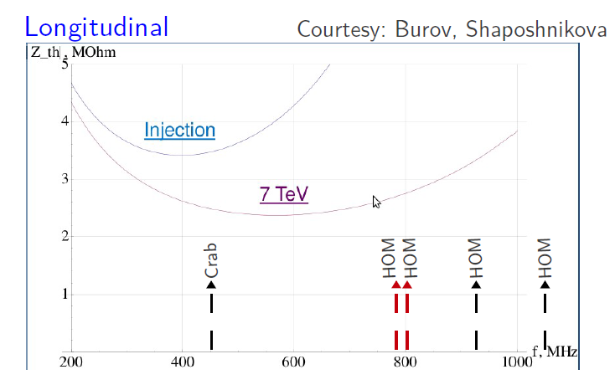
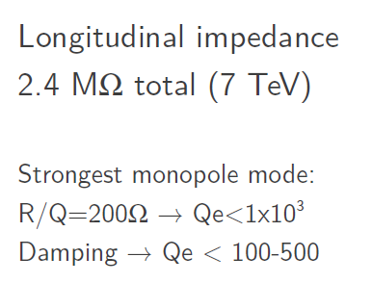
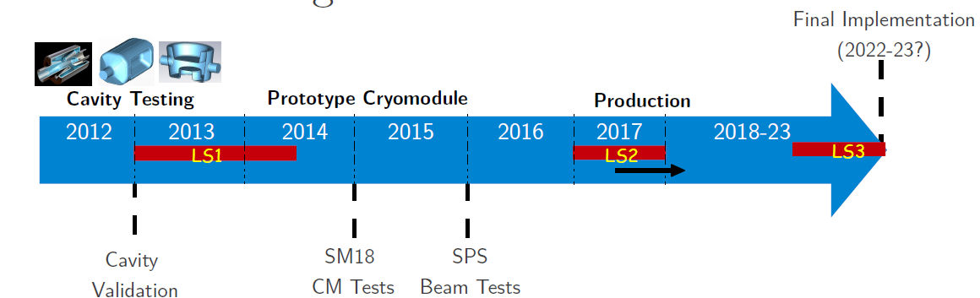
LHC Upgrade & Crab Cavities ( Rama Calaga - CERN)
Overall planning

Slide 9
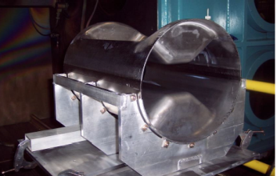
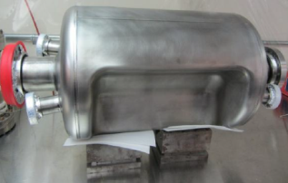
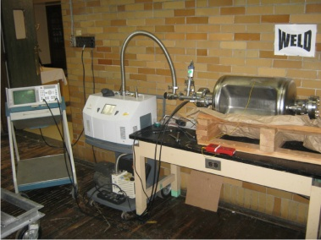
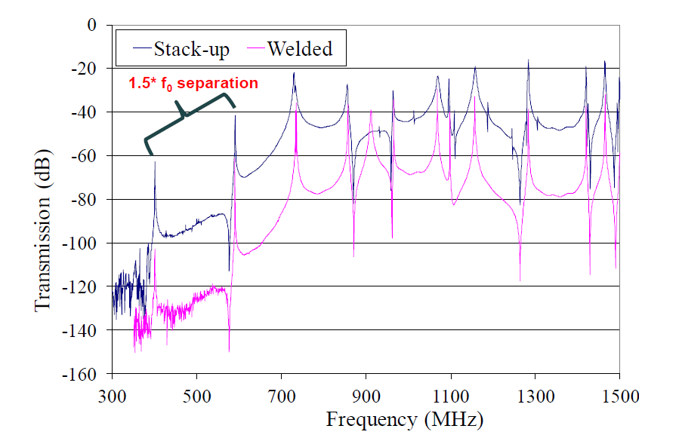
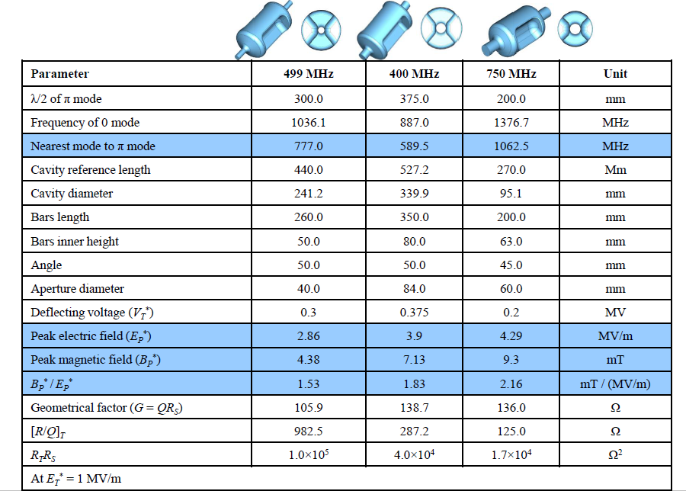
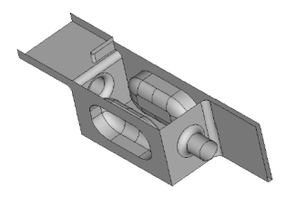
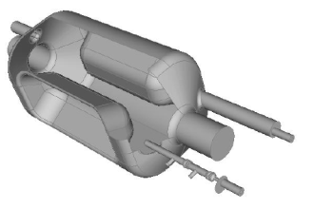
Compact TEM-type cavities (Jean Delayen - ODU/JLAB)
Prototyping of 400 MHz ( ODU/Niowave)
400 MHz square cavity options
  Consideration of field uniformity and impedance budget
HOM damping
Review of 4-rod structures
  499 MHz NC separator at JLab
  U. Lancaster/JLab
ODU parallel-bar and its design evolution
  Significant design optimization
    Ep/Et and Bp/Et vs. cavity length, Bp/Et vs. Ep/Et for different bar height
  Analysis of HOM properties ( 400, 499, 750 MHz)
Parallel-bar/ridged WG to rf dipole
Stacked
Welded
Coax high-pass filter coupler
WG to damp h/v dipole and accel HOMs
One WG /plane
May need WG stub to symmetrize field
Details in S. de Silva’s talk

Slide 10
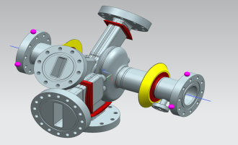
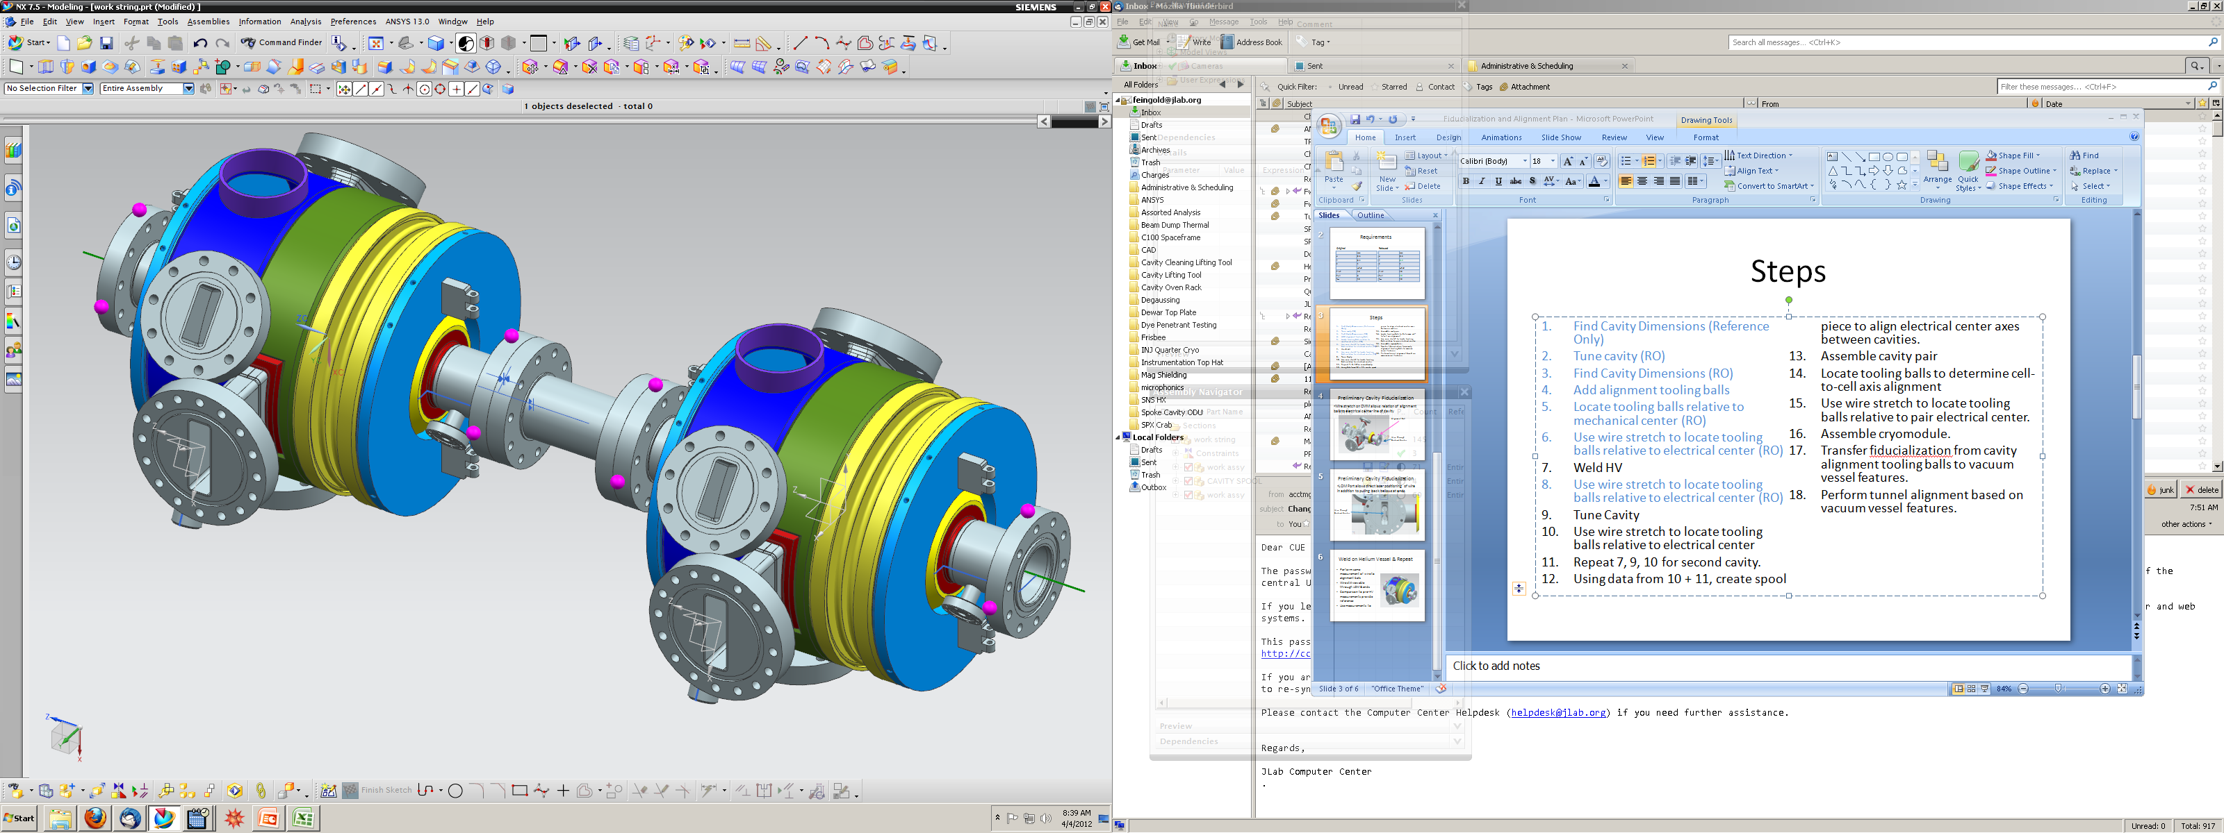
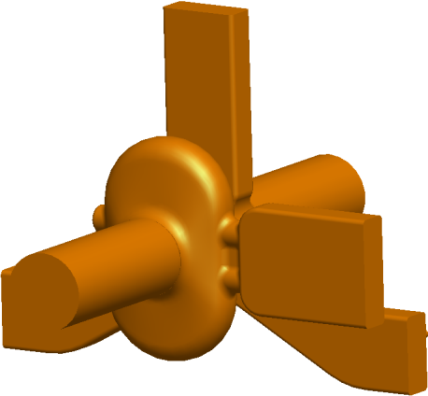
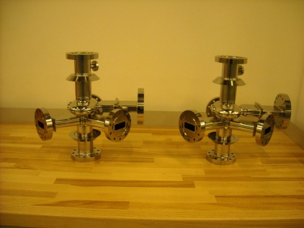
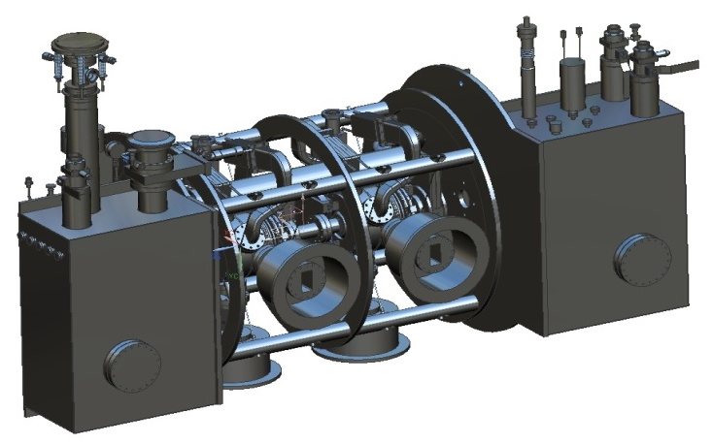
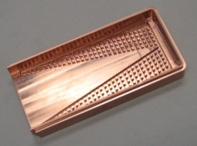
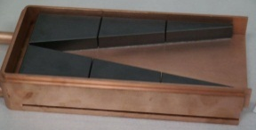
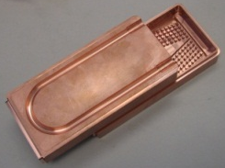
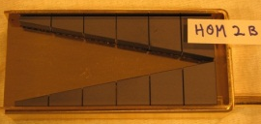
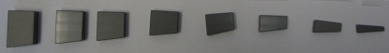
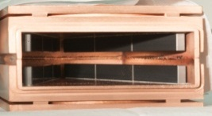
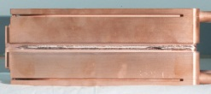
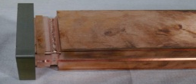
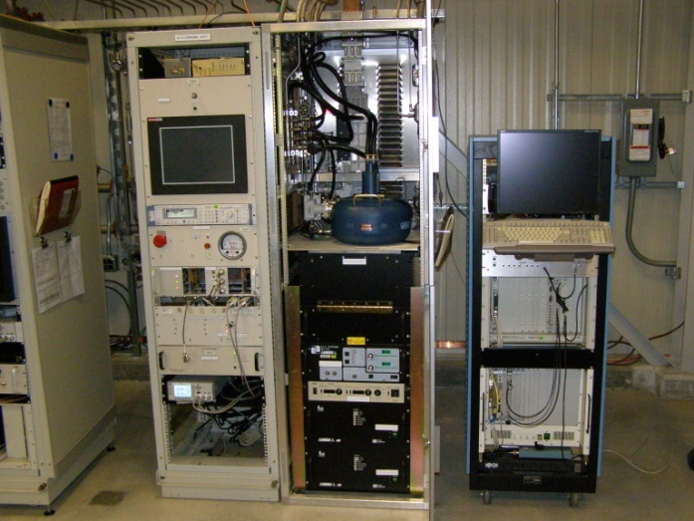
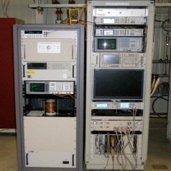
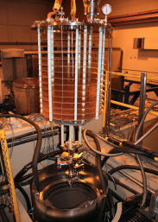
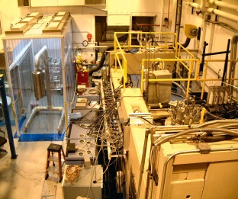
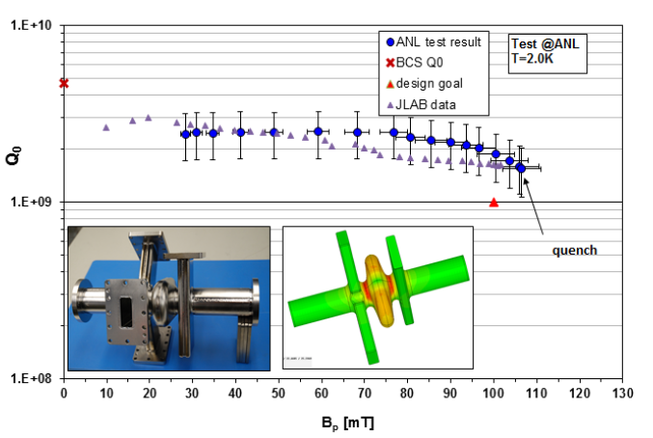
SPX R&D –SPX0 (Wu, Nassiri - ANL)
Production of ps x-ray pulses with SRF deflecting cavities.
Collaboration with JLAB on cavity/cryomodule designs.
Design, fabrication and testing of prototype dampers
Quantity | Value
Electron beam current | 100 mA
Number of cavities | 2
Total voltage | 1.0 MV
RF Frequency | 2815.486 MHz
Cavity tunability | 200 kHz
Source tunability | 1.5 kHz
Operating temperature | 2 K
Longitudinal non-deflecting mode impedance | <0.44 MΩ-GHz
Horizontal non-deflecting mode impedance | <1.3 MΩ/m
Vertical non-deflecting mode impedance | <3.9 MΩ/m
Flat bed HOM
Pin bed HOM
Machining
Brazing
RF test stand to support R&D
eBeam welding
4kW klystron
275 W TWT
Dewar insert
ATLAS test area
SPX R&D is progressing well
Strong ongoing collaboration with JLAB, LBNL and SLAC
Recent test result in H. Wang’s talk

Slide 11
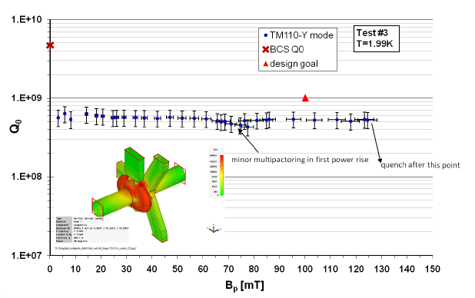
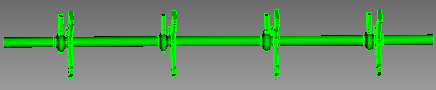
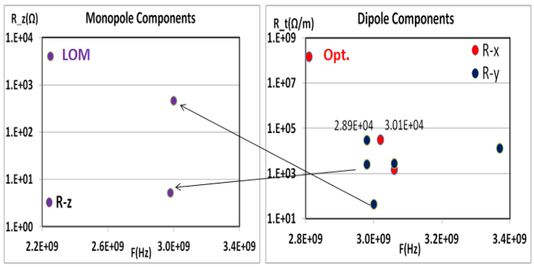
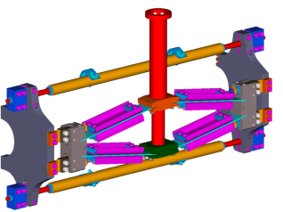
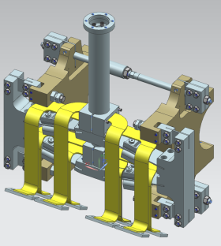
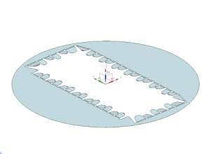
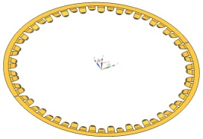
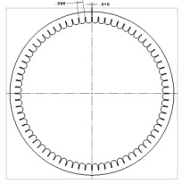
APS SPX cavity and cryomodule ( Robert Rimmer-JLAB)
MARK II (CC-A2) cavity test @ JLab
Trapped HOM mode analysis in 4-cavity cryomoule.
DFM power leakage to LOM WG port
  Tune the cavity after bulk chemistry and notch filter on the LOM WG can minimize the power leaking out.
Tuner design
  C100 SPX
    Shorter axial length ( 62% reduction
    New space envelop
    Greater resolution (40 Hz)
Power distribution
Concepts for rf seals are being developed
  Beryllium Copper is the intended material choice
w/o FPC and LOM coupler windows
Omega3P simulation studies by SLAC ACD group – L. Xiao, Z. Li
 | Tuning Sensitivity (Mhz/mm)* | Cavity Stiffness (klbs / in)**
Predicted | 12.2 | 113.5
Measured | 13.0 | 101.6
* - The tuning sensitivity with a He vessel is expected to decrease by 26%
** - The stiffness with a He vessel is expected to increase by 12%
Modeling Validated
Finger geometry and clocking feature need to be finalized
Details in H. Wang’s talk

Slide 12
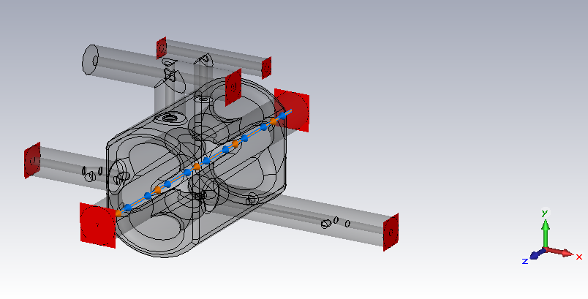
Wakefield/impedance considerations for APS&LHC crab cavities (H. Wang – JLab)
Review of multi beam wake excitation scheme
  MAFIA T3 simulation using MB excitation technique for JLAB ½-scale high current cavity
Benchmark ( MAFIA T3, E3 and bench measurement) on 1.3 GHz , 5-cell H.C. cavity
LHC 4-rod crab cavity
Port 4: DMC 1
Port 5: DMC 2
Port 3: HOM2
Port 1: HOM1
Port 6: BP1
Port 2: LOM
Port 7: BP2
Preliminary LOM/HOM damping power estimates
581 mA
Port LOM HOM1 HOM2 DMC1 DMC2 BP1 BP2
kW 113 11.6 26.6 4.2 NA 0.843 4.8 ? 5.7?
Power handing and cooling on the coaxial couplers on all LHC crab cavities will be very challenging
The HOM damping design is very important part of LHC crab cavity. It should be one of critical requirements for the down selection process.

Slide 13
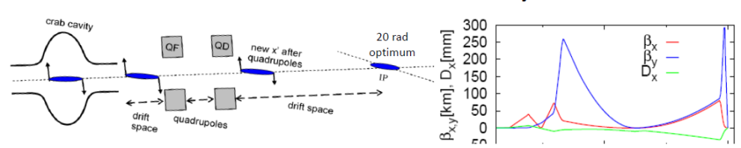
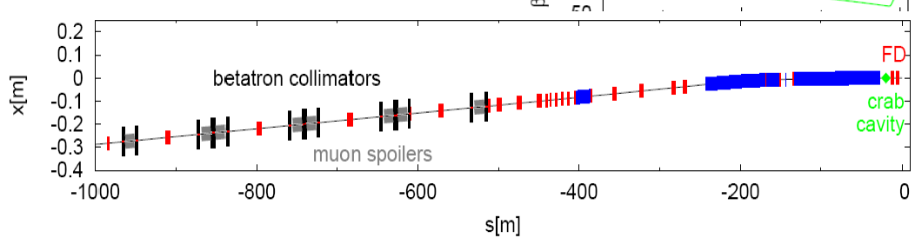








CLIC Crab Cavity(Praveen Ambattu - Lancaster University)
X-band (12 GHz) Travelling wave
Requires a kick of 2.55 MV per beam for CLIC crossing angle of 20 mrad
A 12-cell with beam pipe radius of 5 mm ( 13 MW per beam)
CTF3 prototype will include wakefield dampers for beam test
Prototype 1 fabricated and cold tested at SLAC
Prototype 2 fabricated and cold tested at CERN
Prototype 3 under design
Symmetric or dual-feed coupler. Asymmetric/single-feed
Transverse beam size @ IP: 1 nm x 45 nm
- Requires strong focusing by the final quads
SLAC Prototype 1
Avoids the splitter, more compact.
Asymmetry induces multipole components, especially monopole.
Prototype 3
Increases trans size of the cavity.
Makes cell tuning difficult.
Advantage: No coupler induced monopole component due to the symmetry of the fields.
CERN Prototype 2

Slide 14

























Advanced Modeling of Deflecting/Crabbing Cavities – Zenghai Li, SLAC)
Parallel higher-order finite-element method
  Conformal ( tetrahedral) mesh with quadratic surface
  Higher-order elements (p=1-6)
  Parallel processing (memory and speed)
Large system simulation
  T3p – wakefield coupling in CLIC structures
Shunt impedance – (R/Q)*Qext
Deflecting cavity MP analysis
Ridged WG defector for H&V crabbing
monopole power transfer
F=2.415GHz
F=3.287GHz
Multi-cavity need to be simulated because of cavity-to-cavity coupling
Operating voltage: 3.3MV
dipole wakefield coupling

Slide 15



















Crabbing cavity multipacting simulation with VORPAL (C.D. Zhou – TECH-X)
Electrons seeded in the gap between the fingers of the cavity get accelerated out of the gap before multipacting is established
4-rod crab cavity design
Includes HOM, LOM and PC imported from CAD file
Mode reconstruction shows B_{t} fields for dipole modes
Good agreement on transverse cavity shut impedance between test and VORPAL
Operating and HOM dipole modes
Accelerating monopole modes
Initial position of the seed electrons
Towards the end of one RF cycle
Beam pipe
0.5 1.0 1.5 2.0 2.5 3.0
GHz
0.5 1.0 1.5 2.0 2.5 3.0
GHz
Initial position of the seed electrons
After many RF cycles
Electrons seeded in p.c. can produce a multipacting population
Power coupler
400 MHz
890 MHz
1050 MHz
1400 MHz
1700 MHz
2000 MHz
Charge density towards the end of many RF cycles I the power coupler
R/Q ( 400 MHz)
G. Burt, et al. VORPAL (2.54 MV)
802 Ω 798.2 Ω
Electrons at the inner radius of coax
Electrons at the outer radius of coax

Slide 16









Bunch shaping for future dielectric wakefield accelerators ( Wei Gai – ANL)
Emittance exchange (EEX)
EEX- HHG FEL(ultraviolet /soft x-ray radiation)
Beam line
Cornacchia and Emma beam line
First EEX proposal
Easy to implement
Kim beam line
EEX is not complete
EEX is complete
Chicane-type beam line
Cornacchia and Emma
PRST-AB, 5, 084001 (2002)
Dogleg introduces offsets in beam orbit
-I section to reverse η
Emma et al., PRST-AB, 9, 100702 (2006)
EEX is complete
NO offset in beam orbit
Xiang and Chao, PRST-AB, 14, 114001 (2011)
Separated energy bands
EEX-based bunch shaper (future FEL)
y
Beam
Mask
Dipole
Deflecting cavity
(a)
(b)
I
Bunch phase space after mask
x
drive
Energy bands @z2
Density modulation @z4
(c) (d)
t
witness
Works well for a few nC charge after mask;
flexible with mask shape
witness bunch can be produced with the same mask to avoid the timing jitter;
Jiang et al., PRL, 106, 114801 (2011)
Simulation by P. Piot.

Slide 17




Applications of transverse deflecting cavities in x-ray FELs (Yuantao Ding – SLAC)
RF “streak” camera for e-beam
Slice emittance measurements @LCLS
XTCAV+ e-beam E-spectrometer
RF
‘streak’
beam screen
V0(t)
σ_{y} ~ σ_{z}
e⁻
S-band (2856 MHz)
σ_{z}
single-shot, absolute bunch length measurement
Maximum deflecting voltage: 48 MV;
Required input power: 40MW.
transverse RF deflector
β_{d} ,β_{s} : beta functions
Δψ: phase advance
ϕ: rf phase (=0 @zero-crossing)
project started in summer 2011
commissioning in spring 2013
Higher frequency and voltage, lower energy and emittance, larger beta function at deflector are preferred.
Ding et al., PRSTAB 2011.
High resolution, ~ few fs;
Applicable in all FEL wavelength;
Beam profiles, single shot;
No interruption with operation;
Both e-beam and x-ray profiles.
Calibration is done by varying rf phase (near zero-crossing) and recording the beam centroids.
Central slice
time-sliced emittance 20pC*
Measured (blue or dark gray dots) and
simulated (green or gray curve) time-sliced horizontal emittance
along the length of the bunch at a charge of 20 pC. f(t) is the bunch temporal distribution on an arbitrary scale.
deflector OFF
deflector ON
γεx=0.14 μm ±0.01
~1 mm
time
(~3 ps)
~0.05 mm
*Emma, Frisch, Krejcik, LCLS-TN-00-12, 2000.
*Ding et al., PRL 2009.

Slide 18
Acknowledgement
Special thanks to IMP and the Local Organizing Committee for hosting this workshop and their warm hospitality.
Yuan He (Chair) IMP, China
Wenhui Huang (Co-Chair) Tsinghua University, China
Wenzhong Tang IMP, China
Yawei Yang Tsinghua University & ANL
Xiaohua Yuan IMP, China
Workshop presentations are available at:
https://conferences.lbl.gov/conferenceDisplay.py?confId=18

Slide 19






Home vs. Visitors (3 : 3)

