Slide 1
Condition of electron beam welding toward a high gradient application
TESLA Technology Collaboration (TTC) Meeting
November 6, 2012, Thomas Jefferson National Accelerator Facility
Takayuki Kubo
H. Hayano, S. Kato, H. Monjyushiro, T. Saeki, M. Sawabe
KEK 1-1 Oho, Tsukuba, Ibaraki, Japan

Slide 2
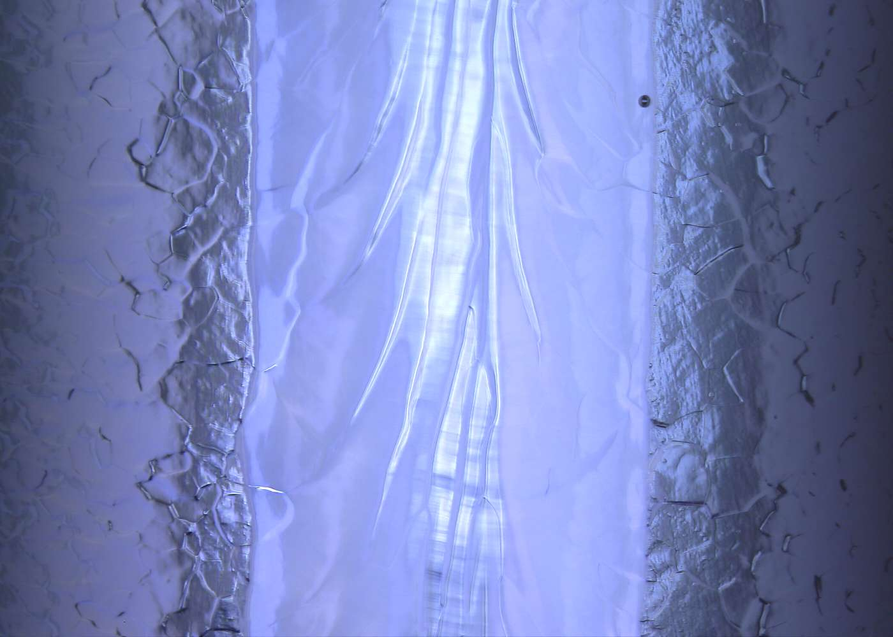
motivation
Surface defects of superconducting rf cavity cause locally enhanced electric and magnetic field, and trigger electron field emissions and thermal magnetic break down. Therefore surfaces must be smooth.

Slide 3
motivation
On and around electron beam welding (EBW) seams, however, defects are often found.
An optimum parameter of EBW to minimize a number of defects should be studied.

Slide 4
motivation
As a first step, we are now studying
Surface condition of Nb before EBW
In this talk, I will focus on the recent study about surface condition before EBW, namely, just after the pre-weld etching by buffered chemical polishing (BCP).

Slide 5
Outline
Existences of carbon including contaminants after BCP
What is the origin of contaminants?
What is the problem?
Removal of contaminants
Summary

Slide 6
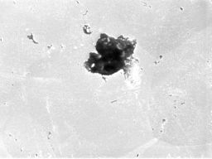
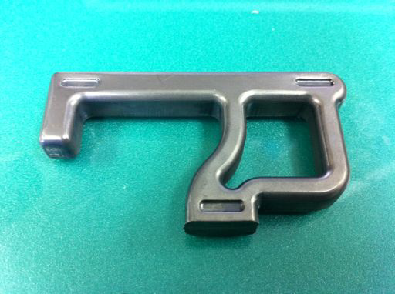
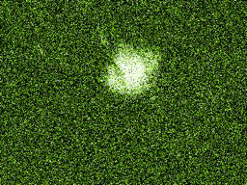
Existences of carbon including contaminants after buffered chemical polishing
In the process of observing the surface of HOM antenna cut by water jet, carbon including contaminants were found.
～10μm
carbon
SEM-EDX
HF rinse (30min) + BCP (200μm) + HF rinse (30min)
Shigeki Kato

Slide 7
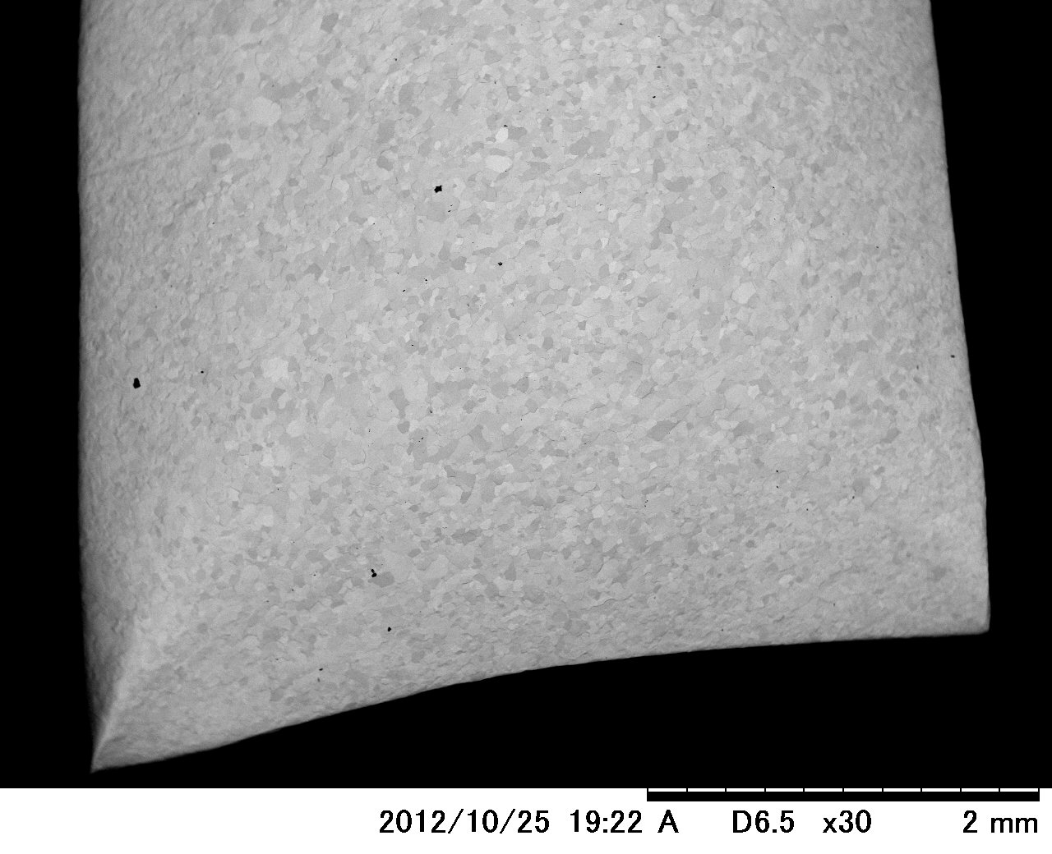
Example of a surface condition just after
BCP + pure water rinsing
Around the same time, similar contaminants were found on Nb pieces just after BCP.

Slide 8
Example of a surface condition just after
BCP + pure water rinsing

Slide 9
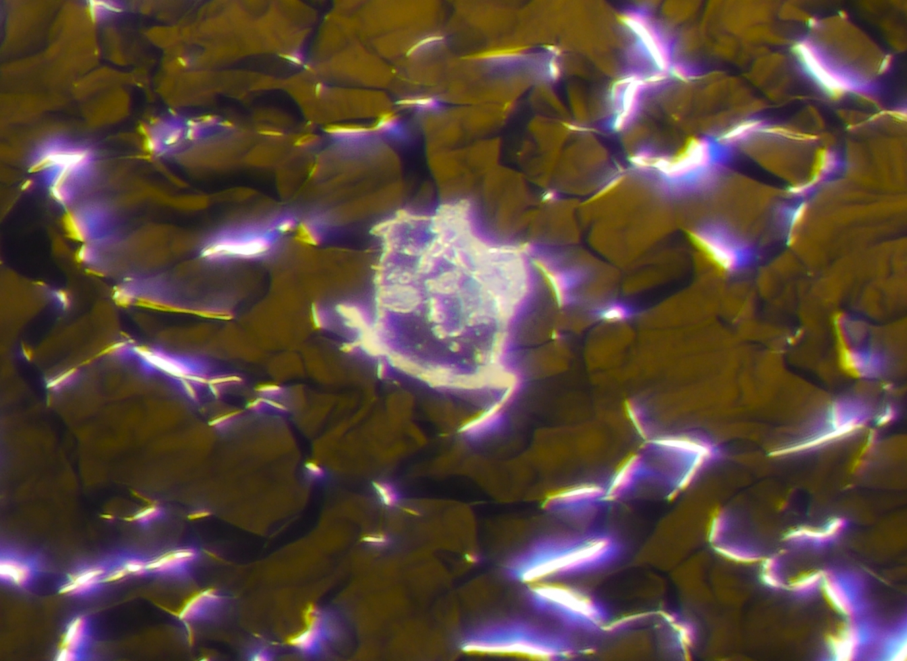
Scanning Electron Microscope
A contaminant is transparent and like a membrane.
Optical Microscope
Motoaki Sawabe

Slide 10
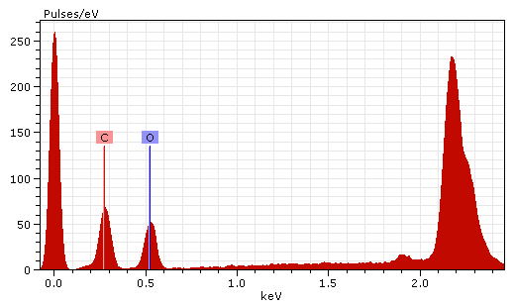
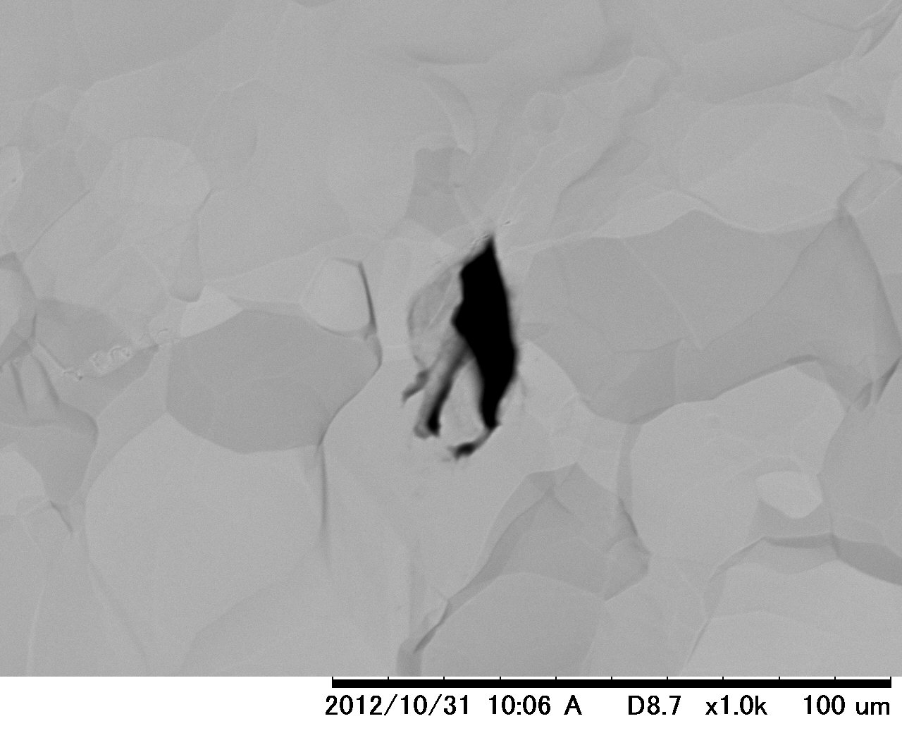
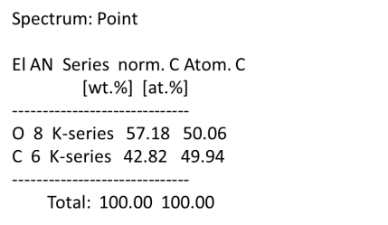
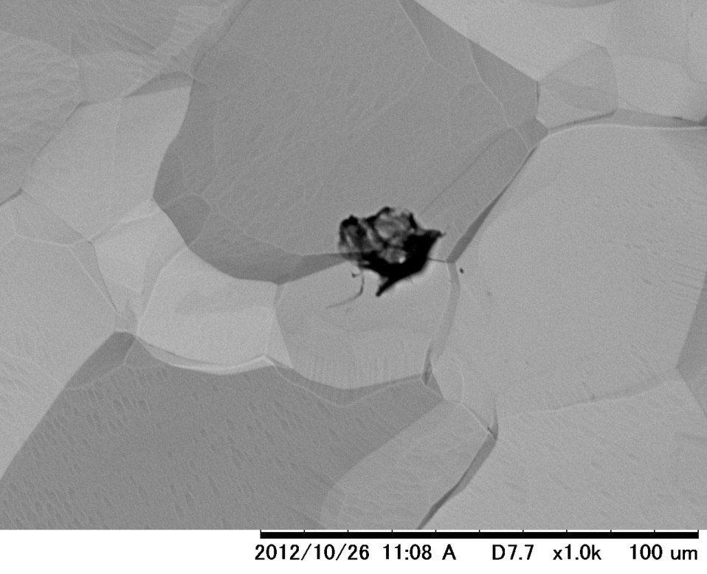
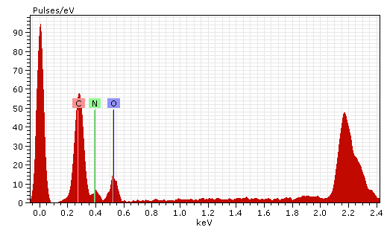
EDX analysis indicates the contaminants contain “carbon”, “oxygen” and sometimes “nitrogen”.
Nb
20μm
Nb

Slide 11
What is the origin of contaminants?
Origin of “carbon including contaminants” have not been understood.
BCP solution container ( PTFE, PFA )?
BCP solution contamination?
From environment?
Carbon in Nb ( < 10ppm)? → likely

Slide 12
BCP solution
BCP solution
BCP
Nb
Interstitial carbon atoms
Nb
Reaction
(Polymerization?)
BCP solution
BCP solution
adhere
Nb
Nb
For the case that 40μm of materials are removed from Nb piece (5mm × 10mm), the volume of dissolved Nb is 2×10⁻³cm³. Its weight is about 2×10⁻²g. This means that 2×10⁻⁷g carbons(10ppm contaminants in Nb) are dissolved or drifting in BCP solution. This corresponds to 1×10⁵μm³ in terms of graphite volume, which is equivalent volume of 1000 pieces of contaminants with 1μm × 10μm ×10μm!
For the case that 40μm of materials are removed from Nb half cell (inner diameter: 56mm, outer diameter: 260mm), the total weight of carbon from Nb corresponds to 2× 10⁻⁴g. This corresponds to 1×10⁸μm³ in terms of graphite volume, which is equivalent volume of 10⁶ pieces of contaminants with 1μm × 10μm ×10μm!

Slide 13
What is the problem?
This means that EBW processes have been carried out under the presence of “carbon including contaminants” so far!
Carbon including contaminants
Nb
Nb
Electron beam
Contaminated EBW environment might be a part of reasons generating pits found on and around EBW seams.
→ Effect on pit formation should be studied.

Slide 14
Pit formation mechanism?
Nb
Nb
Carbon including contaminants
Electron beam
Contaminants and Nb evaporate
Molten Nb
Some contaminants on the molten Nb remain
Molten Nb with contaminants flood into hall

Slide 15
Removal of contaminants
Way of removing the contaminants is under study.
The following methods are effective at present:
Ultrasonic cleansing with degreaser(FM20)
H₂O₂ with UV (decomposition by “OH radical”)
As we will see later,
these methods are effective but not perfect.

Slide 16
Ultrasonic cleansing with degreaser (FM20)

Slide 17
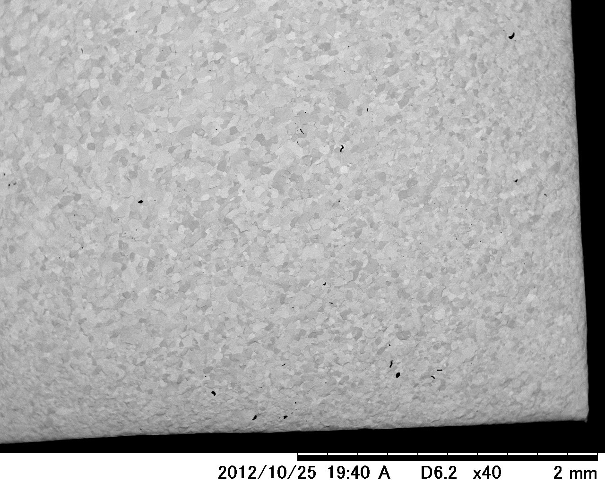
Example of a surface condition just after
BCP + pure water rinsing

Slide 18
Example of a surface condition just after
BCP + pure water rinsing

Slide 19
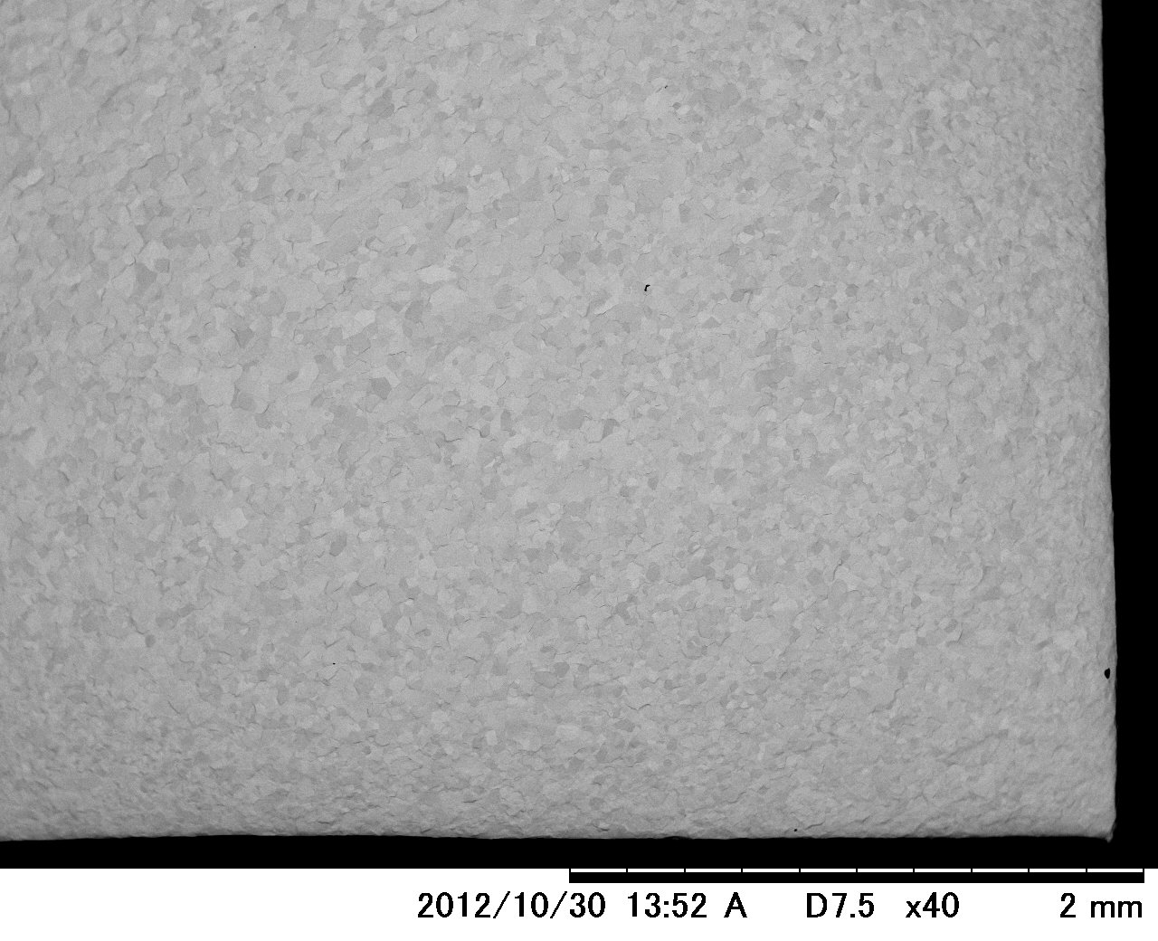
A surface condition just after
Ultrasonic cleansing with FM20 (60min)

Slide 20
A surface condition just after
Ultrasonic cleansing with FM20 (60min)
Effective, but not perfect
residue

Slide 21
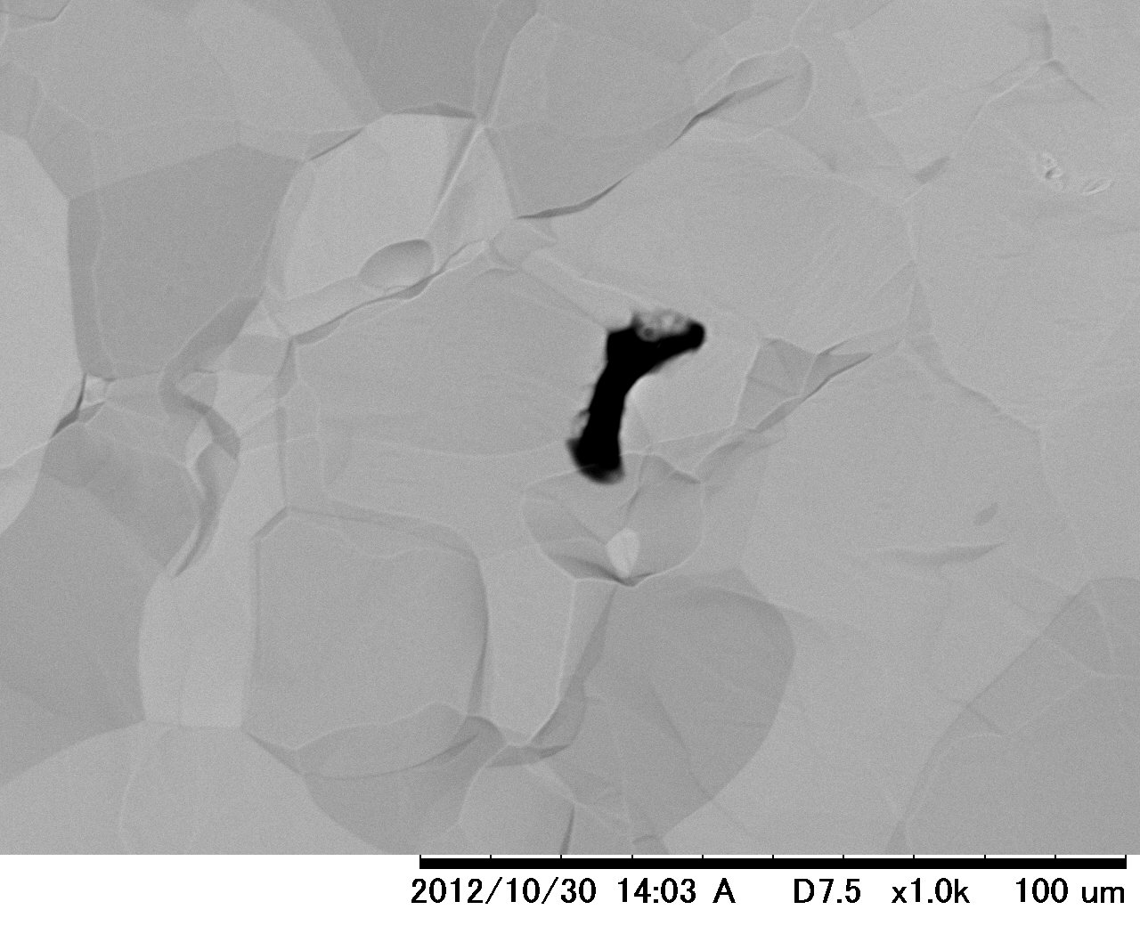
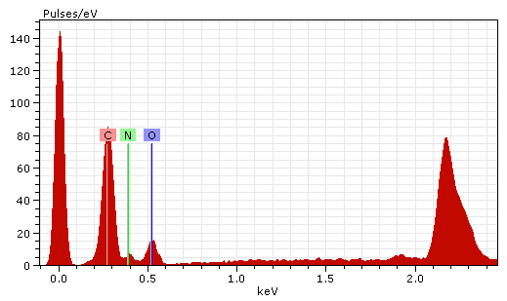
A surface condition just after
Ultrasonic cleansing with FM20 (60min)
Effective, but not perfect
30μm
Nb

Slide 22
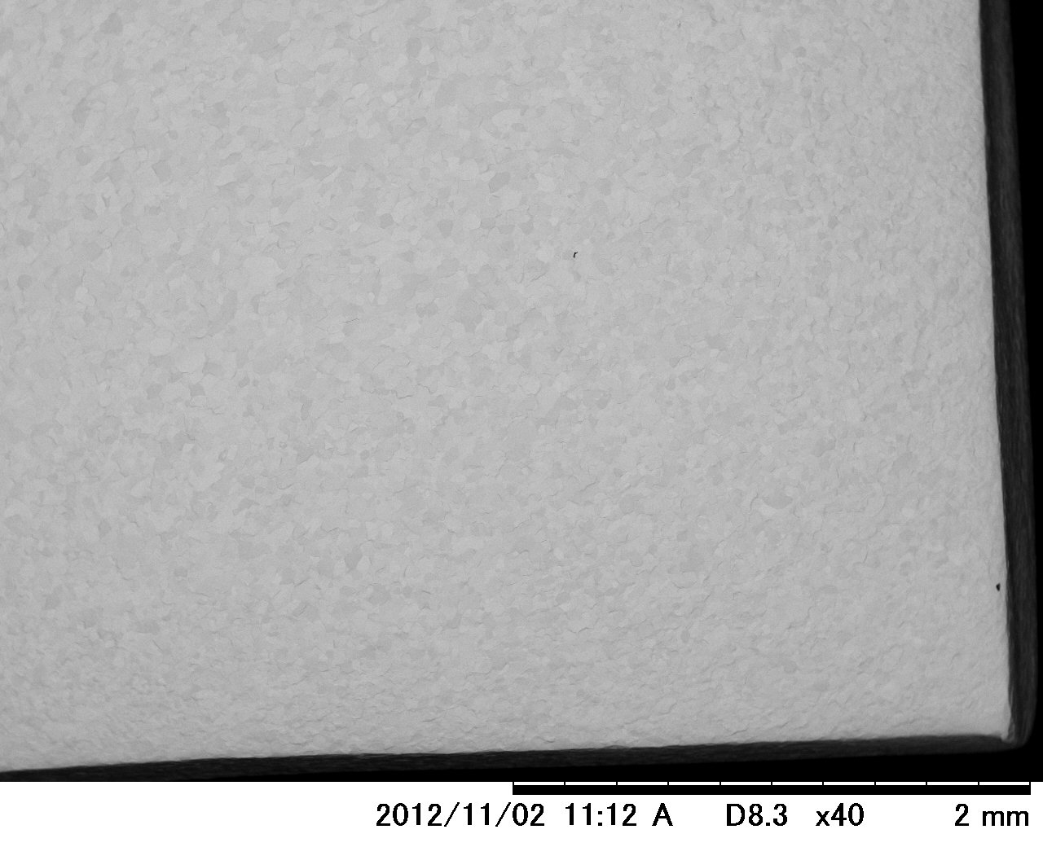
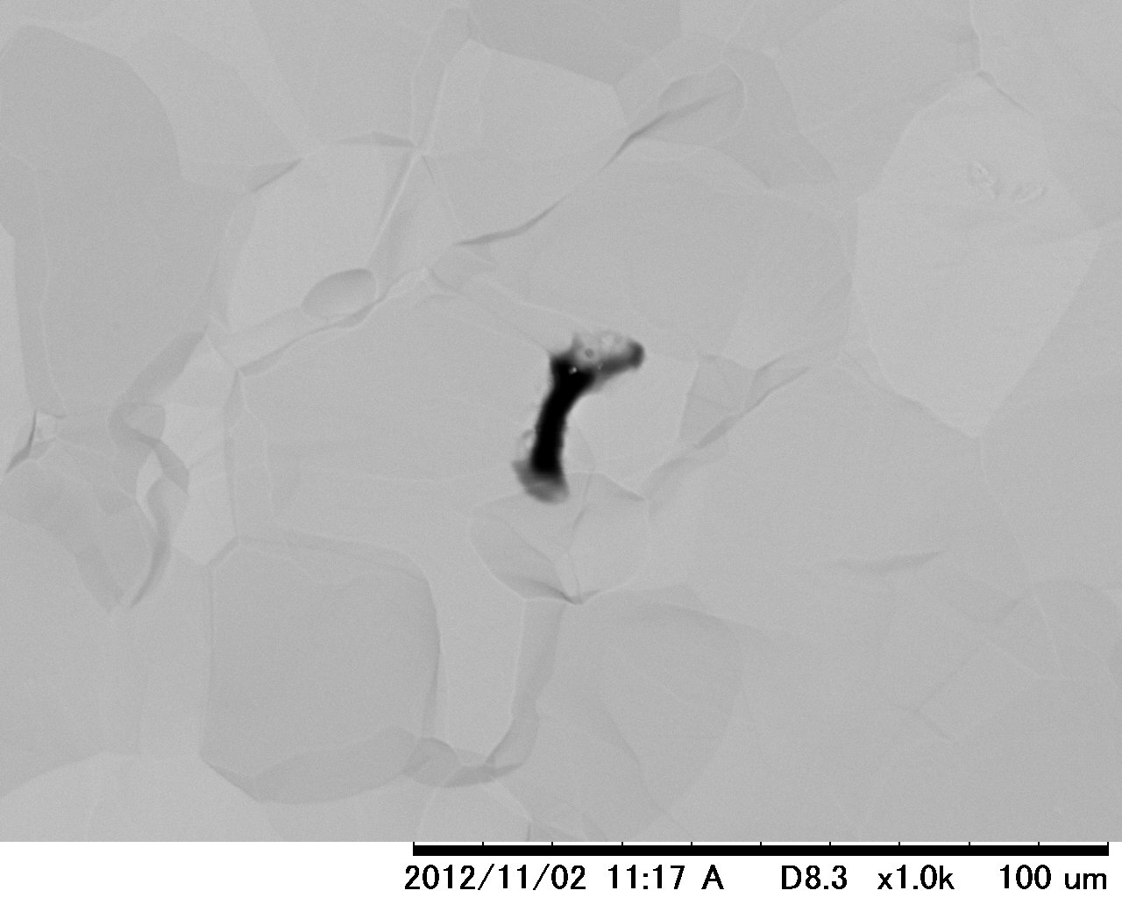
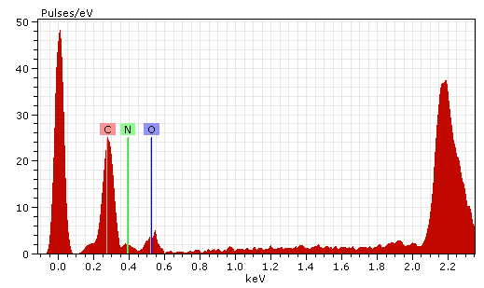
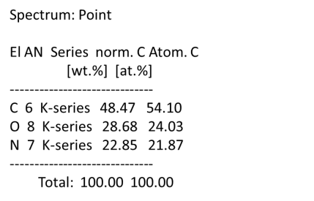
A surface condition just after
Ultrasonic cleansing with FM20 (165min)
Additional 105 min → null effect
30μm
Nb

Slide 23
H₂O₂ with UV (decomposition by “OH radical”)

Slide 24
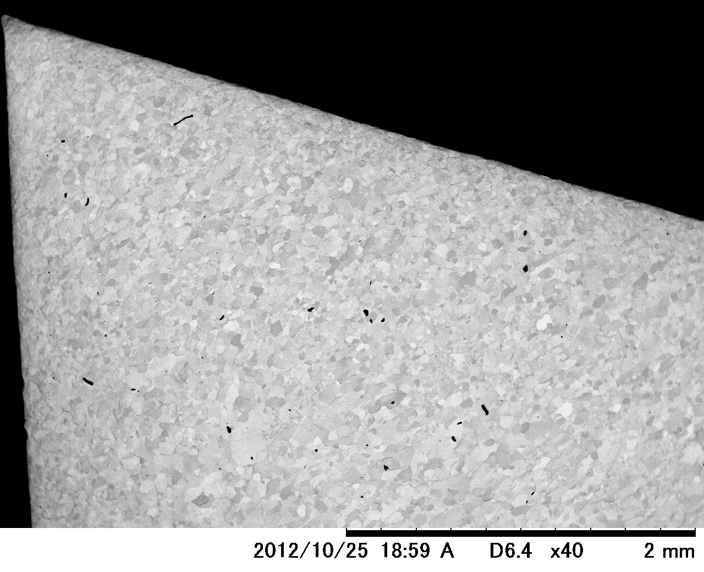
Example of a surface condition just after
BCP + pure water rinsing (Before H₂O₂ with UV)

Slide 25
Example of a surface condition just after
BCP + pure water rinsing (Before H₂O₂ with UV)

Slide 26
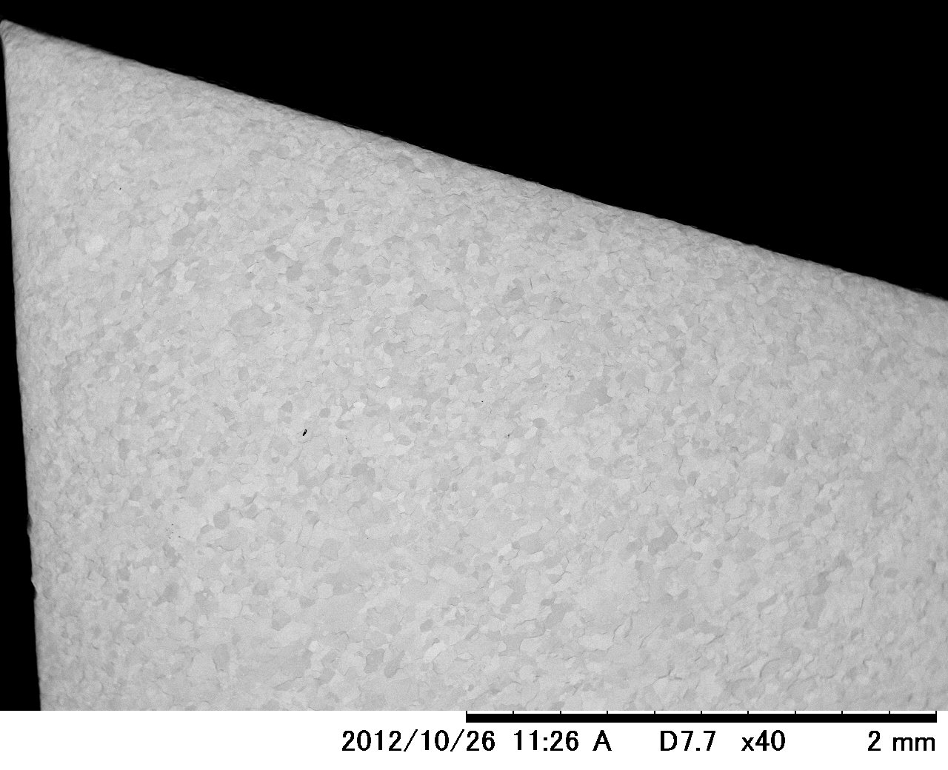
Example of a surface condition just after
decomposition by H₂O₂ with UV irradiation (50min)

Slide 27
Example of a surface condition just after
decomposition by H₂O₂ with UV irradiation (50min)
residue
Effective, but not perfect

Slide 28
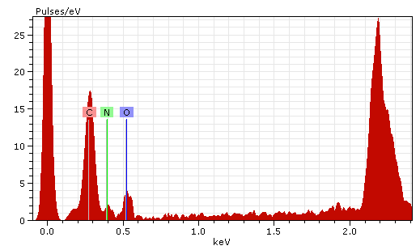
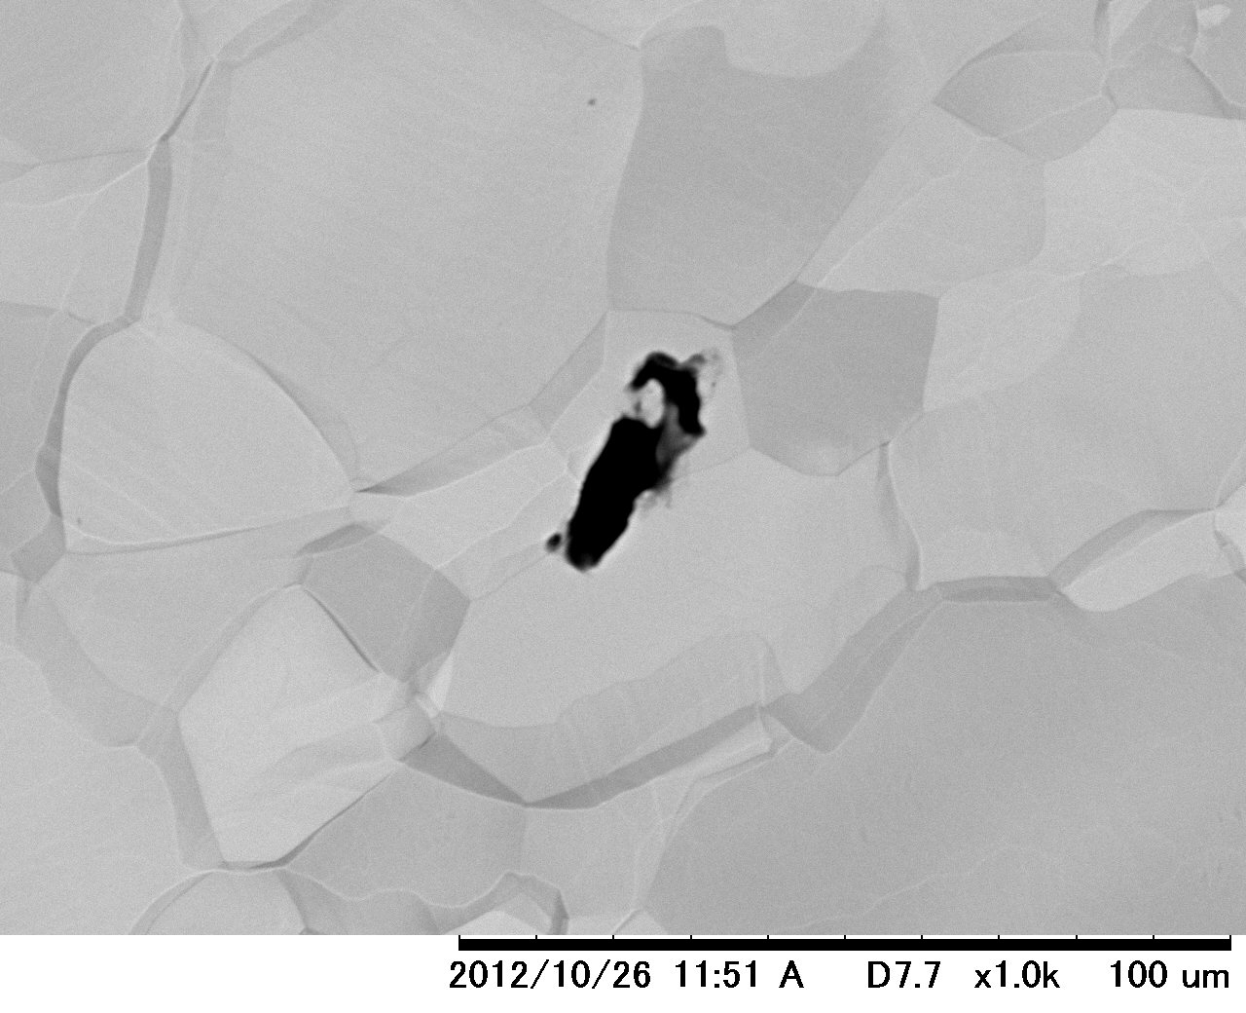
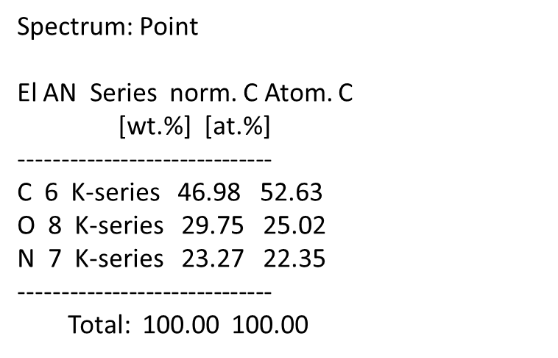
Example of a surface condition just after
decomposition by H₂O₂ with UV irradiation (50min)
Nb
30μm
Effective, but not perfect

Slide 29
Ultrasonic cleansing with degreaser (FM20)
+
H₂O₂ with UV (decomposition by “OH radical”)

Slide 30
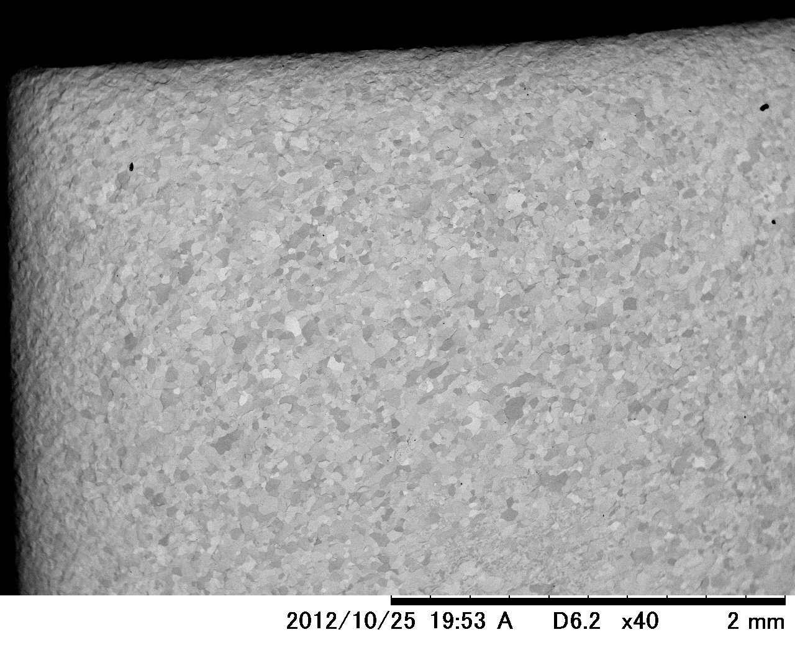
Example of a surface condition just after
BCP + pure water rinsing

Slide 31
Example of a surface condition just after
BCP + pure water rinsing

Slide 32
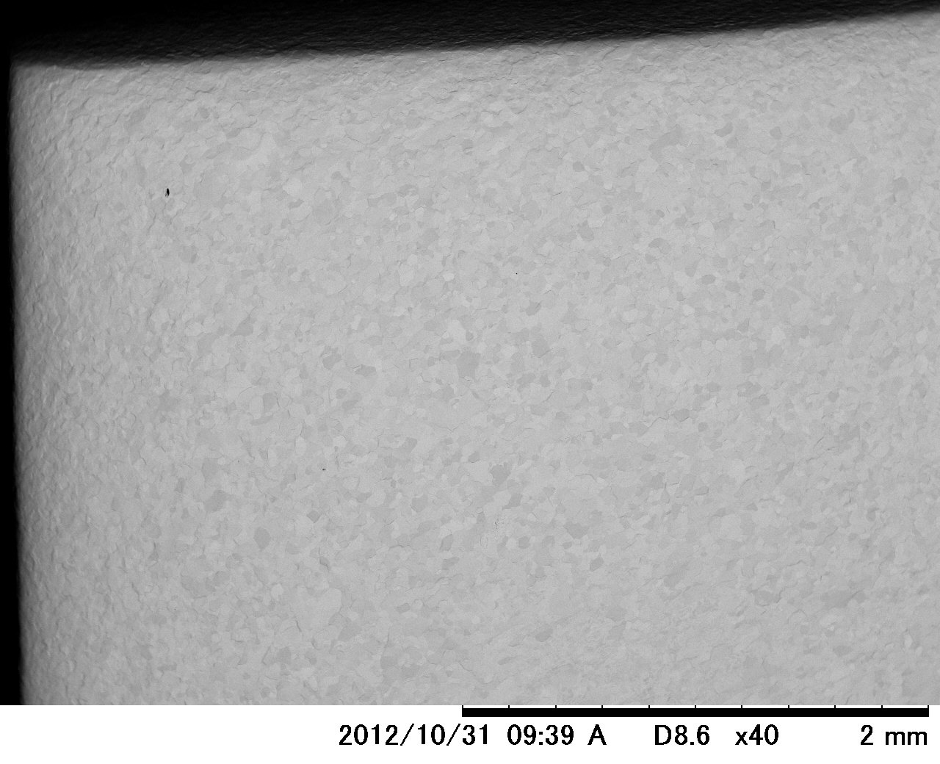
A surface condition just after
Ultrasonic cleansing with FM20 (60min)

Slide 33
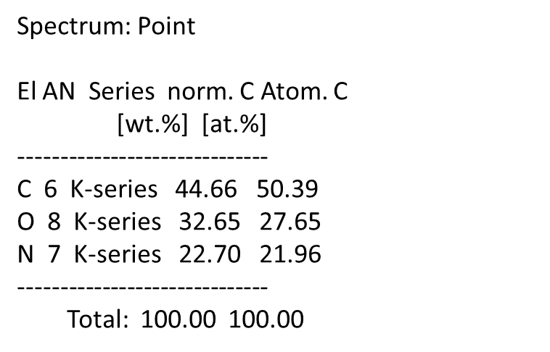
A surface condition just after
Ultrasonic cleansing with FM20 (60min)
Effective, but not perfect

Slide 34
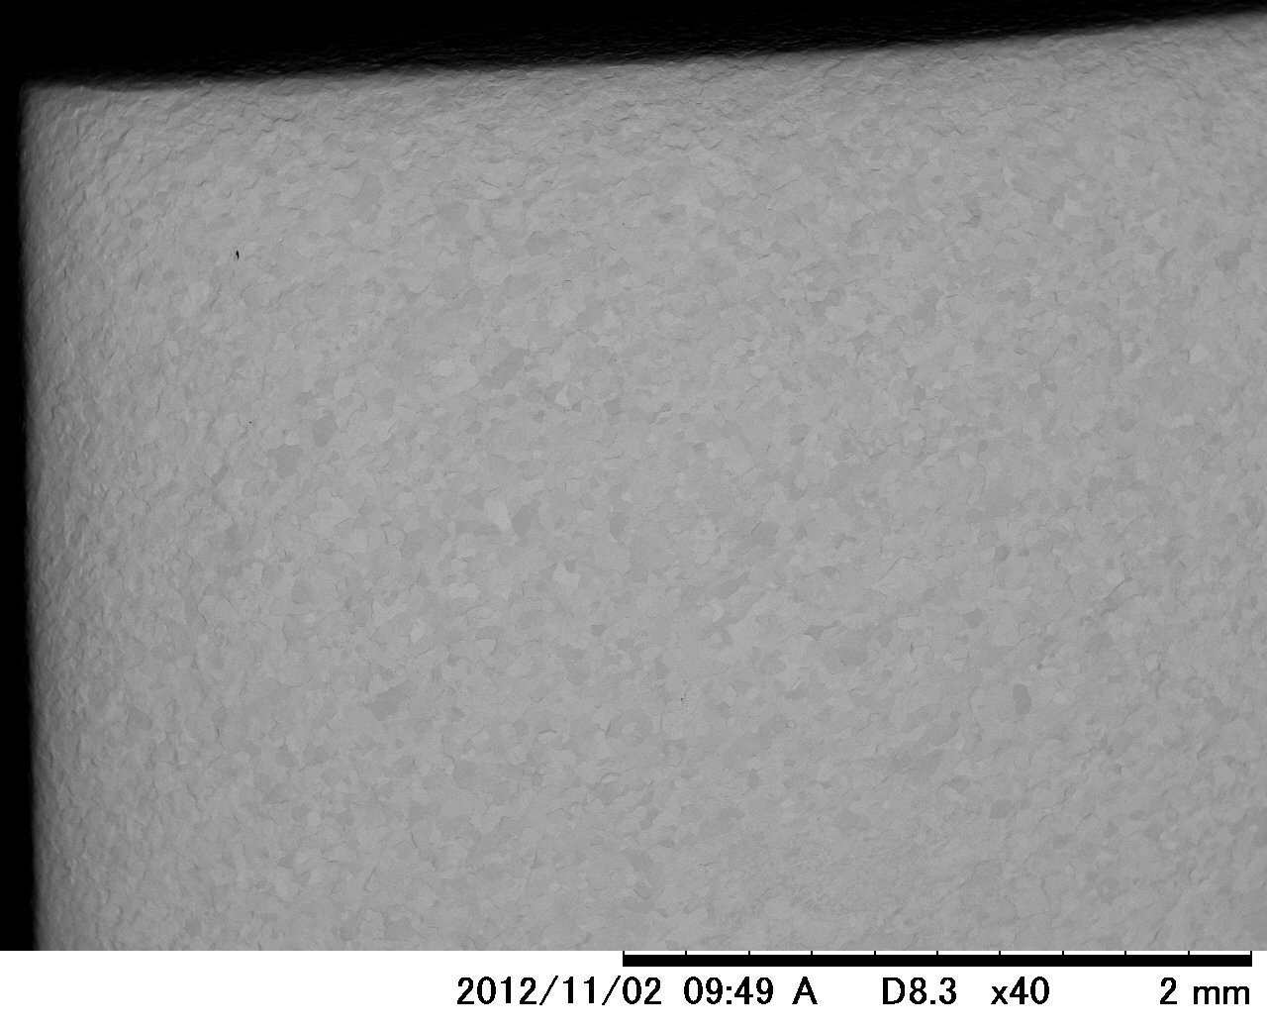
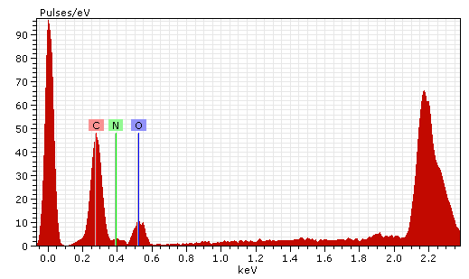
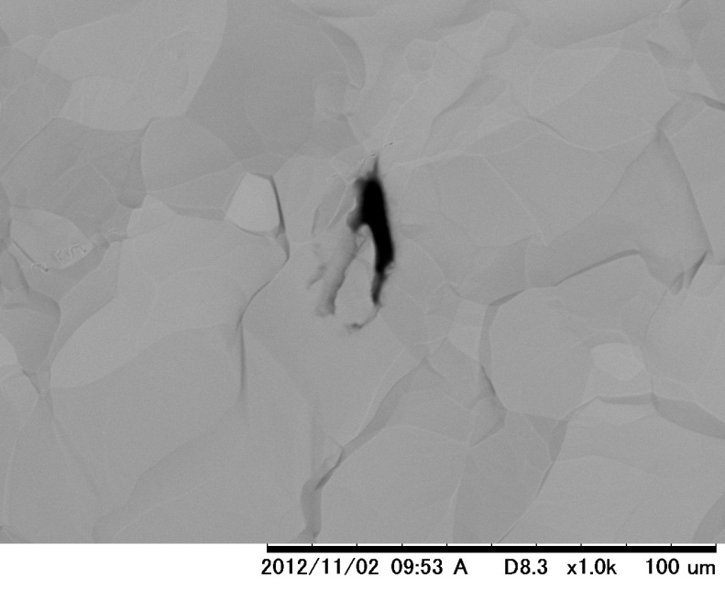
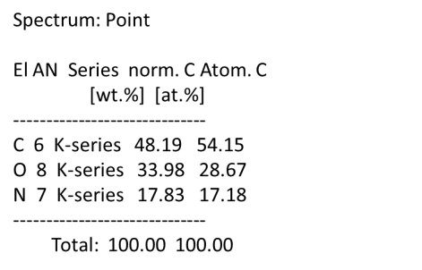
A surface condition just after
H₂O₂ with UV (60min) in addition to Ultrasonic cleansing with FM20 (60min)
Before
After
Not enough

Slide 35
Summary
We found that a lot of contaminants adhere on Nb pieces after BCP.
Contaminants include carbons. However we have not identify their chemical structure.
The origin of carbon has not been identified yet. Carbons in Nb ( < 10ppm) are likely candidates.
Way of removing “carbon including contaminants” is under study. “Ultrasonic cleansing with FM20” and “decomposition by H₂O₂ with UV irradiation” are effective, but a complete removal has not been successful.
Effects on pit formation at EBW seam should be studied.

Slide 38
note

Slide 39
Standard Nb sample for BCP experiments
We prepared Nb pieces as clean as possible in order to check that “carbon including contaminants” are produced in the process of BCP.
procedure
Cut: Cut Nb plate into several pieces by wire-EDM or shear etc.
BCP-1: Chemically polish a Nb piece in order to remove contaminations by cut process such as machine oil, wire-derived copper, and so on.
Remove contaminants after BCP1: There are a lot of carbon including contaminants on the Nb surface. But we do not know whether these contaminants are originated from BCP-1 itself or machine oil before BCP-1. Therefore we remove these contaminants and consider a obtained piece as a standard Nb sample.
BCP-2：BCP is applied to the standard Nb sample obtained through the above processes.
Observe

Slide 40
Removal of contaminants
Way of removing the contaminants is under study.
So far we have tested the following method:
Ultrasonic cleansing with acetone
Ultrasonic cleansing with pure water
HF rinse
Ultrasonic cleansing with HF
EP solution rinse
Phosphoric acid rinse
brushing
Etching by H₂O₂ including BCP solution
H₂O₂ with UV (decomposition by ・OH radical)

Slide 41
Ultrasonic cleansing with acetone

Slide 42
A surface condition just after
BCP + pure water rinsing

Slide 43
A surface condition just after
BCP + pure water rinsing

Slide 44
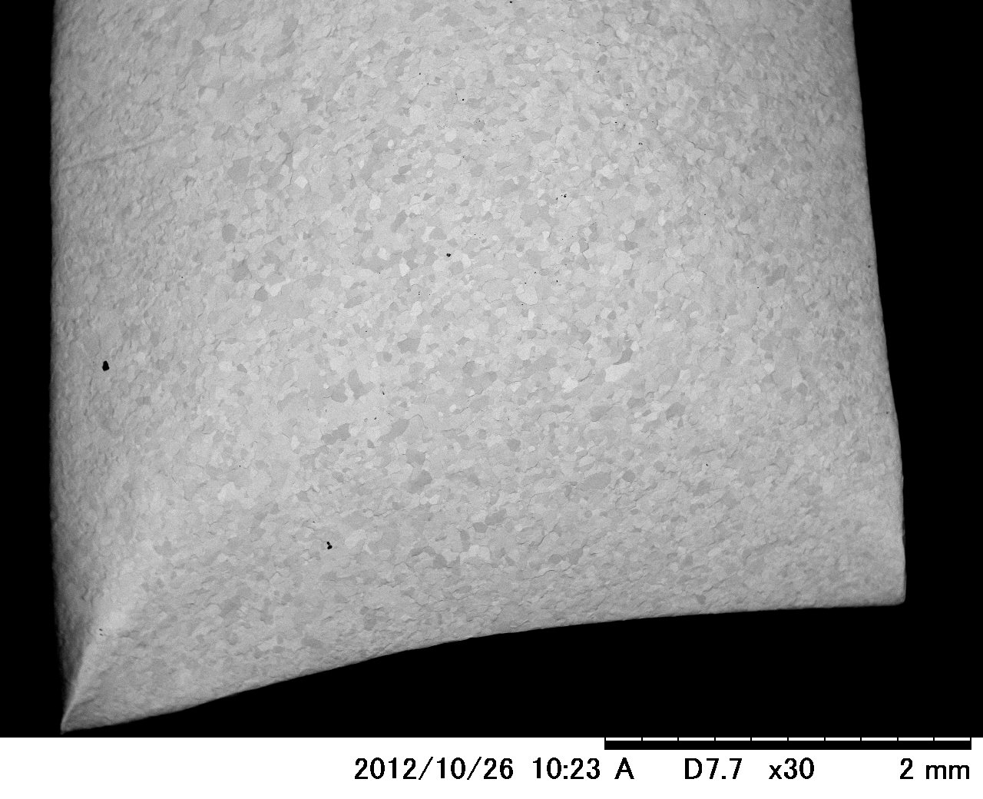
A surface condition just after
Ultrasonic cleansing with Acetone (35min)

Slide 45
A surface condition just after
Ultrasonic cleansing with Acetone (35min)
redeposition
residue
We can not remove “carbon including contaminants” by ultrasonic cleansing with acetone.

Slide 46
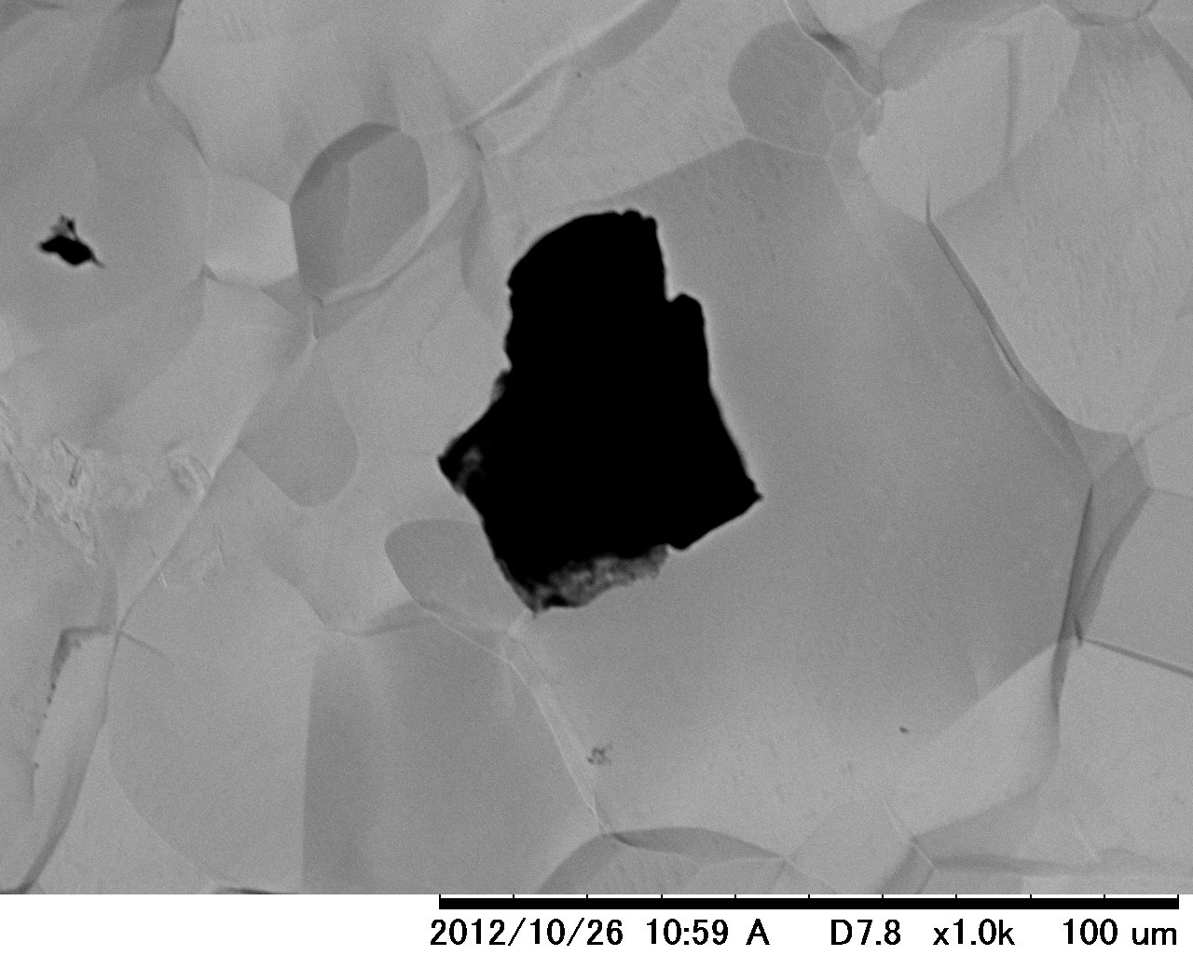
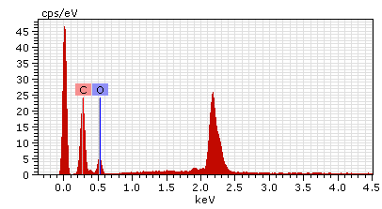
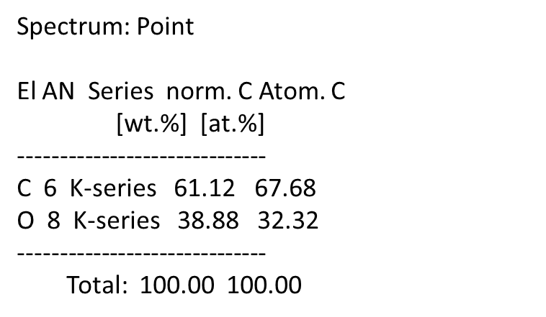
A surface condition just after
Ultrasonic cleansing with Acetone (35min)
40μm
Carbon and oxygen
Nb

Slide 47
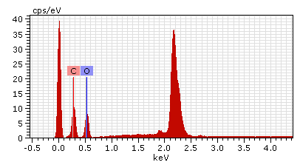
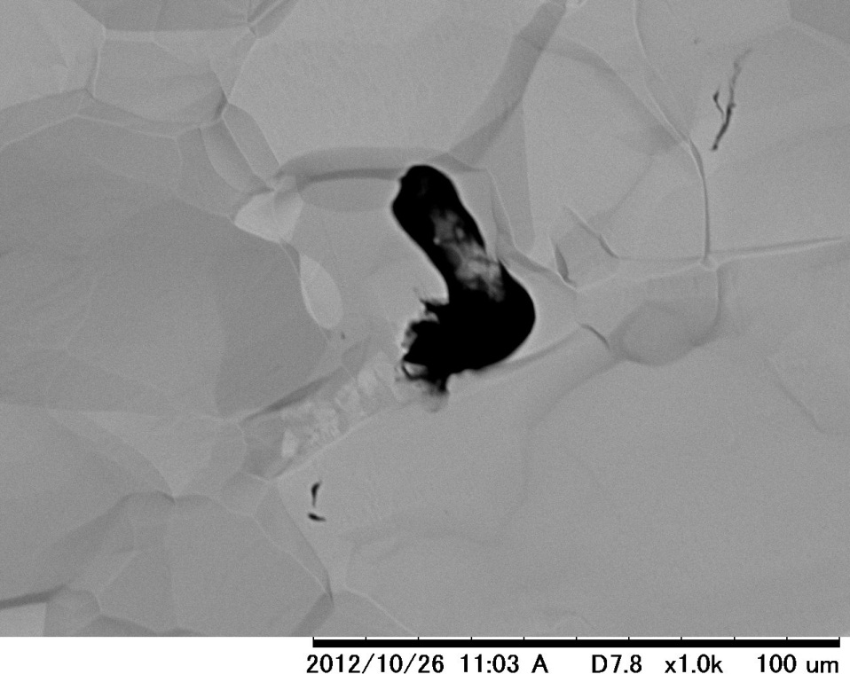
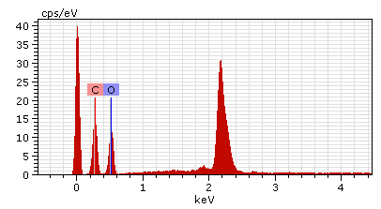
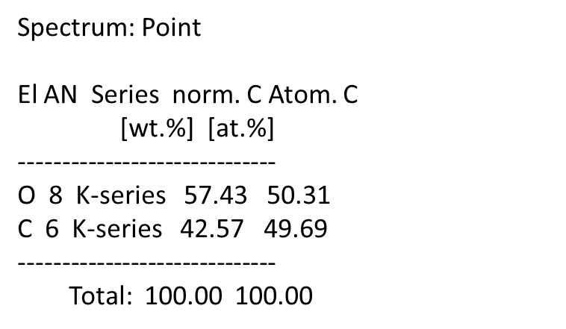
A surface condition just after
Ultrasonic cleansing with Acetone (35min)
Carbon and oxygen
20μm
Nb
20μm
Carbon and oxygen
Nb

