Slide 1
Closing Remarks
We have been beautifully hosted by the Thomas Jefferson National Accelerator Facility, a première. Many thanks to:
Charles Reece
and his JLab colleagues for the perfect organisation,
in particular that of the visit of Jlab facilities with about 100 visitors.
Many thanks to:
Fulvia Pilat, John Mammosser, Robert Rimmer
and Andrew Hutton for making it possible.

Slide 2
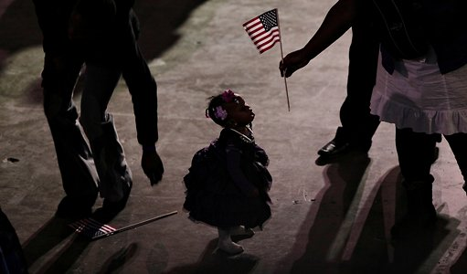
The TTC has a future, see you in 2014

