Slide 1
TESLA Technology Collaboration
JLab, 5-8 November 2012
Collaboration Board Report
O.Napoly, CEA-Saclay
TTC Chairman

Slide 2
It’s TTC, …
TTC has:
a mission
a scope
a policy
two means
Total 1h30’

Slide 3
TTC Mission
MoU says:
“The mission of the TESLA Technology Collaboration (the Collaboration) is to advance SCRF technology R&D and related accelerator studies across the broad diversity of scientific applications, and to keep open and provide a bridge for communication and sharing of ideas, developments, and testing across associated projects.”
Total 1h30’

Slide 4
TTC Scope
Total 1h30’

Slide 5
TTC Policy
MoU says:
“(1) Subject to the provisions of laws applicable to Member Institutions and subject to the agreement of eventually involved third parties the Members will make all efforts to make available to each other free of charge, in writing or in any other appropriate form, the knowledge in their possession relevant for the purposes of the Collaboration.
(2) Each Member may use scientific or technical information generated in the frame of the Collaboration for its own internal research and development purposes, free of charge. Any commercial use of any such information shall be the subject of a separate agreement to be negotiated by the Members on a case-by-case basis.”
Total 1h30’

Slide 6
TTC Means
Technical Annex to the MoU,
e.g. the DESY-FNAL agreement about the construction for the 3.9 GHz FLASH module
TTC Meetings
Total 1h30’

Slide 7
About this Meeting
We heard many remarks
“Not enough time for discussion”
“It’s like a conference”
“No time for questions”
Indeed, counting the number of talks with technical content:
TTC@Beijing : 49 talks in 19:45‘ → 0:24‘ / talk
TTC@JLab : 59 talks in 18:40‘ → 0:18‘ / talk
Total 1h30’

Slide 8
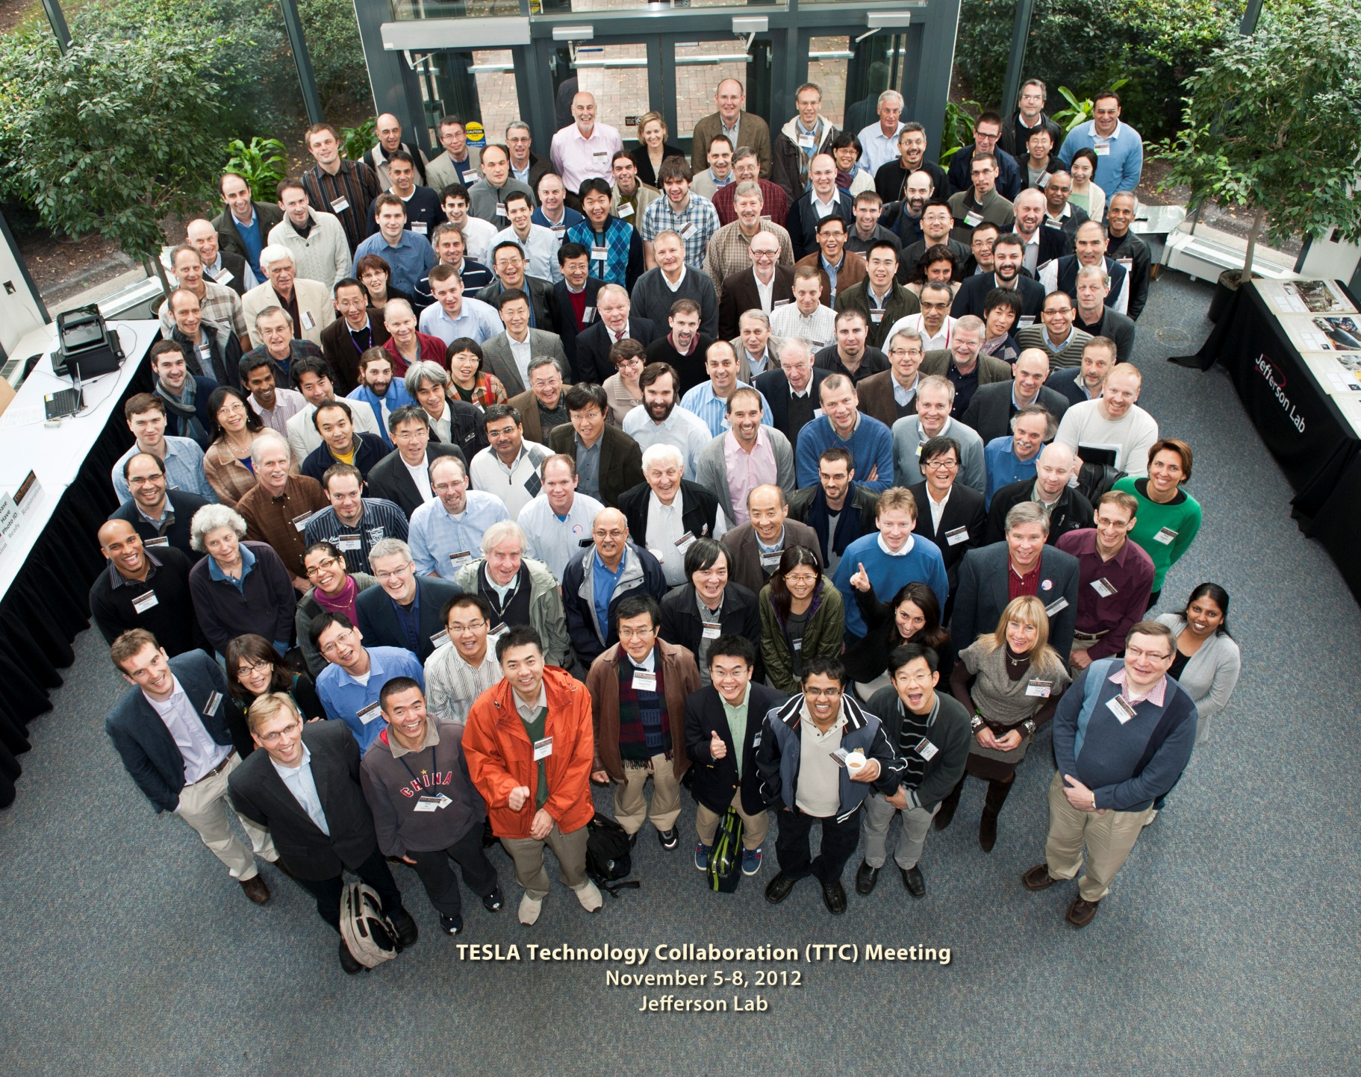
The Program Committee

Slide 9
About the next Meeting
Our community is growing (sign of success)
in the number of labs
in the number of accelerator projects
in the number of applications
Several solutions:
Define the scope of the meeting
Shorten the time for Reviews
Focus on technical advances or difficulties

Slide 10
Collaboration Board Meeting Agenda
Approval or addition to agenda
Approval of the minutes of the last meeting (sent on December 23, 2011)
Summary of ‘Chairmen’ activities over past 8 months
Update on MoU signatures and TTC Membership
Comments/Approval by CB of TB composition
Update of the TTC Web site
Coordination with other SCRF meetings
Venue and date of the next TTC Meeting
Venue and date of the next TTC CB meeting
Contacts for future applications (SCK-CEN, etc….)
Application of SOLEIL Synchrotron Laboratory (France)
Total 1h30’

Slide 11
Participants
Present in person: Chris Adolphsen (SLAC), Ilan Ben-Zvi (BNL), Sebastien Bousson (IN2P3 Orsay), Sergio Calatroni (CERN), Jiyuan Zhai (IHEP) Camille Ginsburg (FNAL, Deputy Chair), Hitoshi Hayano (KEK), Wolfgang Hees (ESS-AB), Walid Kaabi (IN2P3 LAL), Sang-Ho Kim (ORNL-SNS), Jens Knobloch (HZB), Bob Laxdal (TRIUMF), Peter McIntosh (STFC), Paolo Michelato (INFN-Milan), Olivier Napoly (CEA, Chair), Fulvia Pilat (JLAB), Nobu Toge (KEK, TTC-TB Chair), Hans Weise (DESY), Russell Wells (LBNL), Richard York (MSU)
By WebEx: Susanna Guiducci (INFN Frascati), Georg Hoffstaetter (Cornell University), Wolfgang Mueller (TU Darmstadt)

Slide 12
SOLEIL Synchrotron Laboratory in TTC
Application for TTC membership was presented by M. Diop (SOLEIL)
SOLEIL Synchrotron Laboratory is a 3rd generation light source locate on the Saclay campus

Slide 13
SOLEIL Synchrotron Laboratory in TTC

Slide 14
SOLEIL Synchrotron Laboratory in TTC
RF cryomodule for the storage ring (x2)

Slide 15
SOLEIL Synchrotron Laboratory in TTC
Solid State Amplifier for the booster RF at 352 MHz

Slide 16
SOLEIL Synchrotron Laboratory in TTC

Slide 17
SOLEIL Synchrotron Laboratory in TTC
The Collaboration Board Members unanimously supported the SOLEIL application, with particular emphasis that their extensive RF power experience/activity would benefit TTC.
Congratulations !

Slide 18
Next Events: 2013
CERN Accelerator School on “Superconductivity for Accelerators”, 27 April-4 may 2013 http://cas.web.cern.ch/cas/Erice-2013/Erice-advert.html
SRF Conference in Paris on 22-28 September 2013
including a TTC Collaboration Board meeting to
invite potential new Members
define the focus of the programme of the next meeting
General elections in Germany Sept-Oct 2013

Slide 19
Next Events: 2014
European General Elections, 5-8 June 2014
TTC meeting at DESY, spring 2014
It is important to select the dates as soon as possible. (IPAC14 Dresden is June 2014.)
around ‘XM40’ XFEL cryomodule …

Slide 20
Thank you for your attention

