Slide 1
Design and construction of a prototype Main Linac Cryomodule for Cornell's ERL
Ralf Eichhorn
Cornell
on behalf of
Paul Bishop, Benjamin Bullock, Brian Clasby, Holly Conklin, Joe Conway, Brendan Elmore, Fumio Furuta, Andriy Ganshyn, Mingqi Ge, Terri Gruber, Yun He, Vivian Ho, Georg Hoffstaetter, Roger Kaplan, John Kaufman, Gregory Kulina, Matthias Liepe, Tim O’Connell, Hassan Padamsee, Peter Quigley, John Reilly, Dave, Rice, James Sears, Valery Shemelin, John Sikora, Eric Smith, Karl Smolenski, Maury Tigner, Vadim Veshcherevich

Slide 2
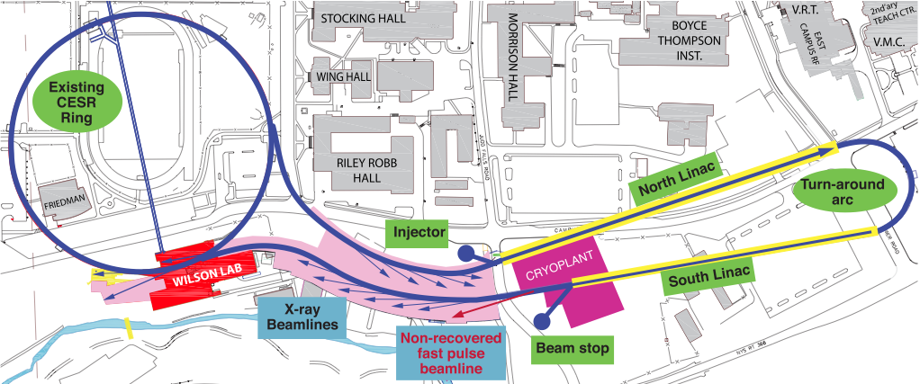
Cornell ERL parameters
5 GeV, 100 mA, 8 pm emittances, 2 ps bunch length,
16 M/m cw , Q > 2*10¹⁰, 200 W HOM power per cavity,

Slide 3
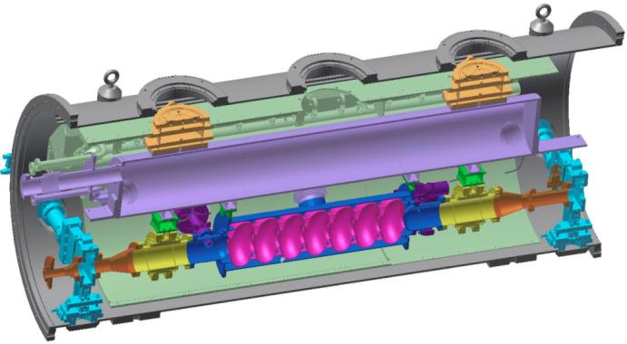
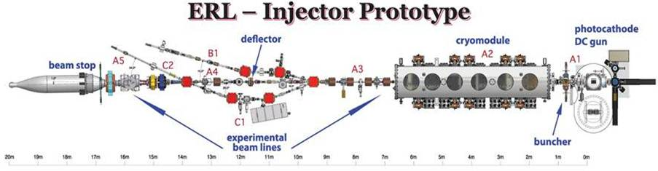
Phase 1 R & D
HGRP
Horizontal Test Cryostat:
16MV/m, 1.8K: Q0 = 2.E10
(reached with coupler)
Q0 = 3.5E10 without coupler
Q0 with 2 HOM absorbers to be measured in January 2013.
80K shield
HOM load
cavity
HOM load
Gate valve

Slide 4
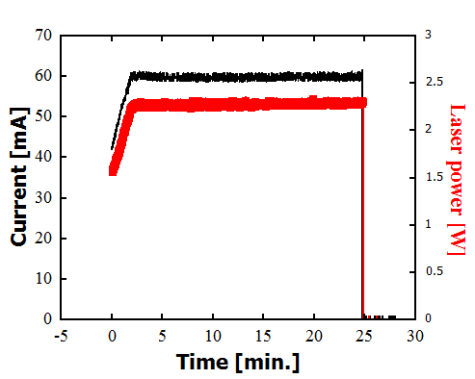
Injector High Current Operation
Using a CsK₂Sb photocathode
(QE of 6-8%)
Maximum current of 65 mA
(1300 MHz CW, 4 MeV)
Ran 60 mA (1300 MHz CW, 4 MeV)
for 20+ minutes without a trip
Ran 50 mA for 8 hours, 40 minutes
max without a trip
Ran 35 mA for 3 hours without
a trip
Previous world record was 35 mA
(Boeing RF gun)
11/02/12

Slide 5
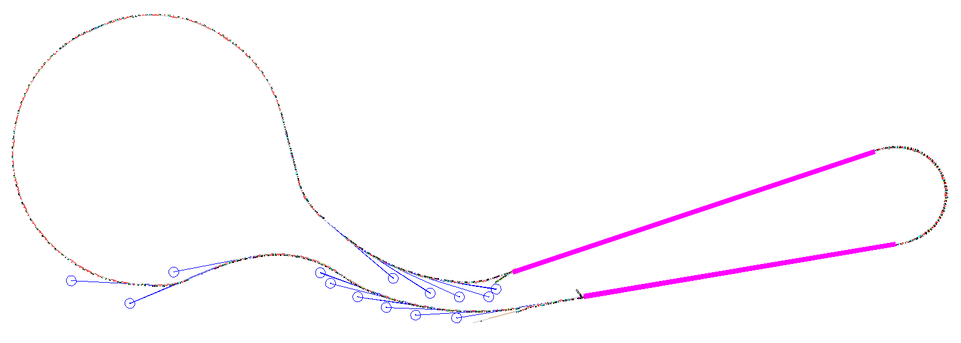
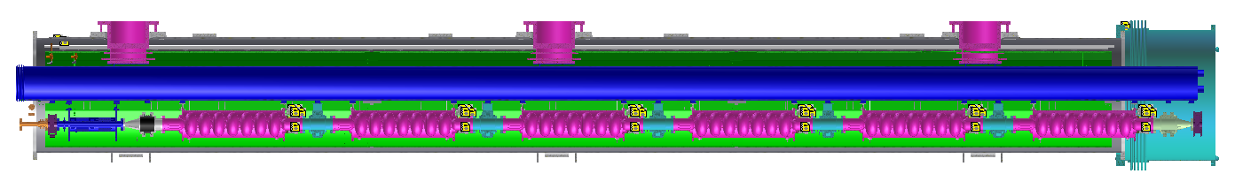
Linac cryomodule for the ERL
Linac A
344 m with 35 cryomodules
Total 64 cryomodules, each:
six packages of 7-cell cavity/Coupler/tuner
a SC magnets/BPMs package
five regular HOMs/two taper HOMs
Linac B
285 m with 29 cryomodules
SC magnets & BPMs
7-cell cavity
Beamline HOM absorber
nominal length: 9.8 m
Intermodule unit

Slide 6
ERL Linac Cryomodule Philosophy
Use the same cryomodule concept in the injector and the main linac.
  Reduces risk
Rely on well established and tested performance of the TTF III technology to reduce risk, cost and minimize development time.
  Some improvements
  Cavities supported by large diameter Helium-gas return pipe (HGRP)
  All cryogenic piping inside of cryomodule
  Some changes needed
Further simplify and reduce cost.

Slide 7
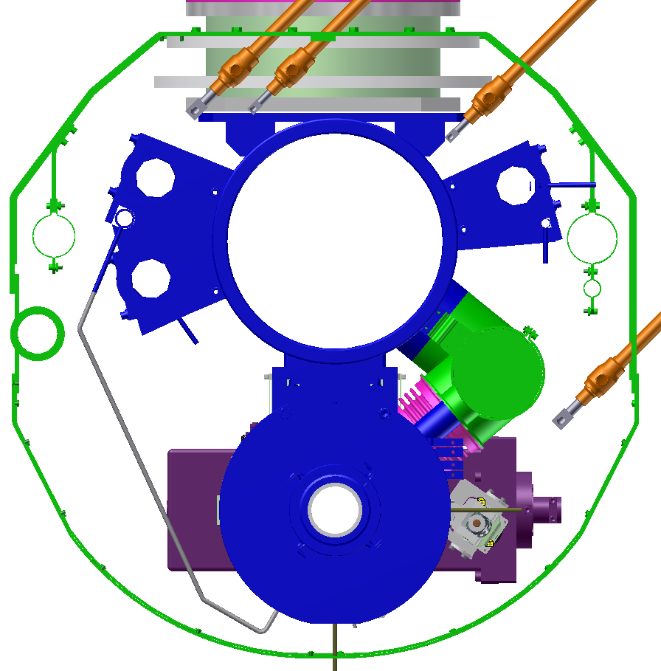
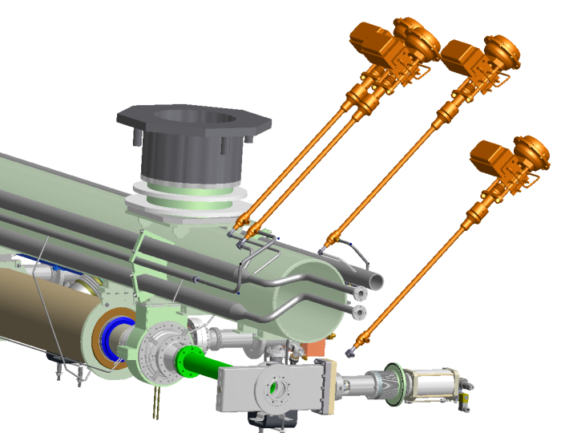
Cryogenic manifolds: six lines
1 line for 2K supply | subcooled liquid @1.2 bar | 2K helium bath for cavities via 2K-2 phase line pre-cool gas for cool-down 90% heat load from RF losses in the cavities
2 lines for 4.5-6K | 3.0 bar He liquid Single phase flow | Thermal intercept for HOM absorbers and couplers 2/3 dynamic heat load
3 lines for 40-80K | 20 bar He gas | Thermal intercept for HOM absorbers and couplers 40K thermal shield, low thermal expansion rate over 40-120K range 90% heat load from HOM
2K supply
subcooled liquid @1.2 bar
6K return
Gas @3 bar
40K supply
Gas @20 bar
HGRP
1.8K gas
80K return
Gas @18 bar
40K delivery
Gas @20 bar
2K-2 Phase
1/3 full level
4.5K supply
Fluid @3 bar
2K

Slide 8
Cryomodule Design
Changes compared to a TTF cryomodule:
  Increase the diameter of the cavity helium vessel chimney to 10 cm for the high CW heat load.
  Include a JT valve in each cryomodule for the high CW heat load.
  Increase the diameter of the 2-phase 2K He pipe to 10 cm for the high CW gas load.
  Do not include a 5K shield.
  Implement beamline HOM loads for strong broadband damping of HOMs generated by the high current and short bunches.
  Use a low average power coax RF input coupler per cavity, with lateral flexibility for cool down and fixed coupling.

Slide 9
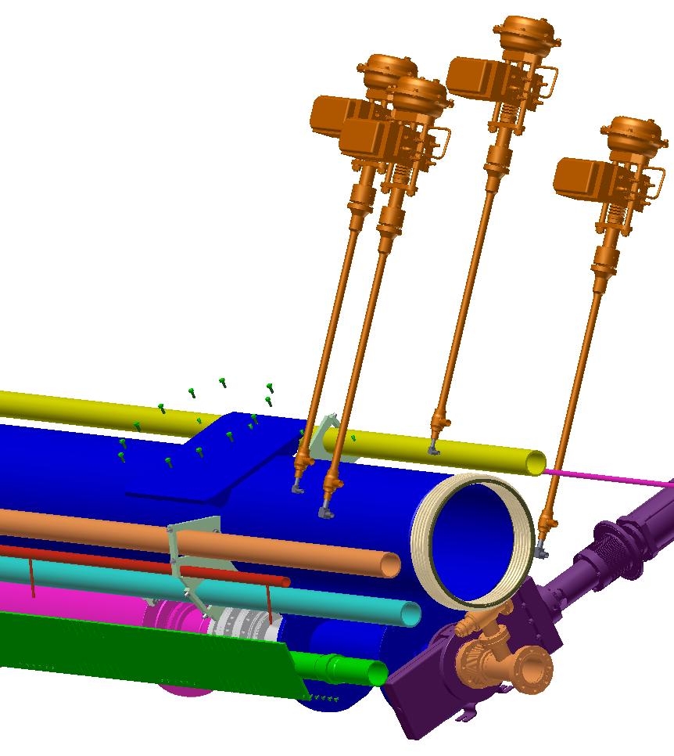
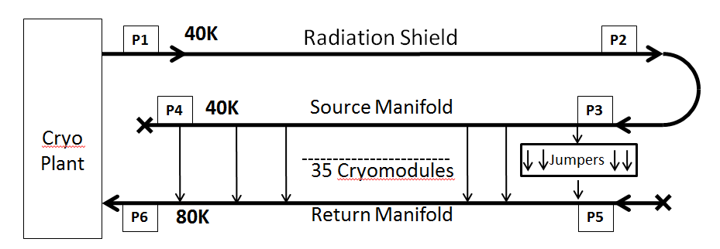
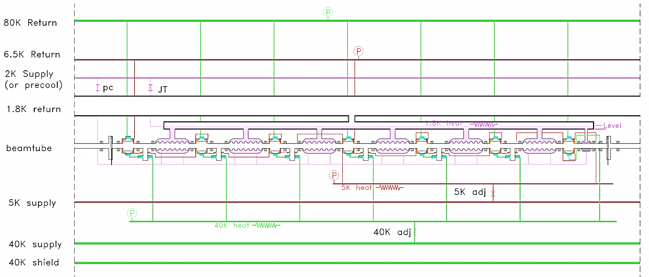
Cryogenic sketch of one Module
2K, 5K and 40K supply pipes run for the entire half linac
4 Valves control flow into local distribution lines:
1.8 K
Pre-cool
5 K
40/80 K
Inside each cryomodule

Slide 10
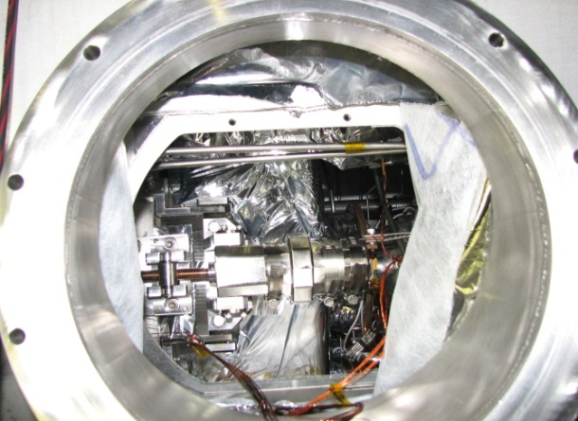
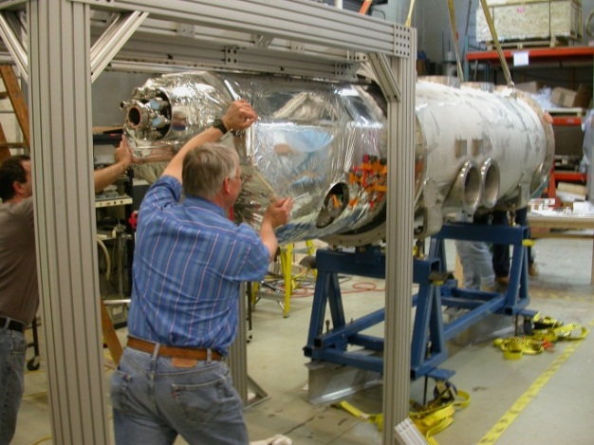
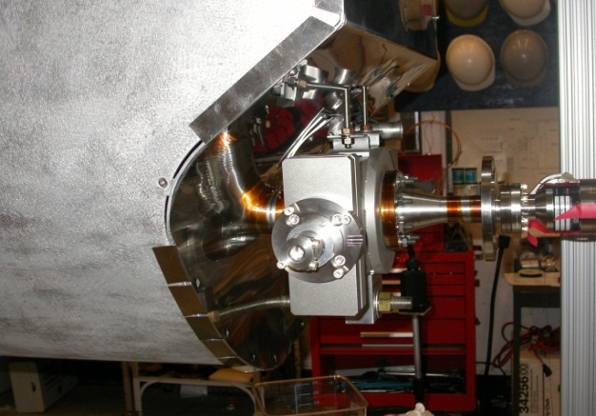
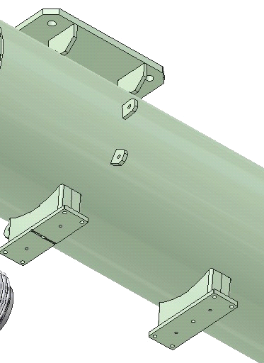
Design “Innovations”
Tuner stepper replaceable while string is in cryomodule
Rail system for cold mass insertion
Gate valve inside of module with outside drive
Precision fixed cavity support surfaces between the beamline components and the
HGRP -> easy “self”
alignment

Slide 11
Cool-Down shrinkage
Axial displacement due to thermal contractions of materials at cold
Components | Material | Temperature | ∆L/L | ∆L
HGRP | Ti | 300K-2K | 0.172% | 17 mm
Thermal shield | Al 1100 | 300K-40K | 0.350% | 34.5 mm
Beamline (cavity) | Nb | 300K-2K | 0.146% | 14.5 mm
Sliding post
Fixed point
Sliding post
9.8 m, vacuum vessel at room temperature
7.5 mm -- HGRP
Axial displacement is allowed by:
Sliding post
Cavity flexible support
Key alignment of component supports
Coupler design allows an offset of 10 mm
Bellows in HOMs
9.5 mm -- HGRP
15.5 mm – thermal shield
19 mm – thermal shield
6.5 mm – beamline
8 mm – beamline
1 mm – cavity LHe vessel

Slide 12
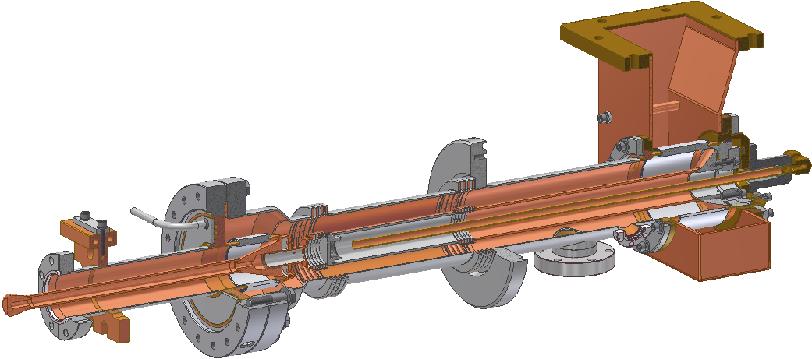
Input Coupler
Most of the Parts:
316 Stainless Steel
with 5m Copper Coating
Waveguide Flange
Warm Ceramic Window
40K Flange
Air Cooling
40K He Gas
Cooling
300K Flange
Cavity
Flange
(2K)
Bellows
Instrumentation Port
Pump Port
Antenna
(Solid Copper)
5K Intercept
Cold Ceramic Window

Slide 13
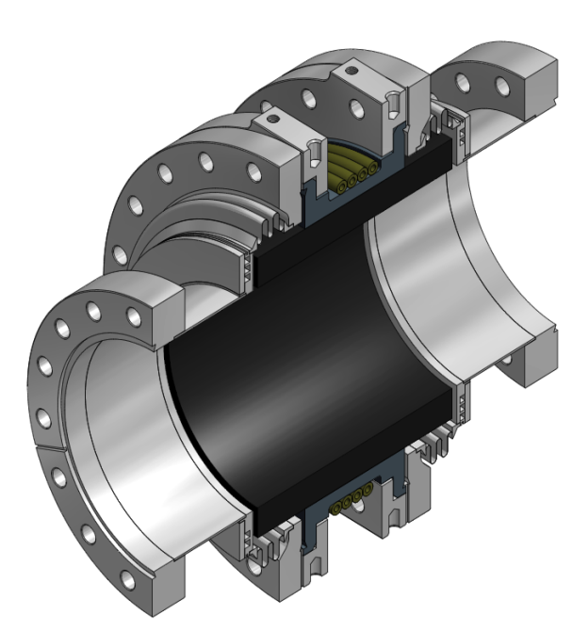
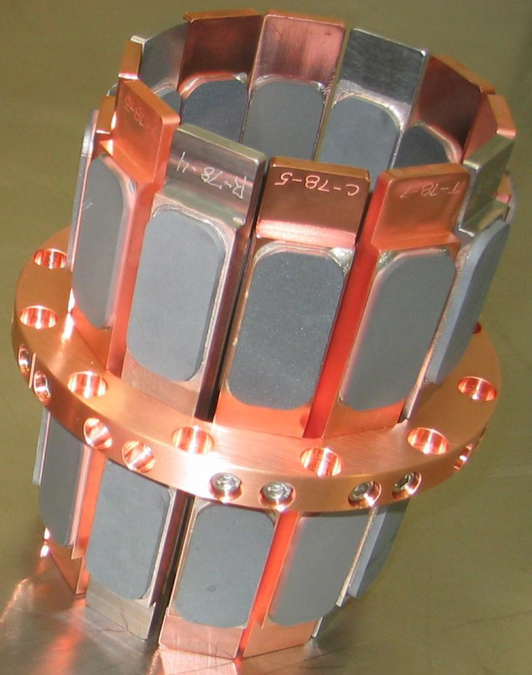
Next Generation HOMs
Based on the first generation ERL HOM load but greatly simplified and improved:
  One absorber instead of many small tiles
  A single braze reduces cost
  Thermal expansion of outer Tungsten ring matched to SiC absorber
  Graphite loaded SiC (SC-35) gives effective, broad band absorbing properties (ε ~ (50 – 25i) ε₀)
ICM Absorbers
MLC Absorbers

Slide 14
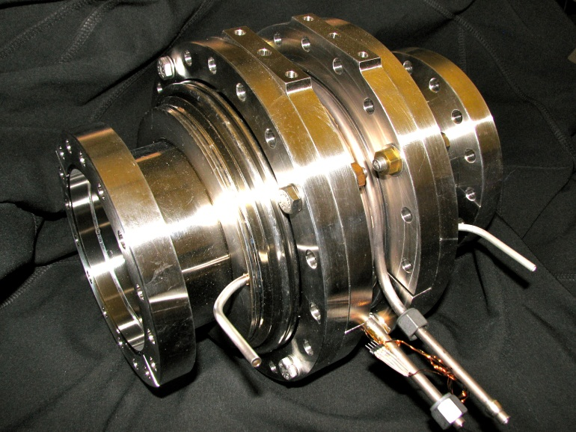
HOM Beamline Loads
Flange for disassembly
40 to 80K intercept
5K intercept
Full-circumference heat sink to allow >500W dissipation @ 80K
Broadband SiC absorber ring
Includes bellow sections
Flanges allow easy cleaning
Zero-impedance beamline flanges
Flange to cavity
SiC absorber ring brazed to metal ring
Shielded bellow

Slide 15
Why we will build a full linac module
To verify cost of this cost-driving part of the full ERL.

Slide 16
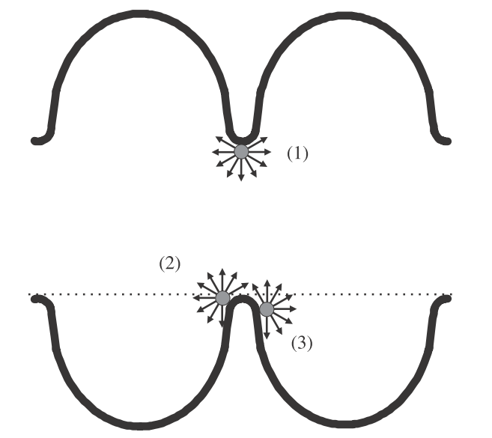
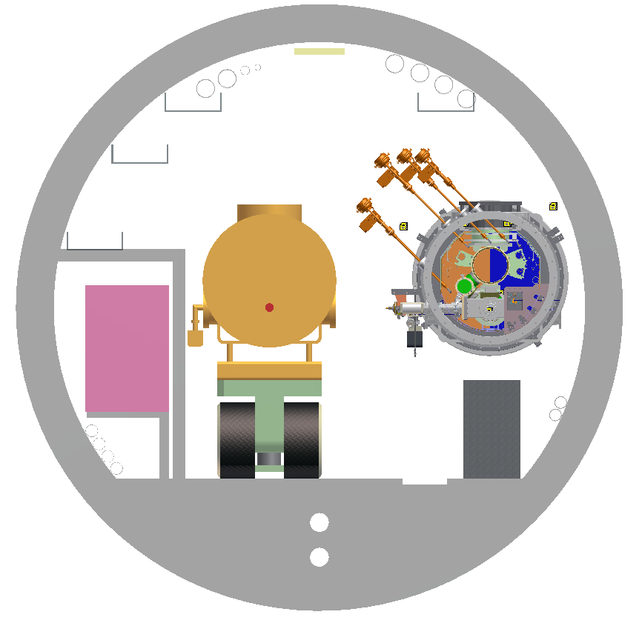
Why we will build a full linac module
To verify cost of this cost-driving part of the full ERL.
Check the x-ray background produced by its dark current (tunnel design and shielding of electronics)

Slide 17
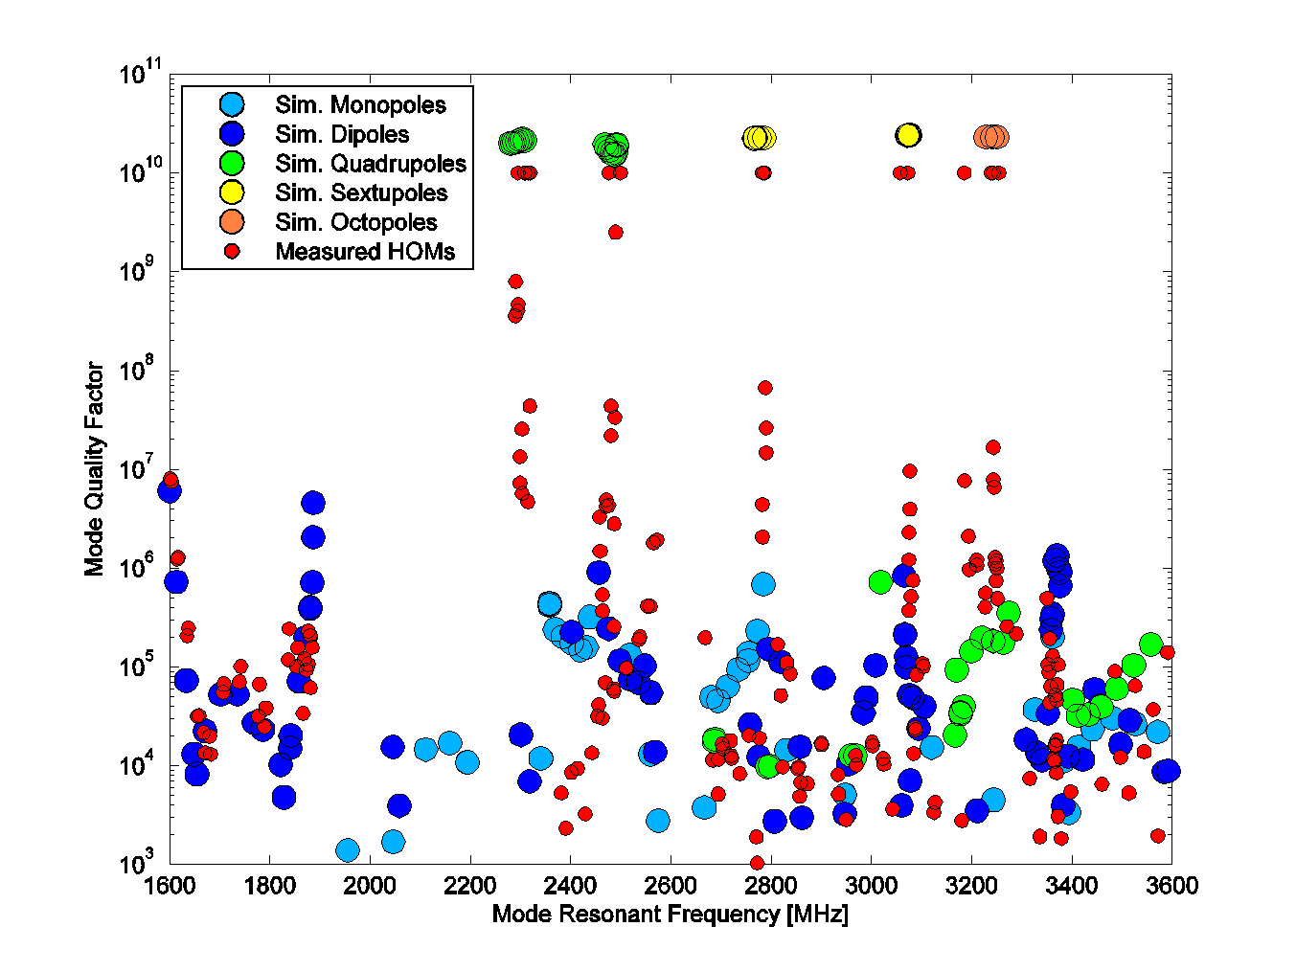
Why we will build a full linac module
To verify cost of this cost-driving part of the full ERL.
Check the x-ray background produced by its dark current (tunnel design and shielding of electronics)
Study of HOMs in multi-cavity structure with imperfect cavities

Slide 18
Why we will build a full linac module
To verify cost of this cost-driving part of the full ERL.
Check the x-ray background produced by its dark current (tunnel design and shielding of electronics)
Study of HOMs in multi-cavity structure with imperfect cavities
High Q performance studies with significant statistics (6 cavities)

Slide 19
MLC Milestones
Oct ‘12 – External design review
Nov ‘12 – 3 unstiffened cavity vertical tests
Dec ‘12 – Order 6 remaining input couplers (6 month fab)
Jan ‘13 – 3 stiffened cavity vertical tests
Feb ‘13 – Award vacuum vessel PO (11 month fab)
May ‘13 – In-house fabrication of string components complete (tuners, HOMs, tapers…)
May ‘13 - HGRP and 2 phase line fabrication complete (vendor)
Jun ‘13 – Begin string assembly in clean room
Sep ‘13 – Begin cold mass assembly and instrumentation (outside clean room)
May ‘14 – Commence MLC testing

Slide 20
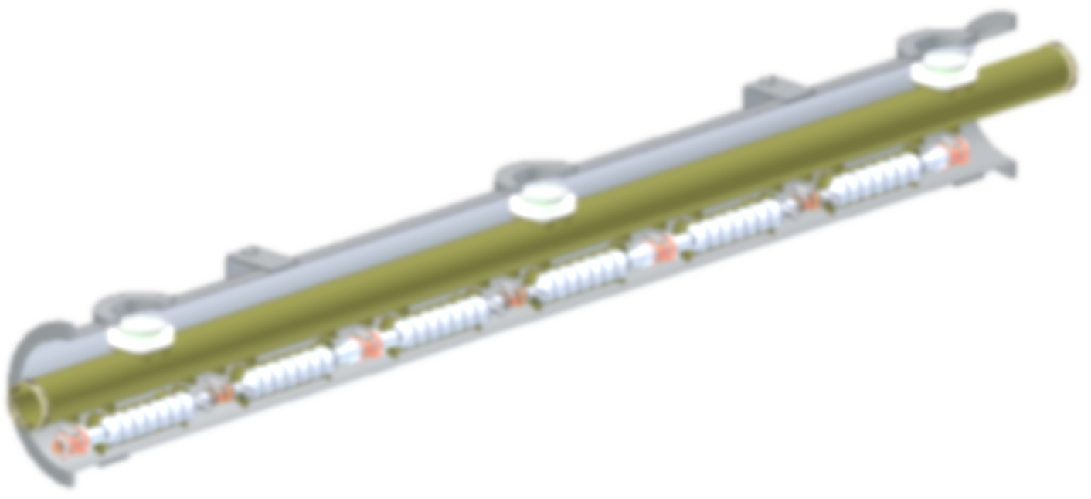
Thank you!

