Slide 1






Integration and Cold Testing of the CW ERL Cryomodule at Daresbury
Shrikant Pattalwar
ASTeC, STFC, Daresbury Laboratory (UK)
On behalf of
ERL Cryomodule Collaboration

Slide 2
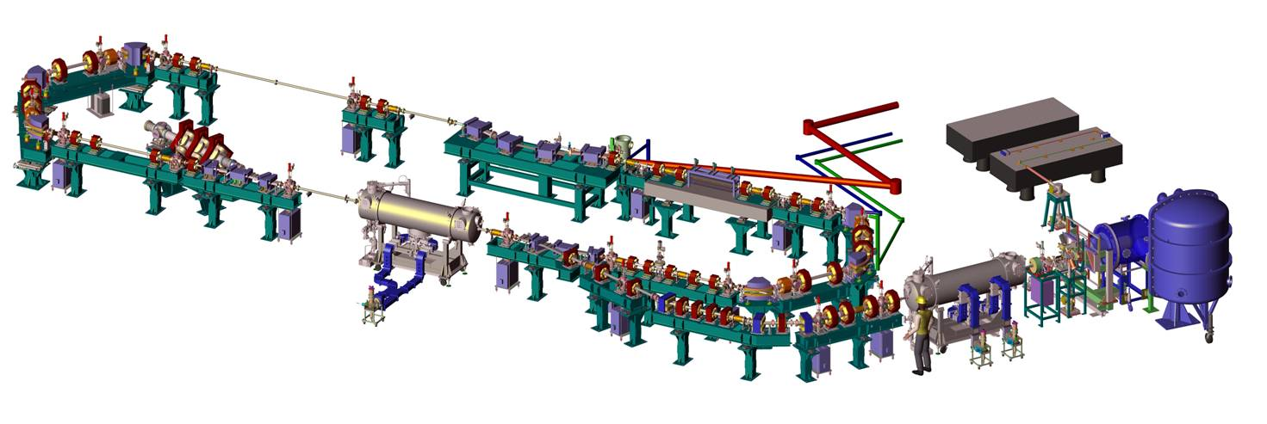
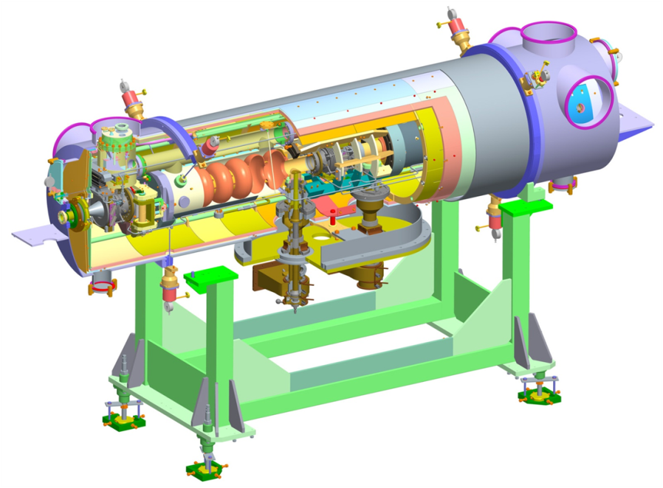
Introduction
The aim – To build and test the ERL Cryomodule
with beam on ALICE
Accelerator and Lasers
in Combined Experiment
Dimensioned to fit on the ALICE ERL facility at Daresbury:
  Same cryomodule footprint.
  Same cryo/RF interconnects.
  ‘Plug Compatible’ with existing cryomodule
2 Shrikant Pattalwar TTC meeting Nov 5-8, 2012 J-Lab

Slide 3
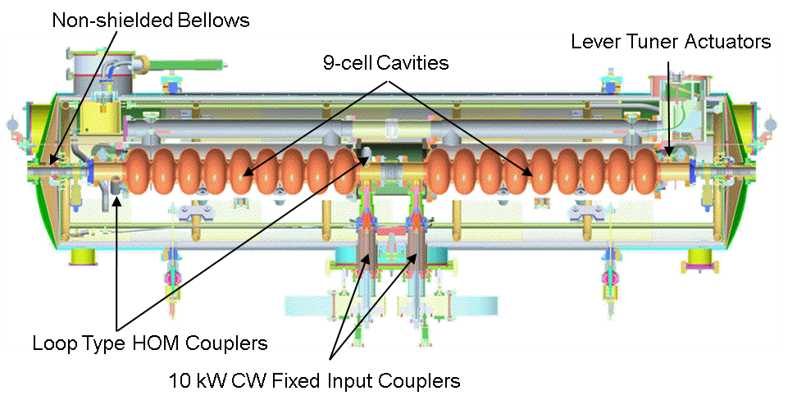
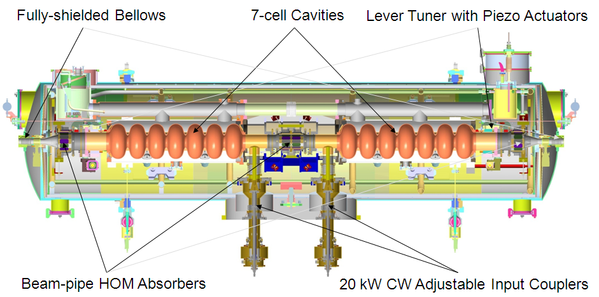
The ERL Cryomodule
Parameter | Target
Frequency (GHz) | 1.3
Number of Cavities | 2
Number of Cells per Cavity | 7
Cavity Length (m) | 0.807
Cryomodule Length (m) | 3.6
R/Q (Ω) | 762
E_{acc} (MV/m) | >20
E_{pk}/E_{acc} | 2.23
H_{pk}/E_{acc} | 46.9
CM Energy Gain (MeV) | >32
Q_{o} | >10¹⁰
Q_{ext} | 4 x 10⁶ - 10⁸
Max Cavity FWD Power (kW) | 20 SW
Existing Cryomodule on ALICE
ERL (New) Cryomodule
3 Shrikant Pattalwar TTC meeting Nov 5-8, 2012 J-Lab

Slide 4
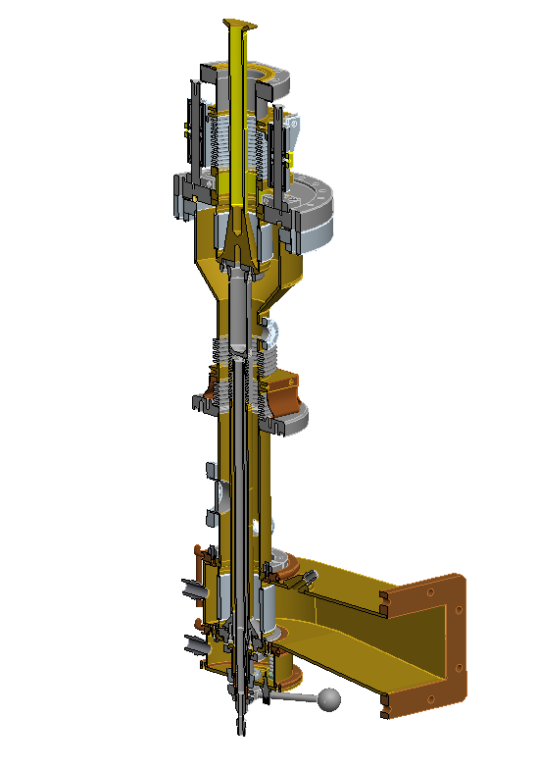
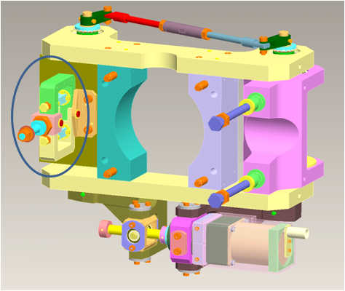
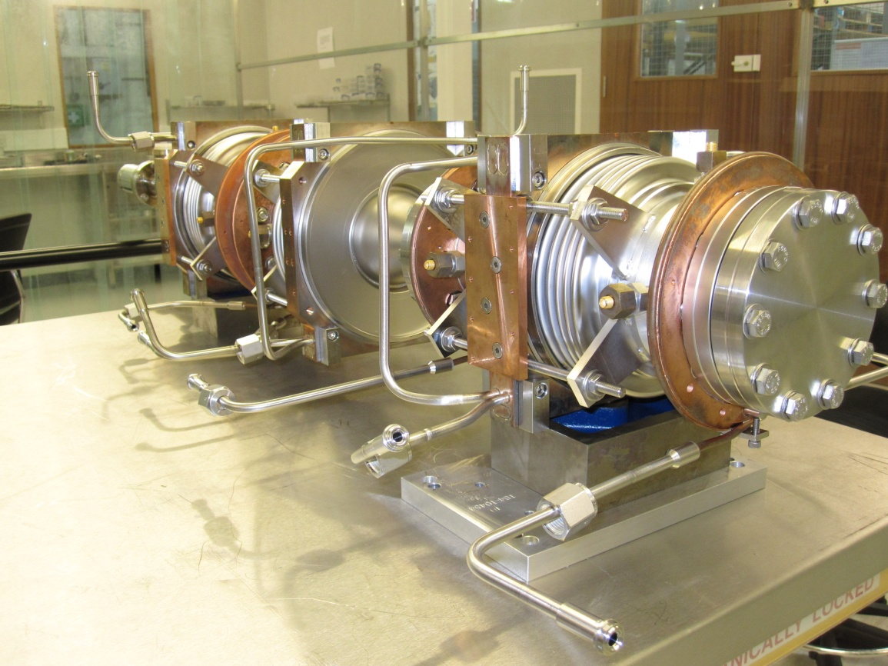
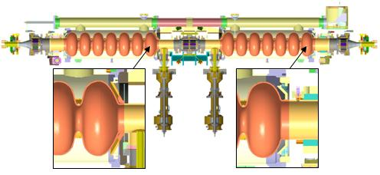
Major Variations in the Design
High Power Input couplers
Saclay II tuners
3. HOM absorbers
4. Several thermal transitions
80-5-2
2-5-80-5-2
2-5-80
2
5
80
4 Shrikant Pattalwar TTC meeting Nov 5-8, 2012 J-Lab

Slide 5
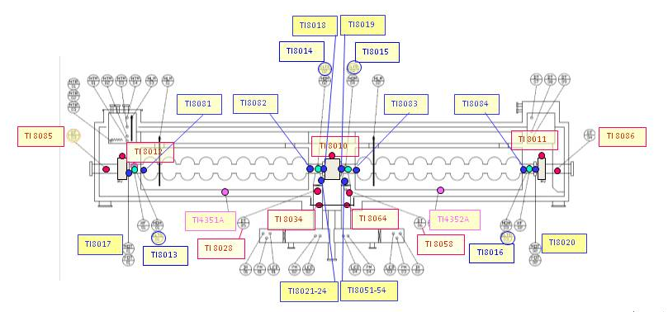
Major Variations in the Design
Radiation Shield, HOMs and thermal intercepts cooled with GHe
6. Additional thermal management scheme
7. Additional Instrumentation
5 Shrikant Pattalwar TTC meeting Nov 5-8, 2012 J-Lab

Slide 6
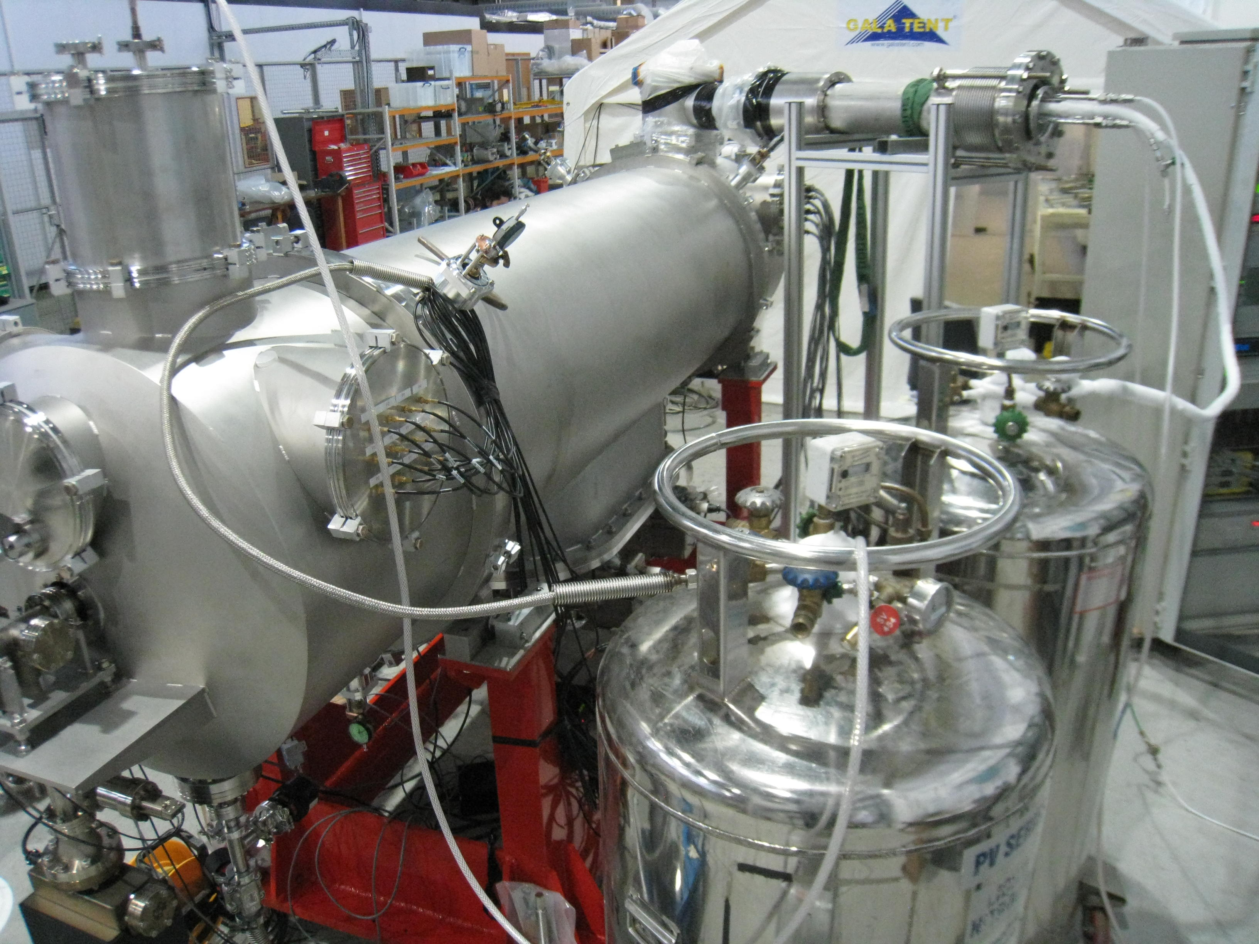
Off - line cold tests
Check the cryogenic performance
Understand the processes and establish commissioning and operating procedures
Validate instrumentation
Make the task of integration with ALICE easier
Identify and resolve any unknown issues
6 Shrikant Pattalwar TTC meeting Nov 5-8, 2012 J-Lab

Slide 7
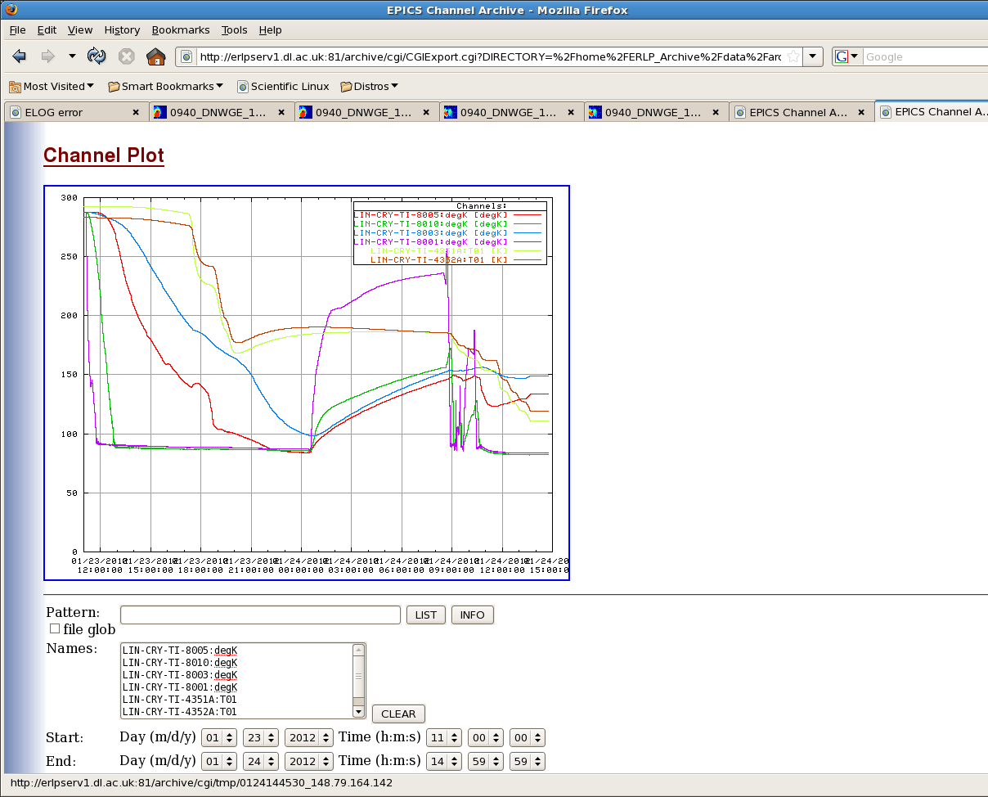
Results
Phase -1 Cool down to 80K (Cryogenics)
Calibration error
Cavity Temperatures
Parameters | Measured* | Specification
Static Heat Load at 80K (HOMs, Thermal shield and intercepts.) | ~ 7 W | 20W
Static heat losses for the cavities at 80K | ~ 3.5 W | 15 W at 4K
Delta T across thermal shield at equillibrium | < 5K | <10K
Delta T across the two cavities during cooldown | < 5K | < 5K Currently 50K to 60K for ALICE
12 hrs
7 Shrikant Pattalwar TTC meeting Nov 5-8, 2012 J-Lab

Slide 8
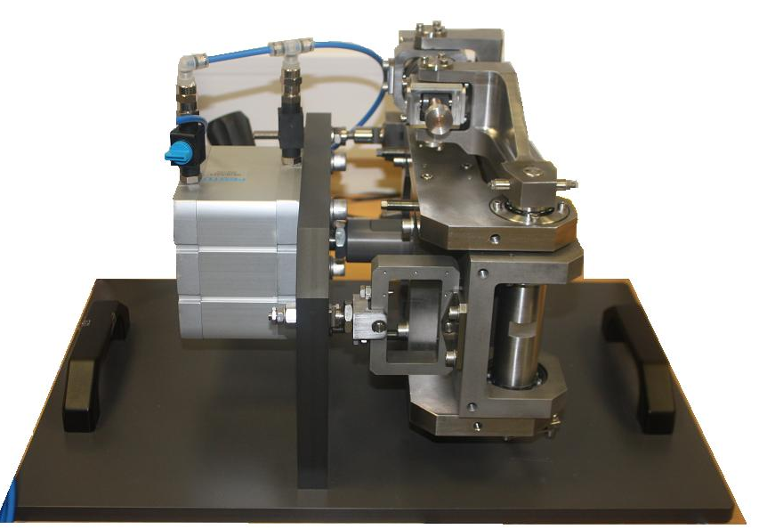
Results
Phase -1 Cool down to 80K (RF)
Tuner for cavity -2 freezes for T< 220K
Additional thermometry was added to
various locations on tuner assembly
Camera was inserted inside the isolation
chamber to observe the physical
movement of the motor
Cold tests were repeated but were
inconclusive
We decided to dismantle the cryomodule
(Clean room operation)
One of the shafts on the tuner assembly
was found to be misaligned
8 Shrikant Pattalwar TTC meeting Nov 5-8, 2012 J-Lab

Slide 9
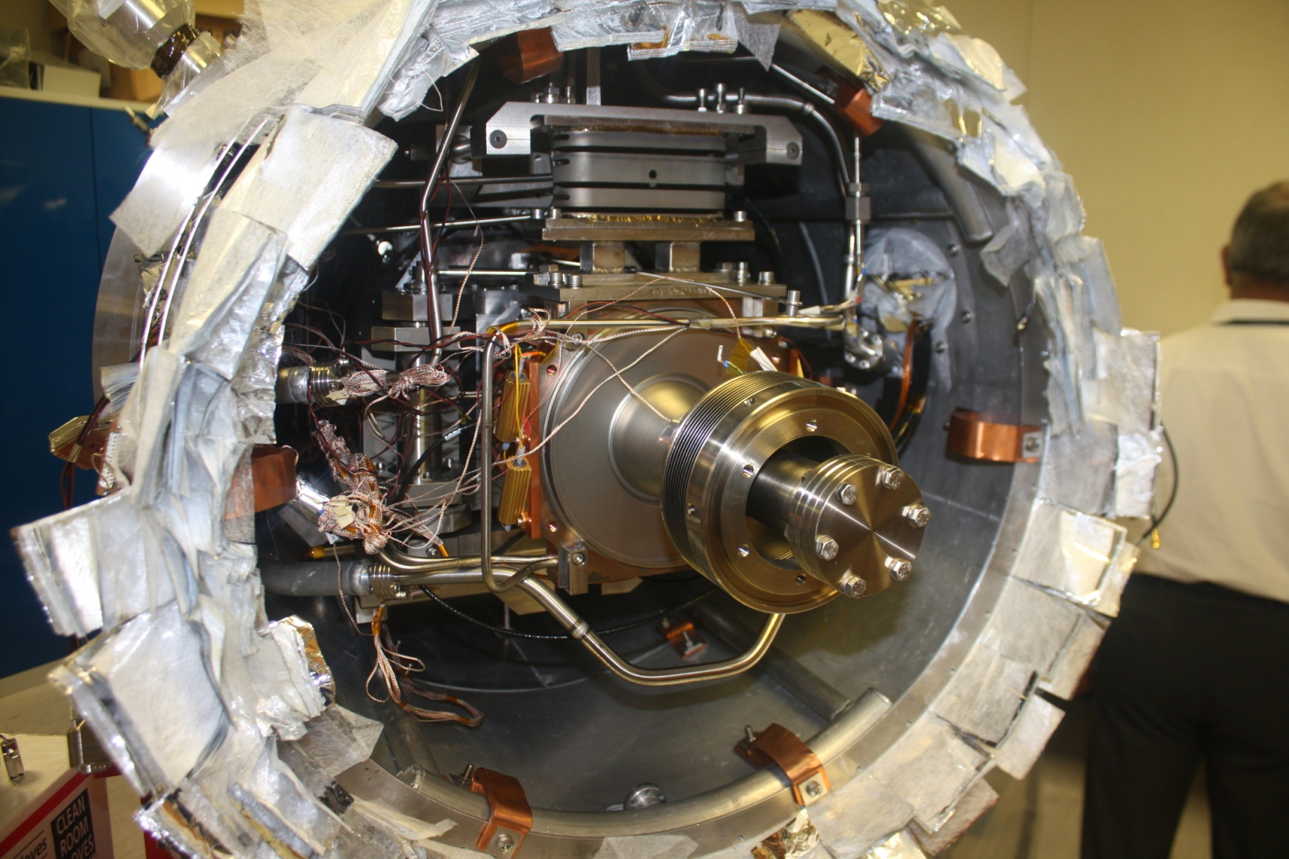
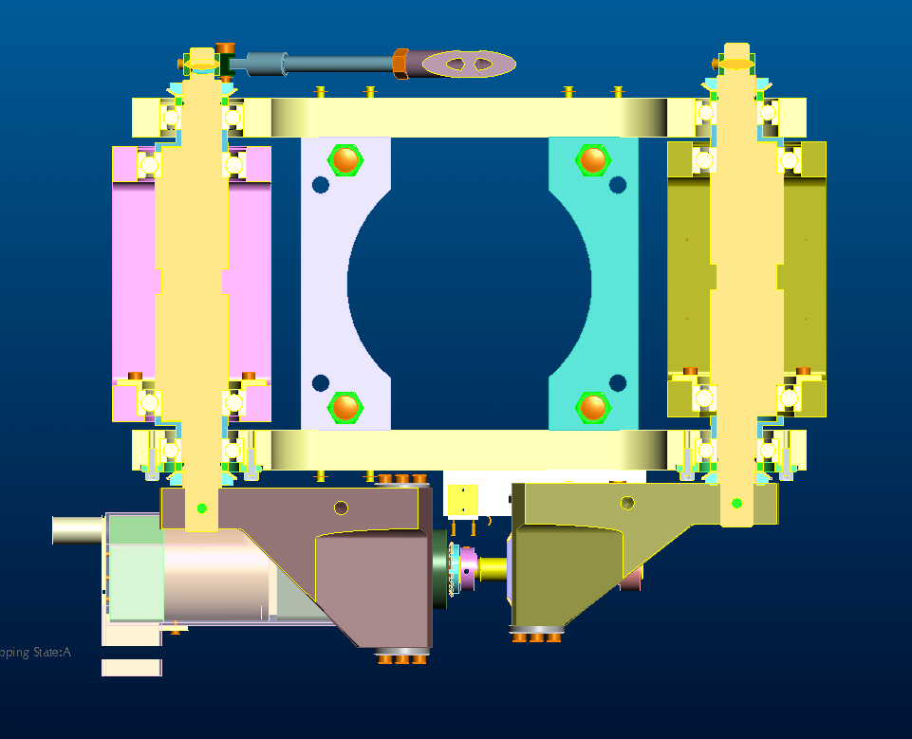
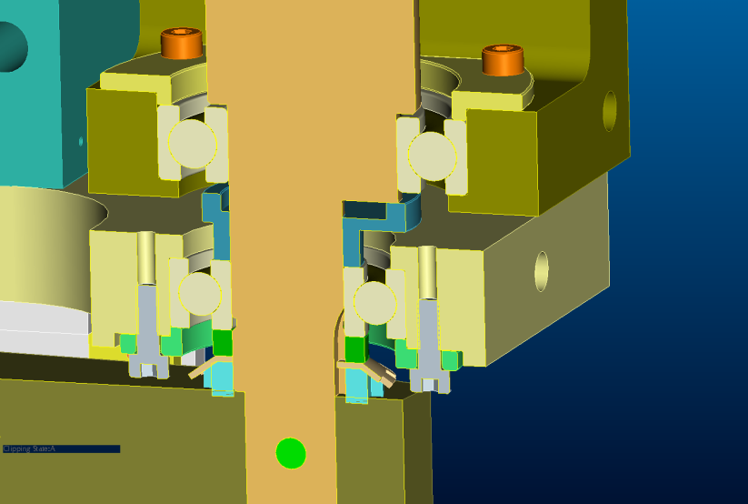
Bearing spacer installed rotated out of position. Shaft not correctly seated. And so 2.5mm high.
9 Shrikant Pattalwar TTC meeting Nov 5-8, 2012 J-Lab

Slide 10
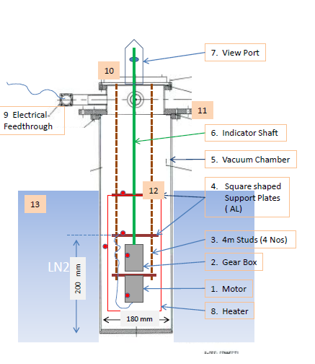
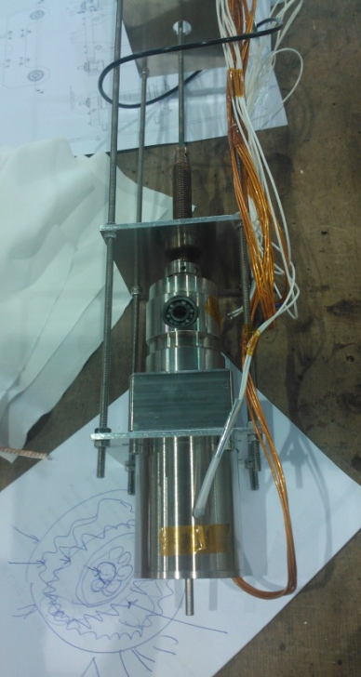
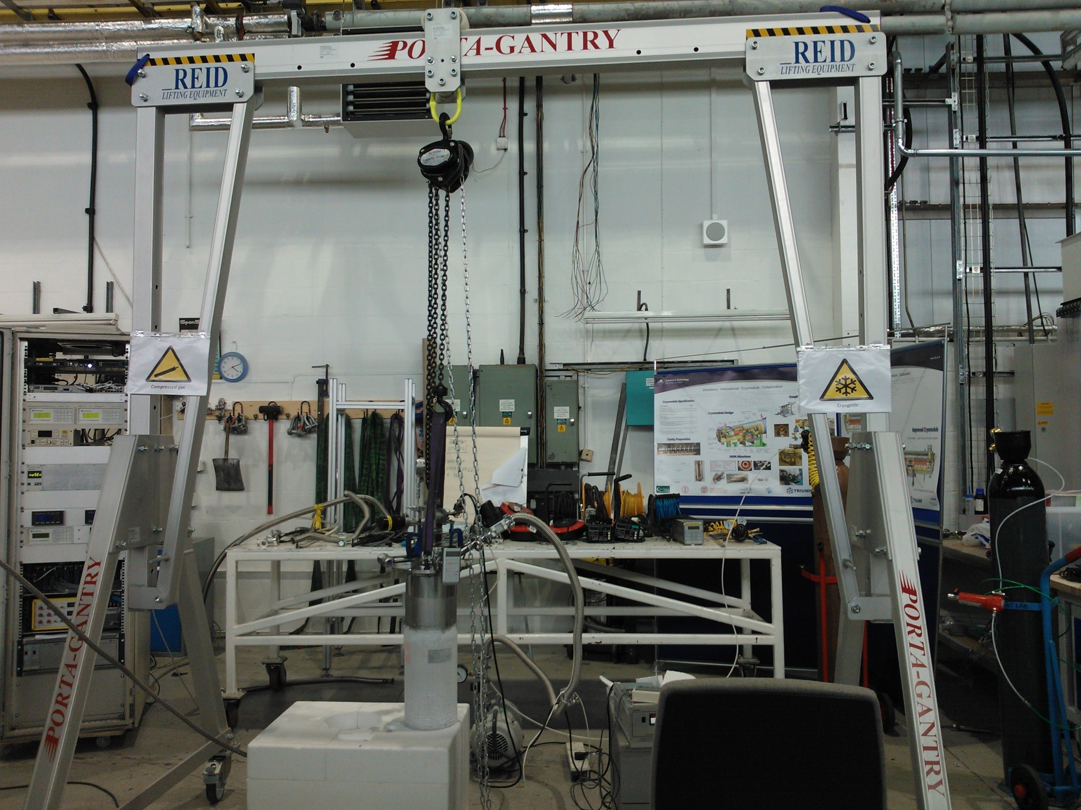
Independent Cold Tests on Tuner
10 Shrikant Pattalwar TTC meeting Nov 5-8, 2012 J-Lab

Slide 11
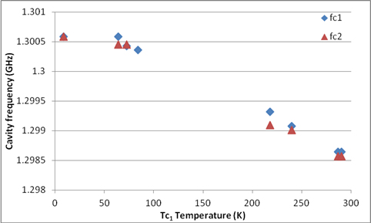
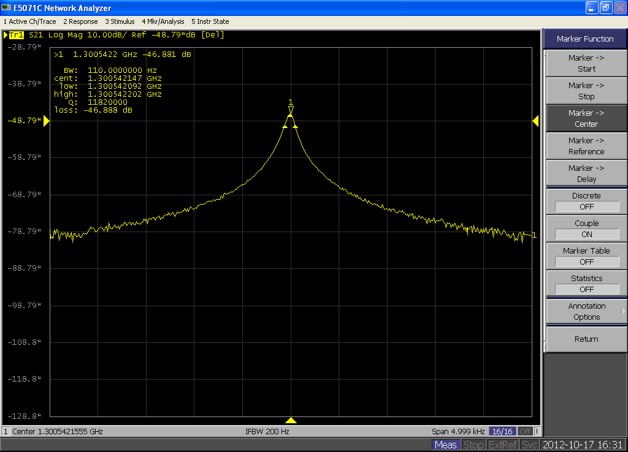
Results
Phase -2 Cool down with LHe⁴
Lowest temperature ~ 8K
Q_{L1}=9x10⁶
Q_{L2}=12x10⁶
Resonant frequencies slightly out of range by ~400 KHz
Line A is expected to be at Line B (need to be adjusted manually)
One motor wired in the opposite direction
A
B
11 Shrikant Pattalwar TTC meeting Nov 5-8, 2012 J-Lab

Slide 12
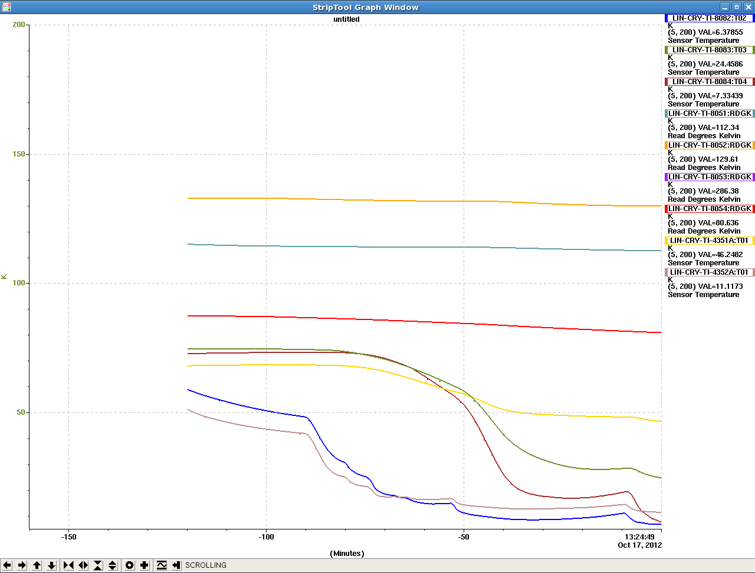
COOL Down to ~ 4K
Lowest temperature ~ 8K
Large Temperature gradient between the two cavities
Helium Reservoirs do not fill together
.......
Most of the issues can be attributed to high static heat load
( ~ 50W ) present during the tests
due to non ideal conditions and floating components
Heat leak will be much lower (< 5W) during actual
operation
150
100
T_C1
50
dT ~ 60K
T_C2
0
12 Shrikant Pattalwar TTC meeting Nov 5-8, 2012 J-Lab

Slide 13
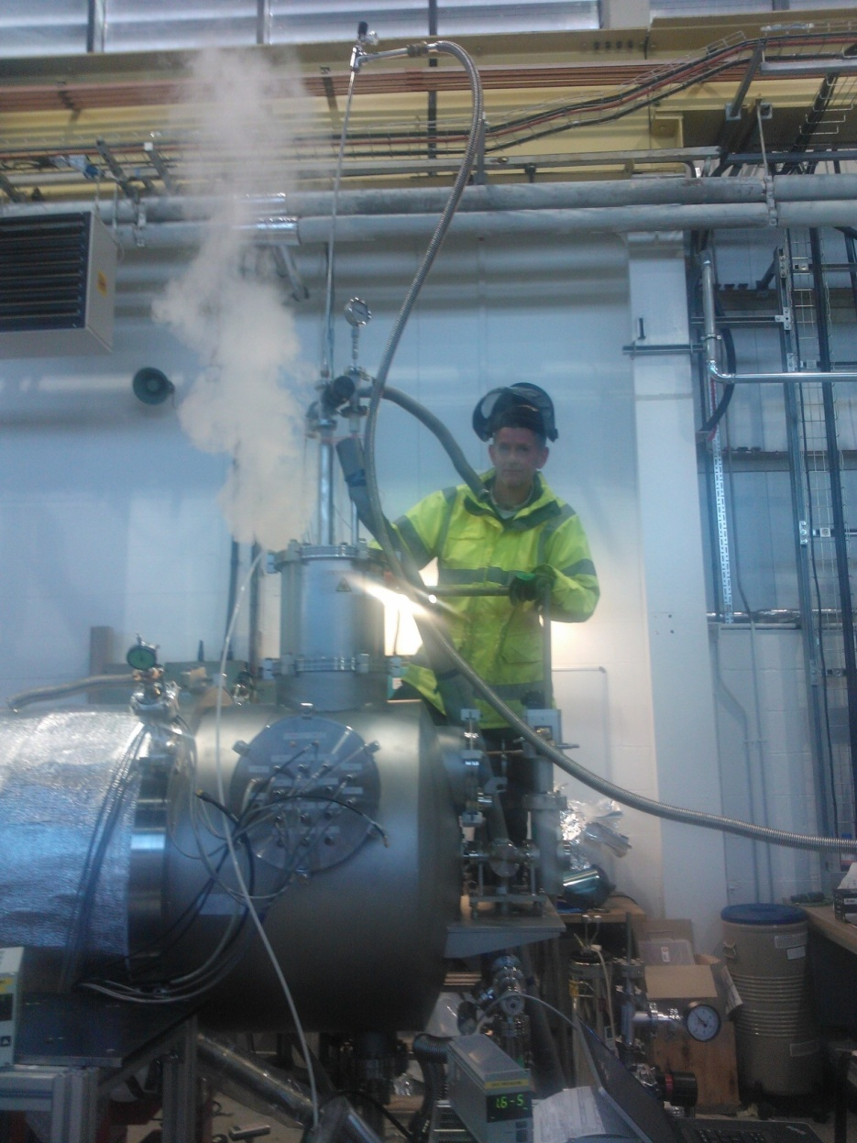
Cold Tests - Conclusions
Off Line Cold tests have proved to be important
Sufficient data has been collected that will help to reduce the cryomodule installation and commissioning period with an increased level of confidence
Most of the difficulties in the cryogenic tests can be attributed to non ideal conditions which will not be present during actual operation on ALICE.
The major issue with the operation of the tuner has been understood and resolved
Few minor problems relating mainly to errors in the sensor calibration or incorrect wiring, which have been identified and will be resolved before installation
13 Shrikant Pattalwar TTC meeting Nov 5-8, 2012 J-Lab

Slide 14
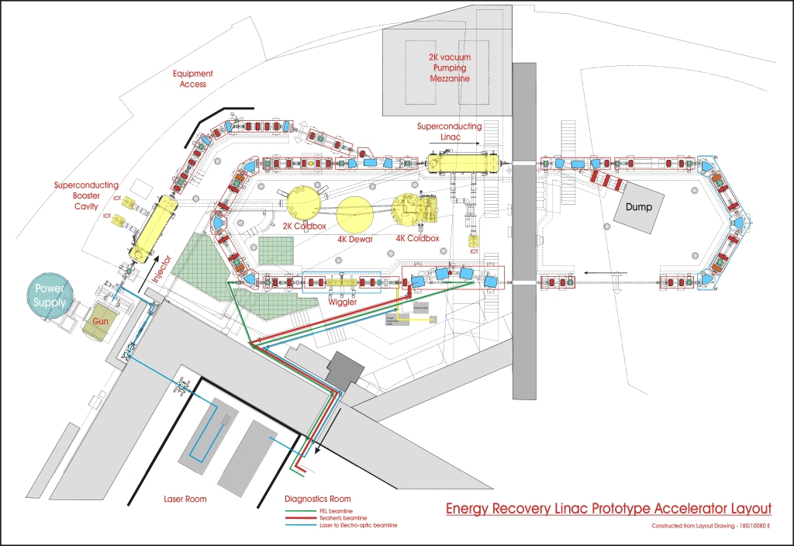
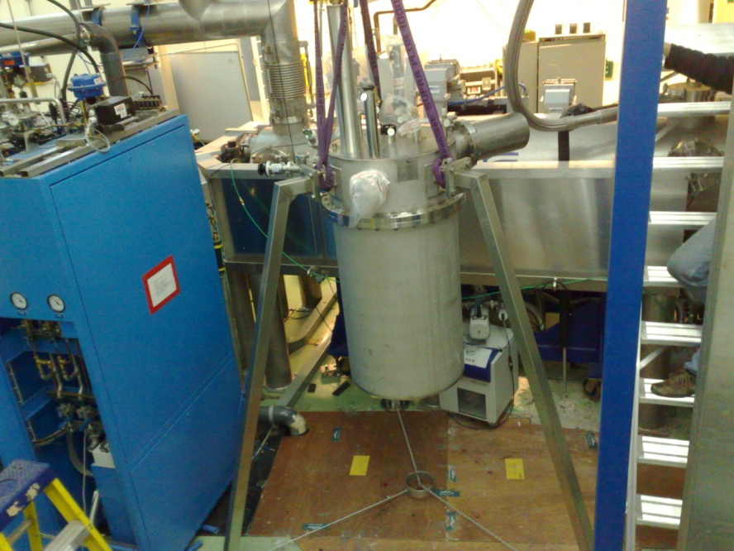
ALICE Cryomodule Integration
Scheduled in January 2013
BOOSTER
2K BOX
1500 L Dewar
TCF 50
NEW LINAC
COOL-IT
14 Shrikant Pattalwar TTC meeting Nov 5-8, 2012 J-Lab

Slide 15
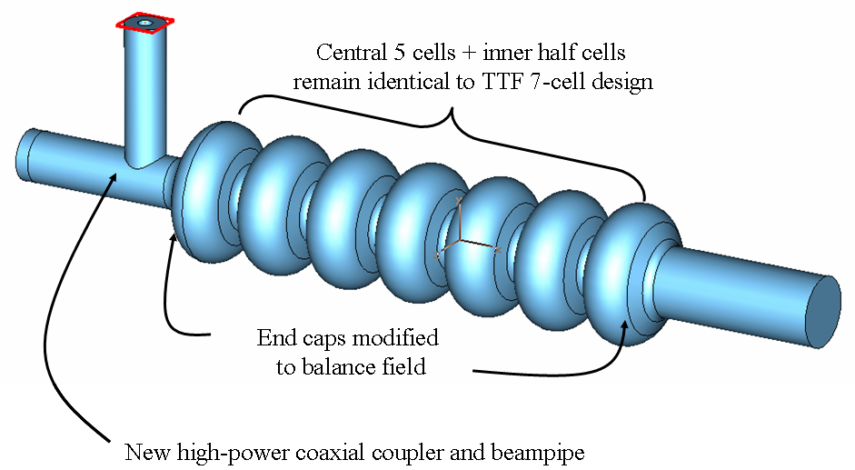
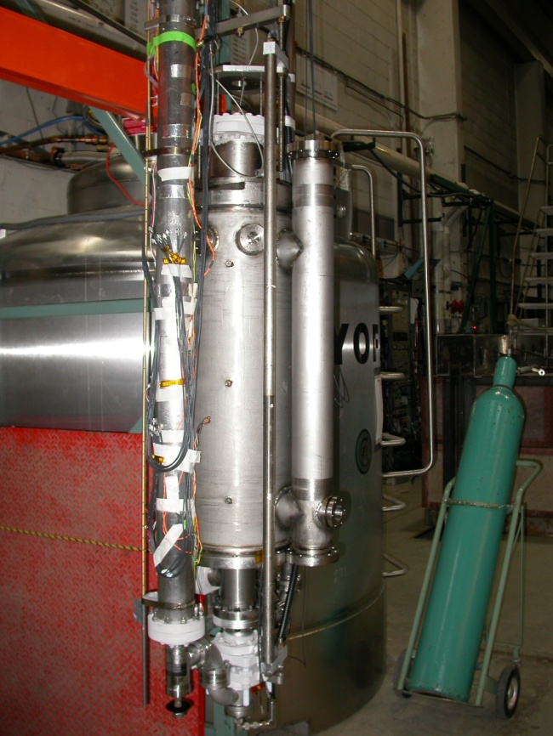
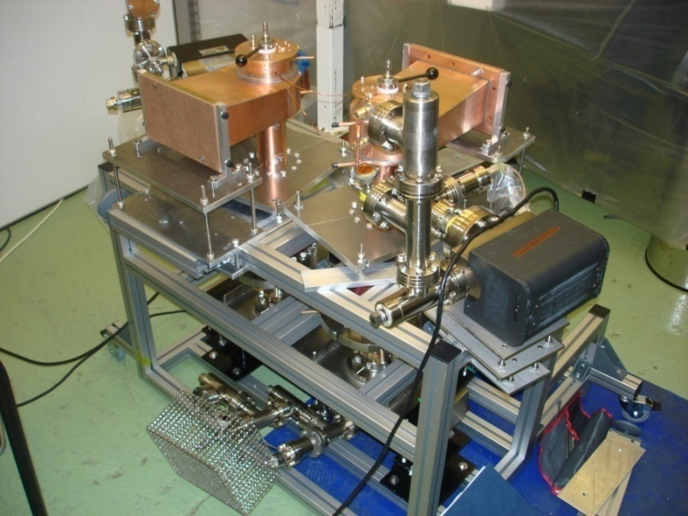
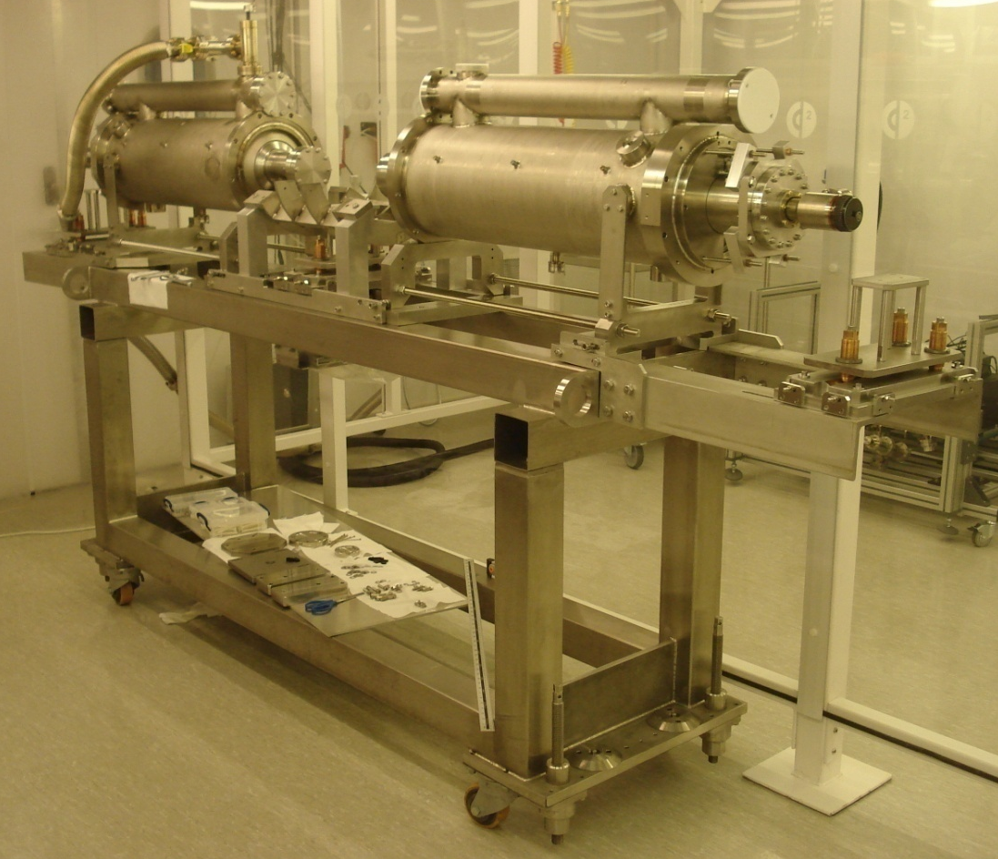

Thank You
2007
2009
2010
2010
2010
2011
2012
2013
15 Shrikant Pattalwar TTC meeting Nov 5-8, 2012 J-Lab

