Slide 1
Update on cavity processing R&D at FNAL
“The hunt for higher Q₀”
Anna Grassellino
TTC Meeting 2012, Jefferson Lab

Slide 2
Outline
Intro to the ‘high Q’ problem: what matters and why?
Some interesting high Q results: niobium nitride
Chemistry free processing: tumbling
Hydrides formation studies

Slide 3
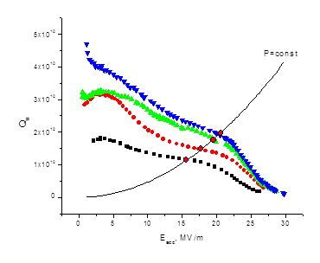
CW machines: high Q₀→ low surface resistance is crucial
Motivation for pushing for higher Qs
RF load in CW regime determines the power consumption of a cryogenic system and thus:
Capital cost of the cryogenic system (significant impact on project)
Operational cost ~ RF load ~ Q₀⁻¹
High Q₀ allows higher gradient at CW and, thus, allows lower capital cost of the linac.
Q₀ = ωU/P_{diss} = G/R_{s}

Slide 4
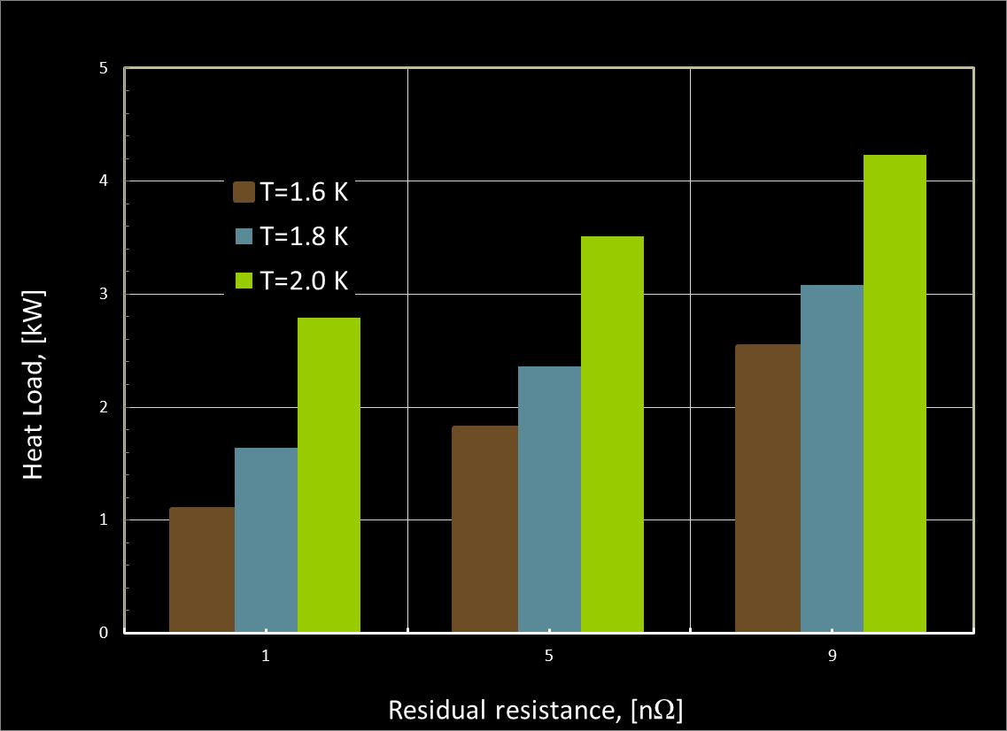
A.Klebaner, NGLS workshop, FNAL, Sept 2012
BCS
RESIDUAL + BCS
RESIDUAL

Slide 5
Typical and new values (FNAL measured values 1.3GHz, 2K, 5MV/m)
 | Q(T=2K) | Rbcs (nOhm) | Ro (nOhm)
BCP (unbaked) | 1.8e10 | 11 | 4
BCP (120C baked) | 2.6e10 | 6.9 | 3.5
EP (120C baked) | 2.7e10 | 5.8 | 4.4
EP (800C baked, no chemistry) – Large Grain | 3.6e10 | 6.1 | 1.5
Tumble+EP +120C+HF rinse | 4.3e10 | 6 | <0.5
EP + prolonged high T treatment + nitridization | 7e10 (~10MV/m) | 3.3 | <0.5
High Q research starts at FNAL (late 2011)

Slide 6
Field dependence of…?
R₀ at operating gradient is what mostly matters!
Rs (H) studies by A. Romanenko
As we switch interest from high achievable gradients to Qs, we need to change the way we test cavities: Q vs E at fixed T does not carry the information we need. Test should be extended to Q vs E at many different T (or Q vs T at several field levels)

Slide 7
Niobium Nitride studies – very preliminary results/thoughts
  SC with larger gap, try to form it via bulk diffusion
  Potential for extremely low surface resistance with no additional cost
  Optimal surface ‘passivation’?
  Different ‘recipes’ tried so far on 4 cavities
RGA data from FNAL IB4
High T furnace

Slide 8
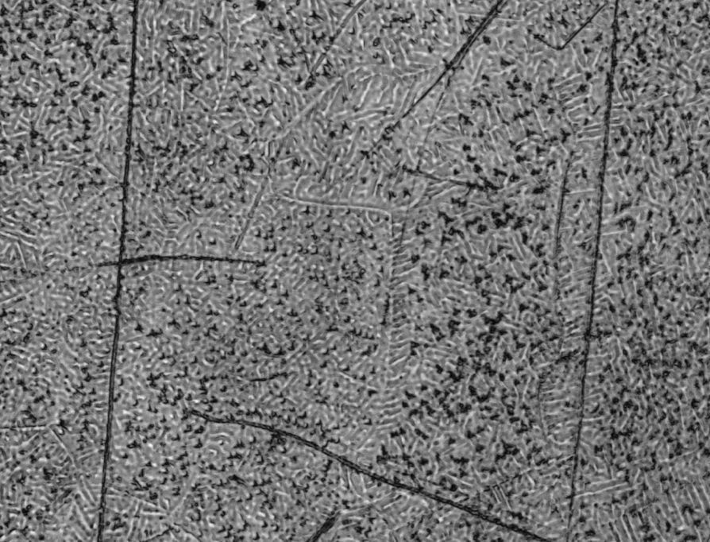
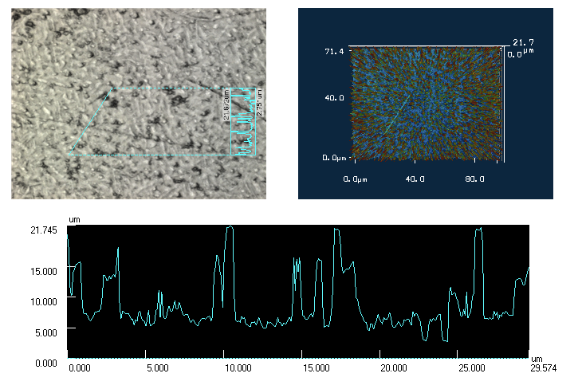
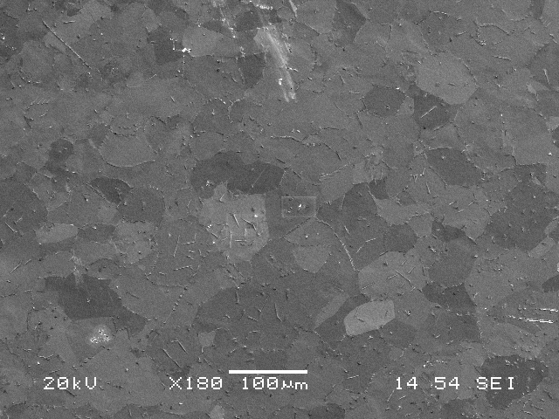
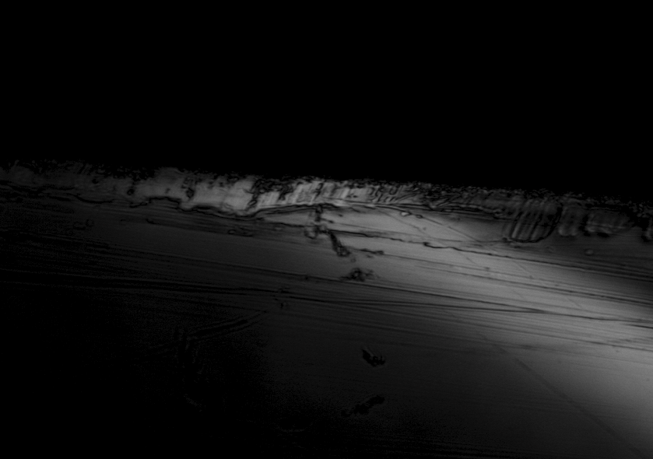
Nitrided surfaces: laser microscopy, SEM – 10 min nitridization
EBSD showing possible NbN and Nb₅N₆ (not conclusive), XPS in progress
Cross section, 10 minutes nitridization,
~ 10-20 microns columnar layer

Slide 9
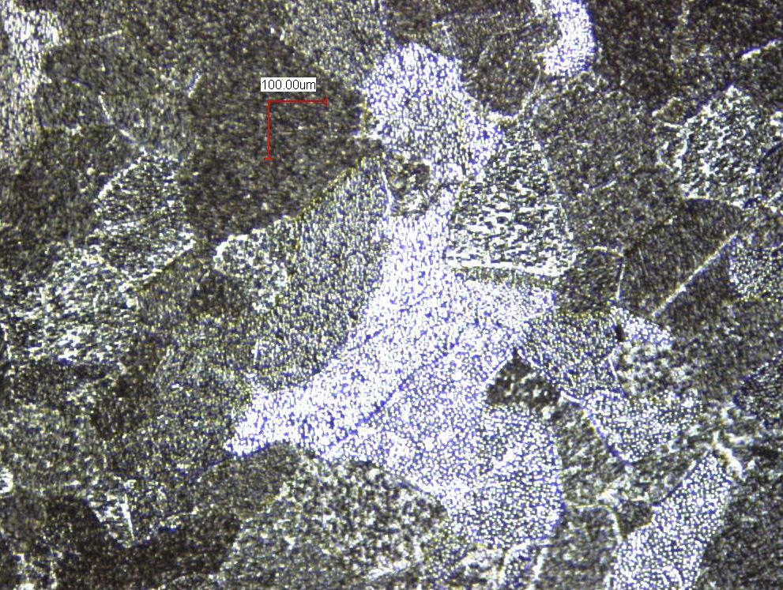
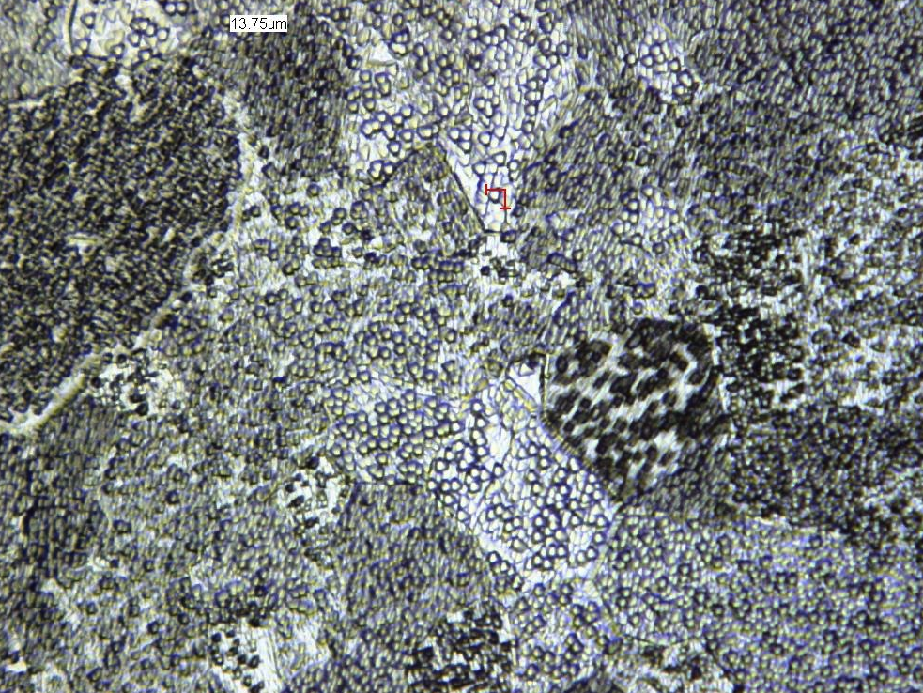
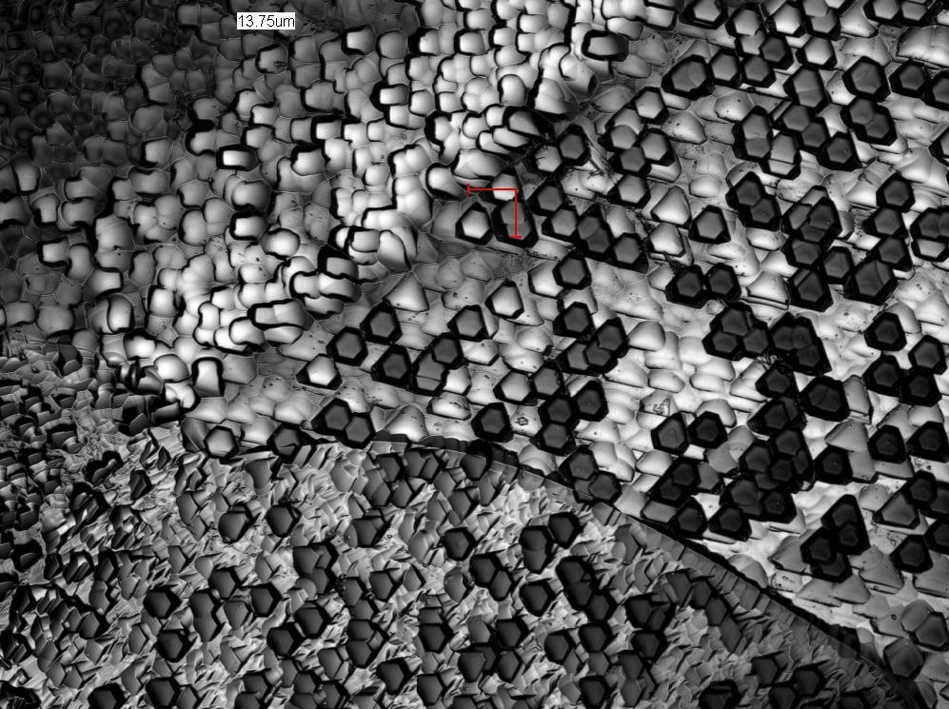
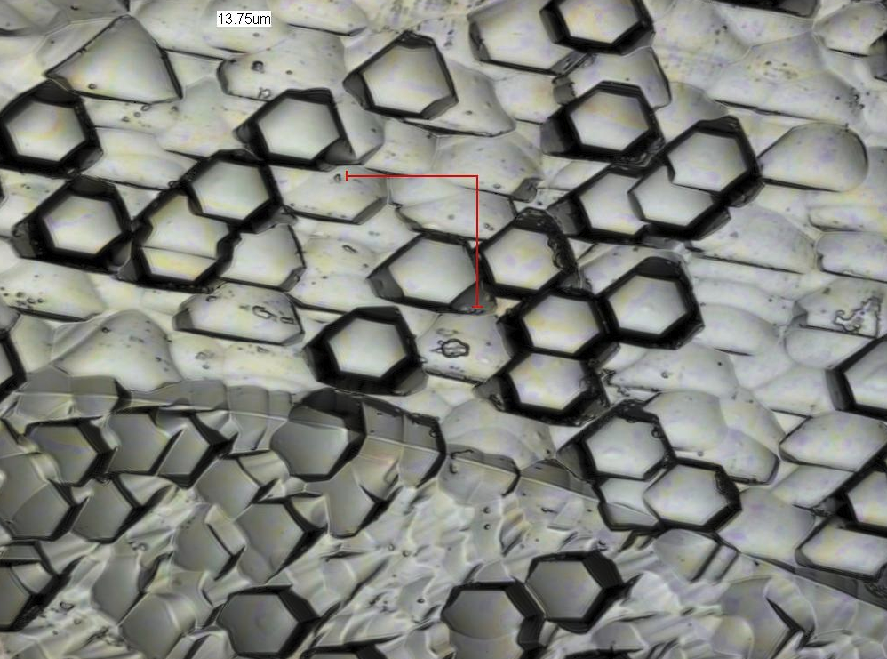
Nitrided surfaces: laser microscopy – post chemistry
(10 minutes nitridization plus 10 microns BCP)
10x
20x
50x
100x

Slide 10
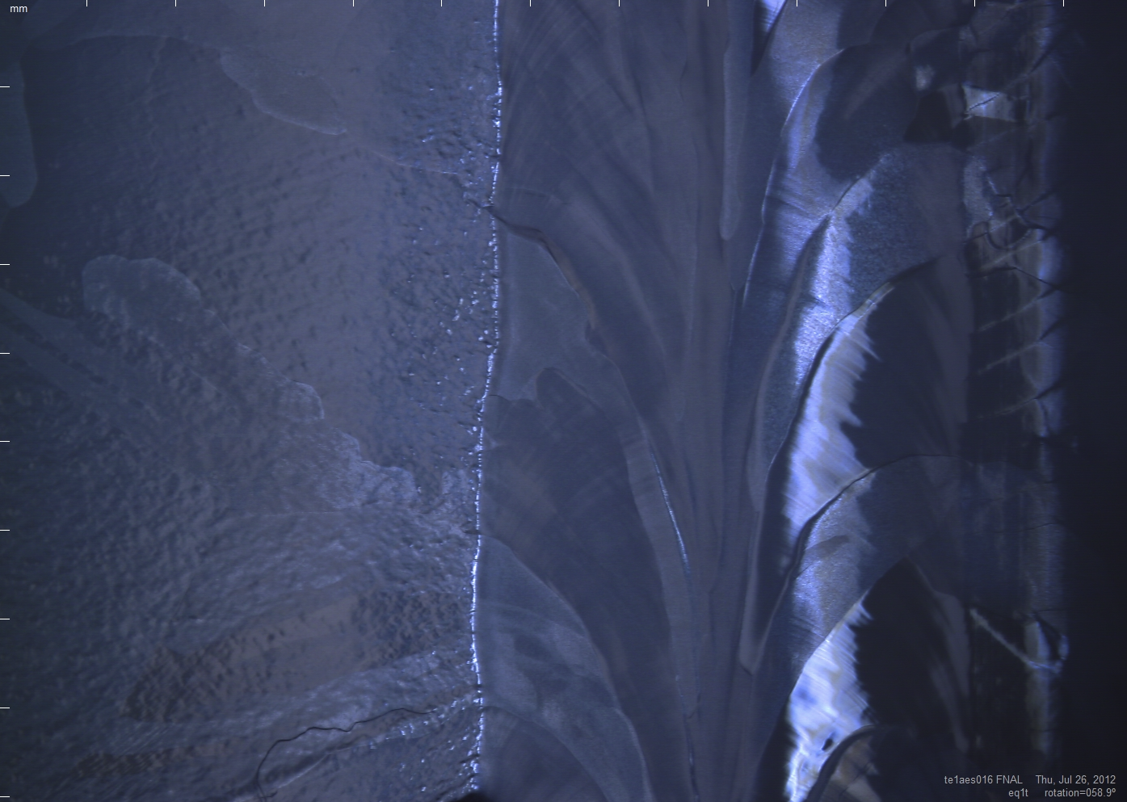
Nitrided surfaces (LG EP): optical inspection- right after nitridization

Slide 11
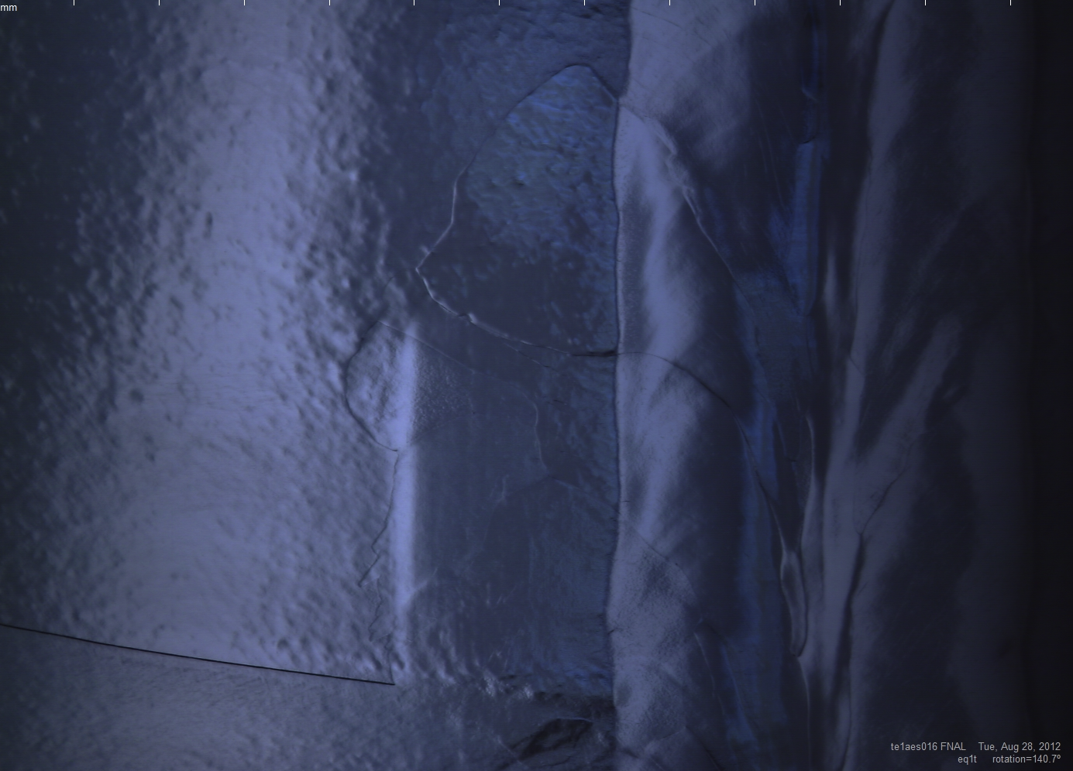
Nitrided surfaces (LG EP): optical inspection – after nitridization plus chemistry (~ 70micron)

Slide 12
Niobium Nitride studies – first test results (before chemistry)
  TE1AES016 (large grain) – 1 hr nitridization @ 1000C, pp ~ 1e-2 Torr → Q ~ 1e7
  TE1AES003 (fine grain) -10 minutes @ 1000C, pp ~ 1e-2 Torr → Q ~ 1e7
  TE1AES005 (fine grain) – 1 hour @ 1000C, pp ~ 1e-2 Torr → Q ~ 1e7
  TE1NR005 (fine grain) – 10 minutes @ 800C, pp ~ 1e-2 Torr → Q ~ 1e8
  Note that AES016 and AES003 had previously received 36 hours 1000C treatment

Slide 13
TE1AES016 (LG)- 1 hr nitridization plus ~ 70 micron removal
x 10¹⁰
x 10¹⁰
Nb typical BCS limit with zero residual
and slope
Anti Q-slope, Q₀ ~ 7e10 at 2K, 1.3GHz
Extremely low residual (fraction of nanoOhm)

Slide 14
TE1AES016, (LG, 1.3GHz, 2K)- treatments evolution

Slide 15
TE1AES016- nitridization plus ~ 70 micron removal
Q vs T
  Residual resistance ~ half nanoOhm
  Coupling factor ~2.6 →1.4 times larger than regular Nb (or Tc ~13K)

Slide 16
TE1AES016 (LG, 1.3GHz)- nitridization plus ~ 70 micron removal
Gap 2.2 and Tc…
f vs T
9.2K
14-16K
Tc measurement: 9.2K! But strange ripple around 14-16K

Slide 17
TE1AES003 (FG, 1.3GHz, 2K)
10 min nitridization plus 10 micron removal
Q
Nb typical BCS limit with zero residual
and slope
Typical Q of this cavity with EP surface
Eacc [MV/m]

Slide 18
TE1AES003 (FG, 1.3GHz, 2K)
10 min nitridization plus 10 micron removal
Nb typical BCS limit with zero residual
and slope

Slide 19
TE1AES003 (FG, 1.3GHz)- nitridization plus ~ 10 micron removal
Q vs T
  Residual resistance ~ 3.8 nanoOhm (~ 2 nanoOhm of trapped flux after quench)
  Coupling factor ~2.9 →1.6 times larger than regular Nb (or Tc ~15K)

Slide 20
TE1AES005 (FG, 1.3GHz, 2K)- 1 hour nitridization plus 20 micron removal
Q
Eacc [MV/m]

Slide 21
Cost saving processing? Chemistry free processing R&D at FNAL
Nb Large grain 1.3GHz cavity tumbled to mirror finish at FNAL (Charlie Cooper)
Heat treated 800C, no chemistry following the tumbling and bake
Very encouraging results show that the problem to overcome is removal of residual hydrogen
Impact on cost to be carefully determined (is there a real advantage vs EP?)
1.3GHz, 2K

Slide 22
Hydride formation studies- mechanically polished sample at 160 K
start
1 minute
3 minutes
Small hydrides (probably another phase) appear at ~100 K
5 minutes
10 minutes
Courtesy of F. Barkov, A.Romanenko

Slide 23
Acknowledgements
-Processing: Allan Rowe, Mayling Wong, Damon Bice, Curtis Crawford, Charlie Cooper
-Testing: Dmitri Sergatskov, Timergali Khabiboulline, Alexander Melnitchouk
-Samples measurements: Alexander Romanenko, Fedor Barkov
-Feedback on this talk: Camille Ginsburg, Alexander Sukhanov, Lance Cooley, Bob Orr
Special thanks to Enzo Palmieri for discussions about the NbN results

