Slide 1

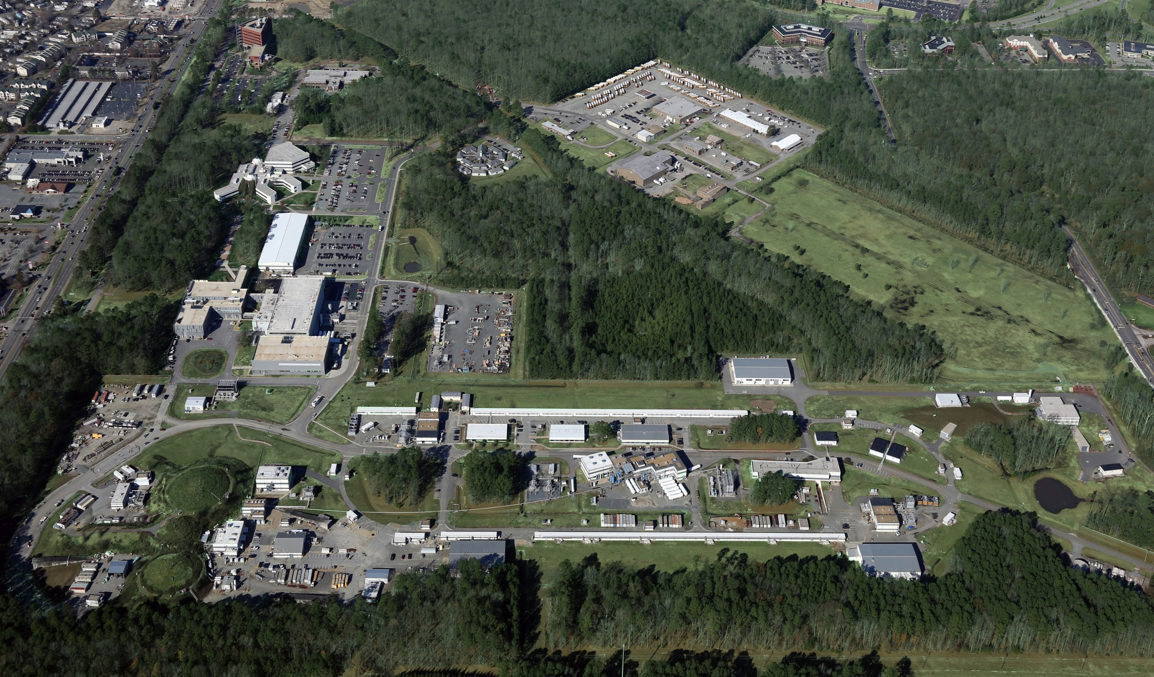
News from the Lab
Stuart Henderson, Laboratory Director
CLAS Collaboration Meeting, Oct. 4, 2017

Slide 2
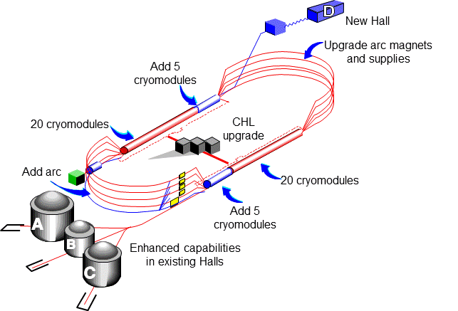
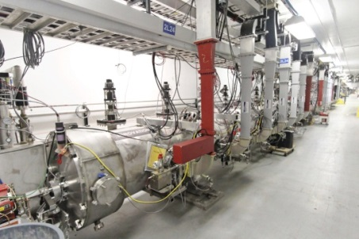
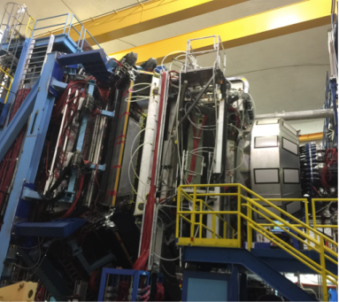
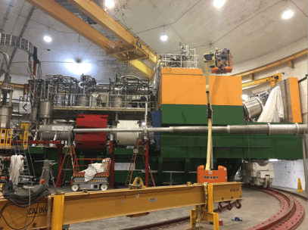
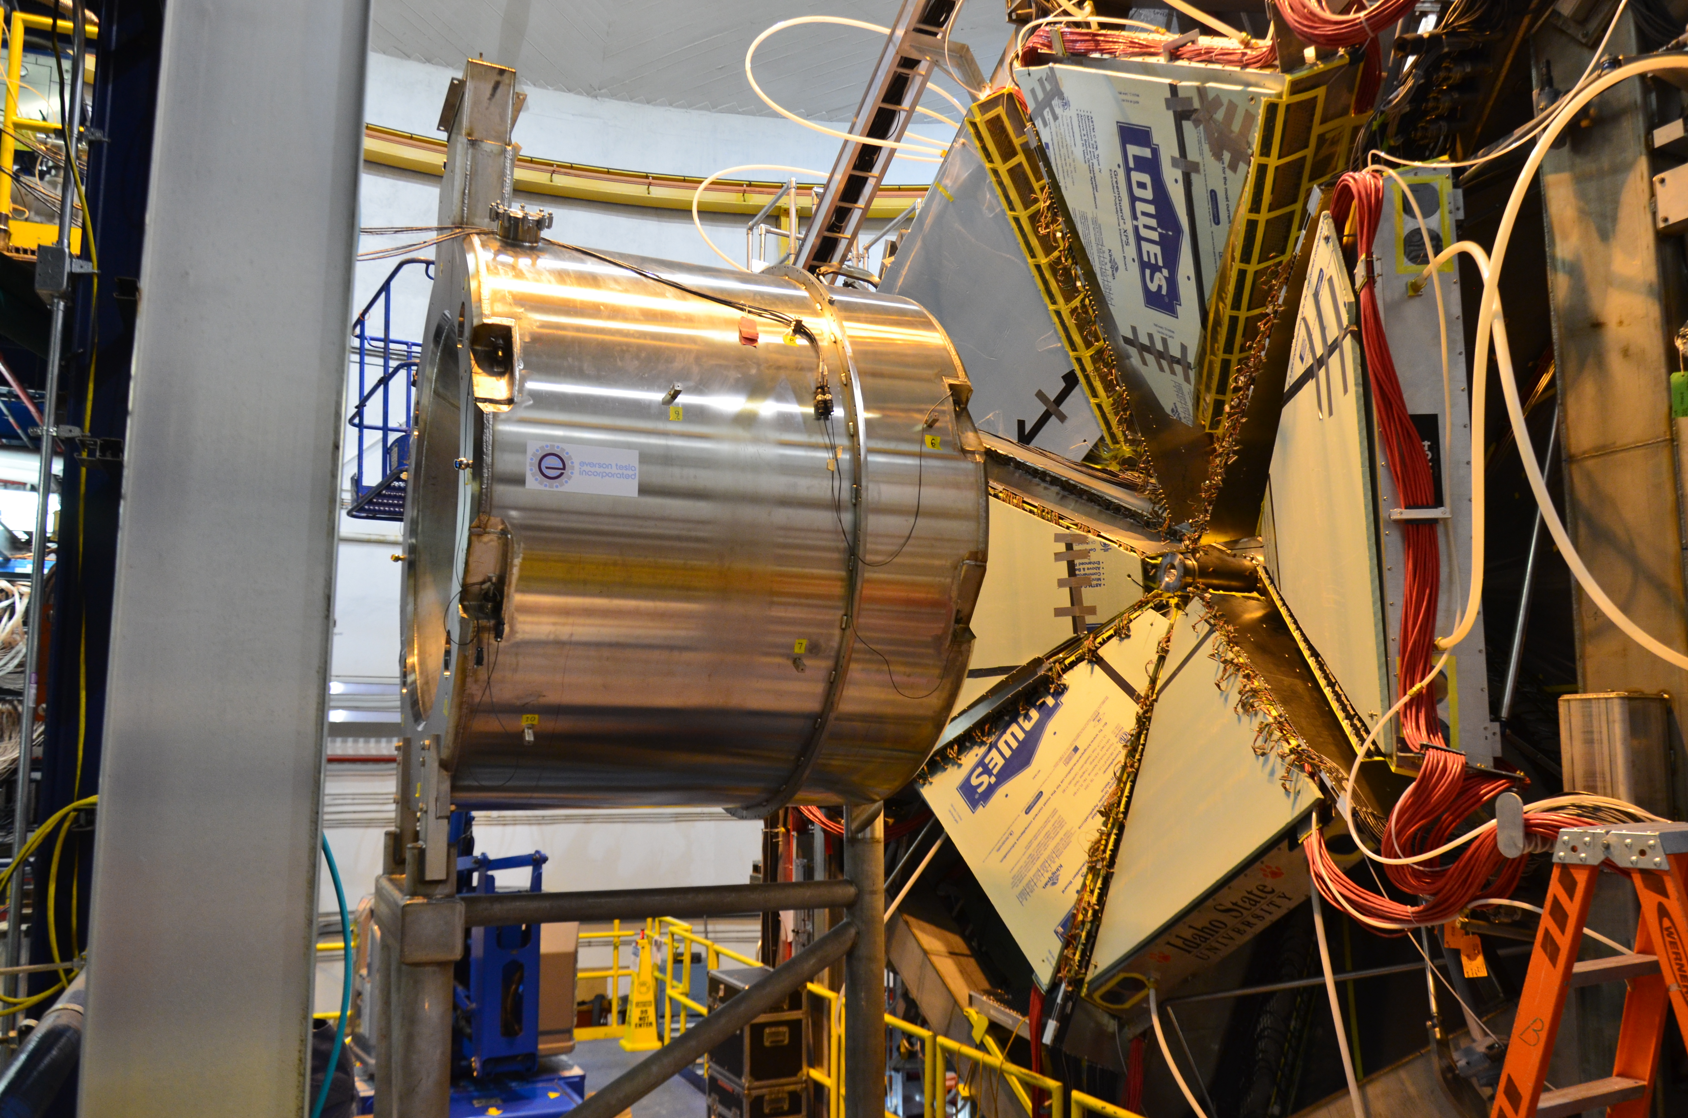
12 GeV CEBAF Upgrade Project is Complete!
Double maximum Accelerator energy to 12 GeV and add 10th arc – DONE
Add new experimental Hall D – DONE
Civil construction including utilities – DONE
Upgrade experimental equipment in Hall C – DONE
Upgrade experimental equipment in Hall B – DONE
Project Status:
Complete!
Total Project Cost = $338M
All Key Performance Parameters demonstrated
All Level 2 milestones complete
All project scope has been delivered
Final task completed: cool down of last superconducting magnet with energization test
Project Completion Approved September 27, 2017

Slide 3
CD-4 Approval

Slide 4
Planning for Sustainable Long-term CEBAF Operation
12 GeV Upgrade Project provides important capabilities for the future
However, many components and systems are “original equipment”
  Some are difficult to maintain, require adequate spare parts, will reach obsolescence
We have initiated an activity to develop a Reference CEBAF Operations Plan to:
  Define set of performance goals (e.g. reliability, energy, …), informed by scientific objectives, vs. time
  Analyze what it takes to ramp up performance, operate and maintain the facility to serve the needs of the community in both the near and long term.
  Assess, in particular, single-point failures, spares planning, …
  Scope includes accelerator, experimental and site operations
FY17 appropriations includes funding for a new 2K cold-box to remedy this severe long-term vulnerability
We have augmented the Accelerator Advisory Committee membership and held a meeting Sept. 13-15, 2017
FY18 Planning includes concerted effort, enabled by budget, to address reliability and energy

Slide 5
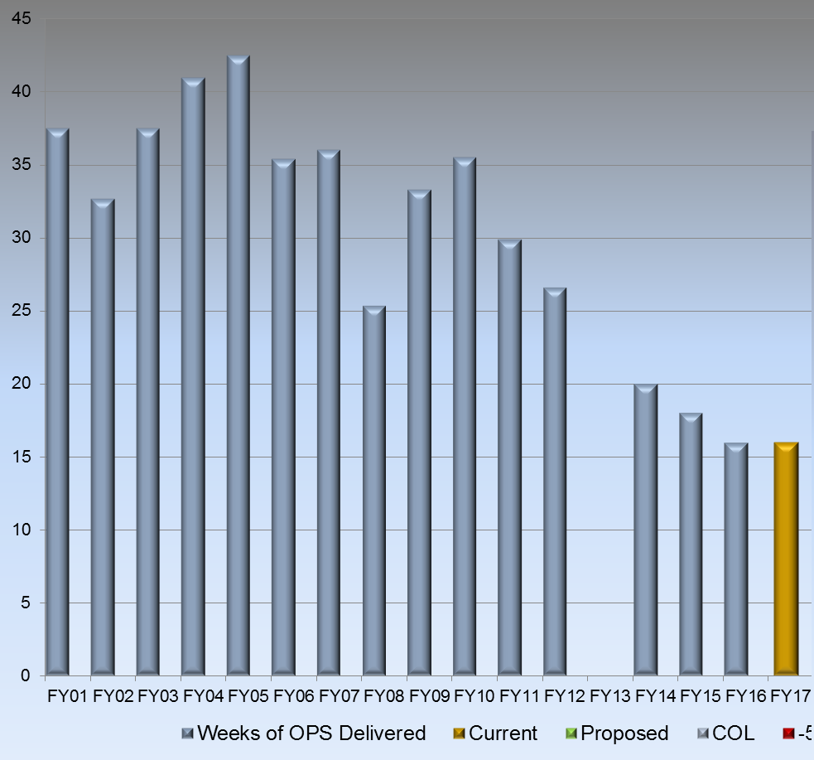
CEBAF Weeks of Operation Delivered
Optimal
# Weeks
Accelerator Shutdown
FY18 Run Schedule posted: 12 weeks of physics running

Slide 6
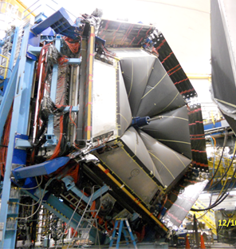
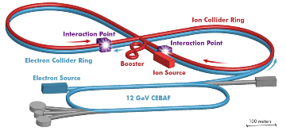
Long-Term Vision for Jefferson Lab
Jefferson Lab is a world-leading center for fundamental nuclear science and associated technologies, serving the nuclear physics user community, in support of DOE Office of Science Mission
Enable Community to Deliver Science
Support Larger DOE Mission and Societal Needs
Develop a Path to the Future
1. Deliver on 12 GeV Science
2. Provide a long-term path for the field
3. Provide technology solutions supporting DOE mission
Laboratory Operations

Slide 7
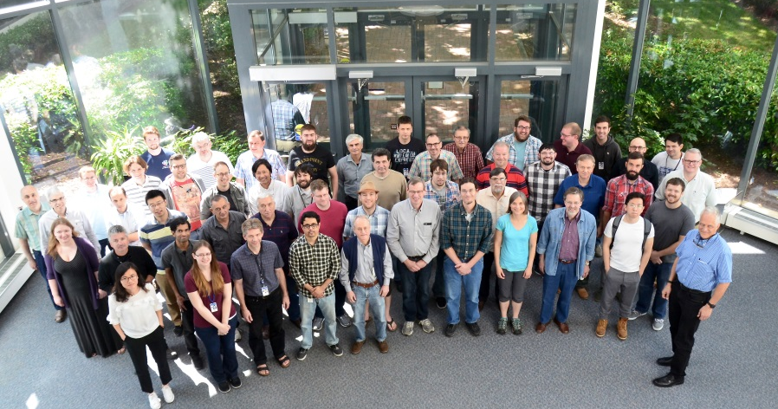
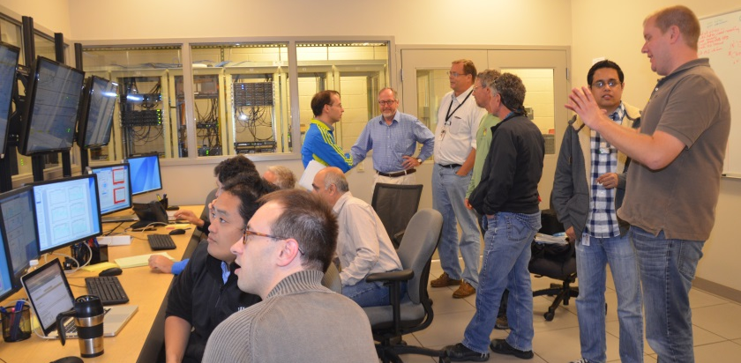
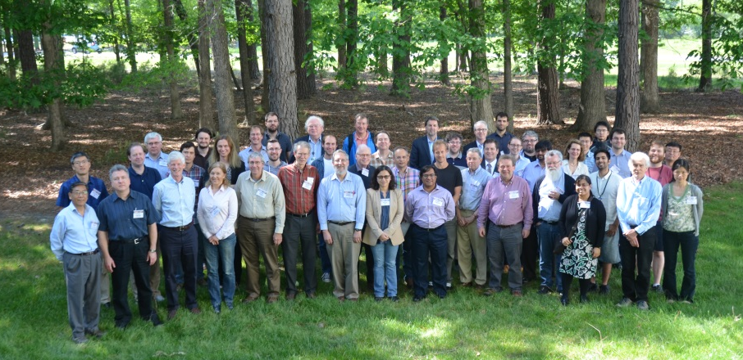
Strategic Objective 1: Enabling the Scientific Community to be Successful in Delivering Results
Deliver on the promise of the 12 GeV Upgrade
Successful, efficient and safe operation of the facility
      12 GeV must work as promised and deliver results
Ensure that experimental measurements translate into scientific knowledge
      Provide the community the tools needed to be successful
      Vibrant theory capabilities
      Computational sciences capabilities
Serve as an indispensable partner to the international scientific community
Get the most out of 12 GeV investment through future initiatives: MOLLER and SoLID
Delivering the 12 GeV Science Program is Job One

Slide 8

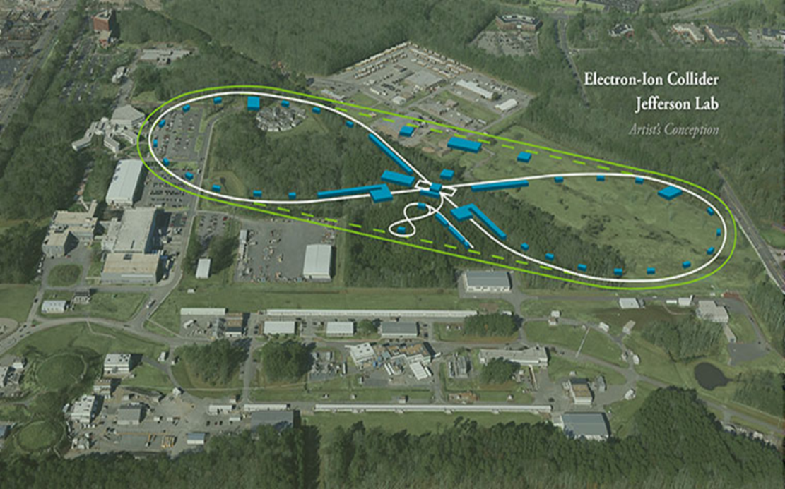
Strategic Objective 2: Providing a Path that Allows the Field to Realize its Long-term Scientific Ambitions
The NSAC Long-Range Plan presents a vision for a future Electron-Ion Collider in the U.S.
Jefferson Lab provides leadership to build a plan and the support to carry it out:
Strong community-driven scientific vision and support
Credible, cost-effective technical and project plan
A team capable of delivering the vision
Working with the nuclear physics community and our national laboratory partners
Working in lockstep with ONP, the nuclear physics community and our national laboratory partners

Slide 9
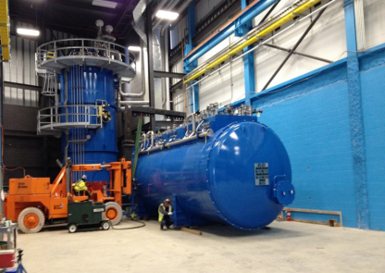
Strategic Objective 3: Technology Solutions Supporting the NP Community, Larger DOE Mission and Societal Needs
Build upon TJNAF position as the “go to” lab for Superconducting RF technology, cryogenics and sources
Deliver on Jefferson Lab’s commitment to LCLS-II and FRIB and lay the groundwork for future SRF projects
LCLS-II Prototype Cryomodule
Aggressively explore opportunities to make a difference in society, partnering with federal and industry partners where appropriate
FRIB Refrigerator Installation
Jefferson Lab strives to be an indispensable partner to Office of Science while pursuing opportunities beyond

Slide 10
Organization
Jefferson Science Associates LLC
Taylor Reveley, W&M (Board Chair)
Jerry Draayer, Chief Exec. SURA
Karl Williams, President PAE
Internal Audit
Gail Lucento
Director’s Office
Laboratory Director
Stuart Henderson
12 GeV Upgrade Project Office
Allison Lung
Communications
Lauren Hansen
CCO
CPO
CRO
COO
Tech Transfer and Commercialization
Drew Weisenberger
LCLS II
Project Office
J. Preble
Planning
Allison Lung
Deputy Director for Science and Tech
Bob McKeown
Operations
Mike Maier
CTO
Legal Counsel
Rhonda Scales
Experimental Physics
Rolf Ent
Accelerator
Fulvia Pilat (Act)
Theoretical and Comp Physics
Jianwei Qiu
Engineering
Will Oren
CIO
CHRO
CFO
Facilities and Logistics
Rusty Sprouse
Information Technology
Amber Boehnlein
Human Resources
Rhonda Barbosa
Finance and Business Services
Joe Scarcello
ESH&Q
Mary Logue

Slide 11
Transitions
Andrew Hutton (Assoc. Dir. for Accelerator) stepped down April 28, after 25 years
Fulvia Pilat is serving as Acting Accelerator AD
  Fulvia has accepted position at ORNL, effective in late Fall
Search Committee was formed:
  S. Henderson (Chair),
  S. Holmes (FNAL),
  K. Kumar (Stony Brook),
  P. Rossi (Expt. Phys.),
  R. Yoshida (Expt. Phys.),
  G. Neil (AD),
  M. Logue (ESH&Q),
  R. Barbosa (HR)
Search is well underway

Slide 12
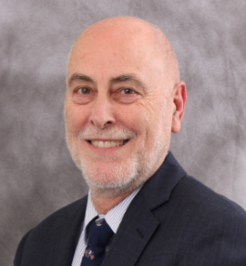
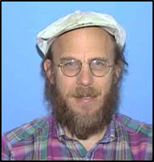
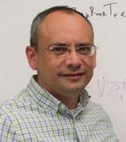

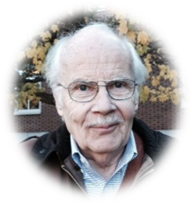
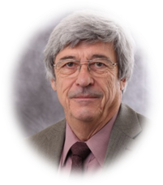

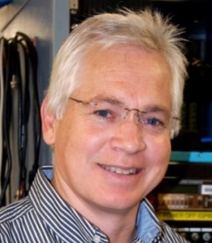
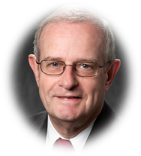


Jefferson Lab Staff and Users Continue to be Recognized for their Accomplishments
APS FELLOW
APS FELLOW
APS FELLOW
…for invaluable contributions to unraveling the structure of the proton and neutron …
…For innovative developments and applications of lattice QCD algorithms and techniques that provide unique insight into low-energy QCD, ranging from nucleon structure to charmed hadron spectroscopy to multi-nucleon systems.…
…for extensive technical contributions to accelerators world-wide as designer and adviser…
Andrew Hutton
(Jefferson Lab)
Peter Bosted
(Jefferson Lab/W&M)
Kostas Orginos
(Jefferson Lab & W&M)
2017 TOM W. BONNER PRIZE IN NUCLEAR PHYSICS
DOE SECRETARIAL DISTINGUISHED SERVICE AWARD
…for groundbreaking measurements of nucleon structure…
…in recognition of over three decades of leadership, distinguished service, and exceptional contributions to research…
2017 OUTSTANDING
NUCLEAR PHYSICIST PRIZE
GLAZEBROOK MEDAL OF THE INSTITUTE OF PHYSICS FOR 2016
Hugh Montgomery
(as Jefferson Lab Director)
…for his pioneering implementation of polarization transfer …
Charles Perdrisat
(The College of W&M)
…for leadership at the Thomas Jefferson National Accelerator Facility and distinguished research in high-energy physics…
APS FELLOW
AAAS FELLOWSHIP
2016 BREAKTHROUGH PRIZE IN FUNDAMENTAL PHYSICS
…For sustained and transformative work on the development of polarized electron beams, opening new vistas in their application to nuclear and particle physics experiments at the frontiers of knowledge.…
…for his distinguished contributions to the field of Nuclear Theory and Computational Physics…
…for the fundamental discovery and exploration of neutrino oscillations, revealing a new frontier beyond, and possibly far beyond, the standard model of particle physics…
Jerry Draayer
(President, SURA)
Robert McKeown
(Jefferson Lab
Deputy Director for Science)
Matt Poelker
(Jefferson Lab/W&M)

Slide 13

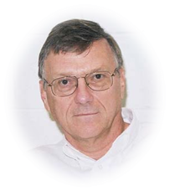
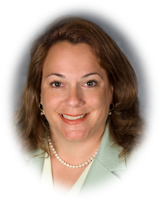
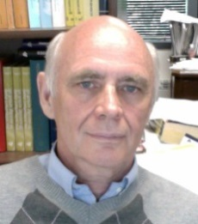
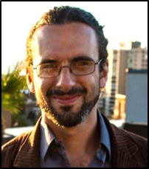
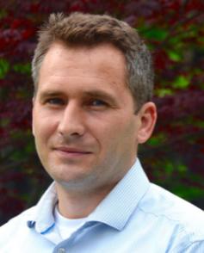
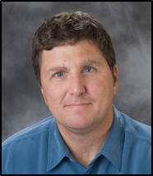
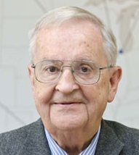
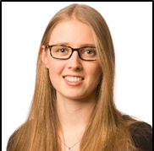
Jefferson Lab Staff and Users Continue to be Recognized for their Accomplishments
2017 OUTSTANDING
NUCLEAR PHYSICIST PRIZE
FRANCES G. SLACK AWARD
JESSE W. BEAMS RESEARCH PRIZE
…For the development of generalized parton distributions within the framework of quantum chromodynamics, enabling for the first time experimental measurements of the three-dimensional structure of the nucleons…
…for his crucial development of polarized electron beam technology…
…for her excellence in service to Physics…
Charles Sinclair
(Jefferson Lab/Cornell – Retired )
Cynthia Keppel
(Jefferson Lab )
Anatoly Radyushkin
(Jefferson Lab & ODU )
2017 KENNETH G. WILSON AWARD
DOE EARLY CAREER AWARD
DOE SECRETARY’S ACHIEVEMENT AWARD
…for Excellence in Lattice Field Theory: For groundbreaking contributions to the study of resonances using lattice QCD…
…to double the efficiency of some of the most efficient particle accelerators being used for research by looking at ways to optimize the preparation of niobium cavities - to coax improved performance from them…
…for his role in the LOB General Purpose Infrastructure Crosscut Committee…
Raul Briceno
(Jefferson Lab)
Grigory Eremeev
(Jefferson Lab Staff Scientist)
Bill Rainey
(Jefferson Lab)
APS DNP MENTORING AWARD
FORBES ’30 Under 30’ in SCIENCE
…In recognition of his sustained excellence in mentoring at all levels, from one-on-one mentoring of more than thirty-five graduate students to his inspired teaching of graduate and undergraduate students in the classroom…
‘One of top 30 under 30’ - she investigates gluons, fundamental particles of matter, found in neutrons and protons.
Dirk Walecka
(Jefferson Lab Emeritus
& The College of W&M)
Phiala Shanahan
(Jefferson Lab/W&M)

Slide 14
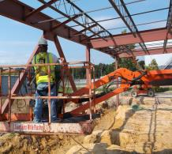
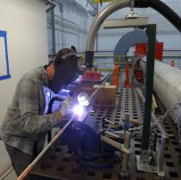
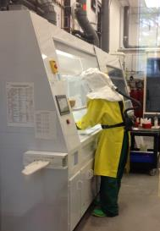
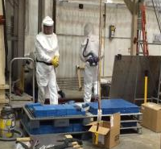
Getting Work Done Safely is Our Highest Priority
Low Injury rates attributable to effective work planning & control
Focus on student safety has been a priority
Last DART - December 2016; last subcontractor TRC – 2012
Recent events point to need for continued vigilance on balanced priorities

Slide 15
Budget
DOE Nuclear Physics Budget
  FY17 enacted $622M
  FY18 President’s Budget Request: $503M (-19%)
  FY18 House $619M (-0.5%)
  FY18 Senate $639M (+3%)
Appropriations Language:
  House: “Within available funds, the Department is encouraged to fund optimal operations at Thomas Jefferson National Accelerator Facility to support runtime at the 12 GeV Continuous Electron Beam Accelerator Facility and at Brookhaven National Laboratory to support runtime at the Relativistic Heavy Ion Collider
  Senate: “The Committee further recommends $174,600,000 for operations at the Relativistic Heavy Ion Collider, and optimal operations for the Continuous Electron Beam Accelerator Facility, the Argonne Tandem Linac Accelerator System, and the Brookhaven Linac Isotope Producer Facility
Jefferson Lab Nuclear Physics Budget (w/o 12 GeV):
  FY16: $107.6M
  FY17: $111.2M
Presently operating under a Continuing Resolution (funding at FY17 levels) through early December

Slide 16
Finally…
We look forward to continuing to work with the Collaboration and larger user community to do all we can so that you are successful
What I would ask is that you keep in mind the competitive environment in which we are operating:
  Keep up the good work and proceed with an appropriate sense of urgency
  Let your voice be heard. Decision-makers need to hear from you about the importance of your work, the importance of training the next generation and the importance of Jefferson Lab for achieving your goals
  Thank you for your continued enthusiasm and support for Jefferson Lab and its future

