Slide 1



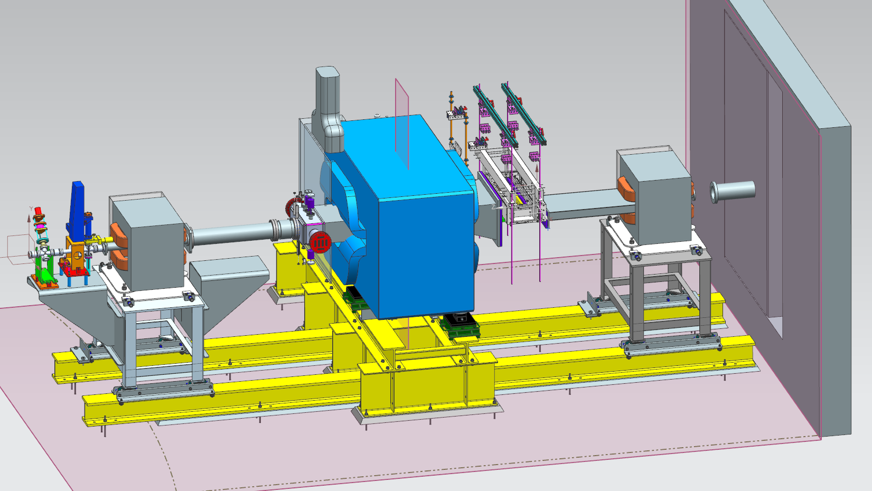
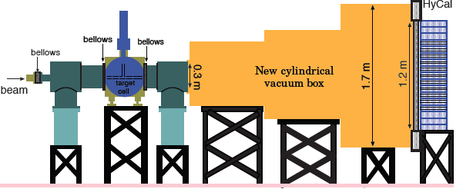
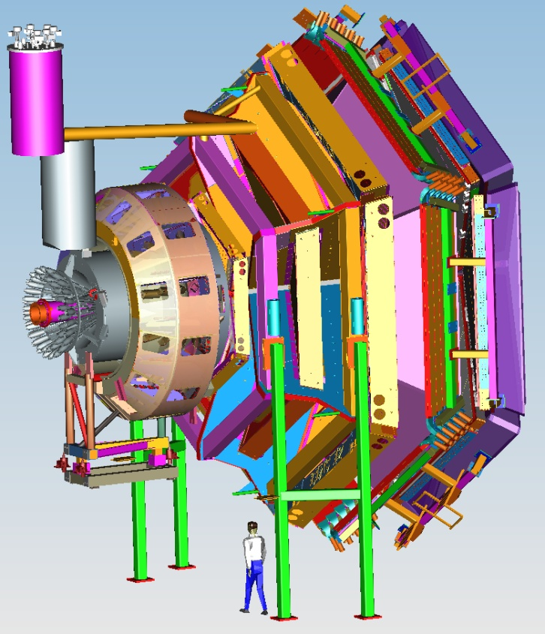
Status of Hall B
CLAS12
Volker D. Burkert
Overview
HPS & PRad update
CLAS physics highlight
CLAS12 status
Preparation for engineering
& physics run
PAC45
Summary
CLAS Collaboration Meeting
October 3 - 6, 2017

Slide 2

CLAS12 Complete
The message from DOE for CD4B

Slide 3
Hall B Overview
The 12 GeV upgrade project is complete, CD4B granted by DOE
CLAS12 upgrades with collaboration driven equipment
  Forward Tagger installed, Central Neutron Detector installed, Barrel and Forward MM integrated with SVT, RICH Detector in final assembly stage
Continued flow of publications in refereed journals and conference talks
  193 science papers + 39 technical papers published in refereed journals
  > 2,150 talks at conference (> 1,300 invited)
  >175 PhD theses completed on CLAS results [30 in progress]
  2017 JSA Thesis Price: Priyashree Roy (FSU) - Polarization observables in vectormeson photoproduction with FROST and polarized photons
  10 PhD theses in progress on CLAS12
Other Hall B experiments
  Proton Radius experiment – 2 PhD theses in process
  Heavy Photon Search – 4 PhD theses completed, 1 in progress, 1st publication in preparation
CLAS12 engineering & physics runs
  Scheduled for December 2017 – March 2018,
Ready for Science
  Review 9/25-26 – implementation of results in preparation for upcoming run

Slide 4

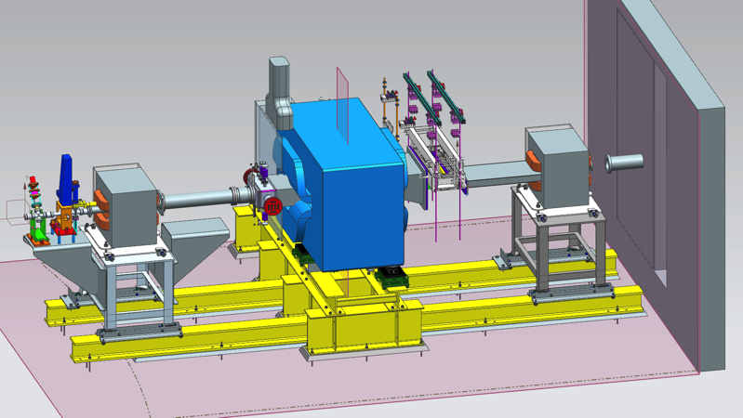
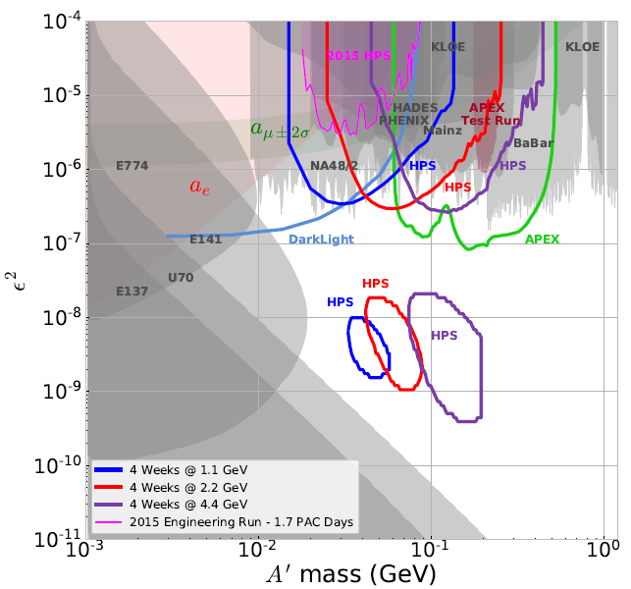
Heavy Photon Search
First Vertexing Results presented in two theses
* Sho Uemura , 10% 2015 (Stanford, 12/16)
* Holly Vance, 100% 2015 (Old Dominion, 9/17)
Reach roughly a factor of 6 worse than projected,
so 2015 running has no sensitivity to A’s.
New SVT Layer closer to target and new positron trigger recover HPS reach.
* Upgrades passed ERR in June
* Construction underway; complete late 2018
HPS will resume A’ search in well-motivated, unexplored parameter space in 2019.

Slide 5
Proton Radius Experiment
All 2.2 GeV beam energy data have been analyzed
A small contribution from the inelastic processes at 2.2 GeV (<2% at highest angles) has been identified:
  simulated and subtracted with a sub percent precision from the physics distributions
Extraction of the ep ➔ ep differential cross sections is expected in October, 2017.
Scattered electron energy distribution from the data (black) and simulation (red) including inelastic processes.

Slide 6
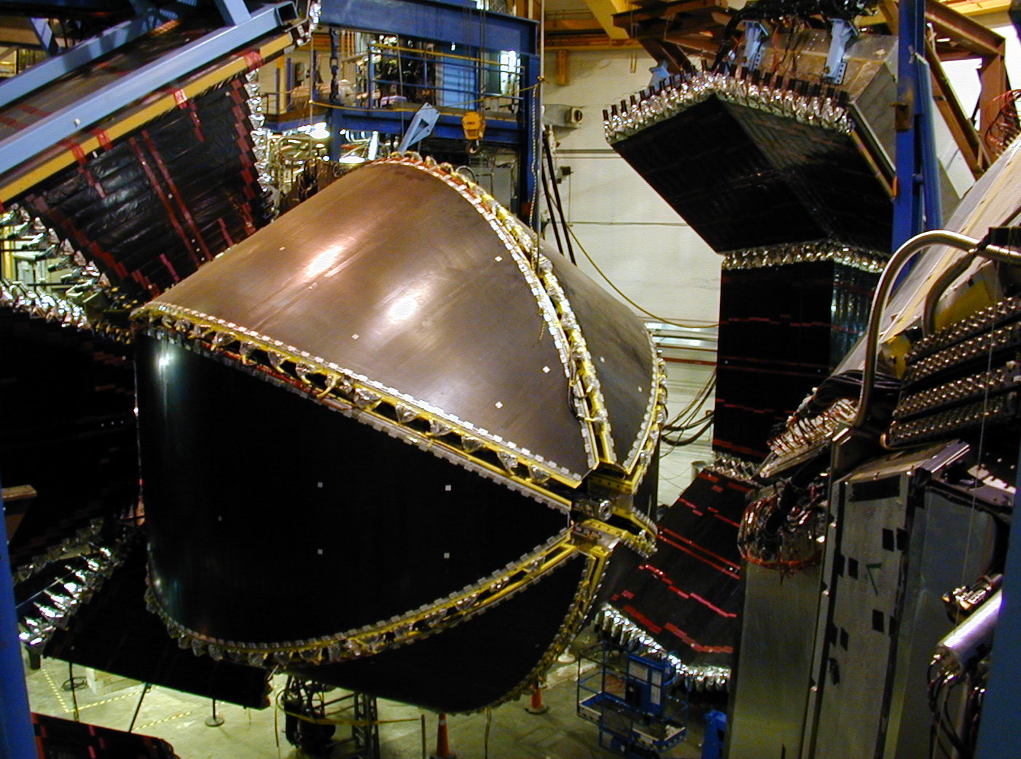
CEBAF Large Acceptance Spectrometer (CLAS)
1997 - 2012

Slide 7
Hall B
Physics Publications in refereed Journals
 | HSWG | DPWG | NPWG | ALL
2000 | - | 1 | 1 | 2
2001 | 2 | 3 | - | 5
2002 | 3 | - | 1 | 4
2003 | 7 | 4 | 1 | 12
2004 | 3 | 3 | 4 | 10
2005 | 7 | 3 | 2 | 12
2006 | 8 | 4 | 3 | 15
2007 | 7 | 2 | 3 | 12
2008 | 4 | 6 | 2 | 12
2009 | 8 | 7 | 4 | 19
2010 | 4 | 2 | 4 | 10
2011 | 3 | 1 | 4 | 8
2012 | 6 | 3 | 2 | 11
2013 | 8 | 6 | 2 | 16
2014 | 5 | 6 | 1 | 12
2015 | 4 | 5 | 3 | 12
2016 | 7 | - | - | 7
2017 | 8+1 | 6+3 | +1 | 14+5
SUM | 94+1 | 62+3 | 37+1 | 193+5
5
10
15
publ
subm.
updated 21 Sep 2017

Slide 8
Conference Presentations
Total: 2165
150
100
50
203
106
17
45
59
62
92
114
93
94
80
113
108
132
137
133
121
154
170
132
0
1998
1999
2000
2001
2002
2003
2004
2005
2006
2007
2008
2009
2010
2011
2012
2013
2014
2015
2016
2017
Source: CSC
updated 2 Oct 2017

Slide 9
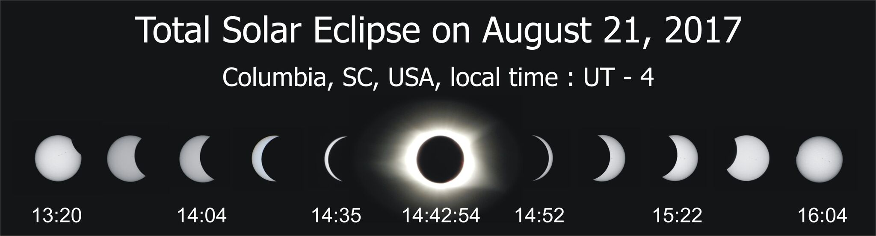
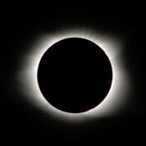
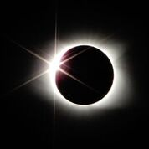
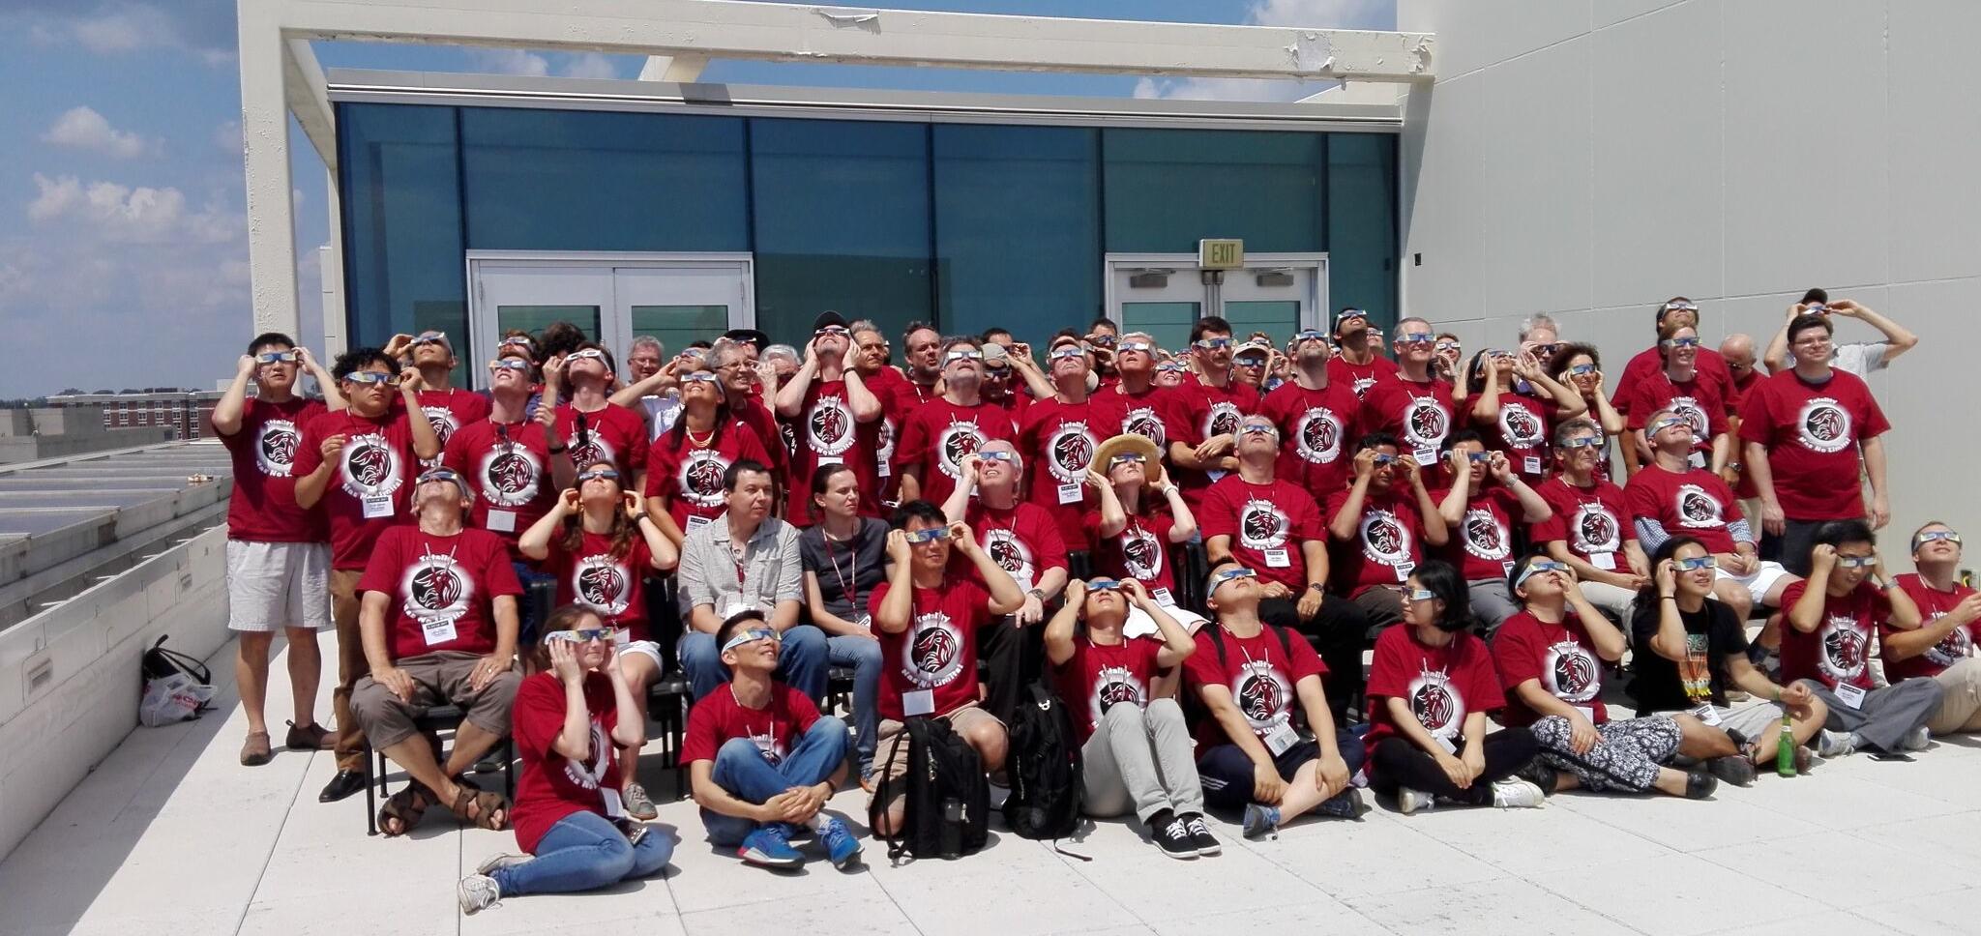
NSTAR 2017

Slide 10
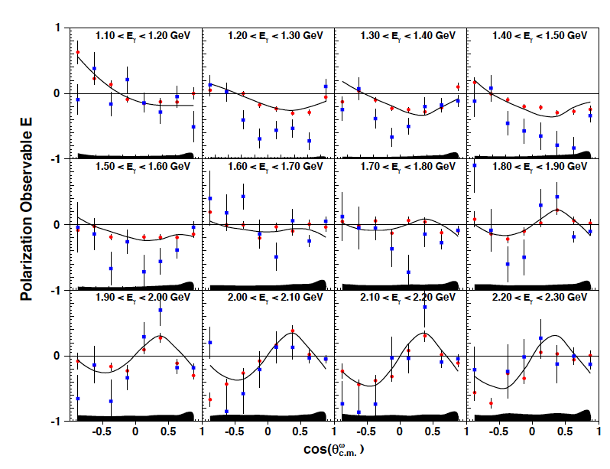
Polarization asymmetry E in γp → pω(π⁺π⁻π⁰)
Z. Akbar et al., arXiv:1708.02608 (2017)
CLAS-FROST
CB-ELSA
In the Bonn-Gatchina
multi-channel partial-wave analysis the CLAS data show strong evidence for “missing” N(2000)5/2⁺.
State was previously seen in 2009 CLAS paper on pω partial wave analysis on SDME.

Slide 11
2017 CLAS data in evidence for new N*’s
Paper | Reference | N*’s
Strong evidence for N*’s near 1900 MeV | A.V. Anisovich et al., PRL 119 (2017), 062004 | N(1895)1/2, N((1880)1/2⁺ N(1900)3/2⁺
Helicity asymmetry E in γp->pω(π+π−π⁰) | Z. Akbar et al., arXiv:1708.02608 (2017) | N(2000)5/2⁺ N(2120)3/2⁻
Beam-Target Helicity Asymmetry for γn→πp in the N∗ Resonance Region | D. Ho et al., Phys.Rev.Lett. 118 (2017) no.24, 24200 | N(2040)3/2⁺
N∗→Nη′decays from photoproduction of η′ mesons off protons (E) | A.V. Anisovich et al., Phys.Lett. B772 (2017) 247 | N(1895)1/2, N(1900)3/2⁺ N(2100)1/2⁺ N(2120)3/2⁻
Photon beam asymmetry Σ In the reaction γp→pω | P. Collins et al., Phys.Lett. B773 (2017) 112-120 | J^{P}=3/2⁺
Differential cross sections and polarization observables from CLAS K* photo-production and the search for new N* states | A.V. Anisovich et al., Phys.Lett. B771 (2017) 142 | N(1895)1/2-, N(2100)1/2+
Photon beam asymmetry Σ for η and η′ photoproduction from the proton | P. Collins et al., Phys.Lett. B771 (2017) 213-221 | N(1895)1/2, N(1900)3/2⁺ N(2100)1/2⁺ N(2120)3/2⁻
Evidence forΔ(2200)7/2⁻ from photo-production and consequence for chiral-symmetry restoration at high mass | A.V. Anisovich et al, Phys.Lett. B766 (2017) 357-361 | Δ(2200)7/2-

Slide 12
Progress in Nucleon Spectroscopy
State N((mass)J^{P} | PDG pre 2012 | PDG 2018*
N(1710)1/2⁺ | *** | ****
N(1880)1/2⁺ |  | ***
N(1895)1/2⁻ |  | ****
N(1900)3/2⁺ | ** | ****
N(1875)3/2⁻ |  | ***
N(2120)3/2⁻ |  | **
N(2000)5/2⁺ | * | **
N(2060)5/2⁻ |  | **
Δ(2200)7/2⁻ | * | ***
Star ratings of PDG before 2012 and projections for 2018, most of the data from CLAS experiments.
**** Existence is certain
*** Existence is very likely
** Evidence of existence is fair
* Evidence of existence is poor
*) projected
Notes:
This slides shows a summary of the results in this analysis. The green column shows the rating by the PDG. The two columns show the importance of the strangeness channel in this results.

Slide 13
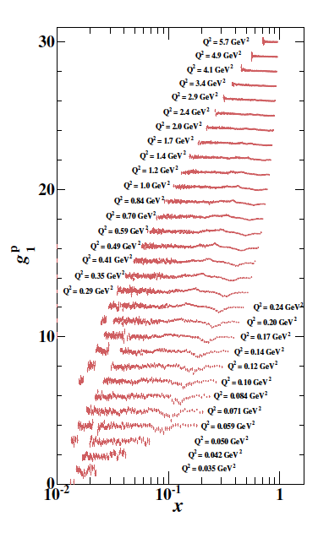
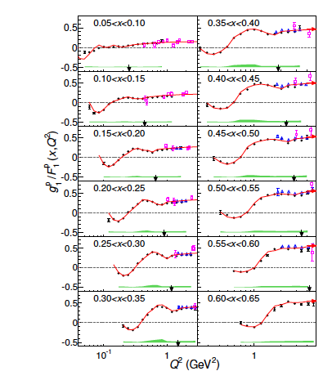
Inclusive beam-target polarization data
EG1: R.G. Fersch et al., arXiv:1706.10289

Slide 14

Detector Systems
CLAS12
Hall B
Forward Detector (FD)
TORUS magnet
HT Cherenkov Counter
Drift chamber system
LT Cherenkov Counter
Forward ToF System
Pre-shower calorimeter
E.M. calorimeter
Forward Tagger
RICH detector
Central Detector (CD)
Solenoid magnet
Silicon Vertex Tracker
Central Time-of-Flight
Central Neutron Detector
  - MicroMegas
Beamline
Photon Tagger
Shielding
Targets
Polarimeter
Farady Cup
MM
CND
FT
Number of readout channels : 111, 832
RICH
https://www.jlab.org/Hall-B/clas12-web/

Slide 15
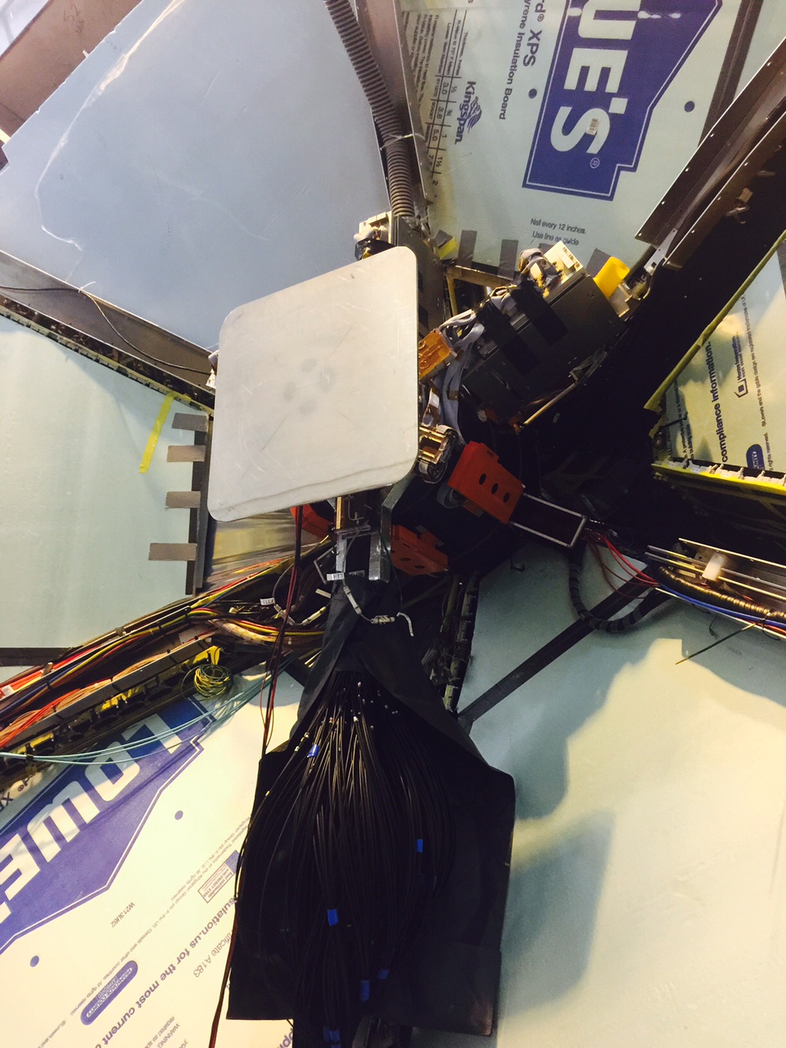
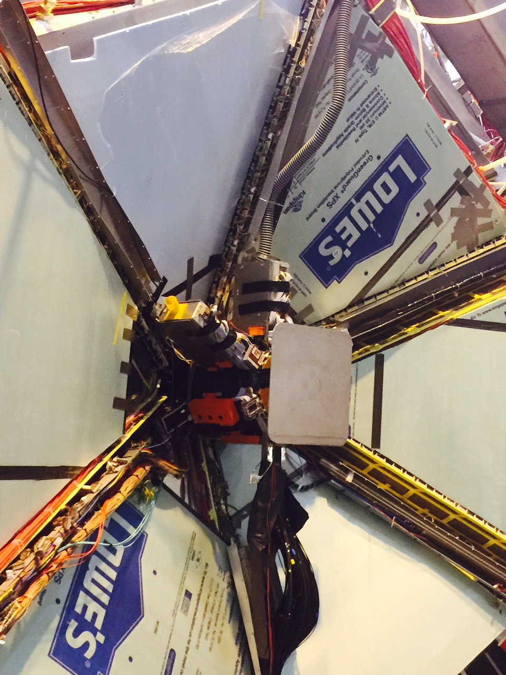
Forward Tagger Installed

Slide 16
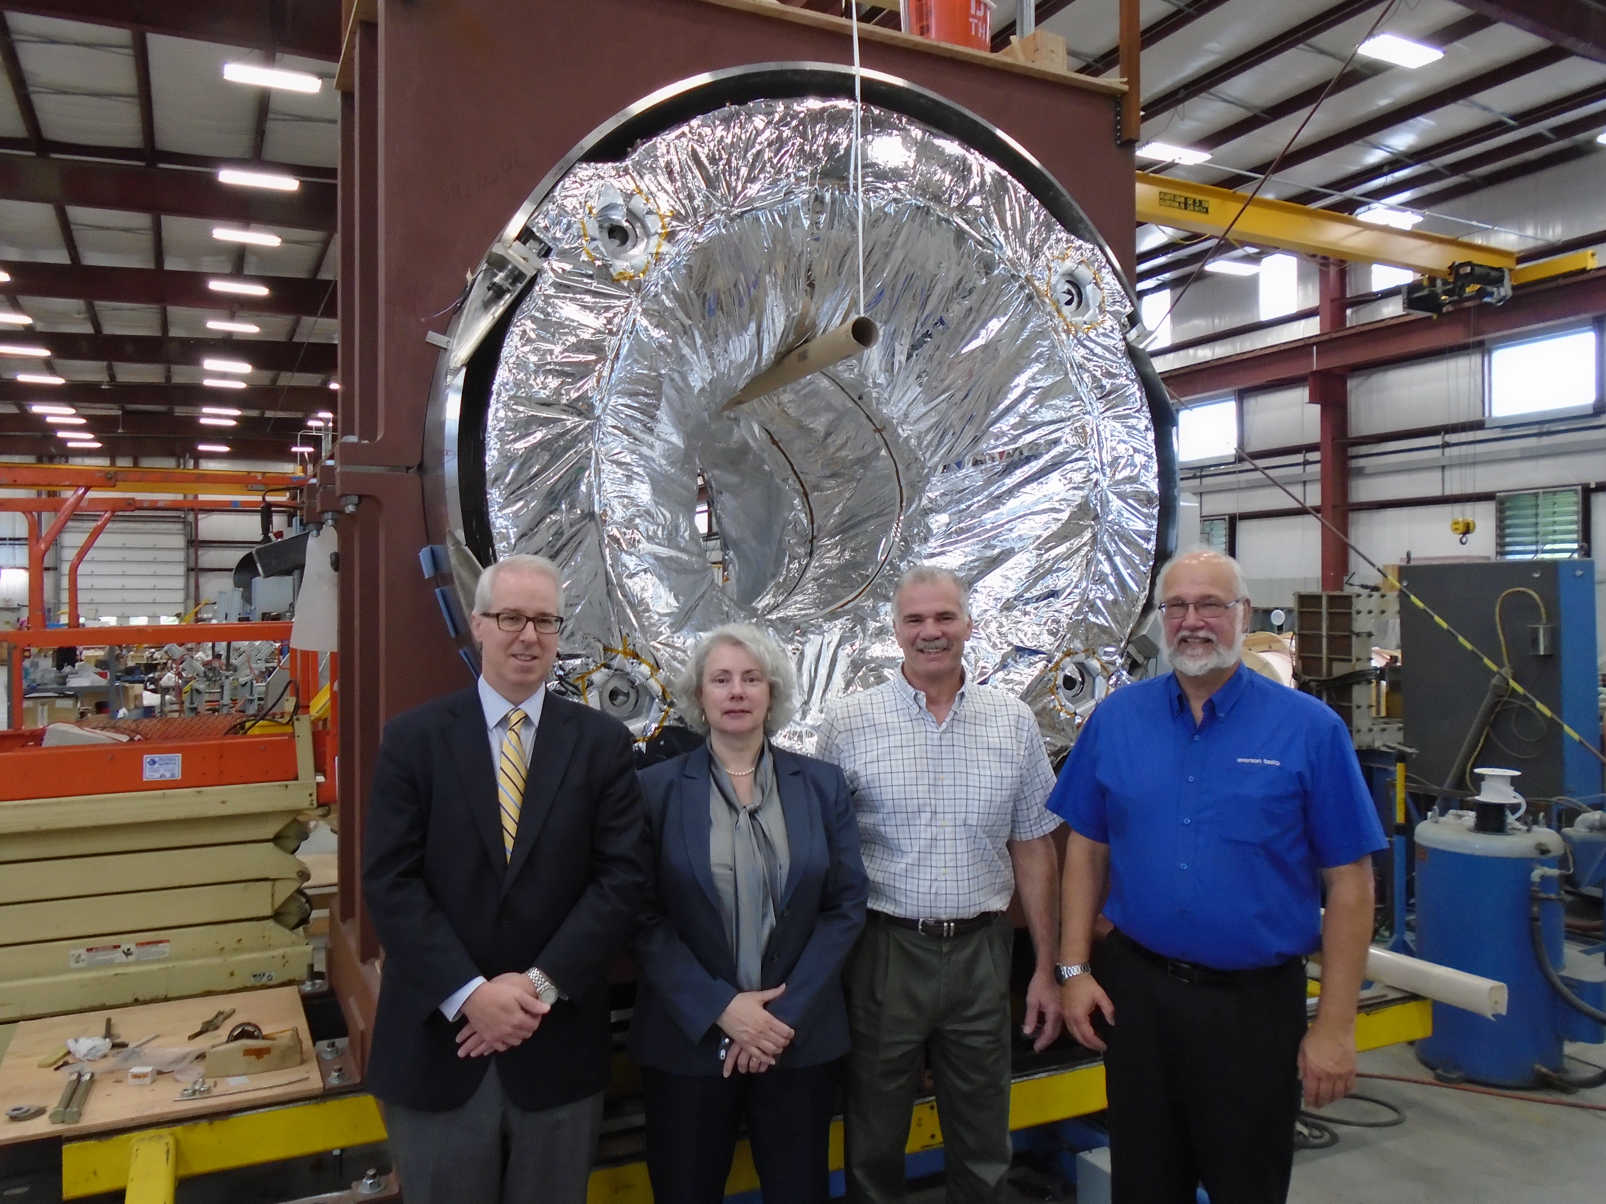
JLab management at ETI

Slide 17
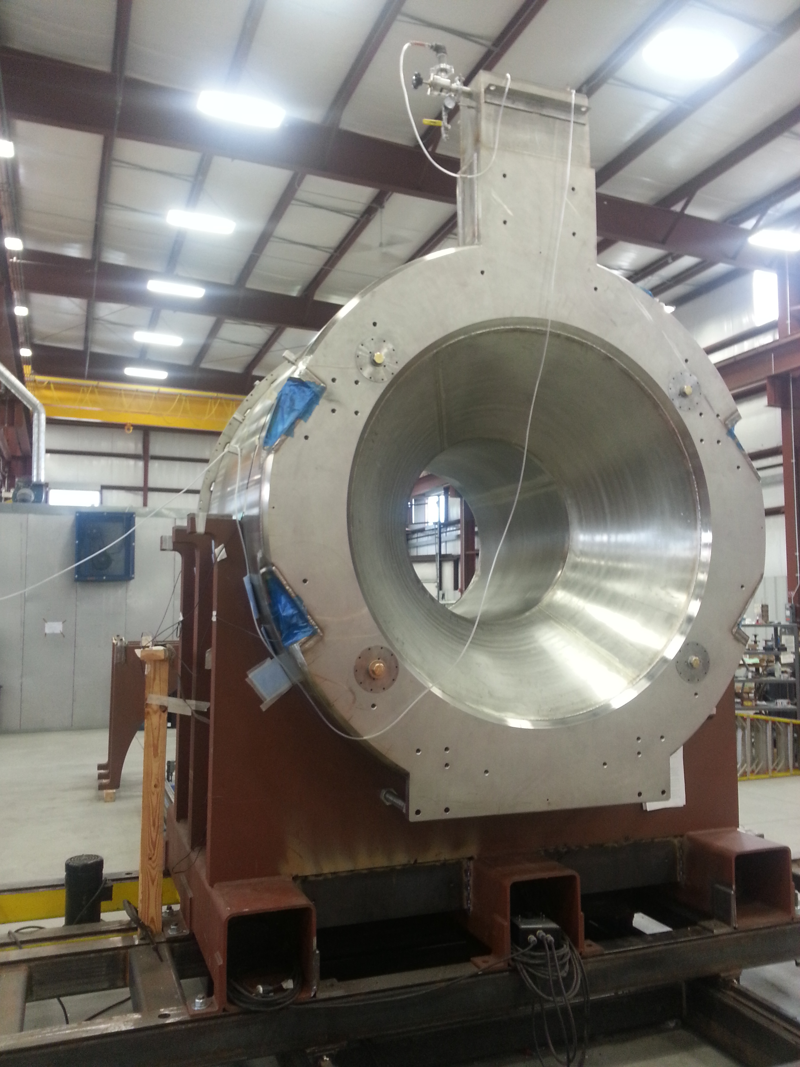
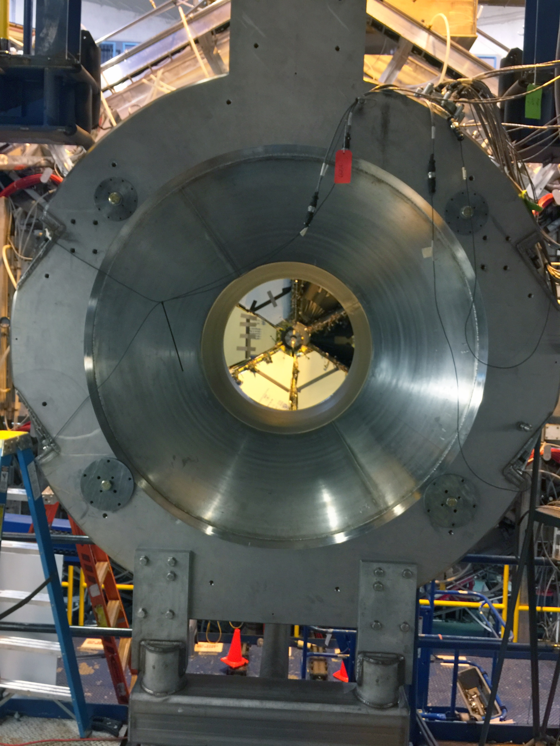
Solenoid Magnet from ETI to Hall B
At ETI 06/24 2017
at Jlab 06/28 2017

Slide 18
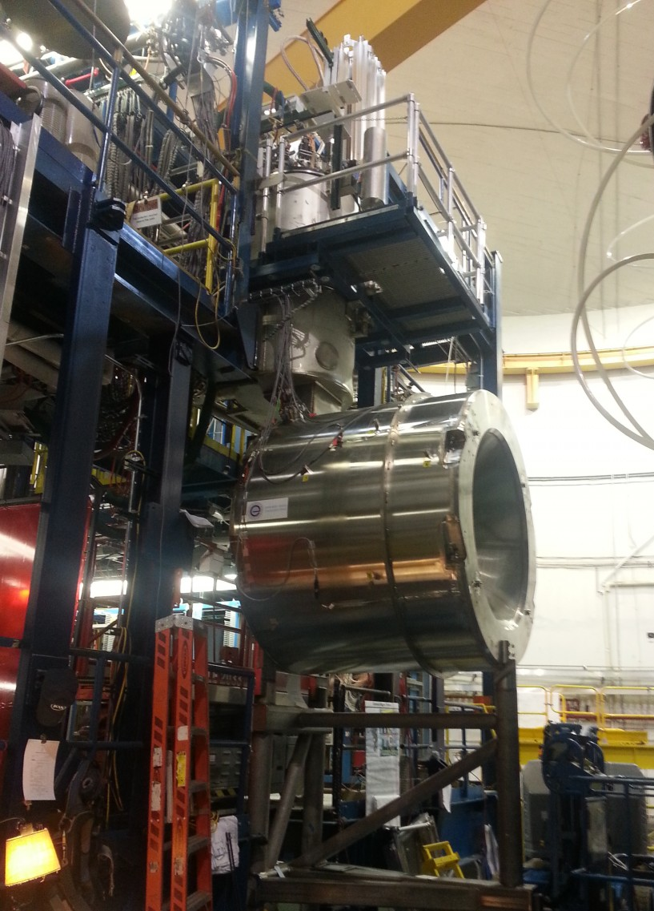
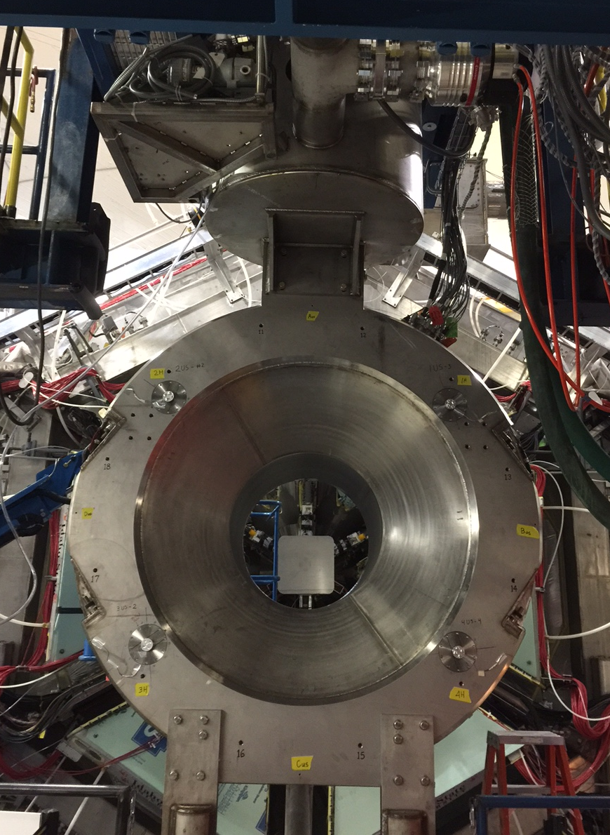
Solenoid on Service Tower – Start of cooldown
August 14, 2017

Slide 19
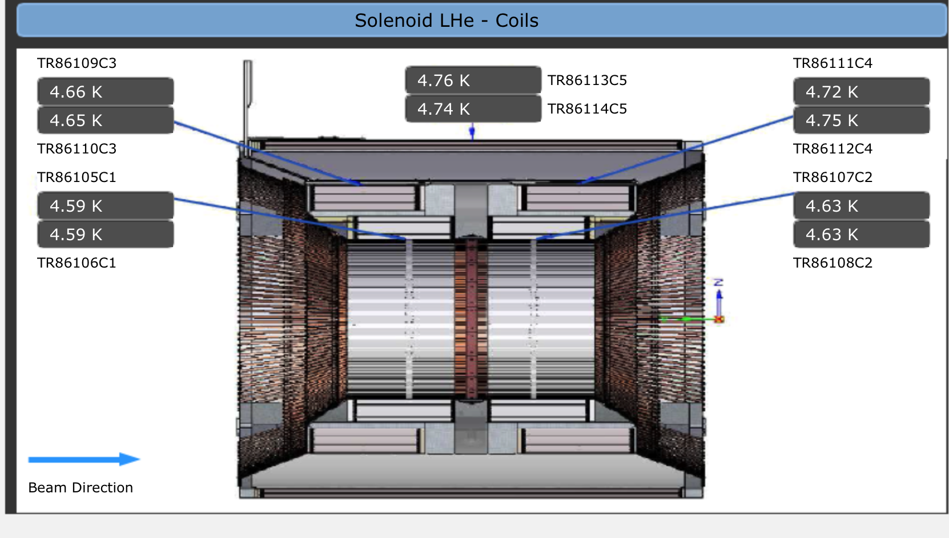
Solenoid Coils @ 4.6K
09/07/2017
COIL 5
COIL 3
COIL 4
COIL 1
COIL 2

Slide 20
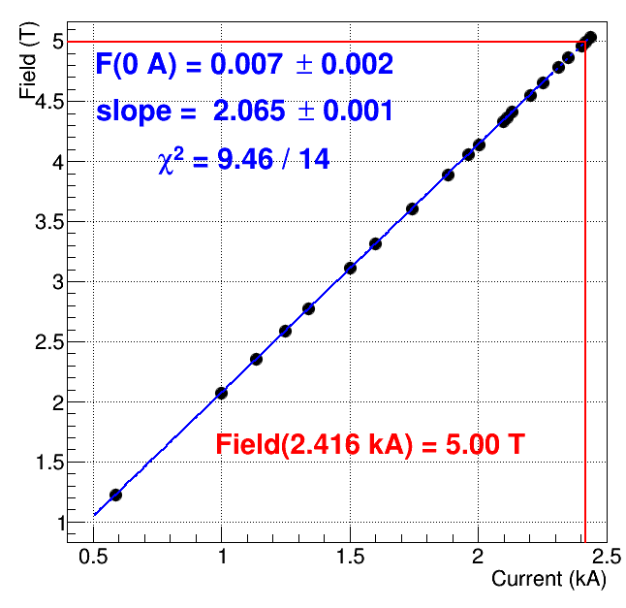
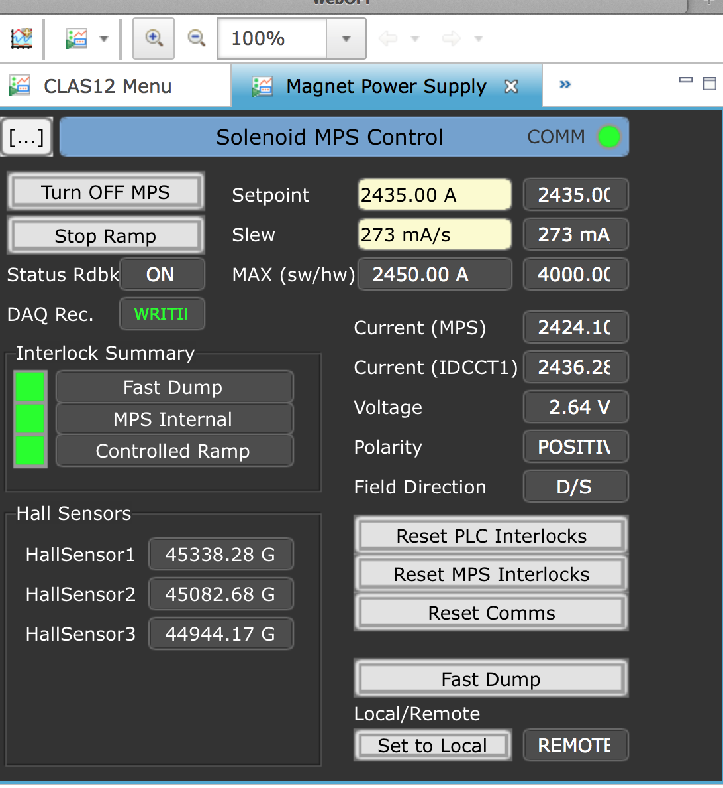
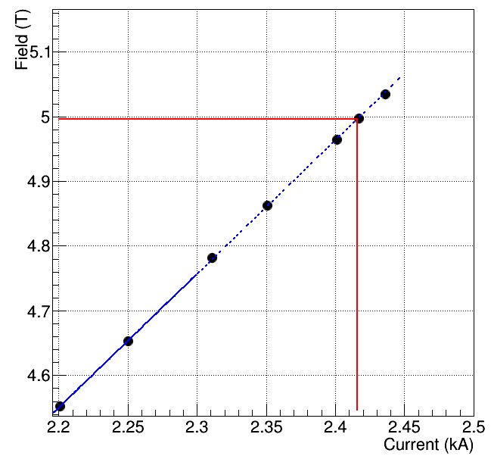
Solenoid reaches full current
Design Current: 2416 A => 5 Tesla central field
Monday 9/18/2017, 11:07 hrs

Slide 21
CLAS12 Complete
The message from DOE for CD4B

Slide 22
Torus Magnetic Field Distribution
→ Midplane B-fields vary by ~ 1/2% Sector to Sector
→+/- 15 Deg. B-fields Vary by < 1% Sector to Sector

Slide 23
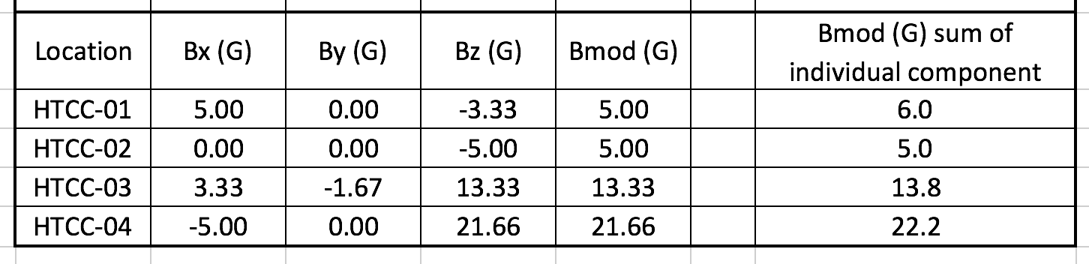
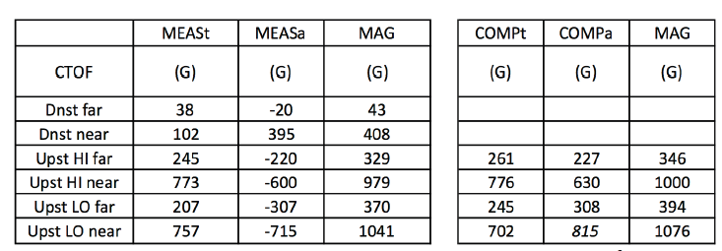
Solenoid Magnetic Fringe Field
≤
35G
Shield coil #5 works as expected, field values are within specs

Slide 24
Solenoid Magnetic Main Field
Azimuthal variation off-bore (12.5 mm)
ΔB/B₀≈3x10⁻⁴
Equality of the off-axis radial components to +/- 30 Gauss
Survey axis agrees with magnetic
axis within 2 mm (preliminary).

Slide 25
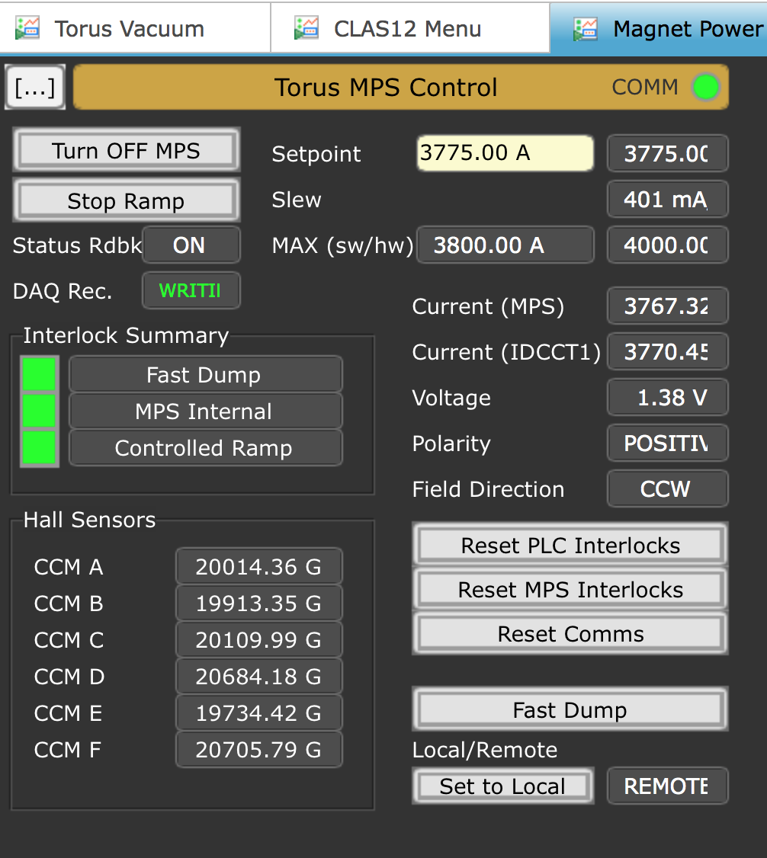
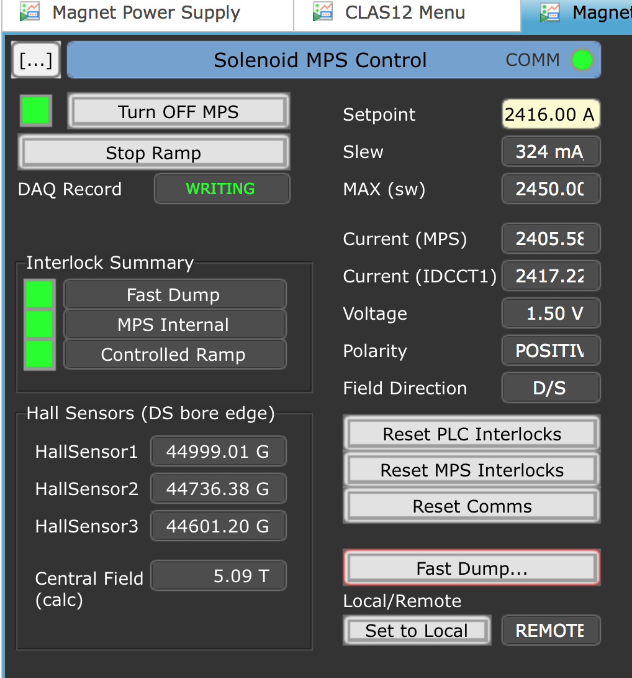
Torus Magnet and Solenoid Magnet at full current
Screen Shot 2017-09-27 at 10.28.24 PM
We have a complete magnetic spectrometer !
Both Torus magnet field polarities + and - were tested

Slide 26
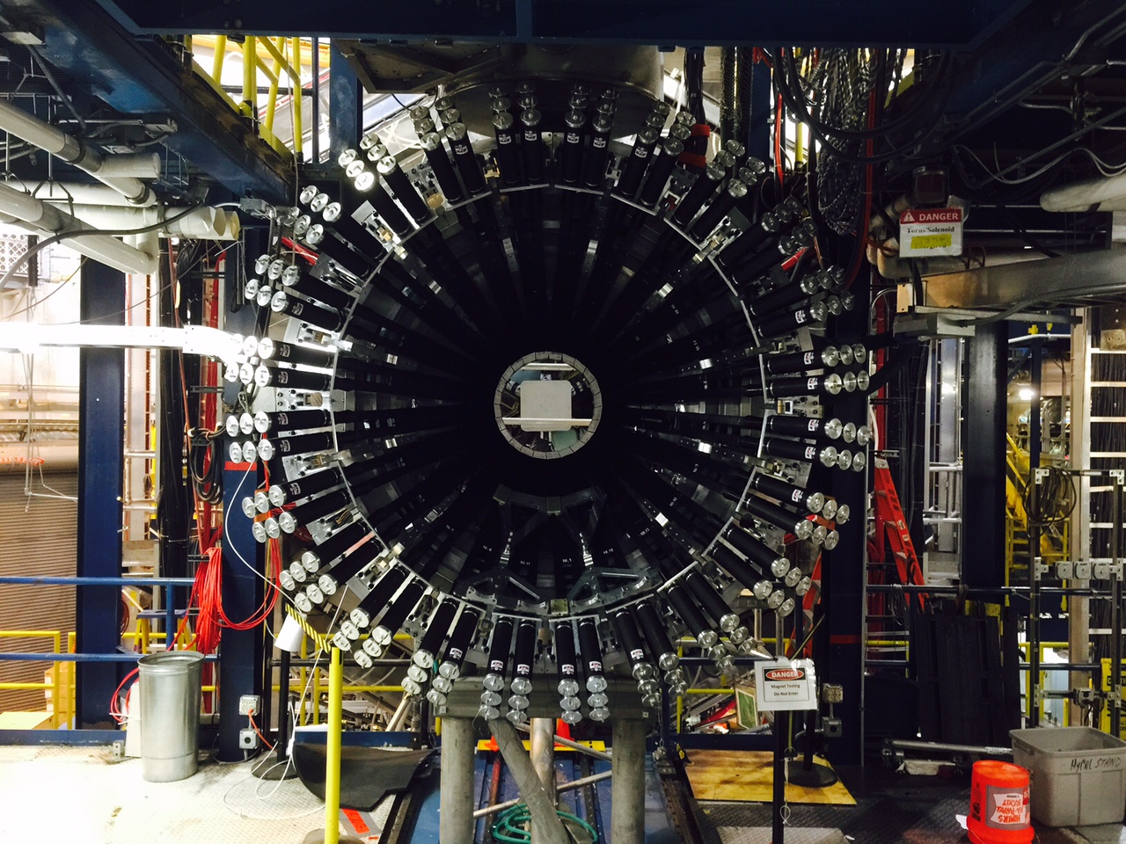
CND installed in Solenoid
09/25/2017
144 PMTs

Slide 27

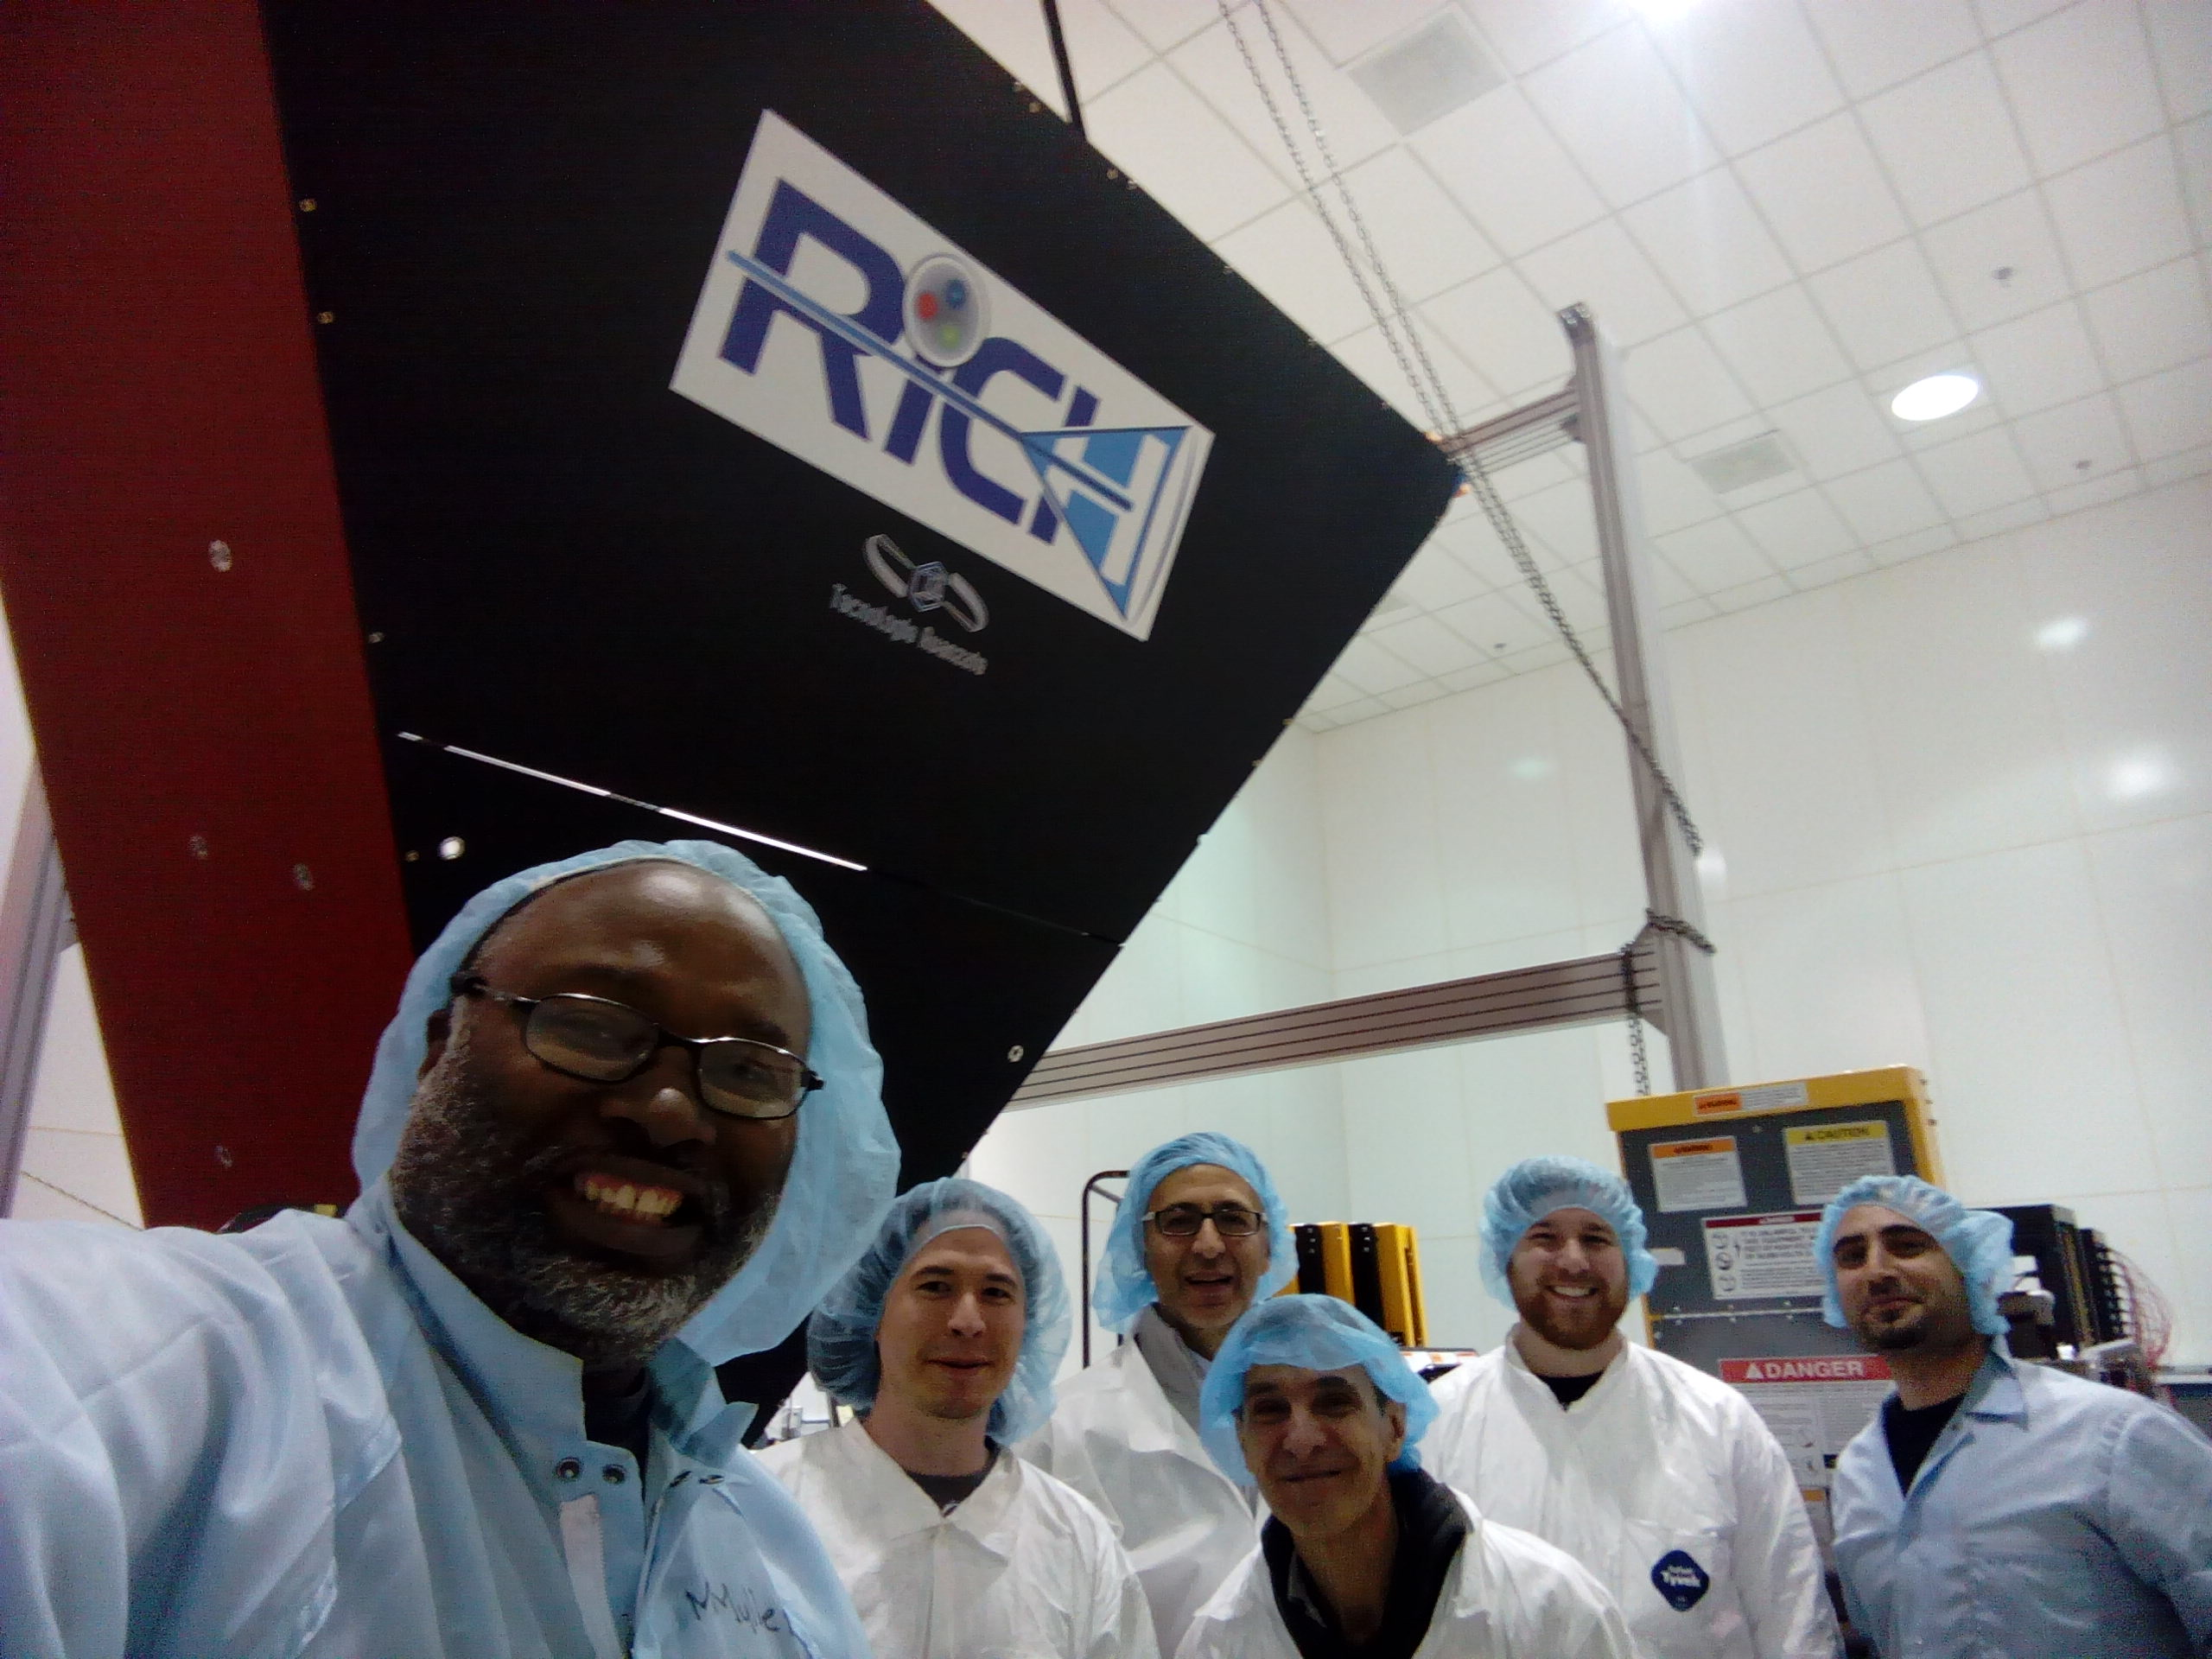
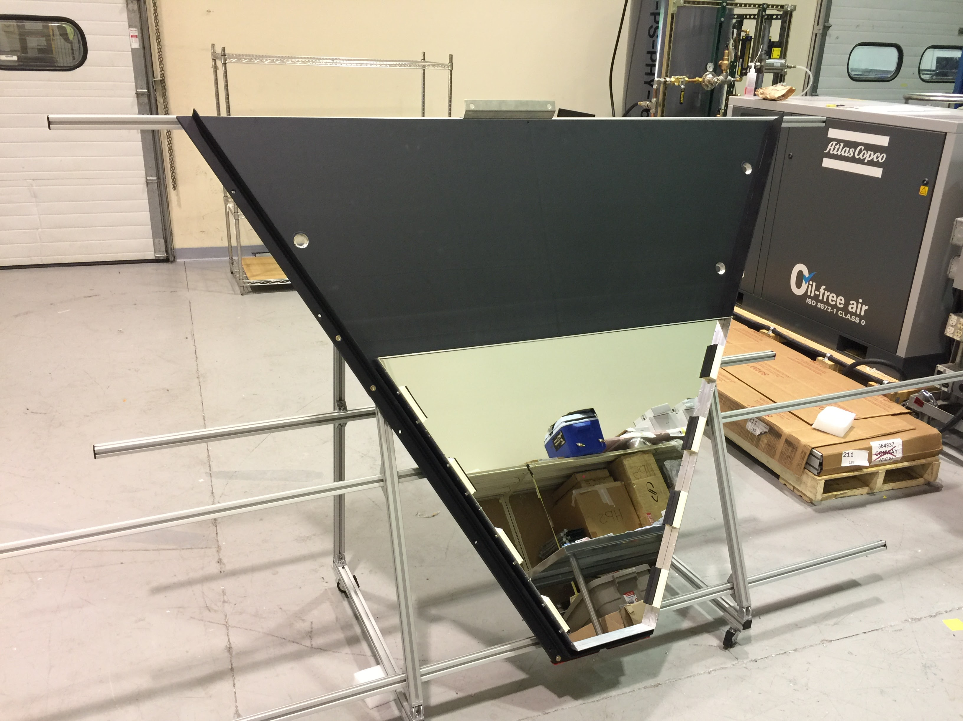
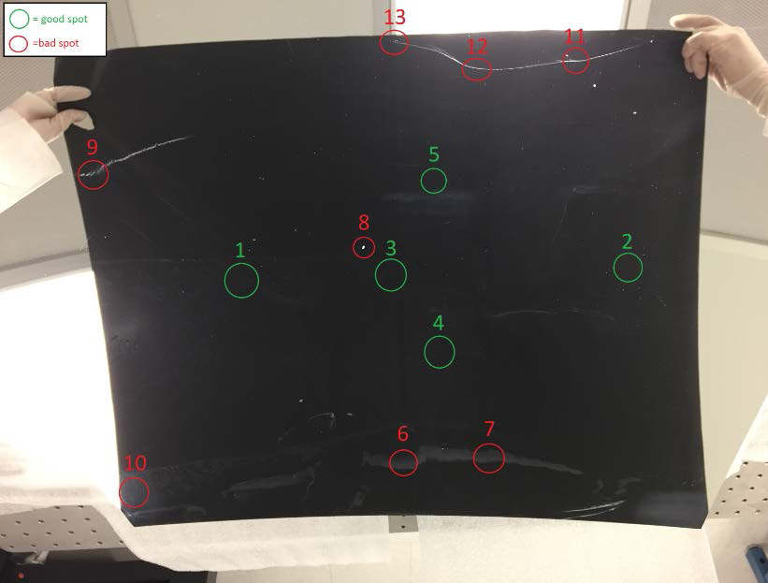
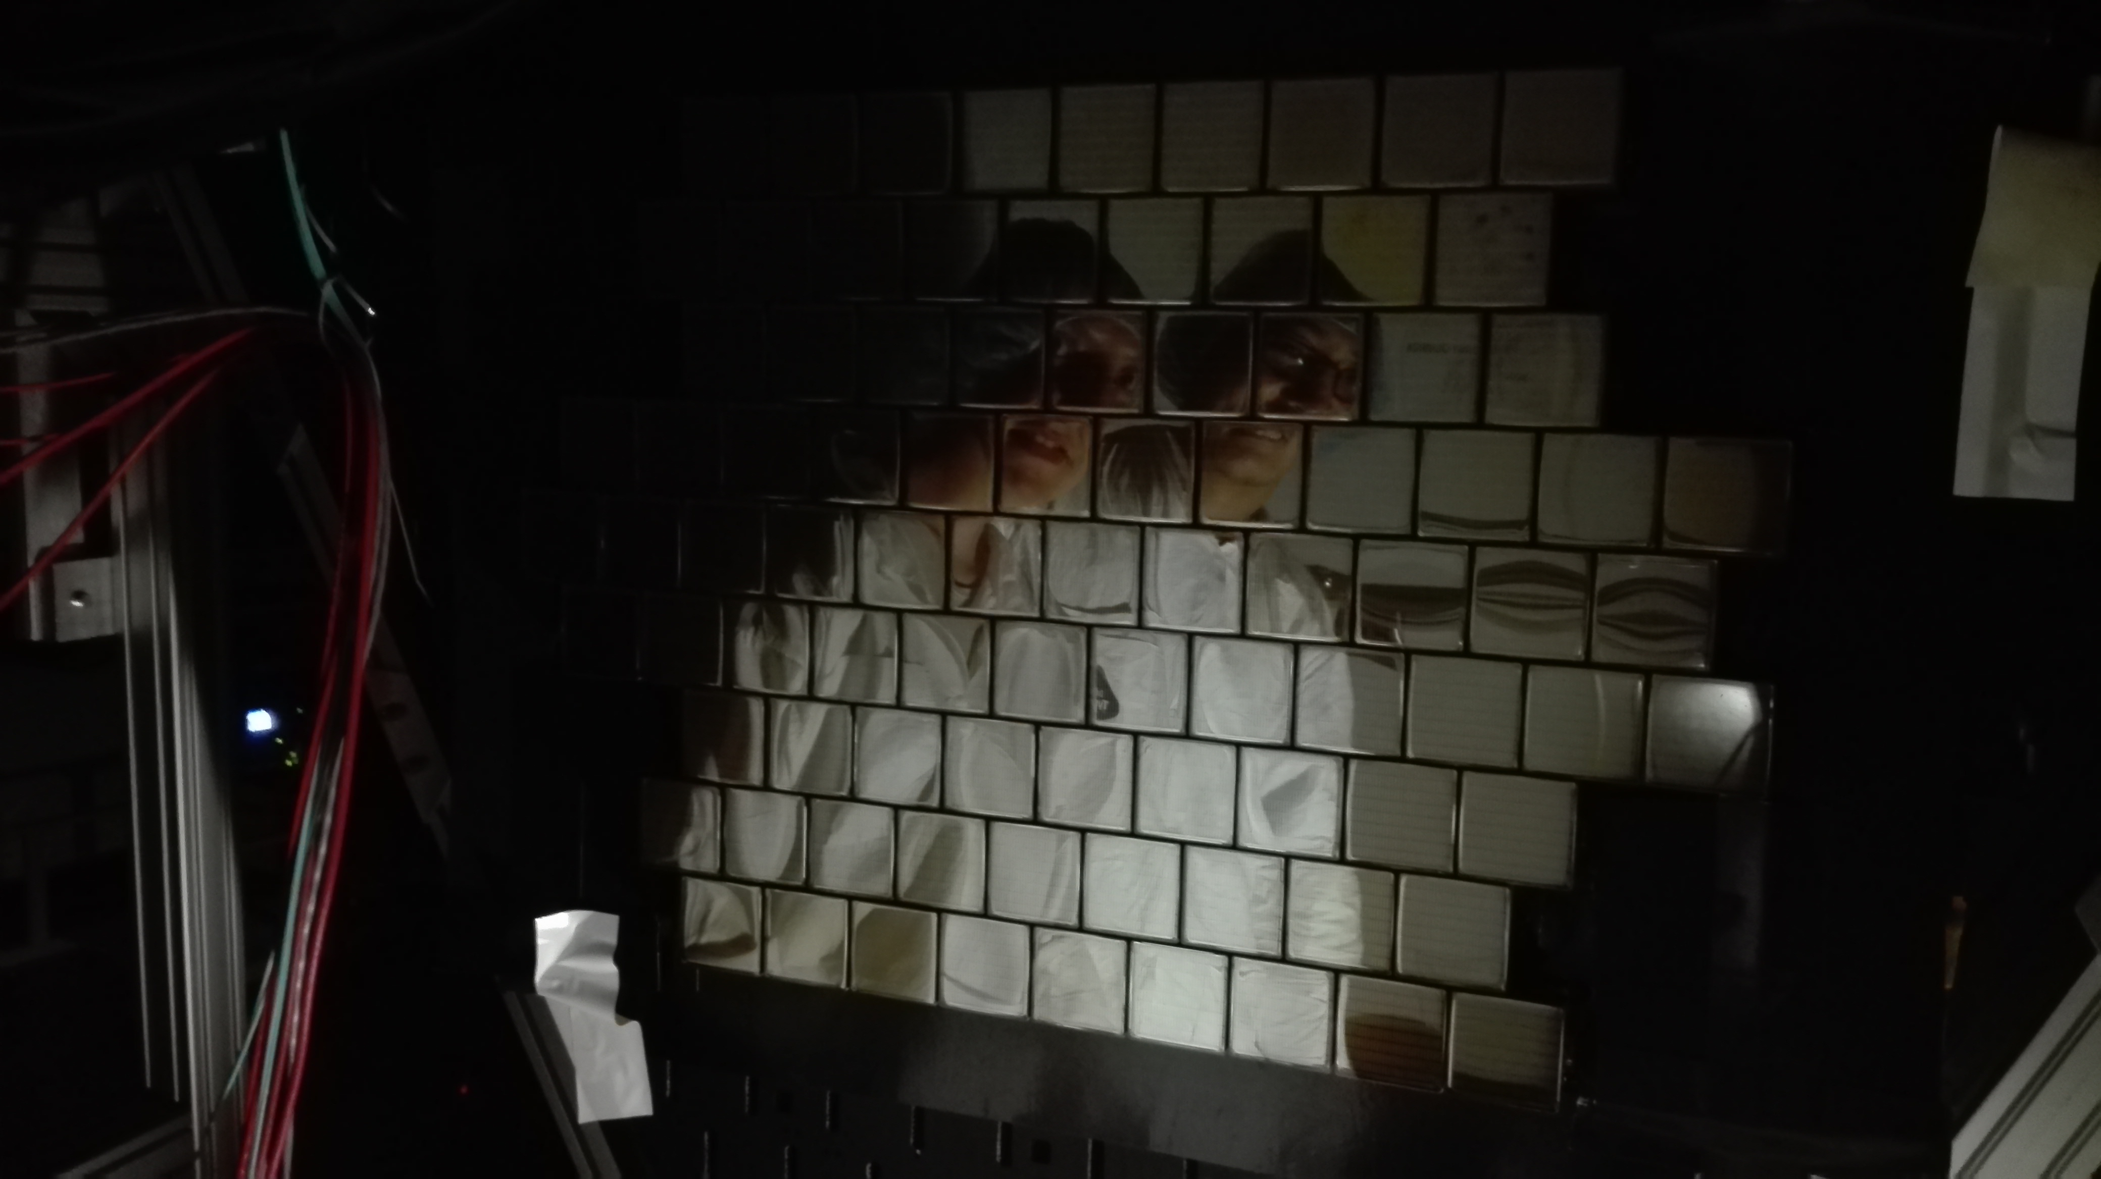
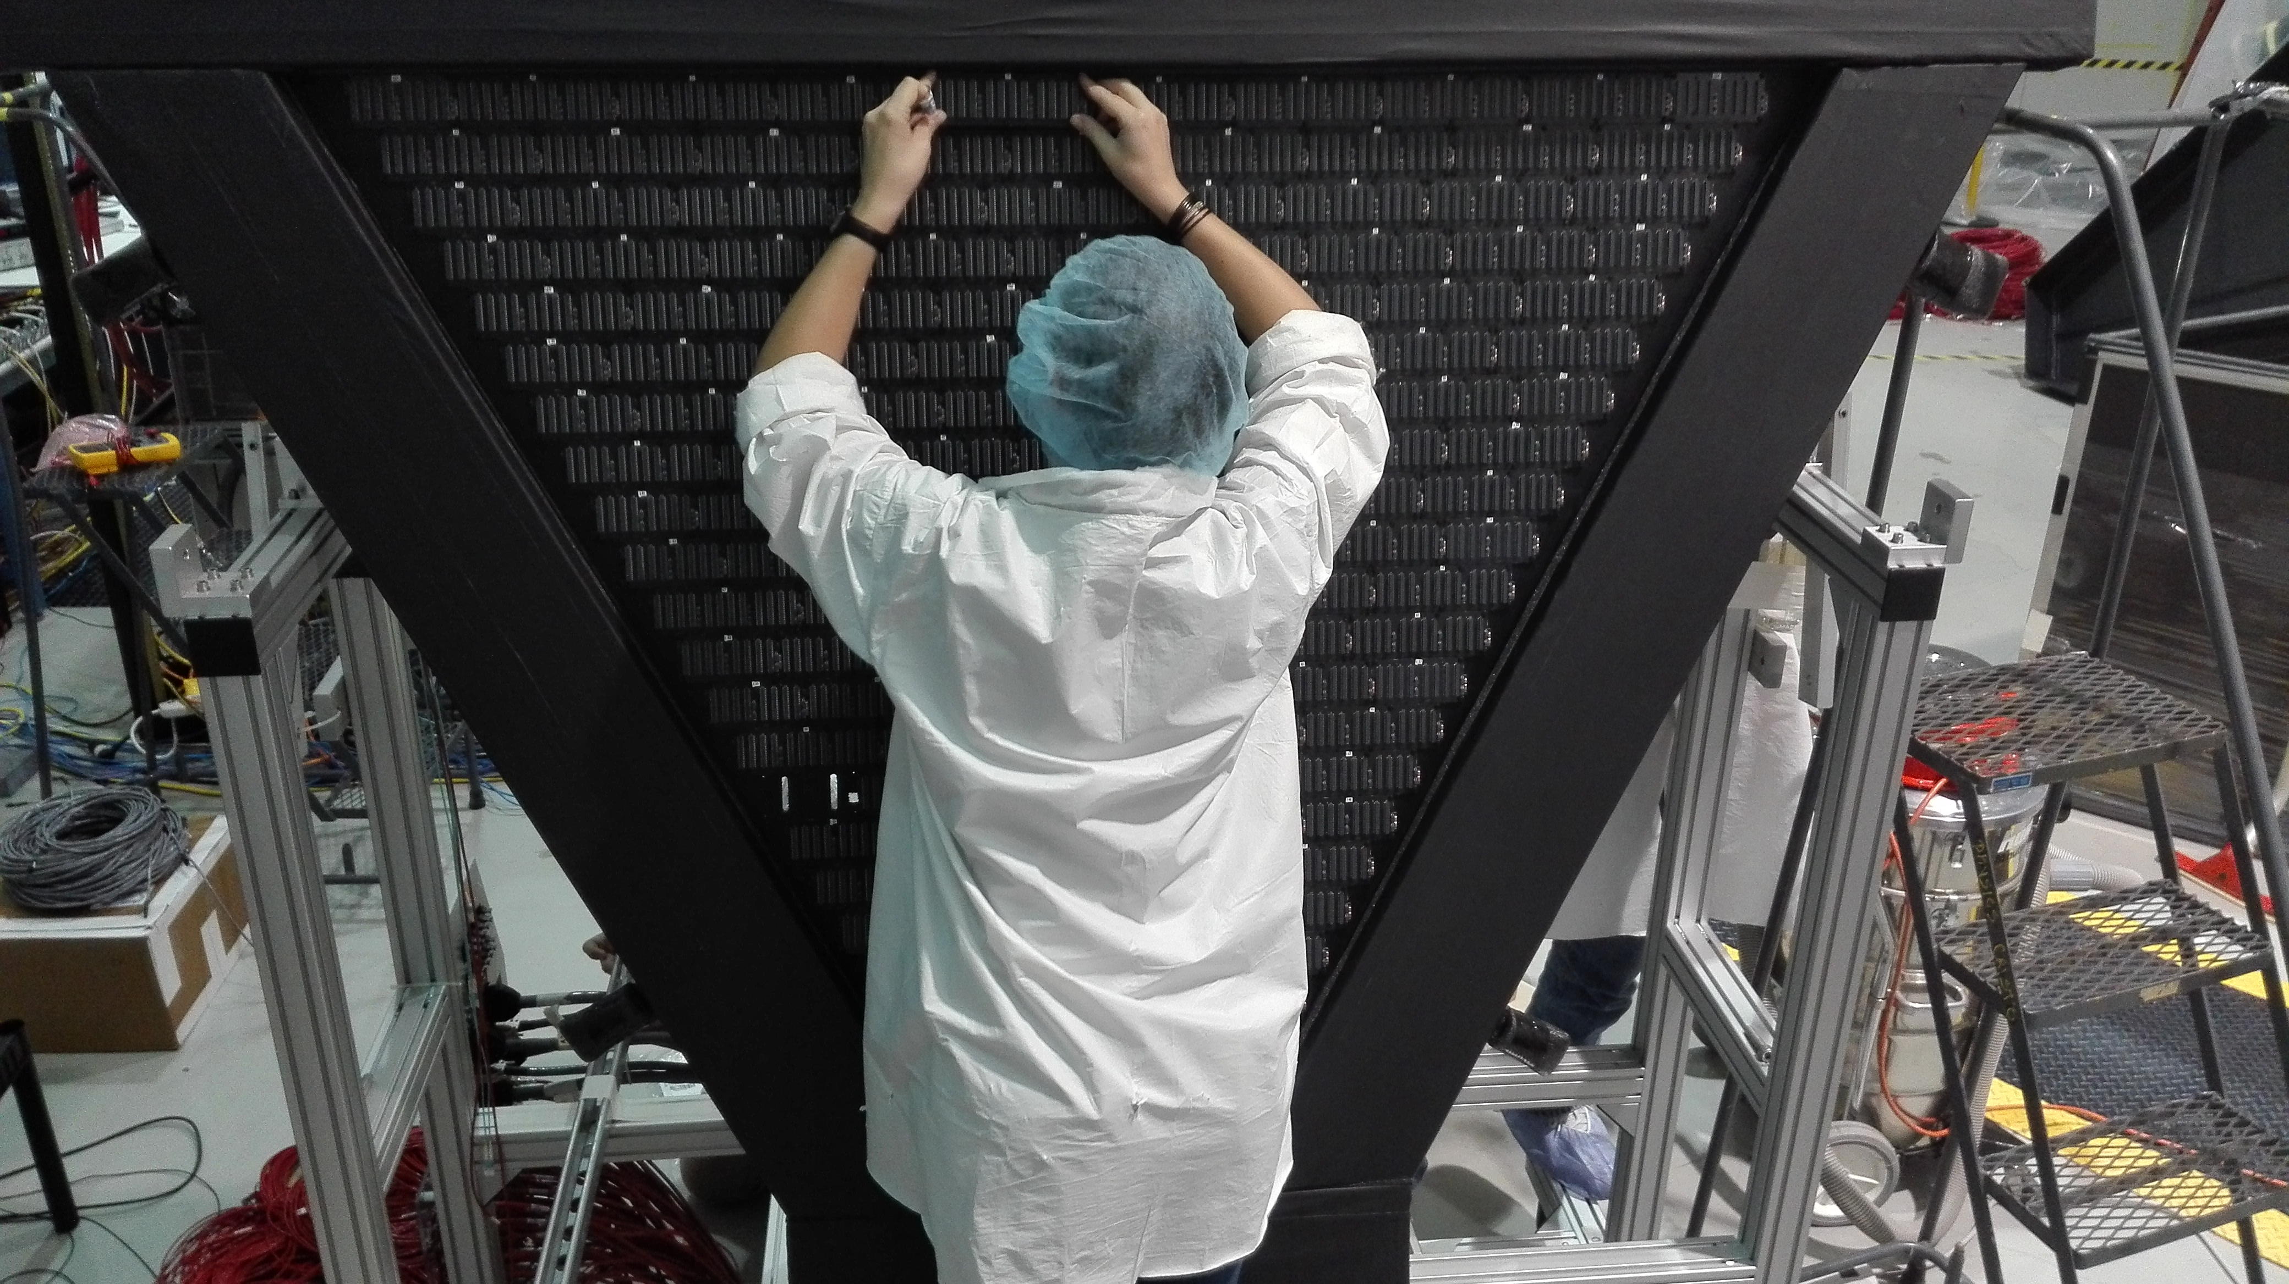
CLAS12
RICH Detector
Hall B
Mechanical structure
Mechanical structure ready
Installation tools in preparation
Aerogel
Baseline production done
Working on additional spares
RICH assembly on track for installation mid November
Mirrors
Spherical reveal defects after coating
Resurface done, coating ongoing
Lateral mirrors at JLab
Front mirrors being delivered
PMT + Electronics
Being assembled
10/4/17
CLAS collaboration meeting, JLab
27

Slide 28
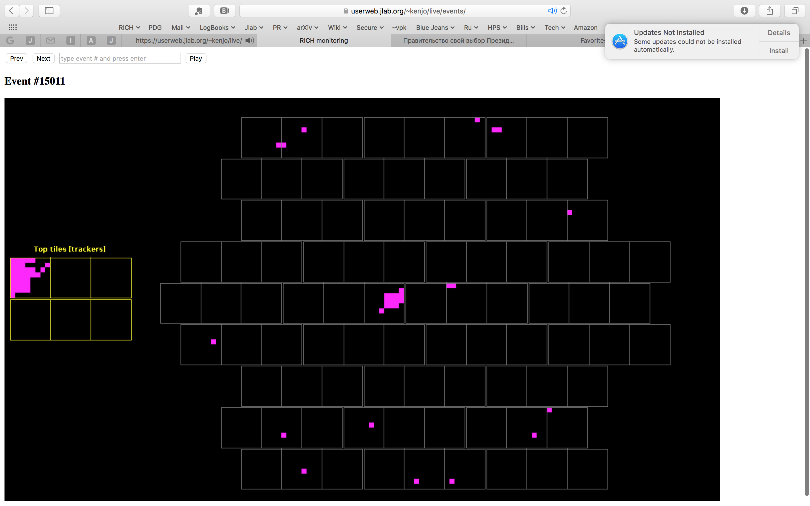
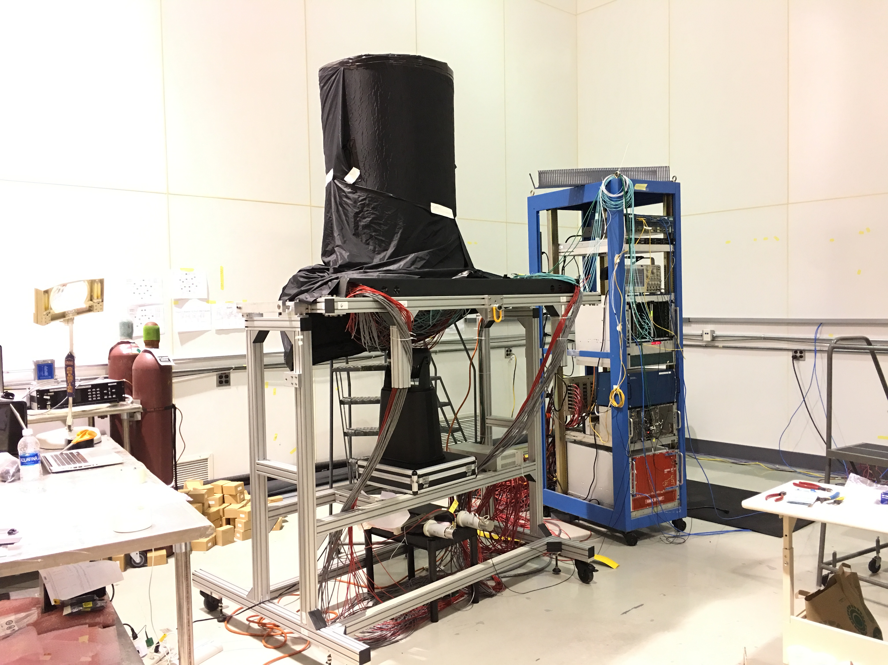
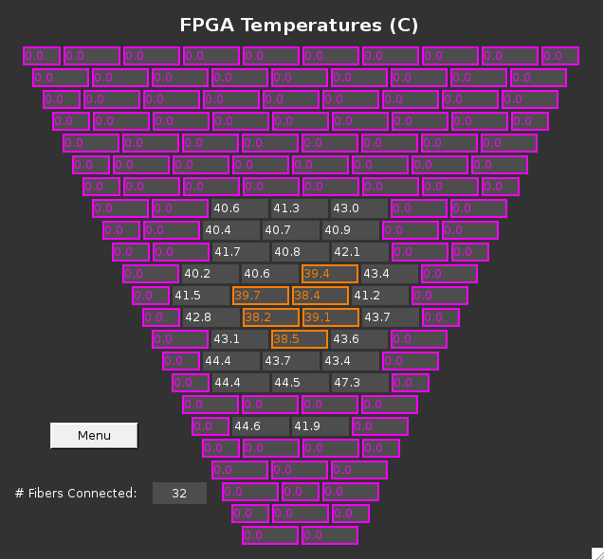
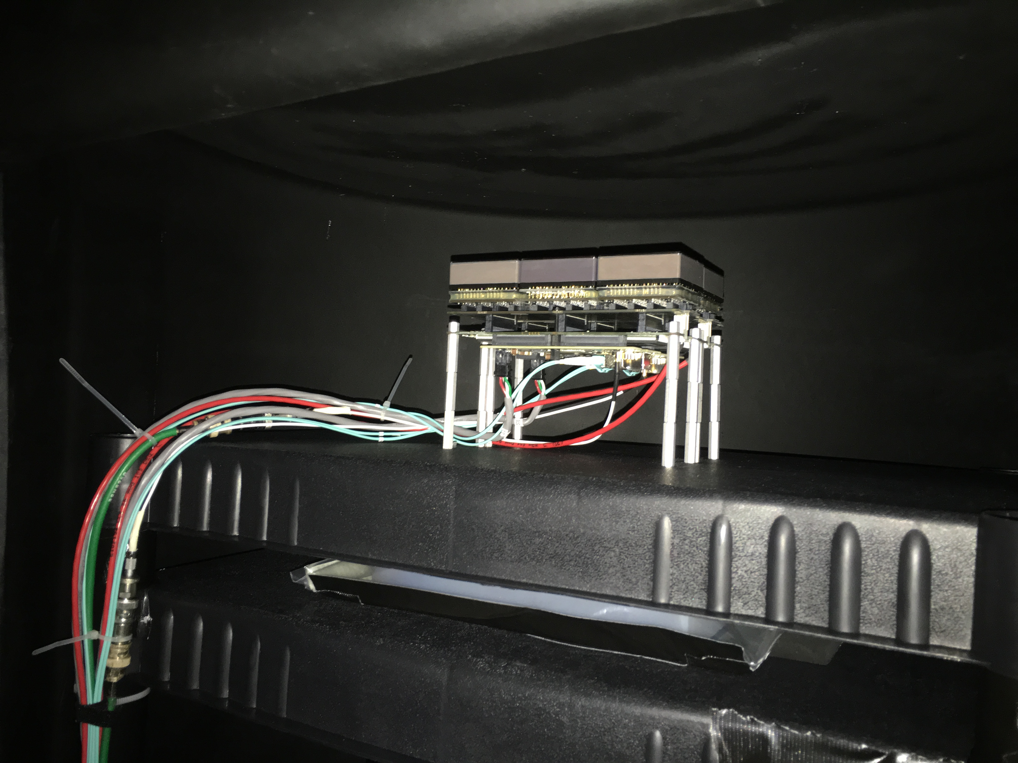
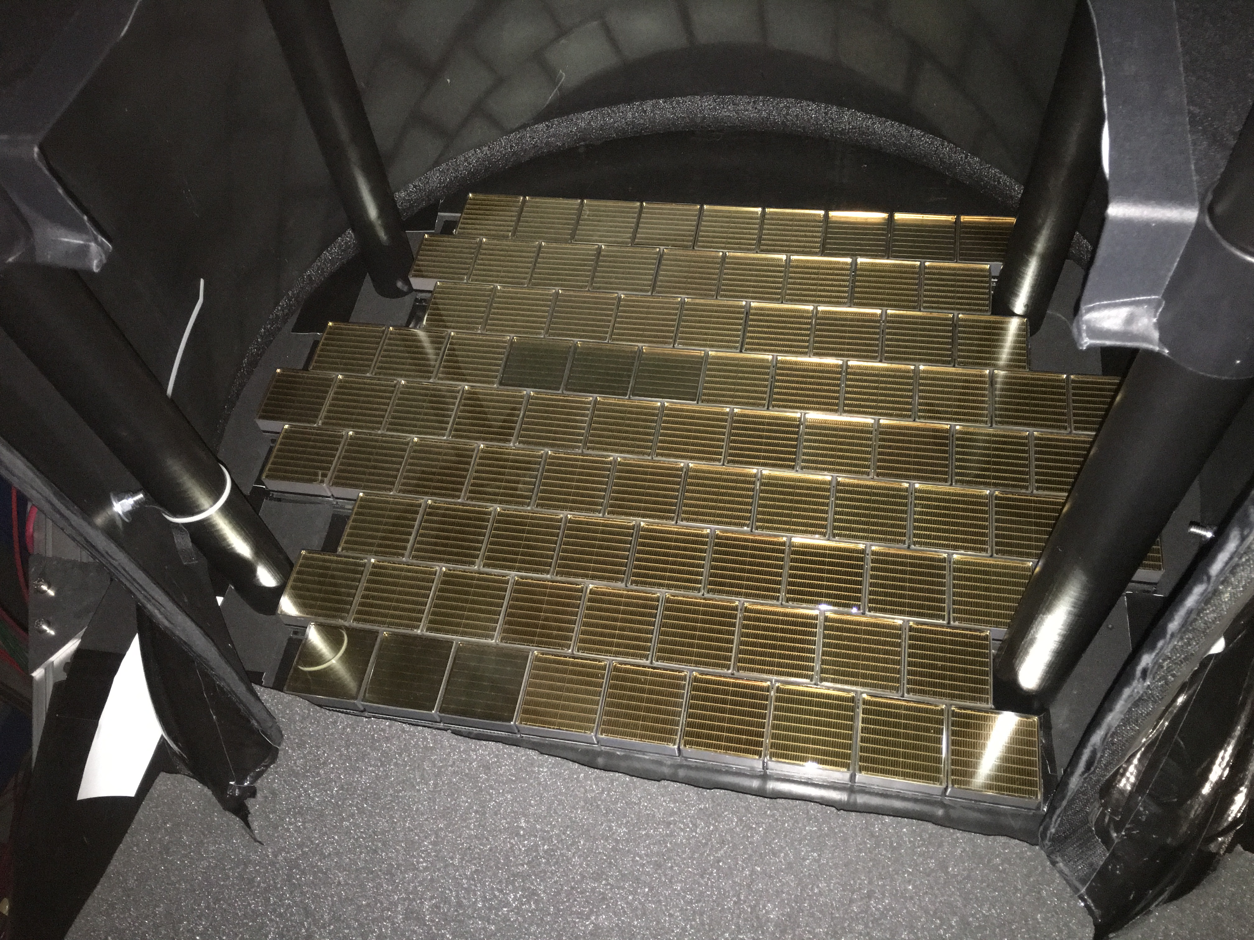
CLAS12
RICH Detector
Hall B
First stage cosmic run successfully completed
Trigger and tracking station
PMT plane
10/4/17
CLAS collaboration meeting, JLab
28

Slide 29
Readiness for Science Review
In preparation for the upcoming engineering run and the following CLAS12 1st Experiment a review of the preparedness of the Hall B/ CLAS team was performed.
Review Committee: K. Giffioen, B. Hess, K. Joo, D. Lawrence, Elton Smith (co-chair), S. Stepanyan (co-chair), B. Zihlmann.
Eight individual charge items covering aspects of commissioning plan, production triggers, monitoring & software tools, on/offline shift staffing, computing resources, documentation, simulations?
The Recommendation of the committee are now are being addressed.
=> Latifa to say more this afternoon.

Slide 30
Basic Installation and Experiment Schedule
Date | Activity
10/04/2017 10/26/2017 11/10/2017 11/15/2017 11/17/2017 12/04/2017 12/17/2017 01/12/2018 01/28/2018 02/05/2018 03/23/2018 | CTOF Installation start CTOF Installation complete Readiness for Engineering run Close Forward Carriage Cosmic Ray Run with all detectors and magnets Engineering run I starts (10.6 GeV) Engineering run I ends Engineering run II starts (10.6 / 6.4/4.3/2.1 GeV) Engineering run II ends Physics Run begins (10.6 GeV) Physics Run ends (46 days)

Slide 31
PAC45 – Hall B approved experiments
Proposals Contact Days
New RG Proposal RG-L
E12-17-012 Partonic Structure of Light Nuclei Meziani 35
E12-17-012A Tagged EMC measurements on Light Nuclei Dupre 45
E12-17-012B Spectator-Tagged DVCS on Light Nuclei Armstrong 45
E12-17-012C Other Physics Opportunities w/ ALERT Hafidi 55
Total Beam Time Requested 55
RG Experiment RG-A
E12-12-001A Near threshold J/ψ production – LHCb pentaquark Stepanyan
New beam time for Hall B Proposals: 55
Total number of Hall B approved experiments
Experiment Count | Experiment Days | Run Groups | RG days | Compression
42 | 3243 | 12 | 1091 | 0.34

Slide 32
Conclusion/Outlook
The CD4B approval by DOE was a huge accomplishment
Now we need to channel the energy to launch a successful 12 GeV science program
The effort of the entire CLAS collaboration is needed!

Slide 34
Run Groups
Hall B
Proposal | Physics | Contact | Rating | Days | Group | Equipment | Energy | Run Group | Target
E12-06-108 | Hard exclusive electro-production of π⁰, η | Stoler | B | 80 | 139 | RICH (1 sector) Forward tagger | 11 | A F. Sabatié | liquid H₂
E12-06-108A | Exclusive N*->KY Studies with CLAS12 | Carman |  | (60)
E12-06-108B | Transition Form Factor of the η’ Meson with CLAS12 | Kunkel |  | (80)
E12-06-112 | Proton’s quark dynamics in SIDIS pion production | Avakian | A | 60
E12-06-112A | SIDIS Λ productiuon in target fragmentation region | Mirazita |  | (60)
E12-06-112B | Colinear nucleon structure at twist-3 | Pisano |  | (60)
E12-06-119(a) | Deeply Virtual Compton Scattering | Sabatie | A | 80
E12-09-003 | Excitation of nucleon resonances at high Q² | Gothe | B+ | 40
E12-11-005 | Hadron spectroscopy with forward tagger | Battaglieri | A- | 119
E12-11-005A | Photoproduction of the very strangest baryon | Guo |  | (120)
E12-12-001 | Timelike Compton Scatt. & J/ψ production in e+e | Nadel-Turonski | A- | 120
E12-12-001A | J/ψ Photoproduction & study of LHCb pentaquarks | Stepanyan |  | (120)
E12-12-007 | Exclusive φ meson electroproduction with CLAS12 | Stoler, Weiss | B+ | 60
E12-07-104 | Neutron magnetic form factor | Gilfoyle | A- | 30 | 90 | Neutron detector RICH (1 sector) Forward tagger | 11 | B K. Hafidi | liquid D₂ target
E12-09-007(a) | Study of partonic distributions in SIDIS kaon production | Hafidi | A- | 30
E12-09-008 | Boer-Mulders asymmetry in K SIDIS w/ H and D targets | Contalbrigo | A- | 56
E12-09-008A | Hadron production in target fragmentation region | Mirazita |  | (60)
E12-09-008B | Colinear nucleon structuer at twist-3 | Pisano |  | (60)
E12-11-003 | DVCS on neutron target | Niccolai | A | 90
E12-11-003A | In medium structure functions, SRC, and the EMC effect | Hen |  | (90)
Beam time partial sum |  |  |  | 765 (1475) | 229

Slide 35
Run Groups
Hall B
E12-06-109 | Longitudinal Spin Structure of the Nucleon | Kuhn | A | 80 | 185 | Polarized target RICH (1 sector) Forward tagger | 11 | C S. Kuhn | NH₃ ND₃
E12-06-109A | DVCS on the neutron with polarized deuterium target | Niccolai |  | (60)
E12-06- 119(b) | DVCS on longitudinally polarized proton target | Sabatie | A | 120
E12-07-107 | Spin-Orbit Correl. with Longitudinally polarized target | Avakian | A- | 103
E12-09-007(b) | Study of partonic distributions using SIDIS K production | Hafidi | A- | 80
E12-09-009 | Spin-Orbit correlations in K production w/ pol. targets | Avakian | B+ | 103
E12-06-106 | Color transparency in exclusive vector meson production | Hafidi | B+ | 60 | 60 |  | 11 | D
E12-06-117 | Quark propagation and hadron formation | Brooks | A- | 60 | 60 |  | 11 | E | Nuclear
E12-06-113 | Free Neutron structure at large x | Bueltman | A | 42 | 42 | Radial TPC | 11 | F | Gas D₂
E12-14-001 | EMC effect in spin structure functions | Brooks | B+ | 55 | 55 | Pol. LiH target | 11 | G | _{LiH}
TOTAL CLAS12 run time (approved experiments) |  |  |  | 1466 (2118) | 631
Proposal | Physics | Contact | Rating | Days | Group | Equipment | Energy | Group | Target
C12-11-111 | SIDIS on transverse polarized target | Contalbrigo | A | 110 | 110 | Transverse target | 11 | H | HD
C12-12-009 | Transversity w/ di-hadron on transvere target | Avakian | A | 110
C12-12-010 | DVCS with transverse polarized target in CLAS12 | Elouadrhriri | A | 110
All CLAS12 transverse target proposals |  |  |  | 330 | 110
E12-11-006 | Heavy Photon Search at Jefferson Lab (HPS) | Jaros | A | 180 | 180 | Setup in alcove | 2.2, 6.6 | I | Nuclear
E12-11-106 | High Precision Measurement of the Proton Charge Radius | Gasparian | A | 15 | 15 | Primex | 1.1, 2.2 | J | H2 gas
Beam time request from CLAS12 C1 experiments + non-CLAS12 experiments |  |  |  | 525 | 305
Beam time from approved CLAS12 experiments (from previous table) |  |  |  | 1466 (2118) | 631
Beam time for Hall B experiments table 1 + table 2 (incl. 110 days of C1 approved exp.) |  |  |  | 1991 (2643) | 936

Slide 36
Run Groups
Hall B
Proposal | Physics | Contact | Rating | Days | Group | Equipment | Energy | Group | Target
E12-16-010 | A search for Hybrid Baryons in Hall B with CLAS12 | D’Angelo | A- | 100 | 100 | Forward Tagger | 6.6, 8.8 | K Confinement & Strong QCD | lH2
E12-16-010A | Nucleon Resonances in exc. KY electroproduction | Carman | A- | (100)
E12-16-010B | DVCS with CLAS12 at 6.6 and 8.8 GeV | Elouadrhiri | A- | (100)
Total Beam time of Run Group K |  |  |  | 100 (300) | 100
E12-17-012 | Partonic Structure of Light Nuclei | Meziani | A- | (35) | 55 | ALERT detector | 2.2, 11 | L | D₂, ⁴He
E12-17-012A | Tagged EMC measurements on Light Nuclei | Dupre | A- | (45)
E12-17-012B | Spectator-Tagged DVCS on Light Nuclei | Armstrong | A- | (45)
E12-17-012C | Other Physics Opportunities w/ ALERT | Hafidi | A- | 55
Total Beam time Run Group L |  |  |  | 55 (180) | 55
Beam time of approved & C1 approved CLAS12 experiments from table 1 + table 2 |  |  |  | 1991 (2763) | 936
Beam time for Hall B experiments table 1 + table 2 + table 3 |  |  |  | 2146 (3243) | 1091
Proposal Count | Experiment Days | Run Groups | RG days | Compression
42 | 3243 | 12 | 1091 | 0.34

Slide 37
Conclusions

