Slide 1
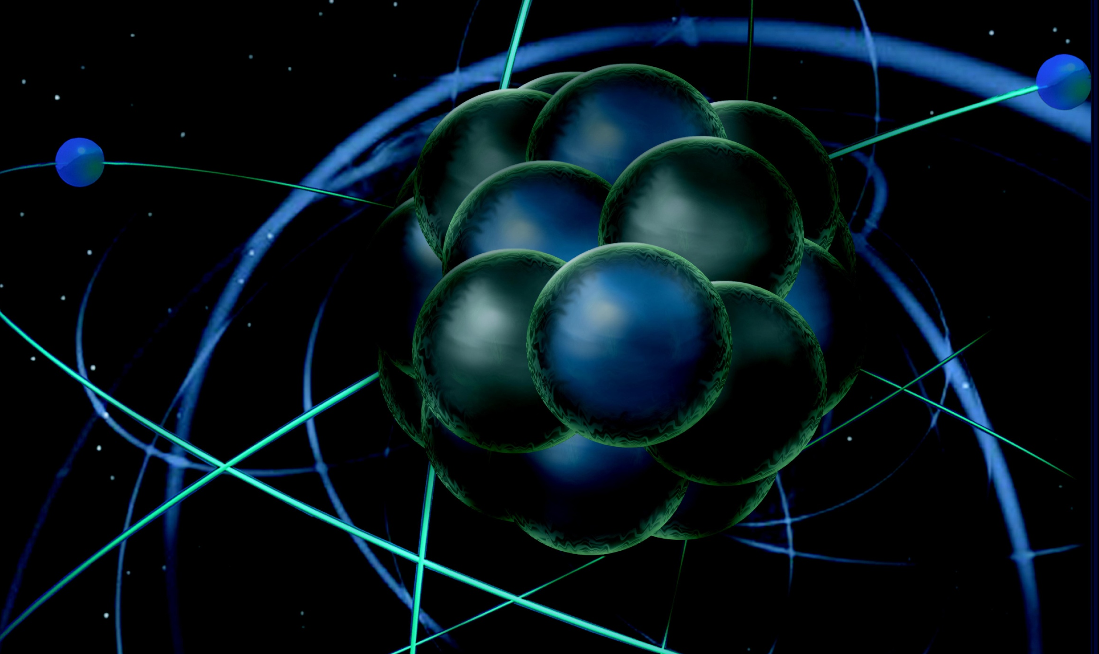
CLAS12 Commissioning with Cosmincs
Latifa Elouadrhiri
Jefferson Lab
CLAS12 First Experiment Workshop
CLAS Collaboration
October 3, 2017

Slide 2
Schedule
Run Schedule: Hall B is scheduled for an Engineering Run for a total of 30 calendar days beginning December 4, 2017, and ending January 28, 2018.
First Experiment is scheduled to begin February 5. There are 8 days of no-beam built into the schedule that can be used to implement changes to CLAS12 components if needed (for example as a result of findings during the engineering run).
CLAS12 Commissioning with Cosmics for 2 weeks stating November 17

Slide 3
CLAS12 DAQ Commissioning
Cosmic test (no central detectors): set electron trigger without HTCC (ECAL+PCAL and ECAL+PCAL+DC), check data integrity, noise for DC and other detectors, and monitoring tools
Cosmic test (central detectors only): set CTOF self-trigger and/or SVT self trigger, check data integrity and monitoring tools
Random pulser test: set low channel thresholds, measure event rate, data rate and livetime; check monitoring tools performance

Slide 4
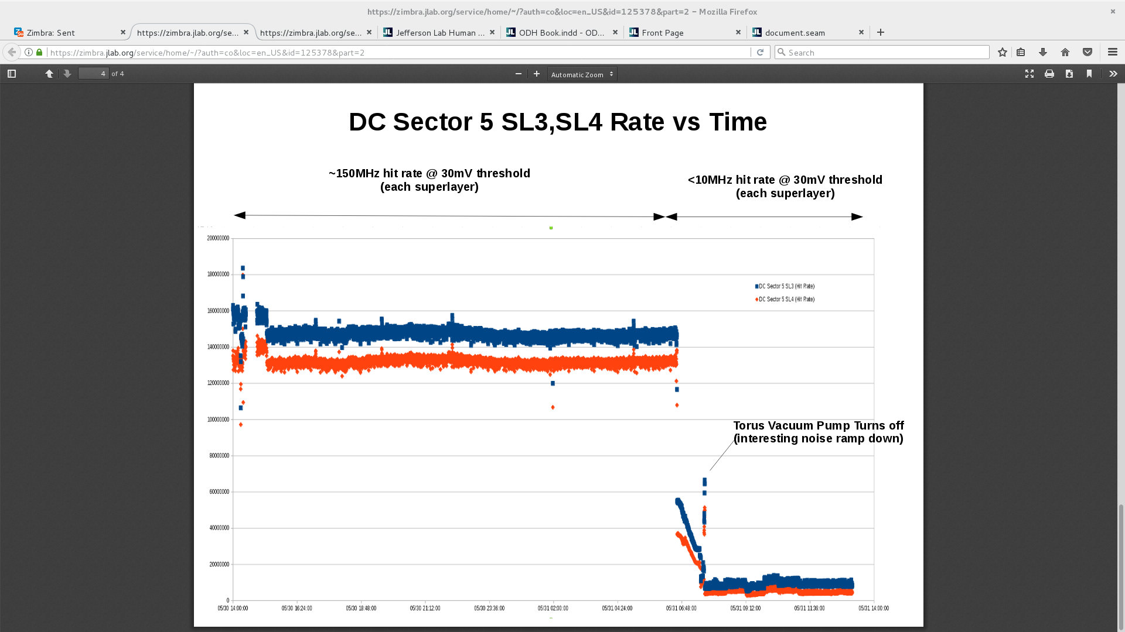
DC Noise (S5R2) @ 30mV
(from B.Raydo)
Before:
(~300MHz hit rate noise)
After:
(<2MHz hit rate noise)
Before:
(~300MHz hit rate noise)

Slide 5
CLAS12 Trigger Commissioning
Validation step 1 (cosmic): running from electron trigger (ECAL+PCAL and ECAL+PCAL+DC) and comparing hardware trigger implementation results with C++ trigger implementation results
Validation step 2 (GEANT with different event generators): processing GEANT evio file (currently contains ECAL and PCAL, will need to add add HTCC, DC and FT) through C++ trigger implementation and producing evio file adding trigger banks for following offline reconstruction analysis

Slide 6
CLAS12 Online Monitoring Commissioning
Run and check basic instrumentation: runtime databases, messaging system, communication with EPICS, communication with data stream
Run and check basic tools: CED(CLAS event display), data collection from different sources (DAQ, EPICS, scalers etc), data insertion into data stream, hardware monitoring tools, trigger monitoring tools
Run and check online data monitoring: running on hot-swap DAQ server (clondaq3) from ET system, check detector data monitoring tools and online reconstruction (CLARA)

Slide 7
Summary
Two weeks before arrival of beam the full CLAS12 system will be commissioned by taking cosmic ray data
Critical to a timely & successful beam commissioning

Slide 8
CED event example

