Slide 1

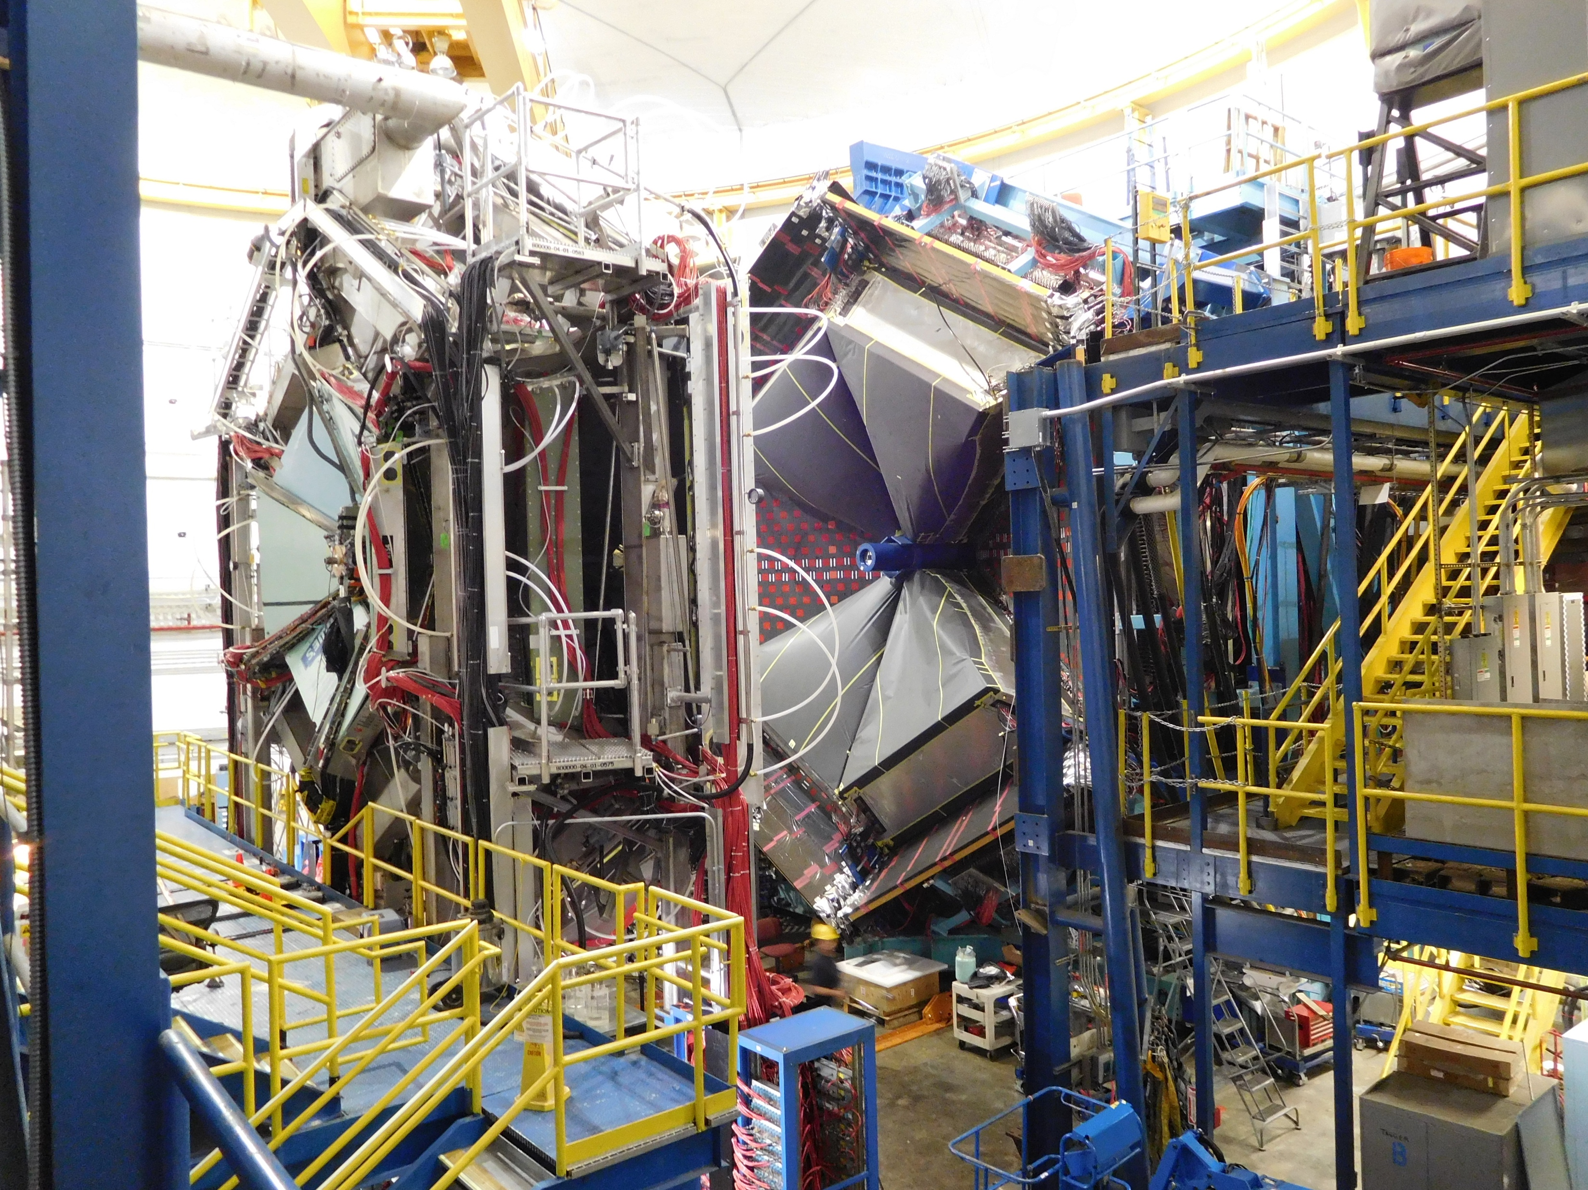
Outline:
Commissioning Objectives
Daily Schedule
Commissioning Details:
  Beamline
  CLAS12
Next Steps
Summary
Daniel S. Carman -- Jefferson Laboratory

Slide 2
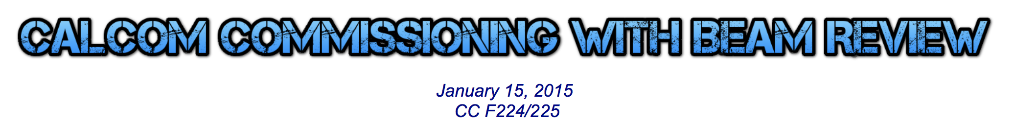
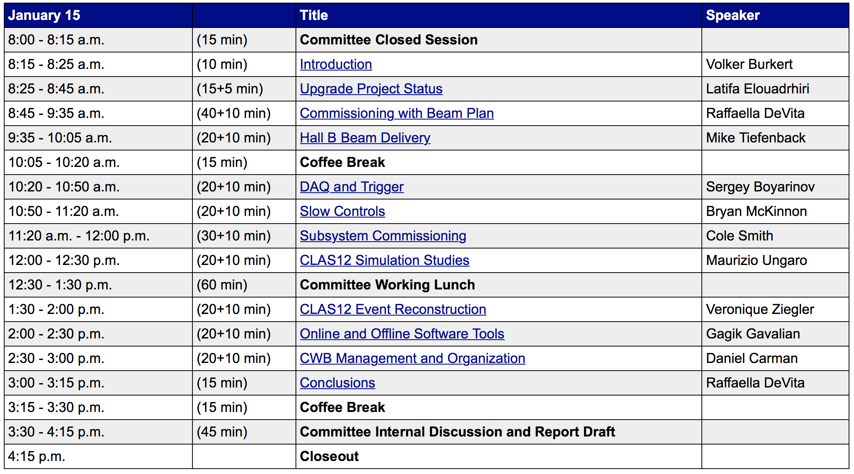
CLAS12 Commissioning Plan
The CLAS Collaboration developed a comprehensive plan to commission the CLAS12 spectrometer and its subsystems in June 2014
Three phases:
  Quality assurance and system checkout
  Commissioning without beam
  Commissioning with beam
Committee: Y. Roblin, E. Smith (chair), L. Schmitt, S. Stepanyan, G. Young

Slide 3
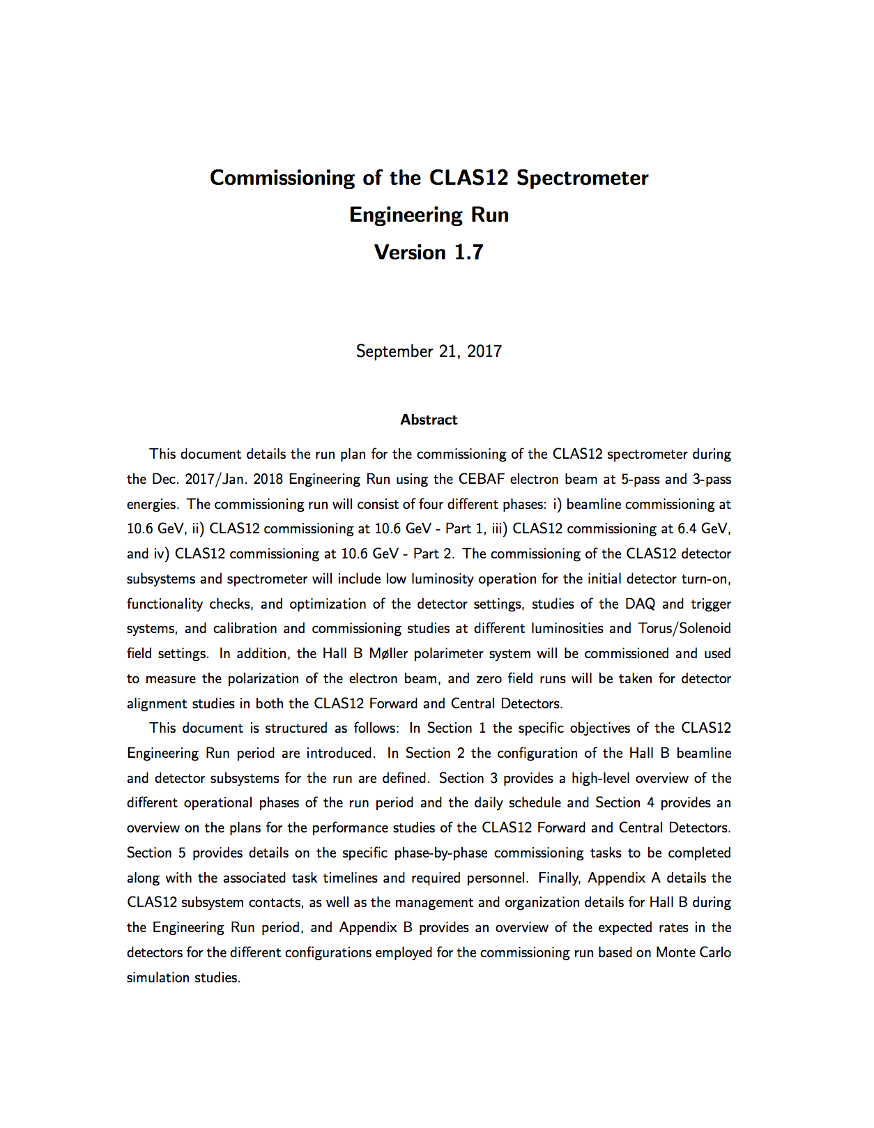
CLAS12 Commissioning Plan
A new comprehensive plan to commission the Hall B beamline and the CLAS12 spectrometer is being developed for the upcoming commissioning run
This plan includes 3 distinct phases:
Beamline commissioning at 10.6 GeV
CLAS12 commissioning at 10.6 GeV
CLAS12 commissioning at 6.4 GeV
*Time allocations assume 50% overall efficiency for accelerator + Hall B
(this might not be conservative enough)
Commissioning Run: 30 days
Dec. 4 – 17, 2017
Jan. 12 – 27, 2018
https://www.jlab.org/Hall-B/calcom/cwb-erun.pdf

Slide 4
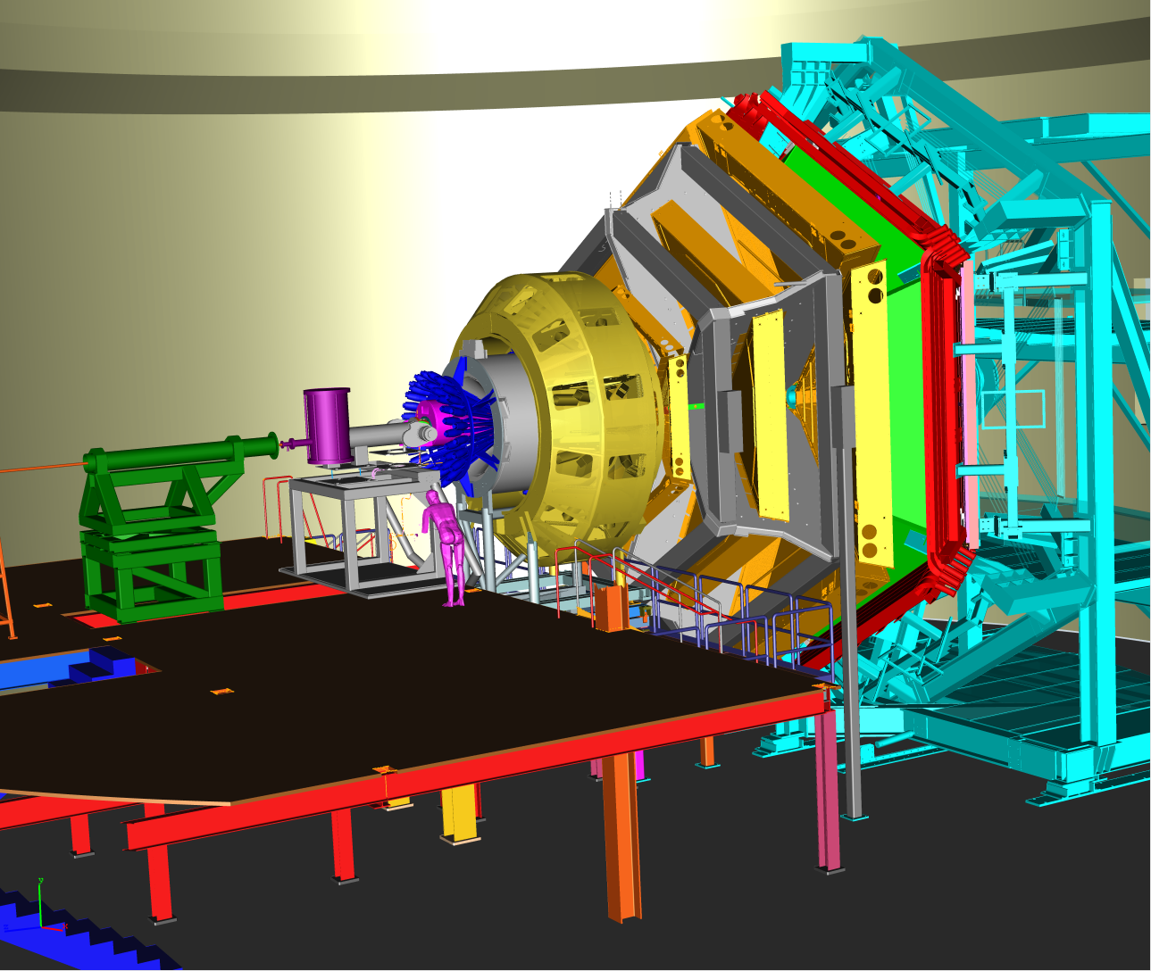
Commissioning Run Objectives
The objectives of the Hall B and CLAS12
commissioning plan are:
to achieve reliable electron beam transport
through CLAS12 to the beam dump using thin
and extended targets
to determine the alignment of the CLAS12
detector subsystems using beam interactions
to study the dependence of the detector performance on the luminosity, beam energy, magnetic field settings
to define the nominal operating luminosity for each configuration
to verify performance of the data acquisition, trigger, and slow controls systems
to accumulate data to perform full calibrations of the CLAS12 detector and assess its performance
Notes:
Should I mentioned satisfying the commissioning requirements included in the project plan?

Slide 5

CLAS12 Engineering Run Daily Schedule
Day 1: Beam tuning Beam diagnostics Beamline commissioning 10.6 GeV | Day 2: Beamline commissioning Möller checks Detector checks 10.6 GeV | Day 3: DAQ studies Detector setup optimization 10.6 GeV | Day 4: DAQ studies Luminosity scans DC plateau scan Trigger studies 10.6 GeV | Day 5: Luminosity study DAQ studies Field studies 10.6 GeV
Day 6: Field studies Empty target run Low luminosity calibration runs 10.6 GeV | Day 7: Low luminosity calibration runs 10.6 GeV | Day 8: Low luminosity calibration runs 10.6 GeV | Day 9: High luminosity calibration runs 10.6 GeV | Day 10: High luminosity calibration runs Möller commissioning 10.6 GeV
Day 11: Pass change Beam tuning Möller studies Detector checks 6.4 GeV | Day 12: DAQ and trigger checks Calibration runs 6.4 GeV | Day 13: Calibration runs Physics studies 6.4 GeV | Day 14: Physics studies 6.4 GeV | End of the year shutdown
version

Slide 6
CLAS12 Engineering Run Daily Schedule
Day 15: (2018) Beam tuning Calibration runs 10.6 GeV | Day 16: Trigger studies Zero field alignment runs Reverse torus field 10.6 GeV | Day 17: Low luminosity calibration runs 10.6 GeV | Day 18: Low luminosity calibration runs 10.6 GeV | Day 19: High luminosity calibration runs 10.6 GeV
Day 20: High luminosity calibration runs Spin dance Calibration runs @ high solenoid field 10.6 GeV | Day 21: Calibration runs @ high solenoid field 10.6 GeV | Day 22: Calibration runs @ high torus field 10.6 GeV | Day 23: Physics studies in RG-A conditions 10.6 GeV | Day 24: Physics studies in RG-A conditions 10.6 GeV
Day 25: Physics studies in RG-A conditions 10.6 GeV | Days 26 – 30: Contingency
version

Slide 7
Input on the Commissioning Plan
From RfS Review:
Consider possible inefficiencies in running and prioritize the plan (must, should, like)
Activities for RG-A preparations should be given the highest priority
Ensure sufficient data taking in December in RG-A conditions to allow testing over year-end break (these conditions are nominally full torus/solenoid fields, neg in)
Identify commissioning tests that can be carried out at a later date
Clear goals and “deliverables” for each step must be defined
Detail trigger commissioning plans and build in sufficient time in schedule
Include running with both raw and integrated data modes
Post RfS Review:
No 3-pass running in December; move to end of Engineering Run
Need detailed input from subsystem groups regarding specific commissioning plans and requirements for each different operating condition during the run
Take data with the “FT OFF” configuration

Slide 8
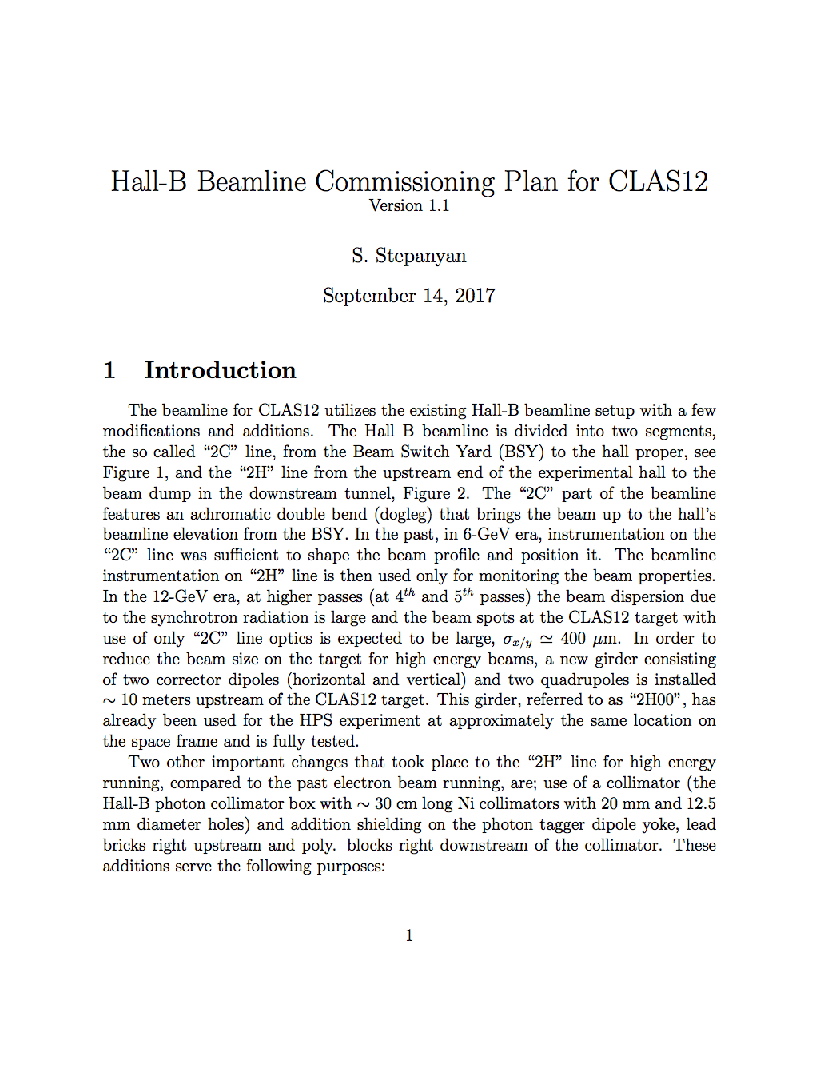
Phase 1: Beamline Commissioning @ 10.6 GeV
  Phase 1 duration = 1.5 days
Study beam tuning procedure with 5-pass beam [7 hr]
Möller polarimeter pre-commissioning [4 hr]
Study affect of solenoid on beam transport [2 hr]
Prepare “physics quality” beam through target to F.C. [12 hr]
Calibrate beamline devices [2 hr]
Note: Beamline commissioning has already taken place as part of the HPS, PRad, and KPP beam runs.
https://wiki.jlab.org/clas12-run/index.php/Engineering_Run

Slide 9
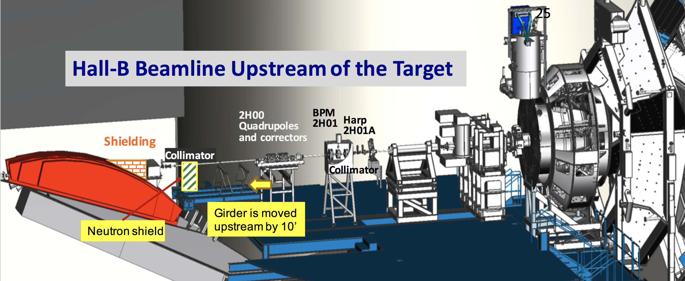
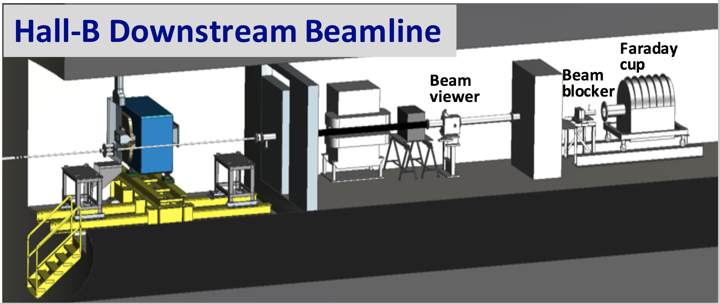
Beamline Configuration

Slide 10
Phase 2: CLAS12 Commissioning at 10.6 GeV
Commissioning with 5-pass beam:
Begin with torus polarity for negatives bending in toward the beamline
More “conservative” running condition
Consistent with main RG-A running conditions
Phase 2a duration = 12.5 days (ending at year-end break)
Detector turn on – Working from least sensitive to most sensitive [4 hr]
Solenoid field scan – Optimize field setting to minimize DC occupancy [2 hr]
Luminosity scan – Study detector rates from L=1/100 to 1.5 L₀ [2 hr]
DAQ studies – Get DAQ operational with appropriate info into event files [2 hr]
Detector setup optimization – Discriminator thresholds/widths, timing, DC plateau [7 hr]
Trigger studies – Optimize loose electron trigger; setup ”higher order” triggers [4 hr]
Luminosity studies – Record data at low and high luminosity for tracking studies [4 hr]

Slide 11
Phase 2: CLAS12 Commissioning at 10.6 GeV
Field studies – Take data at six different torus/solenoid settings to test PMT shielding
effectiveness, reconstruction, and calibrations [24 hr]
Empty target run – Point target test of tracking reconstruction [4 hr]
Low/high luminosity calibration runs - Long runs for subsystem calibrations [60 hr]
* Define operating luminosity for RG-A running
Möller polarimeter commissioning – Optimize polarimeter setup and take data [8 hr]
Spin dance – Study electron beam polarization vs. injector settings (Hall B only) [8 hr]
Alignment studies – Take zero field data for Fwd Carriage, DC, FMT, FT, CVT alignment [10 hr]
Begin calibration runs with reversed torus polarity (100% Neg. Out)
Low/high luminosity calibration runs – Long runs for subsystem calibrations [72 hr]
* Define operating luminosity for this running configuration
End of year shutdown

Slide 12
Phase 2: CLAS12 Commissioning at 10.6 GeV
New year startup
Phase 2b duration = 12 days
Beam tuning and detector turn on [12 hr]
DAQ and rate checks – Optimize field setting to minimize DC occupancy [1 hr]
Trigger studies – Optimize trigger hardware and settings for all RG-A triggers [8 hr]
Low and high luminosity calibration runs – [72 hr]
  Take subsystem calibration data for the CLAS12 subsystems in RG-A conditions
  Take data to study trigger efficiencies for RG-A conditions
  Optimize trigger settings
Calibration runs at lower solenoid field – Take calibration data [24 hr]
Calibration runs at lower torus field – Take calibration data [24 hr]
Physics studies in RG-A conditions – Take extended data in ”final” RG-A conditions [72 hr]

Slide 13
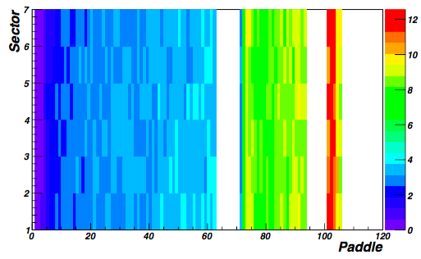
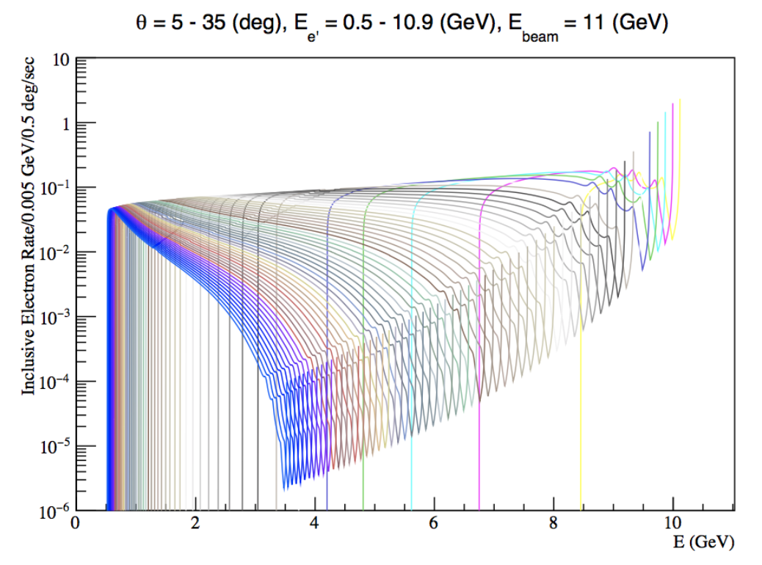
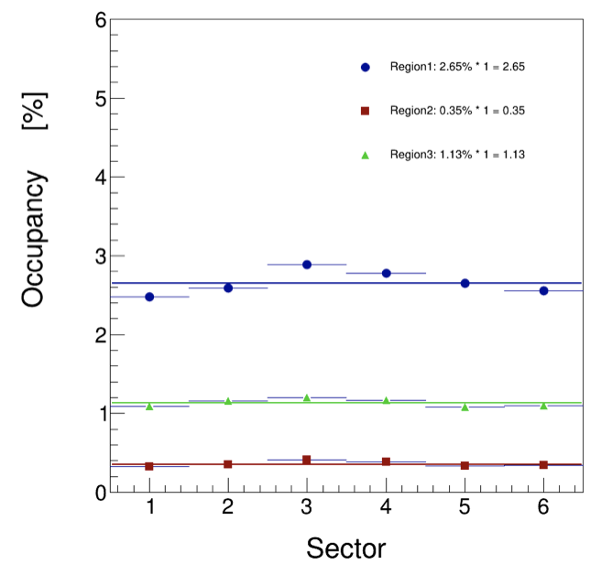
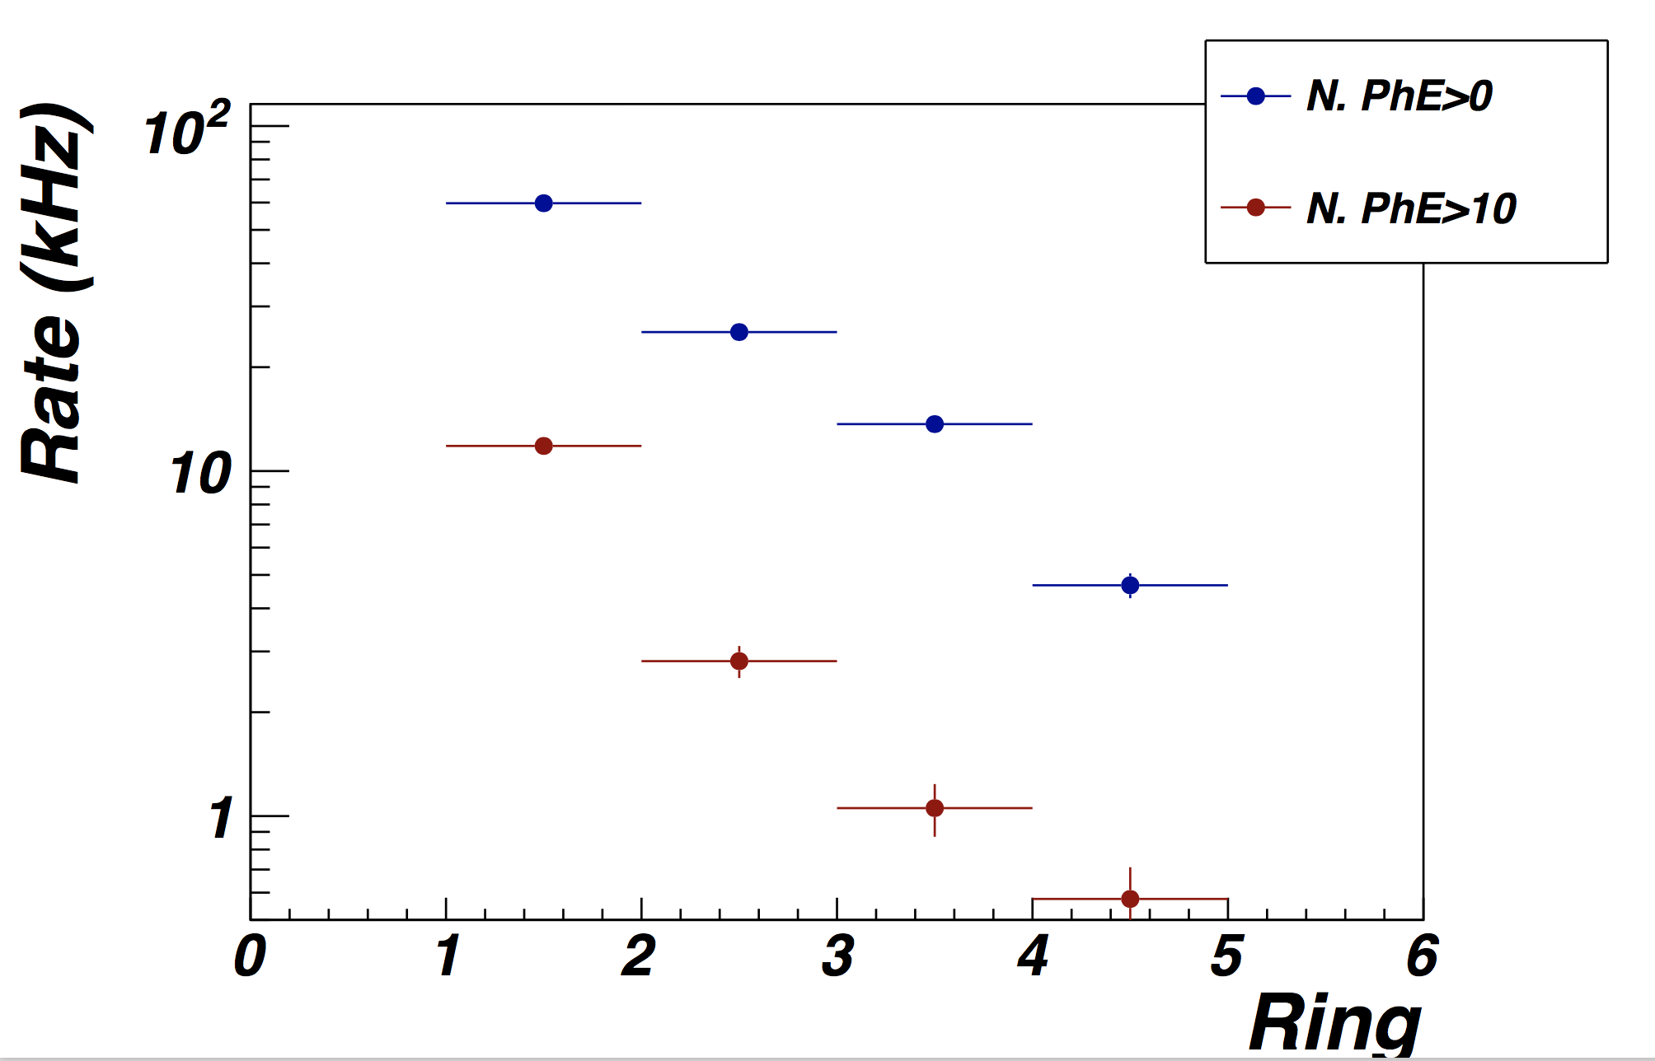
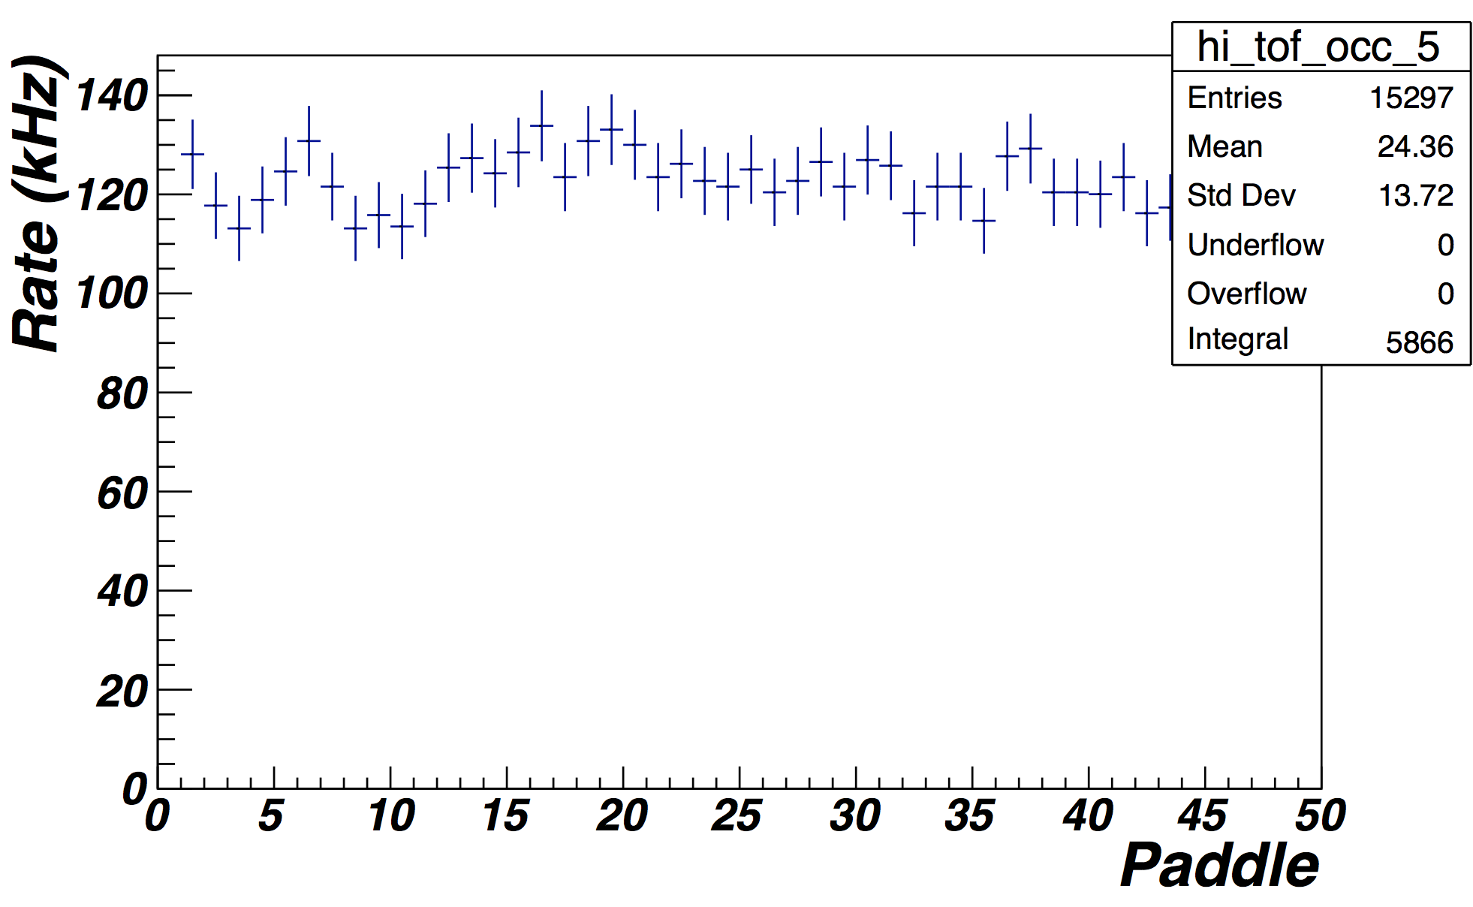
Background Simulations at 10.6 GeV
  GEANT-4/GEMC studies for full torus (IN)/solenoid field, L = 10³⁵ cm⁻²s⁻¹
FTOF Rates (kHz)
Inclusive Electron Rates
5º
DC Occupancies (%)
35º
HTCC Rates
CTOF Rates
Ring
CTOF Rates

Slide 14
Phase 3: CLAS12 Commissioning at 6.4 GeV
Phase 3 duration = 4 days
Pass change and beam tuning [9 hr]
Möller studies [2 hr]
Detector turn on [3 hr]
DAQ and trigger checks - Optimize DAQ and trigger parameters for 3-pass running [2 hr]
Calibration runs – take data for subsystem calibrations; this includes π⁰ calibrations of the
FT and data to cross-calibrate EC/PCAL [24 hr]
Physics studies – [24 hr]
  take data to check detector response including reactions to check CLAS12 normalization from ep elastics, ep → e’X, and ep → epγ
  compare measured cross sections to world data to understand and improve systematic uncertainties
  these data should enable detailed probing of both the CLAS12 Forward and Central Detectors over their full “dynamic” ranges

Slide 15
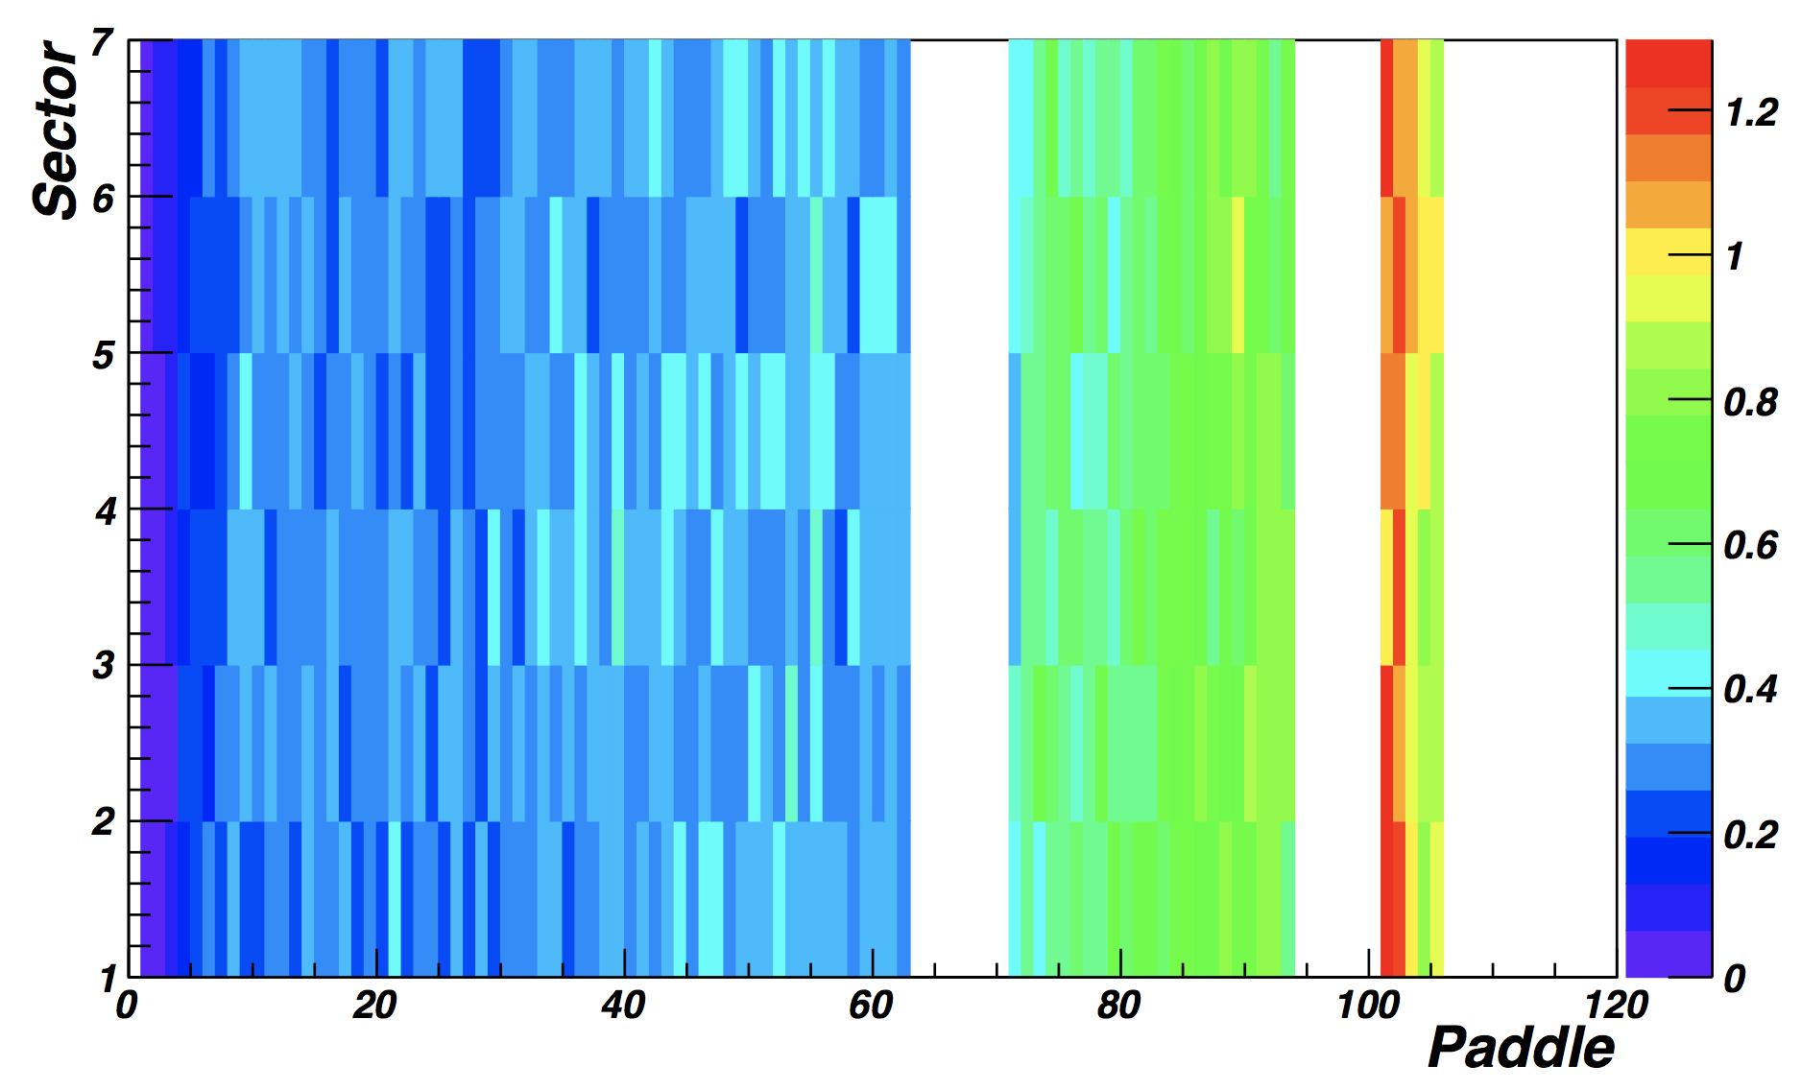
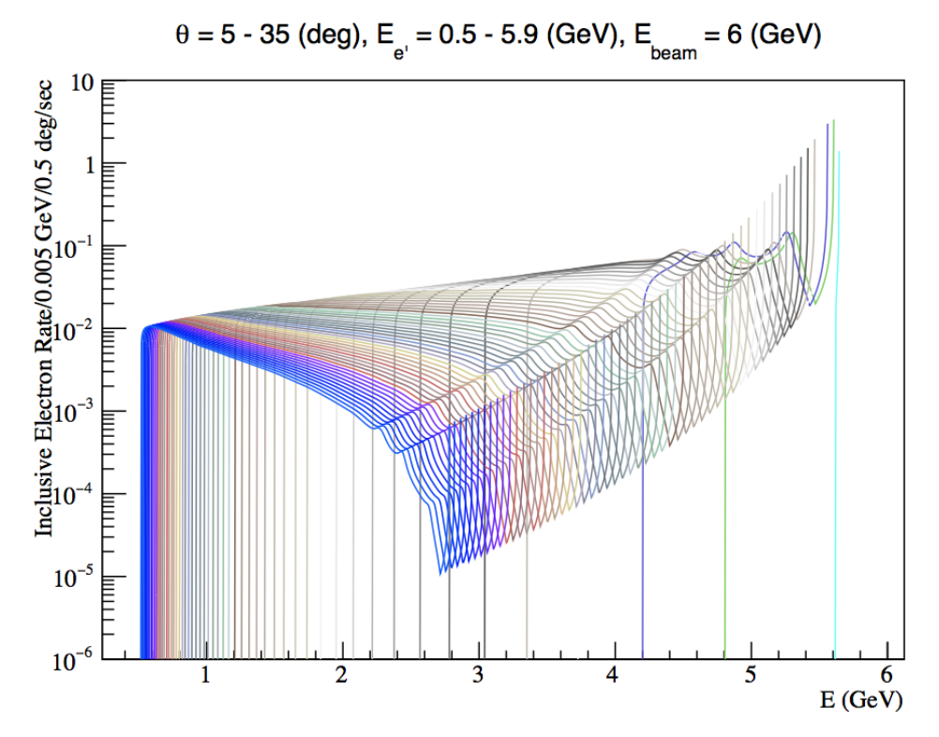
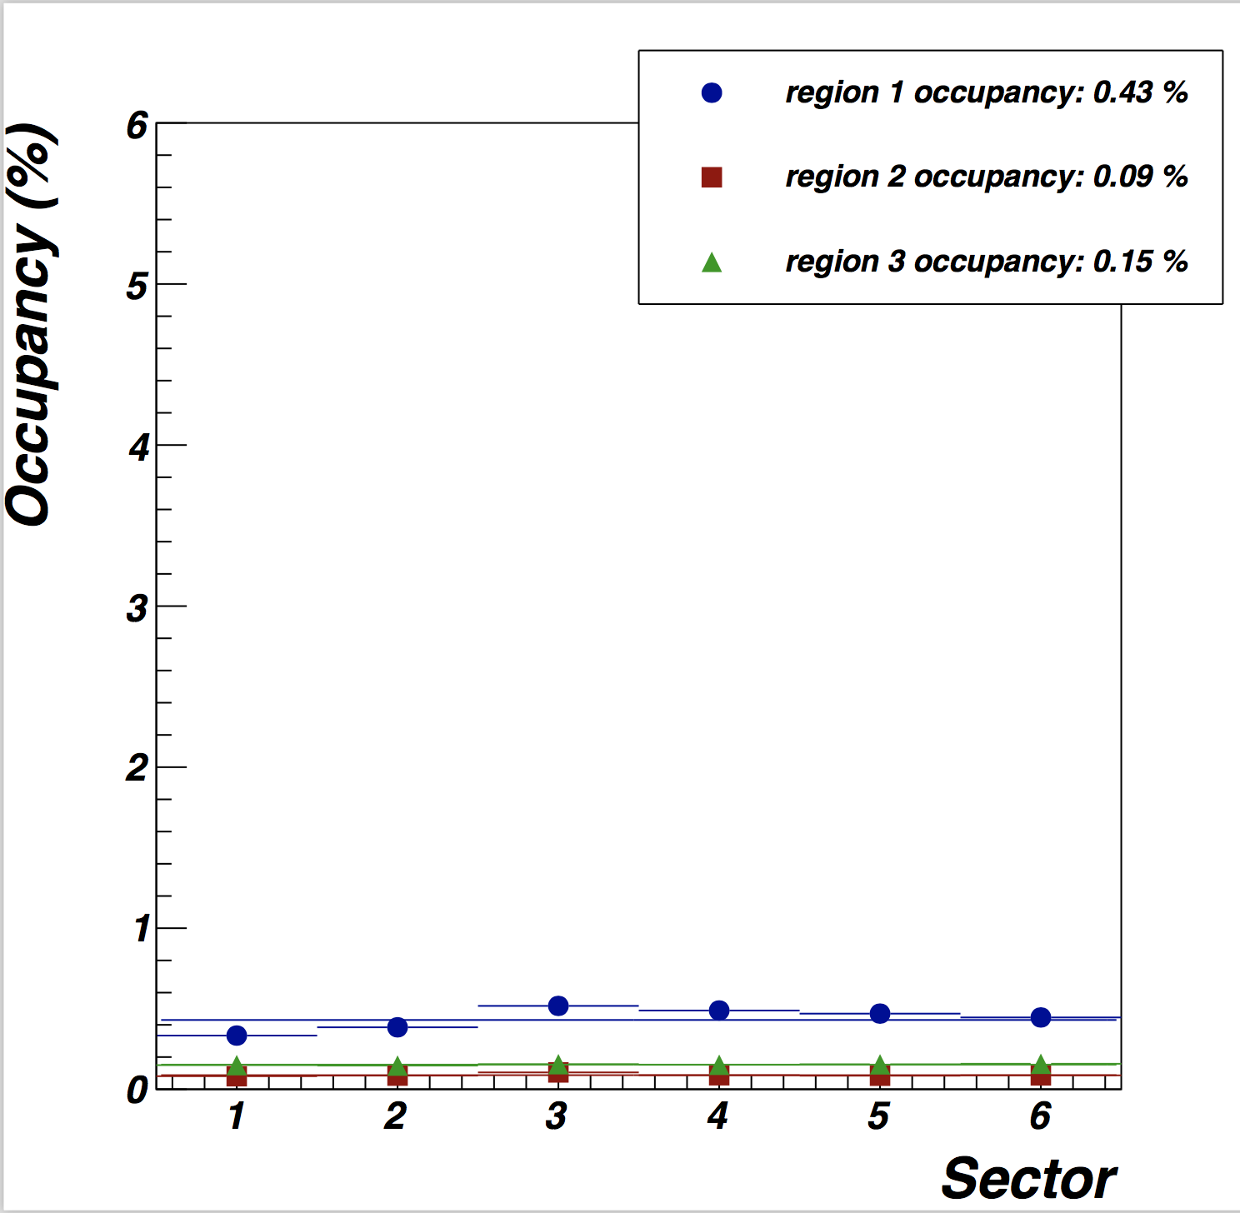
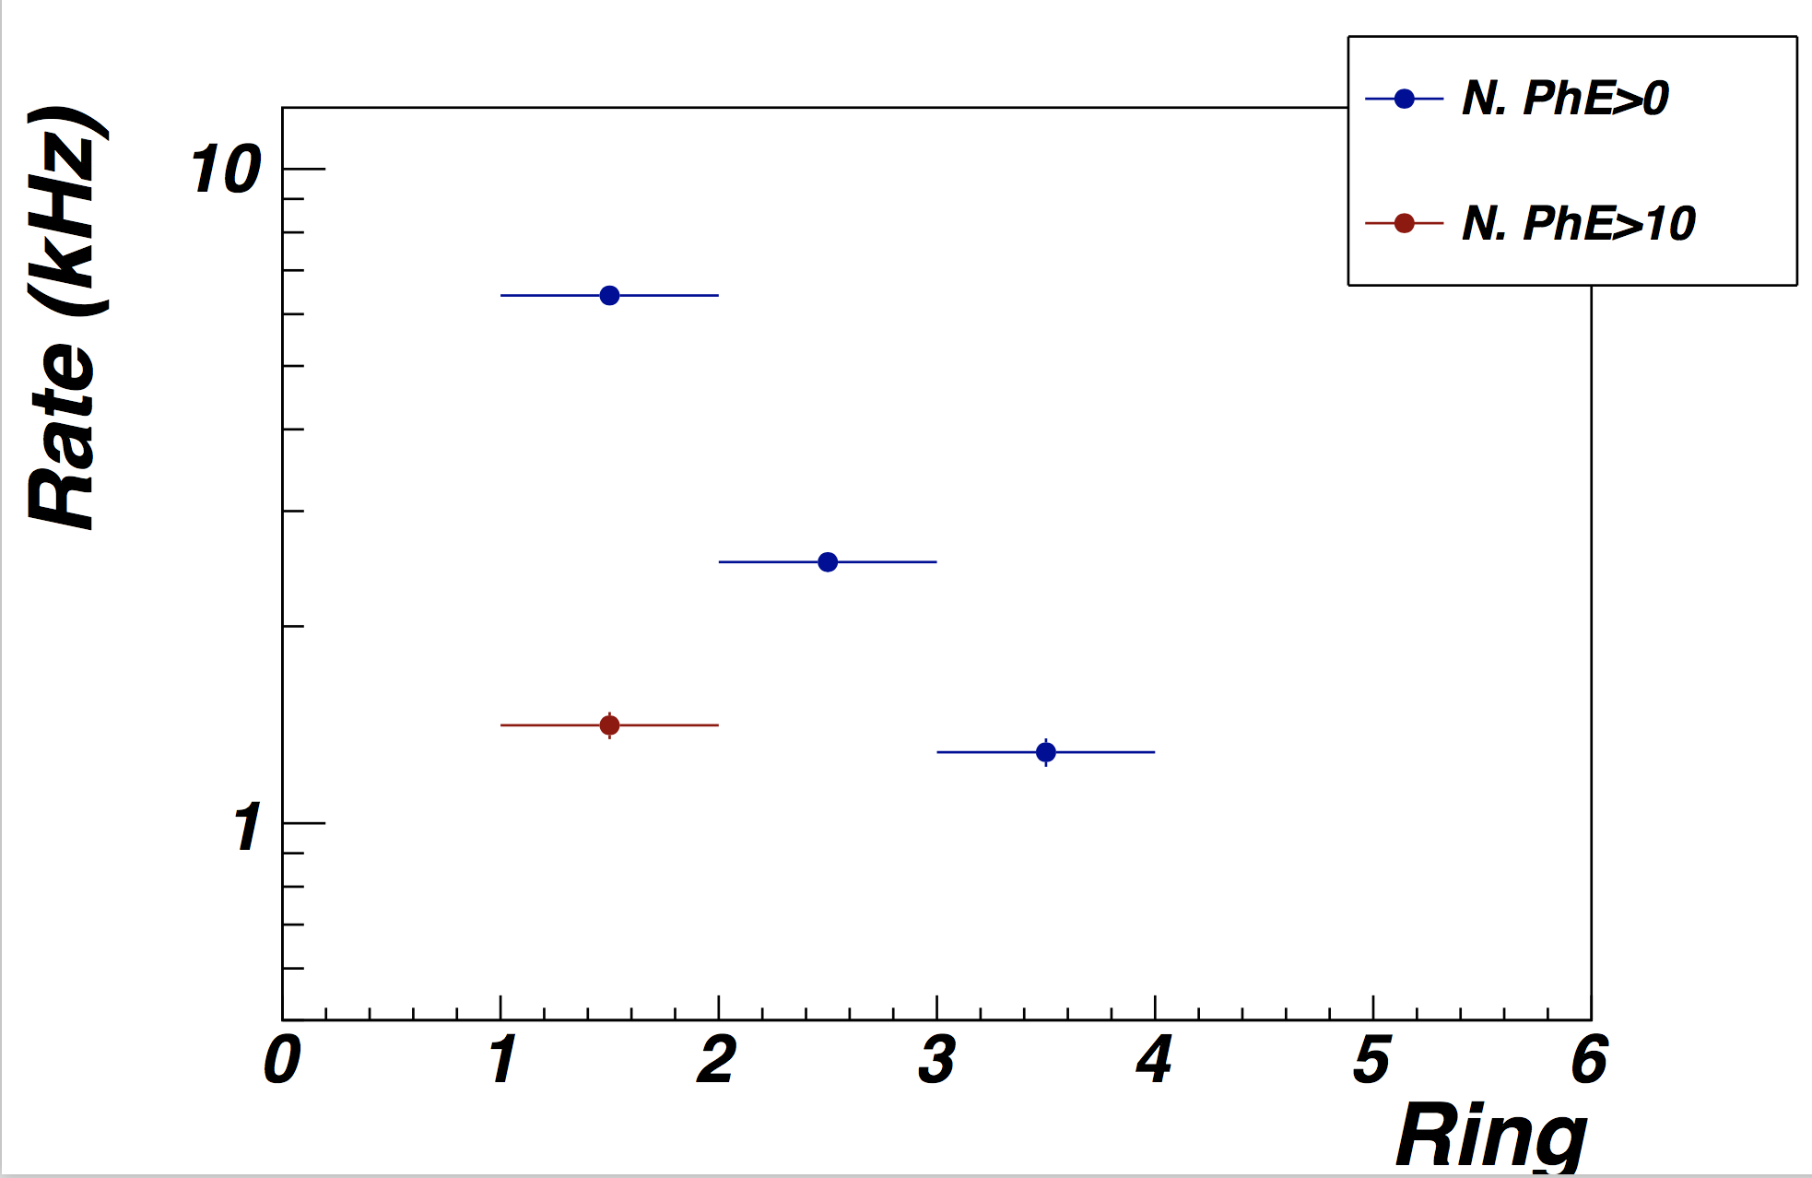
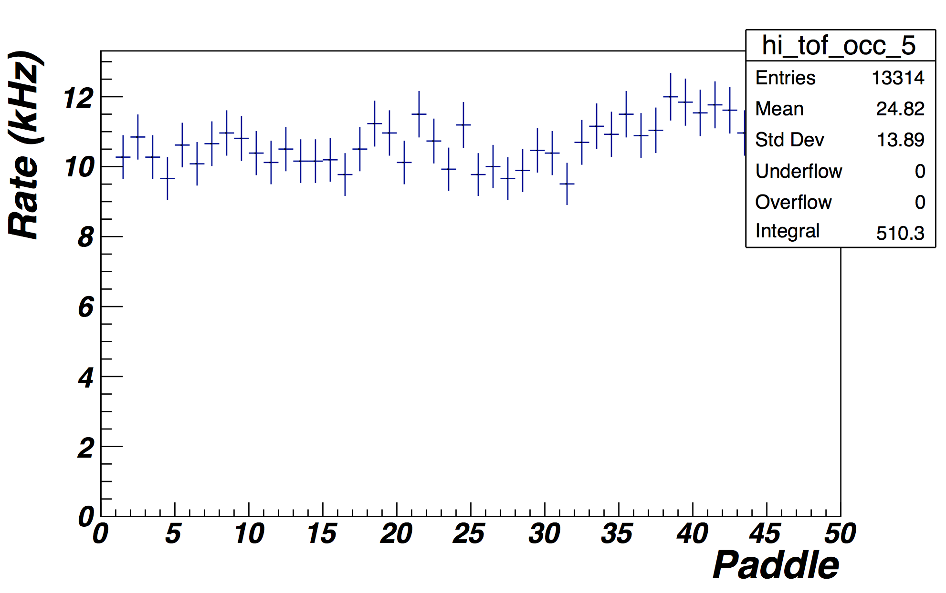
Background Simulations at 6.4 GeV
  GEANT-4/GEMC studies for full torus (IN)/solenoid field, L = 10³⁴ cm⁻²s⁻¹
FTOF Rates (kHz)
Inclusive Electron Rates
5º
35º
HTCC Rates
DC Occupancies (%)
CTOF Rates

Slide 16
Fleshing Out the Commission Plan
The broad conditions of the commissioning plan have been defined:
Organized as blocks of time with data taking under certain conditions
Consider these as steps of an outline
To flesh out the plan in the required level of detail, the subsystem leaders must provide input for each of these outline steps:
Test plan name and goals
Beam conditions, trigger definition, DAQ setup (e.g. mode 1 vs. mode 7)
Test plan steps and instructions (including required data statistics)
  Clearly delineate subsystem expert and shift worker responsibilities
Offline analysis requirements and responsible personnel
  Offline time needed to complete analysis
“Deliverable” of the study
*Note: The Commissioning Plan is purposefully being written in a manner appropriate for the Run Coordinator Shift Worker instruction wikipage

Slide 17


Commissioning Run Organization
Physics Division Liaison
Pasyuk, Stepanyan
Run Coordinator
Carman, De Vita
CALCOM Group
Calibration Team
Hall B Work Coordinator
Tilles
Subsystem Experts
Analysis Coordinator
Baltzell, De Vita
Data Chef
Girod, Harrison
Shift Leader
Shift Workers
Shift Workers

Slide 18
Summary
The Hall B/CLAS12 commissioning run is divided into 3 phases:
Beamline commissioning at 10.6 GeV
CLAS12 commissioning at 10.6 GeV
CLAS12 commissioning at 6.4 GeV
The Commissioning Plan fits within the 30 days of scheduled beam time
assuming a 50% efficiency factor for schedule
The Commissioning Plan has been devised:
to finalize procedures to tune “physics quality” beam in Hall B
to take sufficient data for complete subsystem calibrations
to determine the operating luminosity for CLAS12
to study the trigger efficiency for the primary and secondary CLAS12 triggers
to understand response of the CLAS12 Forward and Central Detectors
The Commissioning Plan is still being worked on to optimize it and to add all necessary details
need input from the different subsystems
focus on RG-A conditions

Slide 19
Backup

Slide 20

Key Documentation
Conduct of Operations
  Required reading list, management overview, operating procedures
Experiment Safety Assessment Document
  Hall hazards, subsystem hazards, mitigation, expert personnel
Radiation Safety Assessment Document
  General beam conditions in hall, radiological control details
JLab Emergency Response Guidelines
  Details on safety hazards and protection systems in Counting House and Hall B
Hall B Standard Equipment Manual
  Details on equipment in Hall B
Shift Taker’s Manuals
  Detailed instructions for dealing with subsystem problems/issues
Counting House Whiteboard
  Special instructions for shift workers and plans for hall access
“Run Info” Web Page
  Web page with contact information, daily run plan, special conditions
Daily meetings: morning (run organization and planning), afternoon (analysis)

Slide 21
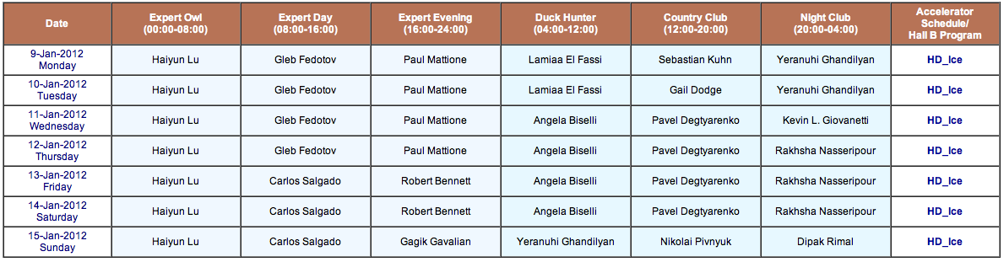
Online Shifts
Standard Hall B/CLAS shift scheduling:
All shift takers required to have current JLab training (RW-I, ODH, safety)
Regular presence of both Run Coordinator and Physics Division Liaison
  Run Coordinator takes direction from CALCOM group
  Subsystem experts present in Counting House during relevant periods
List of on-call experts for each subsystem (pager and phone system)
Engineering on-call (vacuum, hall conditions, LCW, power, configuration changes)

Slide 22
Offline Shifts
Offline Analysis Coordinator
  Organize all offline analysis efforts
  Data cooking
  Working with software experts, subsystem experts, and subsystem calibration teams
  Direct production of physics plots required by commissioning plan
Subsystem Calibrators/Analyzers
  Responsible for using data to calibrate subsystem energy/time response
  Update calibration constant database
  Analyze detector response
Software Experts
  Deal with all issues with the reconstruction, calibration, and simulation code suites
  Deal with usage of common tools for developers
Offline Shift Schedules
  Organize two shifts per day for offline shifts
Daily analysis meetings run by Offline Analysis Coordinator

Slide 23
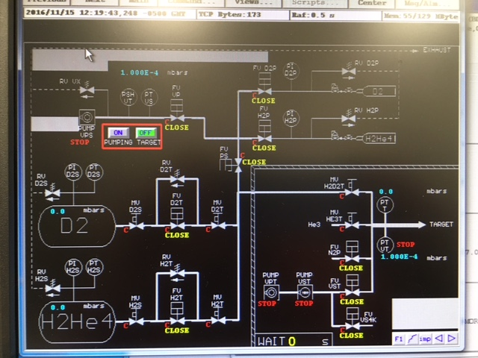
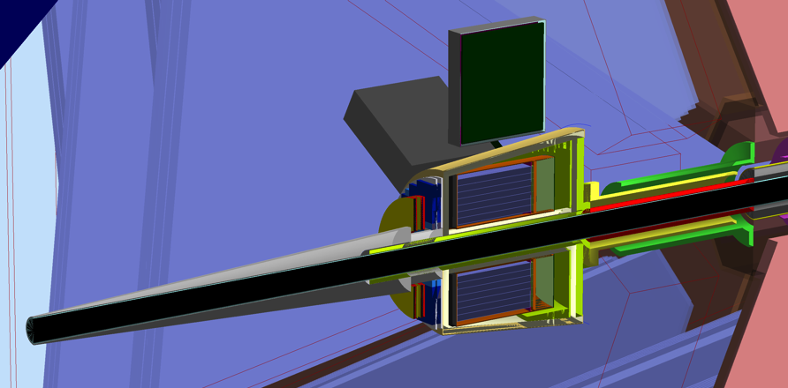
Engineering Run – Target Region
Existing CLAS cryo-target system with few modifications will be used. These include:
  updated controls (the same system)
  a new larger diameter cell with 10 mm diameter windows to accommodate expected large size beams
  longer pipes to the cryostat
A new foam scattering chamber will be used to accommodate the new geometry. The chamber will have an extension piece, 1 mm thick Al tube, to extend the vacuum part of the beamline downstream of FMT close to the tungsten (Möller) cone.
Design of all mechanical parts is done
Cryo-target controls; work in progress
Cryo-target (LH₂) target inside the foam scattering chamber
Tungsten cone
Vacuum window
Vacuum beam pipe
MVT

Slide 24
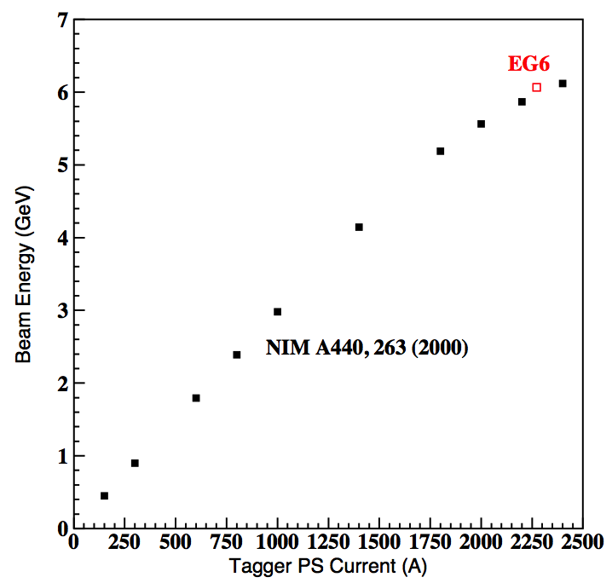
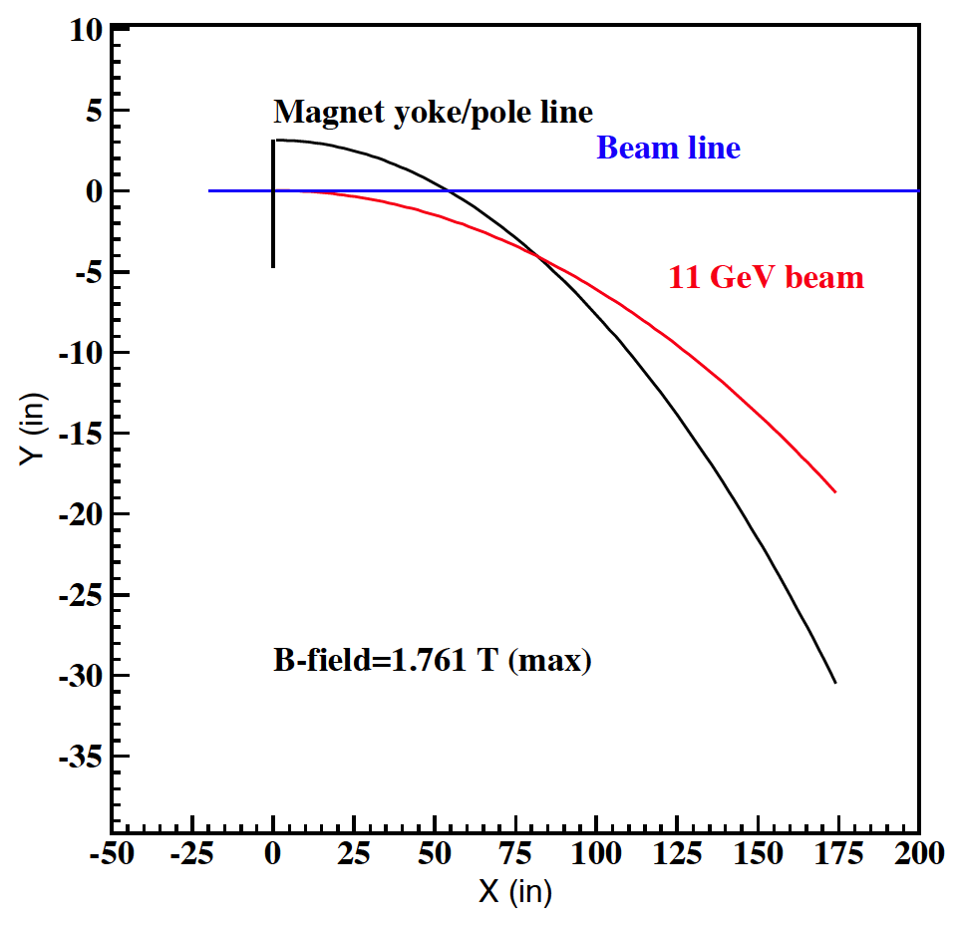
Initial Beam Tune and Möller Runs
During 6 GeV era, the Hall B Tagger dipole was used to prevent errant beam from getting into the hall during the initial beam tune and Möller runs by dumping the beam in the Tagger dump (in the floor before CLAS).
Unfortunately, the Tagger dipole magnet is limited to 2400 A (1.76 T) and cannot direct high energy electron beams (E > 6.12 GeV) to the Tagger dump.
6.07 GeV

Slide 25
Scheme for Initial Beam Tune/Möller Runs
Both initial beam tune and Möller runs require currents <10 nA
Dumping the beam directly into the Tagger magnet yoke is a good alternative
This idea was tested with CLAS in 2007. The rates on the CLAS detectors were tolerable
Current plan: dump the beam in the Tagger yoke, build additional shielding on top of the yoke before the collimator box
Use Ni cylinder in the collimator box to plug the beam pipe (one existing collimator blocks has been modified to be the plug)

Slide 26
SVT/MVT Protection Collimators
Both SVT (radial distance from the beam 57 mm) and FMT (ID of the hole around beam is 50 mm) are located close to the beam
In order to prevent errant beam hitting the detectors, collimators at two locations will be used:
  downstream of the Tagger, Hall B photon collimator box with different size collimators (distance to upstream correctors 20 m, distance to FMT 15.3 m)
  downstream of 2H01 BPM, Hall B photon beam cleanup collimator (distance to correctors on 2H00 ~5 m, distance to FMT ~7 m)
In addition, FSD system based on the beam halo counters will be deployed, which will terminate the beam if beam tails hit the collimators
Hall B photon collimator, half way between upstream corrector dipoles and FMT
Clean-up collimator, half way between upstream corrector dipoles and FMT
12.8 mm
Blank
20 mm
Ni
Ni collimators
14 mm

