Slide 1
HR-TEM and EDS investigation of heat treated large grain Nb (221)
Arti Dangwal Pandey
DESY Nanolab
TTC High-Q meeting 08.09.2017

Slide 2
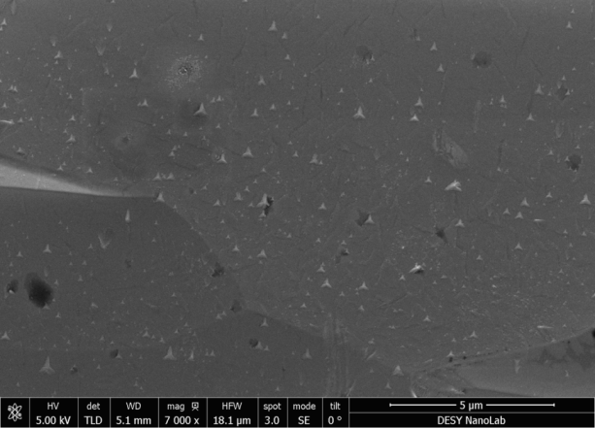
N-infusion of Nb cavities @ DESY
#D5
[M. Wenskat - DESY]
Cavity performance deteriorated
after a heating cycle of 800 °C and 120 °C: 1DE18 in N₂ and 17, 16 without N₂
SEM/EDX of samples not conclusive
all containing precipitates of similar shapes

Slide 3
SEM results:
#D6
#D5
Samples #D5 and D6: BCP 10 μm- by Alena Prudnikova
#D5: 3h@800°C/48h@120°C without N2 , together with the cavity IDE 16,
- precipitates appeared on the surface afterwards.

Slide 4
FIB milling of #D5 @ Nanolab
Pt protective layer deposition
Side view (52°), under-cut
Thomas Keller
Notes:
30 kV, 3 nA to 0.3 nA

Slide 5
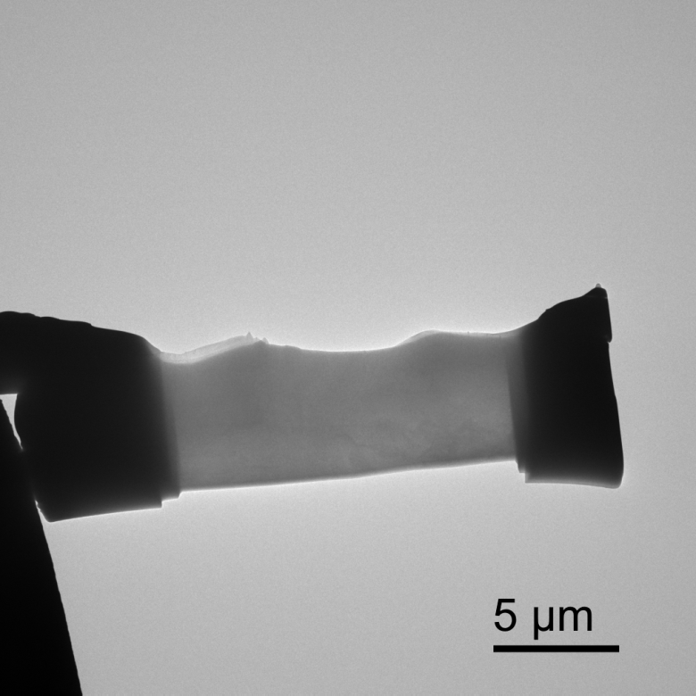
#D5:FIB Lamella Overview
thickness ~ 120 nm
Bright field image of lamella after an additional FIB milling down to ~ 100 nm, just before TEM measurements, performed at electron microscopy facility at TUHH.
Notes:
5kV, 13 pA

Slide 6
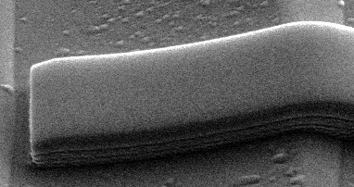
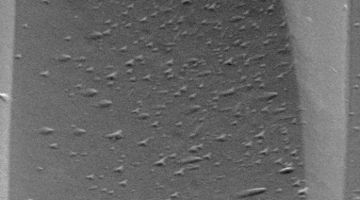
#D5:FIB Lamella Overview

Slide 7
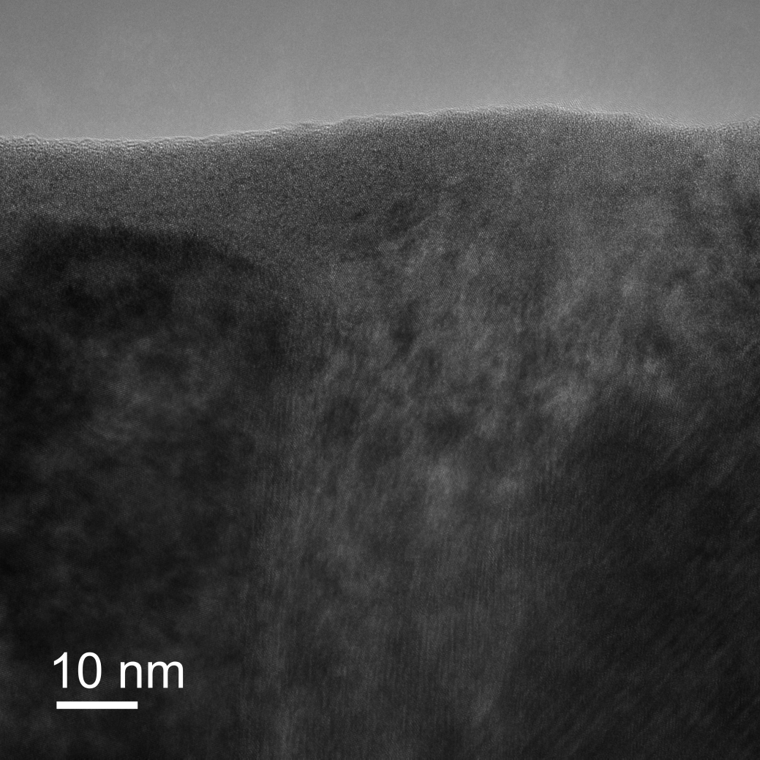
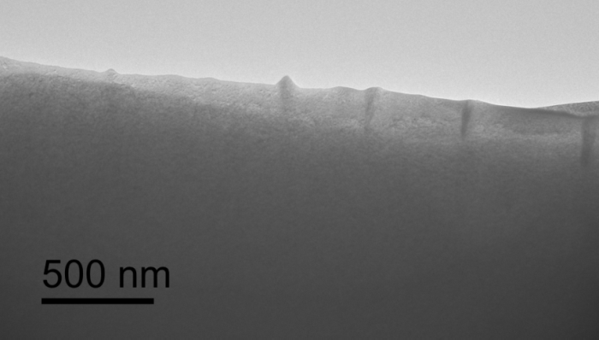
#D5:High resolutionTEM
Precipitates intruding
~ 200 nm deep into Nb bulk
- Look very similar to the β-Nb₂N precipitates formed on N-doping, as reported by Trenikhina et. al. SRF2015
Notes:
a FEI Talos F200X (TEM) equipped with a high brightness X-FEG Schottky emitter and a four quadrant EDX detector system (4 * 30 mm²) with a solid angle of 0.96 sr (Super-X STEM imaging with a probe current of 1 nA for EDX (resolution approx. 1 nm) and 50 pA for imaging. (Resolution limit of 1.6 Angstrom (for an optimum specimen)).

Slide 8
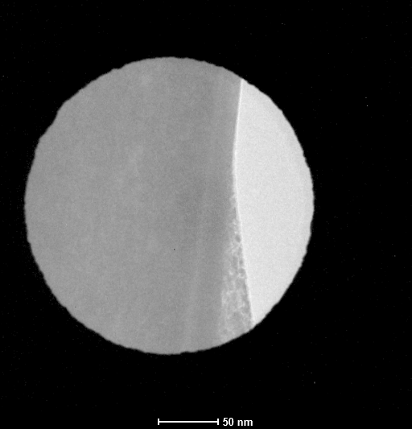
#D5:Electron beam diffraction
without precipitates
Nb matrix
Area including precipitates show additional reflexes

Slide 9
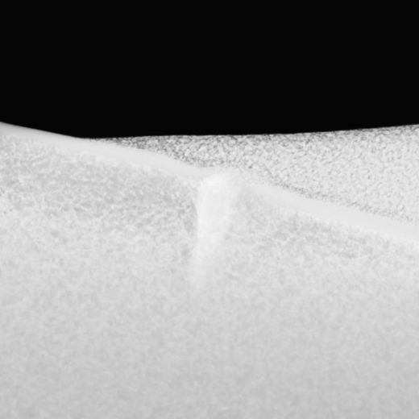
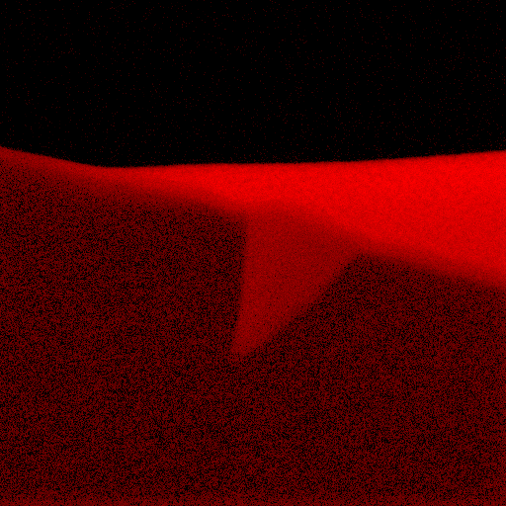
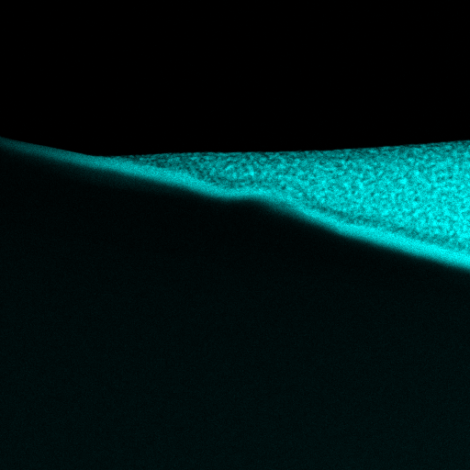
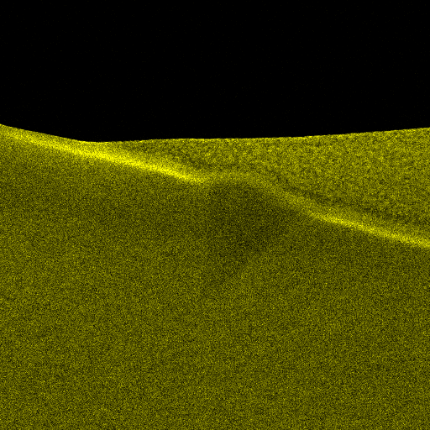
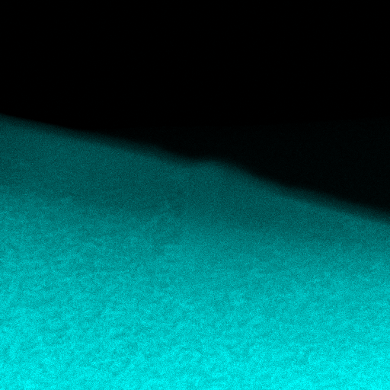
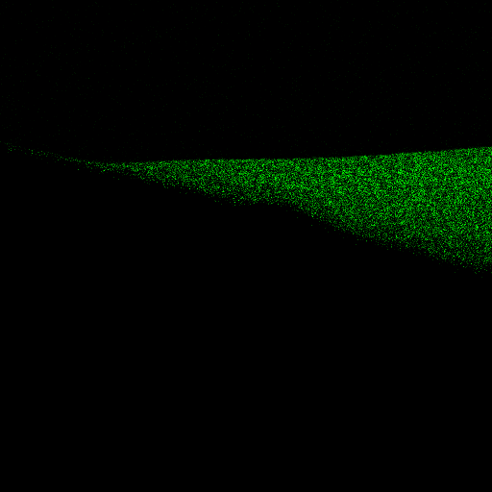
Energy dispersive spectroscopy (EDS)
C
Pt
O
Nb
N

Slide 10
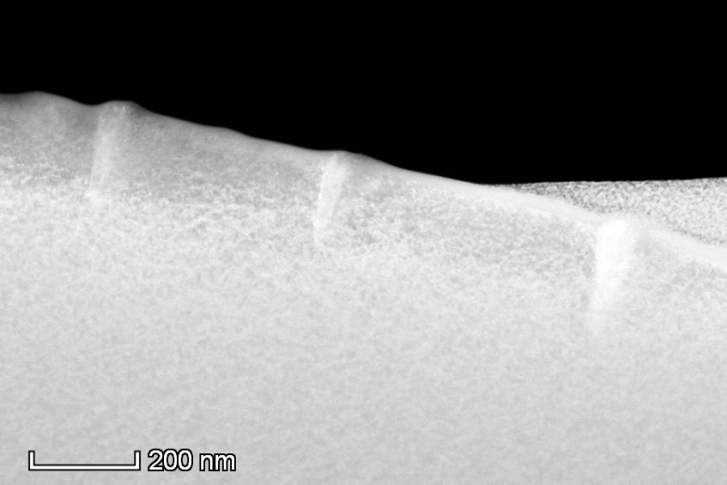
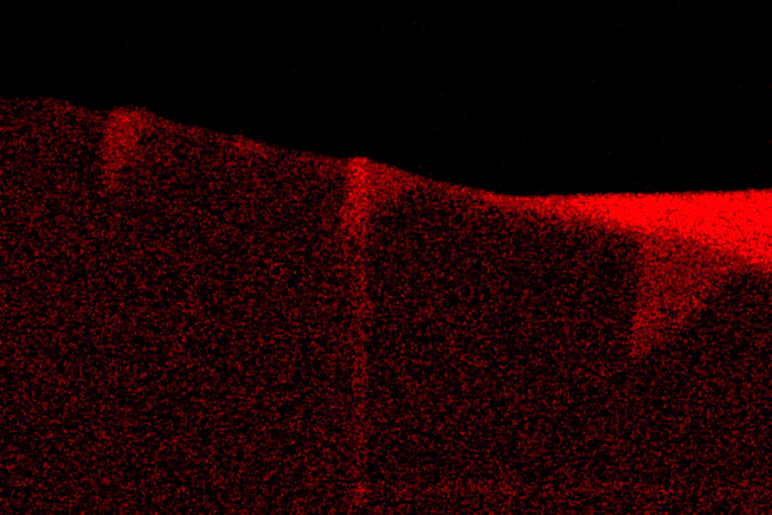
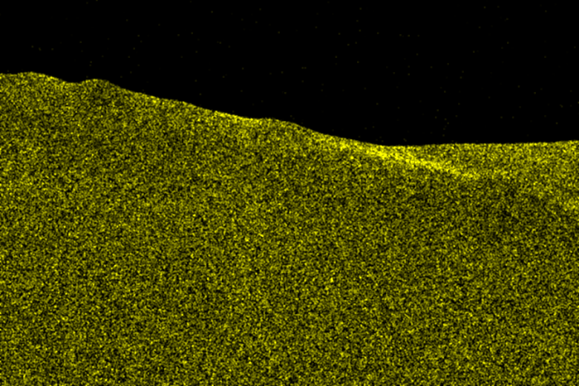
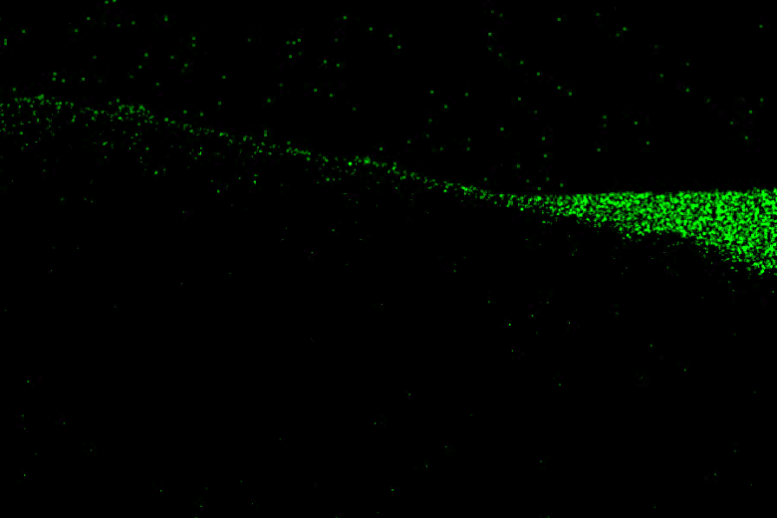
#D5:EDS-MAP
C
O
N

Slide 11
# D5: XPS

Slide 12
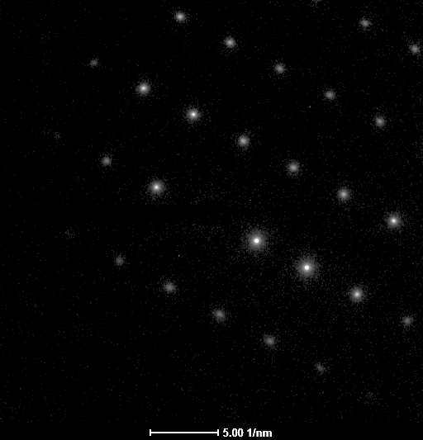
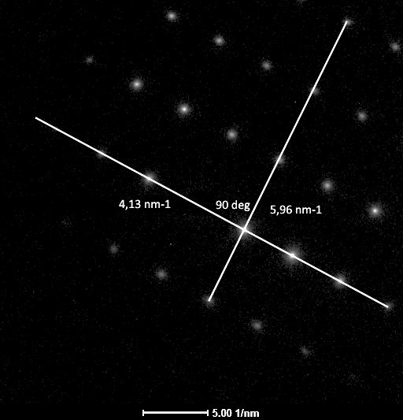
Reference sample # D6
Pure Nb lattice : just beneath Pt layer,
no additional reflexes observed
Notes:
Viewing direction is 011

Slide 13
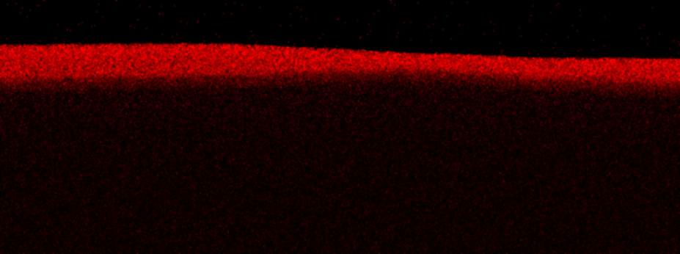
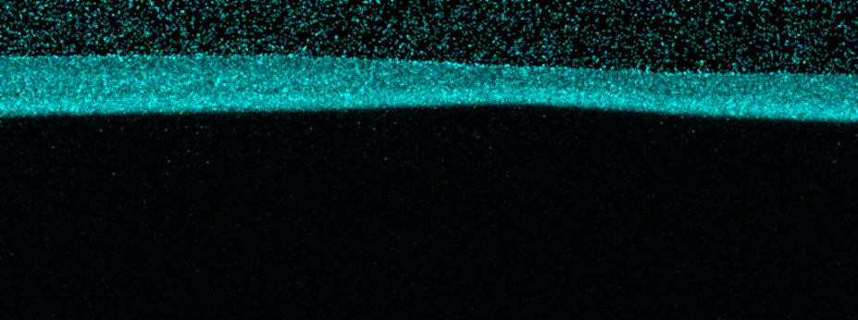
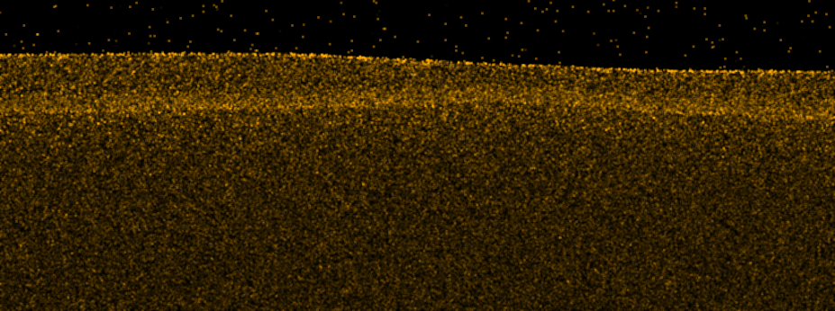
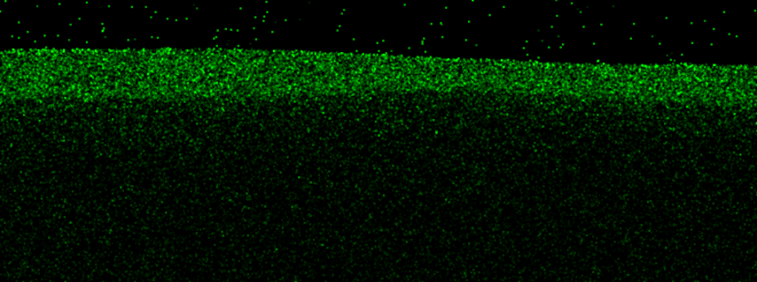
Reference sample # D6
C
Pt
O
Nb
N
Homogeneous elemental distribution

Slide 14
Summary:
Precipitates intruding ~ 200 nm deep in to bulk on a heat treated LG Nb
Additional reflexes in e-diffraction pattern confirms the crystalline nature of the precipitates
EDS maps confirms the C-rich phase of Nb in the precipitates
presence of β-Nb₂N is ruled out.
Still high-Q value of IDE16: here observed Nb-C_{x} precipitates do not result a large Q-drop
‚C-doping‘ : analogous to N-doping, might have occured, but origin of carbon is unclear- either from Nb sample itself or residual gases in the furnace or not properly degassed object within the furnace ??
Samples corresponding to cavities 1DE 17 and 1DE18 are under investigation,
to learn more about the possible reasons for degraded Q-values.

Slide 15
Acknowledgement:
Entire DESY SRF R&D interdisciplinary team
Thank you very much for your attention!

