Slide 1
JLab infusion and LG flux expulsion update
Pashupati Dhakal
09/08/2017
Notes:
Title Page

Slide 2
N-Infusion Update
High purity fine grain Nb Cavity RDL-02: After the fabrication, the cavity was given standard ILC recipe of 150 μm EP, 800 C/2hrs furnace treatment, followed by 20 μm EP.
Cavity was HPR before loading to the furnace and Nb caps were assembled in clean room.
After each heat treatments (with caps), the baseline measurement was done to surface reset with 10 μm EP.
Rs vs T data were taken from 4.3-1.5K at B_{p}~10mT in order to extract the material parameters.
No post chemistry after the furnace treatment.
Correction to earlier report: N2 gas was injected into the furnace ~280-290 C (unintentional)
Notes:
Interior Page Design 1

Slide 3
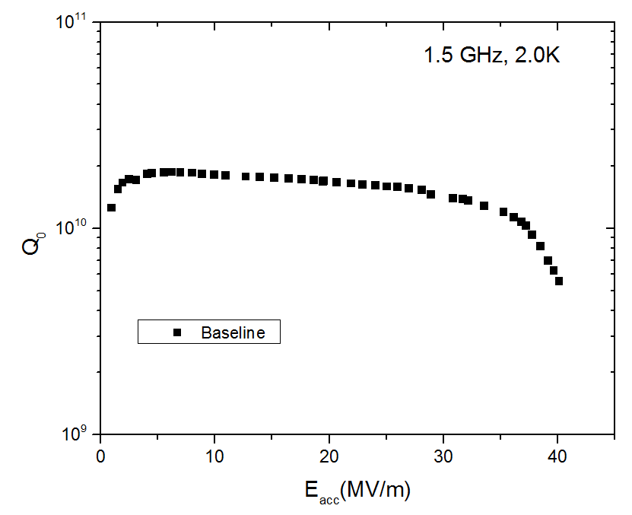
RECENT WORK AT JLAB
Standard ILC EP recipe
Notes:
Interior Page Design 1

Slide 4
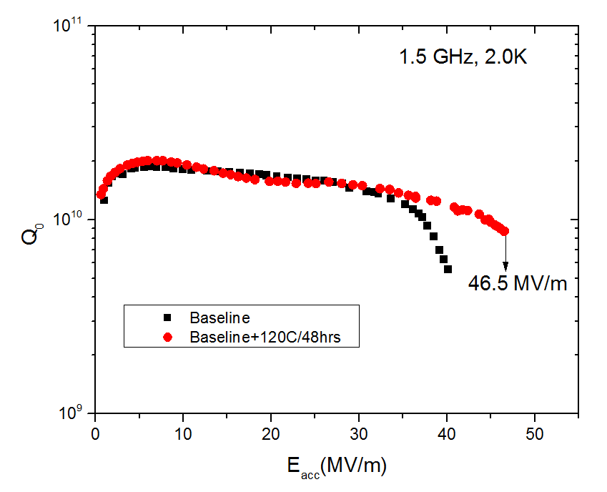
RECENT WORK AT JLAB
Standard ILC EP recipe with Bake
Notes:
Interior Page Design 1

Slide 5
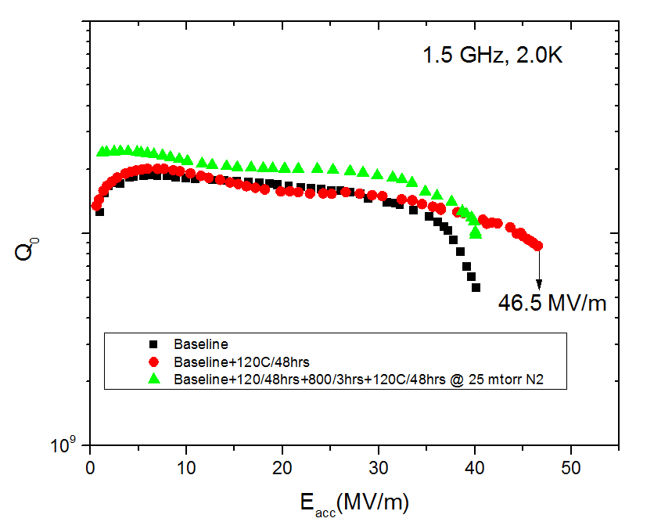
RECENT WORK AT JLAB
Notes:
Interior Page Design 1

Slide 6
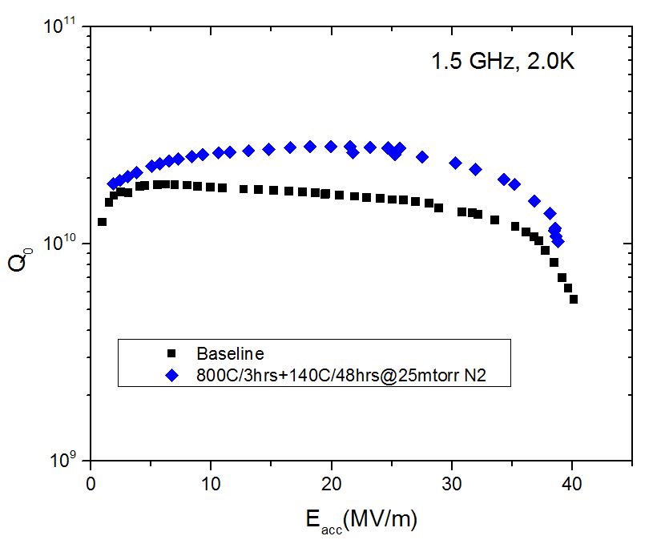
RECENT WORK AT JLAB
Notes:
Interior Page Design 1

Slide 7
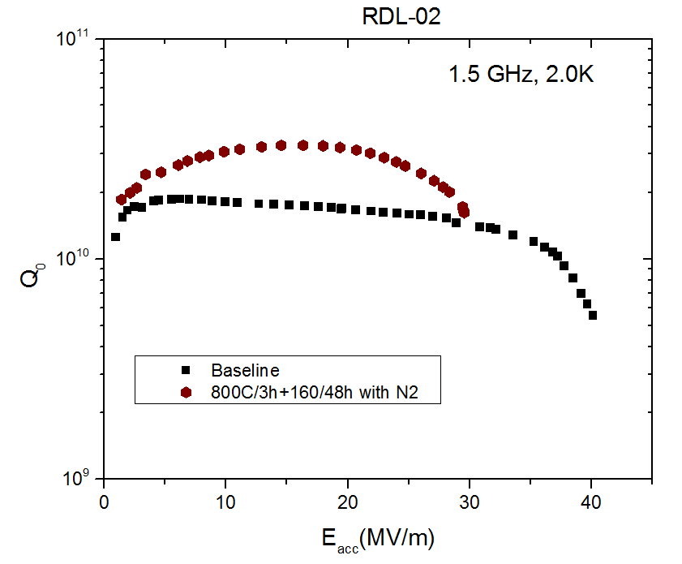
RECENT WORK AT JLAB
Notes:
Interior Page Design 1

Slide 8
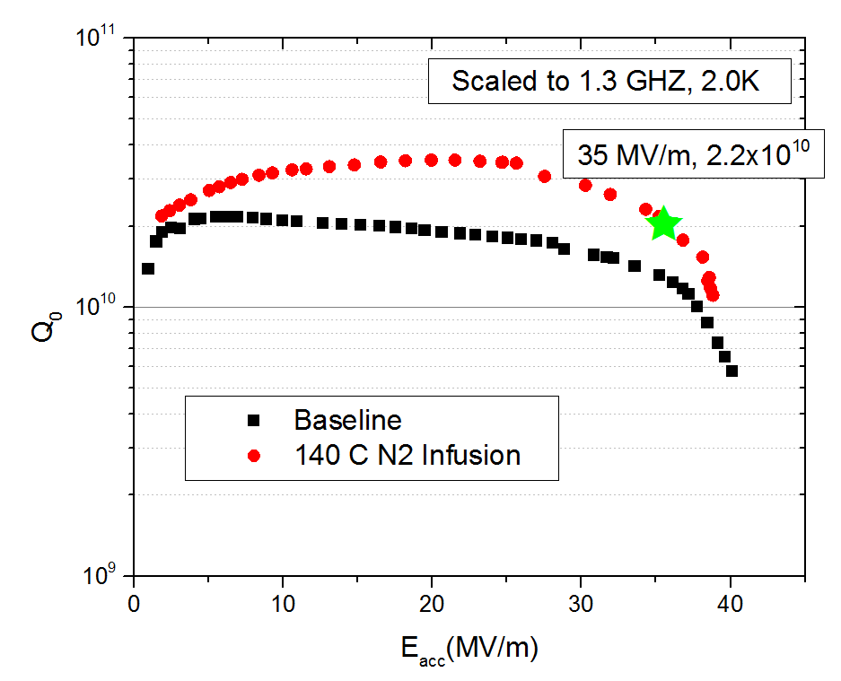
RECENT WORK AT JLAB
Work in Large grain cavities as well as process control are in progress.
Notes:
Interior Page Design 1

Slide 9
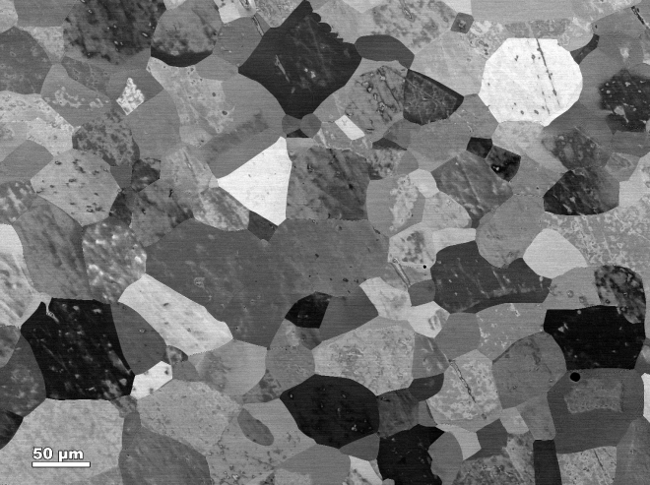
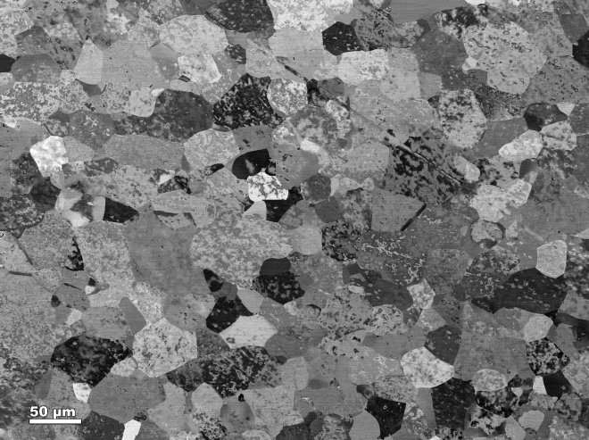
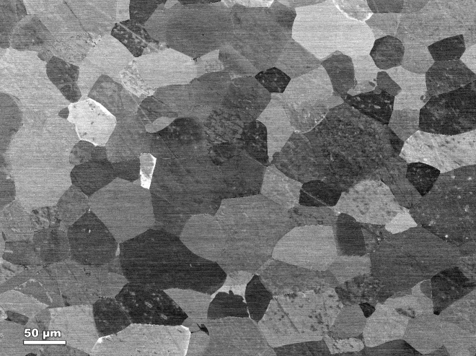
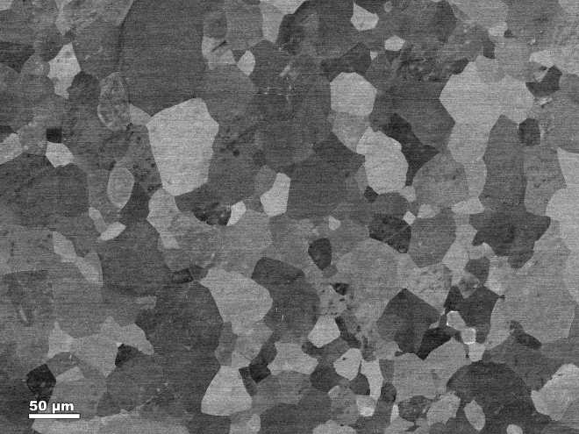
Sample Coupons Study
800°C
800°C+ N₂@120°C
FSU/ASC
800°C+ N₂@140°C
800°C+ N₂@160°C
The material looks non-uniform. Grain sizes vary between 10-70µm
Notes:
Interior Page Design 1

Slide 10
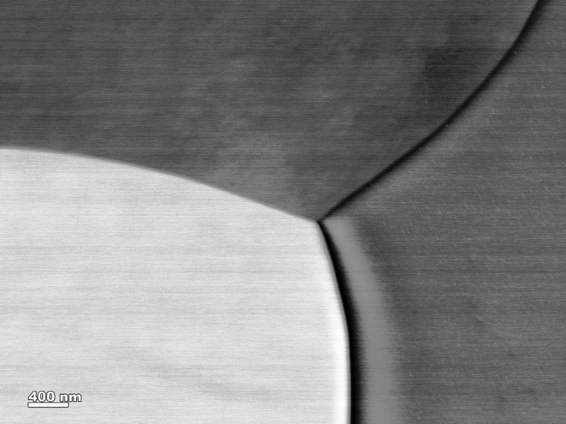
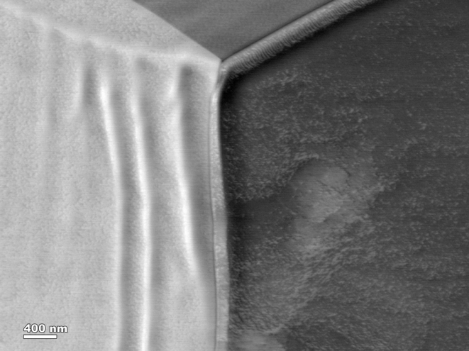
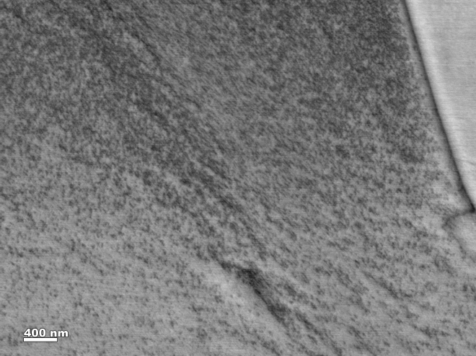
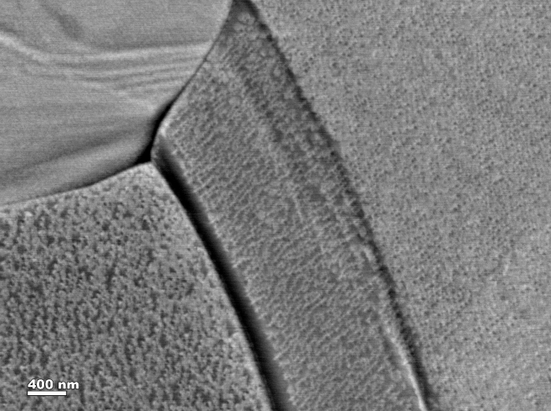
Sample Coupons Study
FSU/ASC
800°C
800°C+ N₂@120°C
800°C+ N₂@140°C
800°C+ N₂@160°C
Granular surface morphology on low temperature N doped samples
Notes:
Interior Page Design 1

Slide 11
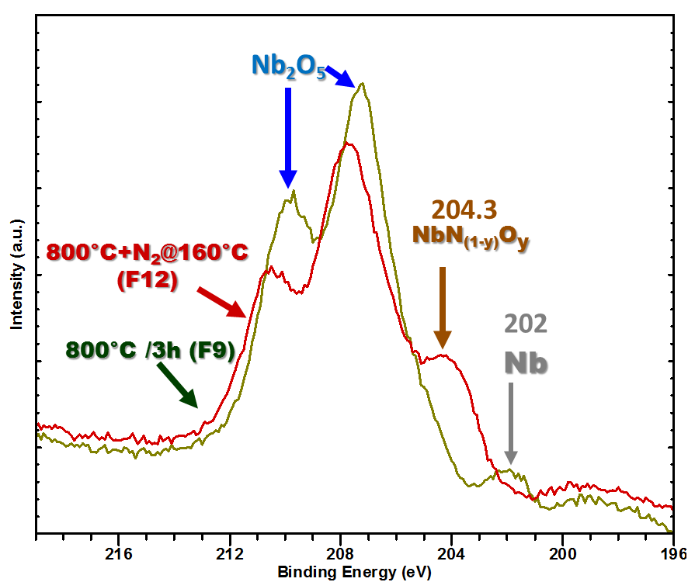
Sample Coupons Study
FSU/ASC
Preliminary XPS Result: Presence of a NbNO peak in low temperature N doped sample
Notes:
Interior Page Design 1

Slide 12
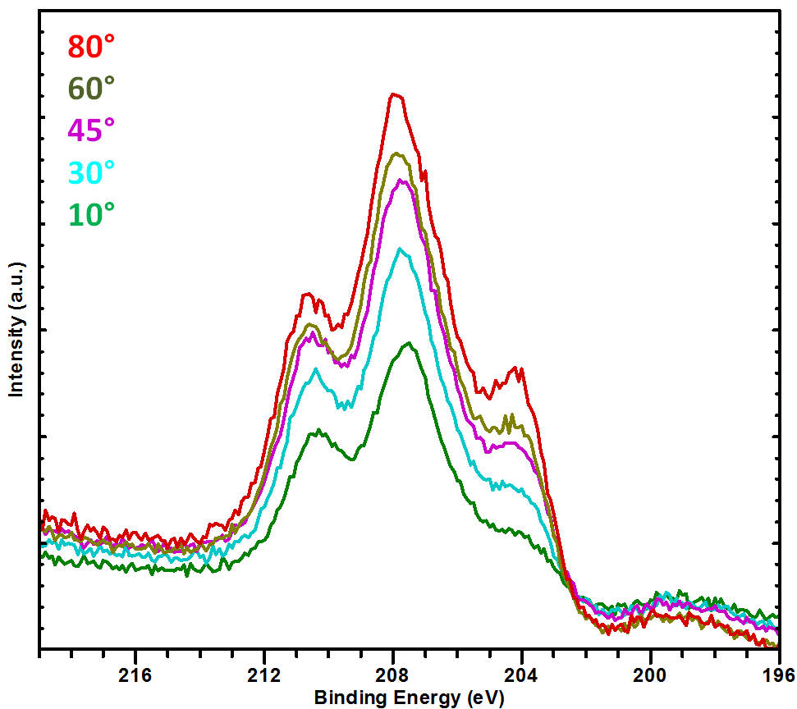
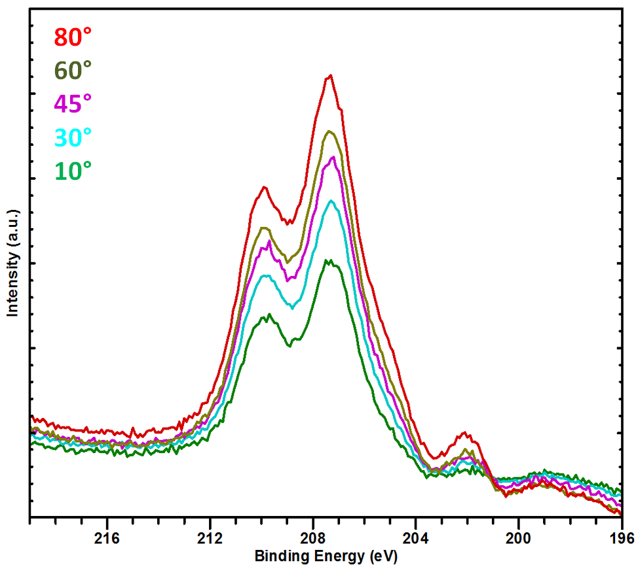
Sample Coupons Study
FSU/ASC
Nb₂O₅
Nb₂O₅
204.3
NbN_{(1-x)}Ox
202.3
NbO_{x}/Nb
800°C+N₂@160°C
(F12)
800°C /3h (F9)
Nb₂O₅
NbOx
Nb₂O₅
NbN_{(1-x)}O_{x}
Nb
Bulk
Nb
Bulk
Nb₂O₅, and NbN_{(1-y)}O_{y} exists within first 10nm in low temperature N infused sample
Notes:
Interior Page Design 1

Slide 13
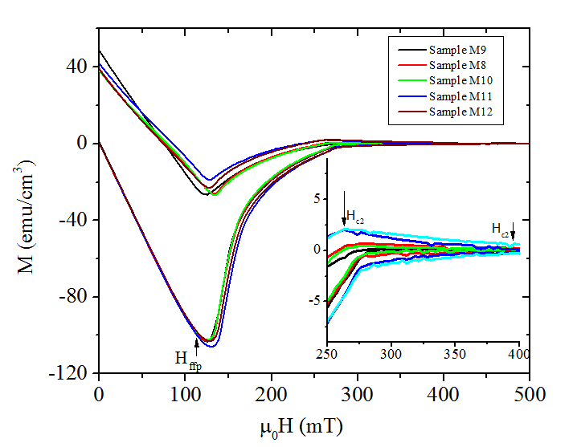
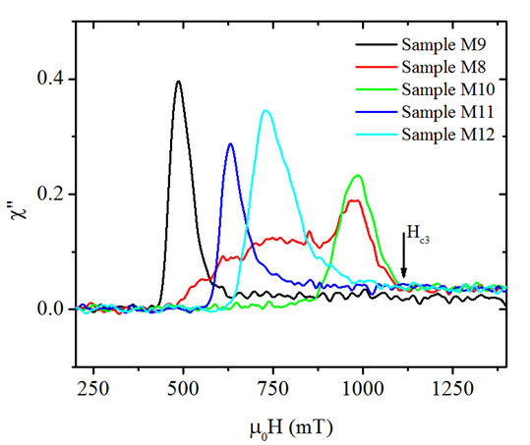
Magnetization/AC Sussceptility
Surface effect with N-infusion

Slide 14
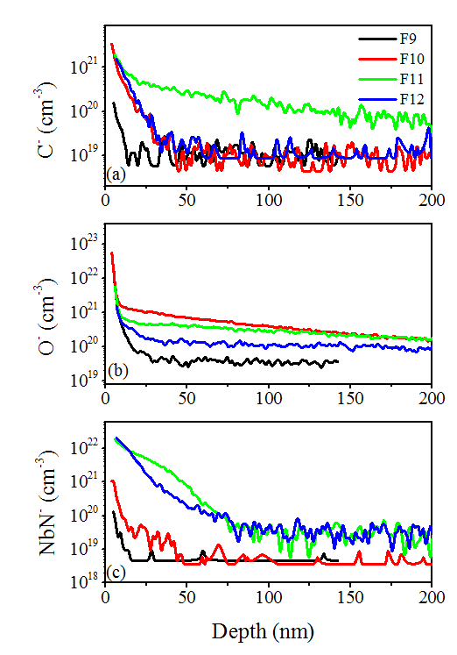
SIMS
One sample shower higher C content, may have segregated C
Oxygen profile consistence with earlier studies of LTB
Higher N concentration for 140 and 160C/48hrs treatments.

Slide 15
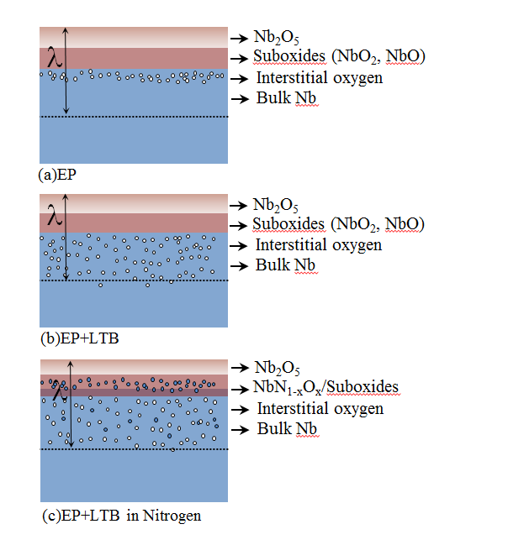
Sample Coupons Study
Q-slope
High Eacc
High R_{res}
High Q
WHY?
The lower residual resistance can be achieved by reducing the thickness of normal layer thickness and also the normal-superconducting interface resistance. Kubo & Gurevich, SRF2017

Slide 16
Conclusions
Nitrogen Infusion at low temperature works and can be ideal processing recipe to achieve high Q, high gradient cavities.
Low temperature N-doping of Nb affects the surface properties significantly
Increase in H_{c3} value, an indication of reduced electron mean free path on surface.
Different baking temperature in N₂ atmosphere leads to different surface condition.
Preliminary XPS on low temperature nitrogen infused sample shows a presence of NbN_{(1-y)}O_{y} and a protective Nb₂O₅ within the first 10nm. The presence of other sub-oxides cannot be ruled out. XPS analysis is in progress.
But the bulk properties remains unaffected
T_{c} is unchanged
Number of pinning sites (evident from magnetization loop) are almost same. The effect is different from high temperature N-doping.
Sample study shows higher flux trapping efficiency, similar to conventional nitrogen doping.
Notes:
Interior Page Design 1

Slide 17
Flux Expulsion on LG cavities
Where does the flux trap? Surface or bulk?
RF only sees the surface flux trapping where as flux expulsion is bulk effect.
We measure the flux expulsion and flux trapping studies on LG cavities with different impurities in order to see the correlation of purity (bulk RRR) and surface preparations (EP, LTB and N-doping)

Slide 18
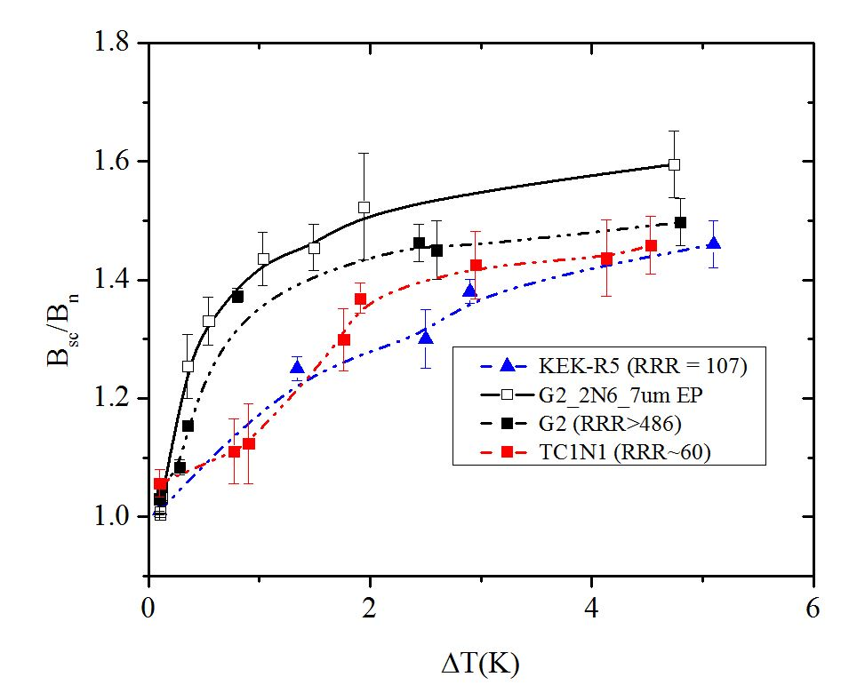
Flux Expulsion on LG cavities

Slide 19
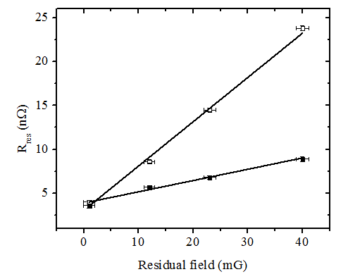
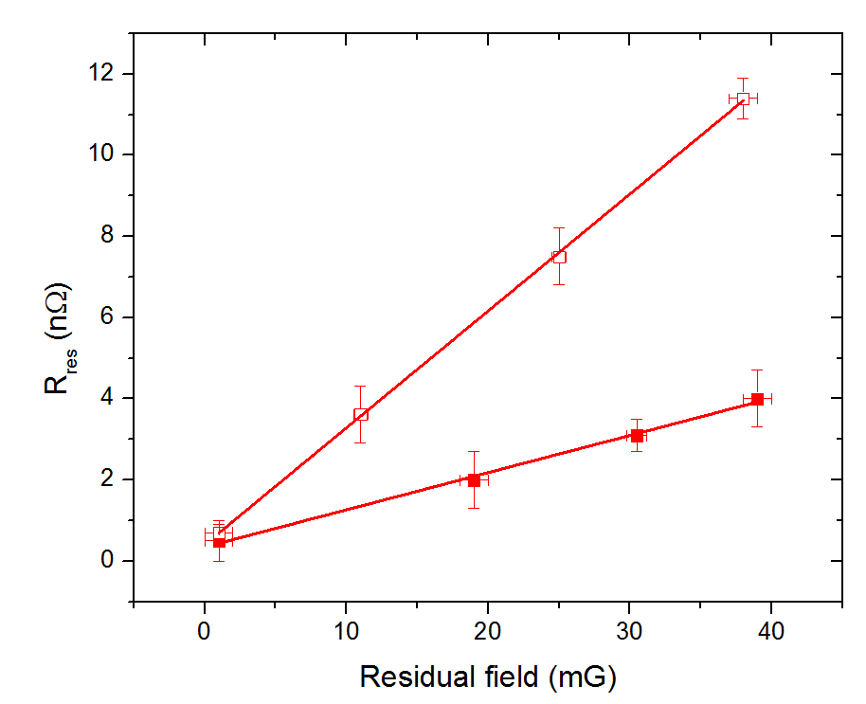
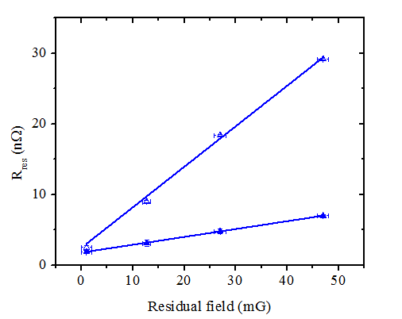
Flux Expulsion on LG cavities Surface (EP)
RRR = 60
RRR = 107
RRR = 486
Cavity | ΔT>4K(B_{sc}/B_{n} ~ 1.5) dRres/dBa nΩ/mG | ΔT<0.1K(B_{sc}/B_{n} ~ 1) dRres/dBa nΩ/mG
TC1N1 (RRR=60) | 0.13 ±0.01 | 0.51 ±0.02
KEK-R5 (RRR=107) | 0.10 ±0.02 | 0.28 ±0.04
G2 (RRR=486) | 0.11 ±0.01 | 0.57 ±0.02

Slide 20
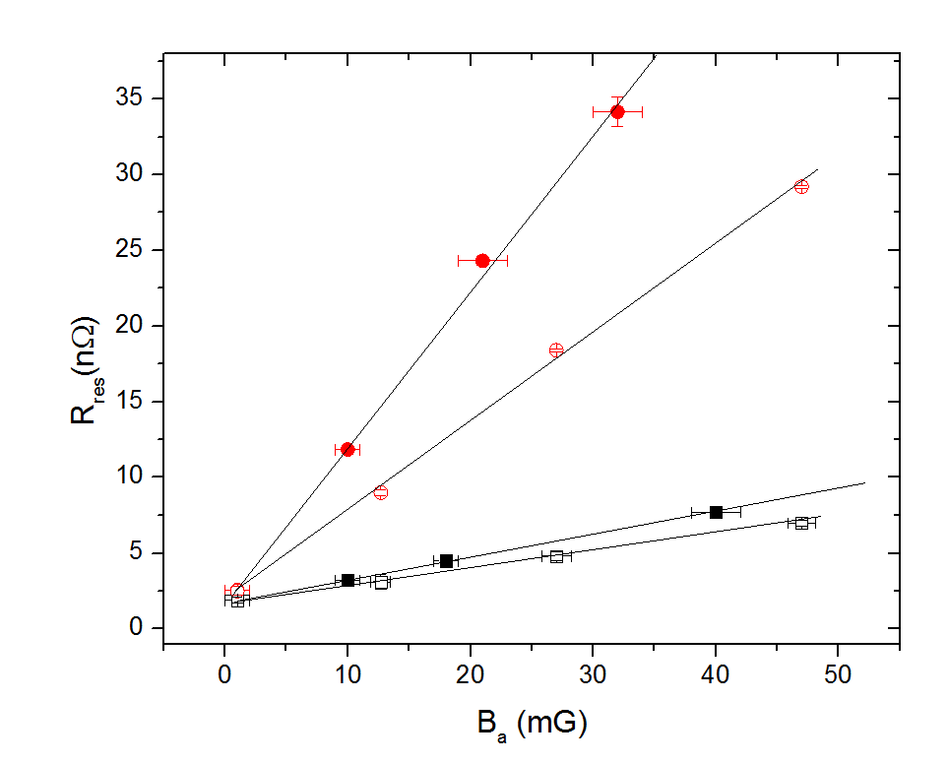
Cavity G2 (EP vs N-doped)
Cavity | ΔT>4K (B_{sc}/B_{n} ~ 1.5) dRres/dBa nΩ/mG | ΔT<0.1K(B_{sc}/B_{n} ~ 1) dRress/dBa nΩ/mG
G2 (EP) | 0.11 ±0.01 | 0.57 ±0.02
G2 (EP+N2-7umEP) | 0.13 ±0.01 | 1.06 ±0.03

Slide 21
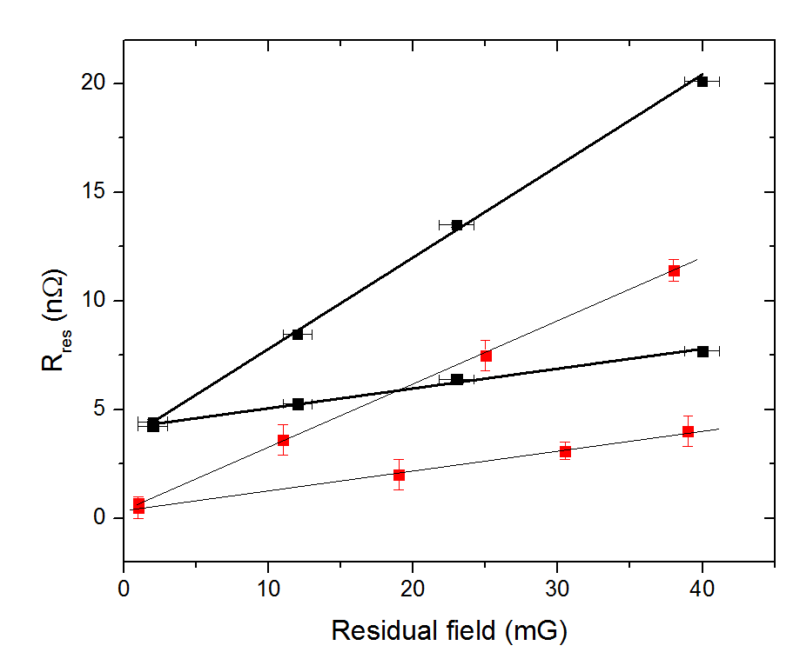
KEK-R5 (EP vs LTB 120/24hrs)
Increase due to LTB
Cavity | ΔT>4K (B_{sc}/B_{n} ~ 1.5) dRres/dBa nΩ/mG | ΔT<0.1K(B_{sc}/B_{n} ~ 1) dRress/dBa nΩ/mG
KEK-R5 (EP) | 0.10 ±0.02 | 0.28 ±0.04
KEK-R5 (EP+LTB) | 0.10 ±0.01 | 0.41 ±0.03

Slide 22
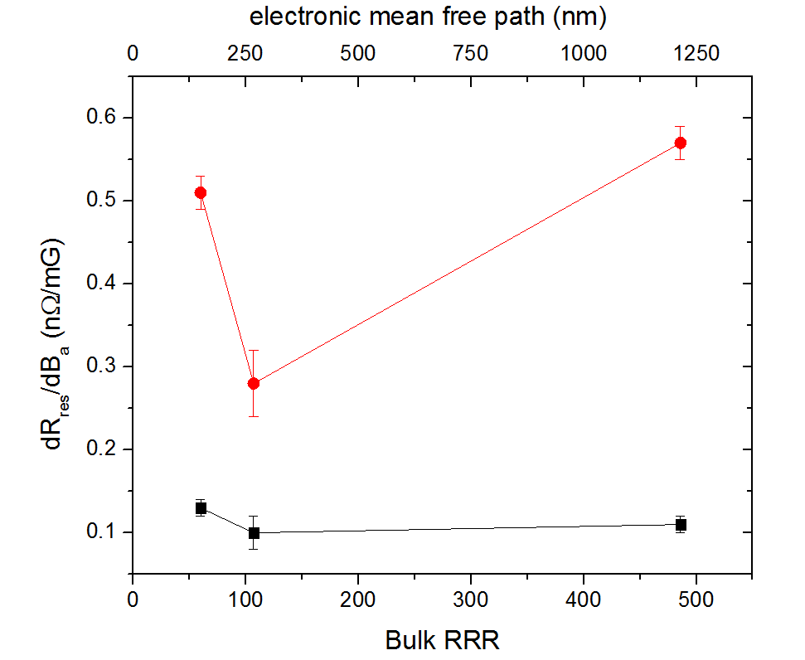
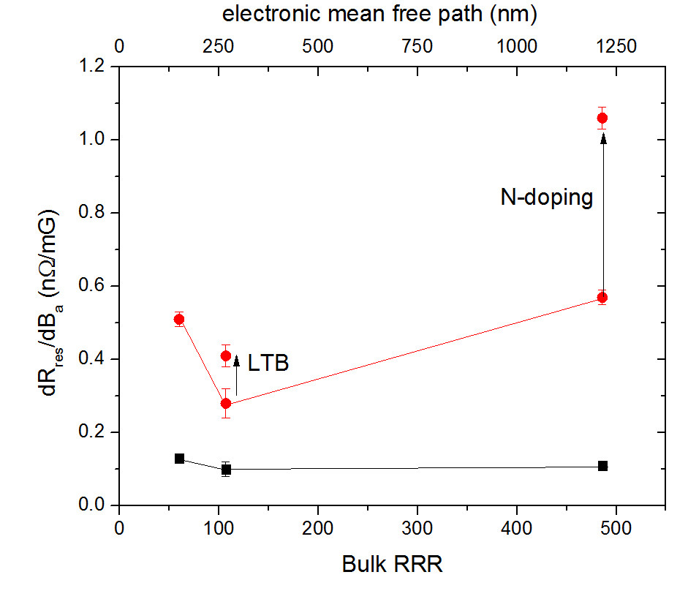
ΔT <0.1K
ΔT >4 K

Slide 23
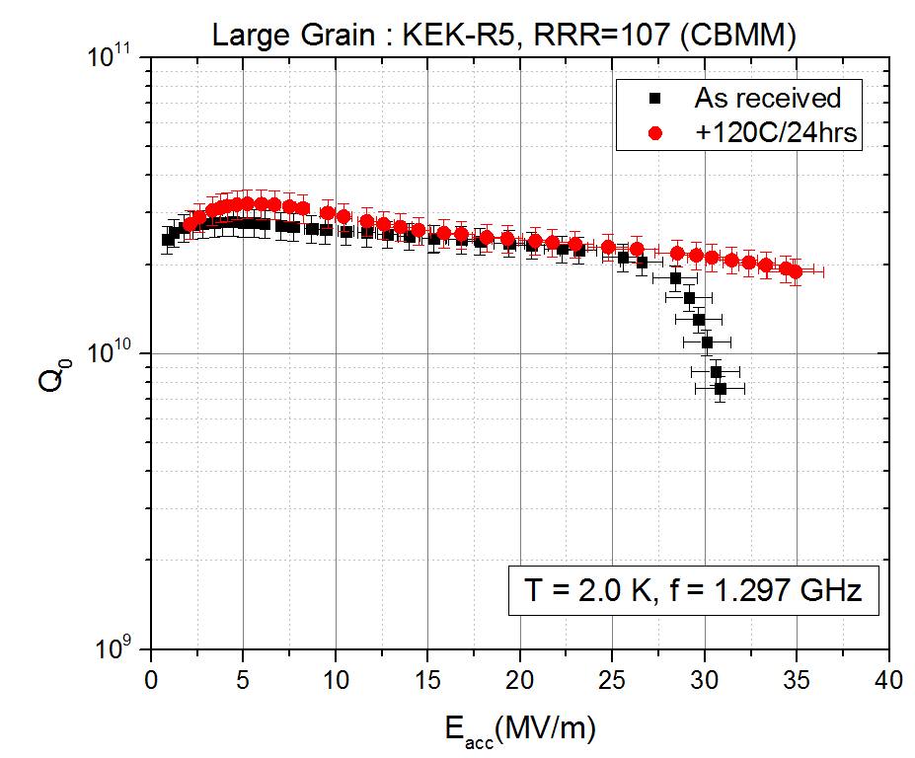
E_{acc} = 36 MV/m, Q₀ = 2x10¹⁰

Slide 24
Summary
Good flux expulsion (ΔT>4K) regardless of RRR
dR_{res}/dB_{a} ~ 0.1-0.13 nΩ/mG, regardless of RRR and surface preparations as long as ΔT > 4K.
The trapping sensitivity increase from 0.57 to 1.06 nΩ/mG (about a factor of 2) in N-doped cavity made from high purity LG niobium
The trapping sensitivity increase from 0.28 to 0.41 nΩ/mG due to LTB in cavity made from medium purity Nb.
May help to understand the bulk/surface pinning effect on R_{res.}
More details analysis to follow…..

