Slide 1
The MESA projects

Slide 2
Current Facility: MAMI
MAMI - Multi-stage microtron
1.5 GeV electrons @ 0.1 mA
Long list of scientific accomplishments
Active since 1979
MESA
Four experimental areas
A1: Electron scattering
X1: Hard X-Ray sources
A2: Real photons
A4: Parity violation (Replaced by MESA)

Slide 3
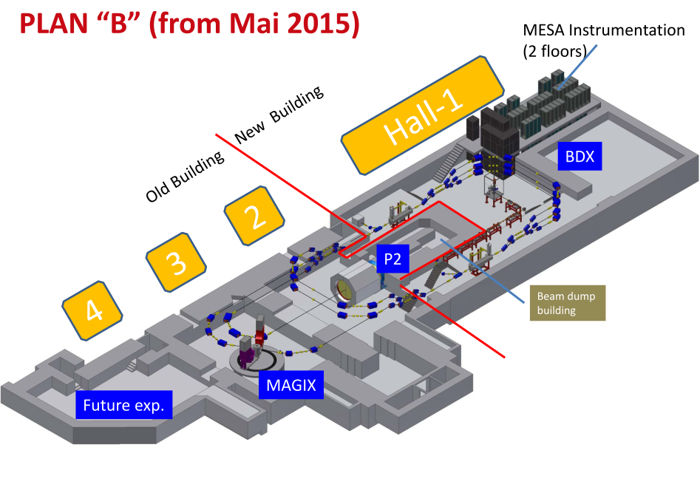
Mainz ER Superconductive Accelerator
Multi-turn, superconducting ERL
Energy recovery mode
105 MeV polarized electrons @ 1 mA
Internal target scattering (MAGIX)
External beam
155 MeV polarized electrons @ 0.15 mA
Dedicated experiment (P2)
Beam dump experiment
Behind the P2 beam dump
About ${10}^{23}$ electrons on target
About 〖10〗^23 electrons on target
Electroweak asymmetry precision measurement

Slide 4
MESA Schedule
Extension hall approved
More space
Delayed schedule
Construction schedule
2017 Ancillary buildings
2018 Ground breaking for the new hall
2019 Underground constructions
2020 Hand over of the new halls
2021 MESA installation and commissioning
2022 Start of operation

Slide 5
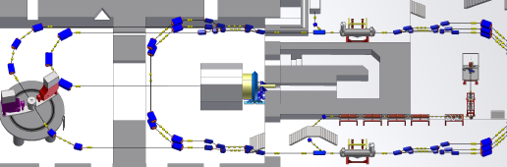
Accelerator layout
5 MeV dump
MEEK-2
Ext. beamline
Gun
P2
155 MeV dump
Recirculation arcs 1-3-5
Recirculation arcs 2-4
BDX
MAGIX
MELBA
MAMBO
ERL loop
MEEK-1
Picture: D. Simon
MELBA
MEsa Low-energy Beam Apparatus
MAMBO
MEEK
MilliAMpere BOoster
Mesa Extended Elbe-type Kryomodule
Room temperature section
Superconductive section
Dumps
Experiments

Slide 6
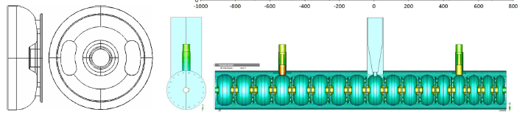
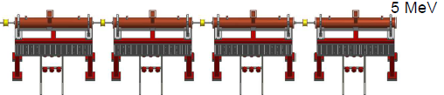
MAMBO: Milliampere booster
Design inspired by the MAMI injector LINAC
4 room temperature RF bi-periodic $π/2$ standing wave structures @ 1.3 GHz
4 room temperature RF bi-periodic 𝜋/2 standing wave structures @ 1.3 GHz
1 graded-β , 3 const. β sections; Energy gain ∆E=1.25 MeV/section
RF-Amplifiers: SSA with ~90 kW (graded β) and 3 x ~60 kW (fixed β)
Status
Design completed
Test cavity ordered
15 kW SSA-prototype ordered
Complete testing on-site before the new-hall construction
100 keV
Pictures: R. Heine

Slide 7
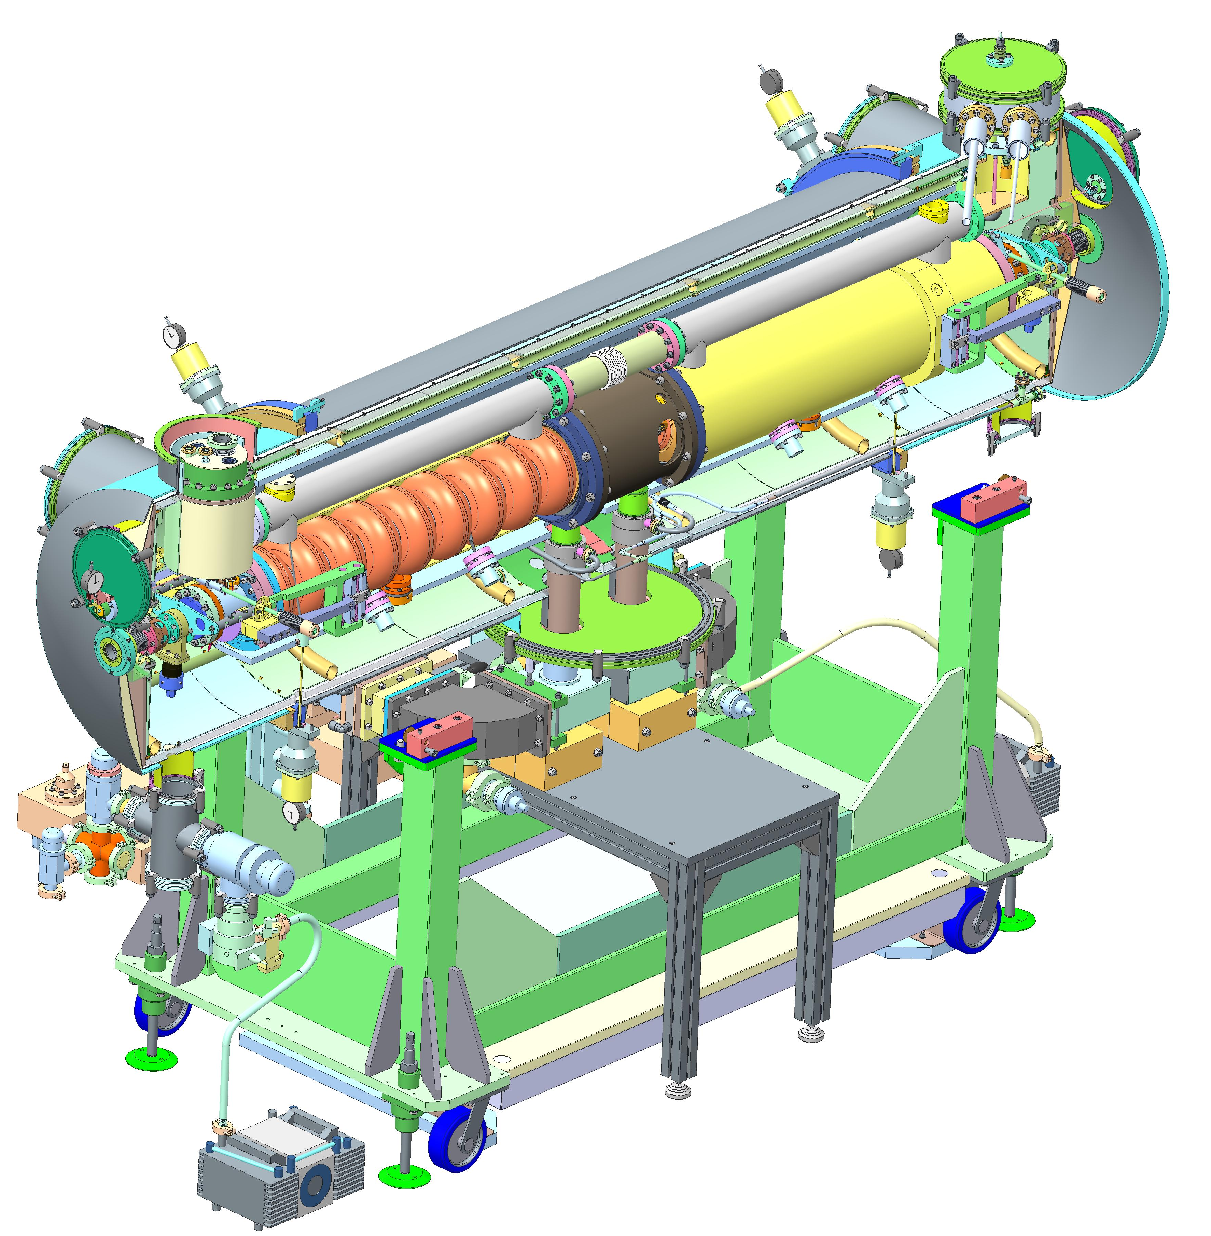
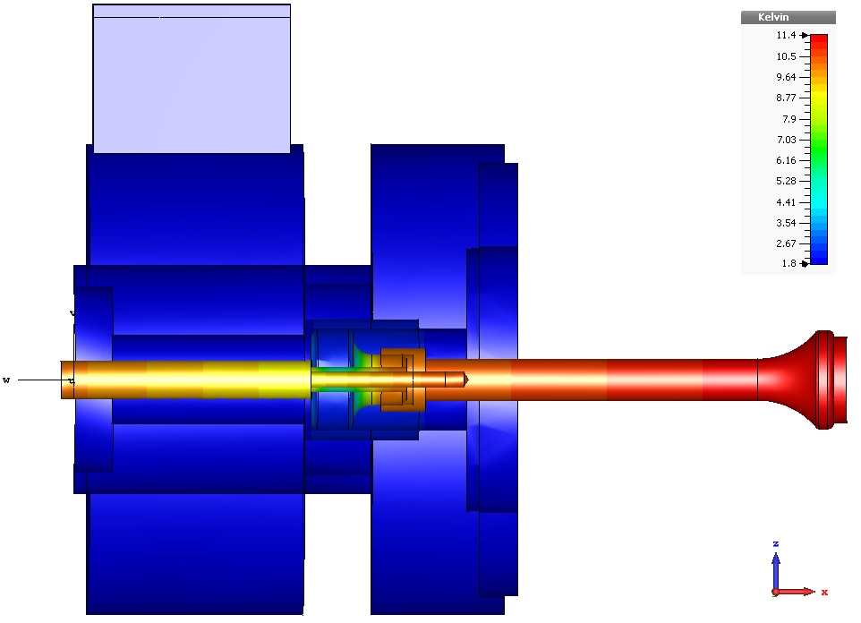
MESA Cryomodules
Rossendorf-type cryomodules
Adaptations for 1 mA operations
HOM antenna development
2x9-cell TESLA/XFEL cavities
Added tuners with piezo-elements
Sapphire windows at HOM feedthroughs
10 mA not achievable with this cryomodule
Thermal calculations for the HOM antenna ongoing
Prototype for thermal conduction tests
Efficiency limited by the heat input from the cable
Cryomodule production
Four cavities and high-power couplers assembled
Component testing ongoing
Completion of first cryomodule planned for September-October 2017
Cryomodule test to start in fall 2017
Picture: HZDR
Picture: T. Stengler

Slide 8
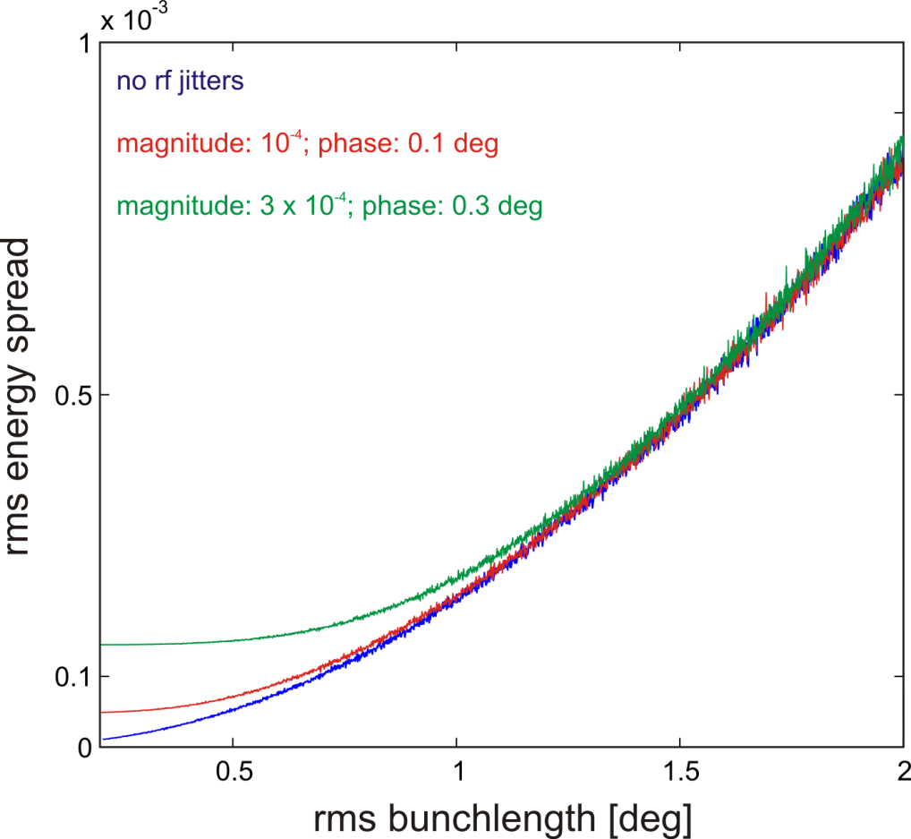
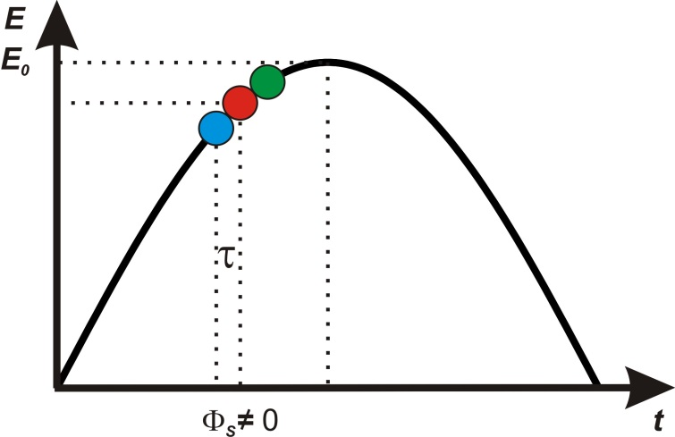
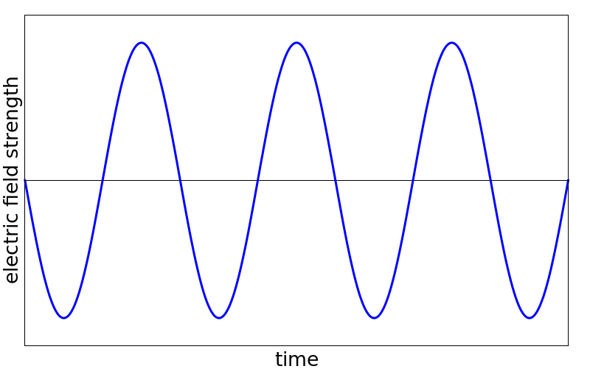
Energy spread reduction
Short bunching
Relative ERL energy spread
EB energy spread
Symmetric non-isochronous acceleration
Energy spread is roughly proportional to the bunch length
Additional errors come from phase and amplitude jitter in the rf
Energy spread reduction through the off-crest acceleration
Efficient energy recovery and no disturbance on the accelerating bunches due to the symmetric charge configuration
$\frac{ΔE}{E}=7.16⋅{10}^{−4}$ for long bunch isochronous acceleration
Δ𝐸/𝐸=7.16⋅〖10〗^(−4) for long bunch isochronous acceleration
$\frac{ΔE}{E}=2.68⋅{10}^{−4}$ for long bunch symmetric non-isochronous
Δ𝐸/𝐸=2.68⋅〖10〗^(−4) for long bunch symmetric non-isochronous
Calculations for the short bunch non-isochronous case are ongoing
$\frac{ΔE}{E}=5.5⋅{10}^{−5}$ short bunches in non-isochronous mode
Δ𝐸/𝐸=5.5⋅〖10〗^(−5) short bunches in non-isochronous mode
< 10 KeV at 155 MeV nominal energy
M. Konrad

Slide 9
P2 experiment
A dedicated measurement of the electroweak mixing angle

Slide 10
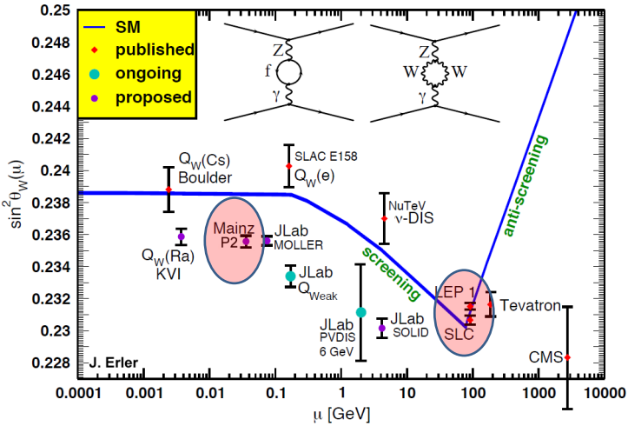
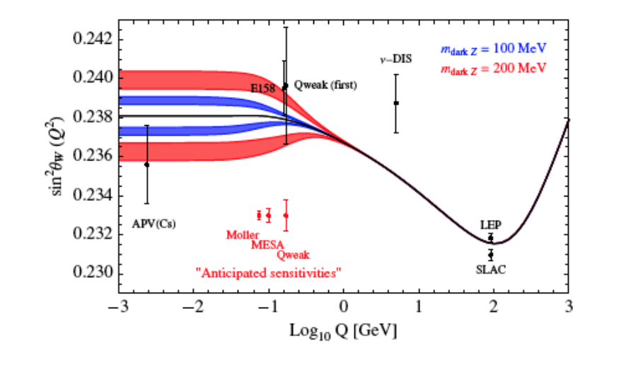
The weak mixing angle
Essential SM parameter
When including radiative corrections it is scale dependent
Current measurements
Most precise measurements at the Z-pole
Many ongoing and proposed experiments at lower energy scales
Low energy measurements
Discrepancies at low energy can be due to new BSM physics
JLAB and Mainz on the front line
E.g. Dark boson hypothesis
F. Maas, PAVI2014
S. Baunack

Slide 11
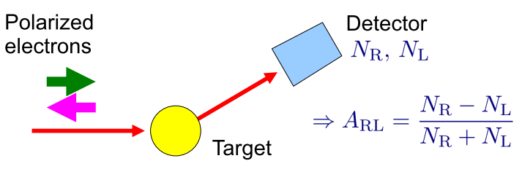

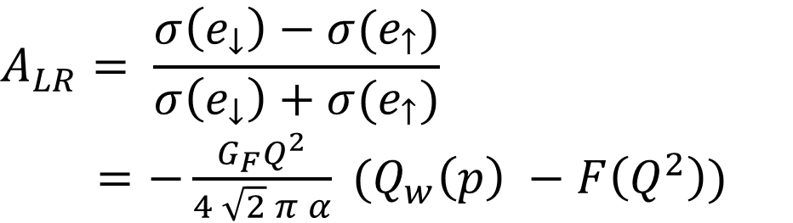
Measurement of the weak angle
Proton weak charge
Weak charge with electron probes
Direct correlation with the mixing angle
1.5% precision in $Q_{w}\left(p\right)$corresponds to a 0.13% precision in $\sin^{2}{θ_{w}}$
1.5% precision in 𝑄_𝑤 (𝑝) corresponds to a 0.13% precision in sin^2⁡〖𝜃_𝑤 〗
Measure the cross-section asymmetry in the elastic electron-proton scattering
Use polarized electrons
The P2 experiment
Fixed target experiment with polarized electron beam
Fix angle integrating detector synchronized with rapidly switching polarized beam
$$Q_{w}\left(p\right)=1 −4 \sin^{2}{θ_{w}}$$
$$A_{LR}= \frac{σ\left(e_{↓}\right)−σ(e_{↑})}{σ\left(e_{↓}\right)+σ(e_{↑})}$$
$=−\frac{G_{F}Q^{2}}{4 \sqrt{2} π α} (Q_{w}\left(p\right) −F\left(Q^{2}\right))$

Slide 12
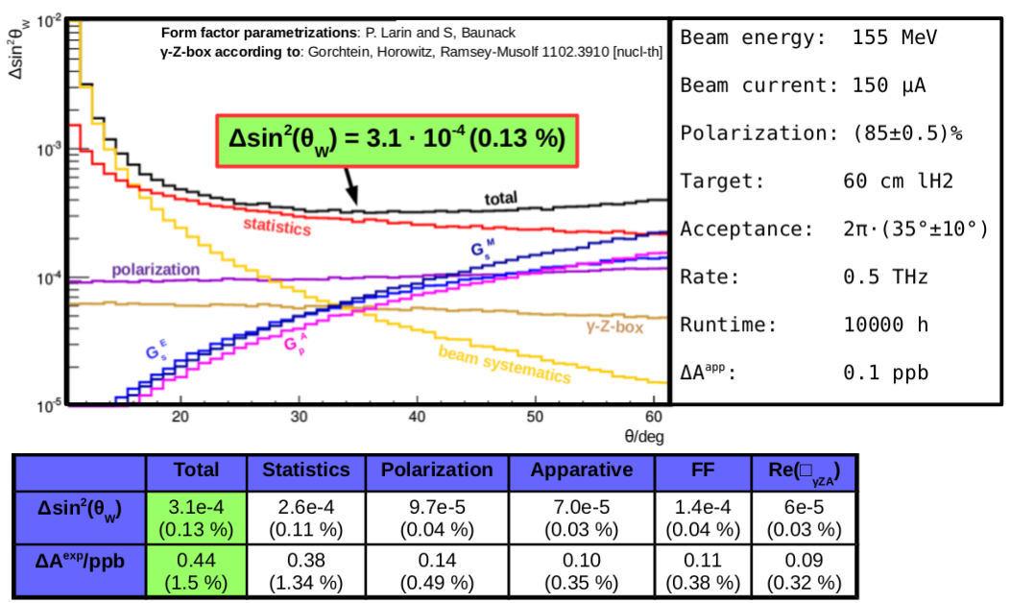
P2 operational parameters

Slide 13
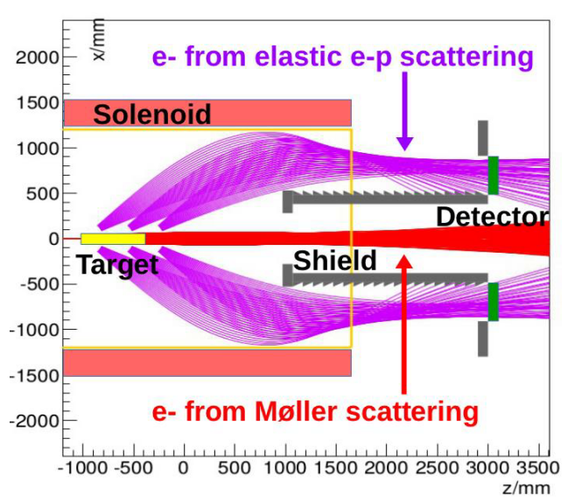
The detector concept
Liquid hydrogen target
Solenoid magnet
Design underway
Focusing the elastic scattered particles on the detector
Integrating detectors
Thin, fast and granular detectors
Simulated with FEM and GEANT
HV monolithic active pixel sensors
Current generation is MUPIX7 with $9.4 {\text{mm}}^{2}$ active surface
Current generation is MUPIX7 with 9.4 〖"mm" 〗^2 active surface
Tested at MAMI

Slide 14
MAGIX experiment
A versatile experiment for precision measurements at low energy

Slide 15
Physics program
Hadronic structure
Few-body physics
Precision cross-sections
Proton form factors (electric and magnetic)
Nuclear polarizabilities
Light nuclei form factors (Deuteron and helium)
Deuteron and ³He breakup
⁴He monopole transition factors
Test of effective field theories
Inclusive electron scattering
¹⁶O(e, e’α)¹²C S-factor
Search for exotica
Direct dark photon search
Invisible decaying dark photon search

Slide 16
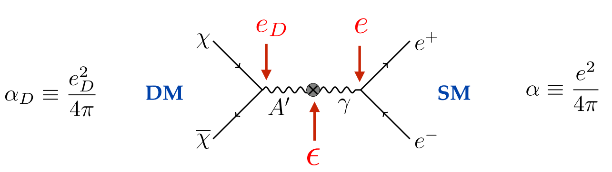
Dark Photon
Dark sector mediator
Massive U(1) boson
Same quantum numbers of the SM photon
Can undergo kinetic mixing with the SM photon (parameterized by $ε$)
Can undergo kinetic mixing with the SM photon (parameterized by 𝝐)
Magix can search for invisible or visible decays (possible when there is no DM particle kinematically accessible)

Slide 17
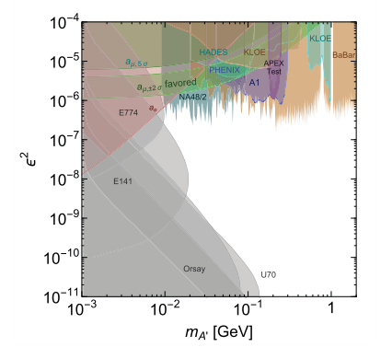
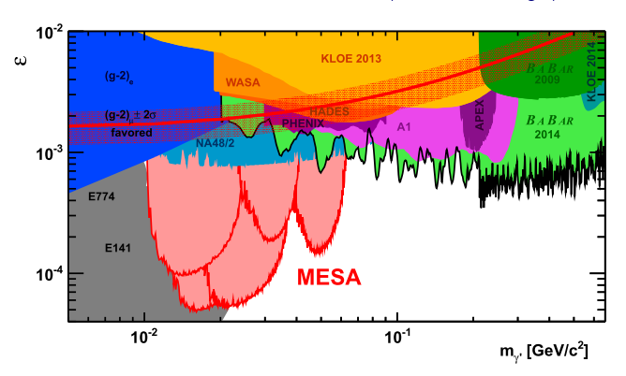
Dark photon visible decays
Measure the momenta of e⁺ e⁻ in coincidence
Bump hunting in the invariant mass distribution
Mass sensitivity: 10 – 60 MeV
Coupling down to about
$ε>5⋅{10}^{−5}$
Coupling down to about
𝝐>𝟓⋅〖𝟏𝟎〗^(−𝟓)

Slide 18
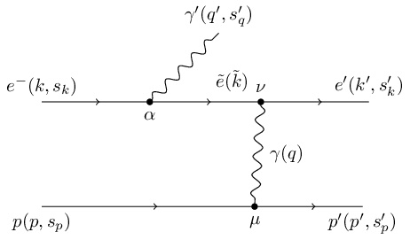
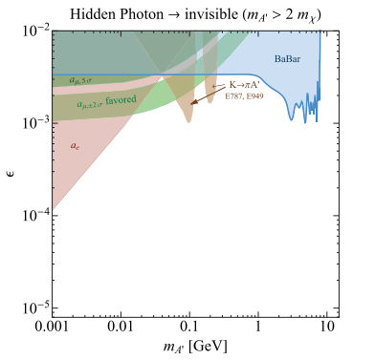
Dark Photon Invisible decays
Mass sensitivity about 10-60 MeV
Coupling sensitivity unknown
Full kinematic reconstruction
Work in progress
Spectrometer for electron
Second detector for the proton
Spectrometer efficiency for proton detection
Do we need a separate recoil detector?
MAGIX

Slide 19
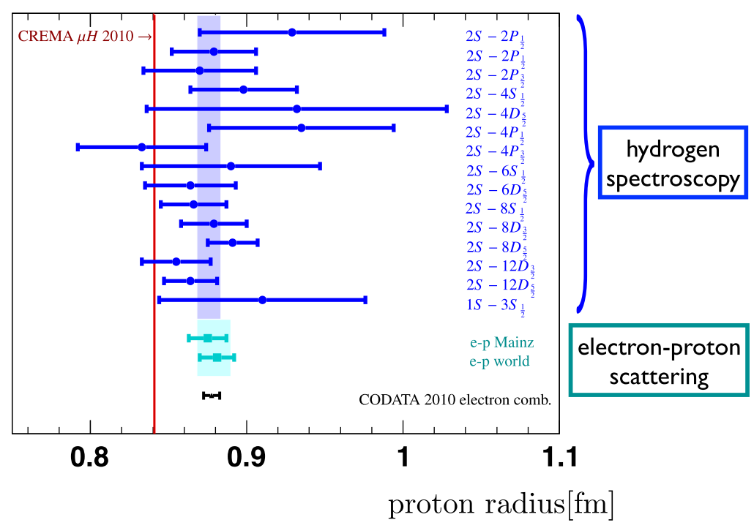
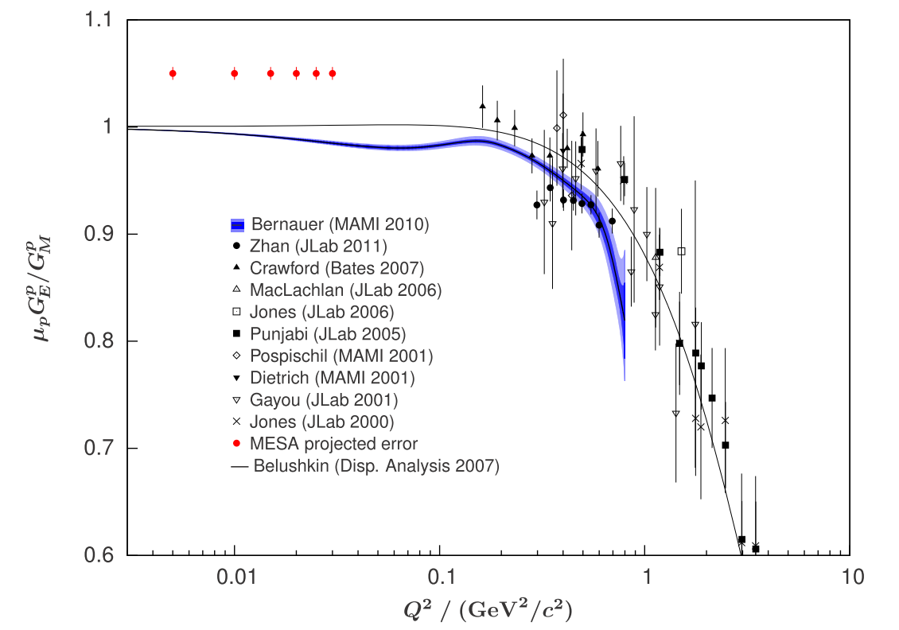
Proton Radius puzzle
Electron scattering Q²
Proton charge radius
The derivative of the form-factor for $Q^{2}→0$
The derivative of the form-factor for 𝑄^2→0
Direct measurements with current experiments $Q^{2}>0.3 {\text{GeV}}^{2}$
Direct measurements with current experiments 𝑄^2>0.3 〖"GeV" 〗^2
Extrapolation to 0 to derive the form factor
Electronic measurements
Hydrogen hyperfine structure
Electron scattering
$$r_{e}= 0.8775(51)$$
𝑟_𝑒= 0.8775(51)
Muonic measurements
Lamb shift of a muonic hydrogen
$$r_{μ}=0.84087(39)$$
𝑟_𝜇=0.84087(39)
Measure the form factors at lower Q²
7 σ discrepancy

Slide 20
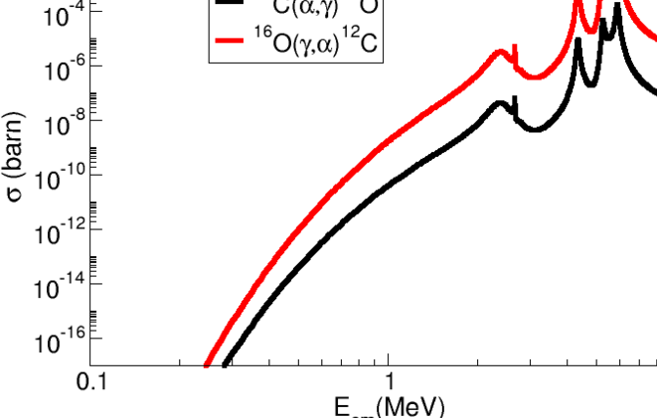
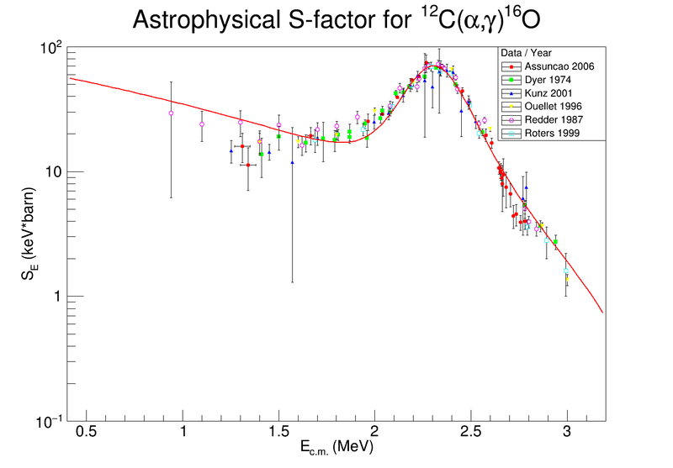
Astrophysical Cross-sections
Low energy nuclear cross-sections
Inverse reaction ¹⁶O(γ,α)¹²C
Relevant for astrophysical modelling
¹²C(α,γ)¹⁶O important to model late stellar burning
Thermal energy at burning point (Gamow peak energy) ~300 KeV
2 orders of magnitude cross-section improvement ${10}^{−16}→{10}^{−14}$ barn
2 orders of magnitude cross-section improvement 〖10〗^(−16)→〖10〗^(−14) barn
Poor data coverage at 1 MeV and below
MAGIX can measure this cross-section at E_{cm} < 1 MeV
Very low cross-section ~10⁻¹⁶ barn
Time-reversal correlation with the previous reaction
Simulations underway

Slide 21
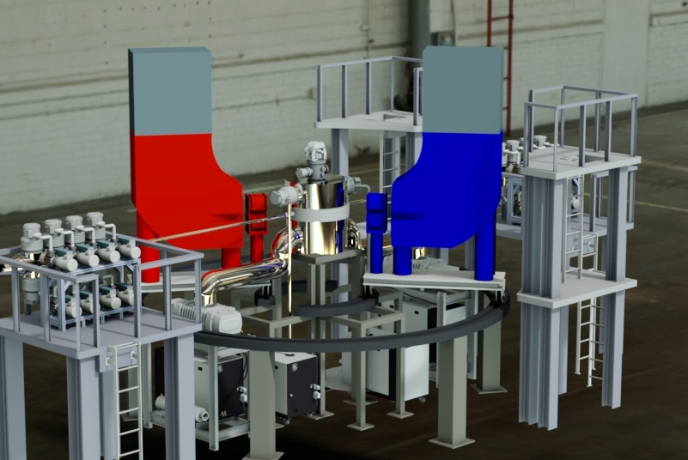
The MAGIX Setup
A high-precision multi-purpose experimental setup
Internal Gas Target
Twin ARm DIpole Spectrometer
Focal Plane Detectors

Slide 22
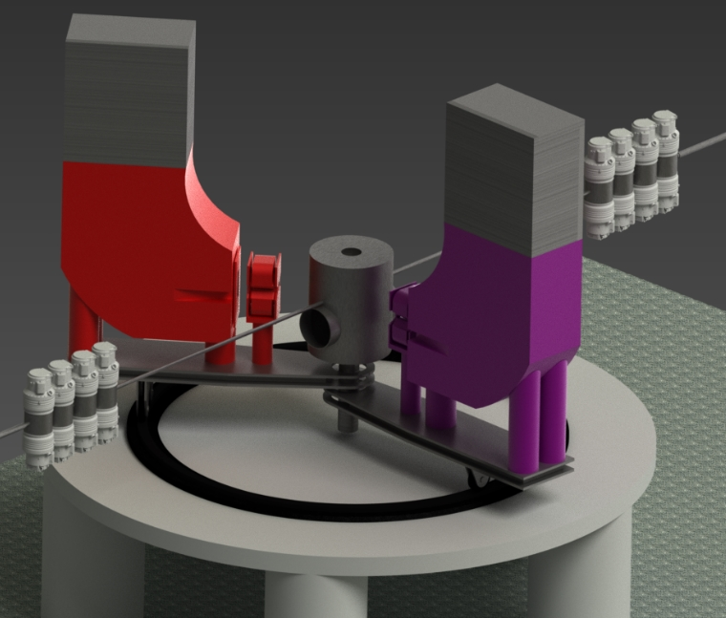
EXPERIMENTAL challenges
High resolution on low momentum electrons
1 < p < 100 MeV
$$\frac{∆p}{p}≈{10}^{−4}$$
∆𝑝/𝑝≈〖10〗^(−4)
$$∆θ≅0.9 \text{mrad}$$
∆𝜃≅0.9 "mrad"
Material reduction
No window before the magnet
Thin detector design
High rate capability
With a CW operation rates up to $O(1 MHz)$
With a CW operation rates up to 𝑂(1 𝑀𝐻𝑧)
Count rates of $O(100 KHz)$
Count rates of 𝑂(100 𝐾𝐻𝑧)
Recoil particle detection
Detection of recoil protons and alphas necessary for some planned experiments (e.g. DP invisible decays)
Uncontained gas target

Slide 23
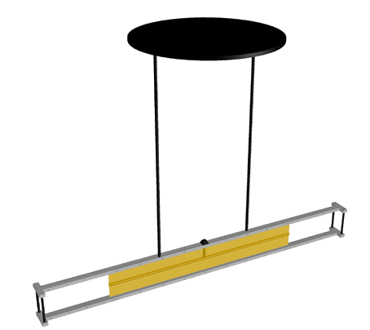
Windowless gas target
Limited material thickness
High luminosity
Gas polarization
Low energy electrons and recoil nuclei to measure
Target luminosity ${10}^{35}{\text{cm}}^{−2}{\text{s}}^{−1}$
Target luminosity 〖10〗^35 〖"cm" 〗^(−2) "s" ^(−1)
Beam recapture after the interaction
Required for some studies
Molecular Flow inside a mylar tube
Supersonic jet
2 mm wide jet stream in vacuum
Cluster-Jet
Molecular clustering @ 40K
Polarized gas
Increase self-conatinment
$${10}^{19}\text{atoms}\text{ / }{\text{cm}}^{2}$$
〖10〗^19 "atoms / " 〖"cm" 〗^2

Slide 24
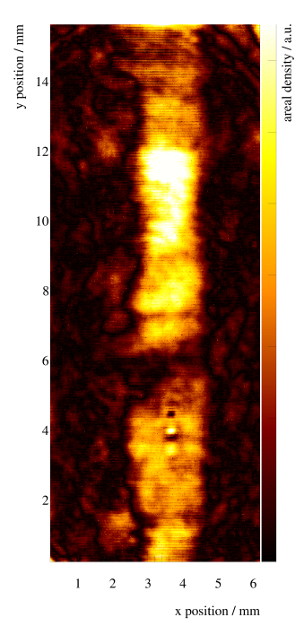
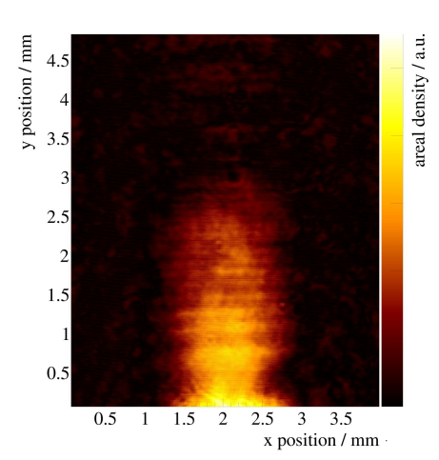
Gas Target developments
Cluster target prototype
A1 target test
40K Hydrogen
4 bar injection pressure
>15 cm long contained beam
Integrated density to be measured
Target prototype currently installed on A1@MAMI
New proton radius measurement with ISR and reduced background
Testing of the gas injection system and the slow control

Slide 25
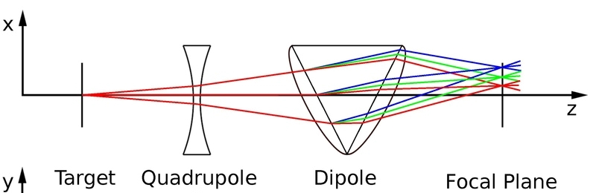
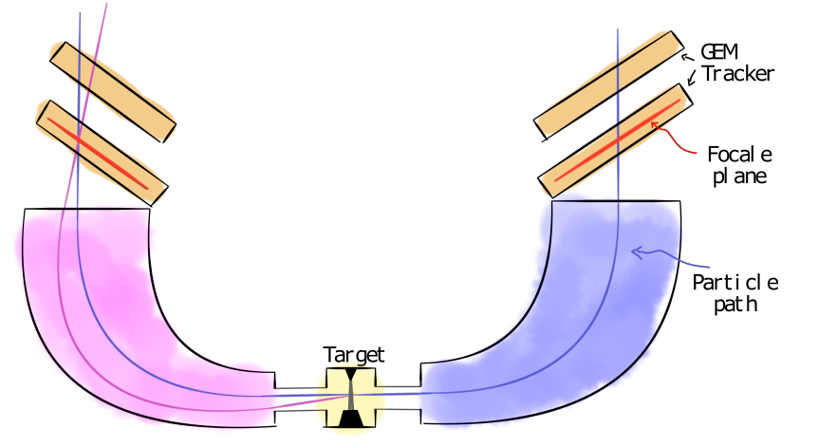
Spectrometers
Momentum focusing
Angular focusing
Linear mapping of momenta to one coordinate in a focal plane
Mapping of the scattering angles to position and angles at the focal plane.
Advantages
Extremely good momentum and angular resolution
Depending on the acceptance of the spectrometer and size of the focal plane
Disadvantages
Limited geometric acceptance
Compensated by the high luminosity

Slide 26
Spectrometer design
Quadrupole + Dipole
200 MeV maximum momentum
45 MeV momentum acceptance @ 100 MeV
Performance simulation
10⁻⁴ relative momentum resolution
Assuming 50 μm resolution at the focal plane
0.9 mrad scattering angle resolution
120x30 cm² focal plane
Currently developing a few additional variants

Slide 27
Focal Plane detectors
Gas detectors
Low material budget
Low cost for large area coverage
MPGD
Resolutions of the order of 50 μm achieved by several detectors
GEM
Modern gas amplification systems
High rate capability
Good stability at high rate
Adaptable to many exp. needs
2 Layer Hodoscope
Short drift TPC
Simple detector to built
Uniform and high position resolution
Moderate material thickness
Only 2 reconstructed points
Challenging at very high rates
Minimal material thickness
Multiple samples and full track reconstruction possible

Slide 28
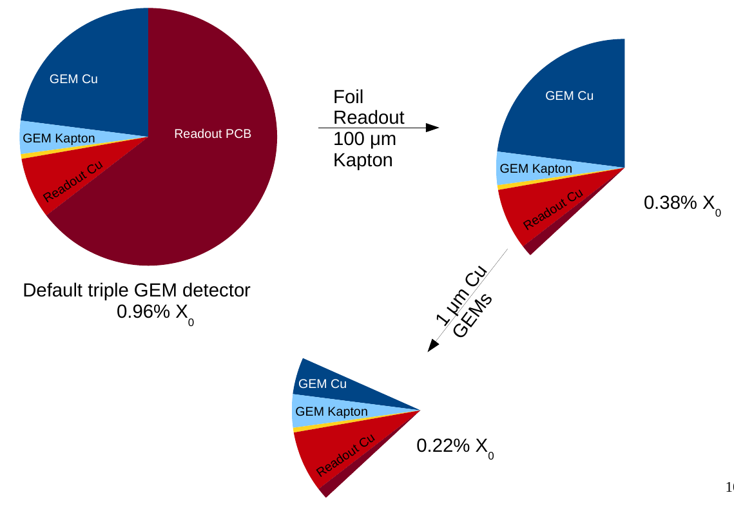
Material minimization
Foil readout
Thin GEM
Inert material reduction
Kapton foil readout planes in the first hodoscope layer
Single layer padded strip layout
Thin copper coating or chromium coating
First test-beam with chromium GEM this summer
Vacuum membrane has cathode
Single gas volume for the two layers
Challenges
Multiple scattering of 10 – 100 MeV electrons between layers less than $∆θ≅0.9 \text{mrad}$
Multiple scattering of 10 – 100 MeV electrons between layers less than ∆𝜃≅0.9" mrad"
Detection of protons of momentum < 50 MeV in the first tracking layer

Slide 29
Additional detectors
Recoil detectors
Trigger and PID
0-degree tagger and forward detectors
Silicon strips integrated in the scattering chamber
Detection of recoil protons and alpha at low momenta
Time-of-flight measurement to reduce cosmic backgrounds
Measurement of forward photons
Integrated in the first bending dipole after the experiment
Fast scintillators for triggering and timestamping
Moller luminometer integrated in the scattering chamber

Slide 30
Beam dump experiment

Slide 31
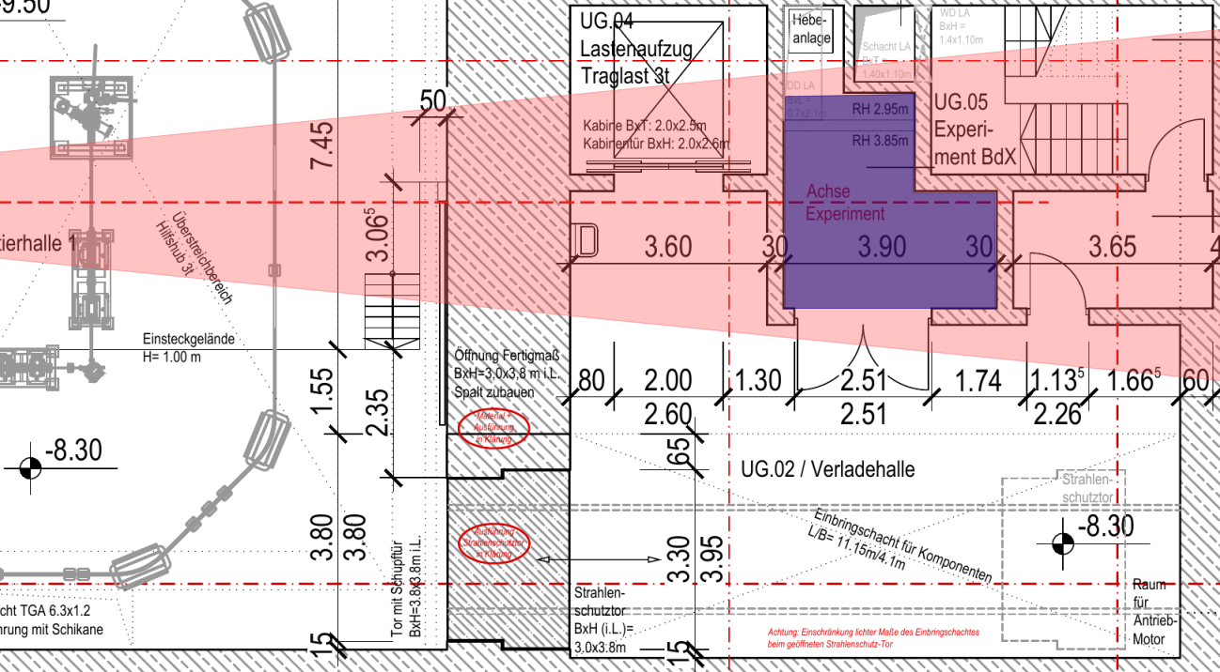
Dark matter beams
A dark matter beam
Detecting a dark matter beam
Dark matter particles may be produced in an electromagnetic shower
Energy and angular distribution depending on the particle mass and initial beam energy
If DM particles are produced in an electromagnetic shower they may be detected via the inverse reaction
Dark matter beam at MESA
Produced by the interaction of the extracted beam with the P2 beam dump
10 degrees angular divergence due to kinematics and multiple scattering in the dump
Shower simulation under way
Detect the electron recoil in a large volume detector

Slide 32
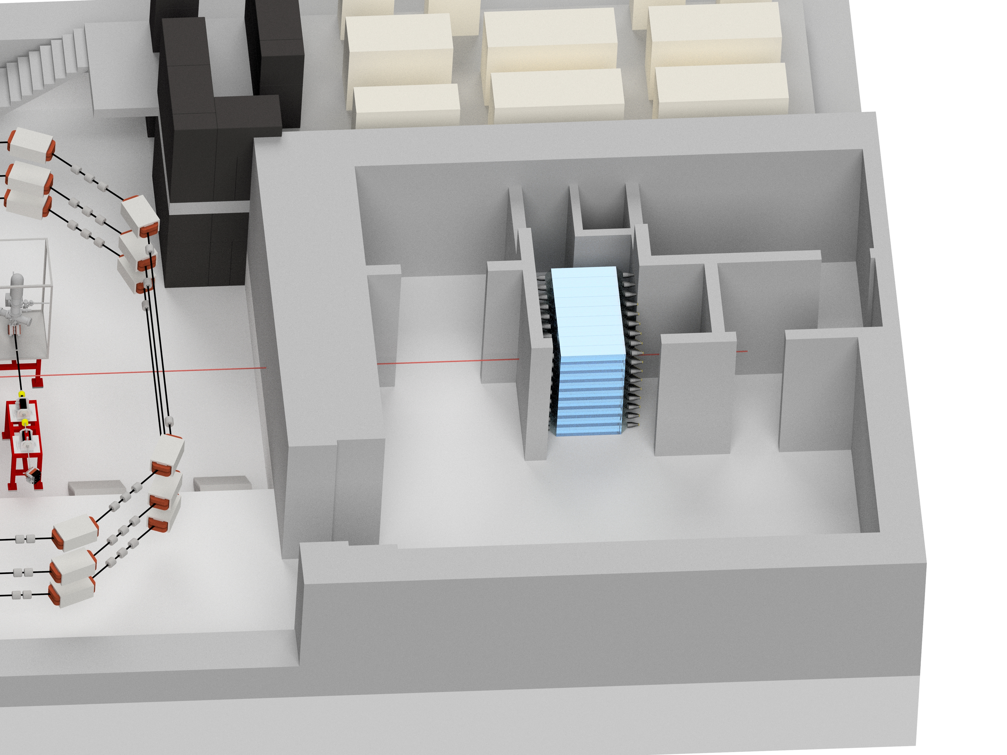
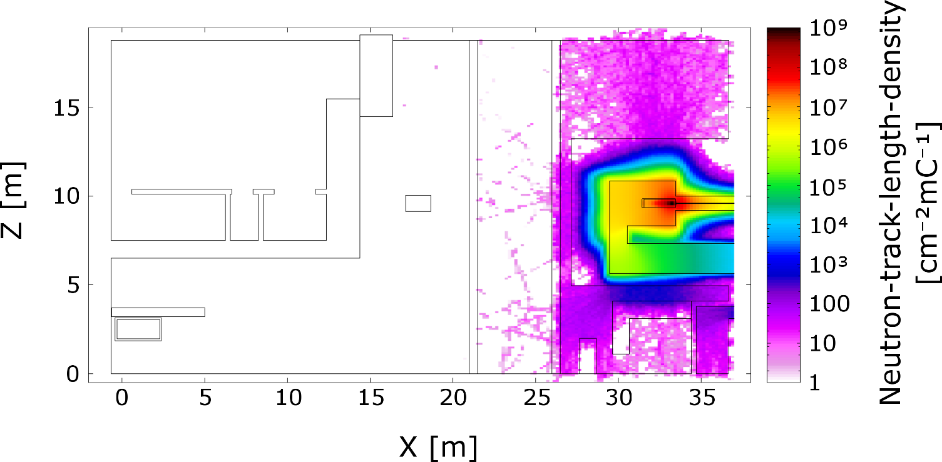
BDX @ MESA
Dedicated floor space
Detector
Allotted space for the experiment in the new hall
About $12 {\text{m}}^{2}$ floor space available
About 12 "m" ^2 floor space available
Good placement flexibility due to the large cone radius (about 4 m)
81 scintillating crystals with PMT readout
Optimized for Cherenkov counting to reduce backgrounds
Double readout and veto detectors for possible background suppression
Development status
Shower simulation under development
Simple detector prototype under study to be tested at MAMI
FLUKA simulation of Neutron background completed with promising results
BDX

Slide 33
Conclusions

Slide 34
Conclusions
MESA
Magix
Beam dump experiment
High intensity and high precision machine
Energy recovery and external beam modes
P2
Dedicated experiment for the measurement of the Weinberg angle
Requires very high polarization and energy control
Versatile experiment for high precision measurements
Wide and growing physics program
Detector prototyping and testing under way
Dedicated space behind the P2 beam dump
Guaranteed ${10}^{23}$ electrons on target from P2 scheduled operations
Guaranteed 〖10〗^23 electrons on target from P2 scheduled operations
Operations expected to start in 2021-2022
Simulations and prototyping under way
Physics simulations in advanced state of development
Some components already ordered

Slide 35
Thank you for your attention

Slide 36
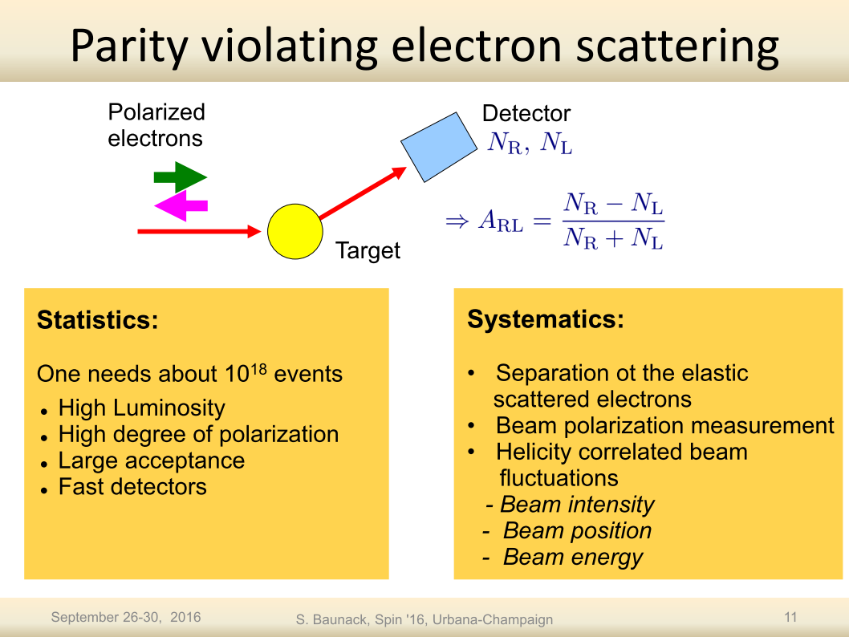

Slide 37
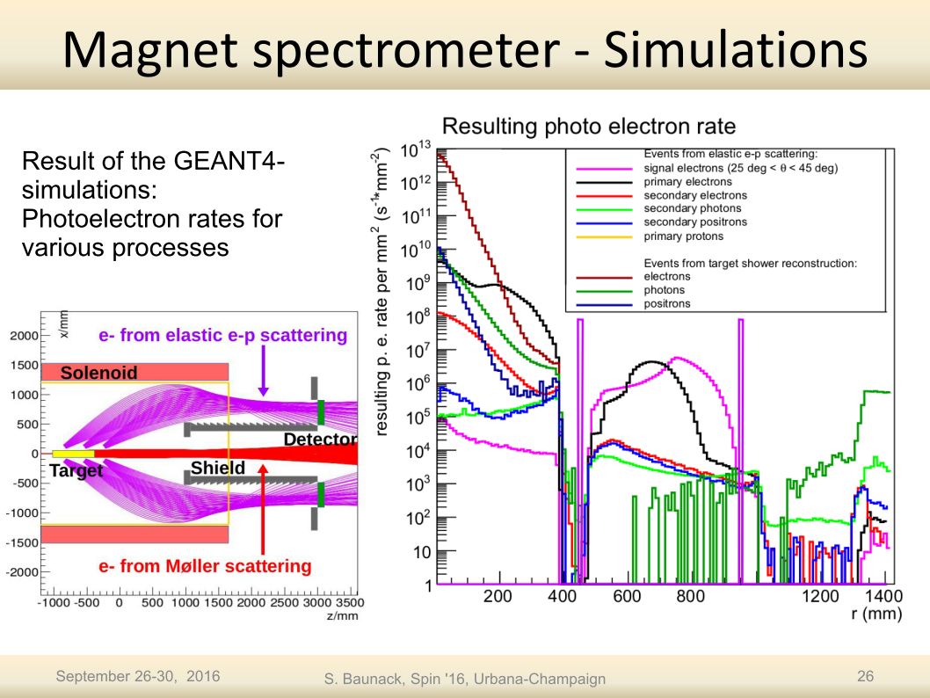

Slide 38
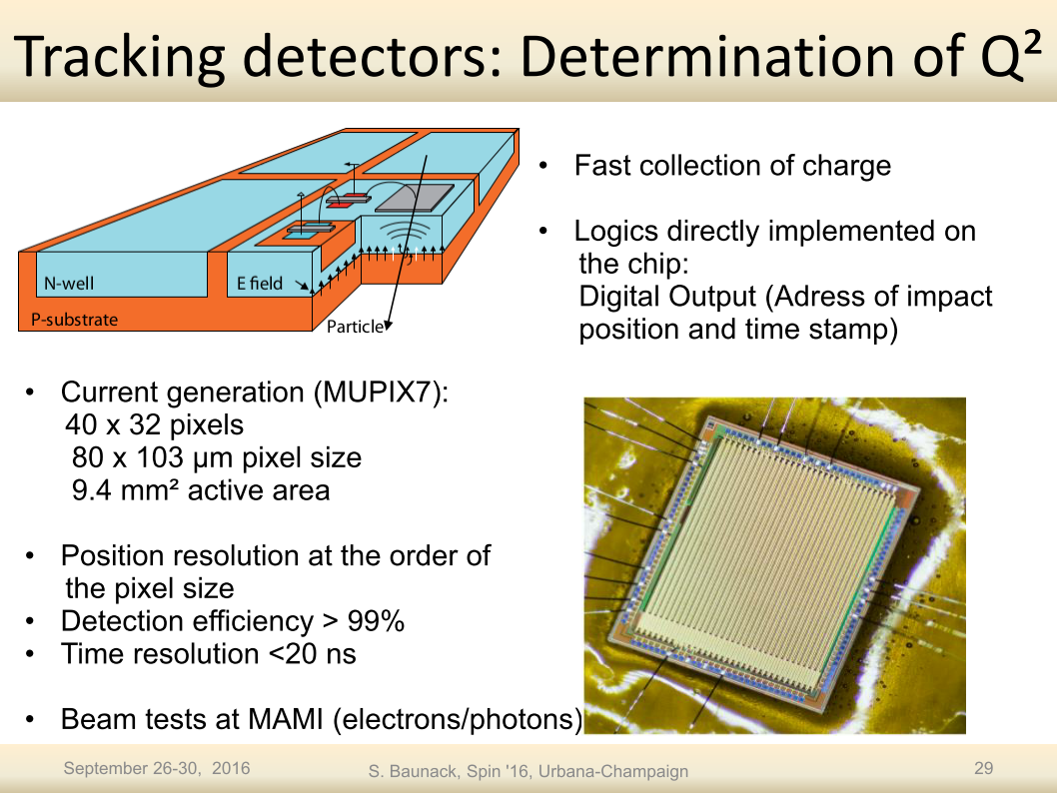

Slide 39
ERL energy stabilization
Energy spread reduction
The typical technique is the off-crest acceleration
Feedback effect tends to reduce the energy spread in the bunch
ΔE_{max}
: reference particle
ΔE
...
...
...
...
ϕ_{s}<0
k_{rf}•z - ω•t

Slide 40
ERL non-isochronous operation
Isochronous operation
Asymmetric non-iso
Symmetric non-iso
Bunches in phase with the rf-peak
High energy recovery efficiency
Decelerating bunches at different phase
Bunches not at the rf-peak
Reduced beam energy spread
Possible due to the double sided design of MESA
First 2 passes on one edge, the other 2 on the opposite
Improved energy spread with increased efficiency
High beam energy spread
Possible influence on accelerating bunches

Slide 42
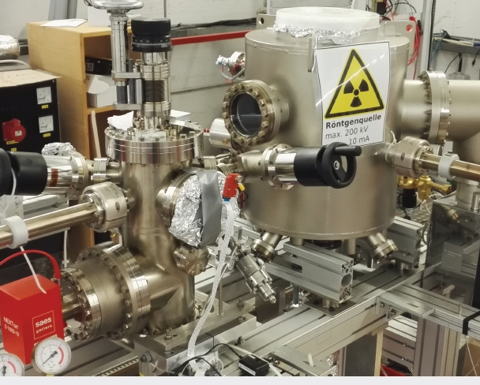
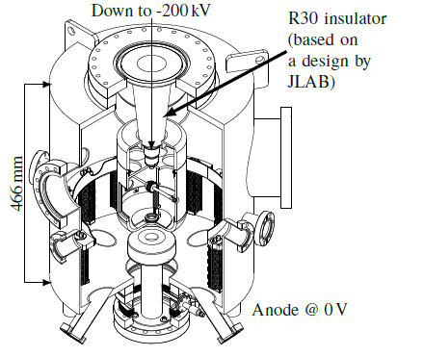
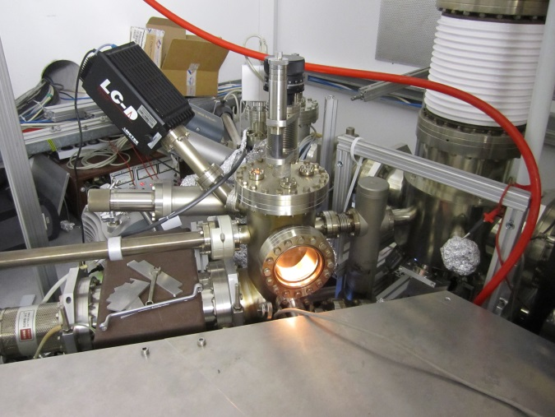
Polarisation: From EB to ERL mode
MESA Polarized Source (MAPS)
Essentially a copy of MOPS
But: higher pumping speed
Many small details…
- better vacuum lifetime (>*2)
Charge lifetime 700C@2mA
(but at 400nm!)
Components for MEsa Low-energy
Beam Apparatus (MELBA) tested:
Beam diagnostics, Wien filter,
Polarimeter, deflector cavity
Small Thermalized Electron-source At Mainz (STEAM)
New approach: inverted source (JLAB)
Higher cathode extraction field at 100kV
Potential for 200kV operation
Main research objective: demonstrate low temperature near bandgap emission
at bunch charge >1pC.
Poster by Simon Friederich, this conf.
First beam expected this summer
Will replace MAPS, if succesful (STEAM→MIST)

Slide 43
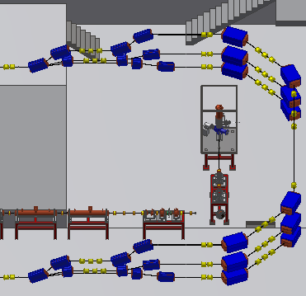
MESA LATTICE
Recirculation lattice under revision
Incorporate the latest changes of the layout
Start-to-end simulation of ERL and extracted beams
Energy spread minimization through non-isochronous beam dynamics
Stability and acceptance maximation
Lattice modelled with:
In-house matrix program
MAD X
PARMELA for space charge and pseudo-damping due to the main linac modules
MATLAB tracking code for non-isochronous working points

