Slide 1
Field Emission, C100 & DTM
3 Aug 2017
R Legg

Slide 2
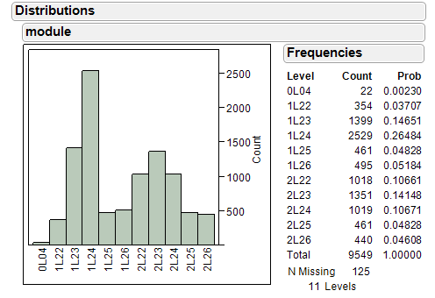
Quenches are Largest Fault for C100s
Track with the radiation activation of C100s

Slide 3
Turn down C100s to improve reliability
Turn down C100 GSETs to FEOnset gradients
Lose about 75 MeV in the North Linac
Lose about 106 MeV in the South Linac
Could reduce radiation by 80% with 90% gradient using FE vs GSET models
Dramatically reduce trip rates and down times, both of more and less than 5 minutes
BUT,
C100’s are assumed to have 2 trips per hour, doesn’t necessarily make the reported numbers better.
Scientific programme will change

