Slide 1
12 GeV Gradient
Ken Baggett
JLab Staytreat, 2017

Slide 2
From Gradient Team Charter
Develop a plan to maintain 2.1+ GeV/pass with an acceptable trip rate (as required to achieve 80% availability, < 5 trips/hour/linac expected) through Fall of 2018.
Required margin is 60MeV/Linac for observed losses and bypass of a C-20
45 MeV to bypass
~15 MeV for annual loss
Preferred margin is 100MeV/linac, to bypass a C-100
Should margin be adjusted (~85 MeV) based on actual performance?
Tasks will align with strategic plans of the Long Range LINAC PIT to meet the energy reach goal of 2.2 GeV/pass with >80% availability.

Slide 3
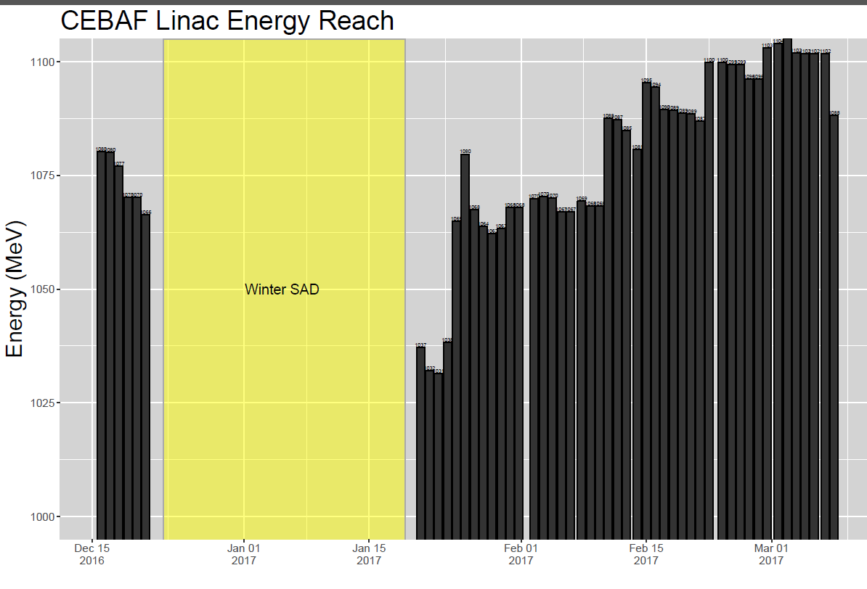
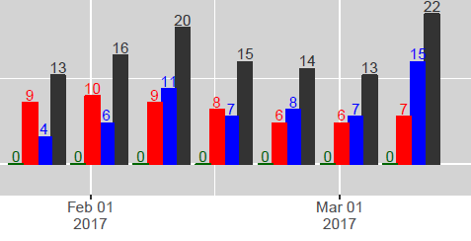
State of the Gradient System
2 Cavities Recovered
SL C100s in independent Heat mode
Lost 2L17
Maintenance Day Cavity Recovery
Put 2L23 Heat in Independent Mode +10MeV
2L26 insulating vac repair +27MeV
Bypassed Cavities

Slide 4
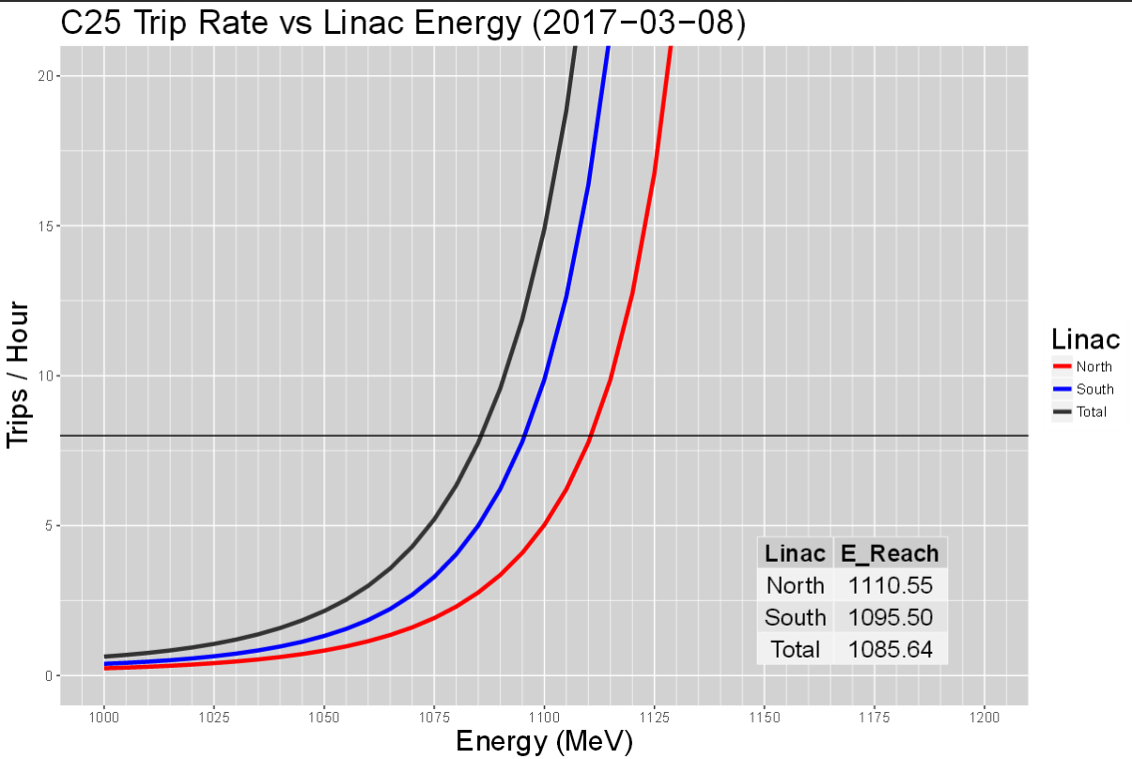
State of the Gradient System (End of Spring Run - 2017)

Slide 5
Summer SAD Tasks
Several tasks were identified for the 2017 summer SAD.
Predictions were made for gains and losses associated with each.
The Fall energy reach was then calculated using 3 confidence factors.
The confidence factor is a percentage of full gain we would get from each improvement.
Low = 50%
Medium = 70%
High = 100%
It does not apply the factor to the expected warm-up loss because this number has statistical precedent.
Risks:
Linac high/low pressure operating point for C100 cryomodules
expected to work in the south but has not yet been demonstrated.
C100s at 0.0405 atm : https://logbooks.jlab.org/entry/3467489
Cryo work schedule and configuration has negatively impacted cryomodule studies over the summer.

Slide 6
Energy Reach Prediction
Minimum Target Energy Reach for 1050 MeV/Linac is 1095MeV
8 trips/hour total
45MeV overhead
We know we won’t get 100% of the possible gains
70% of the potential gains from this SAD gives us sufficient overhead to the end of the run (prior to warm up losses from CHL event).
Several paths to 70%. For example:
~7 MeV if 2L09-1 tuner doesn’t free up
~16 MeV if 2 of the 4 cavities in 1L18 or 1L25 isn’t repaired
50% of the potential gains puts us below the margin minimum
Based on progress so far we believe we will do better than 50%

Slide 7
Reality of summer SAD
Improvement Tasks | Gain/Loss (MeV/pass) | NL | SL
Install all remaining Super MOPs power supplies. | 13 | 6.5 | 6.5
Complete targeted helium processing to get rid of field emitters (list to come from team). 4 Zones at 4MeV/zone | 16 | 8 | 8
Replace cryomodule poly windows with ceramic windows | -27 | -8 | -19
Regain margin on cavitiies limited by CWWT | 5 | 5
2L25 Gradient Push | 0
Install C50 | 25 | 25
 | per pass | NL | SL
SUM MeV | 32 | 36 | -4
Maintenance Tasks
1L10-6 is having intermittent problems registering latched CWWT faults; RFCM swap required; may need further diagnosis or warm IR sweep if that doesn't work. | 5 | 5
1L12-20 and 2L18-50 will require ion pump swap outs and possible temporary supplementary pumping to establish good vacuum again for operation | 2 | 2
1L12-8 Arc Detector Swap | 7 | 7
1L13-6 has a damaged probe cable which requires replacement (does this require a stone drop to pull a new one?) | 5 | 5
2L02-8 circulator swap | 4 |  | 4
2L09-1 requires a 30K cryocycle to unstick the tuner | 7 |  | 7
2L17-3 Persistent CWWT: EES-RF swapped out RFCM and has passed it off to SRF as it persists. Requires further investigation, possible swap to warm IR sweep if it's not the cable/chassis. | 6 |  | 6
2L17 cryo-cycle and repair | 37 |  | 37
Repair 2 cavities 2L18 | 14 |  | 14
Repair 2 cavities 1L25 | 20 | 20
Repair 2 cavities 1L18 (with ceramic window swap, not including gain in line 13) | 13 | 13
 | per pass
SUM MeV | 72 | 51 | 68
Improvement Tasks | Gain/Loss (MeV/pass) | NL | SL
Install all remaining Super MOPs power supplies. | 13 | 6.5 | 6.5
Complete targeted helium processing to get rid of field emitters (list to come from team). 4 Zones at 4MeV/zone | 0 | 0 | 0
Replace cryomodule poly windows with ceramic windows (only SL) | -19 | 0 | -19
Regain margin on cavitiies limited by CWWT | 0 | 0
2L25 Gradient Push | 0
1L14 warmup | -2
Install C50 | 25 | 25
 | per pass | NL | SL
SUM MeV | 17 | 32 | -13
Maintenance Tasks
1L10-6 is having intermittent problems registering latched CWWT faults; RFCM swap required; may need further diagnosis or warm IR sweep if that doesn't work. | 5 | 5
1L12-20 and 2L18-50 will require ion pump swap outs and possible temporary supplementary pumping to establish good vacuum again for operation | 2 | 2
1L12-8 Arc Detector Swap | 7 | 7
1L13-6 has a damaged probe cable which requires replacement (does this require a stone drop to pull a new one?) | 0 | 0
2L02-8 circulator swap | 4 |  | 4
2L09-1 requires a 30K cryocycle to unstick the tuner | 7 |  | 7
2L17-3 Persistent CWWT: EES-RF swapped out RFCM and has passed it off to SRF as it persists. Requires further investigation, possible swap to warm IR sweep if it's not the cable/chassis. | 6 |  | 6
2L17 cryo-cycle and repair | 37 |  | 37
Repair 2 cavities 2L18 | 14 |  | 14
Repair 2 cavities 1L25 | 20 | 20
Repair 2 cavities 1L18 (with ceramic window swap, not including gain in line 13) | 13 | 13
 | per pass
SUM MeV | 66.85 | 45 | 68

Slide 8
Path to full 12GeV Capability
Based on the expected starting point for Fall 2017, several paths forward seem possible.
We aren’t fully 12GeV capable from a production physics perspective
There are several paths to get there based on financials, resources, and schedule.
All assume no further improvements OR losses in accelerator after 2017 summer SAD
Klystrons for ANY program needed going forward ~$300K/zone.
Four scenarios:
Baseline:
C50 changes to C75 swaps at 1/yr
(Overly) Optimistic:
100% gain detailed by gradient team (improvements and repairs) realized for summer 2017
C75 swaps continue at 1/yr
CEBAF Performance Plan (Arne’s Plan):
Aggressive C75 program with 3 years of 2/year
Raid the LERF:
FL04 and F100 added to a C75 program
All scenarios assume:
34 MeV/year annual loss continues (-17 MeV applied to each run period)
25 MeV gain from C50 swap out
45 MeV gain from C75 swap out

Slide 9
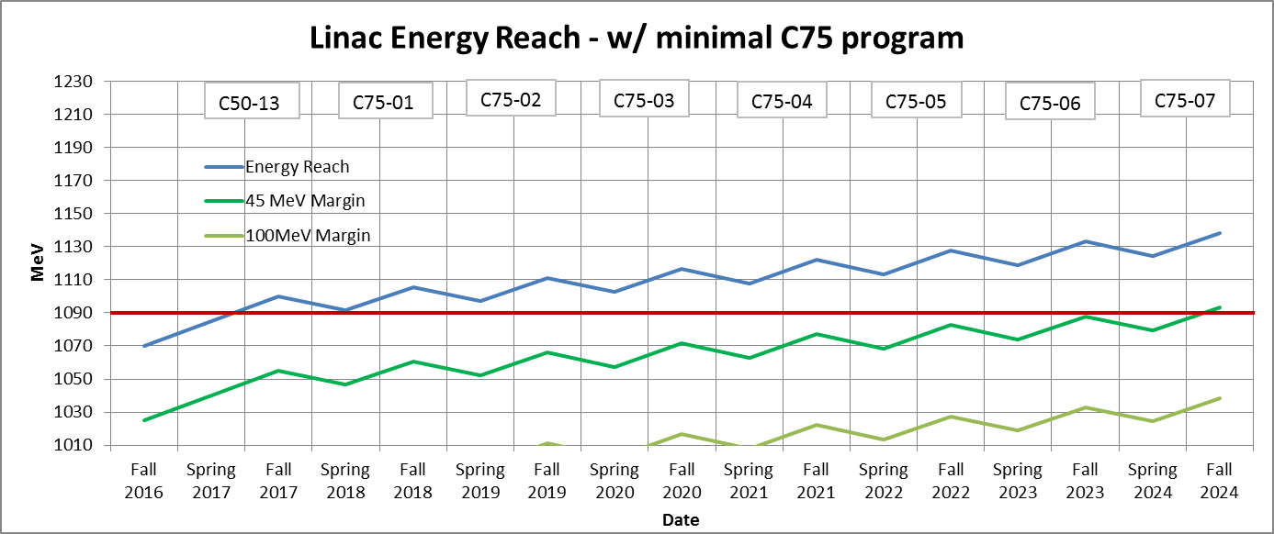
Baseline Scenario
Meets the 1050 MeV/linac w/ 45 MeV requirement
Assumes same losses/recovery will be present during all downs
System has reached stability with annual losses continuing.
Maintains a one cryomodule/year upgrade program and swap to C75 program in FY18.
Assumes we fund new klystrons to power the C75’s

Slide 10
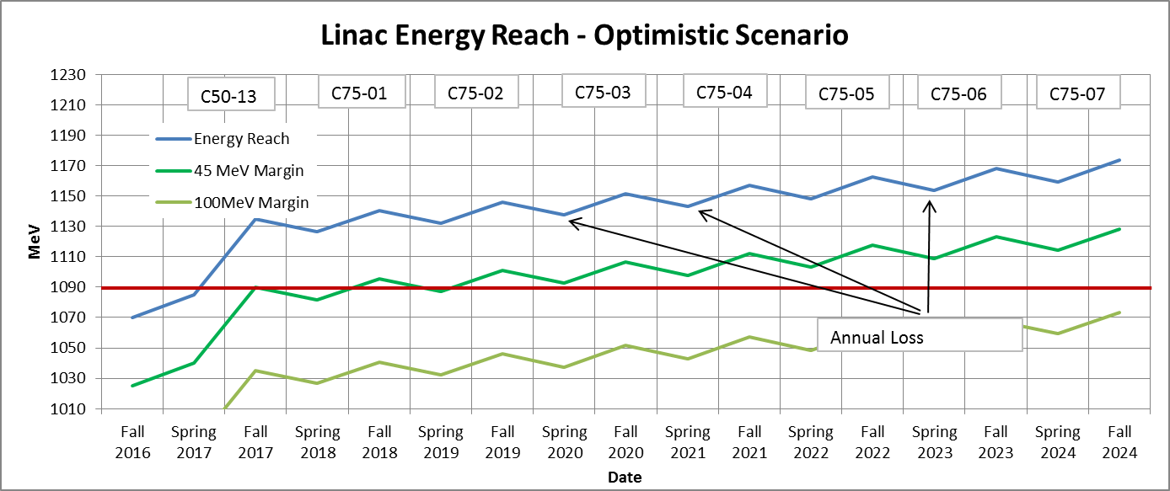
Optimistic Path to 12GeV
This assumes we gain gradient from everything we have identified AND nothing fails AND schedule allows time for all maintenance (i.e. Helium Processing)
Meets 1050 MeV/linac w/ 45 MeV of overhead now (stated minimum requirement)
Reaches sustainable 1090 MeV/linac with 45MeV of overhead in Fall 2019
Continues with a one cryomodule/year upgrade program.
Assumes we fund klystrons to power the new C75’s
CONS:
This is an academic scenario. We have not demonstrated the ability to achieve this in normal operations.
Maybe we improve enough to fold some of this scenario into another plan as we improve our interactions with the gradient system
Assumes 100% of energy gains

Slide 11
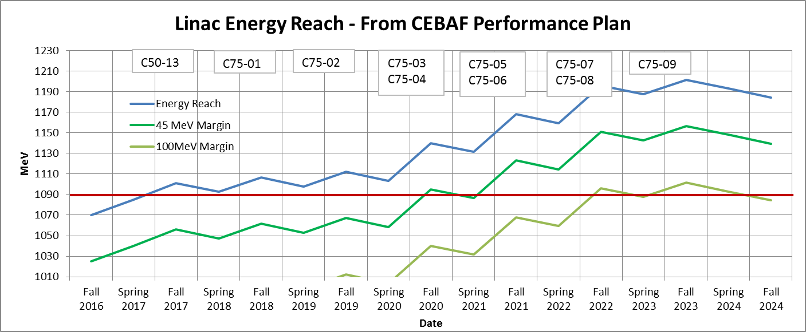
Arne’s Scenario
Provides a clearly sustainable trajectory
Assumes same losses/recovery will be present during all downs
Meets 1050 MeV/linac w/ 45 MeV of overhead now
Meets 1090 MeV/linac with 45MeV of overhead in Fall 2020
100MeV of overhead in Fall 2022

Slide 12
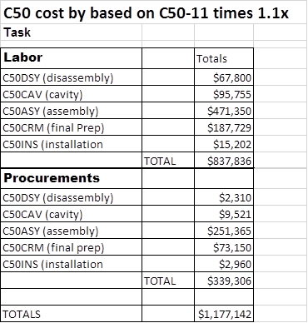
The Bargain Basement Option
What if we utilize LERF resources NOW ?
Could pull the F100 and drop into a C20 zone (FY18)
Drop in cost: ~$300K (based on F100 2014 installation w/ waveguide runs, controls, tuners, etc.)
Provides 2nd module to SRF refurbishment pipeline
Costpoint : ~$1.2M cost for C50.
~$2.5M for C75
Could pull FL04 and drop into a C20 zone (FY19)
Straight drop in based on engineering review.
Still need to steal other components from the LERF for both modules.

Slide 13
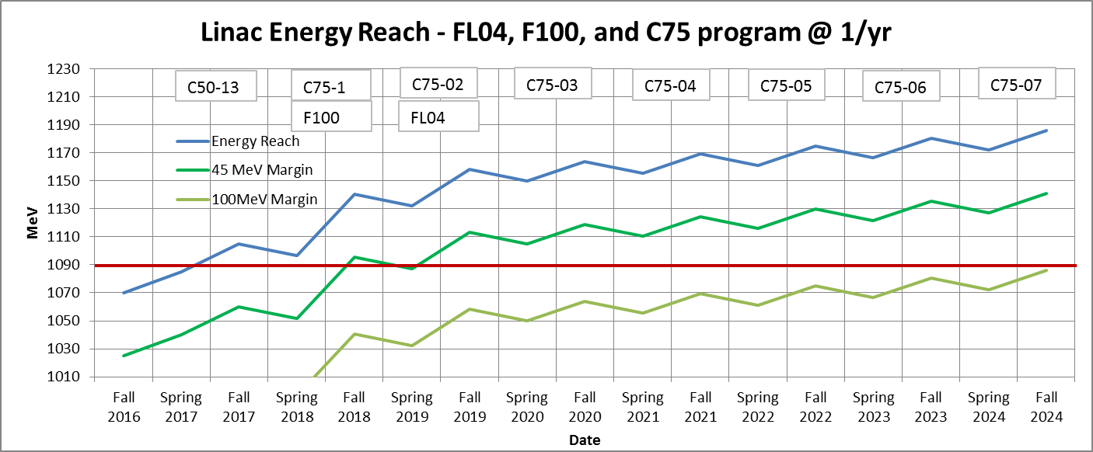
Raid the LERF Option
Use LERF modules in addition to a C75 program
Add F100 - SAD FY18
Add FL04 - SAD FY19
Meets 1090 MeV/linac with 45MeV of overhead in Fall 2019
CONS:
No C100 style cryomodule spare
More klystrons needed sooner (~$300K/zone)
Still need an additional C75 to get to 100MeV overhead before 2024
How will we start a C100 refurbishment program?

Slide 14
Tasks and open questions
2L17 repaired
2L18 cavities repaired
C50-13 Installed (1L13)
SL warm windows replaced on 9 cryomodules
8 Channel heaters production in progress (installation starts next week)
SuperMOPs upgrade completed
Helium Processing not completed – will negatively affect margin
Uncontrolled warmup due to power failure in CHL will cause an additional negative impact
Do the 300K cycles cause a ~0.5 MV/m loss in each cavity?
9 cryomodules worth of warm window swaps should provide good data for evaluation.
Are there significant improvements from running C100s in independent mode vs autoheat?
more from Freyberger later.
Do we realize the predicted gains from the SuperMOPs upgrade?
Balances increased C50 RF heat loads. (Installed in 10 zones)
Does the mechanical bracing to reduce microphonics translate into additional gradient / reduced trips?
Measurable reductions based on installed bracing.
Does this align with what the control algorithm sees or is there more work to do?
Do the new lead collars provide the expected radiation reduction for the warm region girders?
When can the gradient software be developed to drive work prioritization / mitigate operations losses in real time?
When can we develop processes & software to minimize field emissions and maximize gradient during operations?

Slide 15
Issues and Open Questions
The gradient team has not found a “smoking gun” to allow C100s to produce design gradient.
The search continues and recovering the missing 20% remains a high priority.
Barring an epiphany, a change in the current yearly paradigm is required to reach 12GeV
One C50/year just keeps lets us tread water
Arne’s plan gets CEBAF to 12GeV
Plan is based on actual performance and observed losses
Costs are high and requires an increase in the number of modules/yr
All plans require new klystrons – which has been a can kicked down the road for several years now, and we are at the end of the road.
Utilizing F100 and FL04 provides CEBAF the opportunity to improve margin in both linacs simultaneously, save some costs, and possibly make us full 12GeV capable sooner.
Pulls 12GeV capability forward one year by using existing Jlab resources
Fall FY19: 1090 MeV/linac w/ margin (+45 MeV)
Is there value in demonstrating now that we are a “full” 12GeV capable machine?
Requires additional C75 for 1090 MeV/linac w/ margin to bypass a C100
Immediately provides SRF two underperforming cryomodules for refurbishment
All scenarios require klystron purchases beginning in FY18
We are operating at 45 MeV margin now.
Do we move to 1090 MeV/linac once we provide the same margin? Or wait for 100 MeV margin?
Swapping immediately to a C75, using the second module pulled for F100 installation, provides a risk mitigated path to 12GeV with 45MeV of overhead in a reasonable timeframe.

Slide 16
Questions?

